Slide 1
Polymer Melt Flow in 3D Printing
Ahmed Qadi
Abdul Hakim Futyan
Supervisor: Dr. Bahaa Shaqour

Slide 2
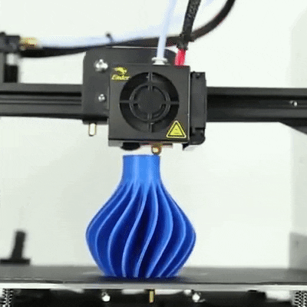
What is 3D Printing
3D printing is a process in which a machine creates a three-dimensional object from a digital file. It is also known as additive manufacturing because it builds up the object layer by layer. 3D printing has a wide range of applications, from prototyping and product design to sculpture and jewellery making.

Slide 3
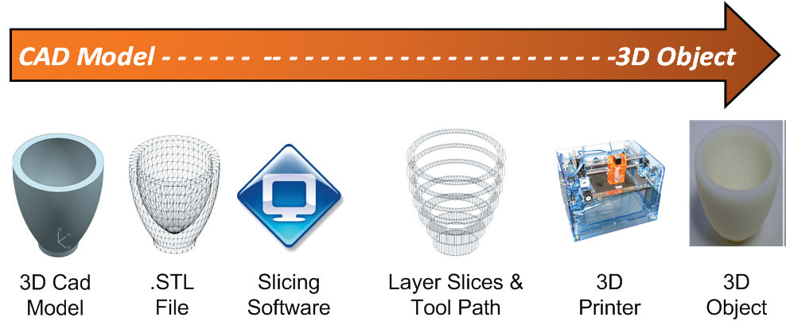
How Does 3D Printing Work

Slide 4
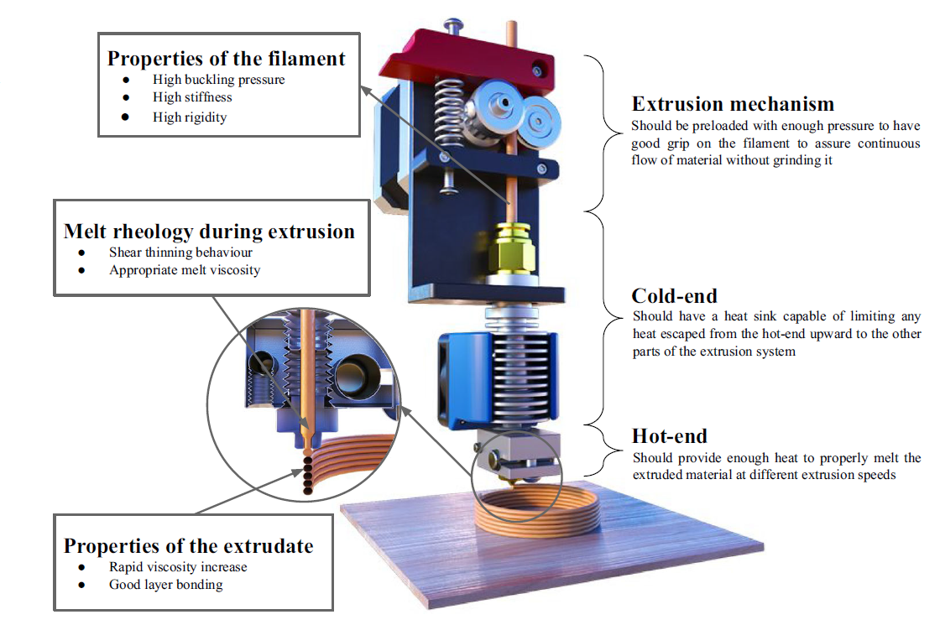
Extrusion Process Explanation

Slide 5
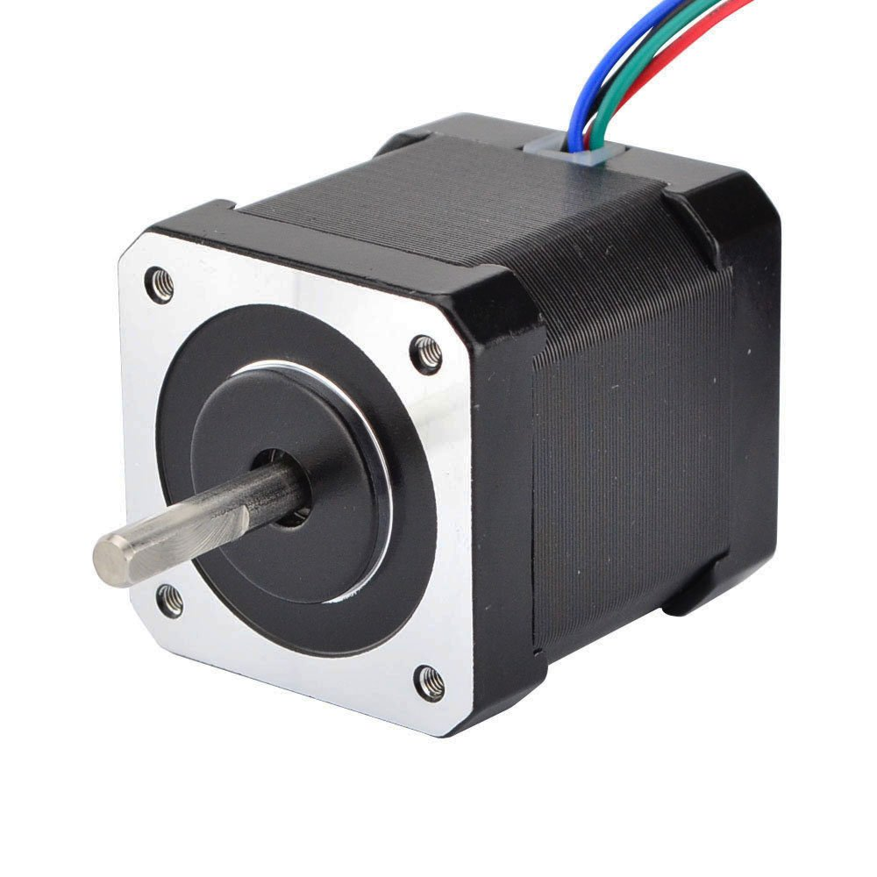
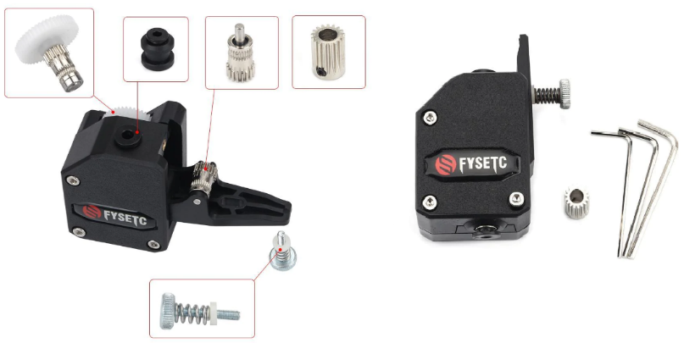
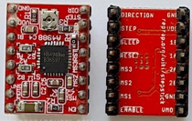
Actuators
Stepper Motor with BMG Extruder

Slide 6
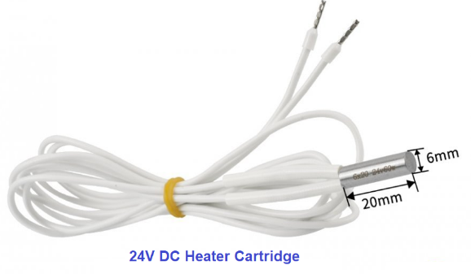
Actuators
Heater cartridge

Slide 7
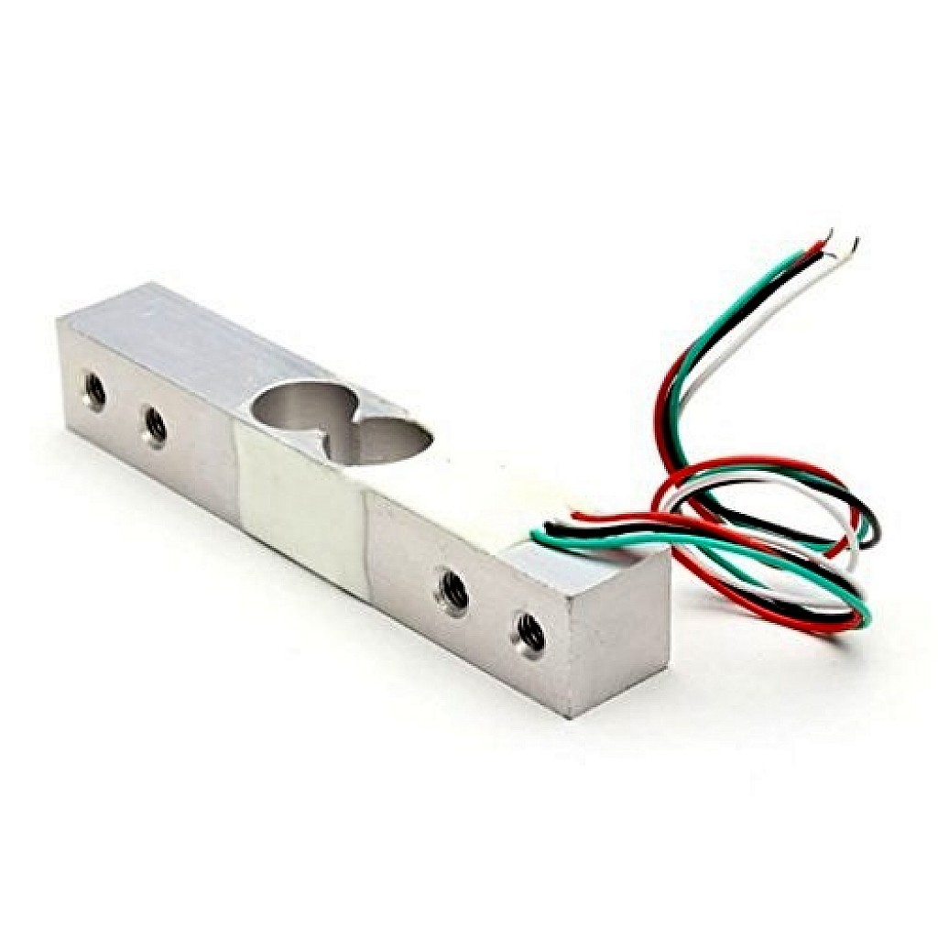
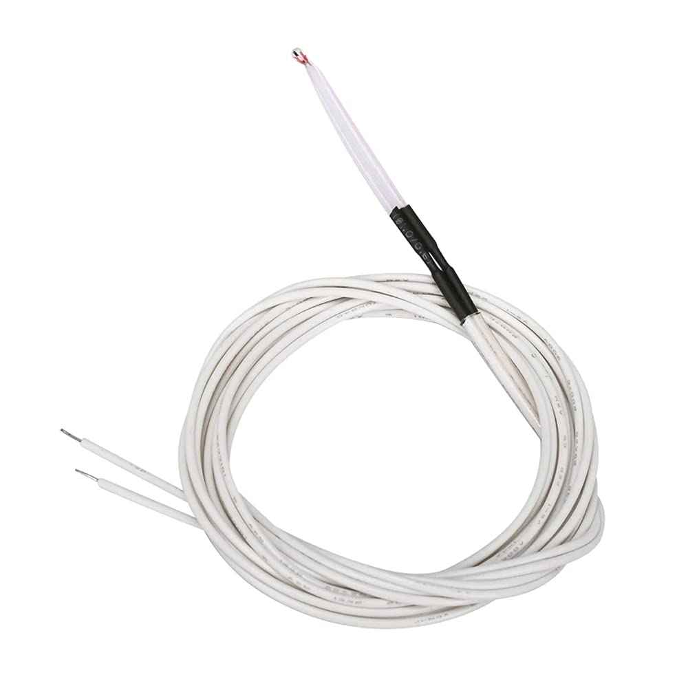
Sensors
100K ohm NTC 3950 Thermistors
20 kg load cell with the interface HX711

Slide 8

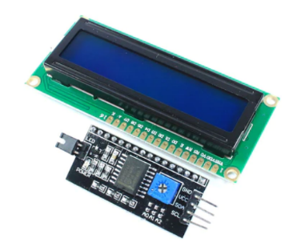
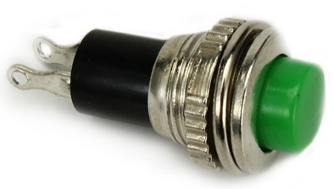
User Interface and Interaction Devices
Keypad
Push buttons
LCD with I2C module

Slide 9
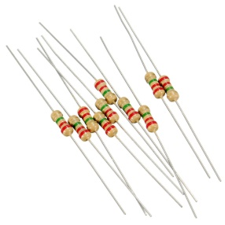
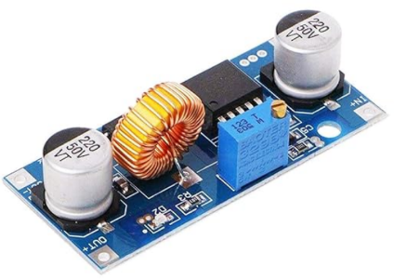
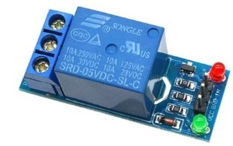
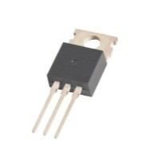
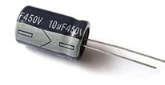
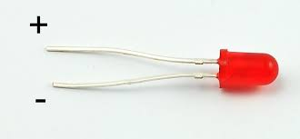
Electronic Devices
IRFZ44 MOSFET
Capacitor
Resistors
Relay Module
DC -DC Step Down converter
LED

Slide 10
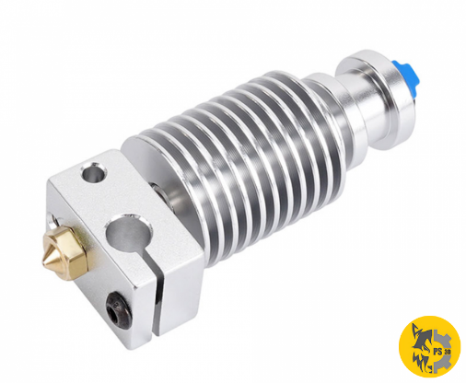
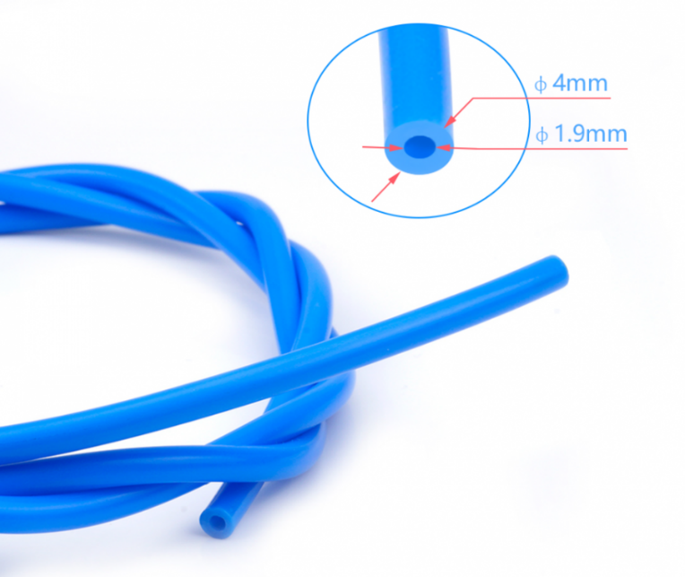
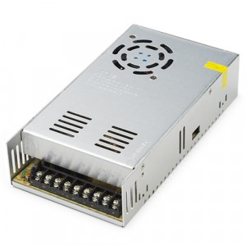
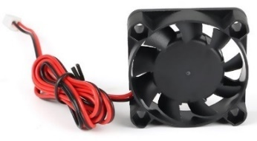
Other components
E3D V6 Hot end
PTFE Bowden tube
Power Supply
Fan

Slide 11
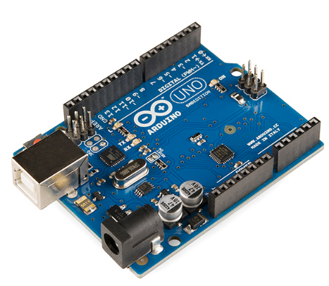
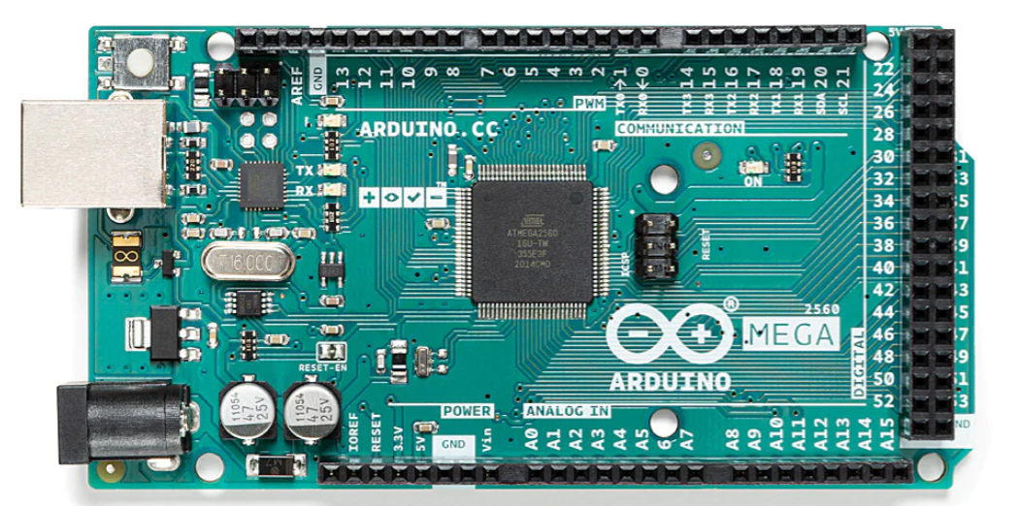
Controllers
Arduino Mega
Arduino UNO

Slide 12
Test setup cad model

Slide 13
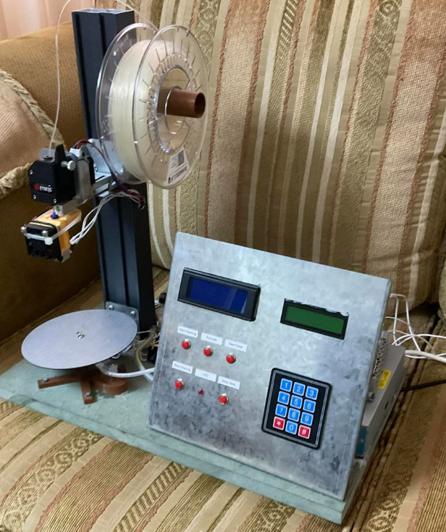
Real Test setup

Slide 14
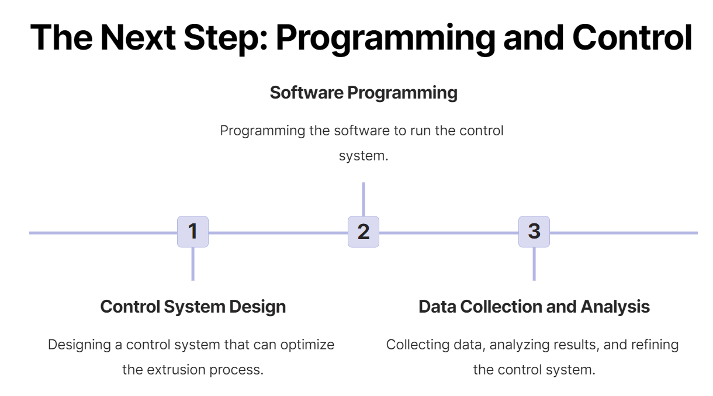

Slide 15
Temperature Control
Setpoint
Controller
PWM signal
Drive circuit
Heater
Output temp
Signal Conditioner
NTC Thermistor

Slide 16
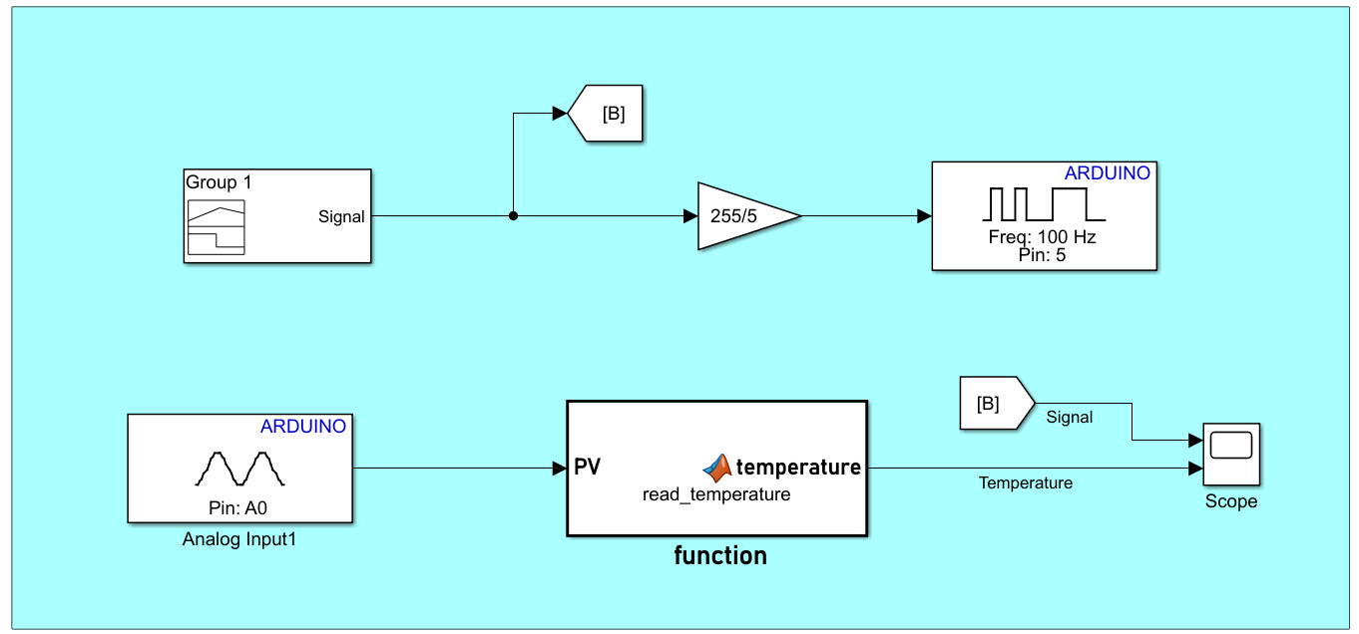
Controller Design
Data Generation and Acquisition

Slide 17
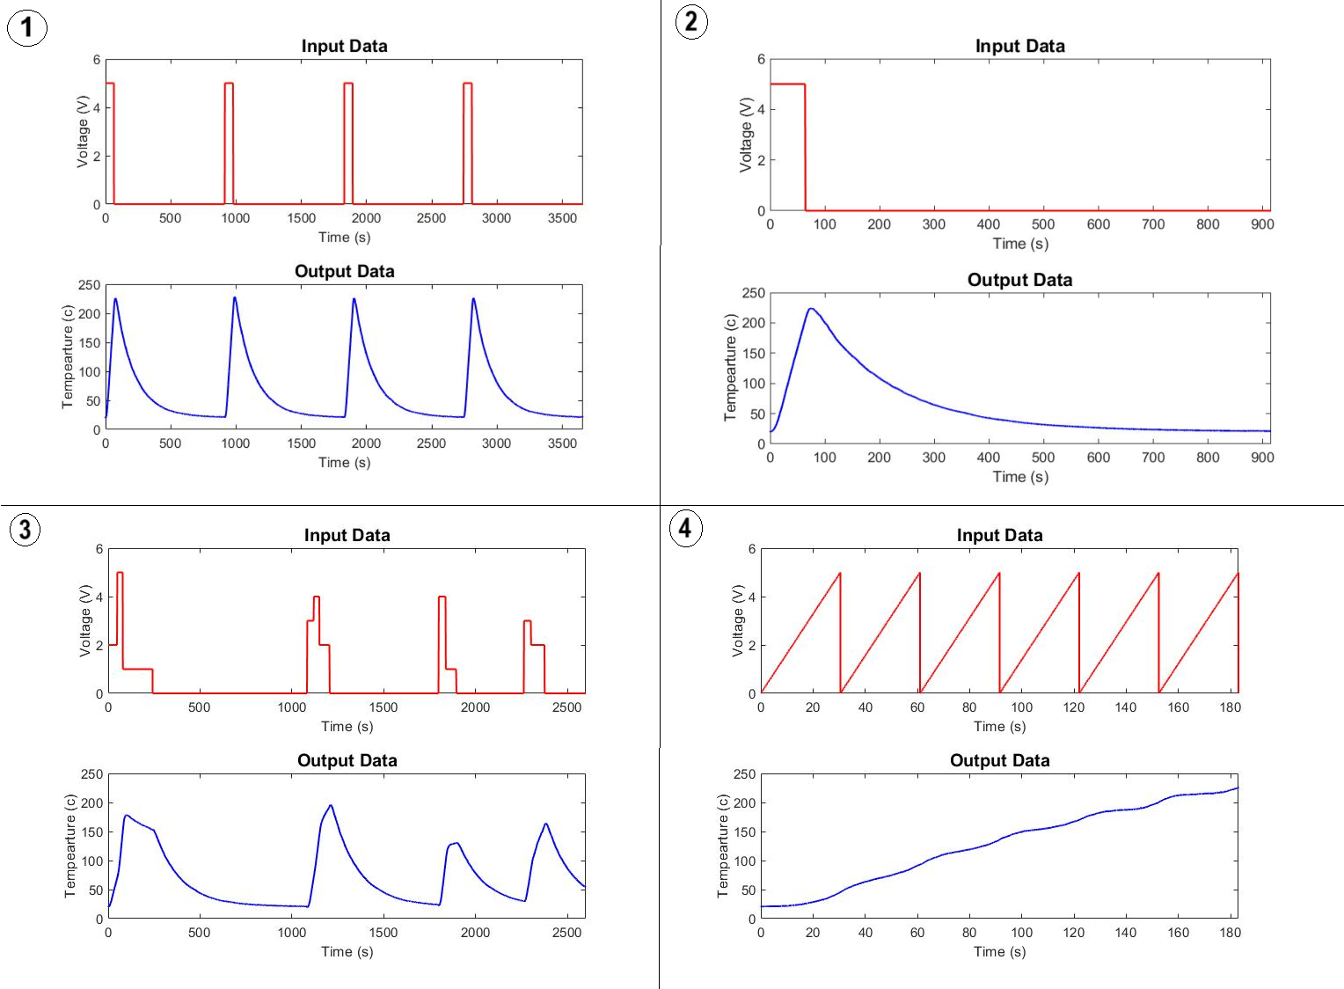
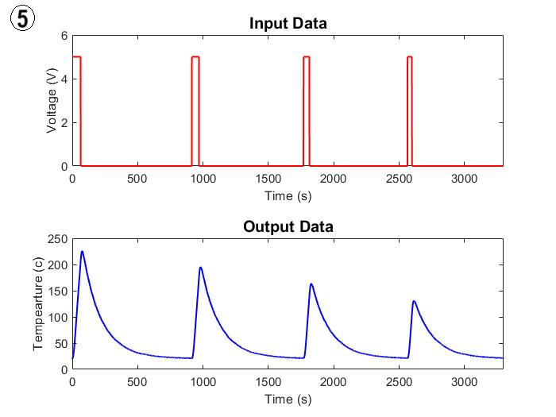
Data Visualization

Slide 18
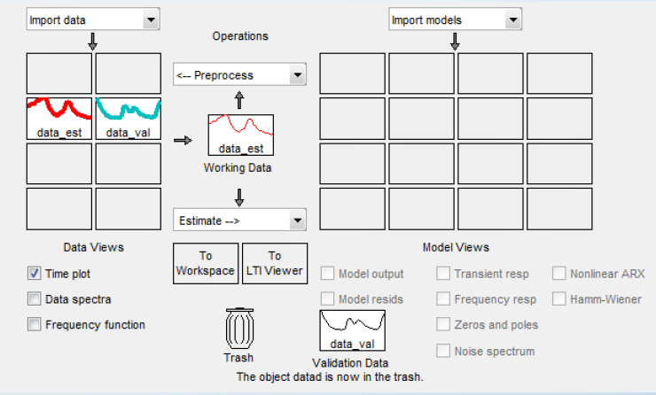
Identify Linear or Non-Linear Model
Using System Identification toolbox to obtain the model for the system.
The analysis of the data indicated that the system exhibited non-linear characteristics.
A Hammerstein model was determined to be a suitable representation of the system and was validated.

Slide 19
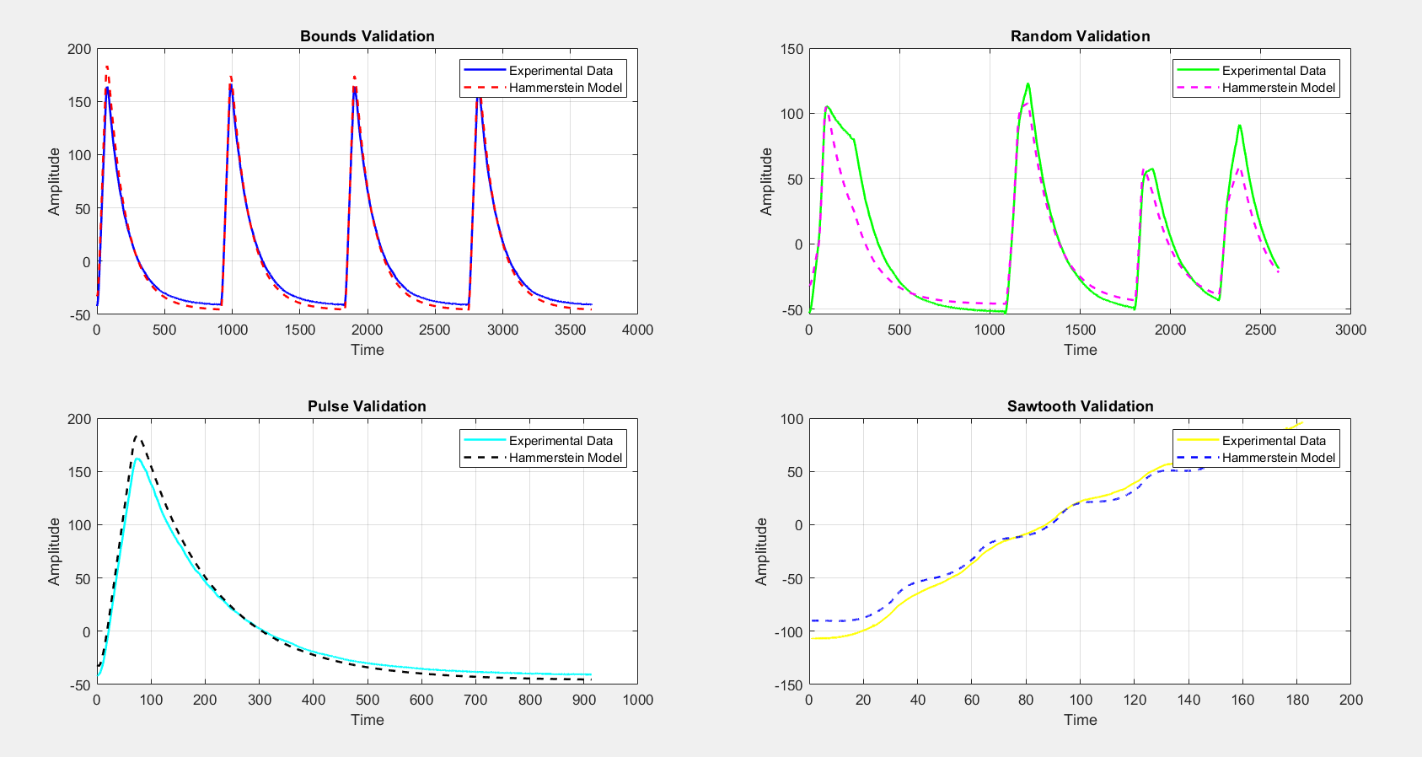
Validate Model

Slide 20
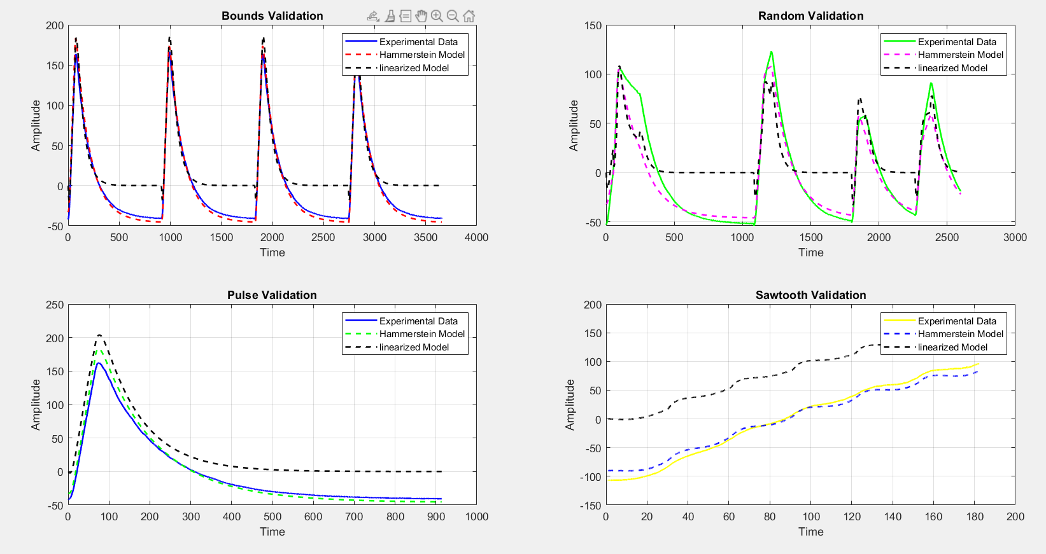
Linearized the Model

Slide 21
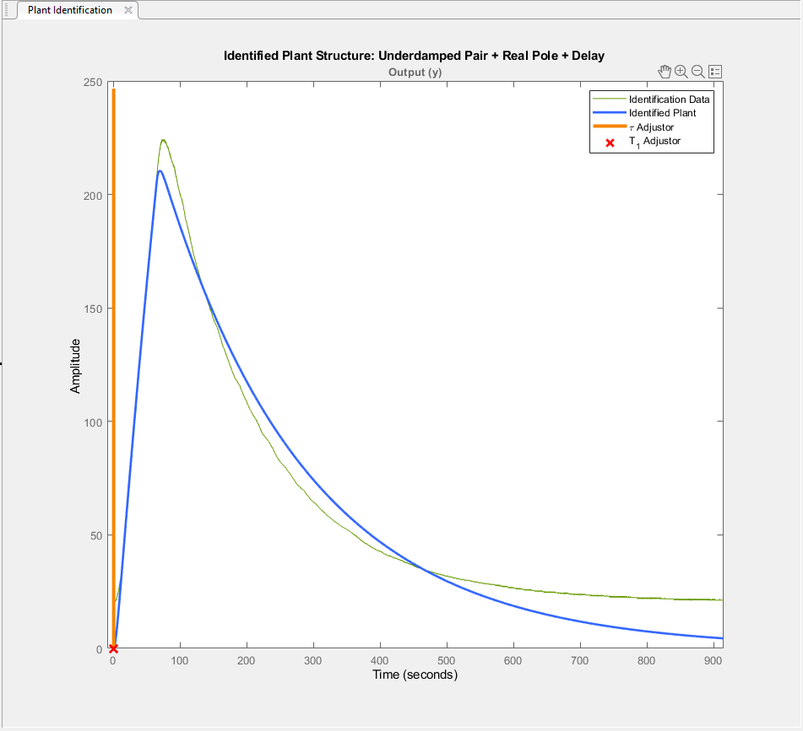

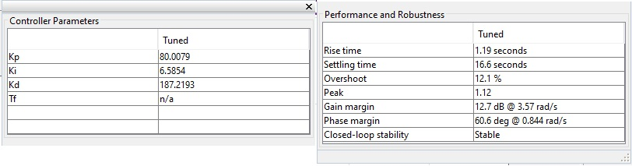
PID controller

Slide 22
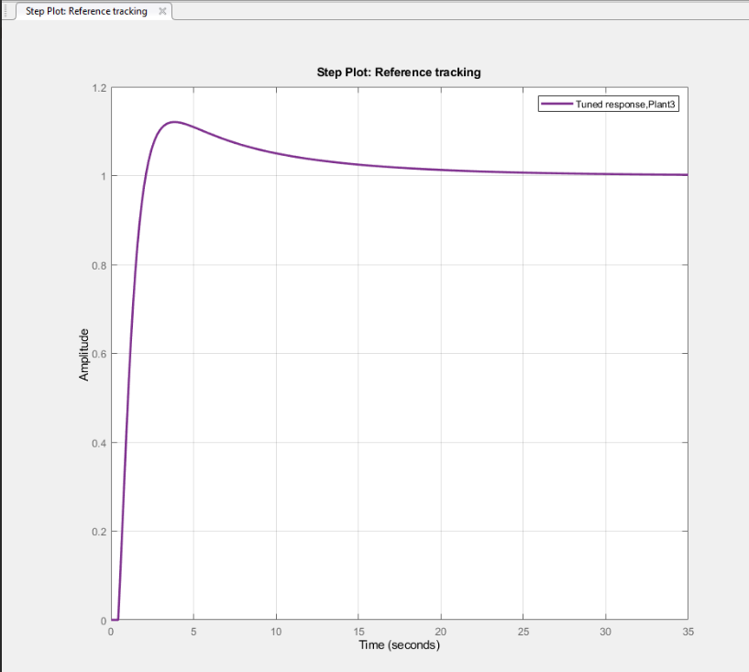
PID controller

Slide 23
Data Collection for PLA and TPU Materials
Initial temperature set at 175°C.
Extrusion speeds varied from 40 to 180 mm/min, increased in 20 mm/min increments.
Extrusion conducted for one minute.
Procedure repeated at 200°C and 225°C.
Upper limit of extrusion speed increased to 280 mm/min at 200°C and 360 mm/min at 225°C.
Each temperature-speed setup replicated three times for data consistency.

Slide 24
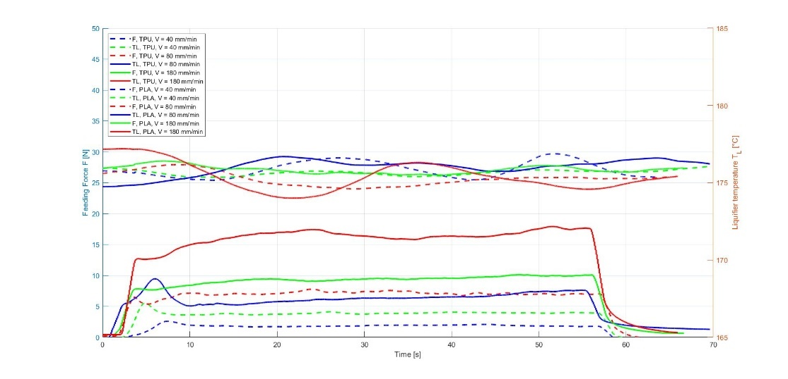
Comparison between PLA and TPU materials

Slide 25
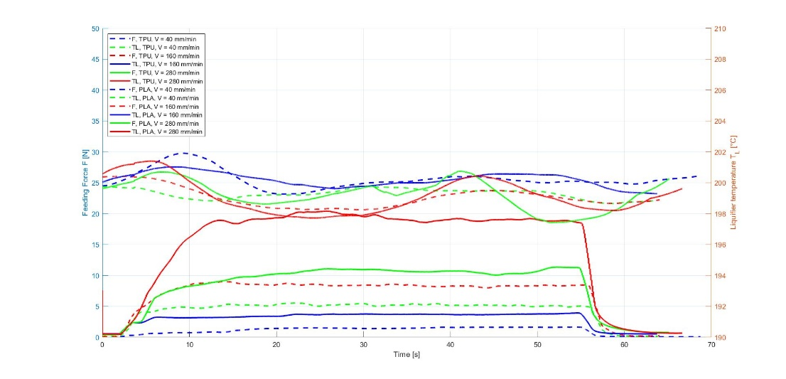
Comparison between PLA and TPU materials

Slide 26
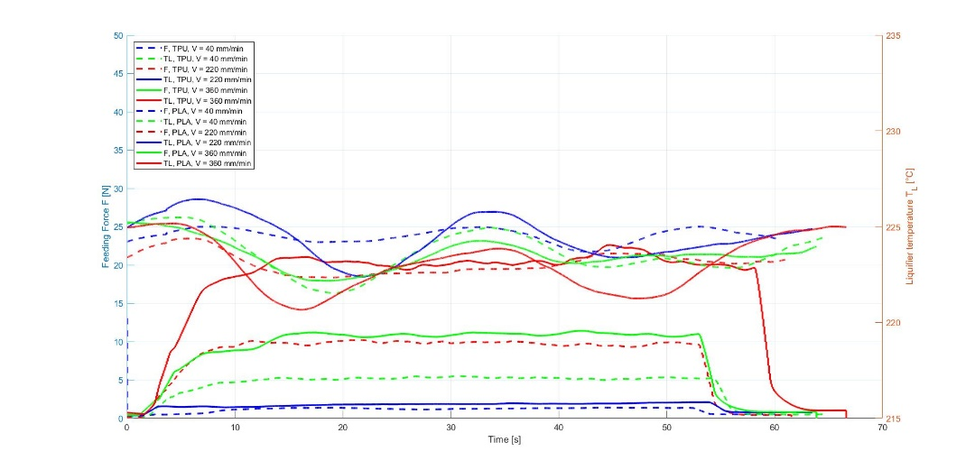
Comparison between PLA and TPU materials

Slide 27
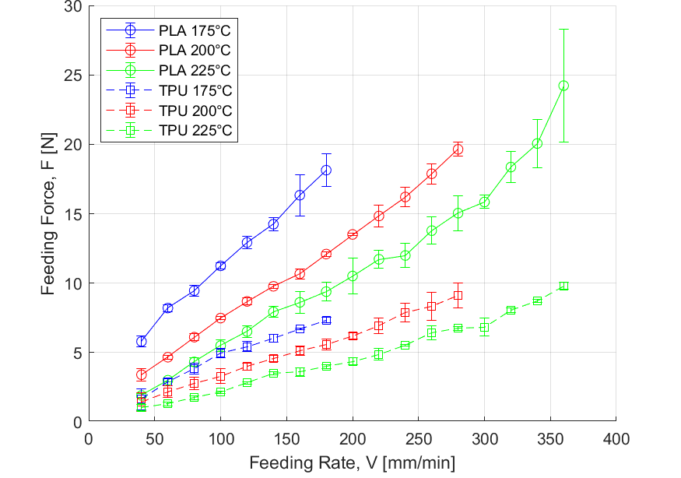
Feeding Force in PLA and TPU Extrusion

Slide 28
Thank you for your attention!

