Slide 1

Smart Lifting Machine
Prepared By :
Nafe’ Hamad
Ahmad Yaqoup
Supervisors:
Dr. Luai Malhis

Slide 2
Outline
Introduction.
Application idea.
Tools.
Features.
Constraints.
Future Work.
Demo.

Slide 3
Introduction
Smart Lifting Machine it is a modern work machine that can be controlled through hand rotation or through a mobile application. This machine uses magnet attached to the arm that can be controlled by hand rotation or application. The machine also carries a sensor that makes it stop moving forward when there is a barrier nearby. Moreover, the machine has the ability to store movements and re-execute them again.

Slide 4
Application idea :
Smart Lifting Machine:
It’s a system consists of glove, car and mobile application.
Glove represents the sender and car the receiver.
Car and arm movement controlled by glove and mobile application .
Car has ultrasonic to detect barriers.
Movements storage and replay are available

Slide 5
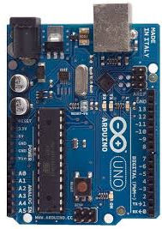
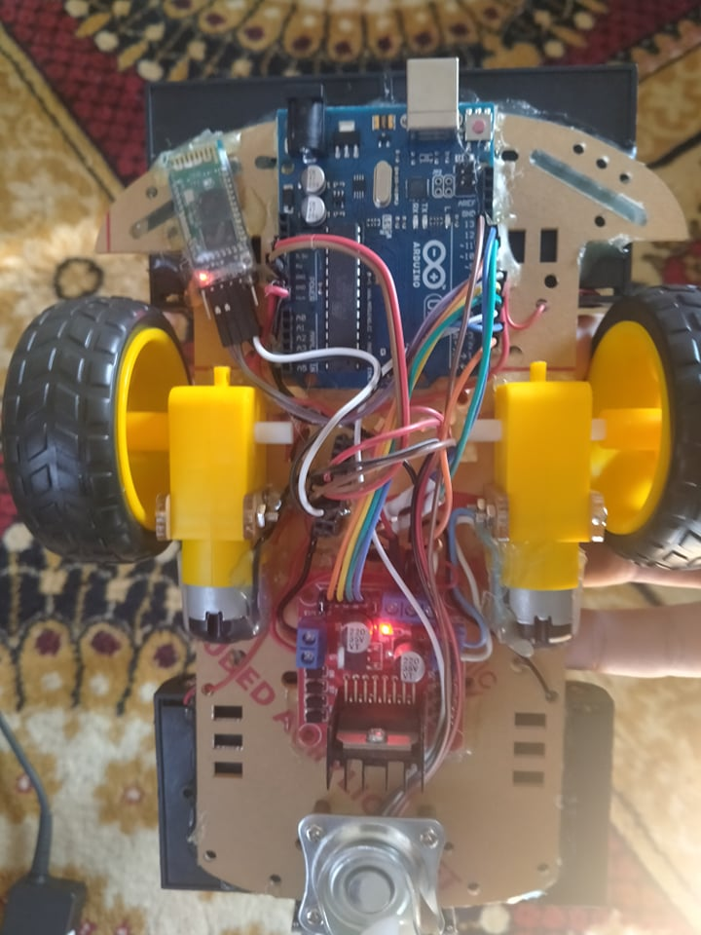
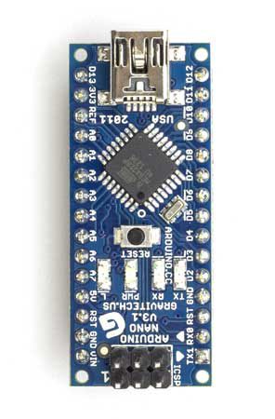
Tools:-
-:Hardware:-
Arduino Uno
car
Arduino Nano

Slide 6
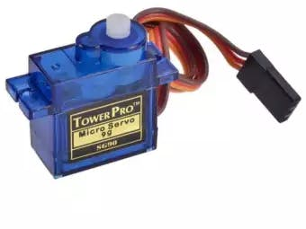
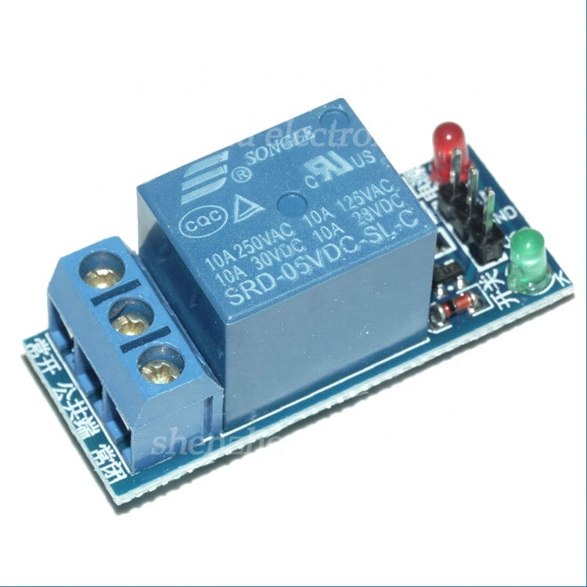
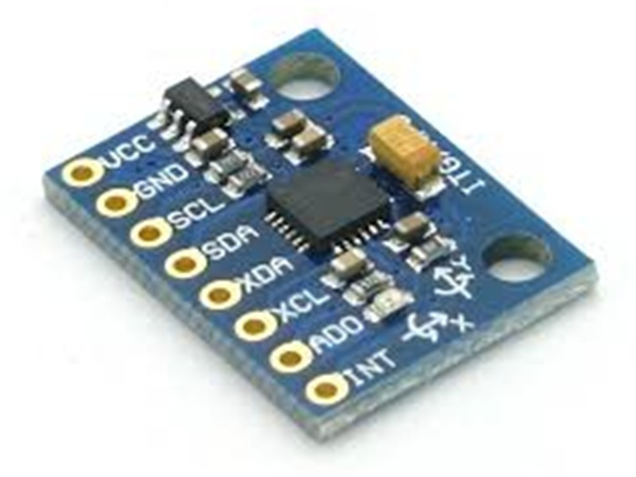
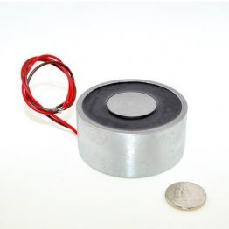
Servo
Relay
gyroscope
Electromagnet

Slide 7
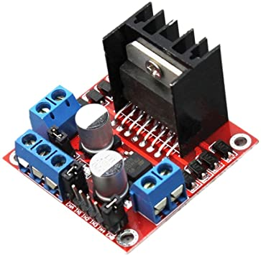
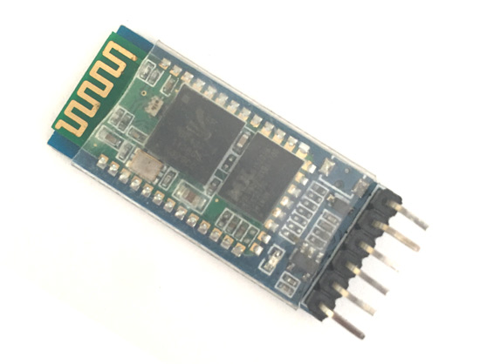
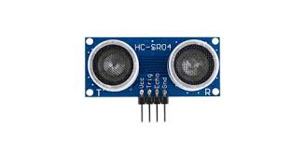
H-bridge
Bluetooth
Ultrasonic

Slide 8
Software:-
Arduino IDE 1.8.13

Slide 9
Features
Control the car by gyroscope or mobile application.
Control the arm with button and gyroscope .
can record the movement of the arm .
Repeating the movements made by the arm for an unlimited number of times.
Control the magnet by a button on the hand.

Slide 10
Constraints
Covid 19 virus.
Learning new technology and skills.
Time And e-learning.

Slide 11
Future Work:
Switch the fixed magnet to another for demolition and lifting.
Add features depends on artificial intelligent.

Slide 12
Demo

Slide 13
Thank You

