Slide 1
Graduation Project
prepared by:
Neveen Moqadeh
Jowana Nasrallah
Supervised by:
Dr.Maher AbuBaker

Slide 2
Assist The Management Of Tulkarem Municipality In Electricity Of Prepaid Bills

Slide 3
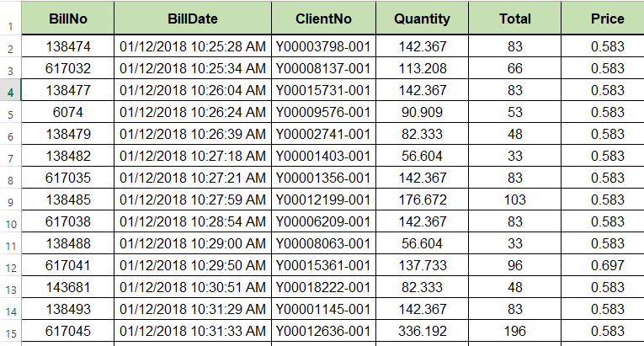

Slide 4
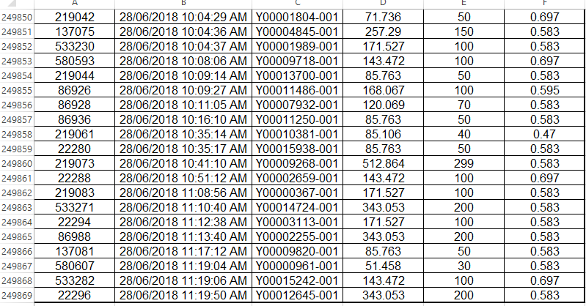
*****************************************

Slide 5
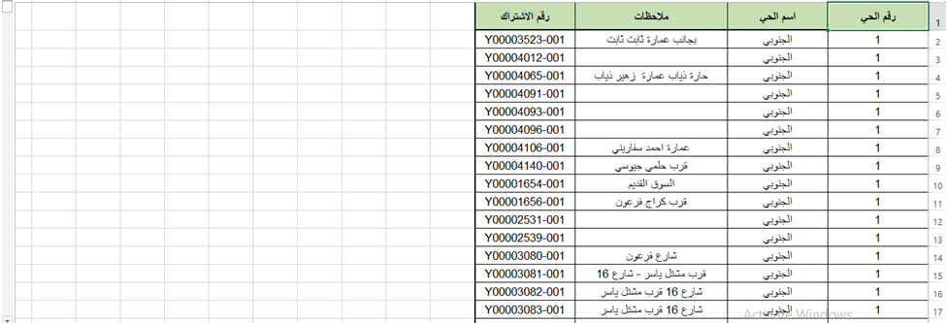

Slide 6
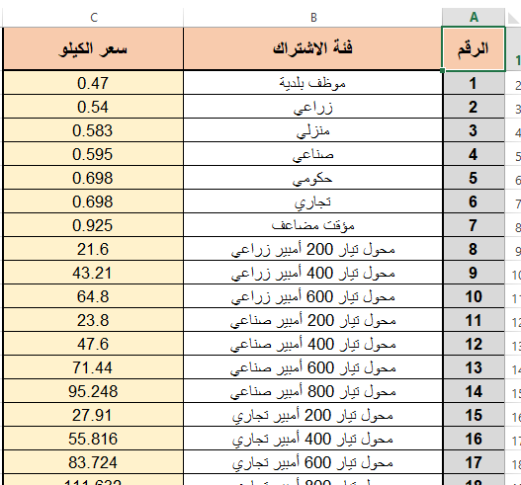

Slide 7
The Main Goal :
Help them to draw their policies in various areas planning and management
Municipality Questions(problems):
1-Split the subscribers according to the charging quantity into three classes
Class 1: 0 _160
Class 2: 161 _400
Class 3: 400

Slide 8
2- The amount of electricity consumption by region to help them make decisions in the locations of electricity charging centers
3- The increase in electricity charging (subscriber
consumption) during the months
4- Number of subscribers classified by classes per months
5- solve the discrepancy the quantity of charging electricity and the employees there serve customers

Slide 9
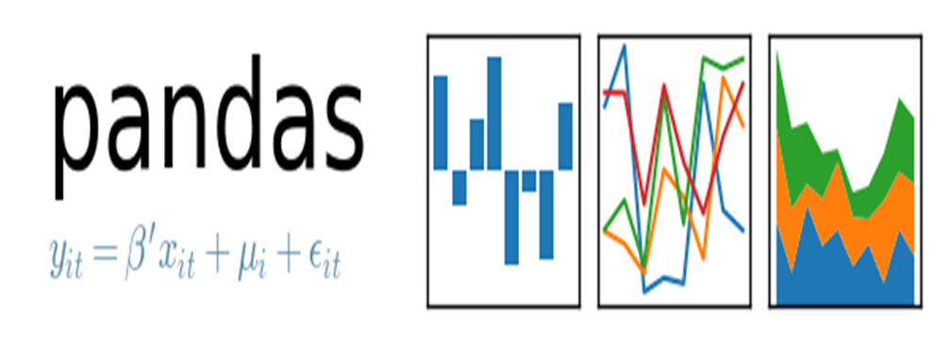
Tool →

Slide 10
….
Preparation
------

Slide 11
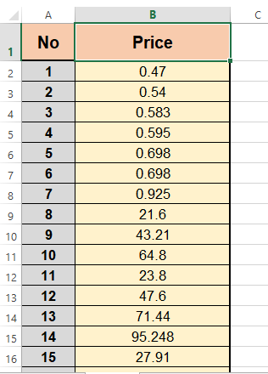
NO..PRICE→

Slide 12
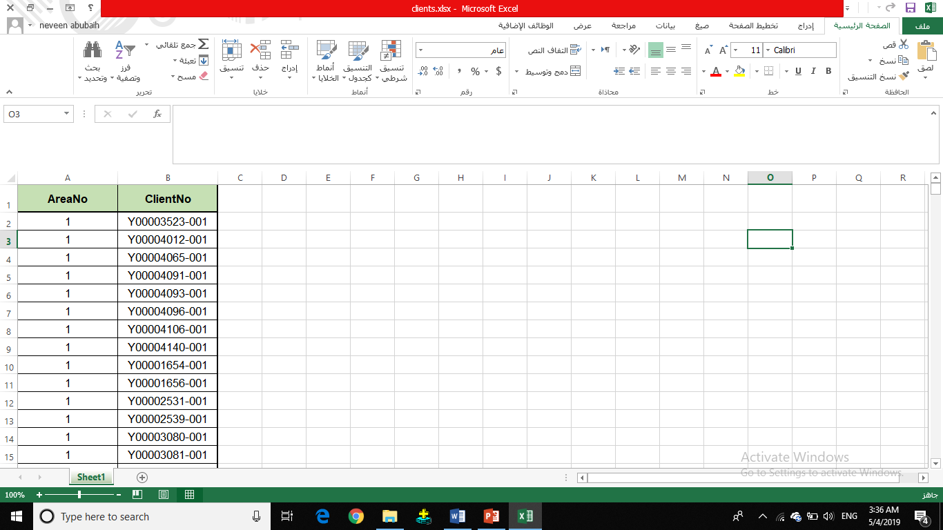

Slide 13
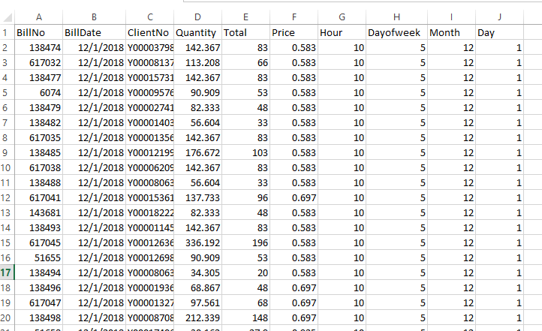

Slide 14
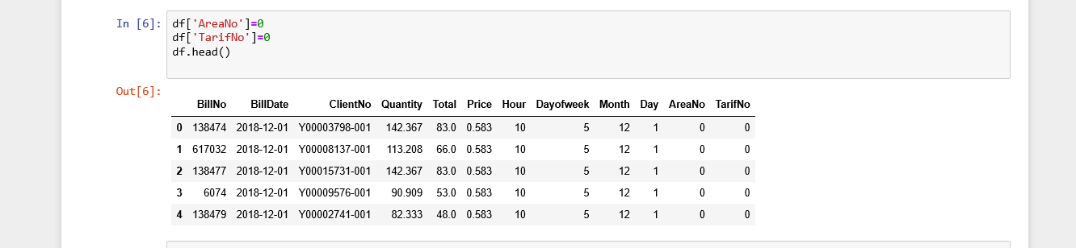
***

Slide 15
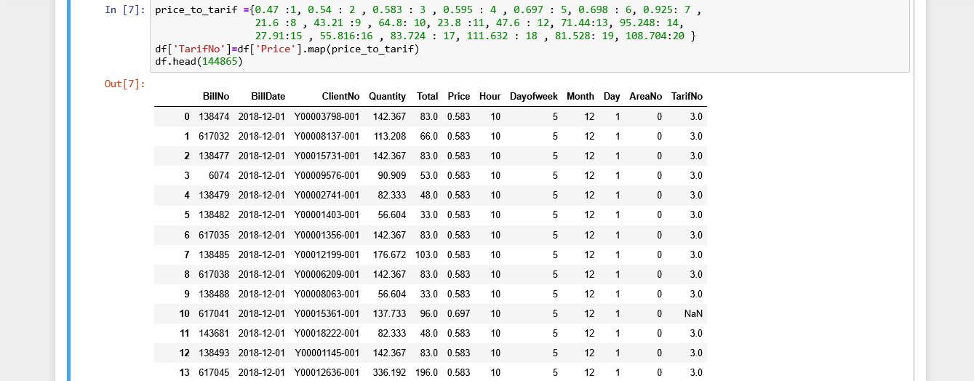

Slide 16
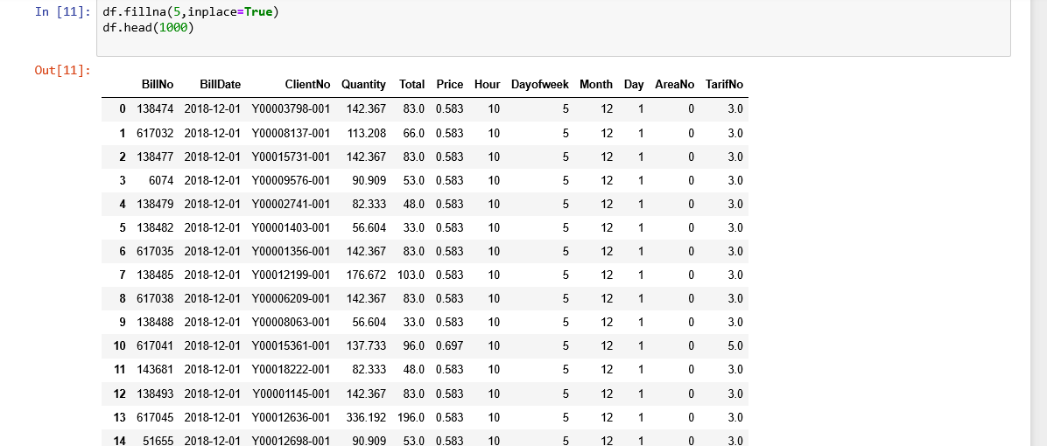
/

Slide 17
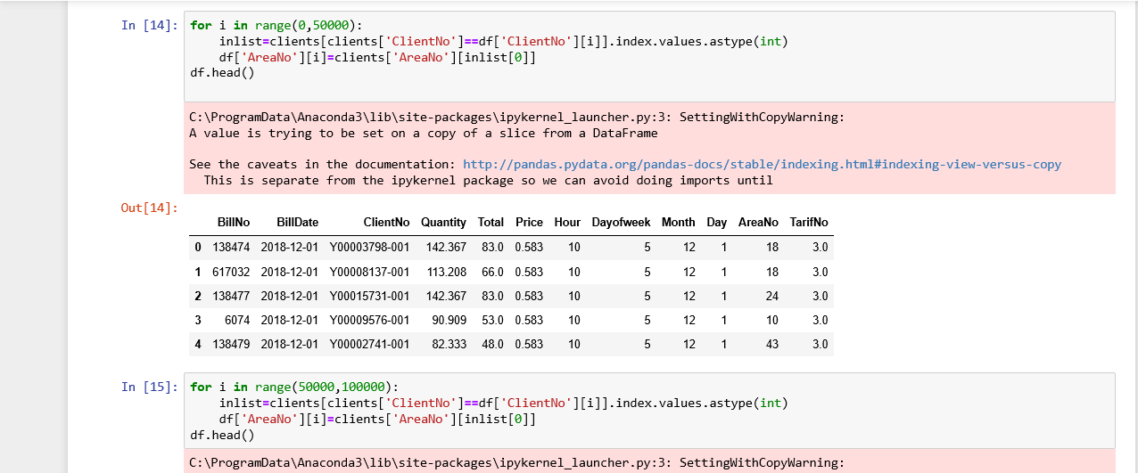

Slide 18
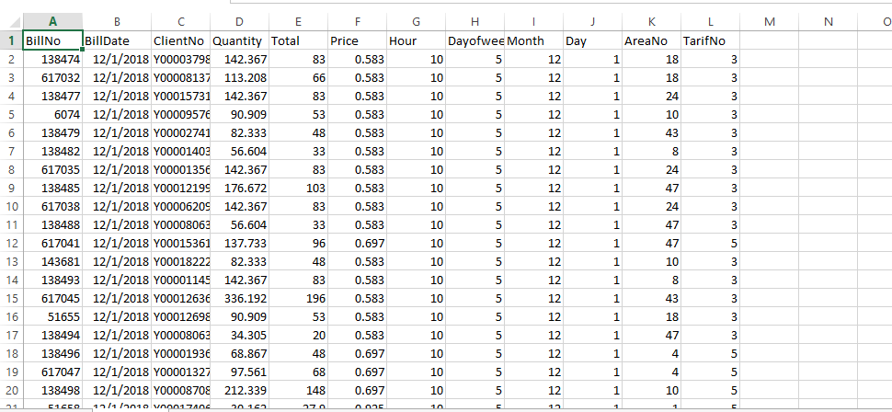

Slide 19
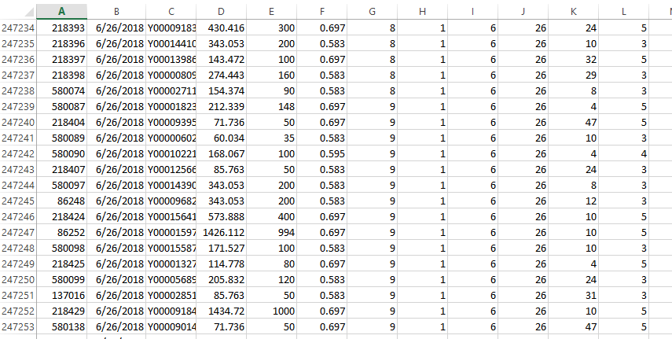

Slide 20
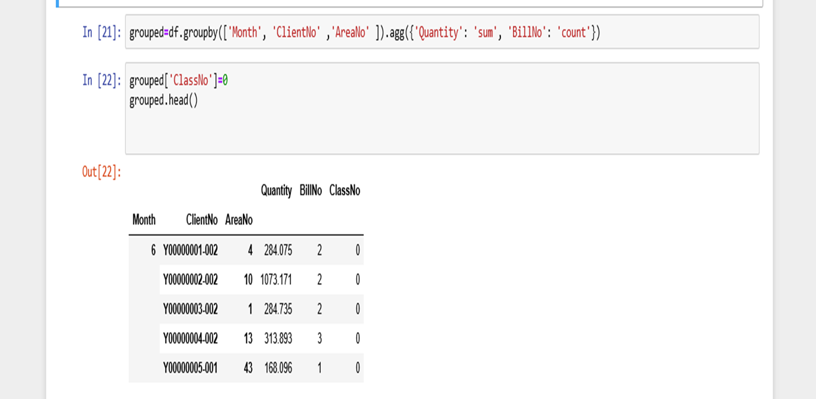

Slide 21
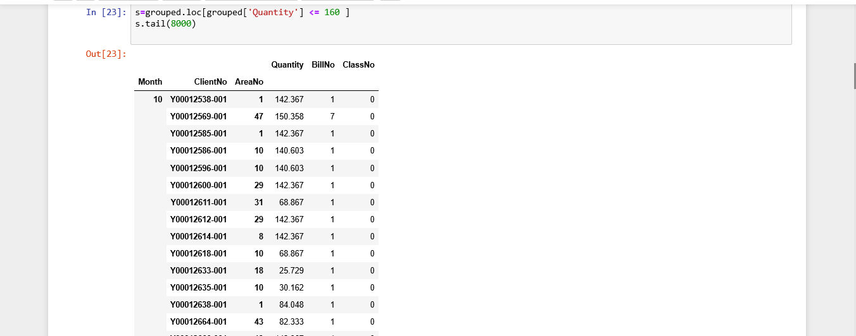

Slide 22
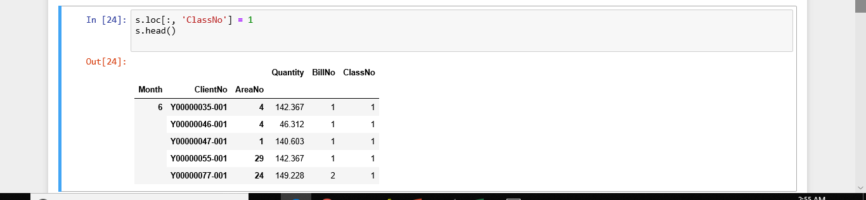

Slide 23
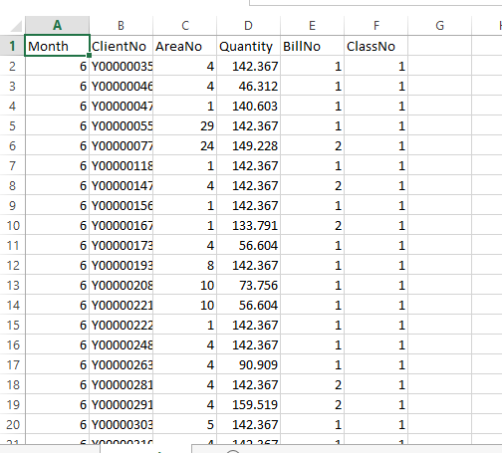

Slide 24
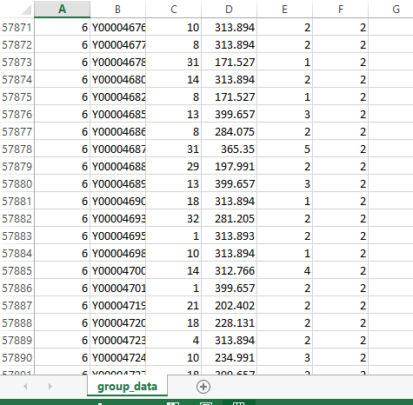
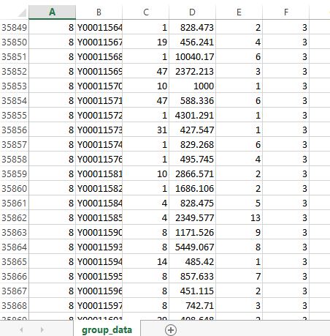

Slide 25
Visualization
****

Slide 26
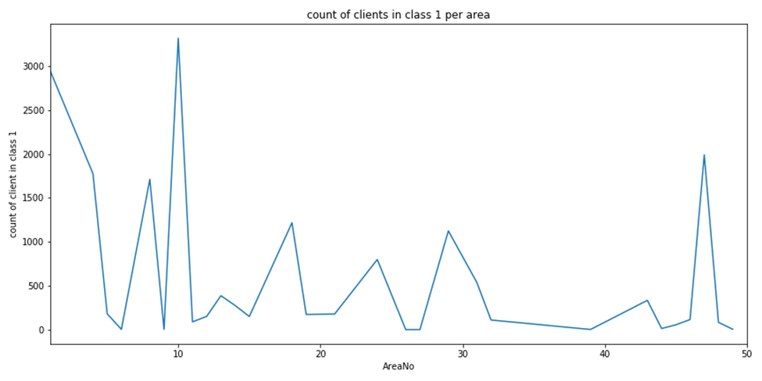
What is count of clients in class 1 in each Area?

Slide 27
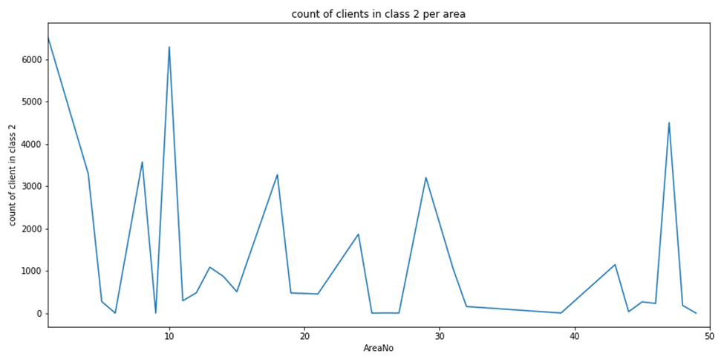
What are the Count of Clients in class 2 in each Area?

Slide 28
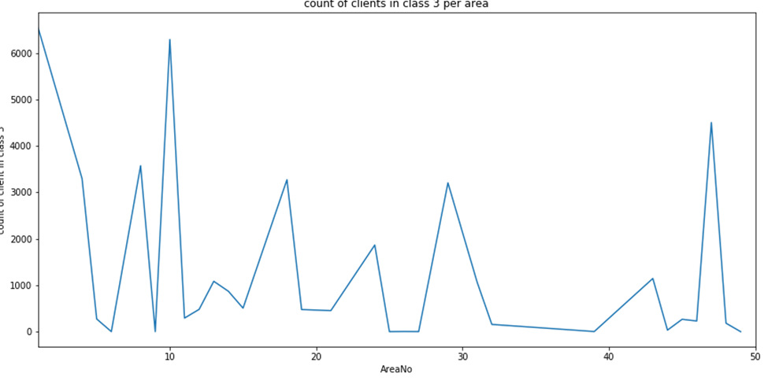
What are the Numbers of Clients in class 3 in each Area?

Slide 29
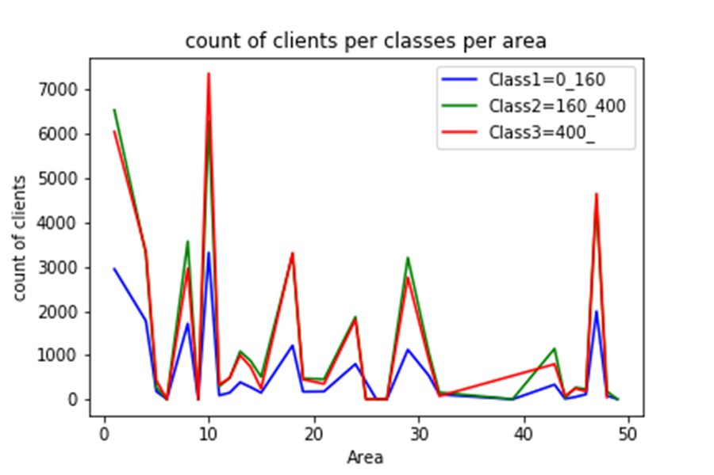
What are the Count of Clients in each Class in each Area?

Slide 30
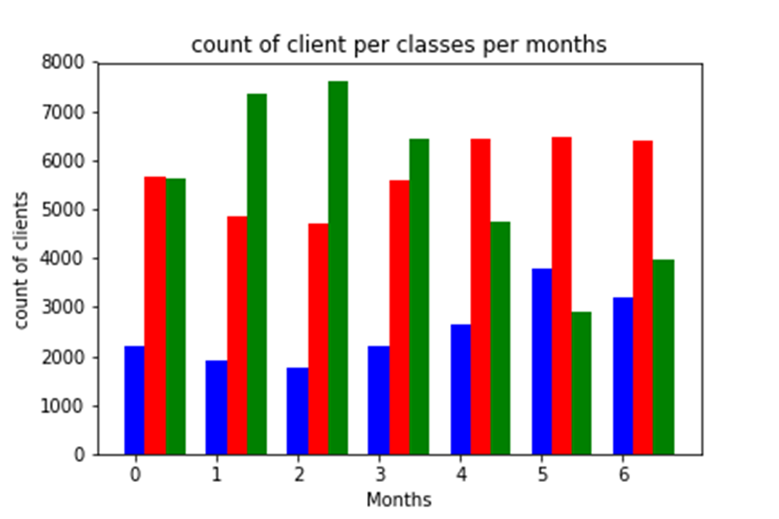
What is the Count of Clients in each Class for each Month?

Slide 31
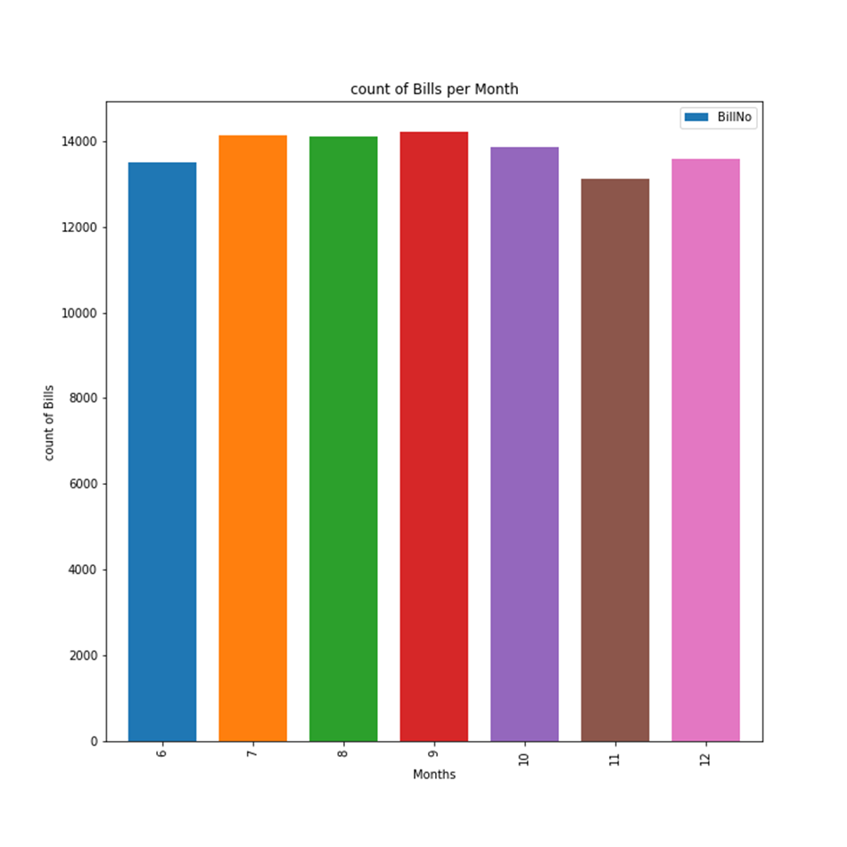
What is the Count Bills per Month?

Slide 32
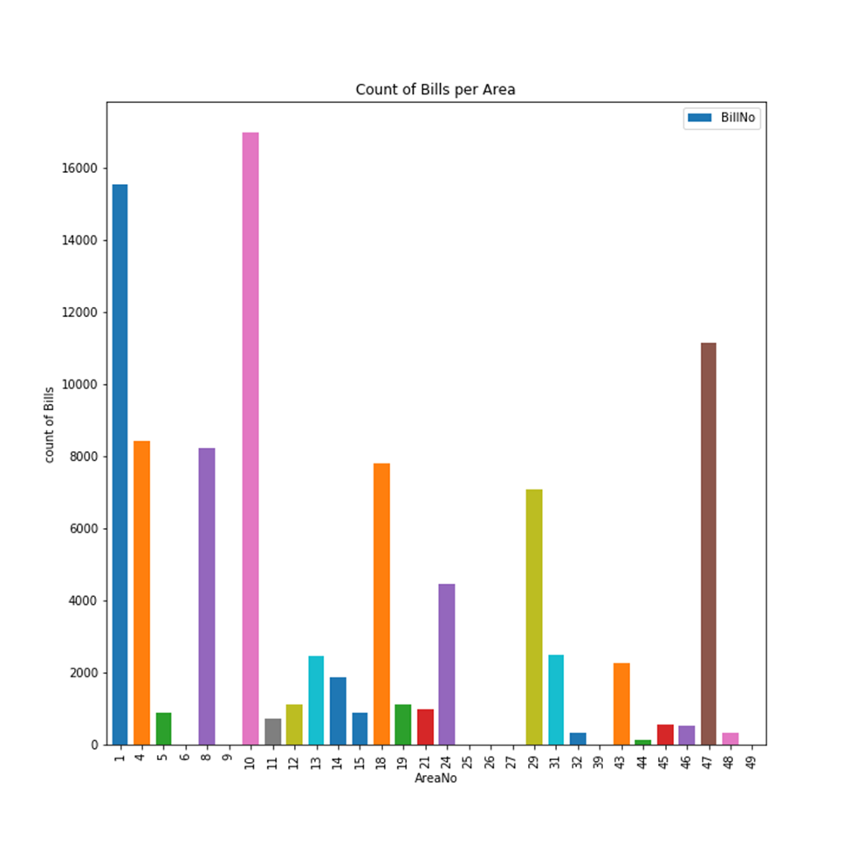
What is the Count Bills in each Area?

Slide 33
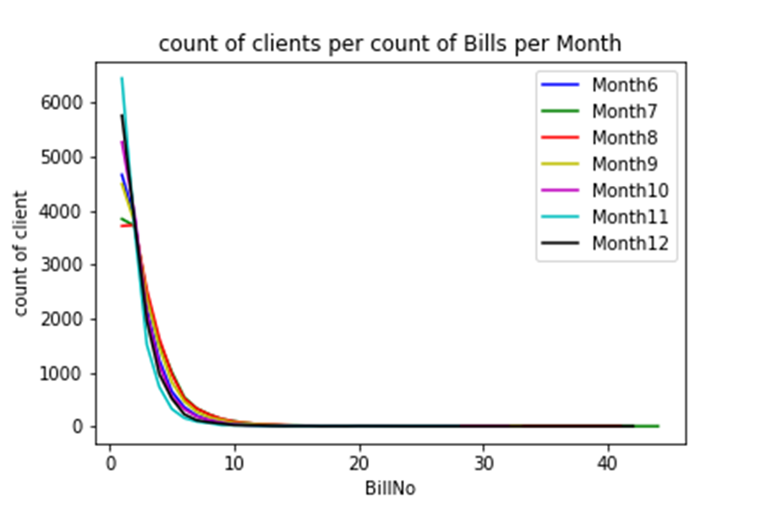
What is the Count of Clients according to Bill Number per Month?

Slide 34
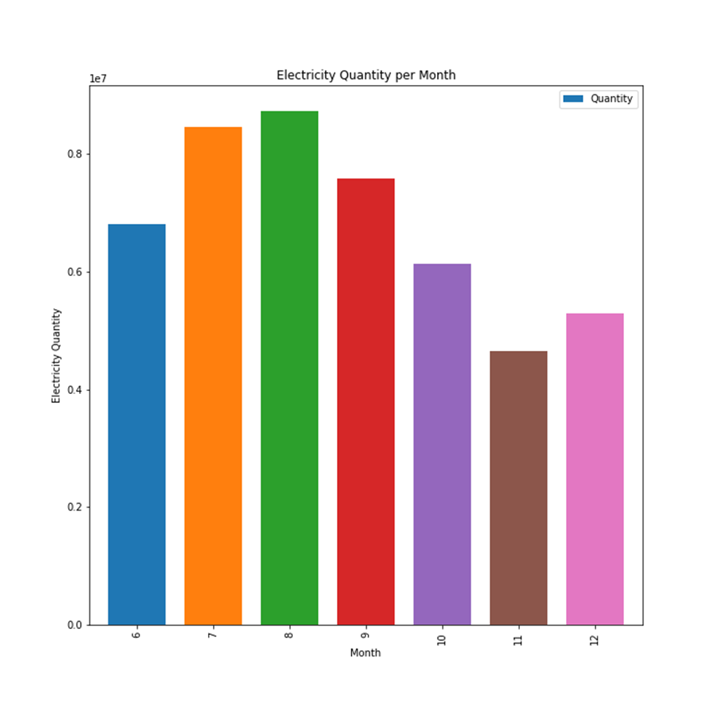
What is the Electricity Quantity consumed per Month?

Slide 35
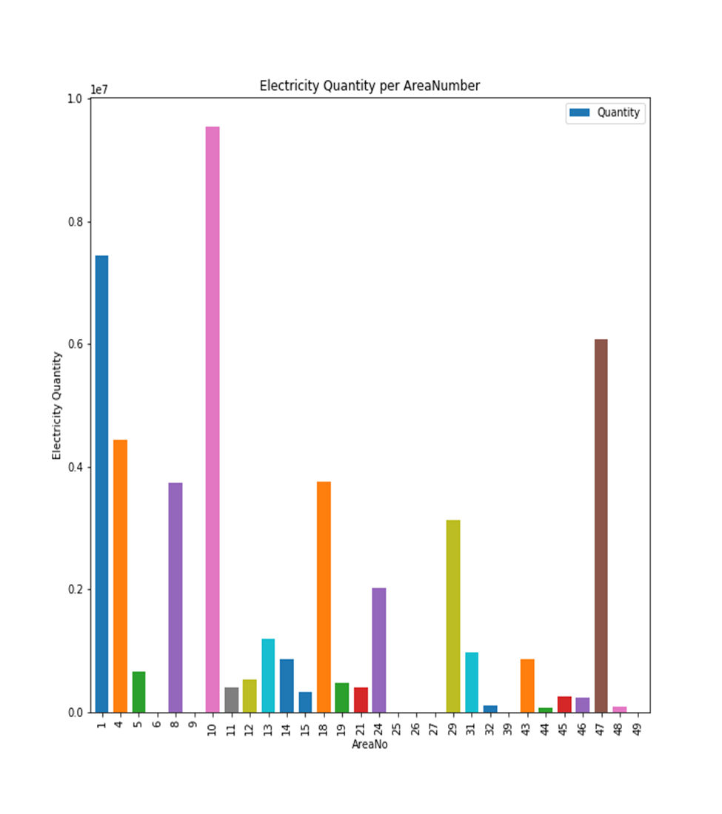
What is the Electricity Quantity Consumed per Area?

Slide 36
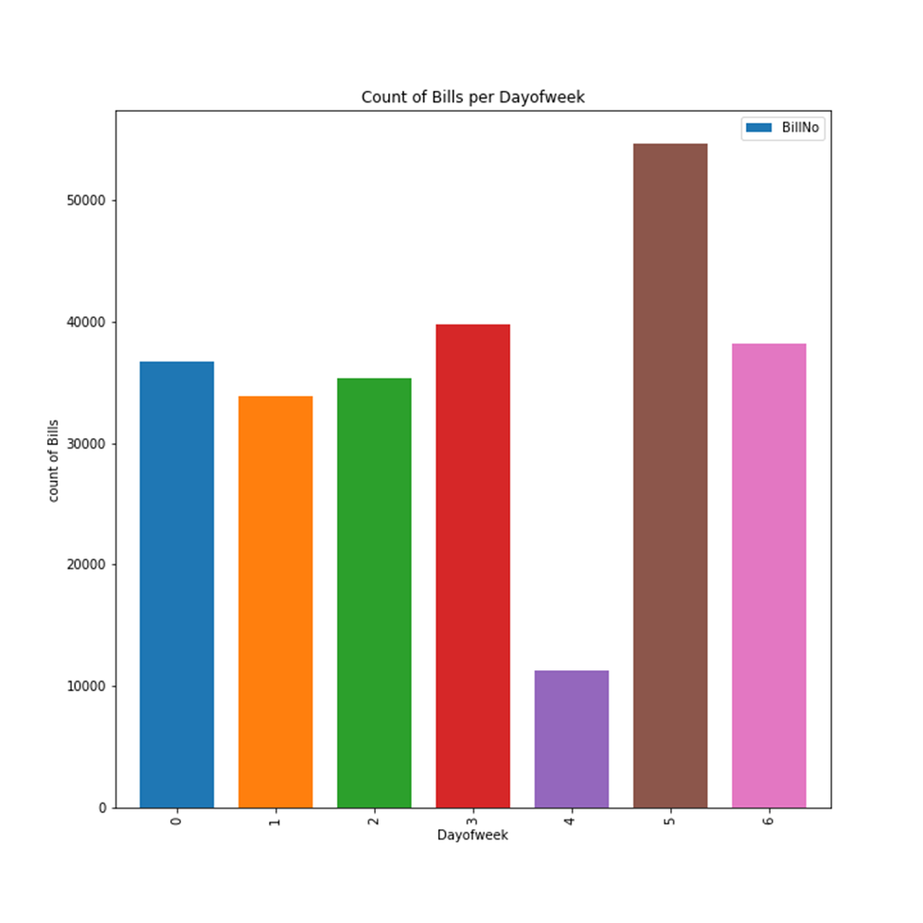
What is the Count of Bills per Day of the Week?

Slide 37
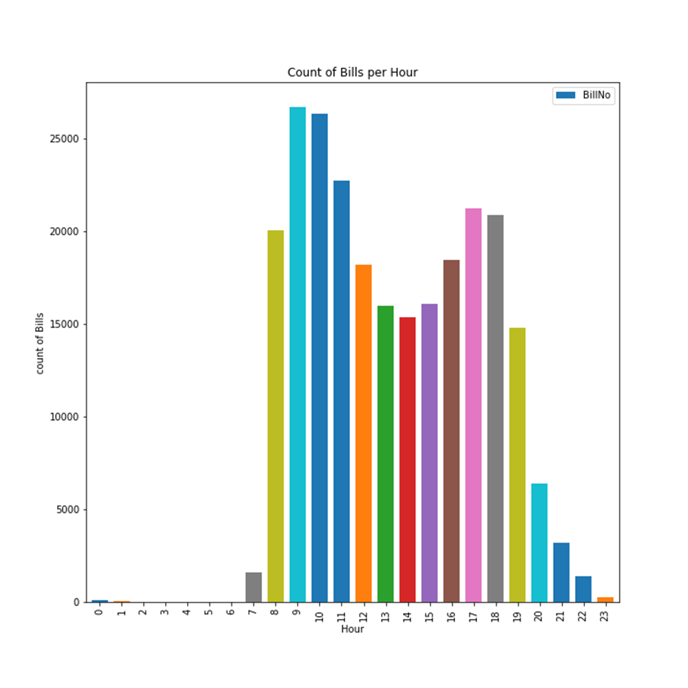
What is the Count of Bills per Hour throw-out the Day?

Slide 38
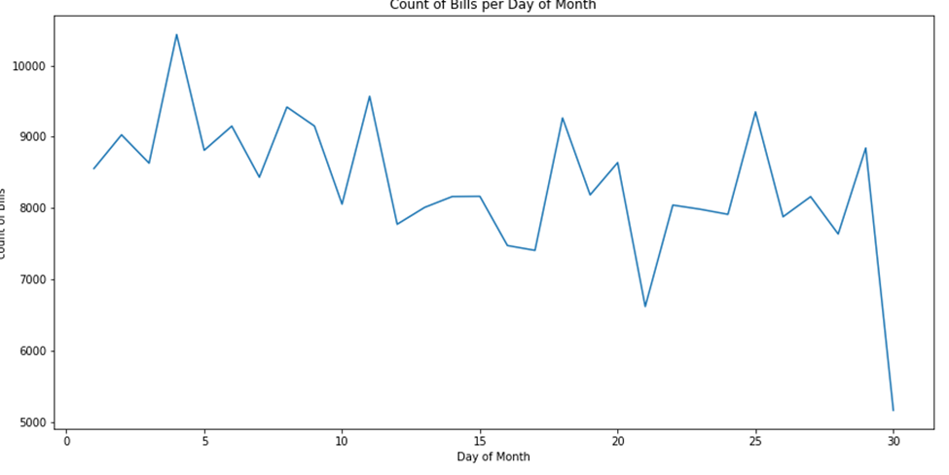
What is the Count of Bills per Day of the Month?

Slide 39
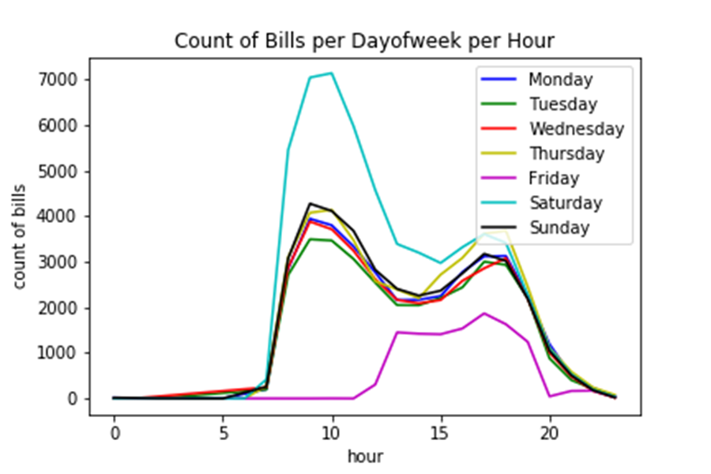
What is the Count of Bills per Hour of each Day of the Week?

Slide 40
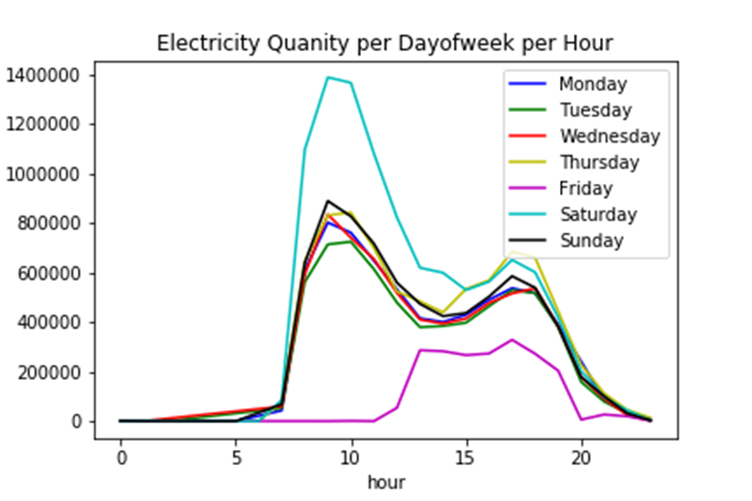
What Is Electricity Quantity Per Hour In each Day Of the Week?

Slide 41
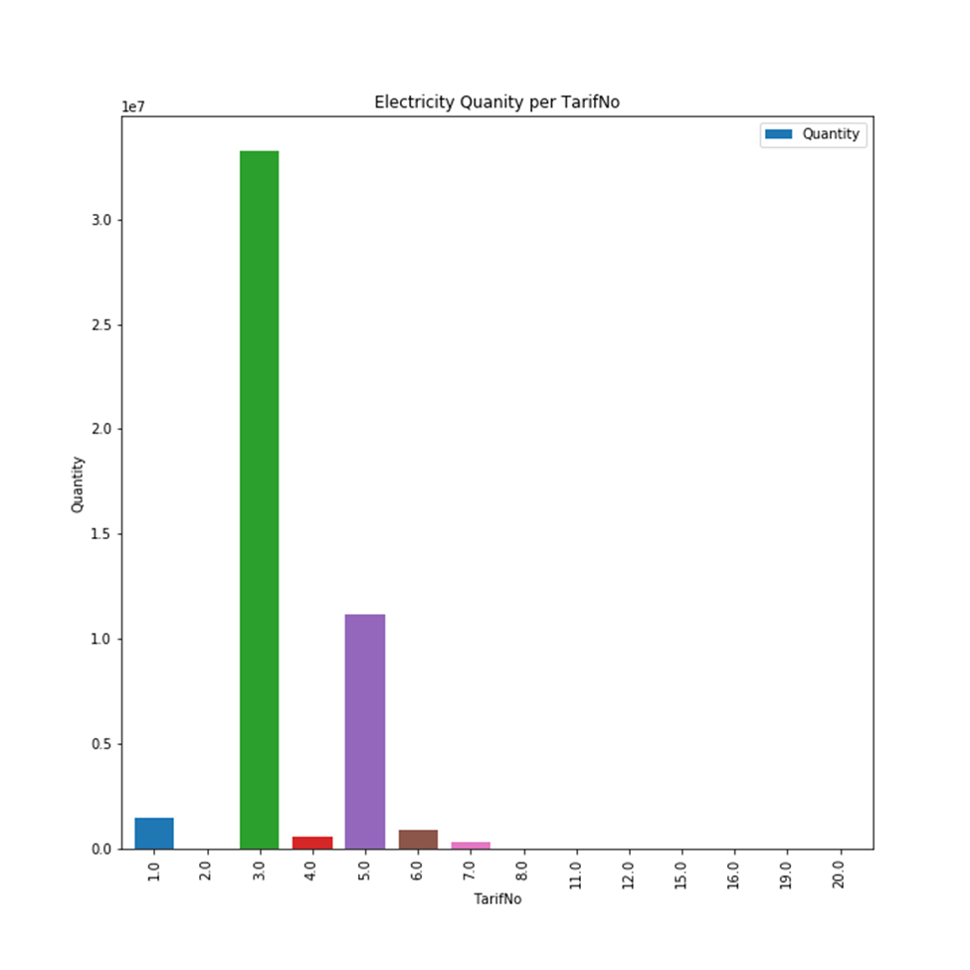
What Is The Electricity Quantity per Tariff?

Slide 42
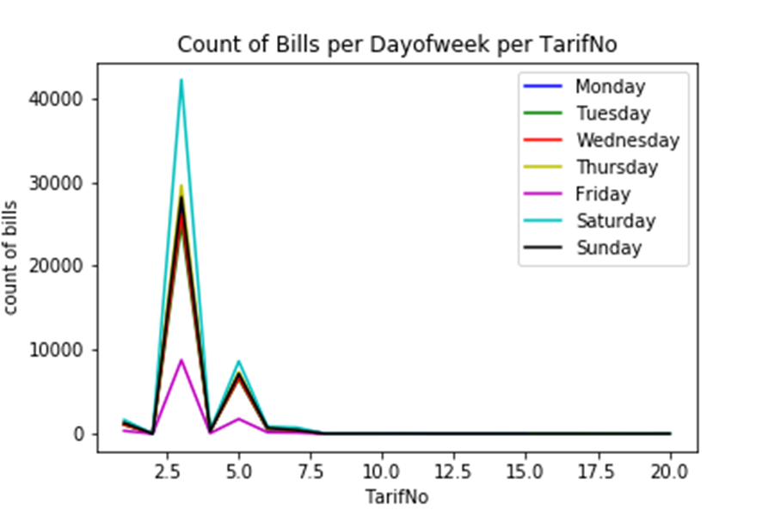
What is the Count of Bills per Tariff of each Day of the Week?

Slide 43
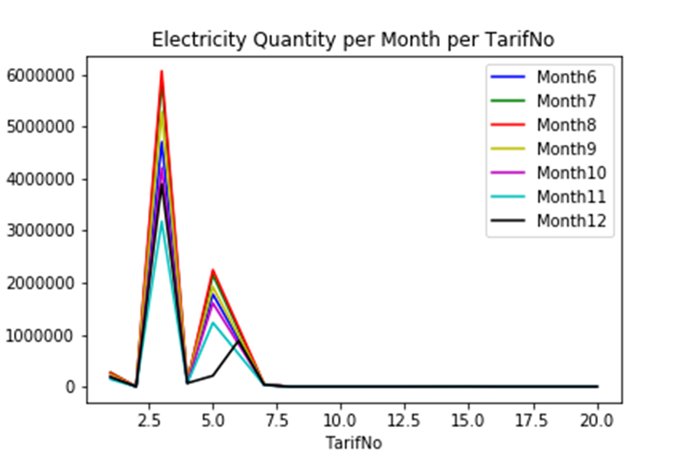
What is the Electricity Quantity per Tariff each Month?

Slide 44
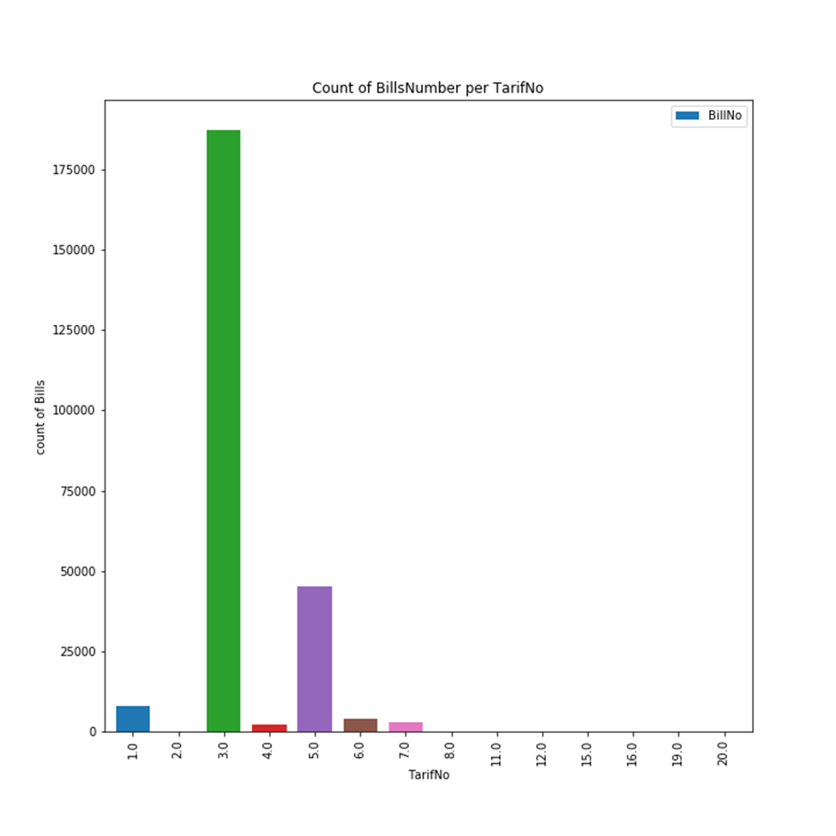
What is the count of Bills per Tariff?

Slide 45
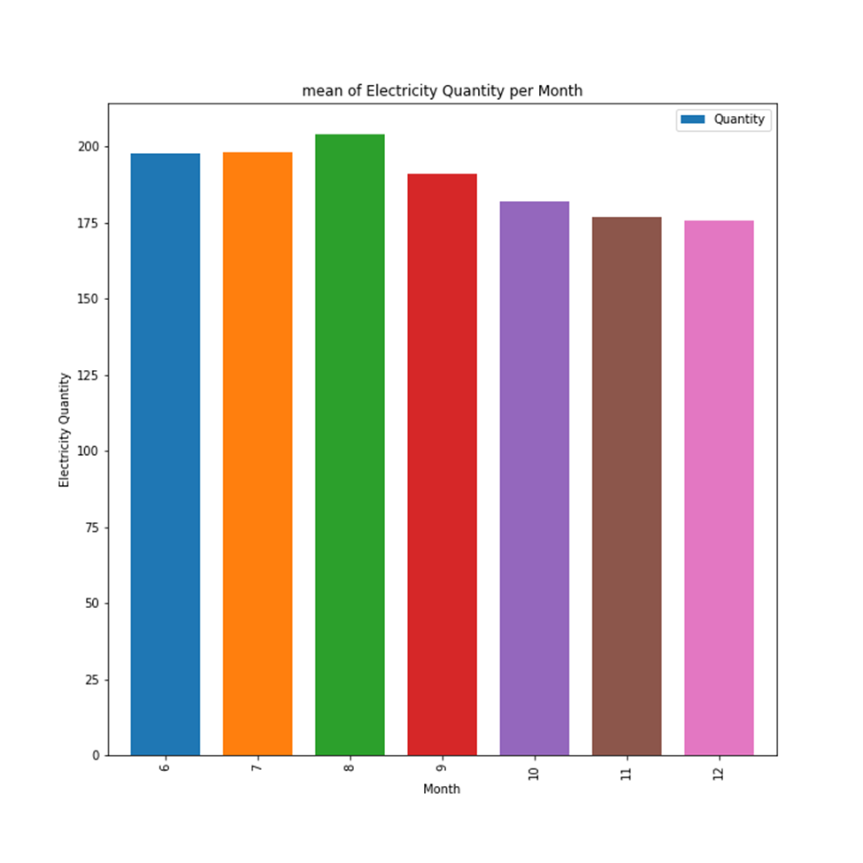
What is the Mean of Electricity Quantity per Month?

Slide 46


Slide 47
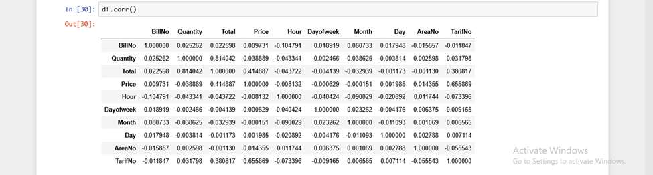

Slide 48
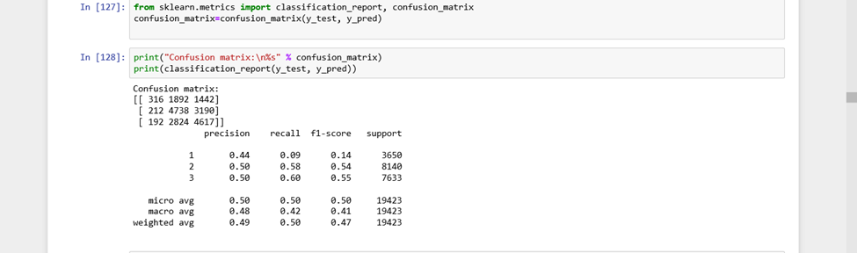
1- Support Vector Machine

Slide 49
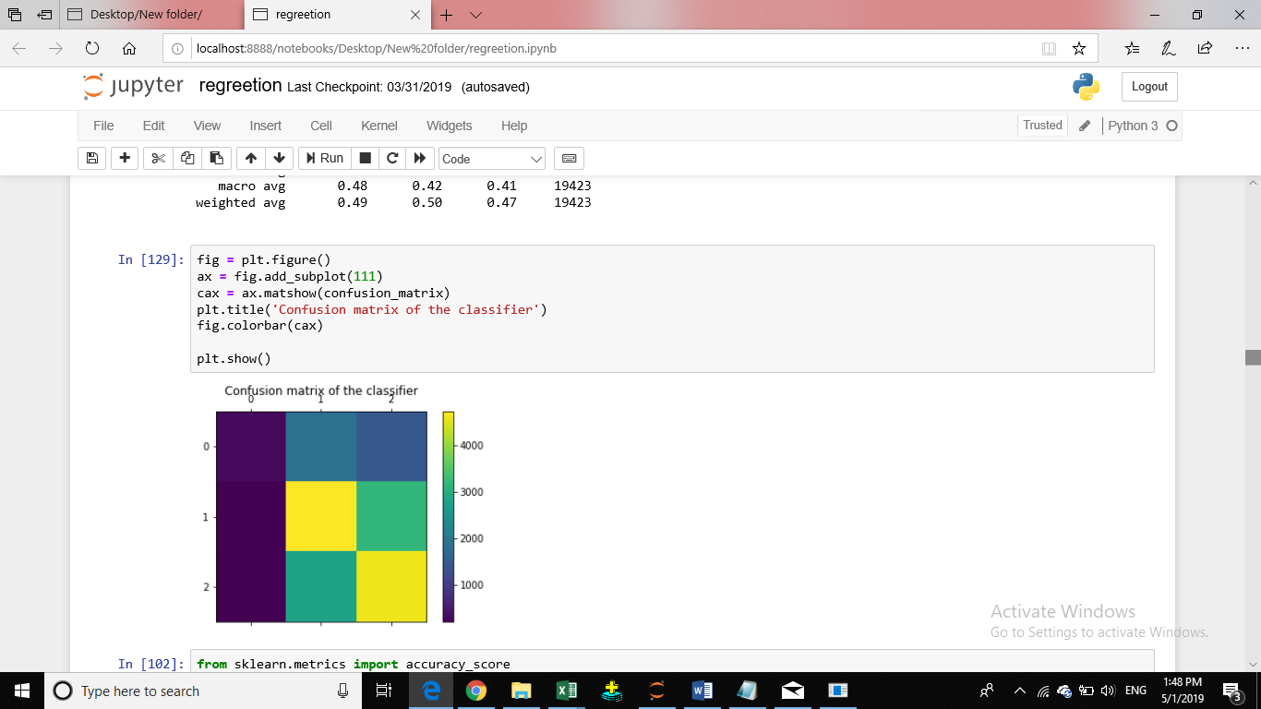

Slide 50
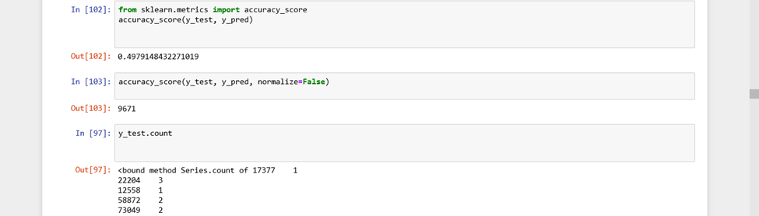

Slide 51
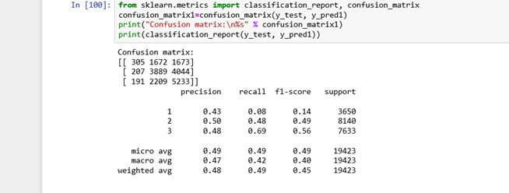
2- Naive_Bayes Classification

Slide 52
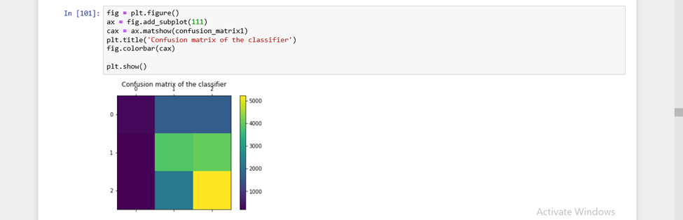

Slide 53
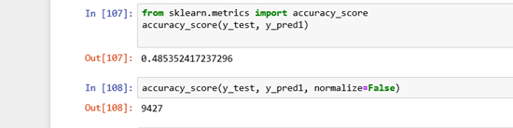

Slide 54
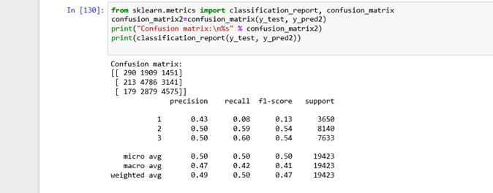
3-Descion Tree Classification

Slide 55
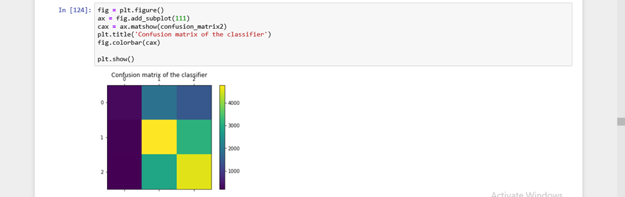

Slide 56
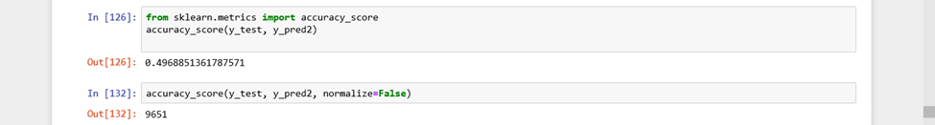

Slide 57

4- K-Nearest Neighbors Classification

Slide 58


Slide 59


Slide 60

5- Neural Network

Slide 61


Slide 62


Slide 63

6- Linear Discriminant Analysis

Slide 64


Slide 65


Slide 66

7- Logistic Regression

Slide 67


Slide 68


Slide 69
RESULT THE
The simple victor machine id give us the large accuracy personage
0.4979148432271019
In simple split
k_ford methods
It has not changed dramatically
.49517312395417684
The simple victor machine id give us the large accuracy personage
In simple split
0.4979148432271019
K-FORD methods
.49517312395417684
It has not changed dramatically

Slide 70


Slide 71

THANK YOUUU
Any Questions ?

