Slide 1


Graduation Project Seminar:
Hand Gestures Based Applications
“Virtual Mouse, Virtual Piano, Integration with Interactive Game”
Supervised by:
Dr. Luai Malhis.
Prepared by:
Suad Seirafy.
Fatima Zubaidi.

Slide 2
Outlines:
Introduction
Accomplishments
Implementation
Experiments
Future Work
Conclusion

Slide 3
Outlines:
Introduction
Accomplishments
Implementation
Experiments
Future Work
Conclusion

Slide 4
Introduction..
Trend:
Computers can communicate with people with body language.
Hand gesture recognition becomes important
  Interactive human-machine interface and virtual environment .
In Today’s world:
  Many devices with integrated cameras.
  Many personal webcams.

Slide 5
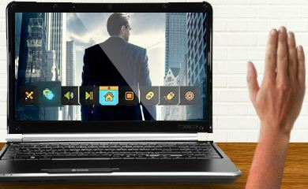
Introduction..
Our Goal:
  To understand how to take advantage of these one camera systems to build interactive real time applications by using the hand gestures.

Slide 6
So, What do We need?!
“A Real Time Hand Gestures Recognition Approach”

Slide 7
Introduction..
Where it can be applied?
Computer Interface
  A real time 2D input device (Hand Tracking).
  Translation of gestures to commands.
Aid for disabled and deaf people:
  Sign language analysis, translation.
Entertainment
  Applications involving hand gesture recognition, from computer games to sound and image design applications.

Slide 8
Outlines:
Introduction
Accomplishments
Implementation
Experiments
Future Work
Conclusion

Slide 9
Accomplishments ..
First Application “ Virtual Mouse”
Virtual Mouse is an idea of implementing an adaptable, multi- functional navigation/interaction tool that overcomes physical barriers.
The system is 'real' enough to not affect the interaction much.
Ease of use is the foremost concern.

Slide 10
Accomplishments ..
First Application “ Virtual Mouse”
This application can control all mouse tasks, such as:
Clicking (right and left)
Double clicking
Dragging and Dropping
Scrolling.
Additional Feature (Show/ Hide Desktop).
Each task has its own hand gesture.
Our system tracks just one hand to recognize its gestures .

Slide 11
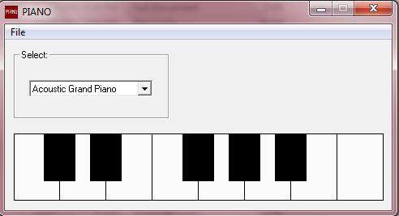
Accomplishments ..
Second Application “ Virtual Piano”
In this application, we needed to keep track of both hands (left and right) to get the correct combination of gestures to relate them with their specific Piano notes.
We’ve supported different gestures for 13 piano notes.

Slide 12
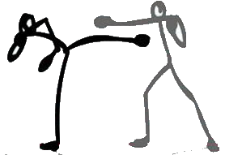
Accomplishments ..
Third Application “ Integration with Interactive Game”
Our Gesture recognition Approach can also be easily integrated into already existing interactive applications.
As an example of this, we integrated it with online interactive 2 player –Stick Fighter- game so that two players can compete in the game each with his right hand.

Slide 13
Outlines:
Introduction
Accomplishments
Implementation
Experiments
Future Work
Conclusion

Slide 14
Implementation..
We’ve implemented our main software using the OpenCV Library in C/C++ environment using Microsoft Visual Studio 2010.
What this gives us?
No Performance Overhead at runtime.
So.. We got Real Time Tracking as fast as we need.
Even if it’s harder to implement.

Slide 15
Implementation..
System Flow Chart
Application Start
Image acquisition
Image processing and hand detection
Application End
Event Generation
Gesture Recognition

Slide 16
Application Start
Image acquisition
Image processing and hand detection
Application End
Event Generation
Gesture Recognition

Slide 17
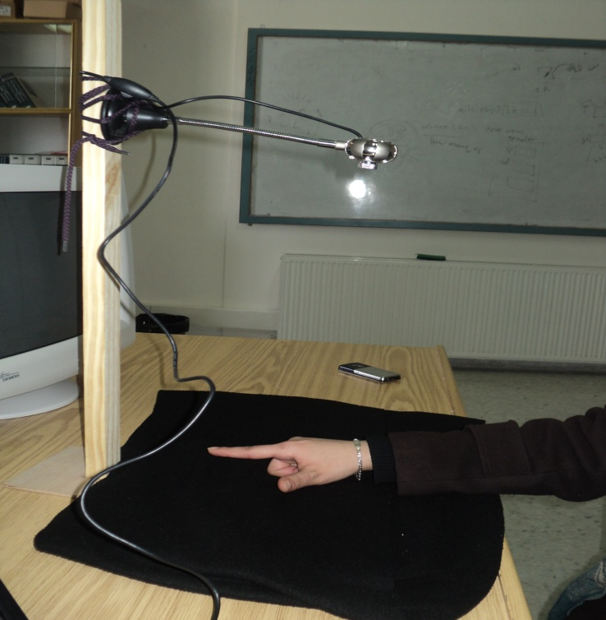
Implementation .. System Flow Chart..
Application Start
User puts his hand/s under the Camera, above a dark background and runs the application.

Slide 18
Application Start
Image acquisition
Image processing and hand detection
Application End
Event Generation
Gesture Recognition

Slide 19

Implementation .. System Flow Chart..
Image Acquisition
Read a video stream frame by frame from the camera then continuously get each frame and analyze it.
Analyze it

Slide 20
Application Start
Image acquisition
Image processing and hand detection
Application End
Event Generation
Gesture Recognition

Slide 21
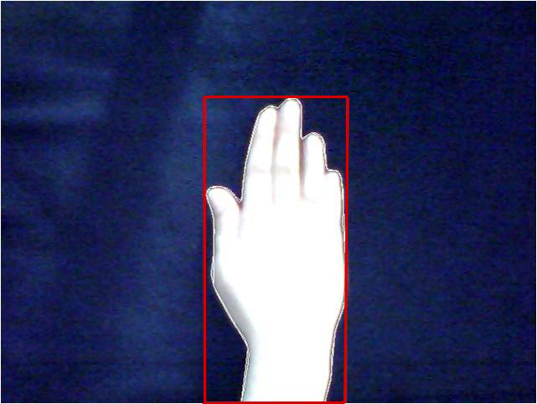
Implementation .. System Flow Chart..
Image Processing and Hand Detection
(1) Take closed hand width.

Slide 22
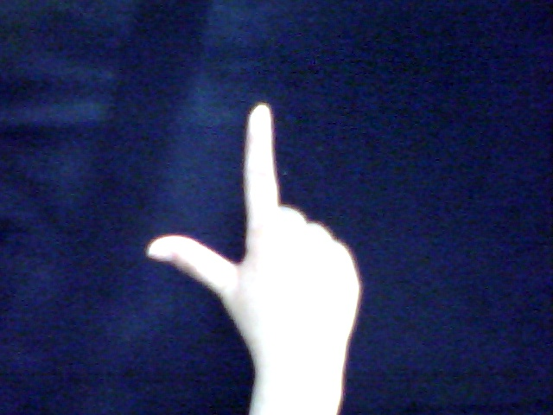
Implementation .. System Flow Chart..
Image Processing and Hand Detection
(2) Gesture done by the user .

Slide 23
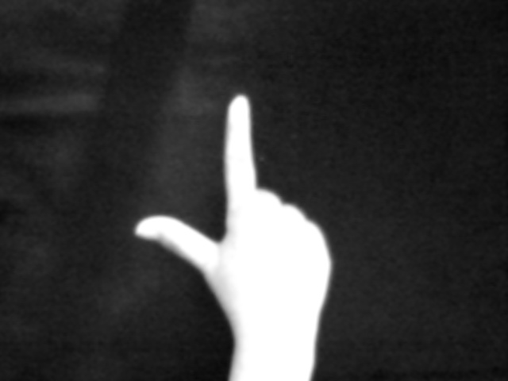
Implementation .. System Flow Chart..
Image Processing and Hand Detection
(3) Convert image to grayscale and smooth it .

Slide 24

Implementation .. System Flow Chart..
Image Processing and Hand Detection
(4) Apply threshold.

Slide 25
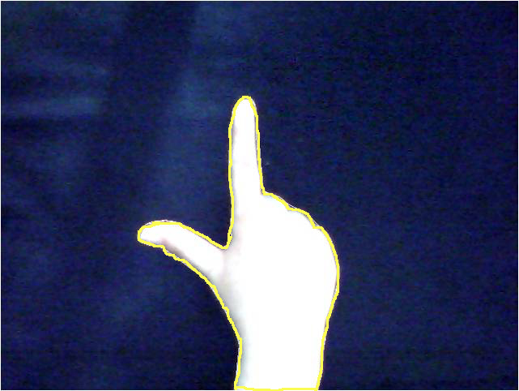
Implementation .. System Flow Chart..
Image Processing and Hand Detection
(5) Enclose the hand by a contour.

Slide 26
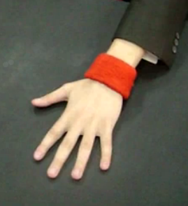
Implementation .. System Flow Chart..
Image Processing and Hand Detection
Do we need a wrist bracelet or a sleeve here ?
Our assumption :
Hand length=Constant* Closed hand width.
Solve this problem.

Slide 27
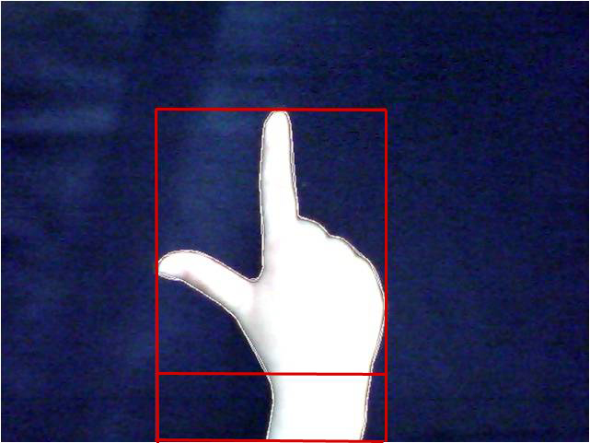
Implementation .. System Flow Chart..
Image Processing and Hand Detection
(6) Enclose the hand by a rectangle (Just take the part above the wrist)

Slide 28

Implementation .. System Flow Chart..
Image Processing and Hand Detection
(7)Set hand as ROI.

Slide 29

Implementation .. System Flow Chart..
Image Processing and Hand Detection
(8) Two step Normalization :
  To Rectangle size.
  Depending on thumb.

Slide 30

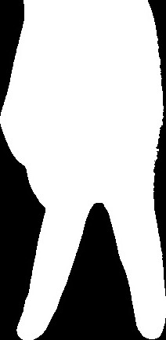

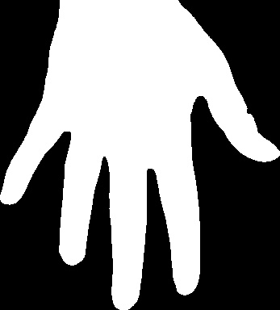
Implementation .. System Flow Chart..
Image Processing and Hand Detection
-Thumb is hidden
-Size : 300*500
-Thumb is apparent
-Size : 500*500

Slide 31
Application Start
Image acquisition
Image processing and hand detection
Application End
Event Generation
Gesture Recognition

Slide 32
Implementation .. System Flow Chart..
Gesture Recognition
Now the image is processed and hands are
detected, ready to be recognized.
We will use the Binary Image resulted from the image processing to recognize the gesture done by the user .

Slide 33
Implementation .. System Flow Chart..
Gesture Recognition.. First Approach
Image Subtraction was our initial choice in order to compare gestures done by the user with set of saved image.
This way worked perfectly if hand was oriented up straight without deviations.
For deviated gestures, this approach failed.

Slide 34
Implementation .. System Flow Chart..
Gesture Recognition Regions
Left Region
Right region
Upper diagonal
Upper region
Lower diagonal
Lower region

Slide 35
Upper region
Upper diagonal
Left Region
Right Region
Lower diagonal
Lower Region

Slide 36
Implementation .. System Flow Chart..
Gesture Recognition
Why Regions and sequences ? !
Sequence
Sequence :
for computing how many changes from black pixel to white in a specific row
→ detecting number of fingers .
Region :
for computing how many white pixel in a specific part of the image
→ detecting the appearance of hand part.
Region

Slide 37
Implementation .. System Flow Chart..
Gesture Recognition
Gesture 2 Recognition

Slide 38


Implementation .. System Flow Chart..
Gesture Recognition
Straight
To the right
To the left
Allowable Deviations in our approach

Slide 39
Implementation .. System Flow Chart..
Gesture Recognition
Sequence
Gesture 0
Gesture 1

Slide 40


Implementation .. System Flow Chart..
Gesture Recognition
Gesture 3 Recognition and allowable deviations

Slide 41
Application Start
Image acquisition
Image processing and hand detection
Application End
Event Generation
Gesture Recognition

Slide 42
Implementation .. System Flow Chart..
Event Generation
Virtual mouse.
Virtual Piano.
2 players game.

Slide 43
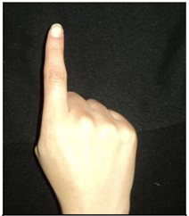
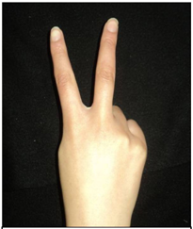
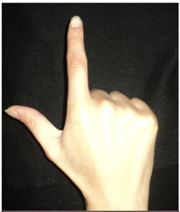
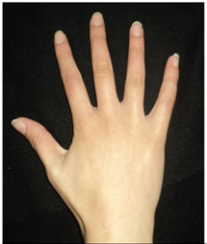
Implementation .. Event Generation ..
Mouse Events
Gesture 0 :
Moving mouse cursor.
Gesture 1 :
Right click.
Gesture 2 :
Single left click.
Gesture 3 :
Scrolling up/down
show/hide desktop

Slide 44
Implementation .. Event Generation ..
Mouse Events
Moving Mouse Cursor
Moving mouse cursor from current position depending on fingertip movement.

Slide 45
Implementation .. Event Generation ..
Mouse Events
Single Right click
Perform right click on current cursor position.

Slide 46
Implementation .. Event Generation ..
Mouse Events
Single left key click
Perform single left key click on current cursor position

Slide 47
Implementation .. Event Generation ..
Mouse Events
Drag and drop
. . . . .
Start drag
drop

Slide 48
Implementation .. Event Generation ..
Mouse Events
Double Click
Perform double click on current cursor position

Slide 49
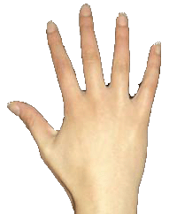
Implementation .. Event Generation ..
Mouse Events
Show/Hide desktop
If desktop is hidden show it.
Else hide it .

Slide 50
Implementation .. Event Generation ..
Mouse Events
Scrolling Up/down
Scroll Up .

Slide 51
Implementation .. Event Generation ..
Mouse Events
Scrolling Up/down
Scroll Down .

Slide 52
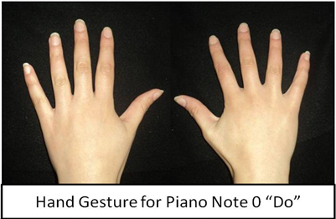
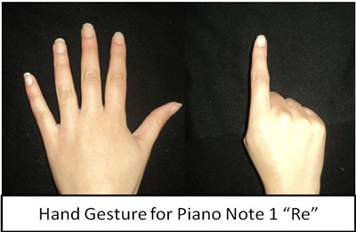
Implementation .. Event Generation ..
Piano Events
To get the Piano sounds, we used
Wrapper Library for Windows MIDI API.

Slide 53
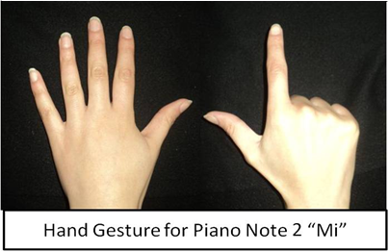
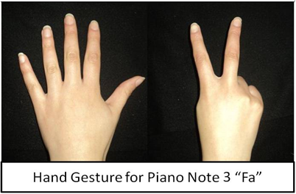
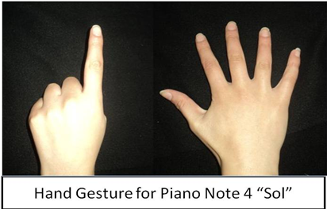
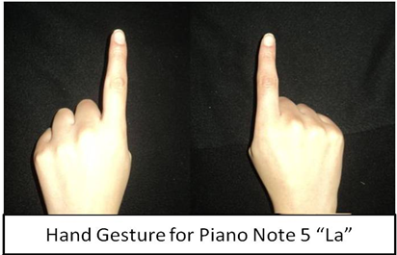
Implementation .. Event Generation ..
Piano Events

Slide 54
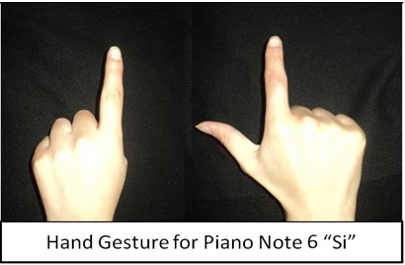
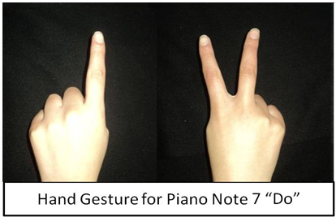
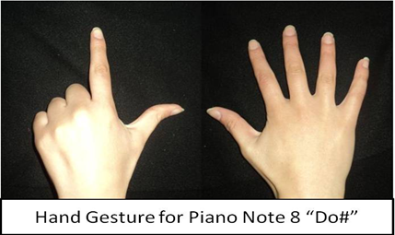
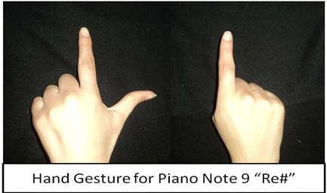
Implementation .. Event Generation ..
Piano Events

Slide 55
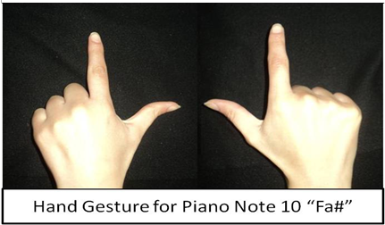
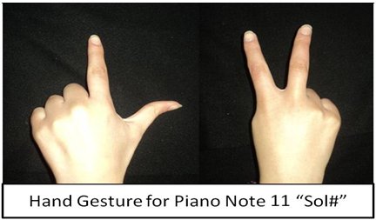
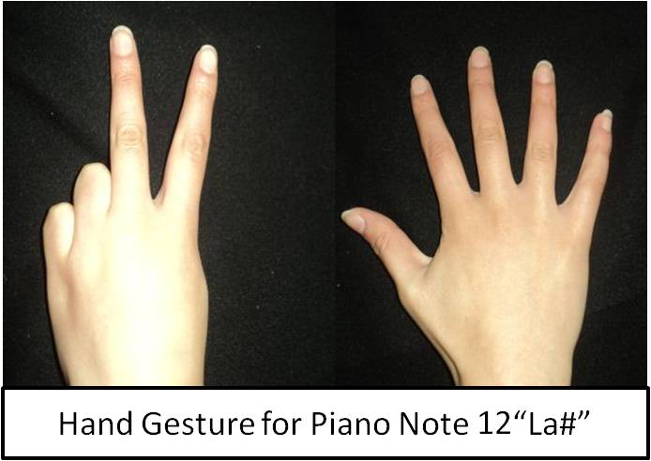
Implementation .. Event Generation ..
Piano Events

Slide 56
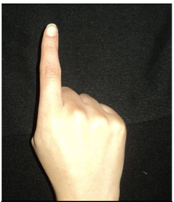
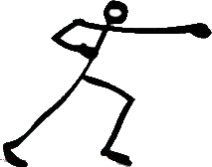
Implementation .. Event Generation ..
Game Events
=
Player fights by his hand

Slide 57
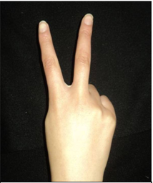
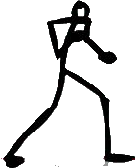
Implementation .. Event Generation ..
Game Events
=
Move player right.

Slide 58
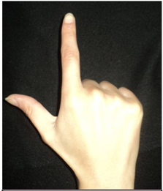
Implementation .. Event Generation ..
Game Events
=
Move player left.

Slide 59
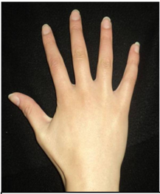
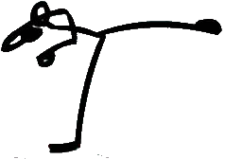
Implementation .. Event Generation ..
Game Events
=
Player fight by his leg.

Slide 60
Application Start
Image acquisition
Image processing and hand detection
Application End
Event Generation
Gesture Recognition

Slide 61
Outlines:
Introduction
Accomplishments
Implementation
Experiments
Future Work
Conclusion

Slide 62
Experiments Results
More than 200 images including all hand gestures needed.
60% for training , 40% for testing.
Data | # of Samples | Recognized Samples | Recognition Rate (%)
Training | 130 | 118 | 90.8
Testing | 90 | 78 | 86.7
Total | 220 | 196 | 89.1

Slide 63
Experiments Results
More than 200 images including all hand gestures needed.
60% for training , 40% for testing.
Data | # of Samples | Recognized Samples | Recognition Rate (%)
Training | 130 | 118 | 90.8
Testing | 90 | 78 | 86.7
Total | 220 | 196 | 89.1

Slide 64
Outlines:
Introduction
Accomplishments
Implementation
Experiments
Future Work
Conclusion

Slide 65
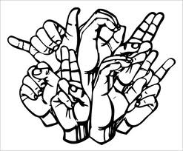
Future Work
A 3-D model-based recognition is suitable in multi-camera vision-based systems.
Real time recognition of sign language gestures.

Slide 66
Outlines:
Introduction
Accomplishments
Implementation
Experiments
Future Work
Conclusion

Slide 67
Conclusion
Different applications of hand gesture recognition have been implemented in different domains.
From simply game inputs to critical applications. Hand gesture recognitions is the natural to interact with vision enabled computers and other machines.

Slide 68
Questions?
Thanks :)

