Slide 1

Commercial Tower
بسم الله الرحمن الرحيم
An-Najah National University
Faculty of Engineering & Information Technology
Department of Building Engineering
Prepared by:
Ahmad Khilleh Areen Hamarsheh
Mustafa Rabaya Ali Daraghmeh
Supervisor:
Eng. Abdelhakeem Al-jawhari

Slide 2
Outline
Slide 1
Architectural Design
Environmental Design
Structural Design
Mechanical And Safety Design
Quantity Survey And Cost Estimation
Electrical Design

Slide 3
Architectural Aspects
Slide 2

Slide 4
Slide 3
Site Location
.

Slide 5
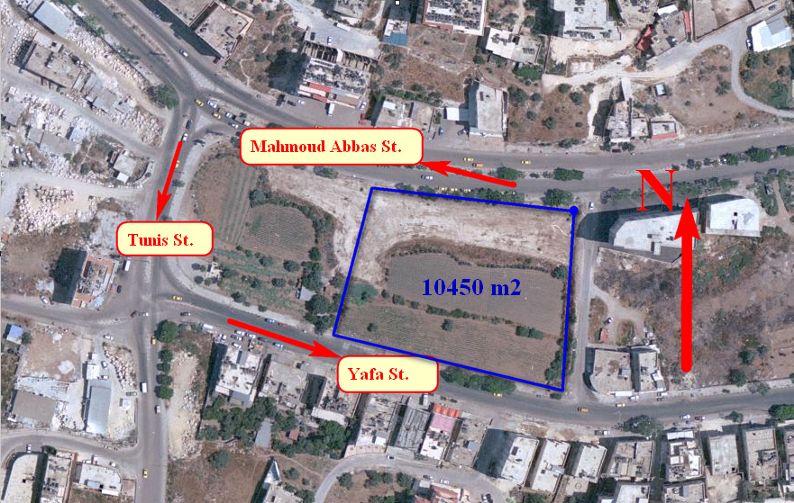
Slide 4

Slide 6
Architectural Design
Slide 5
Site Plan

Slide 7
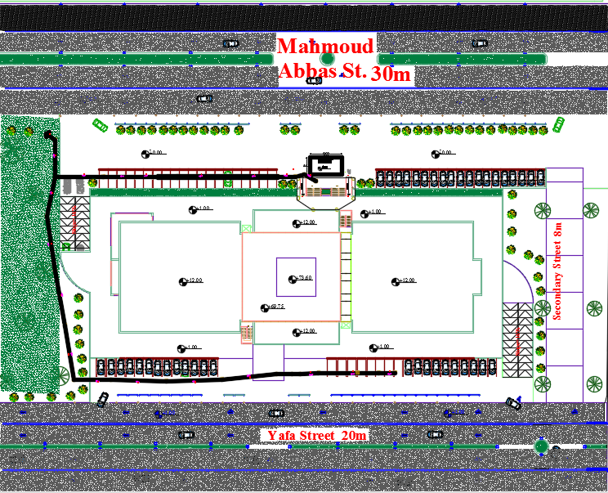
Architectural Design
Slide 6

Slide 8
Slide 7
Architectural
Design
.

Slide 9
Architectural Design
Slide 8
Floor | Area (m²) | Function
Basement one and two | 4960 | Parking
Ground floor | 3057 | Mall and entrance.
First floor | 3036 | Mall and Cafeteria
Second floor | 640 | Billiard and Games.
Third to fourteenth (except 9th) | 640 | Office
Ninth floor | 640 | Office and mechanical
Fifteenth floor | 640 | Office and Cafeteria
Sixteenth floor | 640 | Gymnasium
.

Slide 10
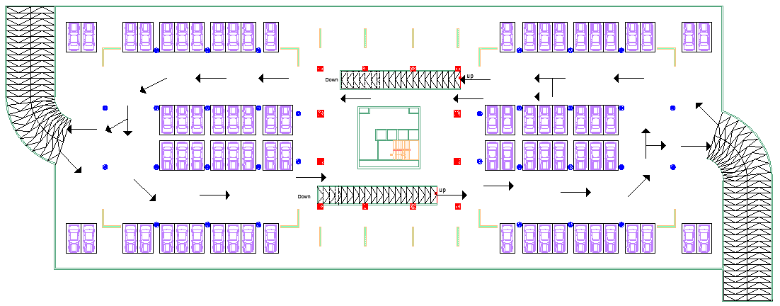
Architectural Design
Slide 9
Parking
Total Parking capacity = 160 car space

Slide 11
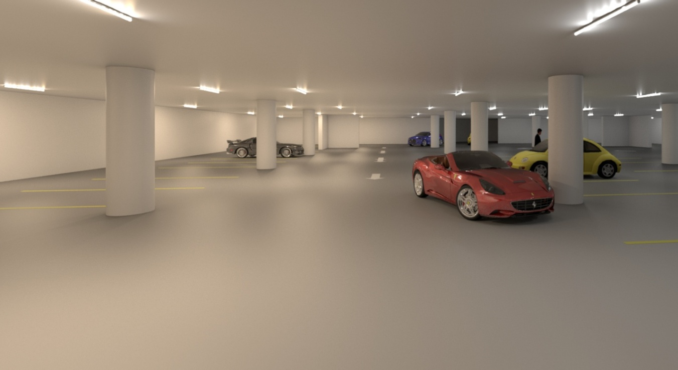
Architectural Design
Slide 10
3D Render view for Parking

Slide 12
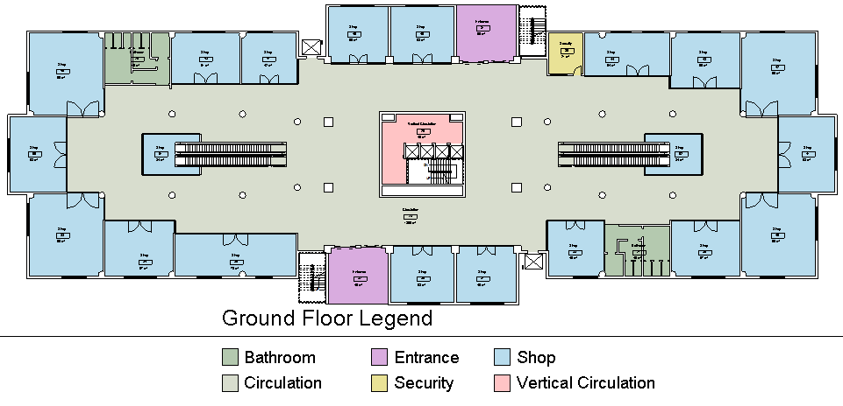
Architectural Design
Slide 11
Space | Area (m²) | Note
Entrance (#2) | 99 | Two different Entrance
Shops (#20) | 1144 | The area for each shop between 35 m² and 90 m².
Security room | 30 | For ground floor.
Circulation | 1390 | Between shops and contains the escalators and double volume.
Core | 46 | Contain elevators and stair.
Bathroom (#2) | 90 | For visitors.
Ground Floor (Mall)

Slide 13
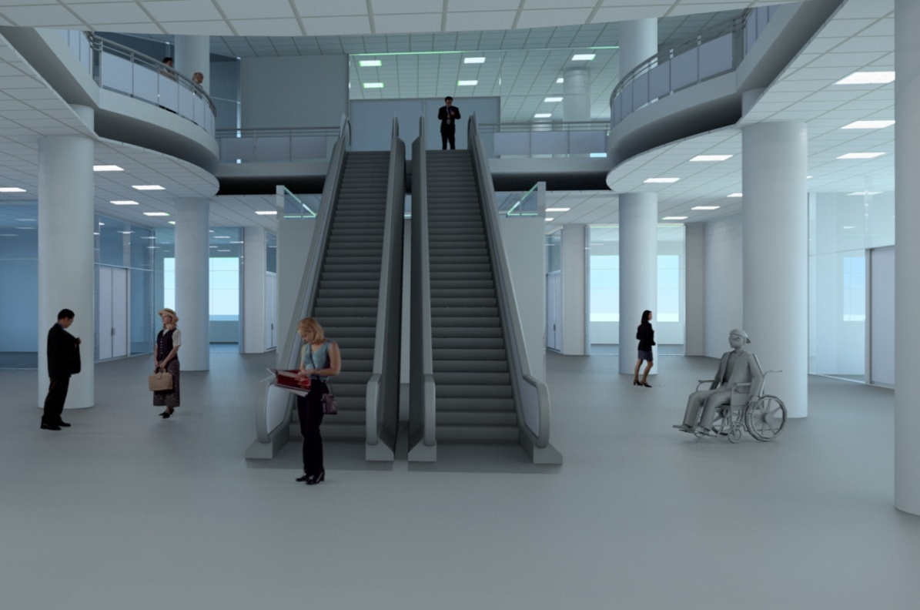
Architectural Design
Slide 12
3D Render view for Mall

Slide 14
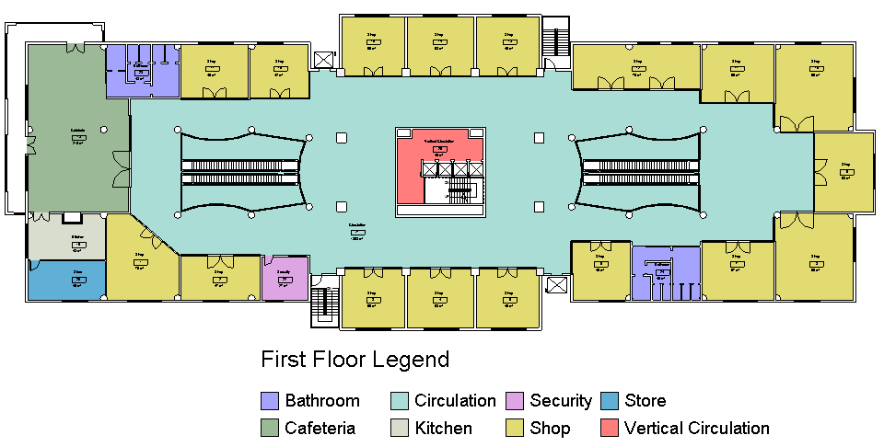
Architectural Design
Slide 13
: Space | Area (m²) | Note
Cafeteria | 210 | For about 60 persons.
Kitchen | 48 | For cafeteria.
Store | 40 | For cafeteria.
Shops (#17) | 990 | The area for each shop between 45 m² and 90 m².
Security room | 27 | For first floor.
Circulation | 1368 | Between shops and contains the escalators and double volume.
Core | 46 | Contain elevators and stair.
Bathroom (#2) | 93 | For visitors.
First Floor (Mall)

Slide 15
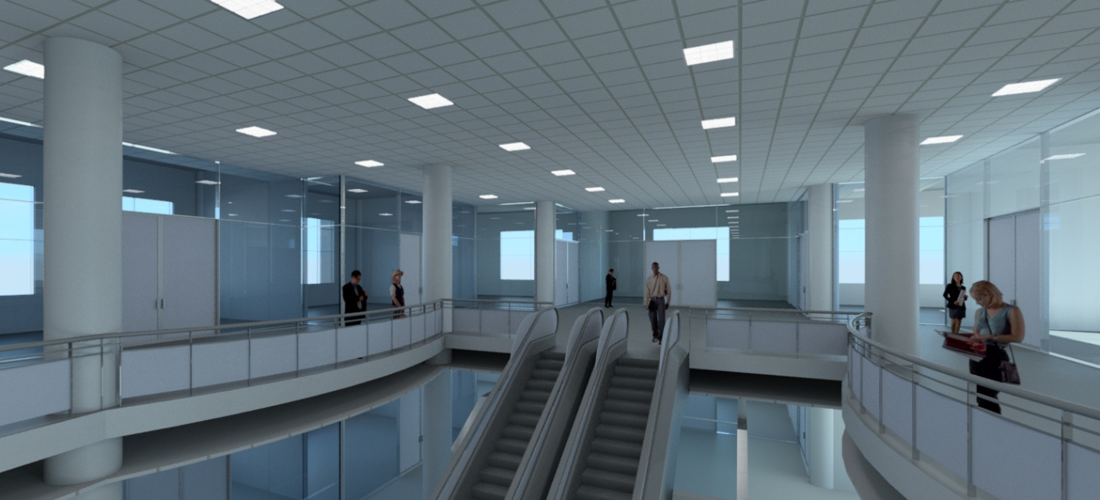
Architectural Design
Slide 14
3D Render view for Mall

Slide 16
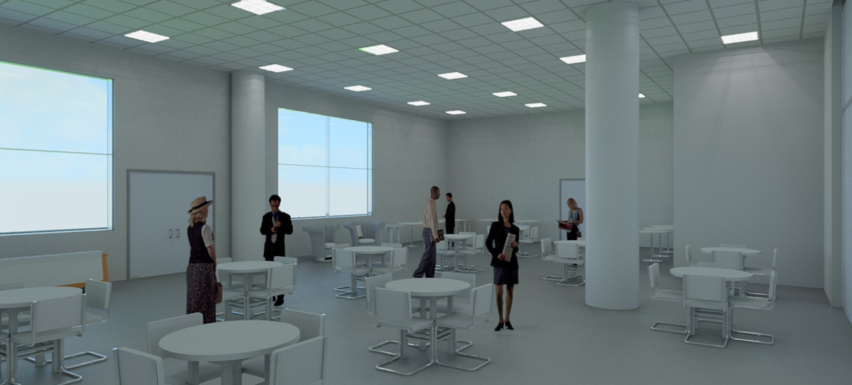
Architectural Design
Slide 15
3D Render view for Cafeteria

Slide 17
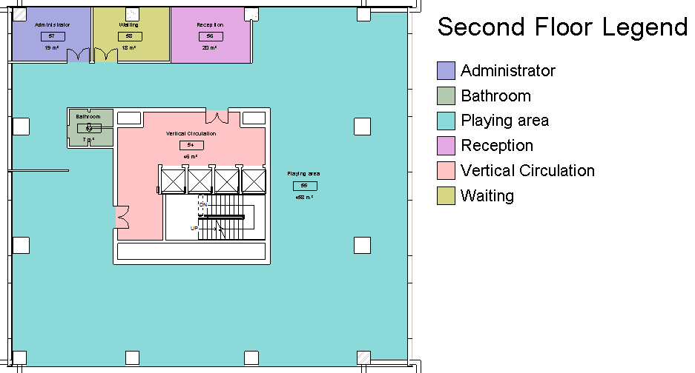
Architectural Design
Slide 16
Space | Area (m²) | Note
Playing area | 480 | Contains the games and main area.
Reception | 20 | For giving information.
Waiting area | 18 | For visitors.
Administer | 19 | For the manager
Core | 46 | Contain elevators and stair.
Bathroom | 93 | --
Second Floor
(Billiard and Games)

Slide 18
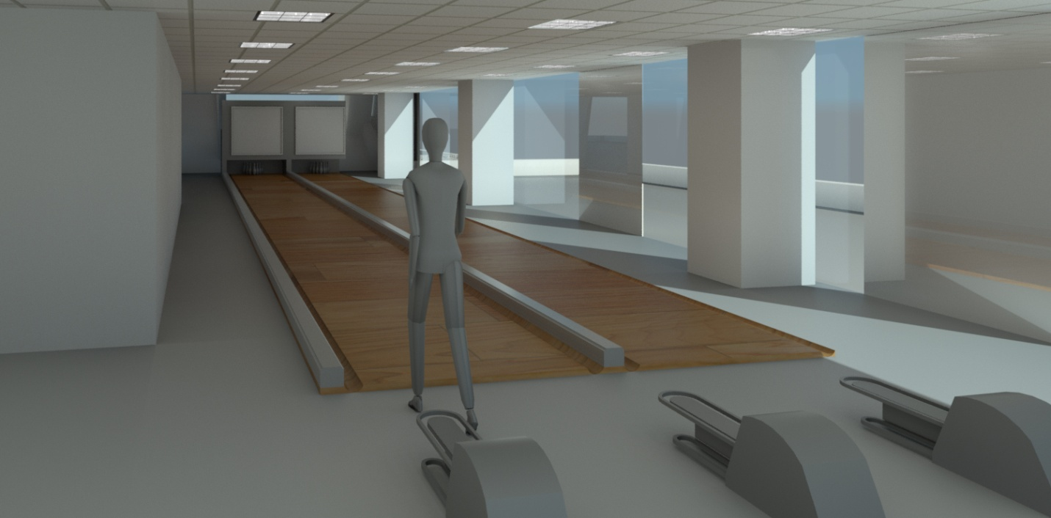
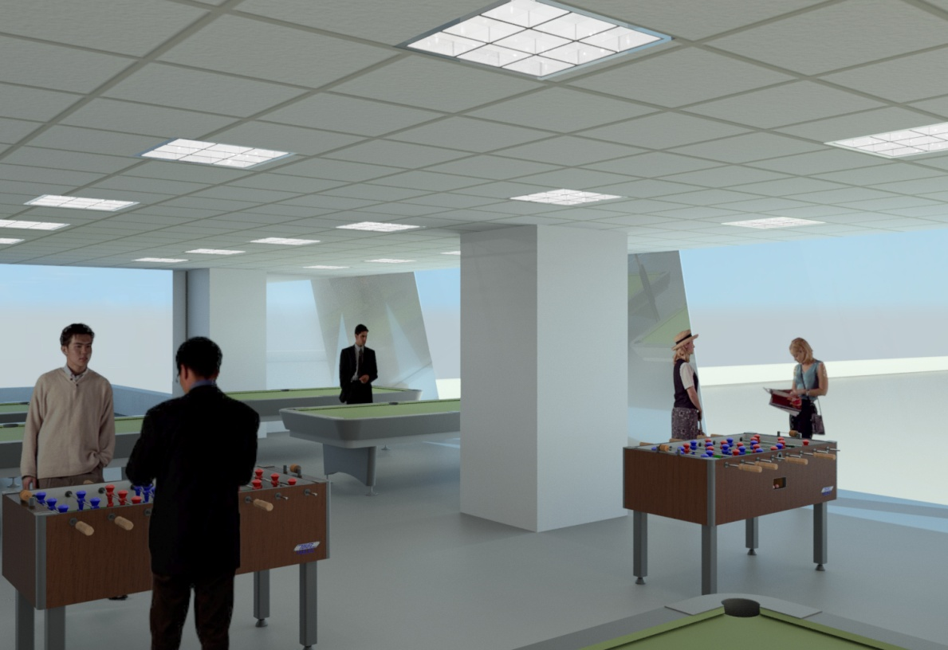
Architectural Design
Slide 17
3D Render view for Billiard and Games

Slide 19
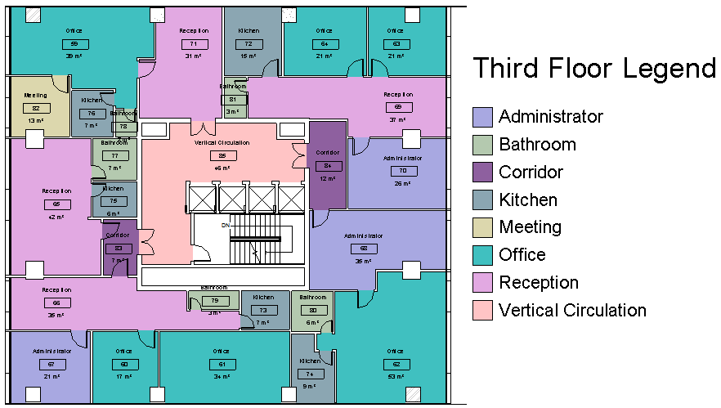
Architectural Design
Slide 18
: Space | Area (m²) | Note
Office (#6) | 185 | Individual or mutual.
Administer (#2) | 47 | For the manager
Meeting room (#1) | 13 | For employees
Reception (#5) | 180 | For giving information and waiting area.
Kitchen (#5) | 44 | --
Bathroom (#5) | 21 | --
Core | 46 | Contain elevators and stair.
Third Floor (Office)

Slide 20
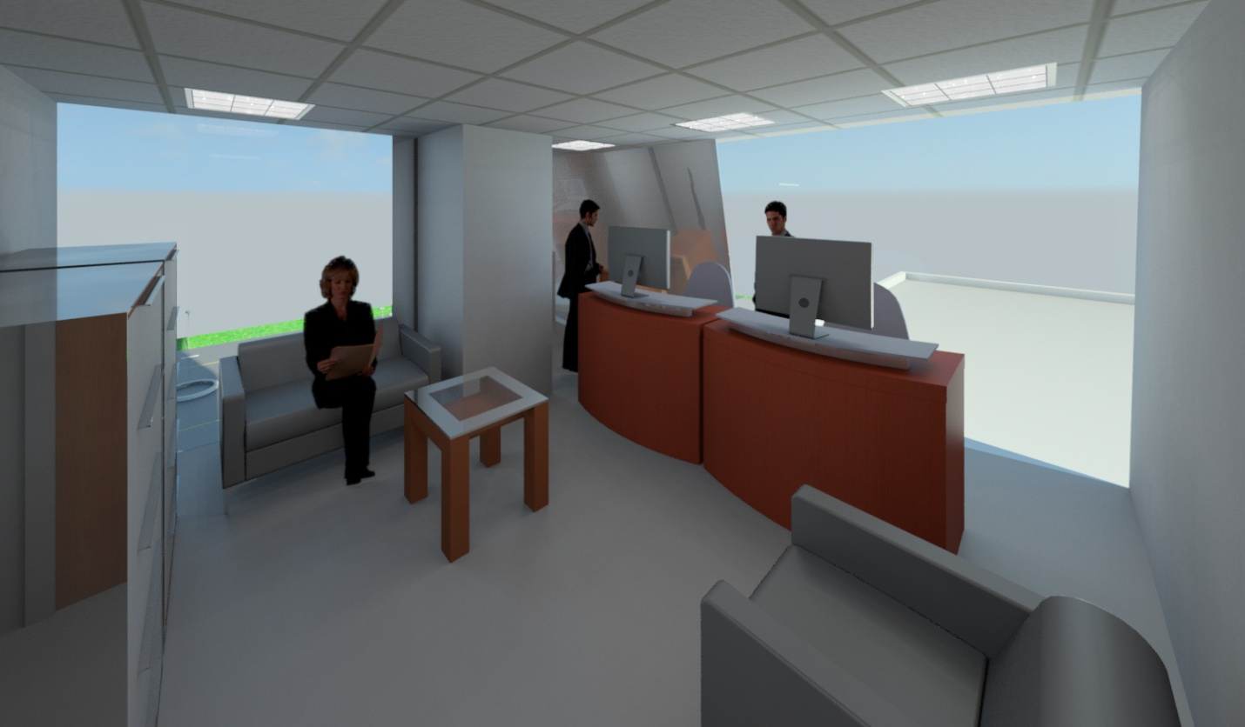
Architectural Design
Slide 19
3D Render view for Office

Slide 21
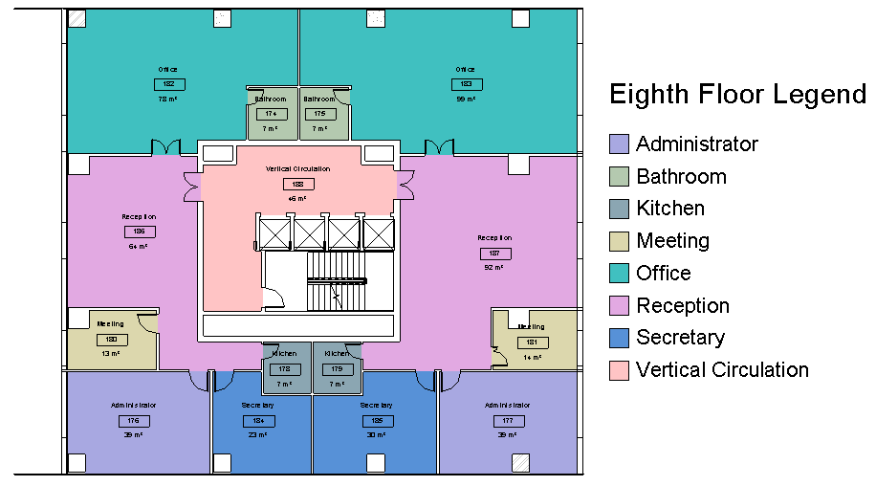
Architectural Design
Slide 20
Space | Area (m²) | Note
Office (#2) | 177 | Mutual open office.
Administer (#2) | 78 | For the manager.
Meeting room (#2) | 27 | For employees.
Secretary (#2) | 53 | --
Reception (#2) | 156 | For giving information and waiting area.
Kitchen (#2) | 14 | --
Bathroom (#2) | 14 | --
Core | 46 | Contain elevators and stair.
Eighth Floor (Office)

Slide 22
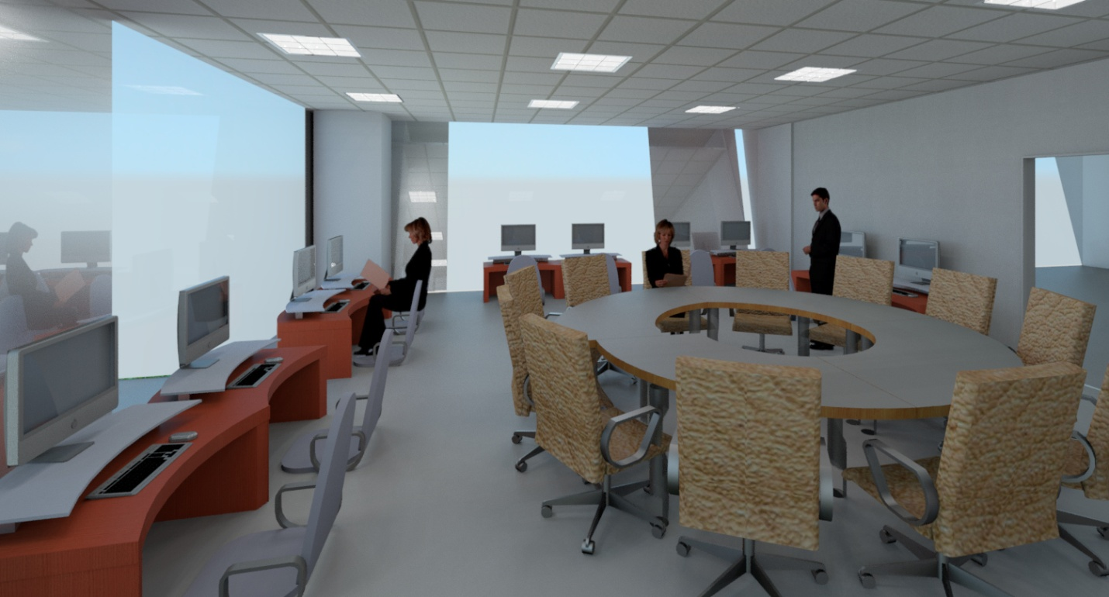
Architectural Design
Slide 21
3D Render view for Office

Slide 23
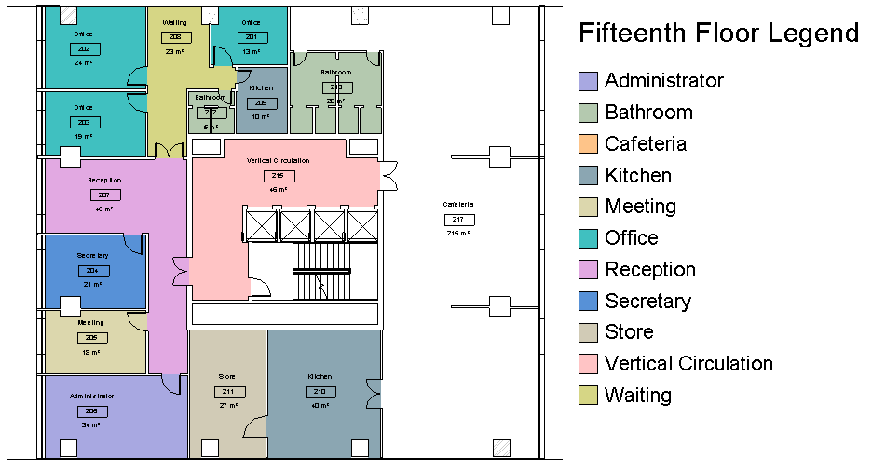
Architectural Design
Slide 22
Fifteenth Floor (Office and Cafeteria)
Space | Area (m²) | Note
Office (#3) | 56 | Individual or Mutual open office.
Administer (#1) | 34 | For the manager
Secretary (#1) | 21 | --
Meeting (#1) | 18 | For employees.
Reception (#1) | 46 | For giving information and waiting area.
Waiting | 23 | Waiting room for visitors.
Kitchen (#1) | 10 | --
Bathroom (#1) | 5 | --
Cafeteria | 215 | For about 80 persons.
Kitchen | 40 | For Cafeteria.
Store | 27 | For Cafeteria.
Bathroom | 20 | For Cafeteria.
Core | 46 | Contain elevators and stair.

Slide 24
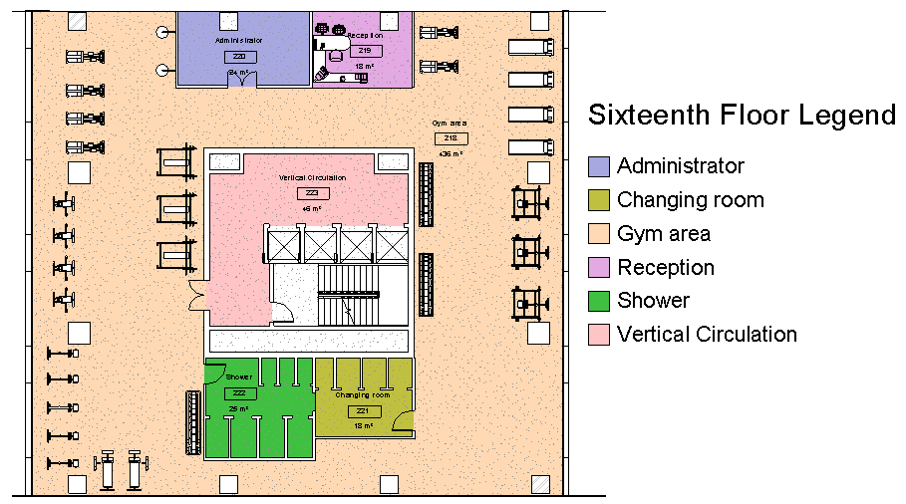
Architectural Design
Slide 23
Sixteenth Floor (Gymnasium)
Space | Area (m²) | Note
Gym area | 436 | Contains the games and main area.
Reception | 18 | For giving information.
Administer | 24 | For the manager
Changing room | 18 | --
Shower | 25 | --
Core | 46 | Contain elevators and stair.

Slide 25
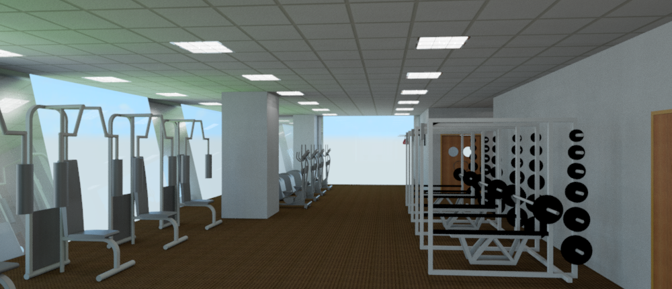
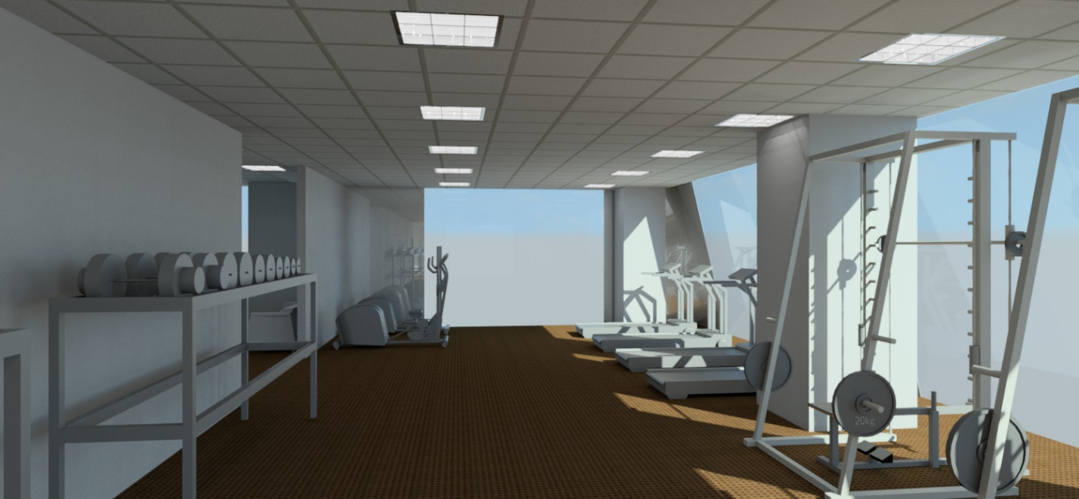
Architectural Design
Slide 24
3D Render view for Gym

Slide 26
Architectural Design
Slide 25
Sections

Slide 27
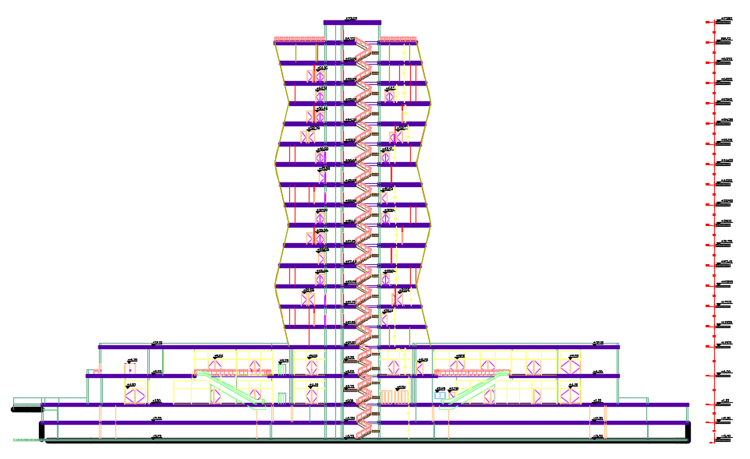
Architectural Design
Slide 26
Section A-A

Slide 28
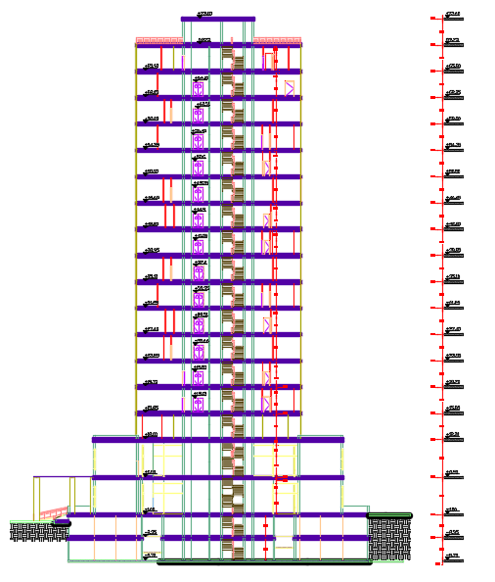
Architectural Design
Slide 27
Section B-B

Slide 29
Architectural Design
Slide 28
Elevations

Slide 30
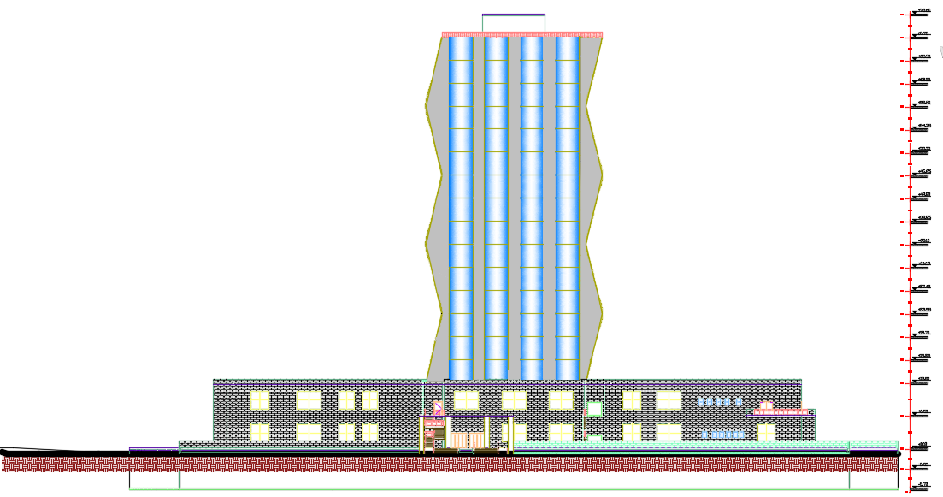
Architectural Design
Slide 29
North Elevation

Slide 31
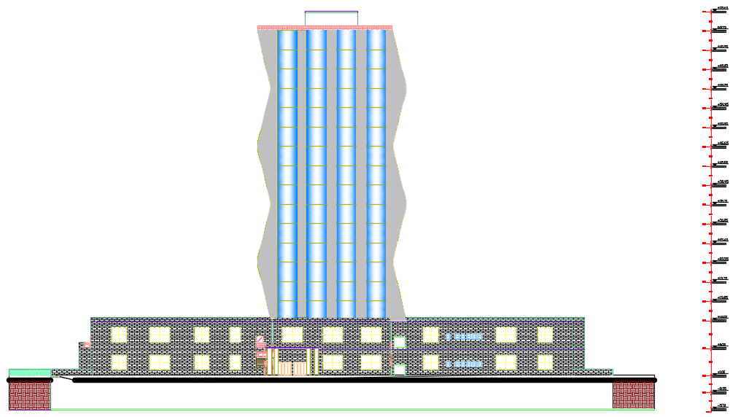
Architectural Design
Slide 30
South Elevation

Slide 32
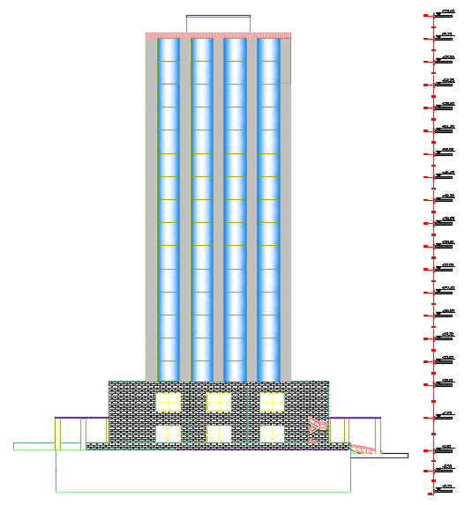
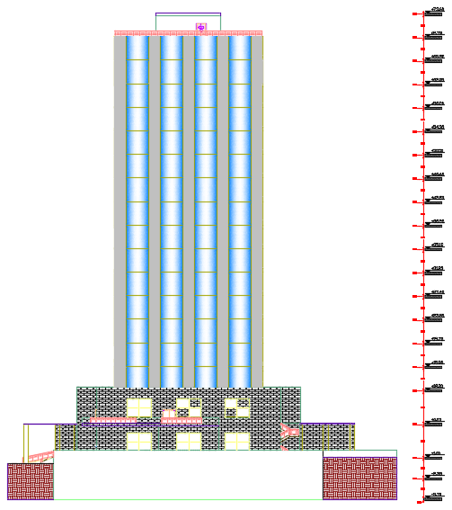
Architectural Design
Slide 31
East Elevation
West Elevation

Slide 33
Architectural Design
Slide 32
3D View

Slide 34
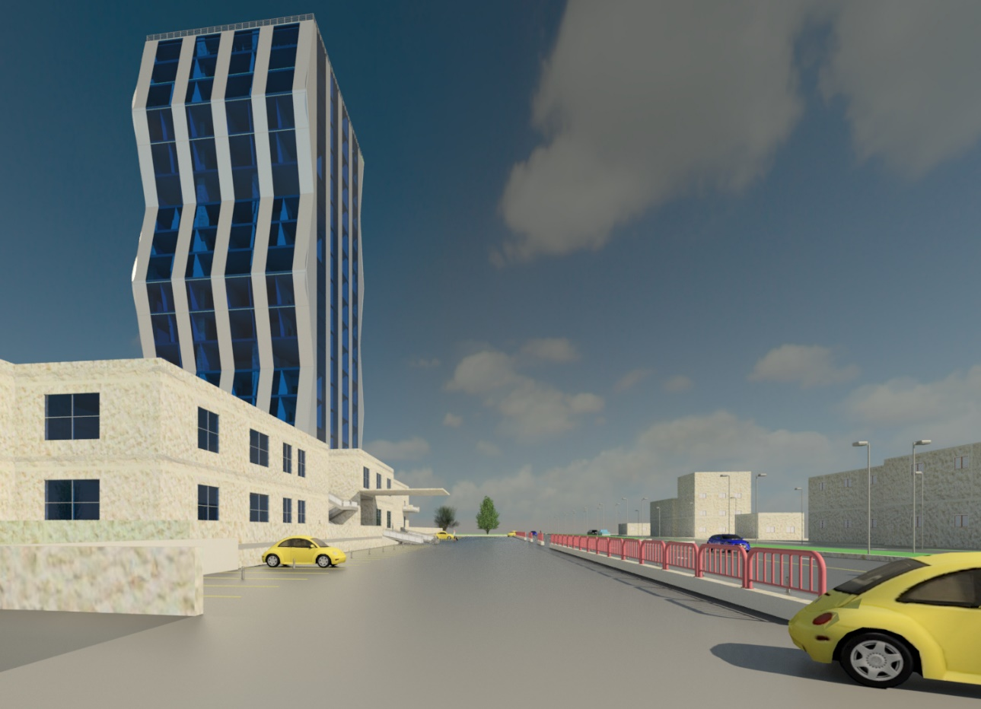

Slide 35
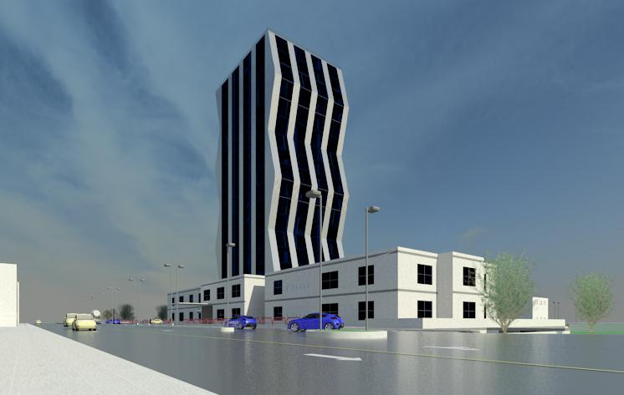

Slide 36
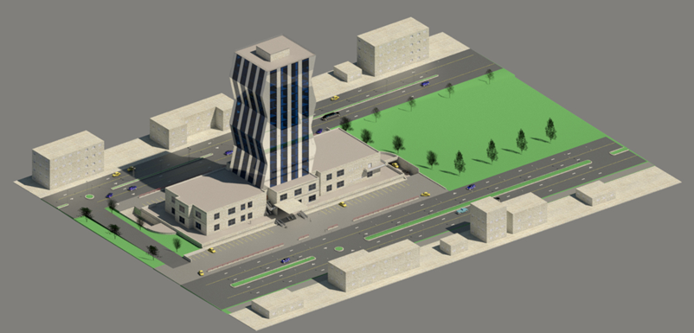

Slide 37
Slide 36
Environmental Design

Slide 38
Environmental Design
Thermal Analysis.
Energy Simulation.
Daylight Simulation.
Acoustical Analysis.
Slide 37

Slide 39
Slide 38
Thermal analysis

Slide 40
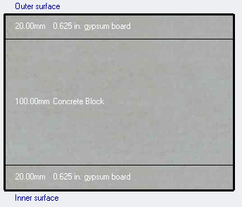
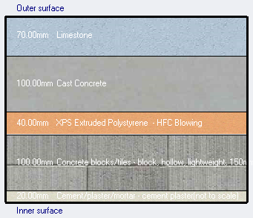
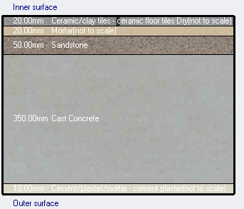
Thermal Analysis
Internal Wall
Slide 39
U value = 0.96 W/m²k
External wall for Mall
U value = 0.53 W/m²k
Internal Floor
U value = 1.47W/m²k

Slide 41
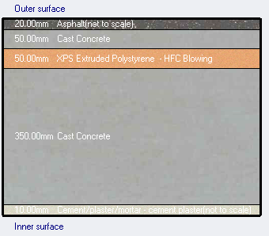
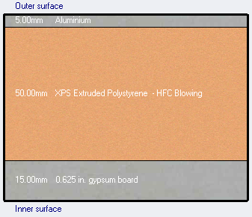
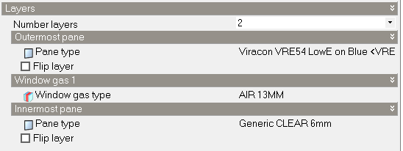
Thermal Analysis
Thermal Analysis
Flat Roof
Slide 40
U value = 0.45 W/m²k
External wall for Tower
U value = 0.49 W/m²k
Window
U value = 1.36W/m²k

Slide 42
Slide 41
Energy simulation

Slide 43
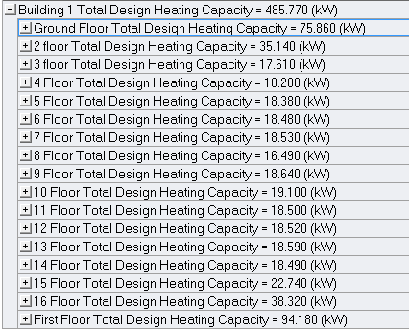
Energy Simulation
Slide 42
Heating and Cooling Load Design
Total Cooling Load= 662 kW
Total Heating Load= 485 kW

Slide 44
Slide 43
Daylight
Simulation

Slide 45
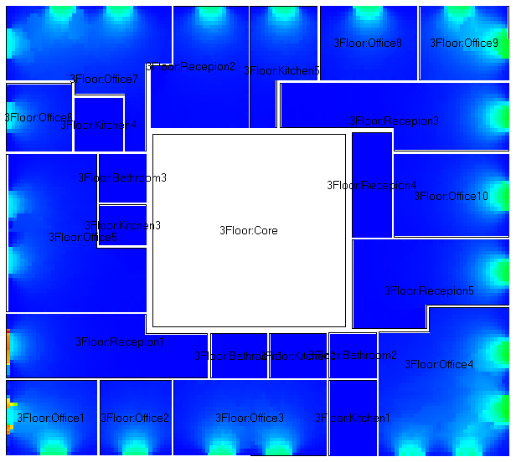
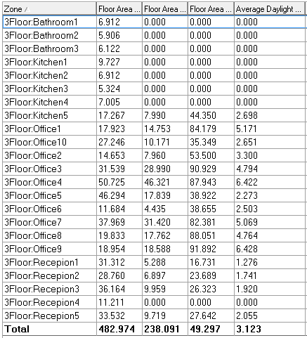
Energy Simulation
Slide 44
Third Floor (Office)
D.F= 3.12%

Slide 46
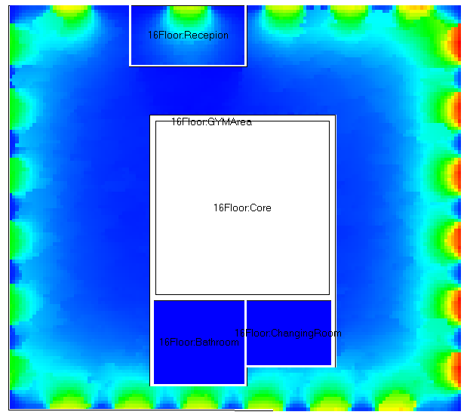
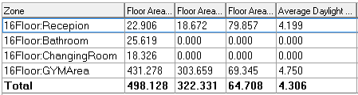
Energy Simulation
Slide 45
Sixteenth Floor (Gym)
D.F= 4.31%

Slide 47
Slide 46
Acoustical analysis

Slide 48
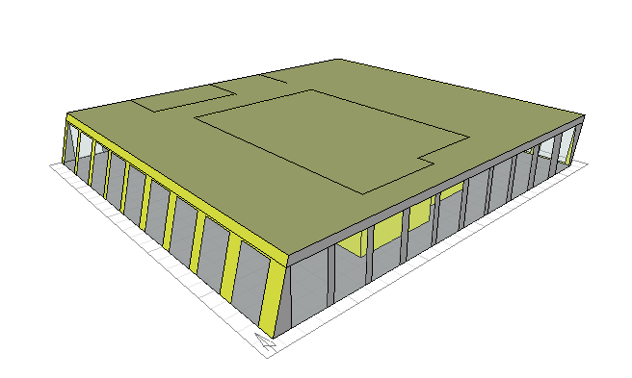
Ecotect model for gymnasium
Slide 47

Slide 49
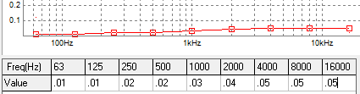
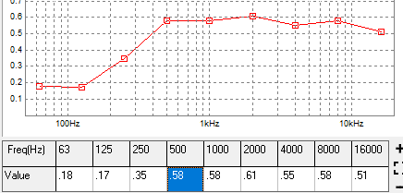
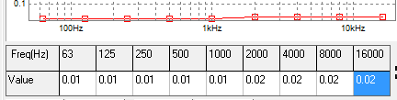
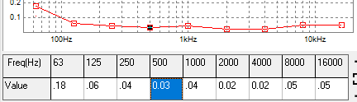
Acoustical Analysis
Slide 48
The materials which used in gymnasium:
External wall: (aluminum, insulation, gypsum board):
Internal wall: (gypsum-insulation-block-insulation-gypsum):
Ceiling tile (suspended ceiling tile):
Floor (glazed tile):
Glass (laminated glass):

Slide 50
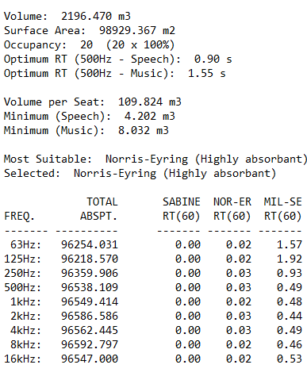
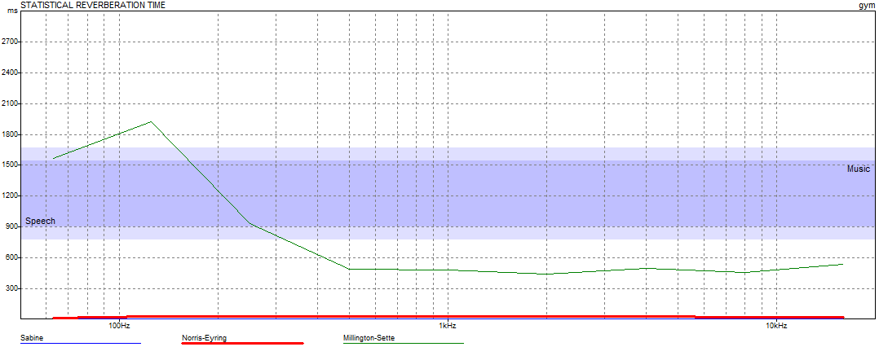
Acoustical Analysis
Reverberation time (RT60) in the gymnasium
RT60 range (0.8 – 1.2) s
Slide 49
From table and figure, the RT60 of the gymnasium is out the range.

Slide 51
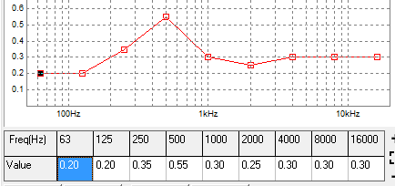
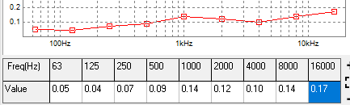
Treatment
Slide 50
Replace the (tile ceiling) with the (plywood ceiling 12 mm thick) which has the following absorption coefficient:
And replace the glazed tile floor with the concrete slab with timber on ground which has the following absorption coefficient:

Slide 52
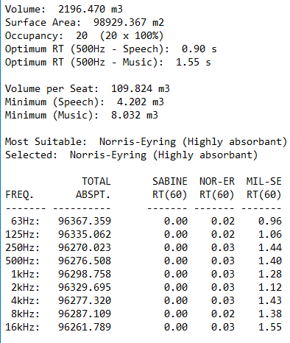

Acoustical Analysis
Slide 51
RT60 Values for main hall after treatment:
From table and figure, the RT60 of the gymnasium is in the range.

Slide 53

Sound Transmission Class (STC)
Slide 52
STC calculation for small office (closed):

Slide 54



Materials used for walls
Slide 53
External wall:
Internal wall without door:
Use 5 mm aluminum, 5 cm insulation, gypsum board 1.5 cm with studs, and 6mm double eliminated glass with 13 mm gape for openings.
Use 1.5 gypsum board for each side, and 5 cm air gape for each side, and 10 cm block between.

Slide 55

Composite STC values at different values of frequency.
Slide 54

Slide 56

IIC Calculations
Slide 55
IIC Calculations for equipment room

Slide 57


Construction of the floor section: (gypsum tiles 15mm – 50 cm air gape with 50mm insulation-7 cm concrete- 28 cm block-filling material-floor tile).
Slide 56
Section in floor
IIC values for equipment room at different frequencies

Slide 58
Slide 57
Structural
Design

Slide 59
Structural Design
Slide 58
Design Codes
The American Concrete Institute code (ACI 318-14).
The seismic design according to UBC-97.
The analysis and design for blocks were done using ETABs program, SAP program for staircase ,ramp ,retaining wall ,and water tank.
SAFE 2014 program for footings design.

Slide 60

Structural Design
Slide 59
Blocks

Slide 61


Structural Design
Block 1
Slide 60
ETABs Models
Block 2

Slide 62
Structural Design
Slide 61
Design Date
1.
Type of frame or shells | Compressive strength of Concrete ―f′c. Mpa
Slabs& Beams & Stair case | 28
Columns & walls for Tower (first block) | 40
Columns & walls for second block | 32
Footings | 32
2.
Yielding strength of steel fy = 420 Mpa.
3.
Bearing capacity for soil after being enhanced (q_{all} ) = 180 KN/m²

Slide 63

Structural Design
Slide 62
Seismic Design Date
1.
Location: Nablus → Zone 2B → Z=0.2
2.
Soil Profile: Silt Clay (S_{D}).
3.
Seismic coefficient (Cv)= 0.4
4.
Seismic coefficient (Ca)= 0.28
5.
Importance factor (I) = 1.25
6.
Structural system: Sway Special → R = 8.5

Slide 64
Structural Design
Slide 63
Structural System
1.
Block 1: Two way ribbed slab using Ytong block with drop beam system.
One way ribbed slab using concrete hollow block with hidden beams system.
(H _{slab} = 35cm , H _{beam} = 60cm).
2.
Block 2: Two way ribbed slab using concrete hollow block with drop beam system.
(H _{slab} = 36cm , H _{beam} = 70cm).

Slide 65

Structural Design
Slide 64
Checks for block 1
1.
Compatibility.
2. Equilibrium.
Load type | Manual result (KN) | ETABs result (KN) | % of difference
D.L | 131224 | 130159 | 0.80
L.L | 37835 | 37013.3 | 2.1%
SID | 36478 | 37819 | 3.7%

Slide 66


Structural Design
Slide 65
Dynamic Checks for block 1.
1. Modal Participation mass ratio > 90%.
2. Period.
T _{Method B} should be ≤1.4 T _{Method A}
T (allowable) = 1.4 × 1.165 sec. = 1.632 sec.
T_{X} = 1.52 < 1.632
T_{y} = 1.638 1.632
≈
3. Base Shear.
Weight of building = 177231 KN.
Cv × I
R × T
0.4 × 1.25
8.5 × 1.16
Base shear (V) =
×
W =
× 117231 = 9447.7 KN
In X-direction:
EQx (ETABs)max = 9482 KN > 9447.7 KN → So it's OK.
EQy (ETABs) = 3007 KN > 0.3 × 9447.7 KN →So it's OK.
In Y-direction:
EQx (ETABs) = 2952.8 KN > 0.3 × 9447.7 KN →So it's OK.
EQy (ETABs)max = 9475 KN > 9447.7 KN → So it's OK.

Slide 67
Structural Design
Slide 66
Dynamic Checks for block 1.
Story | Elevation(m) | Ux (mm) | ΔSx(mm) | ΔMx(mm)
19 | 3.5 | 57.9 | 3.8 | 22.6 < 70
18 | 3.5 | 54.1 | 3.9 | 23.2 < 70
17 | 3.5 | 50.2 | 3.9 | 23.2 < 70
16 | 3.5 | 46.3 | 3.9 | 23.2 < 70
15 | 3.5 | 42.5 | 3.9 | 23.2 < 70
14 | 3.5 | 38.6 | 3.9 | 23.2 < 70
13 | 3.5 | 34.7 | 3.8 | 22.6 < 70
12 | 3.5 | 30.9 | 3.7 | 22 < 70
11 | 3.5 | 27.2 | 3.6 | 21.42 < 70
10 | 3.5 | 23.6 | 3.5 | 20.8 < 70
9 | 3.5 | 20.1 | 3.4 | 20.23 < 70
8 | 3.5 | 16.7 | 3.1 | 18.45 < 70
7 | 3.5 | 13.6 | 2.9 | 17.25 < 70
6 | 3.5 | 10.7 | 2.6 | 15.47 < 70
5 | 3.5 | 8.1 | 2.3 | 13.68 < 70
4 | 3.5 | 5.8 | 2.7 | 16 < 70
3 | 5.15 | 3.1 | 2 | 11.9 < 113
2 | 5.15 | 1.1 | 0.7 | 4.16 < 113
1 | 3 | 0.4 | 0.4 | 0 < 70
4. Drift in
x- direction

Slide 68
Structural Design
Slide 67
Dynamic Checks for block 1.
Story | Elevation(m) | Uy (mm) | ΔSy(mm) | ΔMy(mm)
19 | 3.5 | 67.5 | 4.1 | 24.4 < 70
18 | 3.5 | 63.4 | 4.2 | 25 < 70
17 | 3.5 | 59.2 | 4.3 | 25.6 < 70
16 | 3.5 | 54.9 | 4.3 | 25.6 < 70
15 | 3.5 | 50.6 | 4.3 | 25.6 < 70
14 | 3.5 | 46.3 | 4.3 | 25.6 < 70
13 | 3.5 | 42 | 4.3 | 25.6 < 70
12 | 3.5 | 37.7 | 4.2 | 25 < 70
11 | 3.5 | 33.5 | 4.1 | 24.4 < 70
10 | 3.5 | 29.4 | 4.1 | 24.4 < 70
9 | 3.5 | 25.3 | 3.8 | 22.6 < 70
8 | 3.5 | 21.5 | 3.7 | 22 < 70
7 | 3.5 | 17.8 | 3.5 | 20.8 < 70
6 | 3.5 | 14.3 | 3.2 | 19 < 70
5 | 3.5 | 11.1 | 3 | 17.85 < 70
4 | 3.5 | 8.1 | 3.6 | 21.42 < 70
3 | 5.15 | 4.5 | 2.8 | 16.7 < 113
2 | 5.15 | 1.7 | 1.1 | 6.54 < 113
1 | 3 | 0.6 | 0.6 | 3.57 < 70
5. Drift in
y- direction

Slide 69

Structural Design
Slab Reinforcement
Slide 68

Slide 70

Structural Design
Slab Reinforcement
Slide 69

Slide 71




Structural Design
Beam Reinforcement
Slide 1

Slide 72



Structural Design
Slide 71
Column Reinforcement

Slide 73

Shear wall Reinforcement

Slide 74



Slide 73

Slide 75


Footings Reinforcement
SAFE model
(Block 2)
SAFE model
(Block 1)
Slide 74
Mat & Piles Raft
Mat with voids
(Thickness 170 cm).
(Thickness 90cm).

Slide 76


Slide 75
MAT

Slide 77

Slide 76

Slide 78



Slide 79
Slide 78
Electrical Design

Slide 80
Slide 79
Lighting Design
.

Slide 81

Cafeteria
Slide 80

Slide 82

Result for Cafeteria
Slide 81

Slide 83

Open Office
Slide 82

Slide 84


Open Office
Result
Slide 83

Slide 85

3D Views
Slide 88

Slide 86

Slide 89

Slide 87
Slide 90
Socket distribution
.

Slide 88


Distribution of sockets
First Floor
Slide 91

Slide 89


Distribution of sockets
Third floor
Slide 92

Slide 90
Slide 93
Mechanical and
Safety Design

Slide 91
Slide 94
HVAC
Design

Slide 92



HVAC Design
Slide 95
VRF - multi split unit
Indoor Split unit
Cassette Split unit
Outdoor Unit

Slide 93
HVAC Design
Slide 96
First floor (Mall)
Third Floor (Office)
Space | Cooling load (kW) | Load (Ton) | Condition Tonnage
Circulation | 46.39 | 13.20 | 27 0.5
Shop 9 | 4.41 | 1.30 | 1.5
Shop 3 | 3.10 | 0.89 | 1.0
Shop 4 | 3.12 | 0.89 | 1.0
Shop 5 | 3.24 | 0.92 | 1.0
Shop 6 | 2.76 | 0.79 | 1.0
Bathroom 1 | 1.40 | 0.40 | --
Shop 7 | 3.36 | 0.96 | 1.0
Shop 8 | 5.74 | 1.63 | 2.0
Security | 1.38 | 0.39 | 1.0
Shop 1 | 4.07 | 1.16 | 1.5
Shop 2 | 3.13 | 0.89 | 1.0
Kitchen | 10.09 | 2.87 | --
Cafeteria | 12.18 | 3.46 | 5 1.0
Bathroom | 1.65 | 0.47 | --
Shop 17 | 2.79 | 0.79 | 1.0
Shop 16 | 2.63 | 0.75 | 1.0
Shop 15 | 3.00 | 0.85 | 1.0
Shop 14 | 2.90 | 0.83 | 1.0
Shop 13 | 3.00 | 0.85 | 1.0
Shop 12 | 4.43 | 1.26 | 1.5
Shop 11 | 3.29 | 0.94 | 1.0
Shop 10 | 5.75 | 1.64 | 2.0
Space | Cooling load (kW) | Load (Ton) | Condition Tonnage
Bathroom 1 | 0.23 | 0.07 | --
Office 2 | 0.77 | 0.22 | 0.75
Office 1 | 1.17 | 0.34 | 0.75
Office 3 | 1.61 | 0.46 | 0.75
Kitchen 2 | 0.58 | 0.17 | --
Kitchen 1 | 0.84 | 0.24 | --
Bathroom 2 | 0.21 | 0.06 | --
Office 9 | 1.24 | 0.36 | 0.75
Office 8 | 1.05 | 0.30 | 0.75
Kitchen 4 | 0.6 | 0.17 | --
Office 6 | 0.81 | 0.23 | 0.75
Office 4 | 2.74 | 0.78 | 1.0
Reception 1 | 1.29 | 0.37 | 1.0
Office 5 | 2.64 | 0.75 | 1.0
Kitchen 3 | 0.46 | 0.13 | --
Bathroom 3 | 0.2 | 0.06 | --
Reception 3 | 1.37 | 0.39 | 1.0
Kitchen 5 | 1.53 | 0.44 | --
Reception 2 | 1.03 | 0.30 | 1.0
Office 7 | 2.17 | 0.62 | 1.0
Office 10 | 1.34 | 0.39 | 0.75
Reception 4 | 0.32 | 0.10 | --
Reception 5 | 1.27 | 0.37 | 0.75

Slide 94

HVAC Design
Slide 97
First floor (Mall)

Slide 95


HVAC Design
Slide 98

Slide 96


HVAC Design
Third floor (Office)
Slide 99

Slide 97

HVAC Design
Floor | Zone A& B | Sum | Zone C & D | Sum
Second | 4 | 23.75 | 5 | 22.25
Third | 5.25 |  | 9
Fourth | 5.5 |  | 8.25
Fifth | 9 |  | 4.5 | 21.75
Sixth | 5 | 20.5 | 9.5
Seventh | 6.5 |  | 7.75
Eighth | 9 |  | 4.5 | 18.5
Ninth | 0 |  | 4.5
Tenth | 5 | 26 | 9.5
Eleventh | 9 |  | 4.5 | 20.5
Twelfth | 5.5 |  | 8.25
Thirteenth | 6.5 |  | 7.75
Fourteenth | 9 | 19.75 | 4.5 | 15
Fifteenth | 5.75 |  | 6.5
Sixteenth | 5 |  | 4
Slide 100
Floor | Zone A | Zone B | Zone C | Zone D
G.F | 10.25 | 10 | 9.75 | 10.25
F.F | 10 | 10.25 | 10 | 9.75
Total | 20.25 | 20.25 | 19.75 | 20

Slide 98

HVAC Design
Slide 101
Mechanical floor
model | Tonnage capacity | Number of units
ARUM312BTE5 | 26 | 1
ARUM288BTE5 | 24 | 2
ARUM264BTE5 | 22 | 7
ARUM241BTE5 | 20 | 2
ARUM192BTE5 | 16 | 1

Slide 99
Slide 102
Water supply
.

Slide 100

Slide 103
water consumption:
The consumption of the project of water =13000 liter/day.
Use 8.6x4.6x4.25 m water tank under the ground floor.

Slide 101

water supply system:
Slide 104

Slide 102



water supply design:
Fifth floor
Slide 105
Ground floor
Sixth floor

Slide 103
Pipes Diameters:
Slide 106
Design of zone 3 (floors from 4 – 7)
Type | Weight of fixture units | Number of fixture units | Total fixture units
Lavatory | 2 | 25 | 50
Water closet | 5 | 25 | 125
Kitchen sink | 2 | 14 | 28
total |  |  | 203
For vertical 2.5 with loss = 6.615 psi
And horizontal 2 with loss = 2.15 psi
And branch 0.5 with loss = 8.8 psi
Total losses = 6.615 + 2.15 + 8.8 = 17.565 psi
Available pressure to lose by fitting =
32.14 psi > 17.565 psi →ok

Slide 104
Slide 107
Drainage system

Slide 105



Piping Design for Drainage system ( sixth floor )
Slide 108

Slide 106


Roof and storm water drainage
Slide 109

Slide 107
Slide 110
Safety design

Slide 108


Emergency exits
Slide 111
first
Floor

Slide 109



Safety system:
Slide 112
Third floor
1-SPRINKLERS
2-Fire hose stations

Slide 110
QUANTITY SURVEY
&
Cost Estimates
Slide 113

Slide 111
Slide 114
The quantity survey and cost estimate as shown:
The total cost of the building is 44,497,600 NIS
Total cost per 1 meter square= 2600 NIS/ m²

Slide 112
Slide 114
Thank you

