Slide 1

The possibility of transforming a traditional existing building into a sustainable building
By : Baraa Surakje
Bara’a Shaer

Slide 2
Objectives:
1.The Palestinian reality and the importance of moving toward sustainable development
2.The possibility of retrofitting building to sustainable one.
3.Design a gray water reuse system and rainwater collection system for the College of Physical Education building at An-Najah National University.

Slide 3
Sustainable Vs Green Construction
The main difference between them is that the green buildings is certified but the sustainable buildings do not get a certificate .

Slide 4
Why Green & Sustainable Buildings ?
Green building has to save water 36-40%, save energy 30- 40% and save materials 25-40% compared to conventional building.

Slide 5

WATER
WASTE
LIVING ROOF
INSULATION

Slide 6

Waste:
Advantages
Chute System (Rubble Chute)
Easy and fast installation
All Building
high impact resistant UV stabilized polyethylene
all kinds of climatic conditions

Slide 7
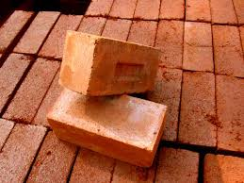
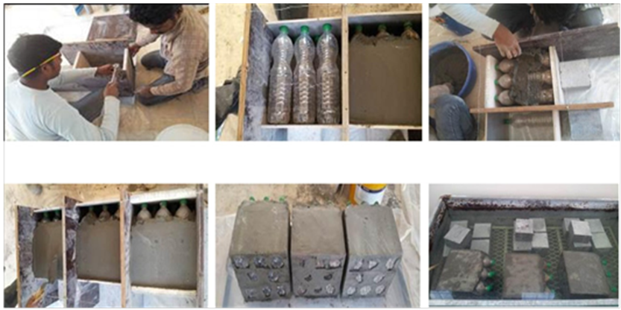
Insulation
Compressed Stabilized Earth Brick (CSEB)
1-inorganic subsoil,
2-non-expansive clay, aggregates and
3-portland cement
OR
Waste plastic bottles

Slide 8
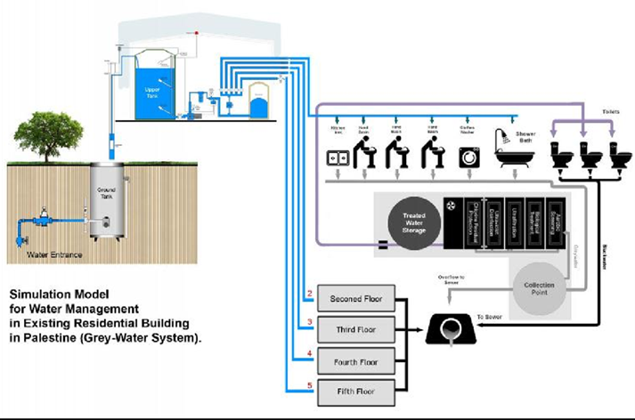
Water:
1.Gray Water Reuse System:
Gray water is wastewater from baths, showers, sinks and wash basins.

Slide 9
Benefits of Gray Water Recycling:
• Lower fresh water use
• Less strain on failing septic tank or
treatment plant
• Less energy and chemical use.
• Plant growth.
• Saving cost.
.

Slide 10
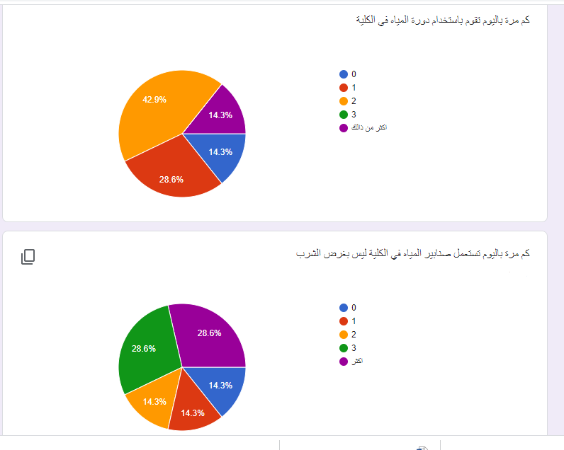

Slide 11
2- Water use
Many interviews and questionnaires were performed with different students in the college. The students were requested to give information on the frequency of use of the plumbing ﬁxtures and amount of time the water is used over
the working days and weekends.
For students and staff of the college:
The water ﬂow rate of each plumbing ﬁxture (liters per second). | Average time of use (seconds /time of use) | Frequency(times per day)/person
5liters for each time | - | 1.5 | Toilet flushing
0.033 | 15 | 2.4 | Hand Washing
.15 | 180 | .5 | Shower

Slide 12
For foreign students:
The water ﬂow rate of each plumbing ﬁxture (liters per second). | Average time of use (seconds /time of use) | Frequency(times per day)/person
5liters for each time | - | .3 | Toilet flushing
.033 | 15 | .7 | Hand Washing
.15 | 0 | 0 | Shower

Slide 13
Daily Water Consumption:
The daily water consumption can be calculated using this
:equation
For students and staff of the college:
:
Daily gray water consumption for all students(litre/day) | Daily water consumption of each plumbing ﬁxture (liters per day)
4275 | 7.5 | Toilet
627 | 1.1 | Hand Washing
7425 | 13.5 | Shower

Slide 14
For foreign students
Daily gray water consumption for all students(litre/day) | Daily water consumption of each plumbing ﬁxture (litres per day)
600 | 1.5 | Toilet
136 | .34 | Hand Washing
 | 0 | Shower

Slide 15

Total gray water for each day
Total grey water consumption (L/d)
763 | Hand washing
7425 | Shower
8188 | Total
By using hand washing and shower as gray water
Gray water= 8188 L/day
c=163.76 /month
For toilet:
C = 97.5 /month
Overflow= 163.76-97.5=66.26

Slide 16
3-Water demand
:
Water demand per month in the college
Water demand(/month) | Month
60 | January
250 | February
304 | March
304 | April
60 | May
70 | June
70 | July
93 | August
250 | September
171 | October
250 | November
70 | December

Slide 17
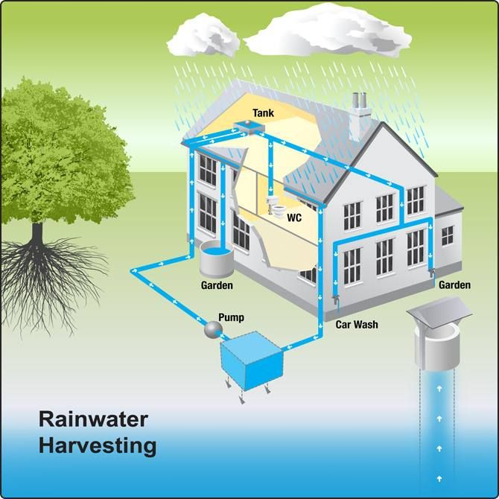
2.Rainwater Harvesting System
RWH is the most traditional and sustainable method that has been used since ancient time in many regions in world in order to provide human needs for water where the basic water sources has not been able to provide

Slide 18
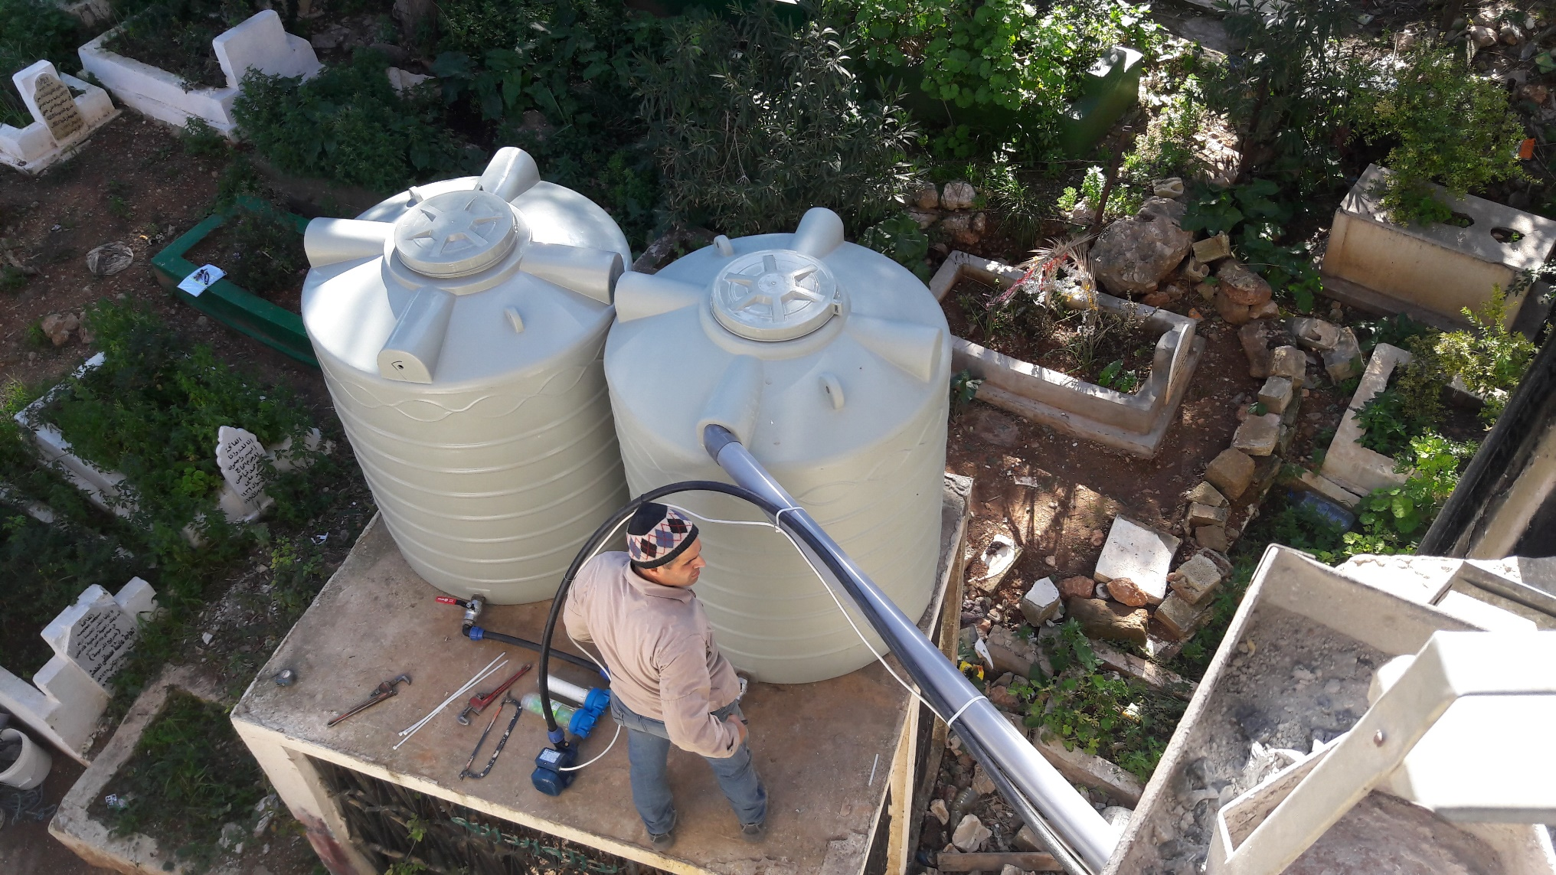
Rainwater harvesting in Palestine

Slide 19
Limitations and objective
Objective
(1) Technical elements (quantity of harvested water, water demand, Tank size)
(2) Economical dimensions (capital cost, economic added value,)
limitations
1-Cost
2-Limited area for storage
3-Data needed

Slide 20
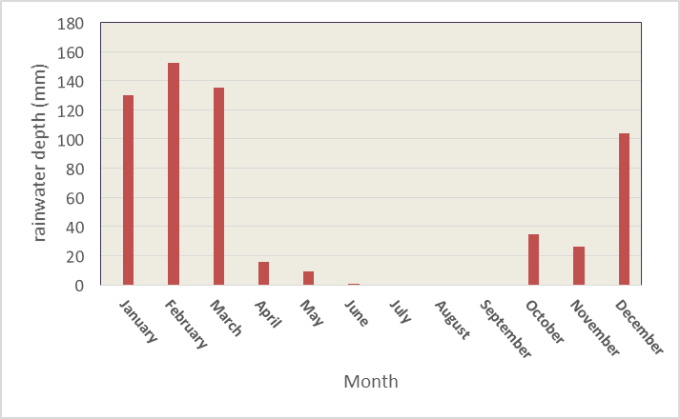
Climate and Rainwater
A Mediterranean climate, with hot, dry summers and mild, wet winters.
Great variations in rainfall and distribution
On average, 51 Rainy days
Mean rainwater in Nablus equals 660mm (Palestinian Central Bureau of Statistics )

Slide 21

Uses
Agricultural irrigation
Residential potable water
Domestic toilet flushing (Non potable)

Slide 22
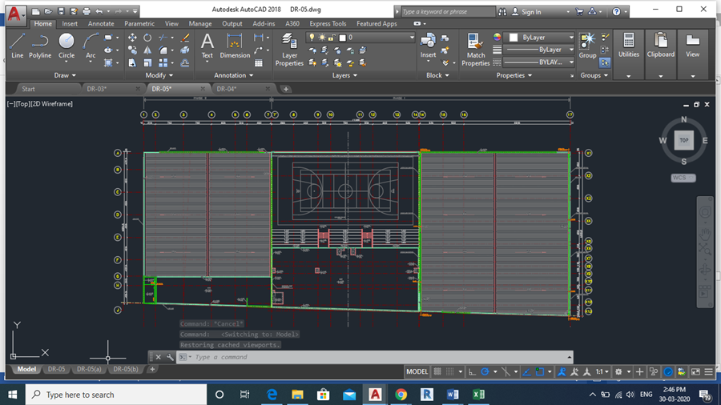

Components
1-Catchment area
(Roofs ,metal ,clay , concrete)
Catchment area=Total Area of the college roof= 3602 $m^{2}$

Slide 23
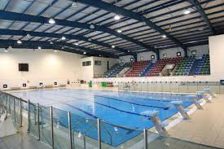
Runoff coefficient: Rainfall loss occurred from the system due to absorption by the roofing material, wind effects around the roof and gutter overflowing
Metal inclined roof (.75-.95)
2-Conveyance: channels or pipes that
transport the water from catchment
area to storage , Pumps.
3- Roof washing (first Flush Diverter):
Pollutants (bird droppings, leaves) that have settled on the roof from
reaching the cistern

Slide 24
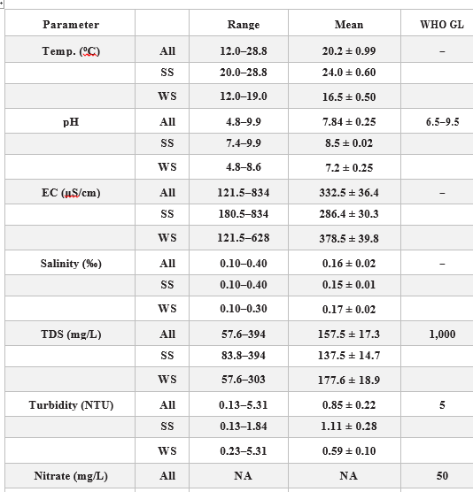
4-Storage tank:
Type , size, Location, cost
5- Purification or treatment
Analyzing

Slide 25

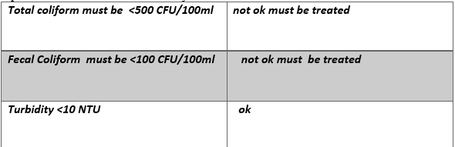
Comparison

Slide 26
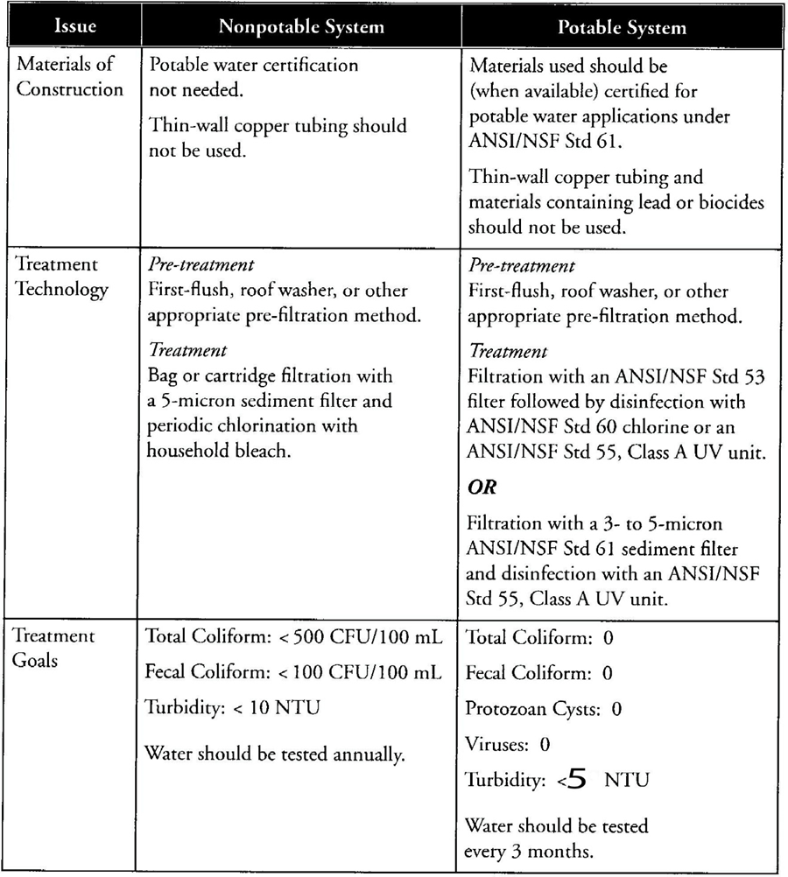
chlorination system

Slide 27
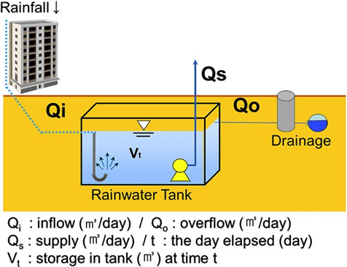

Methodology:
$$V_{t}=\sum_{t=t_{0}}^{t}{Q_{i,t}}−Q_{0,t }–Q_{s,t}$$
1-Supply : rainwater endowment

Slide 28

Rainwater volume (l/month) = d ×R×A×1000
d=rain water depth in m, R: runoff coefficient,
A: catchment area in $m^{2}$
3-Tank Size
2- Demand

Slide 29
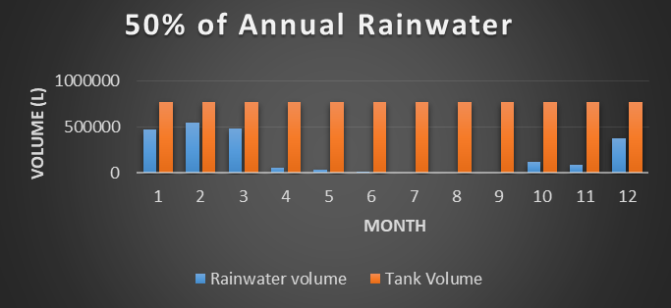
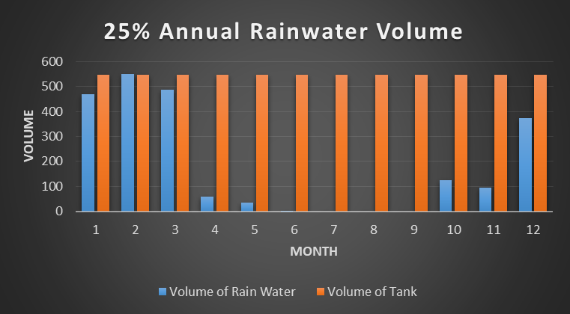
First: annual rainwater proportion

Slide 30
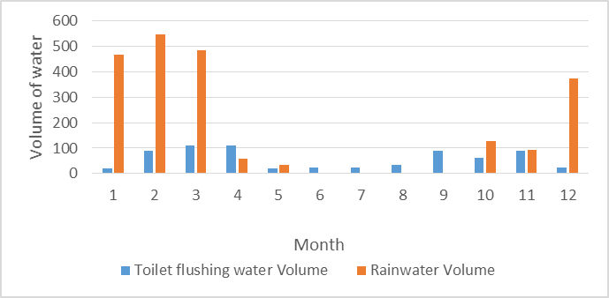

Slide 31
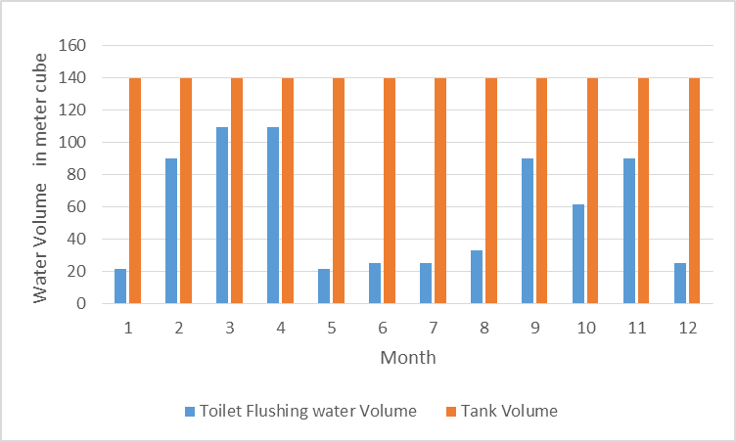
Second :Water demand proportion
For 25% of total Toilet flushing demand

Slide 32
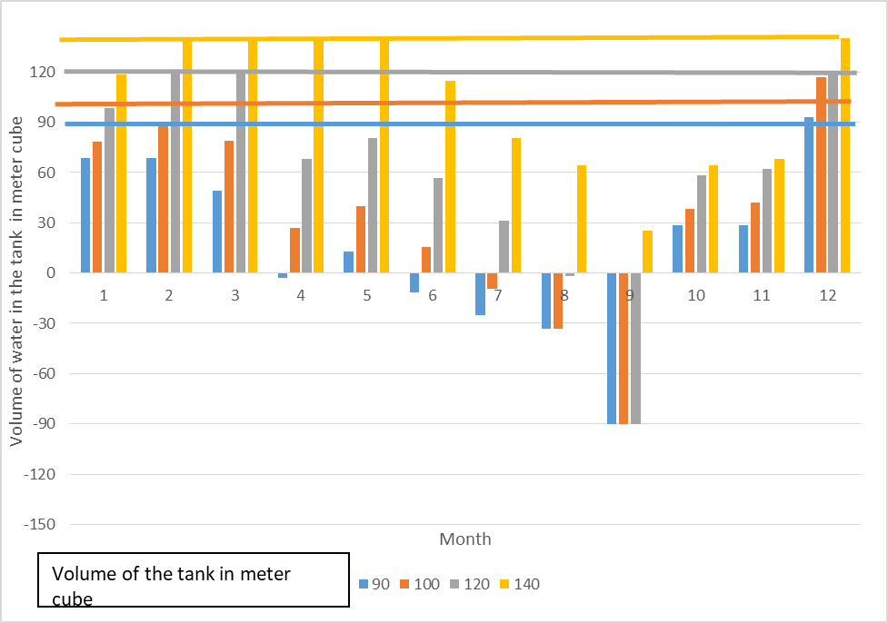
Third : Monthly Average Rainfall Data

Slide 33
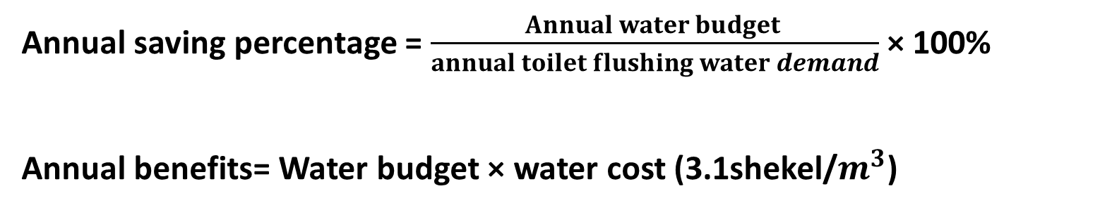
Annual saving percentage = $\frac{Annual water budget }{annual toilet flushing water demand}$ × 100%
Annual benefits= Water budget × water cost (3.1shekel/$m^{3}$)

Slide 34
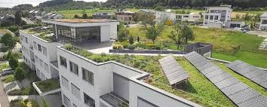
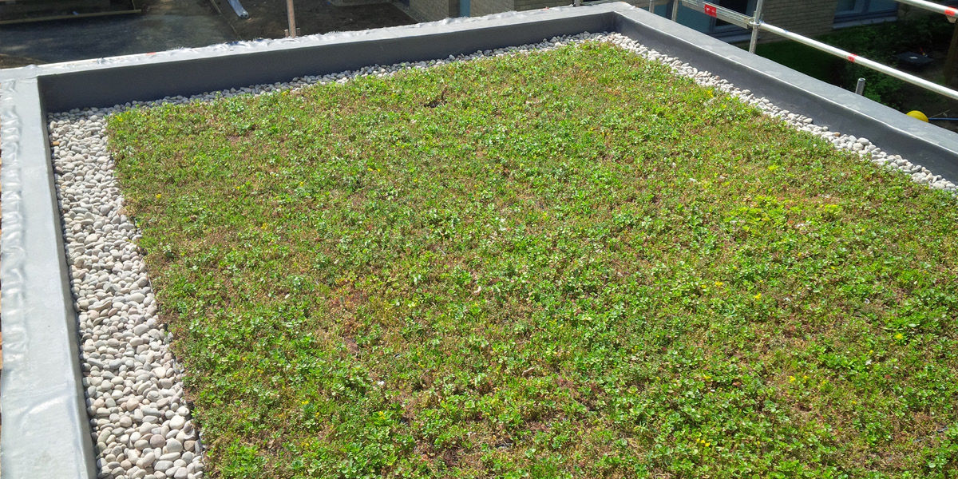
Green Roof

Slide 35
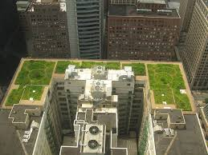
Advantages
1-Storm water management: reduces storm water runoff so there is less water directed into storm drains
2-Energy conservation
3-Urban heat islands
4-Aesthetic and social benefits

Slide 36
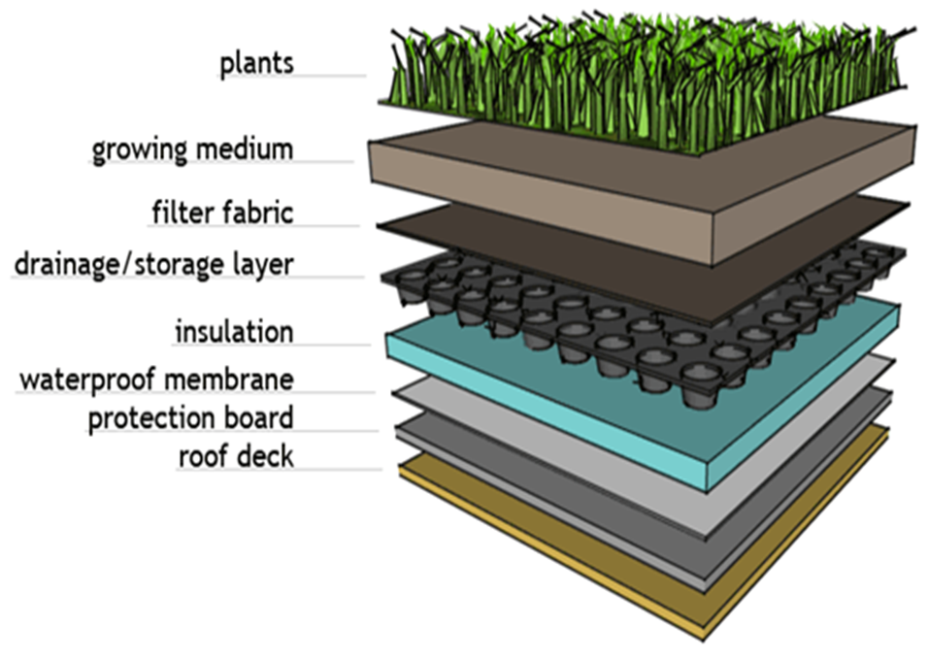
Components

Slide 37
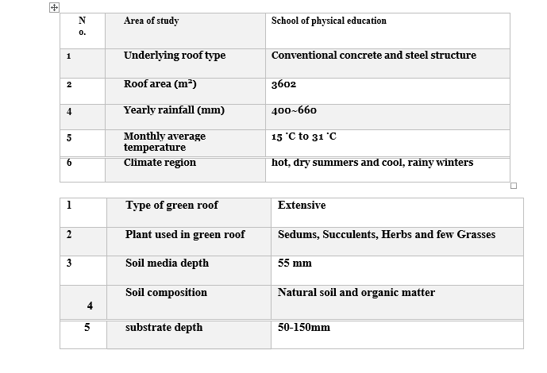

Slide 38
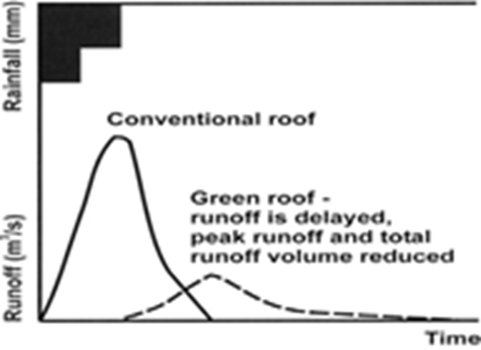
Runoff Reduction
By using Runoff (RO, mm year−1)–rainfall
(P, mm) relationship
RO = 693 − 1.15P + 0.001P2 − 0.8 × S
Run off % =50 as average
In general, the thicker the substrate, the lesser is the discharge ratio so the percentage of runoff needed may determine the depth of the substrate.

Slide 39
Thank You

