Slide 1
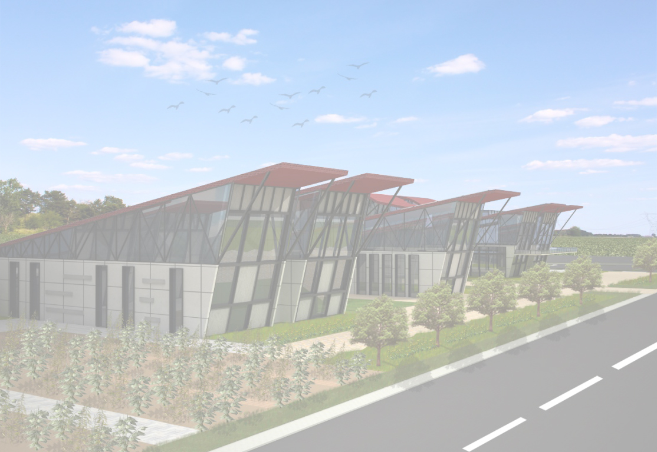
Agricultural Research Center
Designed by :Asal Dado
Presented to : Dr. Iman Assi
Dr. Hasan Qadi
Dr. Khaled Qamheya
Eng. Areej Afifi

Slide 2
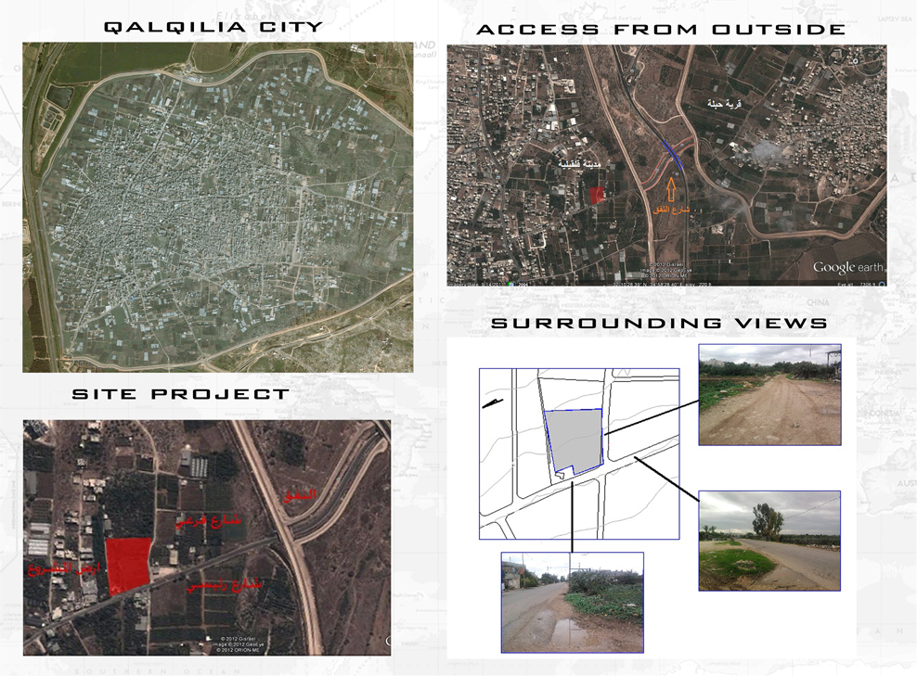
Site Analysis

Slide 3
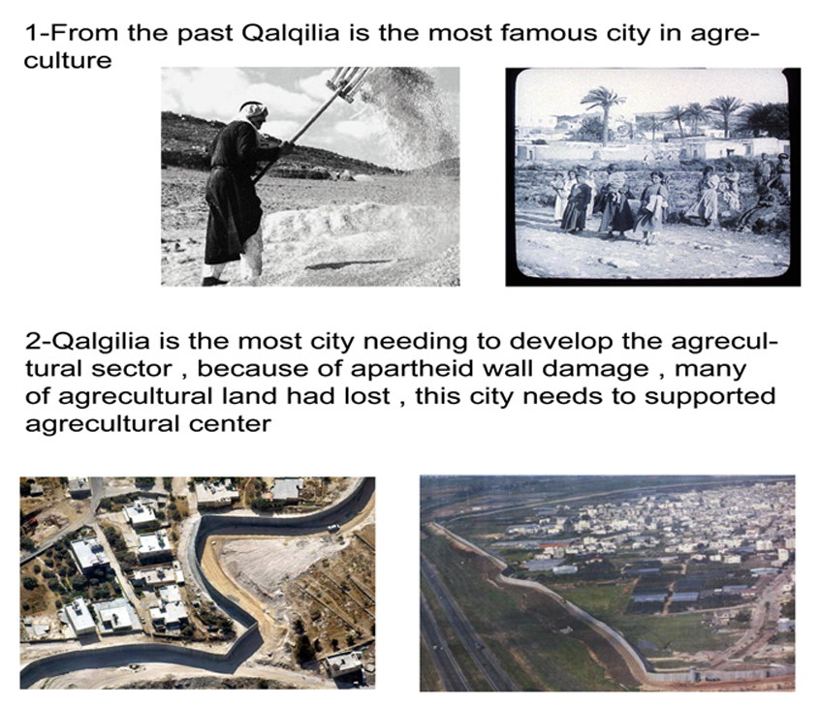
Why Qalqilia City ?

Slide 4

Concept
Simple trying to find architectural solution for improving the environment..
Architectural solution
Technical problem

Slide 5

Concept
Sustainable Approach
Some Sustainable Approach Techniques were used as Architectural Solution to get Green Building ..
Green Building need a high performance sustainable architecture ..Future buildings must have :
Energy Efficient , Environmentally Responsible , Smart Technology .

Slide 6
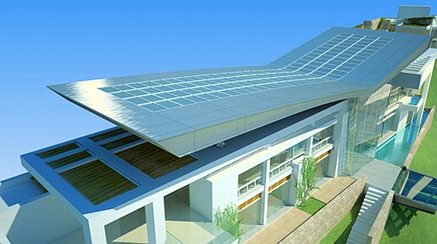
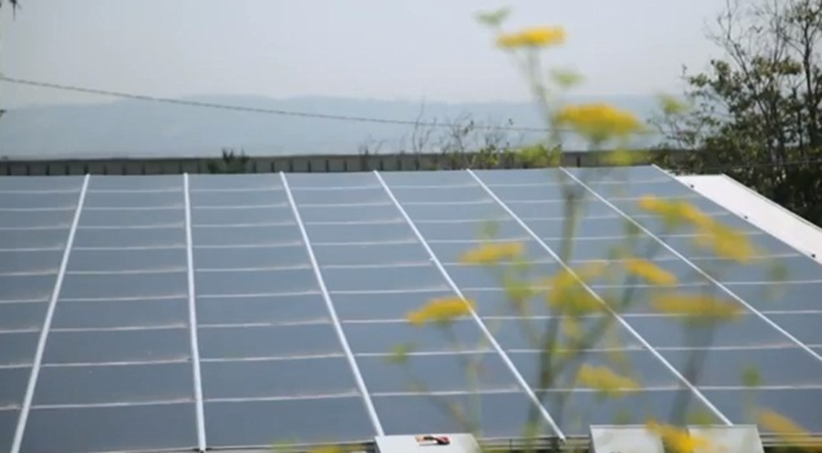
Concept
Energy Efficient by using Solar photovoltaic .
This technique should be integrated with the building to get the best architectural solution .
Solar photovoltaic saves energy and reduces the electricity consumption .

Slide 7
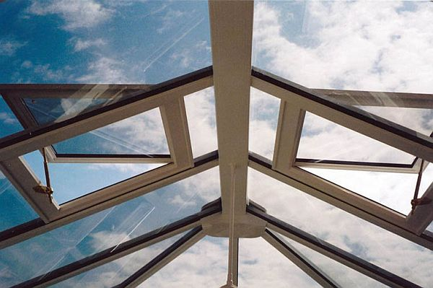
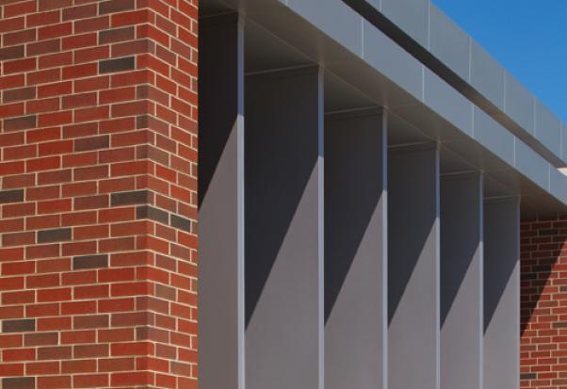
Concept
Smart Technology by using Smart windows and vertical louvers .
Smart Windows are used for good ventilation and light .
Vertical Louvers uses for shading on western and eastern facades .

Slide 8
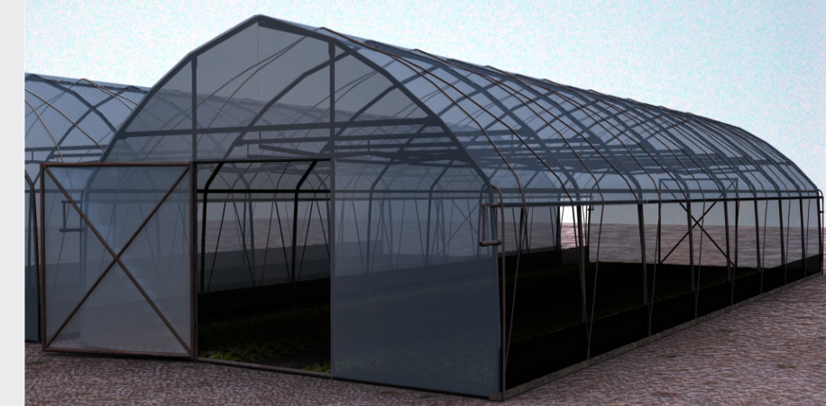
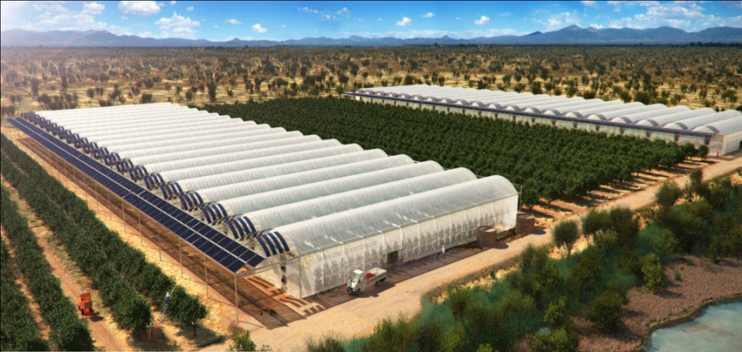
Concept
Environmentally Technology by using Greenhouses .
Greenhouses are used to provide a suitable environment for plants and get improved seed types .

Slide 9
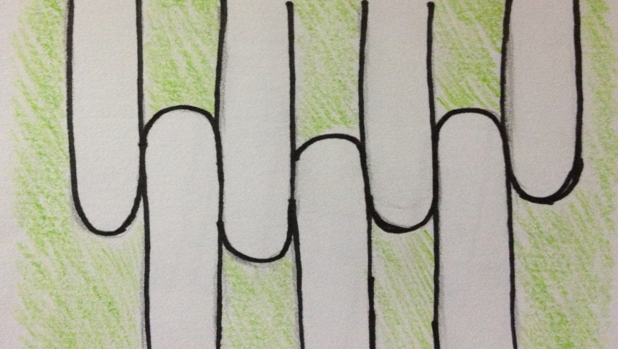
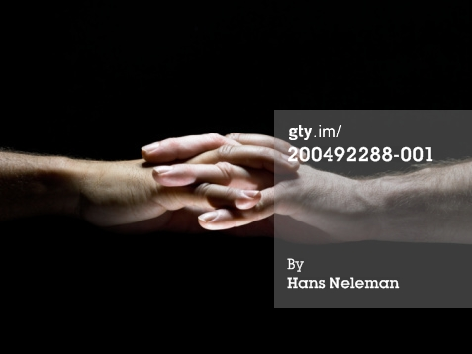
Concept
The Idea ..
Intertwined Fingers give us “Integration with nature”
We need a familiar building with nature by creating a high performance sustainable green building for agriculture sector .

Slide 10
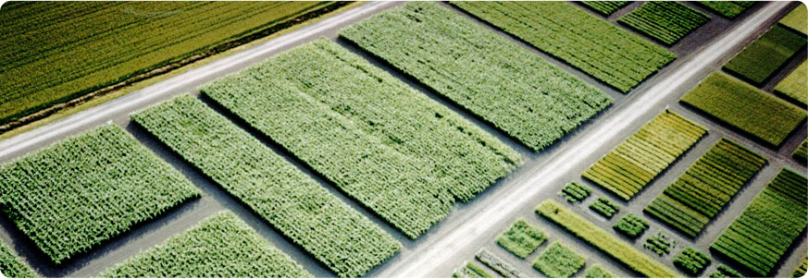
Concept
Strips Agricultural Land (MARS) to make the building part from nature .

Slide 11
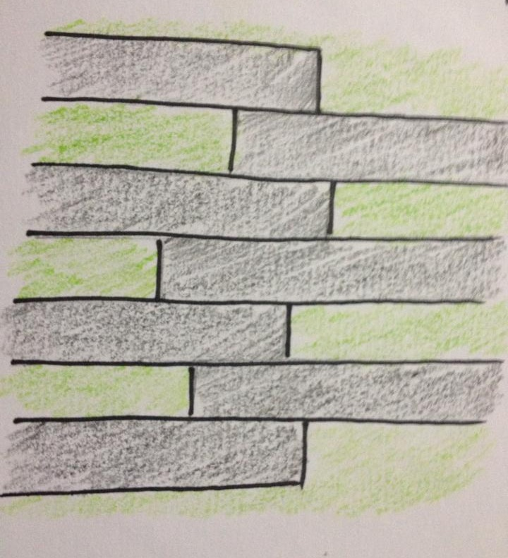
Concept
Integration with nature and the shape of strip lands give the image of project .

Slide 12
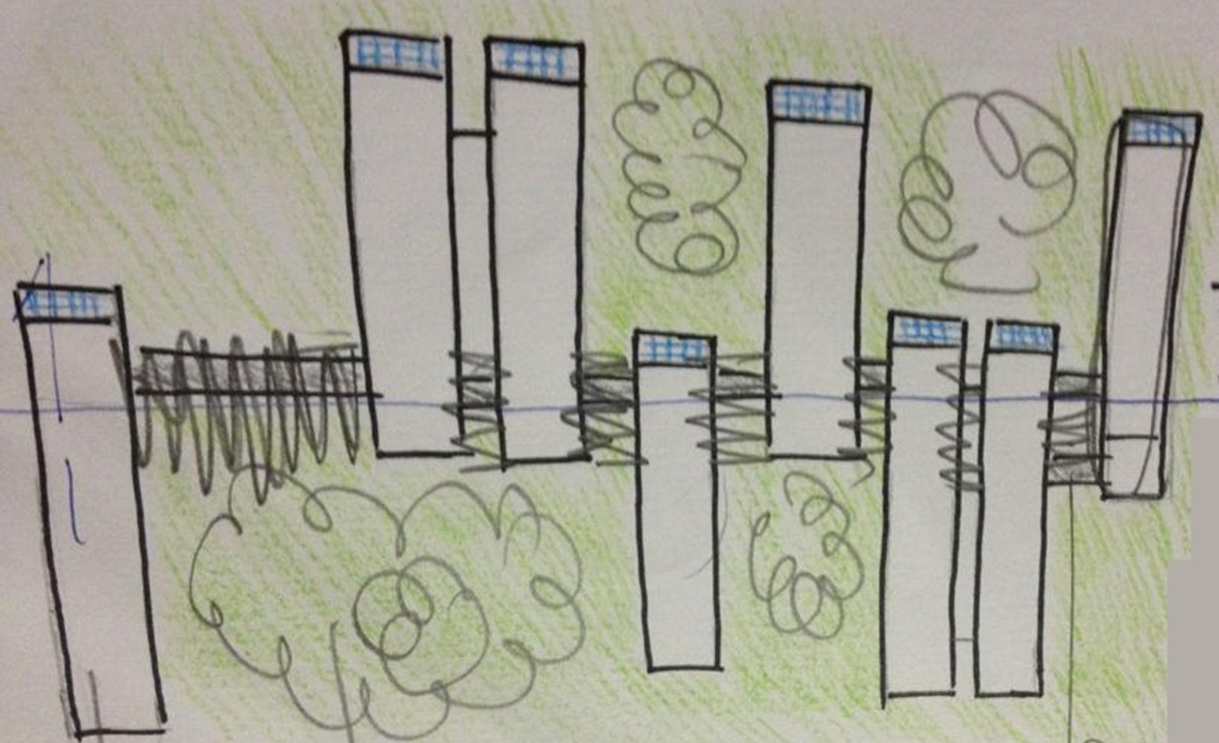
Concept
General image of building integrated with nature .

Slide 13
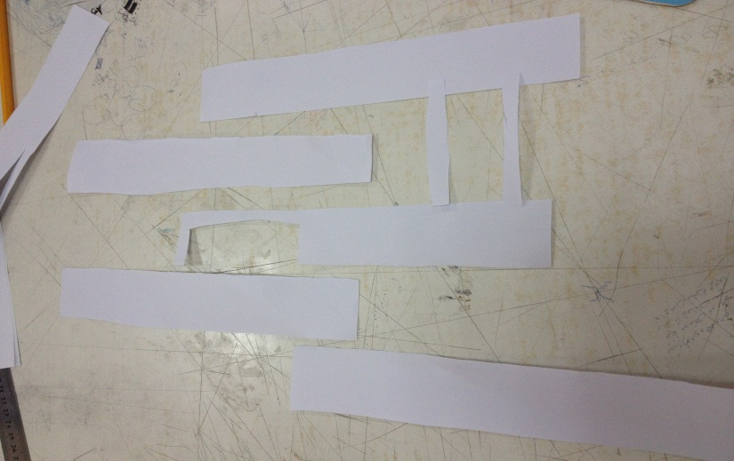
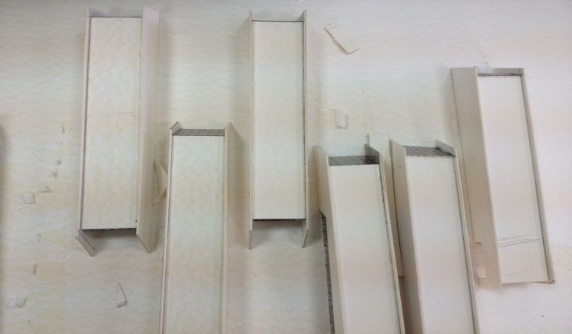
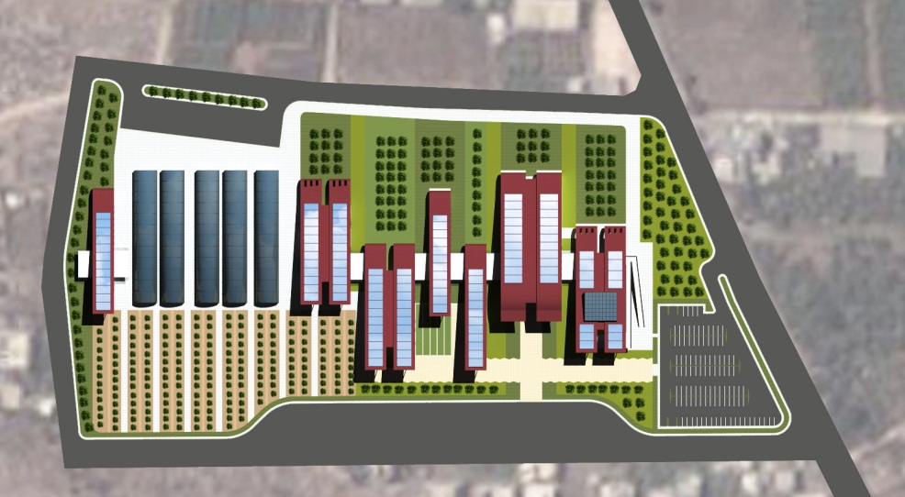
Concept
Development of project

Slide 14
Project
Components
Site area = 68000 m2
Indoor activities = 16060 m2
Outdoor activities = 52629 m2
Parking area =5990 m2
Reception and public area
Environment museum , interior gallery , library .
Cafeteria , guidance Center .
Information center .
Bank of seeds .
Greenhouses .

