Slide 1
Visible light communication
(Sending data through light)
Submitted By:
Ahed Hamed
Maram Afaneh
Alaa Odeh
Supervisor:
Dr.Jamal Kharwsheh

Slide 2
Contents:-
Introduction.
What is VLC?.
Construction and working of VLC.
Results.
Conclusion.
Recommendations.

Slide 3
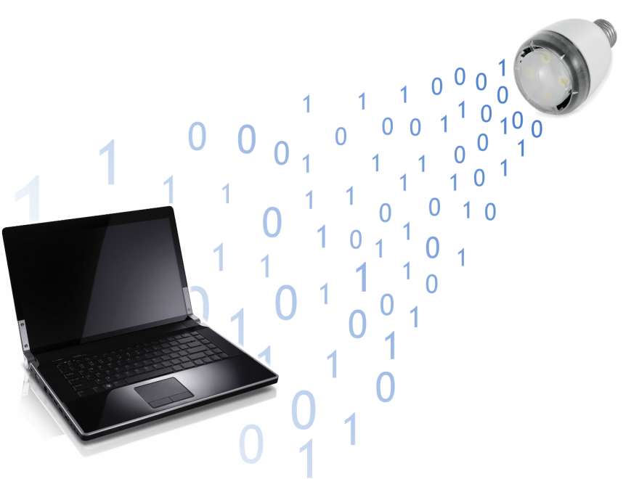
What is VLC?.
The visible light communication (VLC):
refers to the communication technology which utilizes the visible light source as a signal transmitter, the air as a transmission medium, and the appropriate photodiode as a signal receiving component.

Slide 4
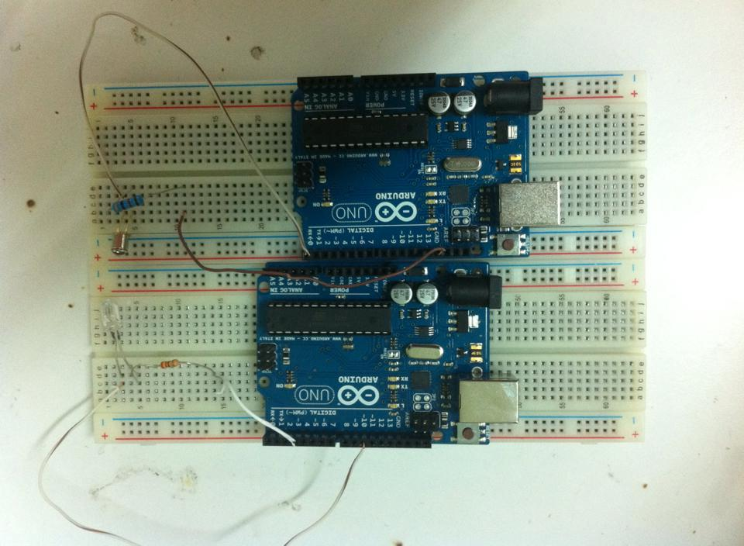
The First Design
Notes:
By using this circuit we was able to send a message from 5cm distance between the transmitter and receiver circuits. in this semester we worked to send other type of data (images) and to increase the distance between the transmitter and the receiver.

Slide 5
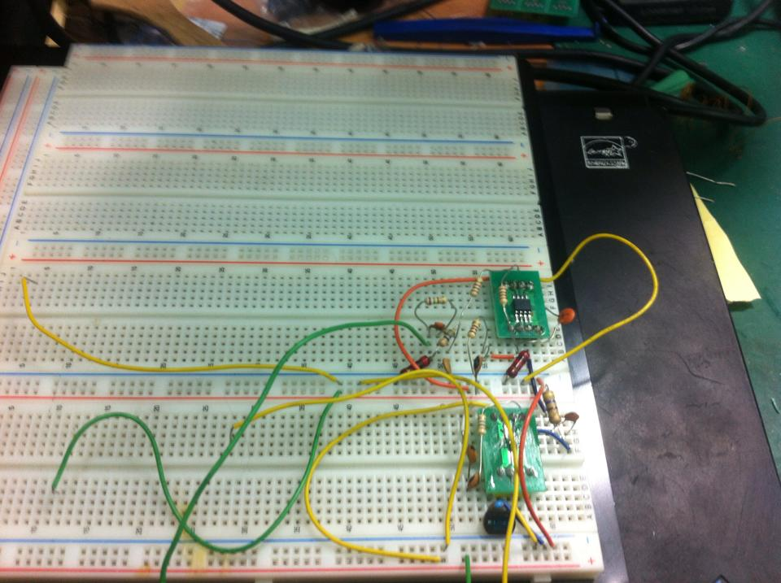
Construction and working of VLC
Hardware Design

Slide 6
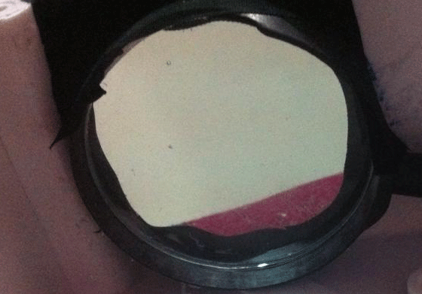
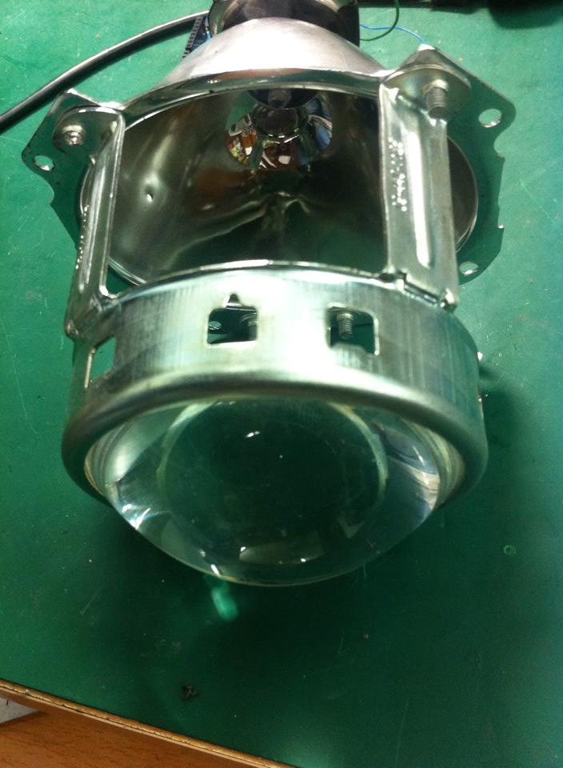
Notes:
So in order to increase the distance we tried to adjust the circuit at first Changing resistors values in the transmitter and receiver circuits and put instead of old ones smaller values. So we put a 60Ω resistor at the transmitter circuit and 20Ω resistor at the receiver circuit.
This increased the distance from 5cm to 30cm.

Slide 7
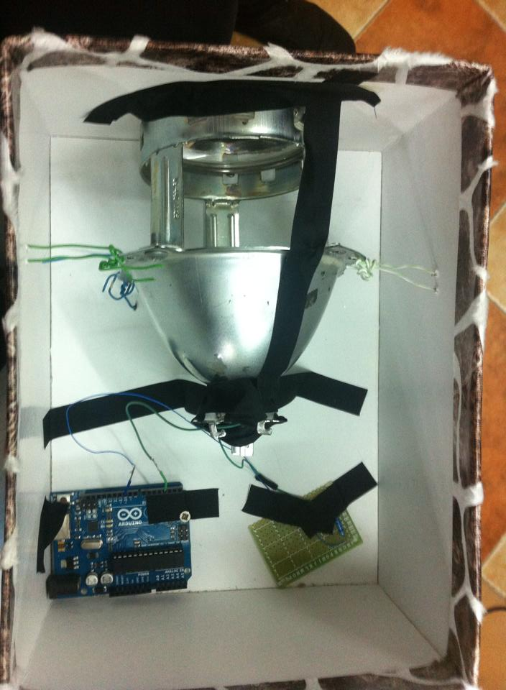
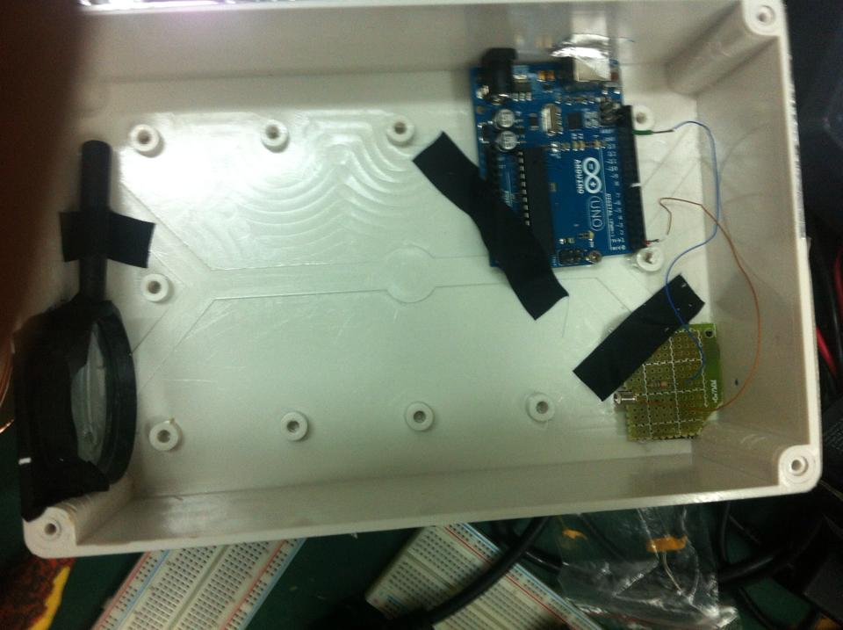
Transmitter circuit
Receiver circuit
Notes:
And the final prototype of our VLC system is shown here

Slide 8
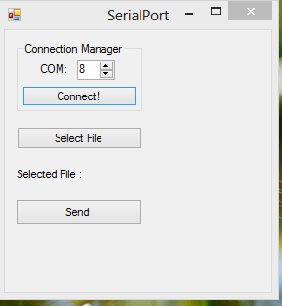
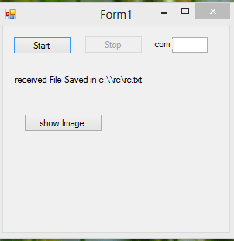
Software Design
Transmitter application
Receiver application

Slide 9
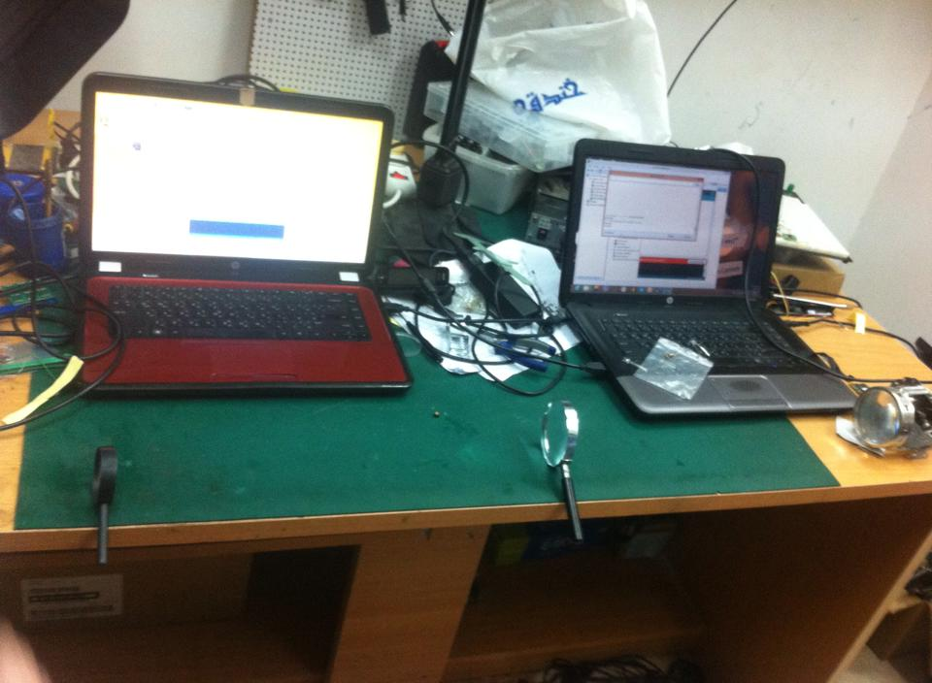
Results

Slide 10
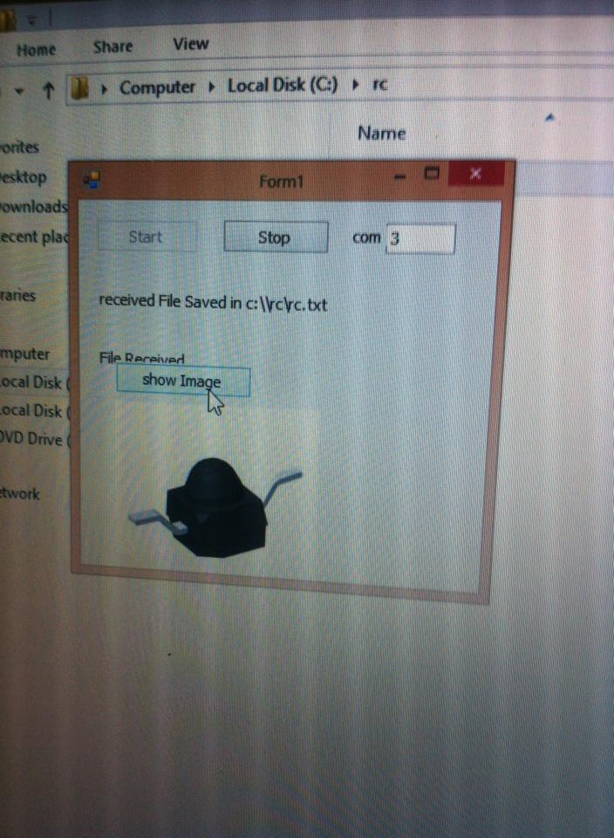
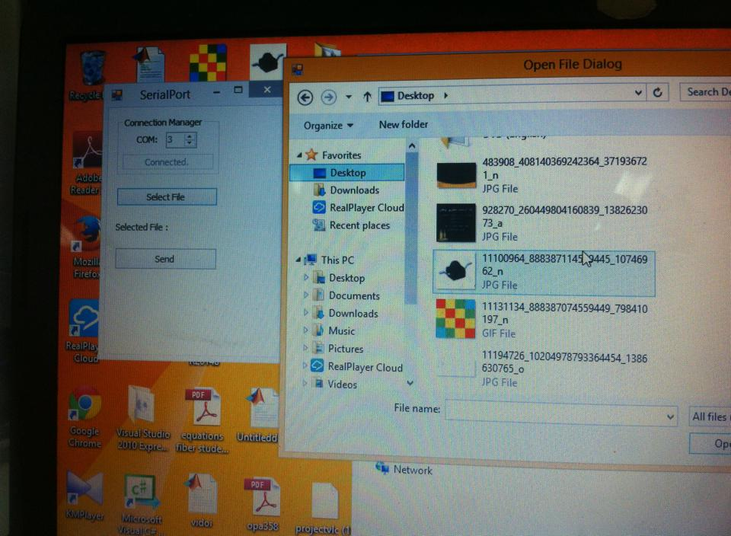

Slide 11
Conclusion
In this project we implemented a visible light communication system that is able to:
Send and receive text message through light at bit rate of 2Mbps.
Send and receive images also at bit rate of 2Mb.
The maximum transmission and reception distance that was achieved is 160 cm .

Slide 12
Recommendation
In the future, VLC will be a very advanced system so that every person will be able to send and receive data through light in an efficient way. i.e. the data rate will be very high, the speed of transferring data also will be very high ( the speed of light) and the most important thing that the integrity and the reliability of the data is very good because we are using visible light for communication (you can see what you send and receive).

Slide 13



