Slide 1
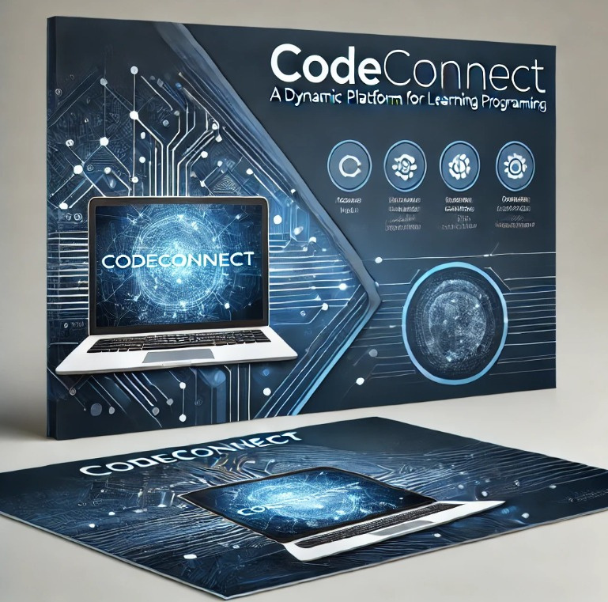

CodeConnect: A Dynamic Platform for Learning Programming

Slide 2

Team: Abdullah Hamza, Monawar Abu Shalbak, Ameera Hakawati
Supervisor: Dr. Amjad Hawash
Institution: Najah National University
Submission Date: February 2, 2025

Slide 3
Problem Statement
Problem 01
Problem 02
Problem 03
Problem 04
Many platforms lack adaptability for teachers and customized learning paths.
No structured student-teacher interaction and contribution in some platforms.
CodeConnect aims to solve these issues by integrating flexibility and interactivity.
Learning paths in most platforms are rigid, not dynamic.

Slide 4
Background
We created a user-friendly platform to simplify coding education by integrating guided lessons, progress tracking, and interactive discussions, making learning more effective.

Slide 5
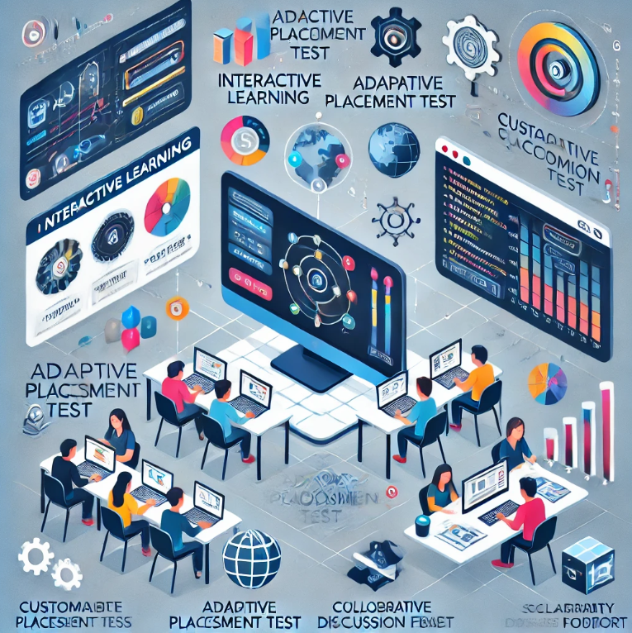
Project Objectives
1. Create an interactive, structured learning platform.
2. Implement an adaptive placement test.
3. Empower teachers to customize content.
4. Foster collaboration with discussion forums.
5. Ensure scalability and support for future languages.

Slide 6
Literature Review
Python as a key programming language: Simple and widely used.
Gamification techniques improve engagement and retention.
Role of teachers in e-learning platforms enhances content quality.
Comparative study: Khan Academy, Codecademy, and freeCodeCamp.

Slide 7

Research through surveys and platform comparisons.
01
Development using React.js (Frontend) and Laravel (Backend).
02
Methodology
Database: MySQL for efficient data handling.
03
Agile development for continuous improvements.
04
05
Integrated Python compiler for real-time coding practice.

Slide 8
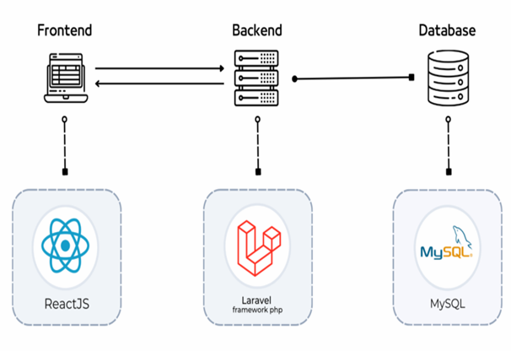
System Architecture
CodeConnect is designed to be scalable, efficient, and user-friendly, ensuring smooth interaction between the frontend, backend, and database.
Key Components:
Frontend: React.js for an intuitive user interface.
Backend: Laravel handles business logic and APIs.
Database: MySQL stores site and user data efficiently.

Slide 9
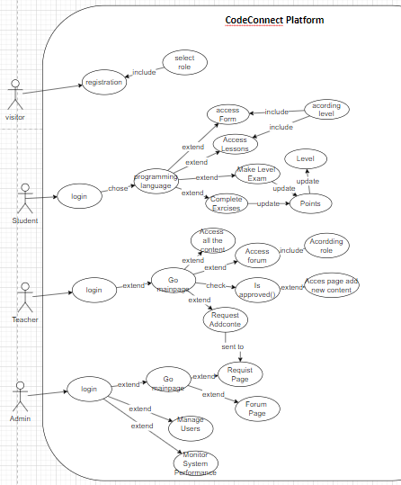
SYSTEM DESIGN

Slide 10
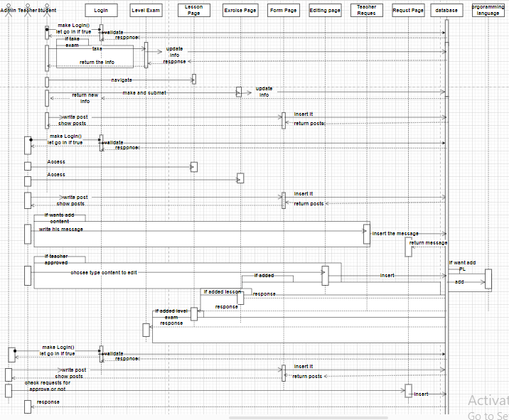
SYSTEM DESIGN

Slide 11
Gamification & Learning
• Students progress through levels.
• Earn points and badges.
• Encourages consistent learning and interaction.
• Quizzes, exercises, and exams ensure knowledge retention.

Slide 12
Implementation Strategy
CodeConnect was developed using a structured, phased approach to ensure flexibility, functionality, and scalability. It focuses on dynamic design to meet the evolving needs of students and teachers.
.
Aaron Loeb
Juliana Silva
Daniel Gallego
Olivia Wilson
CEO & Founder
CEO & Founder
IT Expert
Marketing Head

Slide 13
Implementation Strategy
Development Process:
•Requirements Gathering: Involved surveys, stakeholder sessions, and competitive analysis to define key features.
•Design Phase: Created wireframes and prototypes, ensuring modularity and scalability.
•Frontend Development: Built responsive, interactive UI with React.js for dynamic dashboards and lesson interactions.
•Backend Development: Used Laravel for APIs and business logic.
Aaron Loeb
Juliana Silva
Daniel Gallego
Olivia Wilson
CEO & Founder
CEO & Founder
IT Expert
Marketing Head

Slide 14
Implementation Strategy
Database Design:
•User Management: Role-based access for students, teachers, and admins.
•Lessons & Progress Tracking: Lessons mapped to skill levels and real-time progress tracking.
•Content Requests: Teachers submit requests for content updates, with an auditable workflow.
•Scalability: Designed for future growth, supporting new languages and analytics dashboards.
Aaron Loeb
Juliana Silva
Daniel Gallego
Olivia Wilson
CEO & Founder
CEO & Founder
IT Expert
Marketing Head

Slide 15
Implementation Strategy
System Functionality:
•Progressive Learning: Students earn points through lessons and exams, with automatic promotion upon proficiency.
•Teacher-Driven Content: Teachers can propose new content, with admin approval.
•Immediate Feedback: Quizzes and coding exercises help students to know marks after making exams and exrcises.
•Dynamic Content Updates: Admins ensure timely updates and approval for new languages and content.
Aaron Loeb
Juliana Silva
Daniel Gallego
Olivia Wilson
CEO & Founder
CEO & Founder
IT Expert
Marketing Head

Slide 16
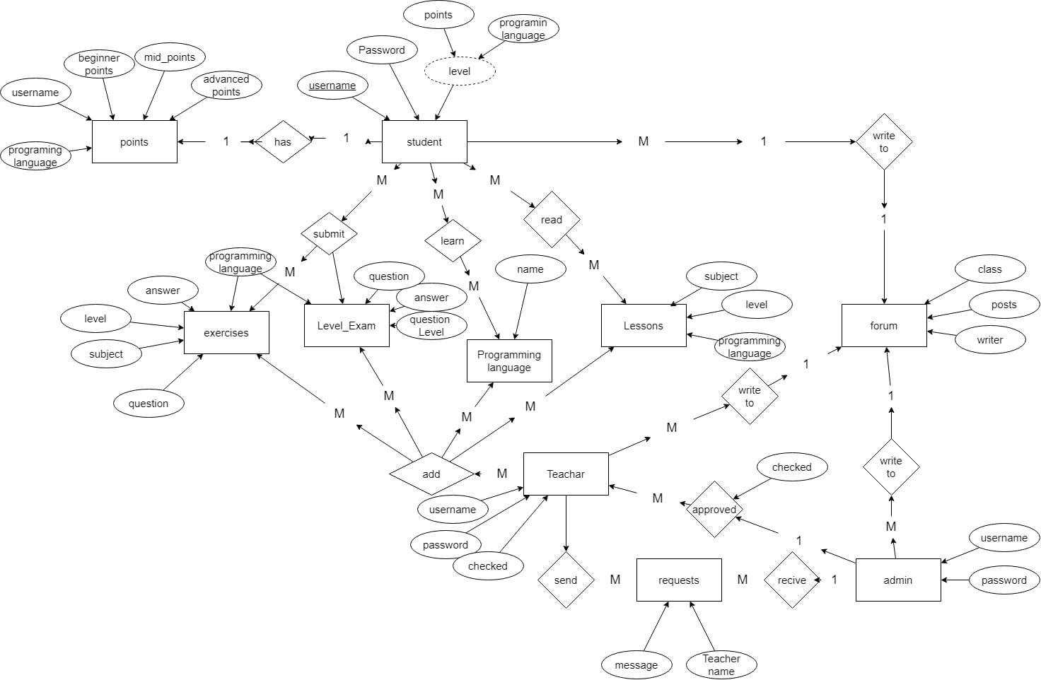

Slide 17
Testing & Results
Testing Methods
Unit Testing: Verified individual functions like user authentication and progress tracking.
Integration Testing: Ensured seamless interaction between frontend, backend, and database.
System Testing: Conducted comprehensive tests to ensure smooth system operation without errors.
Usability Testing: Gathered feedback from students, professors, and experienced developers to refine the system.
Performance Testing: Measured speed, responsiveness, and system stability under different loads.
Aaron Loeb
Juliana Silva
Daniel Gallego
Olivia Wilson
CEO & Founder
CEO & Founder
IT Expert
Marketing Head

