Slide 1

Integrated Design of a Restaurant
Students’ Name:
Supervisor: Eng. Nermeen AL-Barq
Bushra Ebseesih
Dana Hnini
Doa’a Haneish
Nareman Yaseen

Slide 2
outline
Site analysis
Architectural design
Electrical design
Quantity surveying
Mechanical design
structural design
Environmental design

Slide 3
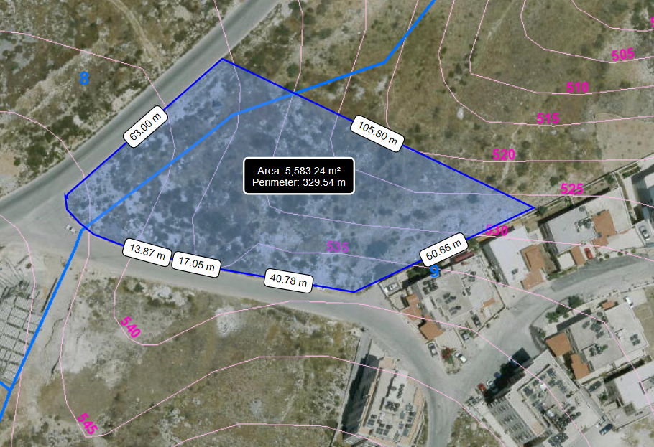
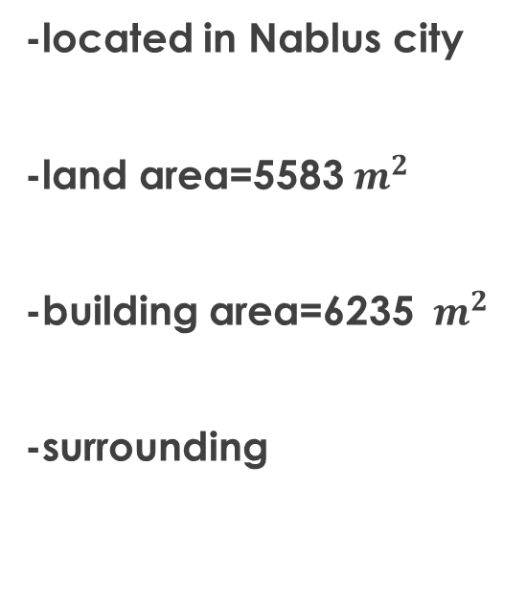
Site analysis
-located in Nablus city
-land area=5583${ m}^{2}$
-building area=6235 ${ m}^{2}$
-surrounding
Area and Surrounding of the site.

Slide 4
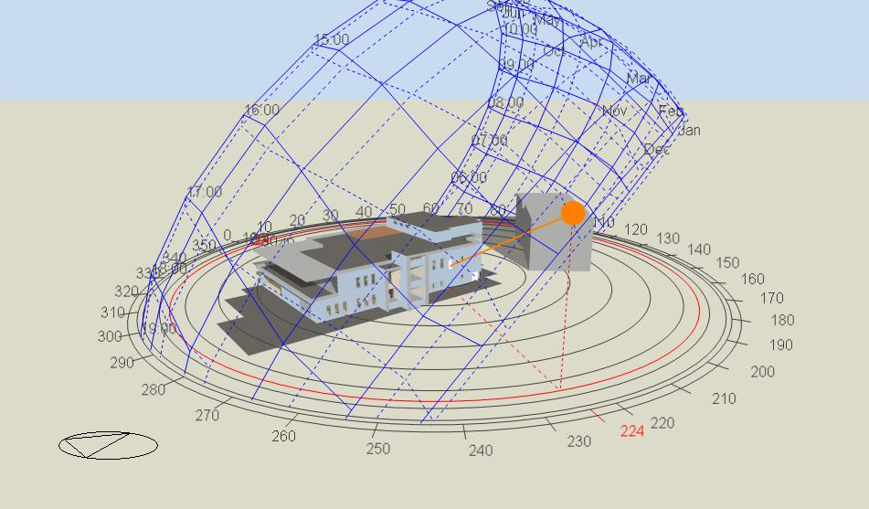
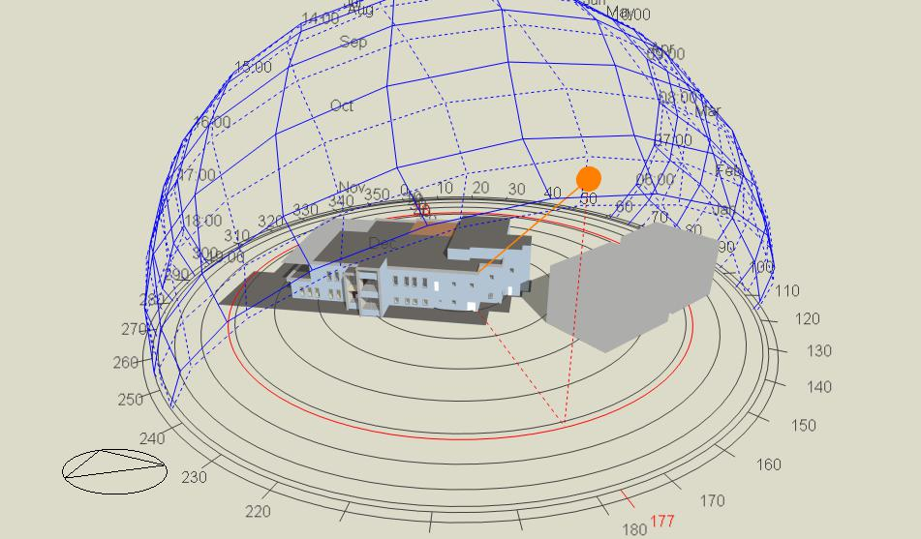
Shading
Overshadowing in January.21 at 12:00 PM.
Overshadowing in January.21 at 9:00 AM
Overshadowing in January.21 at 3:00 PM.

Slide 5
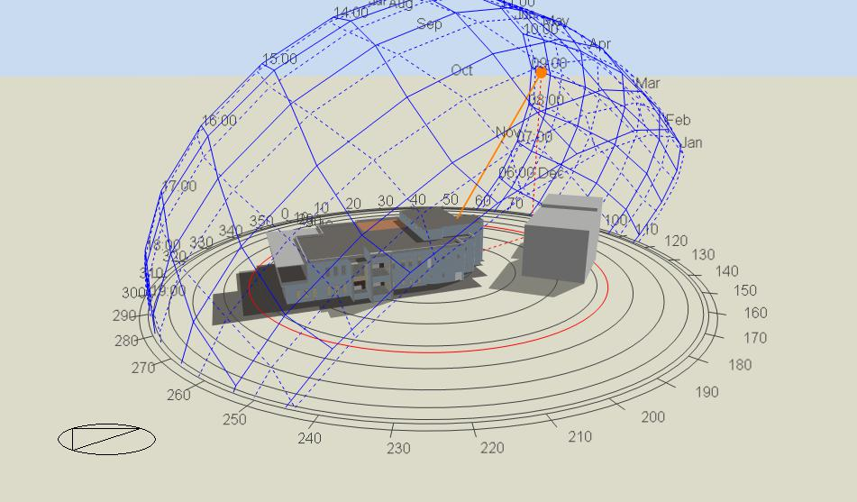
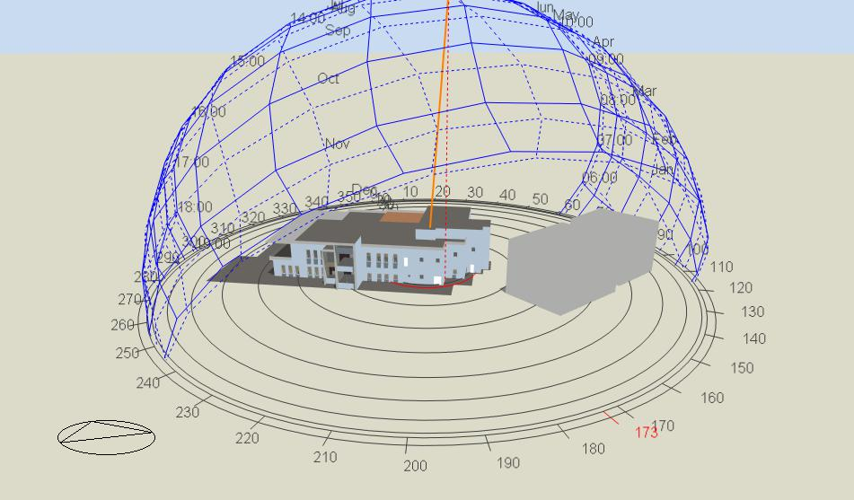
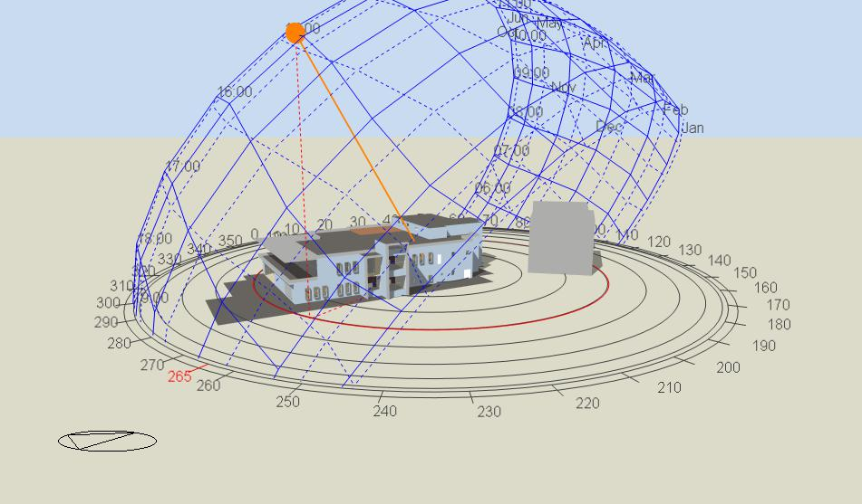
Shading
Overshadowing in July.21 at 12:00 PM.
Overshadowing in July.21 at 9:00 AM.
Overshadowing in July.21 at 3:00 PM.

Slide 6
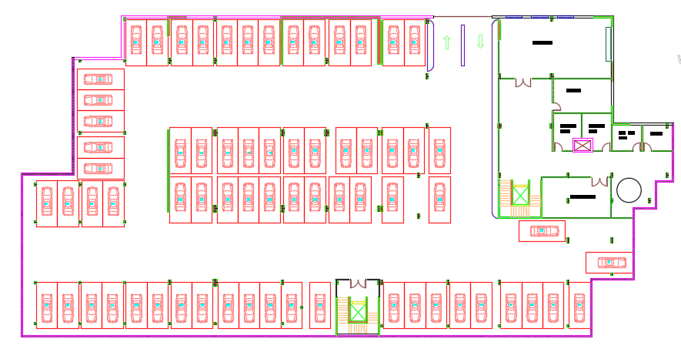
Architectural design
-Basement floor plan
Basement floor plan.

Slide 7
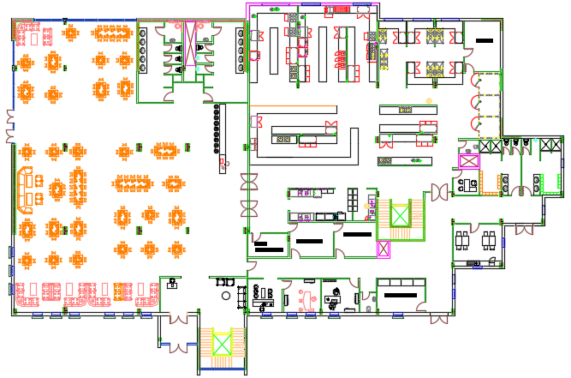
-Ground floor plan
Architectural design
.
ground floor plan

Slide 8
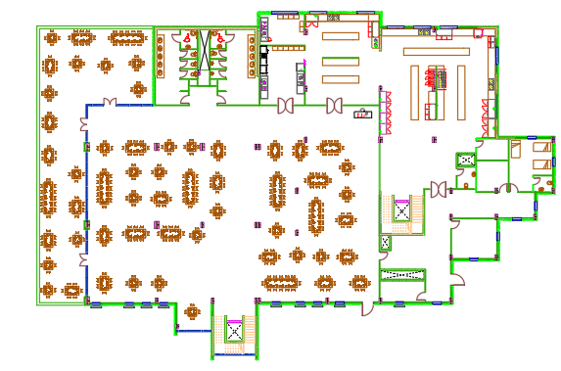
-First floor plan
Architectural design
First floor plan

Slide 9
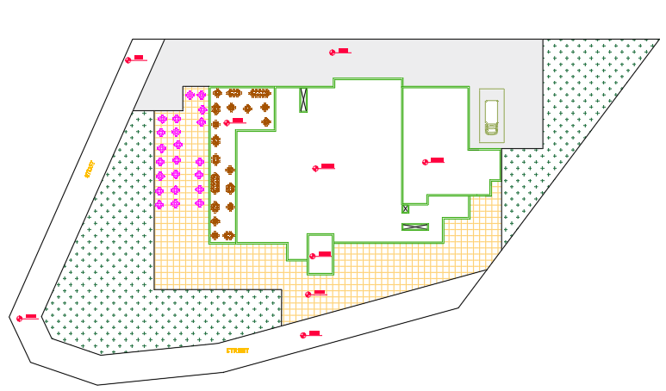
Movement

Slide 10
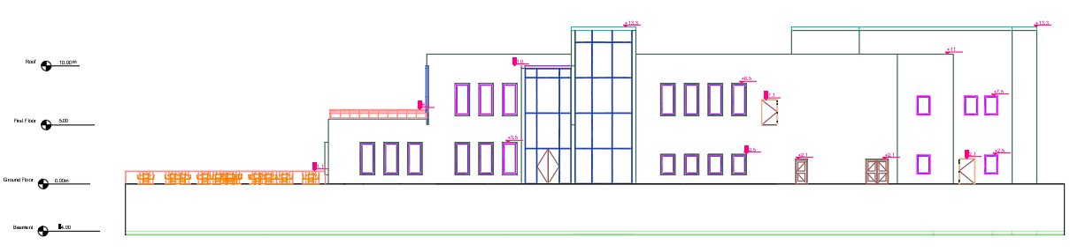
SOUTH Elevation
Architectural design

Slide 11
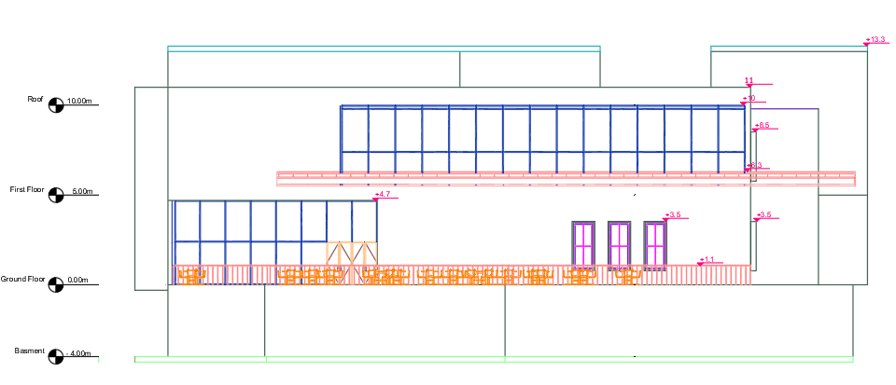
Architectural design
west Elevation

Slide 12
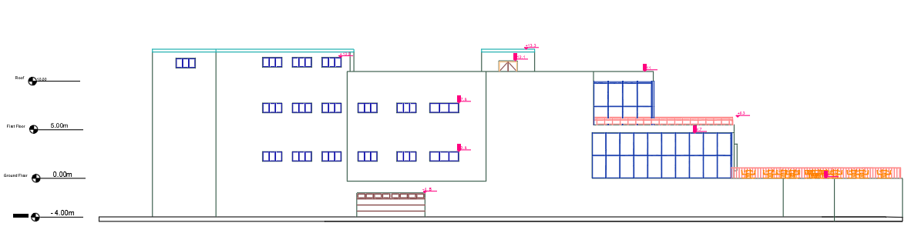
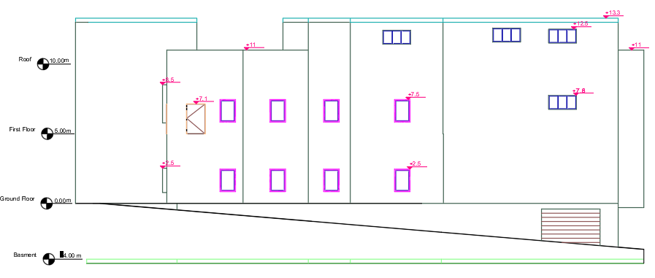
Architectural design
north Elevation
east Elevation

Slide 13
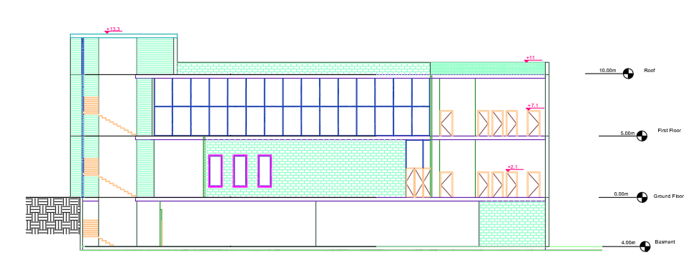
Architectural design
Section1-1

Slide 14
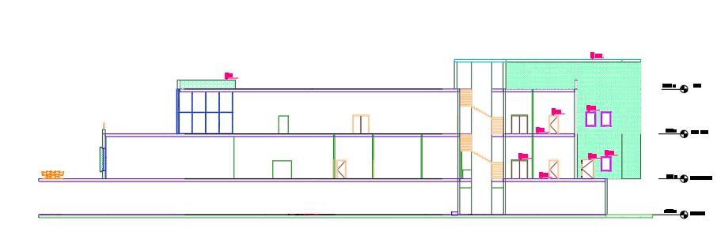
Architectural design
Section2-2

Slide 15
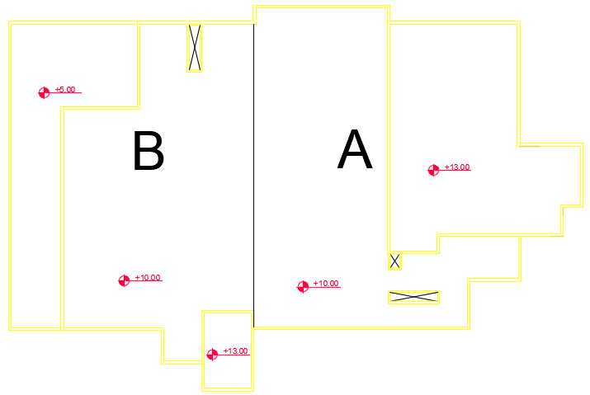
Structural Design
Reinforced Concrete Structure
Codes:
Building Code Requirements for Structural Concrete ACI 318-14(ACI Committee 318 2014).
UBC -97 for earthquake design.
ASCE for loads computations.

Slide 16
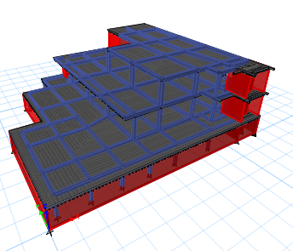
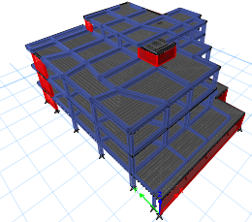
Structural Design
fʹ_{c} = 24 MPa for slabs and beams
fʹ_{c} = 28 MPa for columns, shear walls and foundation.
fy = 420 MPa.
Floor Height = 4m for B.F
5m for G.F and F.F
3m for R.F
Maximum span length = 9.5m
Block B
Block A

Slide 17
Structural Design
Gravity Loads :
SID = 5.52 KN/m².
Live = 4.8 KN/m².
Load from external walls = 25KN/m.
Seismic load:
Soil profiles Sc with a bearing capacity 250 KN/m²
Z = 0.20
I = 1.25
Ca = 0.24
Cv = 0.32
R= 5.5

Slide 18
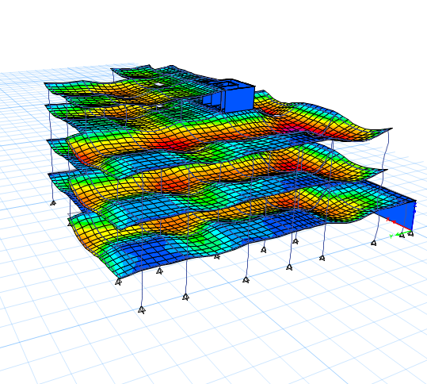
Structural Design
Manual Checks
Compatibility check
Equilibrium check
Internal force check
Modal participation mass ratio
Time period check
Base shear check
Drift check
Deflection checks

Slide 19
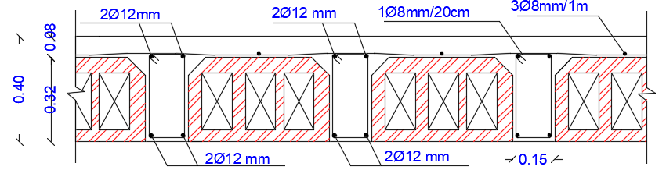
Structural Design
Two way Ribbed Slab
Thickness = 40cm.
Shear Check :
No shear → 1Φ8 per 20 cm in rib

Slide 20
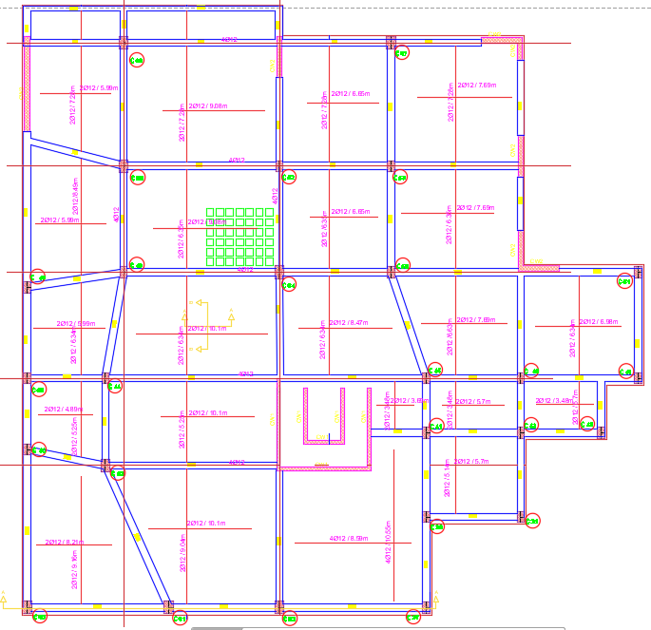
Structural Design
Moment design
As = 2Φ12
As shrinkage = 3Φ8/m

Slide 21
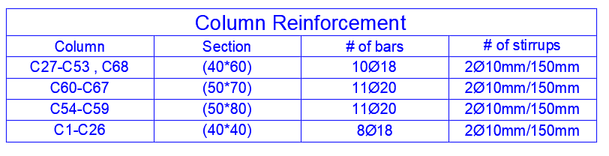
Structural Design
Columns groups and Reinforcement

Slide 22
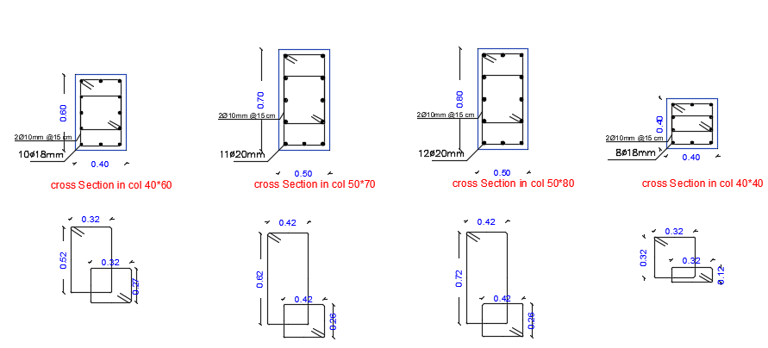
Structural Design
Columns Sections

Slide 23
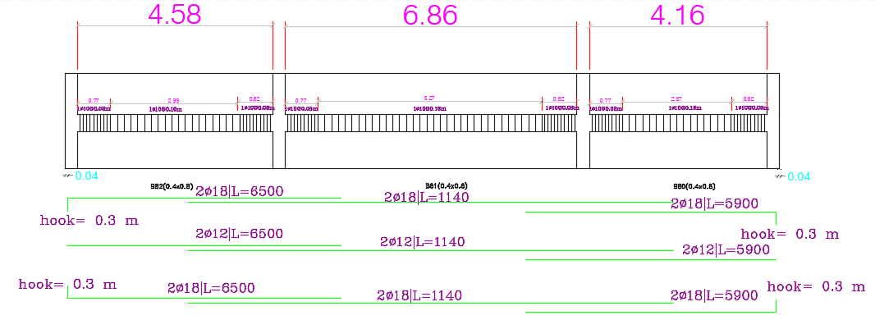
Structural Design
Beams Design
Beam | Section (cm)
B1 | 40*80
B2 | 50*90

Slide 24
Structural Design
Shear wall design
Block A
Wall thickness | vertical direction | horizontal direction
20 cm | 1φ 18 mm / 75 mm | 1φ 10mm / 250 mm
30 cm | 1φ 18 mm / 50 mm | 1φ 10mm / 250 mm
Block B
Wall thickness | vertical direction | horizontal direction
20 cm | 1φ 18 mm / 90 mm | 1φ 10mm / 250 mm
30 cm | 1φ 18 mm /250 mm | 1φ 10mm / 250 mm

Slide 25
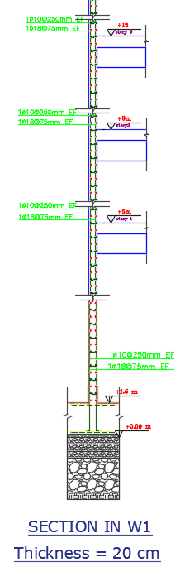
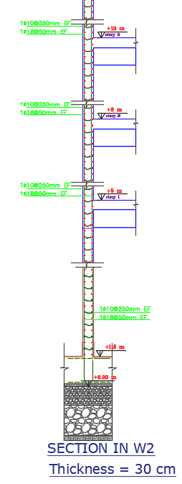
Structural Design
Shear wall design

Slide 26
Structural Design
Footing Design
Matt foundation
Thickness = 1.5 m
Checks :
Compatibility check
Settlement (deflection check)
Bearing capacity check
Wide beam shear

Slide 27
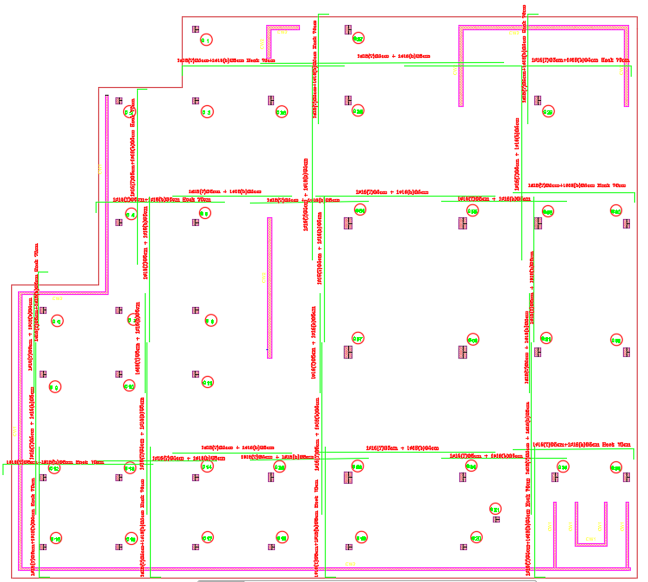
Structural Design

Slide 28
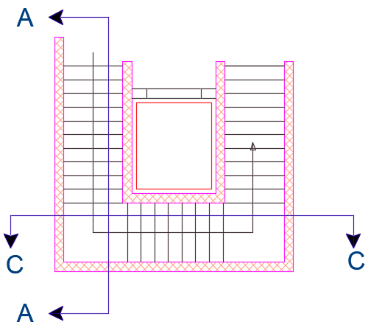
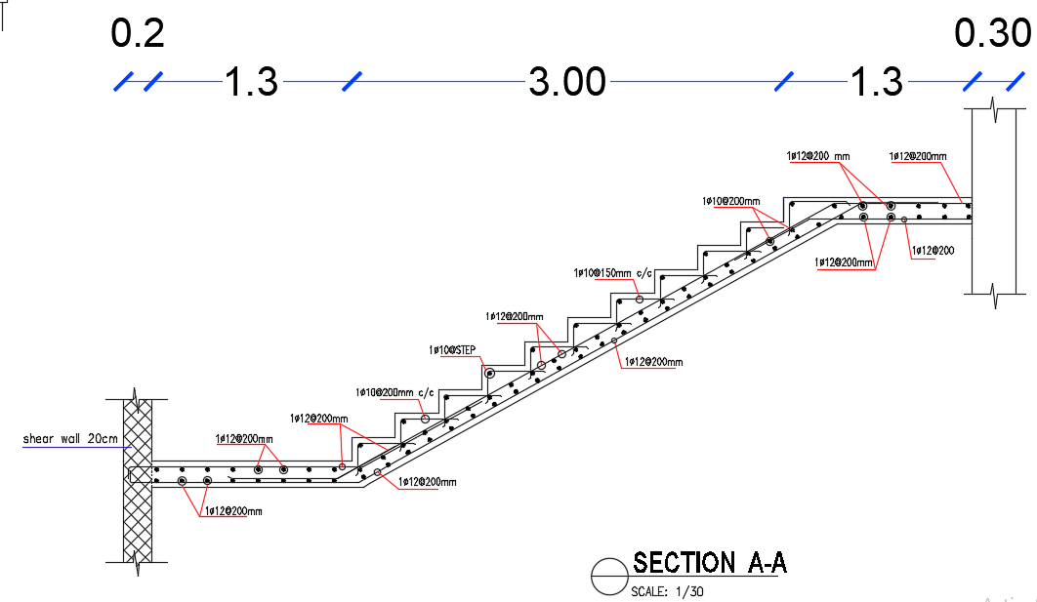
Structural Design
Stair reinforcement and details

Slide 29
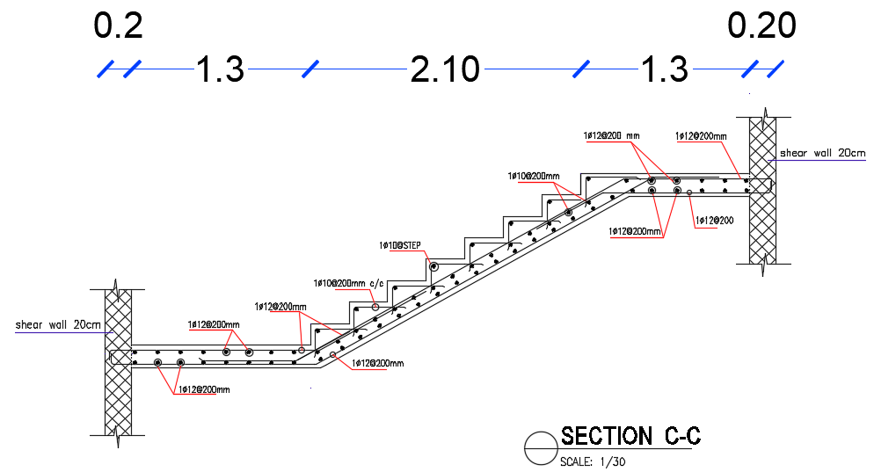
Structural Design
Stair reinforcement and details

Slide 30
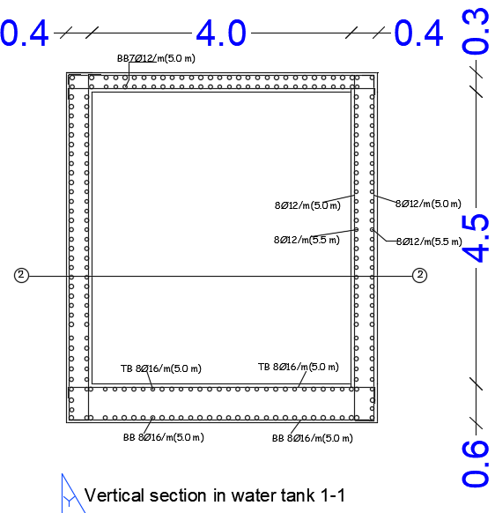
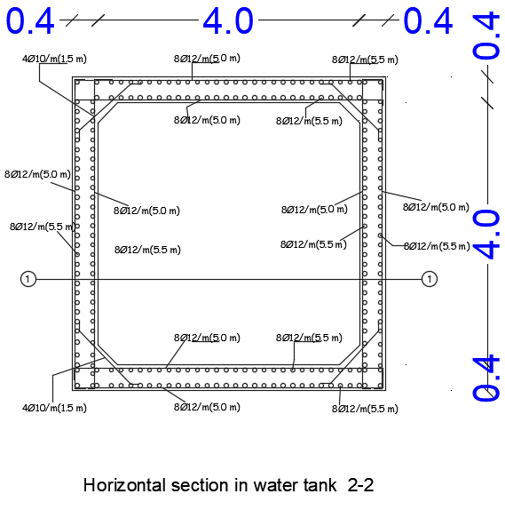

Structural Design
WATER TANK
Dimension = 4.8×4.8×5.4
Water capacity = 72 $m^{3}$

Slide 31
Environmental Design
thermal
acoustical
daylighting

Slide 32
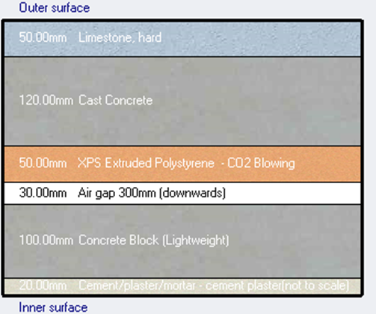
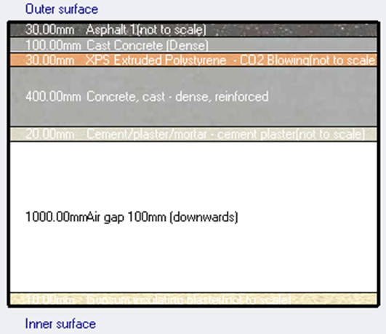
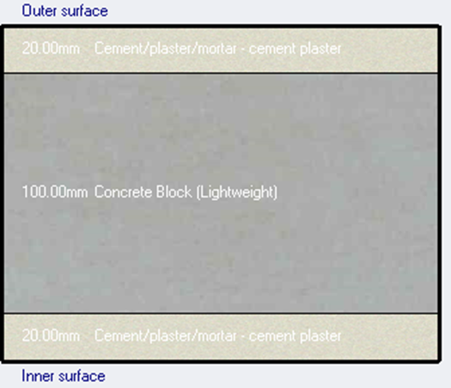
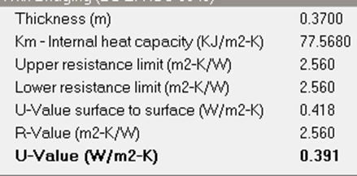
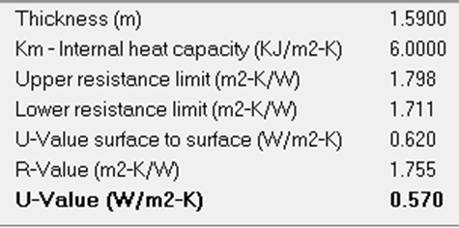
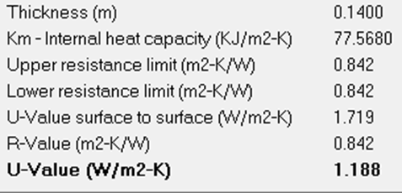
Environmental Design
Layers of the envelope of the building
Layers of external walls and their thermal properties.
Layers of roof and their thermal properties.
Layers of internal walls and their thermal properties.

Slide 33
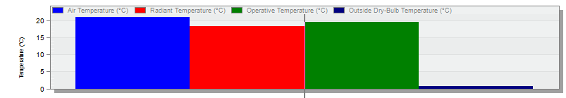
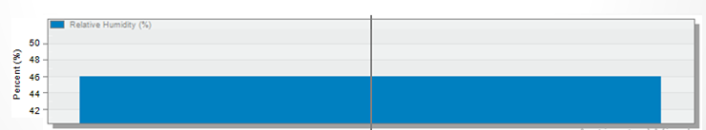
Environmental Design
Thermal Performance Analysis
Temperature
Air temperature = 21 C
Radiant temperature = 18 C
Operative temperature = 19 C
A.R.H = 46%

Slide 34
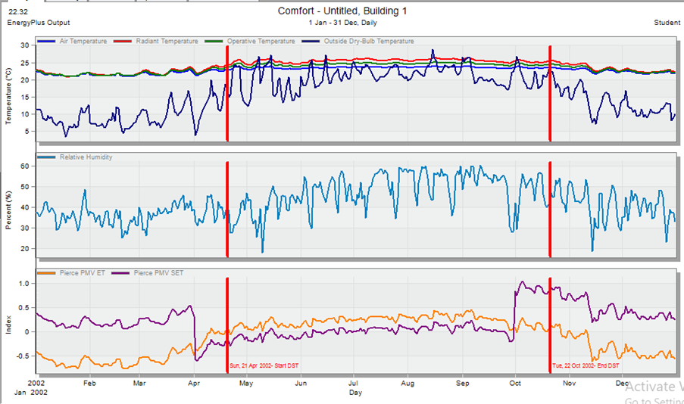
Environmental Design
Comfort curves
Temperature
RH
Fanger PMV
The number of uncomfortable hours in the building = 989 hrs.

Slide 35

Environmental Design
System loads
Total heating load = 198.5 KW.
Total cooling load = 269.11 kW
Energy consumption = 472.22 KWh/$m^{2}$

Slide 36
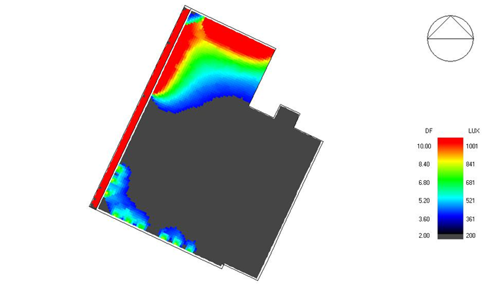
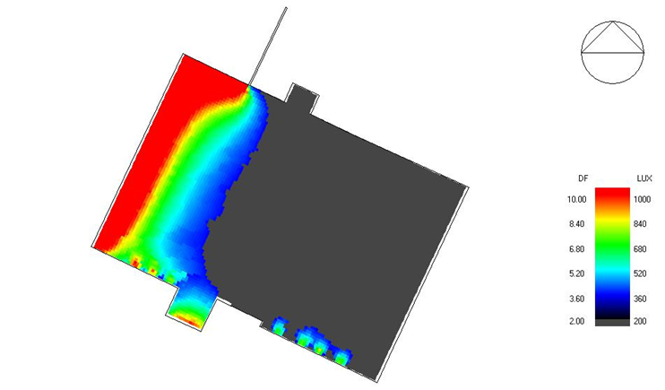
Environmental Design
Daylighting
Daylight analysis diagram for the G.F Dining area.
Daylight analysis diagram for the F.F Dining area.
Average Daylight Factor = 5.42%
Average Daylight Factor = 3.39%

Slide 37
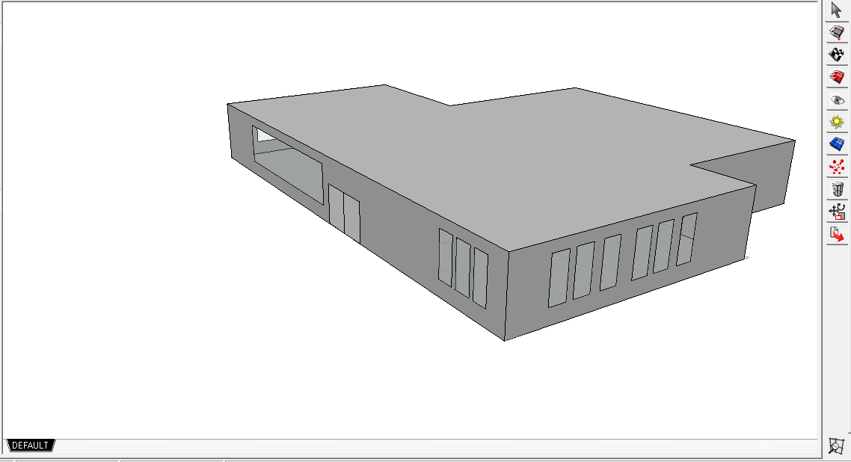
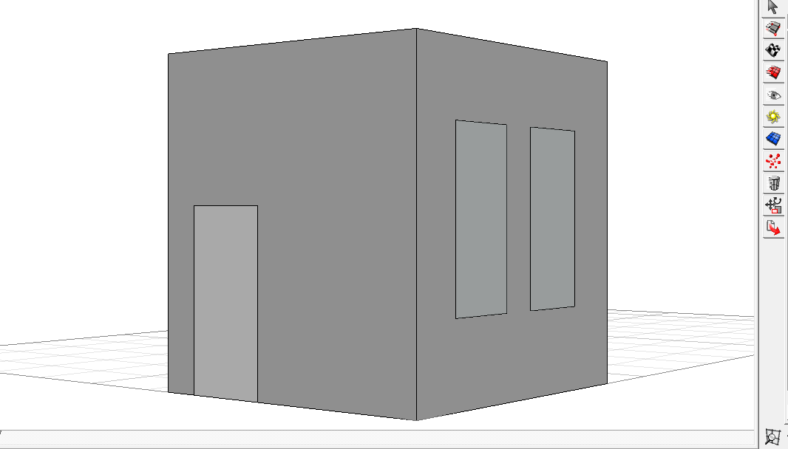
:
Acoustical design:-
Ecotect model for dinning .
Ecotect model for office .

Slide 38
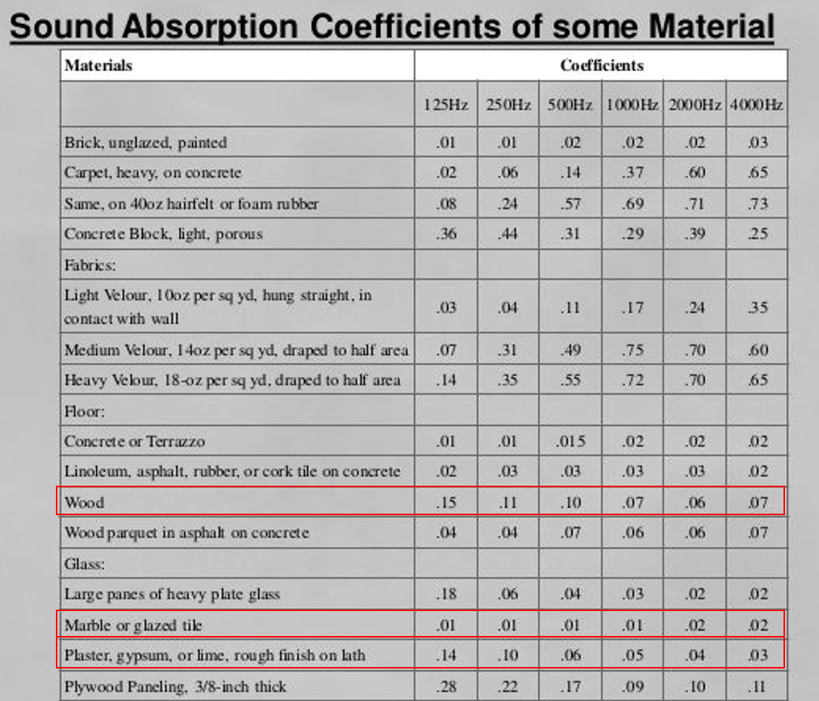
sound absorption coefficient.

Slide 39


sound absorption coefficient for ceiling
sound absorption coefficient.
Figure 125: sound absorption coefficient for glass

Slide 40
-Optimum RT (500Hz - Speech): 0.93 s.
-Optimum RT (500Hz - Music): 1.17 s.
-The range of Reverberation time is suitable for dining room in restaurant which is between the standard limits (0.6-1.2)s.
 | TOTAL | EMPTY | 50% | FULL
FREQ. | ABSPT. | RT(60) | RT(60) | RT(60)
63Hz: | 274.046 | 1.46 | 1.43 | 1.39
125Hz: | 423.892 | 0.95 | 0.94 | 0.93
250Hz: | 506.589 | 0.79 | 0.76 | 0.73
500Hz: | 528.981 | 0.74 | 0.72 | 0.70
1kHz: | 473.227 | 0.82 | 0.80 | 0.77
2kHz: | 450.161 | 0.85 | 0.82 | 0.79
4kHz: | 424.378 | 0.87 | 0.86 | 0.84
8kHz: | 487.671 | 0.75 | 0.74 | 0.73
16kHz: | 507.719 | 0.72 | 0.71 | 0.70
Reverberation time at different occupancy state for dinning.

Slide 41
 | TOTAL | SABINE
FREQ. | ABSPT. | RT(60)
------- | ------- | -------
63Hz: | 8.782 | 0.96
125Hz: | 9.840 | 0.85
250Hz: | 7.723 | 0.90
500Hz: | 5.197 | 1.13
1kHz: | 5.612 | 0.80
2kHz: | 5.502 | 0.72
4kHz: | 5.413 | 0.51
8kHz: | 4.777 | 0.13
16kHz: | 7.092 | 0.16
 | TOTAL | SABINE
-Optimum RT (500Hz - Speech): 0.72 s
-Optimum RT (500Hz - Music): 0.81 s
-The range of Reverberation time is
suitable for office which is
between the standard limits (0.6-0.8)s.
Reverberation time for office

Slide 42


Sound Transmission Class (STC)
STC level for partition Adjacent to Corridor.
STC level for partition adjacent to office.

Slide 43

The recommended sound transmission class (STC) for offices:
The construction we used satisfies the standards.

Slide 44

STC for External Wall of Dining Hall
STC level for external wall.
STC standard value for external walls must be >50db.

Slide 45

Impact Insulation Class (IIC)
IIC for ceiling from Insul program equal 84 as shown in Figure 98. This is an acceptable value for ceiling as the standard value >50db.
IIC for Ceiling from Insul program.

Slide 46

Loudspeaker:-
Ceiling Speaker was used is: VXC4 x 44 (30W (100V))
Density: Minimum Overlap
Basic Pattern: Square
Specification of the speakers

Slide 47

Ground floor dining hall:
Dining hall was divided into two parts
-Part 1
Speakers layout-part1
Figure 139: Sound pressure level map

Slide 48

Dinning hall –Part2
Speakers layout

Slide 49

Speakers distribution

Slide 50

First floor dining hall:
Speakers layout

Slide 51

Speakers distribution

Slide 52
Mechanical design
Water supply
HVAC
Mechanical system
Fire prtection
Drinage system

Slide 53
Water supply system:
Vertical pipe →4 in, Horizontal pipe→2 in, Branch pipes→0.75 in.
Type | Number | WUFU | Size (Inch)
Kitchen Sink | 9 | 3 | 3/4"
 | 9 | 3 | 3/4"
Water closet | 9 | 5 | 3/4"
Lavatories | 10 | 2 | 3/4"
 | 10 | 2 | 3/4"
Dish washing Machine | 1 | 2 | 3/4"
Type | Number | WUFU | Size (Inch)
Kitchen Sink | 17 | 3 | 3/4"
 | 17 | 3 | 3/4"
Water closet | 12 | 5 | 3/4"
Lavatories | 15 | 2 | 3/4"
 | 15 | 2 | 3/4"
Dish washing Machine | 1 | 2 | 3/4"
Ground floor
first floor

Slide 54

Water supply system for ground floor

Slide 55

Water supply system for first floor

Slide 56
Water tanks
*Water supply tank is located under ground which supply the upper tanks on the roof
11 roof tanks with a capacity of 1.59 m³ will be used therefore the capacity of ground
water tank = 72 with volume equals (4×4×4.5) m³
*Gray water tank is located on the passement
*The rain water tank is used to store water to be used to feeds the tanks that exist on the roof of the building, and it can feed for 8% of the amount of daily water consumption.

Slide 57
Drainage System
Type | Stack diameter | Horizontal branch diameter | Vent diameter | Pipe type
costumer’s bathroom | 4" | 2" | 4" | pvc
kitchen | 4" | 2" | 4" | pvc
Worker’s Bathroom | 4" | 2" | 4" | pvc
Bathroom(faucet) | 4" | 2" | 4" | pvc
Horizontal Fixtures Branches and Stack suitable diameters

Slide 58

Drainage system for ground floor

Slide 59

Drainage system for first floor

Slide 60

Rainwater harvesting

Slide 61

HVAC system
Variable refrigerant flow (VRF) system Supply was used
Variable refrigerant flow (VRF) system Supply, install & commissioning Heat pump VRF (variable refrigerant Flow) system from Samsung company.
Outdoor Unit
Variable refrigerant flow outdoor unit, with all scroll compressor with invertors drive, refrigerant R 410 A, including lifting to roof - if needed-, galvanized steel base, vibration absorber and electric connection to Isolator Switch (2 meters max.) .
Outdoor unit from Samsung HVAC Company

Slide 62


Fan coil units
turbo fan coil unit was used and selected from SAMSUNG HVAC Company.
indoor Unit
360 Circular Cassette VRF indoor units with filter, thermostat including on-off, real time clock, schedule timer, fan control, temperature limit operation, and temperature set and display. Indoor design conditions 23C cooling, 50%relative humidity at high speed According to the following capacities:
1-Cooling Capacity 4.5 kw 360 cassette
2-Cooling Capacity 5.6 kw 360 cassette
3-Cooling Capacity 7.1 kw 360 cassette
4-Cooling Capacity 9 kw 360 cassette
5-Cooling Capacity 12.8 kw 360 cassette
6-Cooling Capacity 14 kw 360 cassette
Fan coil units
indoor unit from Samsung HVAC Company.

Slide 63
In door and outdoor units were used in our system
VRF SYSTEM
Item | Description | Unit | Qty.
1 | VRF SYSTEM
A) | Outdoor Units
1.1 | Outdoor unit size 22 HP | No. | 1
1.2 | Outdoor unit size 44 HP | No. | 1
1.3 | Outdoor unit size 80 HP | No. | 1
B) | Indoor Units
1.1 | Indoor Units: 360 Circlar cassette
1.1.1 | Cooling Capacity 4.5 kw 360 cassette | No. | 7
1.1.2 | Cooling Capacity 5.6 kw 360 cassette | No. | 1
1.1.3 | Cooling Capacity 7.1 kw 360 cassette | No. | 2
1.1.4 | Cooling Capacity 9 kw 360 cassette | No. | 2
1.1.5 | Cooling Capacity 12.8 kw 360 cassette | No. | 24
1.1.6 | Cooling Capacity 14 kw 360 cassette | No. | 9

Slide 64

HVAC system in ground floor

Slide 65

HVAC system in first floor

Slide 66

Hoods for kitchen:-

Slide 67

Sketch for hood

Slide 68
Fire fighting system
-The fire suppression system is done by using:
1-sprinkler
2-extinguisher
3-hose station
-Fire detecting using:
Flame and foam detector

Slide 69

Fire fighting system
in ground floor

Slide 70

Ground floor escape plan
Ground floor evacuation layout

Slide 71

Escape plan for first floor
first floor excavation layout

Slide 72
Electrical design
Socket distribution
Control panel
Artificial lighting

Slide 73

Electrical design
Socket distribution
Ground floor

Slide 74

Electrical design
Socket distribution
first floor

Slide 75

Electrical design
Socket distribution
basement floor

Slide 76


Artificial lighting
Dining hall lighting design
Lamp used: Dextra Pro Tec TC-DE 26w C84
Power: 2*26 watt
Number of units: 42
Dextra Pro Tec TC-DE 26w C84
For interior design: these units are not included in the physical
calculations, it is installed for aesthetic purposes:
1-Chandeliers
2-wall light
3-led linear

Slide 77

Artificial lighting
Dining hall lighting design
The illuminance level and the uniformity valuation in dining hall

Slide 78

Artificial lighting
Distribution of luminaires in dinning hall

Slide 79

Artificial lighting
Kitchen lighting design
Lamp used: OSRAM Europlex T26
Power: 2*58 watt
Required lux : 500 lux
Mounting height: 4 m

Slide 80



Artificial lighting
Kitchen lighting design
The illuminance level and the uniformity valuation in cooking area
The illuminance level and the uniformity valuation in preparation area
The illuminance level and the uniformity valuation in service area

Slide 81

Artificial lighting
Manager office lighting design
Lamp used: OSRAM Siteco T16
Power: 4*14 watt
Lighting level : 500 lux
Mounting height: 4m

Slide 82

Artificial lighting
Manager office lighting design
The illuminance level and the uniformity valuation in office

Slide 83

Control panel:

Slide 84
Quantity surveying:
 | Total Cost (NIS)
Excavation works | 476000
Civil works | 2501424
Architectural works | 1714850
Mechanical works | 568890
Electrical works | 166325
Total Cost | 5427489

Slide 85


Slide 86


Slide 87


Slide 88


Slide 89


