Slide 1
Corona Virus & wastewater in Palestine
Prepared by:
Ashraf Taha Noor Surakji
Dana Daraghmeh
Submitted to:
Dr.Abdel-Haleem Khader

Slide 2
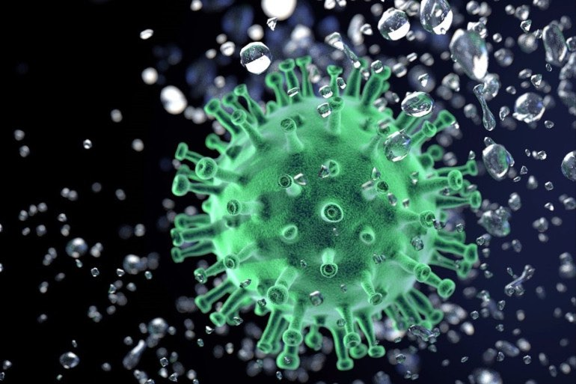
Outline
Introduction about wastewater
Viruses in wastewater
Corona virus
Wastewater treatment plant
Conclusion

Slide 3
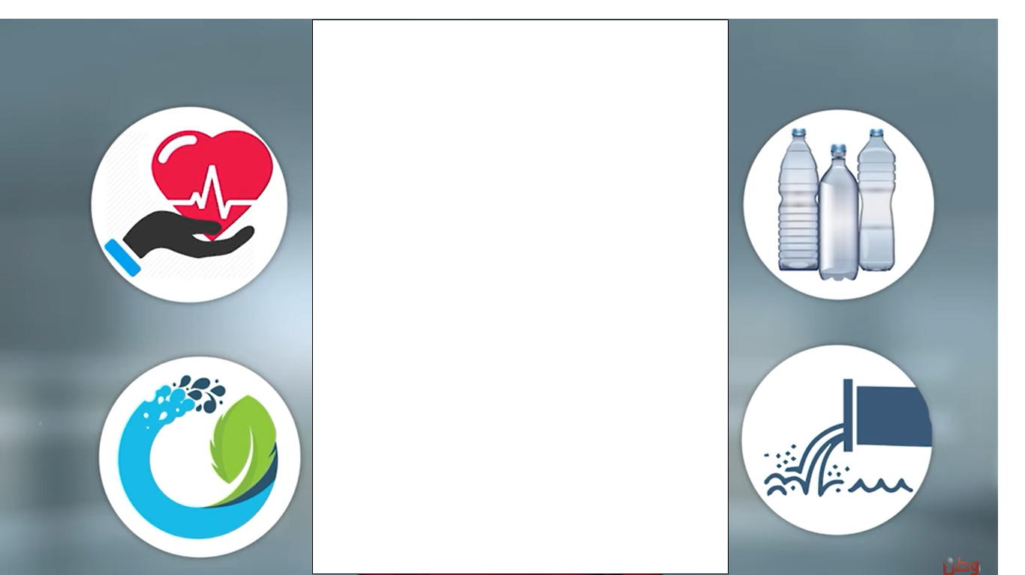
Introduction :
Wastewater is considered a critical pollution source in Palestine
It has a serious negative impact on the surface & ground water , environment and human health.

Slide 4
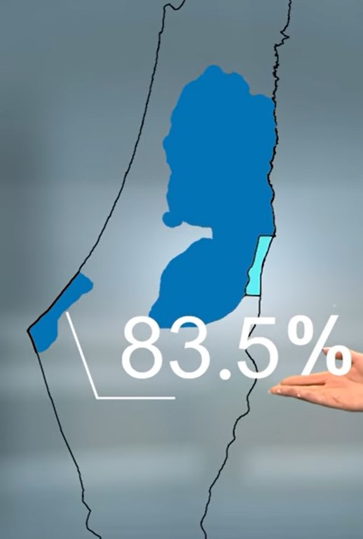
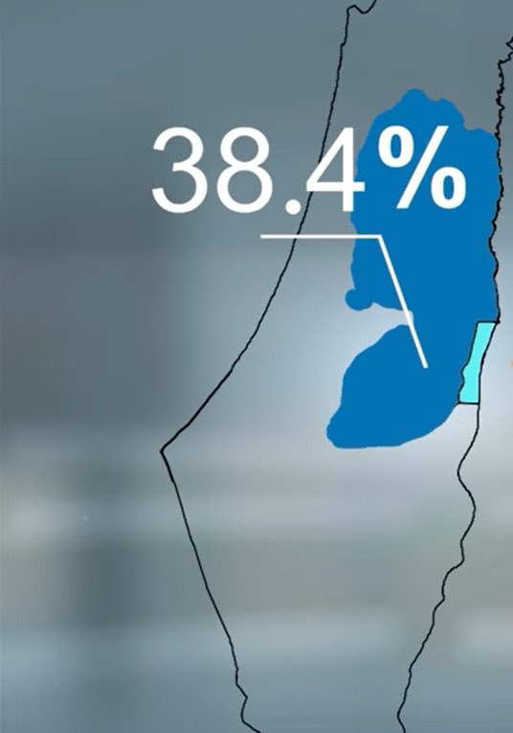
Percentage of communities with sanitation services available through the networks 38.4% in West Bank and 83.5% in Gaza Strip.

Slide 5
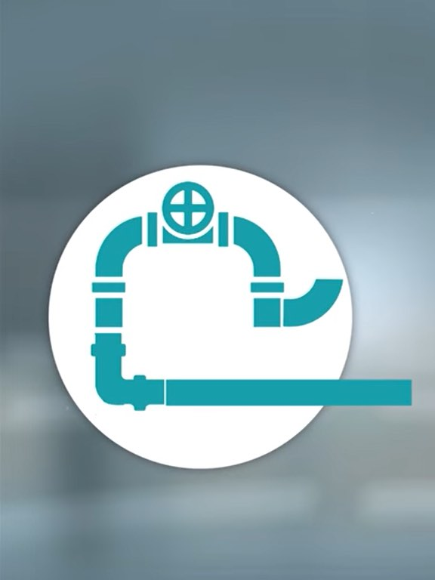
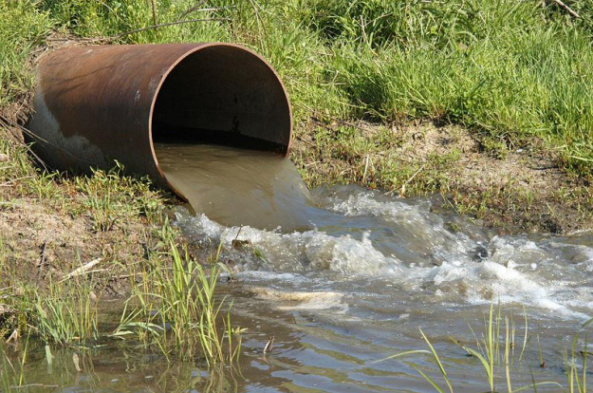
Sewerage system is used, from which wastewater discharge into valleys near residential areas and where most of the fresh water springs or groundwater aquifers are present.

Slide 6
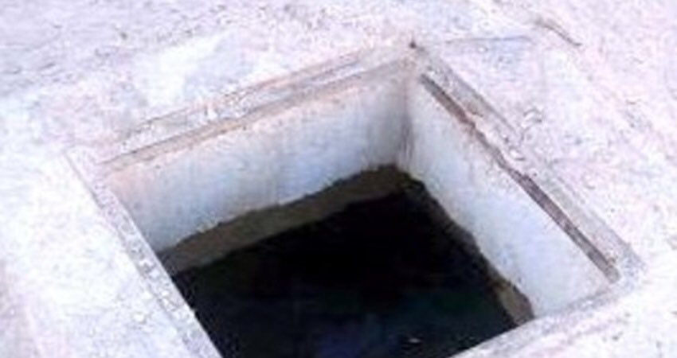
Many Palestinian villages and communities use septic tank to get rid of domestic wastewater, which don't need to be discharged very often, because most of these pits implement wastewater into the soil, but in areas with rocky soil, these pits need to be discharged regularly

Slide 7
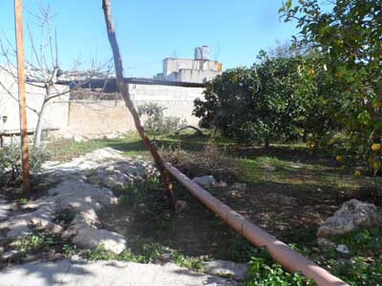
Irrigation with effluent:
During the past twenty years, there has been a growing interest in the use of liquid waste to irrigate crops in arid and semi-arid areas due to the lack of alternative water resources and the need to increase local production of food

Slide 8
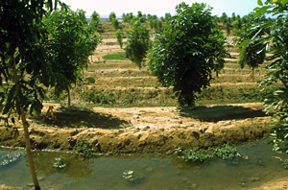
Moreover, the reuse of effluent in irrigation helps in decreasing wastewater discharges to natural waterways, not to mention that some substances which are considered harmful in waterways can be good when used in irrigation. For example, plant nutrients like phosphorus and nitrogen can stimulate harmful algal blooms in water but are a great fertilizer for crops.

Slide 9
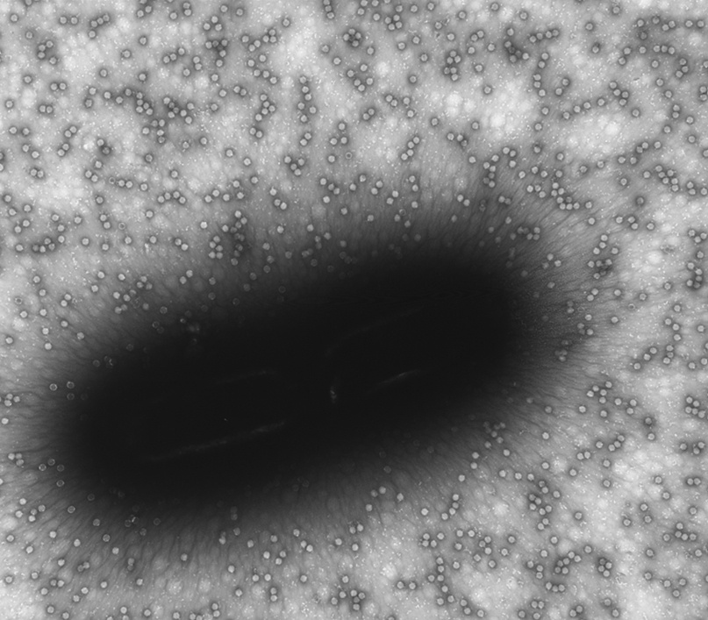
Viruses in Wastewater
Domestic wastewater contains various pathogens, which, if not sufficiently eliminated, may enter the receiving water bodies and cause water-transmitted diseases.
Although most of these viruses do not harm humans directly and significantly, they do harm to marine life.

Slide 10
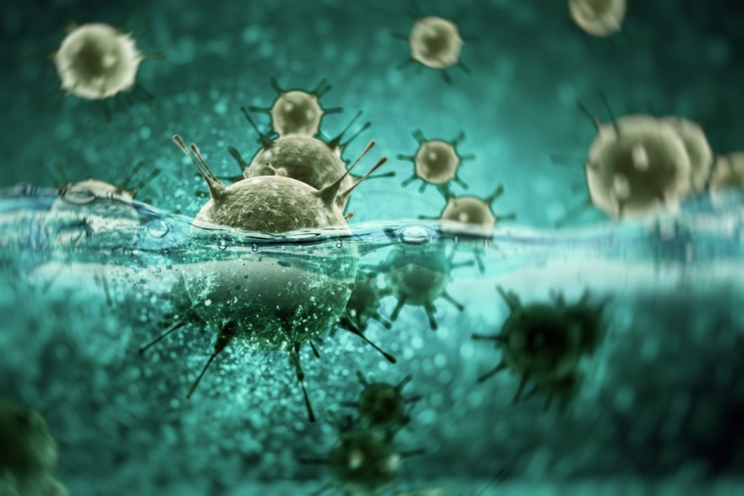
Viruses in Wastewater
These viruses are mostly transmitted from human solid waste to wastewater.
Environmental monitoring is the key to understand the transmission of viruses through wastewater.

Slide 11
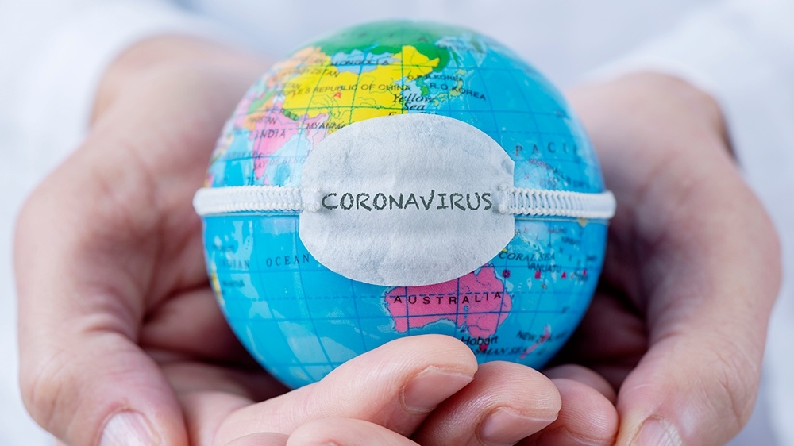
CORONA VIRUS
The current crisis of corona virus :
A new crisis has entered the world after the outbreak of the corona virus pandemic, COVID-19 is a new infectious disease caused by severe acute respiratory syndrome.

Slide 12
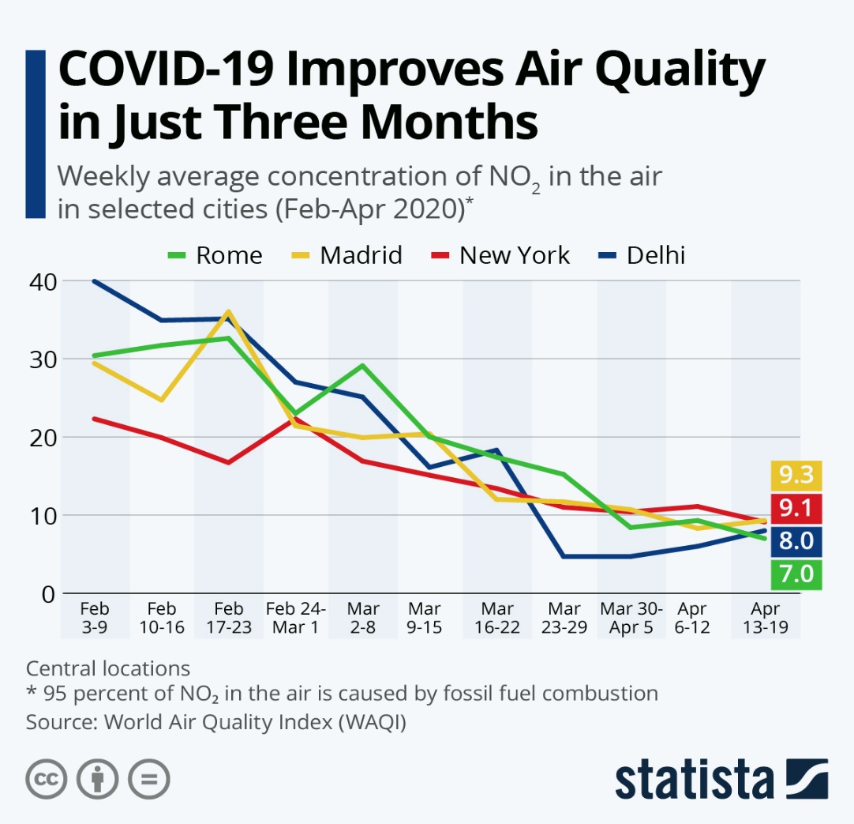
Since the emergence of the virus, the situation has worsened due to the high human and economic losses, but in the midst of its tragic passage, the virus has had good effects, too.
decrease in nitrogen dioxide pollution - one of the most important and most common air pollutants
improvement in the air due to the restrictions imposed on the outbreak of the disease
Decease in CO2 emmisions

Slide 13
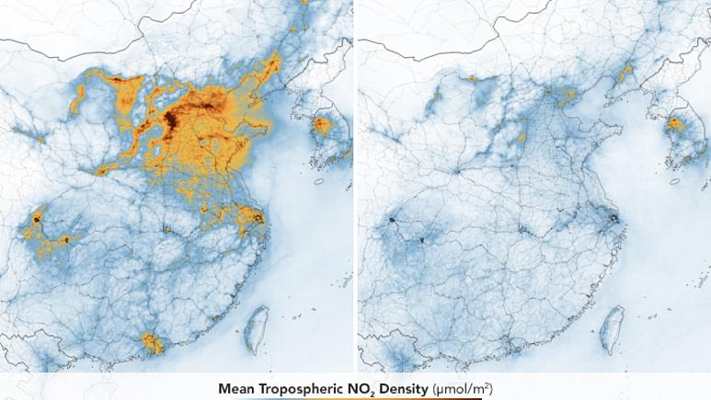

Slide 14
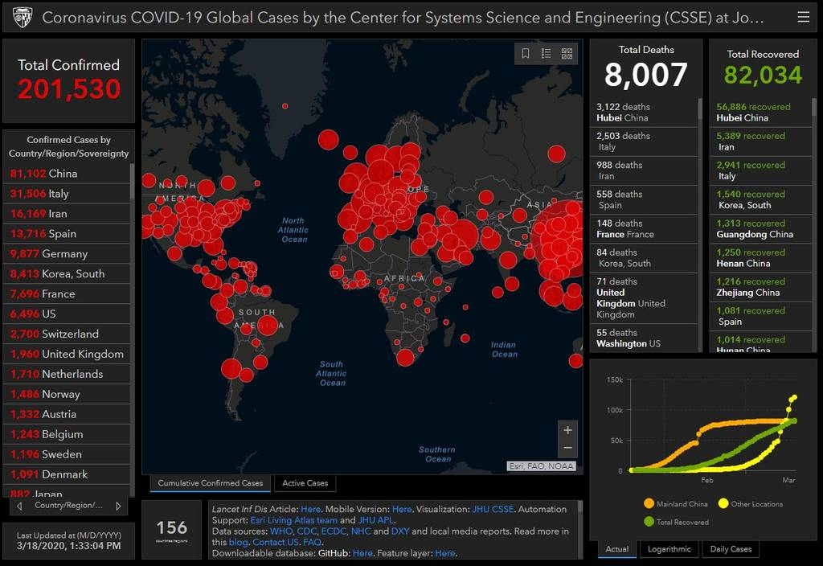

Slide 15
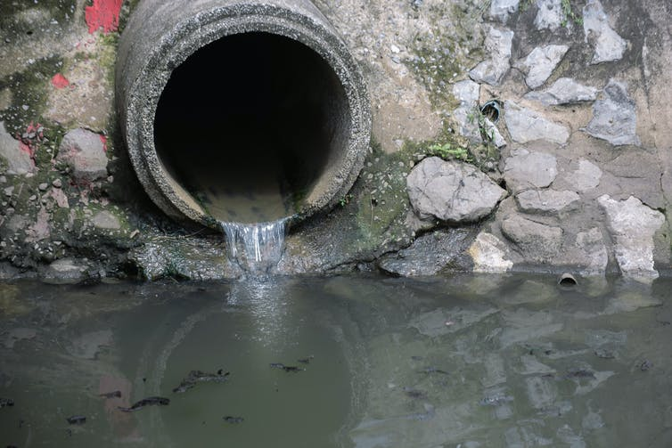
Relationship of the virus to wastewater:
It affects the wastewater of hospitals, care services and patients’ houses
It depends on three factors:
Temperature
Organic compounds
Hostile microorganisms

Slide 16
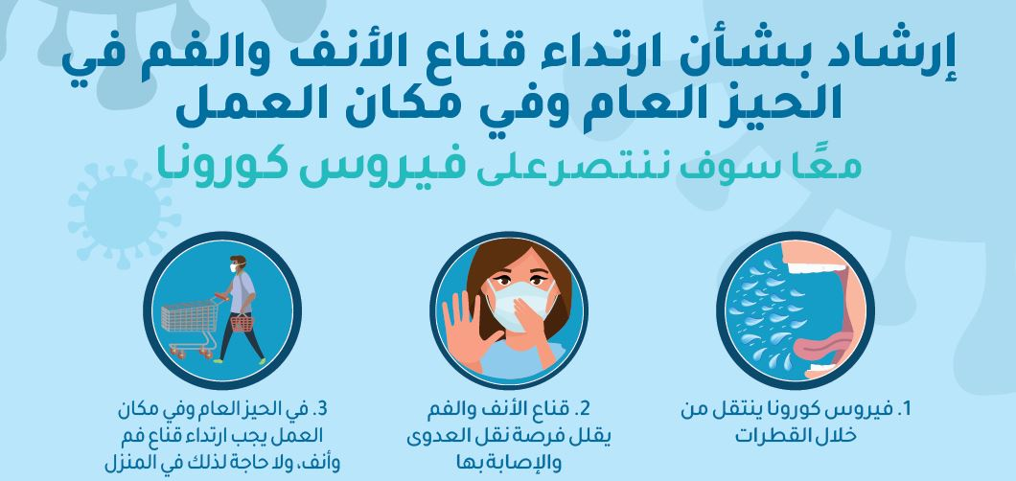

Slide 17
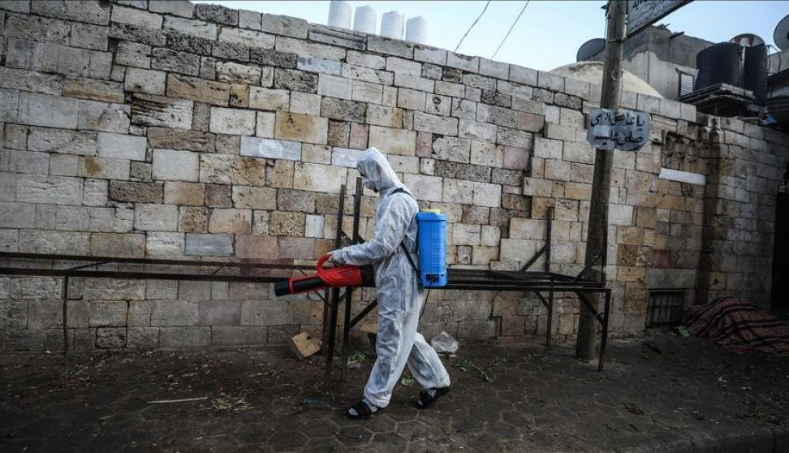

Slide 18
What’s the role of civil engineering in adaptation with the pandemic virus?
digital technology must be developed in the field of engineering.
it is easy to work remotely with digital infrastructure is very easy for designers and consultants, but it is more difficult for construction site workers.
robots are capable to finish the work and also accurately, but robots sometimes lack of the power of the mind.
It is possible to take the crisis measurements and events and start building and eventually take an inspection tour while we are behind the screens

Slide 19
Wastewater Treatment Plants
Wastewater treatment plants are designed to prevent or reduce pollutants that could cause surface or groundwater water pollution.
The three main stages of wastewater treatment ( primary, secondary and tertiary water treatment)
A sediment basin is a simple technique to treat wastewater and destroy pathogens.
Safety procedures must be followed by workers at wastewater treatment facilities to protect their health
Particular attention is paid to the unit operations, which play crucial roles in virus removals.

Slide 20
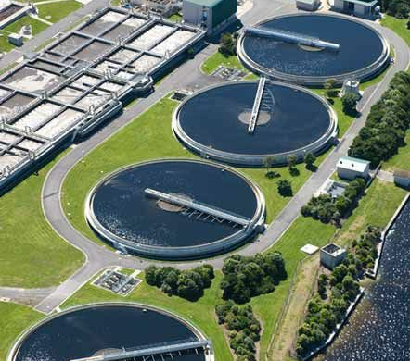
Future needs for the development of new technologies for viruses disposal.

Slide 21
Disinfection
Aerobic treatment processes reduce pathogens, but not enough to qualify as a disinfection process.
Disinfection technologies :
Chlorination
Ozonation
UV light

Slide 22
At the beginning of the 20th Century, water and wastewater were treated by one principle, “the solution to pollution is dilution.”
Disinfection of water and wastewater, by chlorine, has played a large part in the reduction of waterborne diseases.
While new disinfection processes are constantly being developed, the industry cannot abandon proven technology.

Slide 23
Precautions to protect wastewater workers from the COVID-19 virus
no evidence to suggest that additional COVID-19-specific protections are needed for workers.
Typical guidance should be followed by workers and employers
1-Basic Hygiene Practices for Workers
2-Personal Protective Equipment (PPE)
3-Training for Workers
4-Vaccination Recommendations for Workers

Slide 24

Conclusion
Covid-19 consequences on:
-Health.
-Economy.
What have we learned?
It’s expected that the treatment and disinfection processes of the corona virus that causes COVID-19 would be successful.

Slide 25


