Slide 1
Assessment of the Ministry of Public Works and Housing Building
(Quantity Surveying And Cost Estimating)
Prepared By: Abdullah Aqra
Jad Majed Al-Zagal
Laith Fuad Abualrob
Mosab Mohammad Jabir
  Supervied by : Eng. Reema Nassar

Slide 2

Outline
Project management system.
Methodology.
Quantity Survey.
Project Introduction.
Rivet 3D modeling.
Time And Cost Management.
Cost And Price Estimate.
Results And Conclusions.
References.

Slide 3
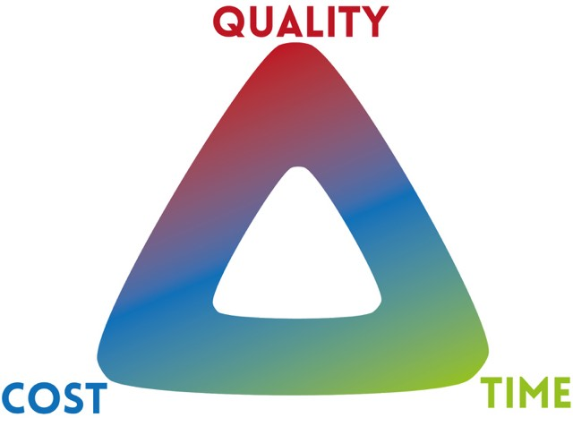
Project management system.

Slide 4
Methodology
Work break down structure.
Quantity Survey Using Rivet Software.
Time schedule using primavera software.

Slide 5

Quantity Survey.
To assist the client to have an accurate estimate of the volume of work as well as the required budget.
To assist in the accurate preparation of tenders, by providing uniform measurement of quantities.
To give insight into the required variation work amount.

Slide 6

Quantity Survey.
Data required for the preparation of an estimate or survey .
Drawings.
Specifications.
Rates.

Slide 7
Delivery Systems
Traditional (Design-Bid-Build)
Design-Build (Turnkey)
Self-performance
Professional Construction Management
Operate Transfer (BOT)

Slide 8
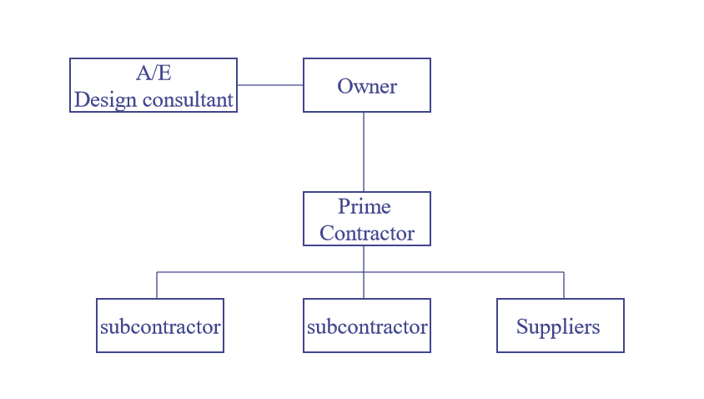
Traditional (Design-Bid-Build)

Slide 9
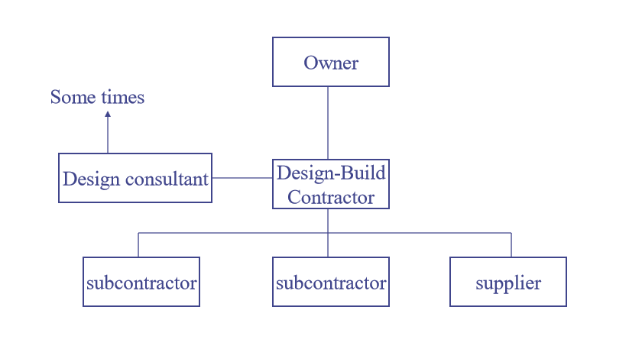
Design-Build (Turnkey)

Slide 10
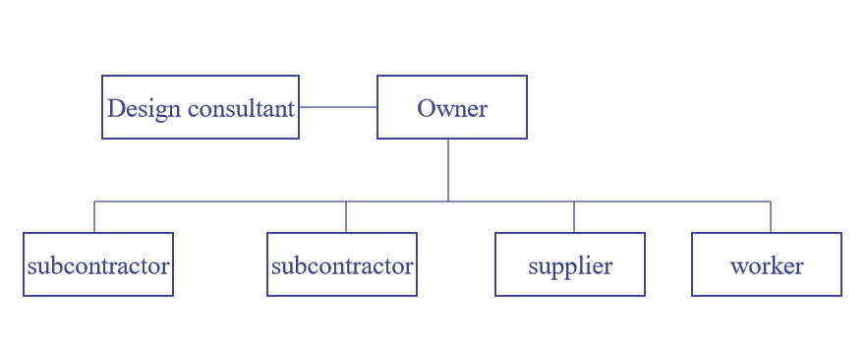
Self-Performance

Slide 11
Construction Contract
Stipulated sum contracts or single fixed cost (Lump sum contracts).
Negotiated Cost plus fee contracts (Cost reimbursement contracts).
Unit price contract (Admeasurements contracts).
Guaranteed maximum price (GMP).

Slide 12
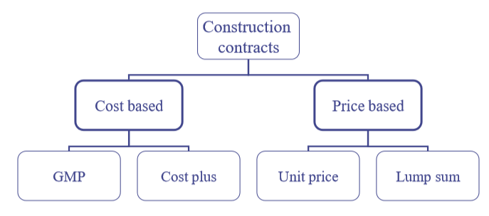

Slide 13
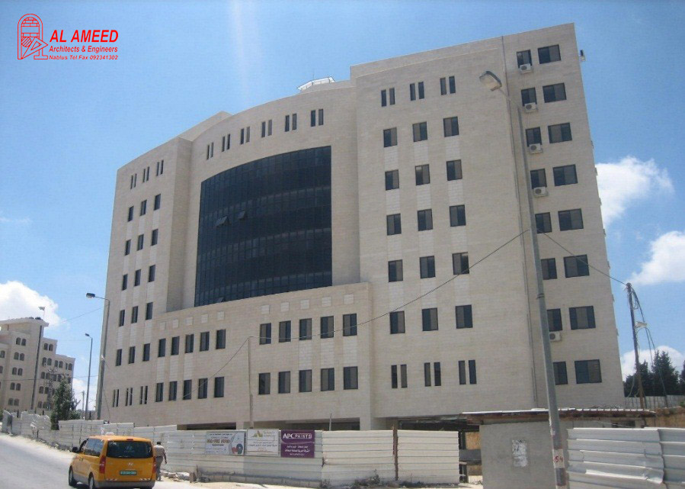
Project Introduction.
Ramallah
10 Floors
18058 m²

Slide 14
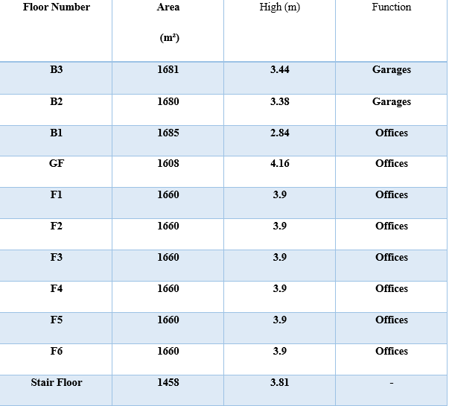
Project Description

Slide 15

Rivet 3D modeling.

Slide 16
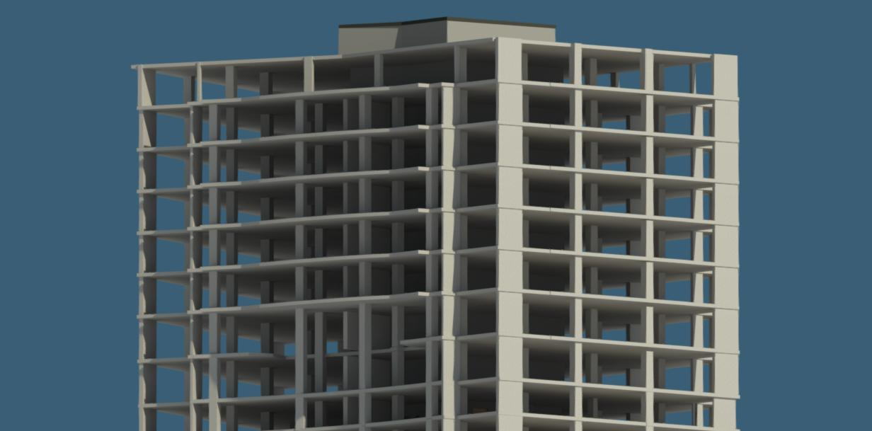
structural Rivet 3D modeling

Slide 17
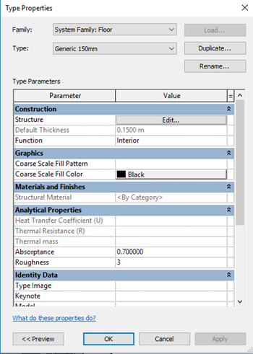
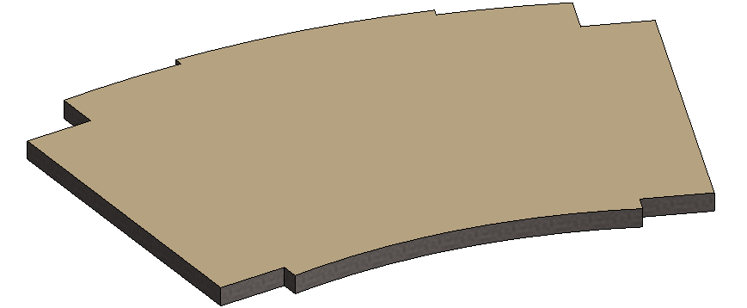
Floor Definition

Slide 18
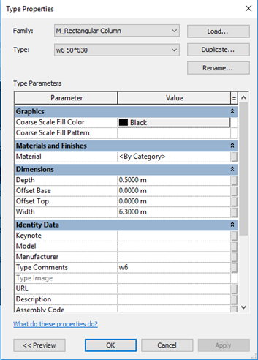


Definition for the Structural Elements

Slide 19
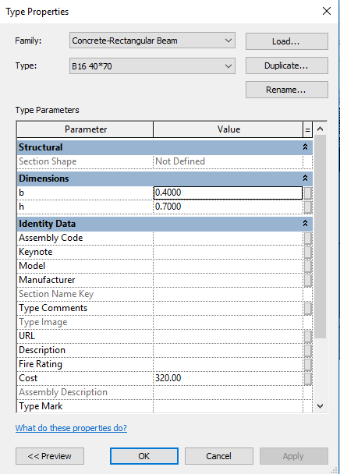
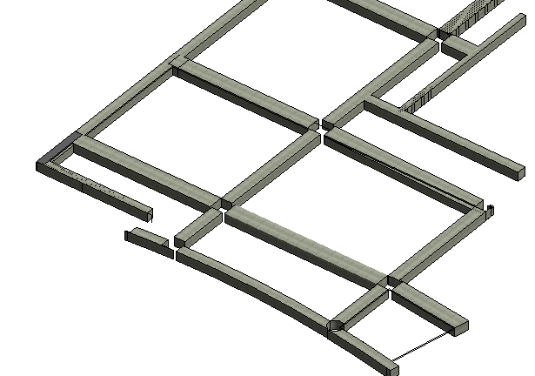
Beam Section Definition

Slide 20
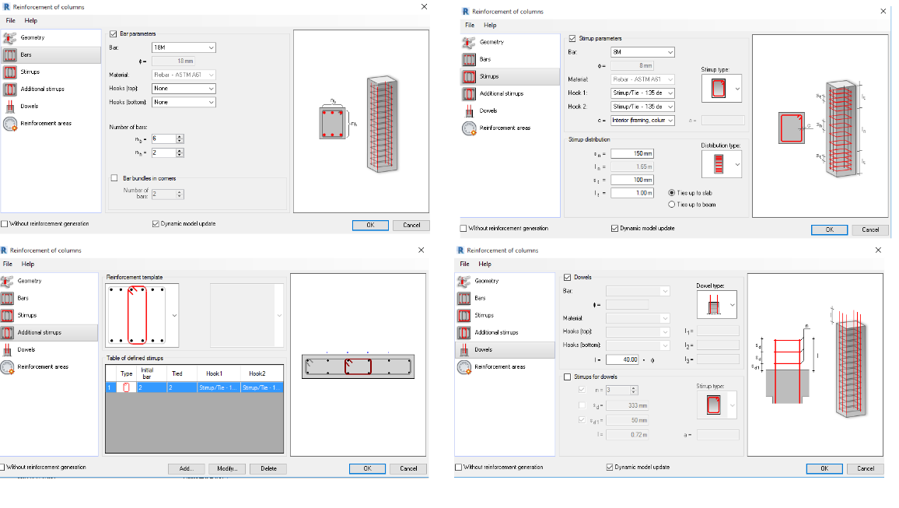
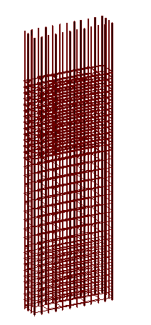
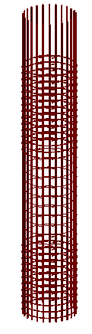
Columns Rebar

Slide 21
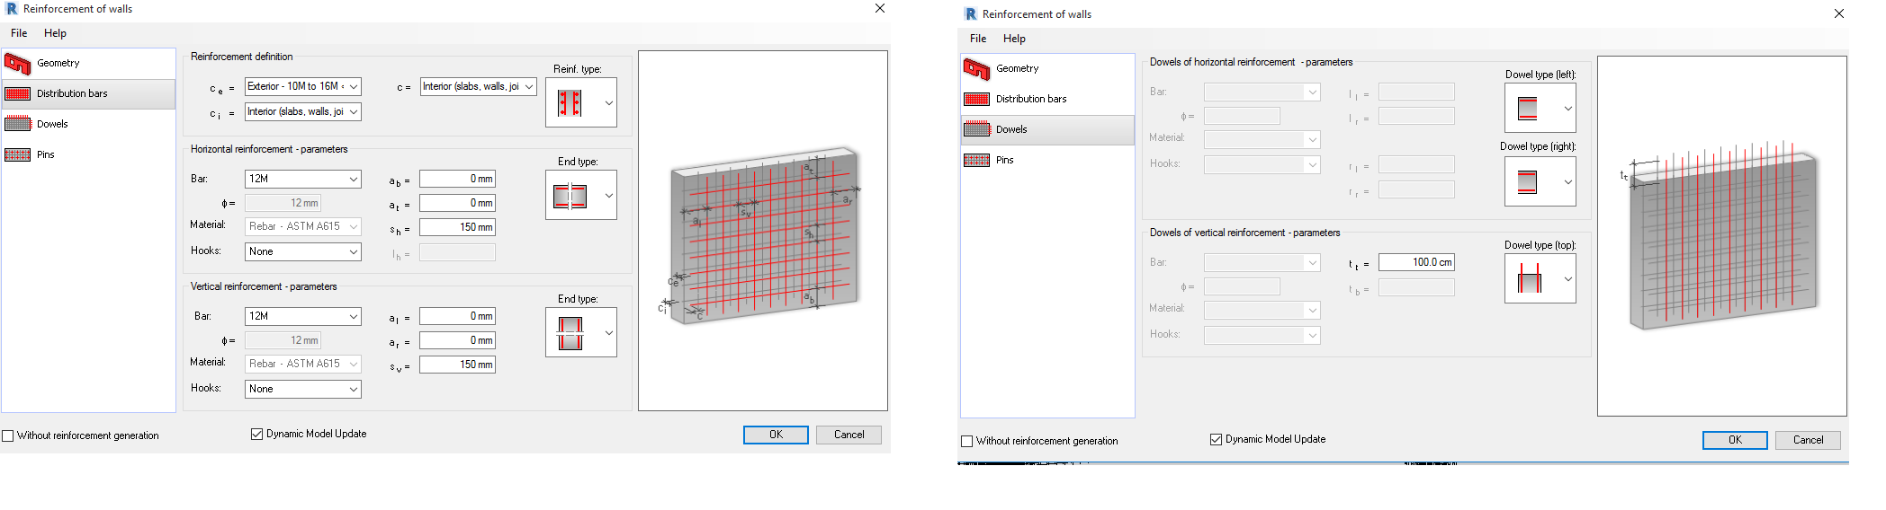
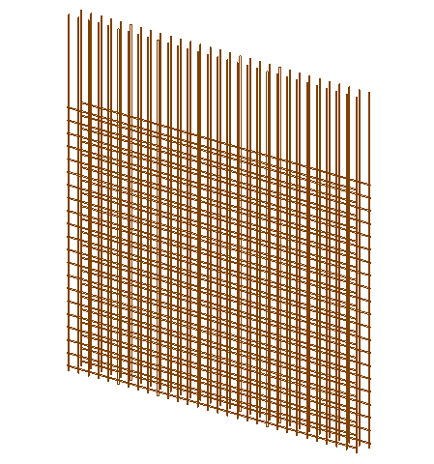
Rebar Extension for Shear Walls

Slide 22
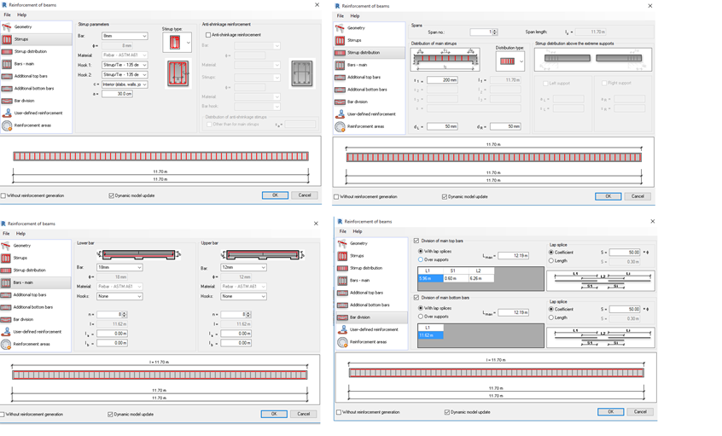
Bars Distribution for Ribs

Slide 23
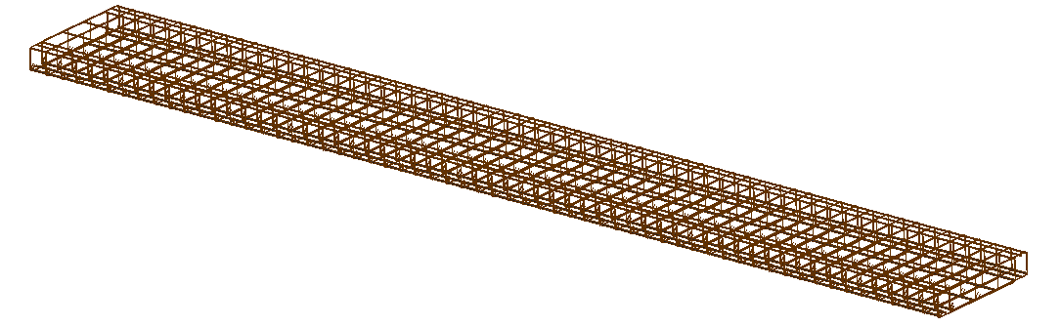
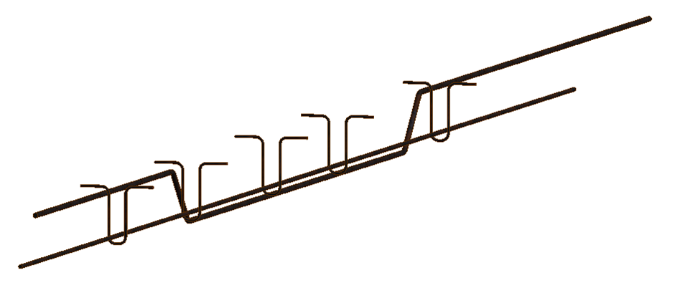
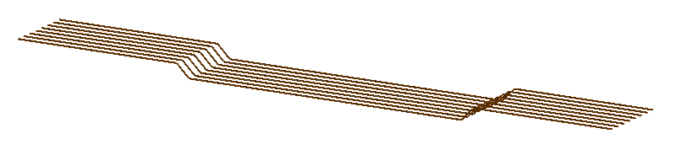
Bars Distribution for Ribs

Slide 24
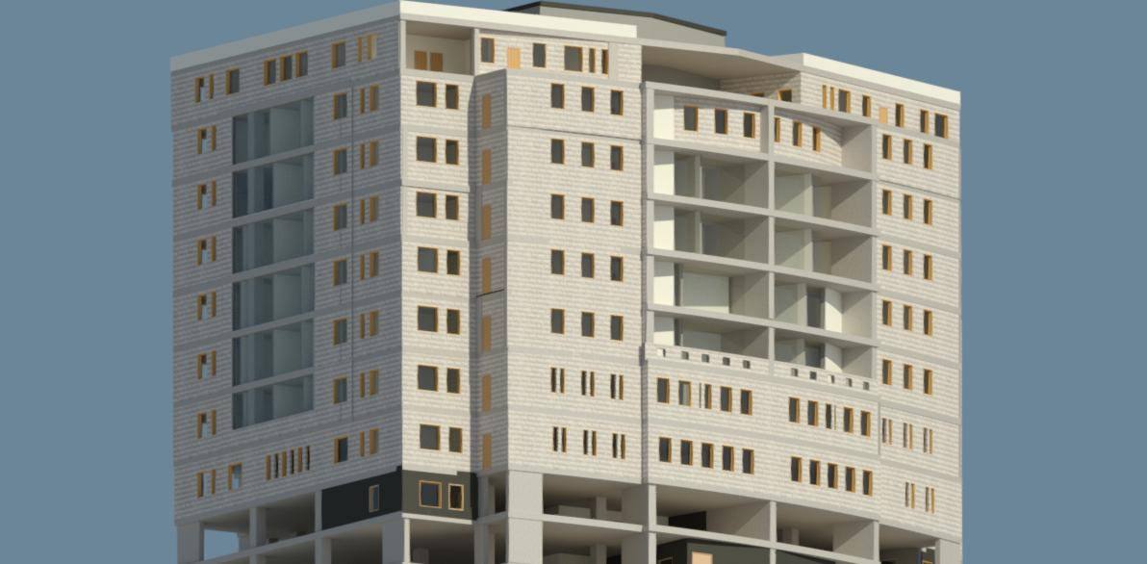
Architectural Rivet 3D modeling

Slide 25
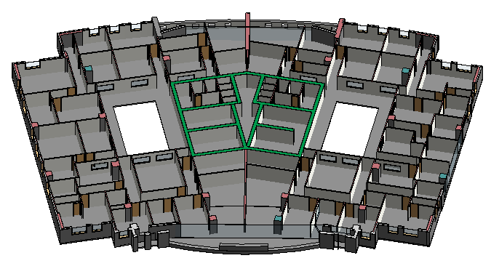

Slide 26
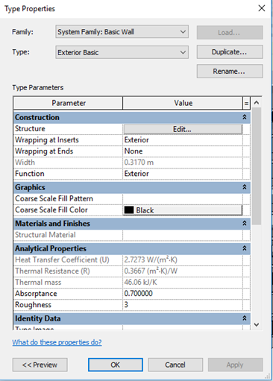
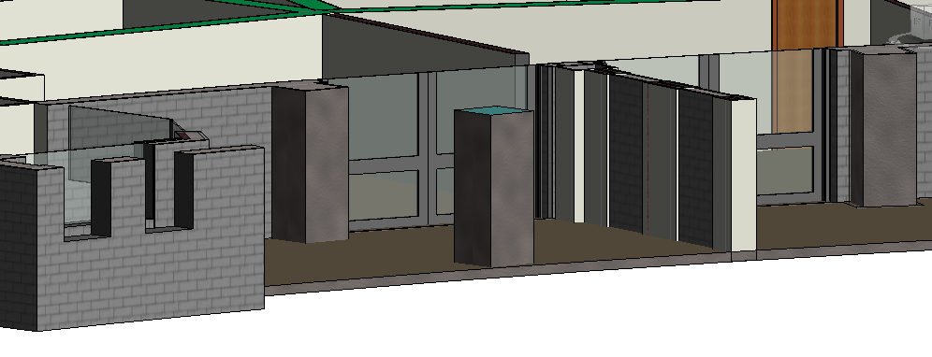
Stone Wall Definition

Slide 27
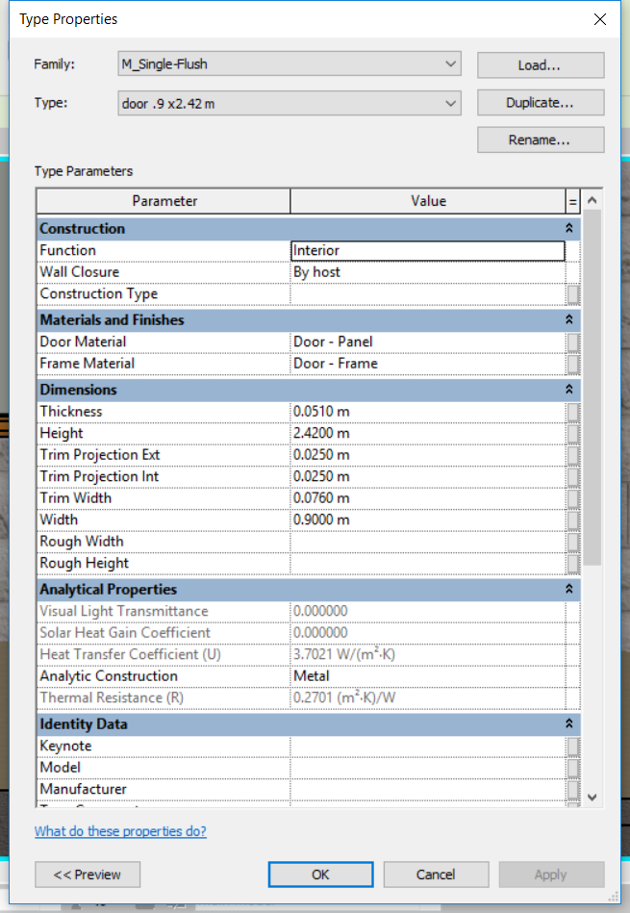
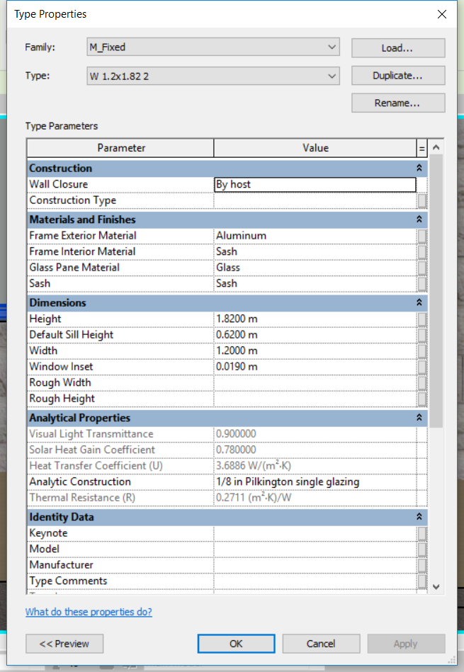
Door and Windows Definition

Slide 28
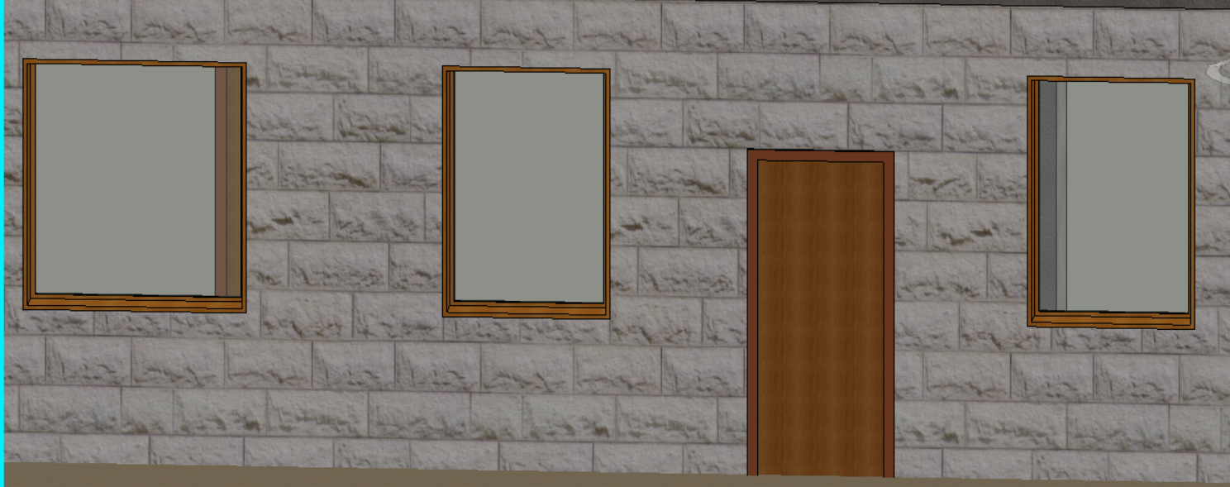

Slide 29
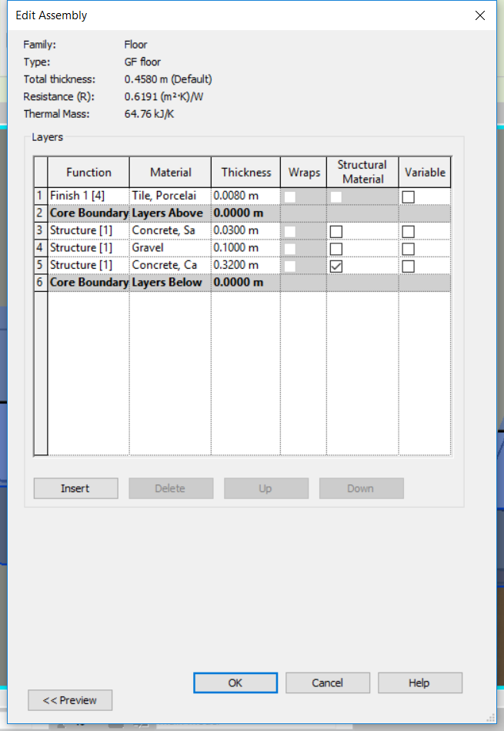
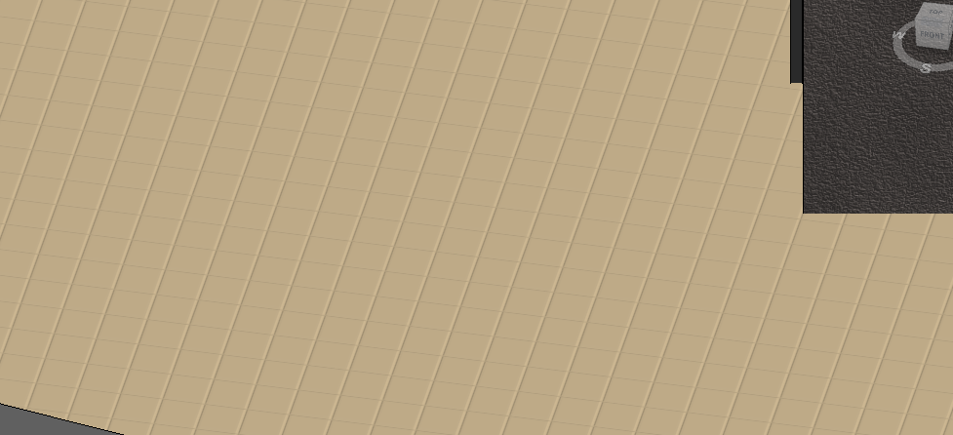
Tile Definition

Slide 30
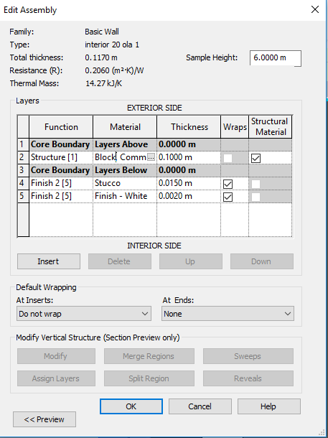
Wall Definition

Slide 31

Time And Cost Management

Slide 32
Estimating
Work Breakdown Structure (WBS)
Work Breakdown Structure is one form of project management forms; it is the basis for time estimation, resource allocation, cost estimation and collection. Company’s owners and project managers used to breakdown the large projects into smaller manageable projects that can be effectively estimated and supervised. However, the work breakdown structure is often misunderstood and not used as it should be in project management.

Slide 33
WBS depend on several factors, some of them are:
Size and complexity of the work.
Project manager judgment of work.
Time available to complete the project.
Degree of uncertainty and risk involved.

Slide 34
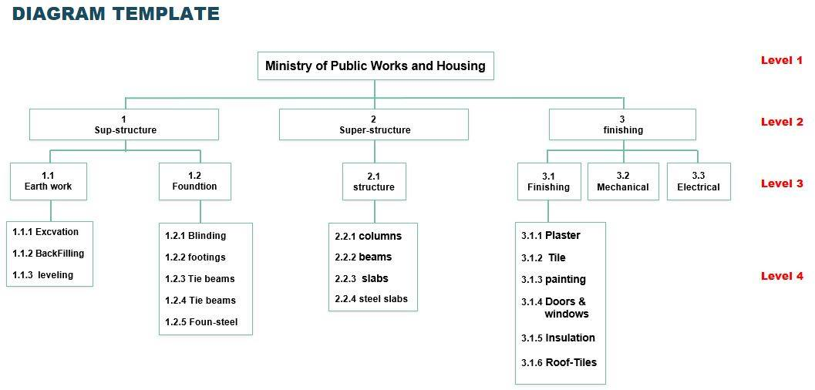

Slide 35
Bill of Quantities
Bill of Quantities is (sometimes referred to as a 'BoQ' or 'BQ') is a document, typically prepared by a cost consultant (often a quantity surveyor) that provides measured quantities of the items of work identified by the drawings and specifications in the tender documentation for a project. It is issued to tenderers for them to prepare a price for carrying out the works.

Slide 36
Project Life Cycle
The major phases in the project cycle that are common to most design and construction projects are:
➢ Project Planning
➢ Design
➢ Construction
➢ Occupancy

Slide 37
Project Definition
The parameters needed to define the project in Primavera software:
Project ID: M.O.P.W.H
Project Name: Ministry of Public Works and Housing.
Project Planned Start Date: 1/1/2015
Major Rate Type: Price/Unit.

Slide 38
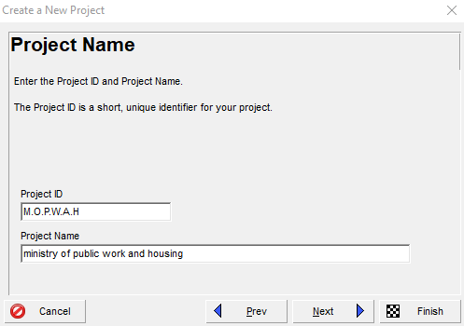
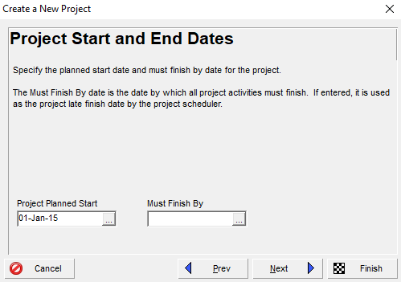

Slide 39
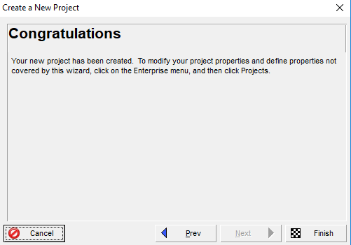
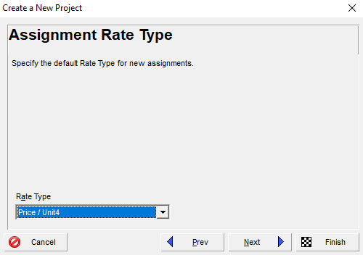

Slide 40
Calendar Definition
The parameters needed to define the calendar in Primavera software:
- Work Hours per Day: 8.0 hr/d.
- Calendar Weekly Hours: 8.0 hours for all week’s days but Friday is holiday.
- Hours per Time – Period:
8.0 hr/day.
48.0 hr/ week.
206.0 hr/month.
2496 hr/year.

Slide 41
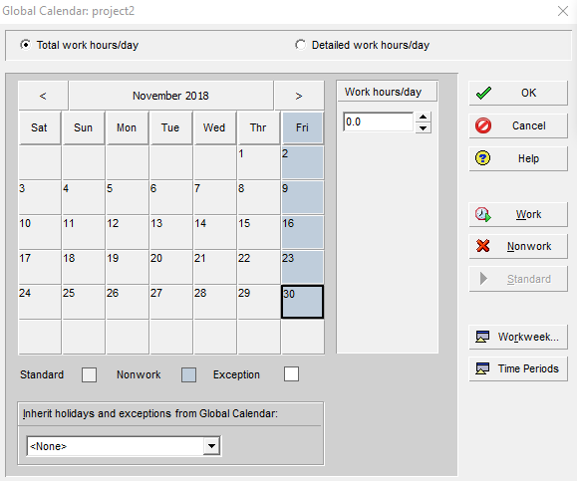
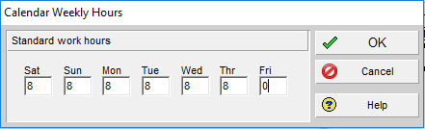

Slide 42
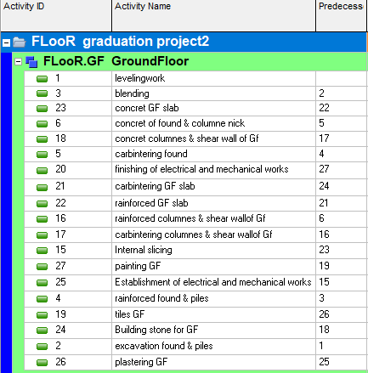
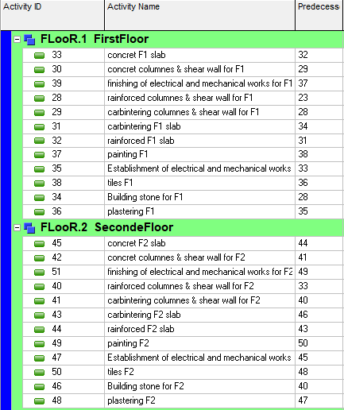
Activity Relationship

Slide 43
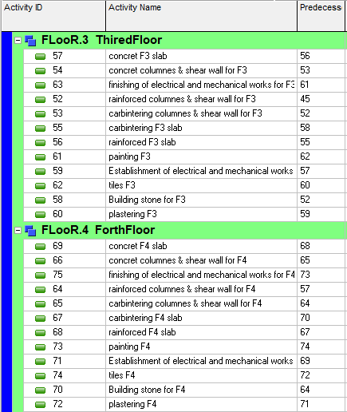
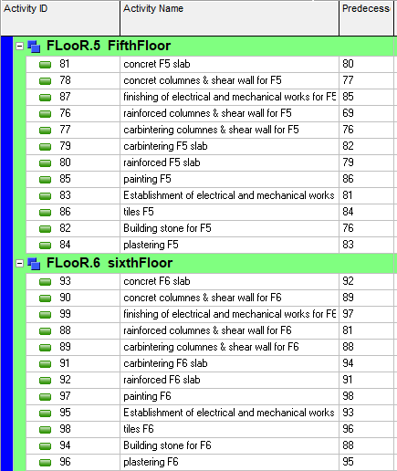

Slide 44
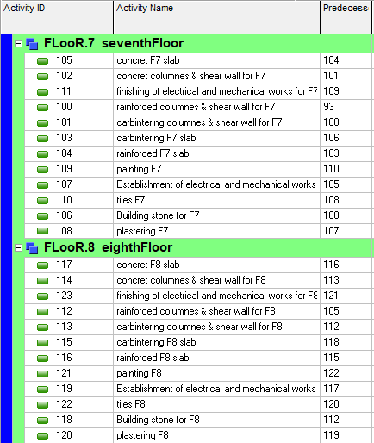
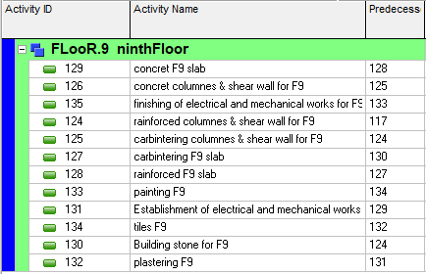

Slide 45
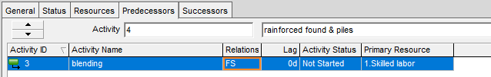
Activities Relationships Assignment
According to sequence of activities, take one activity as an example, the following figure shows the relationships assignment between activates:

Slide 46
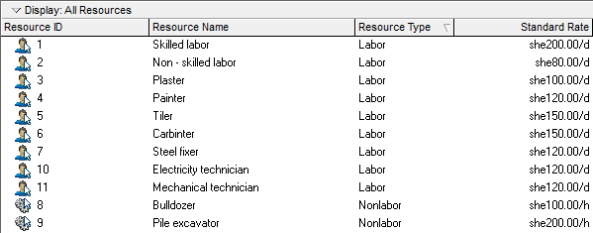
Resources Definition

Slide 47




Resources Definition For Activities

Slide 48




Resources Definition For Activities

Slide 49
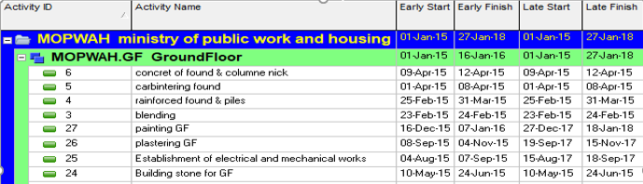
Results from Primavera
Early start, early finish, late start, late finish, total float and free float for each activity found in the attached report and critical activity.

Slide 50
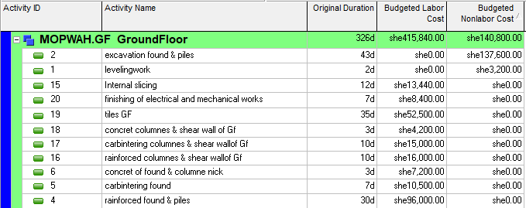
Results from Primavera
budgeted labor cost and budgeted Non-labor cost and Original Duration found in the attached reports.

Slide 51
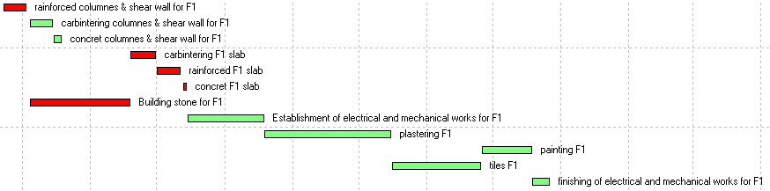
Results from Primavera
Gantt chart found in the attached Gantt chart sheets.

Slide 52

Resources Definition

Slide 53
Cost And Price Estimate.
  Assumption for pricing :
Job overhead cost = 10%
Operating overhead cost = 5%
Profit = 15%
Waste factor for materials = 5%
Waste of mortar in plastering = 13

Slide 54


Slide 55


Slide 56
Results And Conclusions
As we said in the introduction of this chapter, we applied the principles of project management to analyze our project and we show what an expected life of project management is, so we gain from this project a lot of experience and information in how to deal with projects and manage it in time, cost & performance.
First, we use Revit program to analyze the quantities then make the WBS and activity list and enter it into Primavera Project Planner (16.1) and run the program and take the results.
The total project cost is 9241457 NIS.
The total project price is 12274965 NIS.

Slide 57
References
Ahmad, H. (n.d.). Quantity Surveying Class Notes.
Ashworth, Alan; Perera, S. (2015). Cost Studies of Buildings Allan Ashworth.pdf, 570.
Course, P. (2012). Construction Cost Estimates, 276.
Dagostino, F. R., & Peterson, S. J. (2011). Estimating in building construction.
Date, B. S., Costs, B., & Arrangements, S. C. (2010). Construction Contracts.
E, R. (2007). Work breakdown structure. Project Management Practices (Work Breakdown Structure), (June), 1–3. https://doi.org/10.1007/0-306-48489-7_4.
Heldman, P. M. P. K. (2005). Project Management JumpStart. Management. Retrieved from http://www.amazon.com/dp/0782136001.
Introduction to Primavera. (n.d.).

Slide 58
Jackson, B. J., Best, T., & Step, F. (2010). Construction Management.
Juliana, C. N., Ramirez, A. M., & Larkin, B. J. (2005). Construction Management / Design-Build Prepared and Presented by : Construction Management / Design Build, 213. Retrieved from https://www.hillintl.com/PDFs/Construction Management Design Build -11-24-04 Ramirez, Alann.pdf.
Office, P. S., & Division, P. M. (n.d.). Project Management.
PMI. (2013). A Guide to the Project Management Body of Knowledge. Project Management Institute (Vol. 5). https://doi.org/10.1002/pmj.20125.
Portny, S. (2010). Project Management For Dummies 3rd Edition V413HAV.pdf. Retrieved from www.wiley.com.
Richman, L. (2011). Successful Project Management.

Slide 59


