Slide 1

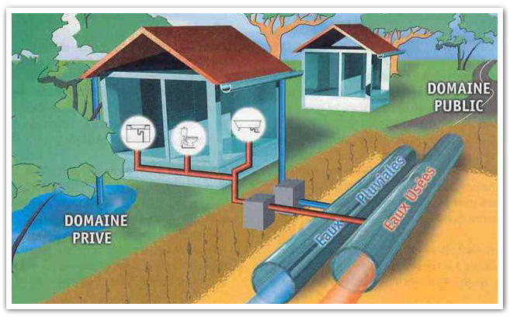
The Design of a Combined Wastewater and Stormwater Collection Network in Sabastia.
Prepared by:
Areej Zakarneh.
Yara Kazem.
Supervised by:
Dr. Mohammad N. Almasri.

Slide 2
Outline:-
Definition of the problem.
Study Area.
Methodology.
Data collection and calculation.
Design of the Networks.
Results and Recommendations of Networks

Slide 3


Definition of the problem
Nowadays, with the increasing population and consumption of water, that in the light of the global warming we face, would leave us with scarcity of water.
In addition, consumption of water is critical due to the fact that it produces sewage, and how we choose to dispose it is one of our main focuses, along with the discharge of the stormwater.

Slide 4
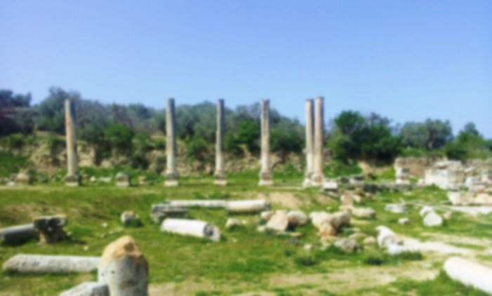
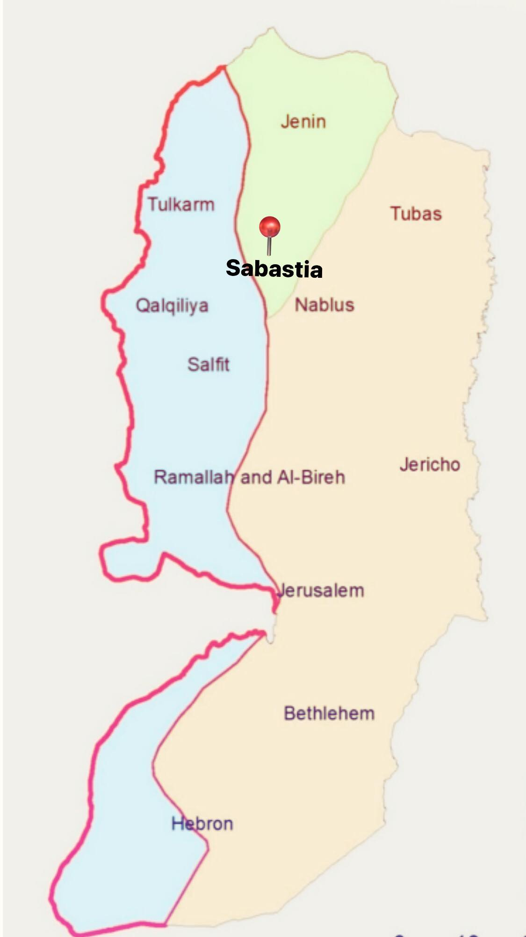
Location and Topography of study area:
Sabastia is a town located in the northwest of Nablus, 15 km away [32.276111°N 35.195278°E], specifically on the road between Nablus and Jenin, located at the foot of a mountain 450 meters AMSL that ends with a plain surrounded by fields and fresh orchards, and it is famous for planting olives and fruit trees such as peaches and apricots. The village's total area is 4,810 dunums, the urban area which comprises 150 dunums of that total. Much of the village lands (42%) are located in Area C under the Oslo Accords.
Climate: rainfall, temperature, wind, humidity

Slide 5

In the Village of Sabastia, which is considered one of the most important archaeological monuments in Palestine, the presence of many cesspits is not only a health concern but it also would pose a great threat to the remains and ruins that exist beneath the ground, and the running stormwater, over time would cause erosion to the remains that are exposed to the elements.

Slide 6
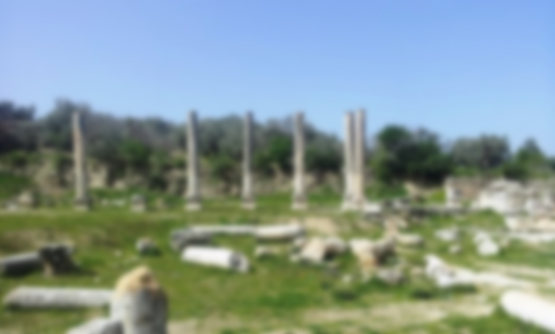
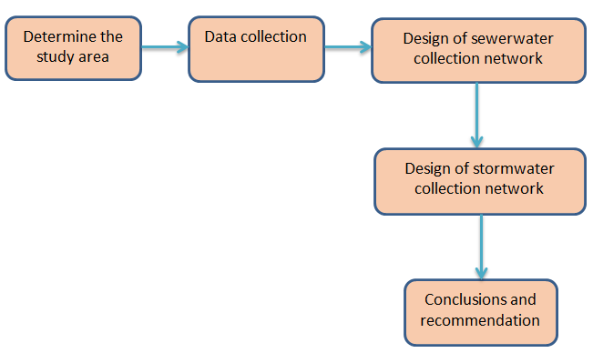
Figure3.1:Research methodology.

Slide 7
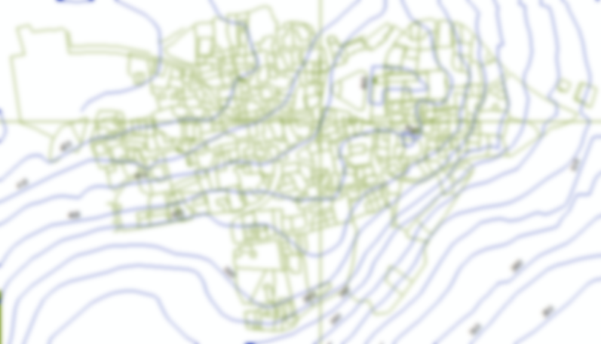
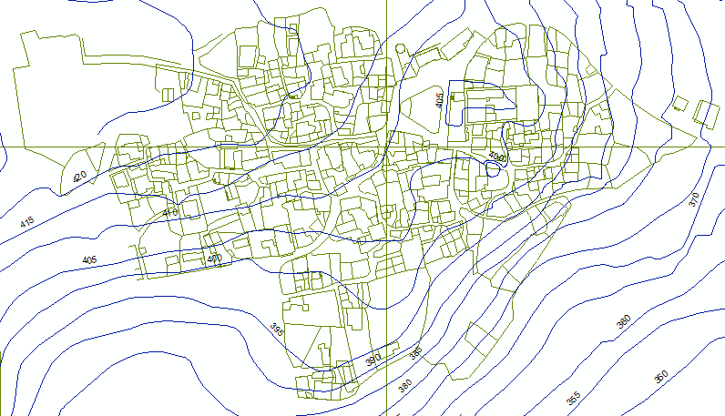
Collection data about the study area, such as:
Org chart & shapefile like a contour map, town boundaries, and buildings, main and secondary roads.

Slide 8
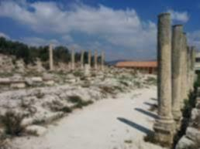
population in previous years (2007, 2017).
We got the data that we need for population calculations from Palestinian Central Bureau of Statistics (PCBS).
Table : Summary of population census for Sabastia town.

Slide 9
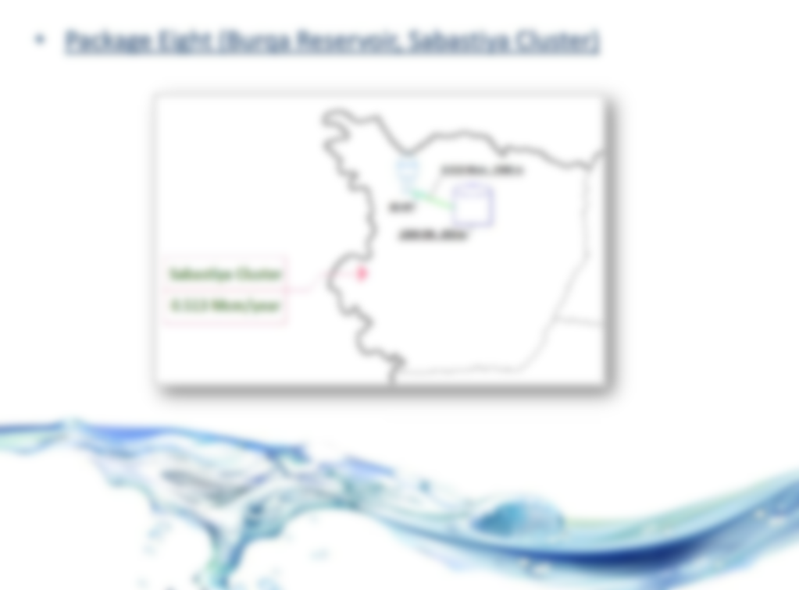
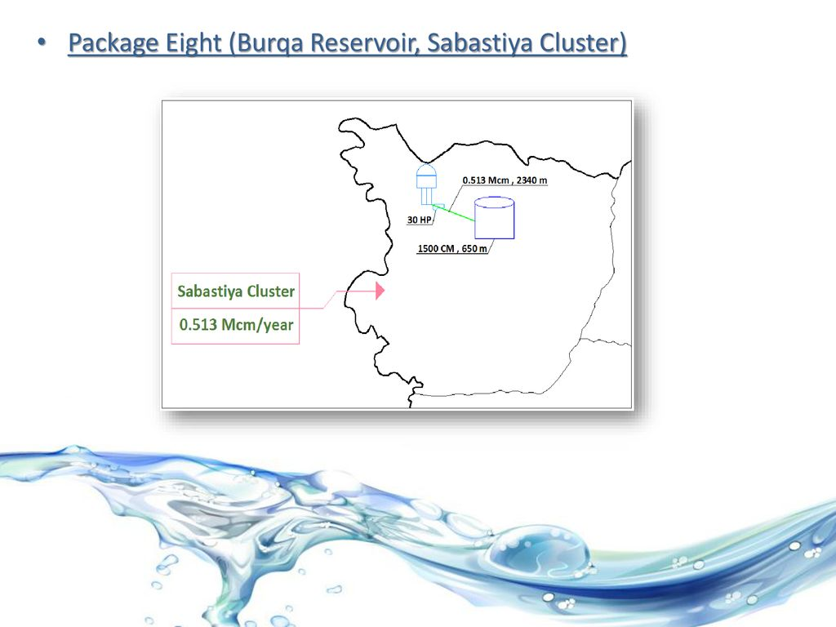
Its people get their water from a well in the town of Burqa to the northeast of Sabastia, and another will in the northern part of the town. Other sources of water include Ain Haroon owned by the people of Sabastia, located east between Sabastia and its neighboring village An- Naqura.

Slide 10
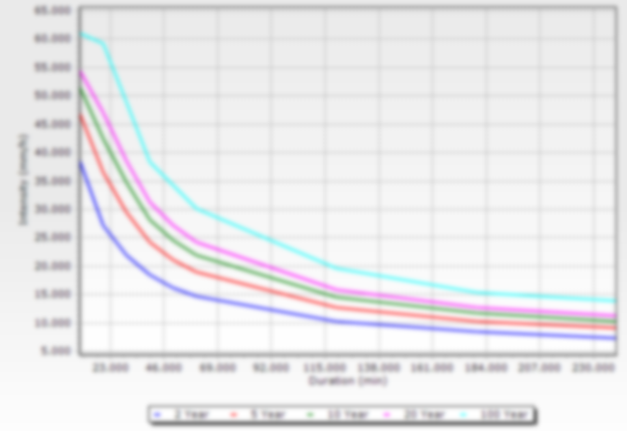
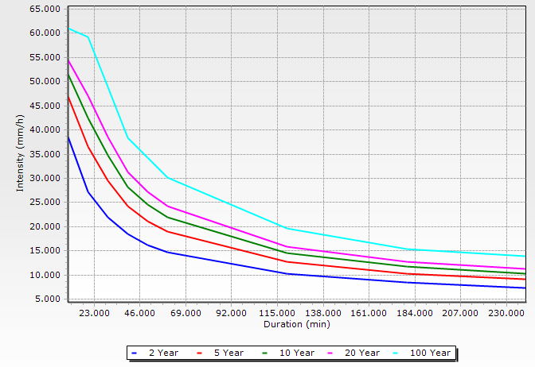
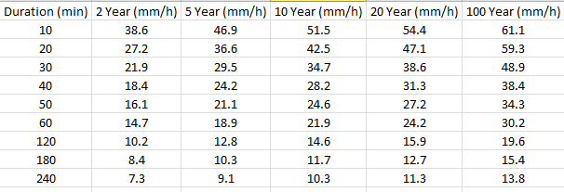
6
The IDF table is the real one for Nablus City (Source: Palestinian Water Authority)

Slide 11
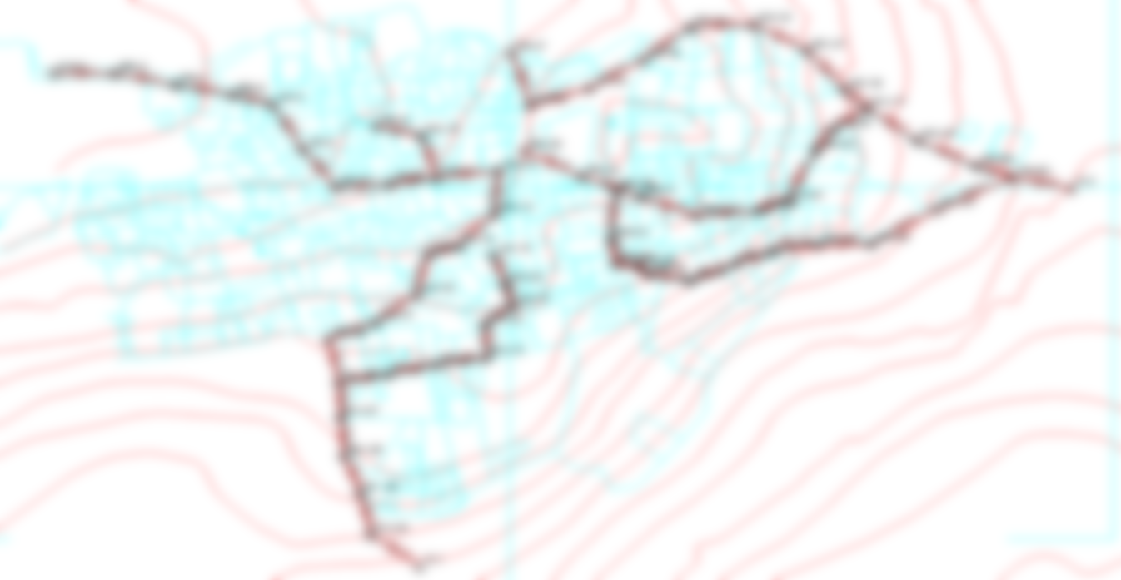
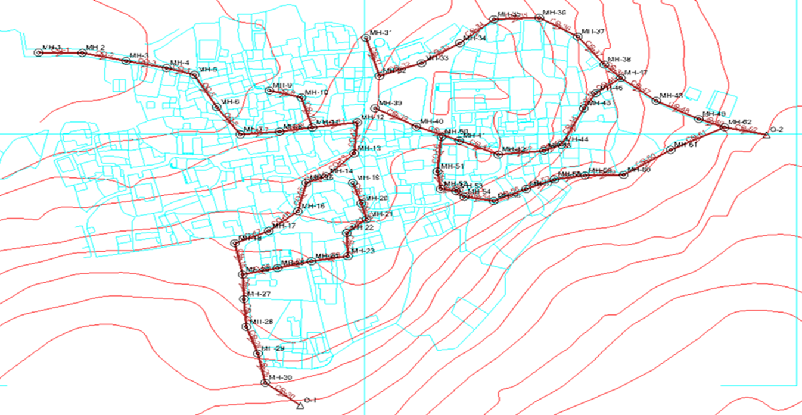
The assumptions that will be considered in the design wastewater collection network:
Design period 30 years.
Uniform distribution of the load on each manhole.
Determine outfalls(After studying the map for study area, the first outfall on eastern side, and second outfall on the southern side).
Water Demand (120 L/c.day), water consumption is (80%), infiltration as (20%).
The value of peak hourly factor ranges from (2-4) so we used 4.
Maximum distance between manholes 30m and the diameter of manholes 1m.
PVC circular conduits.
Network layout.

Slide 12
Design Constrains for sewage Network:
We set Velocity (Minimum) value to 0.6 m/s and (Maximum) is set to 3 m/s.
We set Cover (Minimum) value to .8 m and (Maximum) is set to 4.5 m.
We set Slope (Minimum) value to 1% and (Maximum) is set to 12%.

Slide 13

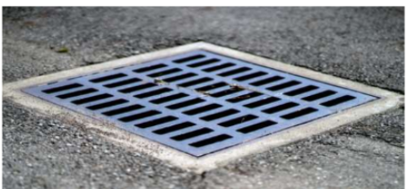
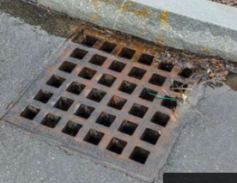
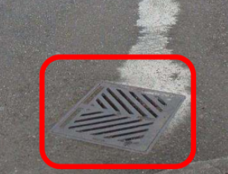
For the stormwater network:
Design period for 5 years and partial flow design is 75%.
The Rational coefficient =.8, the rate of runoff depends on:
The average intensity of the rainfall.
The size of the drainage area.
The type of the surface of the drainage area.
IDF curve of Nablus City was used as if the same for Sabastia.
Use circular concrete pipes.
The running coefficient C = 0.85.
Clogging Factor 20%.
Inlet location: in Sag, type: Grate (0.6x0.6).
type grate: curved vane (0.5x0.5).

Slide 14
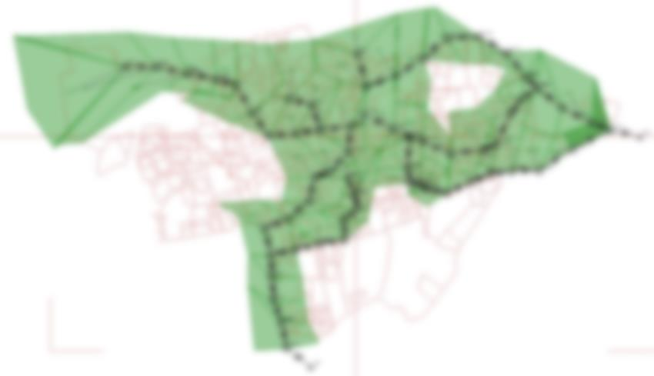
Design Constrains for Stormwater Network:
We set Velocity (Minimum) value to 0.6 m/s and (Maximum) is set to 5 m/s.
We set Cover (Minimum) value to 1 m and (Maximum) is set to 5 m.
We set Slope (Minimum) value to 1% and (Maximum) is set to 10%.

Slide 15
Load computation:
Population calculations for Sabastia:
We calculated the population growth rate and estimated the
future population after 30 years for Sabastia using the following equation:
P(f) = 〖Pn (1 + r)〗^n
where:
P(f): Estimated future population.
Pn: Current population.
r: Growth rate.
n: Number of years.
r = .025 =2.5%
P (2051) = 7194 ≈ 7200 capita.
Density = (P of Sabastia)/(Area ).
= 1.5 capita/m2
P of old city=Area x Density
=90 capita

Slide 16

Estimation of Wastewater load for each manhole using the uniform distribution method:

Slide 17
Calculate the Wastewater quantity:-
Q(ww)=((P×q×r×PF)+( P×q×r×i) )/1000
where:
Q (ww): Wastewater quantity (m3/day).
P: Population (capita or person).
q: Average water demand (L/c.day).
r (%): Return fraction.
i: Infiltration factor.
PF: Peak hourly factor.
Q (w(= 36.3m3/day.

Slide 18
Estimate the load for each manhole using the Equal Flow Distribution method.
So, the load on each manhole =Q (ww)÷# of manhole.
= 36.3 ÷ 61
= 0.6 m3/day.
Calculation for Stormwater Collection Network:
Consider a 5-year return period.
Pipes (conduits) are all of concrete.
Catch basins are Box Structures
[Length (m) = 0.9 and Width (m) = 0.9]
outfall is 2
Road Cross Slope is 0.035
Compute the overland-flow time :
to = 1.8(1.1 – C) *L^0.5/S^0.333 [The Federal Aviation Agency (FAA) formula]
where C = the rational coefficient.
L = overland flow length in ft.
S surface slope in %.
to is in minutes.

Slide 19
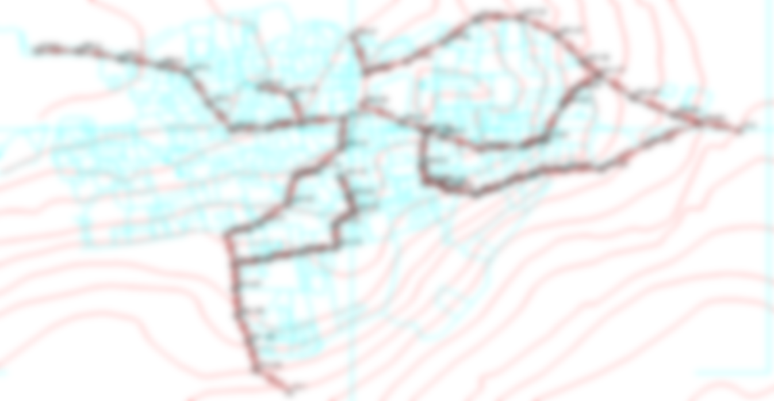
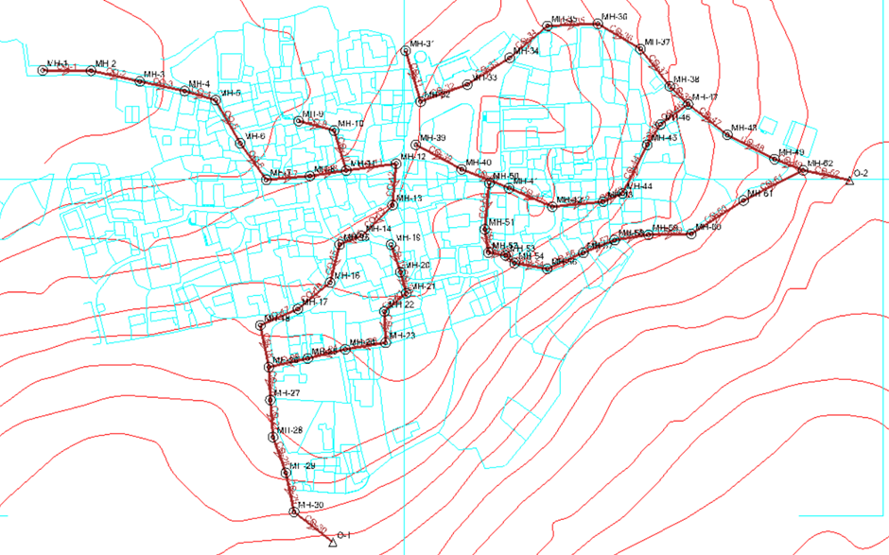
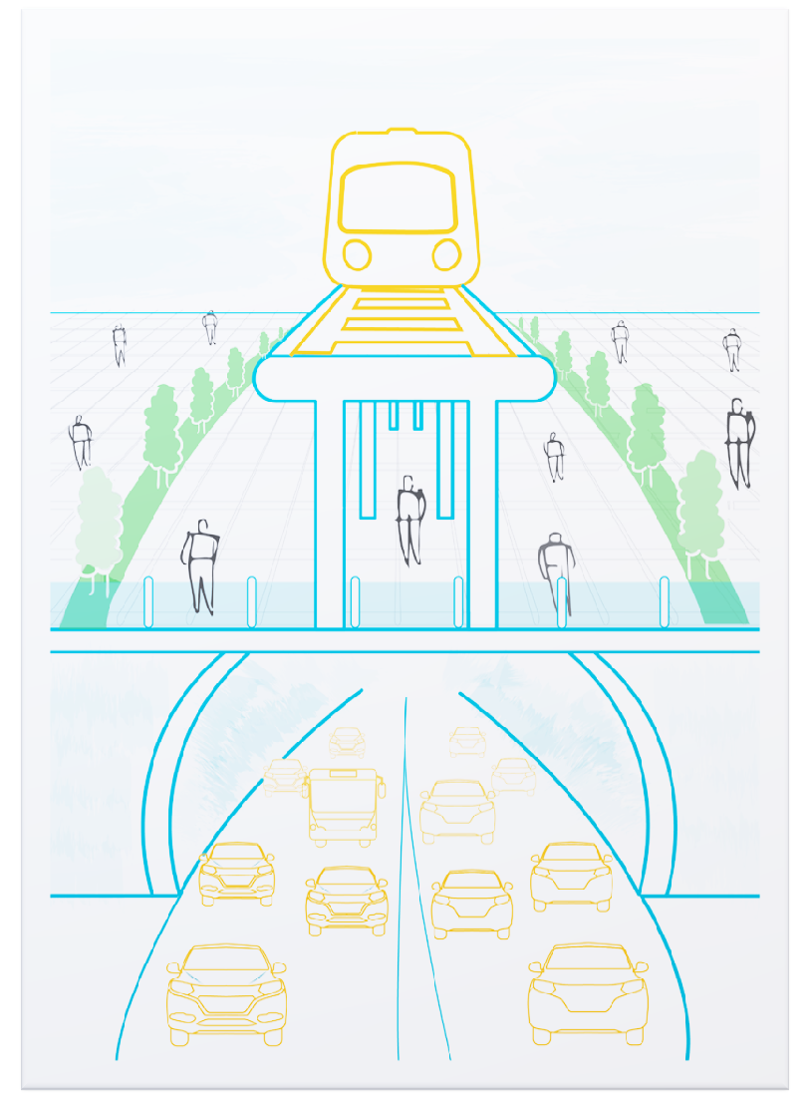
Figure : Manholes and Conduits Layout

Slide 20

Figure : Catchments, catch basin &conduits

Slide 21
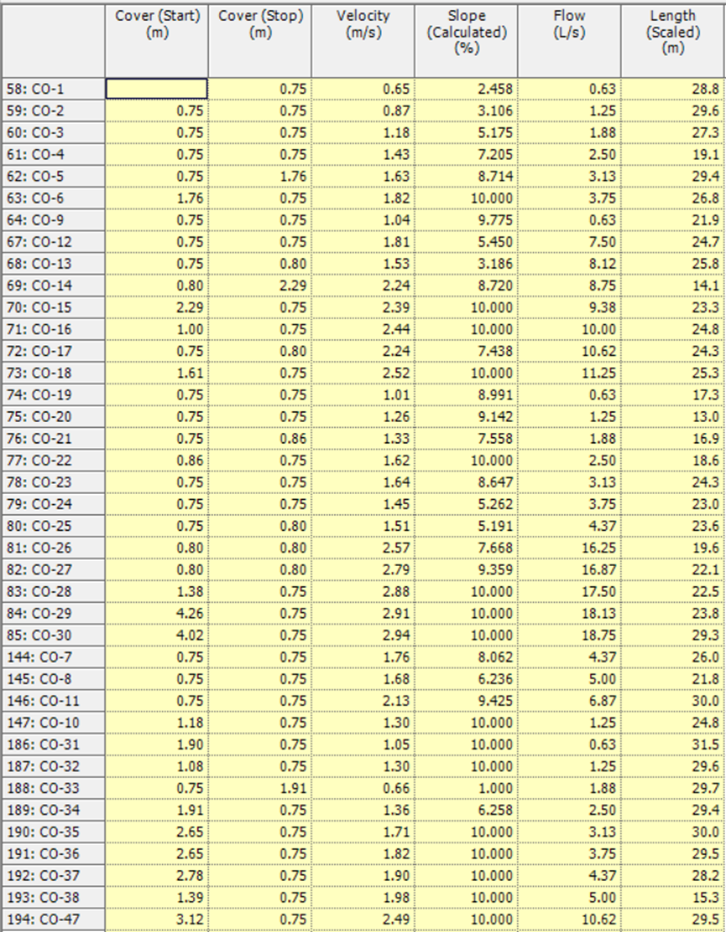
SewerCAD Output Data:-

Slide 22

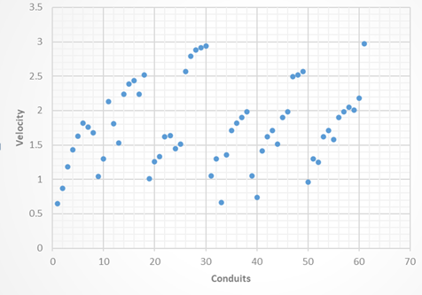
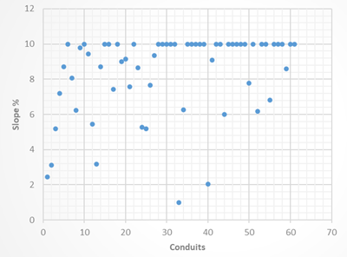
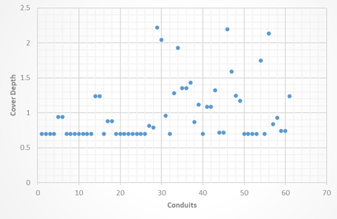
Design Constrains Relationships in Wastewater Collection Network:

Slide 23
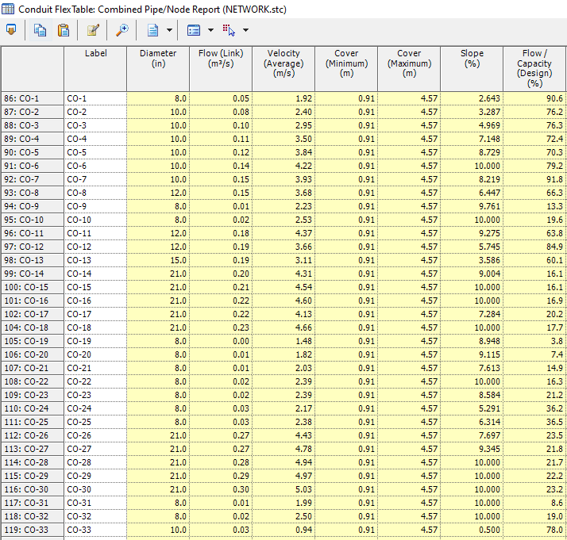
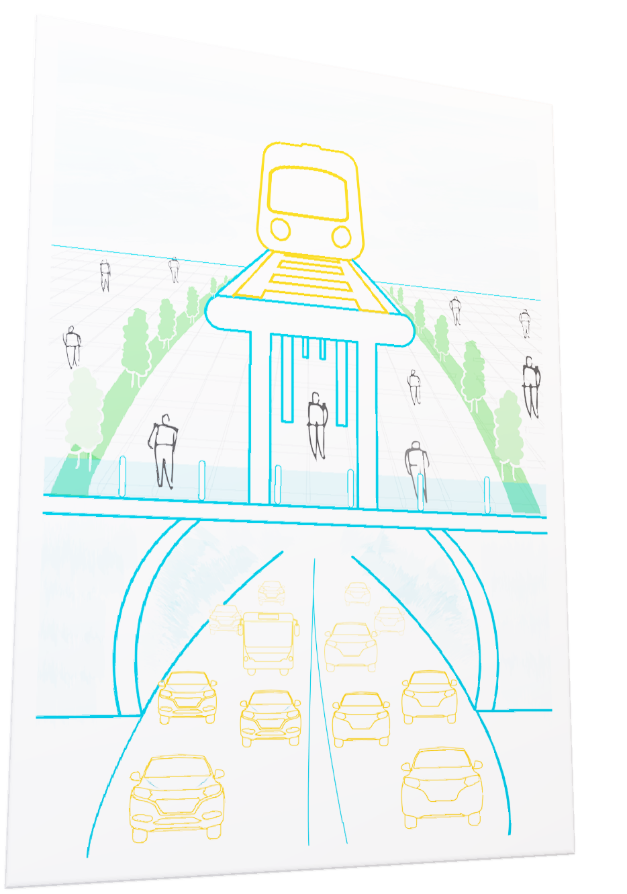
StormCAD Output Data:

Slide 24

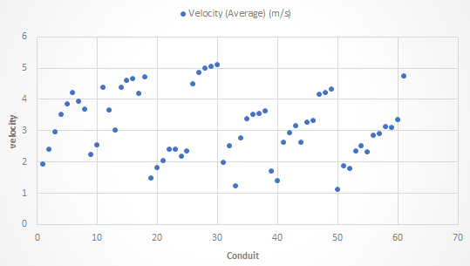
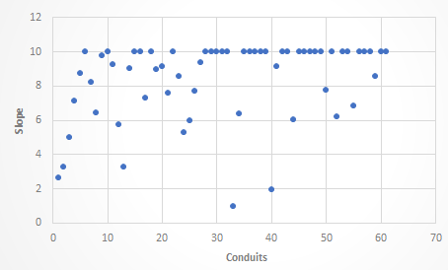
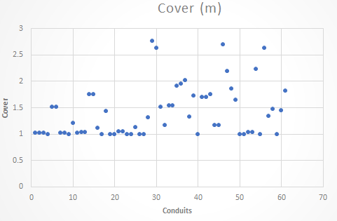
Design Constrains Relationships in Storm water Collection Network:

Slide 25

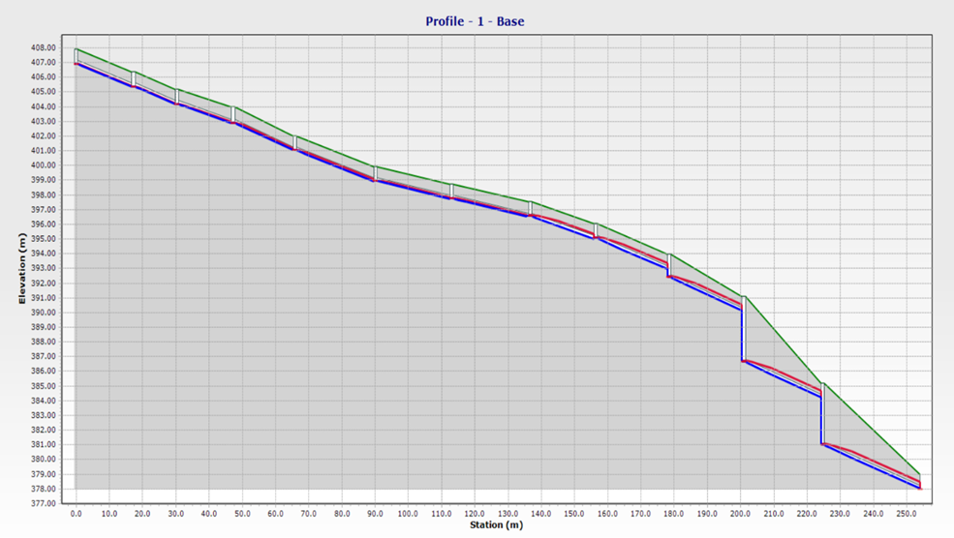
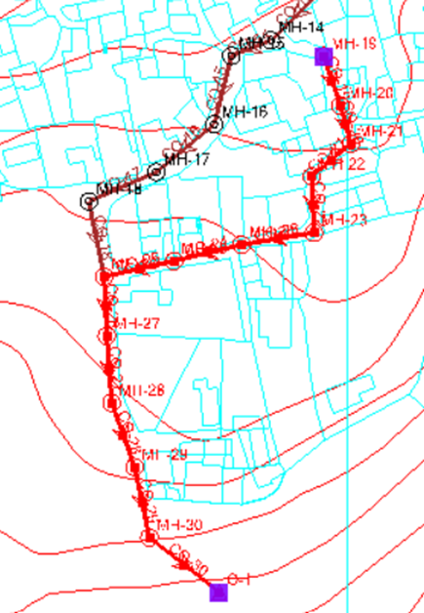
Profiles for Wastewater Network:
Profile 1
Location of Profile 1

Slide 26
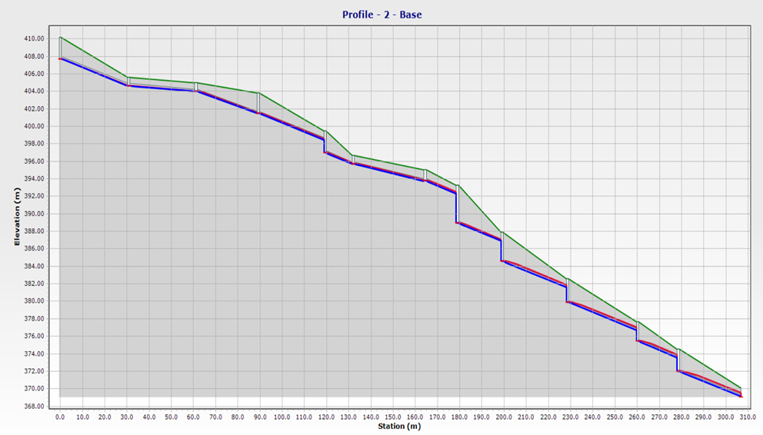
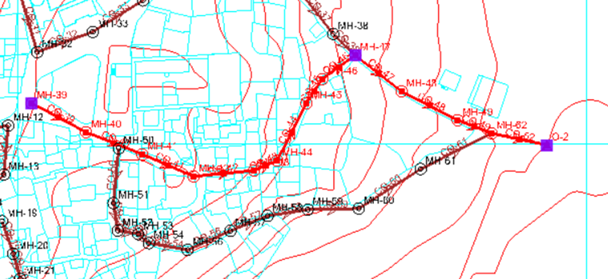
Profiles for Wastewater Network:
Location of Profile 2
Profile 2

Slide 27
Conclusion Recommendations:
The combining of the networks was proposed due to the fact the old town’s population is low, which means relatively lower values of wastewater production, and establishing another network to collect stormwaters in the narrow routs, would be counterproductive to protecting the ruins, as the additional excavation might cause them more damage.
•The results of the diameters of conduits in StormCAD were taken and they were entered into the SewerCAD Software, to make sure the drainage water network that can drains the sewage flow without any problems in terms of slopes or large diameters, which have excessively low speeds.
•The choice to go with concrete pipes for the combined network, was based upon concrete being a tried, tested and proven material that has a long history of use in the manufacturing of strong, reliable pipes.

Slide 28
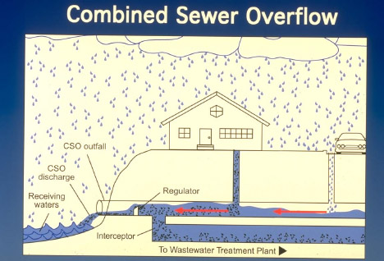
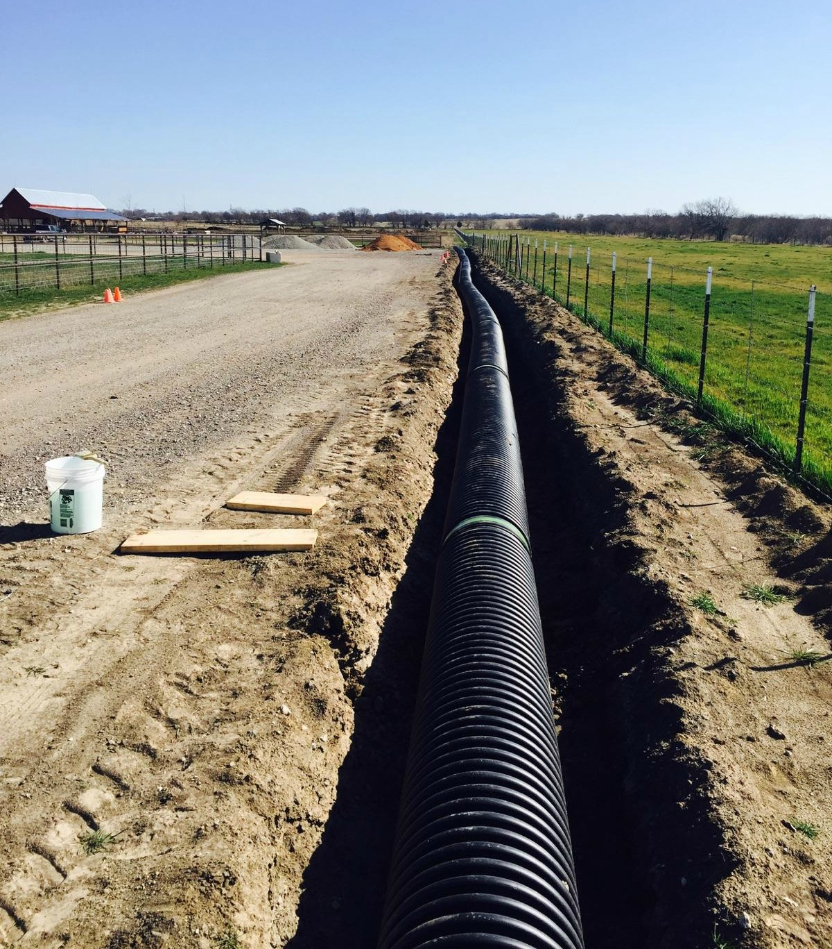

Slide 29
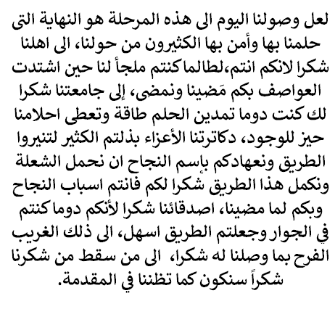
Thank you!

