Slide 1

Multi-tone Test
Yusri Maslamani
Mohammad Essa
Bleal Azaar
Supervisor :
Dr. Falah Hasan

Slide 2
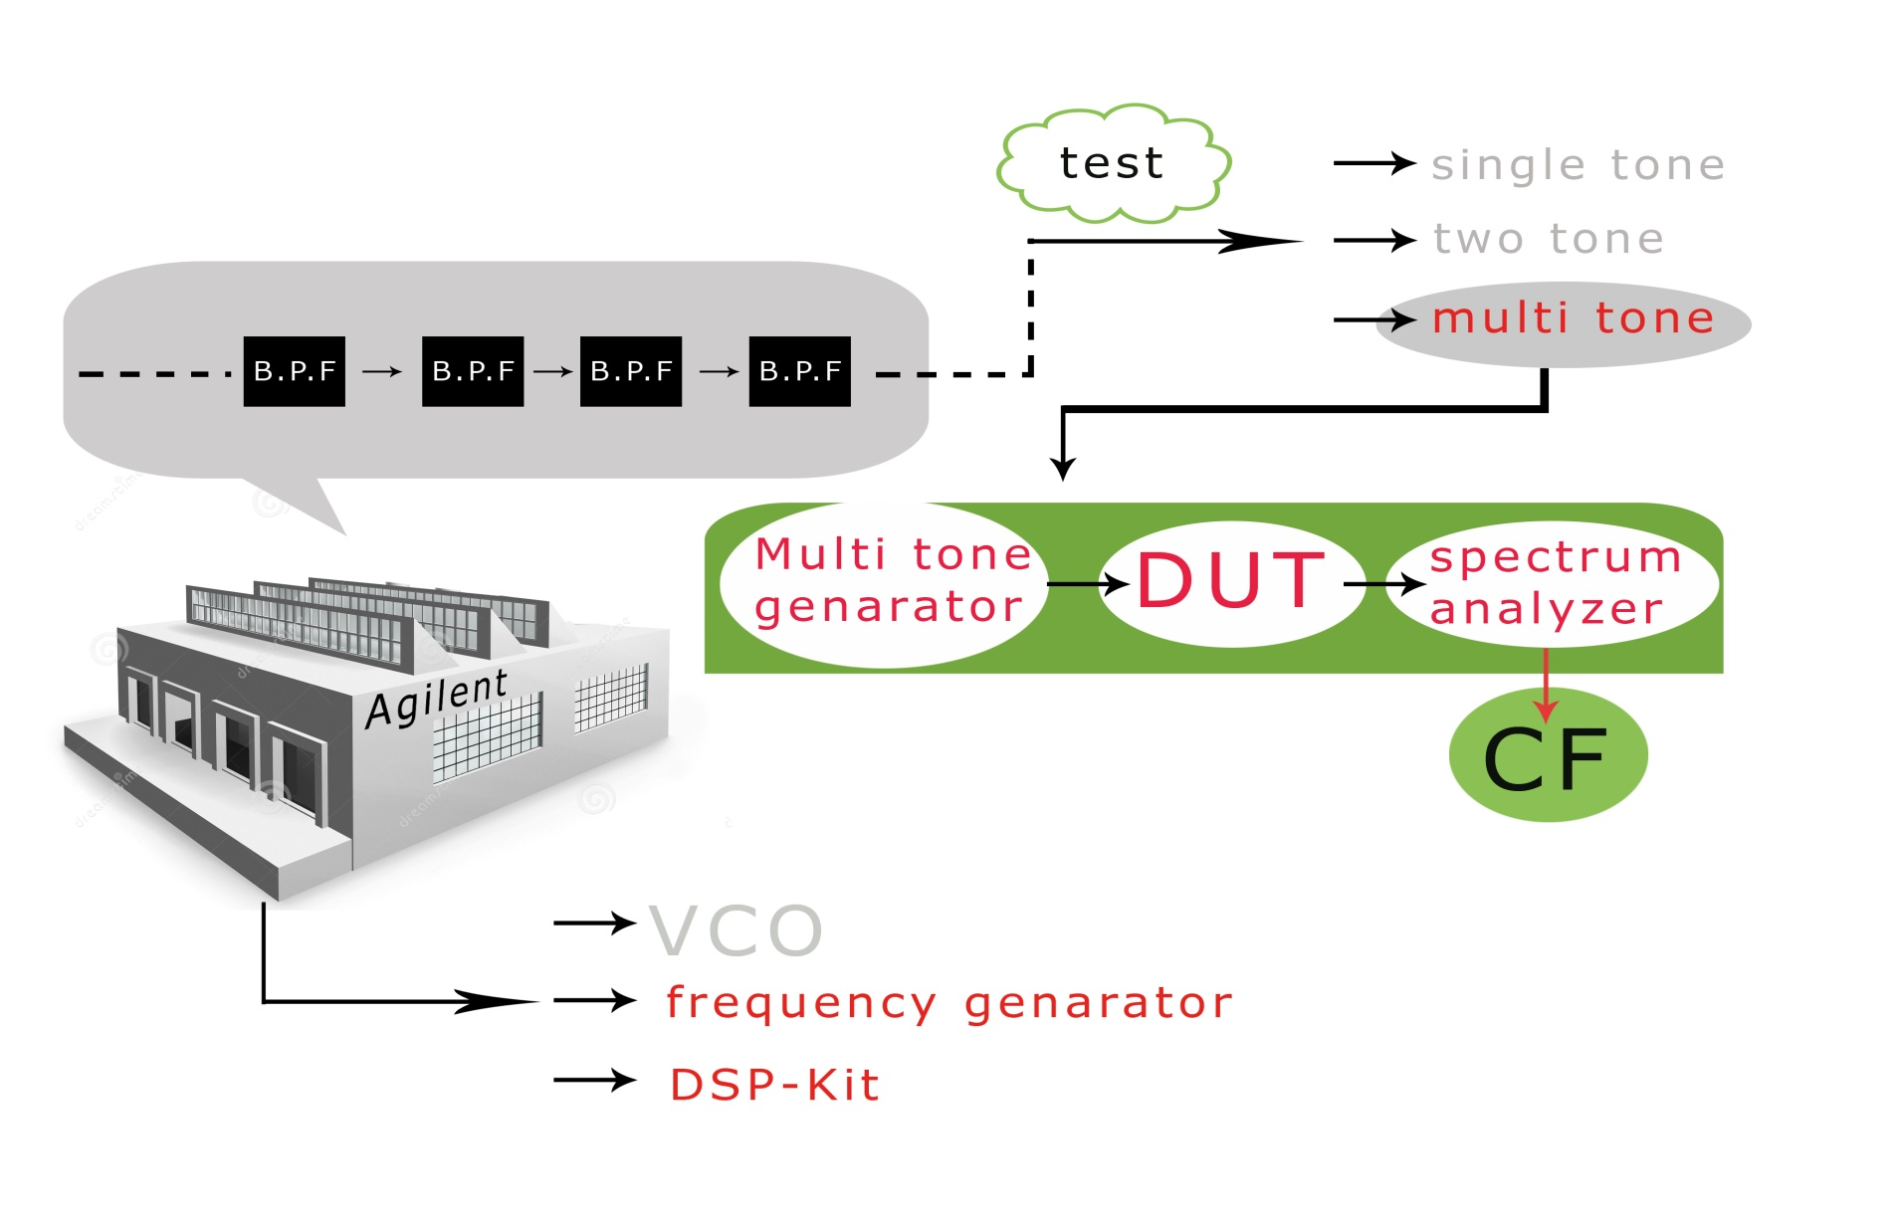
Introduction

Slide 3
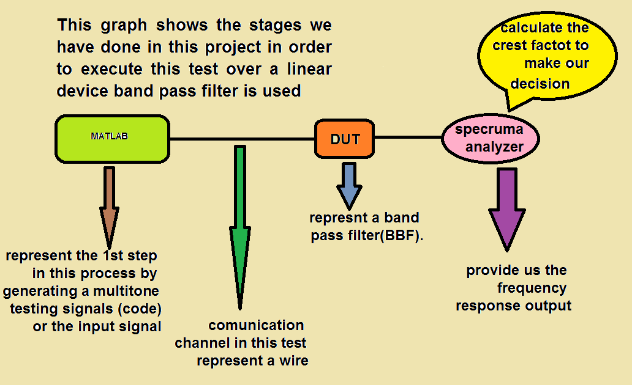
Using Matlab

Slide 4
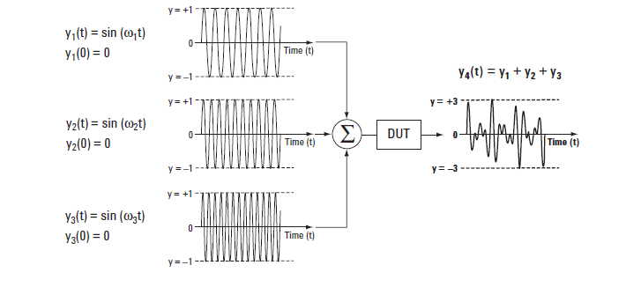
Practical work
The main advantage of multi-tone test is that we can characterize the frequency response of an unknown device in very short time

Slide 5
In order to show that we applied the principle of single tone test and multi-tone test and make a comparison between them
Single tone test
It based on keep changing the frequency every time in order to get the frequency response
Signal generator
DUT
Spectrum analyzer

Slide 6
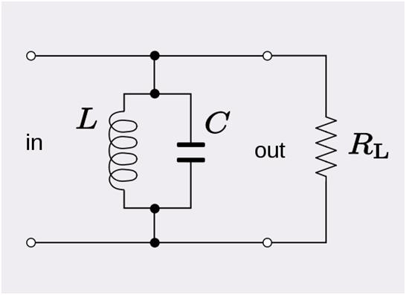
First ,we decide the type of DUT we used to be a Band Pass Filter(parallel RLC) with these specifications : Band width = 4 KHz , cutoff frequency (Fc) = 10 KHz
Accordingly the values R = 1k Ω,L = 0.25μF, C=1mH

Slide 7
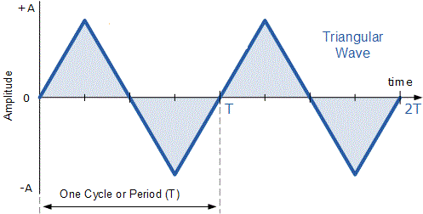
Apply the principle of single tone test
The fist application was a voltage controlled oscillator VCO
IN out CH2
ch1
Low frequency
F = 10 HZ
T = 100 ms
VCO
DUT
Oscilloscope

Slide 8
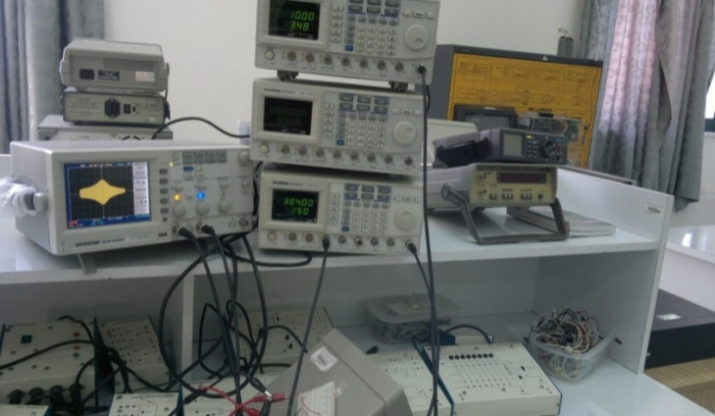
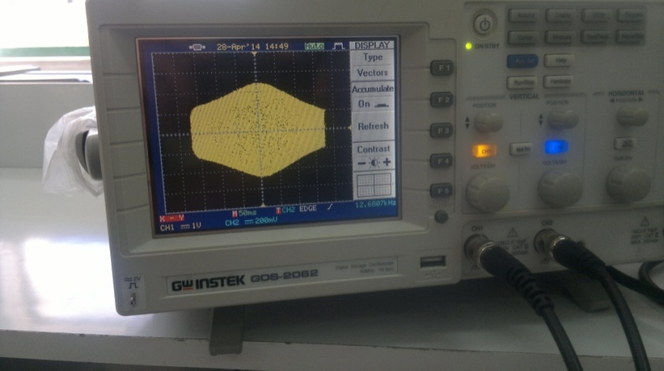
VCO using frequency generators
parallel RLC output with C= 2.2 μF
Notes:
part (a) parallel RLC output with C= 2.2 μF part (b) same filter but di
we notice from figure 29 part (a) that we use the principle of single tone by using a function generator with ramp output to test the RLC parallel circuit and the output was typically a BPF with fc=12.33 kHz and the circuit has And we find R = 1k Ω,L = 0.25μF, C=1mH while part (b) same filter but we changed the value of C we can see that the output is defected ,also the center frequency changed in order to get the output correct which it is the shape of BPF we need to change the frequency from the function generator to get the correct BPF and this action take a lot of time due to manual calibrating.

Slide 9
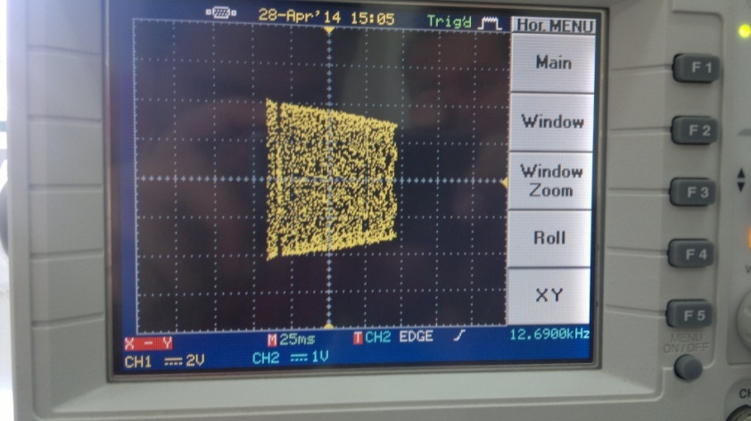
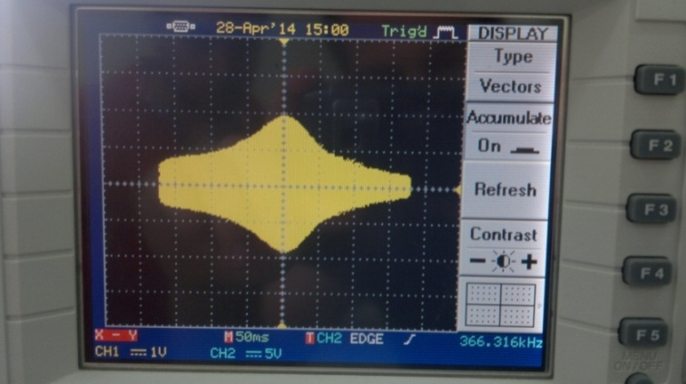
This picture shows a parallel RLC circuit with different value of capacitor C = 10 μF
This picture shows a series RLC circuit with different value of capacitor C = 10 μF

Slide 10
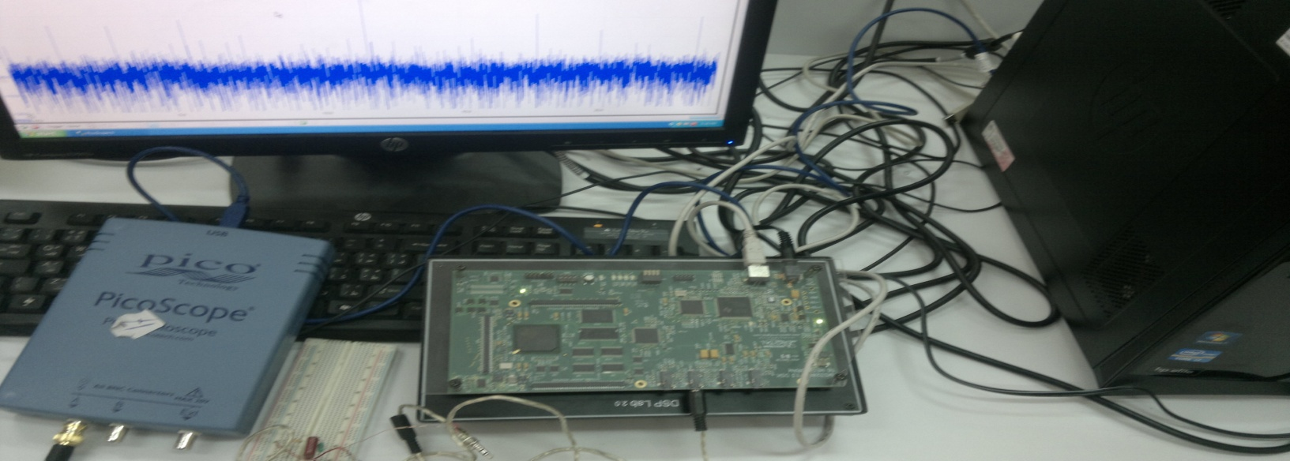
Generating the multi-tone signal using DSP kit
To apply the multi-tone test :
First ,we convert the multi-tone code which was written in Matlab to C language in order to deal with code composer studio to be able to download the code on the DSP kit

Slide 11
Second ,after that we take the output line from the kit and connected to the B.P.F to get the frequency response by using the Pico scope
Sample vector = 128 sample
Number of tones = 32
Fs = 96 KHz
Ts = 1.3 ms
Samples of multi tone
DSP kit
Pico scope
DUT

Slide 12
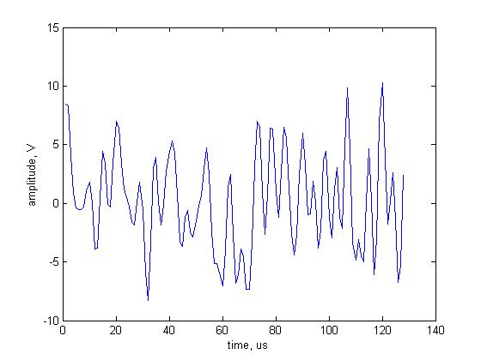
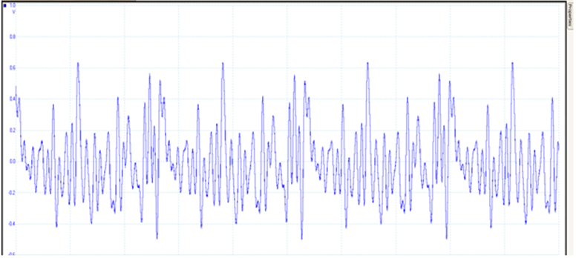
This is multi-tone signal in time domain which we deal with without testing the RLC from Matlab :
This is the multi-tone signal which we see from using the DSP kit and picoscope in time domain :

Slide 13
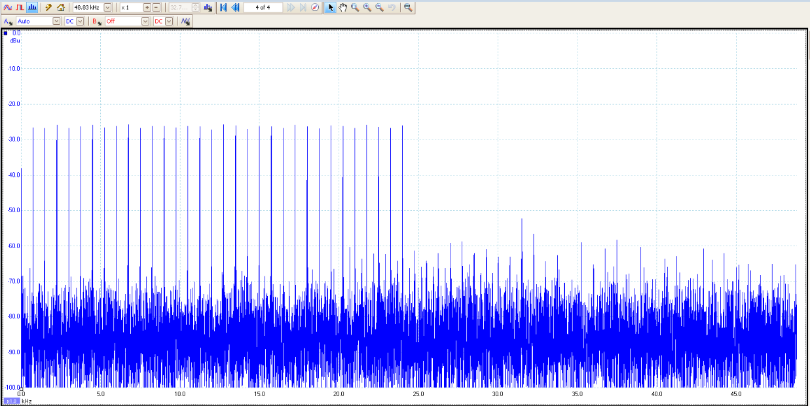
This picture represent the multi-tone spectrum before testing the filter . We notice that the multi-tone cover a range of 24 KHZ which mean it can cover the range of bandwidth for the B.P.F

Slide 14
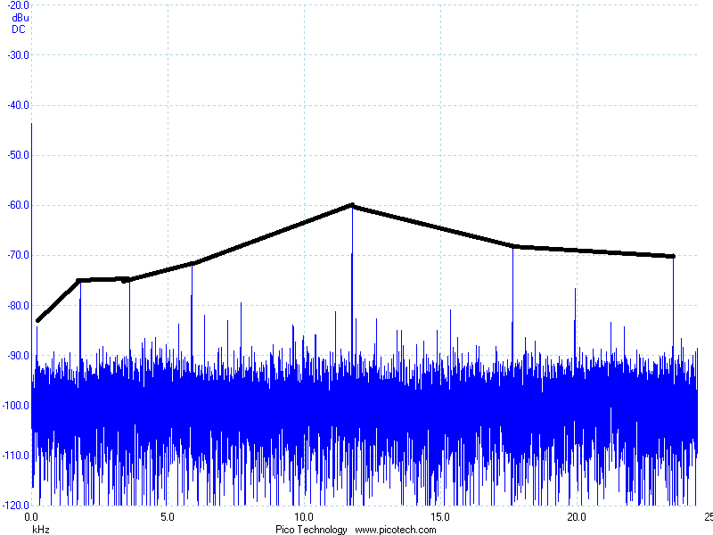
The spectrum of BPF after the test
From this figure we find that the crest factor CF equal to 2.587 and this is the value which represented by using a band bass filter with these specifications R = 1k Ω,L = 0.25μF, C=1mH

Slide 15
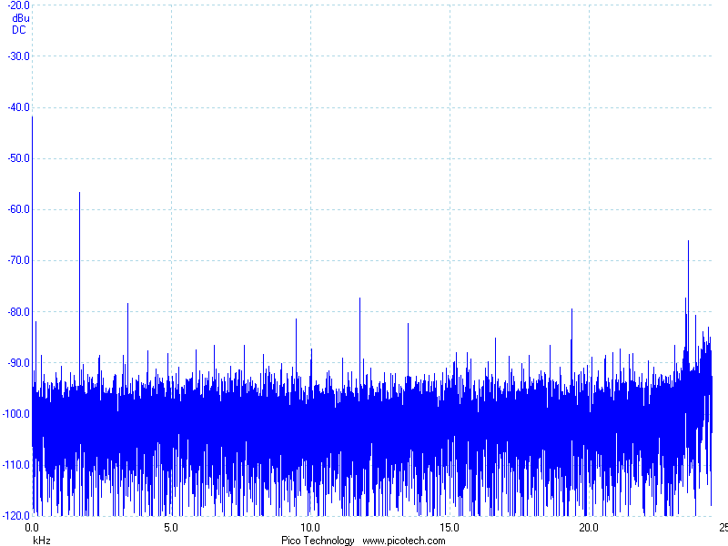
The spectrum of BPF using R = 1k Ω,C = 10pF, L=1mH :
Notes:
شو نعلق عليها

Slide 16
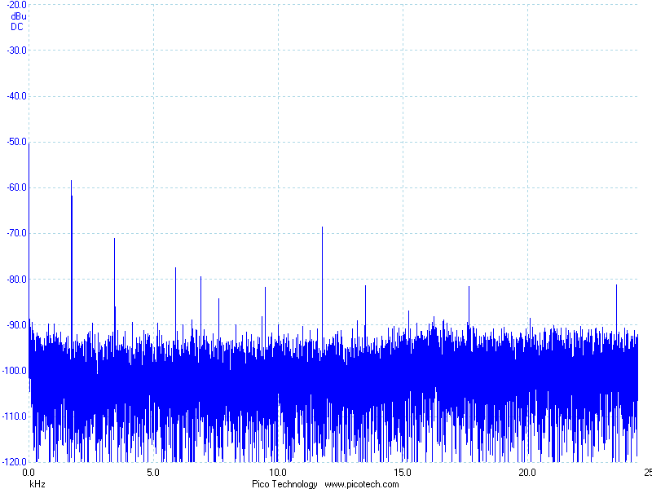
: The spectrum of BPF using R = 1k Ω,L = 100pF, L=1mH

Slide 17
Conclusion
We find that using the multi-tone teqnique and the crest factor to judge for the device to be accepted or not is an efficient way since any change in any parameters on the device lead to change the crest factor and this what we are looking for that this test can let us compare between any two devices easily and within milliseconds
This mean this test can give between any active or passive device and accurate results in less time due to compare with using a VCO and single tone principle which need more time and less in accuracy and hard to judge when comparing

Slide 18
Thanks For Listening

