Slide 1
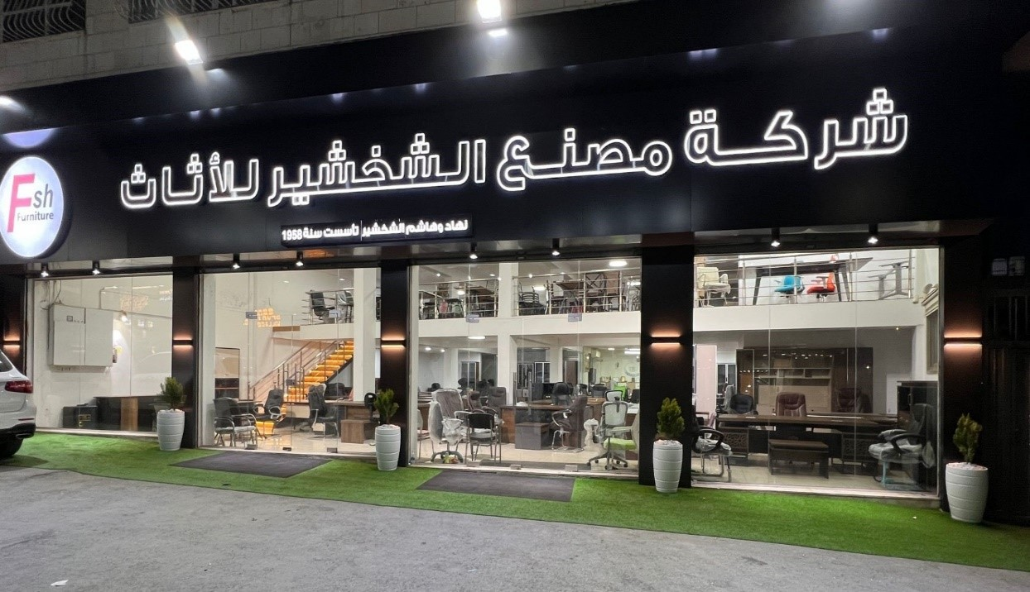
Operations Improvement For Al- Shakhshir
Furniture Factory
Graduation Project 2
By:
Ruba Barmawi
Masa Qadi
Fadi Al-Asaad
Supervisor:
Eng.Suleiman Daifi

Slide 2
Outline
1
2
3
4
5
6
7
Problem
Statement
Literature
Review
Conclusion & Recommendation
Introduction
Objectives
Methodology
Results

Slide 3
01 Introduction
Al - Shakhshir Furniture Factory Established in 1959 in the city of Nablus.
It is structured into three sections: The Smithing section, Upholstery section
and Carpentry section
It’s specializing in the production of office, school, and restaurant furniture.
Two showrooms operated by The Factory :
1- the first one can be found in Nablus.
2- the second one in Al-Bireh – Ramallah.

Slide 4
02 Problem Statement
Lack of Documented SOPs
Lack of Production Planning
Lack of Effective Layout
Lack of Inventory Management

Slide 5




03 Objectives
01
02
03
04
Production Planning Development
SOPs Development
New Factory Layout Development
Inventory Management

Slide 6

04 Literature Review

Slide 7

Theoretical Background
Job Description
Documentation
Flowcharts
SOPs
Facility Layout
Forms
Production Planning
Flowcharts
Inventory Management
Organizational Structure

Slide 8
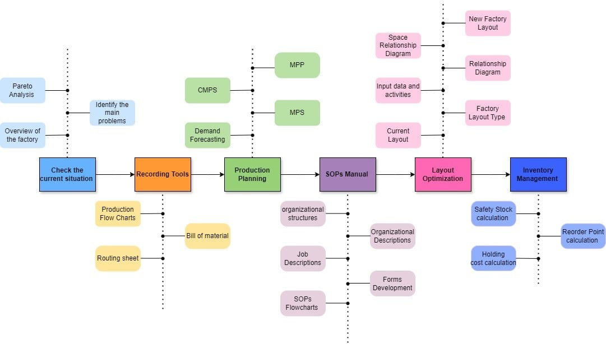
05 Methodology

Slide 9
06 Results

Slide 10

Production Planning

Slide 11
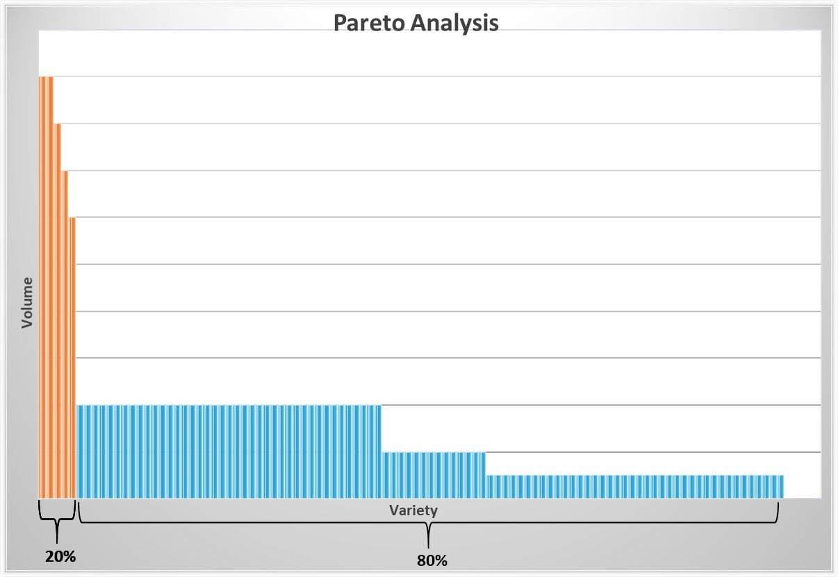
Pareto Analysis

Slide 12
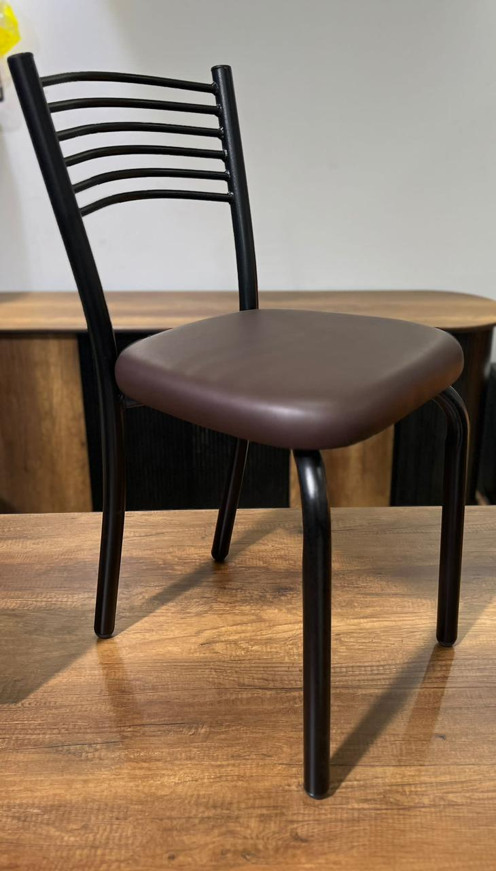
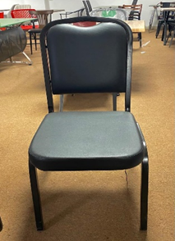
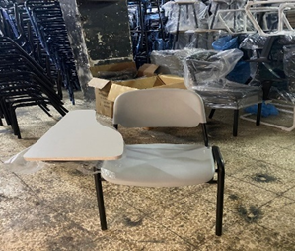
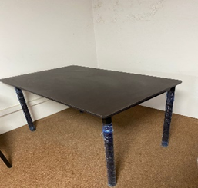
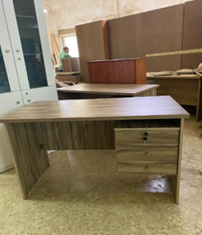
Products Selection
Production percentage out of the factory’s total production | Figure | Product
5% |  | Feno chair
6% |  | Guitar chair
3% |  | Student chair
4% |  | Rectangular Table
6% |  | Wooden office desk

Slide 13
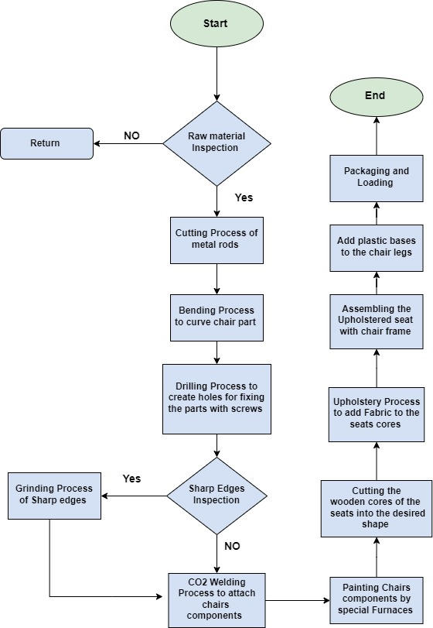
Flow Chart of Feno Chair Production Proces

Slide 14

Bill Of Material

Slide 15
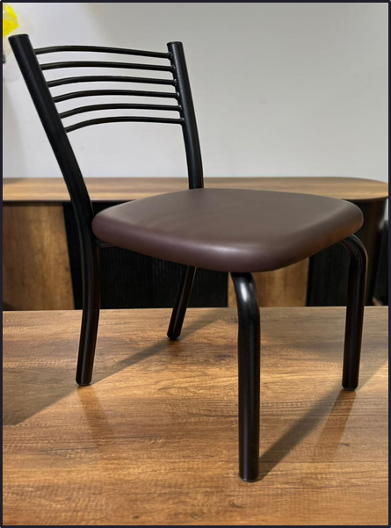
Bill Of Material For Feno Chair
Bill of material
Product description :Feno Chair Stock number : (01)
Component |  | Quantity (Amount) required | Source
Stock No. | Description
32 | Circular Metal rod - (d = 32 mm) | 4 | Purchasing
13 | Circular Metal rod - (d = 13 mm ) | 6 | Purchasing
40 | Wood - (Sandwich) | 1 | Purchasing
3 | Sponge - (t = 3cm) | 1 | Purchasing
1 | Sponge - (t = 1cm) | 1 | Purchasing
50 | Leather | 1 | Purchasing
8 | Screw | 4 | Purchasing
34 | Plastic Base | 4 | Purchasing

Slide 16

Routing Sheet

Slide 17
Routing Sheet For Feno Chair
Routing Sheet
Product: Feno Chair Part No.: 01
Operation |  | Machine | Aux.Equip. | Setup Time (hr.) | Hr./Pc | Hr./component | Pc/Hr.
No. | Description
1 | Cutting process of metal rod | Cutting machine | Gloves |  | 0.0014 | 0.014 | 360
2 | Bending process | Rod bending machine | Gloves |  | 0.00194 | 0.0194 | 257
3 | Drilling process | Drill press | Gloves |  | 0.00056 | 0.00224 | 900
4 | Polishing process | Polishing machine | Gloves |  | 0.0014 | 0.014 | 360
5 | Welding process | CO2 welding machine | Welding mask, gloves and chair mold. |  | 0.0334 | 0.0334 | 30
6 | Painting process | Painting oven | Spray painting, Gloves | 0.167 (10min) | 0.0167 | 0.0167 | 30
7 | Wood cutting machine | Table Saw machine | - |  | 0.0167 | 0.0167 | 30
8 | Contouring process | Vertical Saw machine | - |  | 0.033 | 0.033 | 15
10 | Upholstery process | - | Electrical Staple gun |  | 0.167 | 0.167 | 3
11 | Assembly process | - | screws |  | 0.0167 | 0.0167 | 30
12 | Packaging and loading | - | - |  | 0.0167 | 0.0167 | 30
Total |  |  |  | 0.167 (10min) |  | 0.35 (21 min)

Slide 18

Demand Forecasting

Slide 19


Demand Forecasting
A
A
B
B
Data
Graphical Represintation
The demand data in previous 2 or 3 years
Graphical Representation of the data
D
C
Check
Forecasitng
Checking the accurecy of the forecasting results
D
C
Demand Forecasting using the suitable model

Slide 20
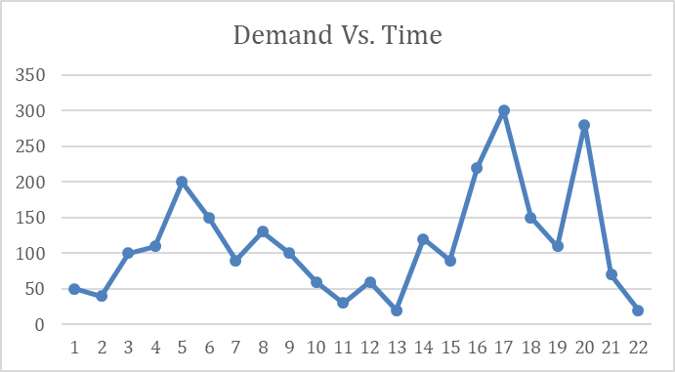
Feno Chair Demand Forecasting

Slide 21
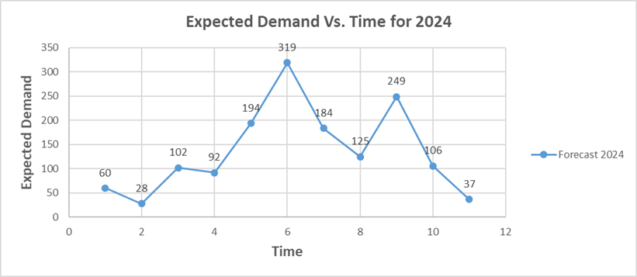
Feno Chair Demand Forecasting
Simple Exponential Smoothing Model

Slide 22
MPS For Feno Chair
 |  | Period
Product: Feno Chair | On hand | 1 | 2 | 3 | 4 | 5 | 6 | 7 | 8 | 9 | 10 | 11
Forecast |  | 60 | 28 | 102 | 92 | 194 | 319 | 184 | 125 | 249 | 106 | 37
Projected available balance | 60 | 50 | 52 | 50 | 58 | 54 | 52 | 58 | 53 | 54 | 58 | 51
Master production schedule (MPS) |  | 50 | 30 | 100 | 100 | 190 | 320 | 190 | 120 | 250 | 110 | 30
Lot size = 10
Safety stock = 50

Slide 23
Consolidated MPS
 | Period
Product | 1 | 2 | 3 | 4 | 5 | 6 | 7 | 8 | 9 | 10 | 11 | Total
Feno chair | 50 | 30 | 100 | 100 | 190 | 320 | 190 | 120 | 250 | 110 | 30 | 1490
Guitar Chair | 60 | 20 | 100 | 110 | 520 | 420 | 40 | 10 | 20 | 20 | 10 | 30
Rectangular Table | 100 | 50 | 45 | 100 | 50 | 55 | 50 | 215 | 125 | 65 | 25 | 880
Student chair | 27 | 15 | 6 | 37 | 24 | 65 | 305 | 591 | 225 | 11 | 12 | 62
Wooden Office desk | 30 | 38 | 24 | 45 | 25 | 37 | 31 | 62 | 52 | 34 | 23 | 401

Slide 24
Monthly Production Planning (MPP)
MPP FOR JUN
Product | Week 1 | Week 2 | Week 3 | Week 4 | Total
Feno chair | 150 | 120 | - | 50 | 320
Guitar chair | 200 | 140 | - | 80 | 420
Rectangular Table | 25 | 15 | - | 15 | 55
Student chair | 20 | 15 | - | 30 | 65
Wooden Office desk | 15 | 15 | - | 7 | 37
Total | 410 | 305 | - | 182 | -

Slide 25
Inventory Management
Safety Stock Determination
Re-order Point Calculation
Holding Cost Calculation

Slide 26
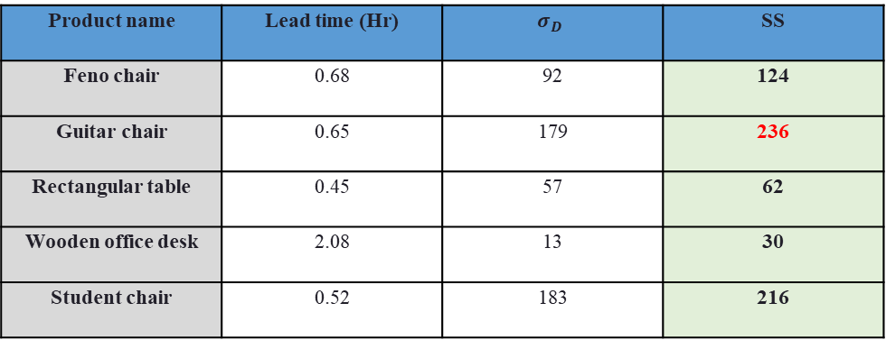
Safety Stock Calculation
Product name | Lead time (Hr) | $$σ_{D}$$ | SS
Feno chair | 0.68 | 92 | 124
Guitar chair | 0.65 | 179 | 236
Rectangular table | 0.45 | 57 | 62
Wooden office desk | 2.08 | 13 | 30
Student chair | 0.52 | 183 | 216

Slide 27
Reorder Point Calculation
Product name | Demand(avg) | Lead time | Safety stock | ROP
Feno chair | 125 | 0.68 | 124 | 209
Guitar chair | 113 | 0.65 | 236 | 309
Rectangular table | 74 | 0.45 | 62 | 95
Wooden office desk | 34 | 2.08 | 30 | 100
Student chair | 115 | 0.52 | 216 | 275

Slide 28
Total amount of raw materials required for the five products
Raw material name | Feno chair | Guitar chair | Rectangular table | Wooden office desk | Student chair
Circular metal rod – d= 32 mm | 4 |  | 4 |  | 2
Circular metal rod – d= 13 mm | 6 |  |  |  | 2
Wooden Boards – sandwich | 1 | 2 | 1 | 22 | 1
Sponge - t =3 cm | 1
Sponge - t =1 cm | 1 | 2
Leather | 1 | 2
Screw | 4 | 8 | 8 | 52 | 12
Plastic base | 4 | 4 | 4 | 4 | 4
Rectangular metal rod – 25 mm |  | 5 | 4 |  | 4
Sponge – t = 7 cm |  | 2
Corner metal brackets |  | 4 | 4
Corner braces |  |  |  | 12
Metal drawer slide |  |  |  | 6
Metal drawer handle |  |  |  | 3
Drawer key |  |  |  | 1
Plastic backrest and seat |  |  |  |  | 2

Slide 29
Raw Material Safety Stock levels
Raw material name | Feno chair | Guitar chair | Rectangular table | Wooden office desk | Student chair | Total SS
Circular metal rod – d= 32 mm | 4(124) |  | 4(62) |  | 2(216) | 1052
Circular metal rod – d= 13 mm | 6(124) |  |  |  | 2(216) | 1176
Wooden Boards – sandwich | 1(124) | 2(236) | 1(62) | 22(30) | 1(216) | 1534
Sponge - t =3 cm | 1(124) |  |  |  |  | 124
Sponge - t =1 cm | 1(124) | 2(236) |  |  |  | 596
Leather | 1(124) | 2(236) |  |  |  | 596
Screw | 4(124) | 8(236) | 8(62) | 52(30) | 12(216) | 7032
Plastic base | 4(124) | 4(236) | 4(62) | 4(30) | 4(216) | 2672
Rectangular metal rod – 25 mm |  | 5(236) | 4(62) |  | 4(216) | 2292
Sponge – t = 7 cm |  | 2(236) |  |  |  | 472
Corner metal brackets |  | 4(236) | 4(62) |  |  | 1192
Corner braces |  |  |  | 12(30) |  | 360
Metal drawer slide |  |  |  | 6(30) |  | 180
Metal drawer handle |  |  |  | 3(30) |  | 90
Drawer key |  |  |  | 1(30) |  | 30
Plastic backrest and seat |  |  |  |  | 2(216) | 432

Slide 30
Raw Materials ROP
Raw material name | Feno chair | Guitar chair | Rectangular table | Wooden office desk | Student chair | ROP
Circular metal rod – d= 32 mm | 4(209) |  | 4(95) |  | 2(275) | 1766
Circular metal rod – d= 13 mm | 6(209) |  |  |  | 2(275) | 1804
Wooden Boards – sandwich | 1(209) | 2(309) | 1(95) | 22(100) | 1(275) | 3397
Sponge - t =3 cm | 1(209) |  |  |  |  | 209
Sponge - t =1 cm | 1(209) | 2(309) |  |  |  | 827
Leather | 1(209) | 2(309) |  |  |  | 827
Screw | 4(209) | 8(309) | 8(95) | 52(100) | 12(275) | 11768
Plastic base | 4(209) | 4(309) | 4(95) | 4(100) | 4(275) | 3952
Rectangular metal rod – 25 mm |  | 5(309) | 4(95) |  | 4(275) | 3025
Sponge – t = 7 cm |  | 2(309) |  |  |  | 618
Corner metal brackets |  | 4(309) | 4(95) |  |  | 1616
Corner braces |  |  |  | 12(100) |  | 1200
Metal drawer slide |  |  |  | 6(100) |  | 600
Metal drawer handle |  |  |  | 3(100) |  | 300
Drawer key |  |  |  | 1(100) |  | 100
Plastic backrest and seat |  |  |  |  | 2(275) | 550

Slide 31
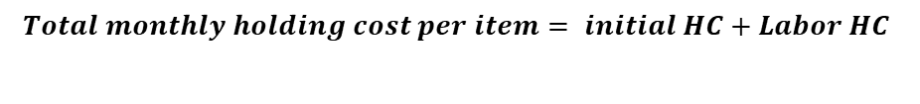
Holding cost
$$Total monthly holding cost per item= initial HC+Labor HC$$
Product name | Initial HC (NIS/item) | Labor HC (NIS/item) | Total HC (NIS/item)
Feno chair | 0.175 | 0.87 | 1.04
Guitar chair | 0.175 | 0.87 | 1.04
Rectangular table | 2.6 | 13 | 15.6
Wooden office desk | 1.9 | 9.4 | 11.3
Student chair | 0.97 | 4.8 | 5.77

Slide 32

SOPs Manual Development Steps
01
Organizational Structures Development
02
Job and Organizational Descriptions Development
03
Forms and Reports Development
04
SOPs Flow Charts Development
05
SOPs Manual Development

Slide 33

Organizational Structures
Administrative Organizational Structure
Functional Organizational Structure

Slide 34
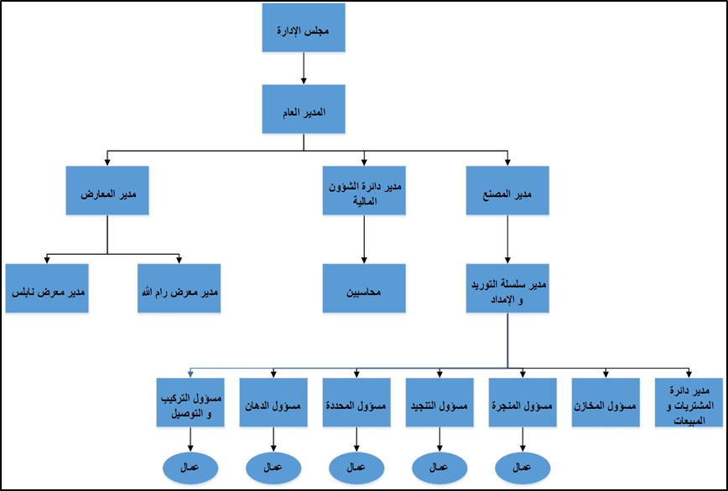
Current Administrative Organizational Structure

Slide 35
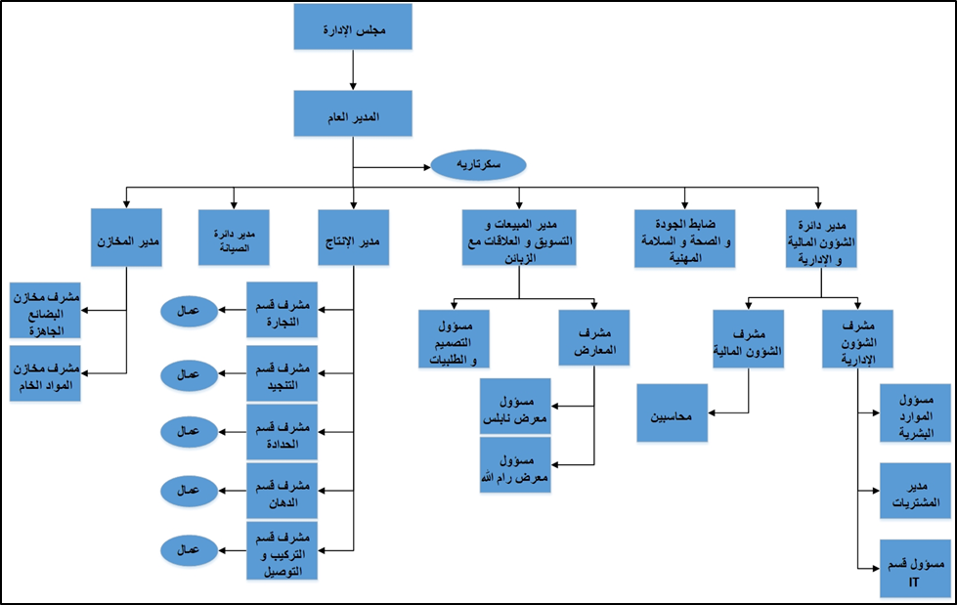
New Administrative Organizational Structure

Slide 36
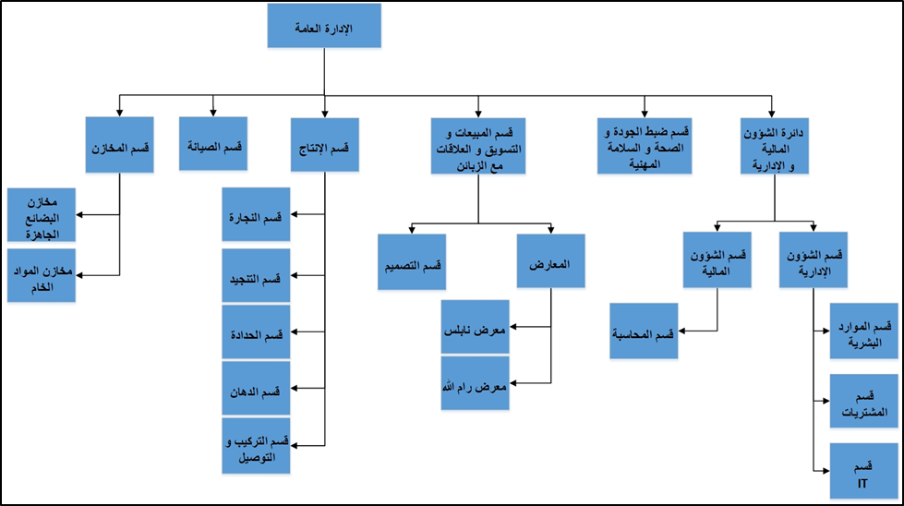
Functional Organizational Structure

Slide 37
Organizational Descriptions
Production Department
Sales, Marketing and Customer Relations Department
            Finance and Administration Affairs Department
            Warehouses Department
Maintenance Department
            Quality Control and Occupational Health and Safety Department

Slide 38
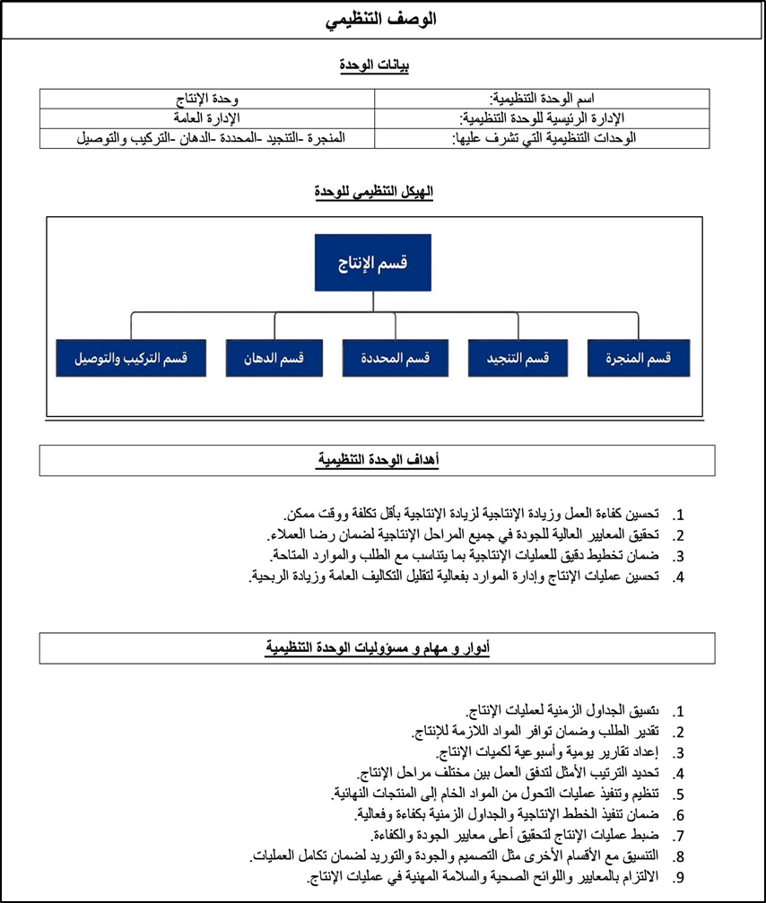
Organizational Description for Production Department

Slide 39
Job Descriptions

Slide 40
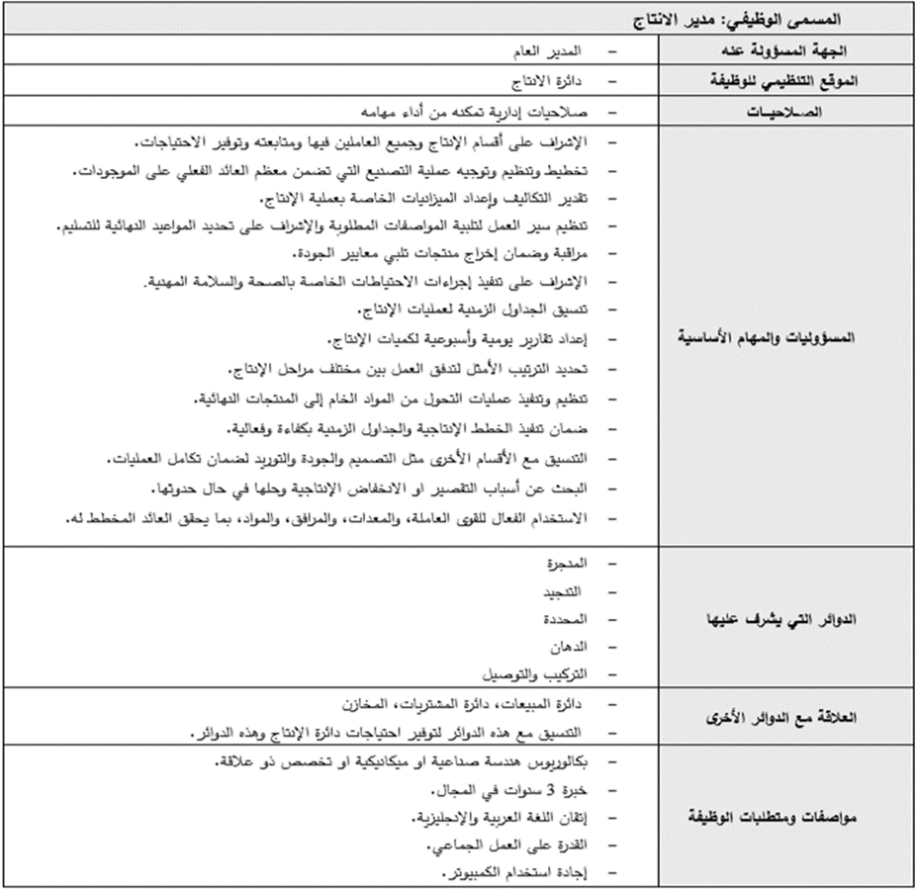
Job Description for Production Manager

Slide 41

SOPs Flow Charts Development

Slide 42
SOPs That Have been Developed:

Slide 43
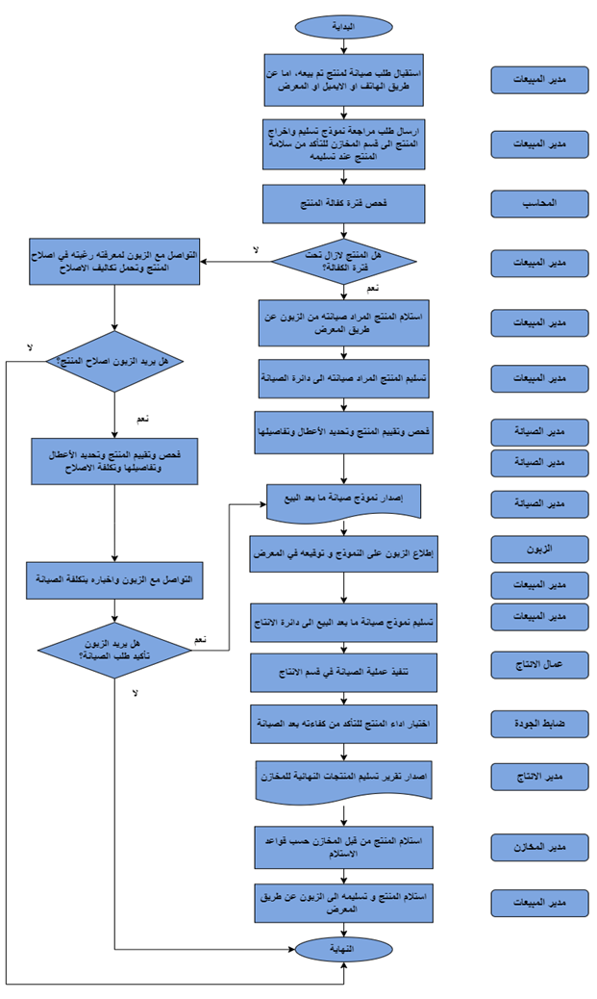
After-Sale Maintenance Standard Operating Procedure

Slide 44
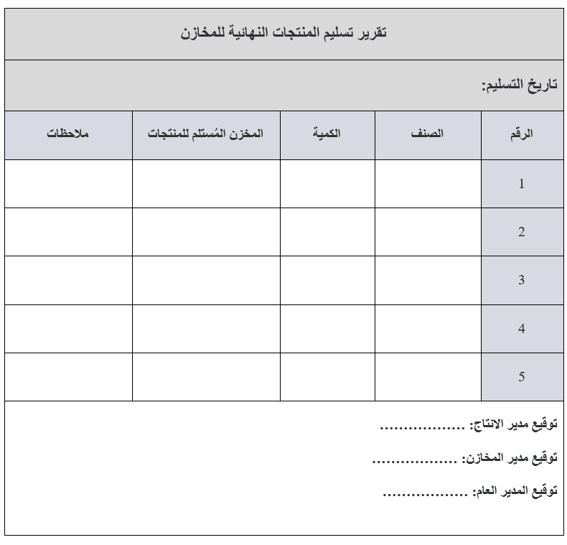
Final Products Delivery to Warehouses Report

Slide 45
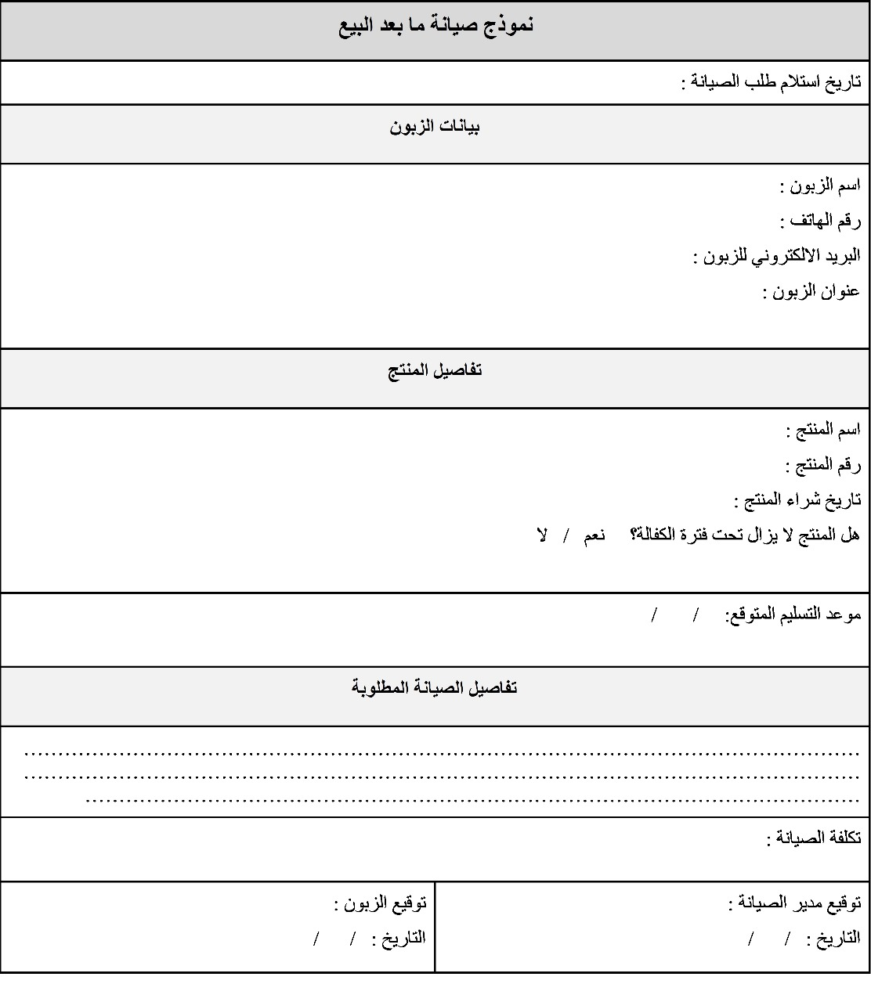
After-Sale Maintenance Form

Slide 46

Standard Operating Procedures (SOPs) Manual

Slide 47

Factory Layout Optimization

Slide 48
Factory Floors
Carpentry Department
Third Floor
Upholstery Department
Factory-Produced and Imported Products Inventory
Second Floor
Showroom Department
Smithing and Assembly Department
Imported Desks Inventory
Ground Floor

Slide 49
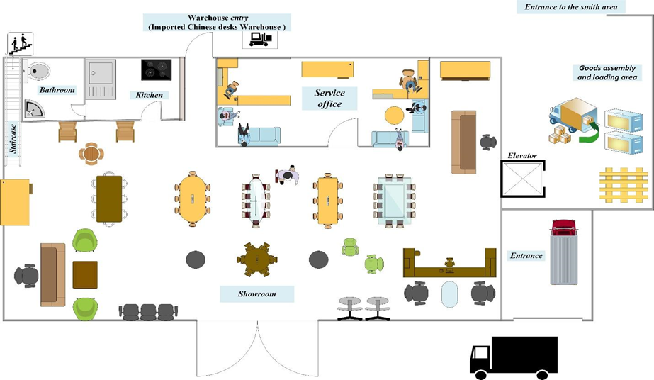
Layout Design of The First Floor
1
Showroom Department
2
Assembly and Loading Department
2
1

Slide 50
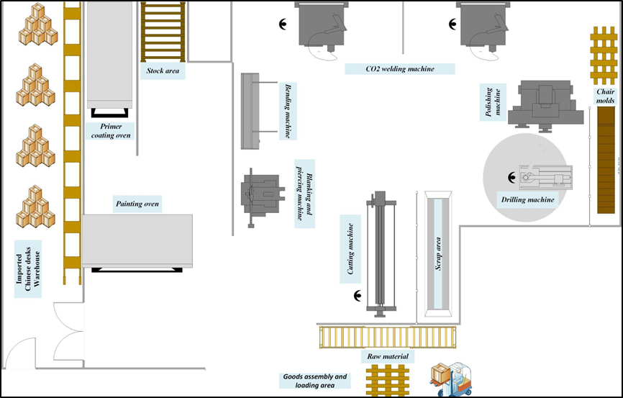

Layout Design of The First Floor
1
Smithing Department
2
Assembly Department
1
3
Imported Desks
Inventory
3
2

Slide 51
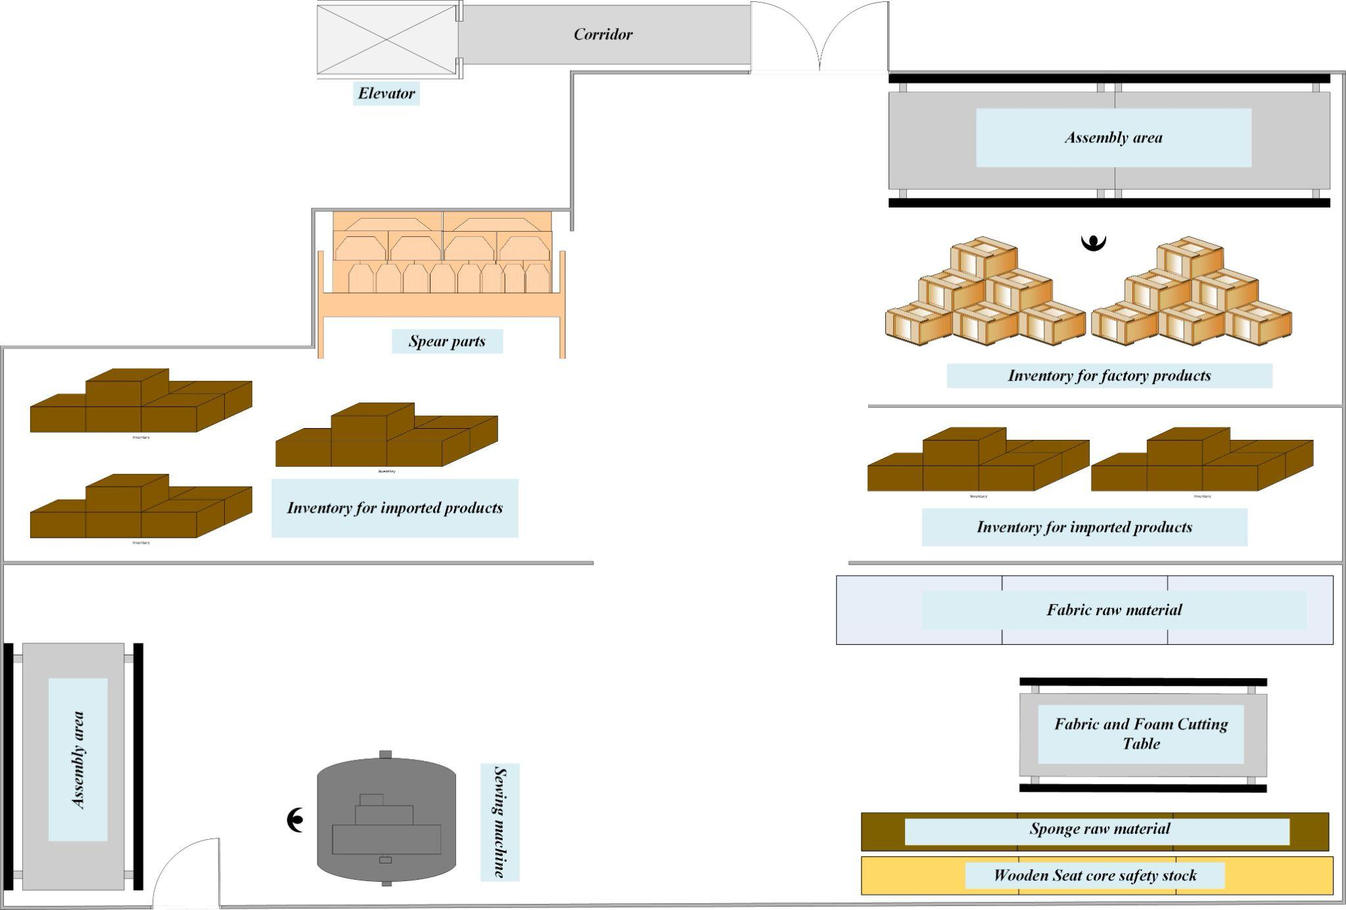
Layout Design of The Second Floor
1
Upholstery Department
5
2
Imported Products Inventory
3
4
3
Spare Parts Inventory
2
4
Factory-Produced Products Inventory
5
Assembly Area
1

Slide 52
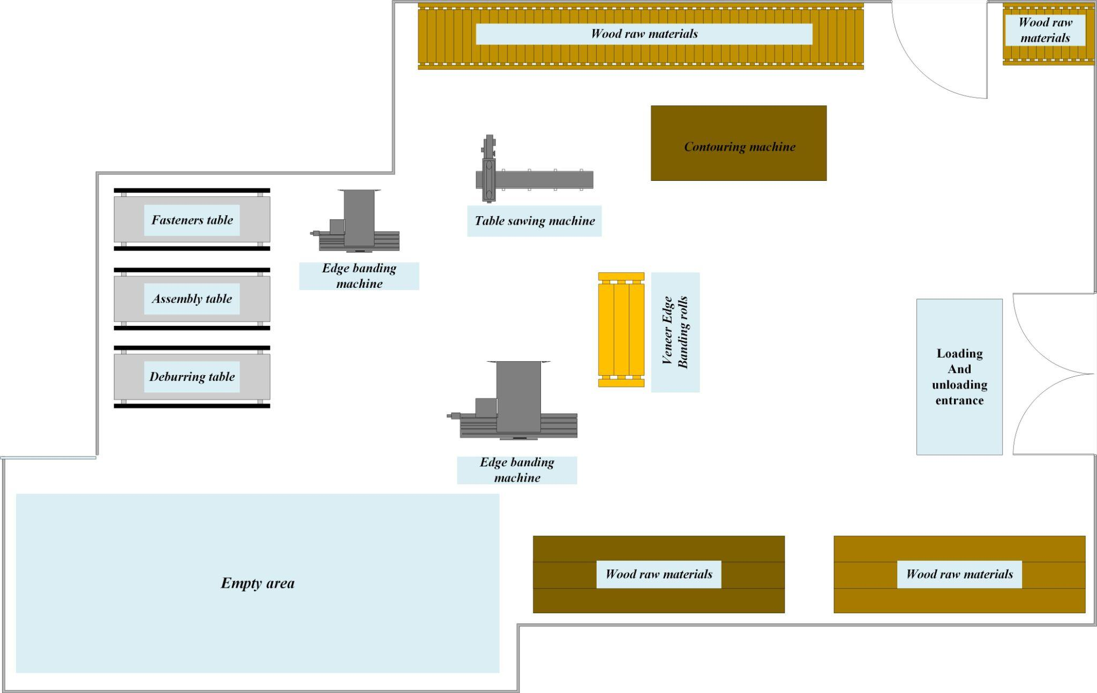
Layout Design of The Third Floor
Carpentry Department
1
Production and Assembly Area
2
Empty (unused) Area
1
2

Slide 53
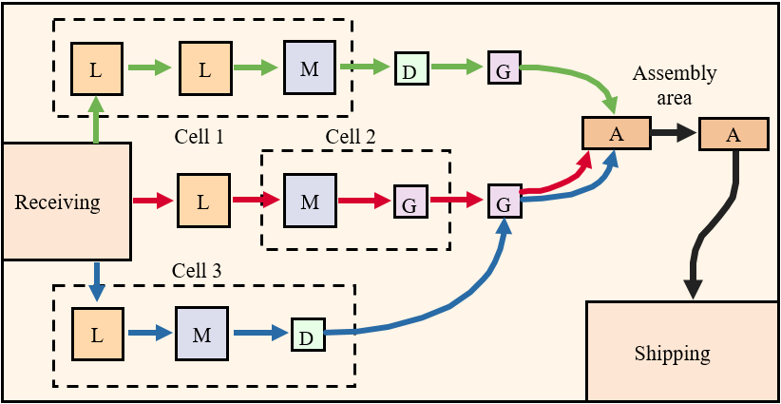
Factory Layout Type
cellular (or group family) layout

Slide 54
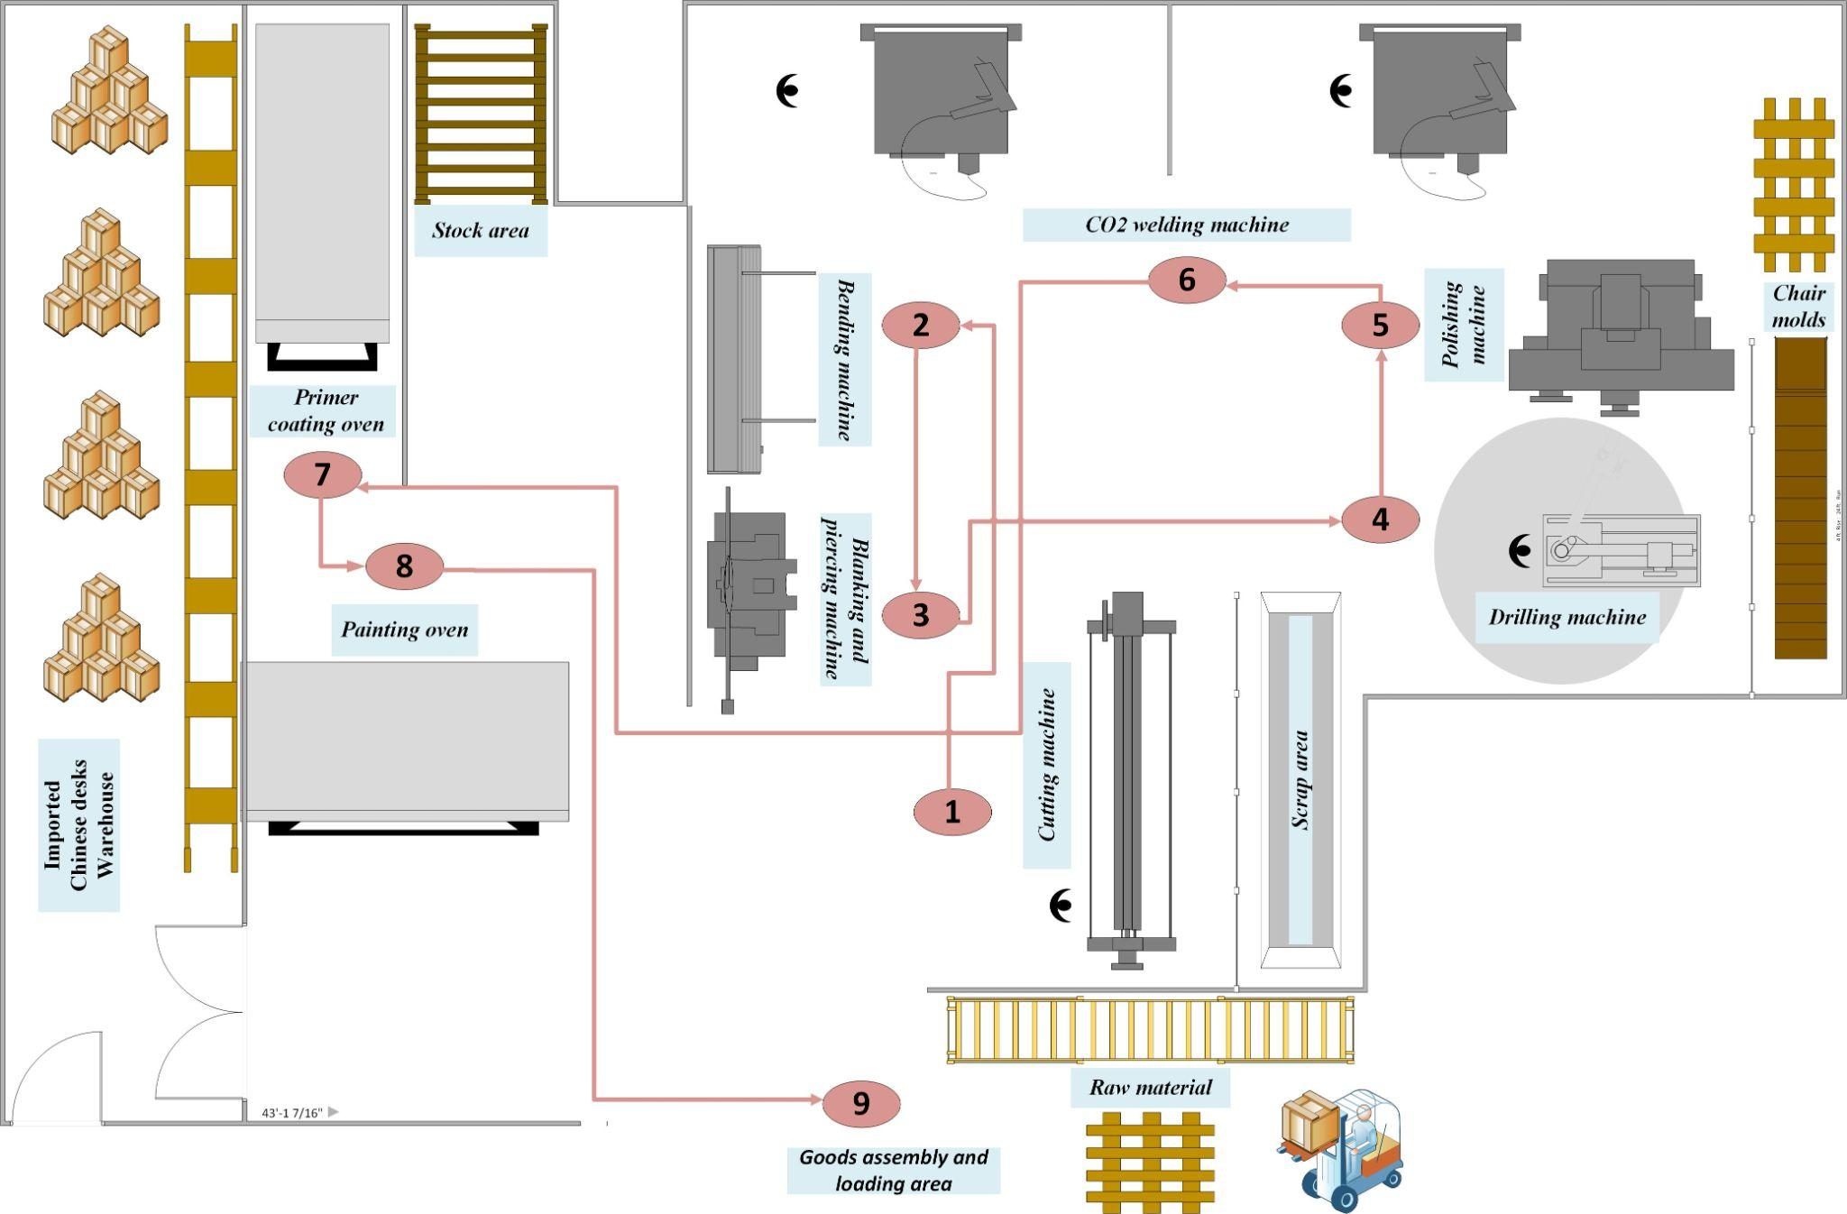
Spaghetti Diagram
Smithing Department

Slide 55
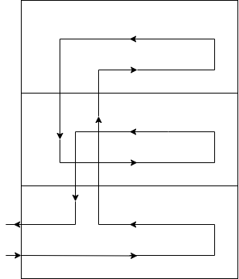
Vertical Flow Pattern
Third Floor
Second Floor
Ground Floor

Slide 56
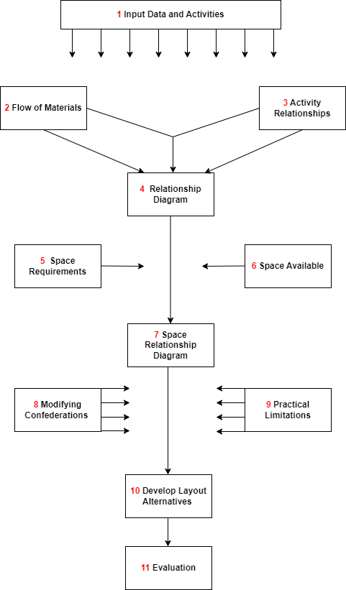
Systematic Layout Planning Procedure

Slide 57
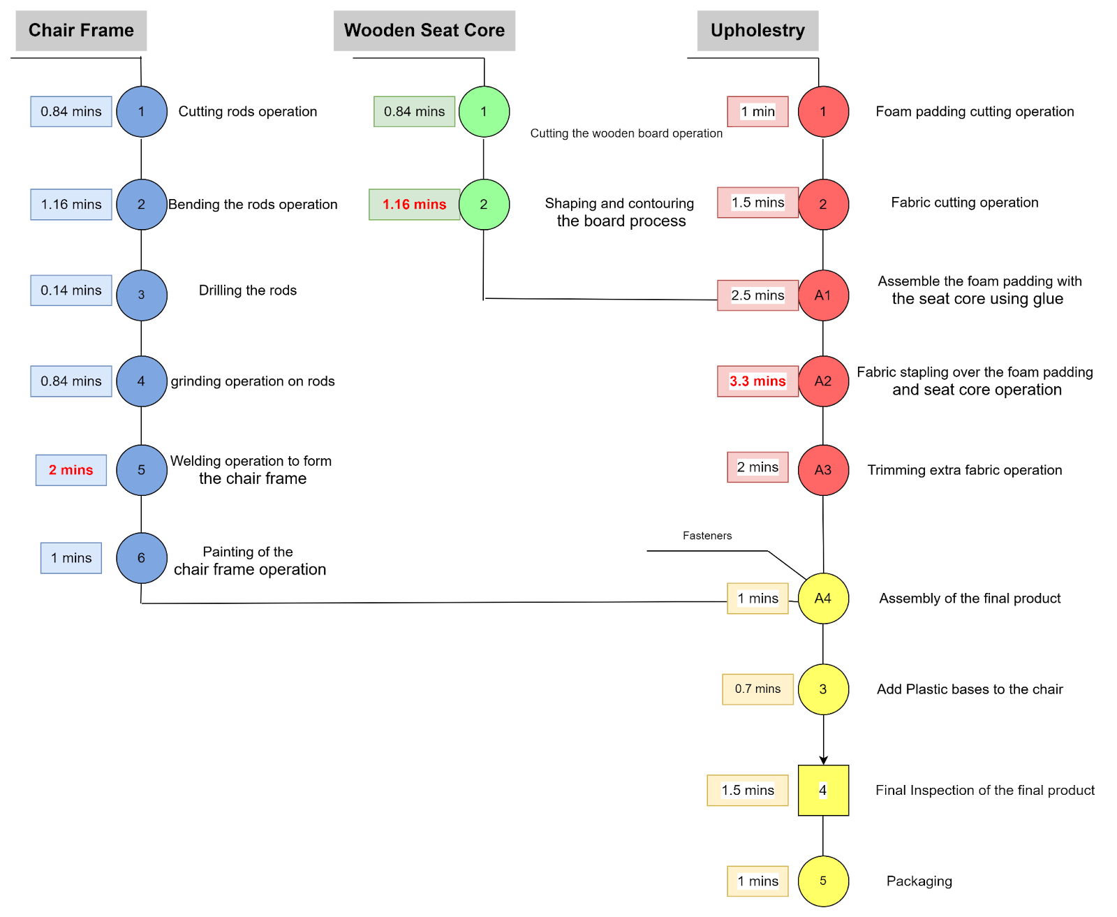
1. Input Data and Activities
Operation Process Chart

Slide 58
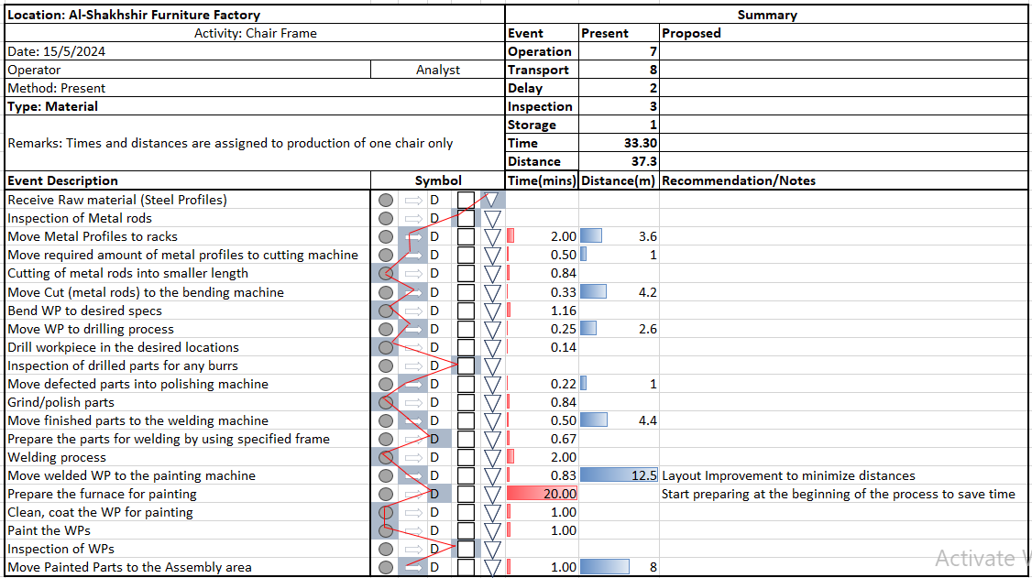
2. Flow of Material
Process Flow Chart

Slide 59
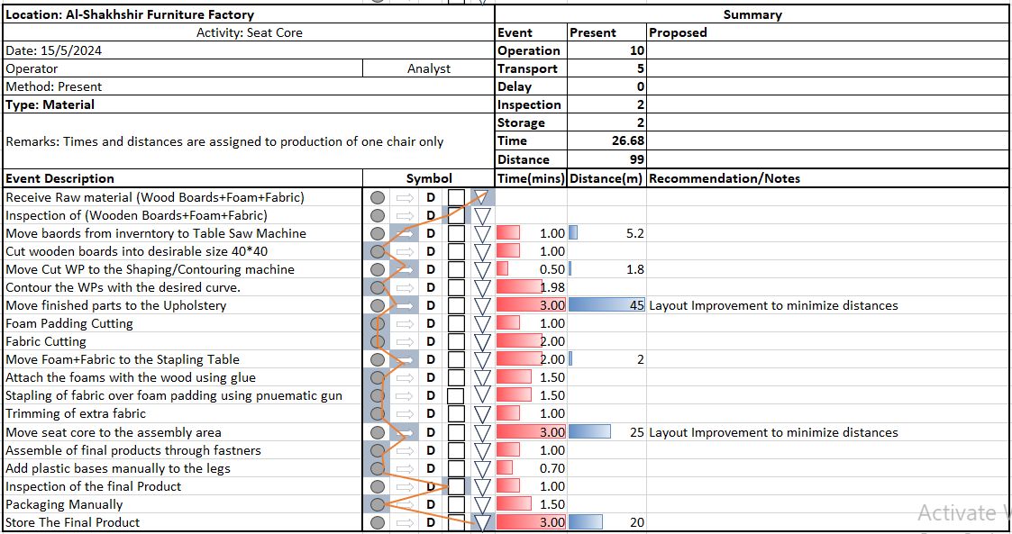

Slide 60
From-To Chart
Department | Department symbol
Smithing Department | A
Carpentry Department | B
Upholstery Department | C
Assembly Department | D
Chairs Inventory Department | E
Imported desks and tables inventory | F
Product | Component | Production Quantities (per day) | Movement Factor | Equivalent Flows (per day) | Routing
Guitar chair | 1 | 10 | 1 | 10 | A-B-C-D-E
Feno Chair | 2 | 15 | 1 | 15 | A-B-C-D-E
Rectangular Table | 3 | 6 | 2 | 12 | A-B-D-F

Slide 61
From-To Matrix
To From | A | B | C | D | E | F
A |  | 1 - 10 2 - 15 3 - 12 |  |  |  | 1 - 10 2 - 15
B |  |  | 1 - 10 2 - 15 | 3-12
C |  |  |  | 1 - 10 2 - 15
D |  |  |  |  | 1 - 10 2 - 15 | 3-12
E
F

Slide 62
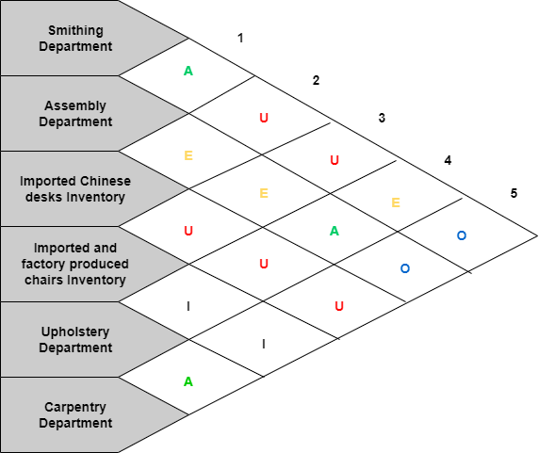
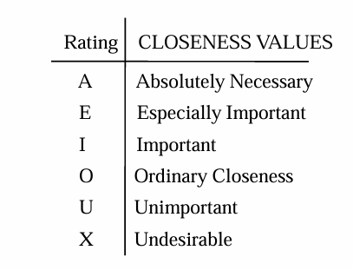
3. Activity Relationships
Relationship Chart

Slide 63
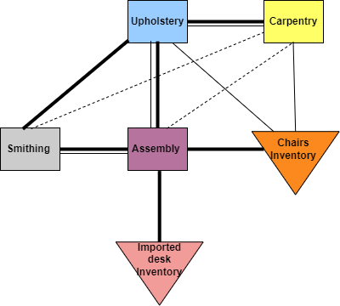
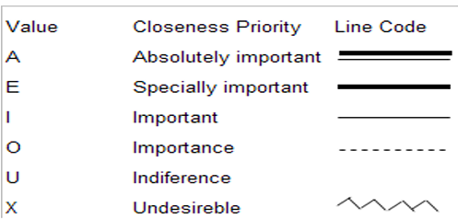
4. Relationship Diagram

Slide 64
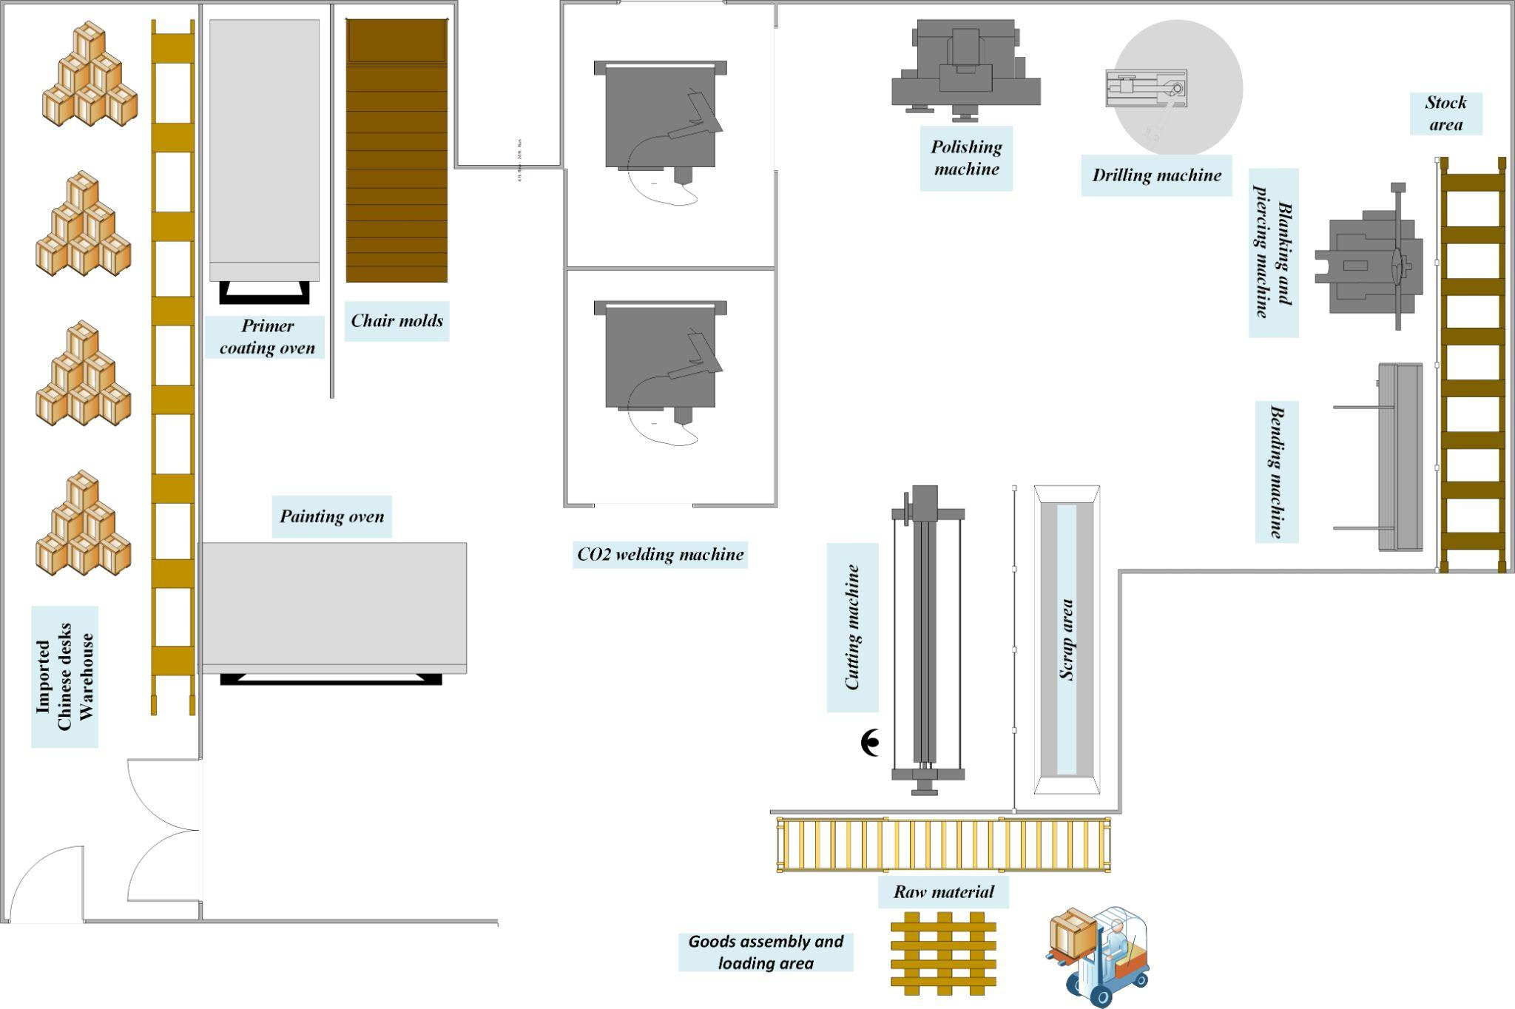
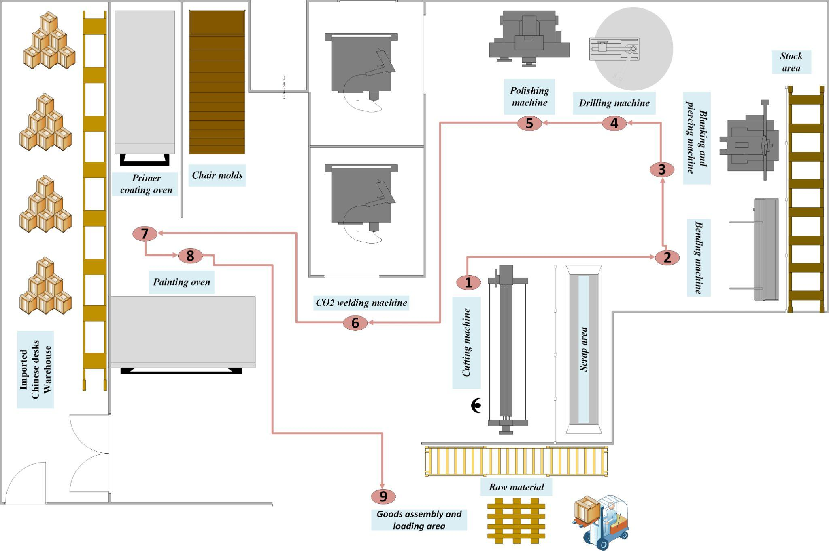
5. New Factory Layout
Ground Floor - Smithing Department
Detailed Layout
Spaghetti Diagram

Slide 65
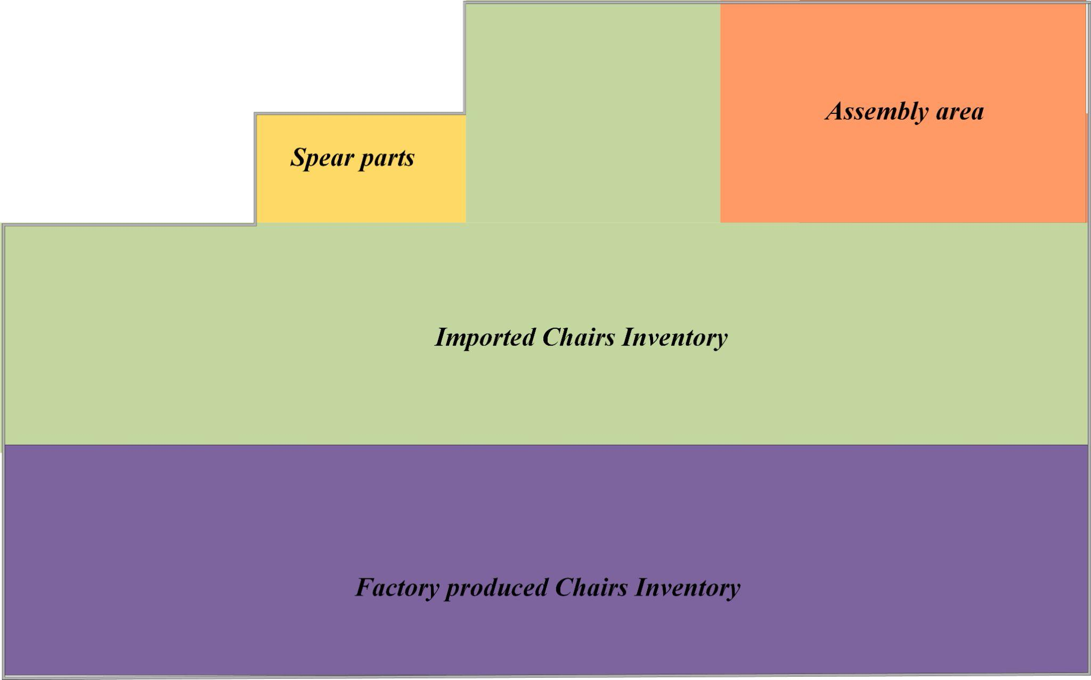
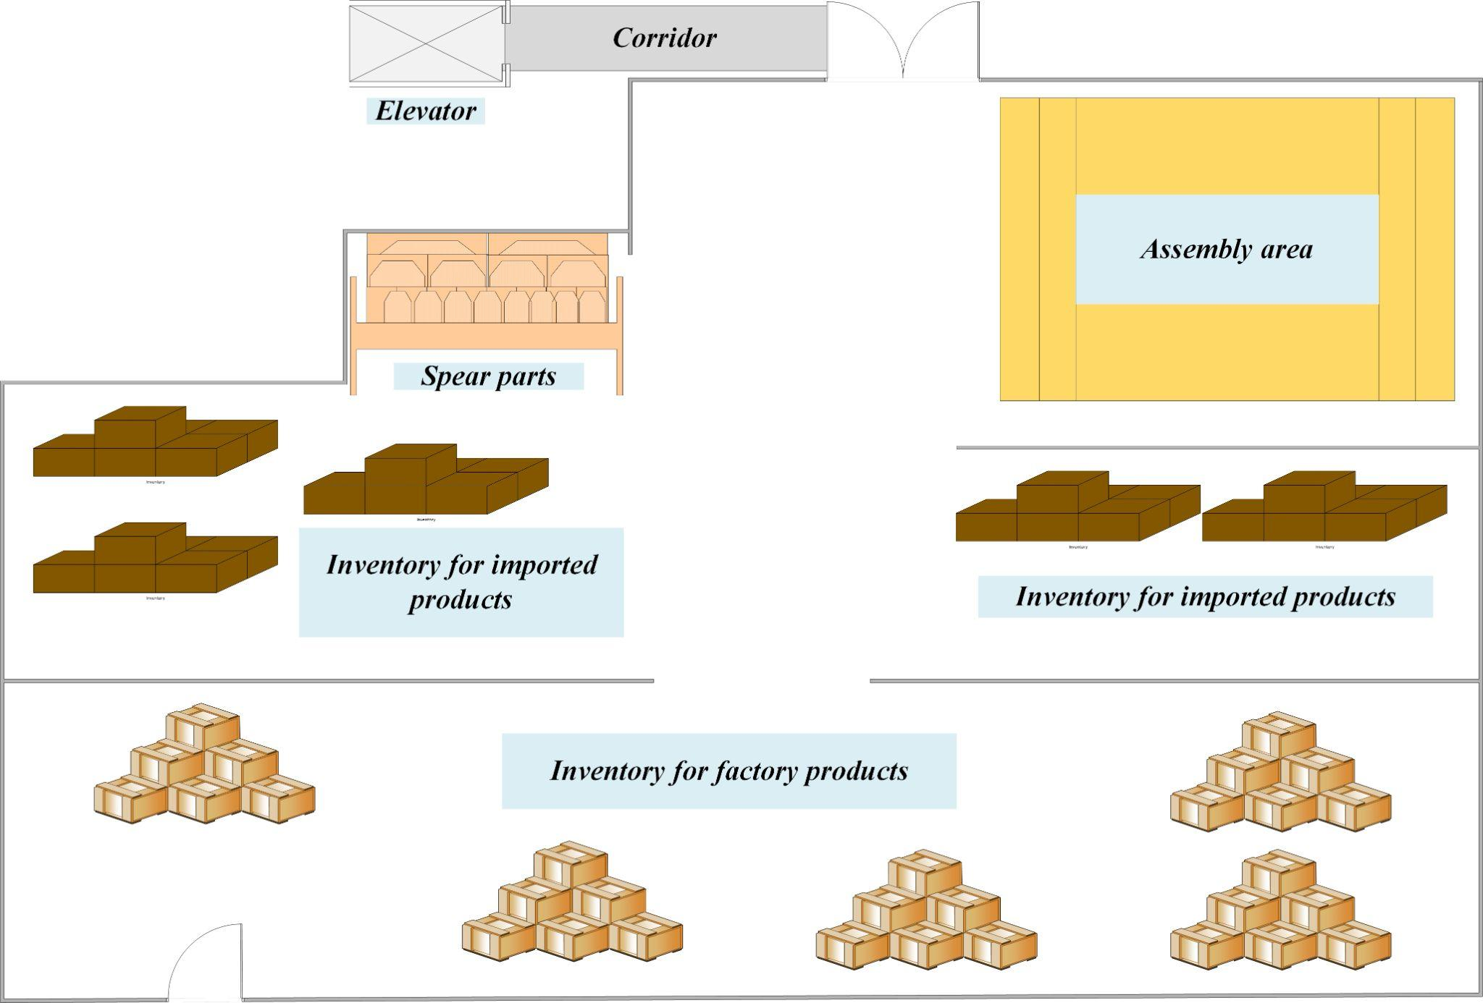
New Factory Layout
Second Floor - Inventory Department
Block Layout
Detailed Layout

Slide 66
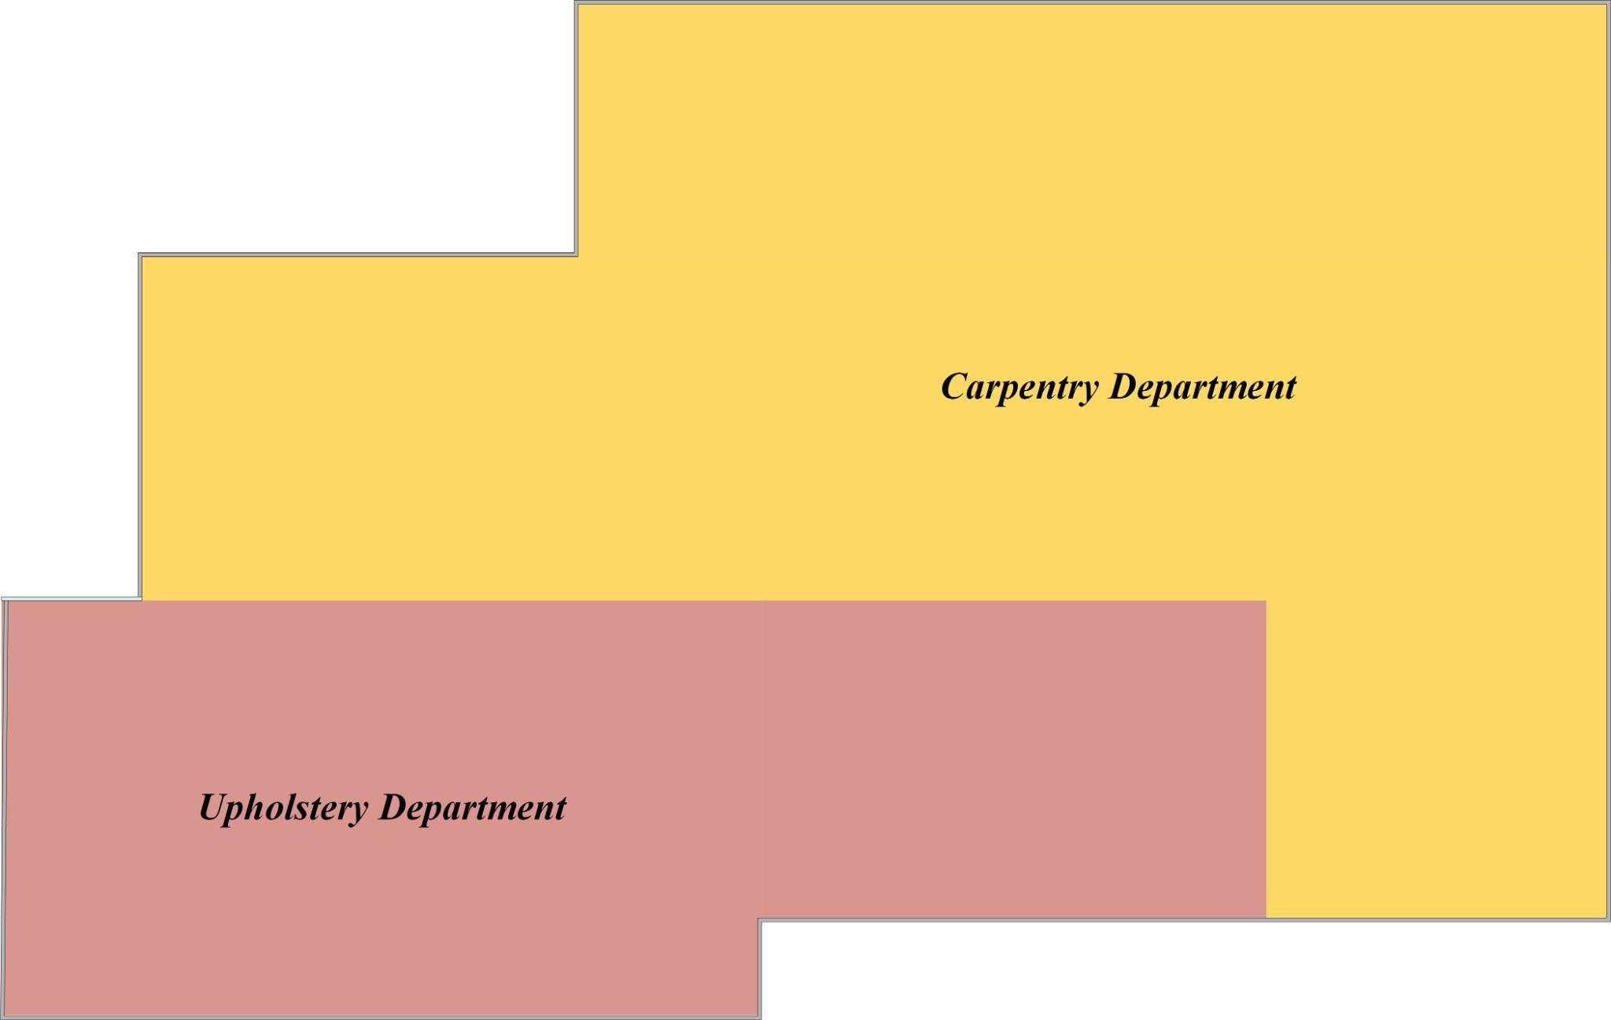
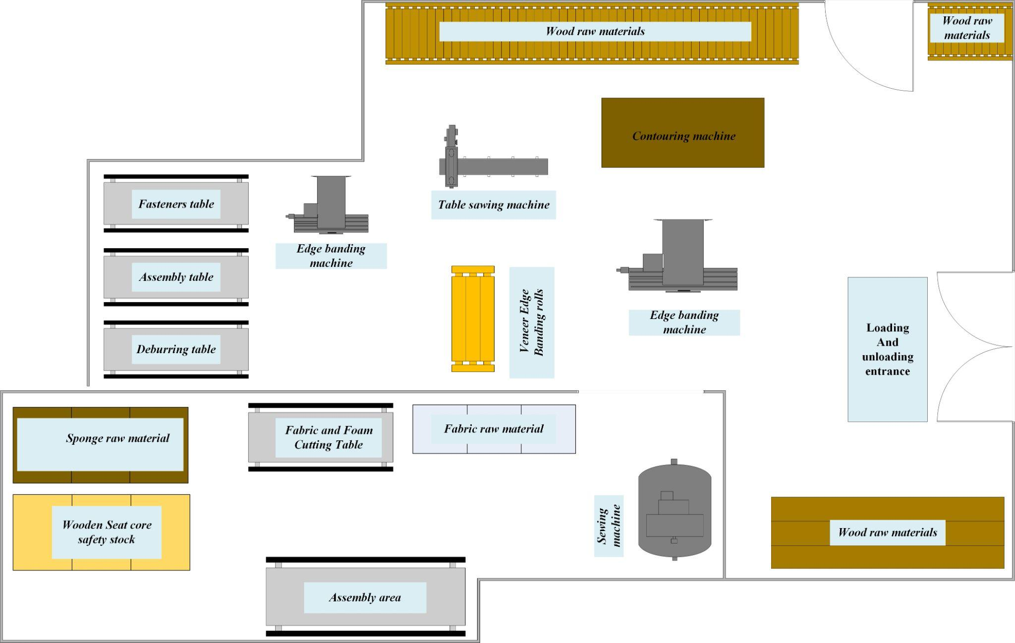
New Factory Layout
Third Floor - Carpentry and Upholstery Department
Block Layout
Detailed Layout

Slide 67



07 Conclusion
Production Planning
System
Optimaized Factory Layout
SOPs
Manual
Inventory
Management
System

Slide 68
07 Recommendations
1
Implement the newly developed layout
2
Improve the organization of warehouse spaces
3
Adopt the designed work procedures and the enhanced organizational structure
4
Implement the inventory management calculations developed in the project
5
Apply the production planning system developed in the project
6
Develop both preventive and corrective maintenance systems

Slide 69



THANKS!
Masa Qadi
Fadi Al-Asaad
Ruba Barmawi

