Slide 1

An-Najah National University
Faculty Of Engineering
Civil Engineering Department
Graduation Project II
Analysis and Redesign of Water Distribution Network and Design of Wastewater Network for Zaita Village
Prepared By :
Ahmad Shtaiwi
Ahmad Zaid
Ali Al-Khateeb
Date :30/12/2020
Supervision of Eng. Hamees Tubeileh

Slide 2
Outline:
Objective of the project.
Study area.
Questionnaire analysis.
Analyzing the water distribution network.
Redesign of water distribution network.
Design of wastewater collection network.
Summary.

Slide 3
Objective
Analyze the existing water network.
Redesign the water network in the town.
Design of wastewater collection network.

Slide 4
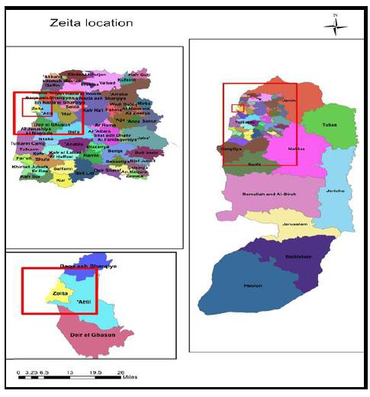
Study area

Slide 5
Study area
Location :
Zaita town is located 14 kilometers to the north of Tulkarm.
Climate :
The annual average maximum temperature is 27Cº and the annual average minimum is 16Cº

Slide 6
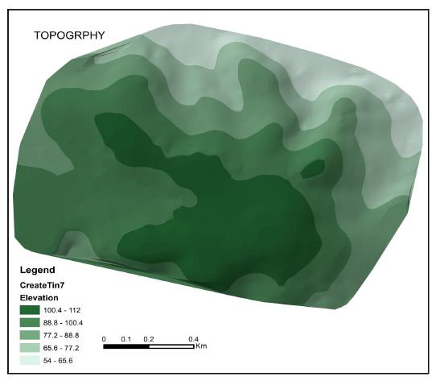
Topography

Slide 7
Study area
Population :
The total population of the town was 3500 capita in 2017.
Water resources :
Zaita town have three wells and it sells water to the near villages .

Slide 8
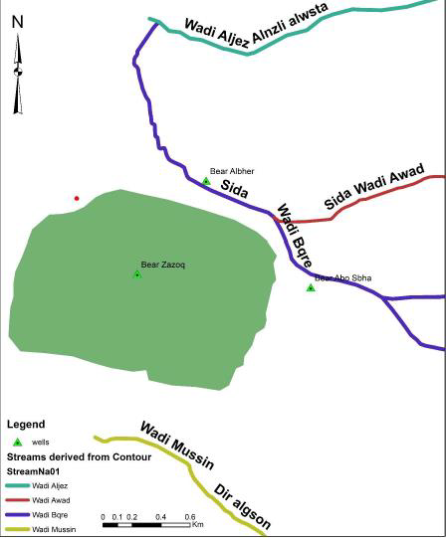
Study area

Slide 9
Questionnaire analysis

Slide 10
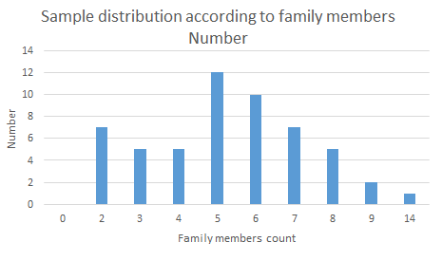
Questionnaire analysis

Slide 11
Questionnaire analysis

Slide 12
Questionnaire analysis

Slide 13
Questionnaire analysis

Slide 14
Questionnaire analysis

Slide 15
Questionnaire analysis

Slide 16
Questionnaire analysis

Slide 17
Questionnaire analysis

Slide 18
Questionnaire analysis

Slide 19
Analyzing the Network

Slide 20
Modeling of WDN
Year | Population
1997 | 2852
2007 | 3231
2017 | 3500

Slide 21

Modeling of WDN
The present population is about 3570 so the growth rate according to the following equation is about 0.9905%
$P=P0{\left(1+G\right)}^{n}$
$P2019=3500{\left(1+0.9905/100\right)}^{2}=3570$
Year | Population
2012 | 3394
2013 | 3428
2014 | 3462

Slide 22
Modeling of WDN
Year | Flow Rate(M3/Year)
2012 | 155083
2013 | 186913
2014 | 196949

Slide 23
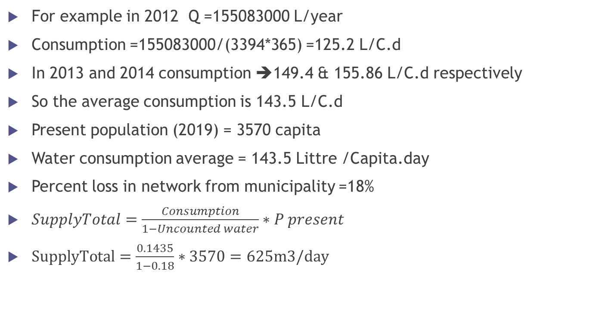
Modeling of WDN
For example in 2012 Q =155083000 L/year
Consumption =155083000/(3394*365) =125.2 L/C.d
In 2013 and 2014 consumption ➔149.4 & 155.86 L/C.d respectively
So the average consumption is 143.5 L/C.d
Present population (2019) = 3570 capita
Water consumption average = 143.5 Littre /Capita.day
Percent loss in network from municipality =18%
$SupplyTotal=\frac{Consumption}{1−Uncounted water}∗P present$
$SupplyTotal=\frac{0.1435}{1−0.18}∗3570=625m3/day$

Slide 24
Modeling of WDN
From the municipality the agricultural use is about 427 m³/day .
The total use for the town is 1052 m³ /day.

Slide 25
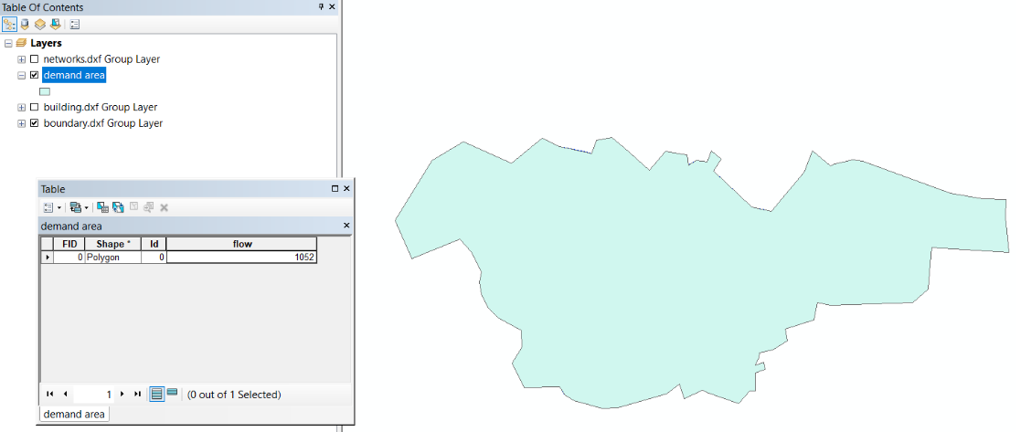
Modeling of WDN

Slide 26
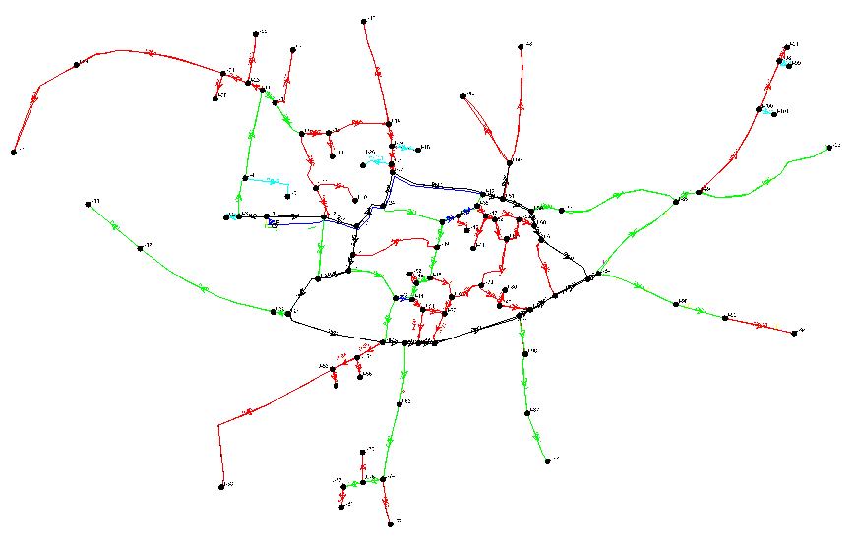
Drawing The Network Using WaterCAD

Slide 27
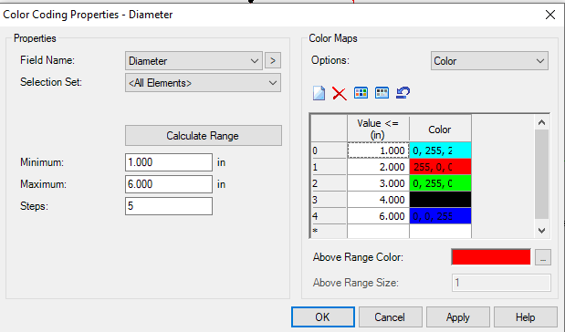
Drawing The Network Using WaterCAD

Slide 28
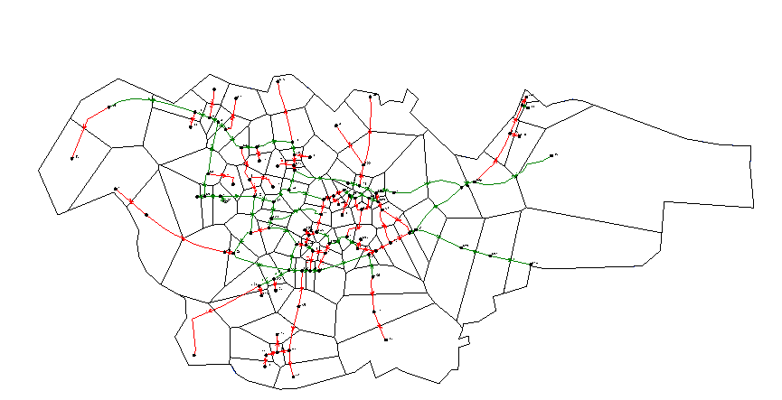
Modeling of WDN

Slide 29
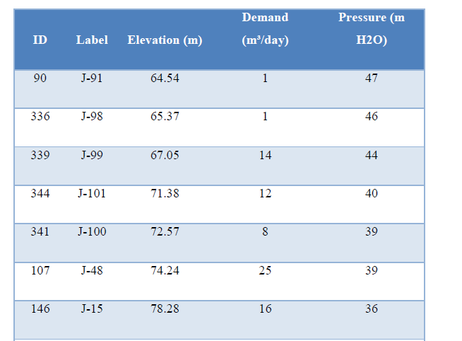
Demand on Nodes

Slide 30
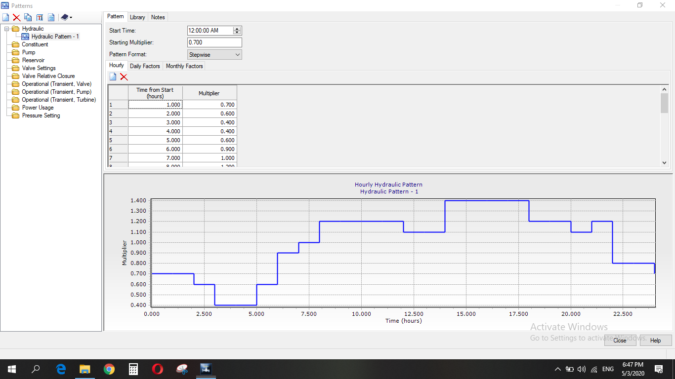
The Pattern Demand Values

Slide 31
Statistics Summary
Reservoirs | 1
Nodes | 102
Pipes | 117
Valves (FCV) | 0

Slide 32
WDN
Design constraints:
Pressure at junction between (20-100) m.H₂O.
Velocity in pipe (0.3-3.0) m/s.

Slide 33
Result of analysis of WDN
Pressure at minimum demand (4:00 am).

Slide 34
Pressure at maximum demand (2:00 pm).

Slide 35
Result of analysis of WDN
Velocities at minimum demand (4:00 am).

Slide 36
Velocities at maximum demand (2:00 pm).

Slide 37
Redesign of WDN

Slide 38
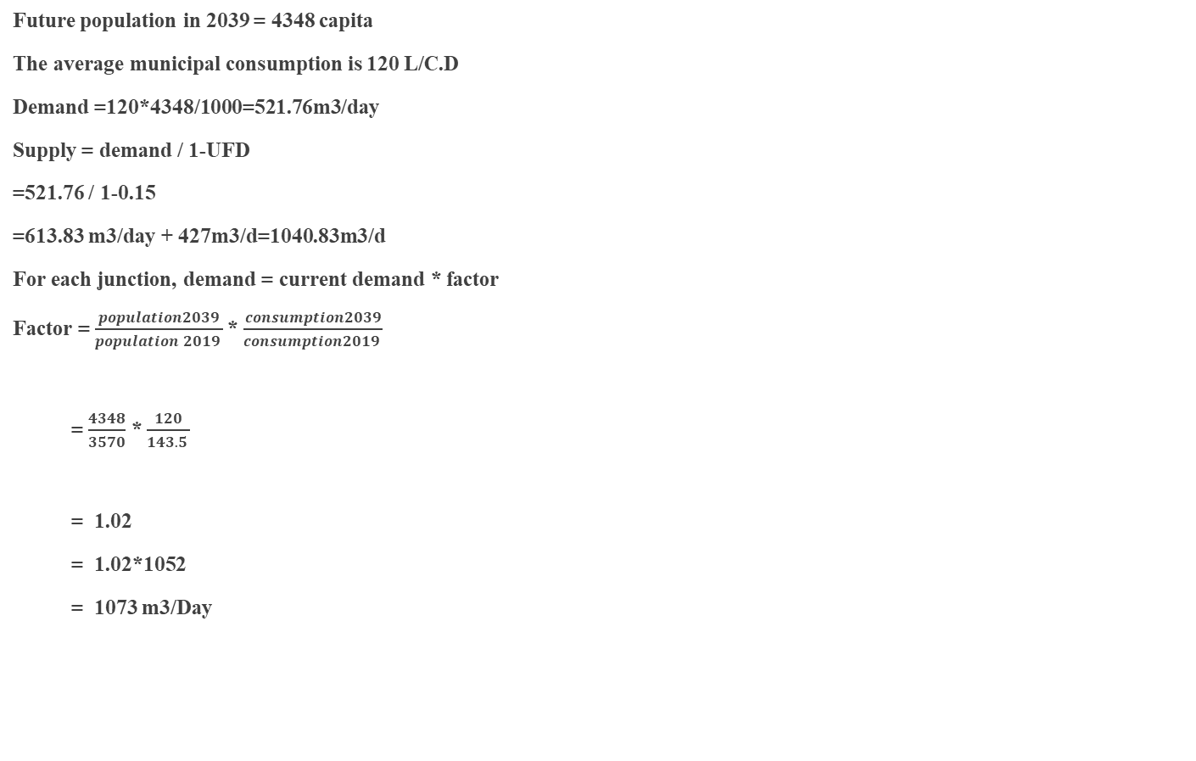
Data of future population
Future population in 2039 = 4348 capita
The average municipal consumption is 120 L/C.D
Demand =120*4348/1000=521.76m3/day
Supply = demand / 1-UFD
=521.76 / 1-0.15
=613.83 m3/day + 427m3/d=1040.83m3/d
For each junction, demand = current demand * factor
Factor = $\frac{population2039}{population 2019 }$* $\frac{consumption2039}{consumption2019 }$
= $\frac{4348}{3570}$ * $\frac{120}{143.5 }$
= 1.02
= 1.02*1052
= 1073 m3/Day

Slide 39
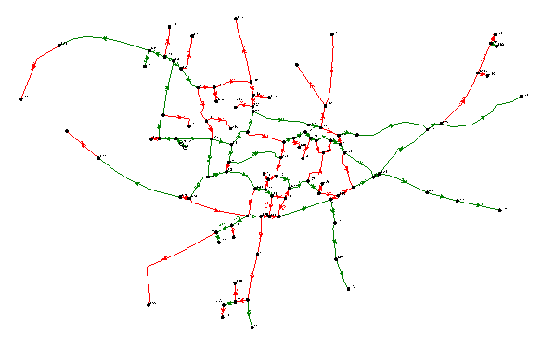
Model of WDN

Slide 40
Drawing The Network Using WaterCAD

Slide 41
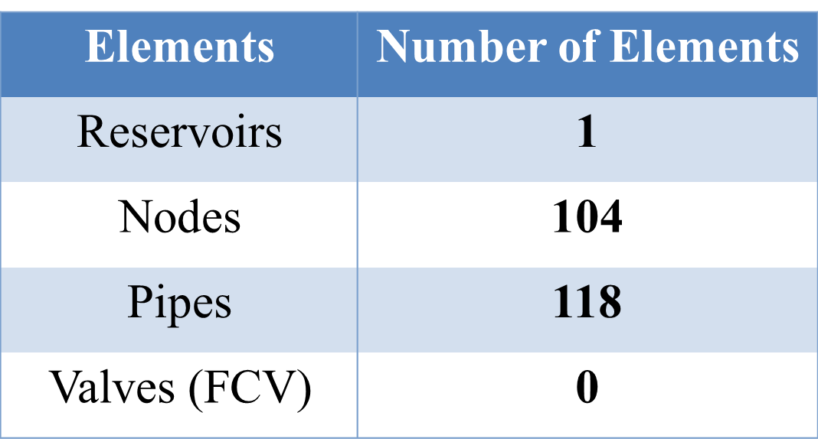
Run statistics summary

Slide 42
Design Criteria
Pressure criteria from 20 to 100 mH2O.
Velocity criteria from 0.3 to 3 m/sec.

Slide 43
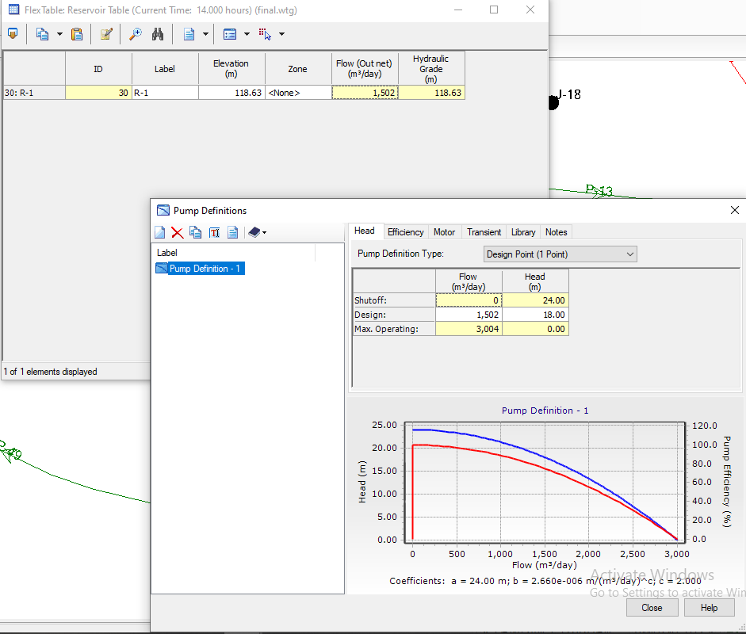
The pump definition carve

Slide 44
Results of WDN for Design
pressure at 2:00PM. (high Demand)

Slide 45
Results of WDN for Design
pressure at 4:00AM. (low Demand)

Slide 46
Results of WDN for Design
velocity at 2:00PM (Maximum demand)

Slide 47
Results of WDN for Design
velocity at 4:00AM (Minimum demand)

Slide 48
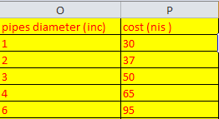
Cost estimation
An example :
Pipe 3 length = 27 m
Pipe 3 diameter = 4 inch
The cost of pipe = 27 *65= 1755 NIS
Pump cost depend on pump flow and pump head our pump costs about 25000 NIS
Sum= 25000 +total pipes cost
= 25000 + 371791
= 396791 NIS
=113369$

Slide 49
Design of Wastewater Network

Slide 50
WWCN
Conduites
Manholes
Outfalls
Length <=30
Diameter>=8in
Material (PVC)
n
Diameter
Drop Manhole
Material
Loads
Elevation
Location
Elevation
Slope

Slide 51
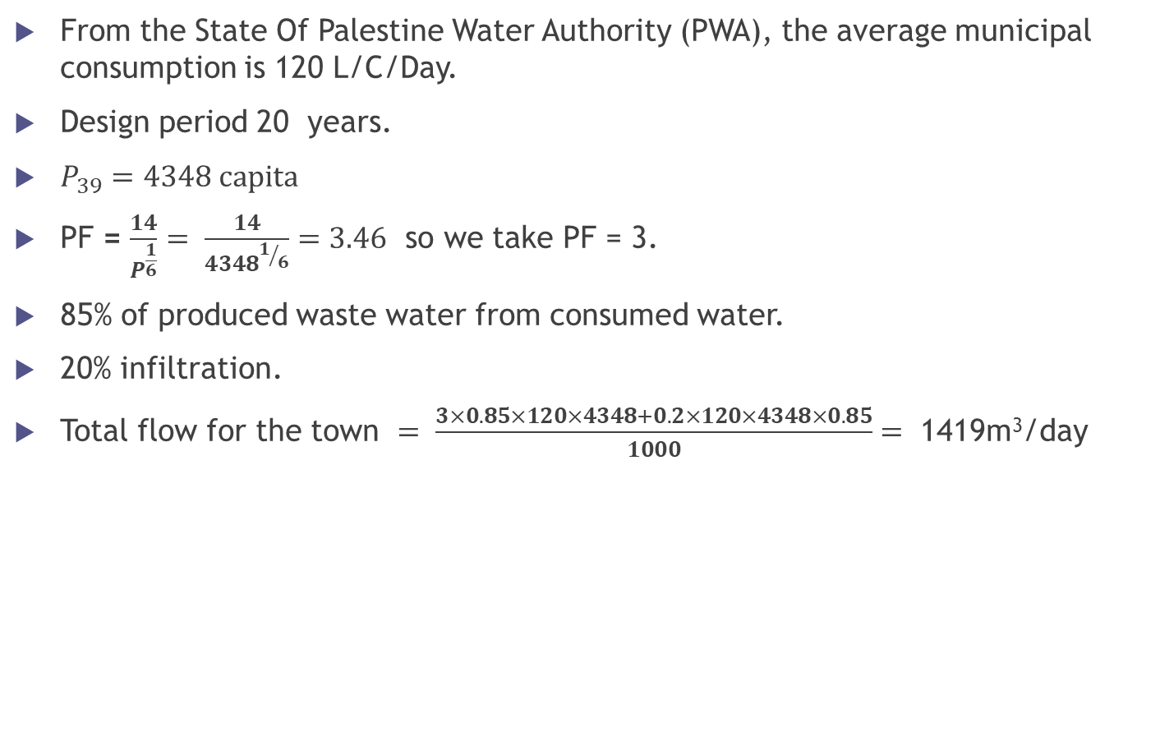
Wastewater Generation
From the State Of Palestine Water Authority (PWA), the average municipal consumption is 120 L/C/Day.
Design period 20 years.
$P_{39}=4348 capita$
PF = $\frac{14}{P^{\frac{1}{6}}}= \frac{14}{{4348}^{1/6}}=3.46$ so we take PF = 3.
85% of produced waste water from consumed water.
20% infiltration.
Total flow for the town $= \frac{3×0.85×120×4348+0.2×120×4348×0.85}{1000}=$ 1419m³/day

Slide 52
Design Criteria
The velocity : (0.6 – 3 m/sec)
The cover : (1-5m)
The slope : (1-12%)
The distance between manholes are less than 30 m.

Slide 53
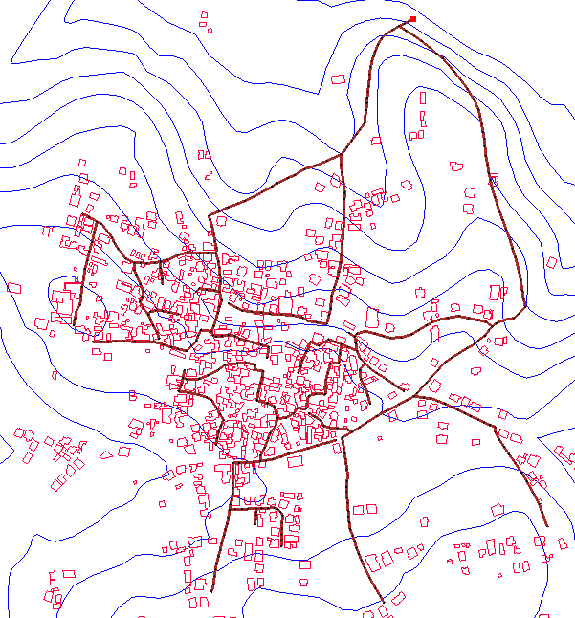
Model of the wastewater network

Slide 54
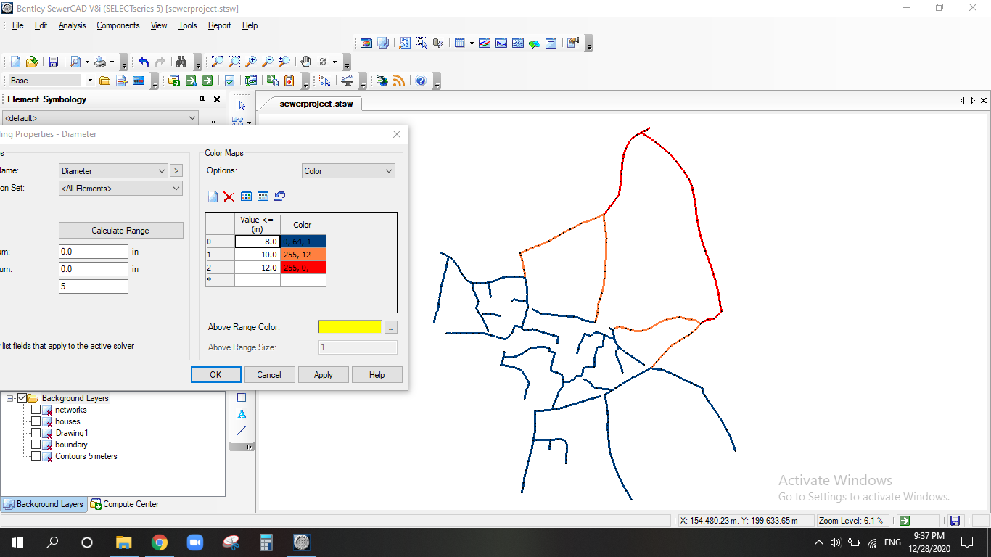
Model of the wastewater network

Slide 55
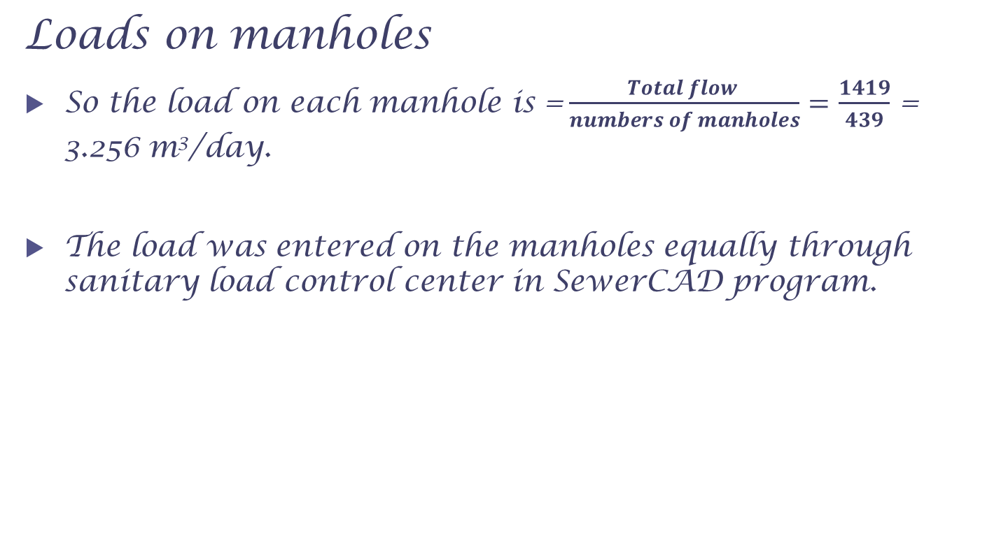
Loads on manholes
So the load on each manhole is =$\frac{Total flow }{numbers of manholes}=$ $\frac{1419}{439}$ = 3.256 m³/day.
The load was entered on the manholes equally through sanitary load control center in SewerCAD program.

Slide 56
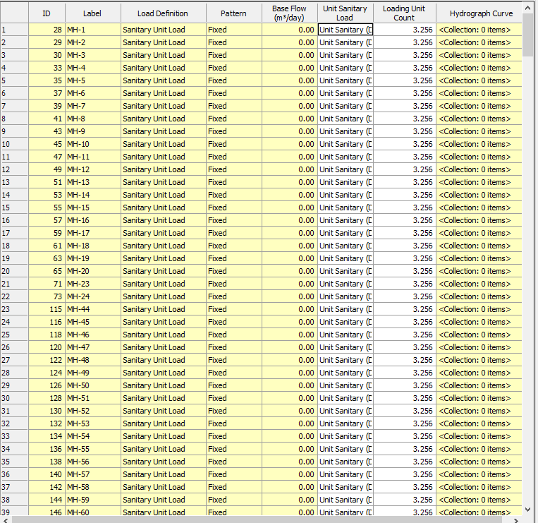

Slide 57
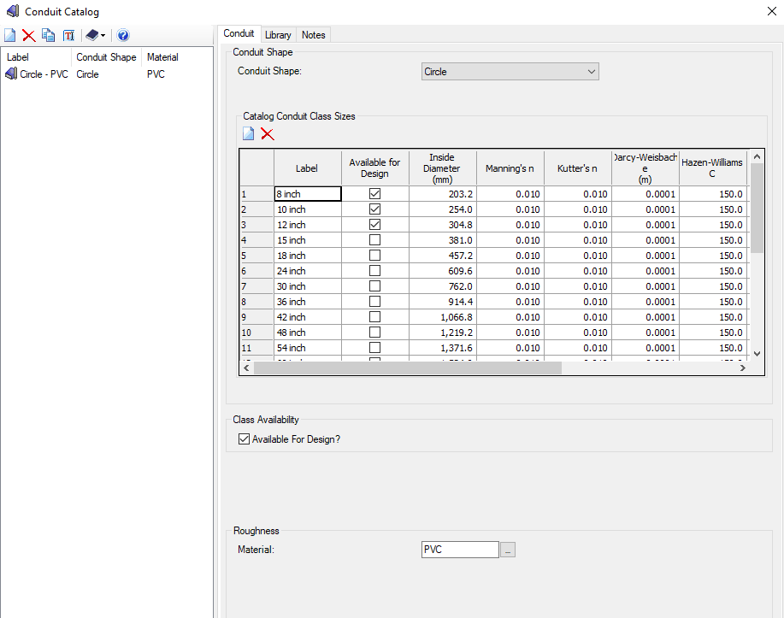
Conduit Catalog

Slide 58
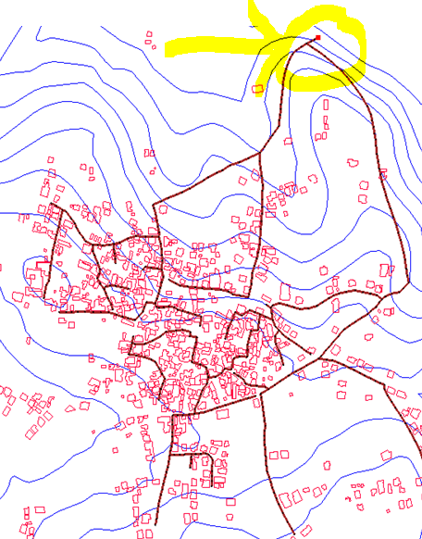
Outfall
After we located the network we put our outfall in the lowest point in the network due to topography and elevation variation.(invert elevation = 64.5m, ground elevation = 65m)

Slide 59
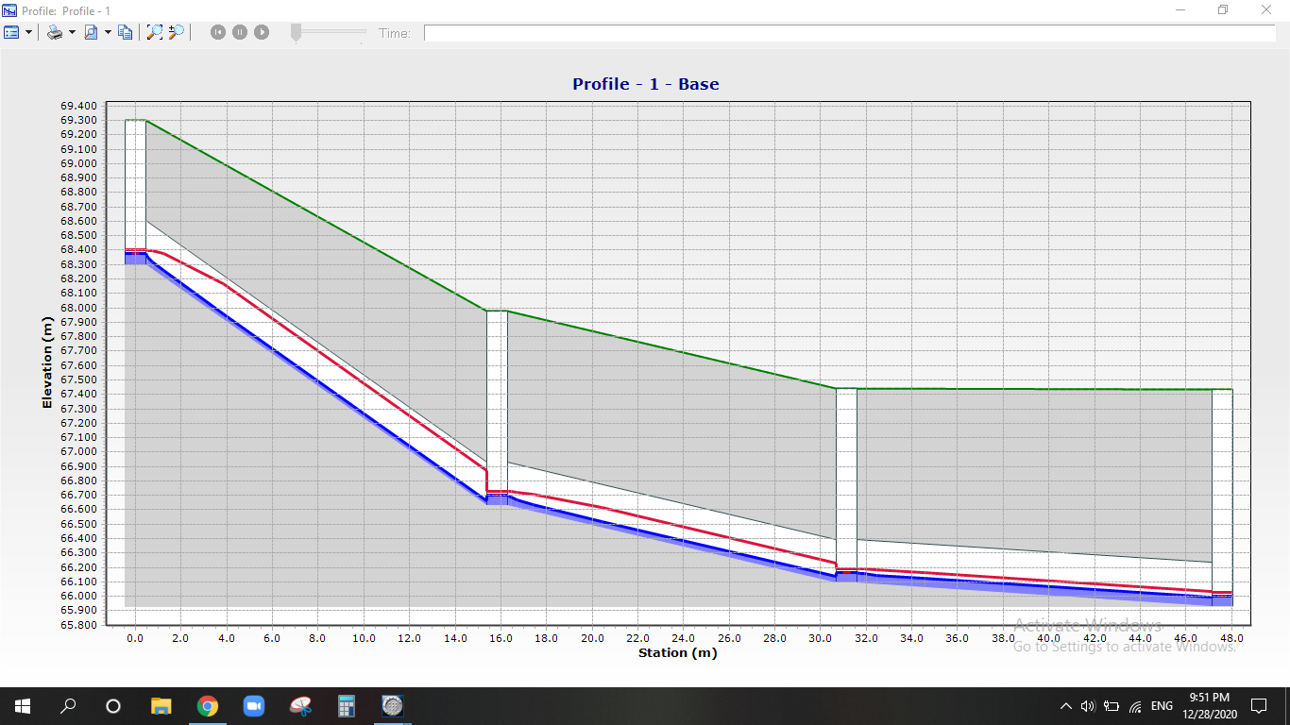
Profile

Slide 60
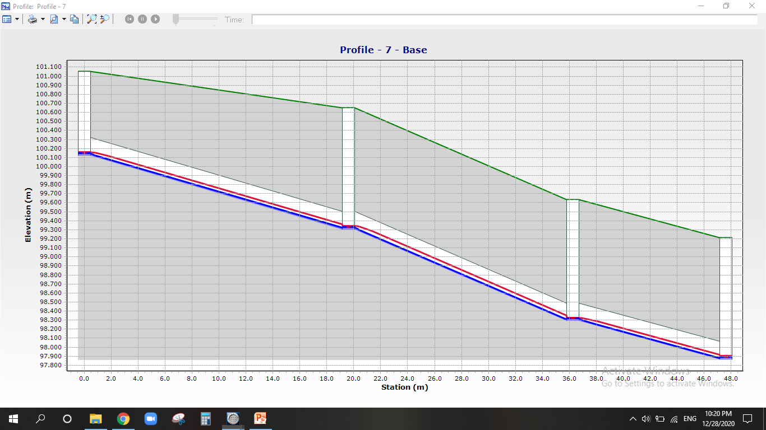
Profile

Slide 61
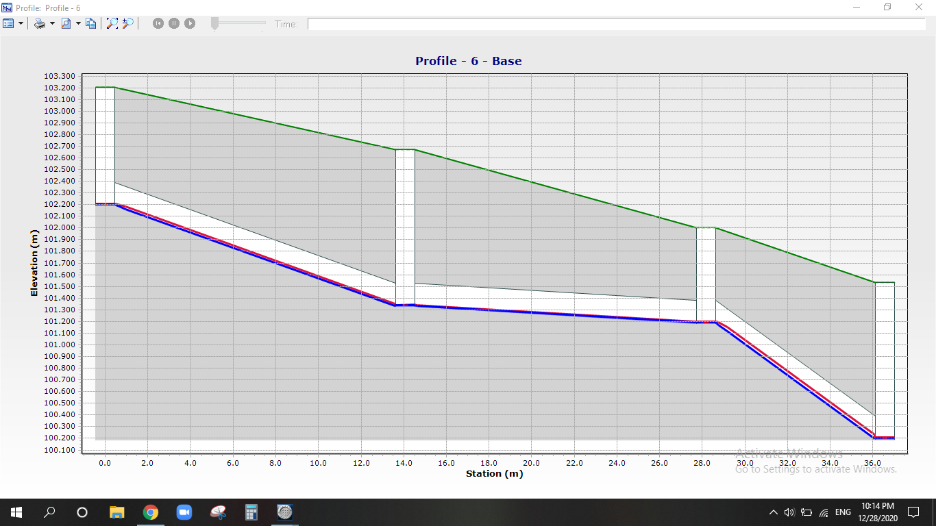
Profile

Slide 62
Results

Slide 63
Slope Result

Slide 64
Velocity Result

Slide 65
Cover Result

Slide 66

Cost Estimation

Slide 67
WWCN COST
CONDIUT SIZE (INCH) | COST(NIS)
8 | 75
10 | 105
12 | 160

Slide 68
WWCN COST
An example of estimation the cost of (WWCN)
conduit 13 length = 17.8 m
conduit 13 size = 8 inch
The cost of conduit = 17.8 *75= 1335 NIS
Total cost = 522610.5 NIS
=149317$

Slide 69
Summary

Slide 70
Summary
We designed the water distribution network where the number of nodes 104 is and the number of pipes 118 is with a total cost of conduits just as a material
= 113369$
We designed the waste water collection network with number of manholes 439 and number of conduits 439 with total cost of conduits just as a material
=149317$

Slide 71


