Slide 1
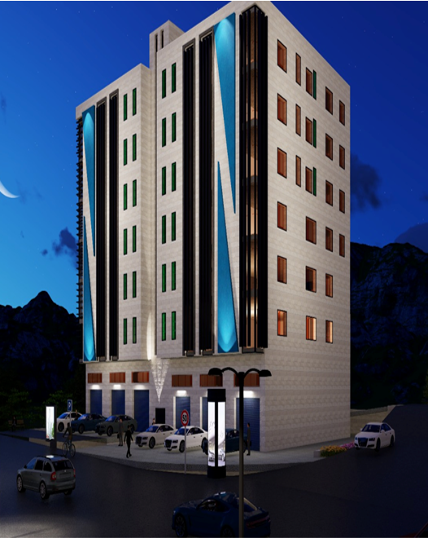

An-Najah National University
Faculty of Engineering and Information Technology Building Engineering Department
Graduation project II presentation
Commercial building that embodies an integrative approach to design and community
Prepared By:
Nasser Maqboul
Waleed Al Shaikh Ibrahim
Mohammad Owaisi
Jameel shashtari
Supervised by: Dr . Nermeen barq

Slide 2


Introduction
CONTENTS
Architectural Aspect
Environmental Aspect
Structural Aspect
Electro-Mechanical
Aspect
Quantity surveying

Slide 3
Introduction
CONTENTS
Architectural Aspect
Environmental Aspect
Structural Aspect
Electro-Mechanical
Aspect
Quantity surveying

Slide 4


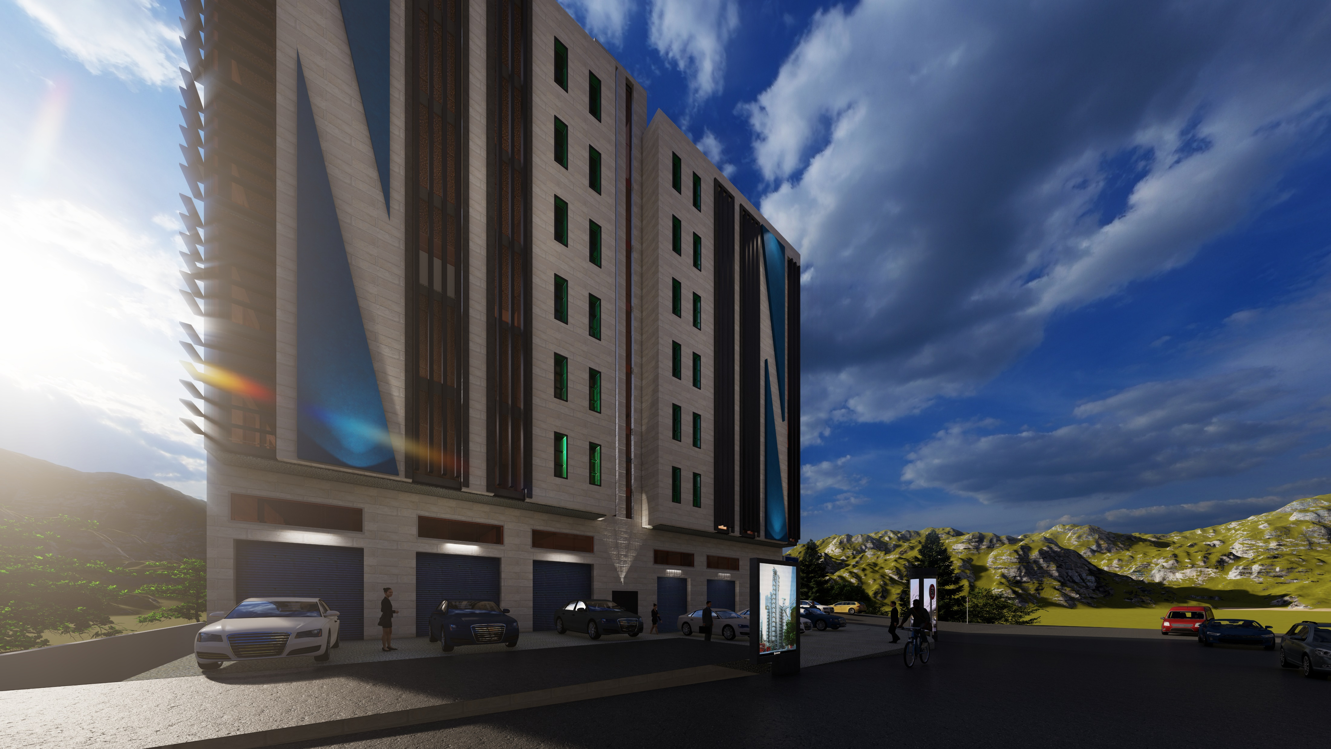
Introduction:
Location : Askar - Nablus – Palestine
Land area : 1059 m^2
Budling total area : 5599 m^2
Contains : 7 floors + 2 basement
Name of Story | Area (m2)
Basement 2 | 708.5
Basement 1 | 879.0
Ground floor | 487.0
Attic | 312.0
1st floor | 525.0
2nd floor | 525.0
3rd floor | 525.0
4th floor | 525.0
5th floor | 525.0
6th floor | 525.0

Slide 5
Introduction
CONTENTS
Architectural Aspect
Environmental Aspect
Structural Aspect
Electro-Mechanical
Aspect
Quantity surveying

Slide 6
Architectural
Site Analyze
Architectural plans

Slide 7
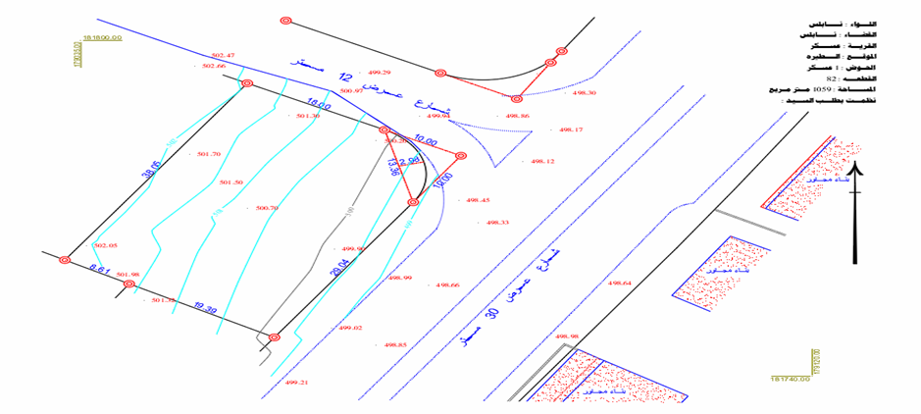
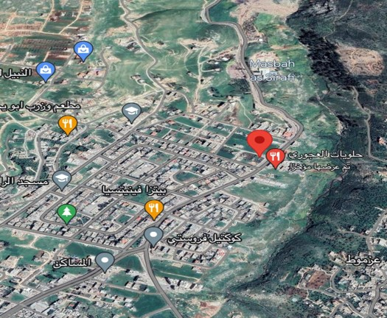
Site Analyze
- Site location
- Land topography

Slide 8
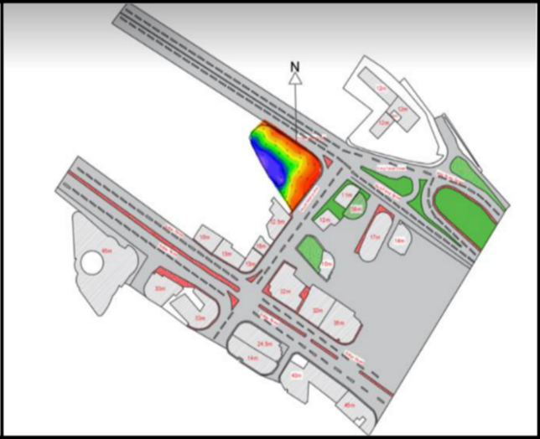
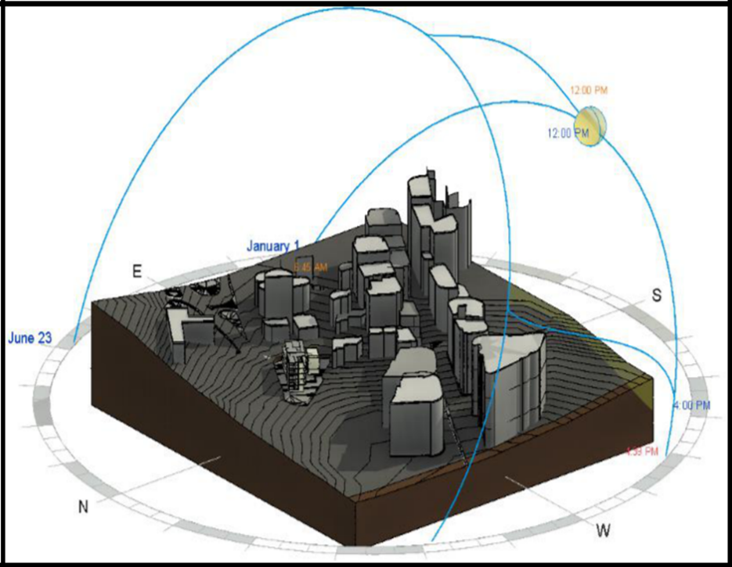
Site Analyze
Noise Analysis
Sun Path diagram

Slide 9
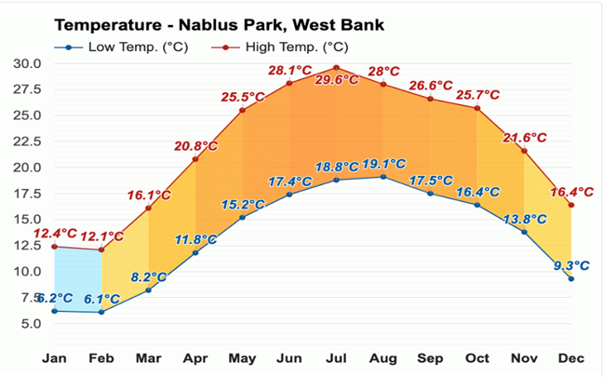
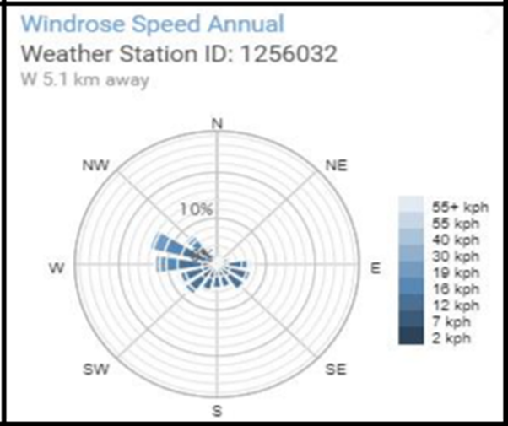
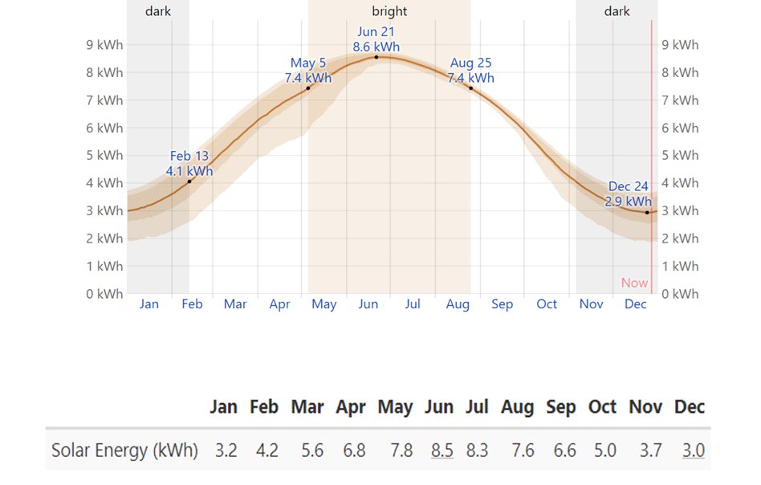
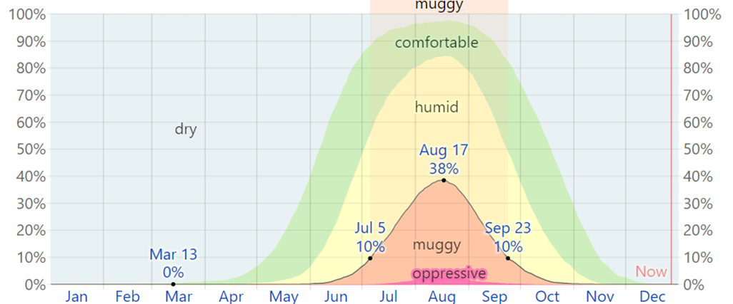
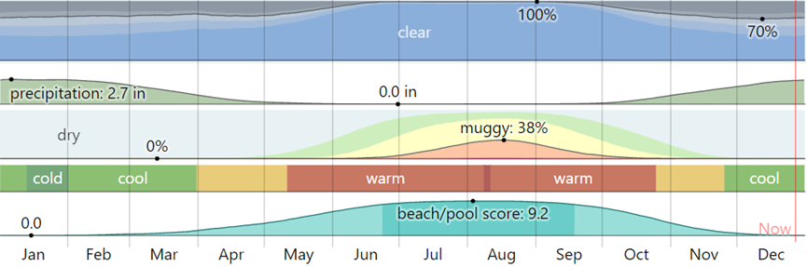
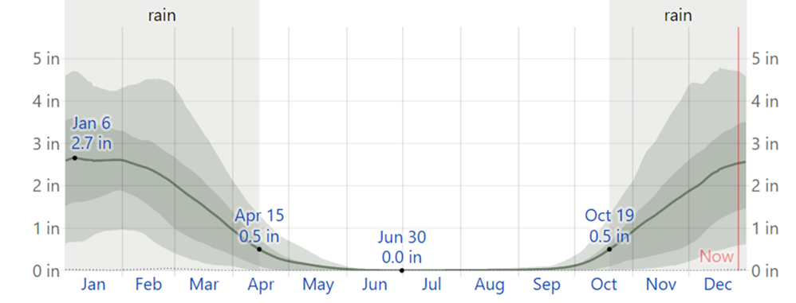
Site Analyze
Temperature
Wind speed
Solar radiation
Humidity
Climate
Rainfall

Slide 10
Architectural plans

Slide 11
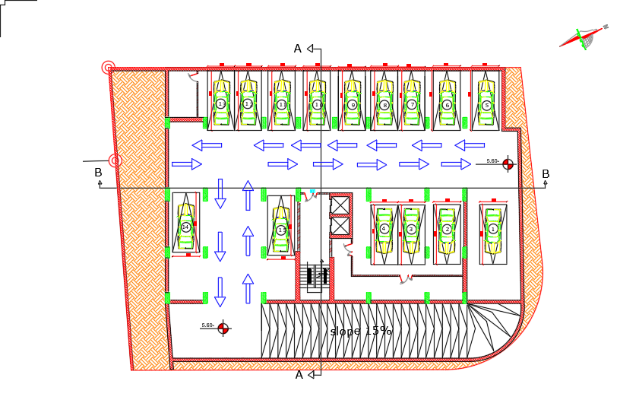
Before & after modifications
Adding Basement (B2)

Slide 12
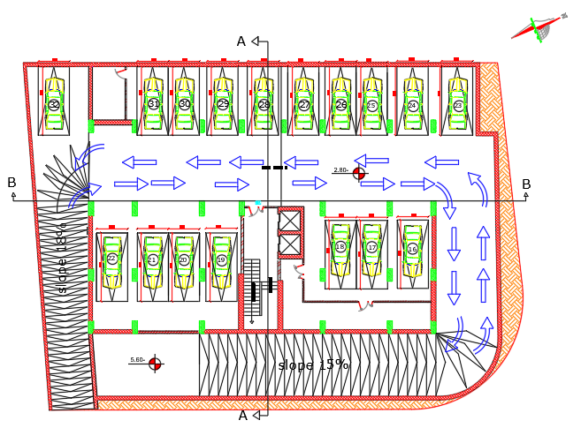
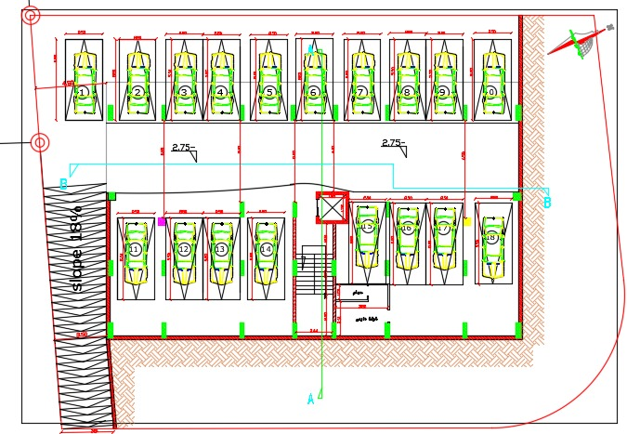
Before & after modifications
First Basement (B1)
Before
After

Slide 13
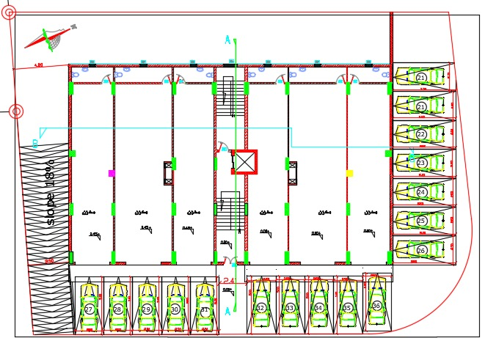
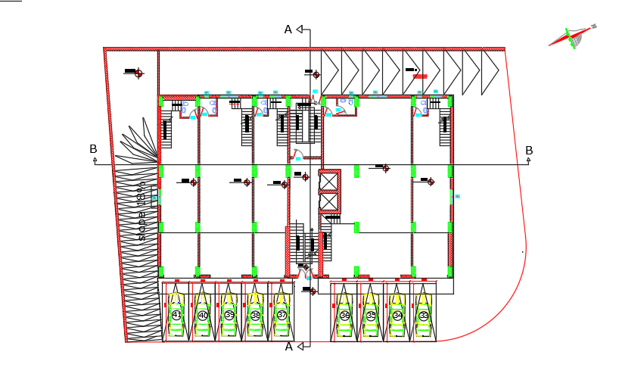
Before & after modifications
Ground floor (GF )
Before
After

Slide 14
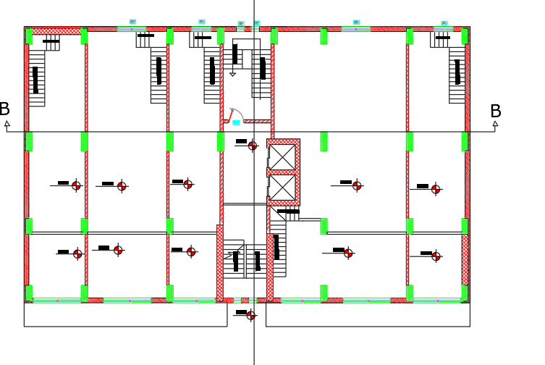
Before & after modifications
Adding ATTIC

Slide 15
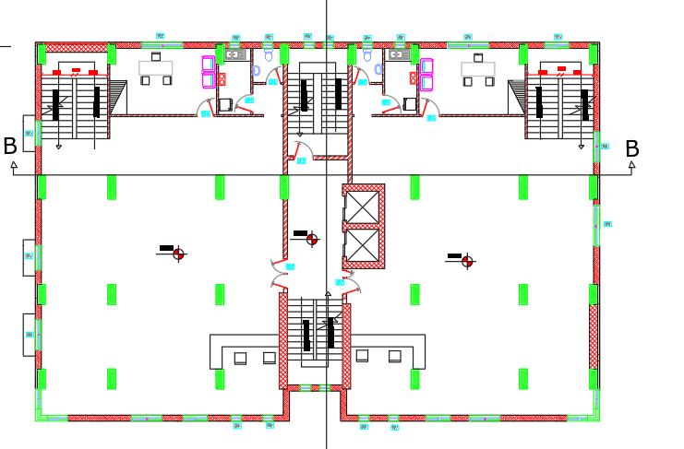
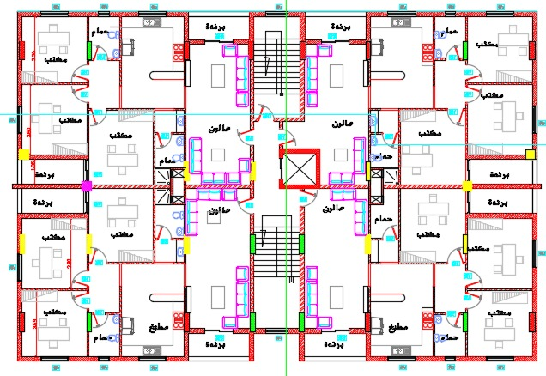
Before & after modifications
First floor (1st)
Before
After

Slide 16
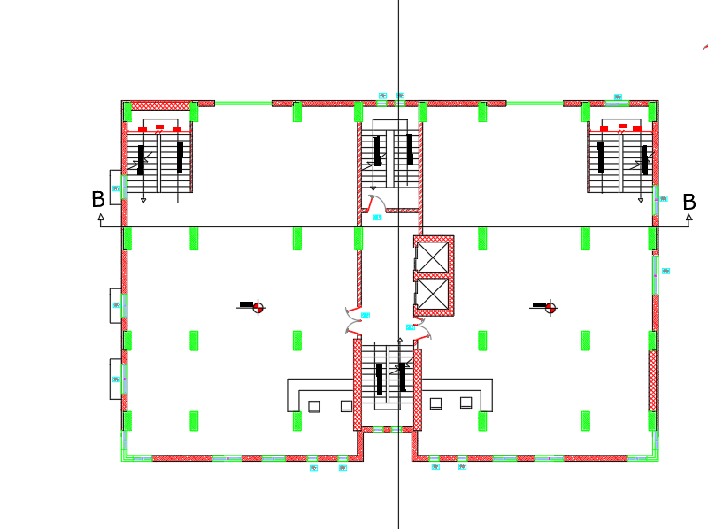
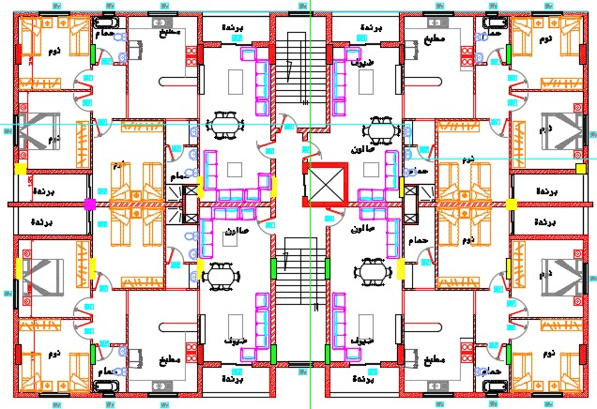
Before & after modifications
Second floor (2nd)
Before
After

Slide 17
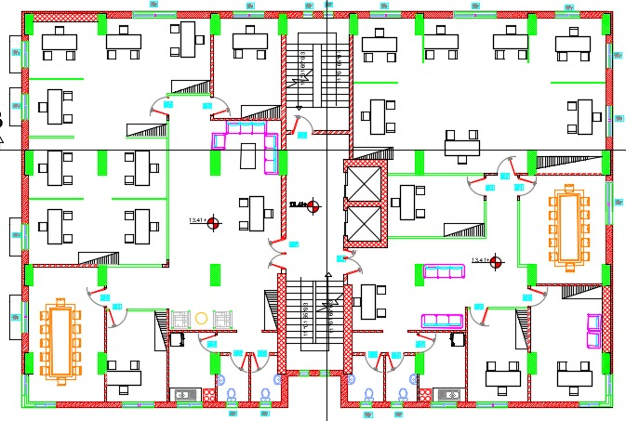
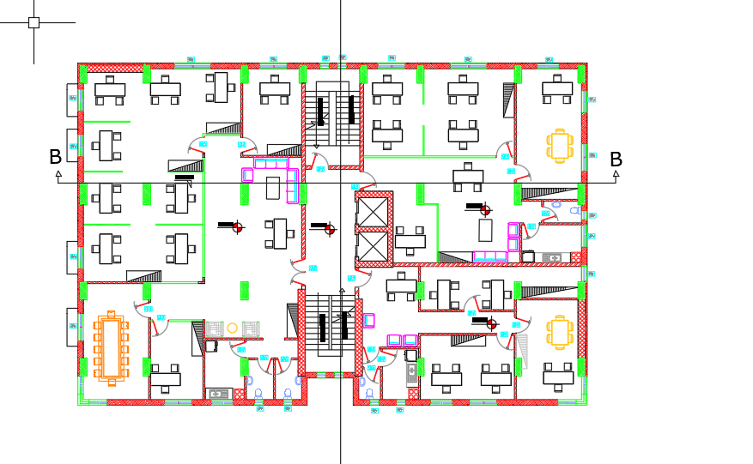
Before & after modifications
Adding third floor (3rd)
Adding forth floor (4th)

Slide 18
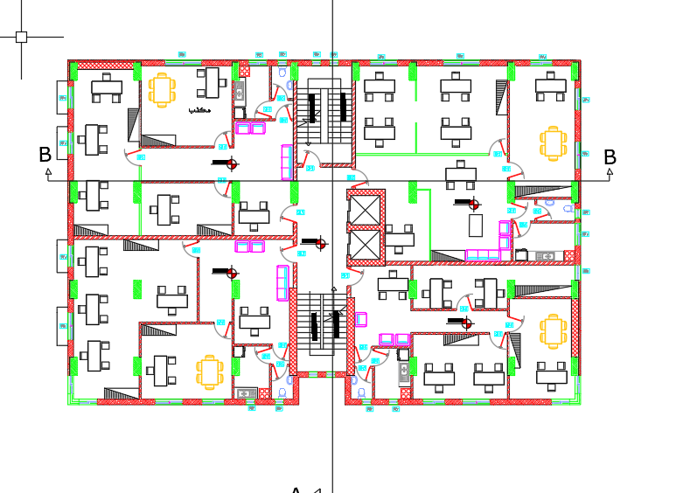
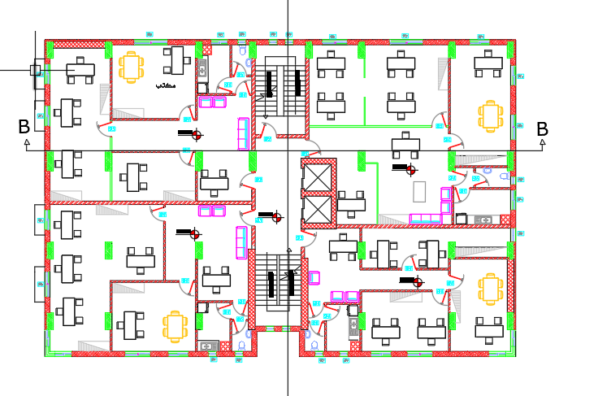
Before & after modifications
Adding fifth floor (5th)
Adding Six floor (6th)

Slide 19
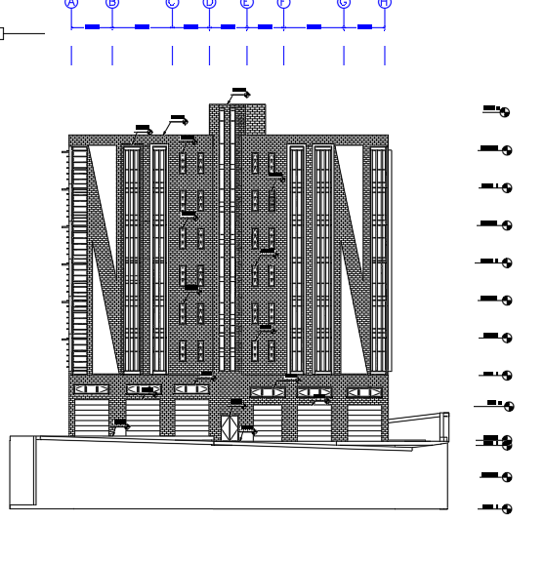
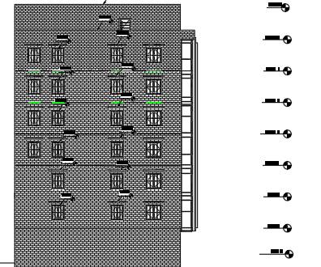
East Elevation after modification
North Elevation after modification

Slide 20
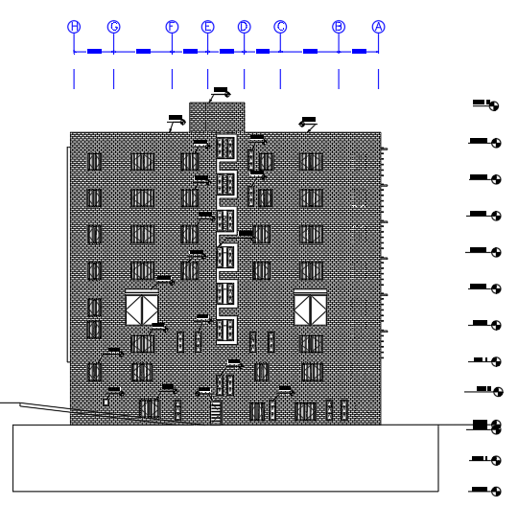
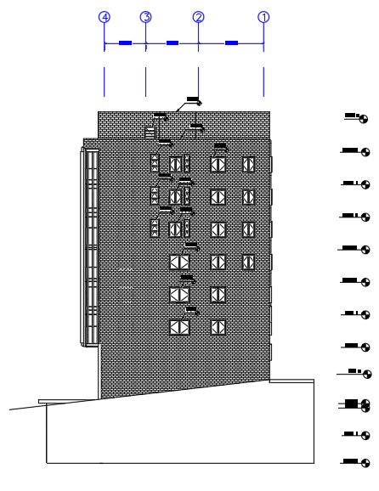
West Elevation after modification
South Elevation after modification

Slide 21
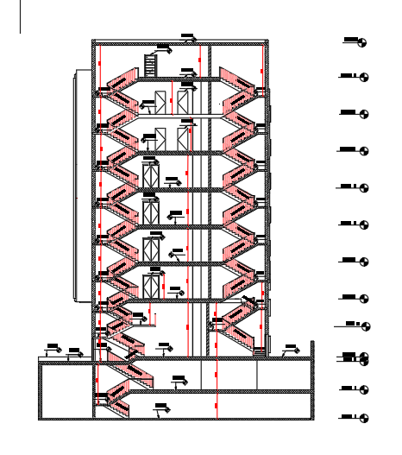
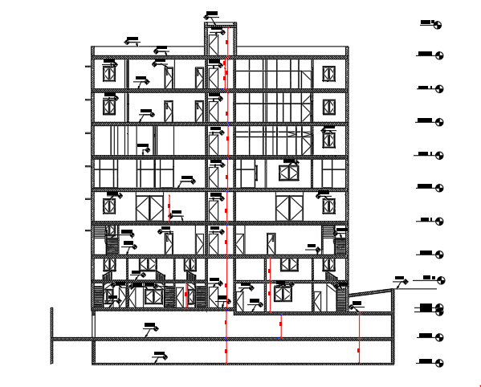
Sections in the building

Slide 22
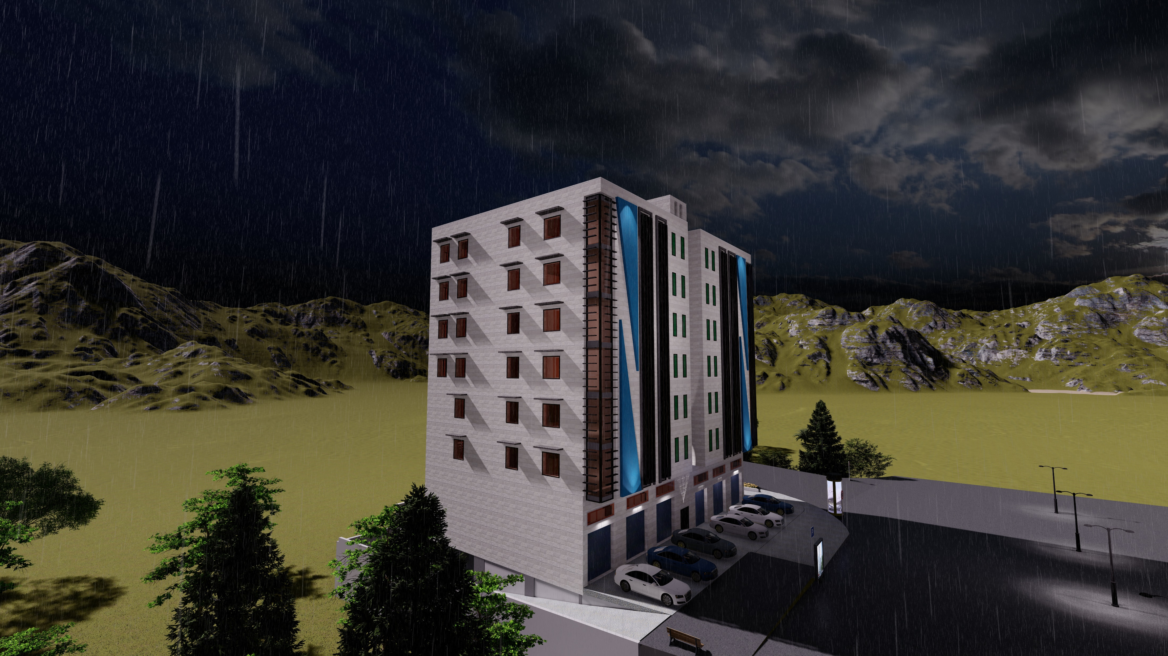
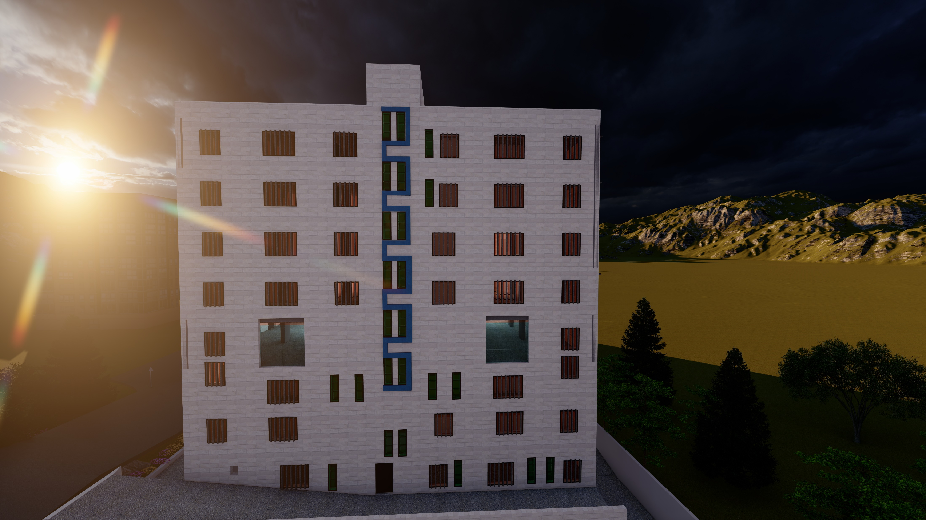
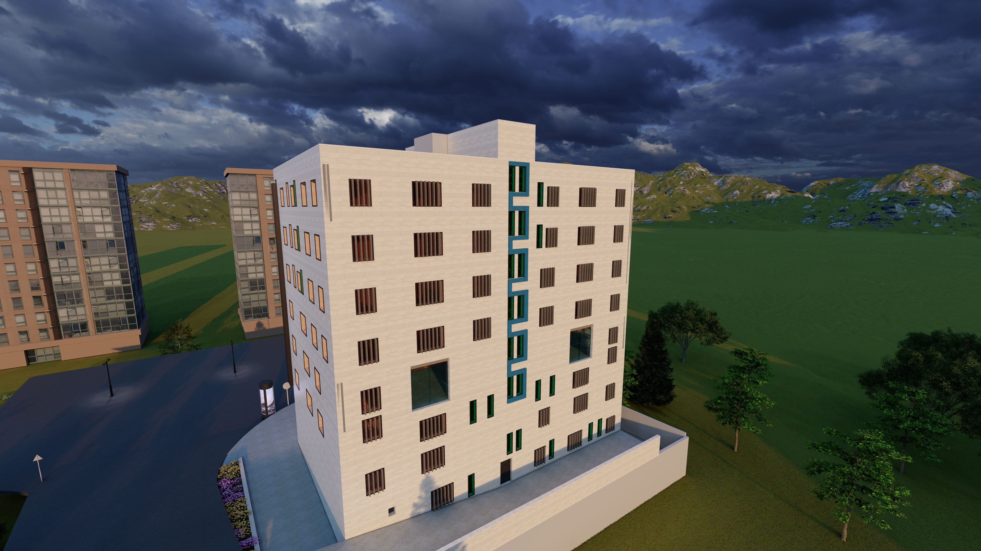
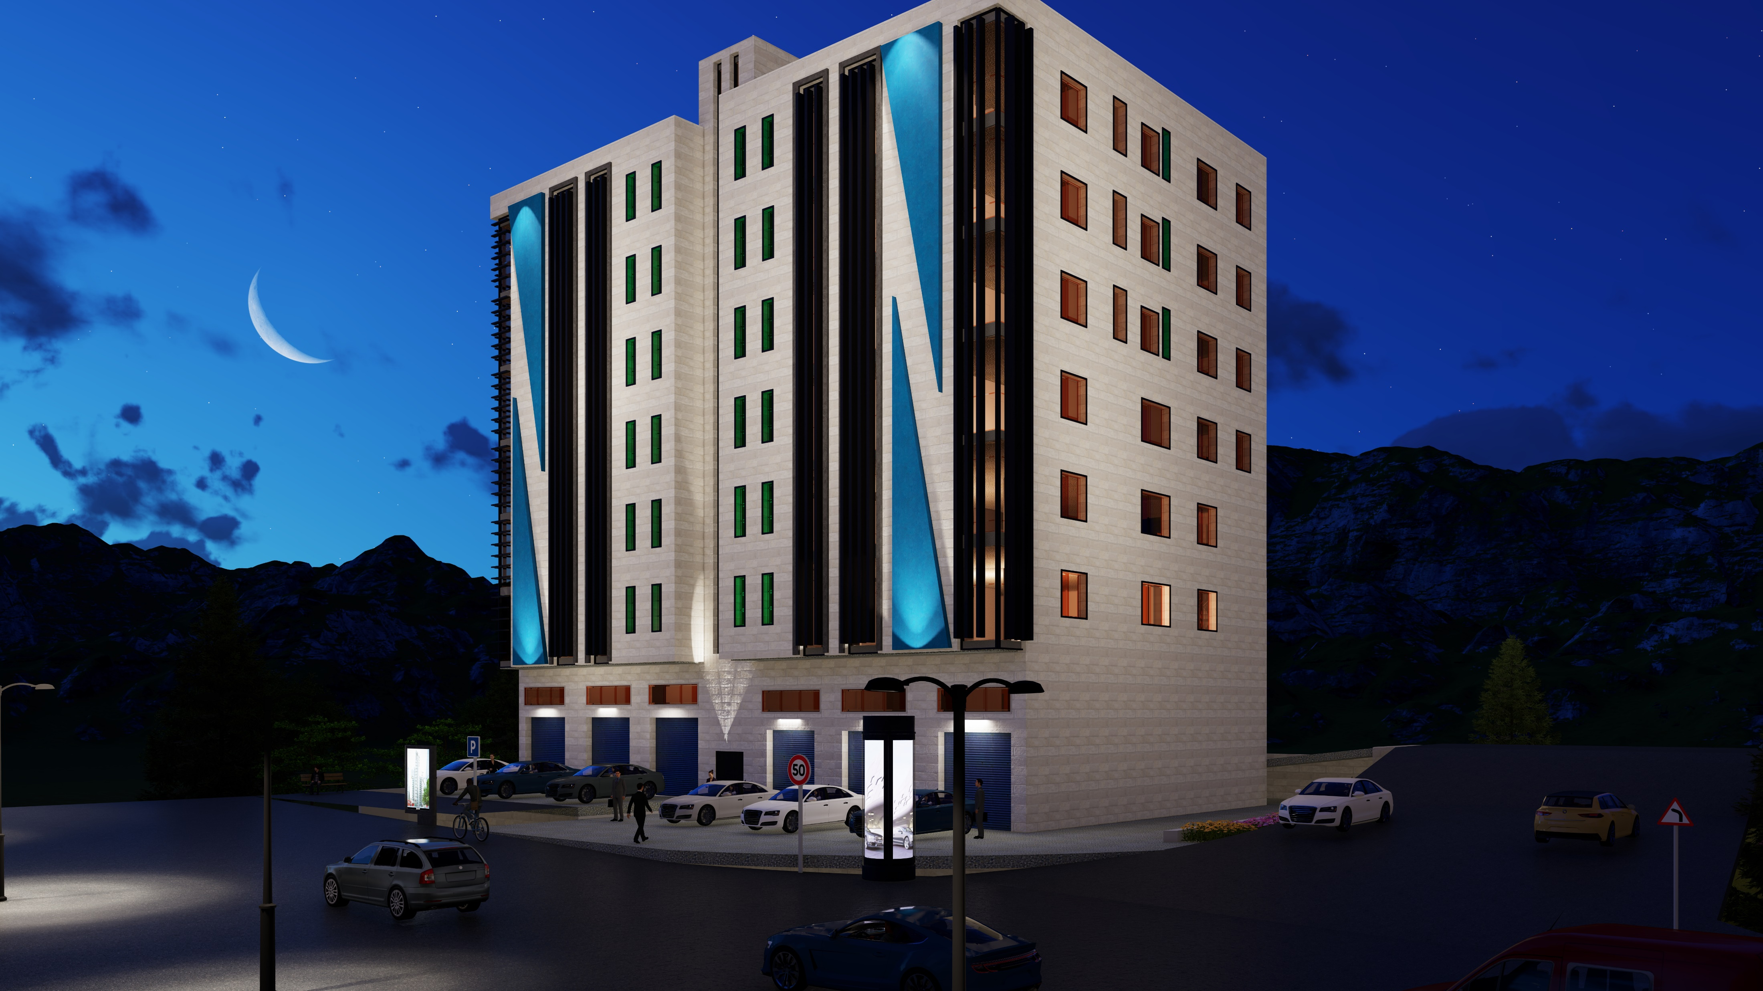
Lumion

Slide 23
Environmental Aspects

Slide 24
Shading and solar radiation analysis.
CONTENTS
daylight factor
Heating and cooling loads.
Thermal comfort
CFD analyze

Slide 25
Shading and solar radiation analysis.
CONTENTS
daylight factor
Heating and cooling loads.
Thermal comfort
CFD analyze

Slide 26
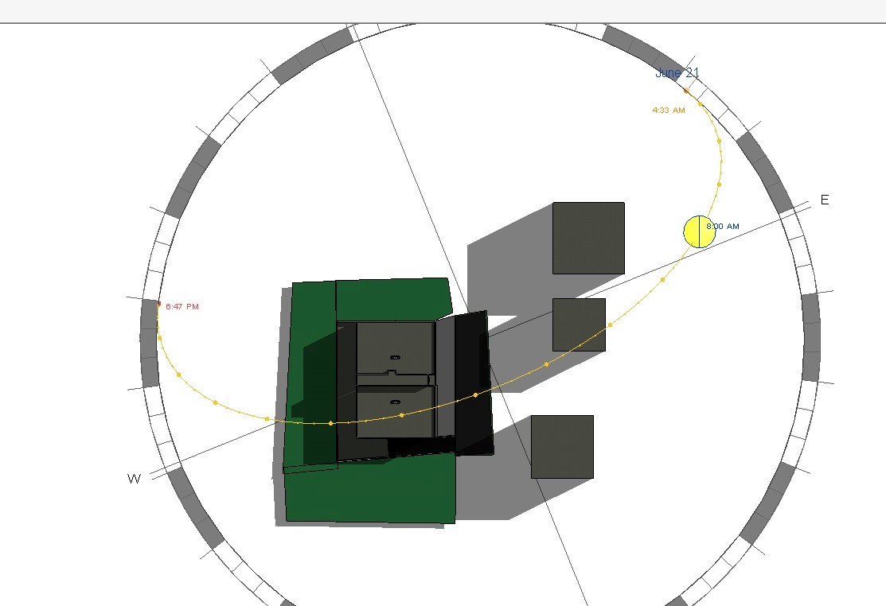
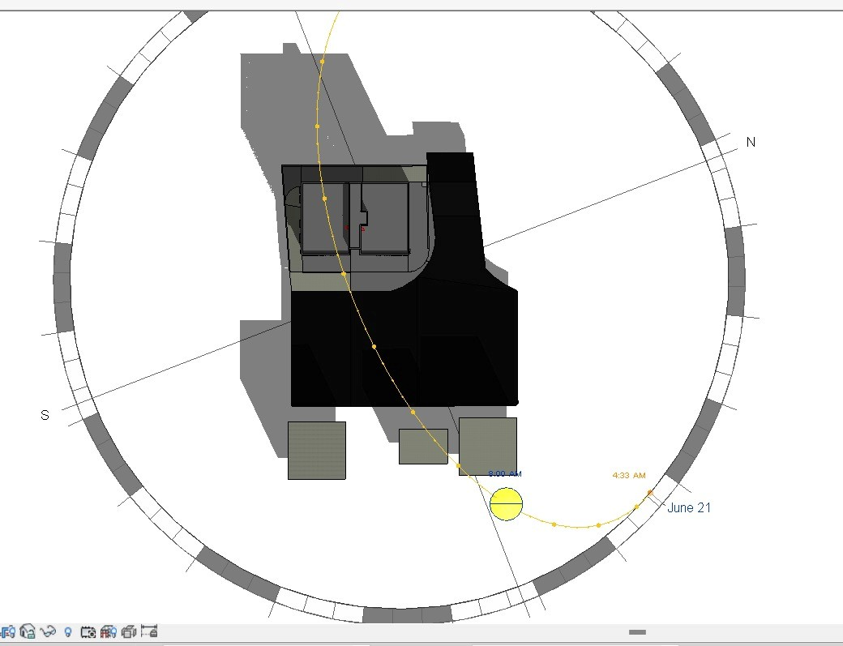
Shading analysis – Summer case
8:00 am
Before
After

Slide 27
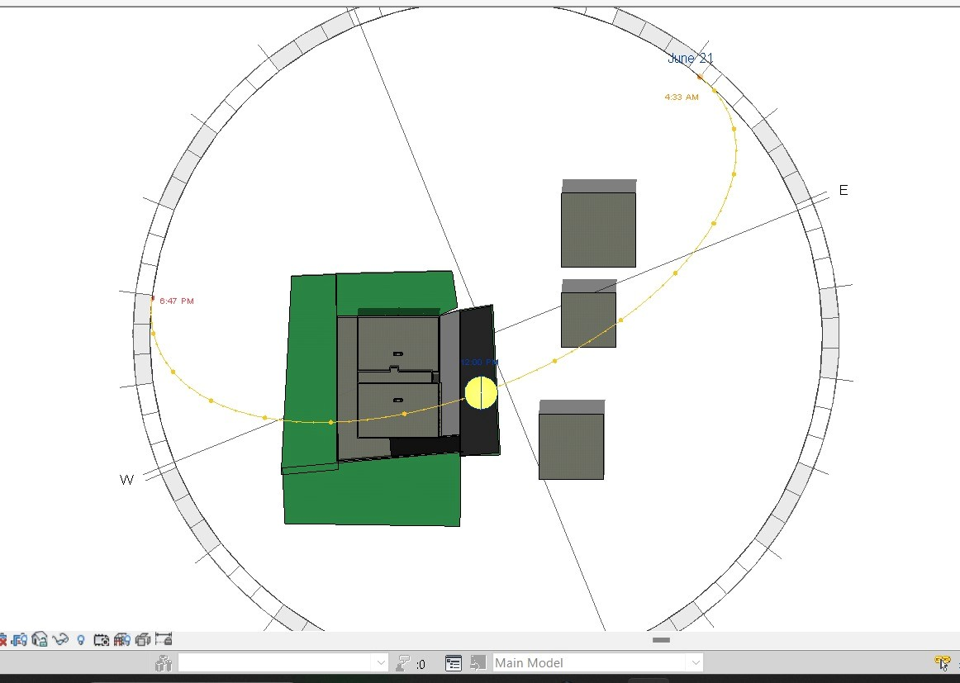
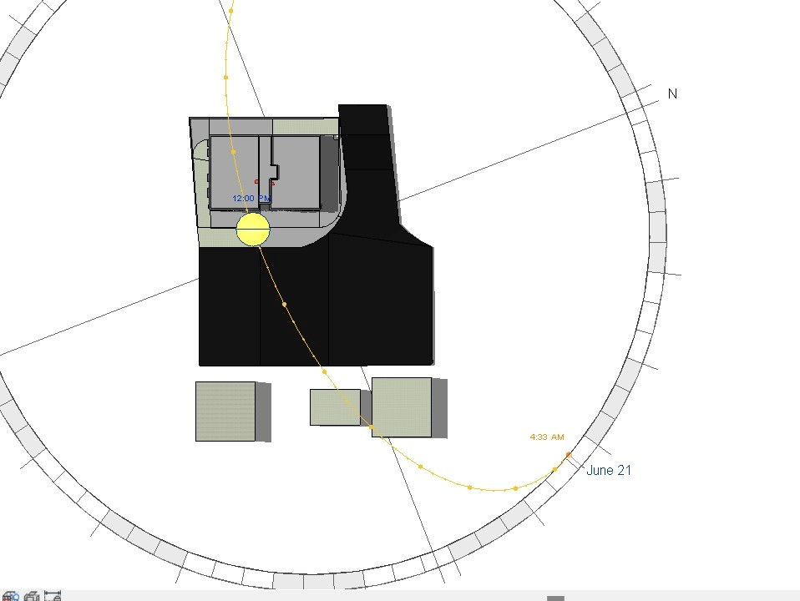
Shading analysis – Summer case
12:00 pm
Before
After

Slide 28
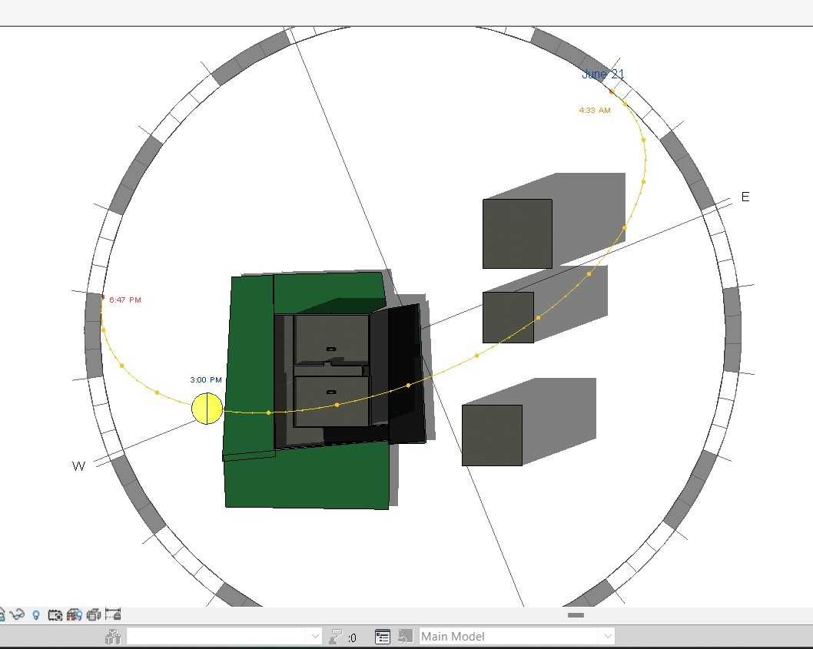
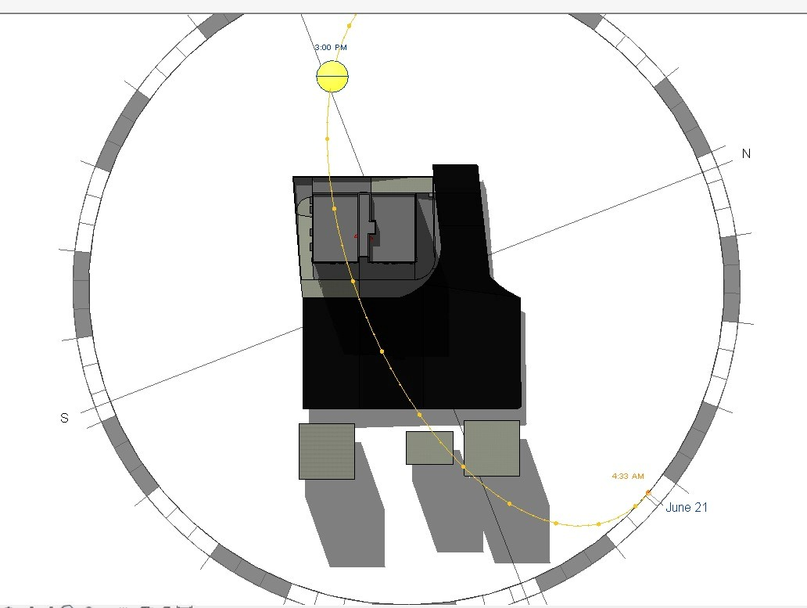
Shading analysis – Summer case
3:00 pm
Before
After

Slide 29
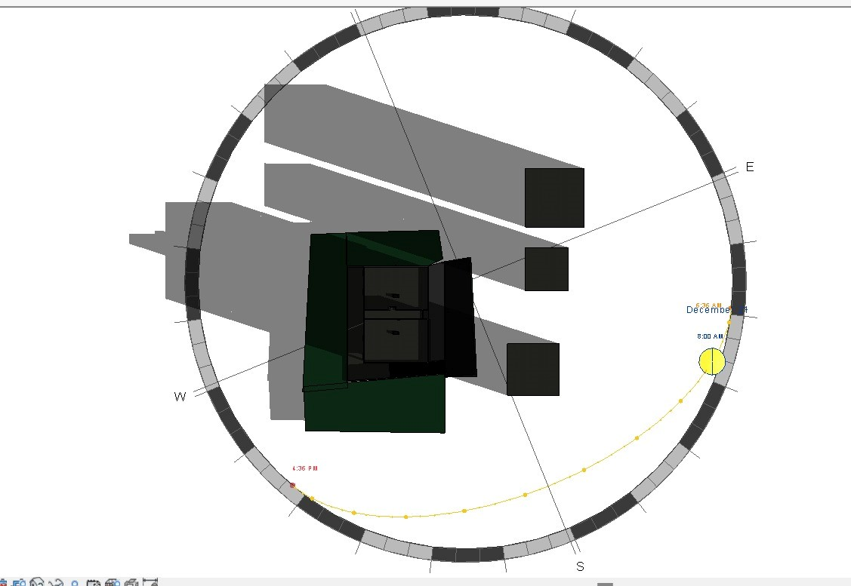
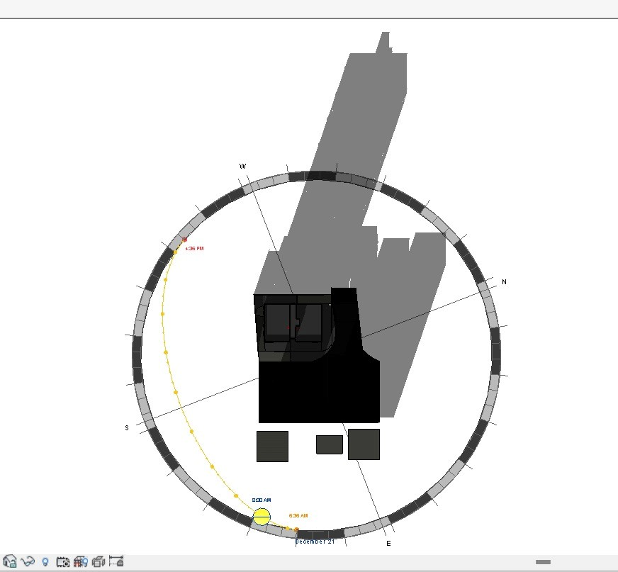
Shading analysis – Winter case
8:00 am
Before
After

Slide 30
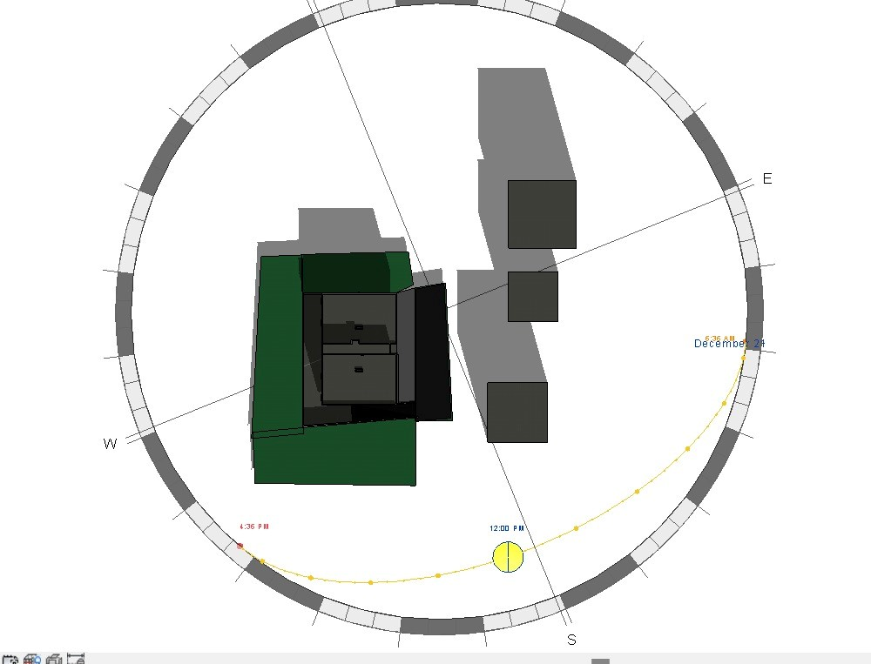
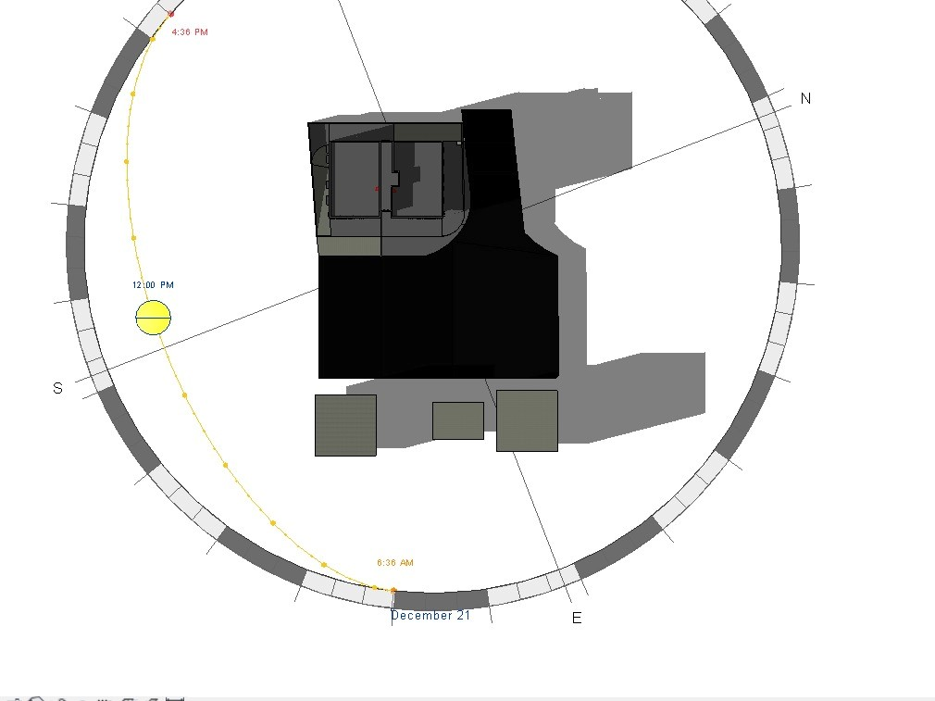
Shading analysis – Winter case
12:00 pm
Before
After

Slide 31
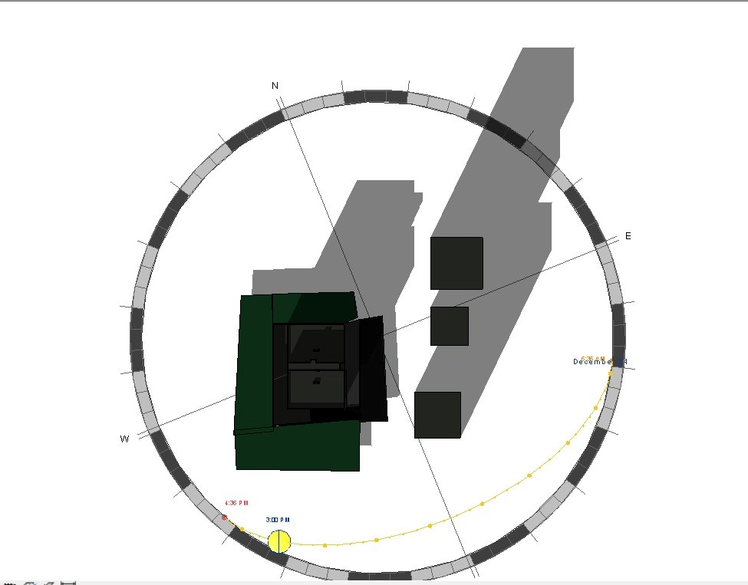
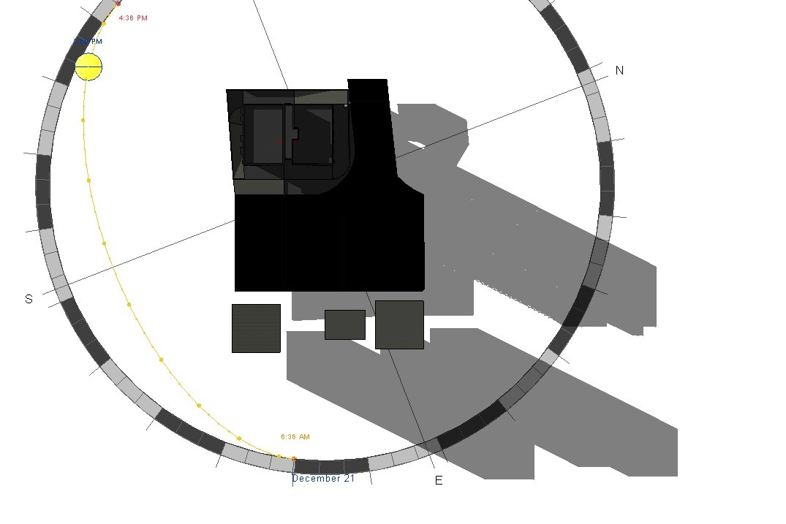
Shading analysis – Winter case
3:00 pm
Before
After

Slide 32
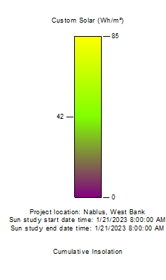
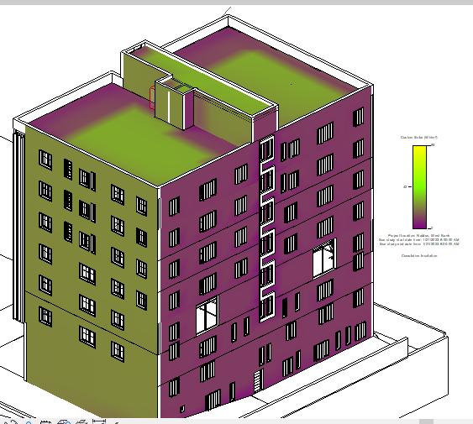

Solar Radiation analysis
at 21-jan at 8 AM

Slide 33



Solar Radiation analysis
at 21-jan at 12 PM

Slide 34



Solar Radiation analysis
at 21-jan at 3 pm

Slide 35



Solar Radiation analysis
At 21-July At 8 Am

Slide 36



Solar Radiation analysis
At 21-July at 12pm

Slide 37
Solar Radiation analysis
At 21-july at 3 pm

Slide 38
Shading and solar radiation analysis.
CONTENTS
daylight factor
Heating and cooling loads.
Thermal comfort
CFD analyze

Slide 39




Daylight factor
Before
After
First floor modification
Second floor modification

Slide 40




Daylight factor
Before
After
Third floor modification
Fourth floor modification

Slide 41




Daylight factor
Before
After
Fifth floor modification
Sixth floor modification

Slide 42


Daylight factor improvement strategy
Glazed facades and glazed partitions
Louvers

Slide 43
Shading and solar radiation analysis.
CONTENTS
daylight factor
Heating and cooling loads.
Thermal comfort
CFD analyze

Slide 44
Heating and cooling loads.
Summary of heating and cooling load
Category | Before Treatments | After Treatments | % Saving
Heating Load | 309.3 | 143.88 | 53.48%
Cooling Load | 344.19 | 212.86 | 38.16%
Results before treatments:
Total heating load = 309.3 KW.0 -
Total Cooling load = 344.19 KW.
Results after treatment :
Total heating load = 143.88 KW
Total cooling load = 221.86 kw

Slide 45




Material used before and after treatment
Before
After
Walls Layers
U-value = 2.33w/m2-k
U-value = 0.457w/m2-k
Internal floor layers
U-value = 0.96w/m2-k
U-value = 0.96w/m2-k

Slide 46




Material used before and after treatment
Before
After
Roof Layers
U-value = 2.25w/m2-k
U-value = 0.522w/m2-k
Window layers
U-value = 2.54w/m2-k
U-value = 1.451w/m2-k

Slide 47
Shading and solar radiation analysis.
CONTENTS
Daylight factor
Heating and cooling loads.
Thermal comfort
CFD analyze

Slide 48


Thermal comfort
PMV
Before
The PMV values are high in the most days of the year which is not ok.
After
The PMV values are from -0.7 to 0.7 in the most days of the year which is ok.

Slide 49


Thermal comfort
Consumption
Before
After
Consumption before = 170.69 KWH/m2
Consumption After = 82.86 KWH/m2
%saving = 51.4 %

Slide 50
Shading and solar radiation analysis.
CONTENTS
Daylight factor
Heating and cooling loads.
Thermal comfort
CFD analyze

Slide 51



CFD analyze -
Exterior CFD
Average wind speed used in software = 5m/s.
The number of iterations made = 1000 iterations.
The wind currents flow to all buildings without any prevention, which is ok.

Slide 52





CFD analyze -
Interior CFD
The air movement is from bottom to top which is ok.

Slide 53

Baseline
The saving percentage =53.86%

Slide 54
Introduction
CONTENTS
Architectural Aspect
Environmental Aspect
Structural Aspect
Electro-Mechanical
Aspect
Quantity surveying

Slide 55
Structural Aspect
Assumptions
Structural details
Design
S
Seismic checks
Structural model

Slide 56
Structural Aspect
Assumptions
Assumptions
Codes used in the design
1. (ACI 318-19) for concrete structural design.
2. ASCE 7-22 for structural design loads.
3. UBC-97 code for seismic design.
Materials
- Concrete compressive strength(f'c) = 24 MPa for slaps and beams.
-Concrete compressive strength(f'c) = 28 MPa for columns and shear wall.
-Concrete unit weight = 25 KN/m3.
-Yielding strength of steel (fy) = 420 MPa.
-

Slide 57
Structural Aspect
Importance factor = 1
R = 5.5
Z = 0.2
Soil profile: SD
Seismic zone: 2B
Seismic loads
Ca = 0.28
Cv = 0.40
Assumptions
Loads
-Live load = $\left\{\begin{aligned}\text{2.5 }\text{KN}\text{/}\text{m}\text{2 }\text{for} \text{offices}\text{ .} \\ \text{3.}\text{5} \text{KN}\text{/}\text{m}\text{2 }\text{for} \text{attic}\text{. } \\ \text{5} \text{KN}\text{/}\text{m}\text{2 }\text{for} \text{parking} \text{and} \text{ground} \text{floor} \\ 15 \text{KN}\text{/}\text{m}\text{2 }\text{for} \text{floor} \text{font} \text{of} \text{ground} \text{floor}\text{. }\end{aligned}\right.$
-Live load = {█("2.5 KN/m2 for offices ." @"3.5 KN/m2 for attic. " @"5 KN/m2 for parking and ground floor" @15" KN/m2 for floor font of ground floor. " )┤
- S.I.D = 4.5$\text{KN}\text{/}\text{m}\text{2}$
- Wall load = 18 $\text{KN}\text{/}\text{m}\text{.}$
- S.I.D = 4.5" KN/m2"
- Wall load = 18 "KN/m. "

Slide 58




Structural Aspect
Design
Slab system: One - way ribbed slab and solid slab.
Column’s

Slide 59

Structural Aspect
Design
Beam’s

Slide 60

Structural Aspect
ETABS structural model

Slide 61

Structural Aspect
ETABS model checks
-Compatibility check

Slide 62
Structural Aspect
ETABS model checks
- Equilibrium check
- Deflection check

Slide 63
Structural Aspect
ETABS model checks
- Stress strain check
Column
Beam

Slide 64

Structural Aspect
Seismic checks
-Period check
- Base shear check

Slide 65
Structural Aspect
Seismic checks
-Drift check

Slide 66



Structural Aspect
Structural details
-Column details

Slide 67




Structural Aspect
Structural details
-Beam details

Slide 68




Structural Aspect
Structural details
-Beam details

Slide 69




Structural Aspect
Structural details
-Beam details

Slide 70

Structural Aspect
Structural details
-Beam details

Slide 71

Structural Aspect
Structural details
-Beam details

Slide 72

Structural Aspect
Structural details
-Beam details

Slide 73


Structural Aspect
Slab details
One – way ribbed slab (38cm)

Slide 74


Structural Aspect
Slab details
One – way ribbed slab (32cm)

Slide 75

Structural Aspect
Slab details
Solid slab

Slide 76


Structural Aspect
Structural details
-Mat foundation details

Slide 77


Structural Aspect
Structural details
-Mat foundation details

Slide 78

Structural Aspect
Structural details
-Stair details

Slide 79

Structural Aspect
Structural details
-Stair details

Slide 80


Structural Aspect
Structural details
-Ramp details

Slide 81

Structural Aspect
Structural details
-Shear walls details

Slide 82
Introduction
CONTENTS
Architectural Aspect
Environmental Aspect
Structural Aspect
Electro-Mechanical
Aspect
Quantity surveying

Slide 83
Artificial lighting Design
Hvac design
CONTENTS
Acoustics Design
Fire system
Water supply
Drainage
Vertical transportation(elevators)
Power

Slide 84
Electro mechanical aspects
Artificial lighting Design:
Visual comfort
Illuminance
Uniformity
Glare

Slide 85

Electro mechanical aspects
Artificial lighting Design:
Standard values for office buildings lighting

Slide 86


Electro mechanical aspects
Artificial lighting Design:
Offices room & corridor &Meeting room & Kitchen artificial lighting design.
The used luminaires.

Slide 87
Electro mechanical aspects
Artificial lighting Design:
Toilet artificial lighting design.
The used luminaires.

Slide 88

Electro mechanical aspects
Artificial lighting Design:
Store artificial lighting design.
The used luminaires.

Slide 89


Electro mechanical aspects
Artificial lighting Design:
Offices &Meeting room artificial lighting design.
Results:

Slide 90

Electro mechanical aspects
Artificial lighting Design:
Corridor & Reception artificial lighting design.
Results:

Slide 91

Electro mechanical aspects
Artificial lighting Design:
Toilet artificial lighting design.
Results:

Slide 92

Electro mechanical aspects
Artificial lighting Design:
Store artificial lighting design.
Results:

Slide 93



Electro mechanical aspects
Artificial lighting Design:
Results:
Offices room
Meeting room
For Toilet

Slide 94


Electro mechanical aspects
Artificial lighting Design:
Results:
Corridor:
Store:

Slide 95


Electro mechanical aspects
Electrical Design:
B2
B1

Slide 96


Electro mechanical aspects
Electrical Design:
G floor
Attic floor

Slide 97


Electro mechanical aspects
Electrical Design:
1st floor
2nd floor

Slide 98


Electro mechanical aspects
Electrical Design:
3rd floor
4th floor

Slide 99


Electro mechanical aspects
Electrical Design:
5th floor
6th floor

Slide 100
Artificial lighting Design
Hvac design
CONTENTS
Acoustics Design
Fire system
Water supply
Drainage
Vertical transportation(elevators)
Power

Slide 101





HVAC Design
The system used for HVAC design is Variable refrigerant flow “ VRF system ”
Total heating load after treatment = 143.88 KW
Total cooling load after treatment= 212.86 KW
Split unit
Diffusers
VRF component
Fan coli
Out door Unit

Slide 102



HVAC Design
Ground floor
First floor

Slide 103


HVAC Design
Second floor
Third floor

Slide 104


HVAC Design
Forth floor
Fifth floor

Slide 105

HVAC Design
Six floor
Out door unit

Slide 106
Artificial lighting Design
Hvac design
CONTENTS
Acoustics Design
Fire system
Water supply
Drainage
Vertical transportation(elevators)
Power

Slide 107




Acoustics design
Material used :
1-Meeting room:
1.Paint in the ceiling.
By using EASE software:
2.Plaster in the wall.
3.Terrazzo in the floor

Slide 108


Acoustics design
2-Offices:
By using EASE software:

Slide 109

Acoustics design
3- Between offices (Internal partition):
By using INSUL software to find STC:
The recommendation STC is 35.
The STC for partition wall is 44 >>>> 35, its ok.

Slide 110

Acoustics design
4- Internal glazing walls:
By using INSUL software to find STC:
The STC for partition wall is 44 >>>> 35, its ok.

Slide 111


Acoustics design
5-External walls:
By using INSUL software to find STC:
The recommendation STC is 38.
The STC for partition wall is 90 > 38, its ok.

Slide 112


Acoustics design
6-Floor:
By using INSUL software to find STC:
Recommended IIC between (34-55) db.
IIC = 60 >>>>55 ITS ok.

Slide 113


Acoustics design
6-Roof:
By using INSUL software to find STC:
Drainage
Drainage
LIA =21 dB that’s ok in the rang (15-20).

Slide 114
Artificial lighting Design
Hvac design
CONTENTS
Acoustics Design
Fire system
Water supply
Drainage
Vertical transportation(elevators)
Power

Slide 115



Evacuation ways
Fire fighting and fire alarm systems
Second floor
Ground floor
First floor

Slide 116



Evacuation ways
Fire fighting and fire alarm systems
Third floor
Fifth & Sixth floor
Forth floor

Slide 117

Fire fighting and fire alarm systems
1) Emergency signs:

Slide 118


Fire fighting and fire alarm systems
Fire alarm systems:
2) Smoke detectors
3) Heat Detectors

Slide 119


Fire fighting and fire alarm systems
Fire alarm systems:
4) Fire speakers:
5) Fire alarm bell and manual call point. (Break glass unit)

Slide 120



Fire fighting and fire alarm systems
5) Fire rated facade
6) Fire extinguishers:
Class A

Slide 121



Fire fighting and fire alarm systems
7) Fire Hose Cabinet:
8) Water sprinklers system:
Class I system:

Slide 122


Fire fighting and fire alarm systems
Basement 2
Basement 1

Slide 123


Fire fighting and fire alarm systems
Ground floor
Attic

Slide 124


Fire fighting and fire alarm systems
First floor
Second floor

Slide 125


Fire fighting and fire alarm systems
Third floor
Forth floor

Slide 126

Fire fighting and fire alarm systems
Fifth floor and sixth floor (typical)
Roof tank with pump

Slide 127
Artificial lighting Design
Hvac design
CONTENTS
Acoustics Design
Fire system
Water supply
Drainage
Vertical transportation(elevators)
Power

Slide 128



Water Supply Design
First basement
Ground floor

Slide 129


Water Supply Design
Attic
First floor

Slide 130


Water Supply Design
Second floor
Third floor

Slide 131


Water Supply Design
Forth floor
Fifth floor

Slide 132

Water Supply Design
Sixth floor
Roof Tanks

Slide 133
Artificial lighting Design
Hvac design
CONTENTS
Acoustics Design
Fire system
Water supply
Drainage
Vertical transportation(elevators)
Power

Slide 134


Drainage Design
Ground Floor
Attic

Slide 135


Drainage Design
First floor
Second floor

Slide 136


Drainage Design
Third floor
Forth floor

Slide 137


Drainage Design
Fifth and sixth floor
Rood drain slop

Slide 138
Artificial lighting Design
Hvac design
CONTENTS
Acoustics Design
Fire system
Water supply
Drainage
Vertical transportation(elevators)
Power

Slide 139

Elevator design
Elevator design

Slide 140
Artificial lighting Design
Hvac design
CONTENTS
Acoustics Design
Fire system
Water supply
Drainage
Vertical transportation(elevators)
Power

Slide 141
Power design
Sample for third floor
Item | total power | Cable dimension
Lighting | 2393.6 w | 3*25 mm^2
Normal socket | 5500 w
Special | 4000 w
Total | 11893.6 w

Slide 142


Power design
The MDB distribution

Slide 143


Power design
Lighting and power layout sample for third floor
Power
lighting

Slide 144

Power design
Backup power generators:

Slide 145
Introduction
Site Analysis and
Outline
Architectural Aspect
Environmental Aspect
Structural Aspect
Electro-Mechanical
Aspect
Quantity surveying

Slide 146

Quantity surveying and cost estimation aspect
Work breakdown structure

Slide 147
Quantity surveying and cost estimation aspect
Cost summary
Cost type | Total cost | Unit cost (/m2)
Building cost | ILS 9,003,750.18 | ILS/m2 1607.81
Earth work cost | ILS 236,000.00 | ILS/m2 42.14
Sub-structural work cost | ILS 1,006,635.47 | ILS/m2 179.76
Suber-structural work cost | ILS 6,513,605.61 | ILS/m2 1163.14
Electrical cost | ILS 157,715.00 | ILS/m2 28.16
Mechanical cost | ILS 81,794.00 | ILS/m2 14.61
Hvac cost | ILS 1,008,000.00 | ILS/m2 180.00

Slide 148
Thanks!
Any questions?

