Slide 1
Al-Najah National University
Engineering Faculty building Engineering Department
Graduation Project:
Complex of Ministries
Supervied by : Dr. Monther Dwaikat
Prepared by: Haneen Ghanem
Lama Droobi
Rana Faris

Slide 2

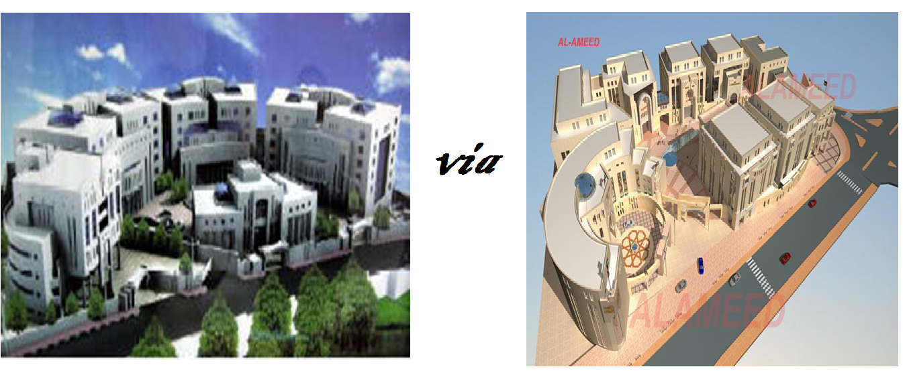
Chapter One : Introduction
Complex of Ministries

Slide 3
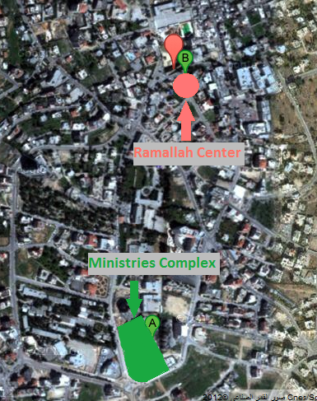
Site Description

Slide 4
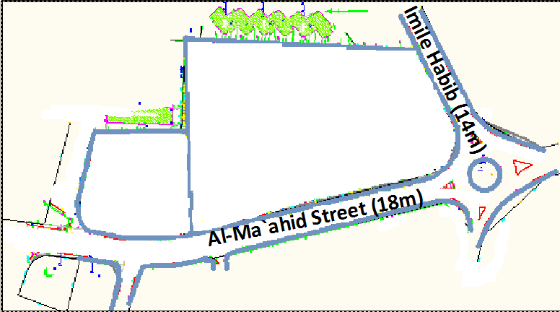
Site Description

Slide 5
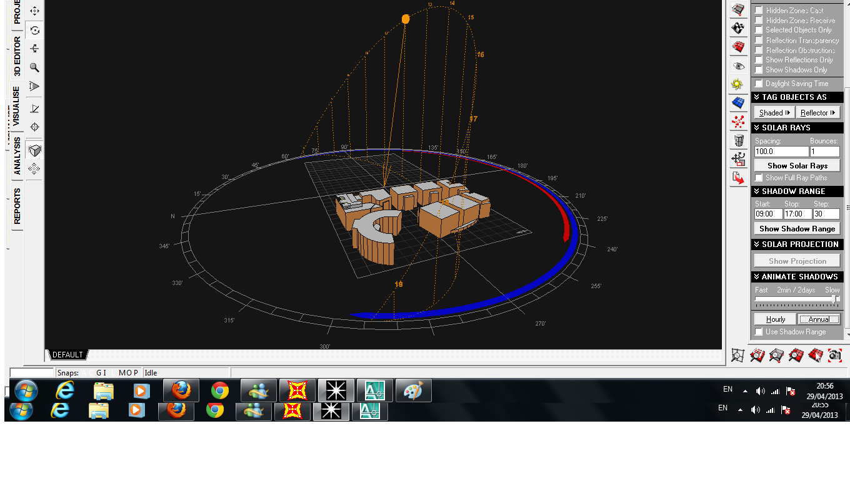
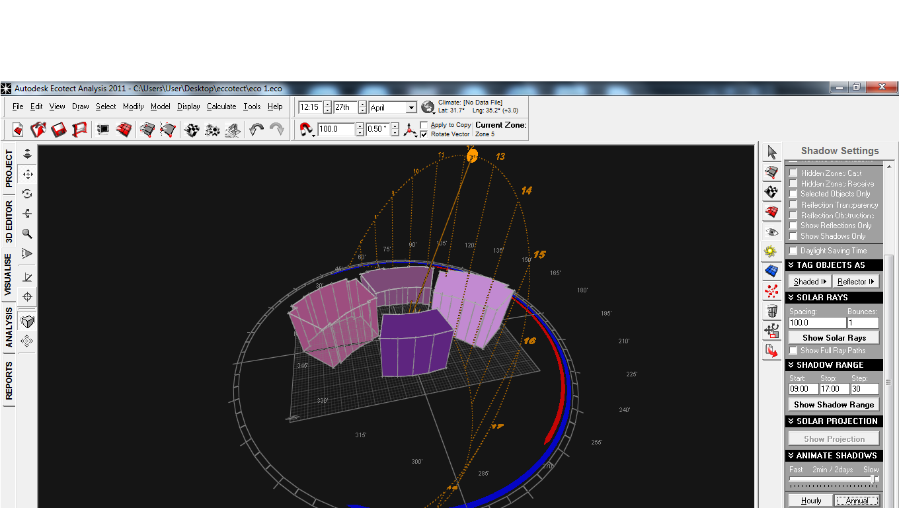
Comparing
Due to Solar Exposure

Slide 6
Comparing
Solar Exposure Value`s
Project A | Solar Exposure | Project B | Solar Exposure
1 | 321830 | 1 | 288965
2 | 178638 | 2 | 295384
3 | 665375 | 3 | 299986
4 | 238771 | 4 | 338305
 |  | 5 | 325649
 |  | 6 | 291600
 |  | 7 | 221080
 |  | 8 | 300814
 |  | 9 | 292773

Slide 7
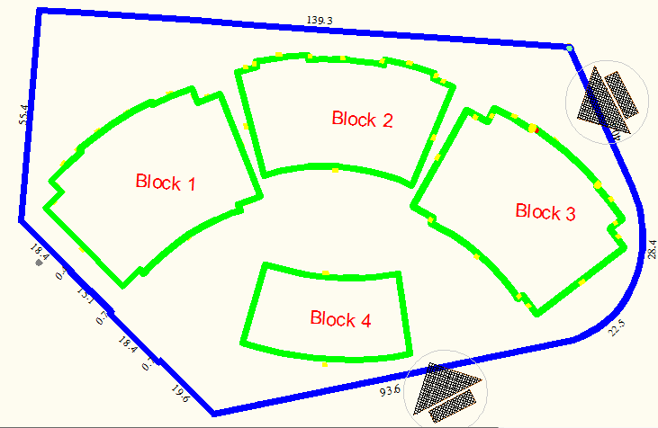
PROJECT A

Slide 8
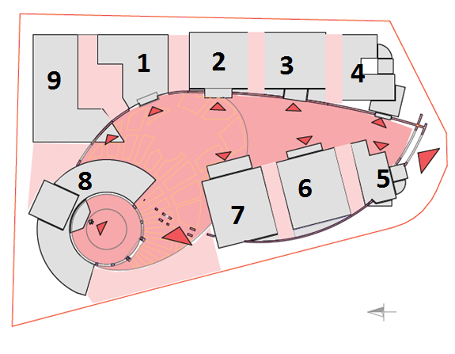
PROJECT B

Slide 9
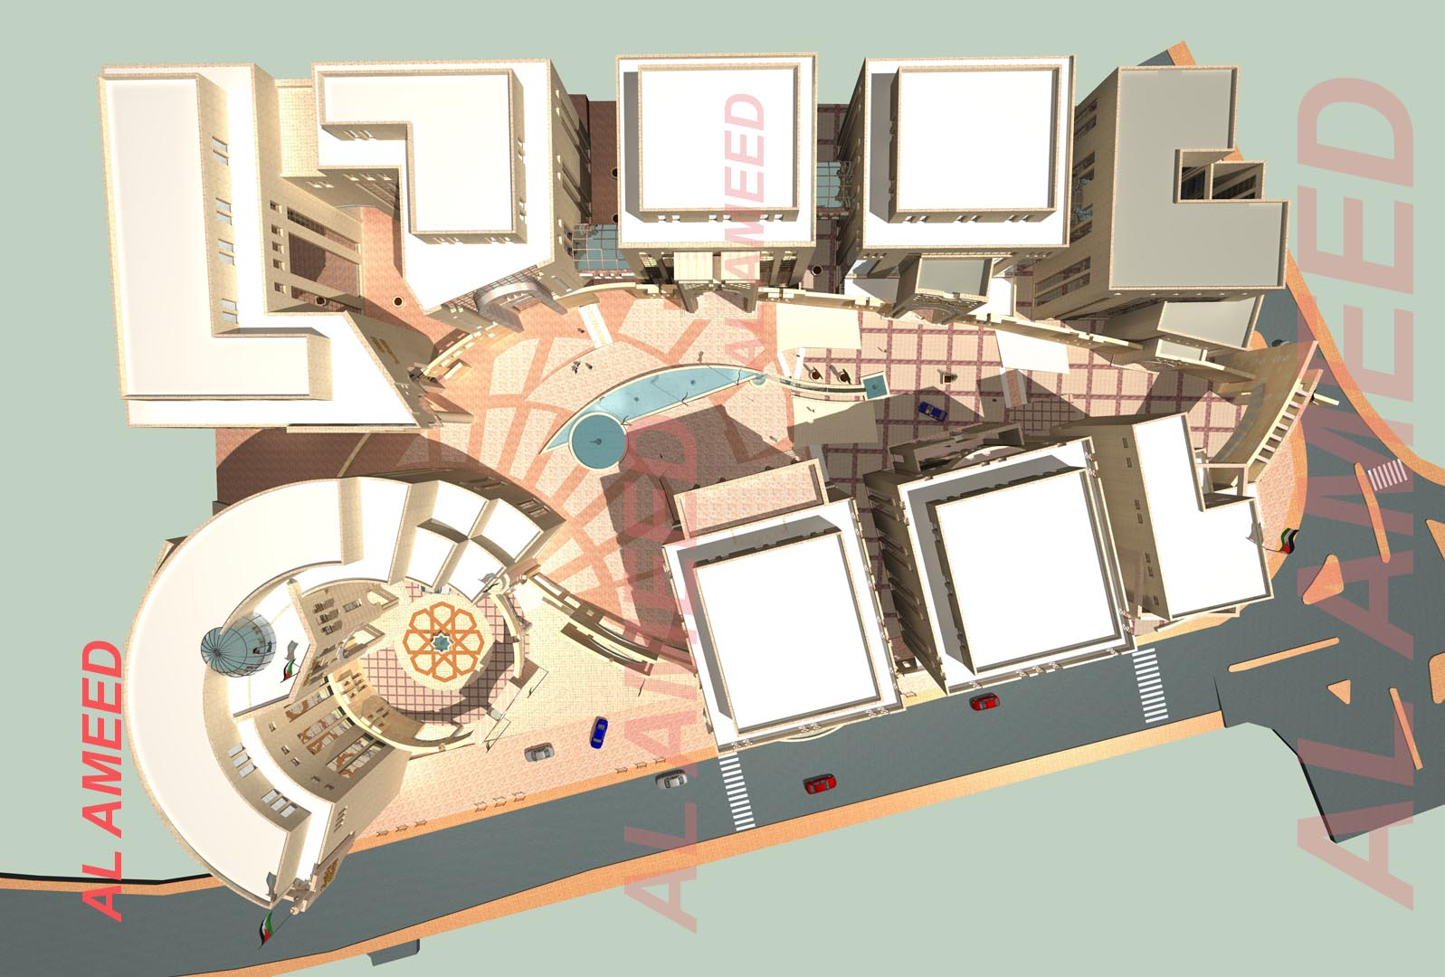
PROJECT B

Slide 10
Environmental analysis

Slide 11
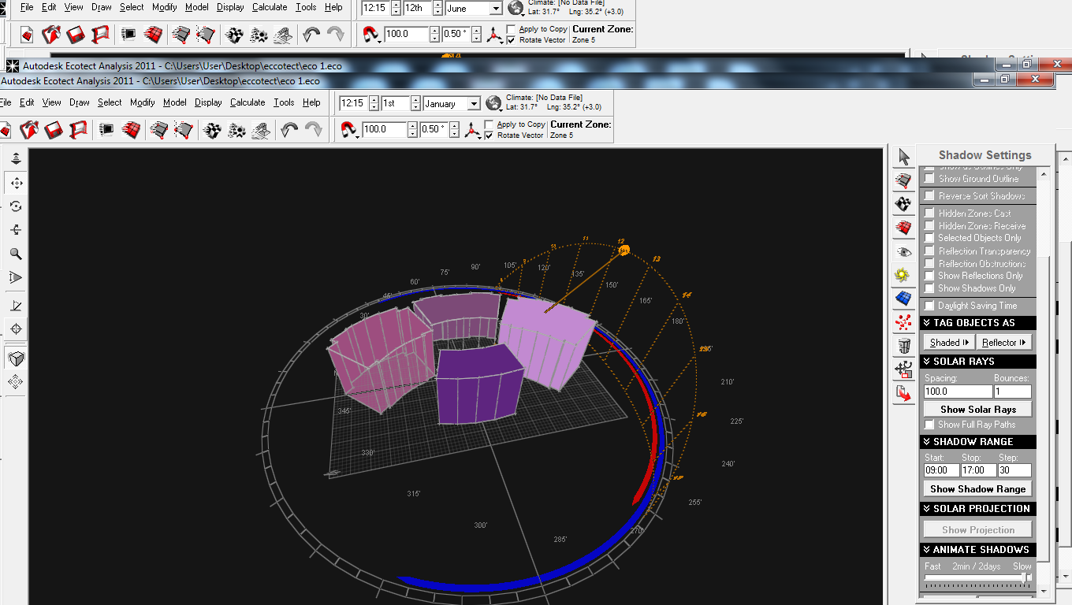
Sun path in winter for project A

Slide 12
Sun path in summer for project A

Slide 13
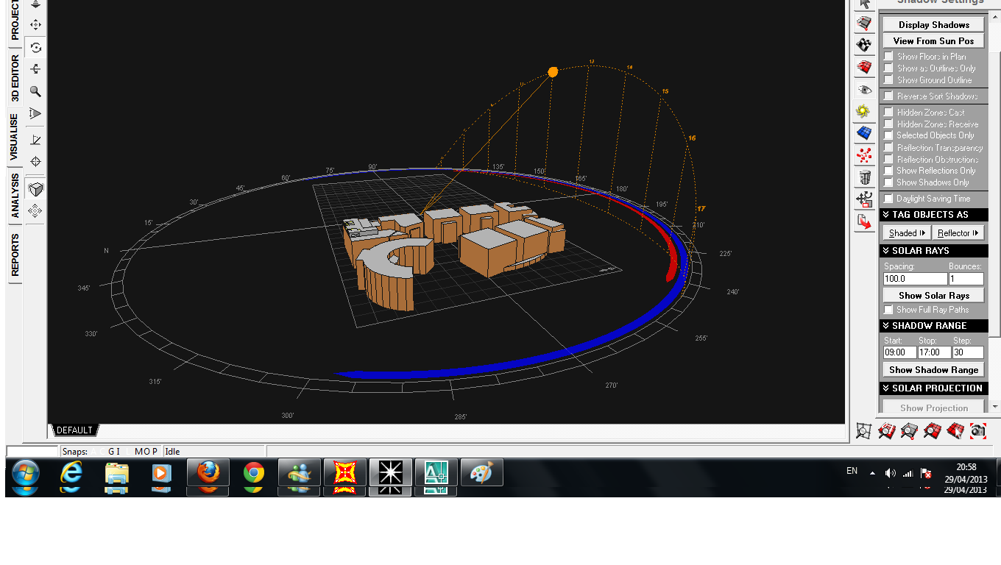
Sun path in winter for project B

Slide 14
Sun path in summer for project B

Slide 15
Comparing
Solar Exposure Value`s
Project A | Solar Exposure | Project B | Solar Exposure
1 | 321830 | 1 | 288965
2 | 178638 | 2 | 295384
3 | 665375 | 3 | 299986
4 | 238771 | 4 | 338305
 |  | 5 | 325649
 |  | 6 | 291600
 |  | 7 | 221080
 |  | 8 | 300814
 |  | 9 | 292773

Slide 16
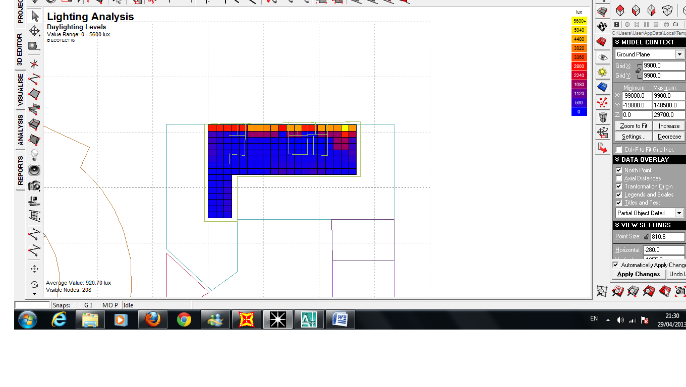
Daylight :

Slide 17
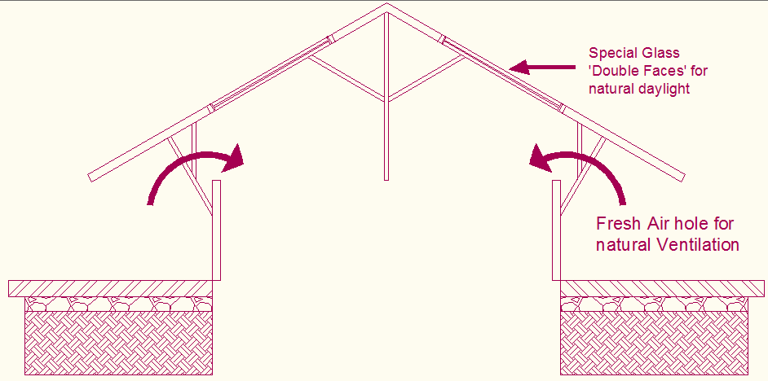
Ground Hole
Section

Slide 18
Architectural design

Slide 19
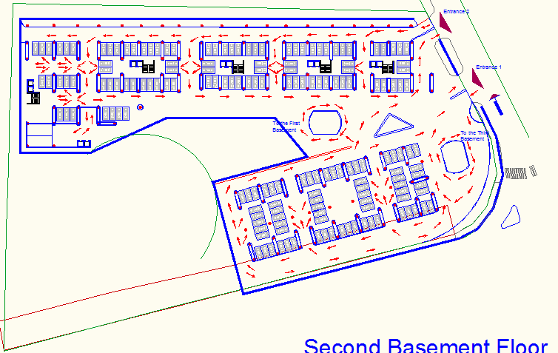
Parking Design

Slide 20
Parking Design
Ramp Length | 24
Slope of the Ramp | 1:10
Floor height | 3
Ramp Radius | 7
straight ramp length | 10
Circular Ramp Length | 20
Total Ramp Length | 30
Road Width | 5.5
Road Width in Circular Ramp | 7.5

Slide 21
Elevators Design
Floor Height | 3.5m
Levels Number | 11 floor
elevator interval time | 25-29 sec
Waiting Time | 15-17 sec
Percent of Population to be carried in 5 min | 14-16%
Net Area ( Normal ) | 10-12m2/person
Round Trip (RT) | 118
handling Capacity (h) | 38.6
Interval (I) | 23.6 sec
Percent of Population (PHC) | 21%
Number of cars needed | 4

Slide 22
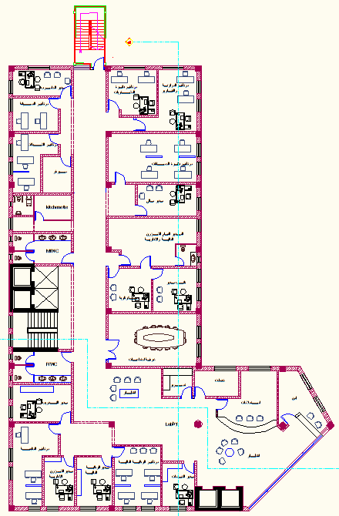
Architectural Design
Plans :
Ground Floor

Slide 23
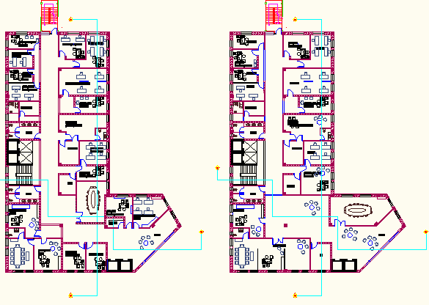
Architectural Design
Plans :5th and 6th Floor

Slide 24
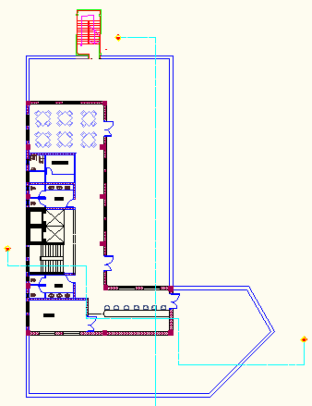
Architectural Design
Plans :
7th Floor

Slide 25
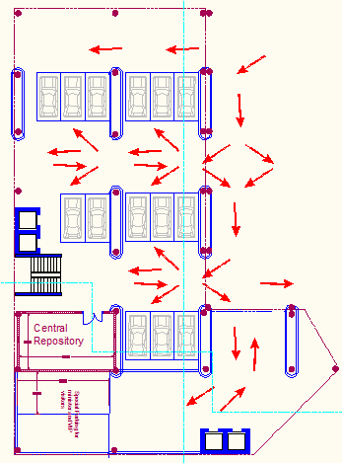
Architectural Design
Plans :
2nd basement
Floor

Slide 26
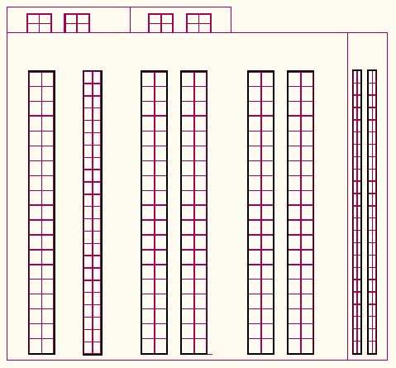
East Elevation

Slide 27
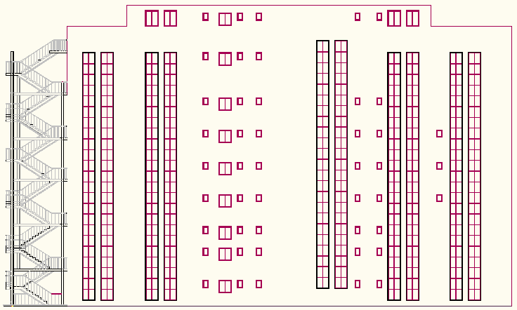
Nouth Elevation

Slide 28
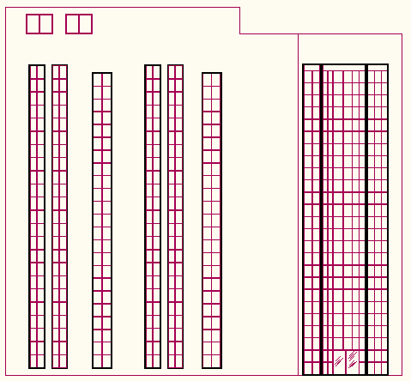
West Elevation

Slide 29
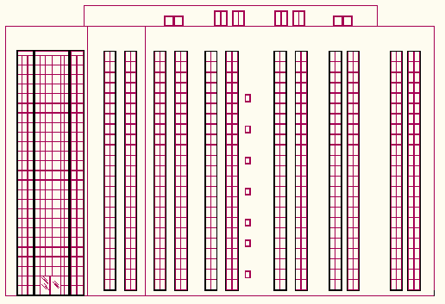
South Elevation

Slide 30
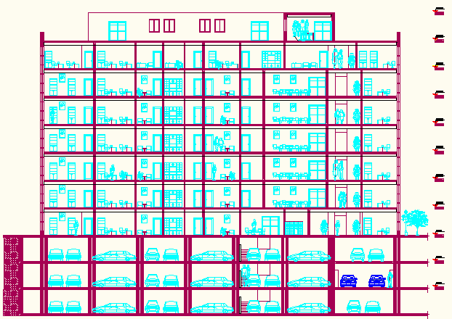
Section A-A

Slide 31
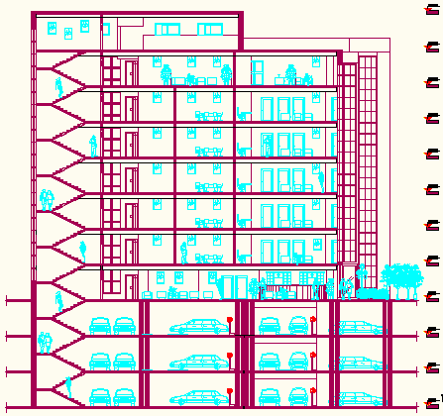
Section B-B

Slide 32
Structural design

Slide 33

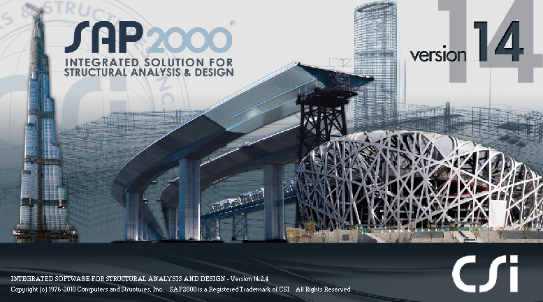
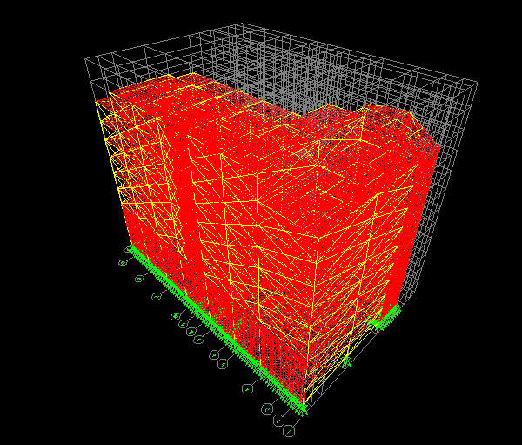
structural design
The structural design was made by SAP program
3D modeling

Slide 34
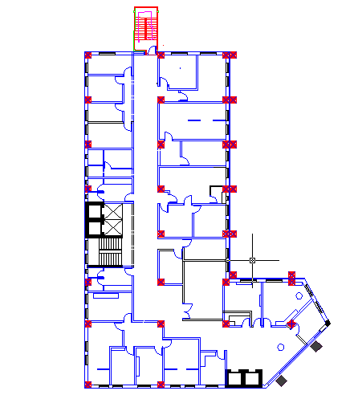
Ministry of Trade and Economy
Typical Plan
Building 3D Model

Slide 35
Codes:
The structures are designed using practice code and specifications that control the design process and variables.
The following codes and standards are used in this study:
* ACI 318-08: American concrete institute provisions for reinforced concrete structure design.
*UBC-97: code which is used here for seismic load parameters determination .

Slide 36
Structural element:
Design will include the following elements :
1) slab ( one way rib slab).
2) beam ( main beam & secondary beam) .
3) column .
4) footing

Slide 37
Design data:
1- Compressive strength of concrete (f\c)
beams
shear walls
columns
Footing
slabs
2- Yielding strength of steel (fy),
3- Bearing capacity of soil=
f\c =400 kg/cm²
fy =4200 kg/cm²
4 kg/cm²

Slide 38
Material :
Unit weight of used materials
Unit weight of materials ton/m³ | Unit weight of materials Kg/m³ | Material
2.5 | 2500 | Reinforced concrete
2.3 | 2300 | Plain concrete
2.6 | 2600 | stone
1.2 | 1200 | Blocks

Slide 39
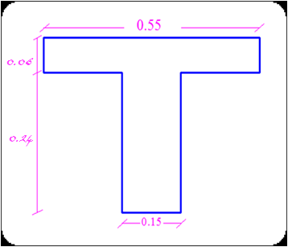
Preliminary Design:
Beam thickness
Main beam→ (60*50) cm
Hidden beam→ (30*50) cm
External beam→ (60*30) cm
Column dimension
G1 → d= 90 cm
G2→ (40*40) cm
G3→ (50*50) cm
G4 → (55*55) cm
G5 → (60*60) cm
G6 → (70*70) cm
G7 → (80*80) cm
Slab thickness

Slide 40
Loads :
Superimposed dead load=4.5 kN/m²
Superimposed dead load for carrage=2.5 kN/m²
Live load =5 kN/m²

Slide 41
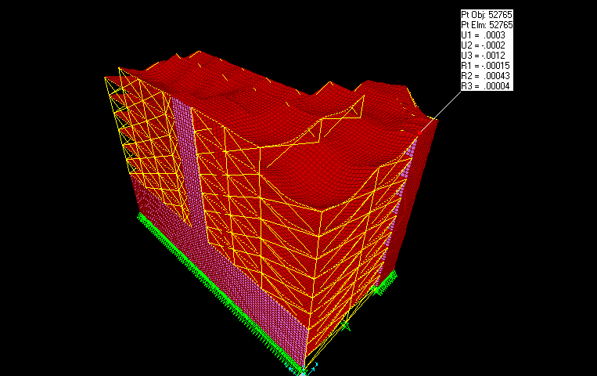
Check for sap model :
Compatibility check

Slide 42
Check for sap model :
Check equilibrium
dead load
127700KN | From sap
128500 | manual
.6% | % of error
live load
33614 | From sap
34200 | manual
1.75 % | % of error

Slide 43
Check for sap model :
local equilibrium (internal force )
# of beam | Sap value | Manual value | % of error
B1 | 475 | 420 | 11%
B2 | 649 | 612 | 5.5%
#of slab | Floor | Mu from sap | Mu manual | % of error
1 | F6 | 79.5 | 75.6 | 5%
2 | F4 | 45 | 37 | 17%
# OF COLUMN | MANUAL Pu | Sap Pu | %of error
C1 | 4963.5 | 5178 | 4.3%
C2 | 2061 | 2538 | 23%

Slide 44
Dynamic Design :
Soil type Sc
Z = 0.2
C v=0.32
Ca =0.24
T- calculation | T- Sap
0.6 S | 0.35 S

Slide 45
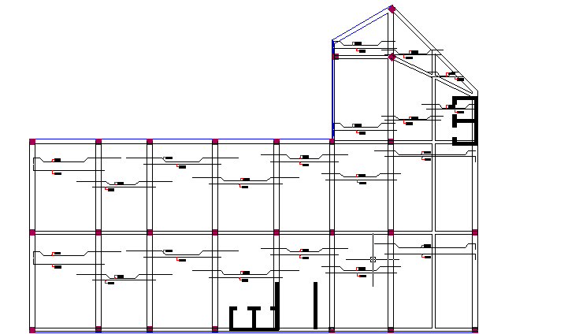
Design :
Design slab

Slide 46
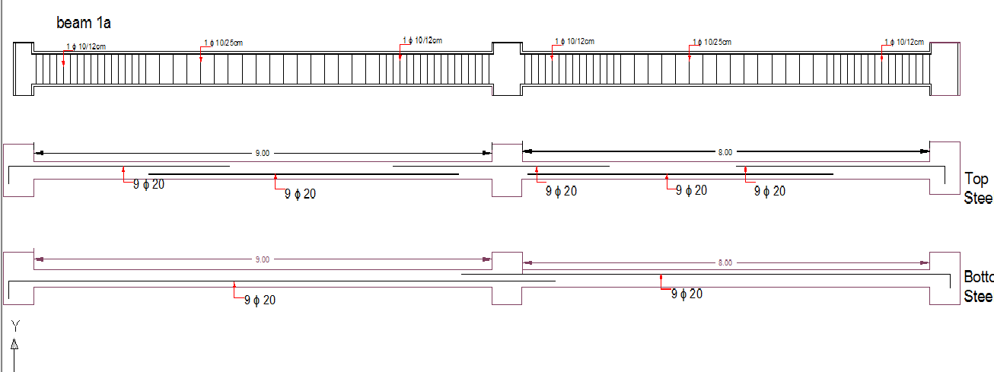
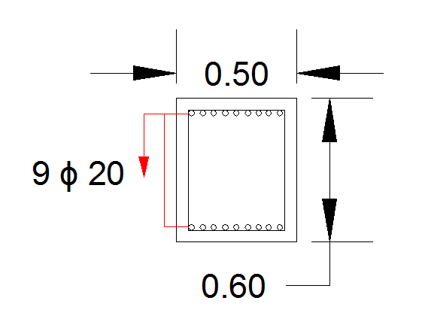
Design :
Beams design

Slide 47
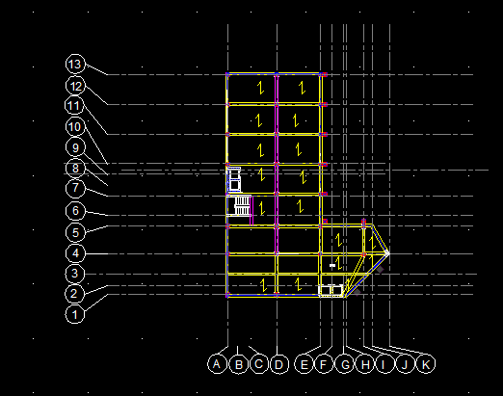
Design:
Column design

Slide 48
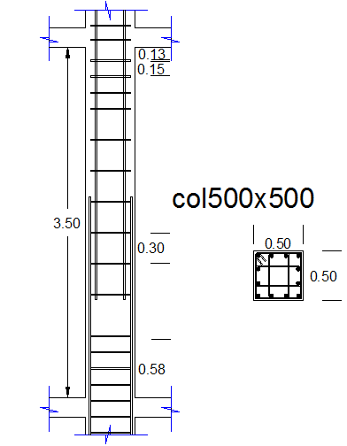
Design:
Column design

Slide 49
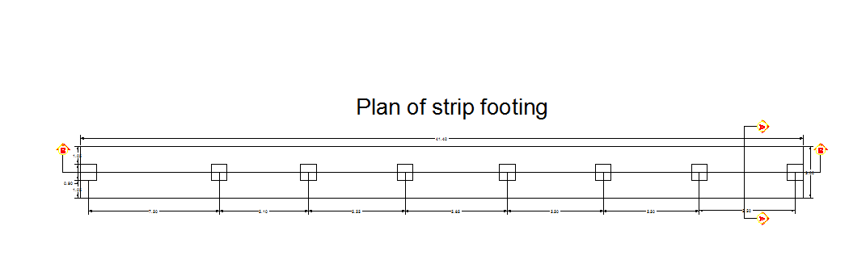
Design:
footing design

Slide 50
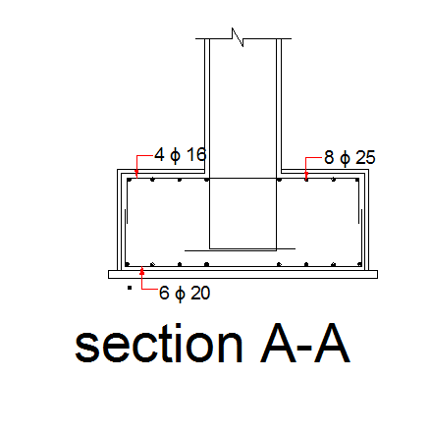
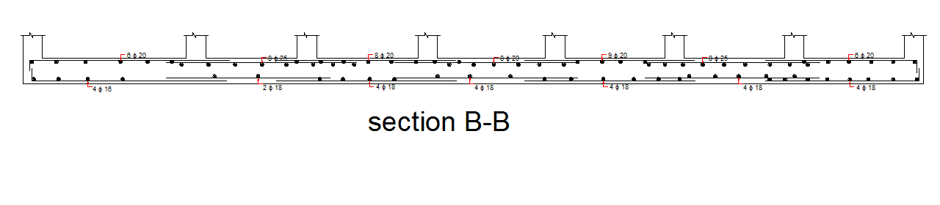
Desing :

Slide 51
Mechanical design
HVAC , water supply
drainage system, fire system.

Slide 52
HVAC system
  - Heating design.
U | The element
0.72 | Outside wall
0.87 | ceiling
0.61 | floor
3.5 | window
7 | Aluminum door

Slide 53
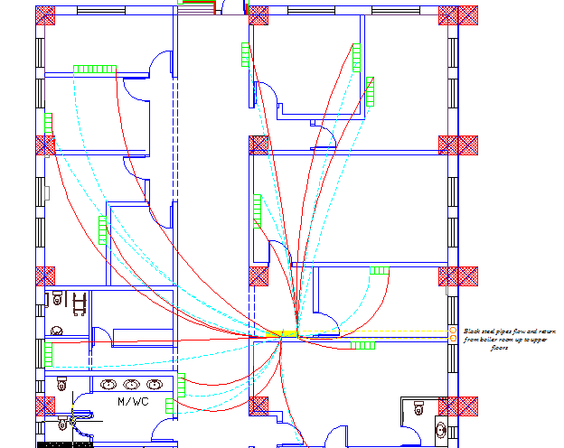

Slide 54
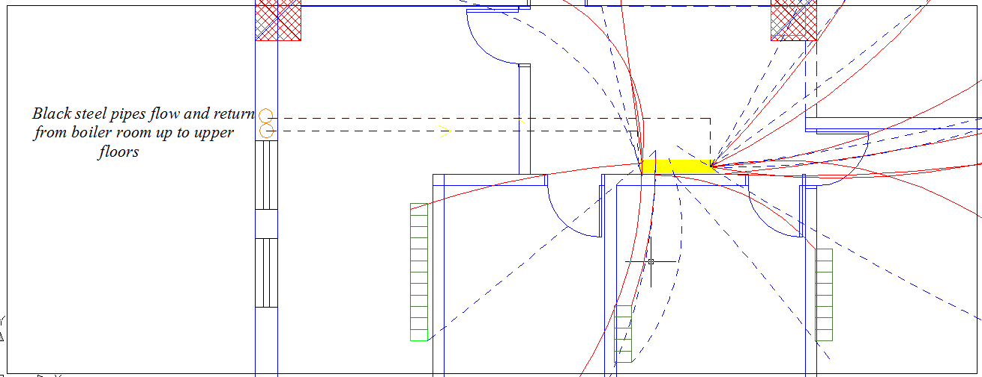

Slide 55
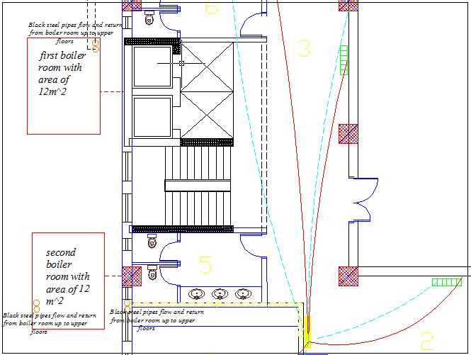

Slide 56
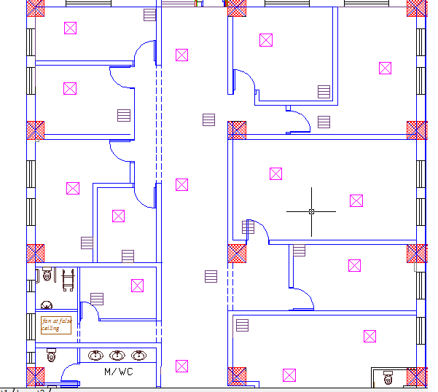
The selection diffuser is a square supply air diffusers of four way flow pattern with size of 46*46 cm
cooling design.

Slide 57
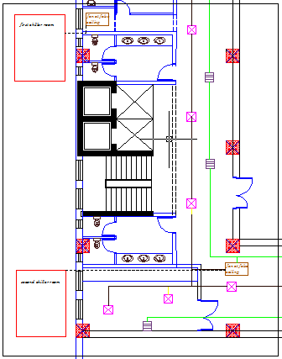

Slide 58
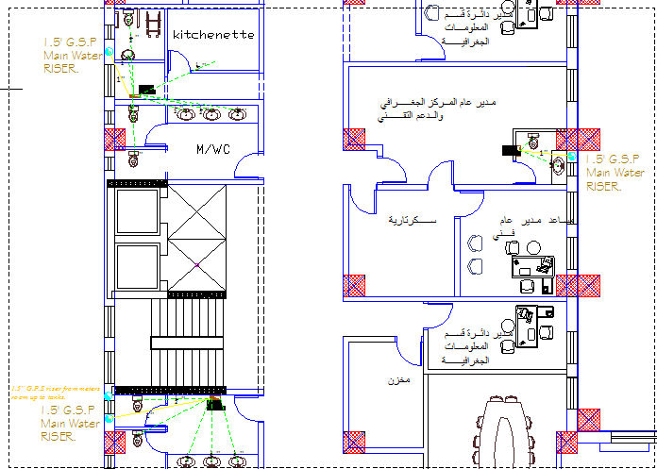
Water supply

Slide 59
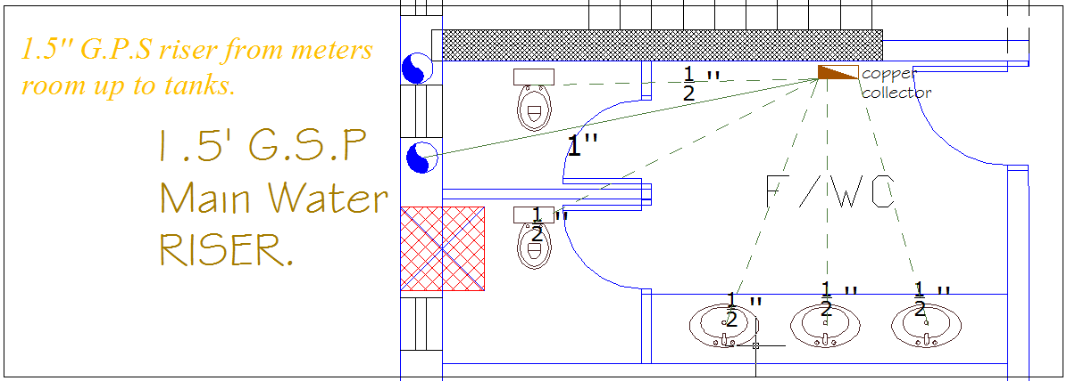

Slide 60
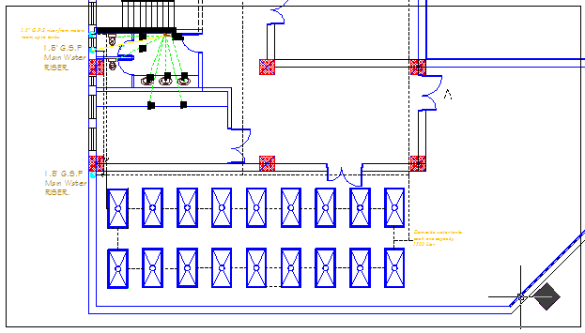

Slide 61
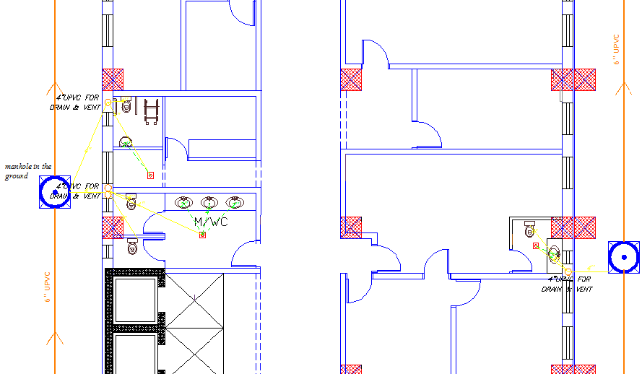
Drainage system

Slide 62
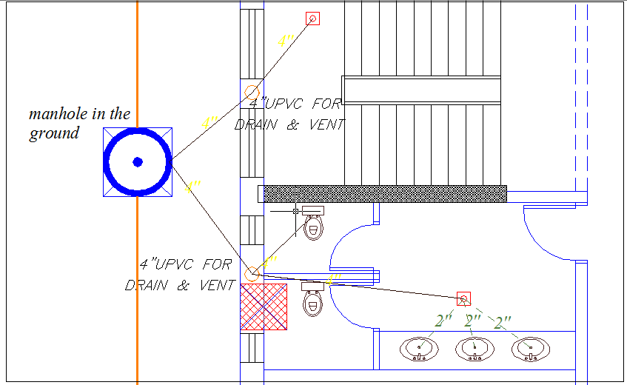

Slide 63
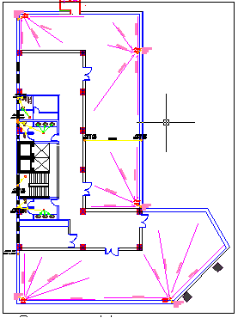

Slide 64
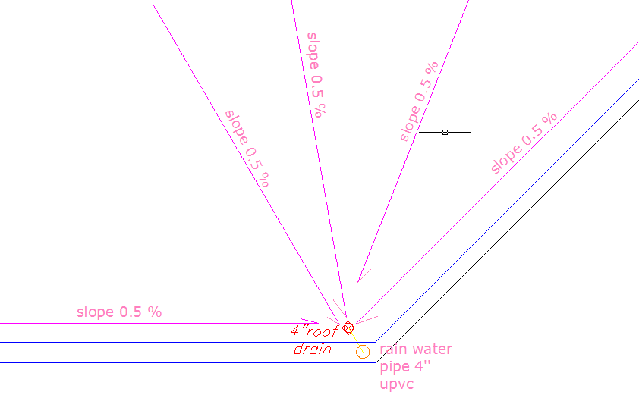

Slide 65
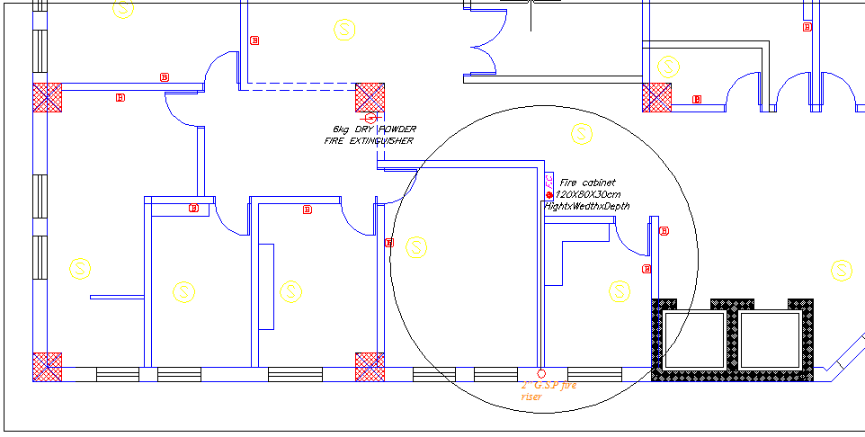
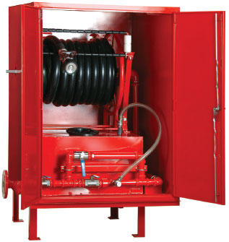
Fire system

Slide 66


Slide 67



Slide 68


Slide 69
Electrical design

Slide 70


Artificial lighting
Florescent lamp (4*T8 18 watt) BEGA 5524 3 TC-D 26W
Luminaire Luminous Flux =5400 lm Luminaire Luminous
Flux =5400 lm

Slide 71

Number of luminaries for each space have been calculated

Slide 72

the seventh floor was design by dialux program lamps that were used are of a type SECOLUX-E PL-L 136EVG. with 36 watt.

Slide 73


Slide 74
Cost estimation

Slide 75

Total cost=45300000 NIS
Total area=14885.92m² cost/m²=3043.14 NIS
Project A

Slide 76

Total cost =25900000 NIS.
Total area= 8957.69 m²
Total cost /m²=2891.3 NIS
Project B
cost | Work
25586010 NIS | Structural & architectural cost
216930 NIS | Mechanical cost
97060 NIS | Electrical cost

