Slide 1
Time and cost assessment of Ministry of Local Government In The City Of Ramallah
Prepared by:
Mohammad Abusa’a
Sadeq Yasin
Ayman Majdi
Yazan Qasem
Supervisor:
Eng Reema Bdair

Slide 2
Presentation content
Introduction.
Case Study.
Purpose of the study.
Methodology.
Work breakdown structure.
Quantity survey.
Cost Estimation.
Time scheduling.
Results and Conclusion.

Slide 3


Introduction
Project Management
Pros of applying project management on the construction projects

Slide 4
Case study
Ministry of local government in Ramallah city.
Building Consist of 9 Floors.
Total area of the building: 7000 square meter.

Slide 5
CASE STUDY
Started at 2015/4/28.
Total cost of the project was 2,512,523 $.
Type of contract: Unit price.

Slide 6

Purpose of study
Apply management principles to assets the project by the terms of time and cost.

Slide 7

Methodology
Site visiting
Collect information.
Primavera
Time estimation.
Revit
Quantity survey.

Slide 8
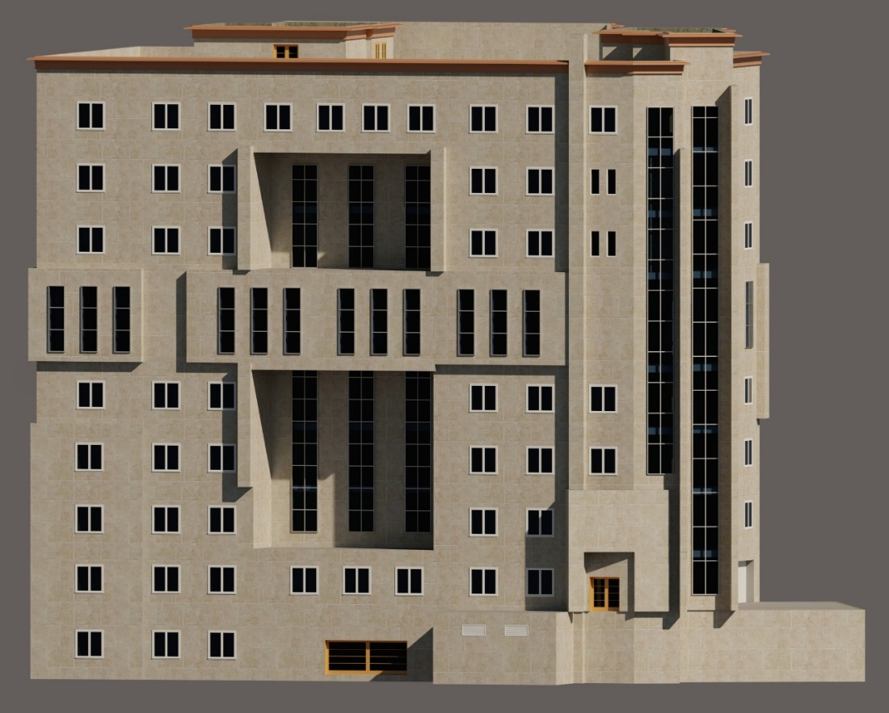
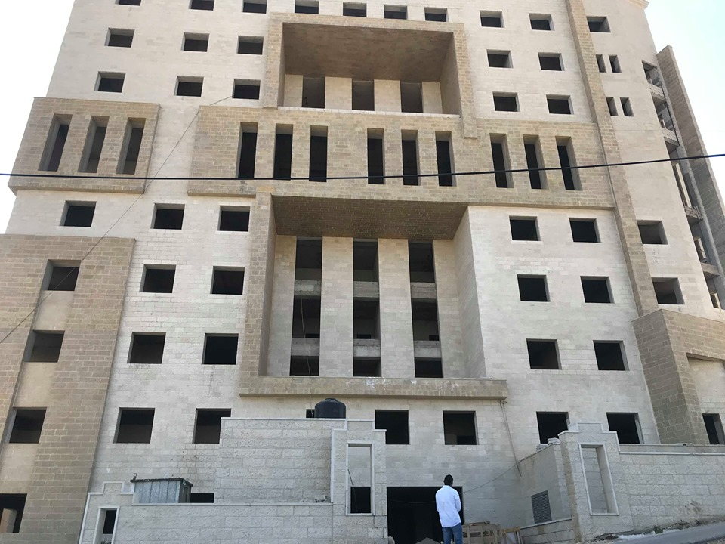
methodology
Revit architectural model
Reality

Slide 9

Work break down structure
It was developed according to the bell of quantity.

Slide 10
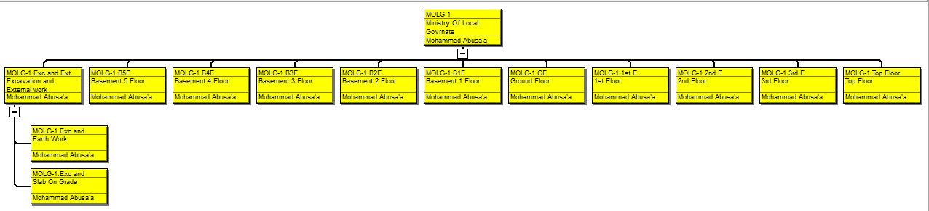
Work break down structure

Slide 11
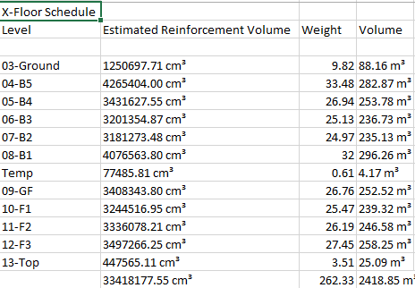
Quantity survey
Slabs concrete volume

Slide 12
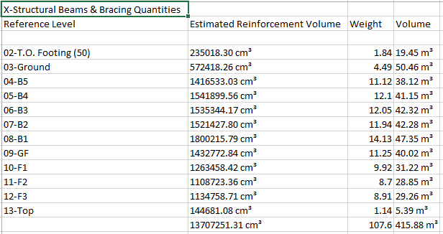
Quantity survey
Beams concrete volume

Slide 13
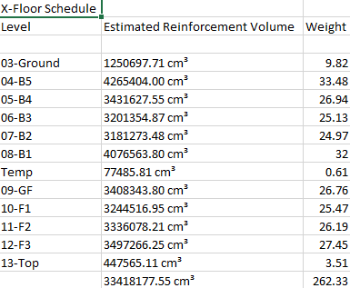
Quantity survey
Reinforcement steel quantities.

Slide 14
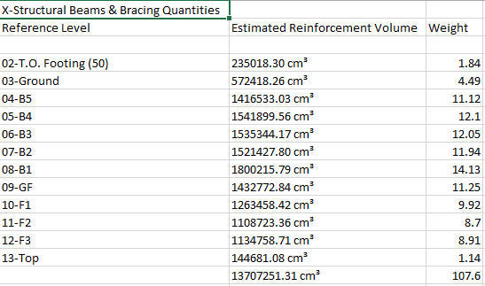
Quantity survey
Reinforcement steel quantities for beams.

Slide 15
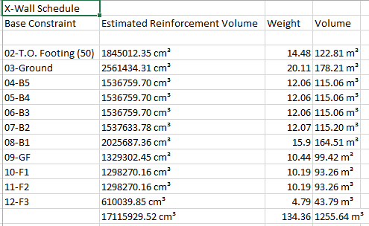
Quantity survey
Walls concrete volume.

Slide 16
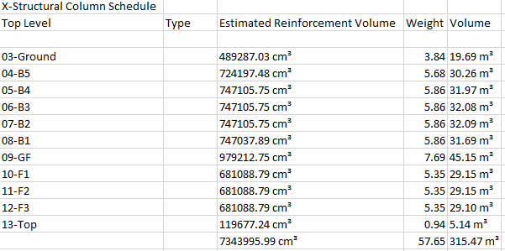
Quantity survey
Columns concrete volume.

Slide 17
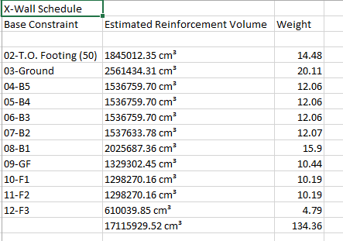
Quantity survey
Reinforcement steel quantities for walls.

Slide 18
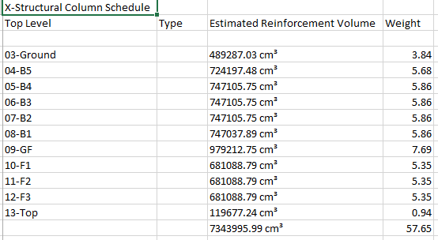
Quantity survey
Reinforcement steel quantities for columns.

Slide 19
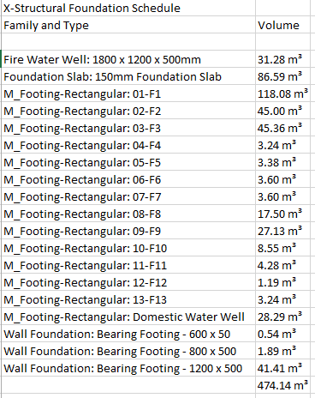
Quantity survey
Foundations concrete volume.

Slide 20
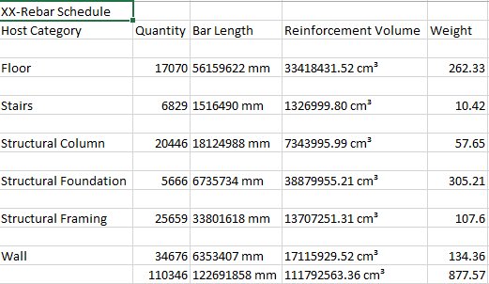
Quantity survey
Reinforcement steel quantities in general.

Slide 21
Cost estimation
Direct cost.
+ Job overhead (%)
+ Overhead (%)
Total Price

Slide 22
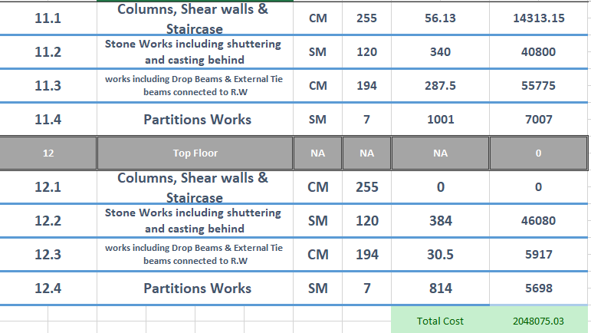

DIRECT COST
Direct cost =
$$\left.Quantity ×(1+\%Wastage)×({Unit}/{Cost}\right)$$

Slide 23
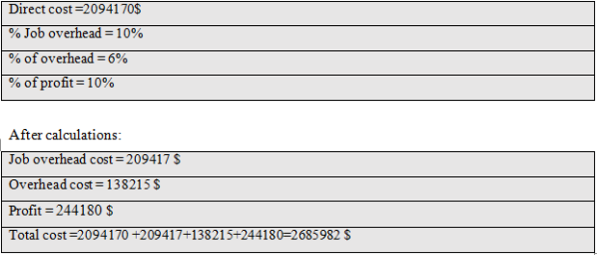

Job overhead
$$\left.DC×(1+\%Job Overhead\right)$$

Slide 24

Overhead
(DC+JO%)*(1+OH%)
$$\left.(DC+\%JO)×(1+OH\%)\right)$$

Slide 25
TOTAL PRICE
(DC+JO%+OH%)*(1+Profit%)
$$\left.(DC+\%JO)×(1+OH\%)\right)$$

Slide 26


Time scheduling
Estimate activities duration.
Insert activities into P6
Estimate project total duration.

Slide 27
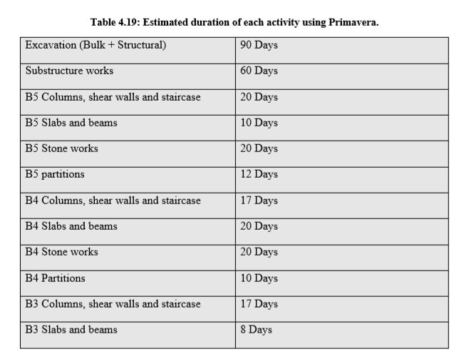
ACTIVITIES DURATION
Activities duration have been taken from the contractor.

Slide 28
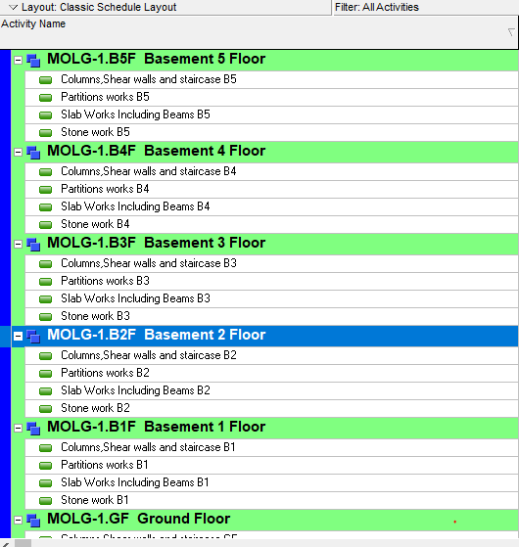
P6 Activities

Slide 29
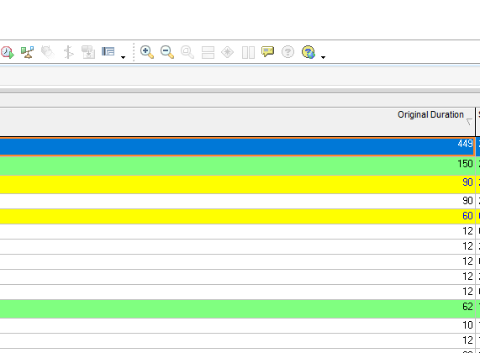
Total duration of the project
Project total duration= 449 working days

Slide 30
Result
Study results:
Project Duration is 449 Working days
Project Total Price =2,685,979 $

Slide 31
Comparison
Study time and cost:
Project duration = 449 working days
Project total price=2,685,979 $
Actual time and cost:
Project duration=635 working days
Project total price=2,512,523 $

Slide 32
Comparison
635-499=136 working days
= 2,685,979 $ - 2,512,523 $ = 173,456 $
Delay in project
Cost Difference

Slide 33
Recommendations
As a result of wrong site investigation and lack of information about the soil, a 135 days of delay occurred.
All Crashing.

