Slide 1
RateRelay
Transforming Feedback, Amplifying Trust!

Slide 2
Table of contents
01
02
03
04
05
06
Motivations
Introduction
Features
Technologies Used
Constraints and Future Work
Conclusion

Slide 3
“There is always a first try for everything, but what if we could receive the best and most reliable try instead?”

Slide 4
01
Motivations

Slide 5
RateRelay includes:
User-friendly mobile application for normal users.
Dedicated website tailored for business administrators.

Slide 6
What are our Motivations?
Users
Businesses
Enhancing the shopping experience.
Users can share their experiences, helping others make informed decisions.
Users can communicate with businesses effectively.
Users can stay informed about business products and services.
Monitoring customer feedback, identifying target customers, and assessing satisfaction levels.
Utilization of a comprehensive dashboard with detailed statistics and charts for insights into customer sentiment.
AI-powered analysis categorizing feedback as positive, negative, or neutral, facilitating targeted service improvements.

Slide 7
02
Introduction

Slide 8
The RateRelay project aims to establish a pivotal platform for enhancing customer-business interactions through robust feedback mechanisms
Transparent Feedback Loop
Business Focus on Satisfaction
Effective Marketing and Reputation Management
Empowers customers to provide valuable feedback, fostering trust and transparency with businesses.
Prioritizes improving customer satisfaction to cultivate loyalty and market competitiveness.
Provides businesses with tools to elevate customer satisfaction and manage their online reputation.
Dual Interface Development
Effective Communication
Addressing Regional Market Gaps
Developing user-friendly interfaces for both customers (mobile app) and businesses (web platform), ensuring accessibility and usability
Purpose includes responding to product/service inquiries and addressing customer complaints for improvement.
Fills a crucial gap in Arabic regions by offering a localized feedback and engagement platform

Slide 9
03
Features

Slide 10

RateRelay Application

Slide 11
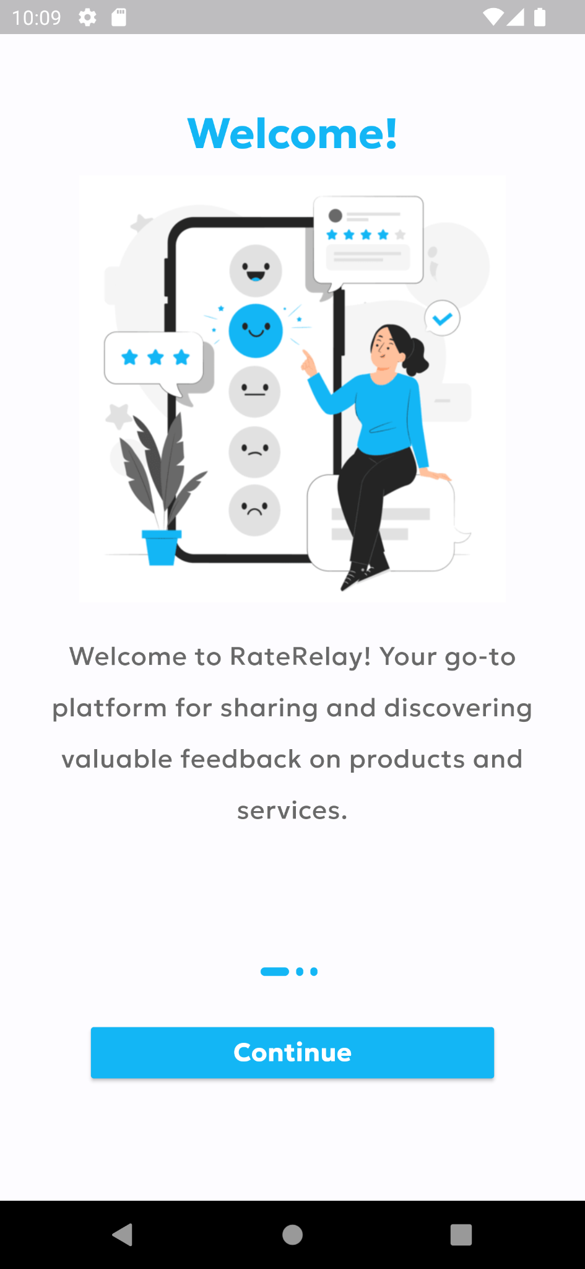
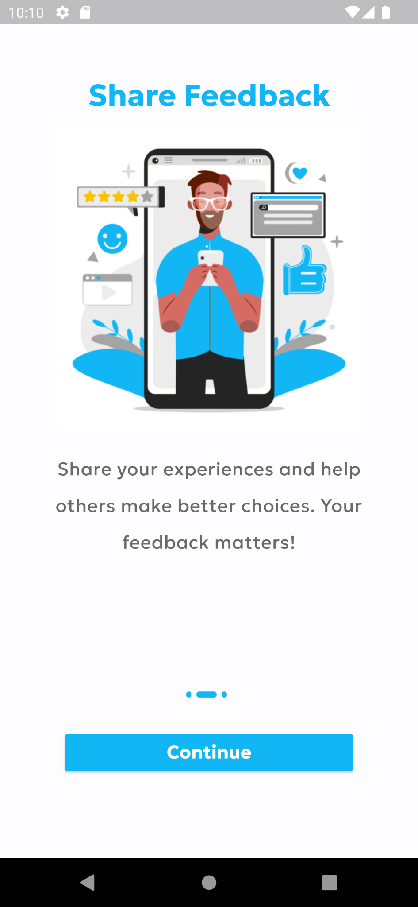
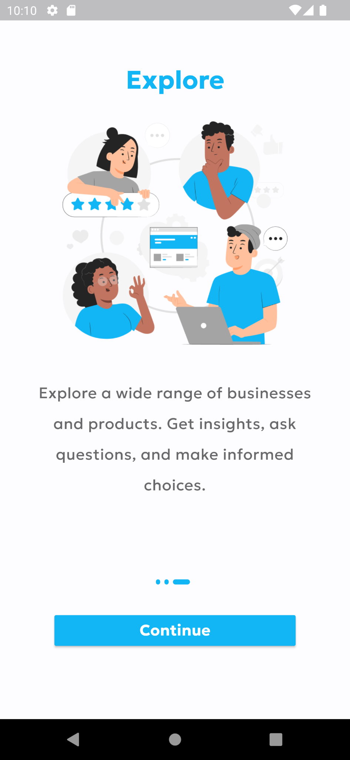
Onboarding screens

Slide 12
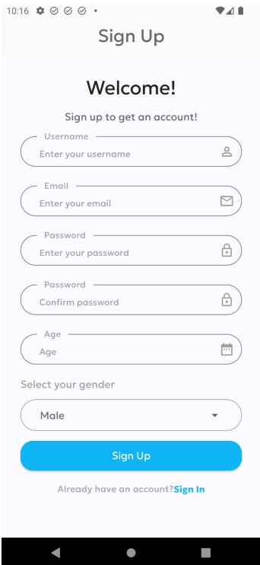
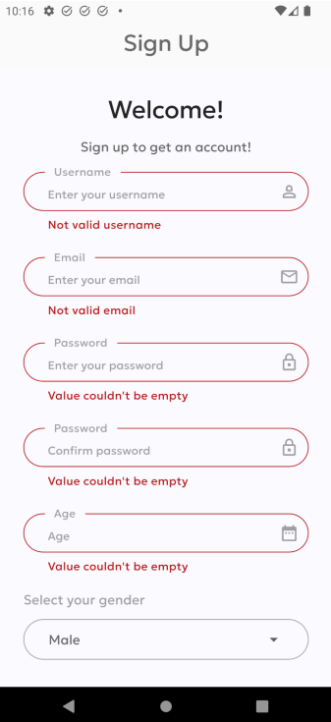
Authentication Screens
Sign-up screens

Slide 13
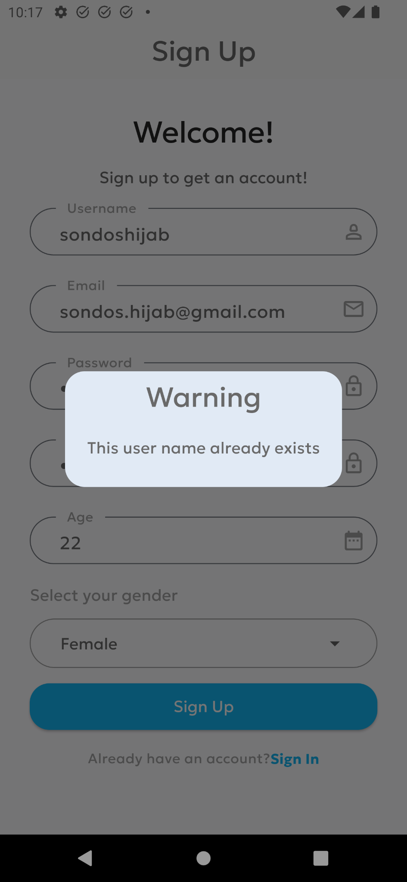
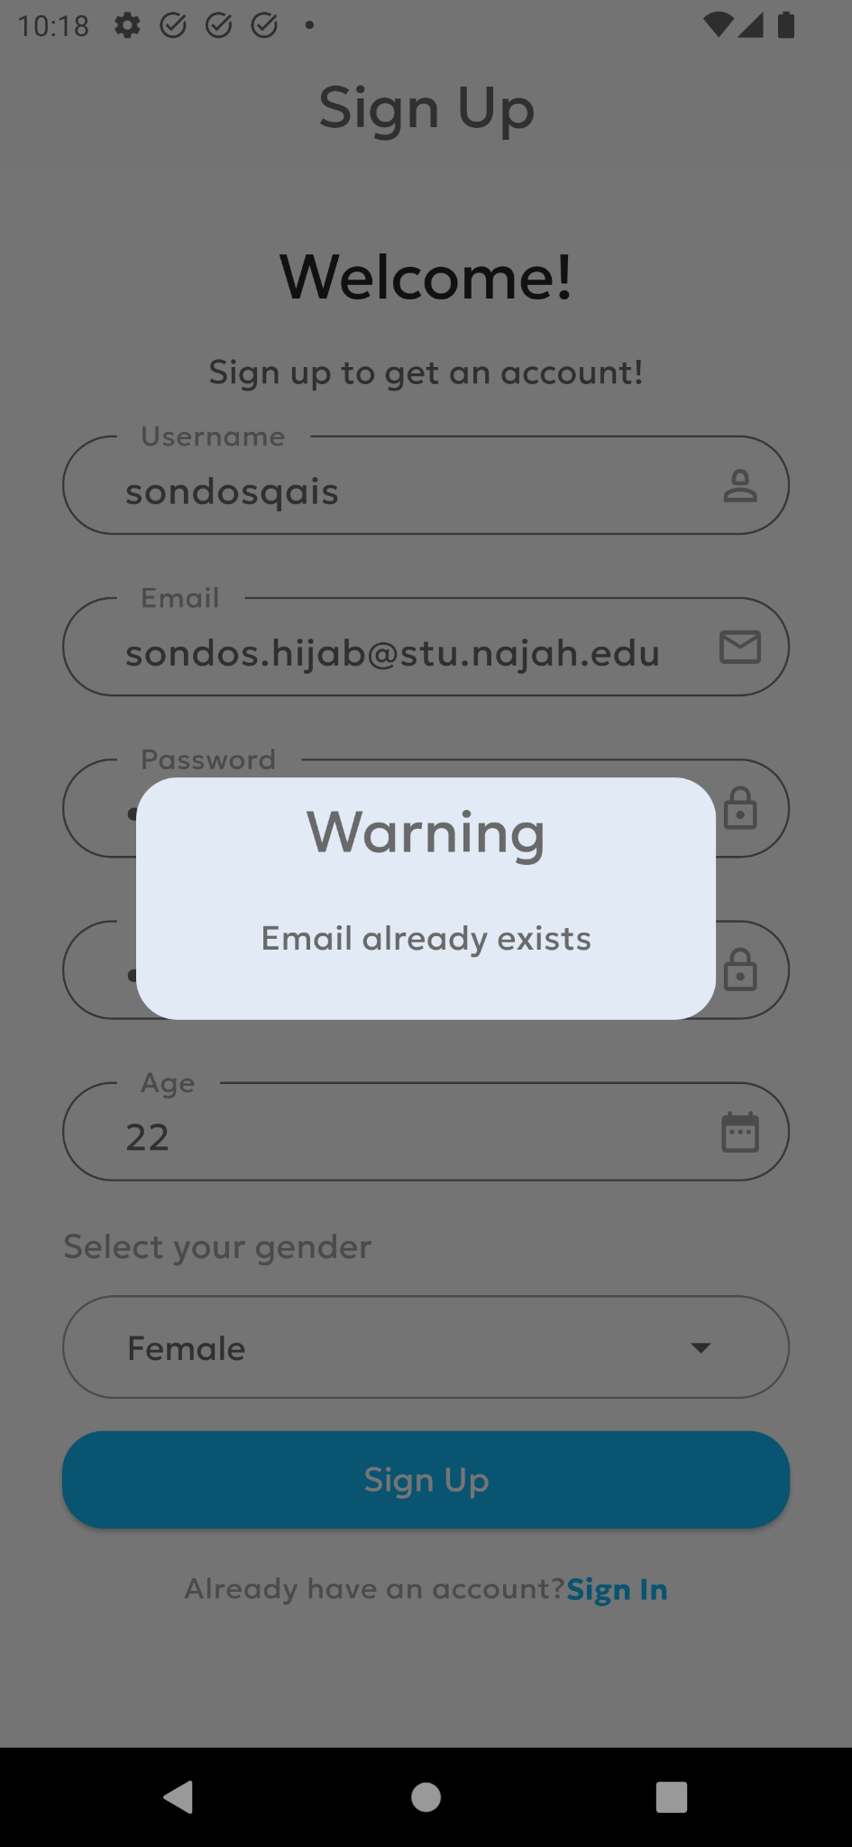
Authentication Screens
Sign-up screens

Slide 14
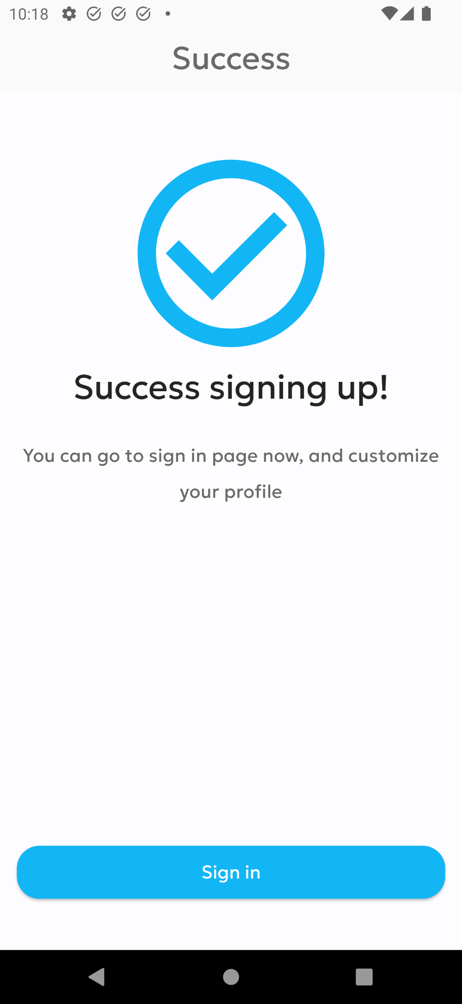
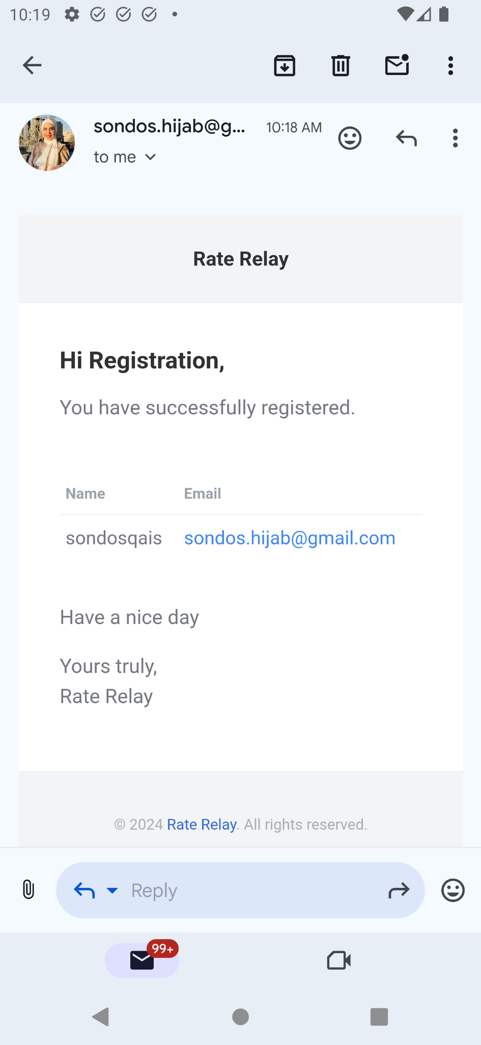
Authentication Screens
Sign-up screens

Slide 15
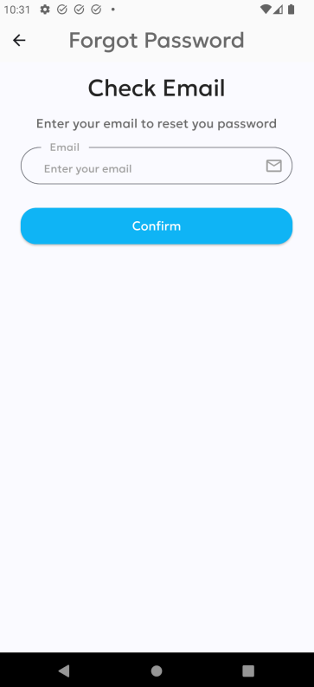
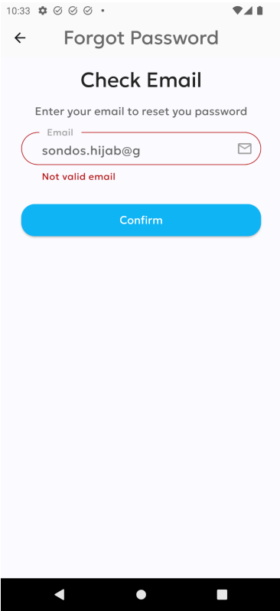
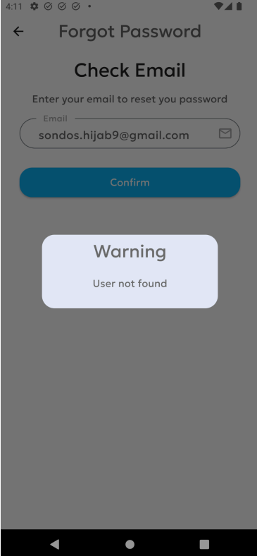
Authentication Screens
Forgot Password screens

Slide 16
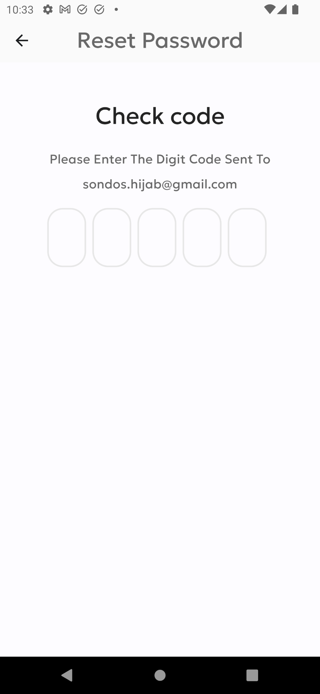
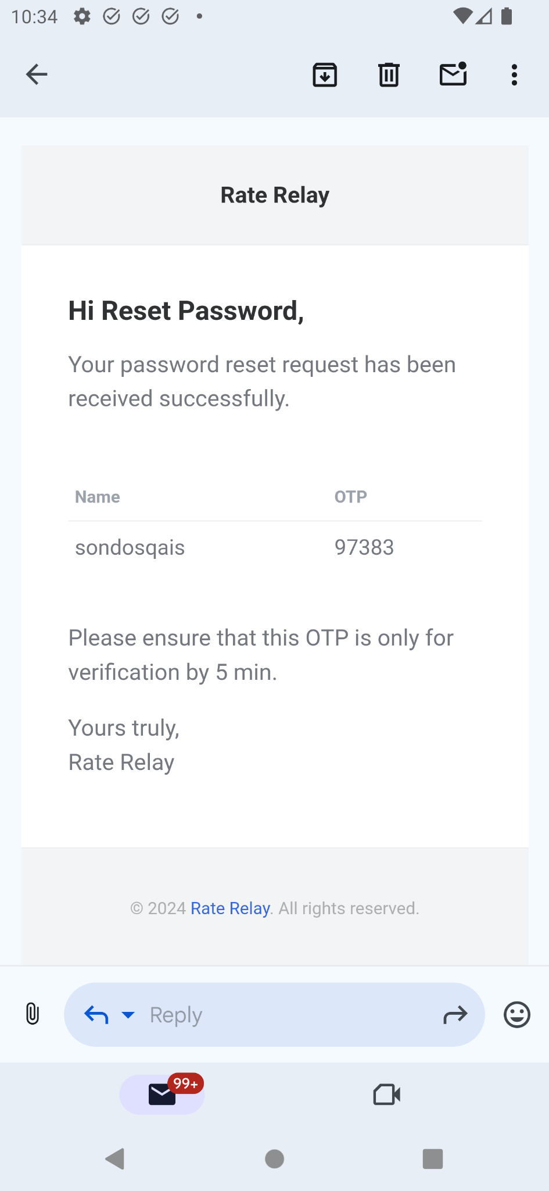
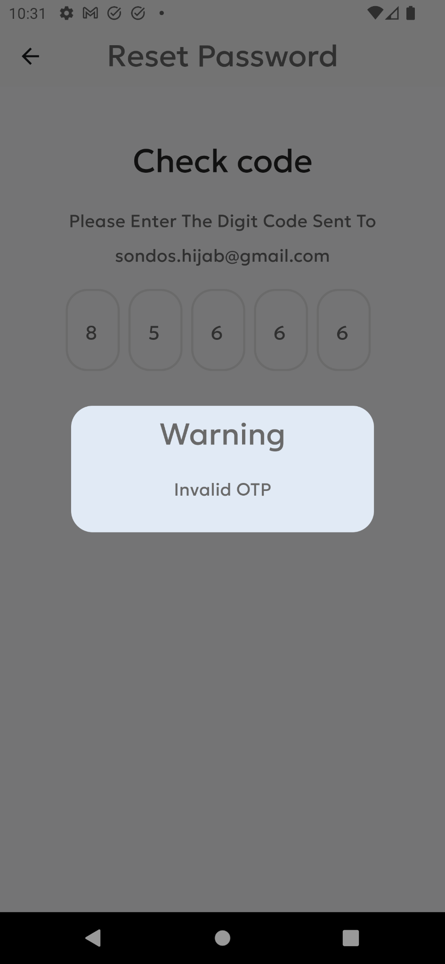
Authentication Screens
Forgot Password screens

Slide 17
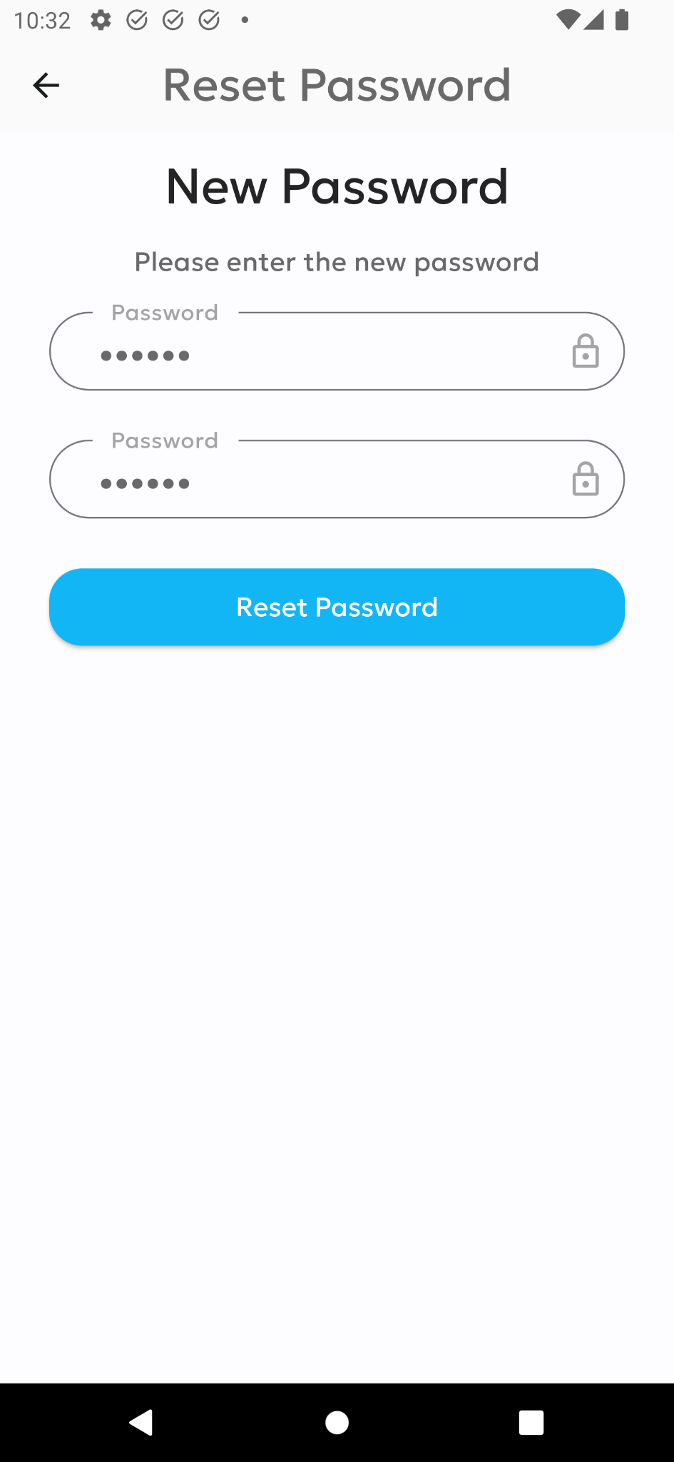
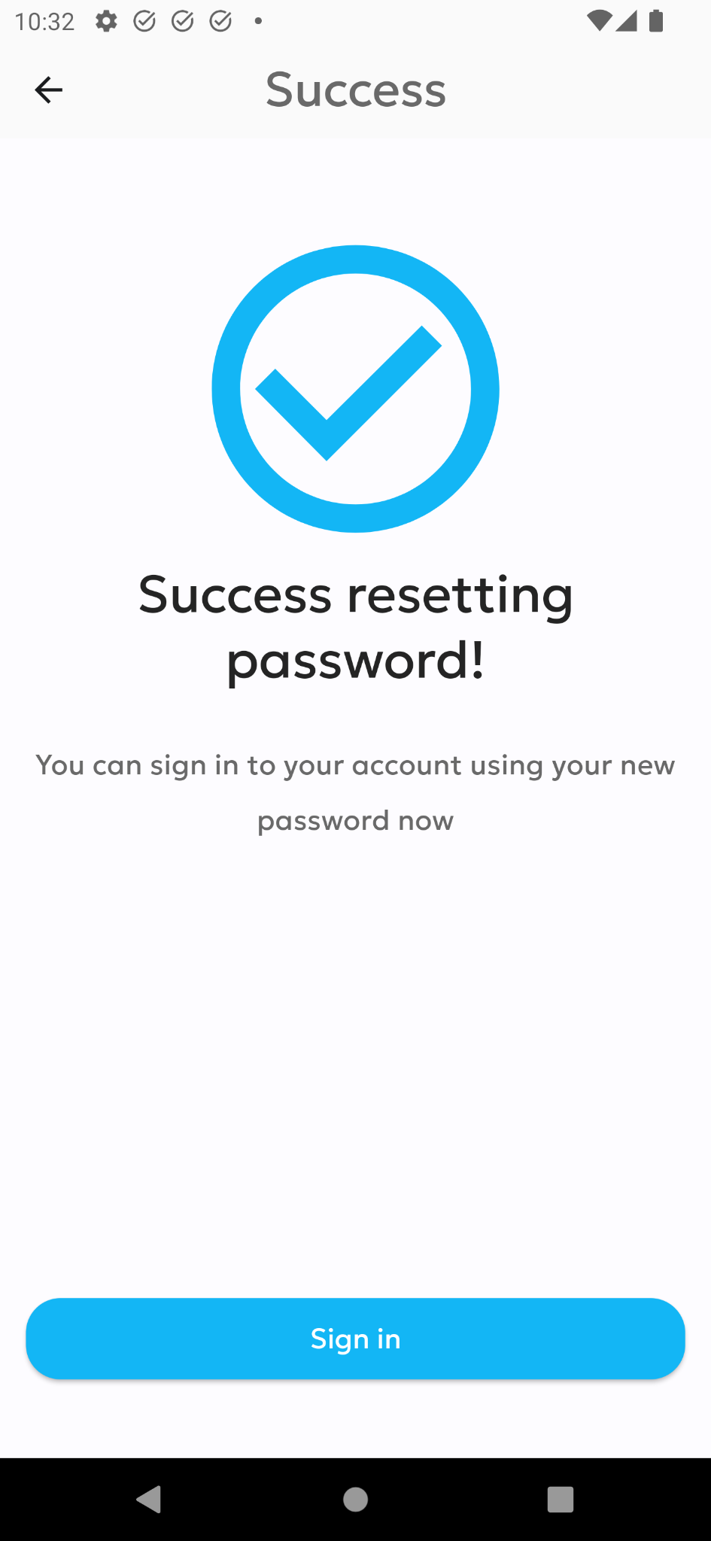
Authentication Screens
Forgot Password screens

Slide 18
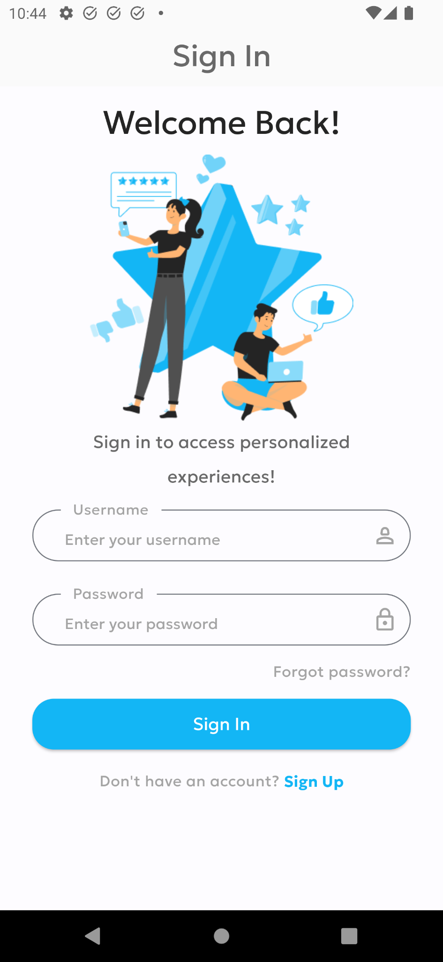
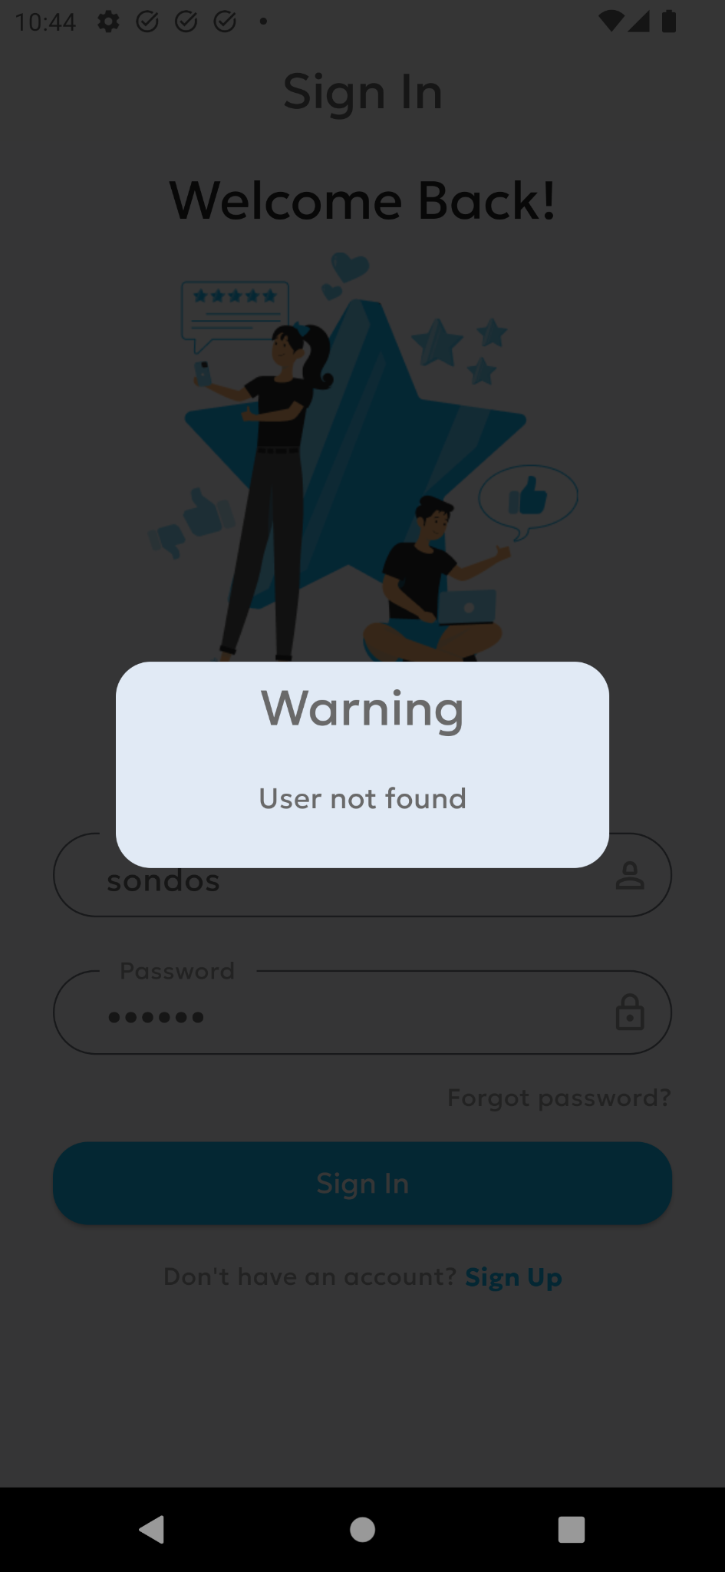
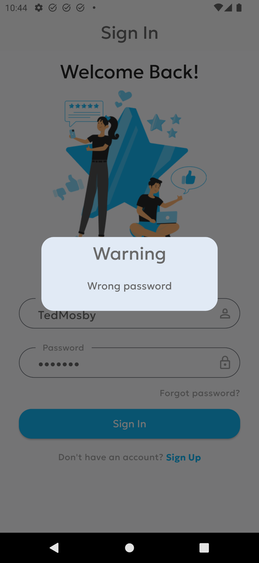
Authentication Screens
Sign in screens

Slide 19
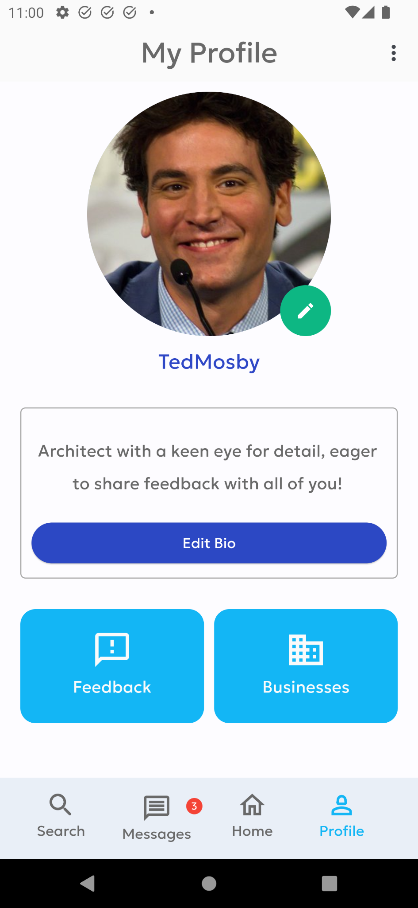
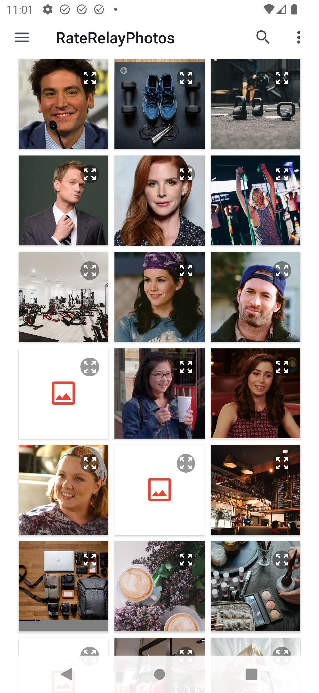
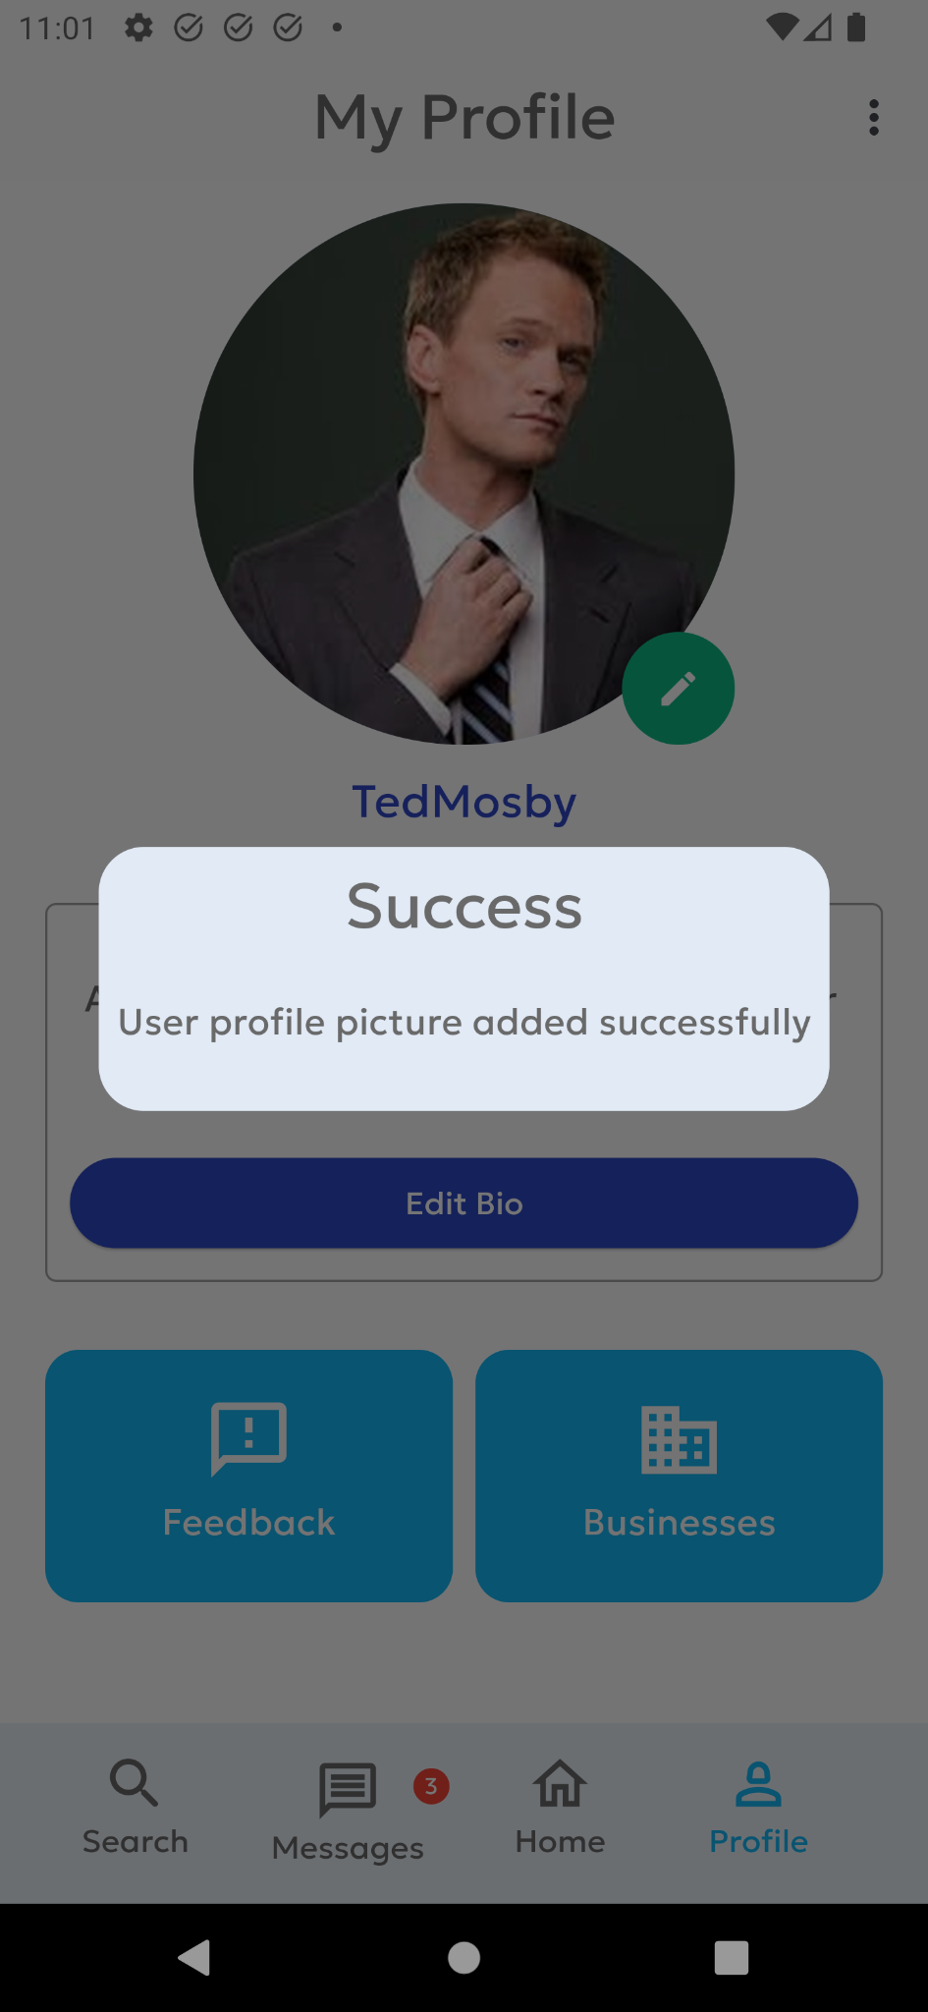
Profile Screens

Slide 20
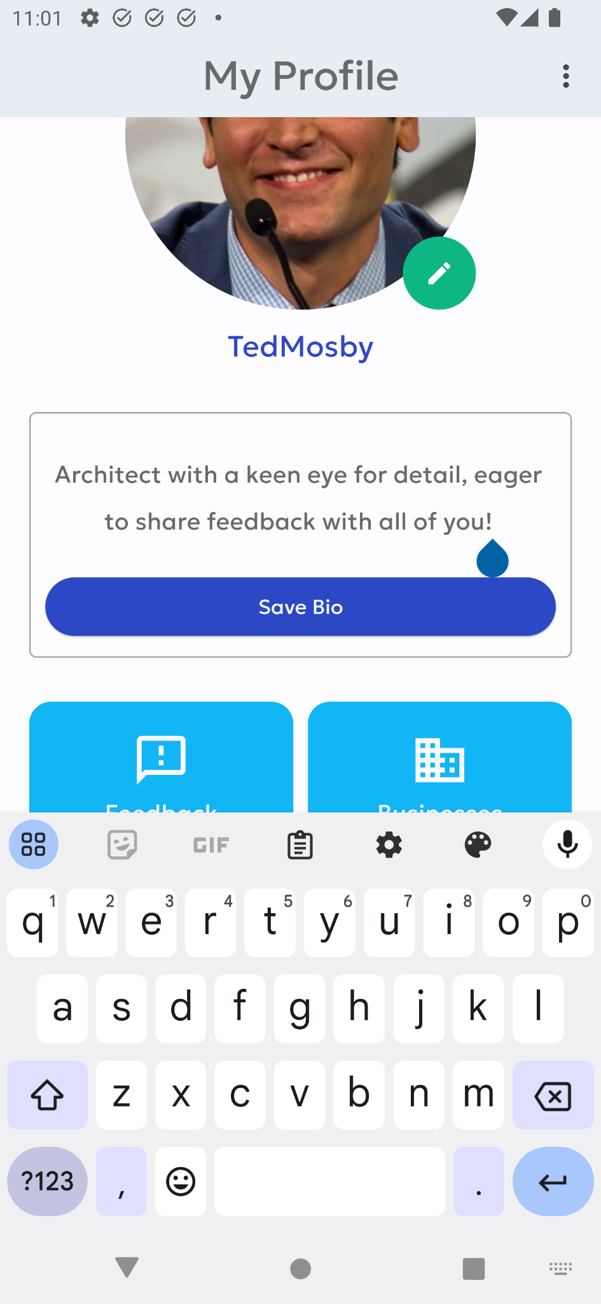
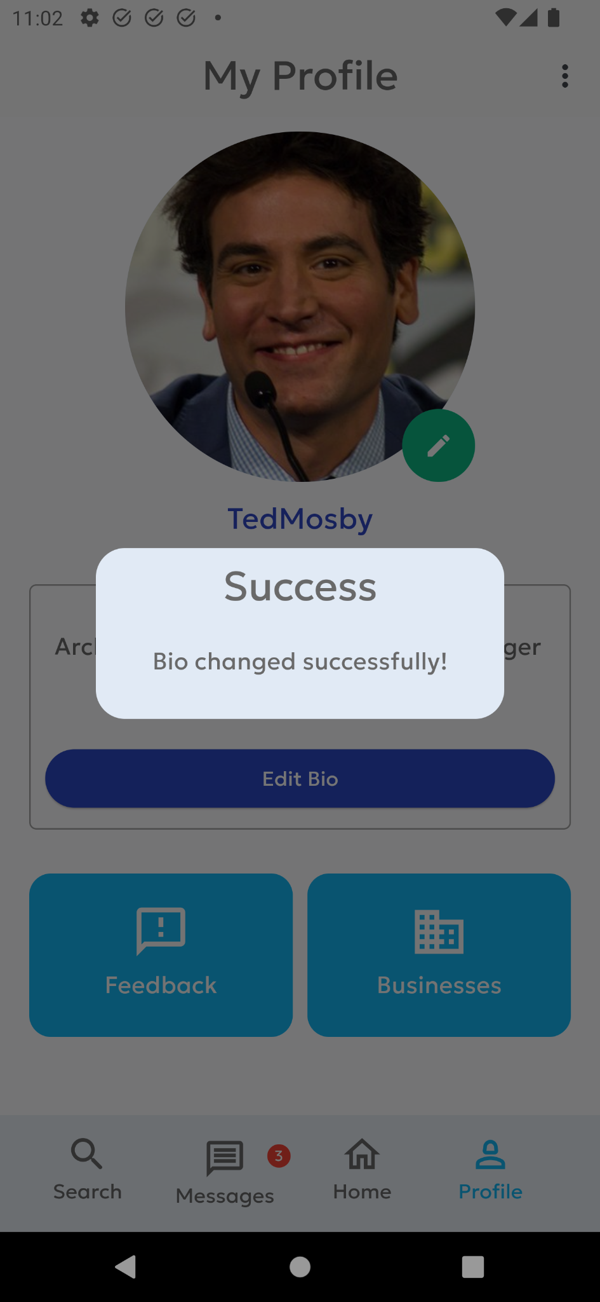
Profile Screens

Slide 21
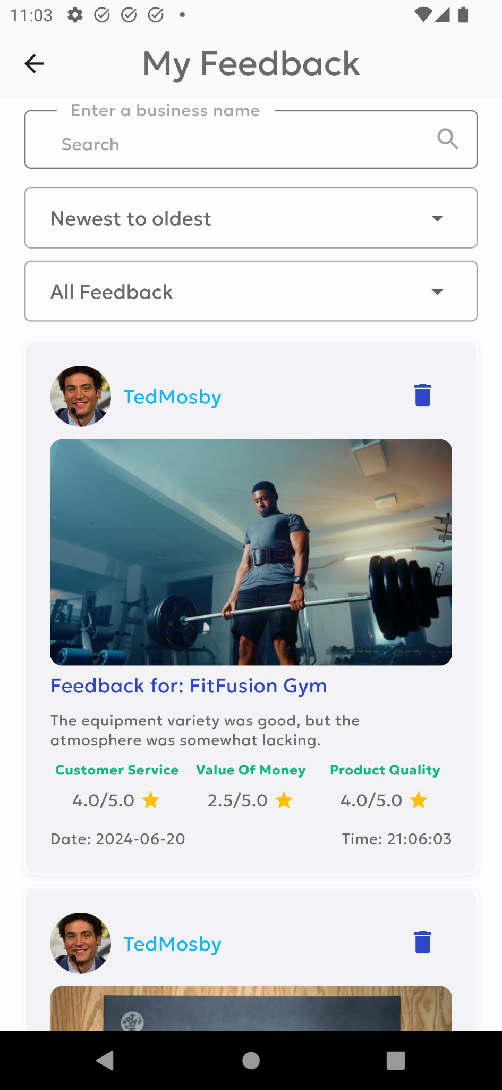
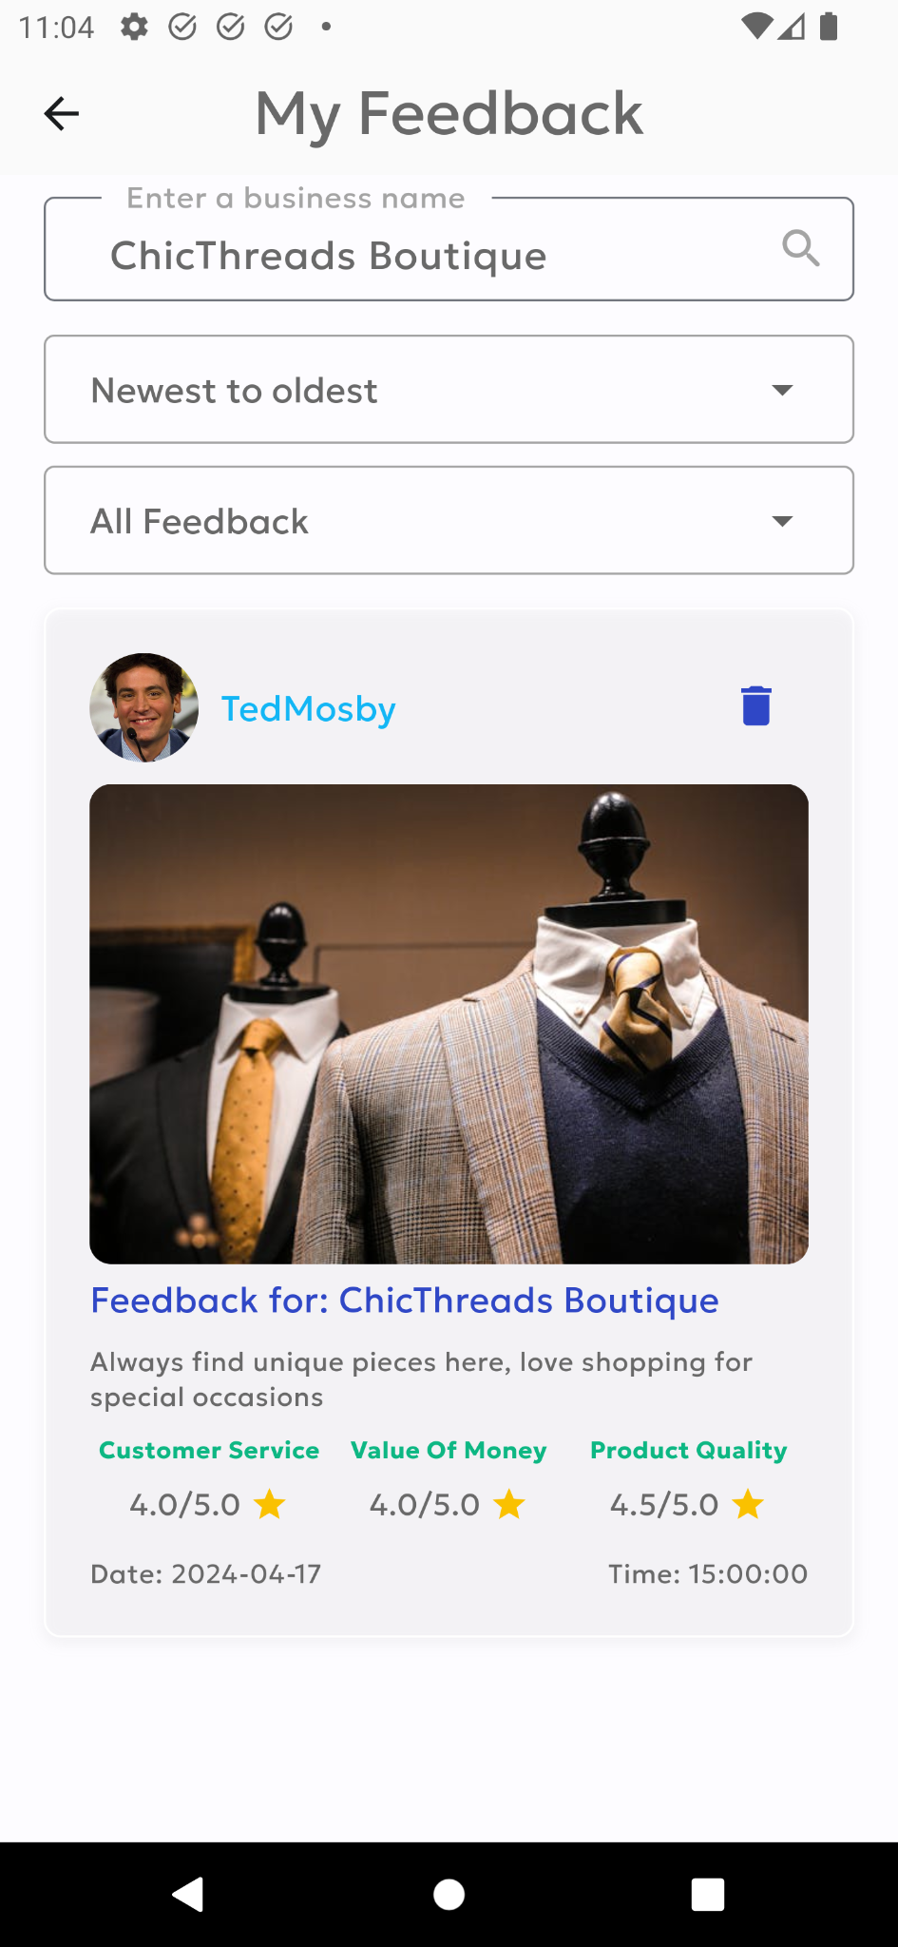
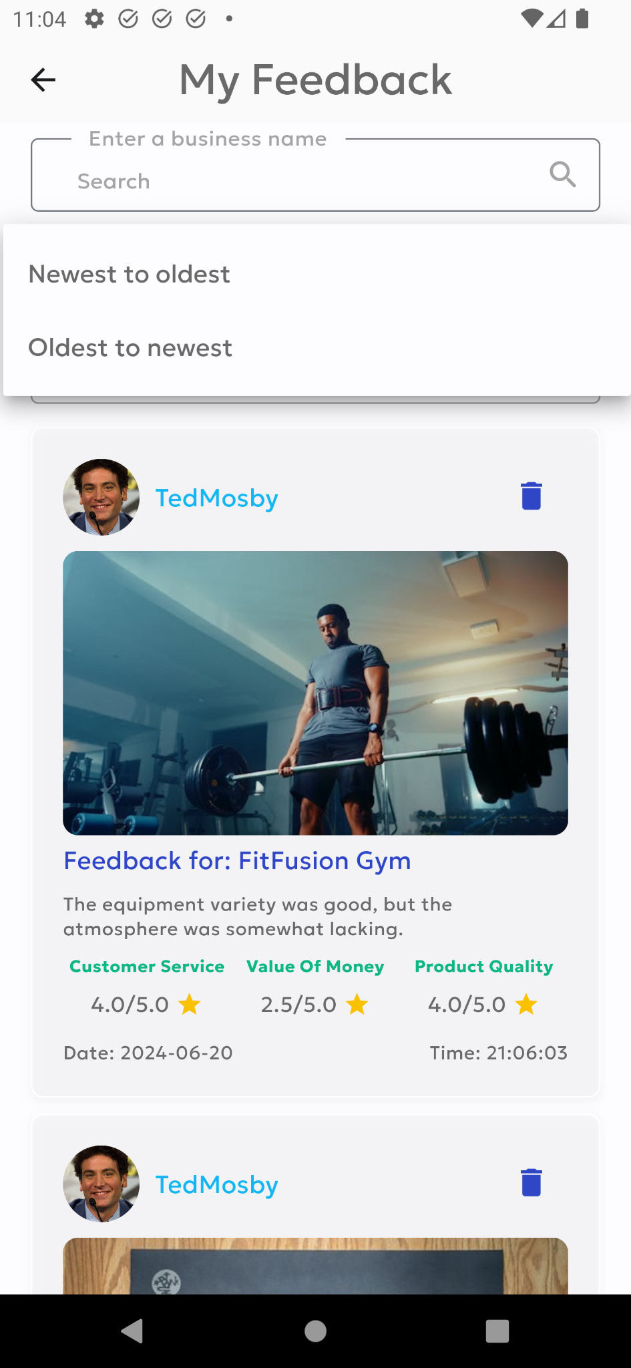
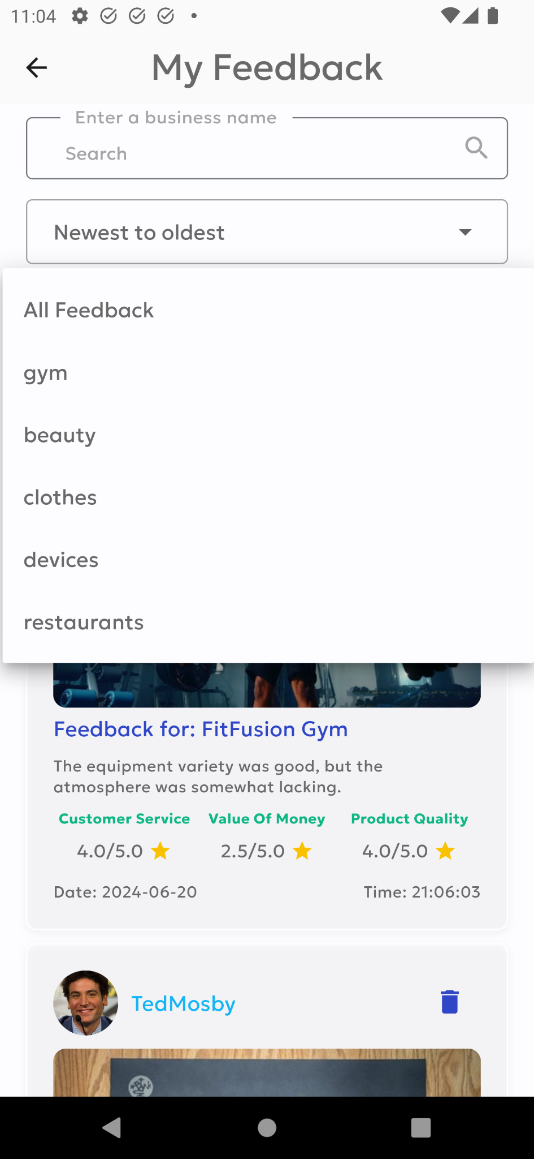
Profile Screens

Slide 22
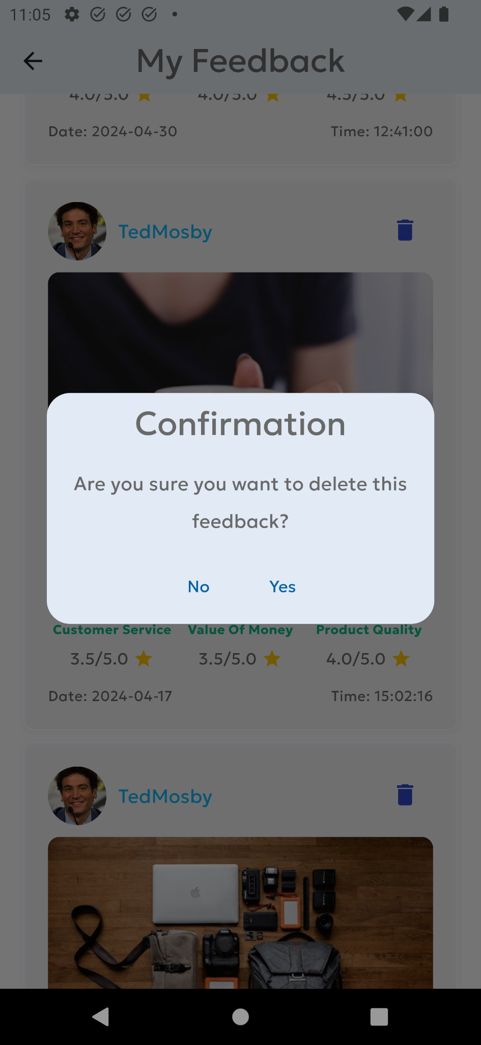
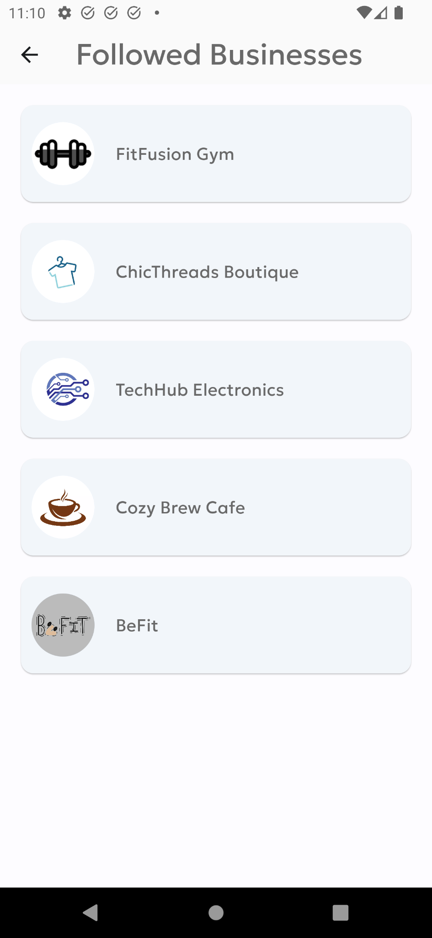
Profile Screens

Slide 23
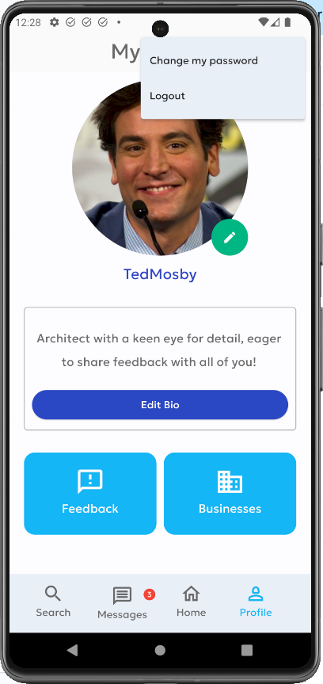
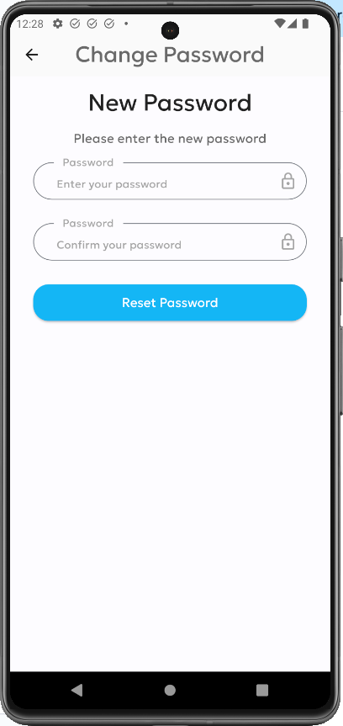
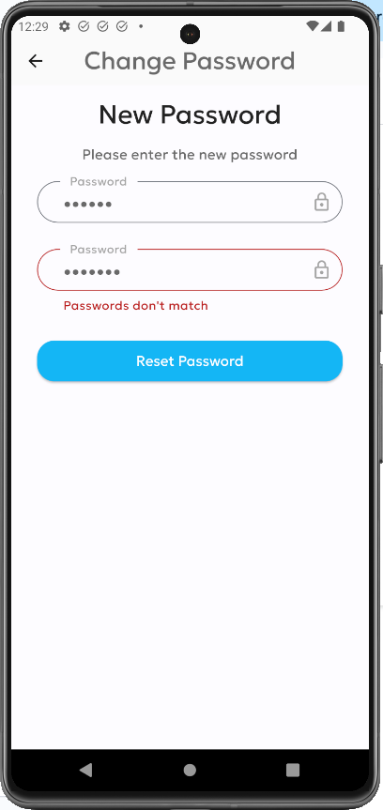
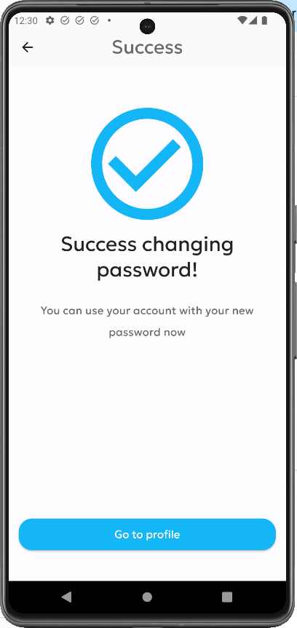
Profile Screens

Slide 24
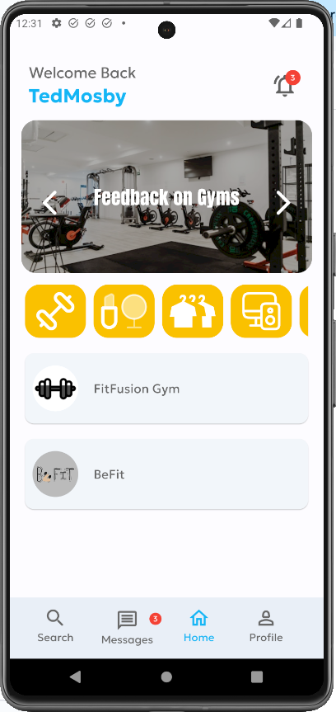
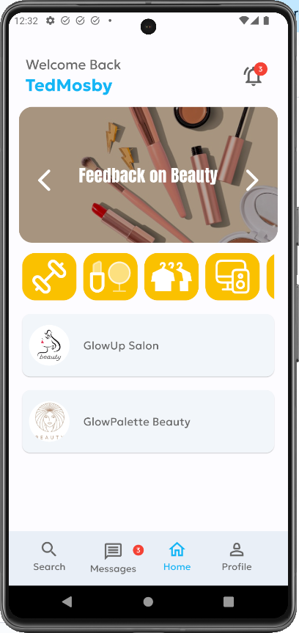
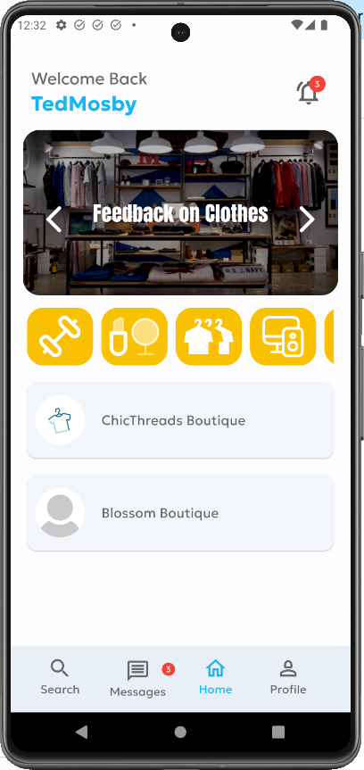
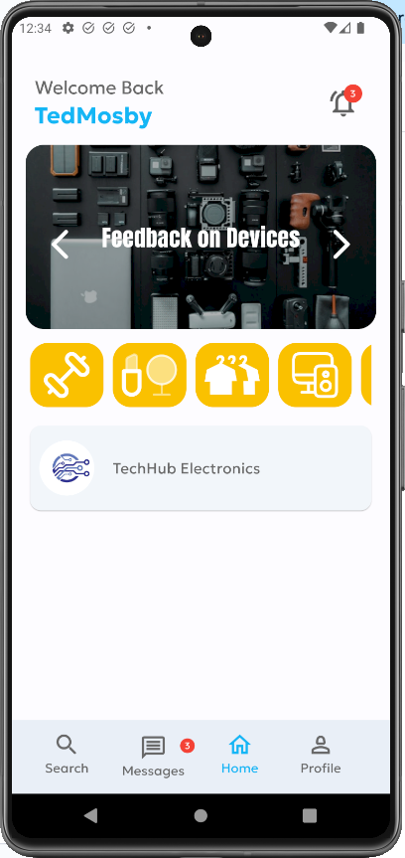
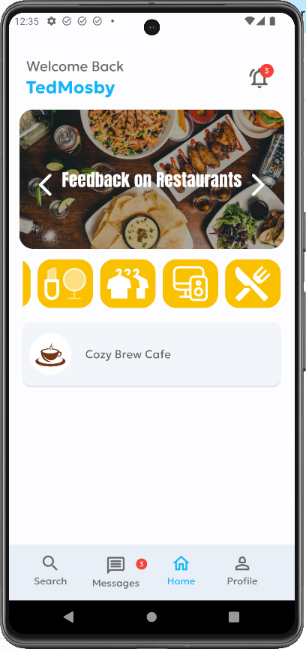
Home Screens

Slide 25
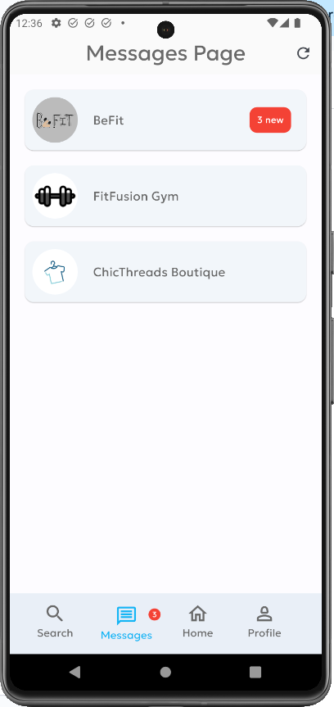
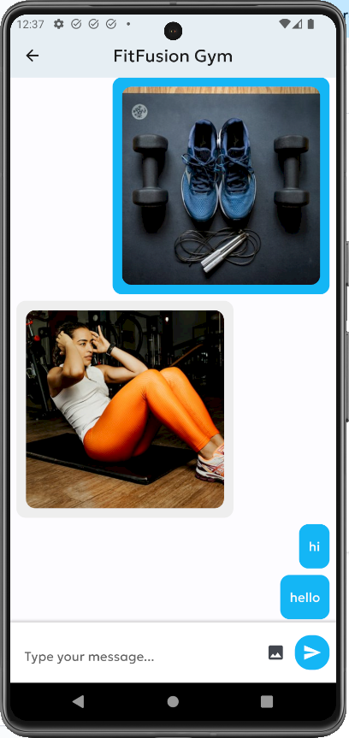
Messages Screens

Slide 26
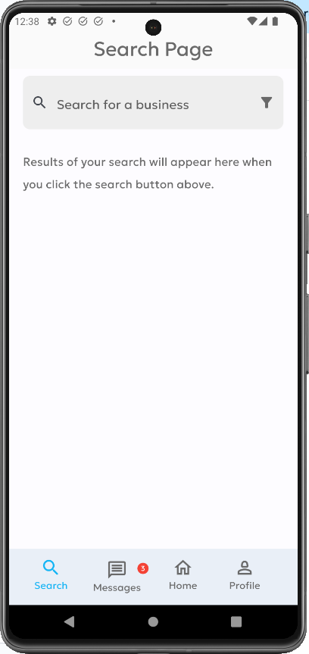
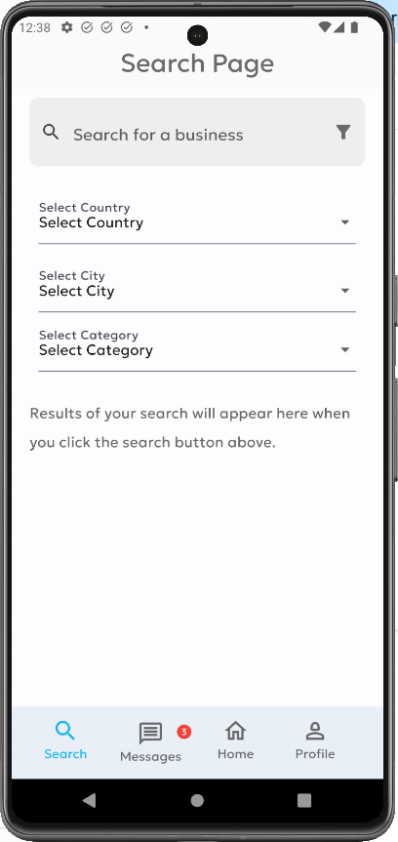
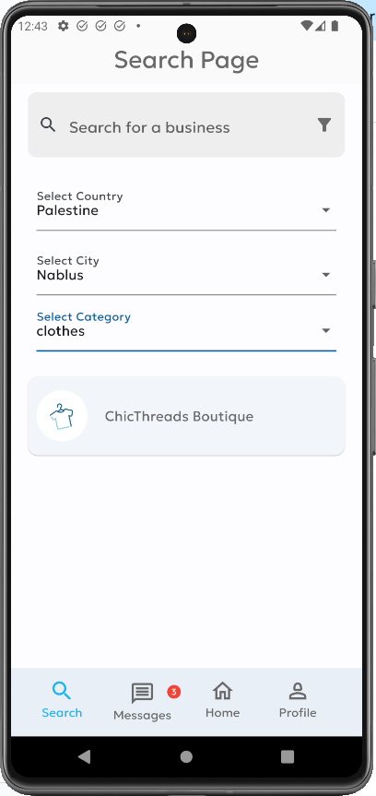
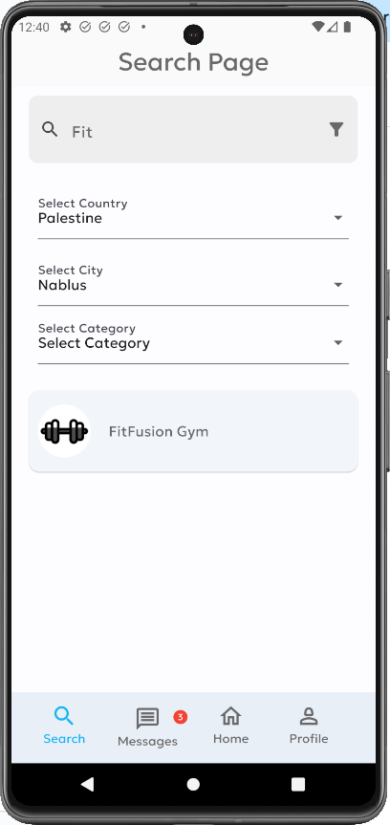
Search Screens

Slide 27
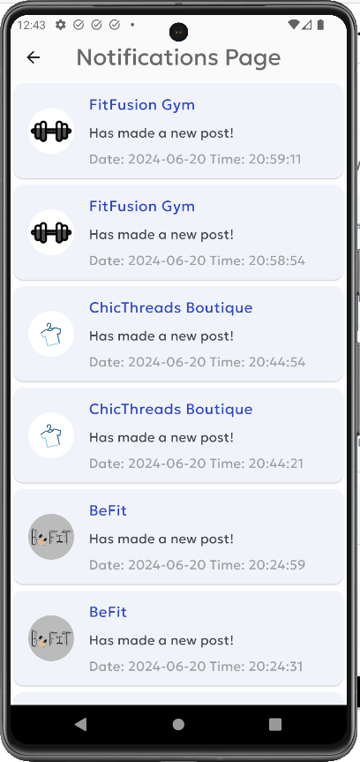
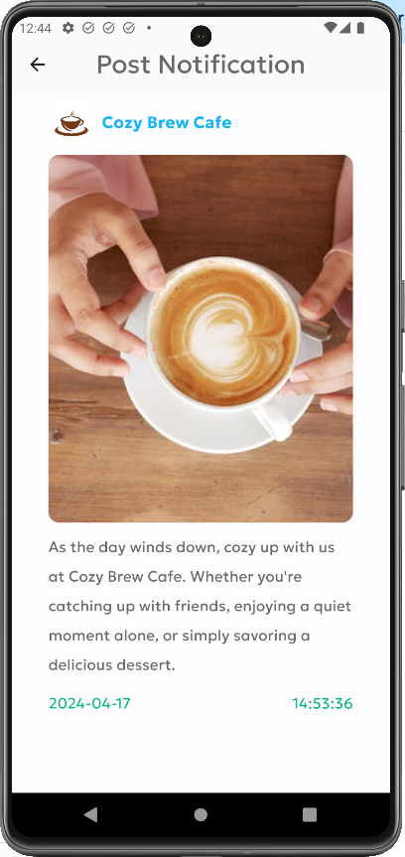
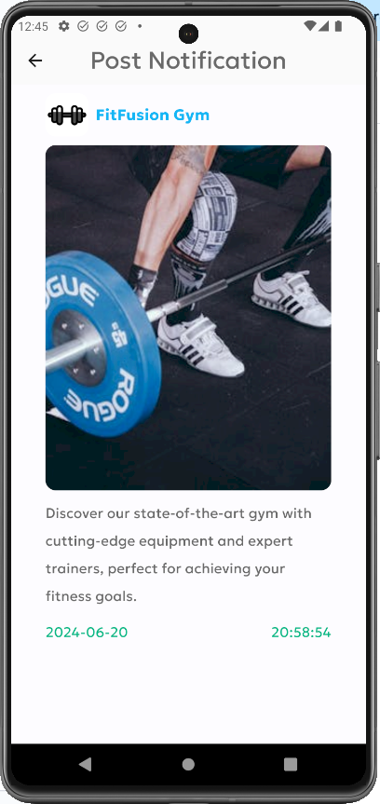
Notifications Screens

Slide 28
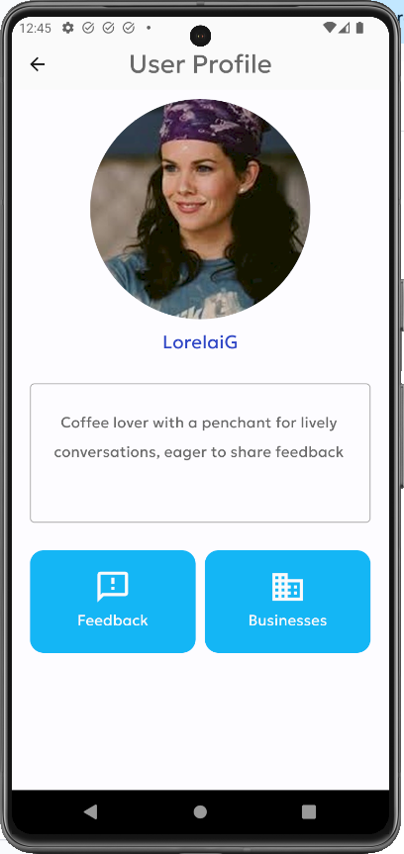


Other Users Profile Screens

Slide 29



Business Screens
Profile screen

Slide 30



Business Screens
Add feedback screen

Slide 31




Business Screens
Feedback screen

Slide 32


Business Screens
Post screen

Slide 33

Business Screens
Followers screen

Slide 34
RateRelay Website

Slide 35

Authentication Screens
Sign-up screens

Slide 36

Authentication Screens
Sign-up screens

Slide 37

Authentication Screens
Sign-up screens

Slide 38

Authentication Screens
Sign-up screens

Slide 39

Authentication Screens
Sign-up screens

Slide 40

Authentication Screens
Sign-up screens

Slide 41

Authentication Screens
Sign-up screens

Slide 42

Authentication Screens
Sign-up screens

Slide 43

Authentication Screens
Sign-up screens

Slide 44

Authentication Screens
Forgot Password screens

Slide 45

Authentication Screens
Forgot Password screens

Slide 46

Authentication Screens
Forgot Password screens

Slide 47

Authentication Screens
Forgot Password screens

Slide 48

Authentication Screens
Forgot Password screens

Slide 49

Authentication Screens
Forgot Password screens

Slide 50

Authentication Screens
Forgot Password screens

Slide 51

Authentication Screens
Forgot Password screens

Slide 52

Authentication Screens
Forgot Password screens

Slide 53
Authentication Screens
Sign in screens

Slide 54

Authentication Screens
Sign in screens

Slide 55

Authentication Screens
Sign in screens

Slide 56

Authentication Screens
Sign in screens

Slide 57

Home Screens

Slide 58

Home Screens

Slide 59

Home Screens

Slide 60

Home Screens

Slide 61

Home Screens

Slide 62

Home Screens

Slide 63

Profile Screens

Slide 64

Profile Screens

Slide 65

Profile Screens

Slide 66

Profile Screens

Slide 67

Profile Screens

Slide 68

Profile Screens

Slide 69

Profile Screens

Slide 70

Profile Screens

Slide 71

Profile Screens

Slide 72

Profile Screens

Slide 73

Profile Screens

Slide 74

Profile Screens

Slide 75

Profile Screens

Slide 76

Dashboard Screens

Slide 77

Dashboard Screens

Slide 78

Dashboard Screens

Slide 79

Dashboard Screens

Slide 80

Dashboard Screens

Slide 81

Dashboard Screens

Slide 82

My Posts Screens

Slide 83

My Posts Screens

Slide 84

My Posts Screens

Slide 85

My Posts Screens

Slide 86

My Posts Screens

Slide 87

Create Post Screens

Slide 88

Create Post Screens

Slide 89

Create Post Screens

Slide 90

Messages Screens

Slide 91

Messages Screens

Slide 92

Messages Screens

Slide 93

Notifications Screens

Slide 94

Notifications Screens

Slide 95

Users Profile Screens

Slide 96

Users Profile Screens

Slide 97

Users Profile Screens

Slide 98

Users Profile Screens

Slide 99

Users Profile Screens

Slide 100

Users Profile Screens

Slide 101

Users Profile Screens

Slide 102

Other Business Profile Screens
Profile screen

Slide 103

Other Business Profile Screens
Profile screen

Slide 104

Other Business Profile Screens
Profile screen

Slide 105

Other Business Profile Screens
Profile screen

Slide 106

Other Business Profile Screens
Profile screen

Slide 107


Responsive Website Screens

Slide 108


Responsive Website Screens

Slide 109


Responsive Website Screens

Slide 110


Responsive Website Screens

Slide 111
03
Technologies Used

Slide 112



Frontend Technologies

Slide 113


Backend Technologies

Slide 114

DBM Technologies

Slide 115

Version Control

Slide 116

Messages and Notifications

Slide 117
Constraints and Future Work
05

Slide 118
Constraints
During the development of our application and website, we encountered several constraints:
1. Lack of Formal Coursework: Without formal coursework in mobile development during university, determining the optimal technologies for implementing our application idea was initially challenging.
2. Google Maps Limitations: The Google Maps feature we used for address selection and business location display had a limited free trial period.

Slide 119
Constraints
3. Development Delays with Flutter: Developing the application with Flutter took longer than anticipated. This was partly because the Android Studio application caused significant slowdowns on our laptop during development.
4. Challenges with Feedback Review Feature: Adding features for our main feature, feedback review, was challenging. Since our idea was new in our country, there was a lack of resources available.
5. Time Constraints: Managing time effectively was a significant challenge throughout the development process.

Slide 120
Future Work
1. Add Video and Voice Chatting: Implement video and voice chat functionalities.
2. Q&A Section for Business Administrators: Introduce a dedicated section for questions and answers in the business administrator account.
3. Likes and Comments: Enable users to like and comment on feedback and posts.

Slide 121
Future Work
4. Product/Service-Specific Feedback: Allow feedback for specific products or services, not just for the business in general.
5. Video Posts: Enable the sharing of videos as posts.
6. Stories Feature: Introduce a stories feature similar to Facebook and Instagram.

Slide 122
Future Work
7. Expanded Categories and Personalized Recommendations: Increase the number of categories and allow users to choose their interests to provide personalized business recommendations and choices.
8. Advertisements for Businesses: Add an advertising feature to help business administrators promote their offerings.

Slide 123
06
Conclusion

Slide 124
Conclusion
In conclusion, our application and website 'RateRelay' address the challenges of communication and limited resources faced by people in Palestine seeking high-quality products and services. By providing a streamlined platform for review feedback, 'RateRelay' offers a much-needed solution for improving user experiences and helping businesses better understand and meet customer needs.

Slide 125
Thank you for your attention.

Slide 126
Any questions or comments?

