Slide 1
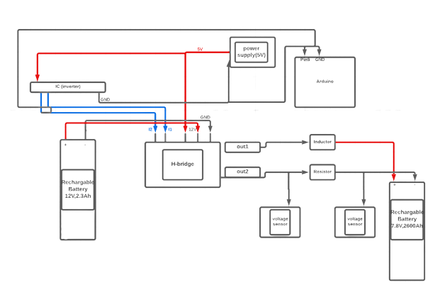
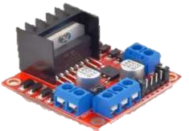
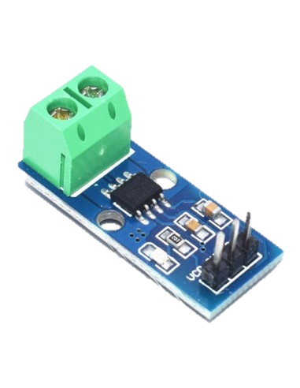
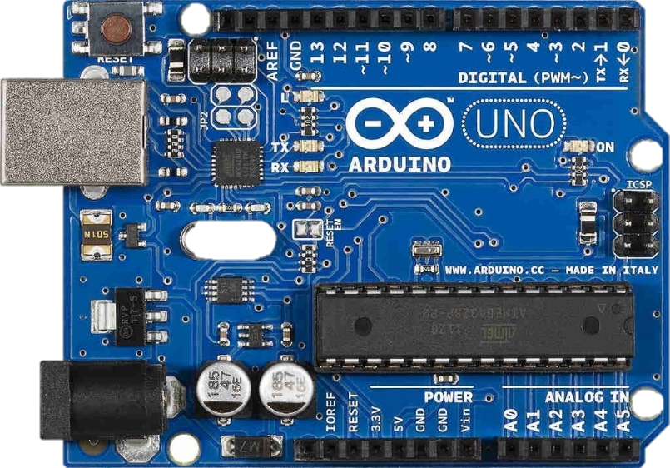
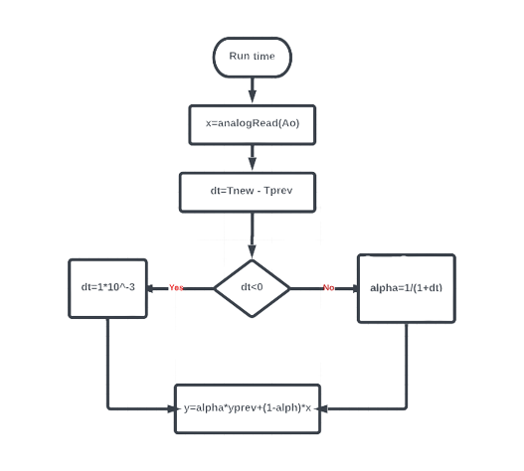
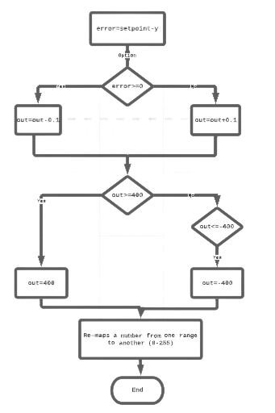
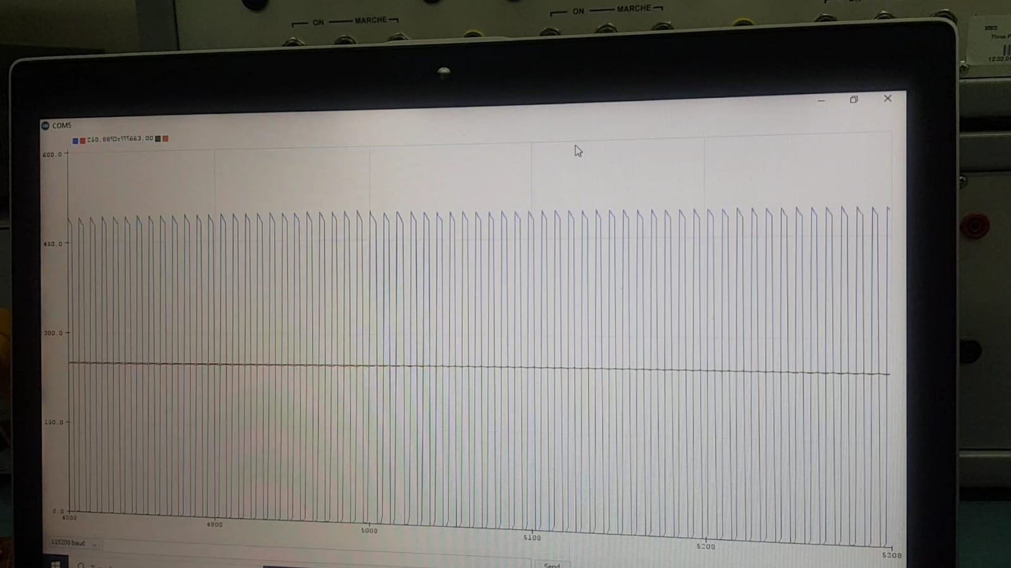
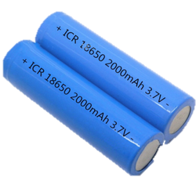
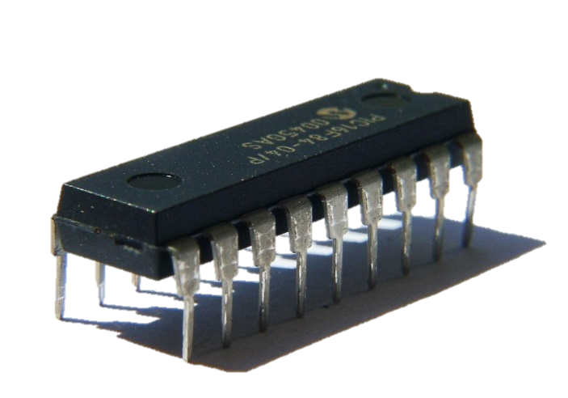
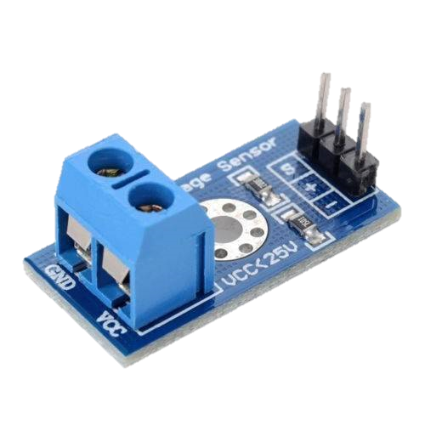

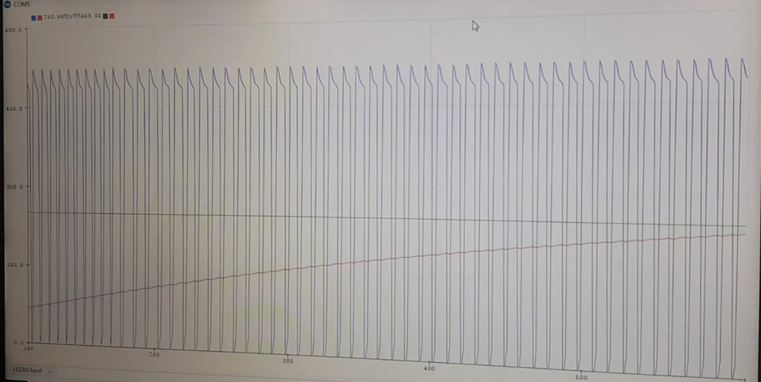
Smart Battery Charger
About us
Objectives
Methodology
Supervisor
Dr.Kamel Saleh
By
Ameed Asmar
Marah Zubdeh
Raghad Abdi
This work aims design, simulate and build a Smart battery charger to charge the battery faster and more efficiently. Monitor the voltage of the battery to decide the best charge current or stop charging.
Increased consumer convenience from the possession of a more universal charger.
A battery with (12V, 2.3Ah) is connected as DC source with single phase H-bridge converter, the first output of the single phase H-bridge (out 1) is connected to the positive part of the battery (7.8 V, 2600 mAh) through inductor (50 mH), and the second output (out 2) is connected to the negative part of the battery through resistor (3 ohm) . we use a pin (9) from Arduino uno and connect it to the first pin of the integrated circuit (inverter CD4069) , to get two opposite signals as input for H-bridge , then we use two voltage sensors to measure and monitor the amount of voltage on a battery and resistance.
Block Diagram
Components
Flow chart
Results
Conclusion
cons
Self-Learning
Lack of resources
pros
Fast charging
Low cost
Safer
Low pass filter
Hysteresis controller
Notes:
For Medical Library: This should be printed at 200% for a 36x60 poster.
Print using standard margins (printing oversize makes uneven margins for whatever weird reason)

