Slide 1
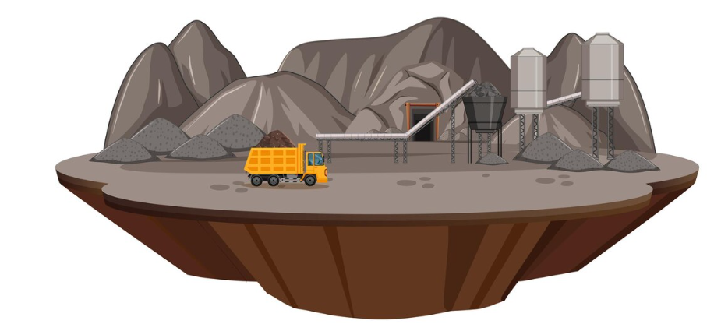
Analysis and evaluation of occupational hazards in the palestinian quarries
Prepared by:
Bara Saifi
Osama Masri
Abed Al-Rahman Assideh
Supervisor Name: Dr. Ramiz Assaf

Slide 2
Table of contents
01
02
03
04
Problem Statement
Objectives
Introduction
Methodology
05
Results and Analysis
06
Conclusion&
Recommendations

Slide 3
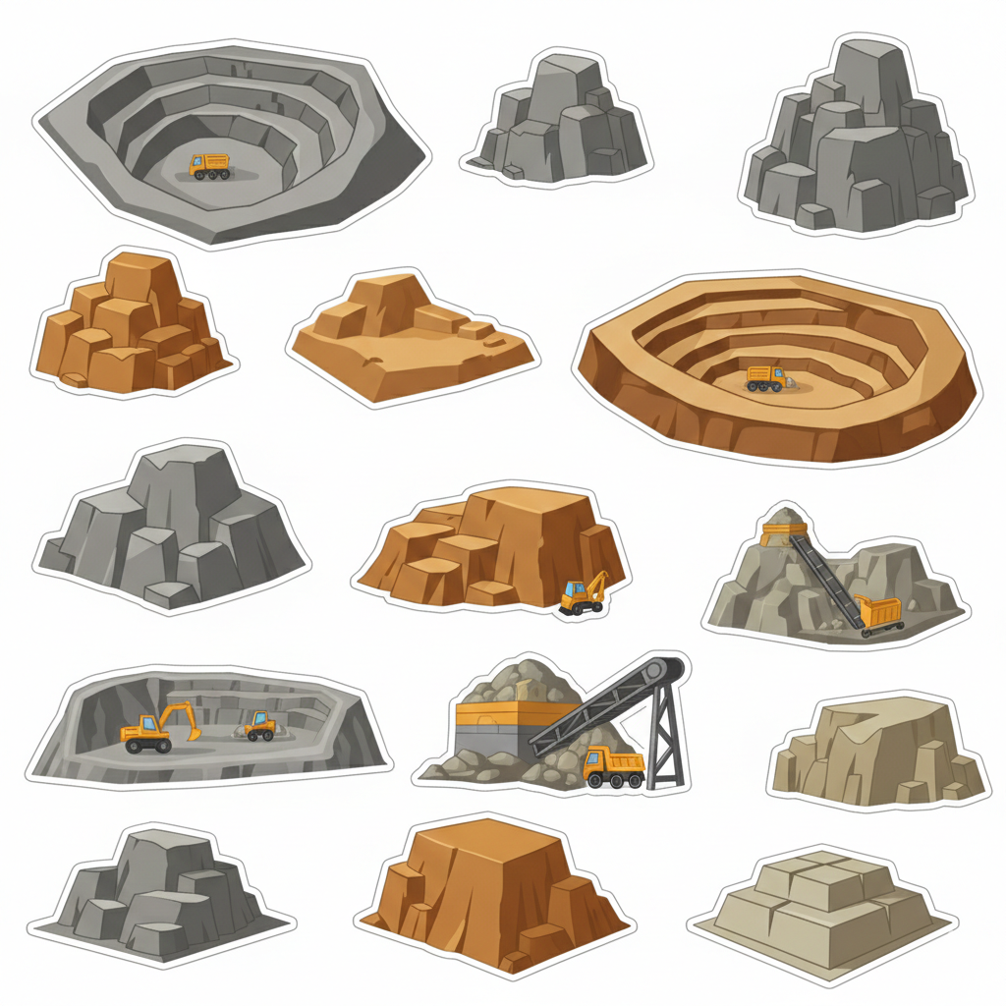
01
Introduction

Slide 4
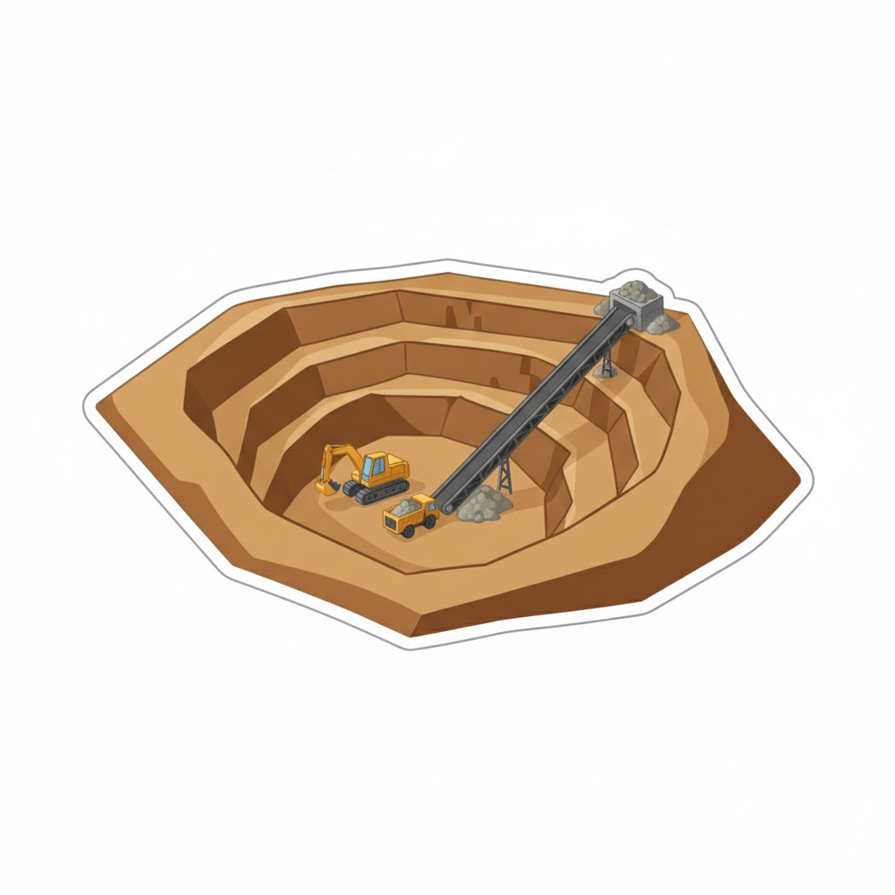
Introduction
Quarry: an open pit or excavation from which stone, sand, gravel, or minerals are extracted, including any location where the extracted material is processed.

Slide 5

02
Problem Statement

Slide 6
Problem Statement
Represents 2.89% of industrial activity
Employs more than 1,700 workers
Recorded a 24.99% increase in production
Lack of occupational safety systems

Slide 7

03
Objectives

Slide 8
Objectives
To identify and analyze occupational hazards in Palestinian quarries and propose practical improvements to enhance safety and productivity
To assess working conditions and safety systems
To analyze health impacts on workers
To propose practical solutions to reduce occupational risks

Slide 9
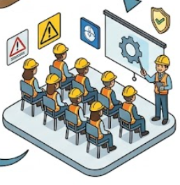
04
Methodology

Slide 10
Methodology
Study sample
Data Collection
Developing a Risk Reduction Plan
Study population
Study tool
Data analysis
1
2
3
4
5
6
Phase 1: Critical & High Risks
Phase 2: Moderate Risks
Phase 3: Low Risks
Northern West Bank Quarries: 280+ Establishments, 1,700+ Employees
visits to the quarries (Direct Observation)
Minitab Software
FMEA Risk Assessment
Risk Ranking & Prioritization
Fishbone Diagram
10 quarries
(Nablus - Jenin - Tulkarm)
A Checklist that includes seven axes

Slide 11

05
Results and Analysis

Slide 12
Results and Analysis
Developing a Risk Reduction Plan
Risk Ranking & Prioritization
And Fishbone Diagram
  Checklist and minitab results
FMEA Risk Assessment

Slide 13
Checklist
General Information
General Safety Conditions
Checklist
Personal Protective Equipment (PPE)
Environmental Risks
Machinery and Equipment Safety
First Aid and Services
Observed Health Indicators

Slide 14
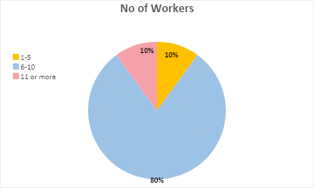
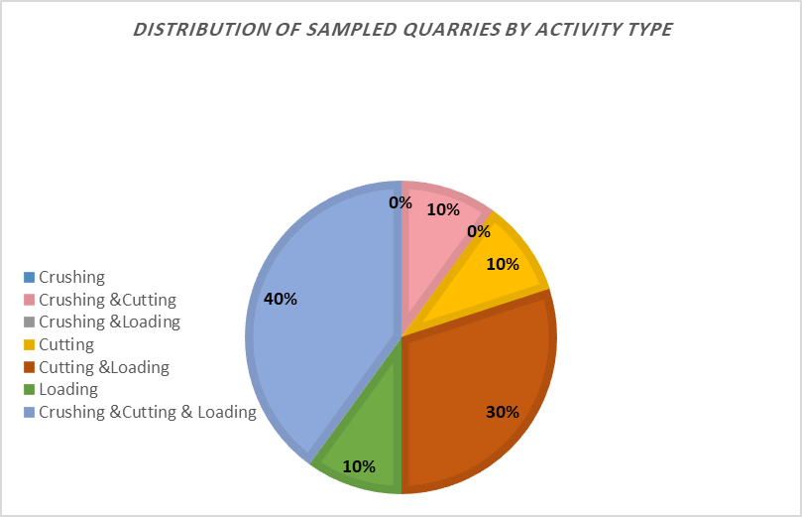
General Information

Slide 15
General Safety Conditions
No | Statement | No(1) |  | Partially(2) |  | Yes(3)
 |  | F | % | F | % | F | %
1 | A safety supervisor is present on site | 10 | 100.00% | 0 | 0.00% | 0 | 0.00%
2 | Clear and posted safety instructions are available | 6 | 60.00% | 4 | 40.00% | 0 | 0.00%
3 | Work is stopped when a clear hazard is identified | 0 | 0.00% | 3 | 30.00% | 7 | 70.00%
4 | Clear and safe pathways for movement are available | 0 | 0.00% | 8 | 80.00% | 2 | 20.00%
5 | The site is organized and free of obstacles | 2 | 20.00% | 7 | 70.00% | 1 | 10.00%
6 | No materials are randomly piled | 7 | 70.00% | 2 | 20.00% | 1 | 10.00%
Variable | Mode | No for Mode
A safety supervisor is present on site | 1 | 10
Clear and posted safety instructions are available | 1 | 6
Work is stopped when a clear hazard is identified | 3 | 7
Clear and safe pathways for movement are available | 2 | 8
The site is organized and free of obstacles | 2 | 7
No materials are randomly piled | 1 | 7

Slide 16
General Safety Conditions
Failure Mode | Potential Effect | S | O | D | RPN | Risk Level
Absence of safety supervisor | Increased unsafe behaviors and lack of hazard control | 10 | 10 | 7 | 700 | Critical
Lack of safety instructions | Workers unaware of hazards and procedures | 8 | 6 | 6 | 288 | Moderate
Random piling of materials | Slips, trips, and falling material injuries | 8 | 7 | 5 | 280 | Moderate
Poor housekeeping and obstacles | Reduced operational safety and emergency access | 7 | 7 | 5 | 245 | Moderate
Unsafe pathways | Worker falls and movement accidents | 7 | 8 | 4 | 224 | Moderate
RPN Value | Risk Level
Above 500 | Critical Risk
300 – 500 | High Risk
150 – 299 | Moderate Risk
Below 150 | Low Risk

Slide 17
Personal Protective Equipment (PPE)
No | Statement | No(1) |  | Partially(2) |  | Yes(3)
 |  | F | % | F | % | F | %
1 | Workers wear helmets | 9 | 90.00% | 1 | 10.00% | 0 | 0.00%
2 | Workers use masks for dust protection | 9 | 90.00% | 1 | 10.00% | 0 | 0.00%
3 | Workers use ear protection | 4 | 40.00% | 5 | 50.00% | 1 | 10.00%
4 | Workers wear safety shoes | 0 | 0.00% | 4 | 40.00% | 6 | 60.00%
5 | Workers wear gloves | 4 | 40.00% | 5 | 50.00% | 1 | 10.00%
6 | PPE is appropriate for the nature of the work | 6 | 60.00% | 4 | 40.00% | 0 | 0.00%
Variable | Mode | No for Mode
Workers wear helmets | 1 | 9
Workers use masks for dust protection | 1 | 9
Workers use ear protection | 2 | 5
Workers wear safety shoes | 3 | 6
Workers wear gloves | 2 | 5
PPE is appropriate for the nature of the work | 1 | 6

Slide 18
Personal Protective Equipment (PPE)
Failure Mode | Potential Effect | Severity (S) | Occurrence (O) | Detection (D) | RPN | Risk Level
Not wearing helmets | Head injuries and fatal accidents | 10 | 9 | 3 | 270 | Moderate Risk
Lack of dust masks | Respiratory diseases and dust exposure | 9 | 9 | 4 | 324 | High Risk
Inappropriate PPE for work activities | Increased exposure to workplace hazards | 8 | 6 | 5 | 240 | Moderate Risk
Lack of gloves | Hand injuries and cuts | 7 | 7 | 4 | 196 | Moderate Risk
Lack of ear protection | Hearing damage due to noise exposure | 7 | 6 | 5 | 210 | Moderate Risk
Partial use of safety shoes | Foot injuries and slipping risks | 6 | 4 | 5 | 120 | Low Risk

Slide 19
Environmental Risks
No | Statement | No(1) |  | Partially(2) |  | Yes(3)
 |  | F | % | F | % | F | %
1 | There is heavy dust at the site | 0 | 0.00% | 2 | 20.00% | 8 | 80.00%
2 | Ventilation or dust extraction systems are available | 7 | 70.00% | 3 | 30.00% | 0 | 0.00%
3 | Water spraying is used to reduce dust | 1 | 10.00% | 2 | 20.00% | 7 | 70.00%
4 | Noise levels are high (difficult to communicate normally) | 0 | 0.00% | 0 | 0.00% | 10 | 100.00%
5 | Barriers or sound insulation are available to reduce noise exposure | 10 | 100.00% | 0 | 0.00% | 0 | 0.00%
6 | There are vibrations from equipment | 0 | 0.00% | 4 | 40.00% | 6 | 60.00%
7 | Lighting is sufficient in all areas | 0 | 0.00% | 4 | 40.00% | 6 | 60.00%
8 | The floor is slippery or uneven | 1 | 10.00% | 7 | 70.00% | 3 | 30.00%
Variable | Mode | N for Mode
There is heavy dust at the site | 2 | 8
Ventilation or dust extraction systems are available | 1 | 7
Water spraying is used to reduce dust | 3 | 7
Noise levels are high (difficult to communicate normally) | 3 | 10
Barriers or sound insulation are available to reduce noise exposure | 1 | 10
There are vibrations from equipment | 3 | 6
Lighting is sufficient in all areas | 3 | 6
The floor is slippery or uneven | 2 | 7

Slide 20
Environmental Risks
Failure Mode | Potential Effect | S | O | D | RPN | Risk Level
No noise barriers or insulation | Hearing damage and communication difficulties | 9 | 10 | 8 | 720 | Critical
Heavy dust at site | Respiratory problems and reduced visibility | 8 | 8 | 5 | 320 | High
Lack of ventilation systems | Poor air quality and respiratory diseases | 9 | 7 | 6 | 378 | High
Slippery or uneven floors | Falls and physical injuries | 7 | 7 | 4 | 196 | Moderate
Equipment vibrations | Fatigue and musculoskeletal disorders | 7 | 6 | 5 | 210 | Moderate
Water spraying for dust control | Dust reduction (partially effective control) | 6 | 6 | 5 | 180 | Moderate
Lighting is sufficient | Reduced visibility in some areas | 6 | 4 | 4 | 96 | Low
High noise levels (inherent operational condition) | Hearing strain and communication difficulty | 8 | 10 | 7 | 560 | Critical

Slide 21
Machinery and Equipment Safety
No | Statement | No(1) |  | Partially(2) |  | Yes(3)
 |  | F | % | F | % | F | %
1 | Machines operate without exposed dangerous parts | 5 | 50.00% | 2 | 20.00% | 3 | 30.00%
2 | Safe distances between machines are maintained | 1 | 10.00% | 7 | 70.00% | 2 | 20.00%
3 | Electrical wires are safe and not exposed | 0 | 0.00% | 1 | 10.00% | 9 | 90.00%
4 | Protective guards are present on machines | 7 | 70.00% | 2 | 20.00% | 1 | 10.00%
Variable | Mode | N for Mode
Machines operate without exposed dangerous parts | 1 | 5
Safe distances between machines are maintained | 2 | 7
Electrical wires are safe and not exposed | 3 | 9
Protective guards are present on machines | 1 | 7

Slide 22
Machinery and Equipment Safety
Failure Mode | Potential Effect | S | O | D | RPN | Risk Level
Missing protective guards | Severe injuries and amputations | 9 | 7 | 5 | 315 | High
Exposed machine parts | Cuts and crushing injuries | 8 | 6 | 5 | 240 | Moderate
Unsafe distance between machines | Collision and operational accidents | 7 | 7 | 5 | 245 | Moderate
Electrical wiring safety (controlled condition) | Minor electrical risk | 5 | 2 | 2 | 20 | Low

Slide 23
First Aid and Services
No | Statement | No(1) |  | Partially(2) |  | Yes(3)
 |  | F | % | F | % | F | %
1 | A first aid kit is available | 5 | 50.00% | 2 | 20.00% | 3 | 30.00%
2 | The location of the kit is known and easily accessible | 1 | 10.00% | 7 | 70.00% | 2 | 20.00%
3 | Clean sanitary facilities (restrooms) are available | 0 | 0.00% | 1 | 10.00% | 9 | 90.00%
Variable | Mode | No for Mode
A first aid kit is available | 3 | 6
The location of the kit is known and easily accessible | 2 | 5
Clean sanitary facilities (restrooms) are available | 3 | 6

Slide 24
First Aid and Services
Failure Mode | Potential Effect | S | O | D | RPN | Risk Level
No first aid kit available | Delayed emergency response and worsened injuries | 9 | 5 | 6 | 270 | Moderate
Unclear location of first aid kit | Delay in providing first aid treatment | 8 | 7 | 6 | 336 | High
Sanitary facilities (well maintained) | Minimal health risk | 3 | 2 | 2 | 12 | Low

Slide 25
Observed Health Indicators
No | Statement | No(1) |  | Partially(2) |  | Yes(3)
 |  | F | % | F | % | F | %
1 | Some workers show signs of coughing or breathing difficulty | 2 | 20.00% | 5 | 50.00% | 3 | 30.00%
2 | Workers appear fatigued or exhausted | 0 | 0.00% | 5 | 50.00% | 5 | 50.00%
3 | Workers complain about noise (e.g., covering their ears) | 6 | 60.00% | 4 | 40.00% | 0 | 0.00%
Variable | Mode | No for Mode
Some workers show signs of coughing or breathing difficulty | 2 | 5
Workers appear fatigued or exhausted | 2.3 | 5
Workers complain about noise (e.g., covering their ears) | 1 | 6

Slide 26
Observed Health Indicators
Failure Mode | Potential Effect | S | O | D | RPN | Risk Level
Workers show respiratory symptoms | Long-term respiratory diseases | 8 | 5 | 6 | 240 | Moderate
Worker fatigue and exhaustion | Reduced productivity and accidents | 7 | 5 | 5 | 175 | Moderate
Noise-related complaints | Hearing strain and discomfort | 6 | 4 | 4 | 96 | Low

Slide 27
FMEA Consolidated Risk Ranking
Rank | Failure Mode | Potential Effect | S | O | D | RPN | Risk Level
1 | No noise barriers or insulation | Hearing damage and communication difficulties | 9 | 10 | 8 | 720 | Critical
2 | Absence of safety supervisor | Unsafe behaviors and lack of hazard control | 10 | 10 | 7 | 700 | Critical
3 | High noise levels (operational) | Hearing strain and communication difficulty | 8 | 10 | 7 | 560 | Critical
4 | Lack of ventilation systems | Poor air quality and respiratory diseases | 9 | 7 | 6 | 378 | High
5 | Unclear location of first aid kit | Delay in emergency response | 8 | 7 | 6 | 336 | High
6 | Lack of dust masks | Respiratory diseases and dust exposure | 9 | 9 | 4 | 324 | High
7 | Heavy dust at site | Respiratory problems and reduced visibility | 8 | 8 | 5 | 320 | High
8 | Missing protective guards | Severe injuries and amputations | 9 | 7 | 5 | 315 | High
9 | Lack of safety instructions | Workers unaware of hazards and procedures | 8 | 6 | 6 | 288 | Moderate
10 | Random piling of materials | Slips, trips, falling material injuries | 8 | 7 | 5 | 280 | Moderate

Slide 28
FMEA Consolidated Risk Ranking
Rank | Failure Mode | Potential Effect | S | O | D | RPN | Risk Level
11 | Not wearing helmets | Head injuries and fatal accidents | 10 | 9 | 3 | 270 | Moderate
12 | No first aid kit available | Delayed emergency response | 9 | 5 | 6 | 270 | Moderate
13 | Unsafe distance between machines | Collision and operational accidents | 7 | 7 | 5 | 245 | Moderate
14 | Poor housekeeping and obstacles | Reduced safety and emergency access | 7 | 7 | 5 | 245 | Moderate
15 | Inappropriate PPE usage | Increased exposure to hazards | 8 | 6 | 5 | 240 | Moderate
16 | Exposed machine parts | Cuts and crushing injuries | 8 | 6 | 5 | 240 | Moderate
17 | Respiratory symptoms (workers) | Long-term respiratory diseases | 8 | 5 | 6 | 240 | Moderate
18 | Unsafe pathways | Falls and movement accidents | 7 | 8 | 4 | 224 | Moderate
19 | Lack of ear protection | Hearing damage due to noise | 7 | 6 | 5 | 210 | Moderate
20 | Equipment vibrations | Fatigue and musculoskeletal disorders | 7 | 6 | 5 | 210 | Moderate

Slide 29
FMEA Consolidated Risk Ranking
Rank | Failure Mode | Potential Effect | S | O | D | RPN | Risk Level
21 | Lack of gloves | Hand injuries and cuts | 7 | 7 | 4 | 196 | Moderate
22 | Slippery or uneven floors | Falls and physical injuries | 7 | 7 | 4 | 196 | Moderate
23 | Water spraying for dust control | Partially effective dust reduction | 6 | 6 | 5 | 180 | Moderate
24 | Worker fatigue and exhaustion | Reduced productivity and accidents | 7 | 5 | 5 | 175 | Moderate
25 | Partial use of safety shoes | Foot injuries and slipping risk | 6 | 4 | 5 | 120 | Low
26 | Noise-related complaints | Hearing strain and discomfort | 6 | 4 | 4 | 96 | Low
27 | Lighting is sufficient (low risk area) | Reduced visibility in some areas | 6 | 4 | 4 | 96 | Low
28 | Electrical wiring (controlled condition) | Minor electrical risk | 5 | 2 | 2 | 20 | Low
29 | Sanitary facilities (well maintained) | Minimal health risk | 3 | 2 | 2 | 12 | Low

Slide 30
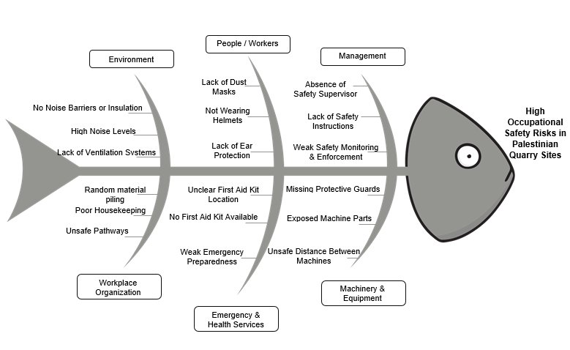
Fishbone Diagram of Occupational Safety Risks in Quarry Sites

Slide 31
Developing a Risk Reduction Plan
Phase One: Critical and High Risks
Phase Two: Moderate Risks
A
B
C
Phase Three: Low Risks

Slide 32
Phase One: Critical and High Risks
Absence of noise barriers or insulation (Critical)
Absence of a safety supervisor (Critical)
High noise levels (Critical)
Lack of ventilation systems (High)
Unclear location of the first aid kit (High)
Lack of dust masks (High)
Heavy dust at the site (High)
Missing machine protective guards (High)
Lack of safety instructions (Moderate–High priority)
Random piling of materials (Moderate–High priority)
Installation of noise barriers and insulation systems to reduce noise exposure
Appointment of a qualified safety supervisor to oversee all site activities
Improvement of ventilation systems to reduce dust and enhance air quality
Provision and enforcement of personal protective equipment (dust masks, ear protection)
Clear identification and accessibility of first aid kit locations
Installation of machine protective guards to prevent direct injuries
Implementation of clear and visible safety instructions across the site
Proper organization and safe storage of materials to prevent clutter
Proposed Actions
Risks

Slide 33
Phase Two: Moderate Risks
Partial lack of personal protective equipment (e.g., gloves, protective shoes)
Inconsistent use of personal protective equipment
Uneven surfaces and slip hazards
Equipment vibrations
Worker fatigue and exhaustion
Poor housekeeping and site organization
Weak compliance with operational procedures
Strengthening continuous safety training and awareness programs
Enforcing full compliance with PPE usage
Implementing a regular housekeeping system
Maintaining floors and walkways to reduce slipping hazards
Improving working conditions to reduce fatigue
Monitoring compliance with operational procedures on a regular basis
Proposed Actions
Risks

Slide 34
Phase Three: Low Risks
Minor lighting or visibility issues
Sanitary facilities in acceptable condition but requiring monitoring
Occasional noise complaints or discomfort
Conducting regular maintenance and improvement of lighting systems
Maintaining cleanliness of sanitary facilities
Addressing worker complaints to improve workplace conditions
Strengthening overall safety culture within the site
Proposed Actions
Risks

Slide 35
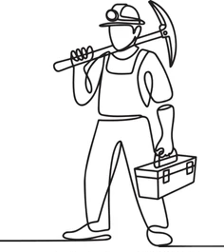
06
Conclusion&
Recommendations

Slide 36
Conclusion
Applied FMEA to assess quarry safety risks.
Critical Risks:
Noise barriers absent (RPN = 720)
No safety supervisor (RPN = 700)
High noise levels (RPN = 560)
High Risks
    Lack of ventilation systems (RPN = 378)
    Unclear location of first aid kit (RPN = 336 )
    Lack of dust masks (RPN = 324)
    Heavy dust at site(RPN = 320)
Developed a 3-phase risk reduction plan.
This phased approach ensures that the most severe hazards are prioritized first, followed by systematic improvement of workplace conditions and long-term safety sustainability.
Expected outcome: Improved safety performance and reduced injuries

Slide 37
Recommendations
Ministry of Labor
Enforce noise control measures.
Require certified safety supervisors.
Strengthen dust and ventilation controls.
Increase quarry safety inspections.
Apply stricter penalties for non-compliance.
Federation of Palestinian Industries
Organizing regular occupational safety training and awareness programs.
Promoting best practices in safety management.
Encouraging the adoption of Occupational Health and Safety Management Systems.
Supporting the use of risk assessment tools such as FMEA.

Slide 38
Thanks

