Slide 1

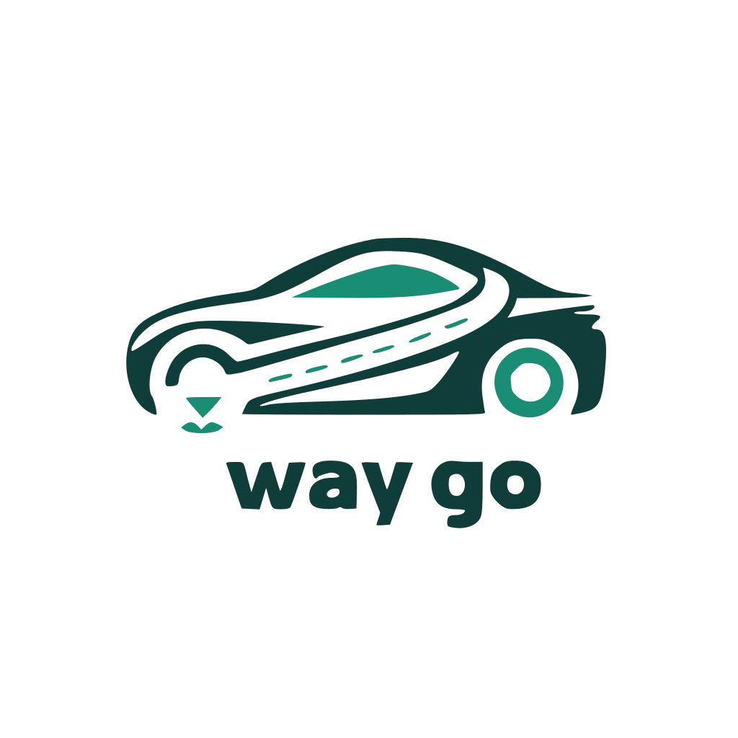

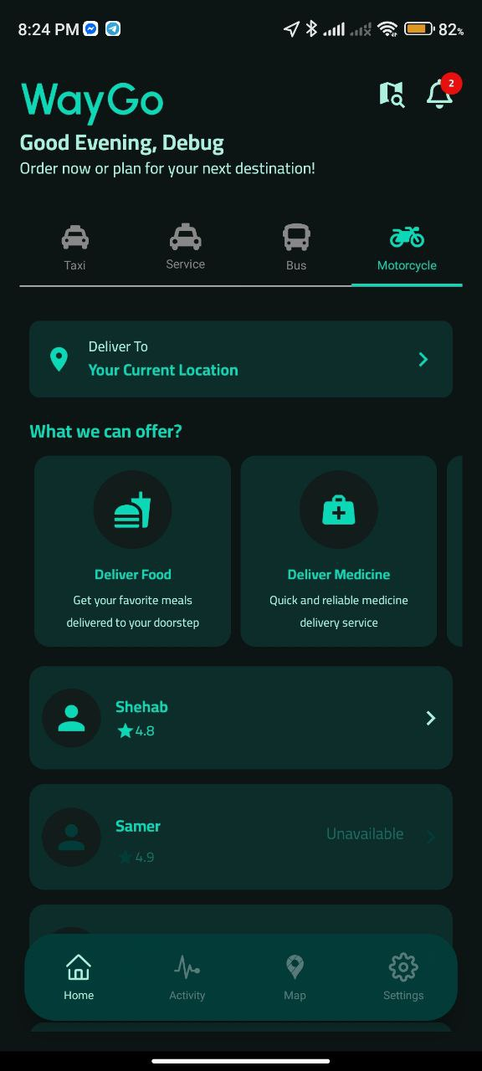
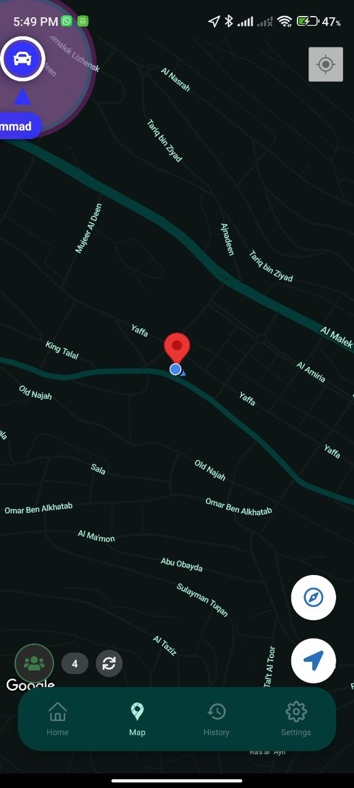
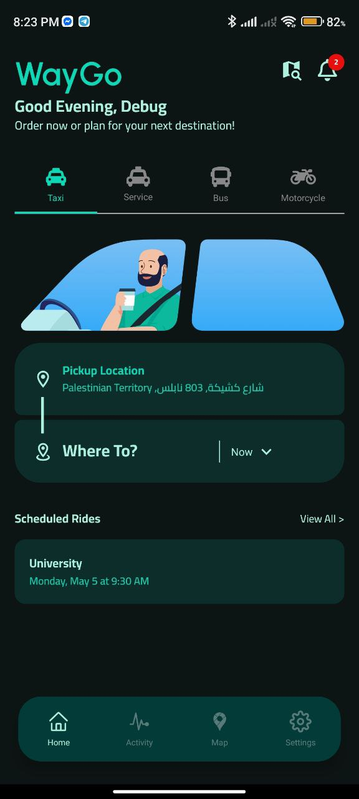
One Tap, All Rides.
Abdalsalam Jodalah
Dr.Amjad Abu Hassan
Shehab Kharaz
Dr.Samer Arandi

Slide 2
Your ride, In our Way.

Slide 3









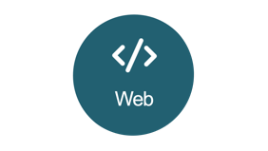
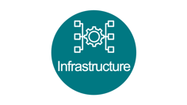





Slide 4

Why WayGo?

Slide 5







The Fragmentation Problem

Slide 6

The Fragmentation Problem

Slide 7
It’s not TaxiGo

Slide 8
It’s not DelivaryGo

Slide 9
Nor BusGo

Slide 10
It’s WayGo

Slide 11
One Tap,
All Rides.

Slide 12



WayGo Ecosystem
01

Slide 13
WayGo Ecosystem
01
Unify
taxi booking, bus seat reservations, and delivery services in one mobile app.
Simplify
Reduce
transportation and logistics for users with a single, user-friendly interface.
dependency on multiple apps for different mobility needs.
01
03
02
Scalability
Support
to support future services like carpooling, inter-city rides, and on-demand transport.
local drivers and businesses by giving them a platform to reach more customers.
05
04

Slide 14

Infrastructure

Slide 15




Infrastructure

Slide 16
Infrastructure

Slide 17


Infrastructure

Slide 18
Infrastructure
User Management
Interactions
Ride Management

Slide 19

Infrastructure
User Management
Interactions
Ride Management

Slide 20
Infrastructure
User Management
Interactions
Ride Management

Slide 21

Infrastructure
User Management
Interactions
Ride Management

Slide 22

Infrastructure
User Management
Interactions
Ride Management

Slide 23


Infrastructure
User Management
Interactions
Ride Management
Docker compose

Slide 24
Infrastructure
Ride S1
Ride S2
LB
Ride S3
Inter S1
Inter S2
LB
RP
Inter S3
User S1
User S2
LB
User S3
Docker copose

Slide 25



Infrastructure
Ride S1
Ride S2
LB
React Native
React Native
React Native
Ride S3
Inter S1
Inter S2
LB
RP
Inter S3
User S1
User S2
LB
User S3

Slide 26
Features

Slide 27








Officer
3
4
Manager
Support
2
5
Driver
Roles
Admin
1
6
User

Slide 28
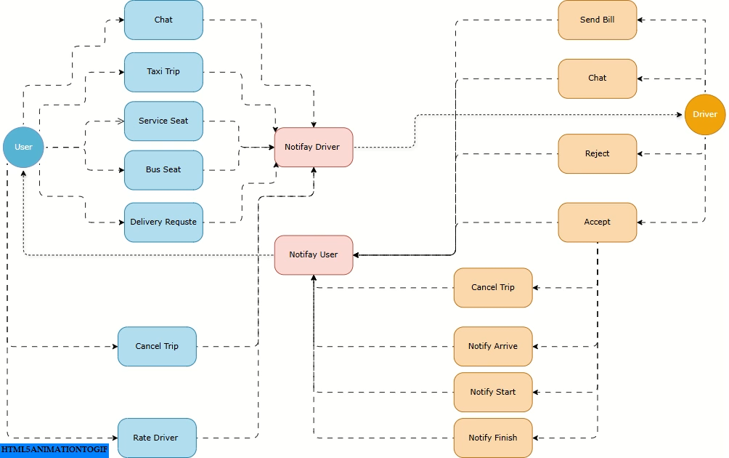

Slide 29
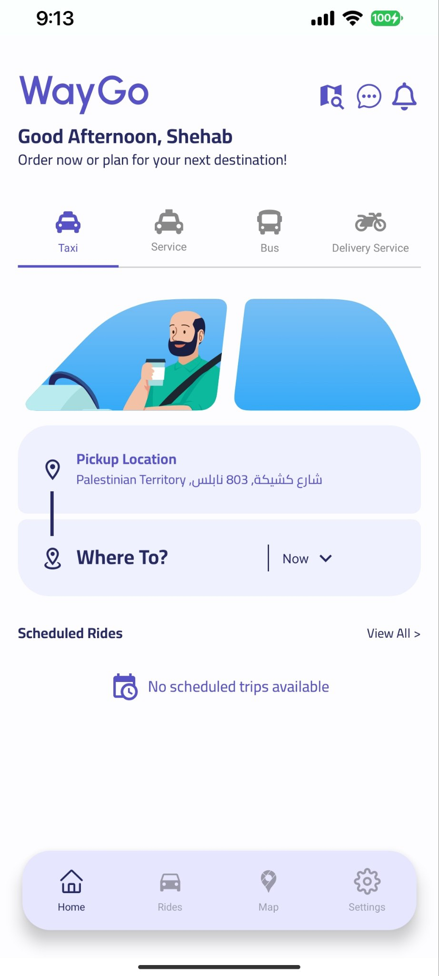
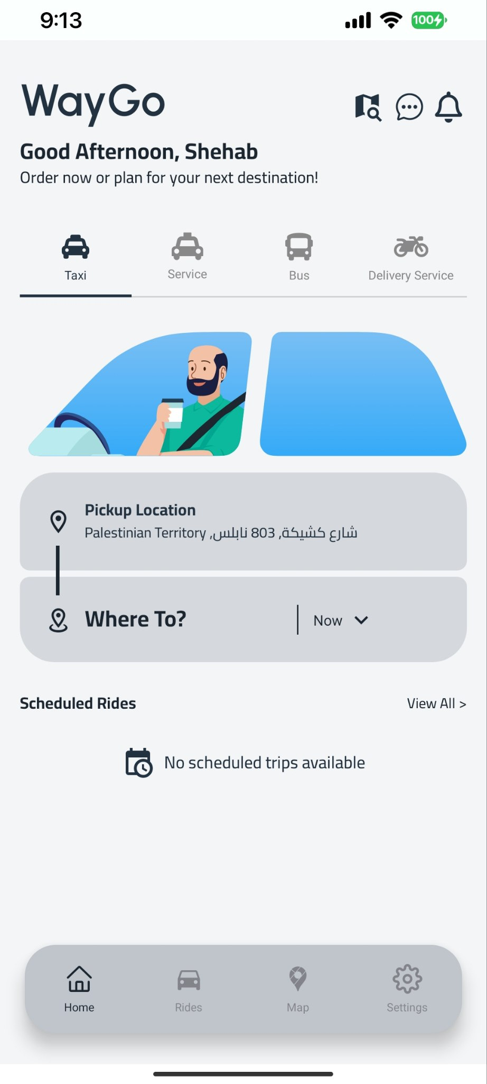
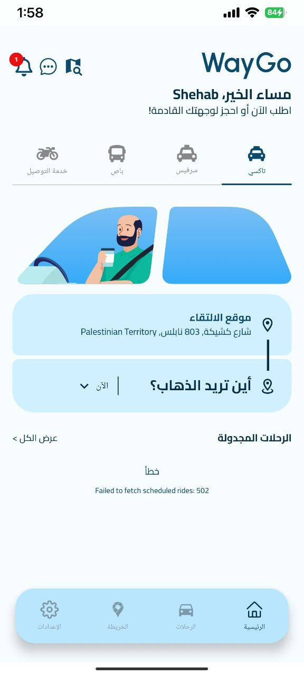

Slide 31

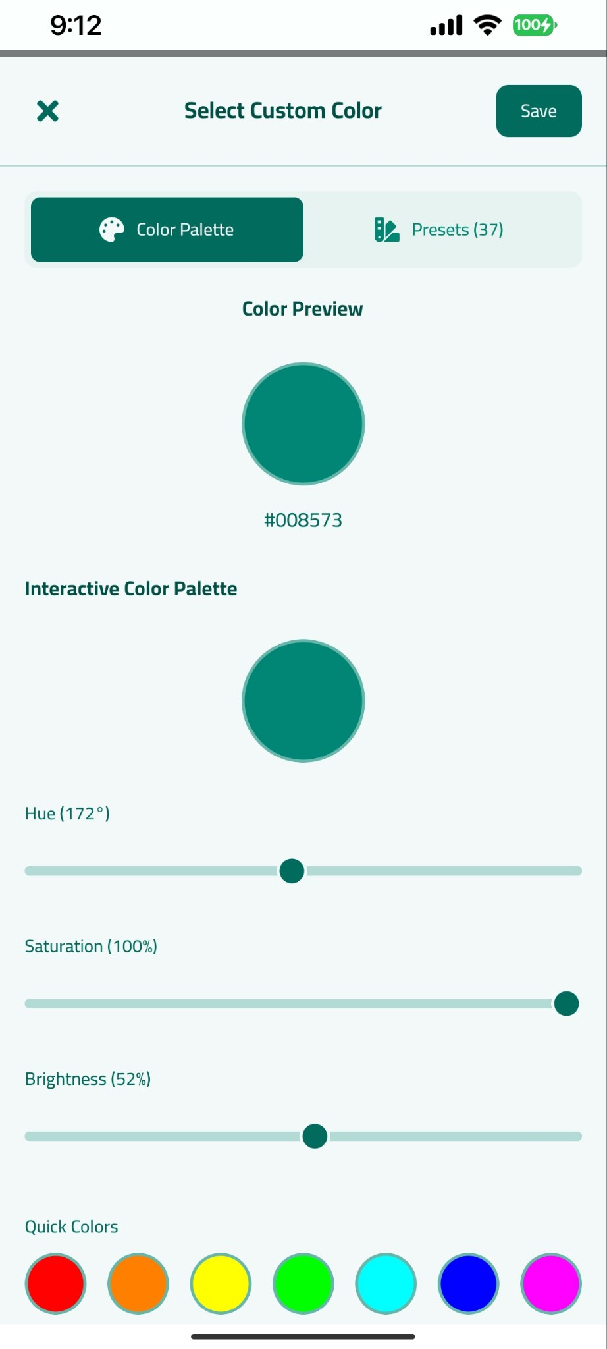

Slide 32
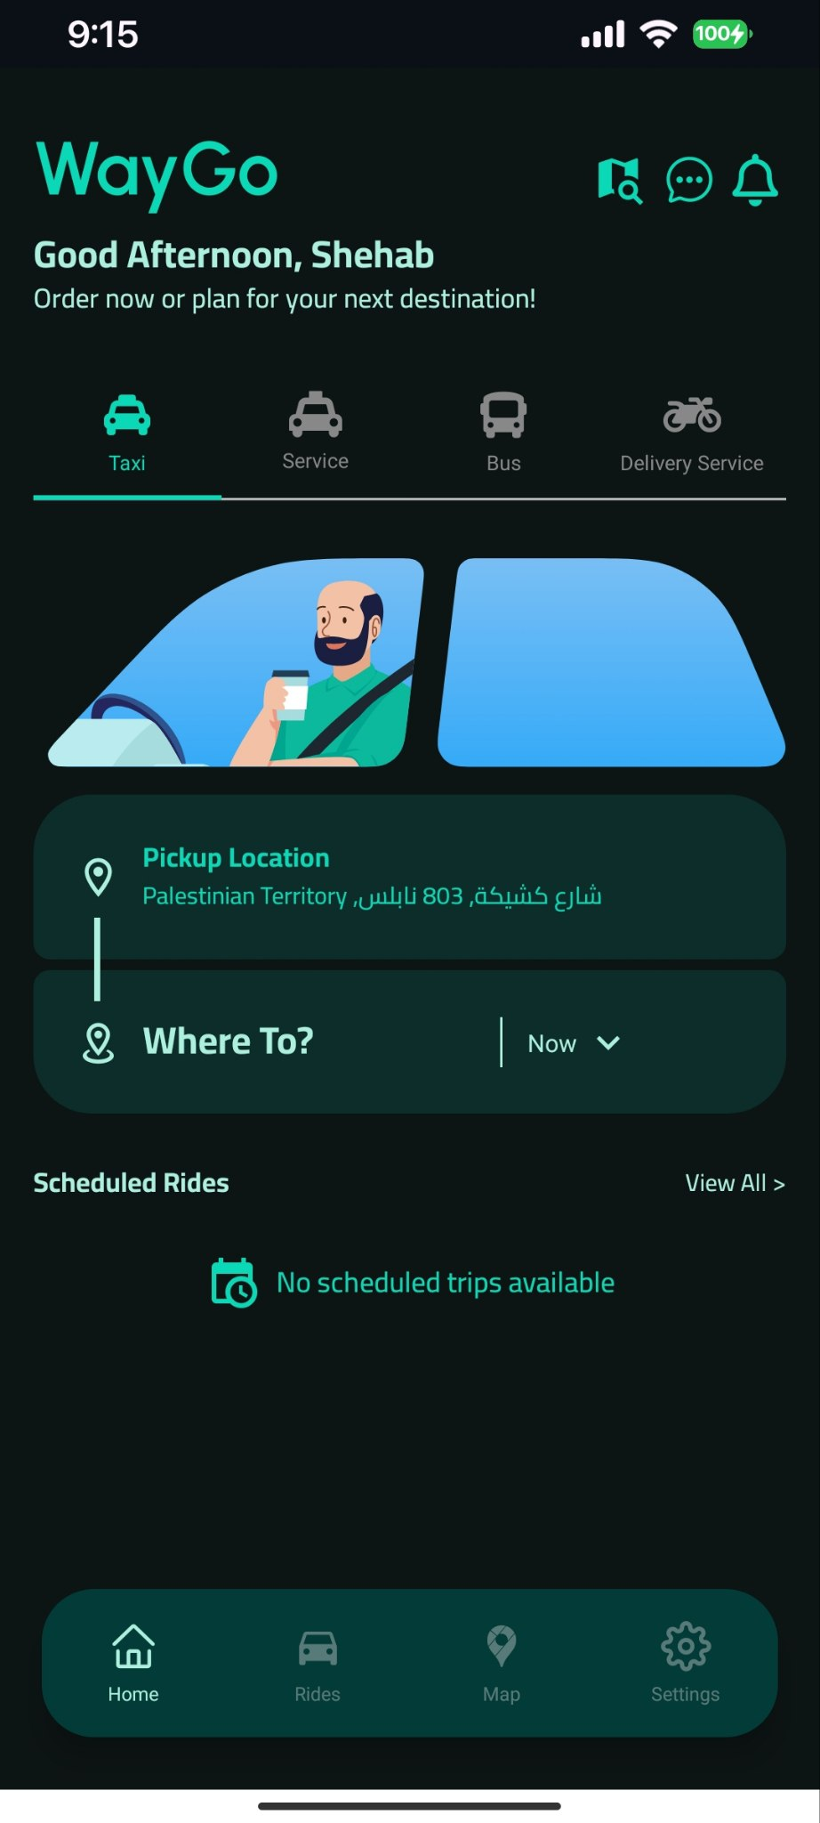
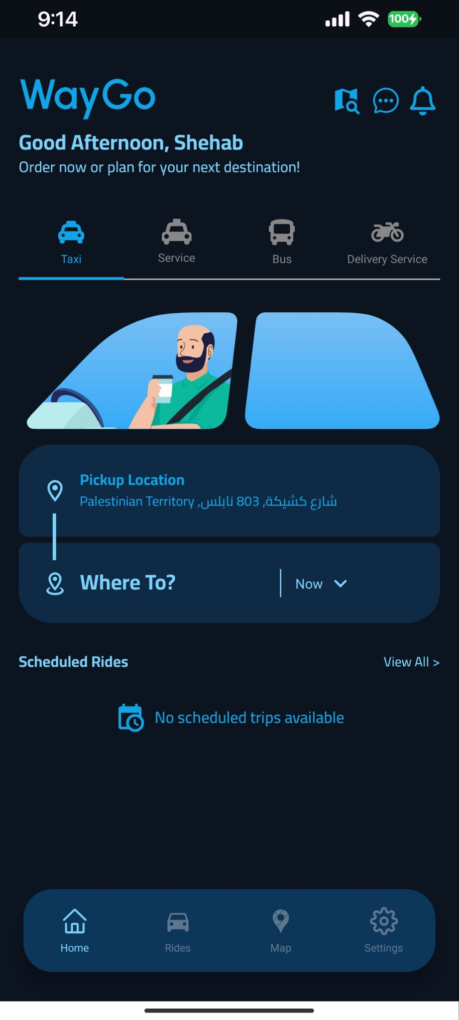

Slide 33
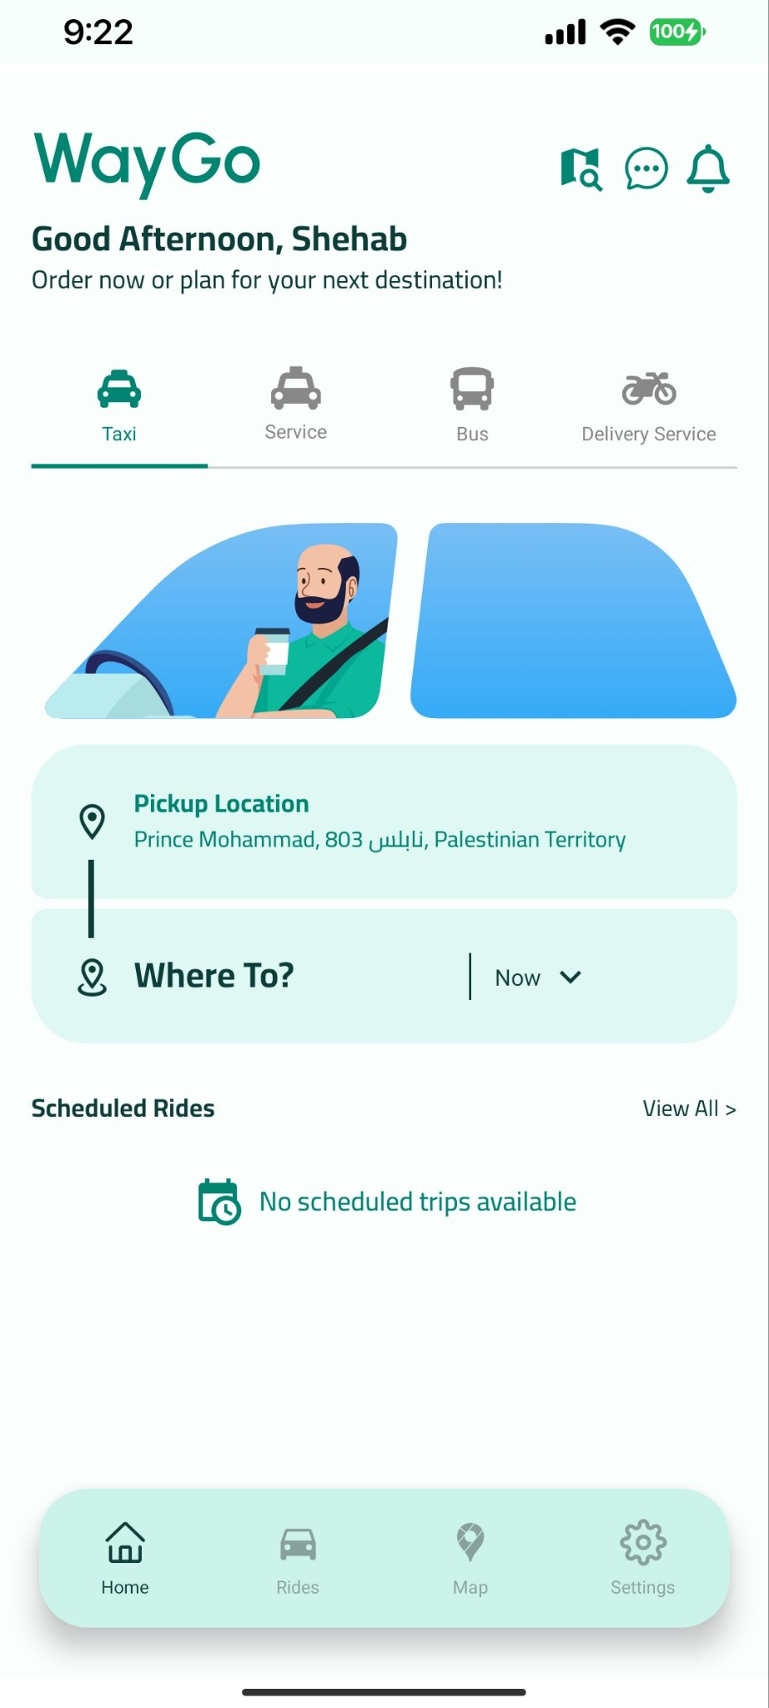
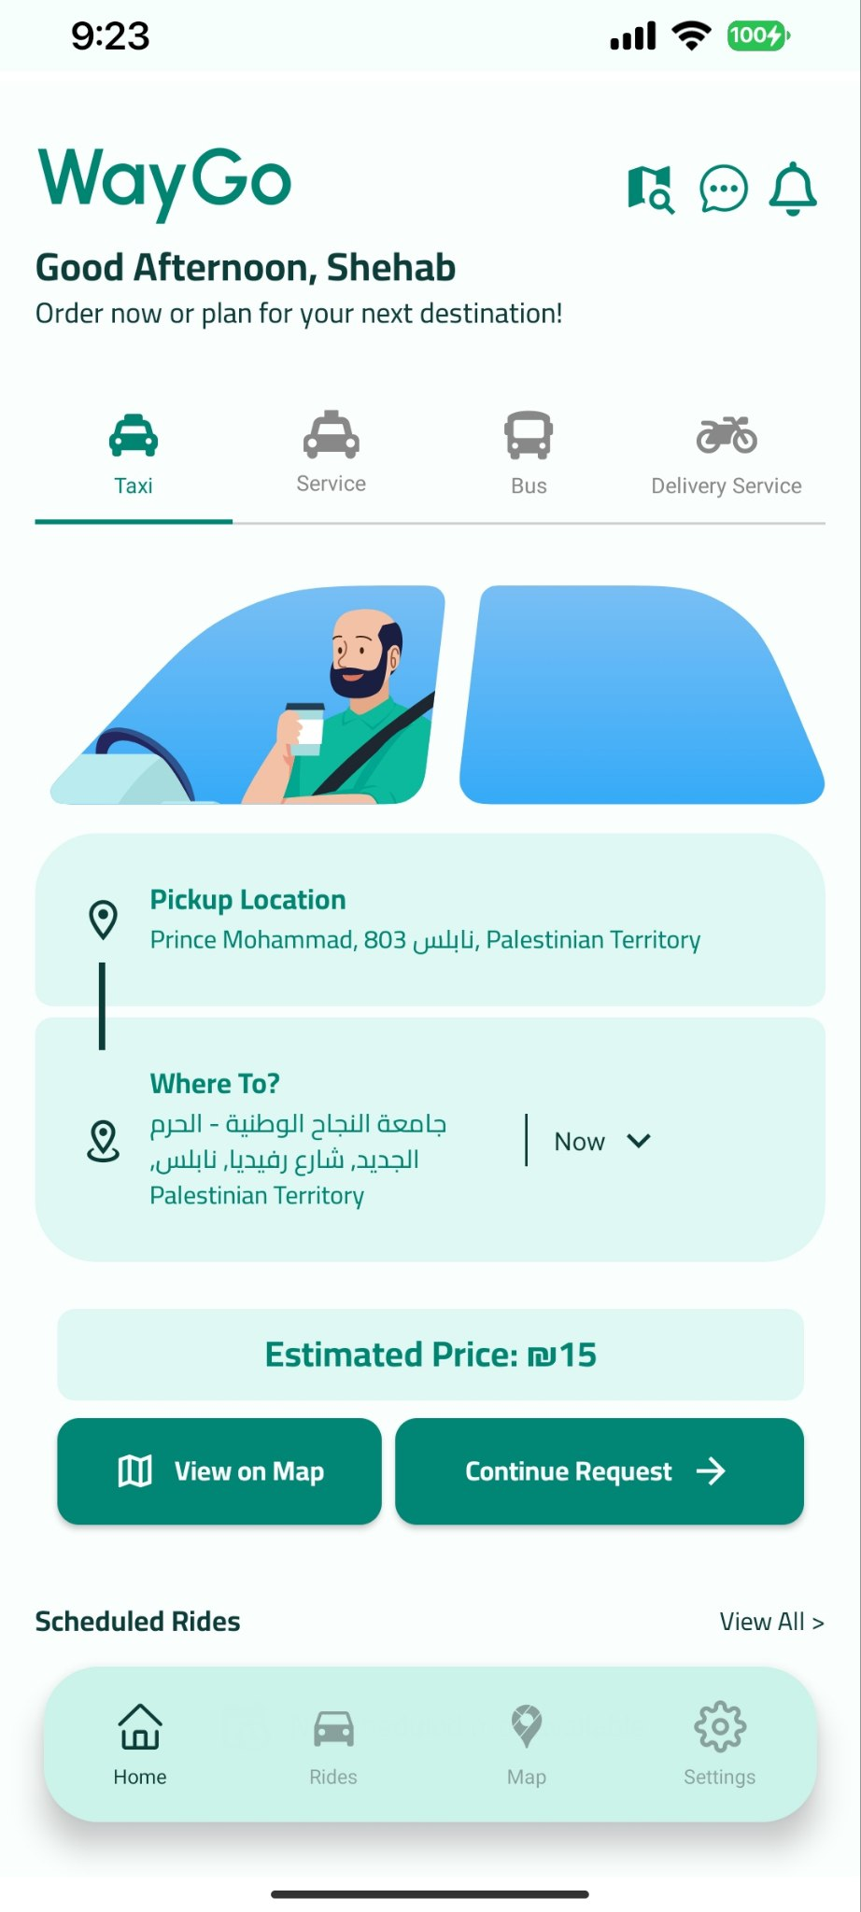
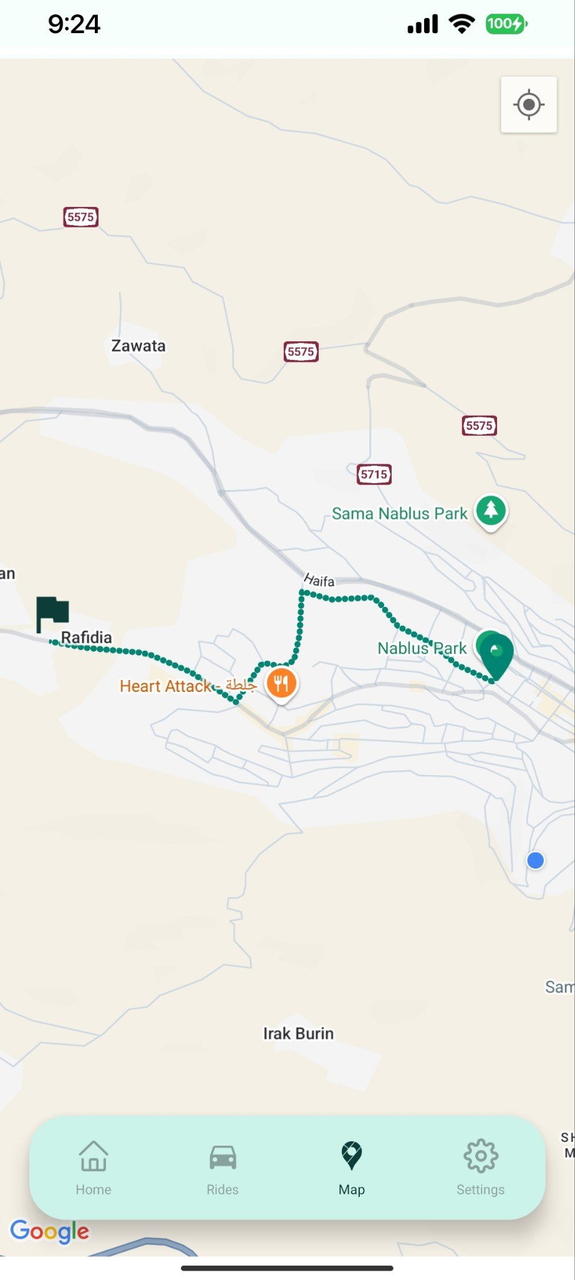
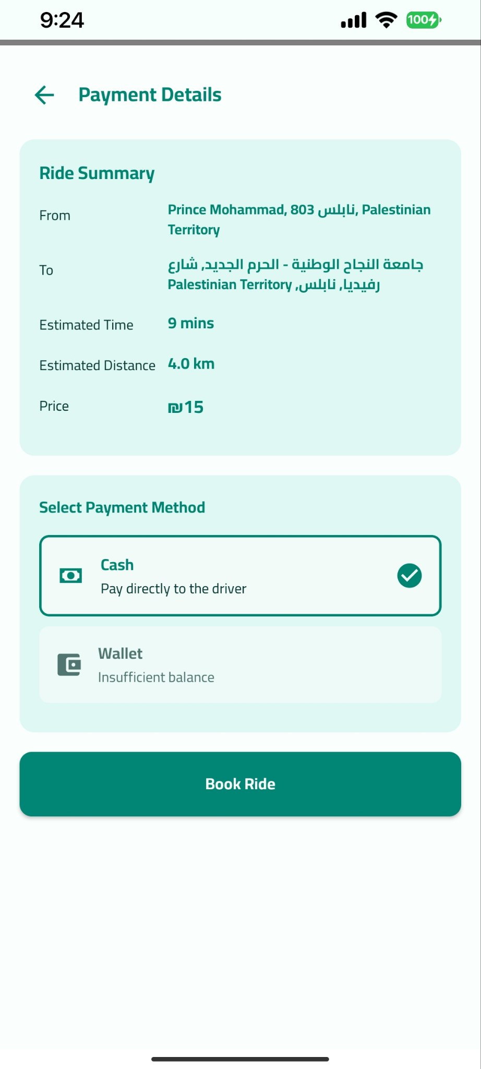

Slide 43

Web

Slide 44

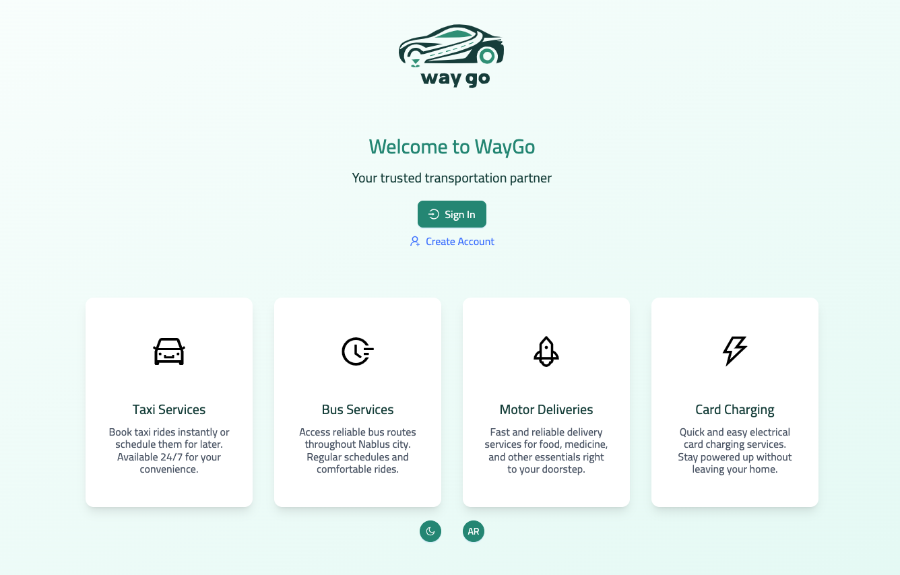

Slide 49



General

Slide 50
Behind The Scenes
SDLC
Cycle
01
02
Design
Patterns
Agile methodology with iterative development and frequent testing.
Component-based architecture with facade and factory patterns.
Best
Practices
03
04
Gathering Real Users' Needs
Clean code, modular structure, and comprehensive documentation.
User research and feedback driving feature prioritization.
CI/CD
Pipelines
05
06
Learning ….
Continuous improvement through metrics analysis and feedback.
Automated testing and deployment reducing release cycles.

Slide 51

Security
01
Role-Based Permissions System
Store roles in DB, dispatch actions to enforce permissions.
02
Authentication & Authorization + cookies
Verify identity and access, and store tokens securely in HTTPOnly cookies.
03
Guarded Routes in UI
Hide protected pages from unauthorized users at the frontend level.
04
Approval Approach
Admin must approve all roles except regular users automatically.
05
MFA: OTP
Require a one-time code for login to strengthen access.
06
HTTPS
Encrypt all data in transit between client and server.

Slide 52





Optimizations
01
User-Driver Matching Algorithm
Proximity-based, weighted scoring for efficient rider-driver pairing.
02
Battery & Location
Adaptive tracking frequency saves battery while maintaining precision.
03
UI Rendering Optimization
Virtualized lists and lazy loading for smooth interaction.
04
API & Network Efficiency
Compressed payloads and request batching for faster responses.
05
Caching & Data Management
Multi-level caching strategy with 87% hit ratio.

Slide 53



Objectives and Motivations
Conclusion

Slide 54





Constraints
Time
Prioritizing core features
over advanced ones.
Technical
Difficulty integrating live
maps with multi-role
access and real-time
updates.
Resource
Limited testing with real drivers or bus operators.
limitations on the GPS.

Slide 55

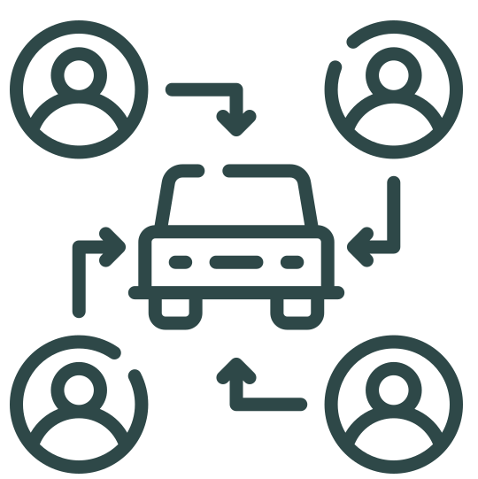


The Road Ahead
AI-Powered Demand Prediction
Carpooling & Ride-Sharing Hub
Machine learning algorithms anticipating peak demand times and locations for optimal driver positioning.
Smart matching for passengers with similar routes, reducing costs by 30% and environmental impact by 40%.
Seamless Offline Experience
Subscription Service Plans
Enhanced architecture enabling full functionality during connectivity gaps, with automatic synchronization upon reconnection
Monthly packages offering priority matching, discounted rates, and premium features across all service types.

Slide 56
WayGo: Achievement Highlights
Your ride, In our Way.

Slide 57
WayGo

Slide 58
WayGo
Q&A

Slide 59
Thank you

