Slide 1
Finding Missing Personal Things Using Bluetooth Technology
Submitted By:
Bahaa Ghithan.
Mais Abu Rajab.
Ghadeer barham.
Supervisor:
Dr. Falah mohammed.

Slide 2
Outlines
Introduction .
Flow chart .
Results .
Conclusion .
the future work .

Slide 3

Introduction
Where’s my wallet?
Where’s my key?

Slide 4
Literature Review
RFID
the red and white robot
the intelligent wrist
using Bluetooth technology

Slide 5
Advantages Of Bluetooth
Simple Setup
Compatibility
An economic wireless solution for short distance
Low power consumption.

Slide 6



Basic Components
Bluetooth
Arduino
Android

Slide 7
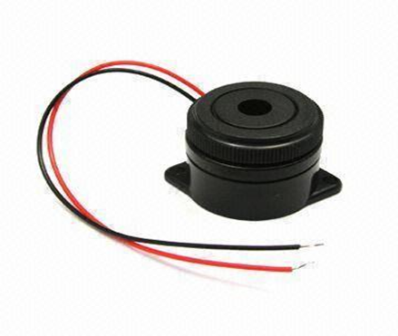
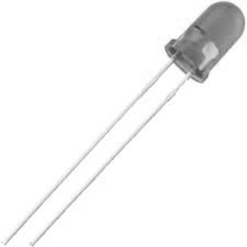
Alarm units
buzzer
led

Slide 8
Block Diagram
Data processing unit
Power supply
Alarm 2
Alarm 1
Bluetooth HC-05

Slide 9



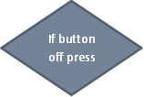




Flow chart
If button on press
No
yes

Slide 10


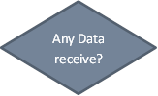






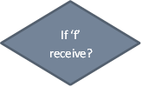

Flow chart
yes
No

Slide 11
Budget
Component | Component price
HC05 Bluetooth module | 50 NIS
Arduino Uno | 70 NIS
LEDS & Buzzer& wires | 30 NIS
Total cost | 150 NIS

Slide 12
Questionnaire
Q #
1 | Have you suffered from losing your stuff?
2 | Does it take long time to find them?
3 | Have you thought of a solution to this problem?
4 | Have you ever thought that if you can communicate with your personal thing
5 | If a product that solves this problem was available at a cost of 8$, would you think of acquiring it?

Slide 13
Result of questionnaire

Slide 14
Future work
GPS out door.
Build an application to control the missing item after founding it.
Put sensor with our product on the Water Pipes .
Build an application contains list about important things .

Slide 15
Conclusion
In the first semester, we succeed in implementing Bluetooth system by using Bluetooth module, Arduino and Alarm units , and sending AT commands serially to programming the HC-05 Bluetooth, Arduino programming ,and builds an android application.

Slide 16


