Slide 1
Acne Vulgaris between Der. Pts in Palestine 2000-2009
By Dr. Hisham Arda, M.D. Ph.D., Associate Prof. AN-Najah Univ.
Nablus-Palestine

Slide 2
Acne Vulgaris is primarily a chronic inflammatory process of the pilosebaceous unit.
Clinically presents as:
Comedones : - open = blackheads
- closed = white heads
Papules
Pustules
OR even as nodulocystic lesions.

Slide 3
The lesions always present in areas rich in large sebaceous glands; the face, chest, shoulders and upper back.

Slide 4
Incidence
  Andrews 2006 ; Acne occurs in 85% of adolescents in USA, but may develop or persist in adults.
  Julie C Harper from Alabama 2007 ; Acne affects 85-100% of people at sometime of their lives.
  70% of adolescents had acne, only 10% asked medical advice, more in boys, in adults acne is more in females.

Slide 5
  At age of 25; 12% of females had acne, and 5% of males had it. At age of 45; 5% of both had acne.
  Acne neonatorum occurs in the first few weeks or months of age.

Slide 6
Pathogenesis
It is exclusively a follicular disease with the principle abnormality being comedo formation. It is produced by the impaction and distention of the follicles with a keratinous plug in the lower infundibulum.

Slide 7
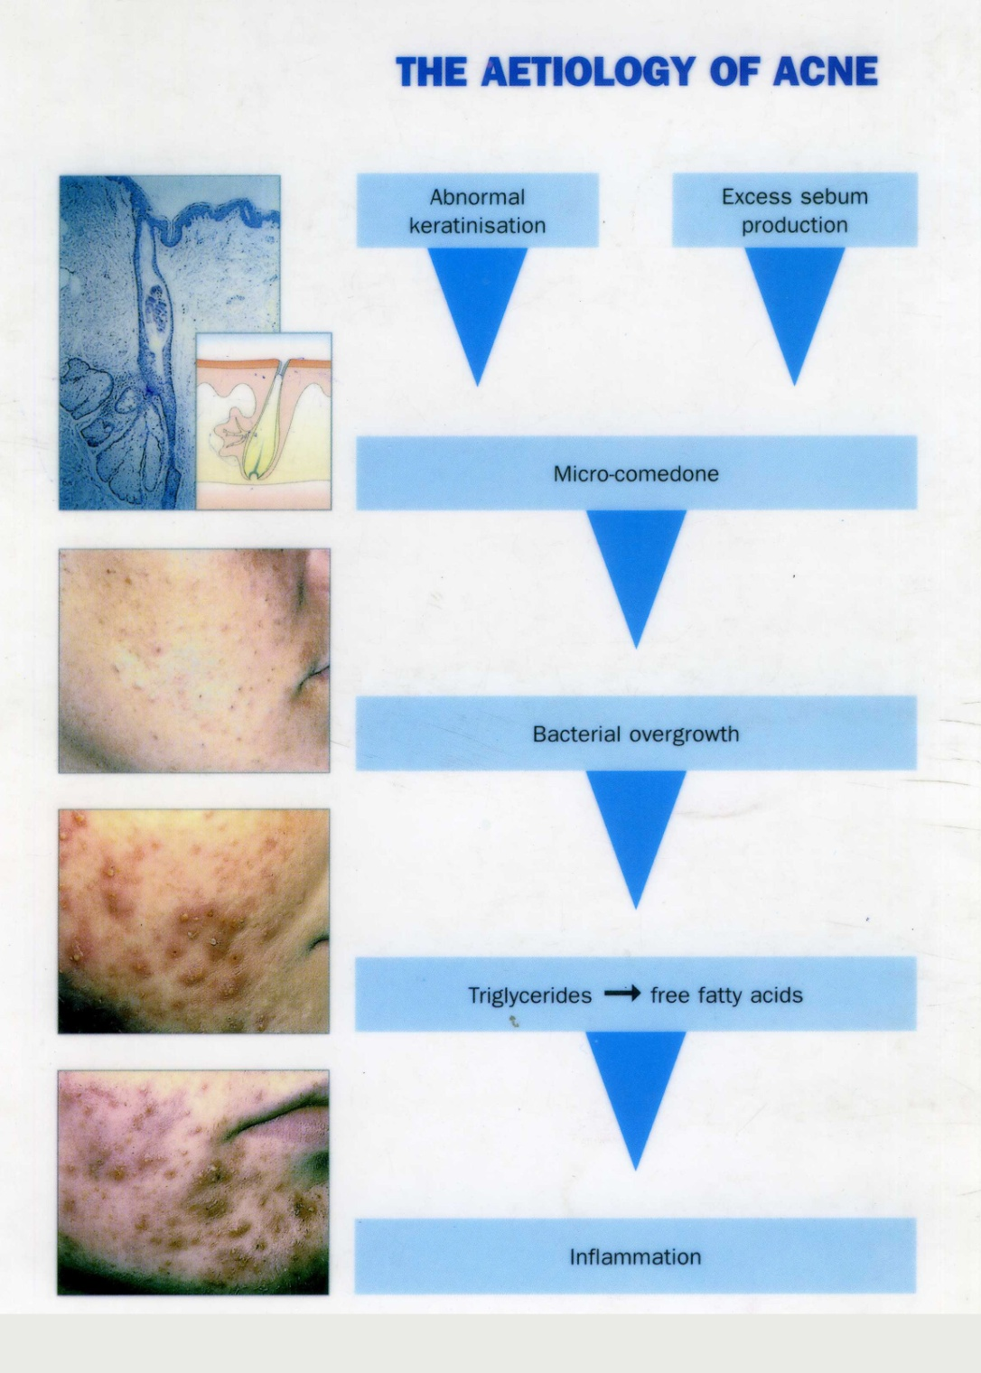

Slide 8
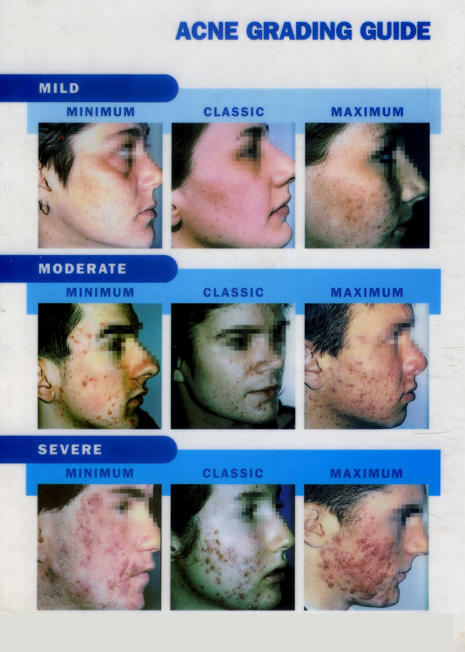

Slide 9
In Palestine
During the period 2000-2009 I treated 5528 patients complaining of Acne Vulgaris (1674 M and 3854 F).
Chart 1 shows the yearly distribution of these patients.
Acne pts constituted 9-12% of my dermatology pts.

Slide 11
Chart 2 shows the age distribution of 727 Acne pts ( 215 M and 512 F ).
The age of pts ranges from 10-50 years with a peak presentation at 16-25 ys (531 out of 727 pts).

Slide 13
Chart 3 shows the monthly distribution of Acne pts during 2009.
There was no seasonal difference in the attendance of pts to the clinic.

Slide 15
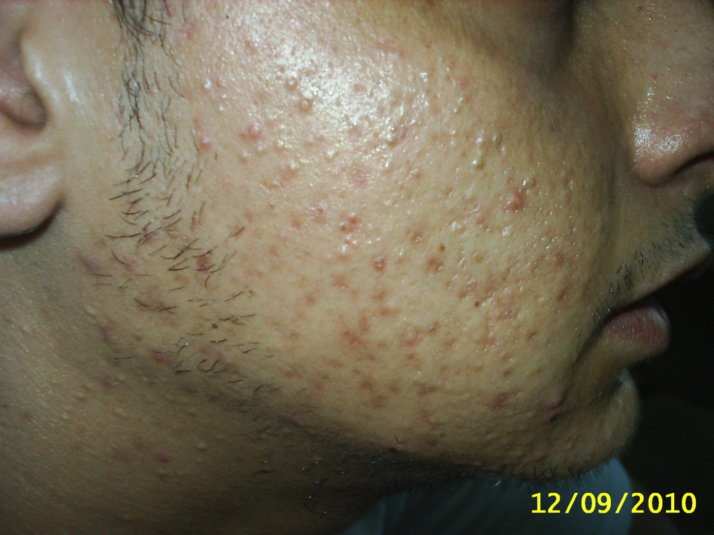

Slide 16
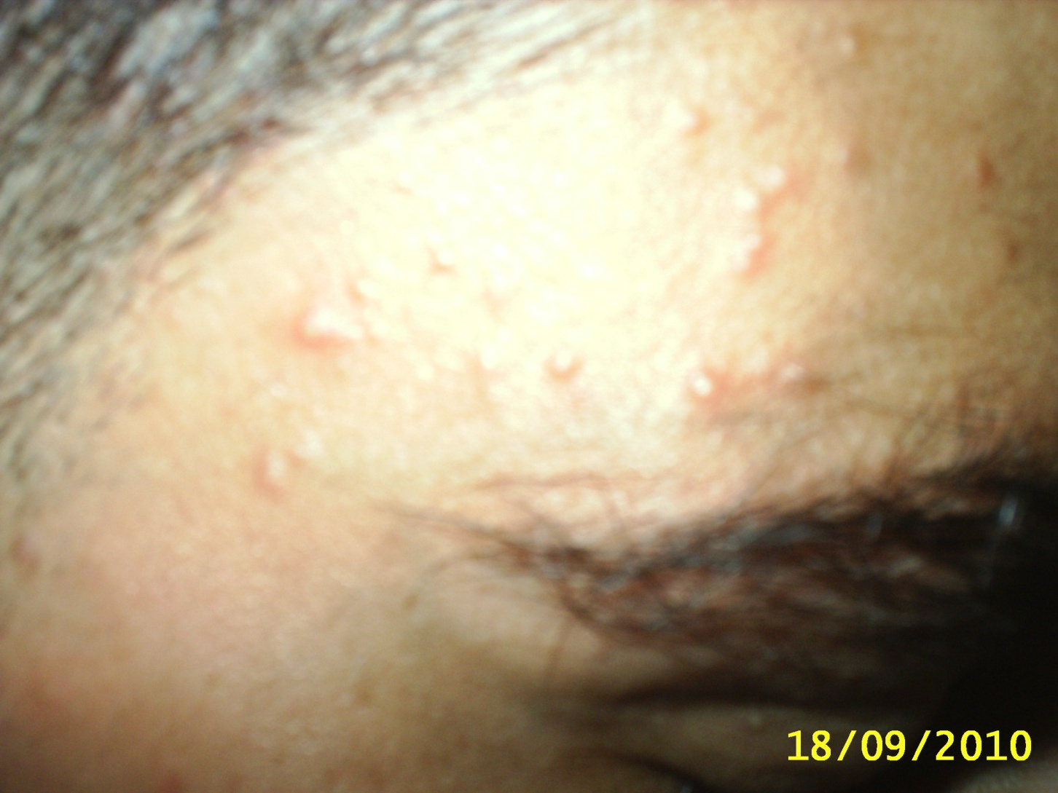

Slide 17
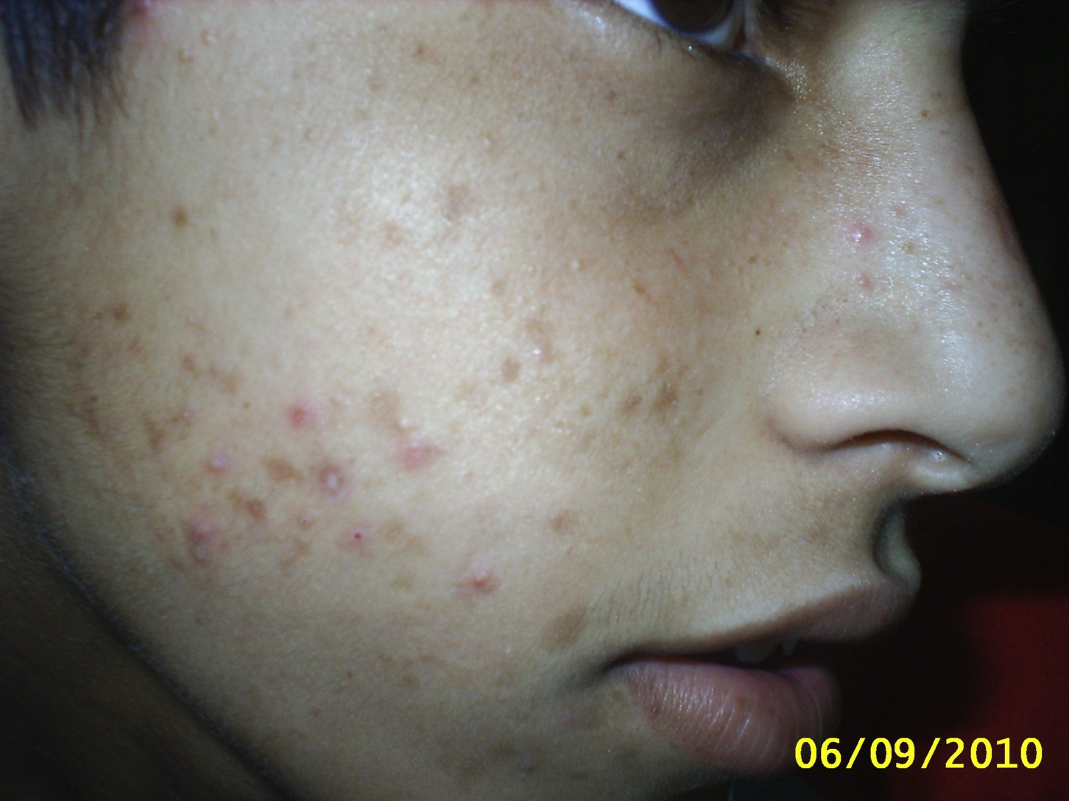

Slide 18
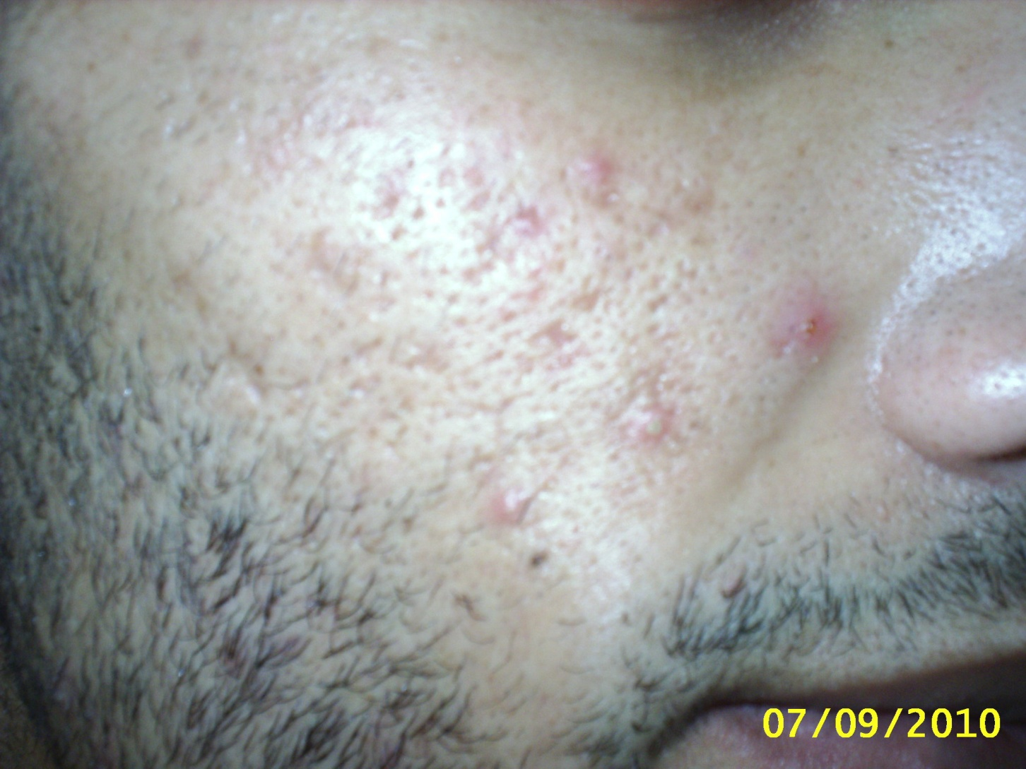

Slide 19
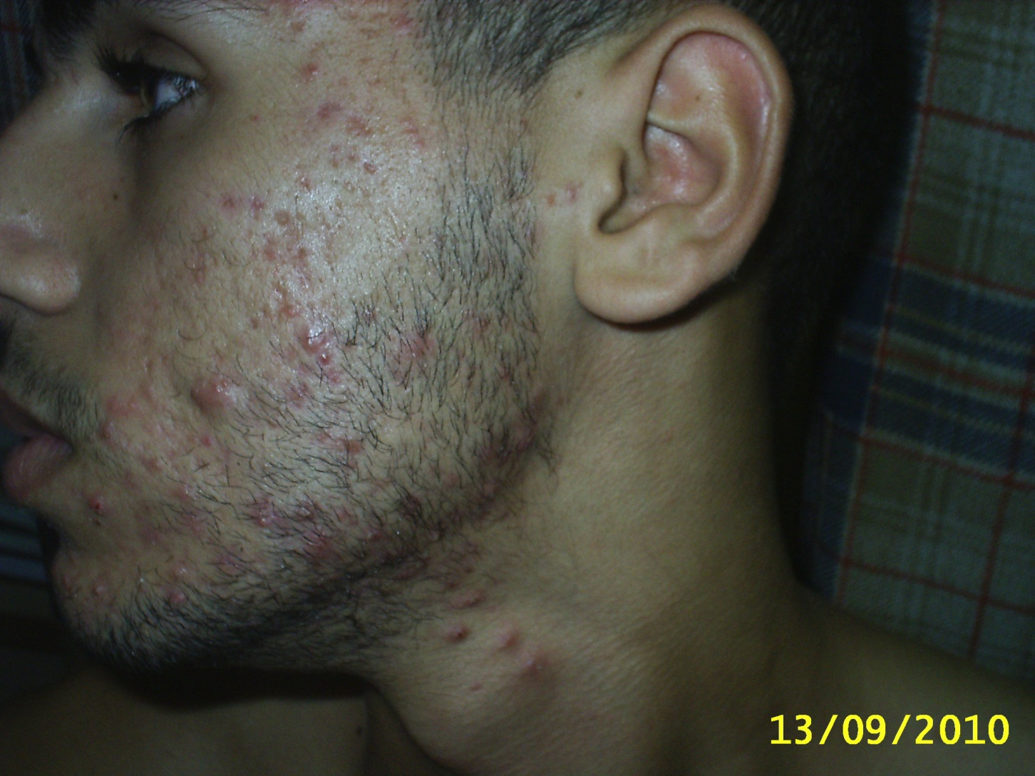

Slide 20
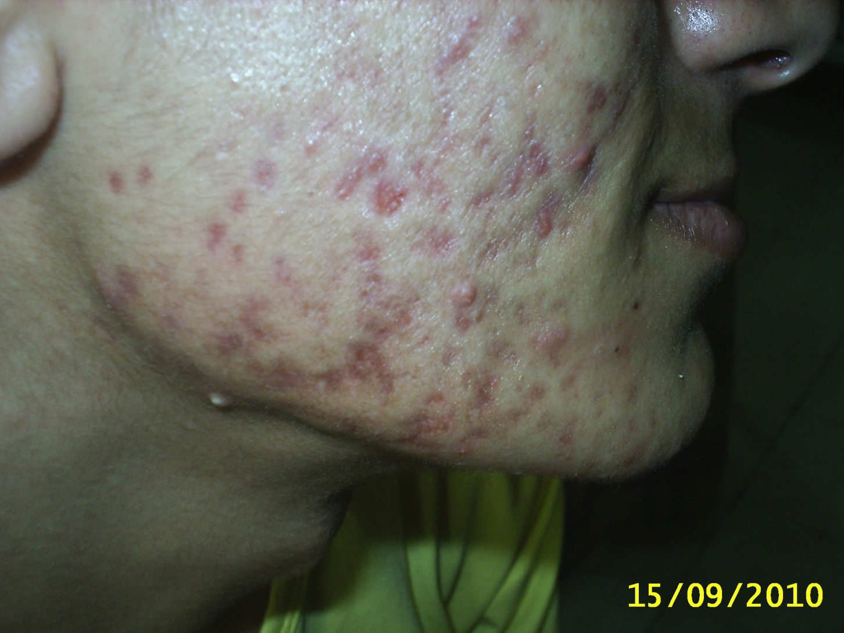

Slide 21
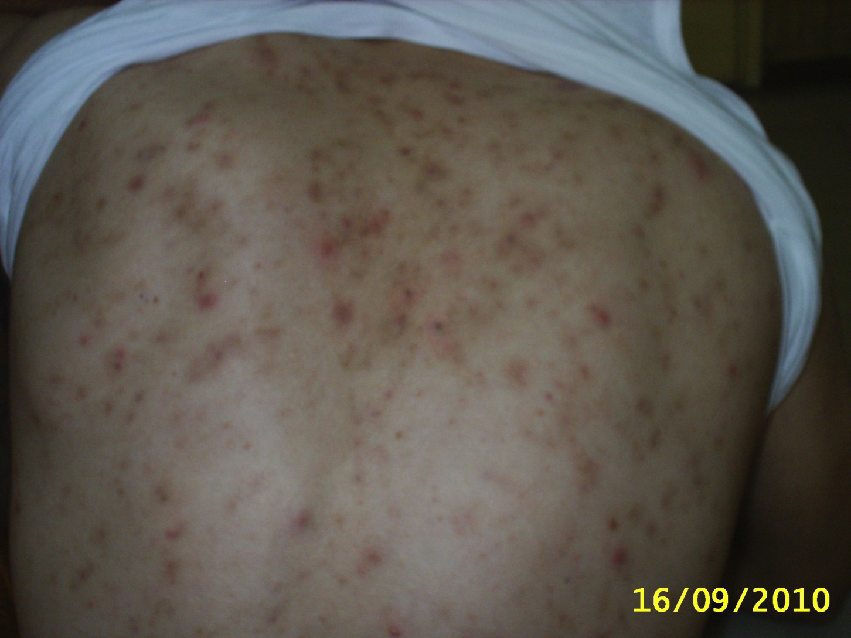

Slide 22
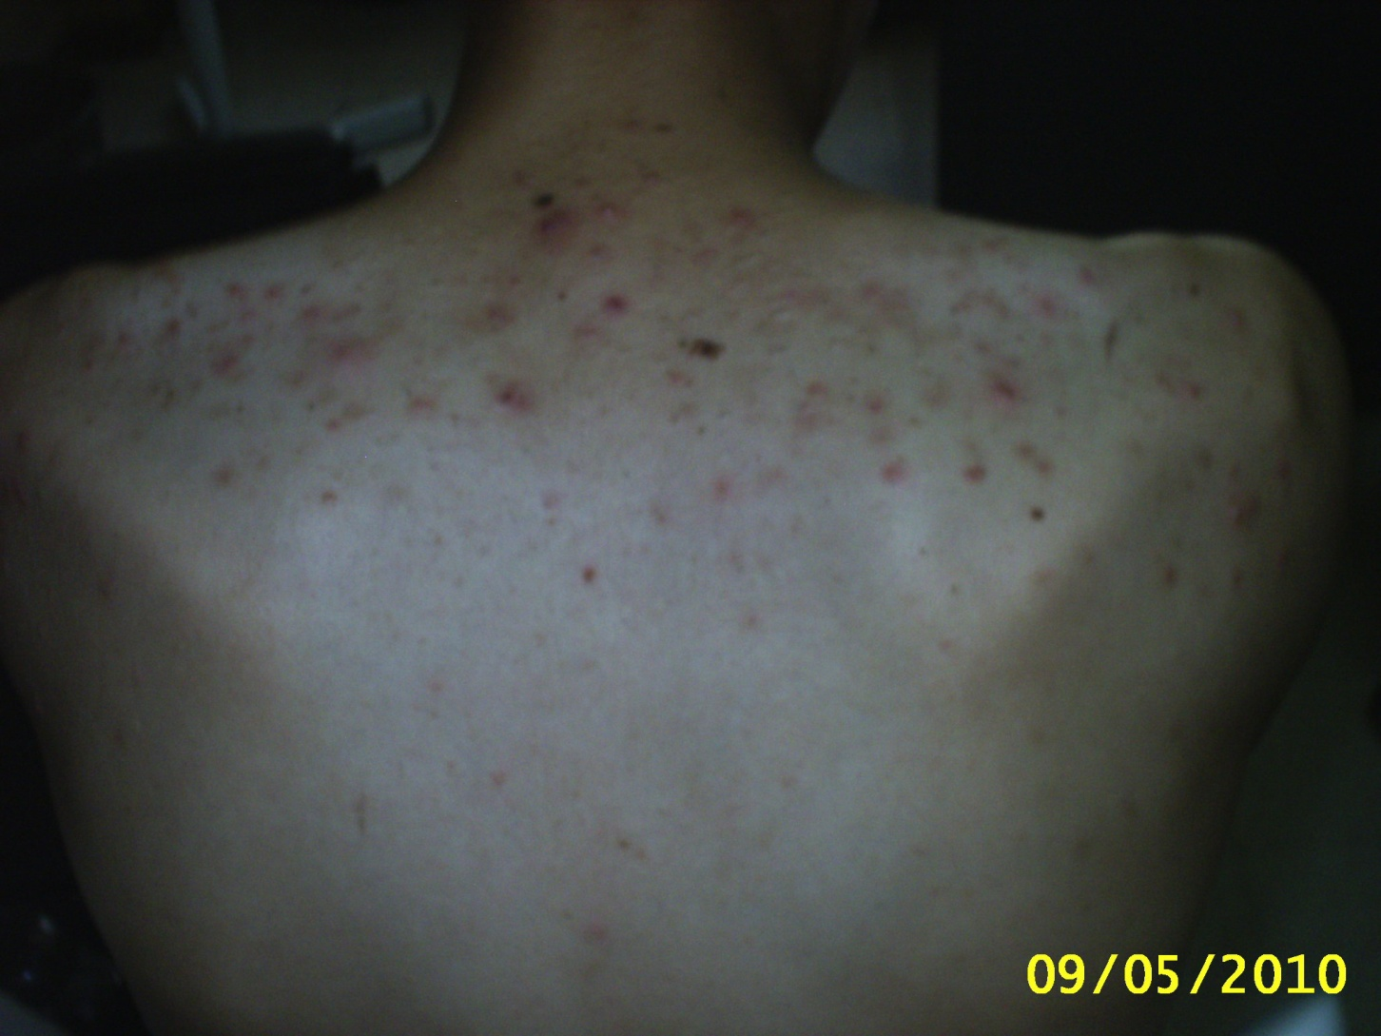

Slide 23
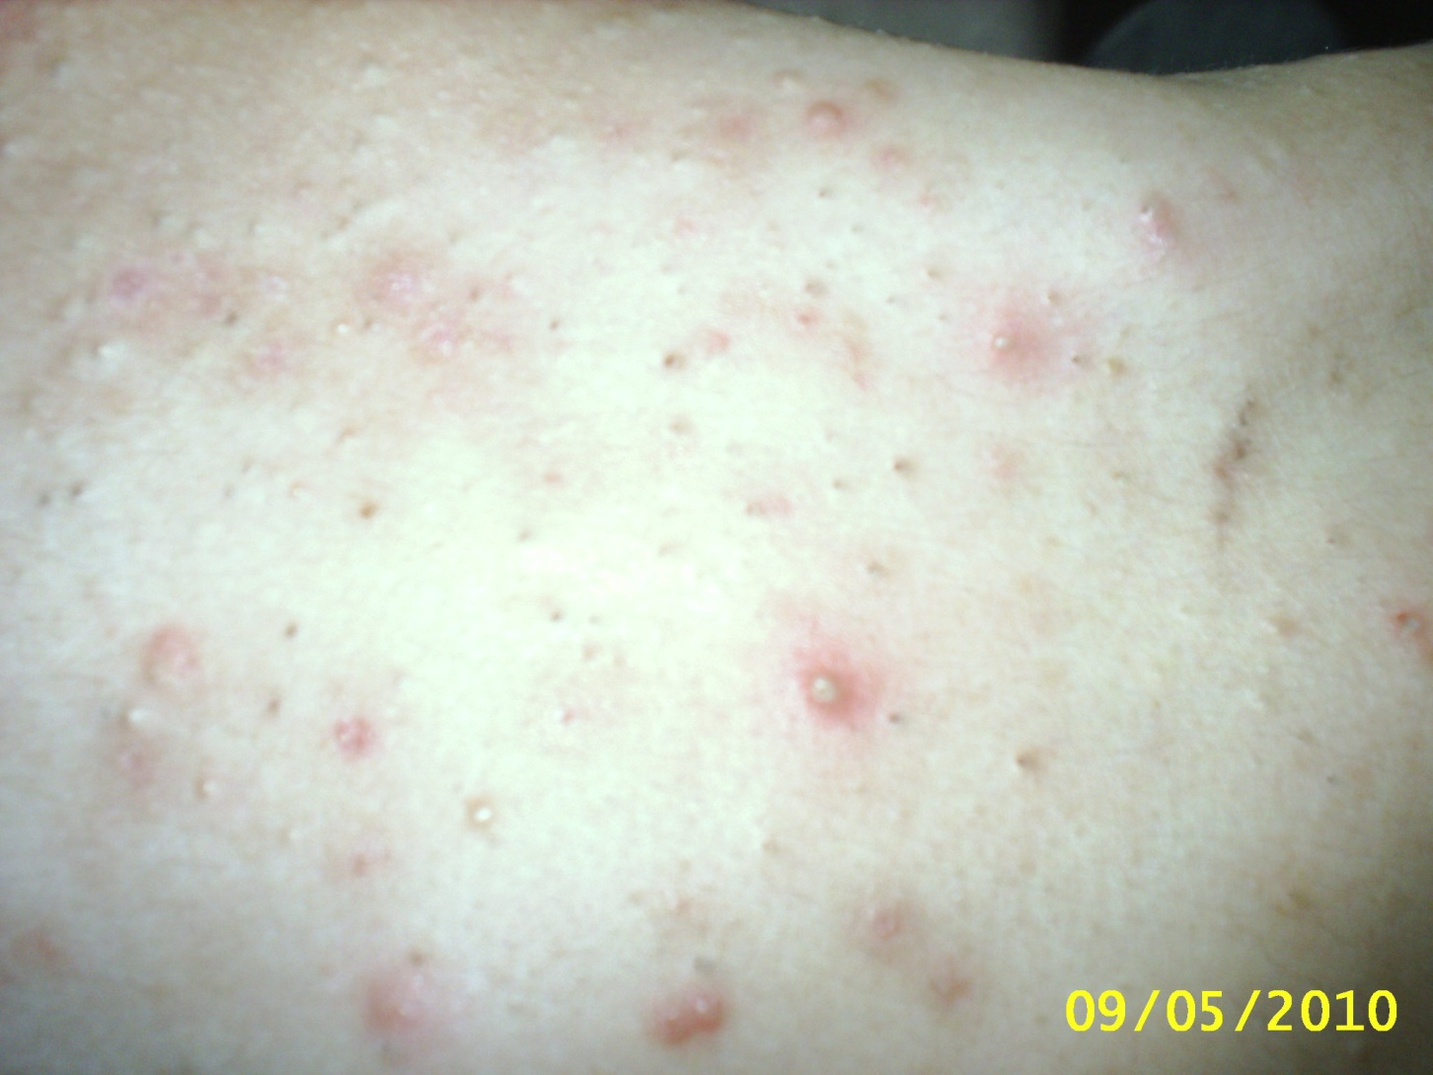

Slide 24
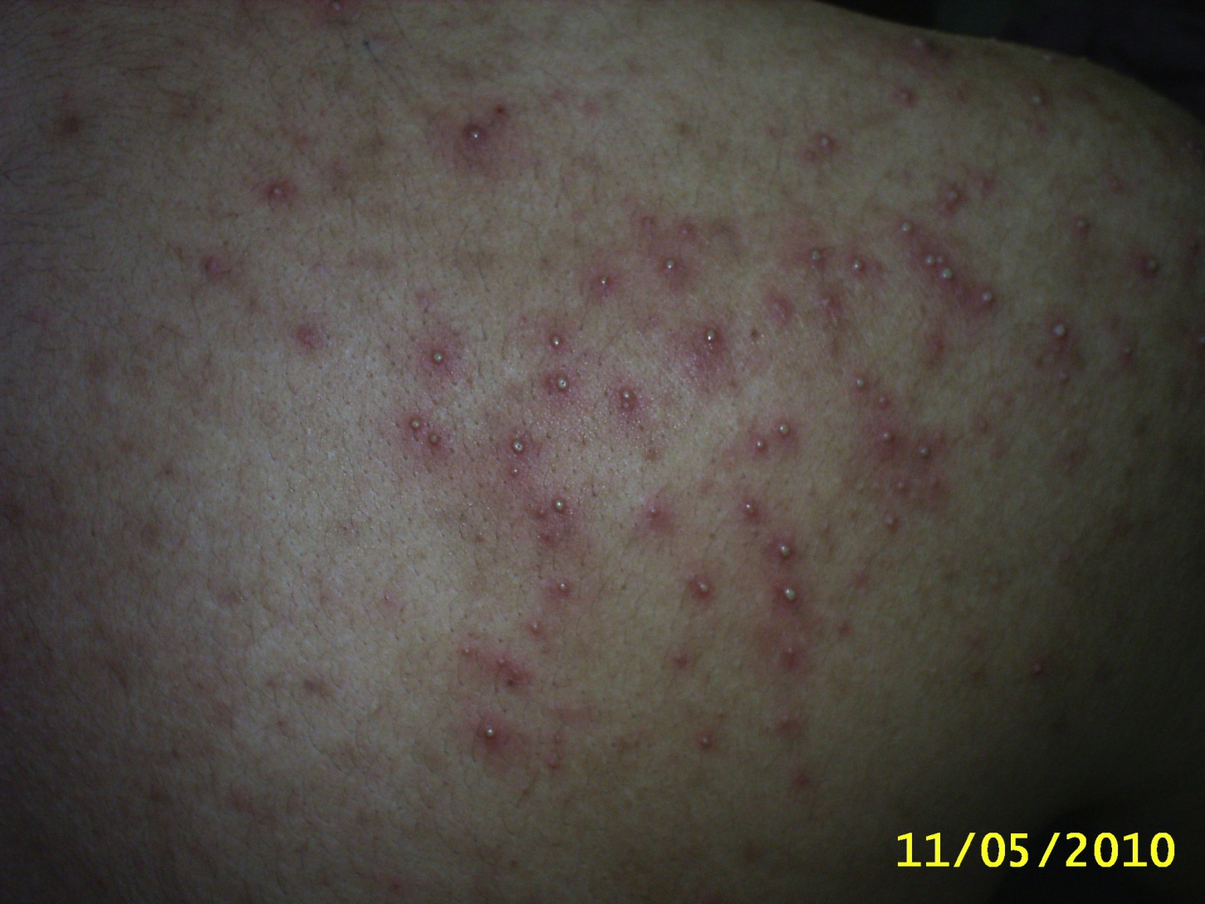

Slide 25
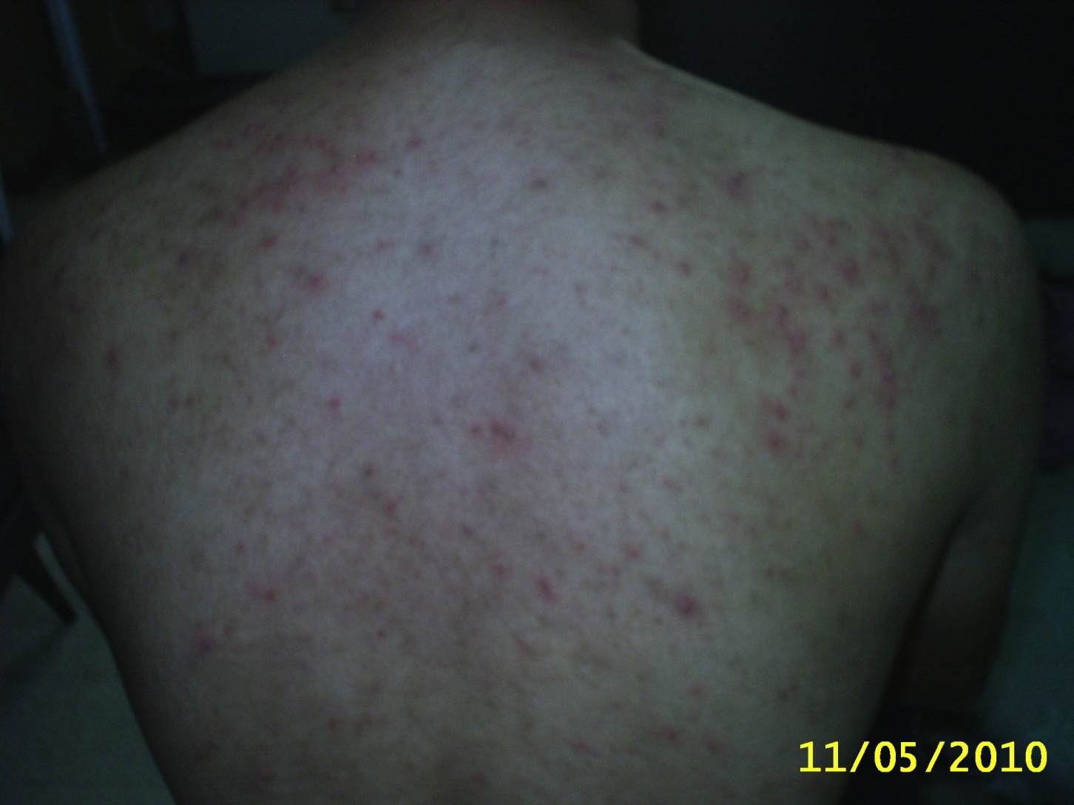

Slide 26
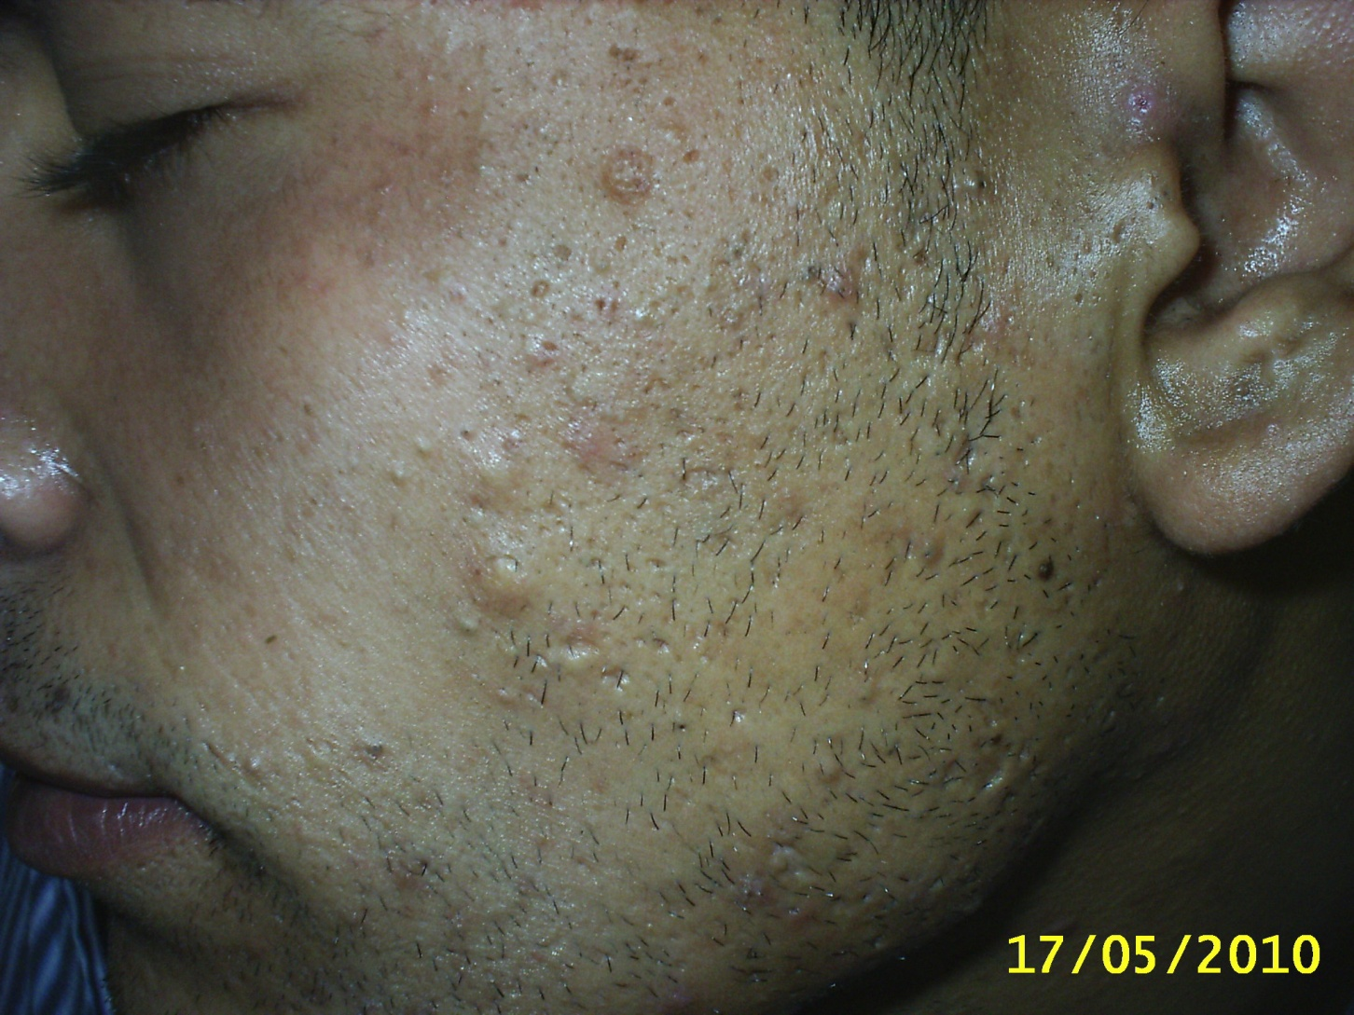

Slide 27
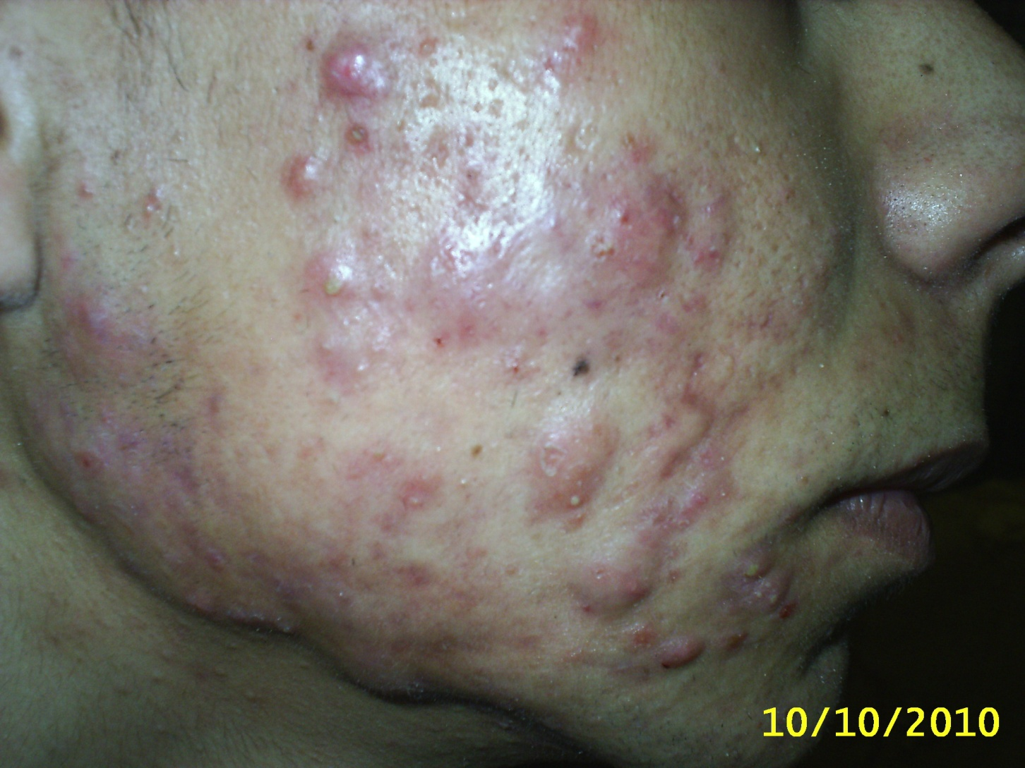

Slide 28
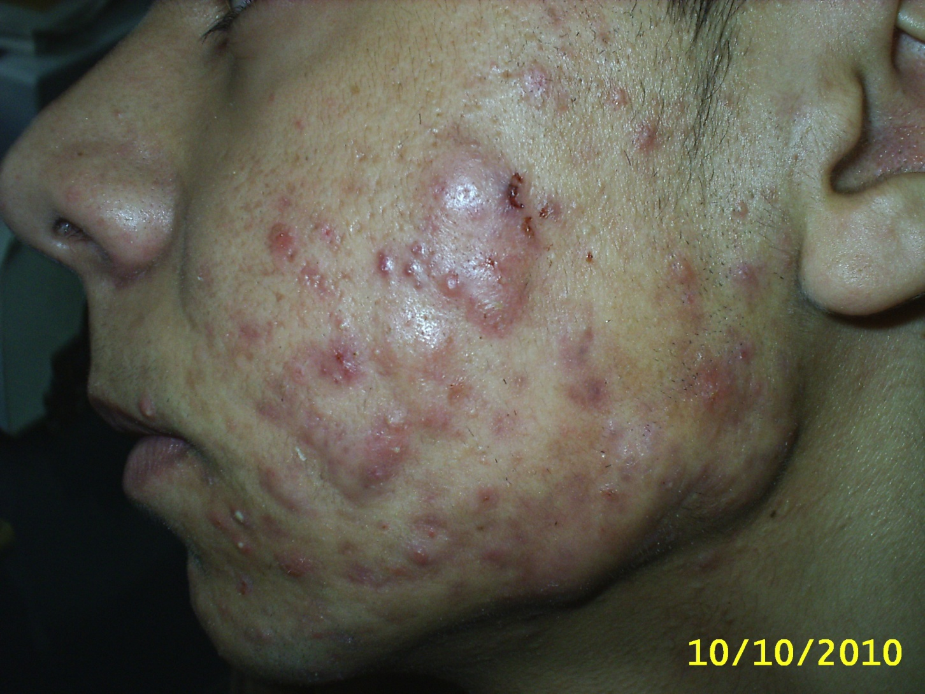

Slide 29
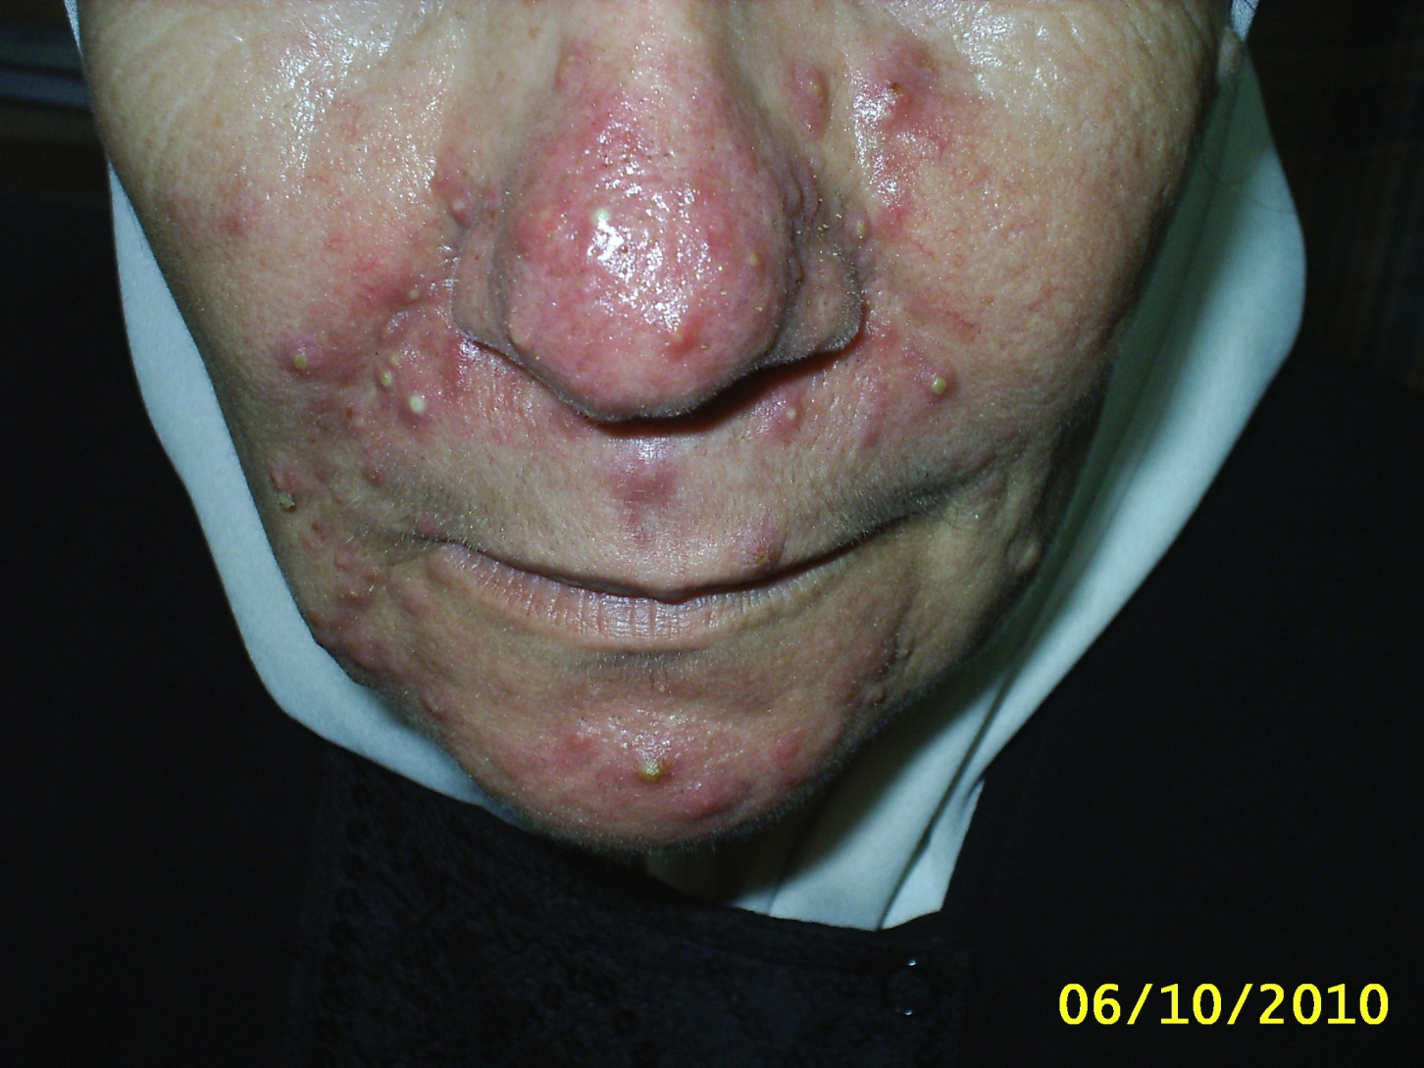

Slide 30
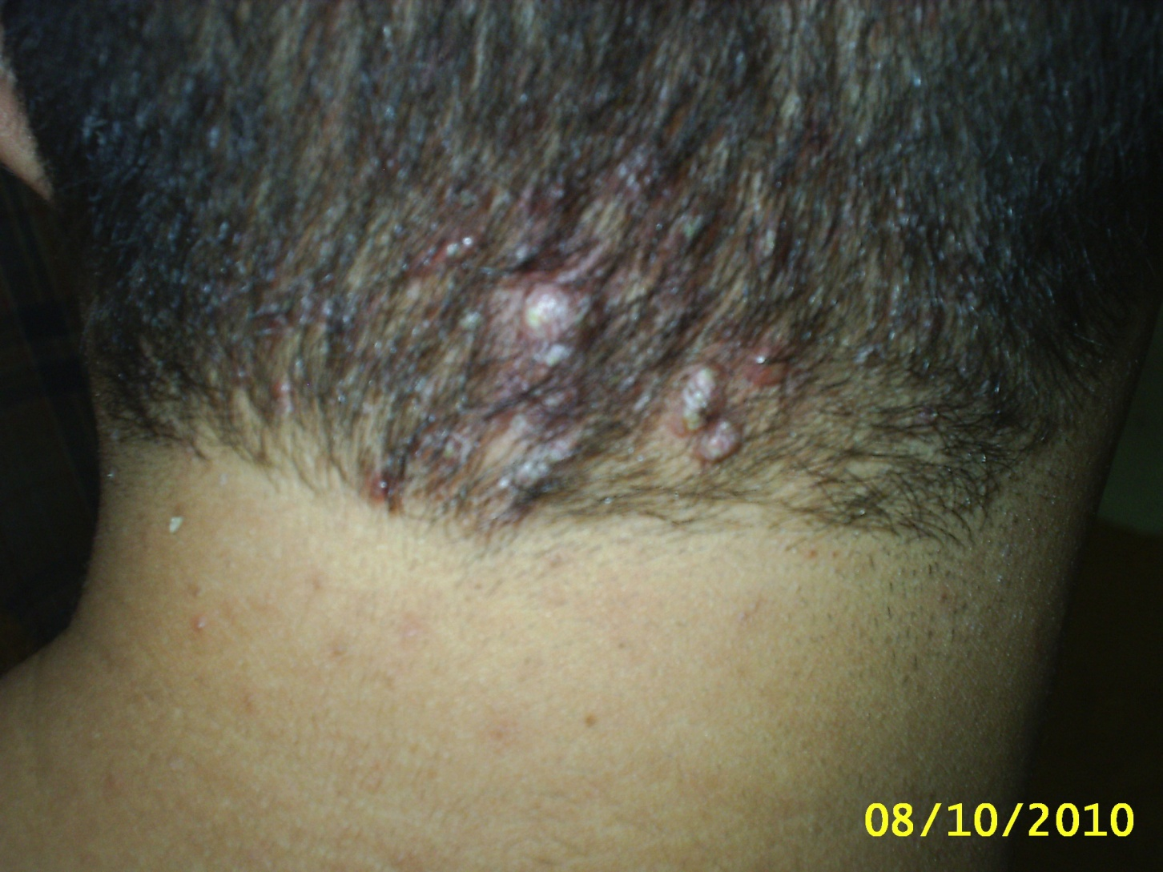

Slide 31
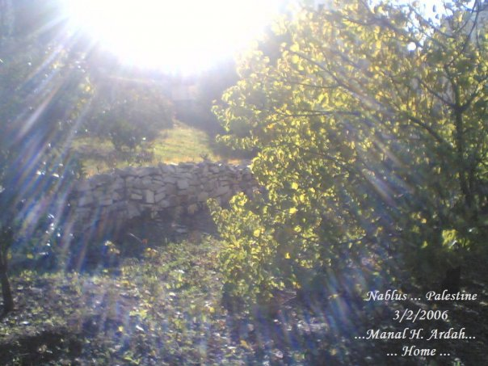
Thank you..

