Slide 1

An-Najah National University
Faculty of Engineering and Information Technology
Department of Computer Engineering
Graduation Project II – 10636582/6

Slide 2
Supervisors:
Dr. Mona Dmaidi
Team Members:
  Mahmoud Mohammad Shayeb
  Mohammad Kamal Hamaydeh
Date: May 19, 2019
Presented in partial fulfillment of the requirements for Bachelor degree in Computer Engineering.

Slide 3
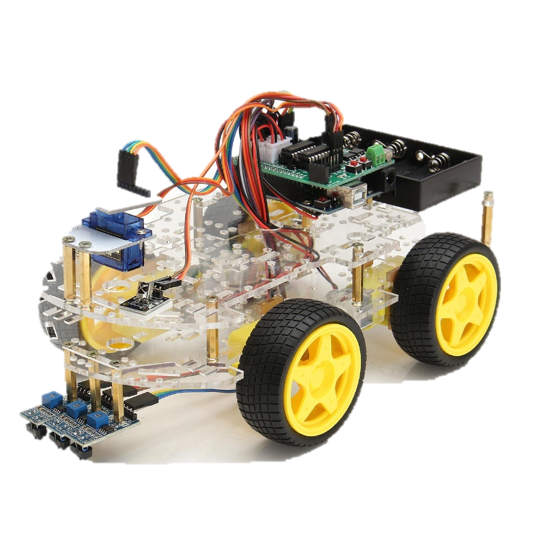
Graduation Project II
Wireless Automated Car System
“ BB – 8 ”

Slide 4
Outline
The BB-8 System.
Motivations.
Methodology.
  Development Tools and Languages.
  Project Hardware Components.
  Project Schematic and Design.
  Software implementation and data analysis.
  Constraints.
  Results.
  Conclusions and Recommendations.

Slide 5
The BB-8 System
The BB-8 is an automated car system using wireless fidelity. It’s a set of hardware components and sensors grouped in two collections; CAR and GLOVE which mainly work by Arduino.
The car connected to an Arduino device used for memorizing path and finding routes, also this device receives orders of basic directions from a wireless glove-controller. As an integrated system, BB-8 represents a new approach of entertaining by utilizing the A.I.

Slide 6
Motivations
Driving the car by gloves.
In a smart way, the car can store the path.
The car can identify obstacles and avoid them.

Slide 7
Methodology

Slide 8
Development Tools and Languages.
Hardware Tools:
© Labcenter Electronics 1989-2012. Release 8.0 SPO, build 15417 with advanced simulation.
With the use of the following libraries:
Adruino Mega 2560 Library for Protues.
Arduino Uno Library for Protues.
L298N.H stepper motor Library for Protues.
RF HC-12 module Library for Protues.
Software Tools:
Arduino Software IDE 1.8.9 for windows x64 C++ gcc compiler. With the use of the “stepper.h” library for stepper motors and other built in libraries.

Slide 9
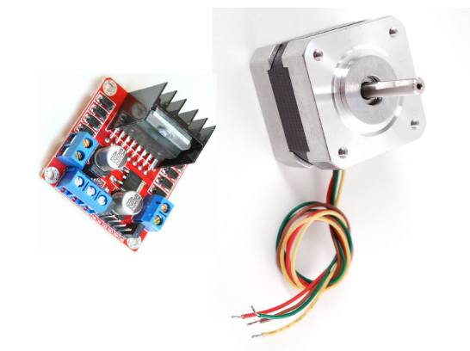
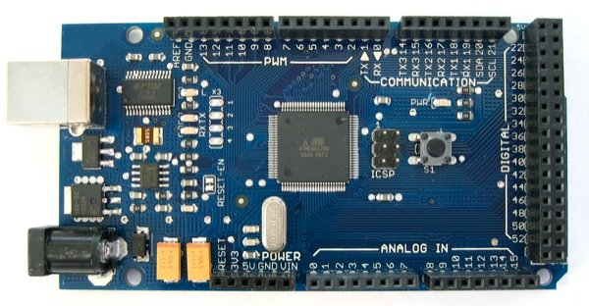
  Project Hardware Components
  The components are illustrated below each for its part:
  CAR Components:
1. Arduino Mega 1280 | 2. Stepper Motors with L298N H-bridge
The core A.I. of the project, receives basic orders from the glove-controller also processes data read by the IR sensor. | responsible of moving the car in the decided directions.

Slide 10
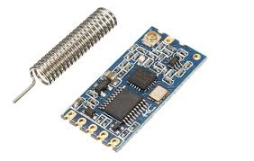
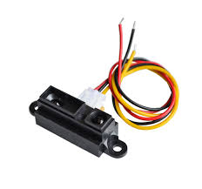
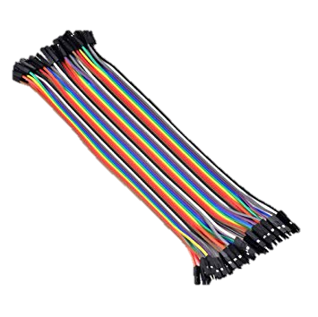
3. RF HC-12 module | 4. IR sharp sensor
works as a data receiver from the controller for directions. | explores the area in 10-80 cm range for obstacles.
5. Switch and male-female wires | 6. Car body built with 3D printer, two wheels and 3*10V batteries.
the switch used to turn on and off the system.

Slide 11
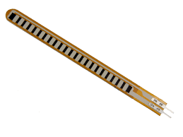
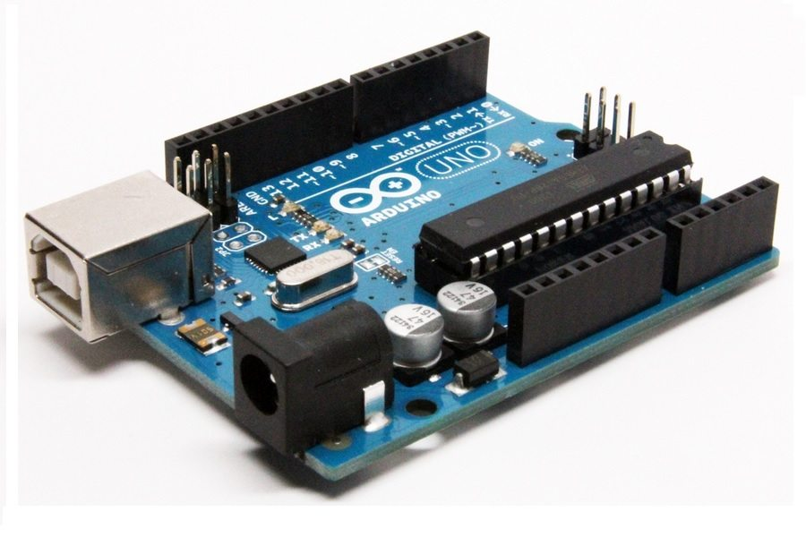
  GLOVE Components
a) Arduino UNO: reads data from flex sensors to generate a direction for the car.
b) Three flex sensors: depending on specific gestures, it generates data of directions.
c) RF HC-12 module: sends the direction to the receiving module on the car.
d) Switch, male-female wires, Push button for moodes and 2*1.5V batteries.

Slide 12
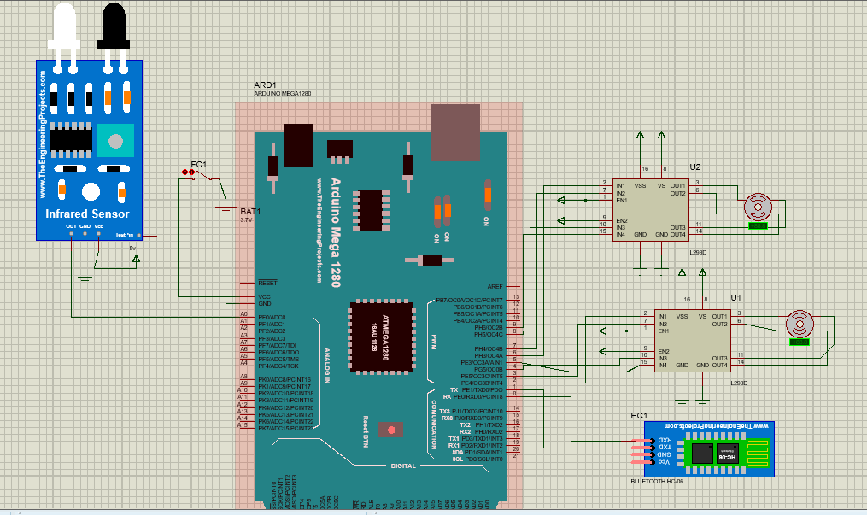
  Project Schematic and Design
Car Schematic

Slide 13
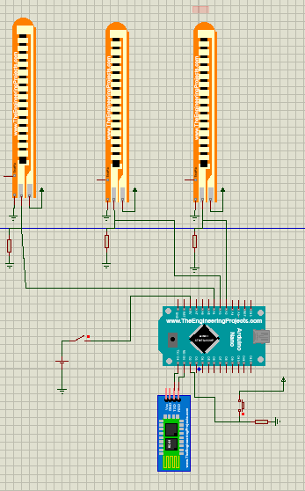
  Project Schematic and Design
Glove Schematic

Slide 14
Software Implementation and Data analysis
The proceeding explanation shows how the progress in the performance is attained each part on its own.
Glove Software.
a. Three Modes, each mode with specific directions.
Car Software.
a. Avoiding Obstacles.
b. Memorizing Path

Slide 15
Glove Software
Three Modes:
1. Mode One: Basic Directions
Forward
Right
Left
Backward
2. Mode Two:
Forward
Backward
Forward with Right
Backward with Left
3. Mode Three: Turn on GO-BACK Algorithm

Slide 16
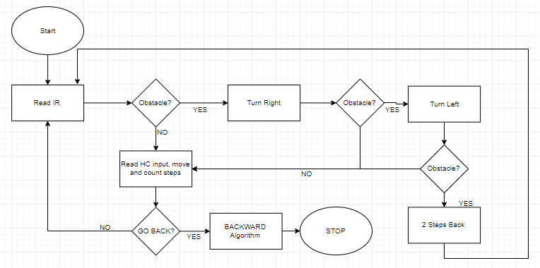
Car Software – Avoiding Obstacles Algorithm

Slide 17
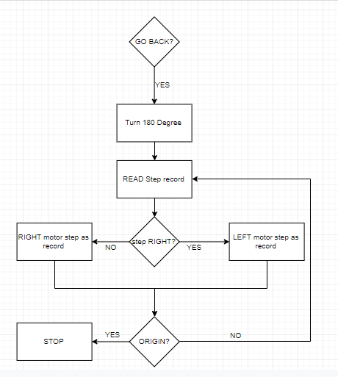
Car Software – Memorizing Path Algorithm

Slide 18
Constraints
During the development of the project, we encountered several determinants.
Lack of knowledge.
Lack of resources.
Lack of funding
Shortage memory space to memorize path.
Time.

Slide 19
Future Work
We added a list of future work as shown in the form of points.
Improve the hardware system, and design a suitable device that works better than the controller.
Improve the A.I. algorithm.
Enhance the safety measure for safer driving experiment.

Slide 20


