Slide 1

An-Najah National University
Faculty of Engineering and Information Technology
Graduation project report II
Water and Sewer Network design for Hajah Village
Prepared by :
Ameer Eid
Rana Jabir
Supervisor: Dr. Anan Jayousi

Slide 2
Main Objective
Analyze the existing water network in Hajah village.
Redesign the water network to meet the requirements for the next 30 years.
Design a sewer network for part of the village for the next 30 years.

Slide 3
Study area
hajah is a Palestinian village in Qalqilya Governorate, 18 Km southwest Nablus.
It is 425 m above sea level.
The total area of urban village is about 23 Km² ( 15.2 %
as urban area)
The total population of the village is about 3700 capita in 2016.

Slide 4
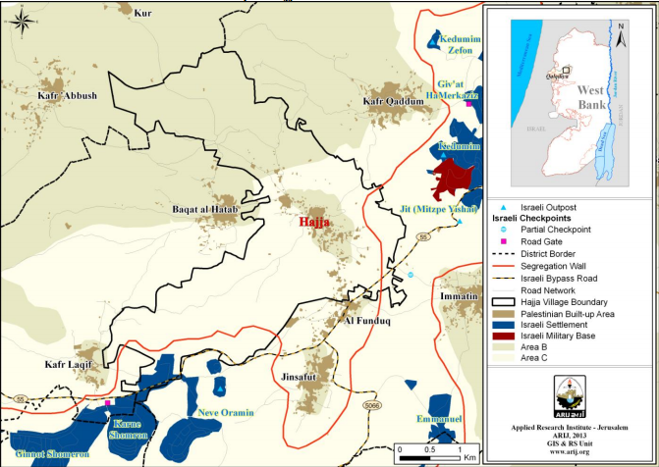

Slide 5
Water status
90% of hajah houses are provided with water by the West Bank Water Department through the public water network established in 2009.
In 2014 the water network was renovated.
The percentage of losses reduced up to 5%.
Thus, the quantity of water supplied to hajah now is 80300 m³ /year.
The rate of the water consumption per capita became 56.48 L/C/day.
According to the World Health Organization, the minimum quantity of consumption is 100 L/C/day.

Slide 6
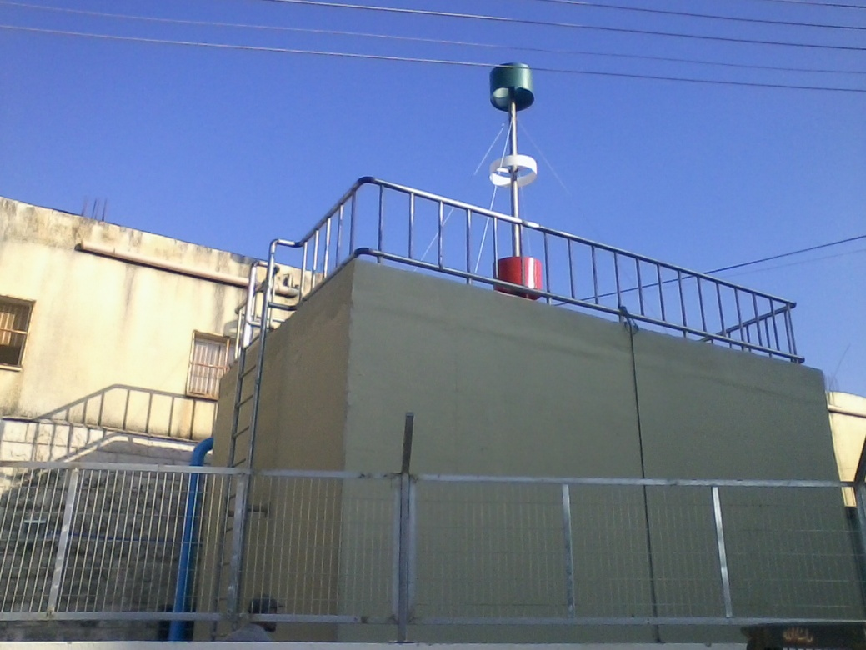
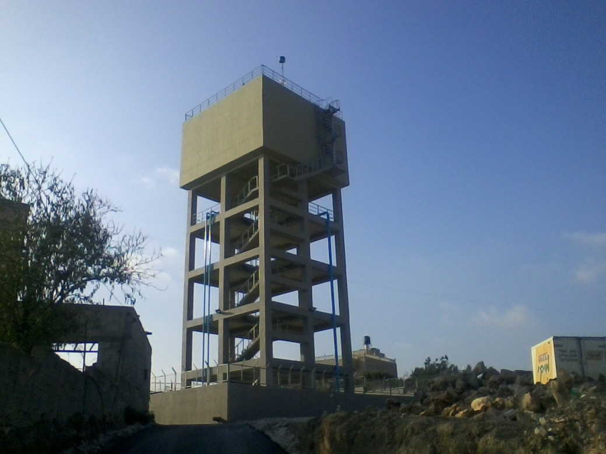
Network components
Booster Station , Reservoir and pumps.

Slide 7
Pipes :
Transition pipe
Main pipes 4 and 6 in.
The transition pipe has a total length of 1134 meter.
Distribution pipes
The distribution pipes have different diameters (1, 2, 3, 4 and 6 inches).
The total length of these pipes is around 13924 meter.

Slide 8
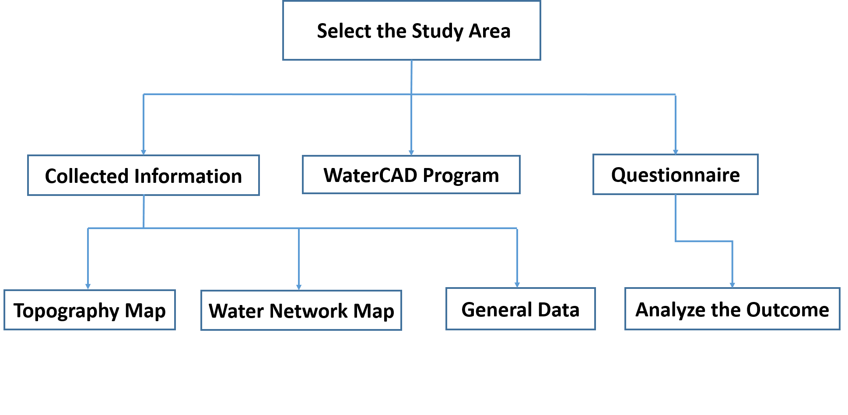
Methodology

Slide 9
Questionnaire outputs

Slide 10
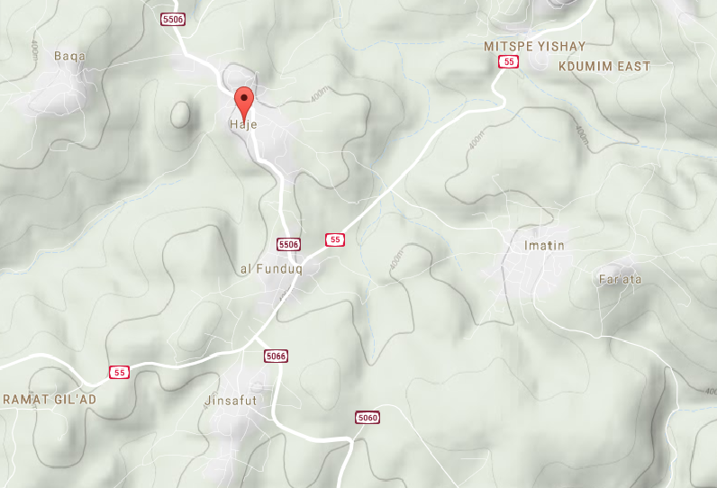
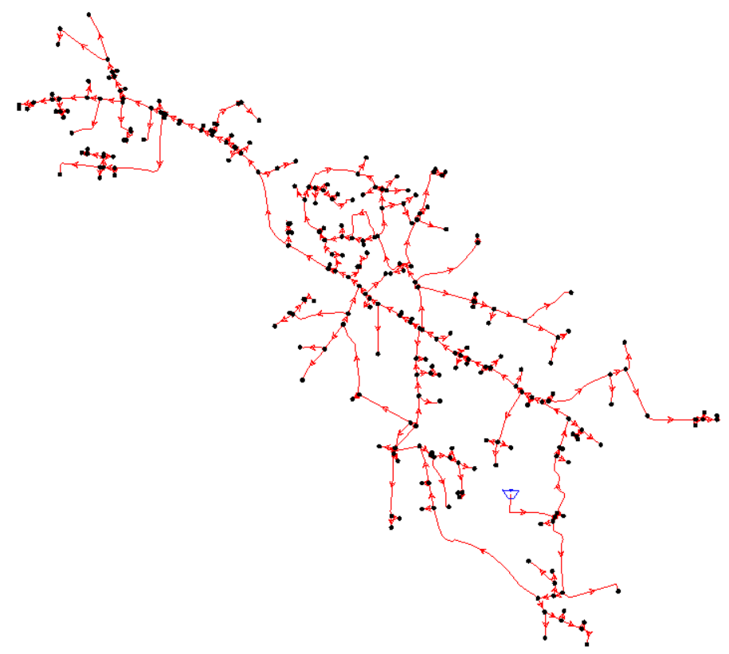
Topography Map
Water Network Map

Slide 11
Calculations
Supply | 80300 meter cubic / year
Consumption | 76285 meter cubic / year
Unaccounted % | 5%
Population Served | 3700 capita
Average water use per capita | 56.48 L /c/day

Slide 12
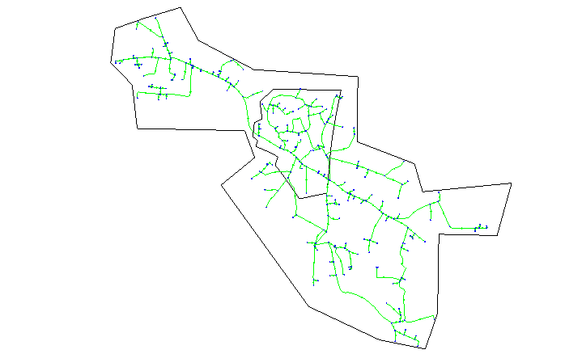
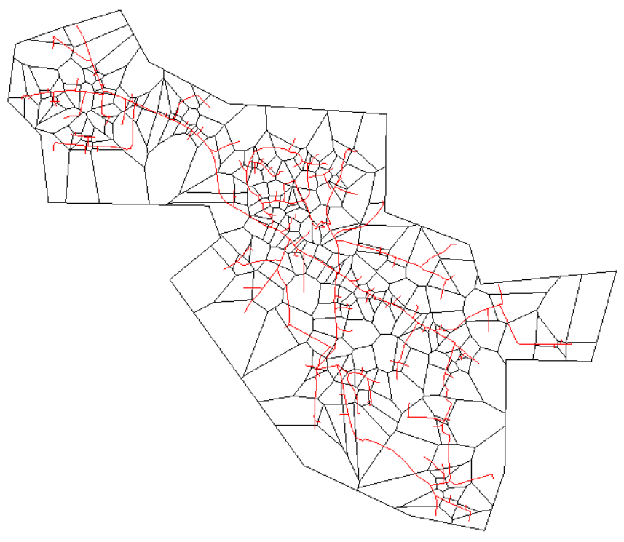
Water CAD
Work on topography map and network map and collected data to develop the data needed for WaterCAD program .

Slide 13
Result from WaterCad
Nodes & junctions

Slide 14
Design Water Network
Complete the Network
Estimation Future population
Estimation Future Demand
Modification

Slide 15
Network design
Estimation of the future population :
P_{future} = P₀ (1+i)^{n}
P₂₀₄₆ = P₂₀₁₆ (1+ 0.025)^30
P₂₀₄₆ = 3700 ( 1+ 0.025) ^30
P₂₀₄₆ = 7761 capita

Slide 16
Future water demand :
F = (P ₂₀₄₆ / P ₂₀₁₆) (water use 2046 / water use 2016)
F= (7761/3700) (120/ 56.48)
F= 4.46
Where F : a factor to calculate the future demand from the current demand.

Slide 17
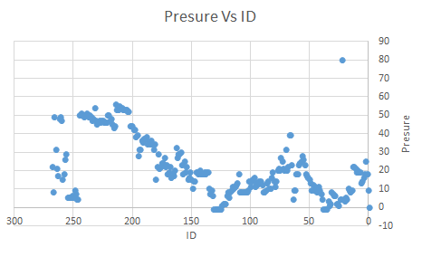
Outputs

Slide 18
Modification :
Law pressure :
Change the diameters of some pipes and set pump
velocity :
Change the diameters of some pipes

Slide 19
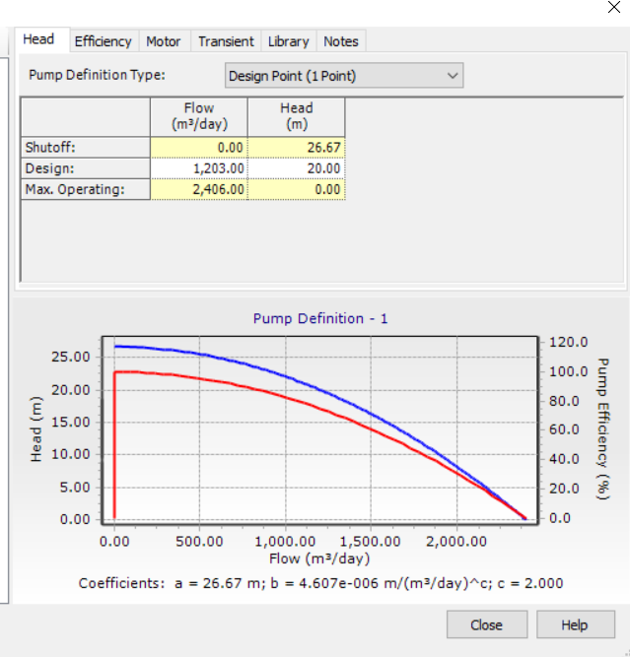
Pump

Slide 20
cost $ | cost unit $/m | Length | New Dia | Old Dia | pipes ID
1040 | 16 | 65 | 6 | 4 | p-31
352 | 16 | 22 | 6 | 4 | p-32
368 | 16 | 23 | 6 | 4 | p-34
957 | 11 | 87 | 4 | 3 | p-83
1276 | 11 | 116 | 4 | 2 | p-104
22 | 11 | 2 | 4 | 2 | p-106
462 | 11 | 42 | 4 | 2 | p-108
737 | 11 | 67 | 4 | 2 | p-110
825 | 11 | 75 | 4 | 2 | p-112
304 | 16 | 19 | 6 | 3 | p-15
512 | 16 | 32 | 6 | 3 | p-19
4784 | 16 | 299 | 6 | 3 | p-81
816 | 16 | 51 | 6 | 3 | p-79
1232 | 16 | 77 | 6 | 3 | p-77
330 | 11 | 30 | 4 | 2 | p-66
1144 | 11 | 104 | 4 | 2 | p-89
1100 | 11 | 100 | 4 | 2 | p-90
165 | 11 | 15 | 4 | 2 | p-92
70 | 5 | 14 | 2 | 1 | p-93
308 | 11 | 28 | 4 | 2 | p-94
40 | 5 | 8 | 2 | 1 | p-95
∑=16844
Results and cost

Slide 21
Outputs

Slide 22
Sewer network
Existing sewer network components :
Manholes
Conduits
Wastewater treatment plant

Slide 23
Manholes and conduits :
Was built in 2010 and it services less than 20% of the village.
Established randomly without taking into consideration the Palestinian Specification.
Leakage, incompetence in drainage and no schemes show the locations for the network parts.

Slide 24
Wastewater treatment plant:
Built in 2014
Ponds system with 4 ponds , two bonds currently are used
Sufficiency can reach 95 %
The treated wastewater is discharged to the Wadi

Slide 25
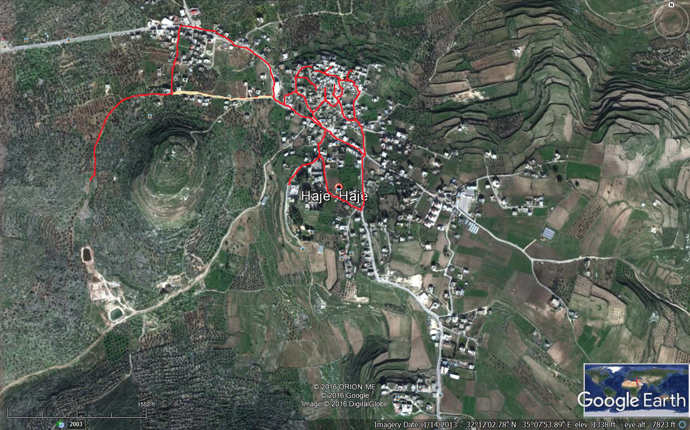

Slide 26
Calculations
Water consumption = 120 L/c/d
Peak hour factor= 5*p^(-1/6)= 3.5
WW = 0.8 * water consumption + infiltration
WW = 0.8 * 120*3.5 + 0.2*120*0.8
WW = 355.2 L/C.day

Slide 27
Compute the area for each manhole and determine the load using GIS program .
Input the data on Sewer CAD V8i program.
Run the model to do the design.

Slide 28
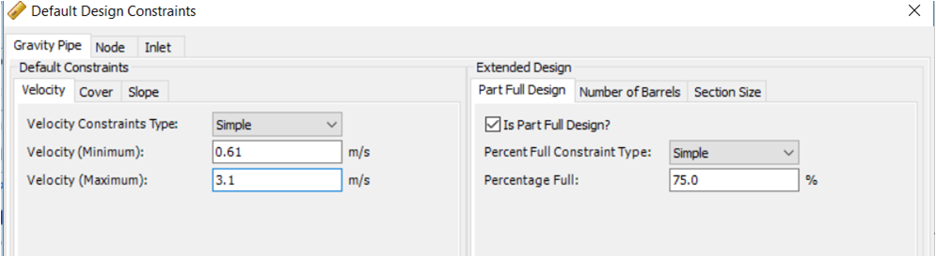
Constraints
Velocity

Slide 29
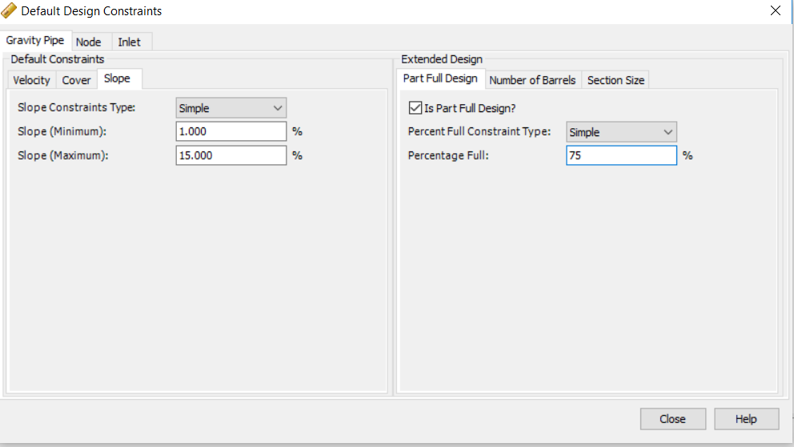
Slope

Slide 30
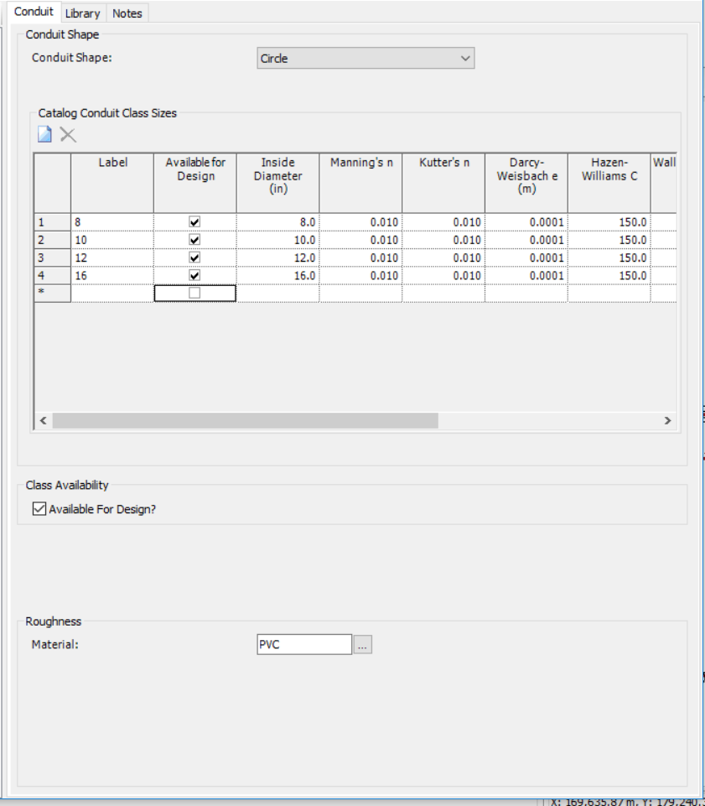
Diameters

Slide 31
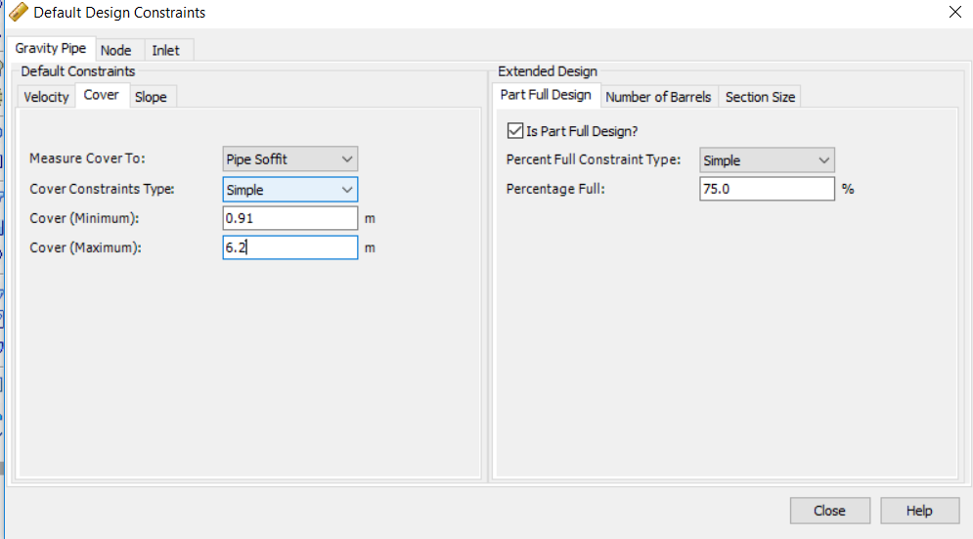
Cover depth :

Slide 32
Results
Velocity

Slide 33
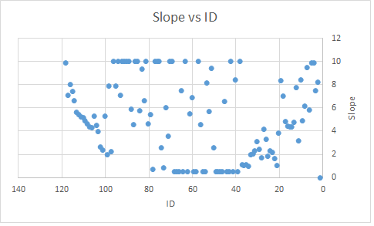
Slope

Slide 34
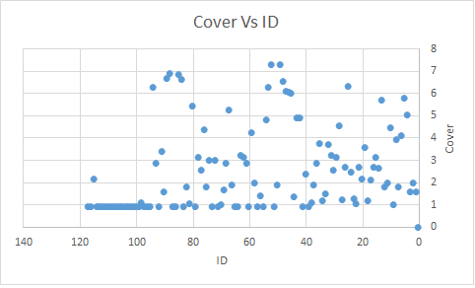
Cover depth

Slide 35
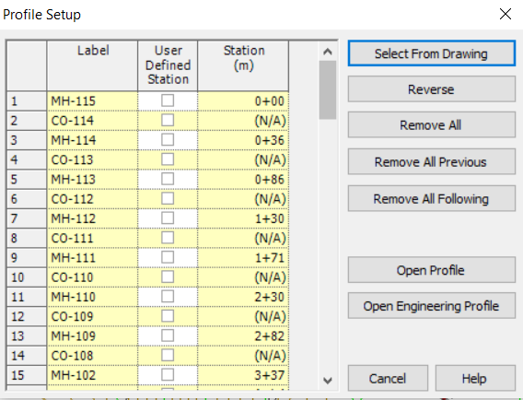
Profile

Slide 36
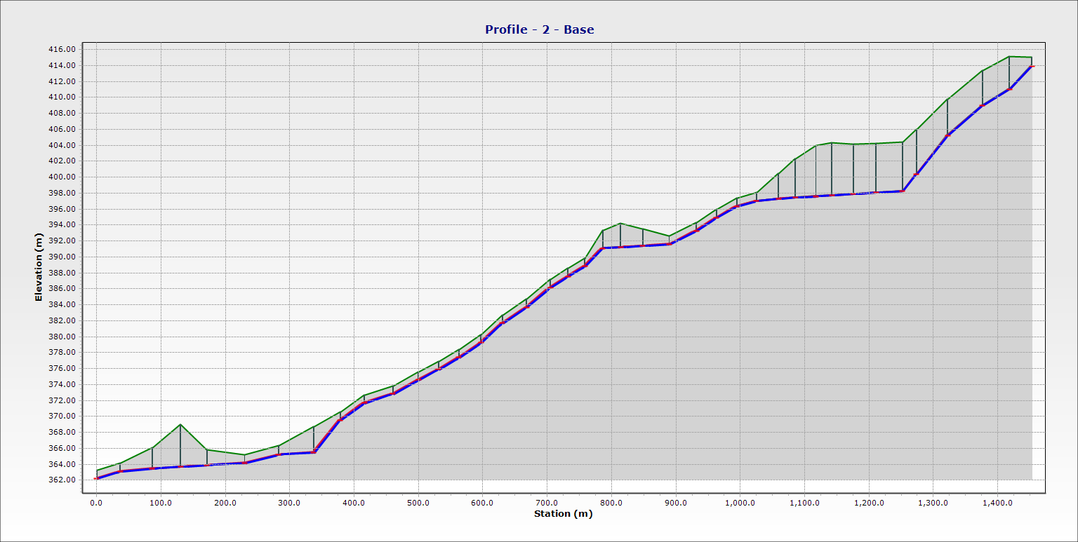

Slide 37
Reusing treated wastewater in Agriculture
The treated water is used to irrigate different types of plants such as, olive, almond, citrus, walnut and pomegranate trees.
80% of the trees in Hajah area is planted olive trees type K18 and almond trees.
Each donum needs 500 m³/year.
Hajah wastewater treatment plant can irrigate around 435 donum of agricultural areas.

Slide 38
Thanks…

