Slide 1
Structural Analysis and Design of
Jalal Safarini Building in Tulkarem-Palestine
By
Ameed Hythm Hindia
Ghassan Mohammed Ewais
Mo’men Yousef Ashayer
Mohammad Adnan Darwazeh
Under supervision of: Dr. Ibraheem Erman

Slide 2
Content
Chapter 1: Introduction
Chapter 2: Preliminary design
Chapter 3: Seismic load
Chapter 4: Three dimensional analysis
Chapter 5: Design of structural concrete members

Slide 3
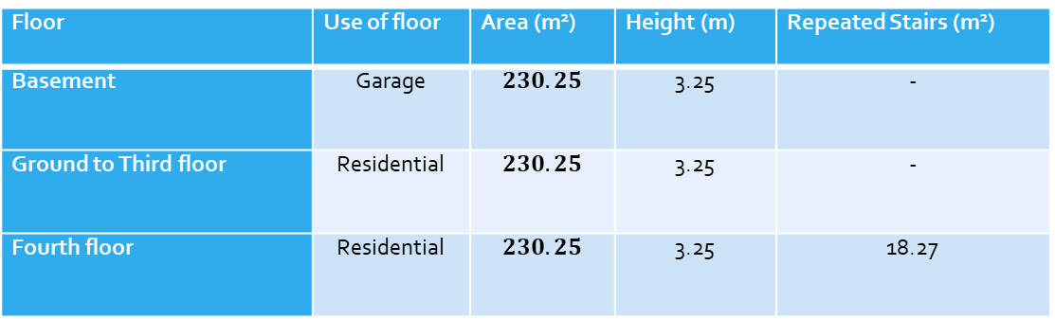
Project Description
The building is consisted of six floors (garage at the basement and the other five floors each of them consisted of two apartments), it has a total area about 1400 m².
Floor | Use of floor | Area (m²) | Height (m) | Repeated Stairs (m²)
Basement | Garage |  | 3.25 | -
Ground to Third floor | Residential |  | 3.25 | -
Fourth floor | Residential |  | 3.25 | 18.27
The architectural drawings are shown in Appendix-A.
The modified and structural drawings are shown in Appendix-B.

Slide 4
Materials
Structural materials
Concrete:
Compressive strength:
f 'c=28 MPa (B350) for columns.
f 'c=24 MPa (B300) for slabs & beams.
Modulus of Elasticity
Unit weight (ɣ)
(plain concrete , reinforced concrete)
Reinforcing Steel:
The steel used in this project is Grade-60 which has a yielding stress of 420MPa.
Modulus of elasticity (E)
200,000 MPa .
Unit Weight (ɣ)
(ɣ) = 77 KN/m³

Slide 5
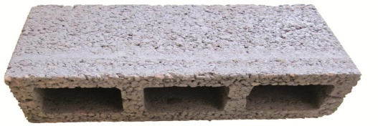
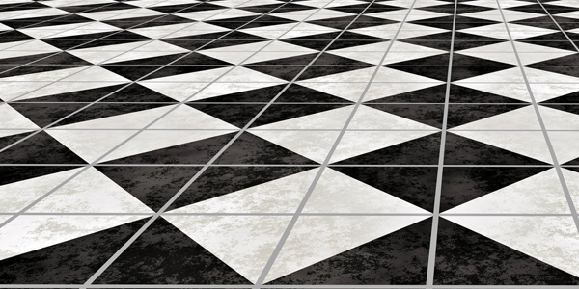
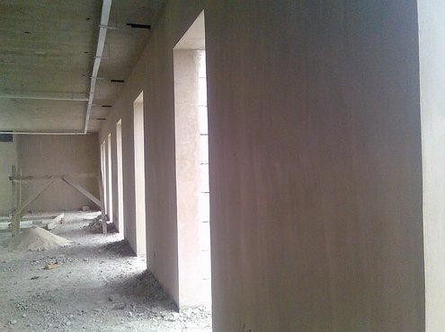
Non- Structural materials
Blocks
Tiles
Plastering

Slide 6

Bonding Agents & Adhesive Products
The most common material in this field is Cetox H
Is especially suitable for thin bed fixing of ceramic tiles
Advantages:
• Bonds strongly on various surfaces as cement or wood.
• Ready to use, easy to apply.
• Can be used as well as a levelling mortar for exterior and interior use before painting.

Slide 7
False-ceiling
It has a weight of 0.1KN/m²
Material | Unit weight (KN/m³)
Block | 12
Tiles | 24
Plastering | 23
Mortar | 23
Bonding Agents & Adhesive Products | 15

Slide 8
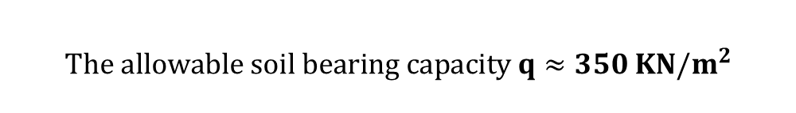
Soil Properties
The type and characteristics of the soil must be known in order to be able to design the footings by choosing appropriate type and it is also needed for the design of seismic load.
$$The allowable soil bearing capacity q≈350 KN/m^{2}$$

Slide 9
Codes and Standards
The following codes and standards are used in this study:
ASCE 7-10 (American Society of Civil Engineers).
ACI318-14 (American Concrete Institute):
IBC2015 (International Building Code).
ISRAELI STANDARD SI 413

Slide 10
Loads
Gravity loads
Dead load
permanent loads that consist of the own weight of the structural members.
superimposed dead loads include the weight of the finishing like the tiles, plastering, cement, blocks and fall-ceiling.

Slide 11

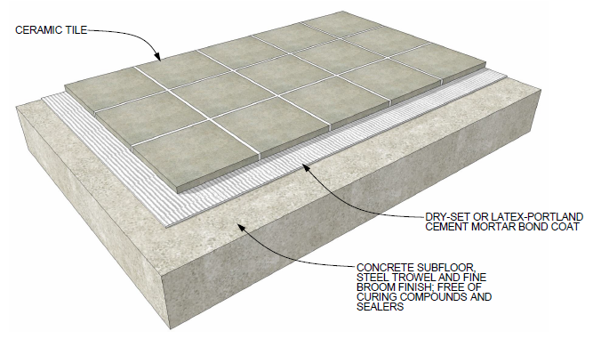
Floor Slab
For SLAB
Material | Unit weight (KN/m³) | Thickness (mm)
Block | 12 | 100
Ceramic Tiles | 24 | 15
Bonding Agents & Adhesive Products | 15 | 4
Plastering (for blocks) | 23 | 40
SD = 3.5 KN/m²

Slide 12
Slab for Staircase
There is only fall-ceiling to be considered as superimposed dead load
Superimposed Dead Load = 0.1 KN/m²
Perimeter Wall
For Perimeter Wall
Material | Unit weight (KN/m³) | Thickness (mm)
Block | 25 | 200
Plastering | 23 | 40
SD = 17.8 KN/m

Slide 13
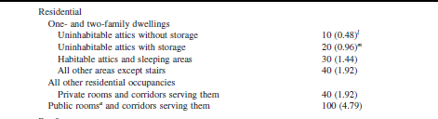
Live load:
ASCE 7-10: Table 4-1
3 KN/m²
For the roof stair case, it is assumed that the water tanks will be above the roof.
So, Live Load = 10 KN/m²

Slide 14
Snow and wind load:
Considering the nature of the area, it can be neglected.
Lateral loads, which include seismic loads

Slide 15
Load combinations
* Ultimate load combinations
1- U=1.4D
2- U= 1.2D + 1.6L
3- U= (1.2+f)D + 1.0L + ρ (E_{y}+ 0.3 E_{x})
4- U= (1.2+f)D + 1.0L + ρ (E_{x}+ 0.3 E_{y})
5- U= 0.9D- f D + ρ (E_{y}+ 0.3 E_{x})
6- U= 0.9D- f D + ρ (E_{x}+ 0.3 E_{y})
* Allowable (service) load combinations
1- U= (1.0 + 0.14S_{DS})D + 0.7 ρ Q_{E}
2- U= (1.0 + 0.10S_{DS})D + 0.525 ρ Q_{E} + 0.75L
3- U= (0.6 – 0.14S_{DS})D + 0.7ρ Q_{E}
Where:
f : 0.2 S_{Ds} (Vertical differences).
S_{DS} = design spectral response acceleration parameter at short periods
ρ : Redundancy factor equals 1.3.
D: dead load.
L: live load.
E: Q_{E} : earthquake Load.

Slide 16
CHAPTER 2:
Preliminary design

Slide 17
Introduction
We do the preliminary design to calculate the preliminary dimensions of structural elements instead of putting a completely random dimensions.
We choose to design using one way slab system.

Slide 18
We choose the solid slab for its advantages in comparison with ribbed slabs:
* Its capability to carry gravity loads and the dynamic loads( seismic).
* Its easier to repair and more economical for short spans.

Slide 19
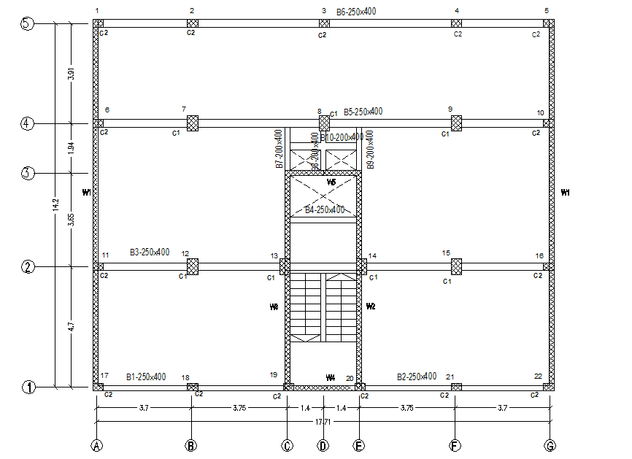
2.2 Preliminary dimension

Slide 20
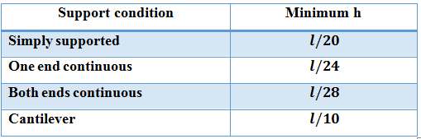
Slab
L=5.6m (Both ends continuous) L/28=0.2 m (Approximately two-way)
L=4.7m (One end continuous) L/24=0.2 m (Approximately two-way)
L = 3.9m (One end continuous) L/24=0.16 m (One-way)
Take h=0.16 m

Slide 21
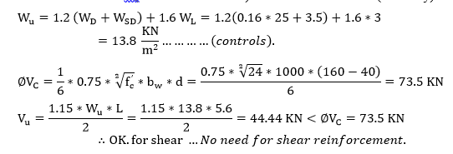

Slide 22
2.2.2 Slab for stairs
L=2.8m (Simply supported)
L/28=0.1 m
Take h=0.16 m

Slide 23
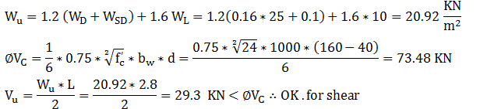

Slide 24
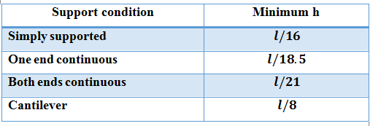
Beams

Slide 25
B1:
L=5.15m (Both ends continuous) L/21=0.25 m
L=3.55 m (One end continuous)
L/18.5=0.2 m
h =0.25m =>Assume b_{w} = 250 mm

Slide 26
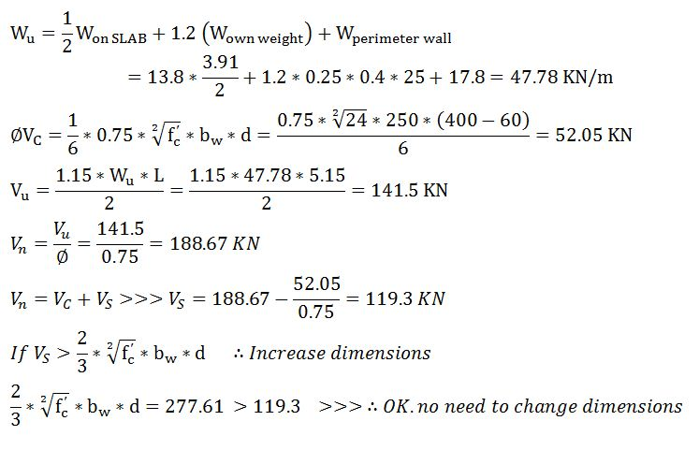

Slide 27
B2:
L=5.15m (Both ends continuous)
L/21=0.25 m
L=3.55 m (One end continuous)
L/18.5=0.2 m
h =0.25m =>Assume b_{w} = 250 mm

Slide 28
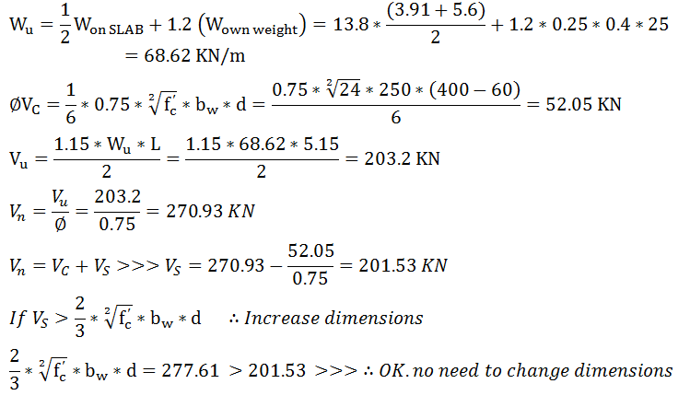

Slide 29
B3:
L=3.75 m (Both ends continuous)
L/21=0.18 m
L=3.7 m(One end continuous)
L/18.5=0.2 m
h =0.2m =.Assume b_{w} = 250 mm

Slide 30
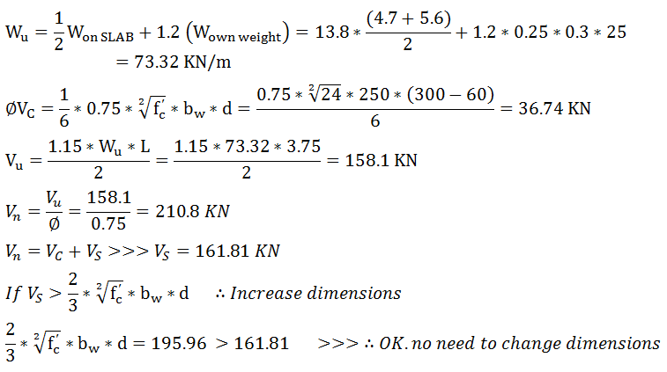

Slide 31
B4:
L=3.75 m (Both ends continuous)
L/21=0.18 m
L=3.7 m (One end continuous)
L/18.5=0.2 m
h =0.2m =>Assume b_{w} = 250 mm

Slide 32
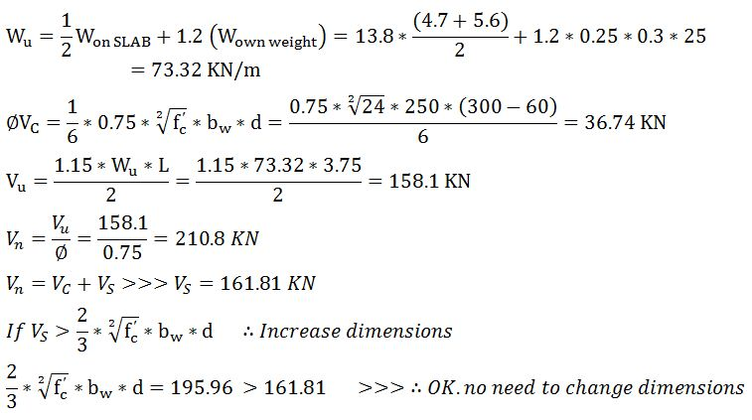

Slide 33
In SAP we choose to take all beams to be 0.4*0.25 (m*m)

Slide 34
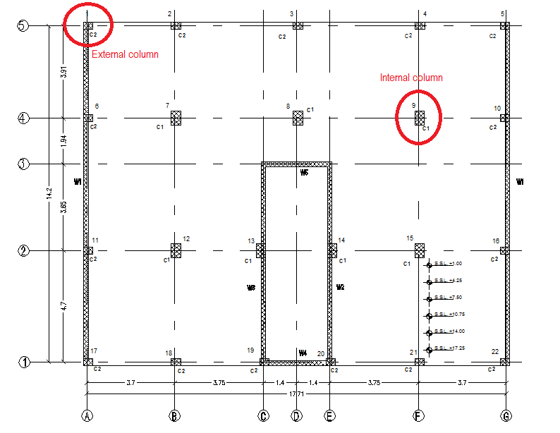
Columns

Slide 35
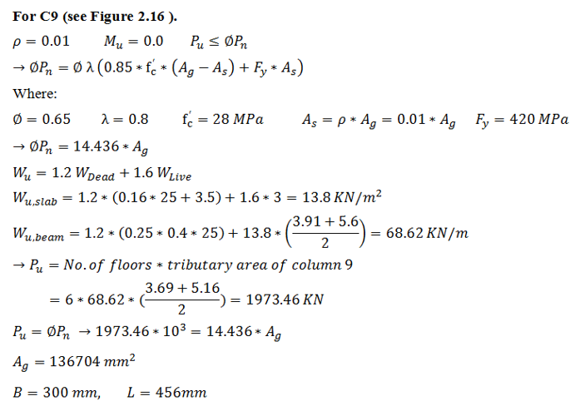

Slide 36
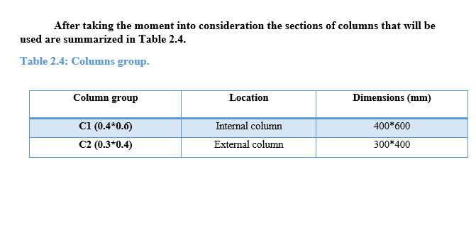

Slide 37

seismic analysis
$$P\left(t\right)=m \ddot{X}+c \dot{X}+k X$$
Chapter three :
define the seismic in the building
structural irregularities
base shear and equivalent static calculations
response spectrum analysis

Slide 38

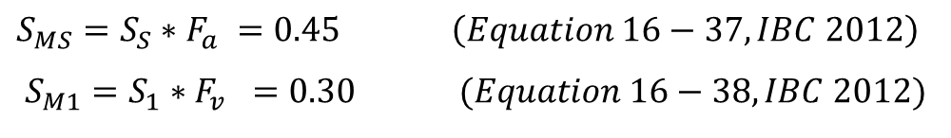

Definitions:
The mapped spectral accelerations for a one- second period:
S1 = 1.25 * Z = 1.25 * 0.15 = 0.1875 sec. Israel standard SI 413 -202.1.2-2b
The mapped spectral accelerations for short period:
Ss = 2.5 * Z = 2.5 * 0.15 =0.375 sec. Israel standard SI 413 -202.1.2-2a
10% probability of exceedance.
$Q_{allow}=200 KN/m^{2}$ the site class C
F_{a}=1.2 F_{v}=1.6125
$$S_{MS}=S_{S}∗F_{a} =0.45 \left(Equation 16−37, IBC 2012\right)$$
$$S_{M1}=S_{1}∗F_{v} =0.30 (Equation 16−38, IBC 2012)$$

Slide 39
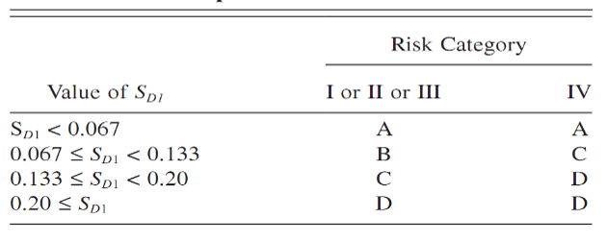
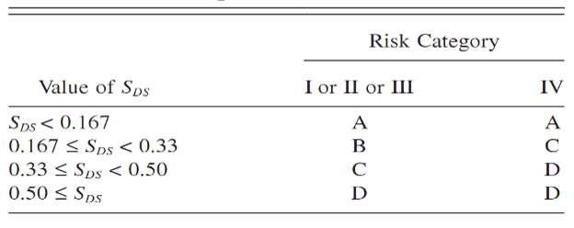
Seismic Design Category Based on Short Period and One Second Period Response Acceleration Parameter
D
0.3
0.45

Slide 40
The seismic force-resisting system is:
Special reinforced concrete shear walls in Y-direction
Special reinforced concrete moment frames in X-direction

Slide 41
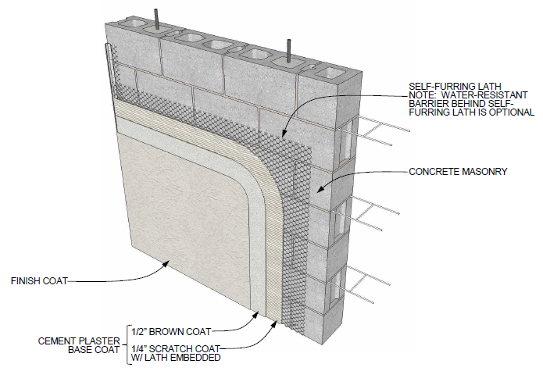
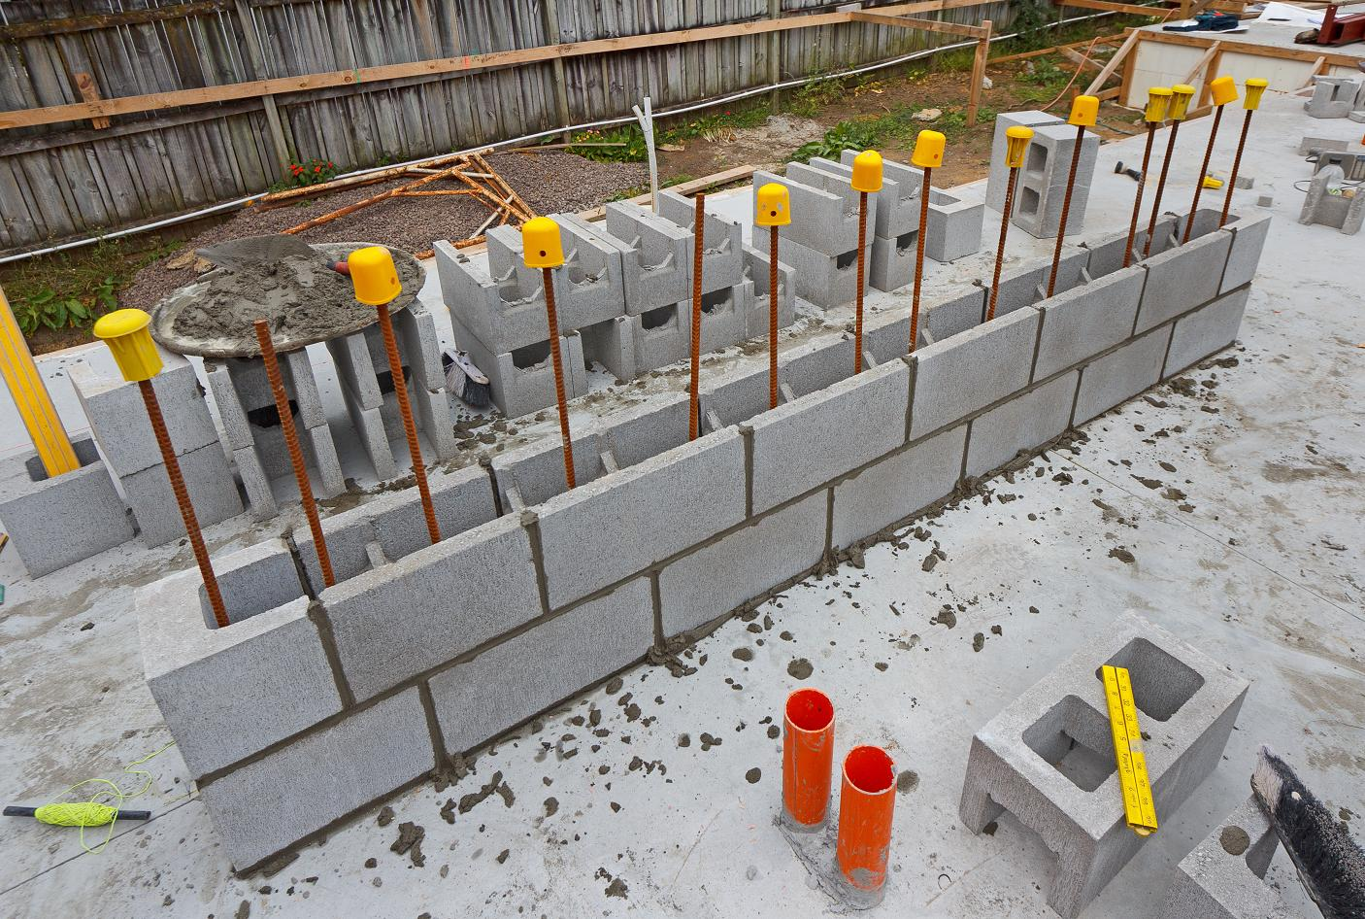

Slide 42
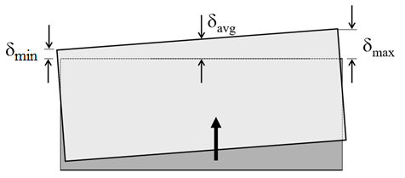
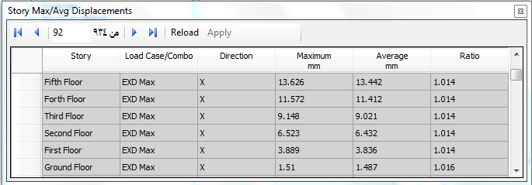
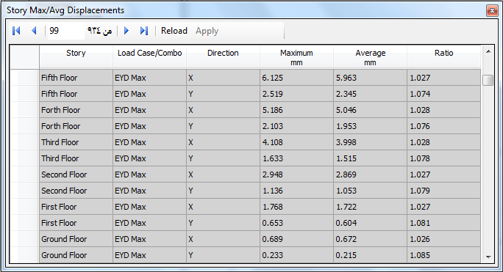
structural irregularities
Plan Structural Irregularities
1a - Torsional Irregularity
1b - Extreme Torsional Irregularity
LOAD CASE EXD
LOAD CASE EYD

Slide 43
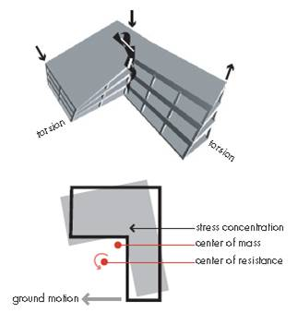
Re-entrant Corners

Slide 44
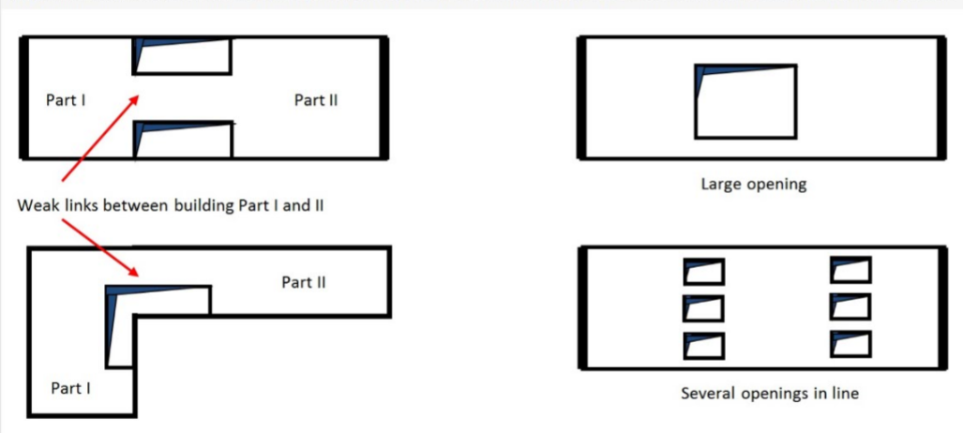
Diaphragm Discontinuity

Slide 45
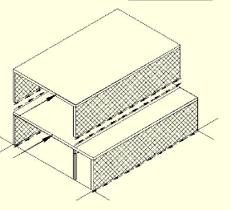
Out-of-plane Offsets

Slide 46
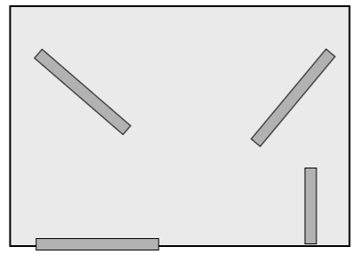
Nonparallel Systems

Slide 47
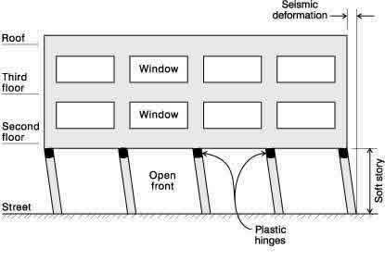
vertical Structural Irregularities
1A- Stiffness Irregularity -Soft Story
1B - Stiffness Irregularity-Extreme Soft Story

Slide 48
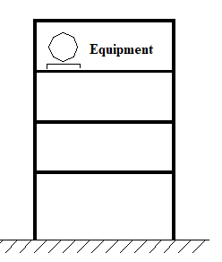
Weight (Mass) Irregularity

Slide 49
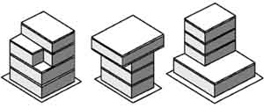
Vertical Geometry Irregularity

Slide 50
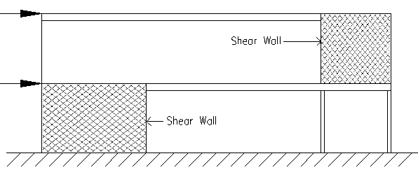
In-plane Discontinuity in Vertical Lateral Force Resisting Elements

Slide 51
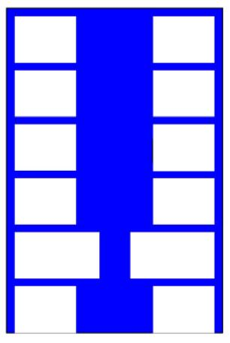
5A - Discontinuity in Lateral Strength-Weak Story irregularity
5B - Discontinuity in Lateral Strength-Extreme Weak Story irregularity

Slide 52
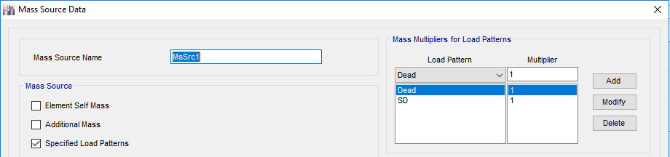
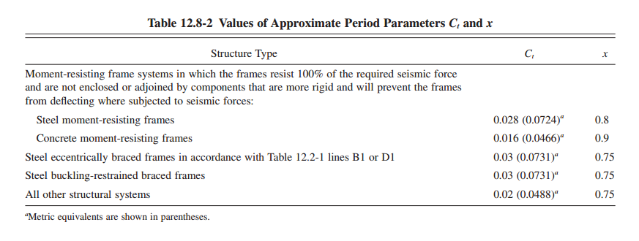
Definition of mass source
$$T = Fundamental period of the structure=C_{T}h_{n }^{x}$$
In X-direction
𝐶𝑡 = 0.0466, 𝑥 = 0.9
Ta = 0.858 sec
In Y-direction
𝐶𝑡 = 0.0488, 𝑥 = 0.75
Ta = 0.553 sec

Slide 53
Calculate Base shear :
𝑉 = 𝐶𝑠∗𝑊 ASCE 7 – equation (12.8_1)
Where:
Cs=the seismic response coefficient.
W=the effective seismic weight.
W: Effective weight
Slabs ,Beams ,Columns ,Walls
Super imposed dead load
For Y-direction
Cs=S_{DS} I/R
Cs_{max}=S_{D1} I/T*R
Cs_{min}=0.044 S_{DS} I
V_{y=}C_{s}y*w =0.075*21318.3=1598.8 KN
For X-direction
V_{x}=C_{s}x*w =0.0437*21318.3= 931.6 KN

Slide 54
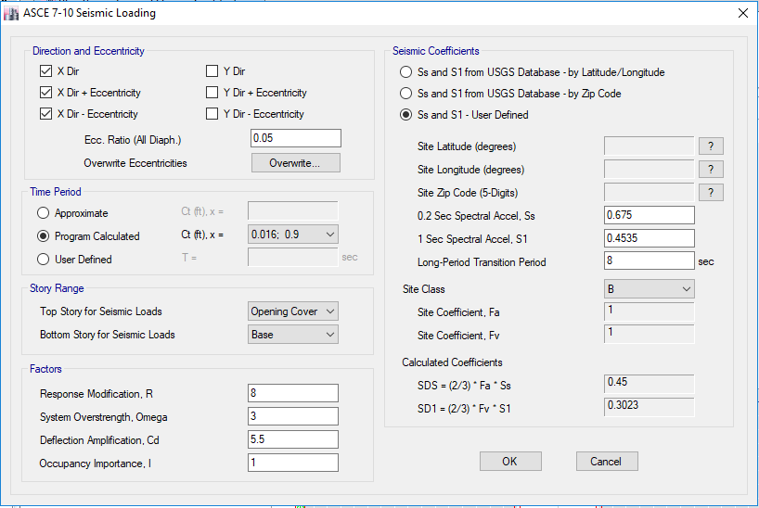
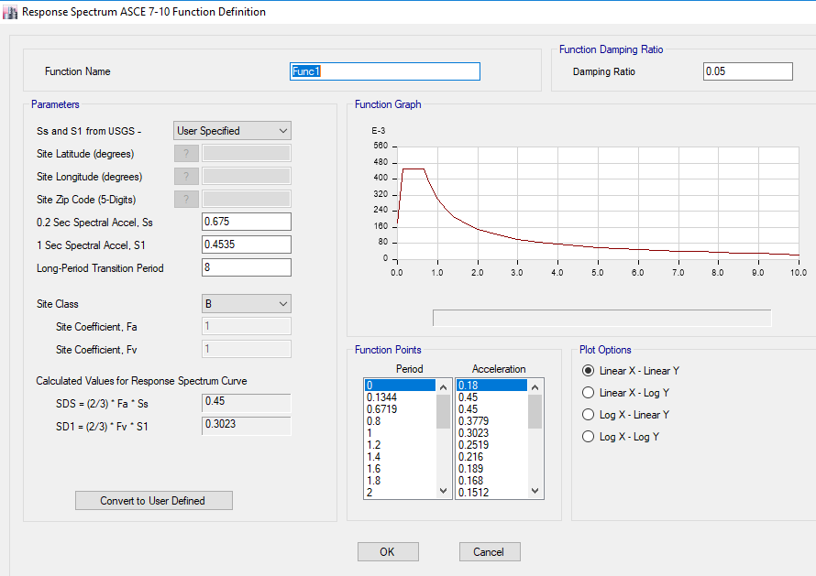

Slide 55
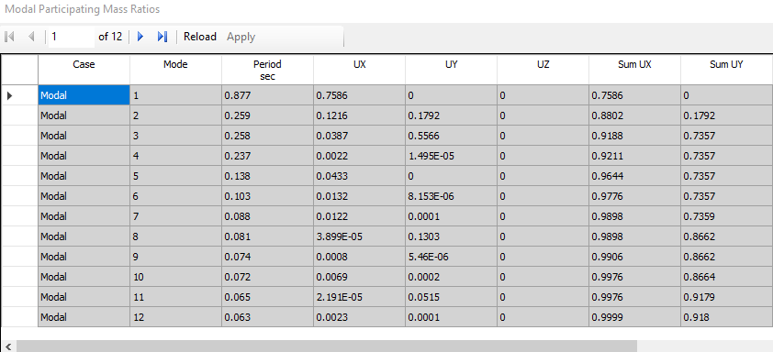
Modal Mass Participation Ratio

Slide 56
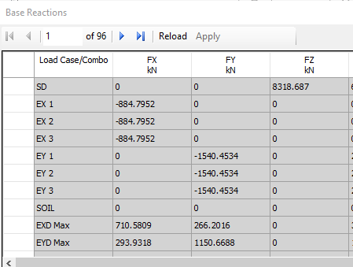
Base Reaction
Difference percentage in X = (931.6 - 884.85 / 931.6) *100% = 5.01% → OK.
Difference percentage in Y = (1598.8 -1540.45/ 1598.8 ) *100% = 3.6% → OK.
The values of response spectrum as seen is less than equivalent static method,
EXD=710 KN <884
And EYD= 1150 <1540

Slide 57
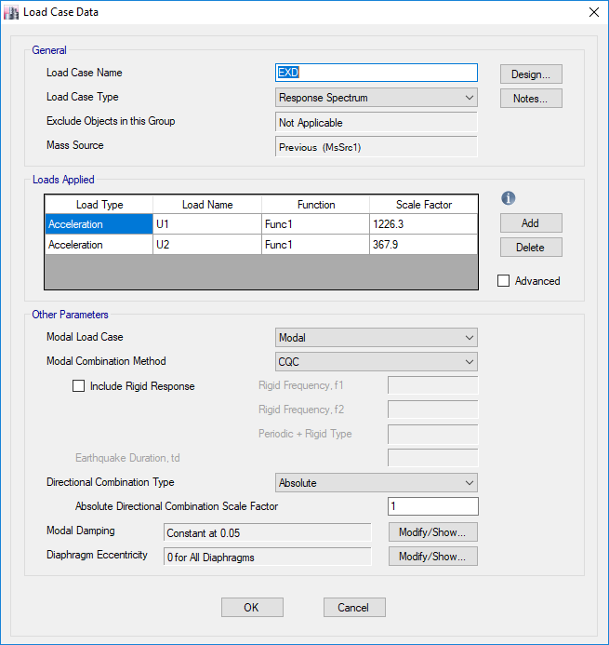
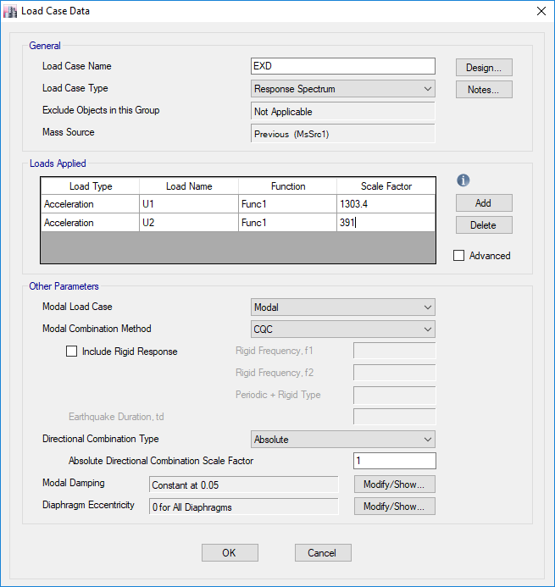
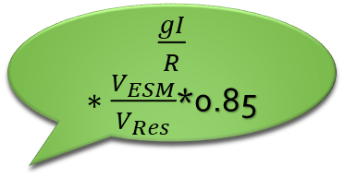
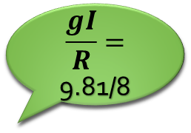
$\frac{gI}{R}∗\frac{V_{ESM}}{V_{Res}}$*0.85
$$\frac{gI}{R}=$$
9.81/8

Slide 58
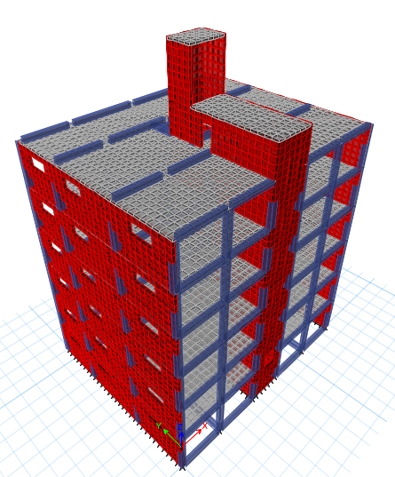
CHAPTER 4:
THREE DIMENSIONAL STRUCTURAL ANALYSIS AND DESIGN
Figure 4.1: 3D model of the structure in ETABS.

Slide 59
4.1 Introduction
3D model will be constructed for whole structure using ETABS
The modeling starts with defining: material, sections (columns, beams, slabs and shear walls), and loads, then drawing elements and making mesh to form a 3D complete model.
make checks that the model is built correctly and the program gives reliable results by comparing values from ETABS with hand calculations

Slide 60
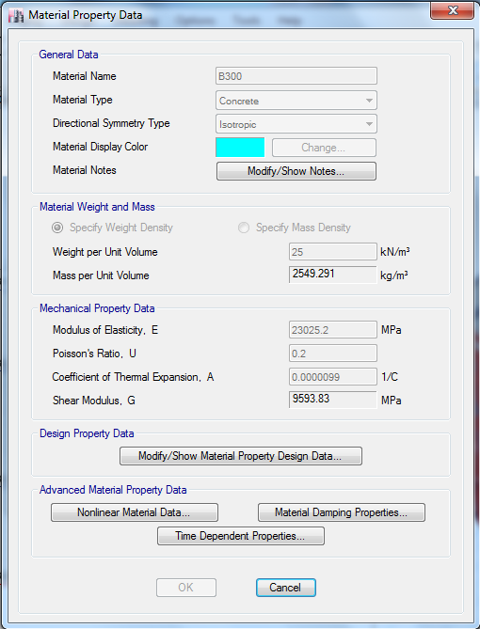
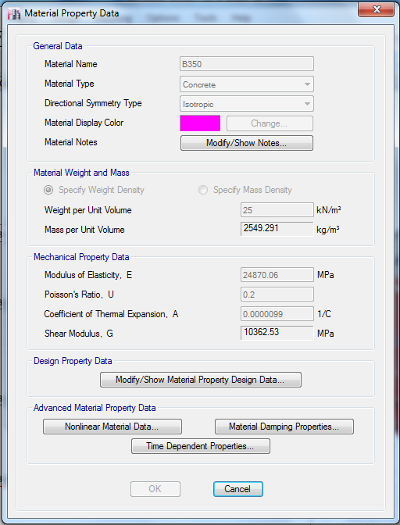
4.2 Modeling
Material
Concrete B300 Concrete B350
Figure 4.2: Properties of the concrete in ETABS (B300)
Figure 4.3: Properties of the concrete in ETABS (B350)

Slide 61
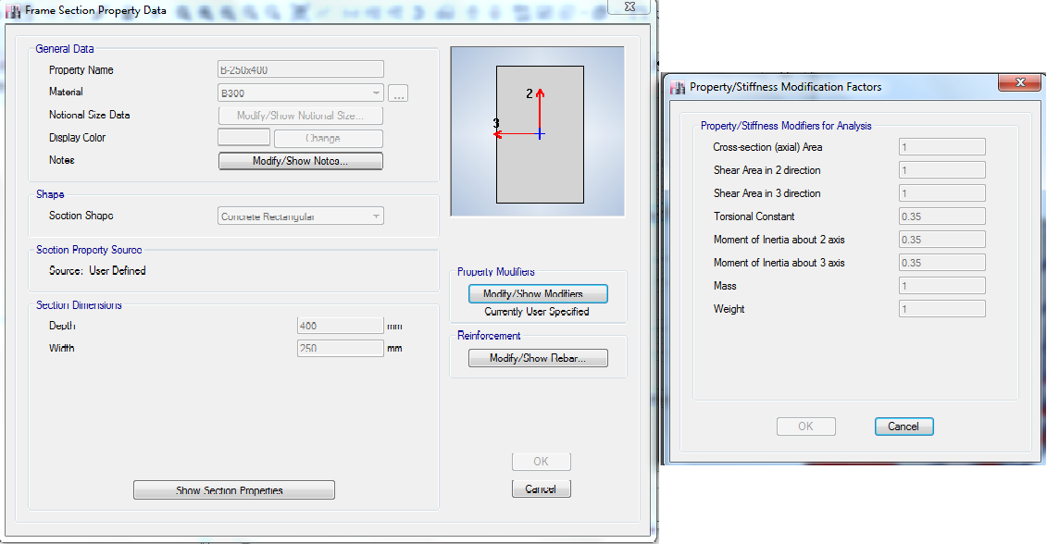
4.2.2 Sections on ETABS
We enter preliminary sections (for beams, columns, slabs and shear walls) on ETABS.
beams
Figure 4.4: Beam (250*400) definition and its modifiers in ETABS.

Slide 62


Columns
Figure 4.5: Column definition 400*600 and its modifiers in ETABS.
Figure 4.6: Column definition 300*400 and its modifiers in ETABS.

Slide 63

Slab
Figure 4.7: Slab definition and modifiers in ETABS.

Slide 64


Shear walls
Figure 4.8: Shear wall 200 definition and modifiers in ETABS.
Figure 4.9: Shear wall 300 definition and modifiers in ETABS.

Slide 65

4.2.3 Loads on ETABS
Figure 4.10: Load patterns definition on ETABS

Slide 66

4.3 ETABS model and verification
Compatibility check
This check aims to decide whether the parts and elements of the structural model is acting as a one unit in a realistic way
Figure 4.11: Compatibility Check

Slide 67

Equilibrium Check
This check aims to ensure that the base reactions resulting from the analysis of different types of loadings assigned to the structural model match the hand calculation with a difference percentage of less or equal 5%
Table 4.1: base reactions taken from different types of load patterns.

Slide 68


Hand Calculation
Table 4.2: Live & SD loads in the structure
Table 4. 3: Dead loads in the structure
The difference in values:-

Slide 69
4.3.3 Check for columns
We choose to check C9 as representative column
Figure 4.12: Columns layout in the structure.
1- Manual axial load

Slide 70


2- Axial load from ETABS = 1729.58 KN
Difference percentage
=
= 5.06 % ≈ 5% → Ok
Figure 4.13: Axial load on columns from ETABS.

Slide 71

4.3.4 Internal forces check (stress strain)
One span in frame in x-direction will be checked, the frame is in the basement floor slab (at elevation Z=1m).
Figure 4.14: Frame in X-direction from ETABS model.

Slide 72
From manual calculation, M_{o} :
Mo =
Where :
L₂: frame width. (L2 =
= 4.75 m )
L_{n}: span length face to face. (Ln = 3.7-0.2-0.2 = 3.3 m).
Mo =

Slide 73

From ETABS, M_{o} :
The moment M₁₁ from (1.2dead+1.6lived) load combination was chosen, and by making three section-cut in the transverse direction.
Figure 4.15: The left negative moment (M₁) of the frame

Slide 74


Figure 4.16: The right negative moment (M₂) of the frame.
Figure 4.17: The positive moment (M₃) of the frame.
M_{o} =
=
= 104.34 kN.m
difference percentage =
= 11.83 %

Slide 75


4.3.5 Check moments in beam
From manual calculation:
We get static moment factors using table 13.6.3.3 from ACI 318-14 code
M_{o} =
Mo =
Figure 4.18: Static moment factors in an end span.

Slide 76



Slide 77



Figure 4.19: Manual moments on beam.

Slide 78

From ETABS:
Figure 4.20: Bending Moment Diagram for the Beam to Be Checked for Internal Forces .
→M, ETABS =
+ 19.37 = 45.77 KN.m
difference percentage =
= 10.3 % ≈ 10 % → OK

Slide 79

4.3.6 Deflection Check
We make a check for deflection of the ground floor slab (at Z=1m).
Deflection from ETABS:
Δ dead = 3.40 mm.
Figure 4.21: Maximum deflection from Dead load.

Slide 80

The long-term deflection is determined by assuming:
No compression steel (ρ compression = 0).
We have 50 % sustained live load.
Δ_{Dead+Sustained Live} = 4.62 mm
→ Δ _{Sustained Live} = Δ_{Dead+ Sustained Live} – Δ_{dead} = 4.62 – 3.4
= 1.22 mm
Figure 4. 22 : Maximum deflection from Dead and Sustained live loads.

Slide 81

Δ_{Dead+Live} = 5.85 mm
→ Δ _{Unsustained Live} = Δ_{Dead+Live} - Δ _{Dead+ Sustained Live}
= 5.85 – 4.62
= 1.23 mm
Figure 4. 23 : Maximum deflection from Dead and live loads.

Slide 82



Δ Long term = Δ_{L-Unsustained}+ (λ∞ * Δ_{D}) + (λ_{t}*Δ_{SL})
Live load assumed to be sustained for (5 -∞) years. That means λ∞ =λ_{t}.
λ =
𝜉=2 from Figure ‎4.27 from ACI code.
→ λ = =2
Δ Long term = 1.23 + (2 * 3.40) + (2*1.22)
=10.47 mm
: multiplier for long term deflection.
ρ` : compression steel ratio.
Figure 4.24: ACI Code multipliers for long term deflections.

Slide 83


Length of the span = 5590 mm
According to ACI-318
The allowable deflection = = = 23.29 mm > 10.47 mm
Table 4.4: Allowable deflection according to ACI-318.

Slide 84
4.3.9 Check for drift
The difference of the deflections at top and bottom of the story.
The drift of building in Y-direction is okay due to shear walls.
𝜹𝒙 = * δxe
Where:
C d: The deflection amplification factor. it equals 5.5.
𝜹𝒙𝒆: The deflection at the location of level x determined by an elastic analysis, will be obtained from ETABS.
Ie: Importance factor. it equals 1.00.

Slide 85

Δ_{allowable} = 0.02 hSX = 0.002* 3250 = 65 mm.
The story drift calculations due to earthquake load in the X-direction, are summarized in Table 4.5.
All calculated stories drift are Ok
Table 4.5: Story drift calculations due to earthquake load in X-direction.

Slide 86


4.3.10 Check soil equilibrium
Bearing capacity:20 KN/m^3 Φ=30 W,live=20 KN/m²
1) K_{active}=(1-sin Φ )/(1+sin Φ )=1/3
Seismic earth pressure =Δp= 0.40K_{h} ¥_{t}H_{rw} (ASCE-41-13)
K_{h}=S_{xs}/2.5 and S_{xs}=S_{DS}=F_{a}*S_{S}
Where:
Δp: additional earth pressure caused by seismic shaking, which is assumed to be a uniform pressure.
K_{h}: horizontal seismic coefficient in the soil.
¥_{t}: total unit weight of soil.
H_{rw} : height of the retaining wall.
S_{xs}: spectral response acceleration parameter.
Δp=0.4*(0.45/2.5)*20*2.25=3.24 KN

Slide 87


2) K_{static}=(1-sin Φ ) = 1/2
As we can see the static earth pressure is the largest so we use it for design.
the resultant force from soil pressure is zero, because there are two forces have the same magnitude but with opposite direction.
Figure 4. 25: Base reaction due to soil.

Slide 88

Design of Structural Concrete Members
Design for Beams
Design of Ground Beams
Design of slabs
Design of columns
Design of shear walls
Design of footings
Design of stairs
Design of infill walls

Slide 89



Design for Beams
Flexure check:
ρ = $\frac{0.85fc′}{Fy}$(1-$\sqrt{1− \frac{2.61Mu}{bd^2 fc′ }}$)
ρ = $\frac{0.85∗24}{420}$(1-$\sqrt{1− \frac{2.61∗41.56∗10^6}{250∗{340}^{2}∗24}}$)
ρ = 0.00396
Area of steel (As) = ρ × b × d = 0.00396× 250× 340 = 336.6 mm2

Slide 90





Shear force check:
V_{p}=$\frac{ФMn++ ФMn−}{l}$
Ф𝑀𝑛= Ф𝐴𝑠𝐹𝑦(𝑑− 𝑎/2)
𝑎= As Fy/ 0.85 𝑓′𝑐 𝑏
Ф𝑉𝑛= Ф(𝑉𝑐+𝑉𝑠)
Vg=WuL/2
Vg=30.67×3.3/2=50.6 KN
$\frac{Av}{s}$= $\frac{45.8∗1000}{420∗340}$ = 0.321mm²/mm
Vp=42.13+25/3.3=20.5 KN
V Design=Vp+Vg =20.5+50.6=71.1 KN

Slide 91



Torsional Check:
𝑇𝑡ℎ= 0.75*$\frac{1}{12}$*1$\sqrt{24}$ ($\frac{(250∗400)^2}{2∗(250+400)}$) = 2355278.6 N.mm = 2.35 KN.m
Tu<𝑇𝑡ℎSo, there is no need torsion reinforcement

Slide 92




Code specifications
Dimensional limits
$\frac{Clear span (𝓵n)}{Effective depth (d)}≥$ 4
bw min of $\left({0.3h \atop 250 mm }\right)$
Longitudinal reinforcement
at least 2 continuous bars at both top and bottom faces
max of $\left[\frac{1.4}{fy}bw∗d , \frac{0.25\sqrt{fc}}{fy}bw∗d\right]$
Spacing of the transverse reinforcement enclosing the lap-spliced bars min of $\left({d/4 \atop 100 mm}\right)$.
Lap splices shall not be used in joints (Within a distance of twice the beam depth from the face of the joint).

Slide 93

Reinforcement Detailing:

Slide 94



Slide 95



Slide 96

Design of Ground Beams
the smallest cross-sectional dimension shall be at least equal Ln/20
Closed ties shall be provided at a spacing not to exceed the lesser of one-half the smallest orthogonal cross-sectional dimension and 300 mm
all ties shall have a design strength in tension or compression at least equal to a force
C_{s} or T_{s}=10% × SDs × largest axial factored dead and live
(As)_{min} larger than
area of steel depending on seismic requirement

Slide 97



Slide 98

Design of Columns
Checks of Columns
Column 9 will be checked as a sample, because it is a critical column, Figure 5.18 shows the location of C9.

Slide 99

Check slenderness of columns
(Column9 in second floor has the highest slenderness ratio)
KLu/r ≤ 34 – 12 (M1/M2) (5.11)
≤ 40
* About X- axis: M1 equal -37.02 kN.m, and M2 equal 37.1 kN.m.
* About Y- axis: M1 equal -3.58 kN.m, and M2 equal 5.09 kN.m.

Slide 100
Assume K =1
Lu = 3.25 – 0.4 = 2.85 m
r = 0.3 h ,h=0.4
By applying (5.11):
* About X- axis:
KLu/r = 23.75 ≤ 34 – 12 ×M1/M2 = 45.9
≤ 40
* About Y- axis:
KLu/r = 15.83 ≤ 34 – 12 ×M1/M2 = 42.44
≤ 40
→ The column is short in two directions, then will be neglect the effect of slenderness.

Slide 101



Check columns design
(Reciprocal Load Method)
=

Slide 102



Po =
Where:
Ag = 400x600 = 240000 mm²
= 2400 mm²
→ Po = 3464.69 KN
That means Pni > Pu. So, the design of ETABS is ok.

Slide 103
Figure 5. 21 : Interaction diagram for C9 at 0 ◦
Figure 5. 22: Interaction diagram for C9 at 90 ◦

Slide 104
Load Combination | Pu | M2 | M3 | Pnx | Pny | Po | Pni | Pni>Pu
 | kN | KN.m | KN.m | KN | KN | KN | KN | ??
1.4D | 1455.74 | 4.85 | 11.75 | 3456.82 | 3456.82 | 3464.69 | 3448.98 | ok
1.2D+1.6L | 1786.01 | 4.73 | 15.37 | 3456.82 | 3456.82 | 3464.69 | 3448.98 | ok
1.29D+1L+1.3EXD | 1697.01 | 5.61 | 20.95 | 3456.82 | 3456.82 | 3464.69 | 3448.98 | ok
1.29D+1L+1.3EYD | 1698.73 | 7.66 | 17.35 | 3456.82 | 3456.82 | 3464.69 | 3448.98 | ok
0.81D+1.3EXD | 861.47 | 3.58 | 21.45 | 3456.82 | 3456.82 | 3464.69 | 3448.98 | ok
0.81D+1.3EYD | 863.20 | 5.63 | 11.31 | 3456.82 | 3456.82 | 3464.69 | 3448.98 | ok

Slide 105
Code specifications
I. Longitudinal Reinforcement.
* Area of longitudinal reinforcement, Ast, shall be at least 0.01Ag and shall not exceed 0.06Ag.
* Lap splices are permitted only within the center half of the member length, and shall be designed as tension lap splices and enclosed within transverse reinforcement conforming to transverse reinforcement.

Slide 106



II. Transverse Reinforcement.
* Transverse reinforcement shall be provided over a length Lo from each joint face and on both sides of any section, the length Lo shall not be less than the largest of:
Lo = max
* Transverse reinforcement shall be provided by either single or overlapping hoops, spirals, circular hoops or rectilinear hoops, with or without crossties.
*Each end of the crossties shall engage a peripheral long reinforcing bar.
* Consecutive crossties shall be alternated end for end and along the longitudinal reinforcement.
* Spacing of cross ties or legs of rectilinear hoops hx, within a cross section of the member shall not exceed 350 mm on center.
* Spacing of transverse reinforcement (S_{o}) along the length of lap splicing:
100 mm
S_{o} = 100 +

Slide 107


* Spacing of transverse reinforcement (S₁) along the length Lo of the member shall not exceed the minimum of:
* According to ACI 318-14 table 18.7.5.4, the total cross-sectional area of rectangular hoop reinforcement shall not be less than that required by the following equation:
𝐴𝑠ℎ = 𝑚𝑎𝑥. 𝑜𝑓:
Where:
Ash: Total cross-sectional area of transverse reinforcement, including crossties, within spacing s and perpendicular to dimension bc, mm².
bc: Cross-sectional dimension of member core measured to the outside edges of the transverse reinforcement composing area Ash, mm.
Ag: Gross cross-sectional area of concrete section, mm².
S: Center-to-center spacing of transverse reinforcement measured along the longitudinal axis of the structural member.
Ach: Cross-sectional area of a member measured to the outside edges of transverse reinforcement, mm².

Slide 108
Figure 5. 23: Example on Transverse Reinforcement in Columns

Slide 109
* Beyond the length Lo, the column shall contain spiral or hoop reinforcement with center-to-enter spacing (S₂) not exceeding the smaller of six times the diameter of the smallest longitudinal column bars and 150 mm.
Figure 5. 24: Longitudinal and horizontal cross sections for column in special moment frame explain the lap splice details and confinement requirements at column ends for rectangular hoop reinforcement.

Slide 110


Design Sample
Column 9 and column 4 will be designed as representative samples for the two column sections used in the building, C1 (400x600mm) and C2 (300x400mm), as shown in Figure 5.18.
Longitudinal Reinforcement for Column 9:
From ETABS, the required area for reinforcement is 2400 mm², use 10Ø18.
* Lap Splice for longitudinal bars shall be extended the value of 1.3 development length:
Ldt =
Ldt =
= 686 mm
Lap splice Ls = 1.3 x 686 = 892 mm, use 900 mm

Slide 111


* Distance (Lo):
Lo = max
= max
→ Lo = 600 mm.

Slide 112


* Spacing between bars:
Spacing between bars =
Spacing in x-direction =
= 132 mm <150 mm → only one steel bar between two tied bars can be left without placing ties on it.
Spacing in y-direction =
= 155 mm > 150 mm → ties must placed on every steel bar.

Slide 113



Transverse Reinforcement for Column 9:
Stirrups of a diameter Ø10 will be used for this column.
* hx = 350 mm
* 100 mm
S_{o} = 100 +
→ S_{o} = 100 mm.
* Stirrups spacing within the distance Lo, (S1)
minimum of
→ S1 = 100 mm.
* Stirrups spacing beyond the distance Lo, (S2)
minimum of
→ S2 = 100 mm.
Referring to Figure 5.23, to calculate Ash,1 and Ash,2 from Eq. (5.13):

Slide 114


𝐴𝑠ℎ,1 = 𝑚𝑎𝑥.𝑜𝑓
→ 𝐴𝑠ℎ,1 = 283 mm²
𝐴𝑠ℎ,2 = 𝑚𝑎𝑥.𝑜𝑓
→ 𝐴𝑠ℎ,2 = 460 mm²
Where: bc1 = 400 – 2x40 = 320 mm.
bc2 = 600 – 2x40 = 520 mm.

Slide 115

According to the column cross section shown in Figure 5.25.
𝐴𝑠ℎ,1, calculated = 2x78.5 = 157 mm² < 283 mm²
𝐴𝑠ℎ,2, calculated = 4x78.5 = 314 mm² < 460 mm²
→ increase diameter of stirrups or increase the number of legs to φ12.
Figure 5. 25 : cross section for column 9.

Slide 116

Longitudinal Reinforcement for Column 4:
From ETABS, the required area for reinforcement is 1200 mm², use 8Ø14.
* Lap Splice for longitudinal bars shall be extended the value of 1.3 development length:
Ldt =
Ldt =
534 mm
Lap splice Ls = 1.3 x 534 = 695 mm, use 700 mm

Slide 117



Lo = max
→ Lo = 475 mm
* Spacing between bars:
Spacing between bars =
Spacing in x-direction =
= 136 mm <150 mm → only one steel bar between two tied bars can be left without placing ties on it.
Spacing in y-direction =
= 86 mm > 150 mm → only one steel bar between two tied bars can be left without placing ties on it.

Slide 118


Transverse Reinforcement for Column 4:
Stirrups of a diameter Ø10 will be used for this column.
* hx = 350 mm
* 100 mm
S_{o} = 100 +
= 100
→ S_{o} = 100 mm
* Stirrups spacing within the distance Lo, (S1)
minimum of
→ S1 = 75 mm.
* Stirrups spacing beyond the distance Lo, (S2)
minimum of
→ S2 = 75 mm.

Slide 119


Referring to Figure 5.23, to calculate Ash,1 and Ash,2 from Eq. (5.13):
𝐴𝑠ℎ,1 = 𝑚𝑎𝑥.𝑜𝑓
→ 𝐴𝑠ℎ,1 = 451 mm²
𝐴𝑠ℎ,2 = 𝑚𝑎𝑥.𝑜𝑓
→ 𝐴𝑠ℎ,2 = 310 mm²
Where: bc1 = 400 – 2x40 = 320 mm.
bc2 = 300 – 2x40 = 220 mm.

Slide 120

Acording to the column cross section shown in Figure 5.26.
𝐴𝑠ℎ,1, calculated = 2x78.5 = 157 mm² < 451 mm²
𝐴𝑠ℎ,2, calculated = 2x78.5 = 157 mm² < 310 mm²
→ increase diameter of stirrups or increase the number of legs
Figure 5. 26 : cross section for column 4.

Slide 121


Figure 5. 27: The detailing for longitudinal reinforcement and distribution of stirrups.

Slide 122



5.4 Design of slabs
5.4.1 Code specifications :
Flexural Capacity for slab:
∅M_{n} = ∅As×𝑓𝑦×(d −a/2) , a =
Shear Capacity of concrete in slab
∅Vc =∅×1/6 × × bw × d
Reinforcement Ratio of steel
𝜌 = (1- ) , 𝜌𝑚𝑖𝑛 = 0.0018

Slide 123


5.4.2 Design Sample :
The ultimate minimum moment in both direction X and Y:
∅M_{n} = ∅As×𝑓𝑦×(d −a/2) , a =
Where :
depth of slap (H) = 160 mm.
width of slap section (b) = 1000 mm.
effective depth of the slap (d) = 120 mm.
As min = 0.0018 x 1000 x 160 = 288 mm2
a = = 5.929 mm.
→ ∅M_{n} = = 12.74 kN.m

Slide 124

Check for the ultimate moment in X- direction (M11):
There are two zones where the moment is more than the ultimate minimum moment.
Mu for zone A = 19.35 kN.m.
→ 𝜌 = 0.003689 → As = 442.68 mm²
Then As for zone A = 4∅12/ 1m.
Mu for zone B = 41 kN.m.
𝜌 = 0.008214 → As = 985.71 mm²
Then As for zone B = 9∅12/ 1m.
Figure 5. 28 : The ultimate moment in X- direction (M11) for the slab in fifth floor.

Slide 125

The area of steel of Slabs in X- direction:
* Use a bottom steel equal 4Ф10/1m and top steel equal 4∅12/ 1m in zone A.
* Use a bottom steel equal 4Ф10/1m and top steel equal 9∅12/ 1m in zone B.
* Use a bottom and top steel equal 4Ф10/1m for the other zones.
Figure 5. 31: Reinforcement of Slab in the X-direction.

Slide 126


II. Check for the ultimate moment in Y- direction (M22):
There are three zones where the moment is more than the ultimate minimum moment.
Mu for zone A = 43 kN.m.
→ 𝜌 = 0.008658 → As = 1039 mm²
Then As for zone A = 9∅12/ 1m.
Mu for zone B = 40 kN.m.
𝜌 = 0.007994 → As = 959.28 mm²
Then As for zone B = 9∅12/ 1m.
Mu for zone C = 15 kN.m.
→ 𝜌 = 0.002833 → As = 340 mm²
Then As for zone A = 5∅10/ 1m.
Figure 5. 29: The negative ultimate moment in y- direction (M22) for the slab in Fifth floor.
Figure 5. 30 : The positive ultimate moment in y- direction (M22) for the slab in Fifth floor.

Slide 127

The area of steel of Slabs in Y- direction:
* Use a top steel equal 9∅12/ 1m in zone A.
* Use a top steel equal 9∅12/ 1m in zone B.
* Use a bottom steel equal 5Ф10/1m in zone C.
* Use a bottom and top steel equal 4Ф10/1m for the other zones.
Figure 5. 32 : Reinforcement of Slab in the Y-direction.

Slide 128

Design of Shear Wall
The definition of wall pier in according to ACI 318-14 code section 2.3 :-
A vertical wall segment within a structural wall, bounded horizontally by two openings or by an opening and an edge.
The definition of wall spandrel :-
A horizontal wall segment within a structural wall, bounded vertically by two openings or by an opening and an edge.

Slide 129


Concrete shear capacity in walls can be calculated from
For the detailed equations to calculate the shear capacity, Table 22.5.5.1 from ACI 318-14 illustrates that, table 5.3 shows the equations.
V_{c}
Least of (a),(b) and (c) |  | (a)
 |  | (b)
 |  | (c)

Slide 130
Nominal shear capacity (V_{n}) for walls
For Spandrel
V_{n} shall not exceed 0.83 ℎ 𝑑
Which,
h: Thickness of wall
d: Shall be taken equal to 0.8
For Pier
Where:
A_{cv}: Gross area of shear wall cross section, which equal b_{w} x L_{w}.
𝛼_{𝑐}: Coefficient = 0.25 For ≤ 1.5.
= 0.17 For ≥ 2.0.
Varies linearly between 0.17 and 0.25 for between 1.5 and 2.0.
𝜌_{𝑡}: Transverse reinforcement ratio.

Slide 131
𝜌𝑡 𝑚𝑖𝑛 = 0.0025.
𝜌𝑙 𝑚𝑖𝑛 = 0.0025.
𝜌_{𝑡} 𝑚𝑖𝑛 = 0.0025.
𝜌_{𝑙} 𝑚𝑖𝑛 = 0.0025 + 0.5 (2.5 - ) (𝜌_{𝑡} − 0.0025) ≥ 0.0025.
Where:
A_{cv} = gross area of concrete section bounded by web thickness and length of section in the direction of shear force considered in the case of walls in mm²

Slide 132

      Spacing of longitudinal reinforcement:
Spacing (S_{L}) of longitudinal bars in cast-in-place walls shall not exceed the lesser of:
3h
450 mm
.
Where l_{w}: length of entire wall, or length of wall segment or wall pier considered in direction of shear force, mm
      Spacing of transverse reinforcement:
Spacing St of transverse reinforcement in cast-in-place walls shall not exceed the lesser of:
3h
450 mm.
.
  Reinforcement spacing each way in structural walls shall not exceed 450 mm.
At least two curtains of reinforcement shall be used in a wall if or

Slide 133

Boundary Elements for Special Shear Walls.
According to ACI 318-14 section 18.10.6, the special boundary elements shall be provided at edges and boundaries of the walls if the maximum compressive stress corresponding to load combinations including earthquake effect (E) exceeds 0.2 f'c.

Slide 134
Wall Pier Demand/Capacity Ratio
The wall pier demand/capacity ratio is a factor that gives an indication of the stress condition of the wall with respect to the capacity of the wall.
If OL = OC (or D/C = 1), the point (P_{u}, M_{3u}) lies on the interaction curve and the wall pier is stressed to capacity.
If OL < OC (or D/C < 1), the point (P_{u}, M_{3u}) lies within the interaction curve and the wall pier capacity is adequate.
If OL > OC (or D/C > 1), the point (P_{u}, M_{3u}) lies outside of the interaction curve and the wall pier is overstressed.

Slide 135

* Sample calculations for Wall pier
W5

Slide 136

Internal forces in shear wall
Width = 2800 mm
Depth = 200 mm
V_{u} = 7.1 KN
ФVc >Vu OK

Slide 137



Ultimate moment in wall pier
M_{u} = 12.8 kN
Calculating the reinforcement ratio (ρ) by the following equation:
Take ρ =0.0025

Slide 138

Ultimate axial force in wall pier
P_{u} = 874.13 KN

Slide 139

For horizontal reinforcement:
For two curtains (layers) of reinforcement with Ø 10 mm

Slide 140

For vertical reinforcement:
For two curtains (layers) of reinforcement with Ø 10 mm

Slide 141

For the D/C ratio =0.003<1, the point (P_{u}, M_{3u}) lies within the interaction curve and the wall pier capacity is adequate.
Another approach for checking the adequacy of the wall pier which is the interaction diagram.
After dropping the values of axial force and bending moment in the x-axis and y-axis the point was in the curve so the section is adequate.

Slide 143


Special boundary elements check
Special boundary elements are needed if the stress σ > 0.2 f'c
σ = 0.2 x 28= 5.6 MPa.
To compute stress from Equation below
Where:
I: Moment of inertia equal 𝑏ℎ³/12 = 200 × 2800³/12= 3.66*10¹¹
C: Equal 0.5*Lw = 0.5*2800 = 1400 mm
Therefore, there is no need for boundary elements.

Slide 144

Sample calculation for Wall spandrel

Slide 145



Width = 912.5 mm, Depth = 200 mm and Height = 1393 mm
V_{u} = 80.4767 KN
ØVc = 161 KN > V_{u} = 80.4767 KN OK.
M_{u} = 13.19 KN

Slide 146


Design for Vertical reinforcement.
For horizontal reinforcement:

Slide 147


No need for coupling beams

Slide 148

Design for Footings
(q all = 350 kN/m2)

Slide 149

Modeling and design calculations for single footings

Slide 150



Check bearing capacity
Check one-way shear
Check two-way shear
Design for flexure

Slide 151



Slide 152

Design calculations for wall footings

Slide 153


Bearing capacity:
q_{max}= $\frac{−P}{A}−\frac{M⋅C}{I}$
q_{min}= $\frac{−P}{A}+\frac{M⋅C}{I}$
2. Wide beam shear check:
Vu=qu(L1-d)
3. Design for flexure
Mu=$(\frac{qu×{L1}^{2}}{2}$)

Slide 154


Slide 155
Design calculations for pile foundation
As a result of analysis the reaction was P tension=-34 KN P compression= 856 KN
Refer to empirical laws of foundations there are 3 methods to know the capacity of each single pile of them.
C=0(sand soil)
Ф=30 ֠ c
Assume diameter =0.6m and length=15m
1- Meyerhof’s method
2- Vesic’s method
3- Method of Coyle and Castello

Slide 156
Meyerhof’s method
Q_{p}=463 KN
Vesic’s method
Q_{p}=1976.1 KN
Method of Coyle and Castello
Q_{p}=2544.5 KN
It appears Q_{p} obtained from the Meyerhof’s method is too small so it will be excluded from calculation.
Q_{p avarege}= 2260.3 KN
Q_{p allowable} = Q_{p avarege} /F. S =2260.3/2.5=904.12 KN
Q_{p allowable =}904.12 KN > P compression= 856 KN
then No Failure

Slide 157


For longitudinal reinforcement:
For spiral reinforcement:
$$ρs=0.425\left\{\frac{A_{g}}{A_{ch}}−1\right\}\frac{F_{c}^{′}}{F_{yt}}$$
S$=\left\{\frac{A_{sp}}{ρs×dc}\right\}$
Where:
A_{sp}: cross-sectional area of spiral wire.
Ag: gross area of pile.
Ach: core area of the pile.
Fyt: yielding strength of spiral steel.
d_{c:} diameter of pile core outside to outside of spiral reinforcement.
So use 1$∅$ 8/100 mm
Po = $∅P_{n}=∅ λ \left(0.85∗f_{c}^{′}∗\left(A_{g}−A_{s}\right)+F_{y}∗A_{s}\right)$
where :
$∅=0.65$
$λ=0.85$
$$f_{c}^{′}=24 MPa$$
Ag = 3.14 * 300² = 282743.3 mm²
$A_{s}=ρ{∗A}_{g}=0.01∗A_{g}$= 2827.4 mm²
$F_{y}=420 MPa$
Po=4483.5 KN >856 KN OK.
Use 9$∅$20

Slide 158


Slide 159

5.7 Design of stairs
5.7.1 Loads on stairs:
The thickness of slab is assumed to be 0.16 m.
→ The total loads on stairs are:
Own weight of stairs = 0.16 × 25 = 4 kN/m².
Live load = 5 kN/m².
SD = 3.5 kN/m².
Figure 5. 57: Plan of stairs in story 1.

Slide 160

5.7.2 Modeling of stairs:
Stairs will be represented by ETABS as one-way solid slab with thickness 0.16 m, and loads will be added to check deflection and shear due to ensure that slab thickness is enough. Then it will be designed.
Figure 5. 58: 3D Model of stairs on ETABS.

Slide 161


Checks of the model:
I. Check defection:
Δ,allowable ≤ = = 11.25 mm.
Δmax = 0.533 mm < 11.25 mm → ok
Figure 5. 59: Max Deflection in Stairs.

Slide 162

II. Check for shear:
Shear capacity of stair slab:
ФVc = 0.75× 1/6 × × b × d
= 0.75×1/6× ×1000× 130 / 1000 = 79.6 kN
Vu = 69.347 kN < 79.6 kN → ok.
So, No need for shear reinforcement.
Figure 5. 60: Ultimate max shear for Stairs.

Slide 163

5.7.3 Design for flexural:
The stair slab is defined as one-way solid slab with y-direction.
Design of flight:
M22 in the flight (positive) = 13.446 KN.m (Bottom steel).
ρ = 0.00215 → As = ρ b d = 0.00215x1000x130 = 279.5 mm².
As min = ρmin b h = 0.0018 ×1000 × 160 = 288 mm² > 279.5 mm²
→ Use As = 288 mm² (4∅10 /1m) for all longitudinal steel (main steel) in the flight.
Figure 5. 61 : Maximum positive moment M22 in the flight.

Slide 164

II. Design of landing:
M22 in the Landing (negative) = 25.241 kN.m (Top steel)
ρ = 0.00412 → As = ρ b d = 0.00412x1000x130 = 535.6 mm².
As min = ρmin b h = 0.0018 ×1000 × 160 = 288 mm² < 535.6 mm²
→ Use As = 535.6 mm² (5∅12 /1m).
Figure 5. 62: Maximum negative moment M22 in the landing.

Slide 165

III Design for Transverse steel:
M11 = 2.256 KN.m → Use minimum steel
As min = ρmin b h = 0.0018 ×1000 × 160 = 288 mm² (4∅10 /1m).
Figure 5. 63: Maximum transverse steel M11.

Slide 166

Figure 5. 64 : Longitudinal section of stair.

Slide 167

Design of Block Wall
The block walls shall be designed seismically according to chapter 13 in ASCE 7-10.
Seismic Design Force (F_{p})
The horizontal seismic design force (F_{P}) shall be applied at the component's center of gravity and distributed relative to the component's mass distribution and shall be determined in accordance with
F_{P} is not required to be taken as greater than
and F_{P} shall not be taken as less that

Slide 168
Where:
F_{P} = Seismic design force.
S_{DS} = Spectral acceleration, short period.
a_{p} = component amplification factor that varies from 1.00 to 2.50 (select appropriate value from table )
I_{P} = Component importance factor that varies from 1.00 to 1.50
W_{P}= Component operating weight.
R_{P} = Component response modification factor that varies from 1.00 to 12 (select appropriate value from table )
z = Height in structure of point of attachment of component with respect to the base.
h = Average roof height of structure with respect to the base.
S_{DS} = 0.45 (From chapter 3)
For the values of (R_{P} & a_{p}) table 13.5-1 in ASCE 7-10 code illustrate it, but to be in the safe side, take R_{P} =1.5 & a_{p} =2.5, to maximize the seismic force.
For I_{P} section 13.1.3 in ASCE7-10 code illustrate that I_{P} shall be taken as 1.5 if the component is required to function for life-safety purposes after an earthquake.
W_{P} = 5.92 KN/m² (exterior wall) and 3.42 KN/m² (interior wall) (From chapter 1)
For the value of z / h, to be in the safe side, equal 1, that indicates the value for the last floor.

Slide 169


According to the limitations, take F_{P} = 6.4 KN/m²
According to the limitations, take F_{P} = 3.7 KN/m²

Slide 170






For exterior walls:
h = Height of the block wall = 3.00 m.
F_{P}= 6.4 KN/m²
= Assume it 6 MPa
A_{s} = ρ*b*d = 333.33 mm²

Slide 171


The type of bolts that will be used is A325-N
Shear capacity of bolt (F_{nv}) =330 MPa
Tensile capacity of bolt (F_{nt}) = 620 MPa
n_{sp} = Number of shear planes = 1.
Ф= 0.75
V= 9.6 KN
T= 9.6 KN
Checks :-

Slide 172

Check for pull out failure in anchor bolt:-
From outside of the wall
Where:
l_{o}= The distance the anchor bolt is in the concrete.
From bottom of the block wall.
Assume l_{o} = 150 mm

Slide 173




For interior walls:
h = Height of the block wall = 3.00 m.
F_{P}= 3.7 KN/m²
= Assume it 6 MPa
A_{s} = ρ*b*d= 0.00577*1000*50 = 288.5 mm²

Slide 174


There is two bolts per meter length in each side, the calculation for their capacity is for shear capacity.
The type of bolts that will be used is A325-N
Shear capacity of bolt (F_{nv}) =330 MPa
Tensile capacity of bolt (F_{nt}) = 620 MPa
n_{sp} = Number of shear planes = 1.
Ф = 0.75
V= 5.55/2=2.775 KN (because each face of the wall exposes a shear force, so divide it)
T= 2.775 KN
Checks :-

Slide 175
Check for pull out failure in anchor bolt:-
From bottom of the block wall.
Assume l_{o} = 150 mm
Development length and splices:
For the bars in the exterior wall (200 mm thickness).
For the bars in the interior wall (100 mm thickness).

Slide 176
Notes about Block wall :
Horizontal bar of 8 mm in diameter is used every 600mm in vertical length (3 blocks rows), to preserve the straightness of the bars.
Around the block wall (top, left, right, front & behind) there 5 cm emptiness, to preserve the frame system and not affect it.
From the (top, right & left) there is a compressible material (silicon).
The bolts inserted in the slab, have 10 cm length inside the slab+2cm length plate, for total length 12 cm.
The bolts inserted in the beam from the exterior block wall (outer face) have a length of 19 cm.
For the exterior walls, there is concrete with 20 cm in depth and 20 cm in width to maximize the sportiness of the wall.
For the dowels inserted in the bottom of the block wall, a 15cm of the length of the bar, is inserted in the beam below the block wall.

Slide 177
References:
ACI Committee 318 “Building Code Requirements for Structural Concrete (ACI 318M-14)” American concrete institute, Michigan, 2011.
ASCE Committee (2010), “American Society of Civil Engineers, Minimum Design Loads for Buildings and Other Structures” American Society of Civil Engineers, Virginia 20191, 2010.
IBC Committee, “the International Building Code. “The International Code Council (ICC), California, 2015.
Nilson, Arther H., David Darwin, Charles W. Dolan.” Design of concrete structures. Fourteenth edition”. New York: McGraw-Hills Companies, Inc., 2010.
Israeli Standard SI 413. June 1995. ,Amendment No.3, September 2009.
International Masonry Institute ( www.imiweb.org ).

Slide 178
Thank you
☺

