Slide 1
AN-NAJAH NATIONAL UNIVERSITY
FACULTY OF ENGINEERING
DEPARTMENT OF BUILDING ENGINEERING
GRADUATION PROJECT(2)
AL- NAJAH ENTERTAINMENT CENTER
PREPARED BY:
HANADE E. SHARAQHAH
SAJA S. ARAR
HAMMAM HARIRI
SUPERVISOR:
ENG.MOAYAD SALHAB

Slide 2
Contents
Site Analysis
Architectural Design
Structural Design
Electrical Design
Environmental Design
Mechanical Design
Safety Design
Total Cost

Slide 3
Site Analysis

Slide 4
3D Revit Model

Slide 5
Site Analysis
Shadow

Slide 6
Architectural Design
N
Site Plan

Slide 7
Architectural Design
ground Floor Plan

Slide 8
Architectural Design
West Elevation

Slide 9
Architectural Design
South Elevation

Slide 10
Architectural Design
East Elevation

Slide 11
Architectural Design
North Elevation

Slide 12
Architectural Design
Section A-A

Slide 13
Architectural Design
Section B-B

Slide 14
Structural Design
ACI code for structral design .
UBC for seismic design.
Live load=3 KN
SID load=4KN
Concret B350
Sesimic loades:
I= 1, Ca= 0.2, Cv= 0.2, z=0.15 and R=4.5,
soil profile SB

Slide 15
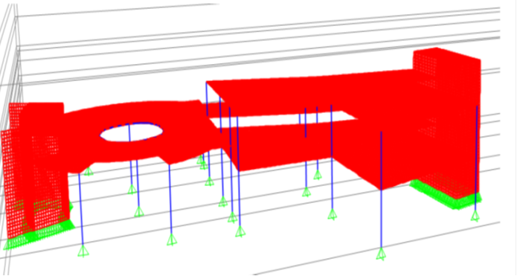
Sap model for block4

Slide 16
Deflection Check:ok
Check Equilibrium:
Total load = 22214.07 KN
From SAP =22093.318 KN/m2
Percentage of error = 22214.07-22093.318/ = 0.005<0.05 GOOD

Slide 17
Structural Design
Columns Center Lines for block4

Slide 18
Structural Design
Slab Section

Slide 19
Structural Design
Detail In f13&C13 Column

Slide 20
Structural Design
Tie Beam Plan for block 4

Slide 21
Structural Design
Sections in Tie beams

Slide 22
Structural Design
Footing Layout

Slide 23
Structural Design
Footing F7 layout

Slide 24
Structural Design
Stair Reinforcement

Slide 25
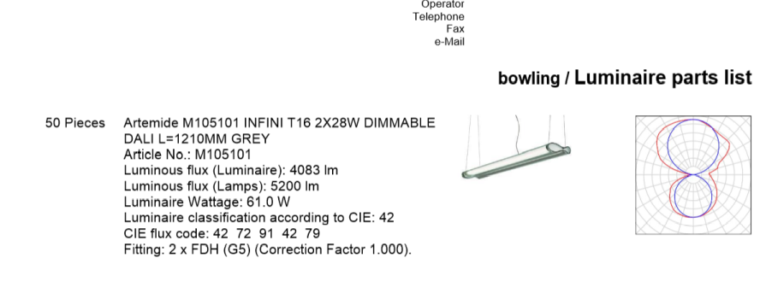
Electrical Design
Lamps Used

Slide 26
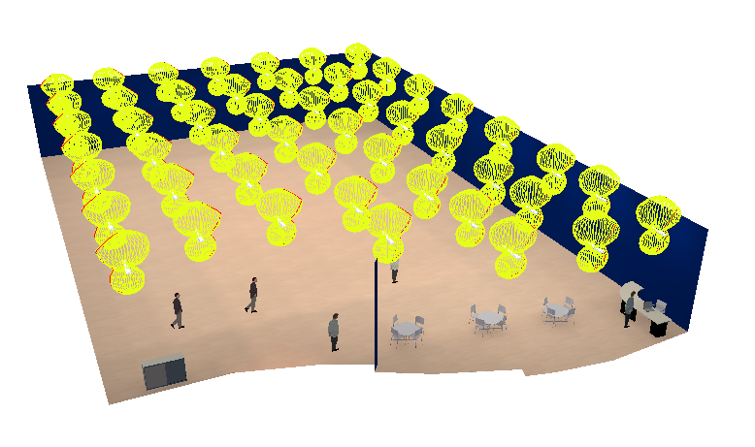
Electrical Design
Dialux Model For bowling

Slide 27
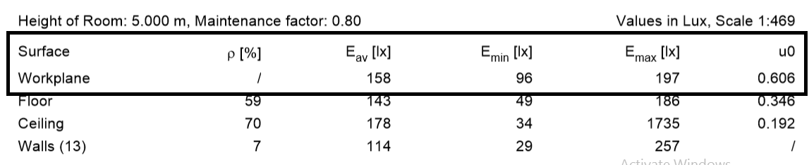
Electrical Design
Uniformity In bowling

Slide 28
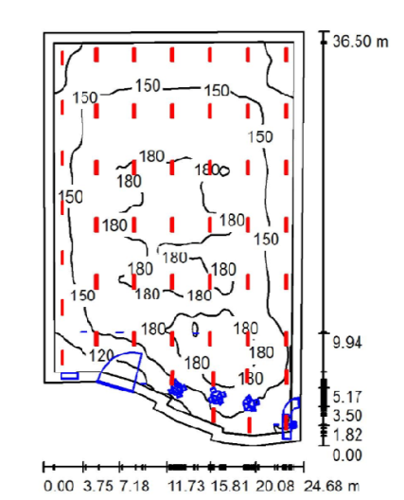
Electrical Design
Bowling lighting plan

Slide 29
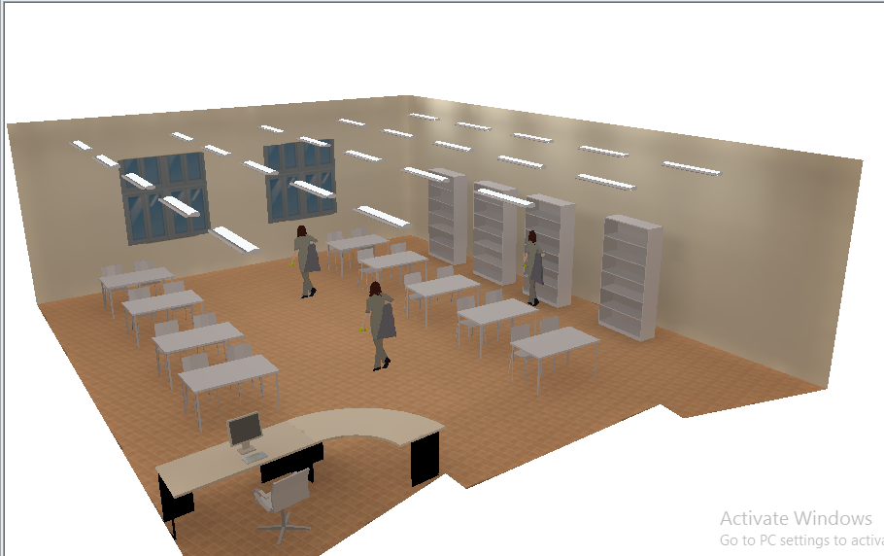
Electrical Design
Dialux Model For library

Slide 30
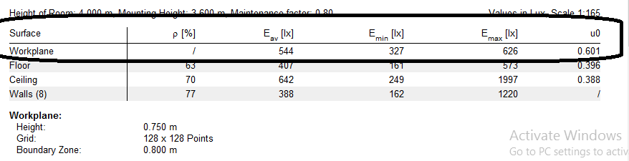
Electrical Design
Uniformity In library

Slide 31
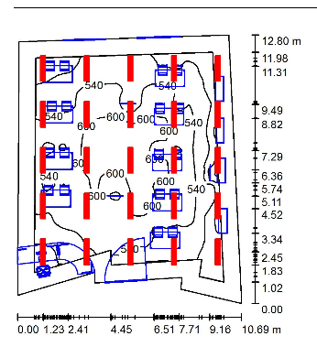
Electrical Design
Library lighting plan

Slide 32
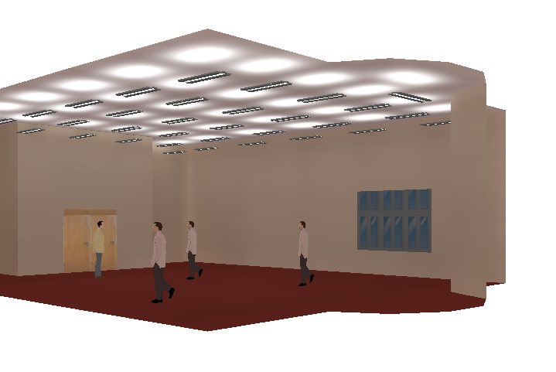
Electrical Design
Dialux Model For pray room

Slide 33
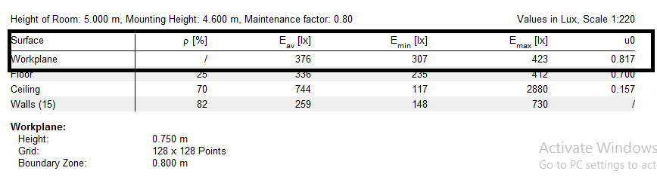
Electrical Design
Uniformity In pray room

Slide 34
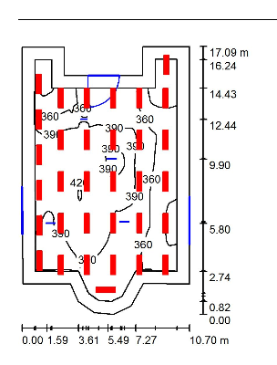
Electrical Design
Pray room lighting plan

Slide 35
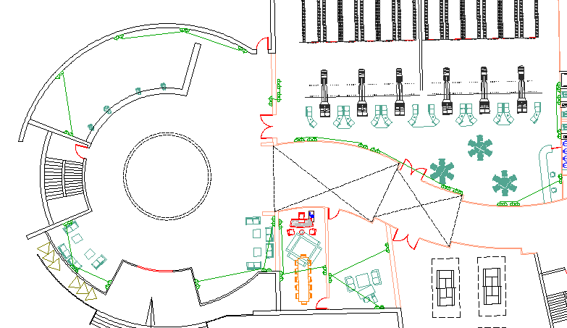
Electrical Design
Distribution of socket

Slide 36
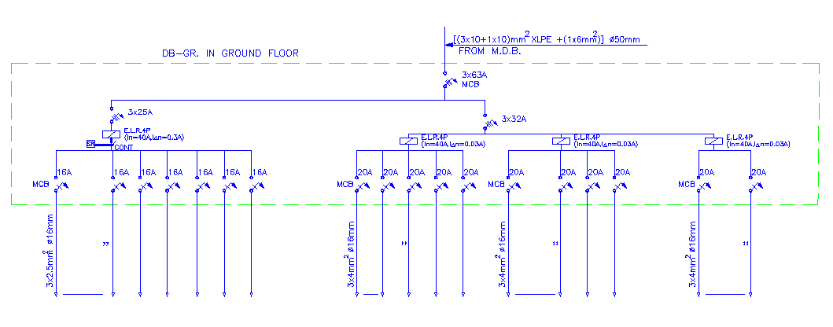
Electrical Design
Circuit Breaker

Slide 37
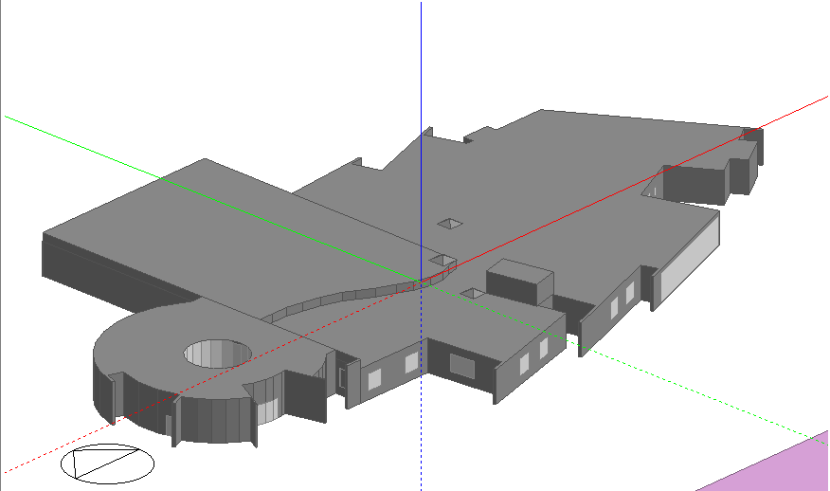
Environmental Design

Slide 38
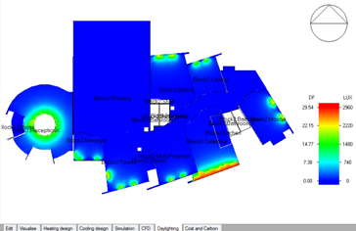
Environmental Design
The distribution of daylight factor in the building

Slide 39

Environmental Design
.
Total Heating and Cooling Load

Slide 40

Environmental Design
In ceiling was used Acoustic Tiles. This element was used in each space of center with sound absorption coefficient as in Table below:
:

Slide 41
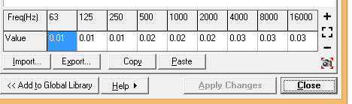
Environmental Design
In wall was used Brick: unglazed & painted, This element was used in each space of center with sound absorption coefficient as in Table below:

Slide 42

Environmental Design
In floor was used concrete or tile, This element was used in each space of center without bowling with sound absorption coefficient as in Table below:

Slide 43
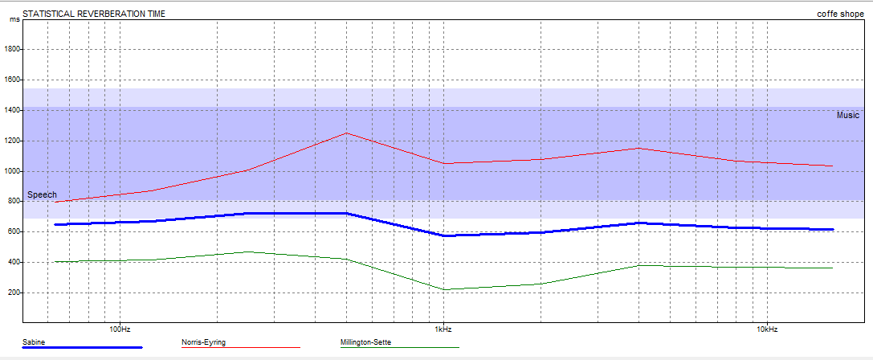
Environmental Design
Rt60 for coffee shop

Slide 44
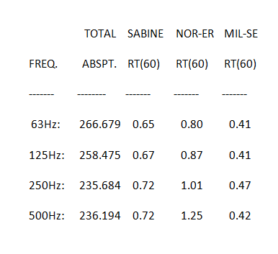
Environmental Design
Rt60 for coffee shop

Slide 45
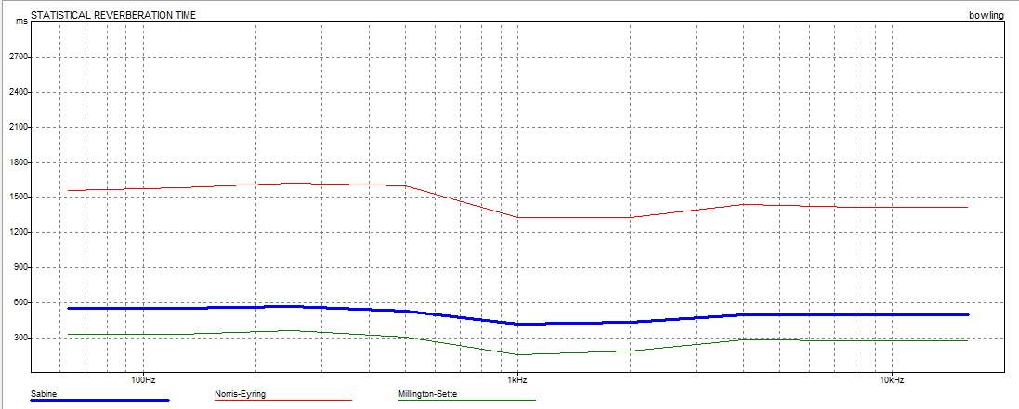
Environmental Design
RT60 for bowling

Slide 46
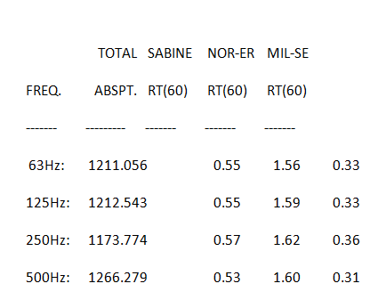
Environmental Design
RT60 for bowling

Slide 47
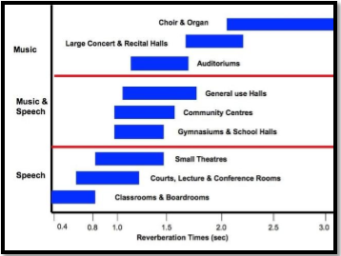
Environmental Design
Based on the above all the values Located between range(0.5-1.5) sec Which is illustrated in the following figure

Slide 48
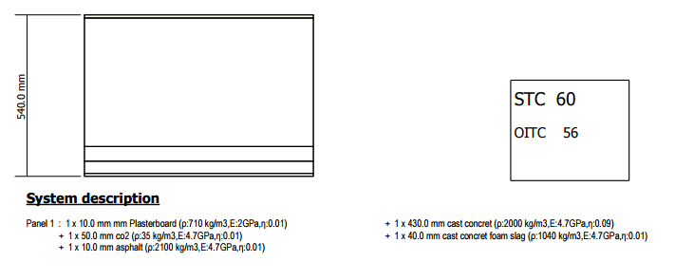
Environmental Design
IIC For roof

Slide 49
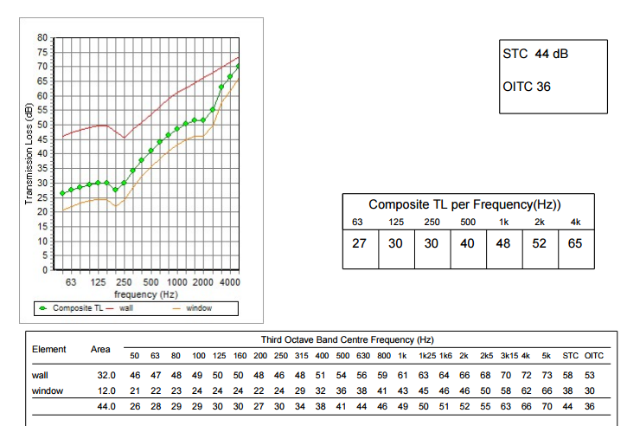
Environmental Design
STC for external wall in billiard

Slide 50
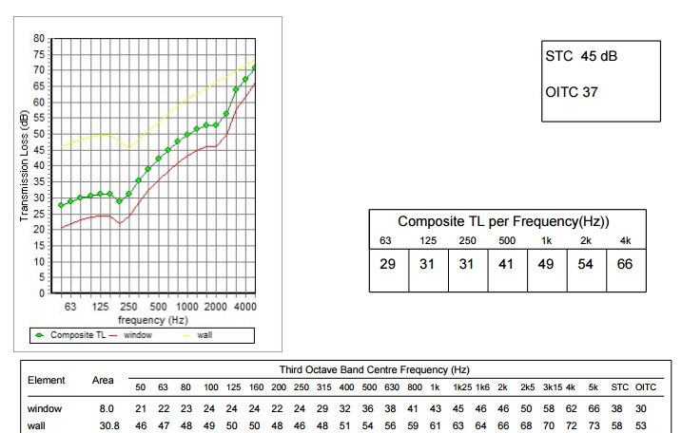
Environmental Design
STC for external wall in library

Slide 51
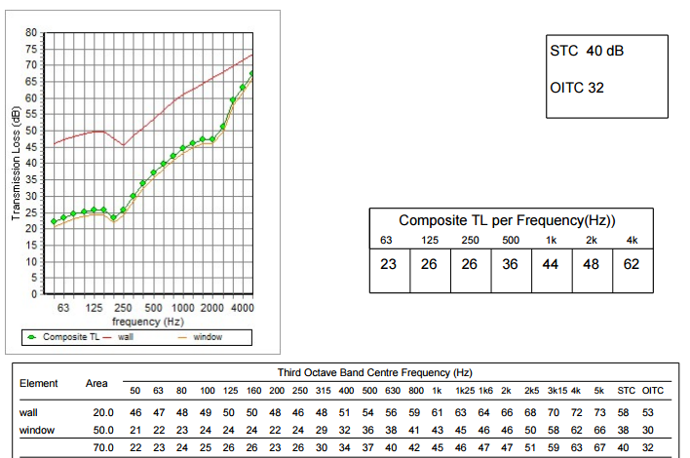
Environmental Design
STC for external wall in coffee shop

Slide 52
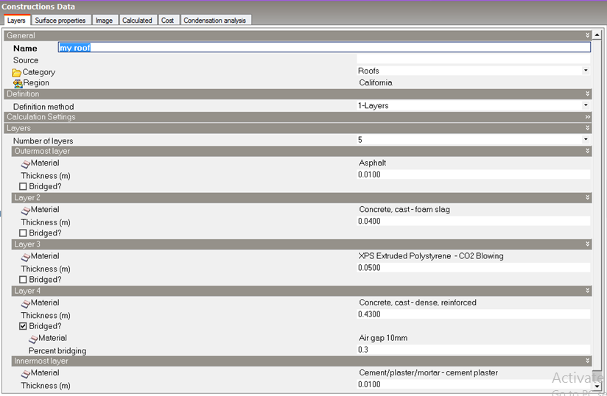
Environmental Design
ceiling with (45 cm) thickness and U-value (0.494 𝑤 𝑚2.𝑘 )

Slide 53
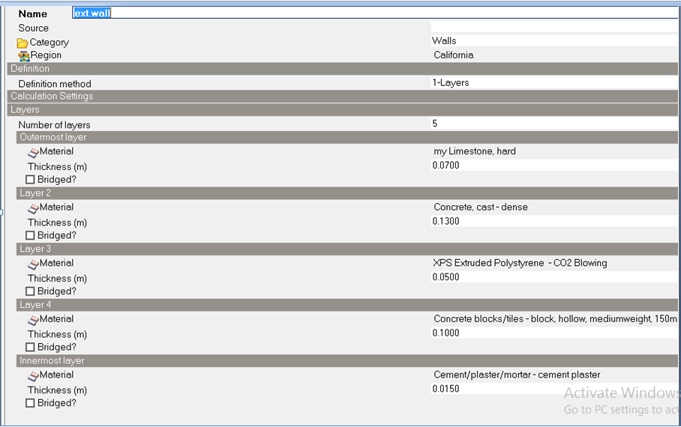
Environmental Design
External wall with (46 cm) thickness and U-value (0.516 𝑤 𝑚2.𝑘 )

Slide 54
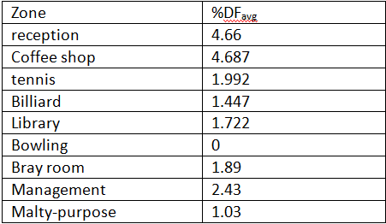
Environmental Design
Daylight factor in each spaces

Slide 55
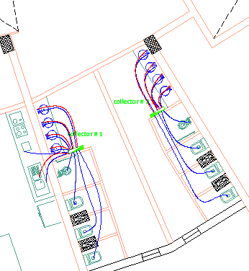
Mechanical Design
Water supply-collector#1 and #2

Slide 56
Piping Design for water supply
Total number of fixture units and Demand
Total FU for collector #1 = 55
Demand for collector # 1 = 32gpm
Fixture | Num. of function | Weight in fixture unit | Total fixture unit
Water Closet | 4 | 10 | 40
lavatory | 4 | 2 | 8
Kitchen-sink | 1 | 4 | 4
Dishwasher | 1 | 3 | 3
total |  |  | 55

Slide 57
Pipes Diameters
Vertical=2.00 in
Horizontal=1.50 in
Branch=1.00 in
∑ Losses = 5 + 0.6 + 9.5 + 0.86 = 16 Psi < 16.7 Psi ➔ OK

Slide 58
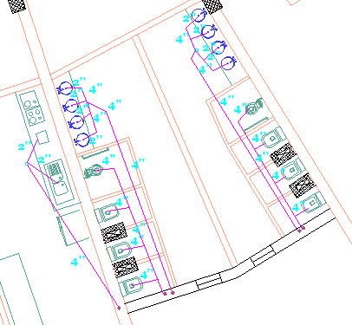
Drainage System
Drainage system for the cafeteria

Slide 59


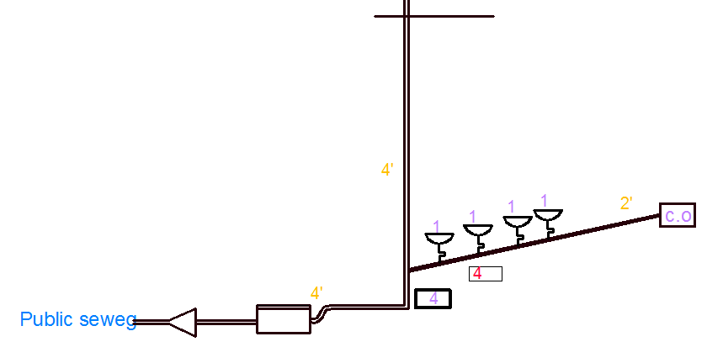
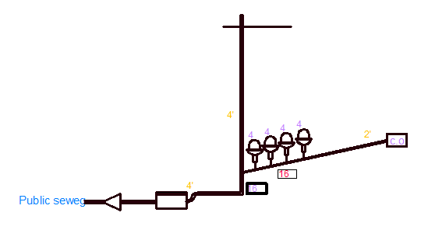
FU's and stack
FU's and stack#2and #4 FU's and stack#3 and #5

Slide 60
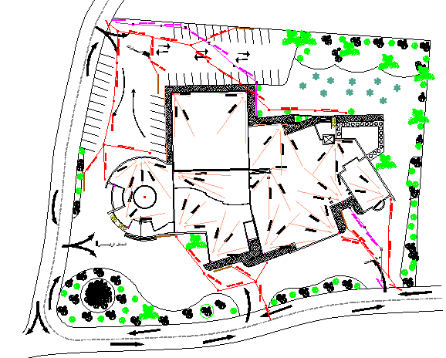
Roof and Storm water Drainage

Slide 61


Fire Safety and Security DESIGN
Distribution for types of Sprinklers used in the project
Zone | Type used | Sprinkler head
Bowling | Foam/chemical suppression systems
Sport halls | Water
Reading hall | foam
Entrance halls and kitchen | Water
Cafeteria | water

Slide 62
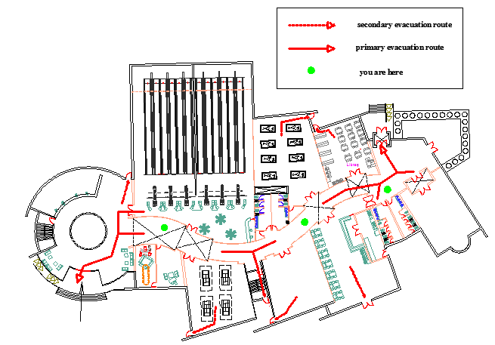
Fire Evacuation map

Slide 63

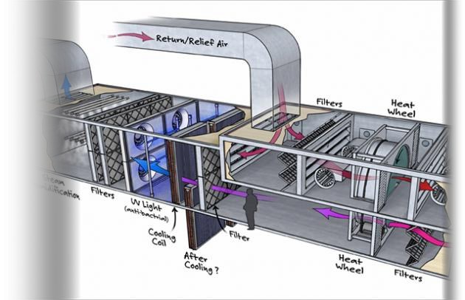
HVAC DESIGN
We chose air conditioning system, which are used for winter heating, as well as for summer cooling.

Slide 64
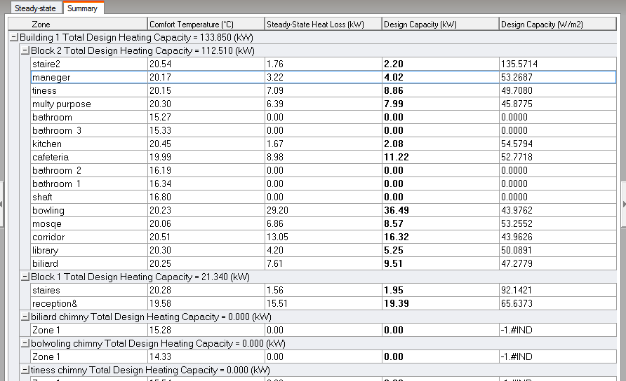
Heating and Cooling Loads for all building
Max Heating: 133 kW at 12:00 on 21th January
Max Cooling: 57.7 kW at 19:00 on 21th July

Slide 65
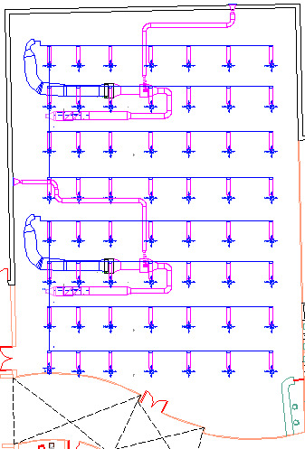
Diffusers distribution in bowling

Slide 66
Total Cost
The Cost of 1 CM of concrete B350 = 350 NIS
The Cost of 1 ton of steel = 2800 NIS
The Total Cost of the Project 2,394,356 NIS

Slide 67


