Slide 1

An-Najah National University Telecommunications Engineering Department Design and Implementation of an Environmental Monitoring Network
Prepared by:
Yasmeen Salhab 11317650
Aseel Naser 11315538
Rand Taslaq 11344418
Supervisor:
Dr. Saed Tarapiah
May - 2018

Slide 2
Outline
Motivations.
Objectives.
Introduction.
Project Discussion
System main components.
Results
Conclusion and Recommendations

Slide 3
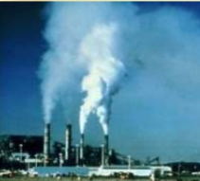
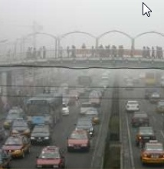
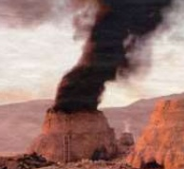
Motivations
Pollution has become a global concern
-UV Radiations
NO2
-Harmful Particles
-Global Warming
-Health Problems

Slide 4
Objectives
keep people safe by avoiding these radiations and particles.
Meteorological science and communication engineering, and can prevent many diseases.
Not only is ethical, but it’s also Humanitarian

Slide 5
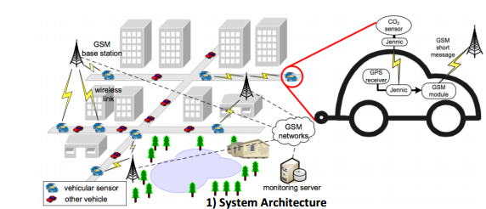
Introduction
The Survey

Slide 6
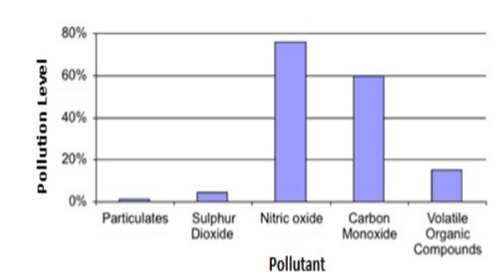
Introduction
The Survey

Slide 7
Introduction
What is the ultra violate (UV) index ?
The UV index is an international standard measurement of the strength of the UV radiation at a particular place and time
What is the Air quality (AQ) index ?
An air quality index (AQI) is a number that represent air pollution and particles concentration in the air.

Slide 8
Project Discussion
Design a smart box attached with multiple sensors.
-UV
-GP2Y
-CO2, NO2
-Temperature
Smart box installed on moving vehicle .
Collect the data and store it on local storage on the smart box.
Transmit the data wirelessly to a mobile phone, which act as a relay station to transmit the data to a Central Processing Station.

Slide 9
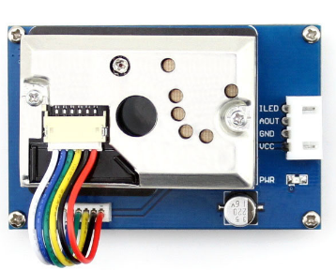
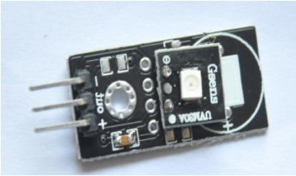
Design of the project
The following sensors will be used to measure the Required environmental variables :
UV-m 30 sensor to measure the UVI.
GP2Y10 sensor to measure the AQI.
These sensors were chosen due to their:
Low power consumption.
High sensitivity.
Small and thin surface .
Low cost.

Slide 10
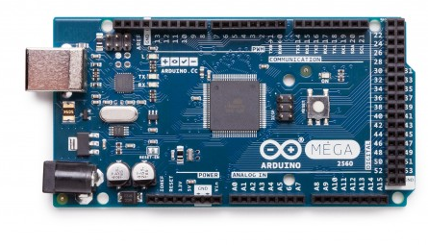
Design of the project
To perform an analog to digital conversion and control our system, Arduino Uno will be used.
Arduino MEGA 2560 was chosen because of it’s of its EEPROM and SRAM size, and speed.

Slide 11
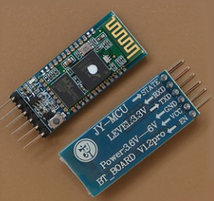
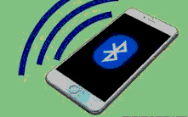
Design of the project
In order to send the measured data to the mobile application, one of the communication standards should be chosen .
Many standards can be chosen such as Bluetooth, NFC, Wi-Fi, ZigBee ..etc.
IEEE 802.15.1

Slide 12
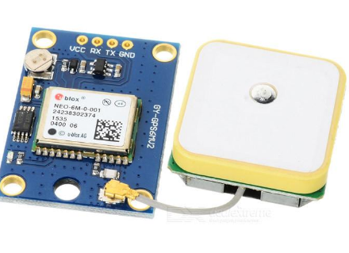
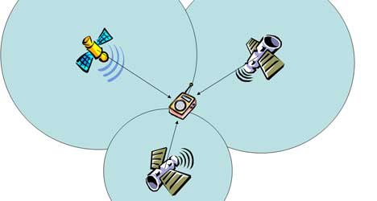
Design of the project
GPS Receiver (how it locate itself )?
GPS Receiver
(how it locate itself )?
Longitude
Latitude
Time Stamp
Distance
Speed = Distance / Time

Slide 13
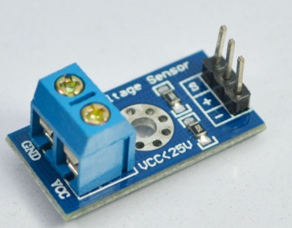
Design of the project
To sense the amount of input voltage incoming for it ,so it will indicate the capacity of charging of the Battery that we will use to power the project
Voltage Sensor module

Slide 14
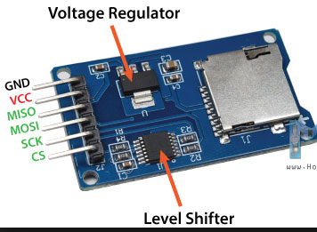
Design of the project
SD Card(16G)
Location (Lat , Long)
Date
Time
UV readings
GP2Y readings

Slide 15
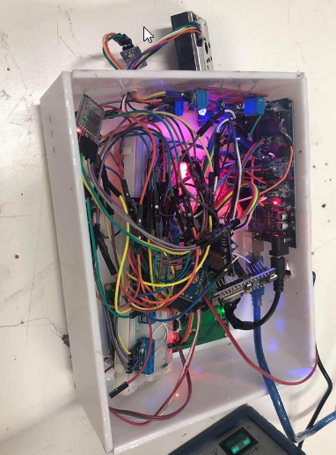
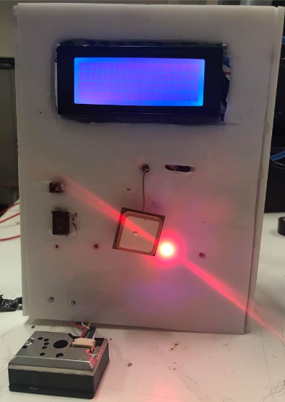
Design of the project

Slide 16






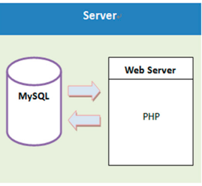
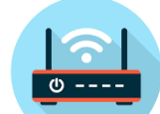
Design of the project
sensors
Dust Density
UV
GPS module
HC-06 Bluetooth
module
ESP module
Mobile App.

Slide 17
Microcontroller Code
start
Initialize Serial data TX.
Read fro GP2Y
YES
Read<=0?
Replace with zero
NO
Read from UVm-30a
Send data to mobile using HC-06

Slide 18
Microcontroller
Microcontroller Code
How does it work?
void CreateSkitch()
{Serial.println("-----------CreateSkitch();---------");
registers[4]=HIGH; WriteREG();
String Day =(String)DateGPS+".txt";
String SCK=Sckitch(Day);
Serial.println(Day);
CreateOrOpinFile(Day);
writeToFile(SCK);
closeFile();}
void loop() {
UpdateGPS();
ReadBT();
CounterMode();}
void Test1(){
Folder = SD.open("130120.txt");
if (Folder){
Serial.println(ReadLine(6));
{
else {Serial.println("no");}
if (Folder)
{Folder.close();
Serial.println("File closed");}}

Slide 19
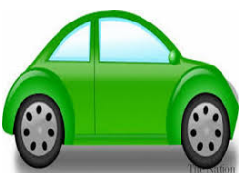

How Does it Work?!
Web Application
Web Application
Website
Web Service
Insert
Longitude: ****** Latitude : ***** UV : **** Dust density: **** Date:****** Time : *****
Receiving
Insert
POST
Web Service

Slide 20
Server
AP
Web Application
GPS
Storage Device
Wi-Fi Interface
Web Application
Microcontroller
Server
ESP module 2866
1. Connect to the AP
2. Data Transmission

Slide 21
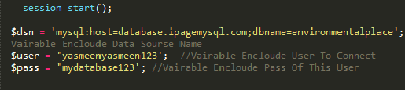
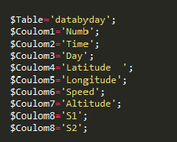
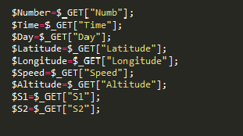
PHP Code

Slide 22
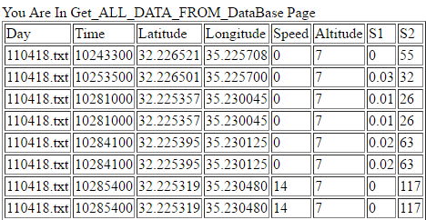
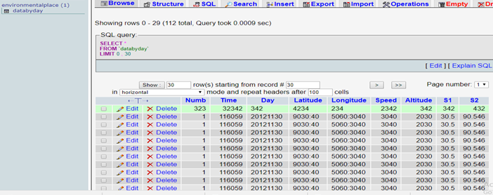
Database tables

Slide 23
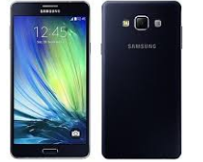
Mobile Application using MIT APP Inventor
Blocks
Design
Buttons
Labels
Text Views

Slide 24
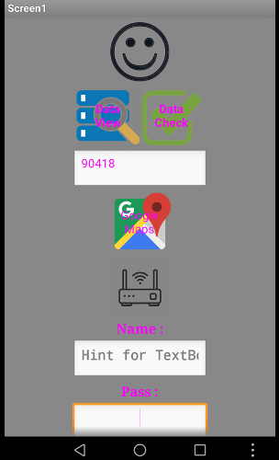
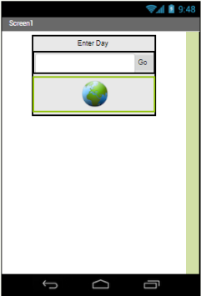
Mobile Application Design

Slide 25
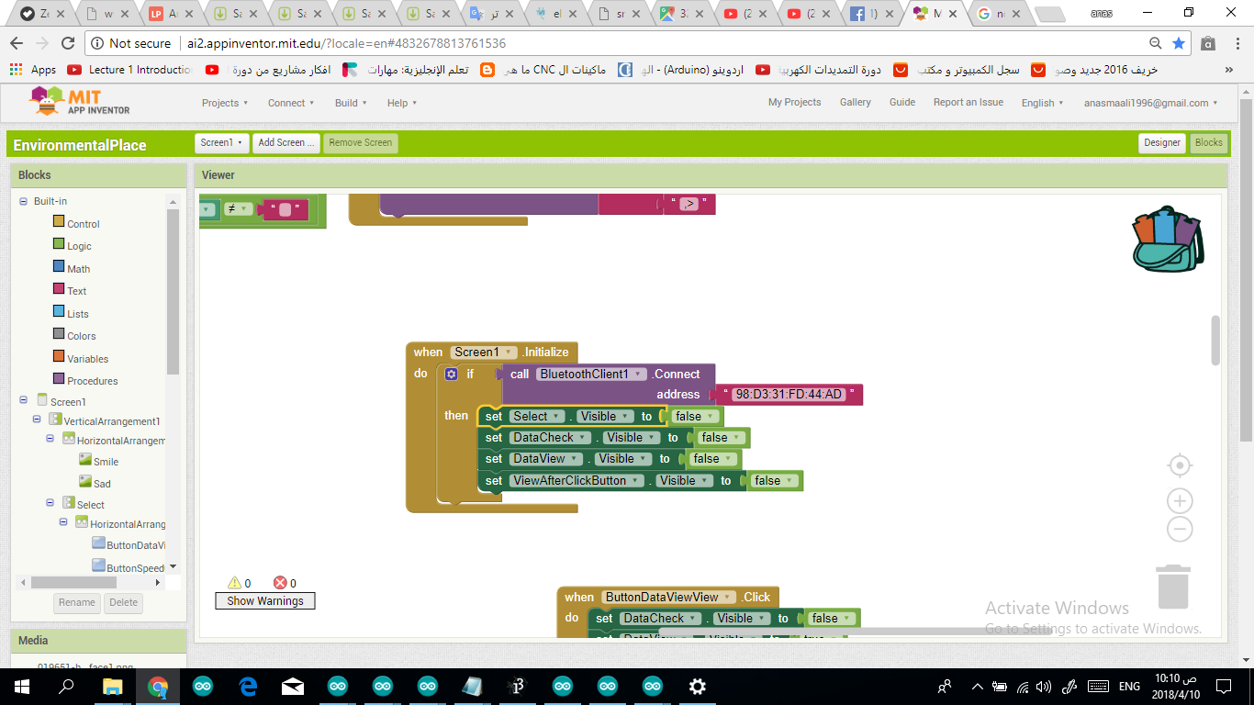
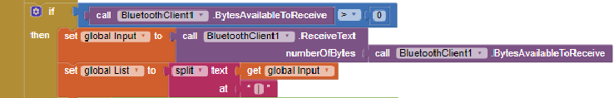
Bluetooth Connection Block

Slide 26
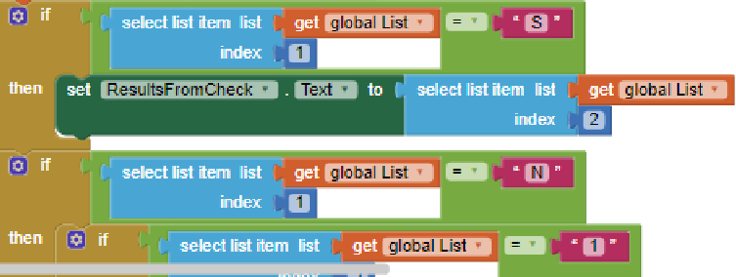
Data View Block

Slide 27
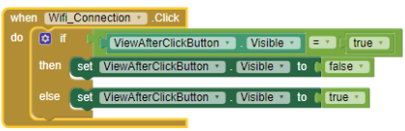
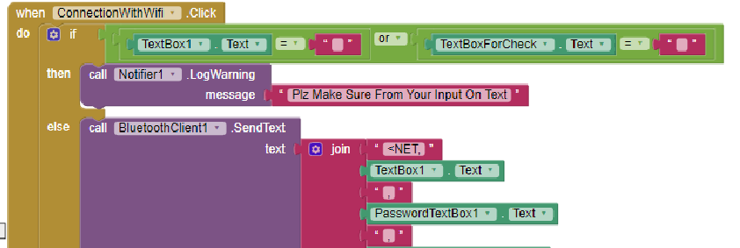
WiFi Connection Block

Slide 28
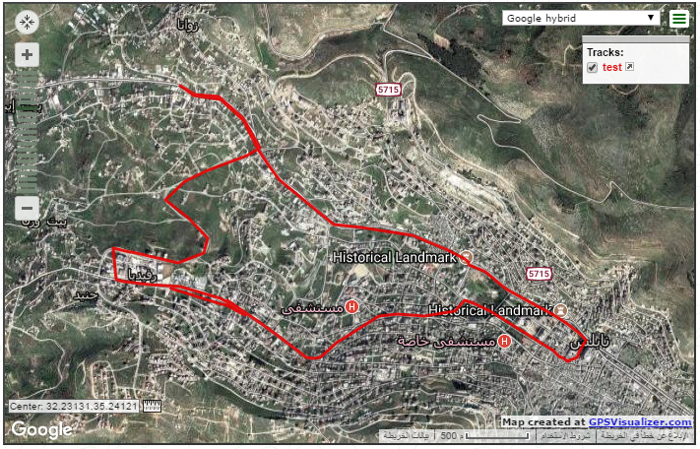
Tested Track

Slide 29
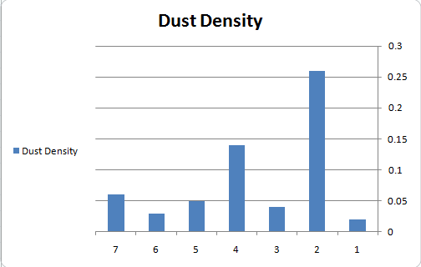
Nablus City:
Avg:.0.1351
Std:0.1748
Mukhayyam Al Ain
City Center
Tulkarem Street
Rafidia
Beit Iba
Academya
Zawata

Slide 30
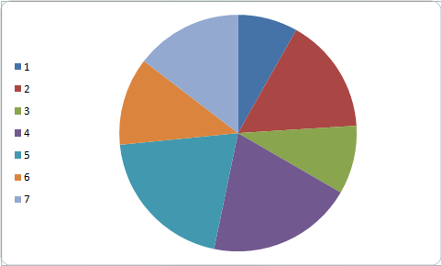
Dust density VS Population(Nablus)
Academya
Mukhayyam AL Ain
Beit Iba
Zawata
Tulkatem Street
City Center
Rafidia

Slide 31
Ramallah City:
Avg:.0.0759
Std:0.0541

Slide 32
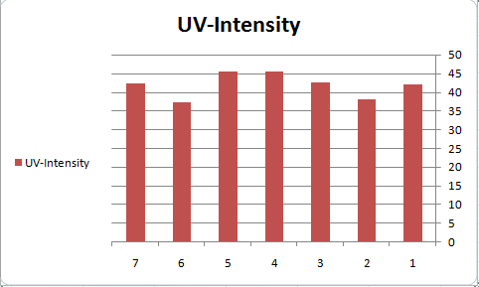
Nablus City:
Avg:40.4286
Std:3.5668
Mukhayyam Al Ain
Rafidia
Tulkarem Street
Acadimya
Zawata
City Center
Beit Iba

Slide 33


Slide 34
Conclusion
We build a System that monitor different environmental parameters
Different experiments and tests implemented on different areas.
We joint our project with Palestinian community ,so they can utilize it In Urban planning.
We implemented a similar system to one that applied In smart cities such as milano In Italy.

Slide 35
Recommendations
More sensors could be attached to the system.
Real time monitoring (3G) ca be implemented instead of offline monitoring.
This system can be used by authorities and Municipalities In Urban Planning projects ,if it is extended to include all streets of the city, or to take prompt actions such as evacuating people ,or declaring an action day when the levels of pollution goes up.

Slide 36
Thank You for Your Kind Attention!

