Slide 1
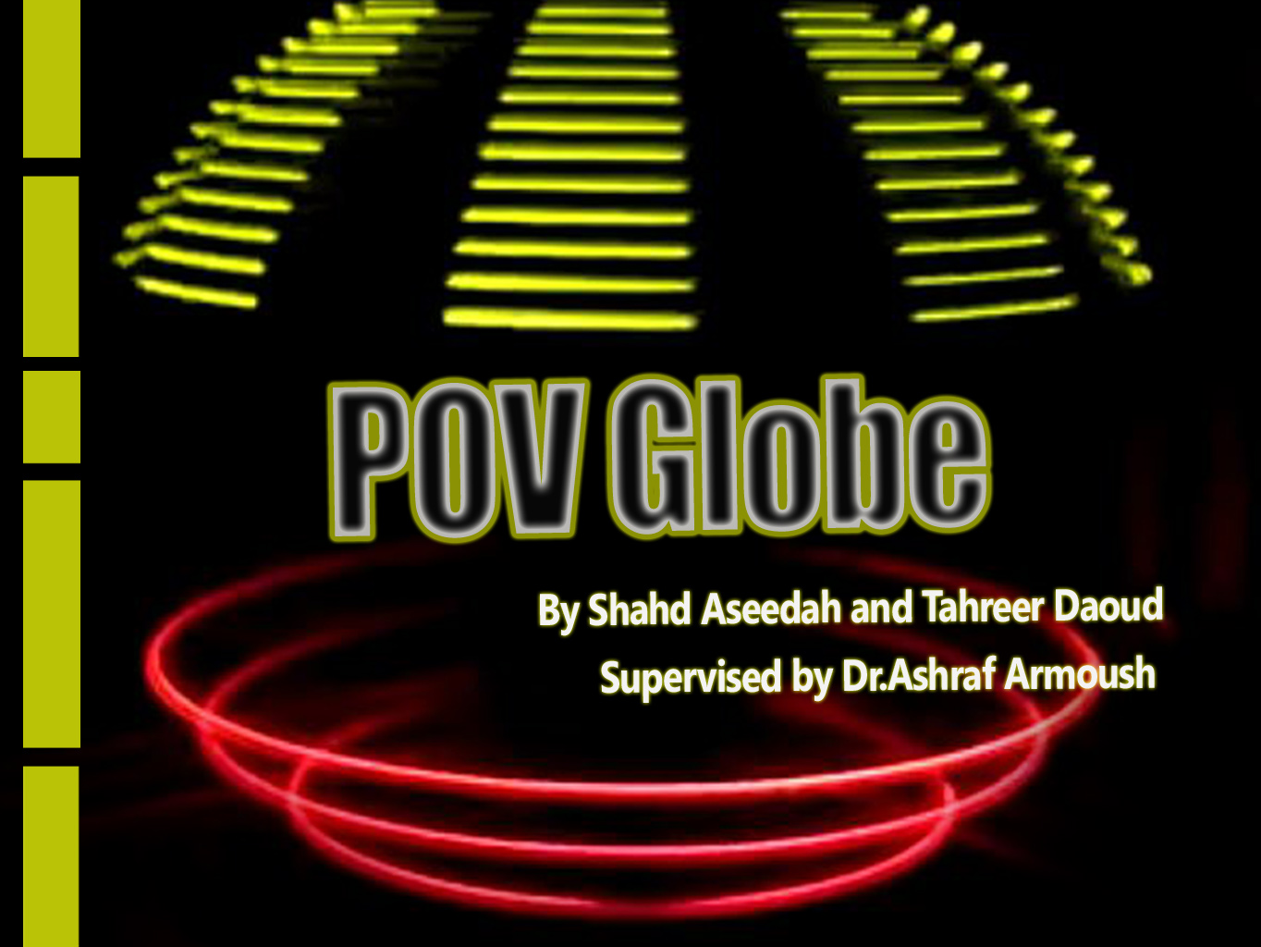

Slide 2
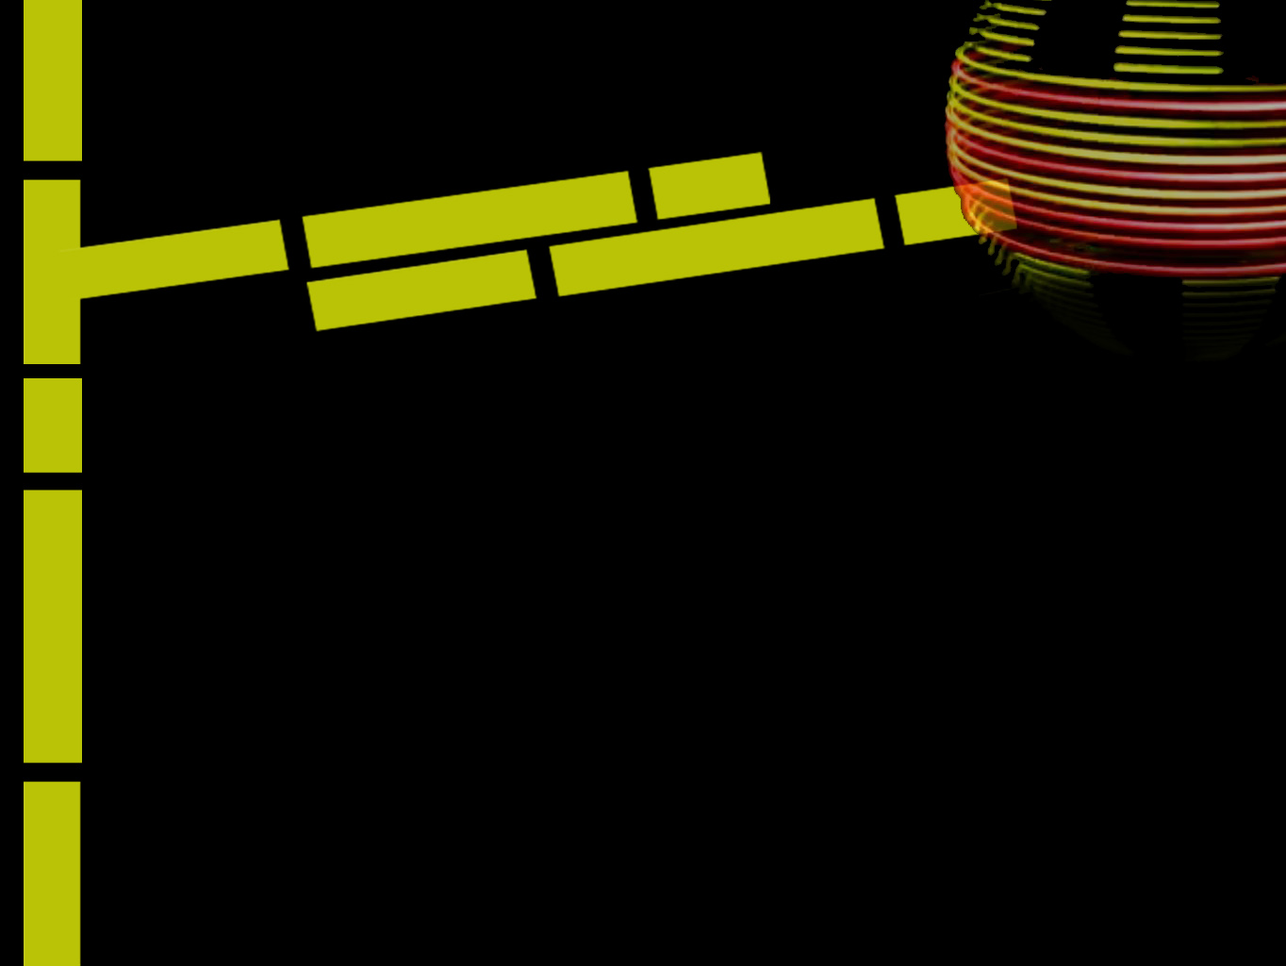
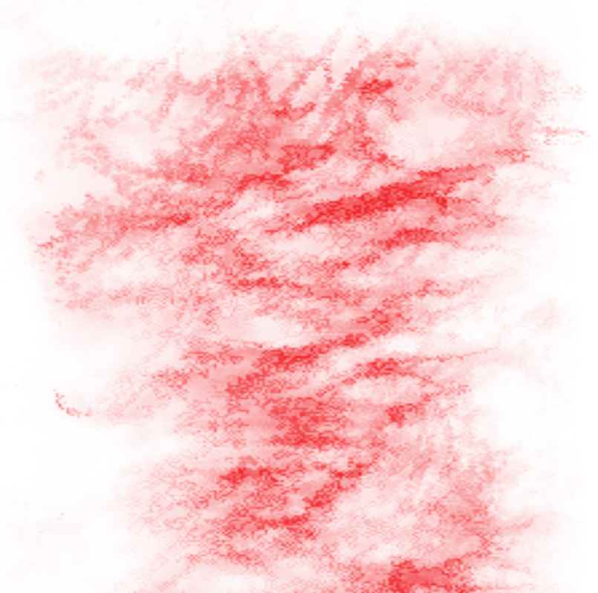
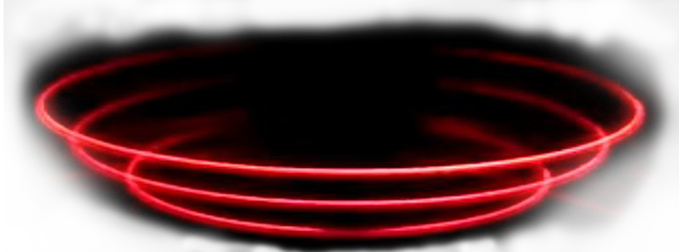
Outlines,,
Main idea of the Project ?
Introduction
Persistence of Vision
Design and Implementation
Problems & Challenges
Applications
Possible Improvements
Demo

Slide 3
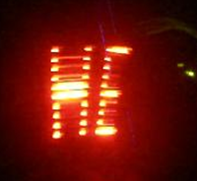
Main idea of the Project?
Our project’s aim is to display a colored sphere image utilizing persistence of vision (VOP) ability of human eye.
This display will allow users to upload an image to be displayed through serial peripheral interface (SPI).

Slide 4
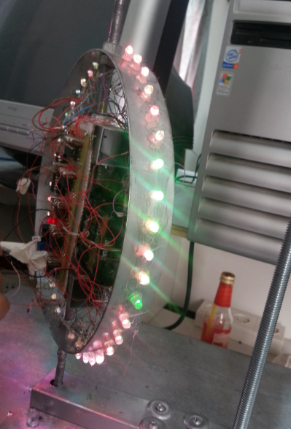
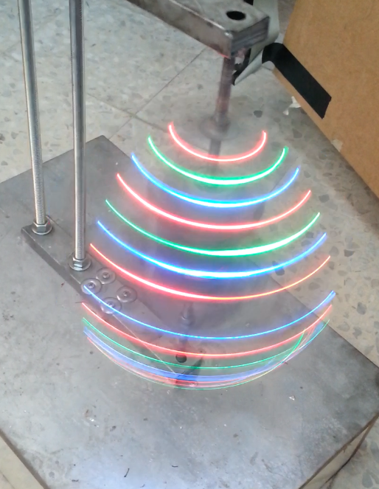
Introduction
An apparatus that will create a visual using 40 LEDs as it spins in a circle

Slide 5
Persistence of Vision (POV)
POV is the ability of the eye to retain the impression of an image for a short time after the image has disappeared.
This ability can be used to create an illusion of images/characters floating in the air, by rapidly flashing a column of LEDs while moving the display in air.
The image “persists” in our vision for about 1/25th of a second.
Notes:
When we observe an image with our eyes, the image “persists” in our vision for about 1/25th of a second.

Slide 6
POV
What we see is a blend of what we are
viewing and what we viewed a fraction of a second before.
We included in the code as a binary array,
image[]={B00000,B10010,B11111,B10000,B00000};
Notes:
For example, if ‘1’ has to be displayed, then the series of lighting up of diodes would be like following:

Slide 7
Design and Implementation
The overall design of this project can be grouped in the following three categories:,, and design.
Mechanical design
Electrical design
Software Part

Slide 8
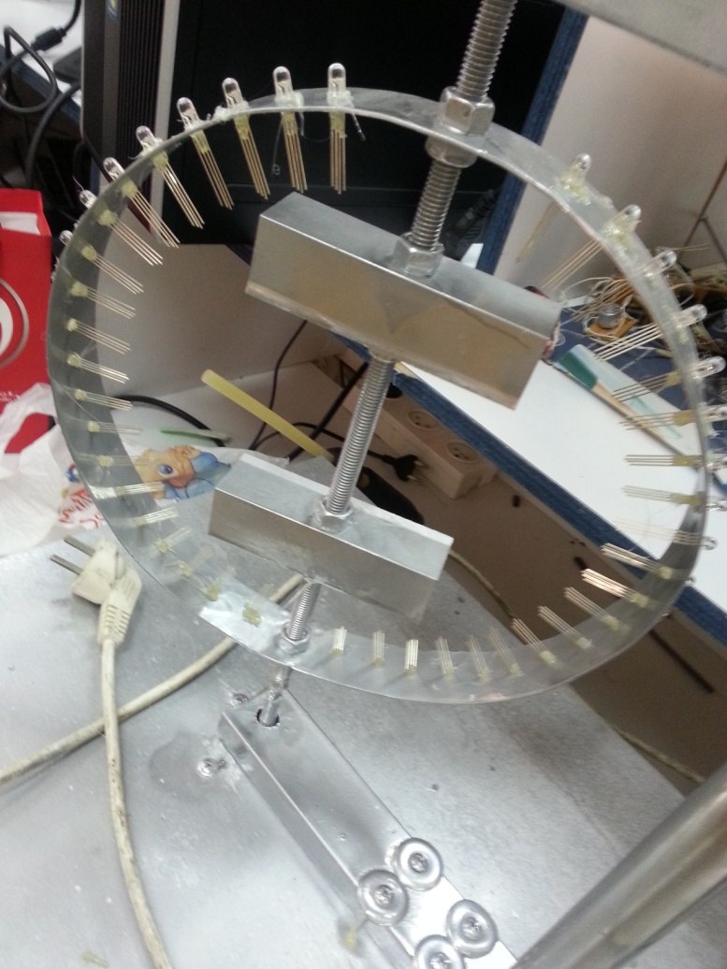
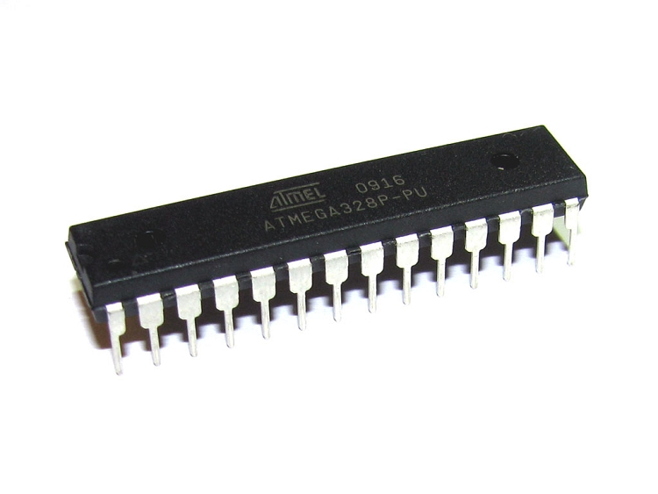
Electrical Part – Components
40 LEDs
ATmega328P microcontroller.
Notes:
An Arduino to control the POV
display that We made from 40 LEDs and a 15 74HC595 shift register, and a Hall Effect switch.
The Arduino senses the rotation from the Hall Effect switch passing underneath. Once sensed, it spits out the information to be displayed in columns of LEDs to the shift registers.
The Arduino turns on the appropriate LEDs representing the first column of a character and waits for a short period of time, say 1ms, then it changes the LEDs to represent the next column, and wait and next.

Slide 9
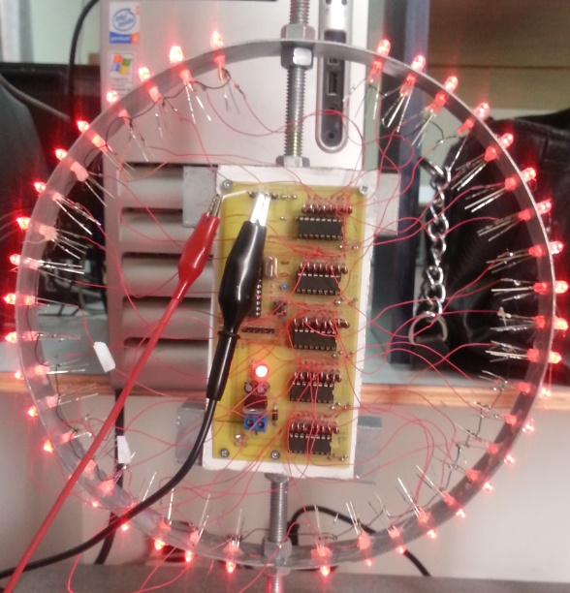
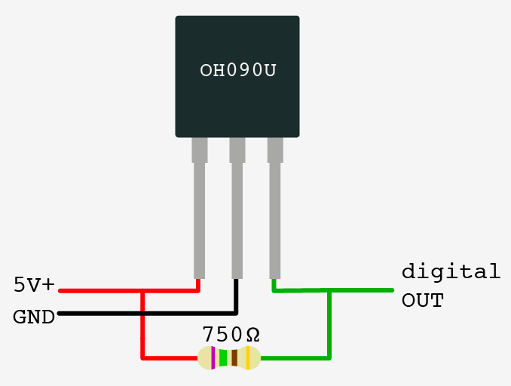
Electrical Part – Components
15 74HC595 shift register
Hall Effect sensor
We used 15 74HC595 shift registers, 5 in series for each color.
5 shift registers X 8 pins = 40 LEDs
Notes:
Hall effect sensors detect whether a magnet is near.
switch to tell us the speed of POV and when to start displaying.

Slide 10
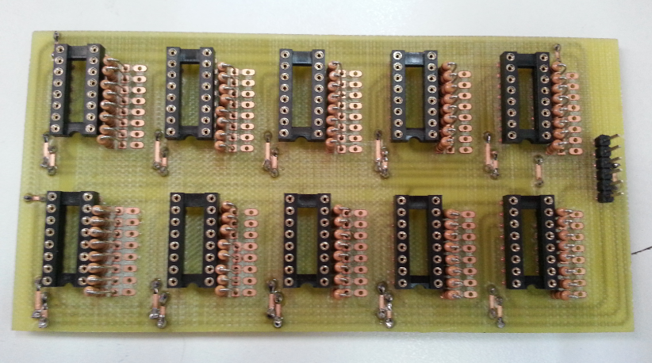
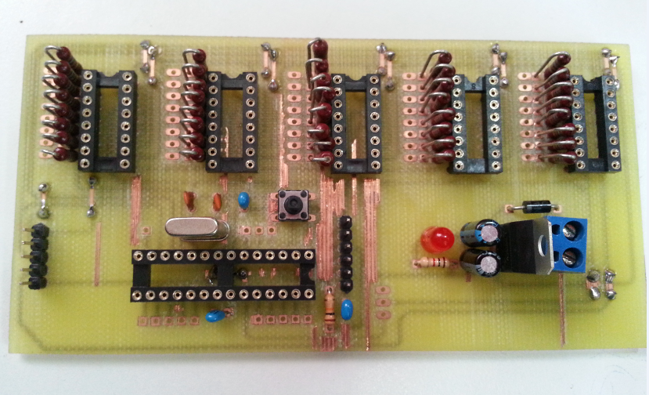
Printed Boards
Notes:
An Arduino to control the POV
display that We made from 40 LEDs and a 15 74HC595 shift register, and a Hall Effect switch.
The Arduino senses the rotation from the Hall Effect switch passing underneath. Once sensed, it spits out the information to be displayed in columns of LEDs to the shift registers.
The Arduino turns on the appropriate LEDs representing the first column of a character and waits for a short period of time, say 1ms, then it changes the LEDs to represent the next column, and wait and next.

Slide 11
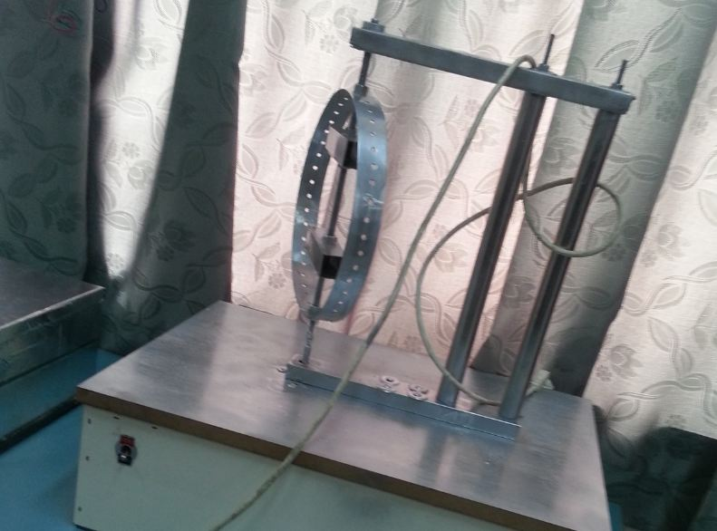
Mechanical design
The model is made of stainless steel & aluminum.
Notes:
Implementation:

Slide 12
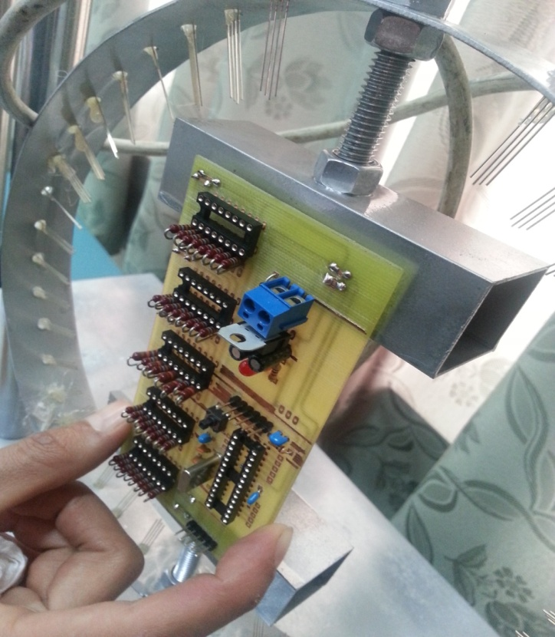
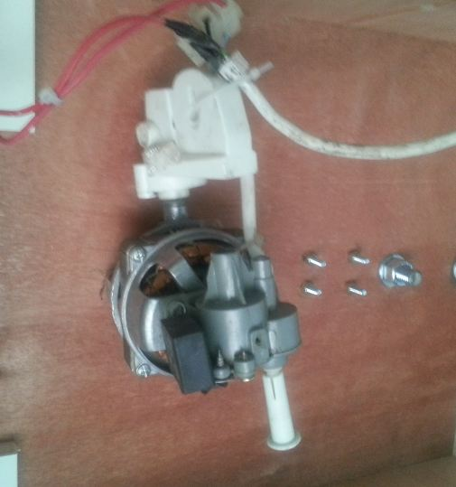
Mechanical design
we used a very fast DC motor.

Slide 13
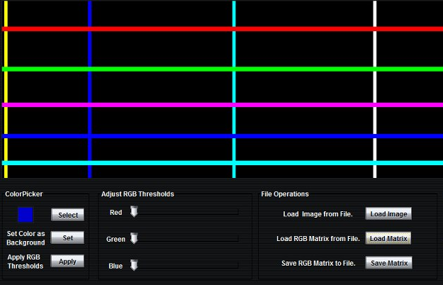
Software Part
we use a special software to convert any text or image to a matrix of binary data .

Slide 14
Problems & Challenges
System balance and weight
Centrifuges
Sensor detection at high speed
Synchronization
Getting power to the rotating circuit
Notes:
POV display projects have some unique challenges
System balance and weight : one of the biggest problems we face was making of the hardware setup as the whole system had to be a light weight, evenly balanced and yet a strong one. Even slight variation of centre of mass from the axle resulted in large scale wobbling of the system.
POWER SUPPLY: Power supply to the two printed boards, electrical IC's and 40 RGB LEDs was a very big problem to us. Because we can't power the circuit by a power supply or any outsource, the source of power must be inside the ring due to its 360 spinning so any outside wire will be cut. So we used 8 battery and tide it between the 2 bread board , that increases the weight but it was the only solution.
BALANCING YOUR SETUP: It’s a crucial problem since our setup will be running at high speed. So wobbling of setup will give distorted image. The design must be balanced and center of mass of setup must be at the point about which setup is rotating. We fix the model many times until get stable.
Centrifuges : it was a really dangerous problem. Component thrown away while spinning of the ring due to the high speed and centrifuges, some buttery jump from its place many times. But finally we tide and fix everything carefully so it becomes safe.
Sensor detection at high speed: To call the interrupt at high speed and change the input, It was difficult to resolve . also, the changing of the speed of the motor. Actually, we couldn't resolve this problem in a perfect way, and this make a distortion image and limit our ability to do draw all images we want.

Slide 15
Applications
Mostly used for many entertainment purposes such as:
displaying text ,name of a logo or motto.
an image of decorating lights for parties.
advertising and marketing campaign.
fun into learning
Notes:
. The POV spinning globe can be mostly used for many entertainment purposes such as displaying time and date or name of a logo or motto or even an image of decorating lights for parties.

Slide 16
Possible Improvements
Increasing number of LEDs 40 on each side not 20 , to get higher resolution.
Using wireless communication
Notes:
Our project could have several improvements include :
Increasing number of LEDs 40 on each side not 20 , to get higher resolution. And , displaying more complex images.
Also, we thought of using wireless communication , that allow users to upload an image to be displayed through wireless communication instead of USB Serial.

Slide 17
Thank you all ^_^
Demo Time

