Slide 1

An-Najah National University
Faculty of Engineering & Information Technology
Energy Engineering and Environment
(Experimental validation of clear sky model for global solar radiation prediction)
Prepared by :Reem Bassm Hnini
Supervisor :prof.Tamer al –khateb
This project is Submitted in Partial fulfillment of the Requirments for the Bachelor Degree on Energy Engineering and Environment.

Slide 2
Outlines:
Introduction:
Problem statement
Objective
Methodology
Literature Review
Theory
Summery

Slide 3
Problem statement:
Many model used theoretical methods for estimating solar radiation and makes recommendations, for models to use when solar radiation measurements
are not available or limited data allow model calibration.
Clear sky models estimate the solar radiation in clear day with no clouds ,to measurement solar radiation at condition clear sky,this condition is not available at all days.

Slide 4
Objective:
predict accurate data need to solar energy system design .
apply clear sky model for many region ,with some parameter such as: Location ,time and sun position to collect specific data .
compare between MATLAB result (theoretical) and measurement (actual ) data

Slide 5
  Methodology:
STEP1:
studied clear sky model and understand its equation's and parameters(special topics in renewable energy ) class.
Step2:
write first MATLAB code (calculates the altitude angle and direct and diffuse radiation for Nablus city ,I define( number of day ,latitude angle for Nablus, longitude angle )And I wrote clear sky model equations it mention in theory later

Slide 6
Methodology:
STEP3:
When the codes completed , I returned solve it manually to confirm match two result
STEP4:
started to write codes to estimate the total global solar radiation (terrestrial solar radiation its total diffuse radiation and direct radiation )and use data for Kuwait City, Kuwait, on the 2nd of May from sunrise to sunset
STEP5:
write the report

Slide 7
Literature Review
(( case study Advantages and drawbacks clear-sky model with photovoltaic power production data(2014)
Case study A Comparison of Five Models for Estimating Clear-Sky Solar
(2007)

Slide 8
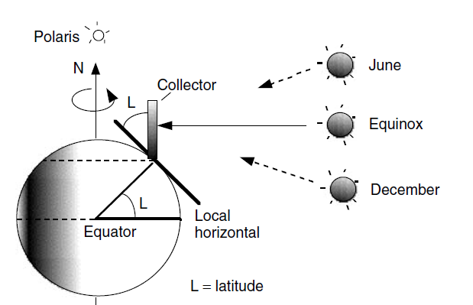
Theory :
Many calculation and equations are used in this project
Altitude angle (ALT):
sin_ALT=(sin(L)sin(DEC))+(cos(L)cos(DEC) cos(W))
Where:
L: latitude of the location
DEC: is the angle of declination, angle between the Earth–Sun vector.

Slide 9
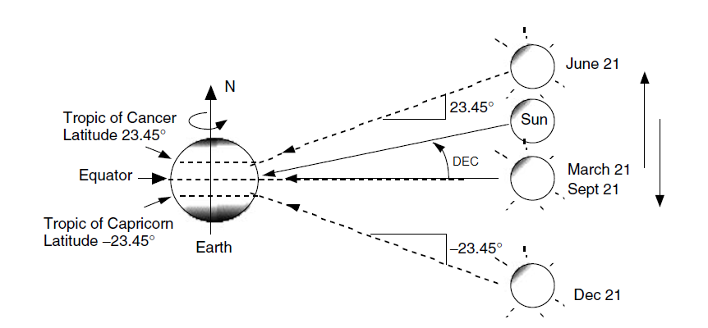
Theory :
DEC=23.45*sin ((360/365)*(n-81))
n : number of day.
W:hour angle.
W=15*(12-(Ts/60))

Slide 10
Theory:
Ts: is apparent or true solar time
Ts=LMT+EQT-4*(LZT-LOD)
Where:
LMT :is the local meridian time.
LOD: is the longitude.
LZT :is the local standard meridian time.

Slide 11
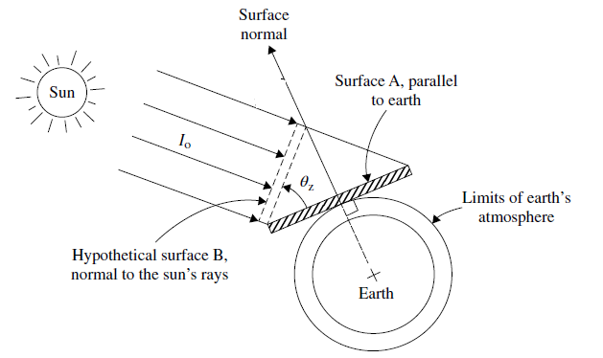
Theory :
LZT=15* T GMT
EQT: is the equation of time
EQT=9.87*sind(2*B)-7.53*cosd(B)- 1.5*sind(B)
B=(360/364)*(n-81)
IB:the direct solar radiation reaching
IB= A*exp(-K/sin(ALT))

Slide 12
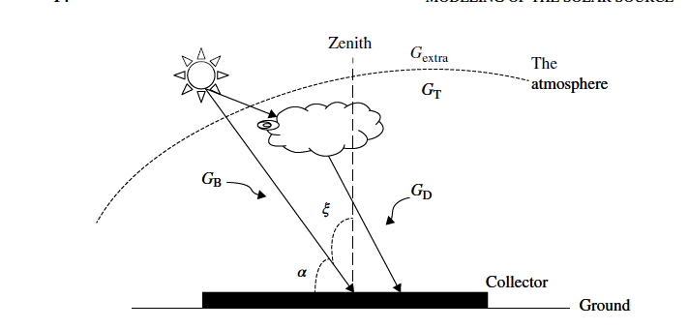
Theory:
A :is an apparent extraterrestrial flux
A=1160+(75*sind((360/365)*(n-275)))
K :is a dimensionless factor called optical depth
K=0.174+(0.035*sind(360/365*(n-100)))
G_B: the direct solar radiation : G_B= IB*sin_ALT
G_D: the diffuse solar radiation: G_D=IB*C

Slide 13
Theory :
C=0.095 + (0.04*sin((360/365)*(n-100)))
GT: is the available solar radiation at sea level below the Earth’s atmosphere
GT=G_D+G_B

Slide 14
Theory :
Sunrise/Sunset: Wsr_ssi=-tan(DEC*pi/180)*tan(L*pi/180)
Sunrise/Sunset hour angle: Wsrsr_ss=acosd(Wsr_ssi);
Sunrise solar time : ASTsr=abs((((Wsrsr_ss/15)-12)*60))
Sunset solar time: ASTss=(((Wsrsr_ss/15)+12)*60)

Slide 15
Theory :
Tsr=ASTsr+abs(Ts_correction)
(Actual Sunrise time)
Tss=ASTss+abs(Ts_correction)
(Actual Sunset time)

Slide 16
Summery:
In this project , I used the clear sky irradiance model to estimate global radiation ,and used modeling solar radiation on horizontal surface to clarification the relation between ( Global solar radiation (W/m2) and the time ) by using( MATLAB) program
And I define data for two region (Nablus and Kuwait ) .

