Slide 1

An-Najah National University
Faculty of Engineering
Department of Mechanical Engineering
Sizing Machine
Graduation Project Submitted in Particular Fulfillment of the Requirement for the Degree of B.Sc. in Mechanical Engineering
Supervisor: The Students:
Prof.Dr.-Ing. Mohammed Abu-Hilal Ayman Issam Rozza
Omar Bassam Samaro
Amjad Rami Kukhon
Abdelrahman Halbouni
2012/2013

Slide 2
Outline
Quick review
Final design
Calculation
Manufacture
Assembly Video
Running

Slide 3
Quick review
The Sizing Machine interested in classify materials and crops in different sizes.
The Sizing Machine has many general objectives, the main one is to grading or sorting olives or fruit, then separate it into small, medium, and large categories, and great flexibility in the choice of sizes.
The sizing machine consist of ropes put between four shafts having same diameter and length , the ropes having different distances between each other, the minimum distance put at the beginning of the machine and the maximum distance put in the end of machine. The first shaft rotating by a small motor, when this shaft starts to rotate the machine will start to supply the classification product by a vibratory box , then the product will move on the ropes and it fall in different size store boxes (small, medium and large).

Slide 4
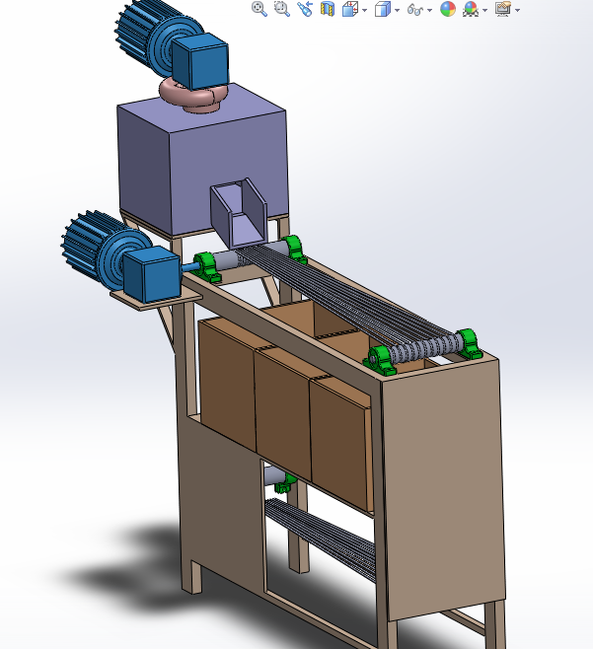
Final Design
- As we can see in this picture , is the final shape of sizing machine
- This picture show all component
of our machine
- In next slides , show the dimension of machine and design.

Slide 5
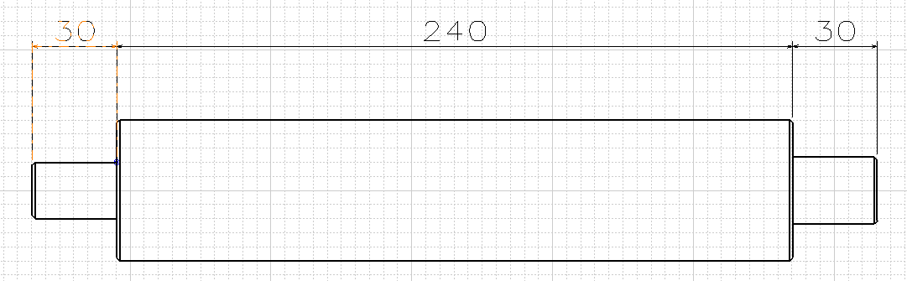
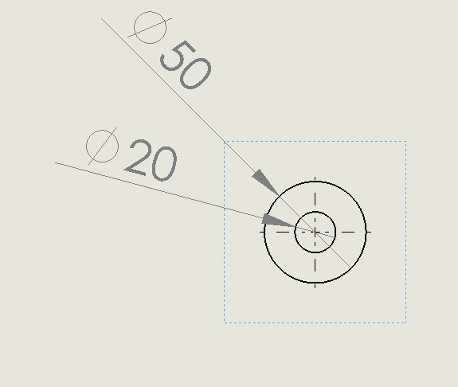
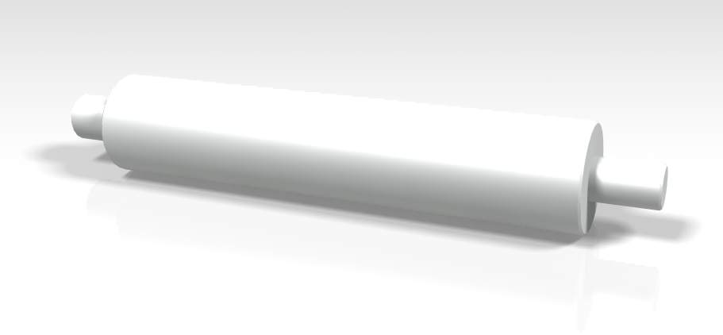
Shaft Design
Shafts are solid
have 5 cm diameters
The 2 cm is to let the shaft to put in the house bearing

Slide 6
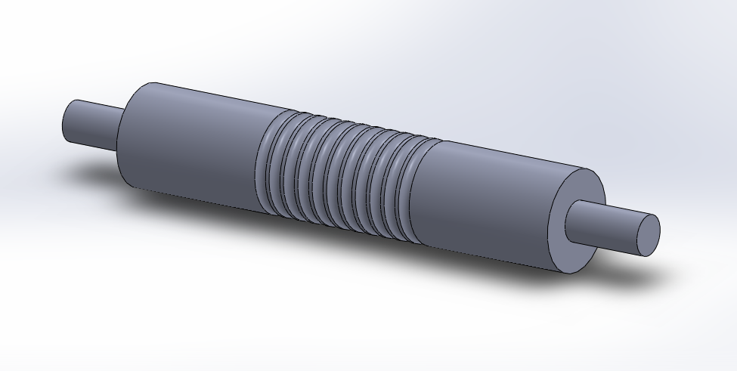
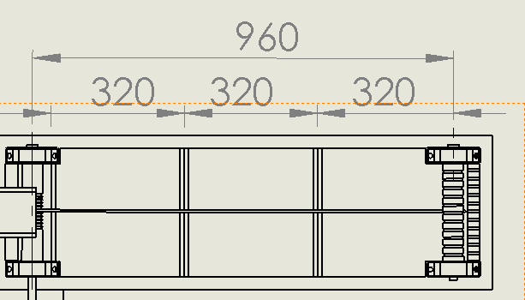
Ropes Design
Shaft grove turning
The length between every tow shafts is 96 cm
Which it divides into three parts, each part has equal length 32 cm

Slide 7
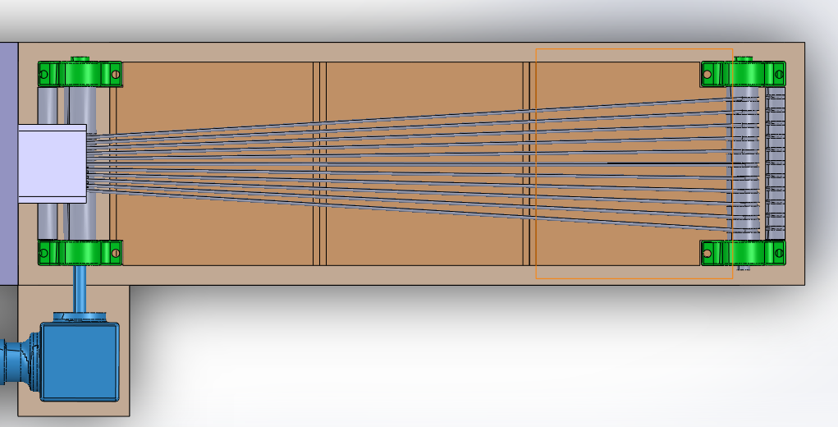
Ropes Design
The distance between ropes is variable, which it increasing from begin to the end, it depends on the diameter of products that will be classified for example, the distance is 2 cm at the maximum one.

Slide 8
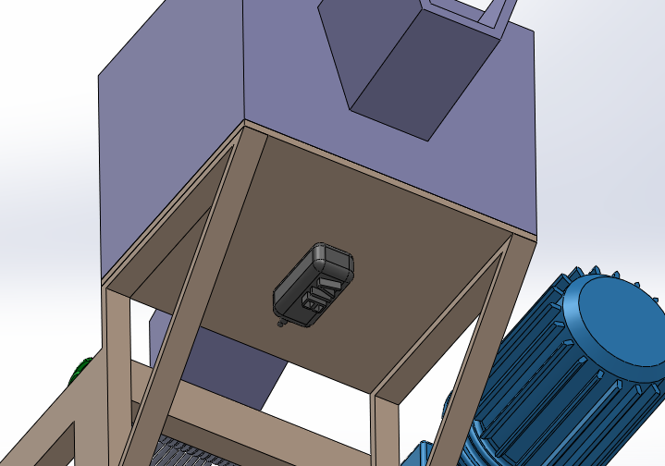
Vibrator Design
Vibrator below the steel box

Slide 9
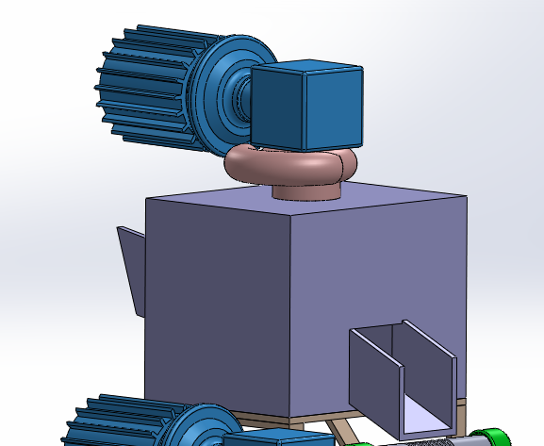
Vacuume Design
Vacuum cleaner on steel box

Slide 10
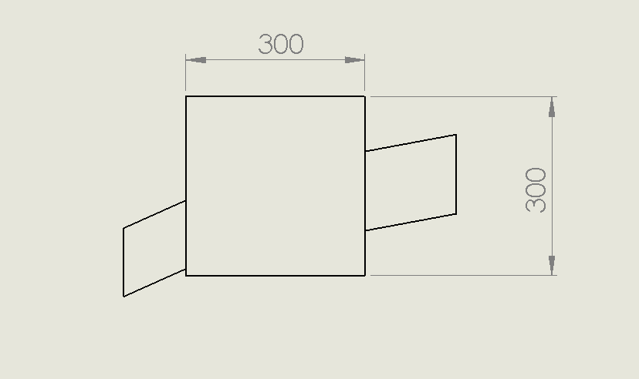
Steel box Design

Slide 11
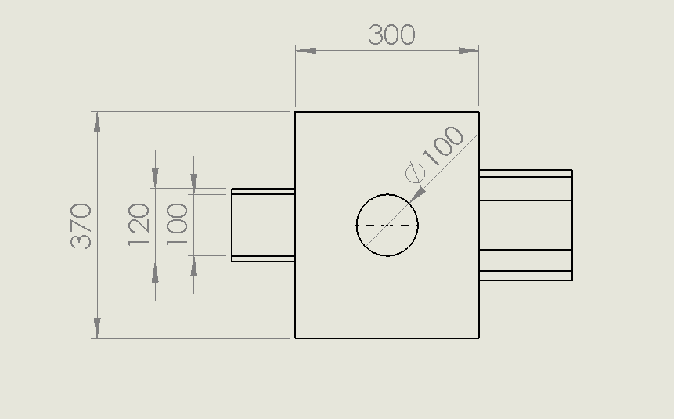
Steel box Design

Slide 12
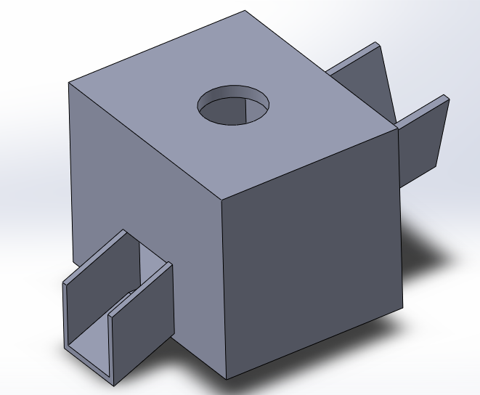
Steel box Design
3D Steel box design
As we can see the final
Shape for steel box

Slide 13
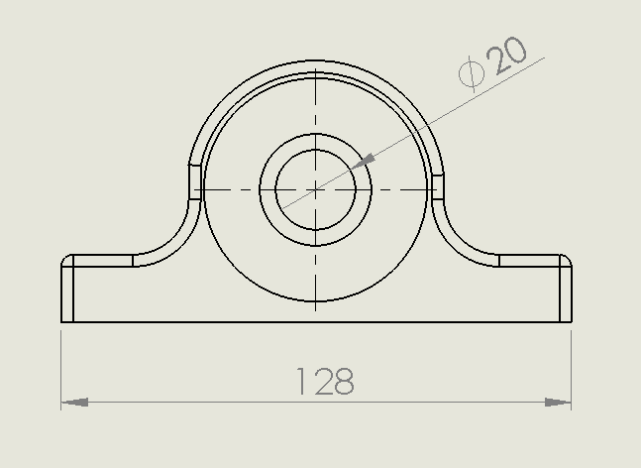
House bearing Design
The length of bearing (L) is equal12.8cm,
Also the diameter (D) is 20 mm.

Slide 14
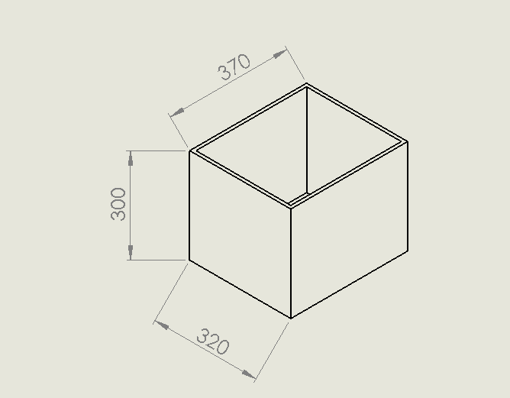
Collect Boxes Design
The length of three boxes should equal the length of the three parts of ropes as shown in figure
The boxes are separated

Slide 15
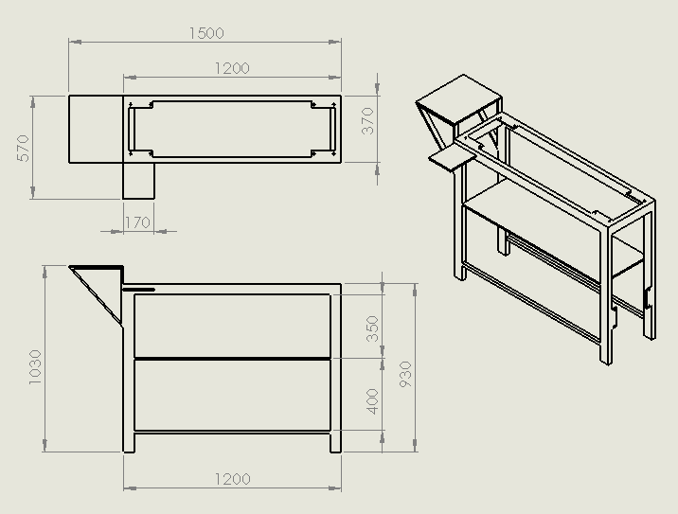
Frame Design
Dimensions frame sizing machine

Slide 16
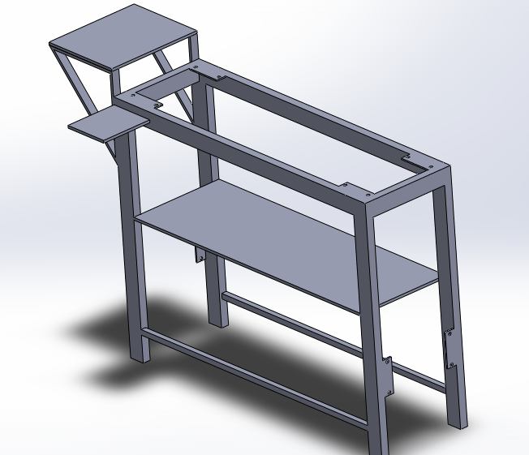
Frame Design
3D-view frame sizing machine

Slide 17
Calculation
  Before start any calculation some data that needed to be know
Weight of each shaft is 4.75 kg.
Weight of each collected box is 1 kg.
Weight of steel box is 3 kg .
Weight of frame only is 14 kg.
Weight of each house bearing is 0.25 kg .
Total weight of sizing machine is 46 kg .
Length of each shaft is 24 cm and the diameter is 5 cm.
Length between tow shafts is 96 cm

Slide 18
Check For Vibration
  To finding the torque due to the machine
Where: - m :- total mass of machine
g:- gravitational constant
d :- The resultant of center of mass.
Total mass "m" equal = 46 kg
Gravitational constant "g" equal = 9.81 m^2/s
By applying center of mass theory d=720mm
=325 N.m

Slide 19
Check For Vibration
  To find the torque require for motor (by using center of mass)
T= F.d
Where F: - the force act on motor.
d :- distance between motor and center of mass.
F= m .g
Where g is 9.81, total mass hold by motor is 19 kg and additional mass approach 3 kg, then total mass "m" in the motor is 22 kg.
F= 22*9.81 = 215.82
By applying center of mass theory d=602mm
T= F.d
= 215.82 * 0.62
T= 133.8 N.m

Slide 20
Power Require For The Motor
The power require for the motor is determine by the below equation :
P=T*W
Where (W) the revolutions per minutes, the motor rotate 10 rpm, and 1.0467 in rad per second.
Then, by applying equation
P=133.8*1.0467=140 watt (w) or 0.1877 in horse power (hp)
But the (0.25 hp) was chosen for factor of safety and the availability in the market.

Slide 21
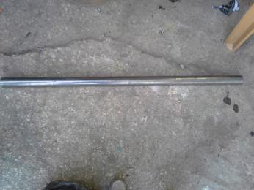
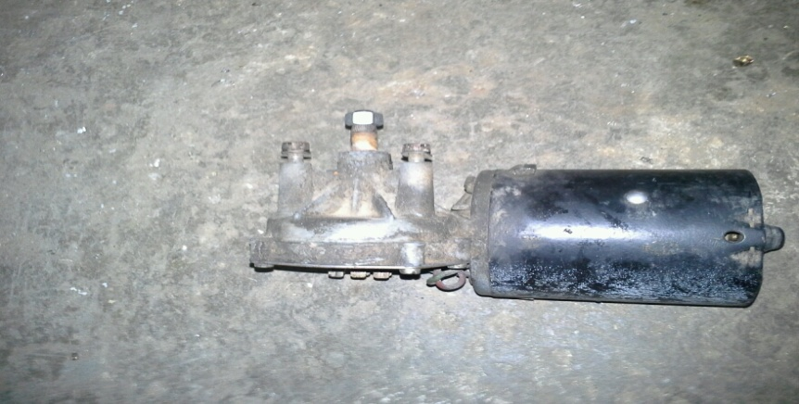
Manufacture
Buy the pieces
Long Shaft with length of 120 cm, diameter of 5 cm, and the weight of 19 kilogram, as show in fig
DC Motor , used DC motor because suitable for the speed of machine, available in market, as shown in fig

Slide 22
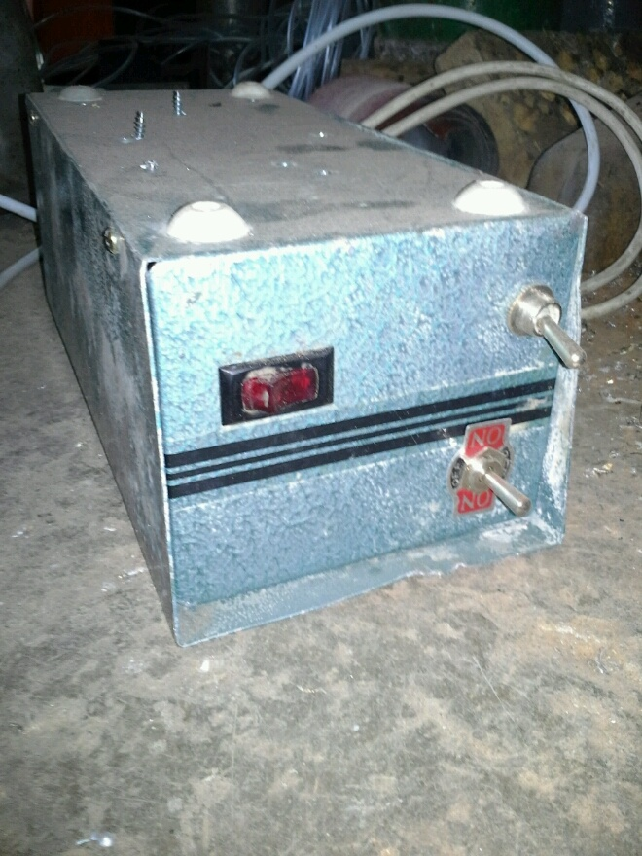
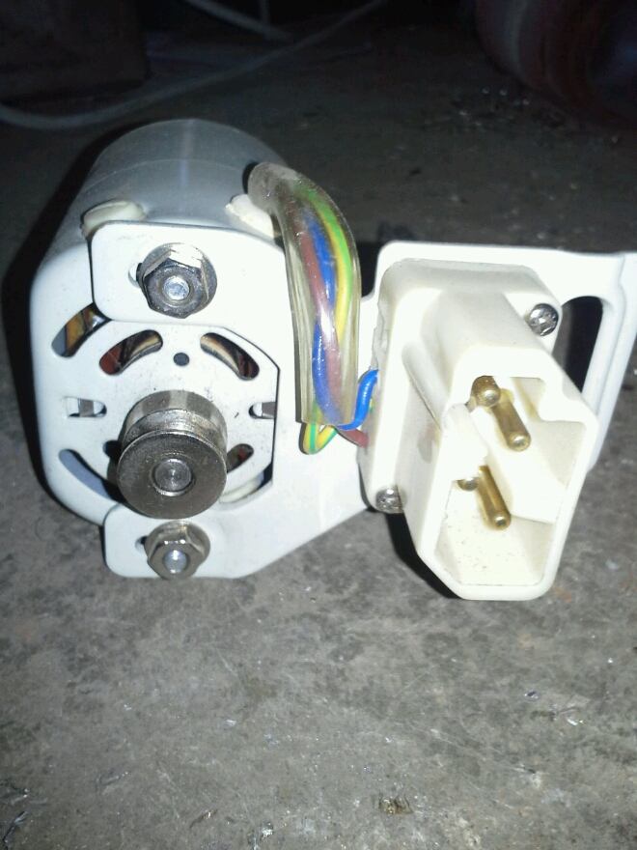
Manufacture
Buy the pieces
Converter, to convert DC voltage to AC voltage, as shown in fig
Vibrator to extract impurities and facilitate the entry of the pills to the machine through a vibration process, as shown in fig

Slide 23
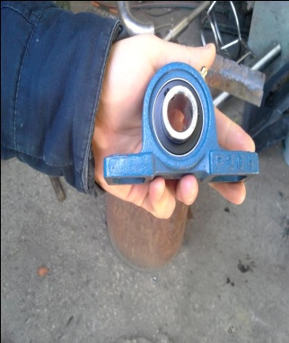
Manufacture
Buy the pieces
House bearing, eight house bearing with 20mm diameter purchased as shown in fig
Plastic rope, about 50 m of ropes, with high ductile materials to understood the strength come from the rotating shaft.

Slide 24
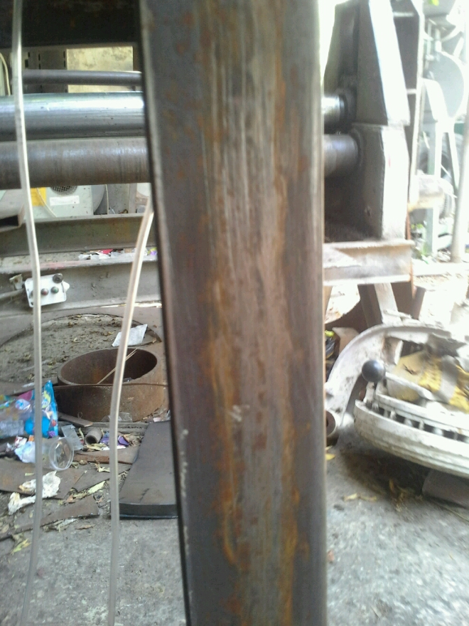
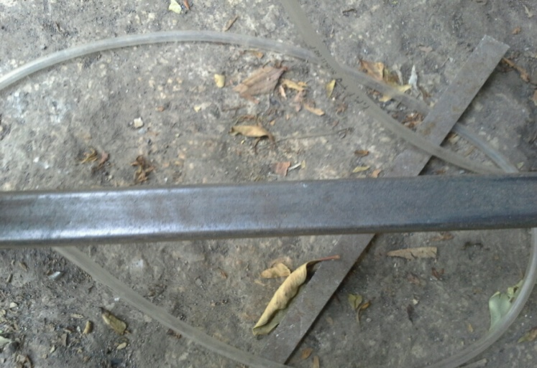
Manufacture
Buy the pieces
Iron profile, weight of 2.32 kg, length equal 120 cm, cross section equal 6*3 cm, as shown in the figure
Iron profile, weight of 1.65 kg , length equal 108 cm, cross section equal 2*2 cm screws, as shown in the figure

Slide 25
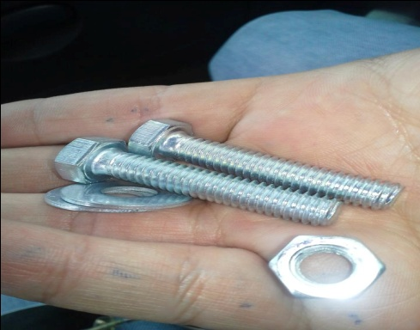
Manufacture
Buy the pieces
Screws 5/16 cm diameter , length 4 cm ,as shown in fig
Gray paints, gray because it's suitable for food machine

Slide 26
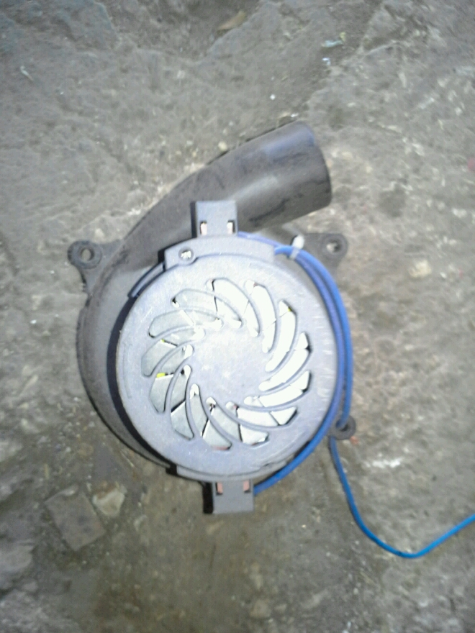
Manufacture
Buy the pieces
Vacuum cleaner as shown in the figure

Slide 27
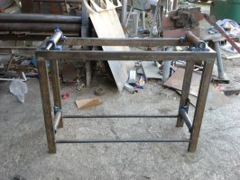
Manufacture
- Build the frame of the machine by depend on the actual dimension ,as shown in figure .

Slide 28
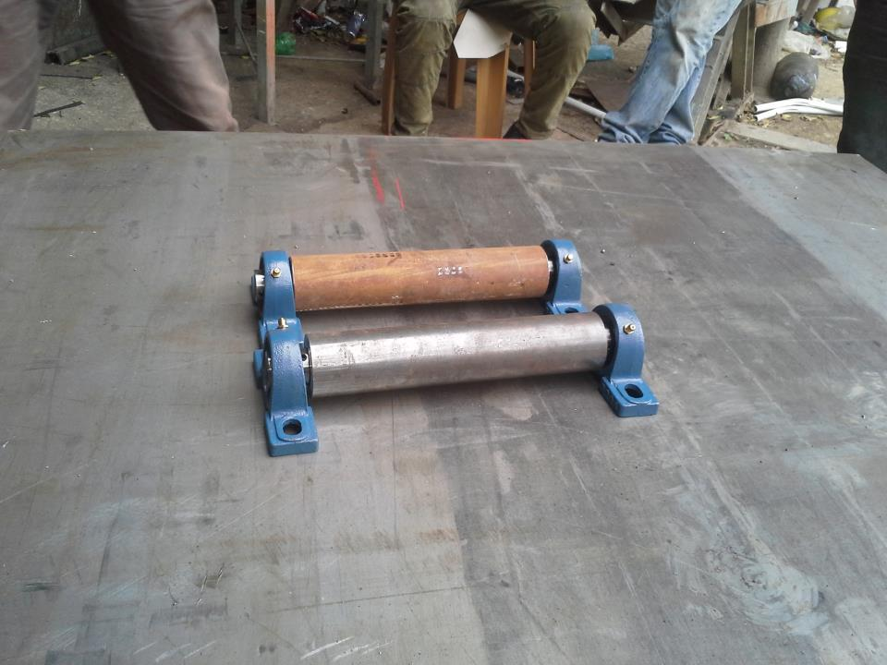
Manufacture
The shaft (cutting)
make the hole in the tow side of the shaft with 20 mm to facilities entering the house bearing into

Slide 29
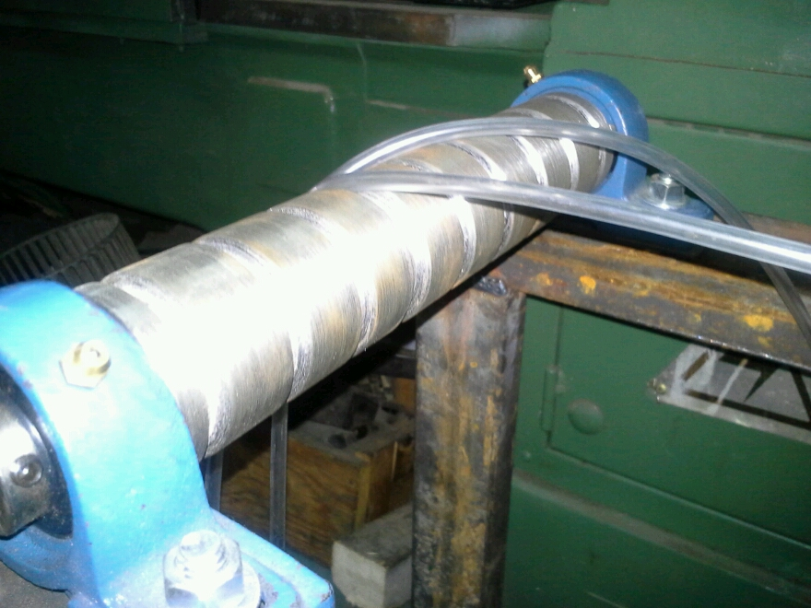
Manufacture
The lathe machine used to make paths in all shafts, the specific paths used to install the ropes inside the shaft as shown in the fig

Slide 30
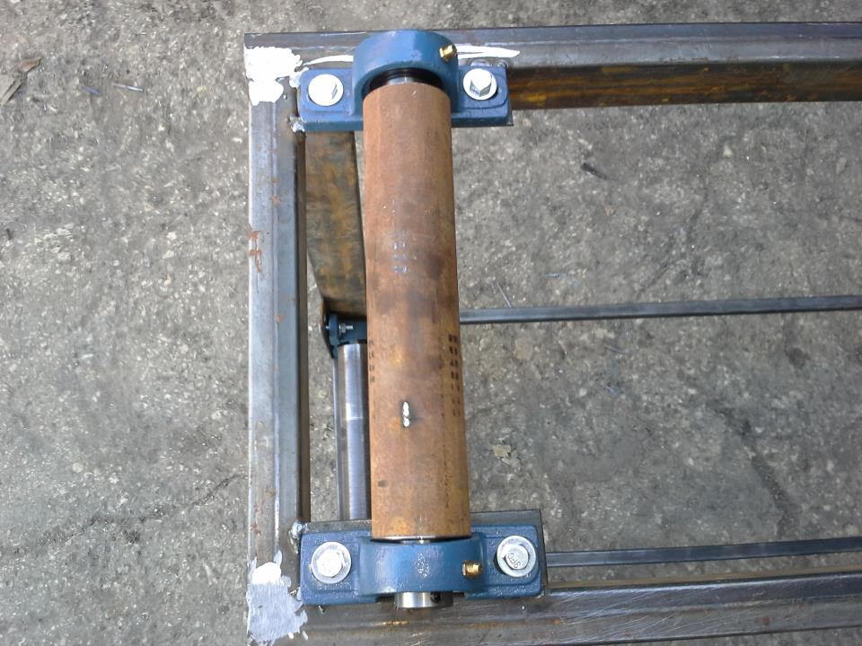
Manufacture
fixed the shaft into frame by use screws

Slide 31
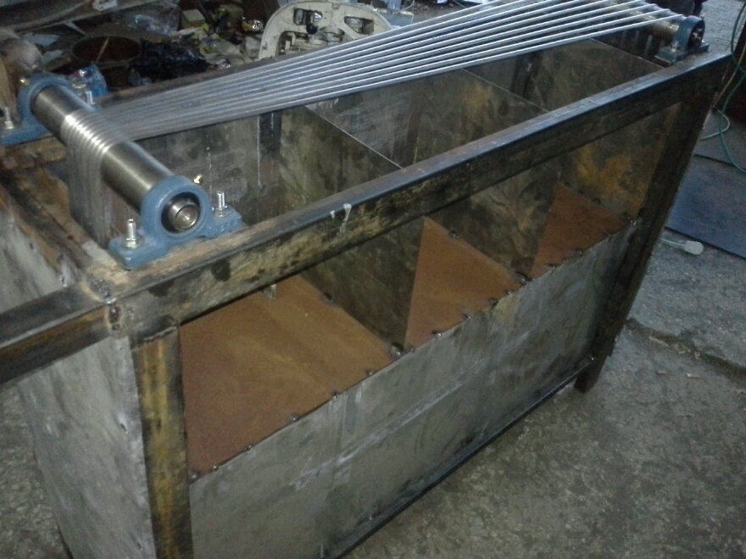
Manufacture
Final shape of frame

Slide 32
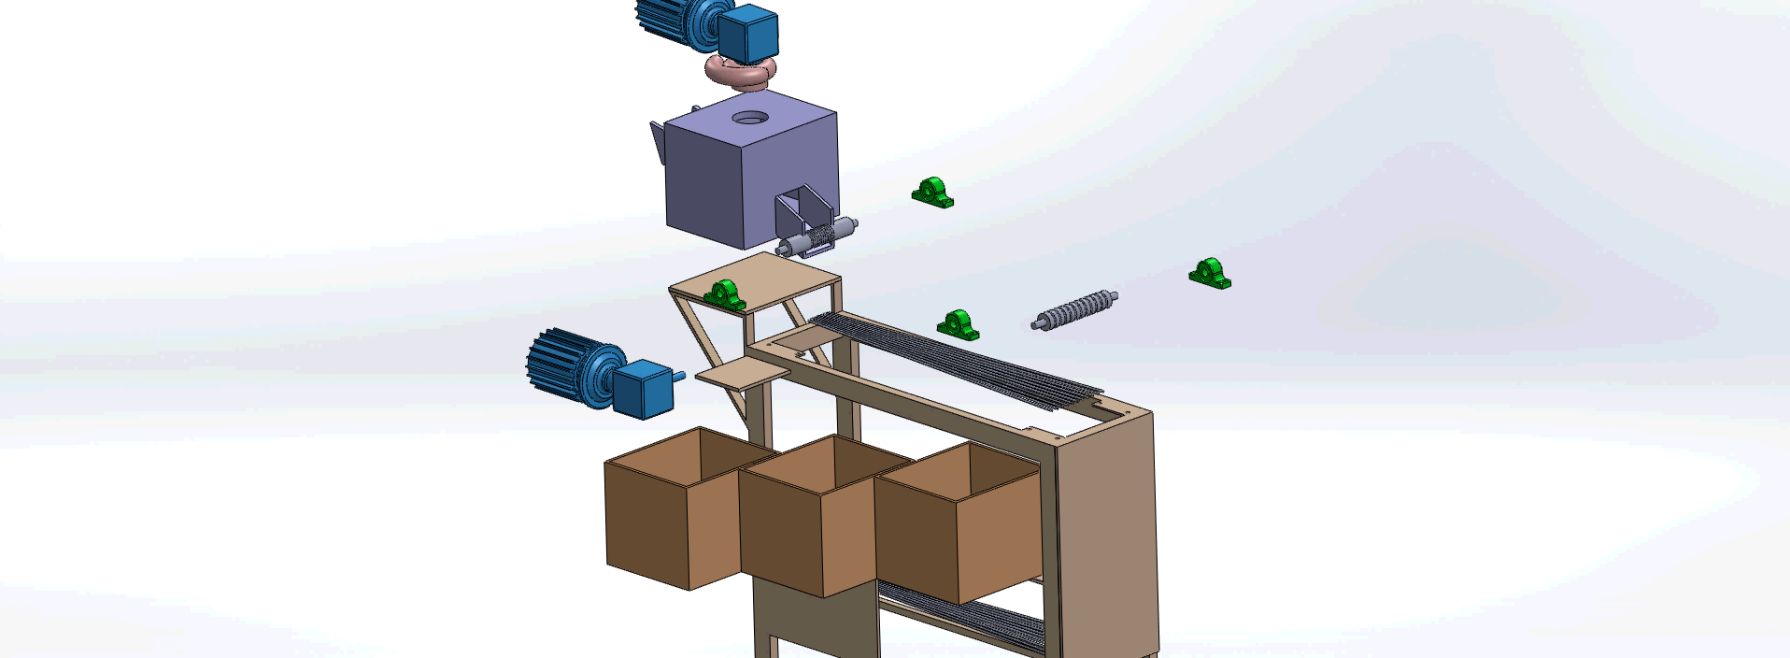

Slide 33
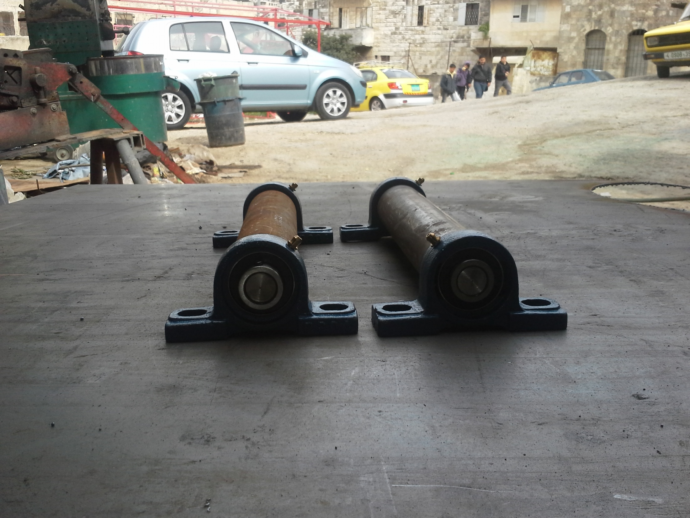

Slide 34
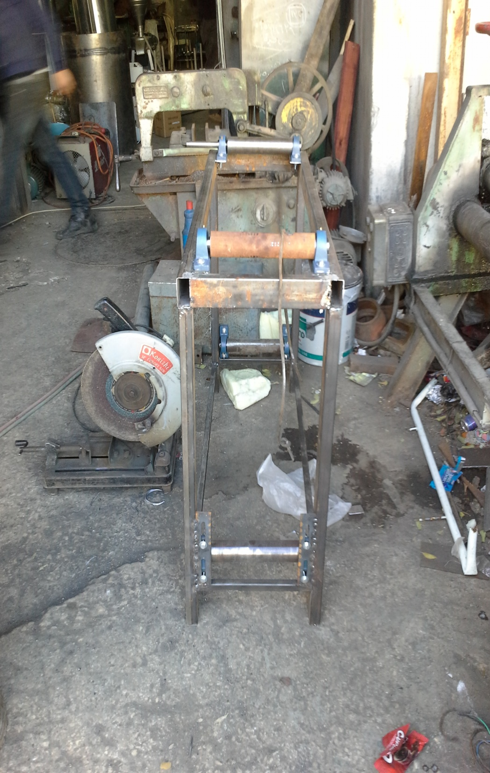
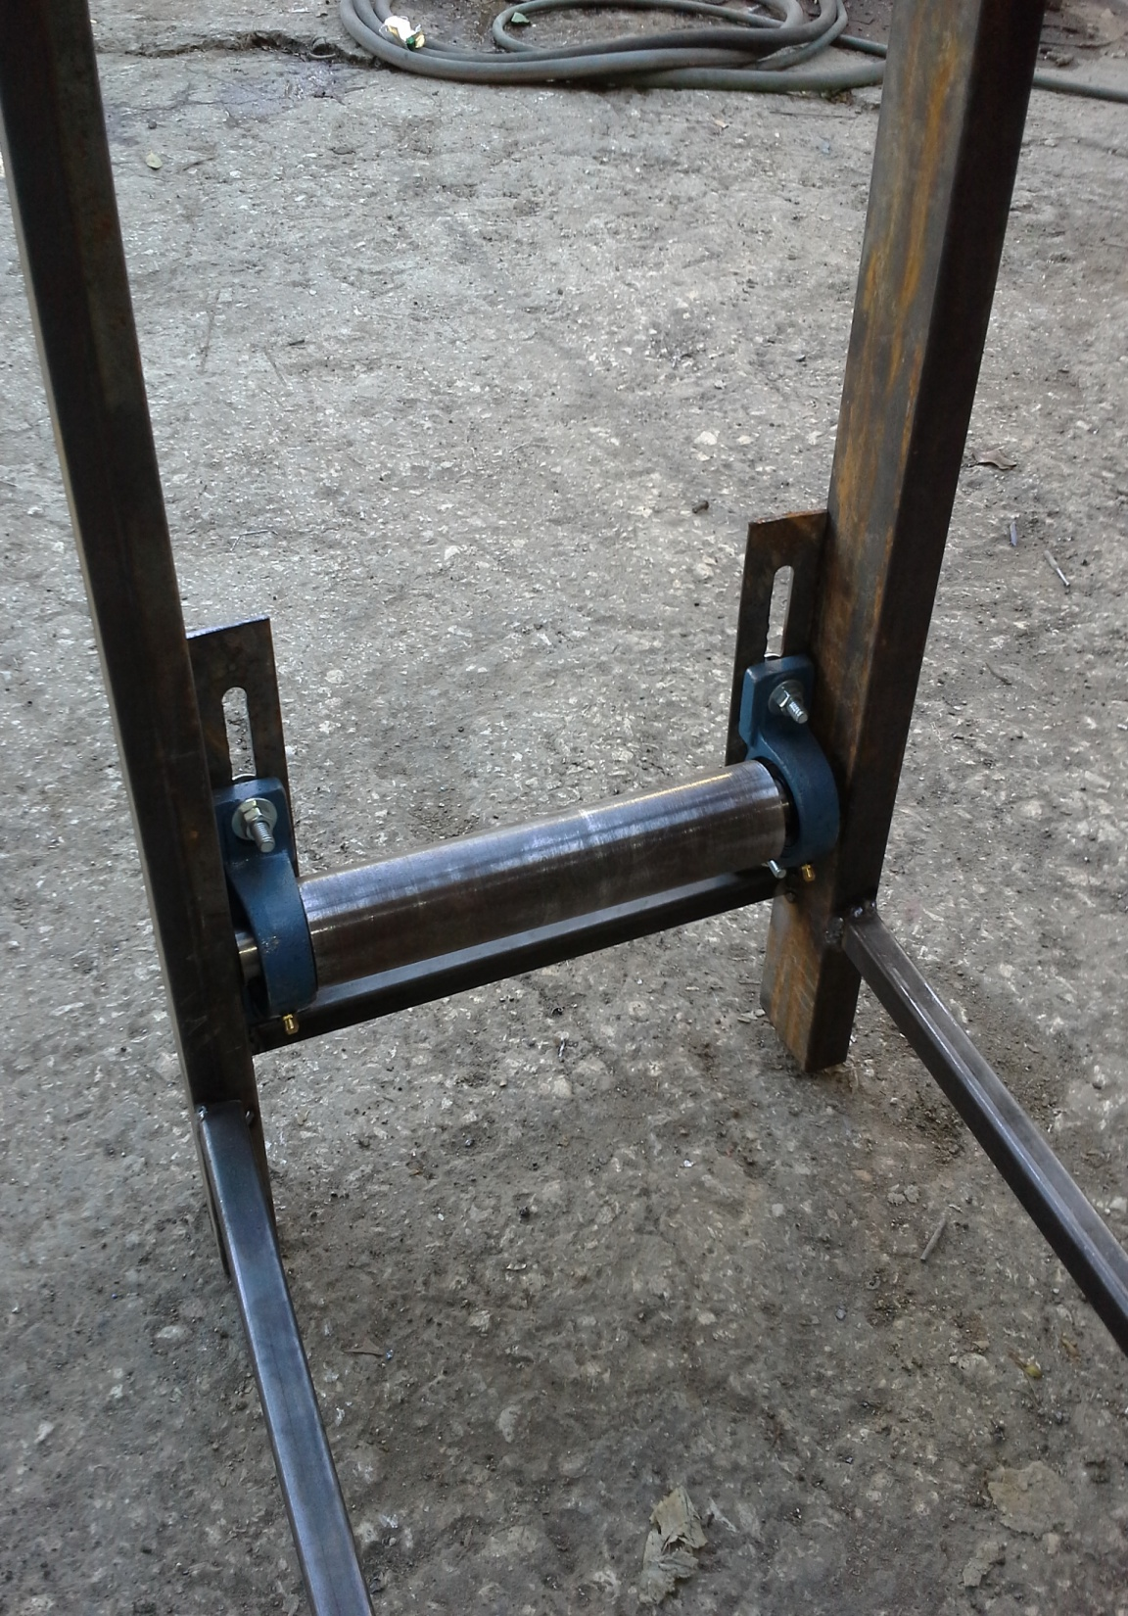

Slide 35
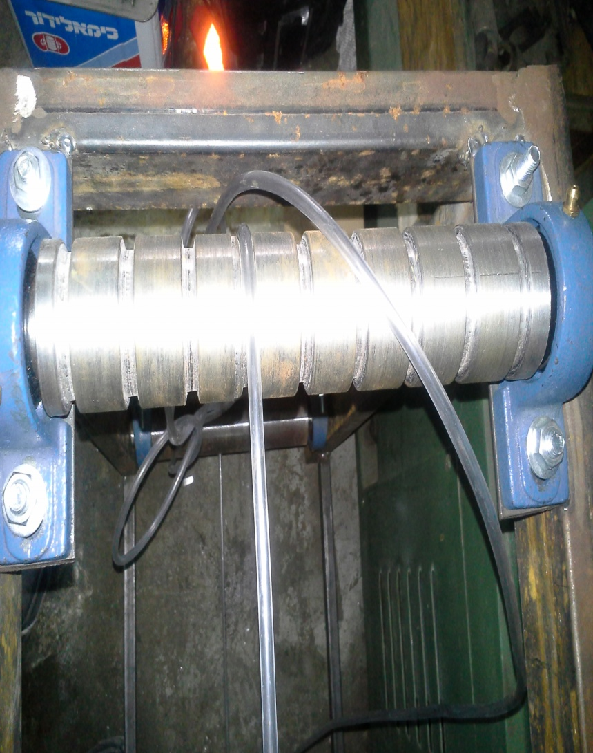
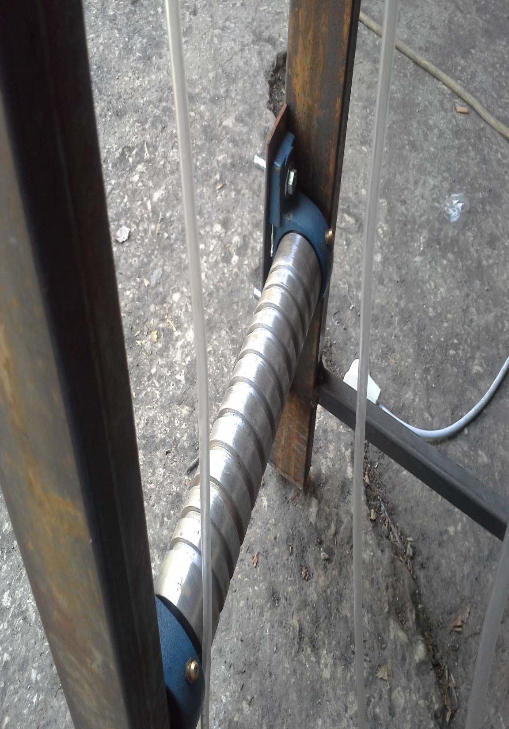

Slide 36
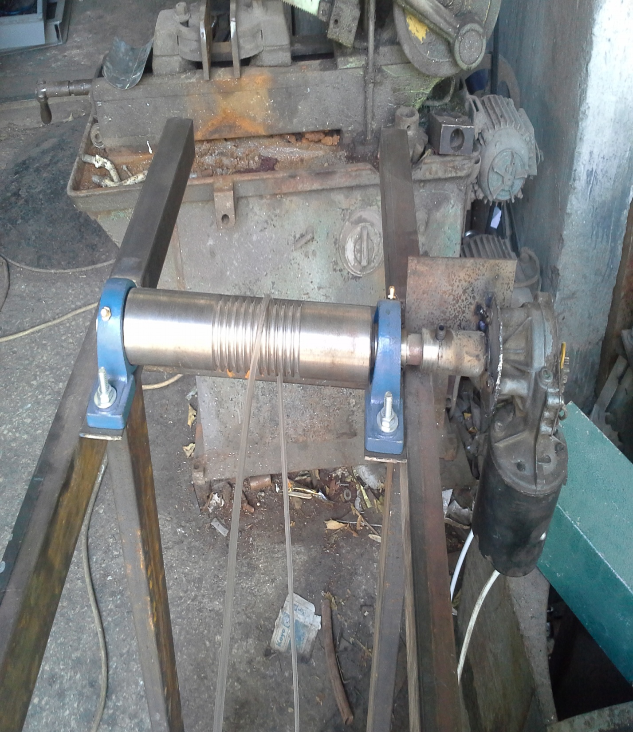
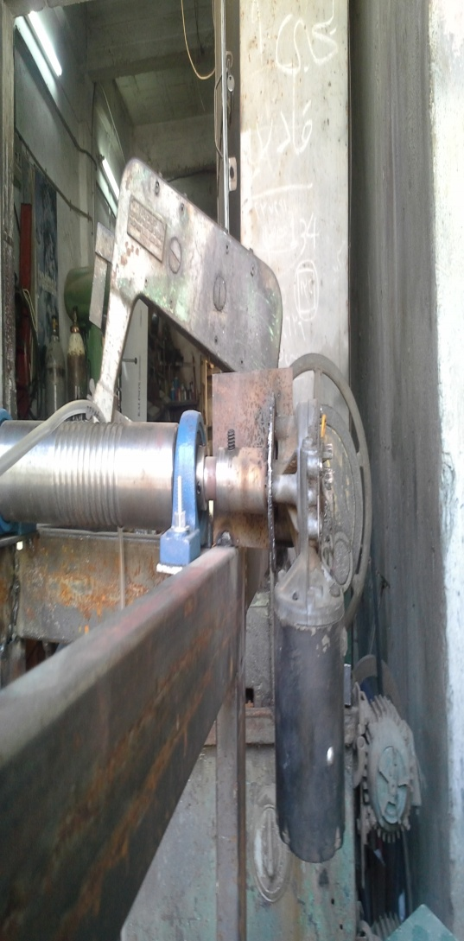

Slide 37
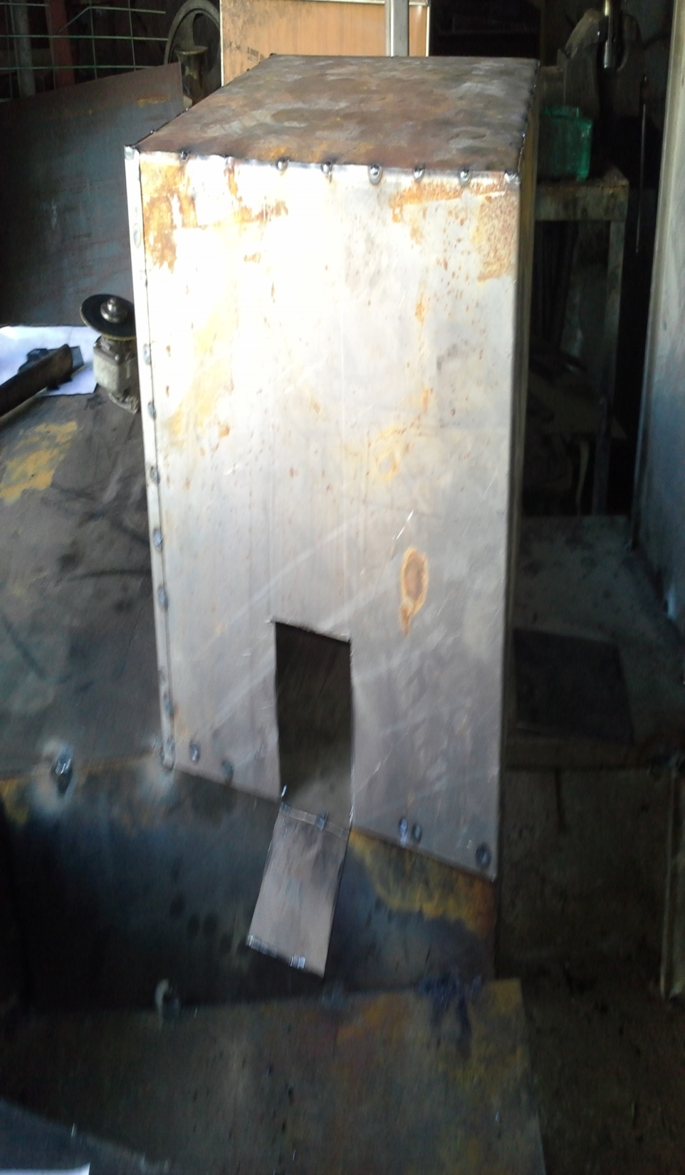
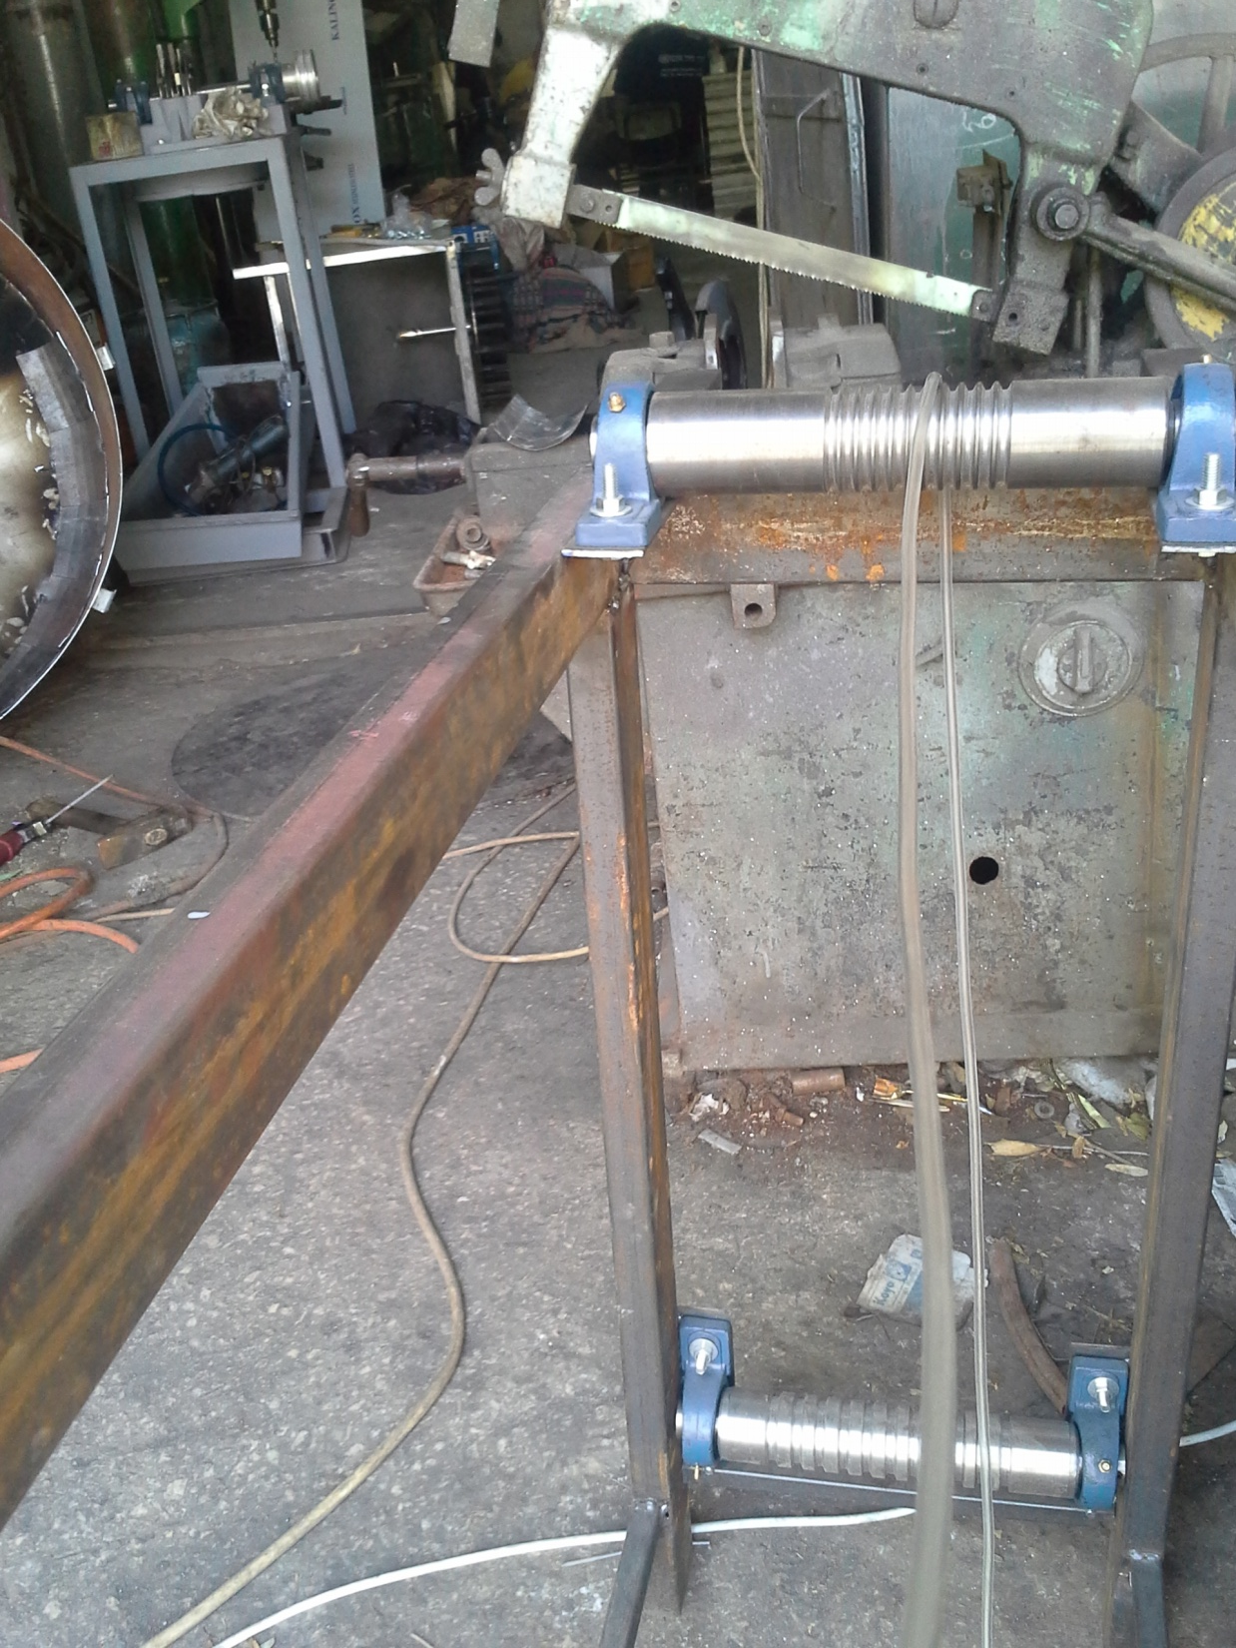

Slide 38
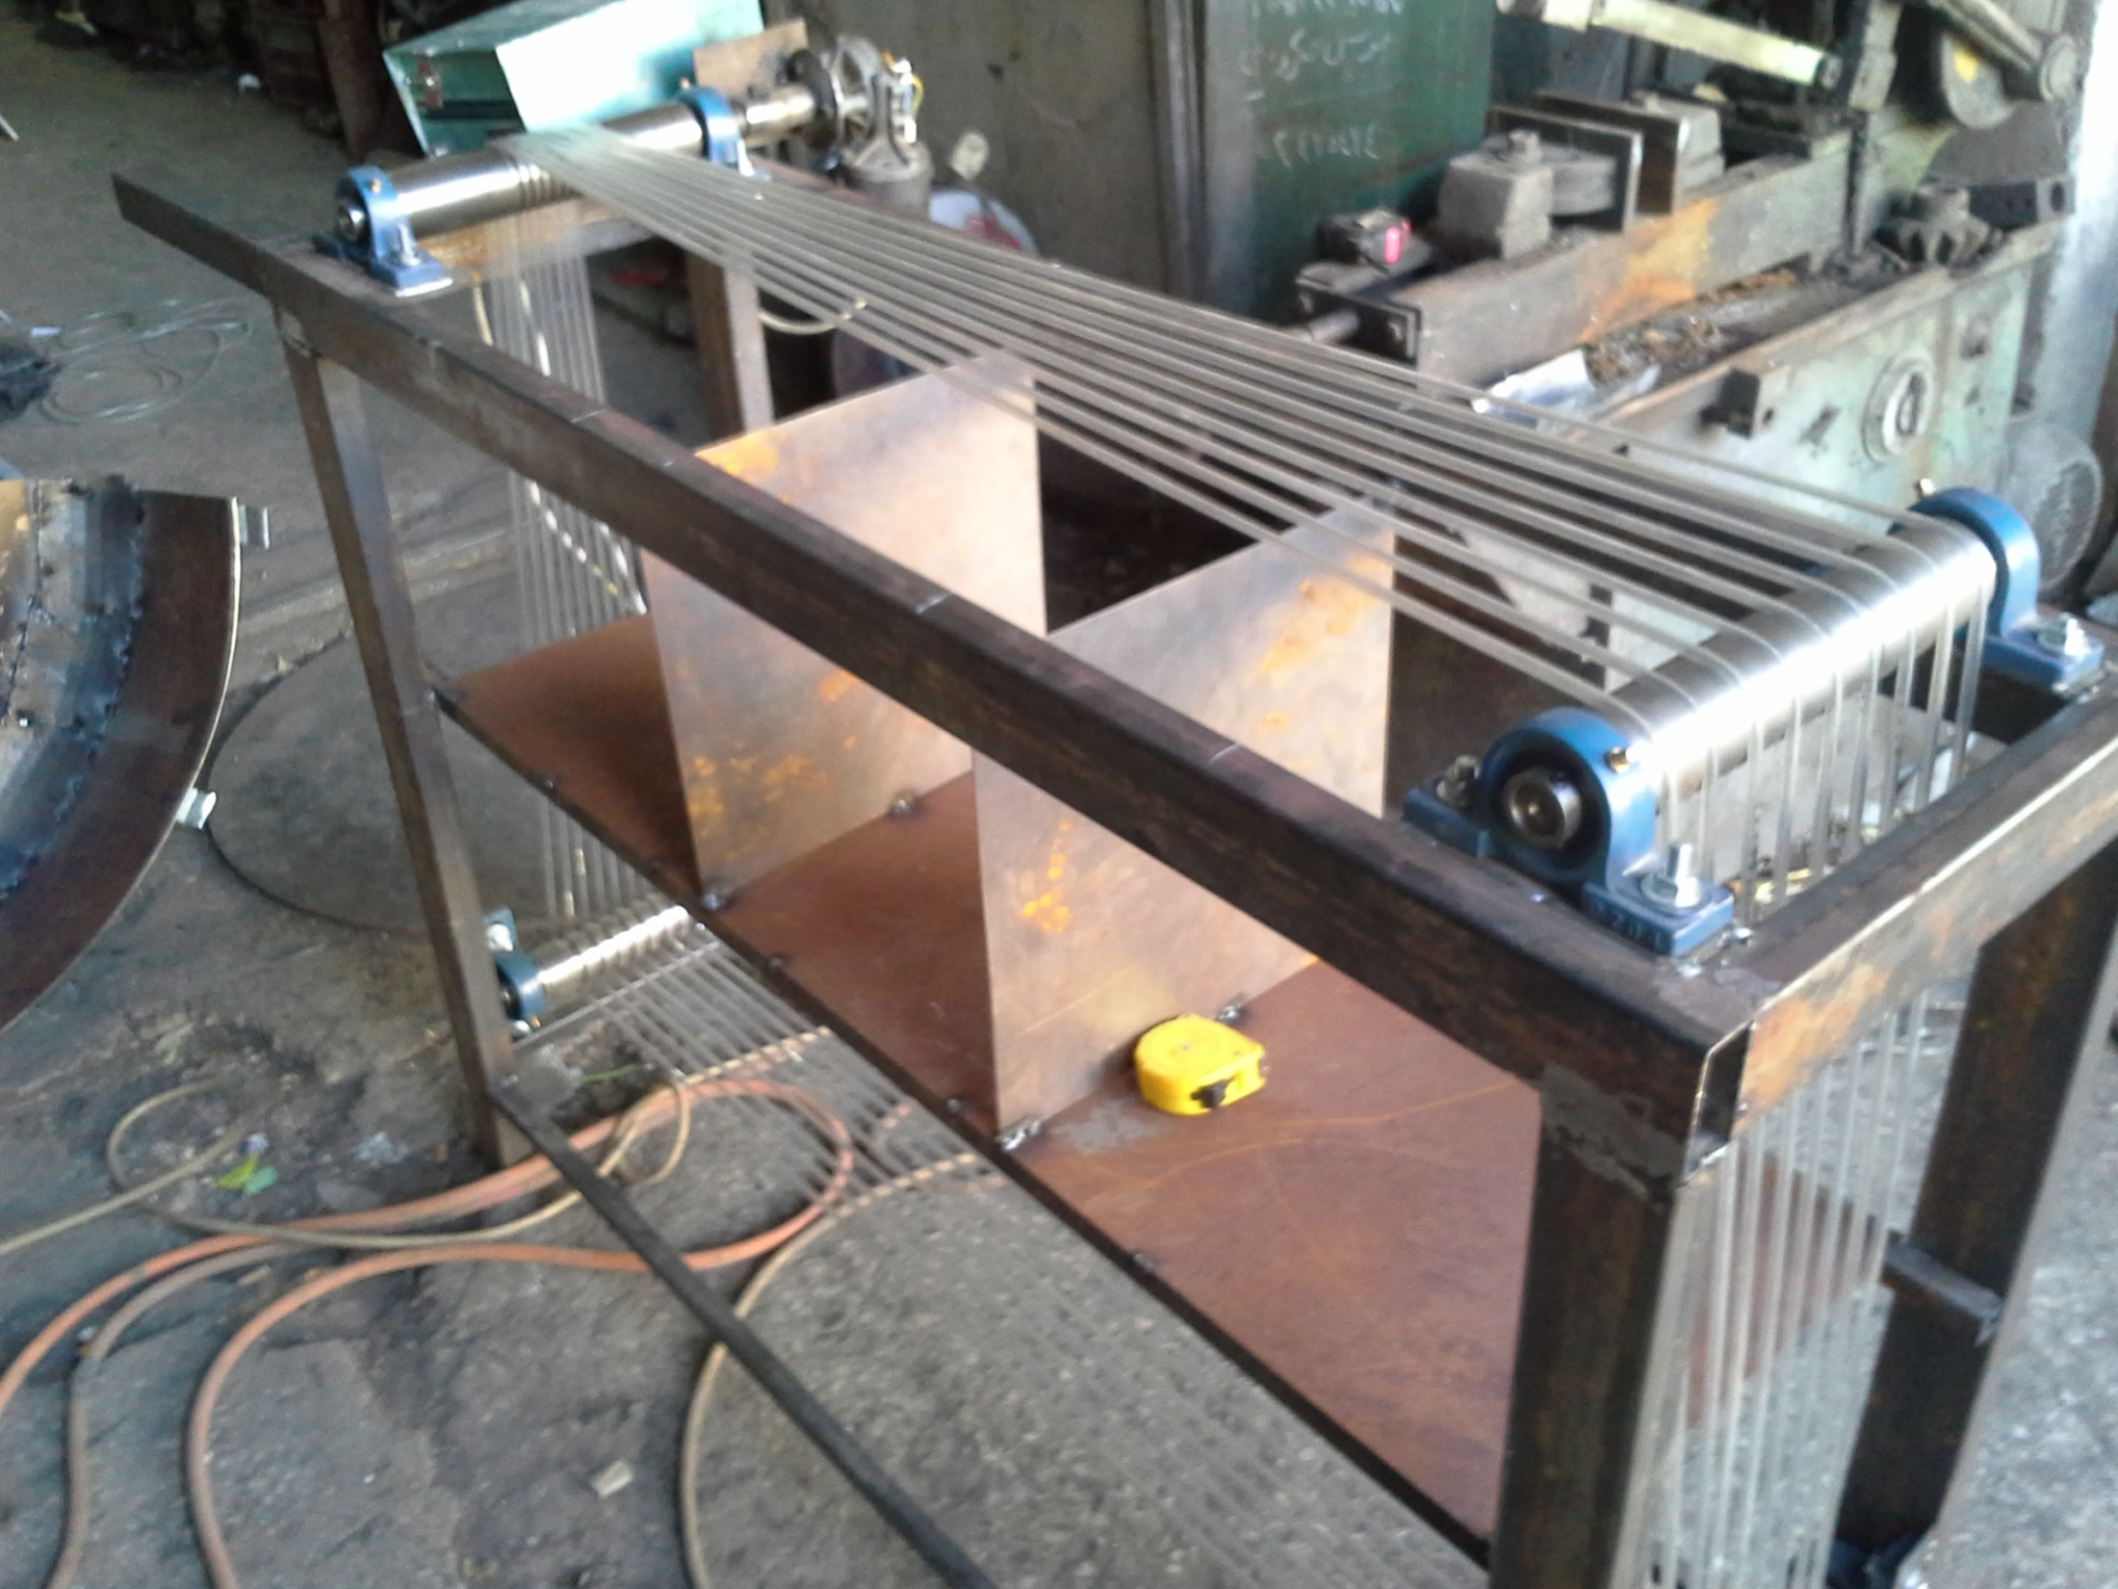

Slide 39
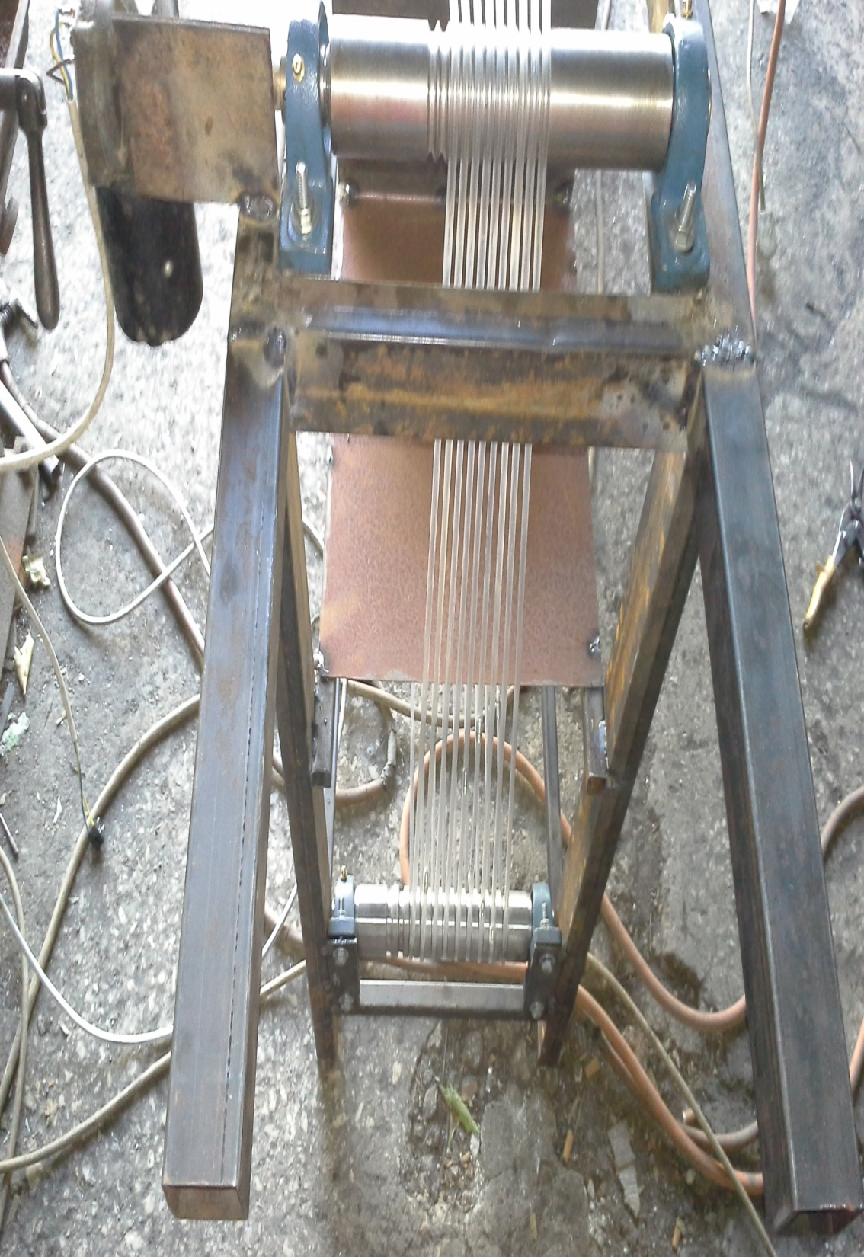
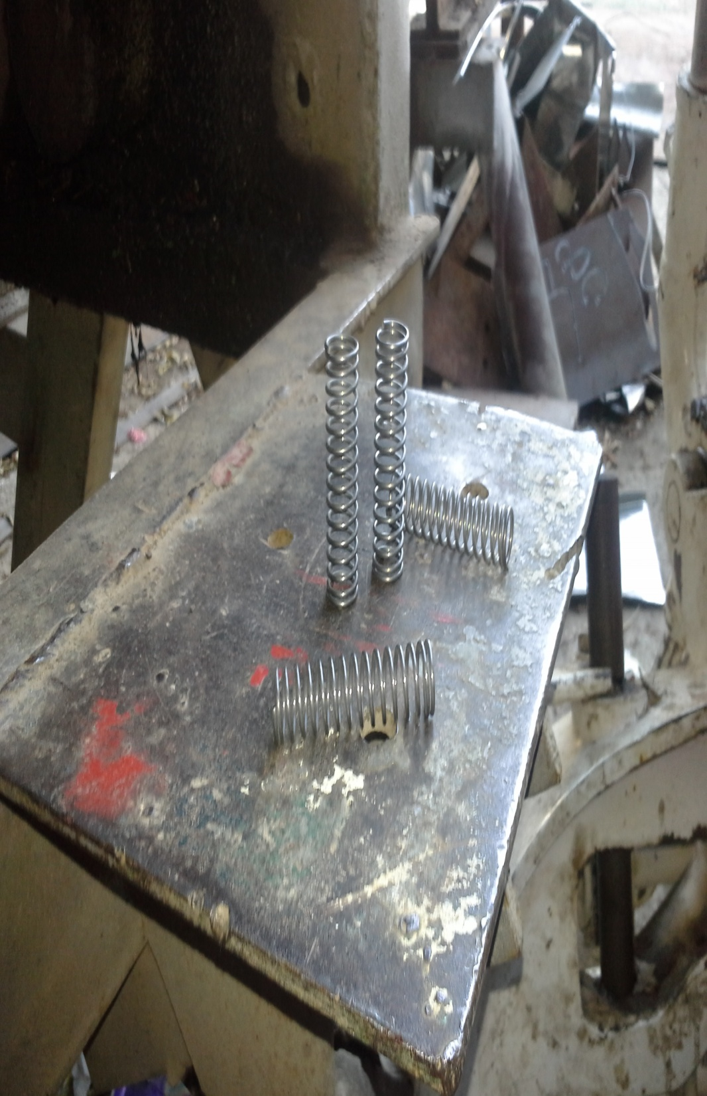

Slide 40
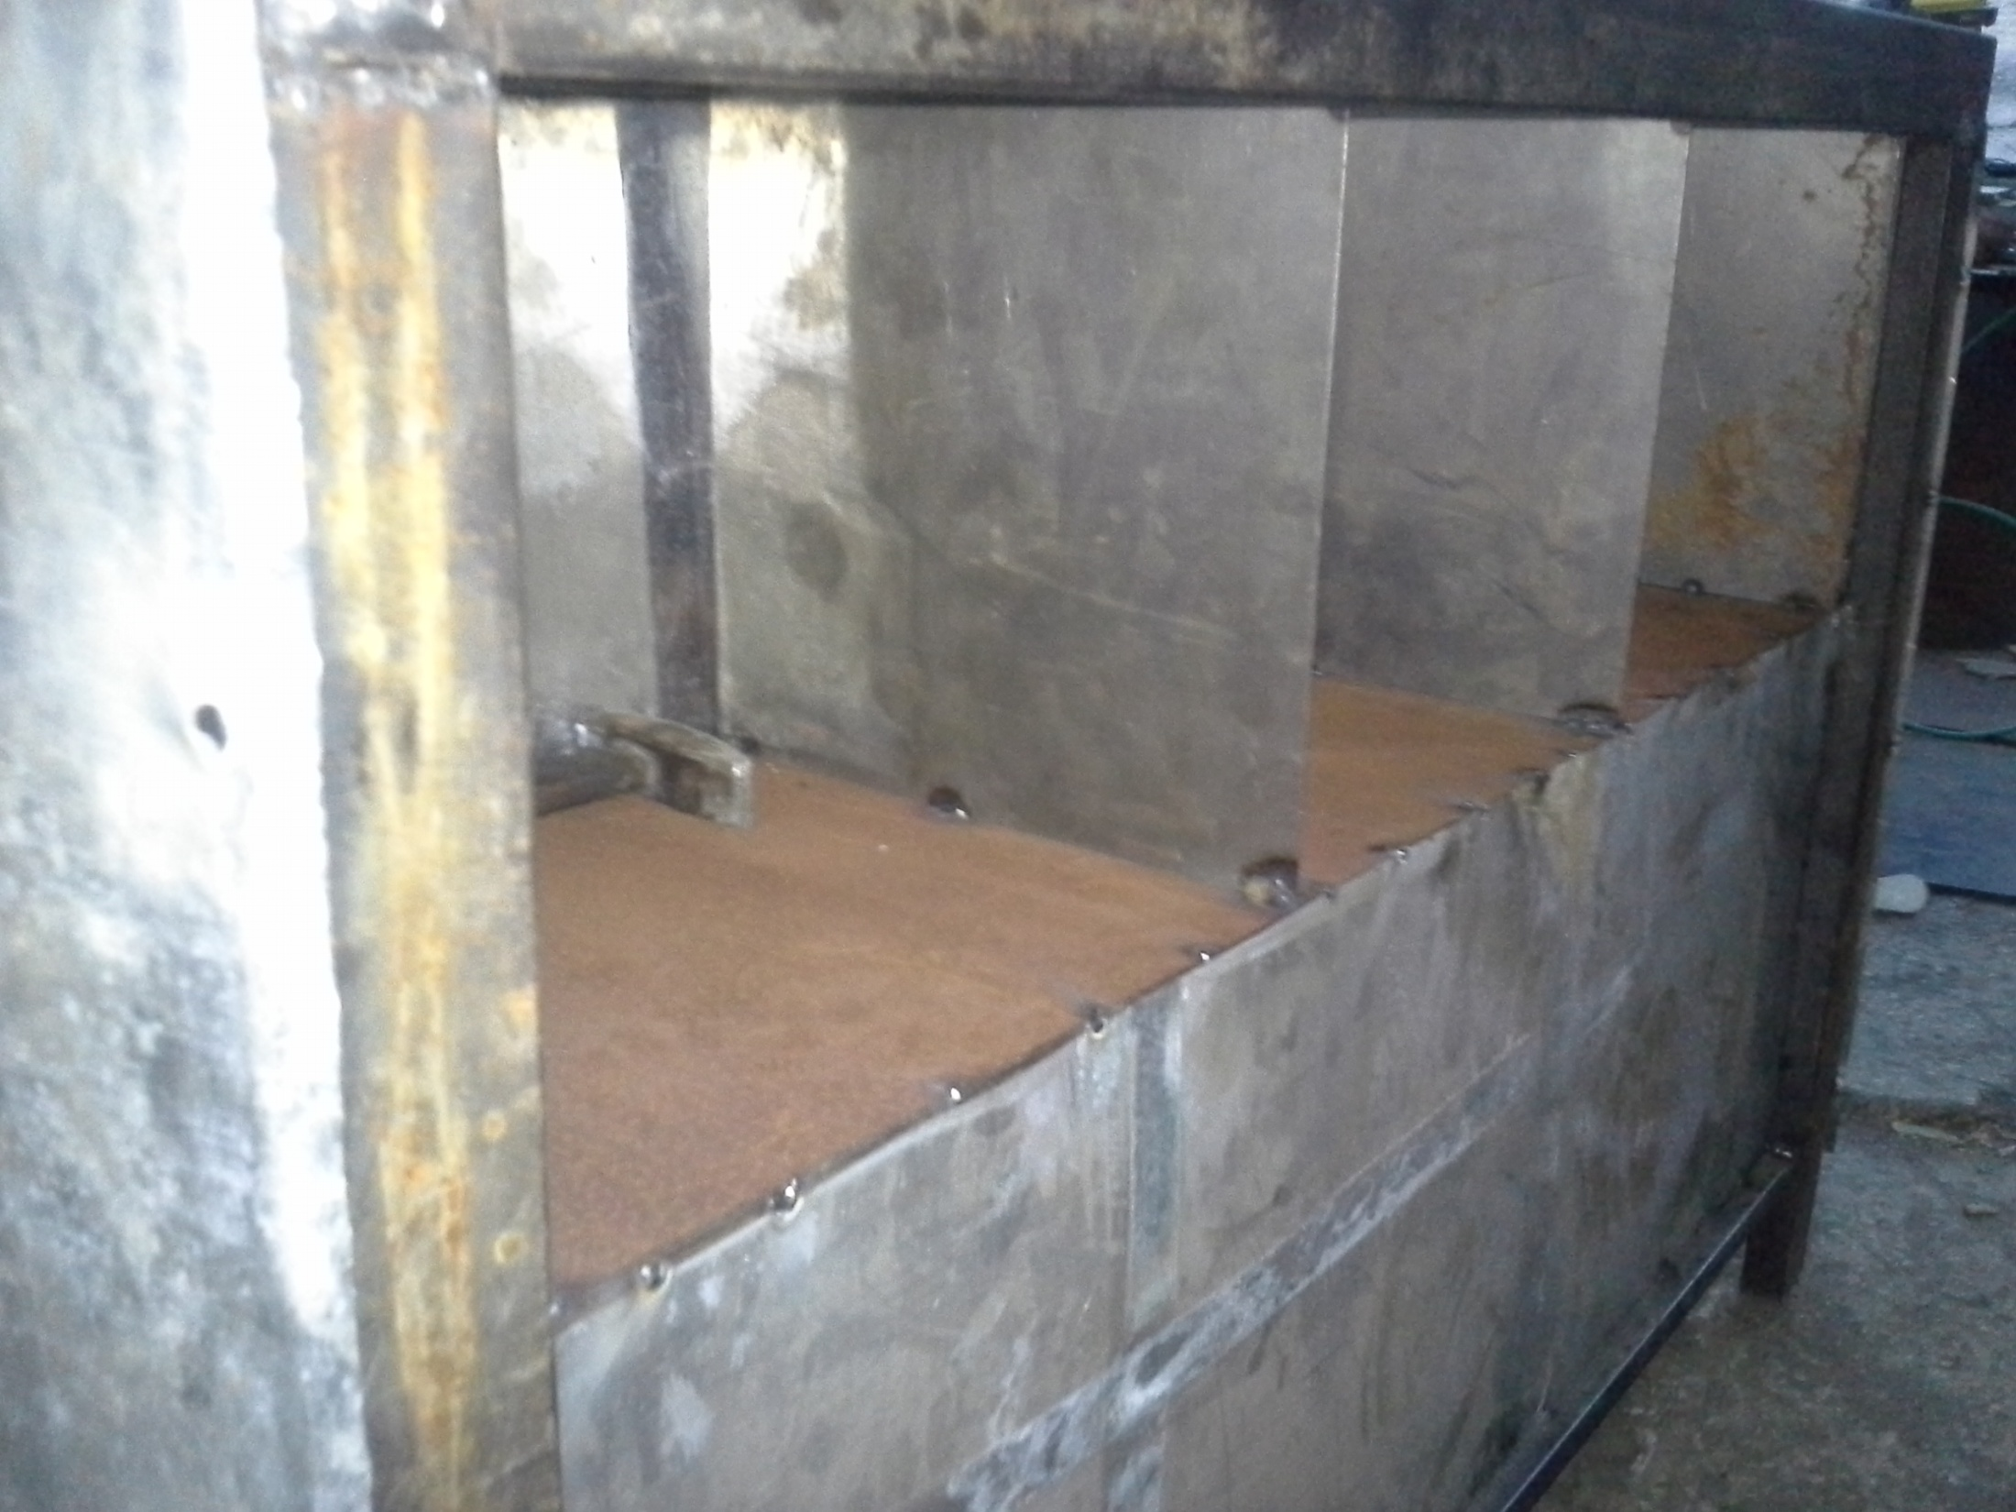

Slide 41
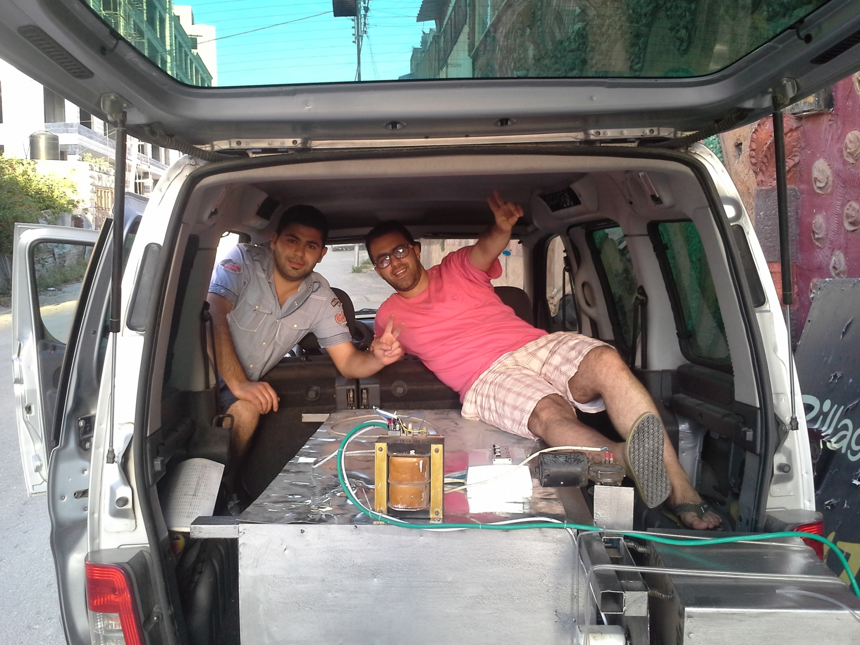

Slide 42
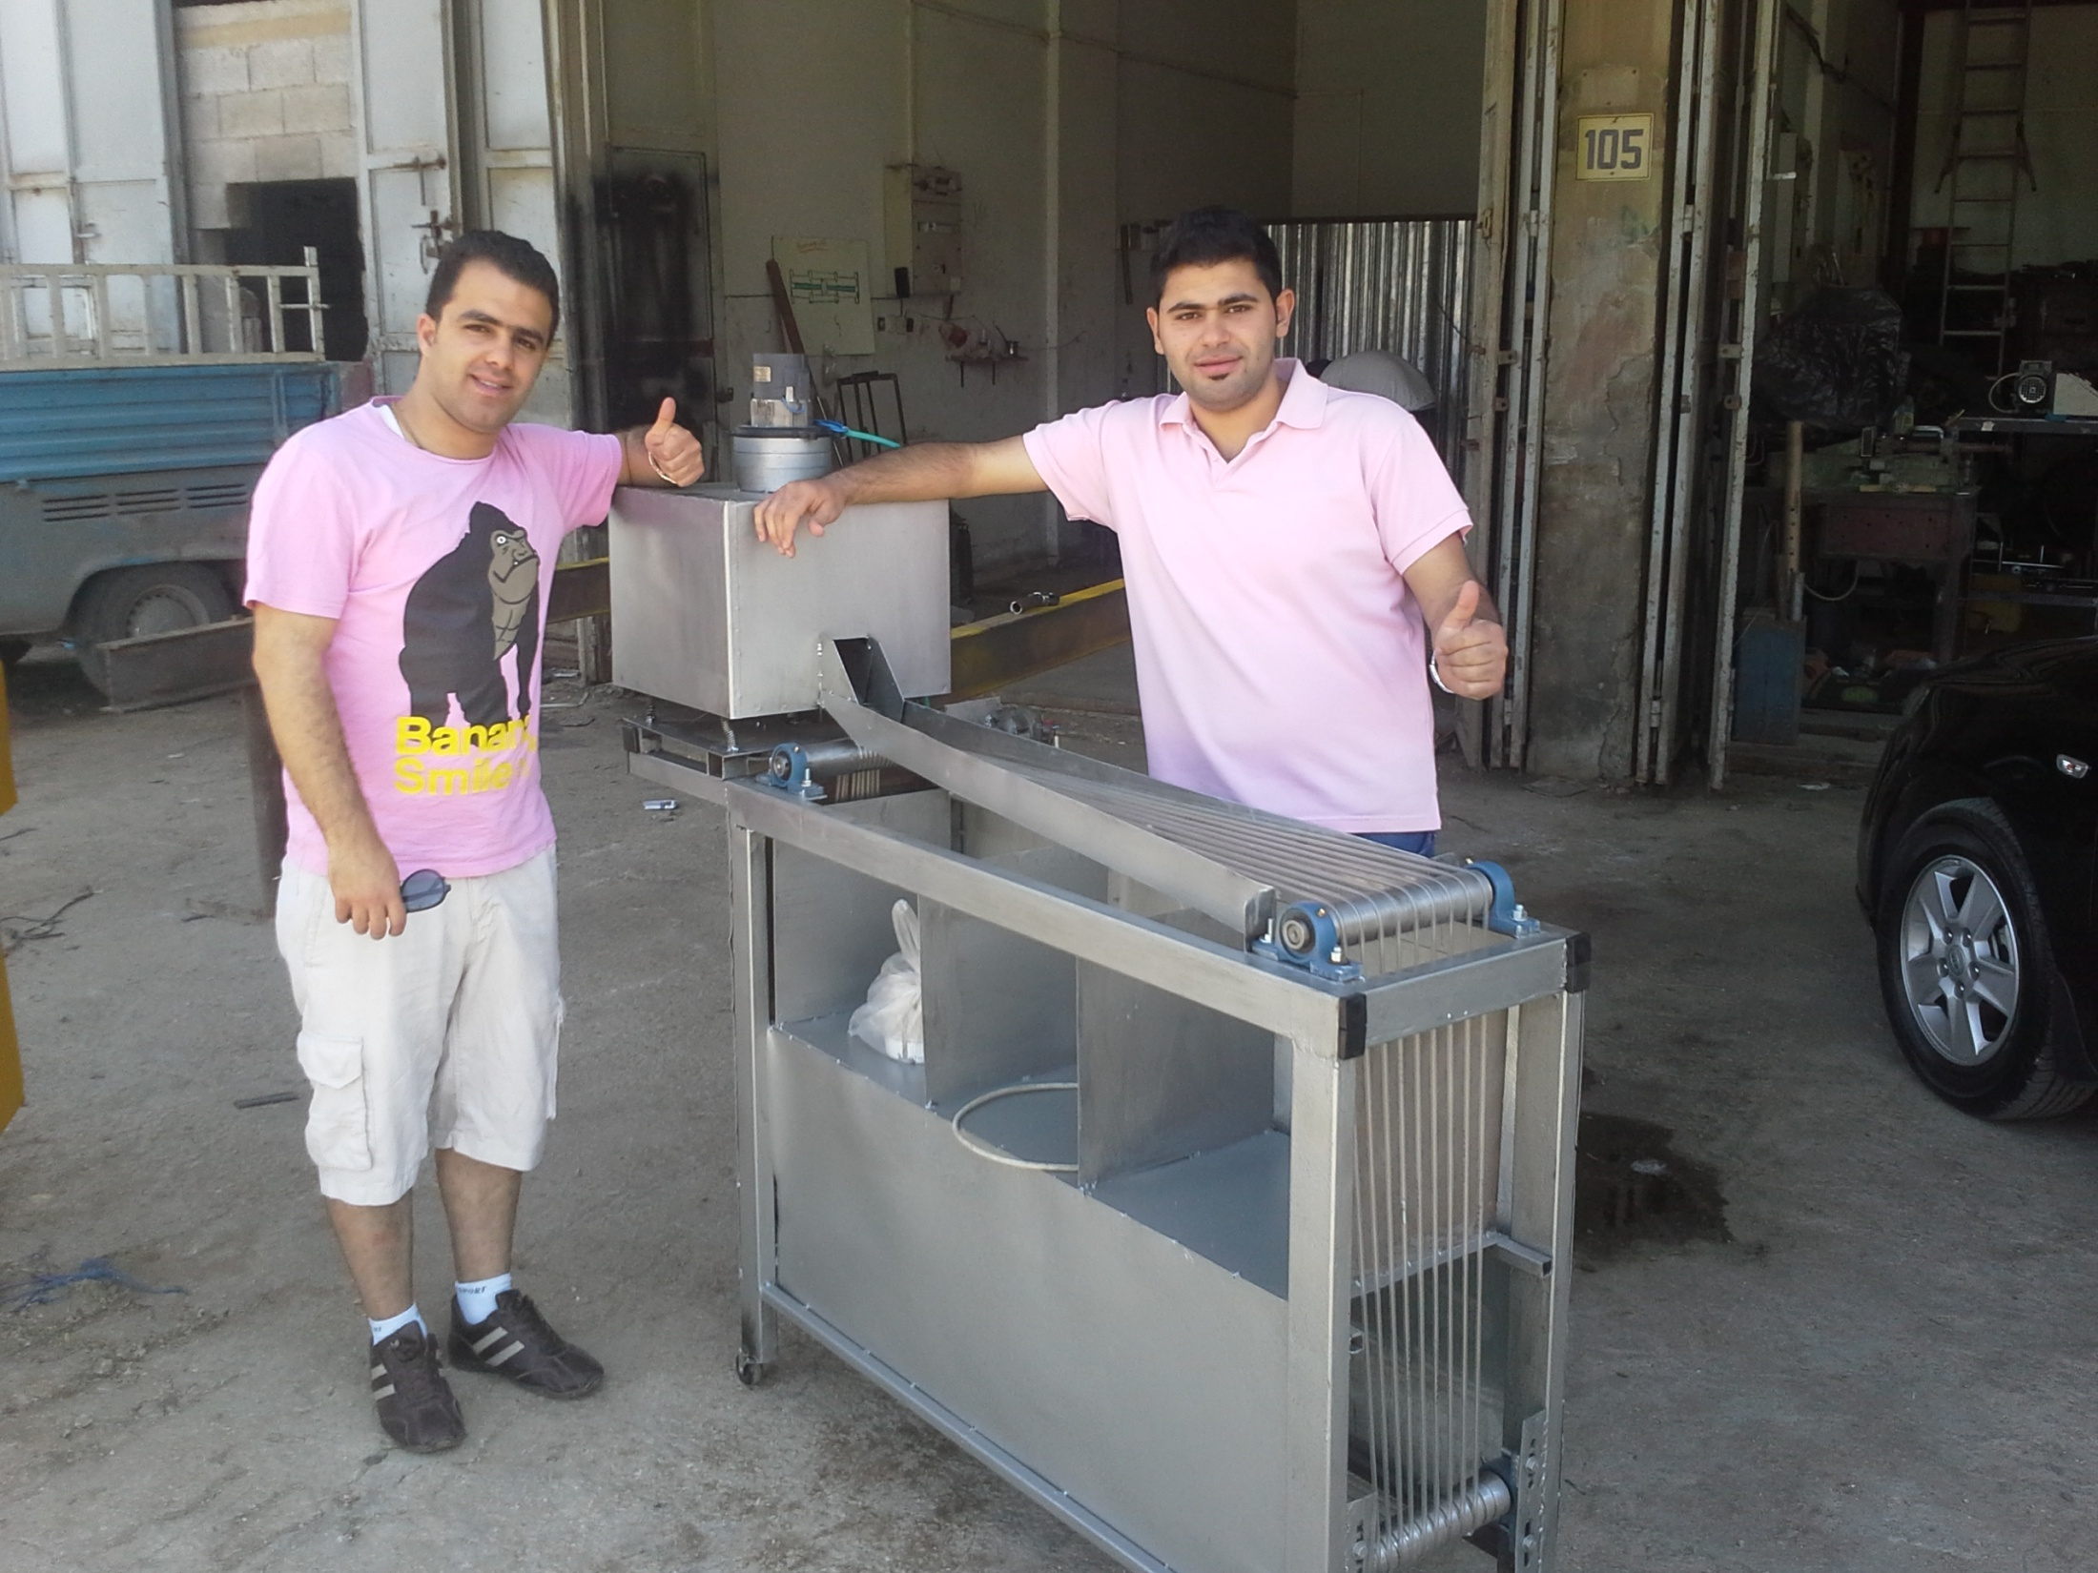

Slide 43
