Slide 1

بسم الله الرحمن الرحيم
An-Najah National University
جامعة النجاح الوطنية
Faculty of Engineering
كلية الهندسة
Civil Engineering Department
Graduation Project II
3D-DYNAMIC ANALYSIS AND DESIGN OF ODEH’S HOTEL IN NABLUS
Supervisor: Dr. Riyad Awad.
Prepared by: Ahmad Abdel All
Omar Barham
Zafer Nasrallah

Slide 2
Outline:
Introduction.
Preliminary dimensions and 3D model.
Dynamic Analysis
Dynamic design.

Slide 3
Challenges and problems :
 The architect didn’t take any consideration for structural purposes.
 The columns was so scattered so we have a panel of 10 * 7 m,and so a long spans
 The unsymmetrical shape of the building causes an extra load from lateral forces and so the natural period is too high .

Slide 4
Introduction
Hotel is located in Nablus city.
The Hotel is composed of two Blocks, A and B.
Both of block A,B have a 7 stories
The total area of structure is 5400 m².

Slide 5
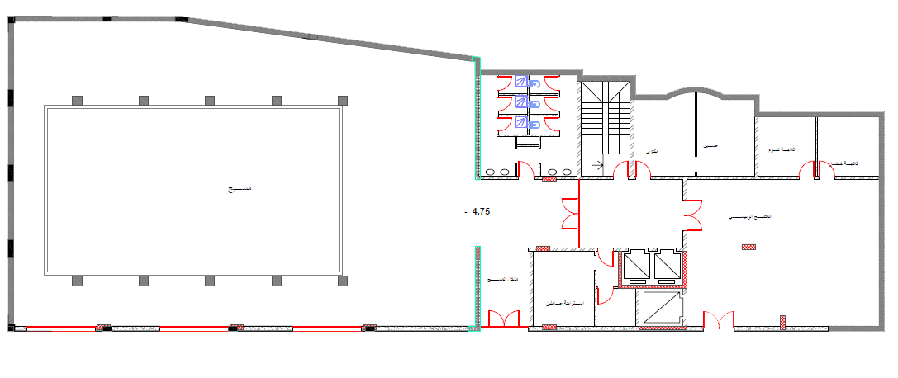
1) Introduction:
Project description:
Basement
Notes:
In this project we’ll design a hotel consist of 7 stories. The total area of the hotel is approximately $5400 m^{2}$.
The basement contain an indoor pool and some facilities for the hotel.

Slide 6
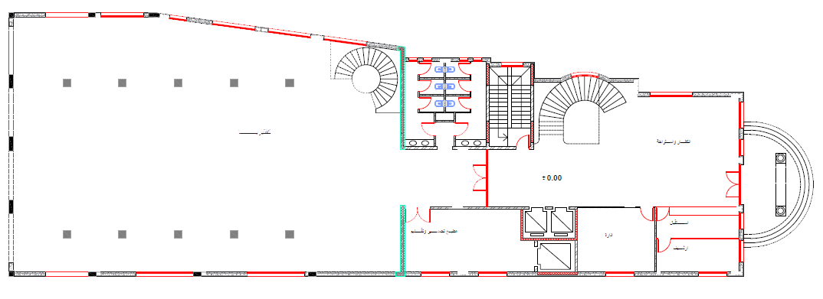
1) Introduction:
Project description:
Ground Floor
Notes:
The ground floor contains the reception, the management offices and cafeteria. In this floor there is a mezzanine.

Slide 7
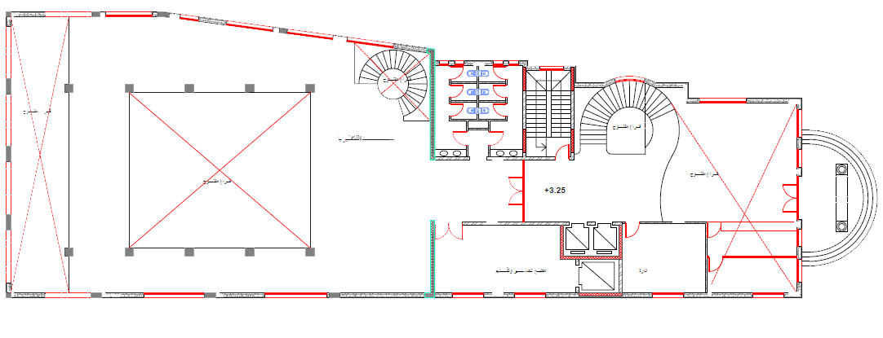
1) Introduction:
Project description:
Mezzanine

Slide 8
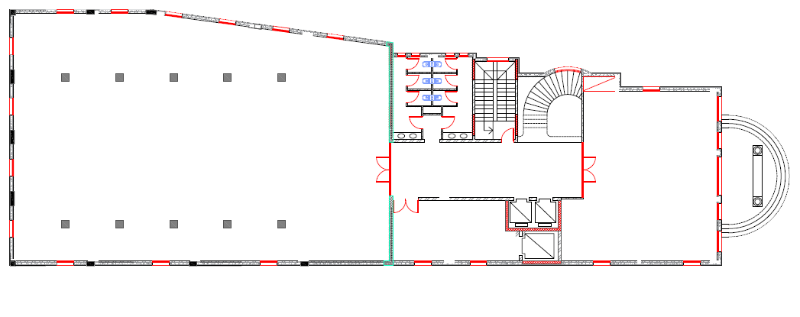
1) Introduction:
Project description:
First Floor
Notes:
A restaurant is located in the first floor.

Slide 9
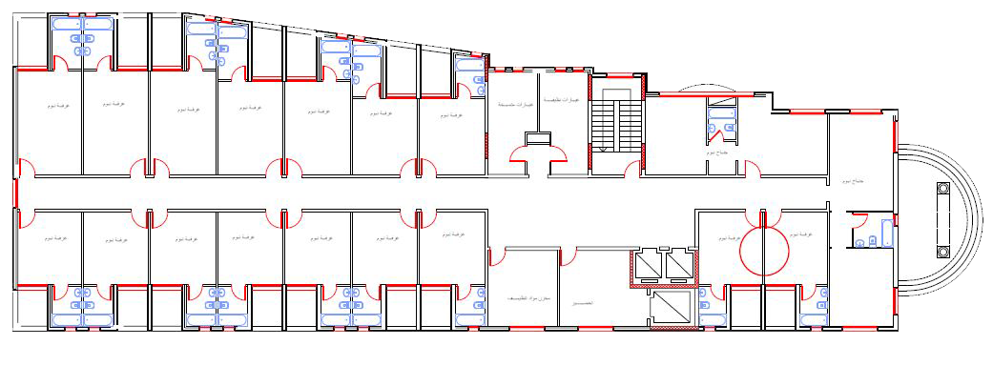
1) Introduction:
Project description:
2nd , 3rd and 4th floors
Notes:
rooms for hotel guests

Slide 10
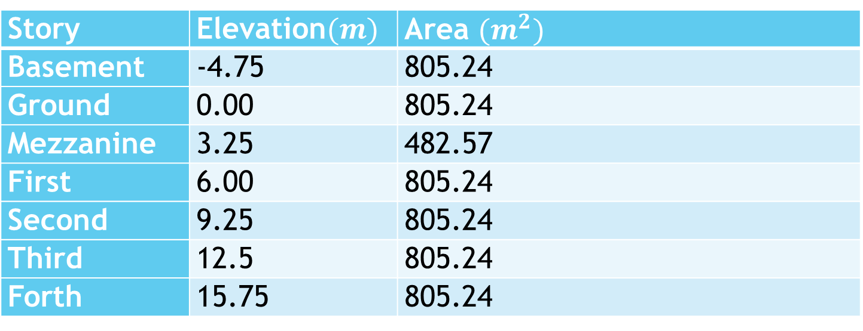
1) Introduction:
Project description:
Story | Elevation$(m)$ | Area ${(m}^{2})$
Basement | -4.75 | 805.24
Ground | 0.00 | 805.24
Mezzanine | 3.25 | 482.57
First | 6.00 | 805.24
Second | 9.25 | 805.24
Third | 12.5 | 805.24
Forth | 15.75 | 805.24

Slide 11

1) Introduction:
Geotechnical information:
Soil layers are close to be soft stone so the design bearing capacity is$250 kN/m^{2}$
Codes and Standards:
IBC 2012
ACI 318M-14
ASCE 2010

Slide 12
1) Introduction:
Materials:
Rebar Steel: - Yielding strength of used steel (fy) = 420MPa.
- Modulus of elasticity of used steel (Es) = 200GPa.
Concrete: strength: 30 MPa
Type: B375

Slide 13
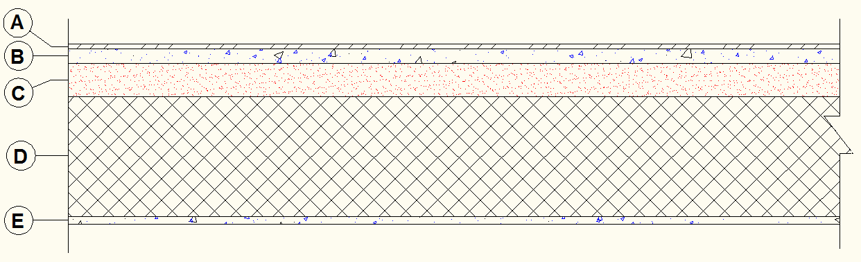

1) Introduction:
Loads:
a. Static load
1- Super-imposed dead load:$3.5 kN/m^{2}$
Zone | Material | Unit Weigh KN/m³ | Thickness cm | Wight (KN/m²) (unit weigh * thickness in m)
A | Ceramic | 0.12 | 1.0 | 1.2 *10‾³
B | Mortar | 23 | 3.0 | 0.69
C | Filling Material | 17 | 7.0 | 1.190
D | Slab Thickness | 25 | - | -
E | Plaster | 23 | 1.5 | 0.345

Slide 14
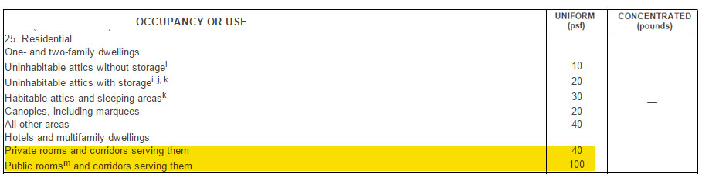
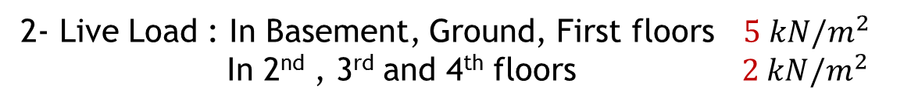
1) Introduction:
Loads:
a. Static load
2- Live Load : In Basement, Ground, First floors $5 kN/m^{2}$
In 2nd , 3rd and 4th floors $2 kN/m^{2}$

Slide 15
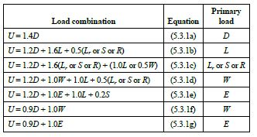
1) Introduction:
Loads:
b. Lateral loads (seismic)
The hotel is located in Nablus area which is classified zone 2B, according to Palestine seismic zone (z=0.2).

Slide 16
1) Introduction:
Programs:
1- ETABS 2015
2- SAFE 2014
3- AutoCAD

Slide 17
Preliminary dimensions and 3D model

Slide 18
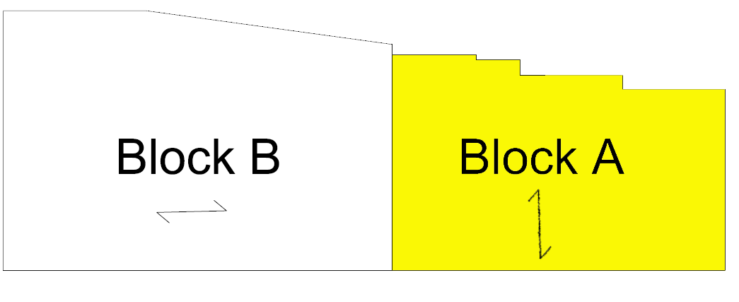
2) Preliminary dimensions and 3D model:
Introduction to structural system.
We divided the project into 2 blocks

Slide 19
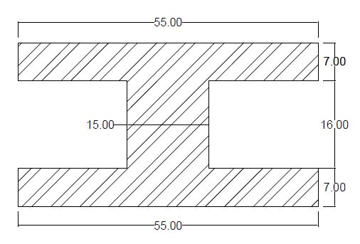
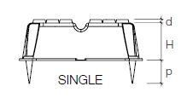
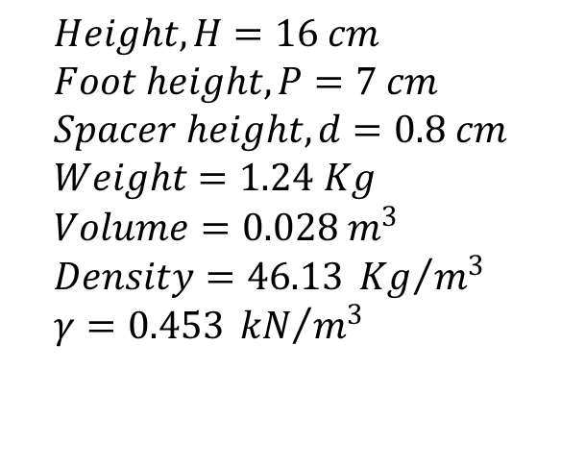
2) Preliminary design and 3D model:
Introduction to structural system.
One-way Voided Slab:
$$Height, H=16 cm \\ Foot height,P=7 cm \\ Spacer height,d=0.8 cm \\ Weight=1.24 Kg \\ Volume=0.028 m^{3} \\ Density=46.13 {Kg}/{m^{3}} \\ γ=0.453 {kN}/{m^{3}}$$

Slide 20
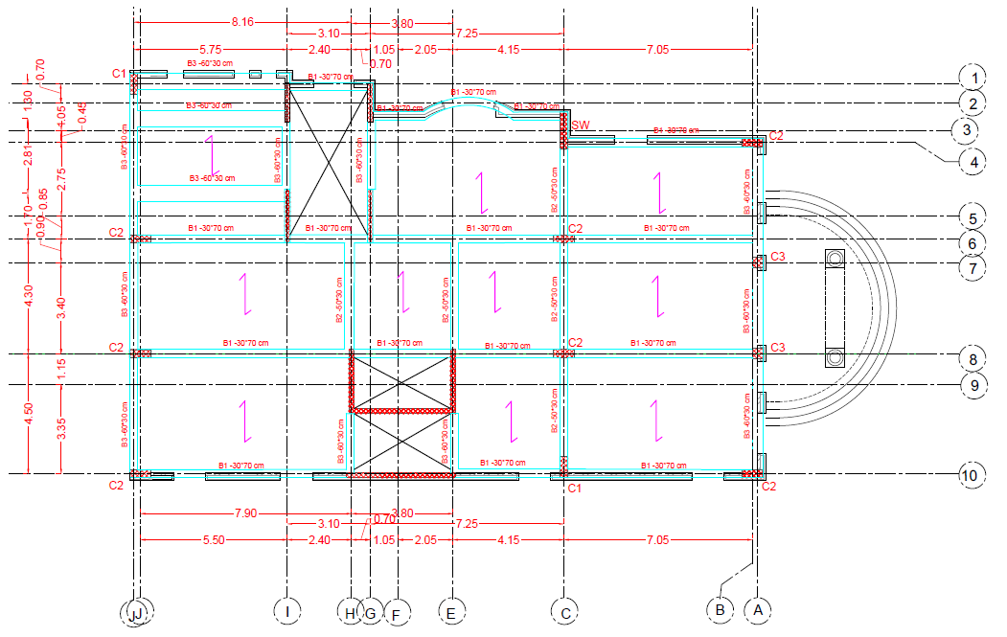
2) Preliminary design and 3D model:
Block A

Slide 21
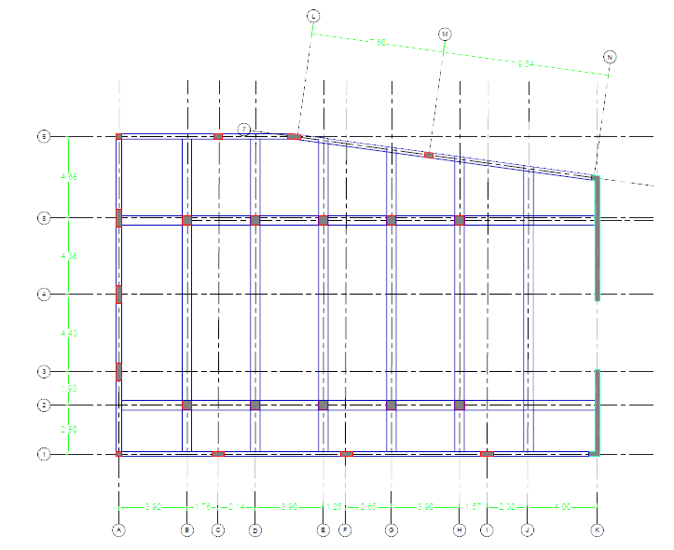
2) Preliminary design and 3D model:
Block B

Slide 22
2) Preliminary dimensions and 3D model:
Preliminary dimensions:
Column dimensions
Name: | Cross section:
C1 | 60x30
C2 | 80x30
C3 | 40x40
CB | 80x40
Beam dimensions
B1 | 30x70 | Drop
B2 | 50x30 | Hidden
B3 | 60x30 | Hidden
B4 | 30x30 | Hidden
B5 | 30x90 | Drop

Slide 23
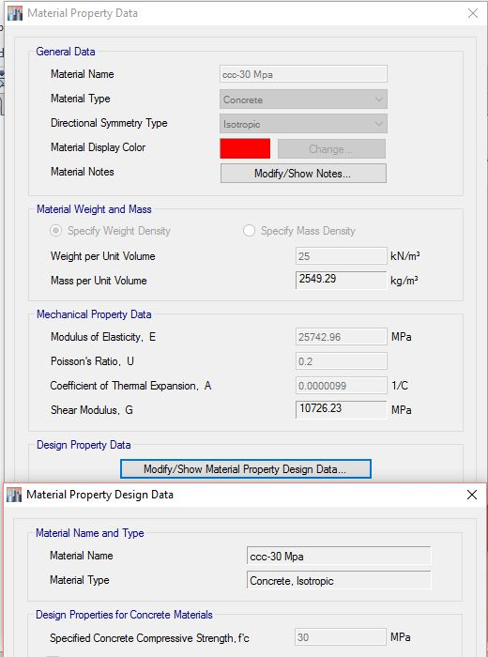
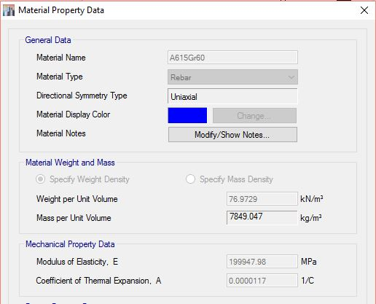
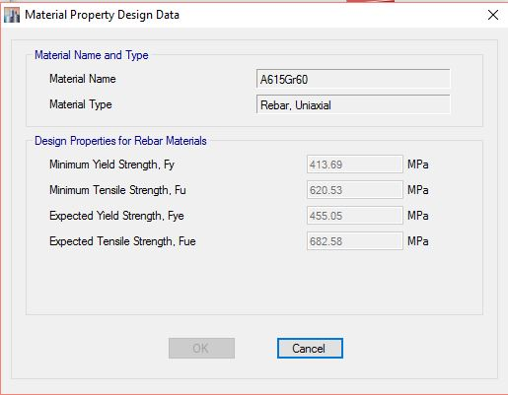
2) Preliminary dimensions and 3D model:
Materials and modifiers:

Slide 24
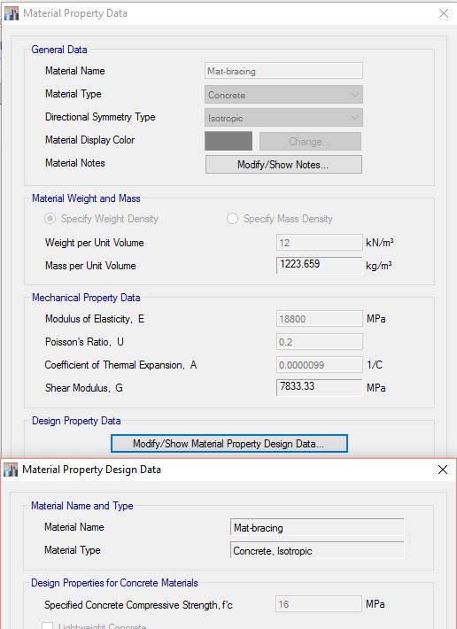
2) Preliminary dimensions and 3D model:
Materials and modifiers:

Slide 25
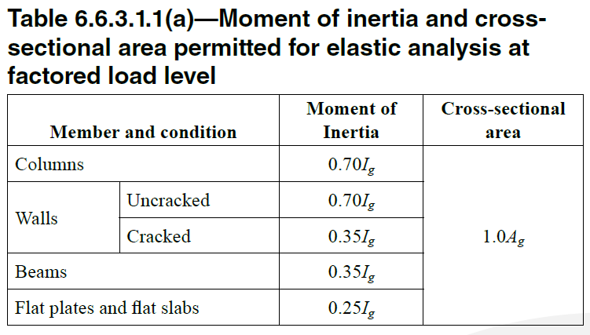
2) Preliminary dimensions and 3D model:
Materials and modifiers:

Slide 26
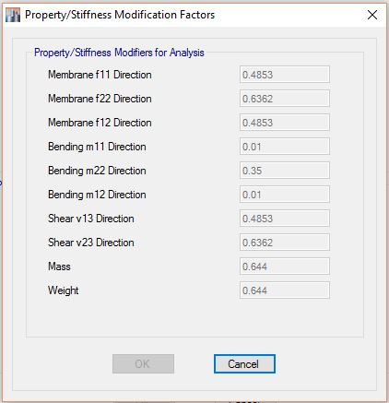
2) Preliminary dimensions and 3D model:
Materials and modifiers:
Slab modifiers in block A

Slide 27
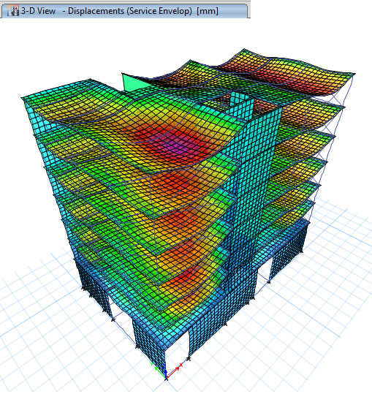
2) Preliminary dimensions and 3D model:
Checks
1- Checks for Compatibility:
As shown the structure
move as a rigid unit
(moving together)

Slide 28
2) Preliminary dimensions and 3D model:
Checks
2- Equilibrium check (Base reactions):
Total load:
By hand |  | By model | Error %
Dead | 23181.15 | 22687.28 | 2.18
Live | 7748 | 7553.819 | 2.58
SD | 8227.345 | 8001.932 | 2.82
Wall | 10013.902 | 9614.58 | 4.15
All less than 5%, OK

Slide 29
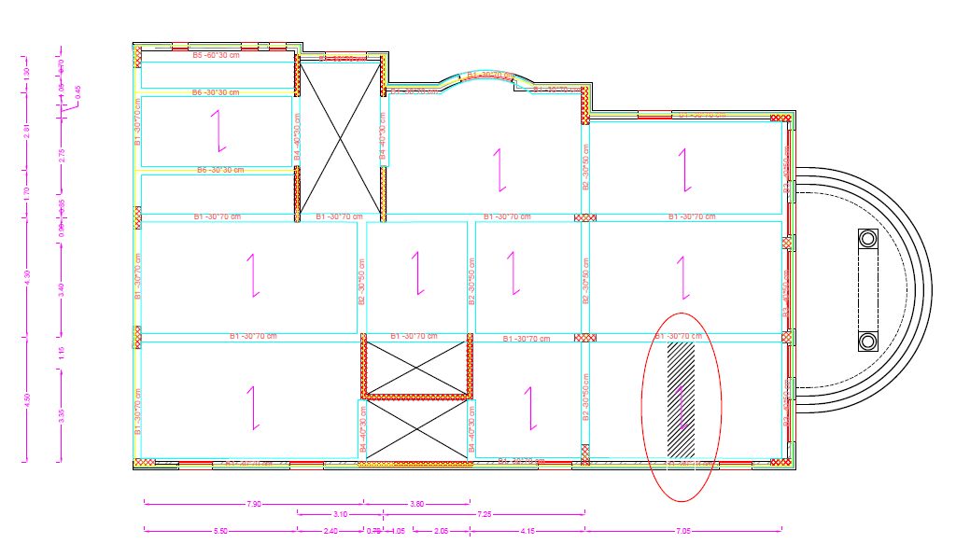
2) Preliminary dimensions and 3D model:
Checks
3- Checks moment stress-strain relationships:
In our calculations we take slab strip and the interior beam in block A

Slide 30
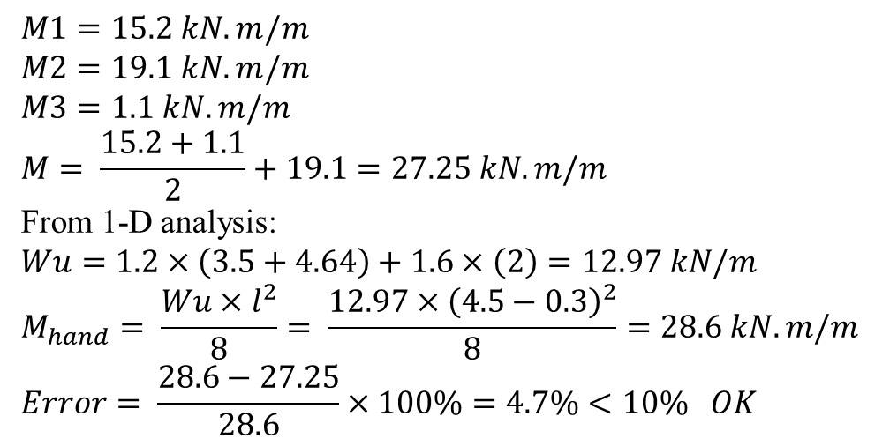
2) Preliminary dimensions and 3D model:
Checks
3- Checks moment stress-strain relationships:
$$M1=15.2 kN.m/m \\ M2=19.1 kN.m/m \\ M3=1.1 kN.m/m \\ M= \frac{15.2+1.1}{2}+19.1=27.25 kN.m/m$$
From 1-D analysis:
$$Wu=1.2×\left(3.5+4.64\right)+1.6×\left(2\right)=12.97 kN/m$$
$$M_{hand}= \frac{Wu×l^{2}}{8}= \frac{12.97×{\left(4.5−0.3\right)}^{2}}{8}=28.6 kN.m/m$$
$$Error= \frac{28.6−27.25}{28.6}×100\%=4.7\%<10\% OK$$
And we did the same for a beam

Slide 31
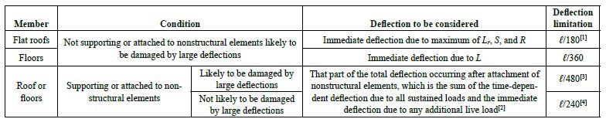
2) Preliminary dimensions and 3D model:
Checks
4- Checks for deflection:
We have case 4 that is: L/240

Slide 32
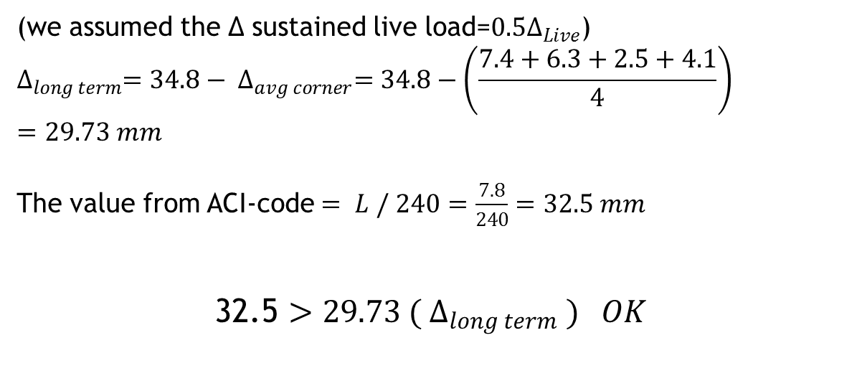
2) Preliminary dimensions and 3D model:
Checks
4- Checks for deflection:
(we assumed the ∆ sustained live load=${0.5∆}_{Live}$)
$$∆_{long term}=34.8− ∆_{avg corner}=34.8−\left(\frac{7.4+6.3+2.5+4.1}{4}\right) =29.73 mm$$
The value from ACI-code $= L / 240$ $=\frac{7.8}{240}=32.5 mm$
32.5 $>29.73 ( ∆_{long term} ) OK$

Slide 33
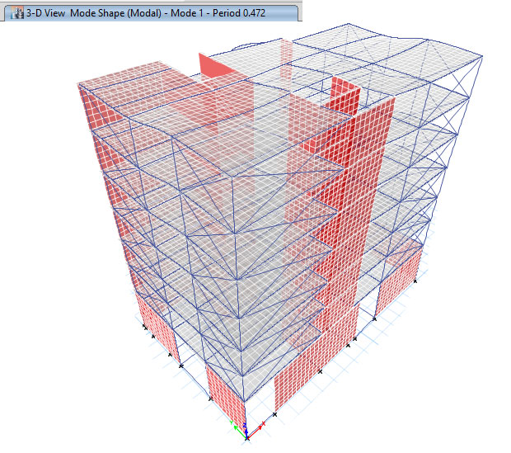
2) Preliminary dimensions and 3D model:
Checks
5- Checks the period:
The fundamental period T=0.472
To check this value, we used Rayleigh analytical
method:

Slide 34
2) Preliminary dimensions and 3D model:
Checks
5- Checks the period:
Mass calculation:
Element/Story | S1 | S2 | S3 | S4 | S5 | S6 | S7
Slab | 1517.87 | 1517.87 | 1517.87 | 1517.87 | 1517.87 | 1517.87 | 1517.87
Masonry Wall | 1450 | 1450 | 1450 | 1450 | 1450 | 1450 | 1450
SID | 1157.8 | 1157.8 | 1157.8 | 1157.8 | 1157.8 | 1157.8 | 1157.8
Stairs | 179.5 | 179.5 | 179.5 | 179.5 | 179.5 | 179.5 | 89.75
Beams | 696.85 | 696.85 | 696.85 | 696.85 | 696.85 | 696.85 | 696.85
Columns | 257.5 | 186 | 164.625 | 157.625 | 157.625 | 157.625 | 78.8125
Walls | 864.75 | 532 | 532 | 532 | 532 | 532 | 266
Mass (kN) | 6124.27 | 5720.02 | 5698.65 | 5691.65 | 5691.65 | 5691.65 | 5257.08
Mass (ton) | 624.29 | 583.08 | 580.90 | 580.19 | 580.19 | 580.19 | 535.89

Slide 35
2) Preliminary dimensions and 3D model:
Checks
5- Checks the period:
To find the period in Y:
Drift values due to (1 KN/m2 – in y-direction)
 | delta1 | delta2 | delta3 | delta average (mm)
story 1 | 0.3 | 0.3 | 0.2 | 0.27
story 2 | 0.8 | 0.8 | 0.8 | 0.80
story 3 | 1.4 | 1.4 | 1.4 | 1.40
story 4 | 2.1 | 2.1 | 2.2 | 2.13
story 5 | 2.8 | 2.9 | 3.1 | 2.93
story 6 | 3.6 | 3.7 | 3.9 | 3.73
story 7 | 4.3 | 4.5 | 4.7 | 4.50

Slide 36
2) Preliminary dimensions and 3D model:
Checks
5- Checks the period:
Period in Y:
 | mass | force | delta | Mass*(delta^2) | force*delta
S1 | 624.29 | 331 | 0.0002667 | 4.44E-05 | 0.088267
S2 | 583.08 | 331 | 0.0008 | 0.000373 | 0.2648
S3 | 580.90 | 331 | 0.0014 | 0.001139 | 0.4634
S4 | 580.19 | 331 | 0.0021333 | 0.002641 | 0.706133
S5 | 580.19 | 331 | 0.0029333 | 0.004992 | 0.970933
S6 | 580.19 | 331 | 0.0037333 | 0.008087 | 1.235733
S7 | 535.89 | 331 | 0.0045 | 0.010852 | 1.4895
Total |  |  |  | 0.028127 | 5.218767

Slide 37
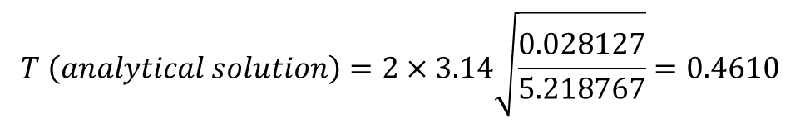
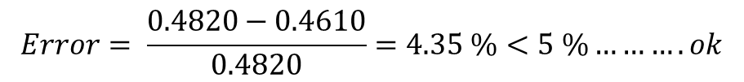
2) Preliminary dimensions and 3D model:
Checks
5- Checks the period:
Period in Y:
$$T \left(analytical solution\right)=2×3.14\sqrt{\frac{0.028127}{5.218767}}=0.4610$$
$$Error= \frac{0.4820−0.4610}{0.4820}=4.35 \%<5 \%……….ok$$

Slide 38
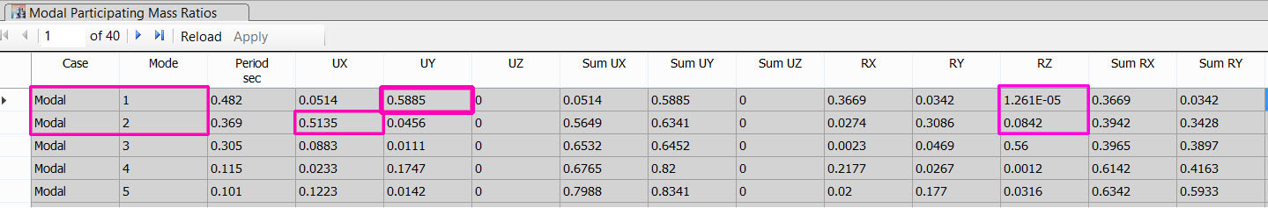
2) Preliminary dimensions and 3D model:
Checks
6- Check if torsion mode exist in 1st two modes:
Notes:
For modal 1 and 2, both modes are transition, no torsion

Slide 39
Dynamic Analysis

Slide 40
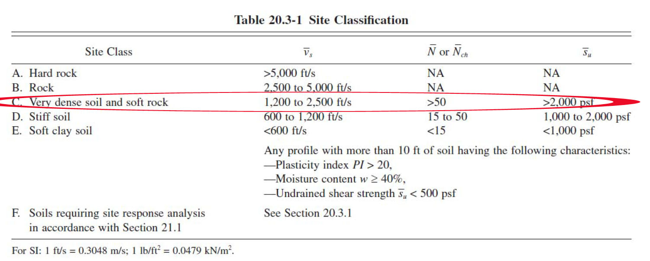
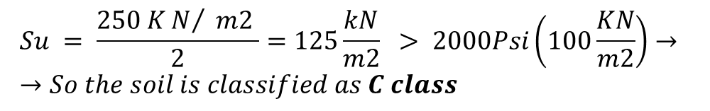
3) Dynamic Analysis:
Seismic Parameters
1- Site classifications
$$Su = \frac{250 KN/ m2 }{2}=125\frac{kN}{m2} > 2000Psi\left(100\frac{KN}{m2}\right)→ →So the soil is classified as C class$$
Notes:
For modal 1 and 2, both modes are transition, no torsion

Slide 41
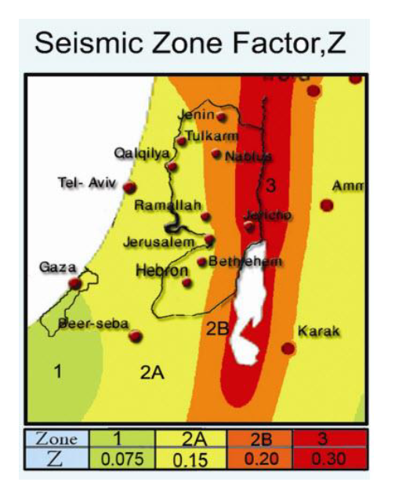
3) Dynamic Analysis:
Seismic Parameters
2- Seismic Zone factor and design seismic spectral acceleration (SD1, SDs):
The hotel located in Nablus city which is in Zone 2B, and has Z = 0.2 g
Notes:
For modal 1 and 2, both modes are transition, no torsion

Slide 42
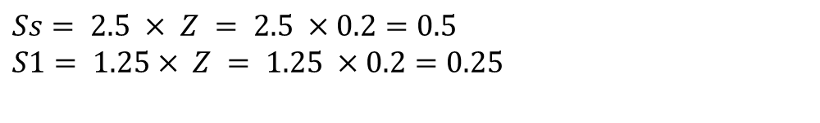
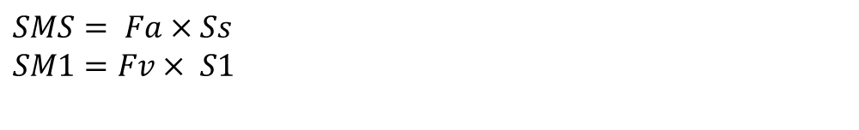
3) Dynamic Analysis:
Seismic Parameters
2- Seismic Zone factor and design seismic spectral acceleration (SD1, SDs):
$$Ss= 2.5 × Z = 2.5 ×0.2=0.5$$
$$S1= 1.25× Z = 1.25 ×0.2=0.25$$
Determine the maximum considered earthquake spectral response accelerations adjusted for site class effects, SMS at short period and SM1 at long period according to IBC 1613.3.3:
$$SMS= Fa×Ss$$
$$SM1=Fv× S1$$
Notes:
For modal 1 and 2, both modes are transition, no torsion

Slide 43
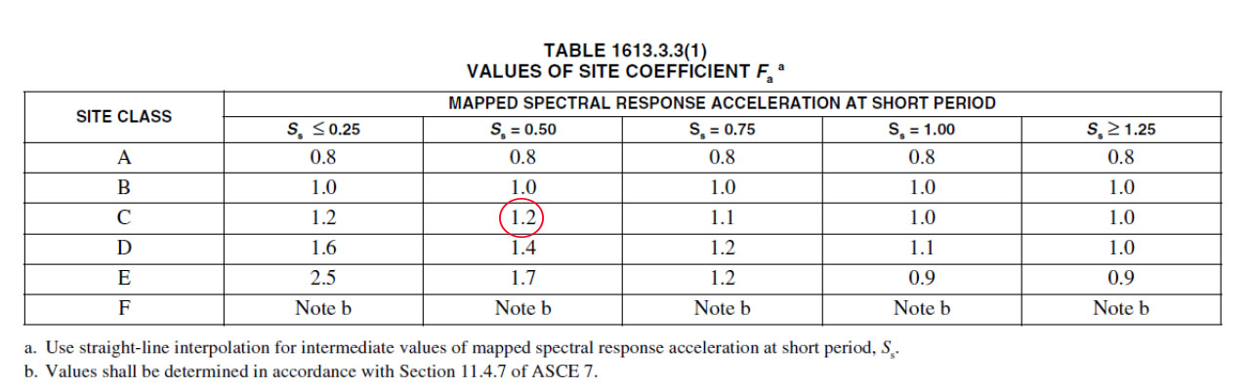
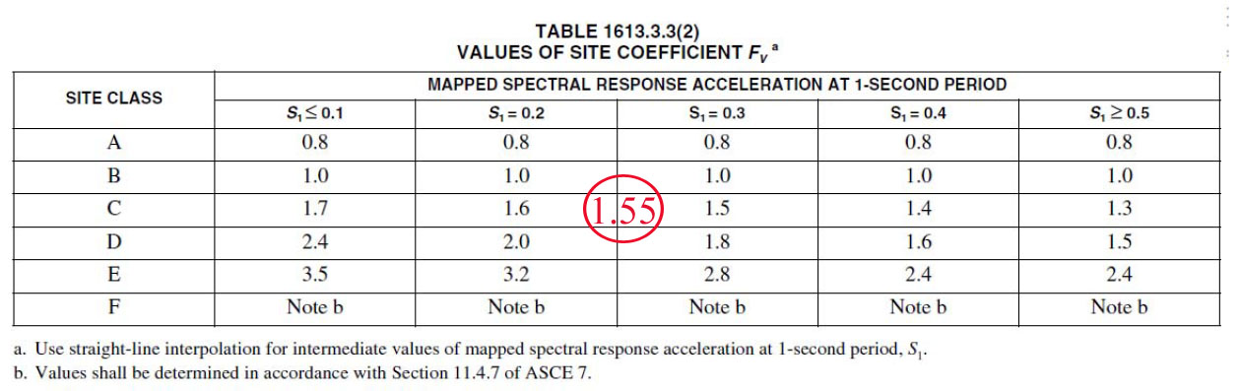
3) Dynamic Analysis:
Seismic Parameters
2- Seismic Zone factor and design seismic spectral acceleration (SD1, SDs):
Notes:
For modal 1 and 2, both modes are transition, no torsion

Slide 44

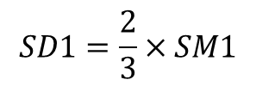
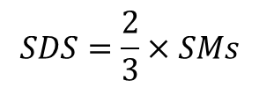
3) Dynamic Analysis:
Seismic Parameters
2- Seismic Zone factor and design seismic spectral acceleration (SD1, SDs):
$$SMS= Fa×Ss=1.2×0.5=0.6 g$$
$$SM1=Fv× S1=1.55×0.25=0.3875$$
Determine the 5% damped design spectral response accelerations SDS at short period and SD1 at long period in accordance with IBC 1613.3.4.
$$SDS=\frac{2}{3}×SMs$$
$$SD1=\frac{2}{3}×SM1$$
Notes:
For modal 1 and 2, both modes are transition, no torsion

Slide 45
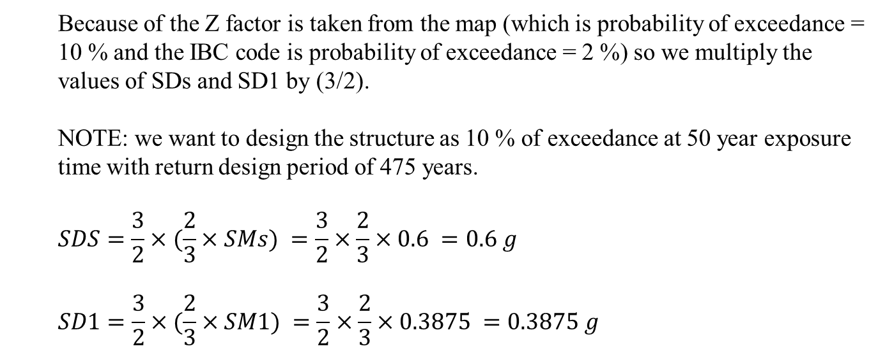
3) Dynamic Analysis:
Seismic Parameters
2- Seismic Zone factor and design seismic spectral acceleration (SD1, SDs):
Because of the Z factor is taken from the map (which is probability of exceedance = 10 % and the IBC code is probability of exceedance = 2 %) so we multiply the values of SDs and SD1 by (3/2).
NOTE: we want to design the structure as 10 % of exceedance at 50 year exposure time with return design period of 475 years.
$$SDS=\frac{3}{2}×(\frac{2}{3}×SMs) =\frac{3}{2}×\frac{2}{3}×0.6 =0.6 g$$
$$SD1=\frac{3}{2}×(\frac{2}{3}×SM1) =\frac{3}{2}×\frac{2}{3}×0.3875 =0.3875 g$$
Notes:
For modal 1 and 2, both modes are transition, no torsion

Slide 46
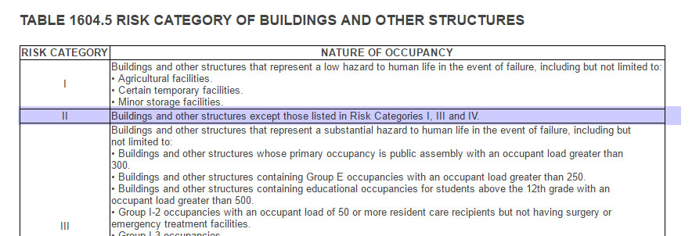
3) Dynamic Analysis:
Seismic Parameters
3- Determination of seismic Design category and importance factor (Ie):
The IBC code classifies the structures according to the nature of occupancy, and the hotel is defined as risk category 2, because it is a normal building.
Notes:
For modal 1 and 2, both modes are transition, no torsion

Slide 47
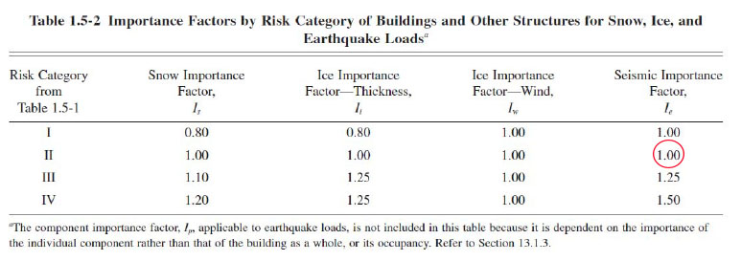
3) Dynamic Analysis:
Seismic Parameters
3- Determination of seismic Design category and importance factor (Ie):
Then using ASCE 7-10 to determine the importance factor of the Building from (table 1.5-2: in ASCE)
Notes:
For modal 1 and 2, both modes are transition, no torsion

Slide 48
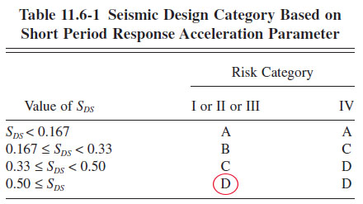
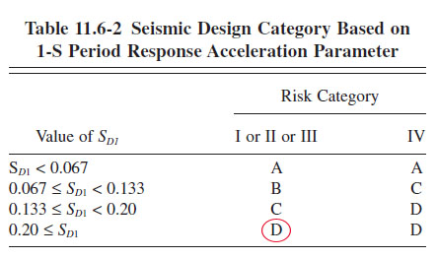
3) Dynamic Analysis:
Seismic Parameters
3- Determination of seismic Design category and importance factor (Ie):
Since all other structures shall be assigned to a seismic design category based on their risk category and the design spectral response acceleration parameters, SDS and SD1. Using ASCE 7-10:
So the seismic design category is D
Notes:
For modal 1 and 2, both modes are transition, no torsion

Slide 49
3) Dynamic Analysis:
Determination of building frame system and Response modification factor (R):
There are 3 types of building frame system according to resistance the gravity and lateral loads:
1- Bearing wall system
2- Building frame system
3- The moment resisting frame system
Notes:
For modal 1 and 2, both modes are transition, no torsion

Slide 50
3) Dynamic Analysis:
Determination of building frame system and Response modification factor (R):
Walls take 97.75% of lateral loads in y-directions
Walls take 98% of lateral loads in x-directions
From this results and since the building is located in moderate seismic area then the system is building frame system with intermediate reinforcement.
Notes:
For modal 1 and 2, both modes are transition, no torsion

Slide 51
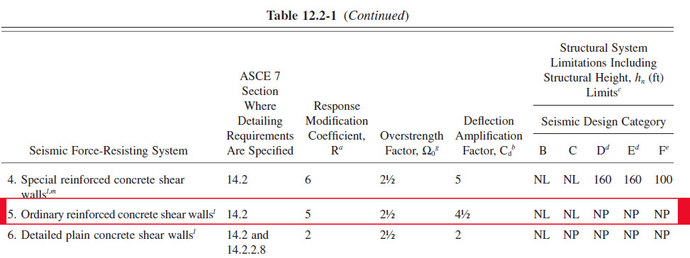
3) Dynamic Analysis:
Determination of building frame system and Response modification factor (R):
So we will use the Ordinary reinforced concrete shear walls system with R = 5, Cd = 4.5 and Ω = 2.5

Slide 52
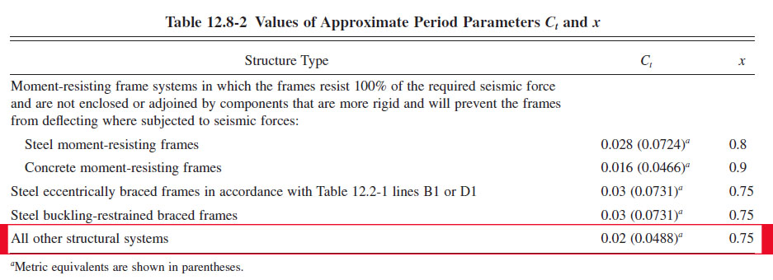

3) Dynamic Analysis:
Determinations of Approximate Fundamental Period (Ta):
According to ASCE 7-10 code the analytical periods shall be less than approximate fundamental method (Ta):
$Ta =Ct× {h_{n}}^{x}$

Slide 53
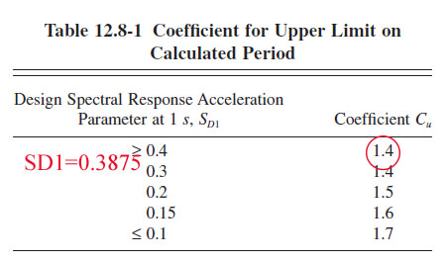
3) Dynamic Analysis:
Determinations of Approximate Fundamental Period (Ta):
$$Ta =Ct× {h_{n}}^{x}= 0.0488∗ {23.75 }^{0.75}=0.525 sec$$
Also the code suggests maximizing this value by multiply it by Cu coefficient of upper limits
$$Ta =Cu×Ta=1.40×0.525 =0.735 sec$$
Notes:
The value from ETABS = 0.482 sec which is less than the approximate fundamental Period (Ta)

Slide 54
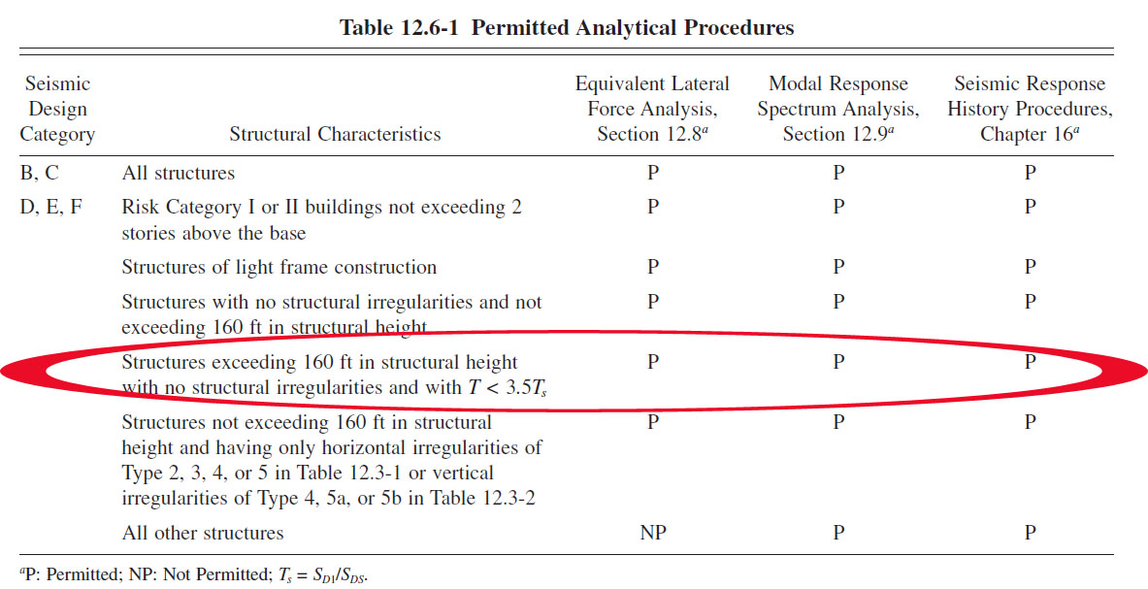
3) Dynamic Analysis:
Determination of Seismic Base reactions:
Equivalent static methods
Dynamic methods: Linear modal response spectrum analysis
Notes:
The structural analysis shall consist of one of the types permitted in ASCE 7-10 Table 12.6-1, based on the structure’s seismic design category, structural system, dynamic properties and regularity. The analysis procedure selected shall be completed in accordance with the requirements of the corresponding section referenced in (Table 12.6-1 in ASCE).

Slide 55

3) Dynamic Analysis:
Determination of Seismic Base reactions:
1- Equivalent Static Method
According to ASCE 7-10, $The Seismic Base shear$
$(V)=CSe×W$
Notes:
First we calculated the base reactions manually and from the ETABS models to compare between both of the results.

Slide 56
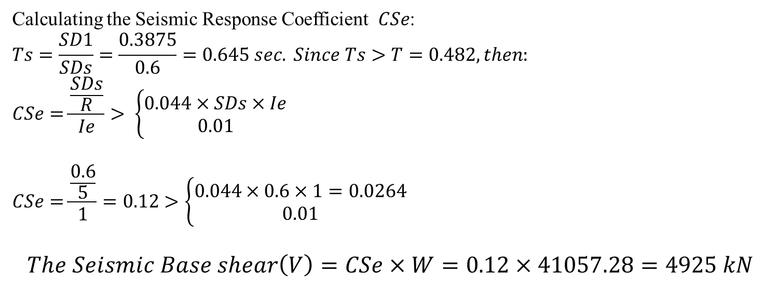
3) Dynamic Analysis:
Determination of Seismic Base reactions:
1- Equivalent Static Method
W = 41057.28 kN
Calculating the Seismic Response Coefficient $CSe$:
$$Ts=\frac{SD1}{SDs}=\frac{0.3875}{0.6}=0.645 sec. Since Ts>T=0.482, then:$$
$$CSe=\frac{\frac{SDs}{R}}{Ie}> \left\{\begin{aligned}0.044×SDs×Ie \\ 0.01\end{aligned}\right.$$
$$CSe=\frac{\frac{0.6}{5}}{1}=0.12>\left\{\begin{aligned}0.044×0.6×1=0.0264 \\ 0.01\end{aligned}\right.$$
$$The Seismic Base shear\left(V\right)=CSe×W=0.12×41057.28=4925 kN$$

Slide 57

3) Dynamic Analysis:
Determination of Seismic Base reactions:
1- Equivalent Static Method
We assigned equivalent static load in ETABS

Slide 58


3) Dynamic Analysis:
Determination of Seismic Base reactions:
1- Equivalent Static Method
The following results was obtained:
$$Error=\frac{4925−4726}{4726}×100\%=4.22\%<5\%$$

Slide 59

3) Dynamic Analysis:
Determination of Seismic Base reactions:
2- Modal response spectrum analysis
Notes:
We used ETABS model to calculate the seismic forces from Response spectrum in two directions (X-direction, Y-direction).

Slide 60



3) Dynamic Analysis:
Determination of Seismic Base reactions:
2- Modal response spectrum analysis
$$Ex=Ex+0.3 Ey$$
$$Ey=Ey+0.3Ex$$
Then, the acceleration of main direction should be
multiplied by a
$$scale factor of=\frac{\left(I×g\right)}{R}=\frac{1×9810}{5}=1962$$
And the other direction should be multiplied by:
$$0.3× \frac{I×g}{R}=0.3×\frac{1×9810}{5}=588.6$$
x-directions
Notes:
Because the earthquake loads don’t come from one directions, so the structure shall be designed to resist any seismic forces in each direction, then to simulate the reality we add 30% of seismic load in perpendicular direction in addition of the main directions.

Slide 61

3) Dynamic Analysis:
Determination of Seismic Base reactions:
2- Modal response spectrum analysis

Slide 62


3) Dynamic Analysis:
Determination of Seismic Base reactions:
2- Modal response spectrum analysis
the response spectrum base shear is less than static base shear so we have to make the response spectrum is the dominant method to make a design by it, to achieve this the ASCE7-10 code scale the forces by multiply the scale factor by
$$0.85×\frac{Vstatic}{Vresponse}$$
So the scale factor for response in X-direction is:
$$=1962×0.85×\frac{4726}{2679.97}=2940.9$$
The scale factor for response in Y-direction is:
$$= 1962×0.85×\frac{4726}{2954.11}=2667.99$$

Slide 63

3) Dynamic Analysis:
Determination of Seismic Base reactions:
2- Modal response spectrum analysis
So the base reaction after modification:

Slide 64

3) Dynamic Analysis:
Determination of Seismic Base reactions:
2- Modal response spectrum analysis
The modal mass participation ratio(MMPR):

Slide 65


3) Dynamic Analysis:
Load combinations:
Ultimate load combinations | Service load combinations
1.4D | D+L
1.2D+1.6L | 1D+0.75L+0.7E
1.2D+1E +1L | 0.6D+0.7 E
0.9D+1E | 1D+0.7E
$E=ρ× Eh±Ev$
Eh including Eh-x and Eh-y
$ρ$= 1.3

Slide 66



3) Dynamic Analysis:
Load combinations:
$$For example: \\ \left.1.2D+1L+1E(response−y\right)$$
$$E=ρ× Eh+Ev$$

Slide 67

3) Dynamic Analysis:
Structural Configuration:
1- Plane Configuration
Displacement from mode 3
Notes:
The code is trying to make the limits of torsional regularity by dividing it in two cases:
Torsional irregularity.
Extreme torsional irregularity

Slide 68


3) Dynamic Analysis:
Structural Configuration:
1- Plane Configuration
$$∆1(y)=0.03459 mm$$
$$∆2(y)=0.03132 mm$$
$$So ∆avg(y)=\frac{∆1+∆2}{2}=\frac{0.03459+0.03132}{2}= 0.03295 mm$$
$$∆ \left(max\right)=0.03559<1.2 ∆avg=0.03954 mm$$
So there is no torsional irregularity nor extreme torsional irregularity.
Notes:
Note that: We didn’t re-do for the rest corners because the plan is nearly square shape after we divided it in two Blocks, in addition the diaphragm is similar in all stories and it is continuous and the opening is less than 50 % of the total area.

Slide 69

3) Dynamic Analysis:
Structural Configuration:
2- Vertical configuration
Soft story checks
The drift values from the ETABS are taken from story 7 and 6 from response in Y-directions:
$$∆\left(6−7\right)=2.3 mm, ∆(5−6)=2.333 mm$$
$$\frac{1}{∆\left(5−6\right)} =0.428>0.7\frac{1}{∆\left(6−7\right)} =0.304$$
$$=0.428>0.7\frac{1}{∆\left(5−6\right)} =0.304$$
So there is no story drift nor extreme story drift
Notes:
the soft story is one of the important issues in seismic design effect, we have to avoid it so let’s check it in-out structure.
1- Soft Story.
2- Extreme soft story.

Slide 70

3) Dynamic Analysis:
Story Drifts Checks and Design of seismic Joint:
Notes:
The maximum story drift in a building shall not exceed the allowable story drift $∆a$ as obtained from table 12.12-1 in ASCE 7-10.

Slide 71

3) Dynamic Analysis:
Story Drifts Checks and Design of seismic Joint:
Risk category: ΙΙ
Structure type: Masonry cantilever shear wall
Allowable story drift $∆a=0.01×3.25=32.5 mm$
But we have seismic design category D. So, according to 12.12.1.1 in ASCE 7-10,
the story drift shall not exceed: ${∆a}/ρ,$
$$ρ=1.3$$
$${∆a}/ρ=\frac{32.5}{1.3}= 25 mm$$

Slide 72

3) Dynamic Analysis:
Story Drifts Checks and Design of seismic Joint:
Notes:
Between 4th and 5th : 2.5mm Y-direction

Slide 73

3) Dynamic Analysis:
Story Drifts Checks and Design of seismic Joint:
12.12.3 in ASCE 7-10: allow for the maximum inelastic response displacement (𝛿𝑀).
$$δ_{M}= \frac{C_{d}×δ_{max}}{I}, \left(C_{d}=4.5\right),\left( I=1\right),\left(δ_{M}=2.5mm\right)$$
$$δ_{M}=\frac{4.5×2.5}{1}=11.25 mm$$
The maximum inelastic story drift (11.25mm) is less than the allowed story drift (25mm)
Notes:
12.12.3 in ASCE 7-10, Separation shall allow for the maximum inelastic response displacement ($δ_{M}$).

Slide 74

3) Dynamic Analysis:
Story Drifts Checks and Design of seismic Joint:
The seismic joint:
According to ASCE seismic separation should be SRSS of inelastic displacements by this formula:
$$∆ ={\left({\left(Inelastic ∆ of block A\right)}^{2}+{\left(Inelastic ∆ of block B\right)}^{2}\right)}^{0.5}$$
$$∆ ={\left({\left(11.25\right)}^{2}+{\left(21.6\right)}^{2}\right)}^{0.5}=24.4mm$$
so take the seismic joint distance equal 3 cm

Slide 75
Dynamic design

Slide 76
Design criteria
Strength
Serviceability and Stability
Cost effective

Slide 77



3) 3-D analysis and Static design:
Check slab for shear:
From V23 the $V_{max}=51.544 kN/m =51.544×0.55=28.35 kN/rib$
$$But ∅V_{c}=\frac{1}{6} √30×150×260=35.6 kN$$
$$∅V_{c}>V_{max},$$

Slide 78


4) Dynamic design
Design of slab for flexure:
The maximum moment is $52.8 (kN.m)⁄m=29.04 (kN.m)⁄rib$

Slide 79

4) Dynamic design
Design of slab:

Slide 80

4) Dynamic design
Design of beams:
Notes:
Beam on grid line 2 as example

Slide 81

4) Dynamic design
Design of beams:
Notes:
+As = 1/3 –As
shear reinf. S1 = 1.5 (2H) each 9 cm
shear reinf S2 = middle each 30 cm

Slide 82

4) Dynamic design
Design of columns:
Notes:
Column A3 as example

Slide 83

4) Dynamic design
Design of columns:
Notes:
At both end … spacing 12 cm for L0= 45 cm
First one not more than 6 cm
in the middle …. Spacing 25 cm
Lab splice middle column

Slide 84

4) Dynamic design
Design of shear wall:
Notes:
Sw 5 as example
$$Lw=1400 mm, Thickness=300 mm$$

Slide 85

4) Dynamic design
Design of shear wall:
Pu | Mu2 | Mu3 | Vu2 | Vu3
3405 kN | 65 KN.m | 160 KN.m | 38.14 KN | 198 KN
$V2=38.14 kN$
$∅VC=\frac{∅×λ×\sqrt{f^{′}c}×Bw×d}{6}=\frac{0.75×1×\sqrt{30}×1000×250}{6∗1000}=194 kN$
$since Vu2 = 38.14 kN<\left(\frac{∅VC}{2}\right)=97 kN$
So we don’t need any reinforcement in the 2-direction (weak direction).

Slide 86

4) Dynamic design
Design of shear wall:
Pu | Mu2 | Mu3 | Vu2 | Vu3
3405 kN | 65 KN.m | 160 KN.m | 38.14 KN | 198 KN
$$2) V3=198 kN \\ ∅VC=\frac{∅×λ×\sqrt{f^{′}c}×Bw×d}{6}=\frac{0.75×1×\sqrt{30}×300×1260}{6∗1000}=248.5KN$$
$$since Vu2 = 198 KN>\left(\frac{∅VC}{2}\right)=129.37 KN , we use min reinforcement$$
$$\left(\frac{Av}{S}\right)min=max\left(0.062 \sqrt{f^{′}c}\frac{bw}{fyt} | \frac{0.35 bw}{fyt}\right)=0.25\frac{mm2}{mm}$$
$$ρt = \frac{A_{v}/s}{t} = \frac{0.25}{300} = 0.000833 < 0.0025 → use ρt, min = 0.0025$$
$$So the At= 0.0025∗300∗1000=750 mm2 (4∅12 /m in each face)$$

Slide 87

4) Dynamic design
Design of shear wall:
Pu | Mu2 | Mu3 | Vu2 | Vu3
3405 kN | 65 KN.m | 160 KN.m | 38.14 KN | 198 KN
Notes:
biaxial columns and using the reciprocal method for design.
$$ρl=0.0025$$

Slide 88

4) Dynamic design
Design of shear wall:
Pu | Mu2 | Mu3 | Vu2 | Vu3
3405 kN | 65 KN.m | 160 KN.m | 38.14 KN | 198 KN
About Y axis(2-direction):
$$h=300 mm,Mu=65 KN.m,ρl=0.0053 (From ETABs)$$
$$γ =\frac{ h −2∗cover}{h}=\frac{300−2∗60}{300}=0.6$$
$$\frac{Mu}{bh^{2}} = (65∗10⁶)/(1400∗(300²)) /7 =0.07369$$
Then from curve of moment-axial interaction diagram we determine:
$$\frac{∅Po}{bh}=1.4$$
So, the $∅Po y=1.46×300×1400=4292$
Notes:
biaxial columns and using the reciprocal method for design.
$$ρl=0.0025$$

Slide 89

4) Dynamic design
Design of shear wall:
Pu | Mu2 | Mu3 | Vu2 | Vu3
3405 kN | 65 KN.m | 160 KN.m | 38.14 KN | 198 KN
About X axis(3-direction):
$$Assume h=1400 mm,Mu=160 KN.m,ρl=0.0053 (ETABS VALUE)$$
$$γ =\frac{ h −2∗cover}{h}=\frac{1400−2∗60}{1400}=0.91 \\ \frac{Mu}{bh^{2}} = (160∗10⁶)/(1400∗(300²)) /7=0.0388$$
Then from curve of moment-axial interaction diagram we determine:
$\frac{∅Po}{bh}=1.5$
So, the $∅Po x=1.5×300×1400=4410$
Pure axial from ACI-code:
$$ΦP0 =0.65×0.85(0.85fc×(Ag−As)+(fy.As))=5922.12$$
Notes:
biaxial columns and using the reciprocal method for design.
$$ρl=0.0025$$

Slide 90

4) Dynamic design
Design of shear wall:
Pu | Mu2 | Mu3 | Vu2 | Vu3
3405 kN | 65 KN.m | 160 KN.m | 38.14 KN | 198 KN
So from equation of reciprocal method:
$$\frac{1}{ΦPn}=\frac{1}{ΦPnx}+\frac{1}{ΦPny}−\frac{1}{ΦPn0}=\frac{1}{4410}+\frac{1}{4292}−\frac{1}{5922.12}=0.00029$$
$$ΦPn=3437.45>3405 kN ≫ok$$
So the assumption is true which is $ρl=0.0053$
Notes:
biaxial columns and using the reciprocal method for design.
$$ρl=0.0025$$

Slide 91


4) Dynamic design
Design of shear wall:
Check for $ρl min$:
$$ρl min=max\{0.0025+0.5∗(2.5−hw/Lw)∗(ρt−0.0025)│0.0025\}=0.0025$$
Since,$ρl=0.0053> ρl\min{ }≫≫≫OK$
So, $Av= 0.0053∗300∗1400=2226 mm^{2} /1.4m(4∅16 /m in each face)$
Notes:
Using the section designer on ETABS to draw a bending moment-axial interaction diagram:

Slide 92

4) Dynamic design
Design of shear wall:

Slide 93

4) Dynamic design
Design of stairs:
Thickness: 20 cm

Slide 94


4) Dynamic design
Design of stairs:
1) Loads
The own weight of stairs $= 0.2∗25=5 kN/m^{2}$
L$ive load=5 kN/m^{2}$
S$uper Imposed dead load=5kN/m^{2}$

Slide 95


4) Dynamic design
Design of stairs:
2) Deflection
Long term max. deflection = 7.3 mm
Deflection limitation: “ACI”
$$\frac{l}{360} =\frac{4240}{360} =11.1 mm$$

Slide 96


4) Dynamic design
Design of stairs:
3) Shear
$$Vu = 46 kN /m \\ d = 200−40 = 160 mm$$
$$∅ Vc = 0.75×\frac{1}{6}×\sqrt{fc` }b×d =0.75×\frac{1}{6}×\sqrt{30}×1000×\frac{160}{1000} = 109 kN /m$$
$Since ∅ Vc=109 kN> Vu=46 kN$, there is no need for shear reinforcement.

Slide 97



4) Dynamic design
Design of stairs:
4) flexure
longitudinal steel
In flight:
For M22 (positive) = 8.5 KN.m, bottom steel
(4 $∅$12 /1m)
For M22 (negative) = 25 KN.m, top steel
Use (4 $∅$12 /1m)
In landing:
M22 in the Landing= 25 kN.m and it is negative moment (top steel)
Use (4 $∅$12 /1m)

Slide 98

4) Dynamic design
Design of stairs:

Slide 99

4) Dynamic design
Design of footings:
To determine the type of footing:
Total load from the building:
Block: | P service (from gravity) | P service (from seismic combination)
Block A | 47857 kN | 47875 kN
Block B | 67089 kN | 68951 kN
Area of footing from gravity loads:
$$Area= \frac{Total P_{service}}{σ}=\frac{114946}{250}=460 m^{2}$$
Area of footing from seismic loads:
$$Area= \frac{Total P_{service}}{1.3×σ}=\frac{116826}{1.3×250}=359.5 m^{2}$$
Notes:
So, we used the larger area which come from gravity service loads.
$The ratio of area= \frac{Area of footing}{area of building}=\frac{460}{835}=55\%$,
It’s preferred to use MAT foundation:
We used CSI SAFE (using finite elements) to analysis and design the MAT footing that consider the footing flexible.
We separated the footing for each block. Below footing A design:

Slide 100


4) Dynamic design
Design of footings:
1) Dimension:
$Area=27x18= 486 m^{2}$,
$depth:1.1 m d_{cover}=7 cm$

Slide 101


4) Dynamic design
Design of footings:
2) Deflection:
$$The maximum deflection is:$$
$$8 mm<10 mm OK$$

Slide 102


4) Dynamic design
Design of footings:
3) Soil failure:
$$\operatorname{Maximum}{allowable stress }is 250 kN/{m^{2}}$$
Maximum stress on the footing is
200.61 kN/m^2
and there is no tension on the footing.

Slide 103

4) Dynamic design
Design of footings:
4) Thickness:
based on punching shear
Notes:
The punching shear ratio to the capacity
is less than 1 for all columns

Slide 104

4) Dynamic design
Design of footings:
5) Design:
Design of one strip

Slide 105


4) Dynamic design
Design of footings:
5) Design:
Column strip
a) Shear:
$V_{u}=1132 kN$
$${ ∅V}_{c}= \frac{0.75}{6}×\sqrt{30} ×\frac{1030×2000}{1000}=1410.4 kN OK$$

Slide 106


4) Dynamic design
Design of footings:
5) Design:
Column strip
b) Flexure:
Moment diagram:
Area of steel (per column strip):

Slide 107


4) Dynamic design
Design of footings:
5) Design:
Middle strip
Moment diagram:
Total maximum moment
= 1500 kN.m /4.1 strip
$$As<{As}_{min}$$
For practical use, A mesh reinforcement of 8∅18/m is used (both top and bottom)

Slide 108
Thanks for your attention.
Any Questions?

