Slide 1

An-Najah National University
Faculty of Engineering & Information Technology
Civil Engineering Department
Graduation Project I
Design a Sewer System of Asira Al Shamaliya
by
Sadi Sawlmeh
Mohammad Abu Hanoud
Hamza Yaseen
Under the direction of
Dr. Hafez Shaheen

Slide 2


design the sewage collection system for Asira Al Shamaliya
Define the area to be served and divide it into main catchments according to the exiting situation using the topographic map and ground truthing.
Estimate the population and their densities for Asira Al Shamaliya area up to the planning horizon 2053, and evaluate the water consumption and the wastewater production.

Slide 3
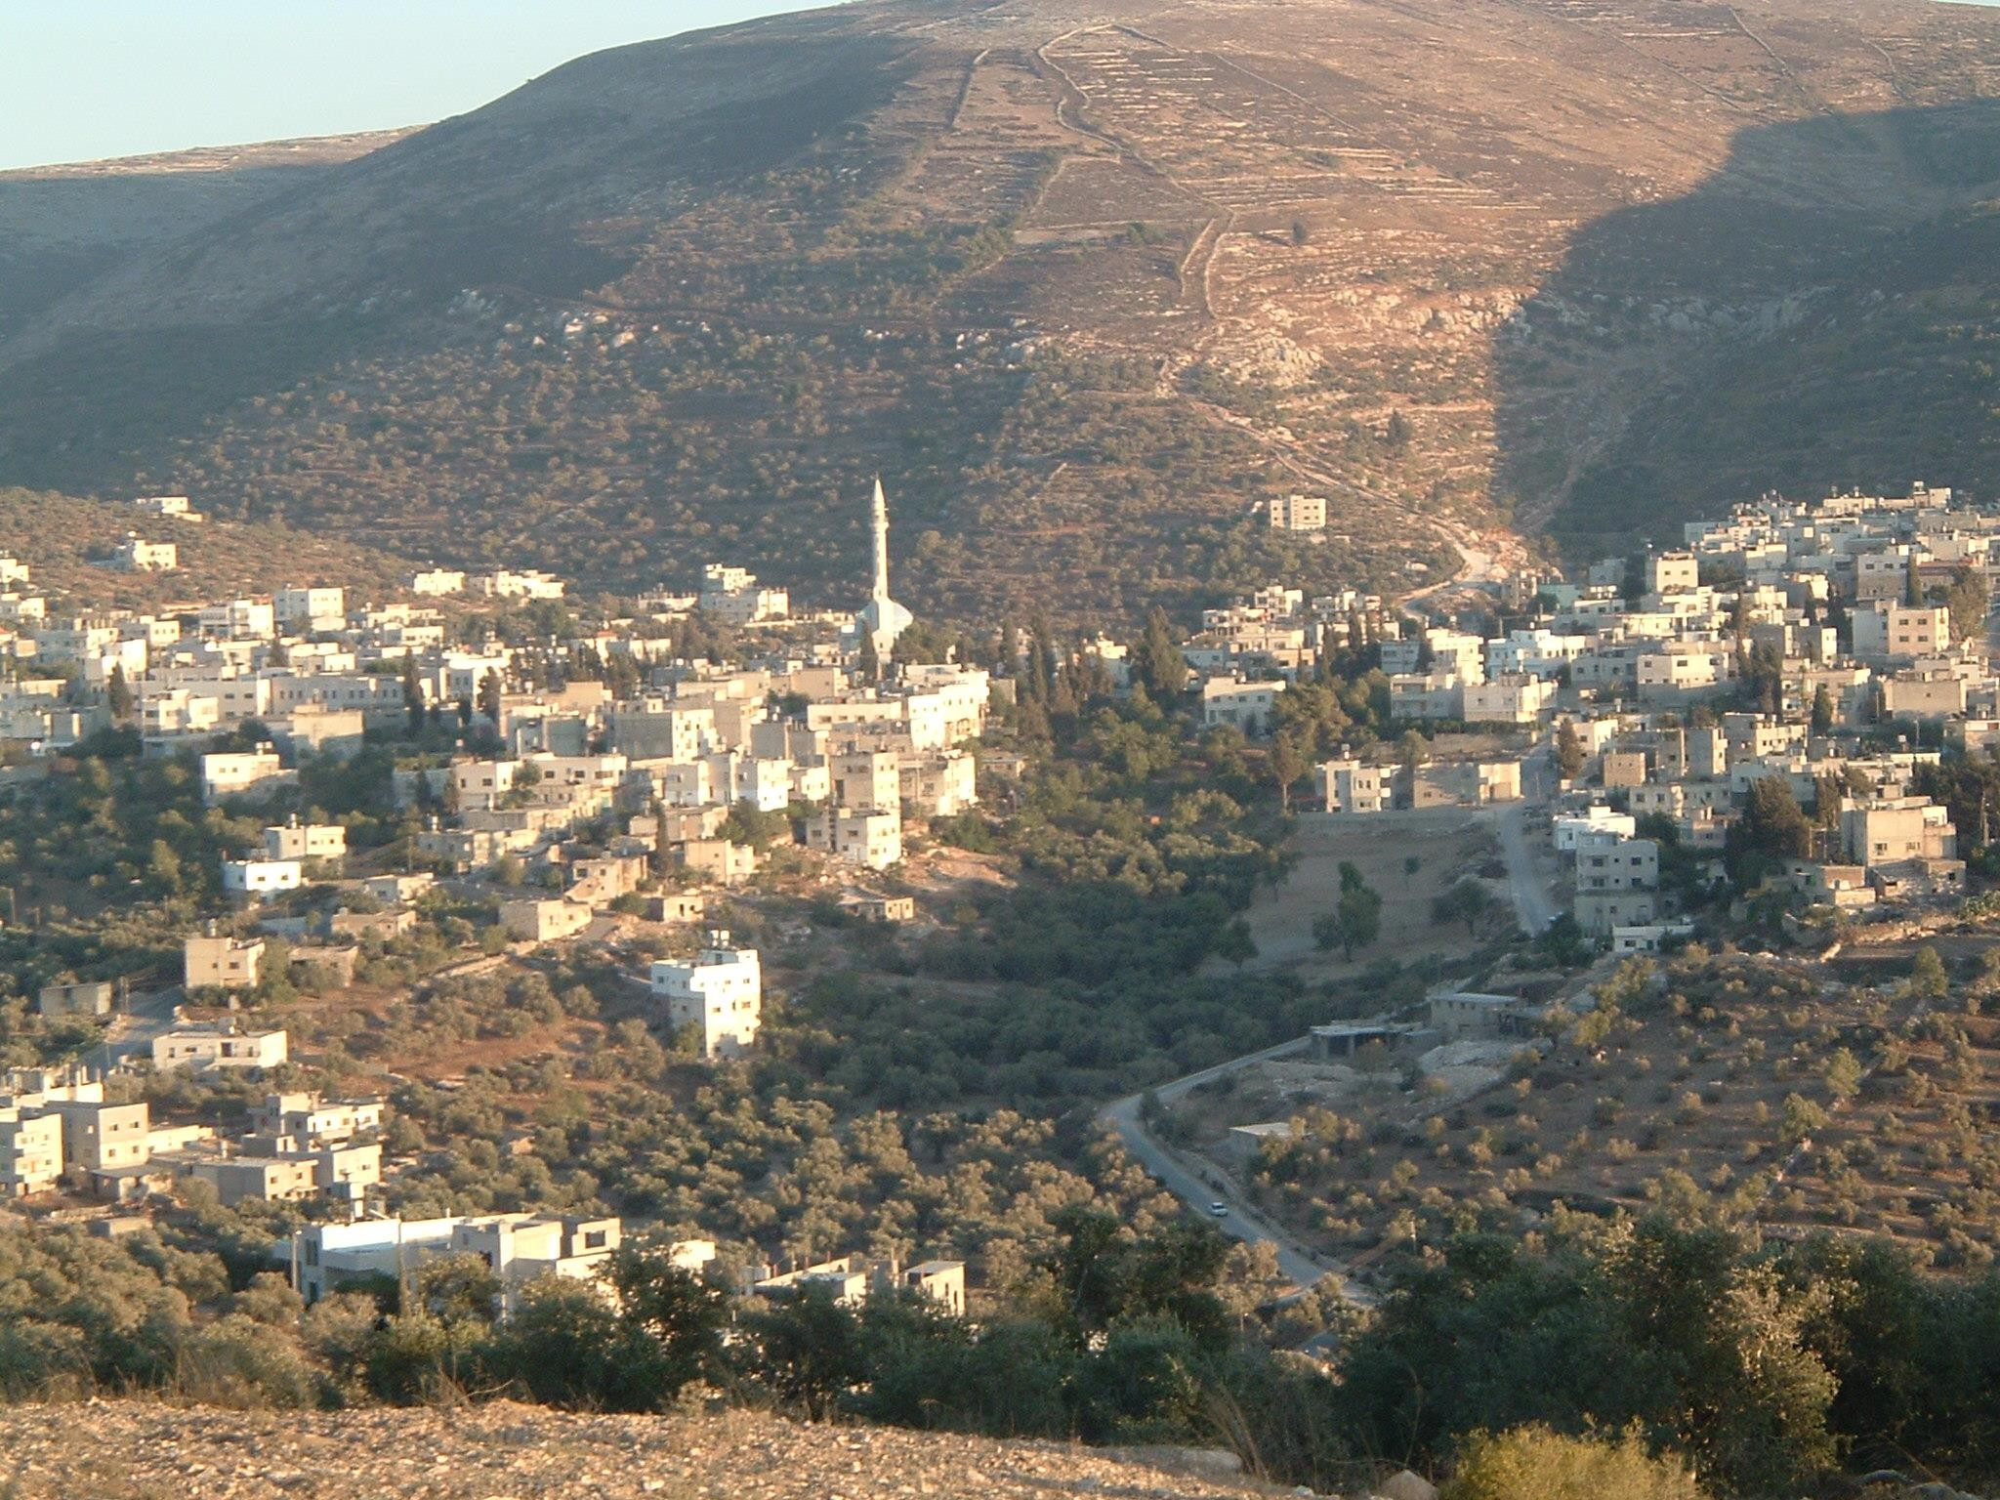










































STUDY AREA
Asira Al Shamaliya is a Palestinian town in Nablus Governorate, located 3.5 km north of Nablus
City. The total area of Asira Al Shamaliya town consists of approximately 29 thousand dunums
Asira Al Shamaliya contains a large number of valleys and mountains. It has several factors including rifting and folding from these valleys and highlands and had managed to increase the intensity and complexity of the topographic feature.
Asira Al Shamaliya boundaries by Talluza, Al Badhan, and Azmut to the east, Nablus city to the south, Zawata, Ijnisinya, and Nisf Jubeil to the west, and Beit Imrin and Yasid to the north .

Slide 4
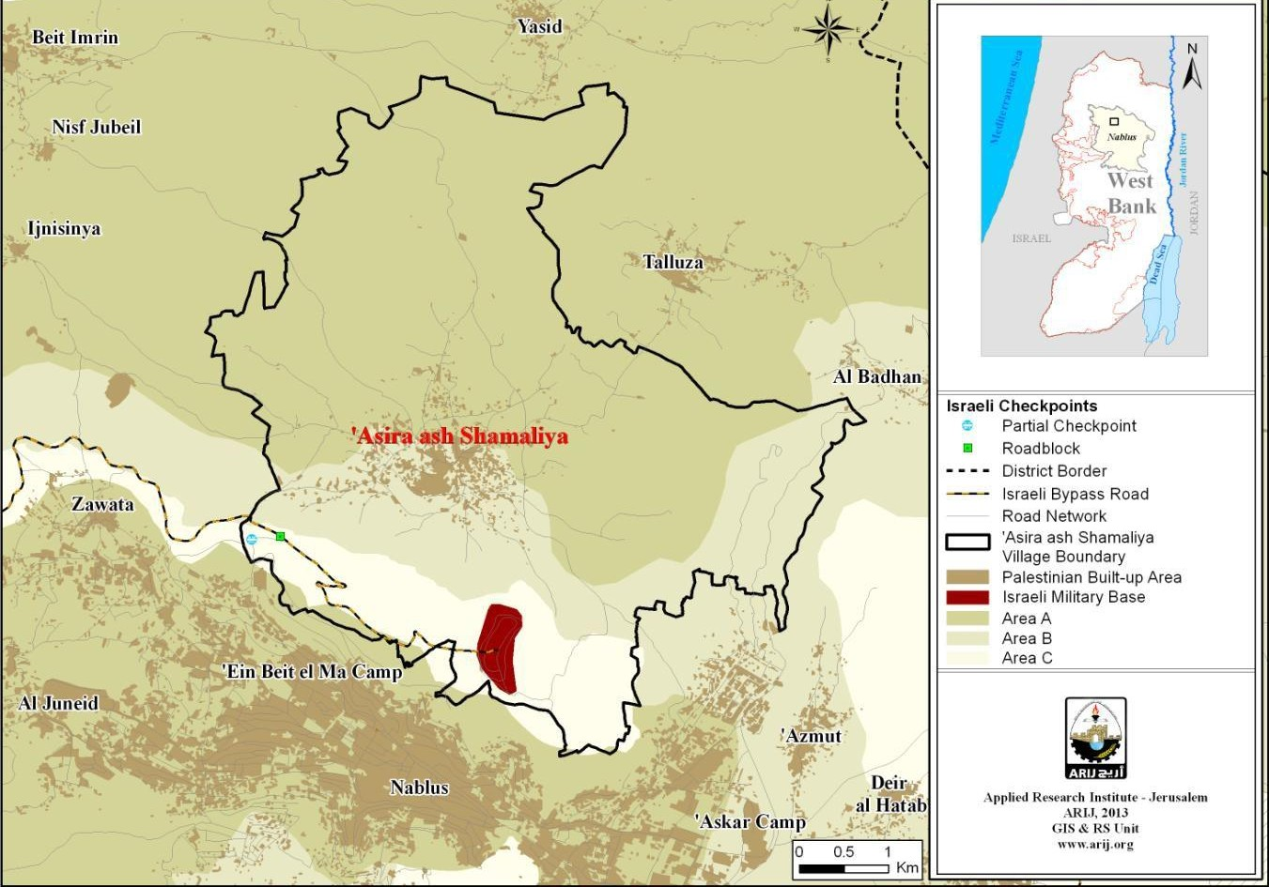

Slide 5

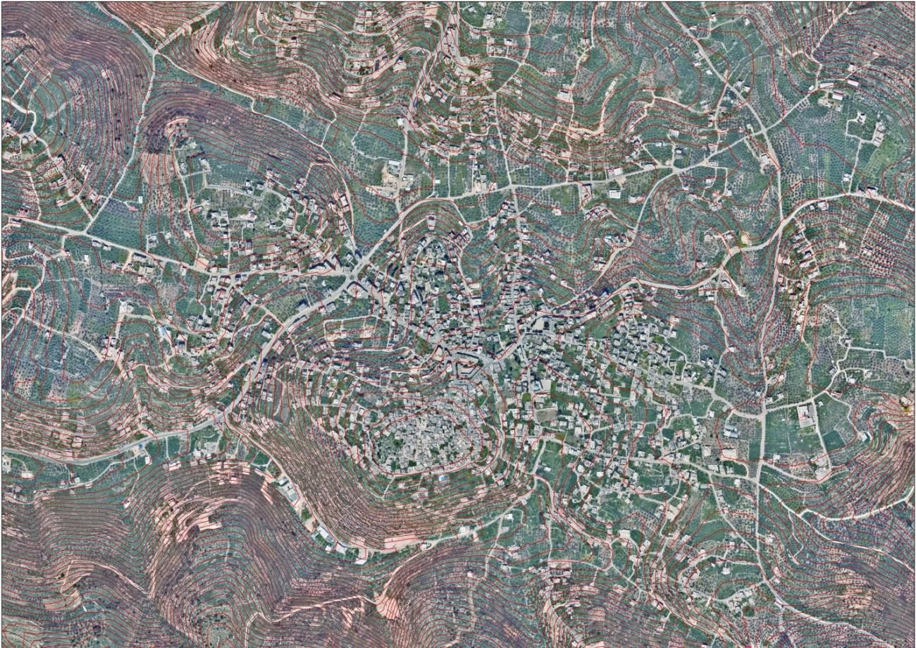
Topography
city center

Slide 6
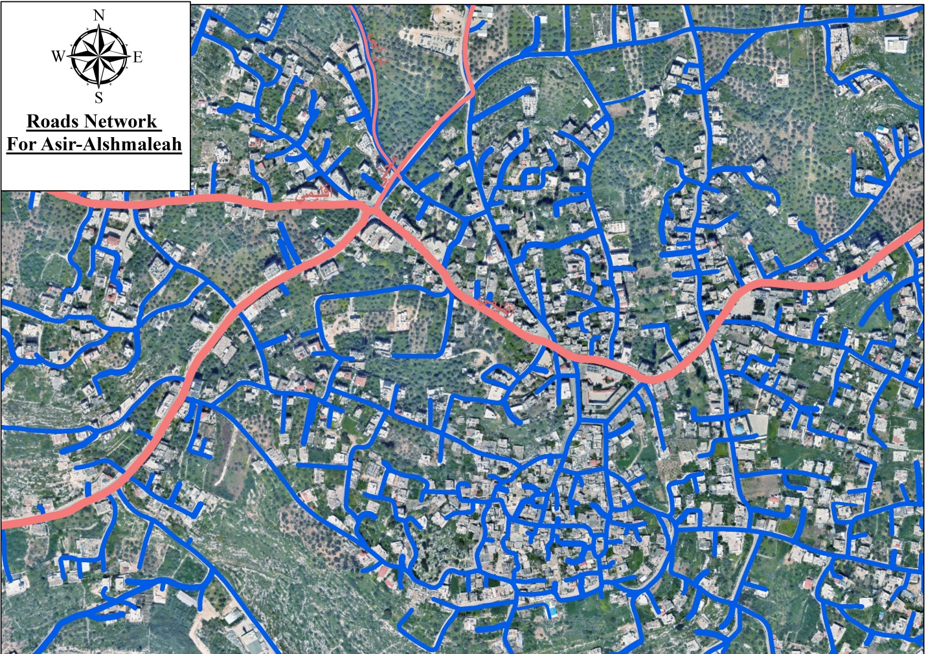
  The road network

Slide 7
Definition of Wastewater
Wastewater is what we flush and what goes "down the drain“. It comes from many different sources, both domestic and industrial and contains many different compounds. Wastewater is composed primarily of natural organic substances. Which are the byproduct of human animal and plant processes. The primary elements in our wastewater include nitrogen phosphorous, ammonia and carbon. The large quantities present in the wastewater could be harmful if they were not removed.

Slide 8
design period
The population growth and water use by the community and the industries
The useful life of component structures and equipment
According to these criteria, and taking into account all factors in predicting population, the design period for this project is chosen to be 30 years

Slide 9
Year | Population | Year | Population
1922 | 1179 | 2000 | 6421
1931 | 1542 | 2007 | 7,441
1945 | 2060 | 2017 | 8737
1961 | 3232 | 2018 | 8906
1967 | 3217 | 2019 | 9078
1975 | 3620 | 2020 | 9254
1987 | 4586 | 2021 | 9432
1992 | 5090 | 2022 | 9613
1997 | 5724 | 2023 | 9795

Slide 10
 |  | R | Census Year
The pre-war in 1967 | 2.66 | 3.03 | 1922-1931
 |  | 2.09 | 1931-1945
 |  | 2.85 | 1945-1961
1967 | 0.078 | 0.07 | 1961-1967
Post-war period in 1976 | 2.57 | 1.49 | 1967-1975
 |  | 1.99 | 1975-1987
 |  | 2.11 | 1987-1992
 |  | 2.37 | 1992-1997
 |  | 3.90 | 1997-2000
 |  | 3.55 | 2000-2007
2007-2023 | 1.82 | 1.61 | 2007-2017
 |  | 1.93 | 2017-2020
 |  | 1.91 | 2020-2023
 |  | 2.21 | Average values previous

Slide 11
  Population Forecast
P_{n} = P₀ (1+r/100)^{n}
Year | Population
2023 | 9795
2053 | 18873

Slide 12
Scenarios for the future population of Asira Al Shamaliya:
That the political situation remains as it is and therefore the population in 2053 will be 18873 people
That there be a political solution, thus assuming that 40% of the population abroad will return to the town
Immigration to Palestine and its liberation

Slide 13
That there be a political solution, thus assuming that 40% of the population abroad will return to the town
Asira population outside Palestine = 9000people
The percentage of the population expected to return to Asira and live there permanently= 40%
A population outside Asira expected to return= 3600
On the assumption that the population increase to the families of Palestinian Asira who are outside are the same for them at home = 2.21%.
Using the previous equation, the number of Asira residents outside Palestine who are expected to return to their country in 2053 = 6939 people

Slide 14
Immigration to Palestine and its liberation
Asira population outside Palestine = 9000people
The population of Asira in the year 2053 with the number of people immigrating to ASIRA = 71396
Using the previous equations to calculate the growth rate, considering the current population to be 9,795 and the future population to be 71396, the growth rate = 4.7%
Considerations of the increase in the growth rate as a result of the liberation of the Palestinian lands
The return of the population to their country of origin
The return of lands (C) that were under the control of the Israeli occupation to the Palestinians, with an estimated area of ​​4016 dunums, which accommodates approximately 28,915 housing units.
Improved economic, social and health conditions

Slide 15
Future population growth areas
Asira Al Shamaliya is divided into a number of areas and housing units. We studied each area separately and the population growth in all areas cannot be considered the same. There are areas where the population increase is very small because it has become densely populated and there is no room for more homes and people.
There are areas that tend towards population sprawl, which are the areas of available modern services and surrounding public facilities as a result of the population increase at a higher rate.

Slide 16
No. | Region | Area (*10³ m²) | The percentage of housing units in each region(%) | Number of housing units | Percentage increase in the region | The number of housing units in 2053
1- | Al-thhore | 1052 | 2.5 | 80 | 4 | 259
2- | Wadi cadarah | 1100 | 5.7 | 182 | 3 | 442
3- | Mascat school | 217 | 3.4 | 109 | 4.5 | 408
4- | Al-quserat | 324 | 4.1 | 131 | 4.5 | 491
5- | Ejnesenya road | 819 | 10 | 320 | 4 | 1083
6- | Wadi al-sabei | 717 | 8 | 256 | 2.5 | 536
7- | Sporting Club old | 121 | 3.1 | 99 | 1.5 | 155
8- | Asira a school for boys | 174 | 5 | 160 | 0.5 | 186
9- | Abu Khalil Mosque | 57 | 5.2 | 166 | 0.5 | 193
10- | Carme sewalem | 182 | 7.0 | 225 | 1.5 | 284
11- | Center of Asira town | 33 | 3 | 96 | 0.5 | 112
12- | Old Asira town | 141 | 10 | 320 | 0.5 | 163
13- | Al-masaih | 92 | 3.5 | 112 | 2 | 203
14- | Haret Abdul al-Jalil | 73 | 5.5 | 176 | 1.3 | 259
15- | Omar ibn Al-Khattab mosque | 58 | 3.3 | 106 | 2 | 192
16- | The old police | 51 | 5 | 160 | 2 | 250
17- | Haret al-safa | 79 | 4.7 | 151 | 2 | 273
18- | Haret Al-mahed | 101 | 8 | 256 | 2.3 | 507
19- | Kalet Al-tine | 61 | 4 | 128 | 3 | 311
 | Total | 5348 | 100 | 3233 |  | 6307

Slide 17
Source of water
The quantity of water supplied to Asira Al Shamaliya town in 2022 was recorded at approximately 328,500 cubic meters/year
The town also has five springs and 1,000 individual household rainwater harvesting cisterns, as well as a public water reservoir with a capacity of 1000 cubic meters

Slide 18
Questions about Rainwater Collection Cisterns
Q 1: Surface area of ​​the house (m ²) =178m ²
Q2: collection well (cisterns) size (m ³) =74 m³
Q3: Distance between collection well and cesspit (m)= 31 m

Slide 19
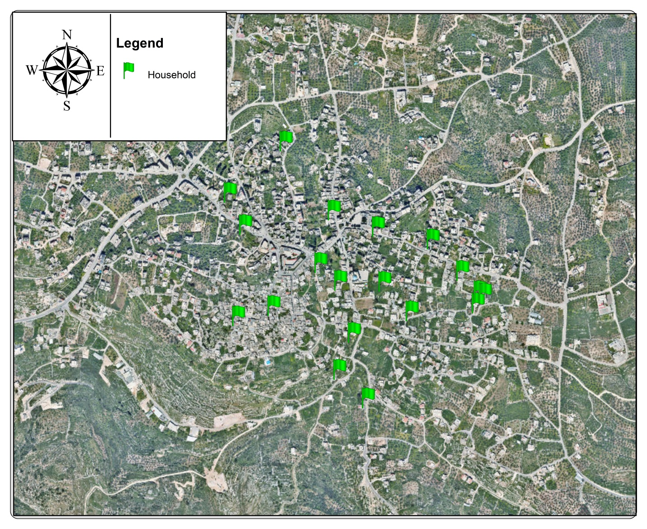

Slide 20

Average per capita consumption of municipal water
Average per capita consumption from a collection well
Quantity of Water consumed per day

Slide 21
Average per capita consumption of municipal water
No. | Region | Average monthly water consumption for a family(M3) | Per capita water consumption (L/D)
1- | Carme sewalem | 10.1 | 67.3
2- | Wadi al-sabei | 11.4 | 76
3- | Al-quserat | 10.25 | 68.3
4- | Old Asira town | 8 | 53.3
5- | Haret Al-mahed | 11.2 | 74.4
6- | Haret al-safa | 14.2 | 94.4
Average =72.3 L/D

Slide 22
Average per capita consumption from a collection well
average size of the collection well = 74m^3
number of family members in the town = 5 people
Average = 74/360 =0.2
Average =0.2/5 =0.041
Average =0.0411*1000 = 41 L/D

Slide 23
Total per capita consumption of water
72.3
41
114 L/D

Slide 24
Water consumption rate for the industrial area
Factories | monthly consumption rate (m ³ ) | daily consumption rate(L/D)
brick factory | 150 | 5000
Olive presses | 500 | 16667
Stone saw | 15 | 500
farmer
Poultry farm | 30 | 1000
Gardens
swimming pool | 65 | 2167
schools
The primary school | 20 | 667
Muscat school | 25 | 834
Jawaher School | 85 | 2834

Slide 25
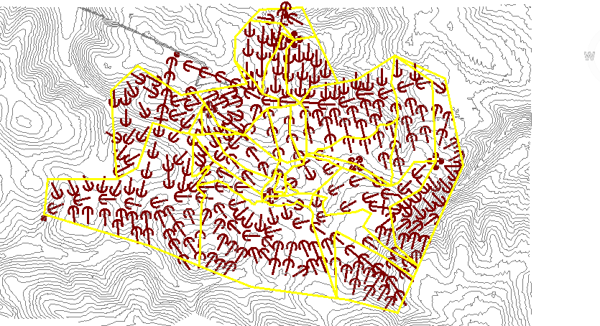
Strom water flow directions of Asira Al Shamaliya
Suggestions for the location of the sewage treatment plant

Slide 26
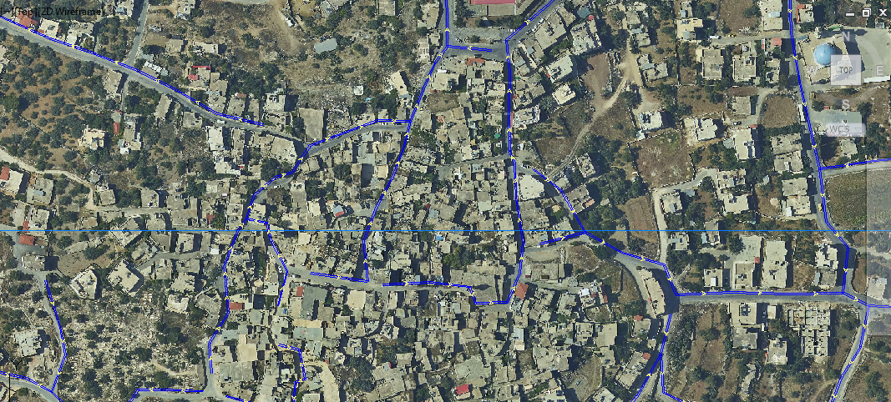
Strom water flow directions of streets Asira Al Shamaliya

Slide 27
Sewage network components
pipe
Manholes

Slide 28
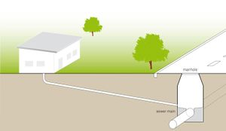
Collection System
The Sanitary Sewer Collection System is a complex network of underground pipes, the pipes are made from several different materials. These materials vary depending on the time they were installed.
Manhole
The sanitary service connection is a pipe that runs from the sanitary main in the street to the residence or buildings. The diameter of the sanitary sewer pipe is usually 8 inch but can be larger for commercial or industrial services
Pipes

Slide 29
Sewerage System Design Criteria
the highest water consumption that was recorded for the village is 95 L/D
Average per capita consumption from a collection well=41L/D
, we can consider 136L/D for the purpose of designing the sewage network
Actual amount of wastewater =0.7*18873*0.136 *5.2= 9343m³ /d
Wastewater Generation

Slide 30
Sewerage System Design Criteria
Minimum Pipe Diameter : the minimum pipe diameter for the collection network is Ф (8in)
Peaking Factor :the projected peak flows that might reach as high as 5 times the average daily flows
Minimum and Maximum Sewage Flow Velocities (0.7-3.0)
Depth of Flow :The depth of sewage flow in the pipes at peak rates is to be maintained within the limit of (d/D) <( 0.70 - 0.75)
Use the Manning equation in the design

Slide 31
graduation project 2
Developing the sewerage network

Slide 32
Before starting the design we have to define some terms related to sewage systems such as:
sewer and sewage.
Sewer is a pipe used to transport human waste to the proper disposal place. The system of sewers is called sewerage or sewerage system.
Sewage or wastewater is water contains wastes which is discharged by domes residences, commercial properties, industry and agriculture, and transmitted by sewers to the place of disposal.

Slide 33
Manholes are used for making connections, performing maintenance on Underground and buried public utility including sewers and storm drains, and For inspection.
Wastewater transfers by gravity until it reaches the final assembly station or treatment plant.

Slide 34
A number of obstacles will appear
pipeline excavation.
limited topography and existing infrastructures.
Also, gravity collection systems may not be practical and the sewage must be pumped through a pipeline to the treatment plant.

Slide 35
Object of project 2
As we mentioned before this project aims mainly to:
Design a wastewater collection network for Asira town using SewerCAD

Slide 36
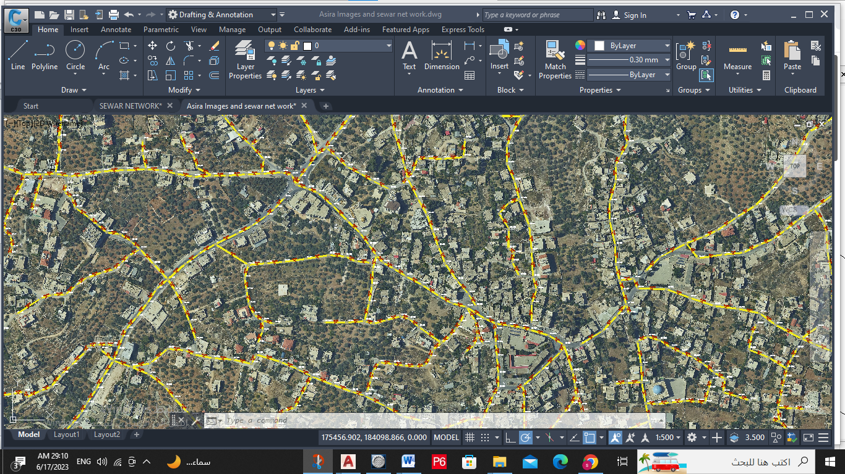

Slide 37
  Methodology of building the network:
Determination of the study area where the networks will be designed
Getting data about the study area (Asira Al Shamaliya)
Start using SewerCAD software
Design of Asira Al Shamaliya sewage network using SewerCAD program:

Slide 38
Determination of the study area where the networks will be designed:
The location of Asira Al Shamaliya according to Nablus.
The Ability to establish the network.
Accessibility.

Slide 39
Getting data about the study area (Asira Al Shamaliya)
Information about water sources of the study area getting from municipality and village council
Contour map represents the study area.
AutoCAD maps for study area including (roads, buildings, contour lines).

Slide 40
Design of Asira Al Shamaliya sewage network using Sewer CAD program:
steps
Draw the network this include (manholes, sewers).
Input data to SewerCAD program. This includes:
Manholes data, represented by manhole diameter, rim invert and ground elevations, and loading.
Pipes data, represented by section shape, material, manning coefficient, section size, upstream and downstream elevations.
Constraints data represented by cover constraints, velocity constraints and slope constraints.
Outlets data, represented by sump, rim and ground elevations.

Slide 41
Save input and then run
The results included errors and warning messages, so we solved these errors by modifying
the design accordingly.
Get the results ,This include:
•Profiles
•Tables of manholes and pipes.
•Plans

Slide 42
Calculating waste water loading:
(design period population * Per capita water demand* % of produced waste water to consumed water *( Infiltration rate peaking factor )
design period population=30 years
per capita water demand=136(L/c.d)
% of produced waste water to consumed water =70
Infiltration rate =20%
=(25812*100*70%*(0.2+5))=12778m3/day

Slide 43
Water consumption (L/c-d) | WW/W percentage | Maximum hourly facto | Infiltration rate (%) | Unit sanitary load (L/d)
136 | 70 % | 5 | 20% | 495

Slide 44
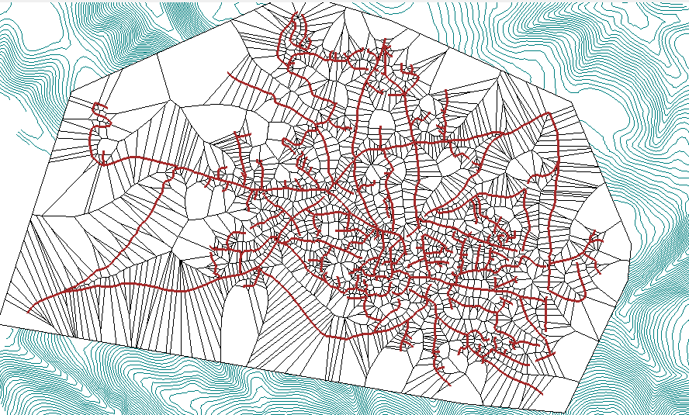
    layout of sewer network:

Slide 45
The demand for manholes
Each manhole tack a of sanitary load depend =( area * density)

Slide 46
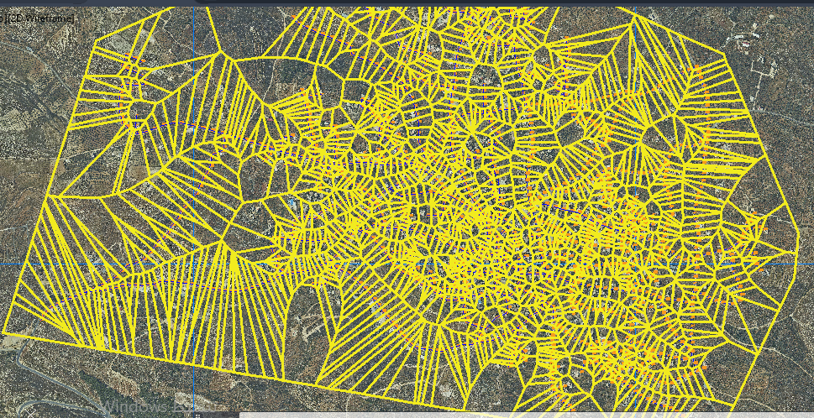
Where we divided the area on each manhole using the Thiessen polygons method

Slide 47
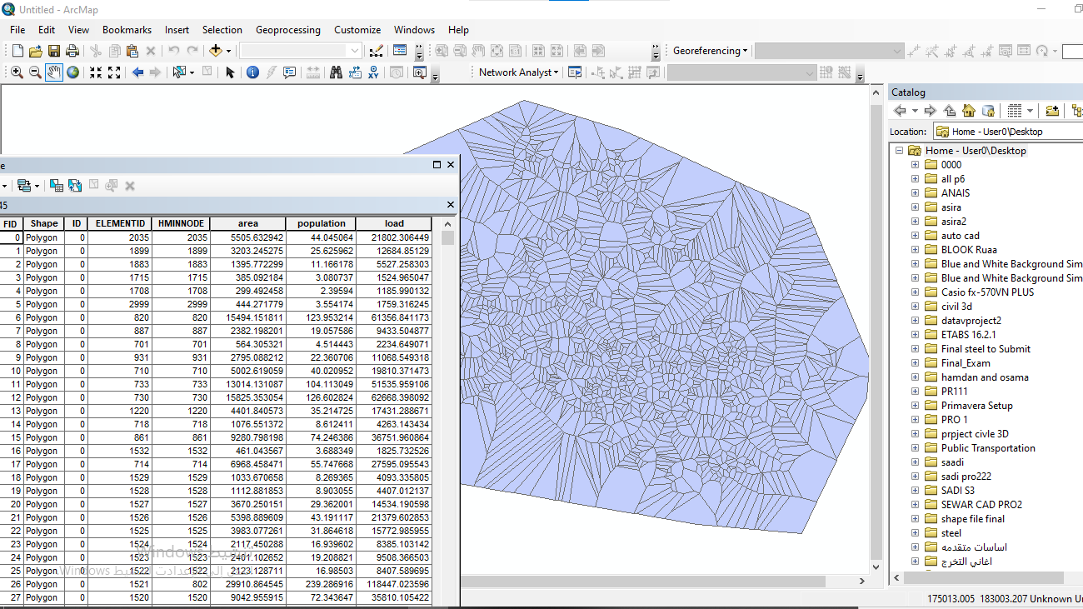
We calculated the area of each polyline and multiplied it by the population density using the ARC Map program

Slide 48
The demand for manholes
The per capita consumption of wastewater is 495 L/D
population * 495

Slide 49
    conduit result:
Desiccation on conduit results:
length of conduit good should be in range between (20-50)m but with any change in direction of street well need to manhole so the length will increase but in general its good .
slop: maximum slop =8% and minimum slop = 1% within the design constrain so very good
section type= circle and catalog class =pvc with 8-inch diameter
velocity: maximum velocity = 4.84 m/s and minimum velocity =0 m/s which it within so very good
cover: maximum cover = 23 m and minimum =0.91 m which are not within the constrain cover
(1 -5m) that we will discuss it latter and found the best recommendation for this problem .

Slide 50
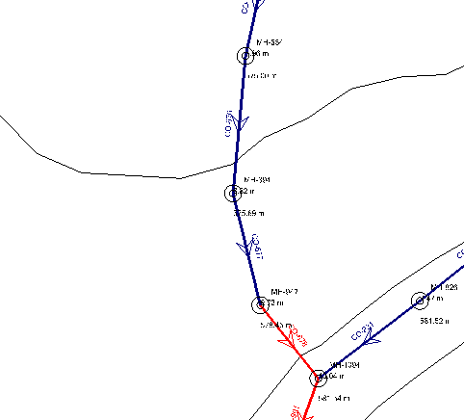
We note that the direction of the wastewater is against the direction of gravity, as shown in the rise of the ground surface of the manholes

Slide 51
the solution:
Suggestion of a pump in CO-673 to pump wastewater to CO-901, which estimates the amount of wastewater to be pumped 1830.82 M³/D

Slide 52
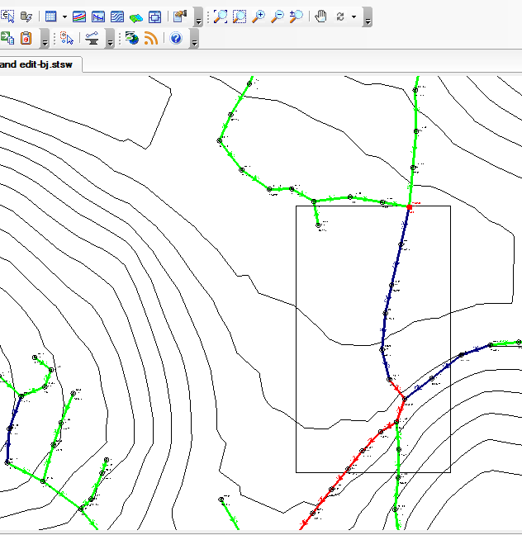
pump

Slide 53
Thank you

