Slide 1


Prepared by :
Shayma Owais.
Sabreen Qadomi.
Supervisor :
Dr. Alaa Almasri
Dr.Hanal Abo Zant

Slide 2
Outline
Overview .
Methodology .
Traditional process Vs. online process .
Online donation .
Online blood bank management .
Future work .

Slide 3
Life Insurance
Projects’ idea ???
Help, facilitate and simplify the management process.
Simple and user friendly system (Donors , Admin) .

Slide 4
Methodology
Languages used :
HTML, CSS (Front End).
PHP language (Back End).Which intended for the development of web applications following the model view controller(MVC) , JavaScript
Xampp Server (for the Database).
Photoshop (for designing).

Slide 5
Traditional process vs. online

Slide 6
Part 1: Online donate process:
Online Donate | Traditional Donate
Time saving | Time consuming
Donors online can know that his/her request accept or reject .If accept ,will give him/her appointment to donate. | Donors must travel, maybe long distances, to ask donate, which may be accept or reject according condition of donate.
Reliable: the donate process are auto recovered, there is no missing paper. | Unreliable: there is a probability of missing paper here.
Our online donate system can be accessed and done from anywhere. | Need a specific physical place in order to be done.

Slide 7
Part 2: Management Blood Bank:
Online management | Traditional management
No need paper and all is save . | Costly: need a paper and files may be lost.
Time saving | Time consuming
More performance | Less performance

Slide 8
now..
Are you ready for ..

Slide 9
Online
Easy, fast way
Secure
Confidence

Slide 10
How our project works??
Part1:Donors

Slide 11
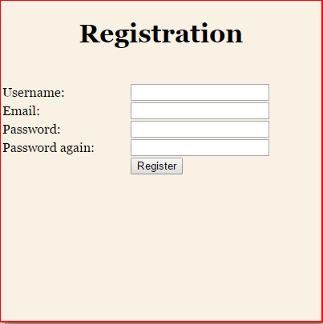
Registration

Slide 12
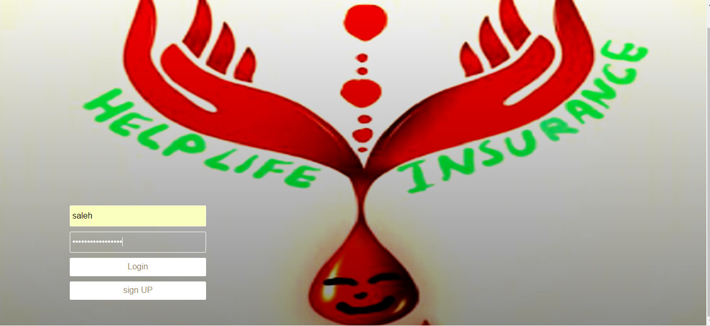
Log In

Slide 13


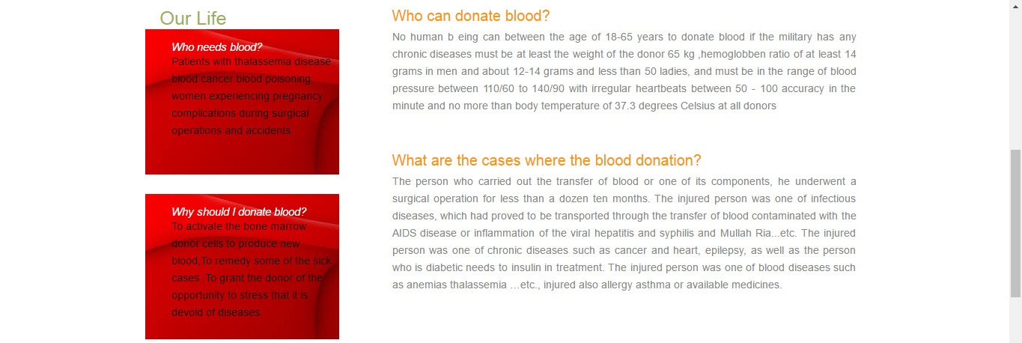
Donor Account

Slide 14
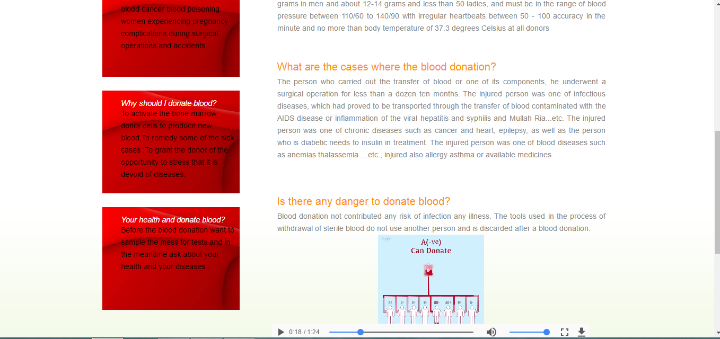
Advices for Donors

Slide 15
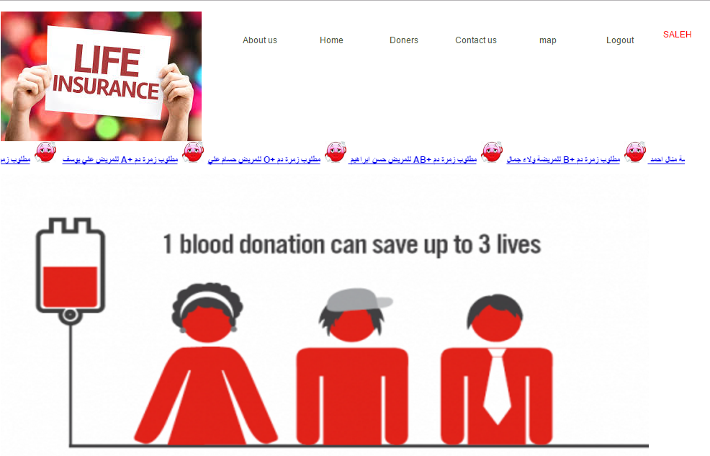
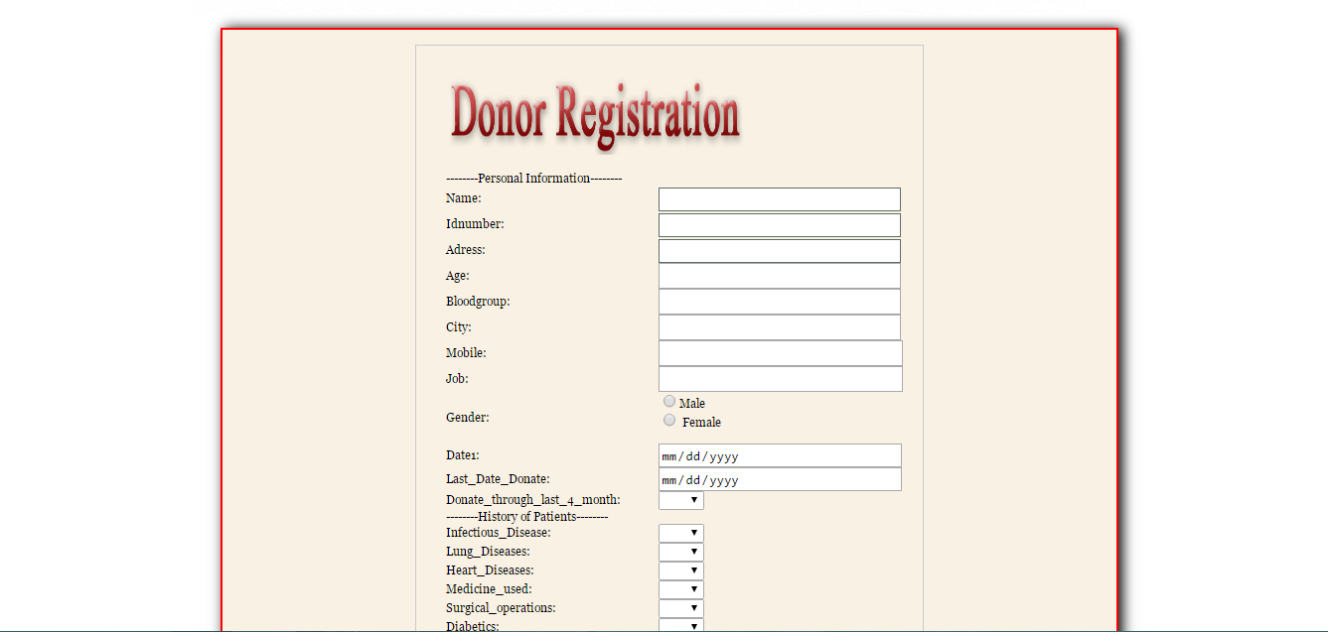
Request Donor Process

Slide 16
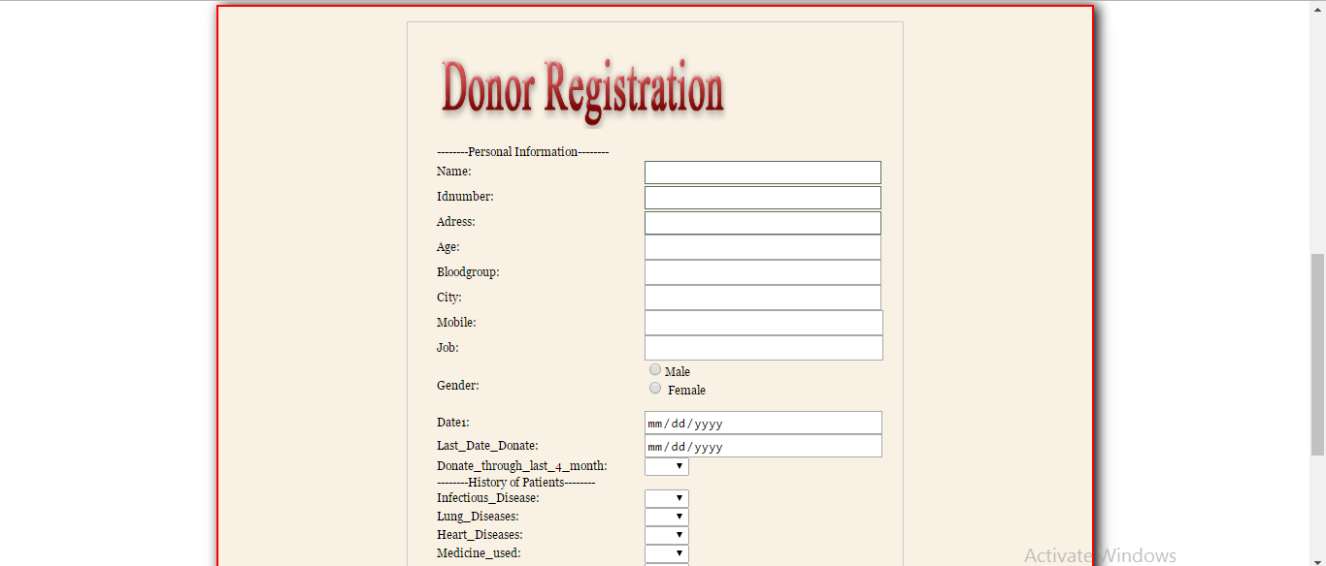
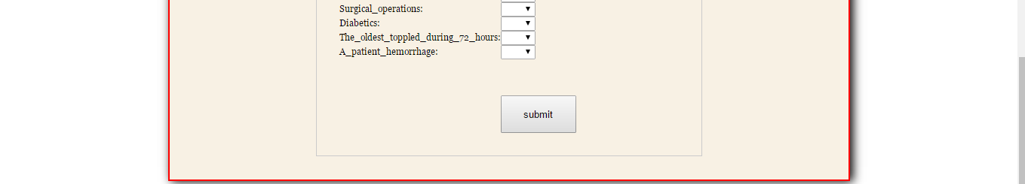

Slide 17
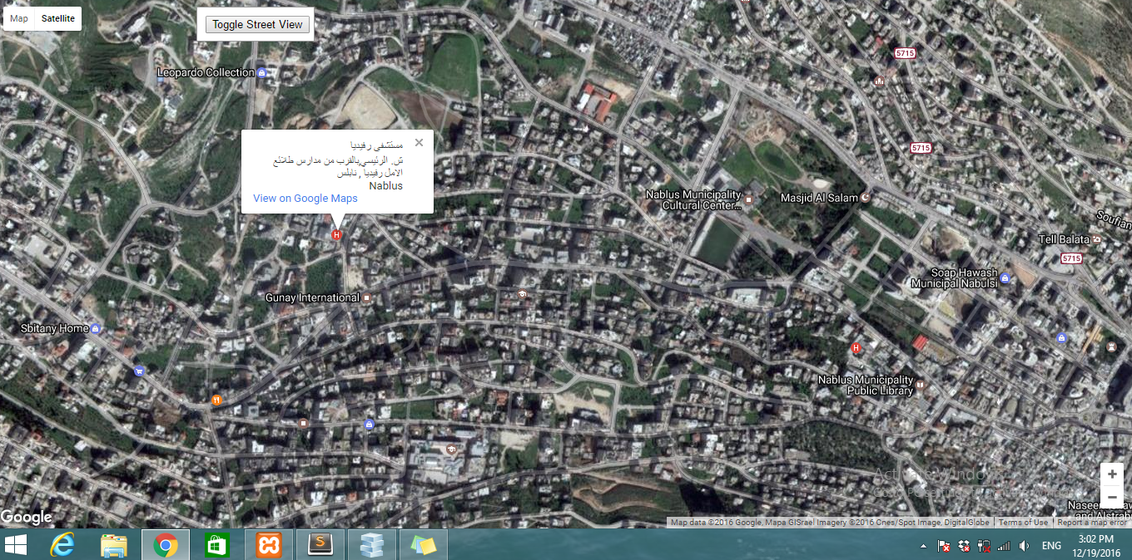
Map ( locate the position of hospitals)

Slide 18
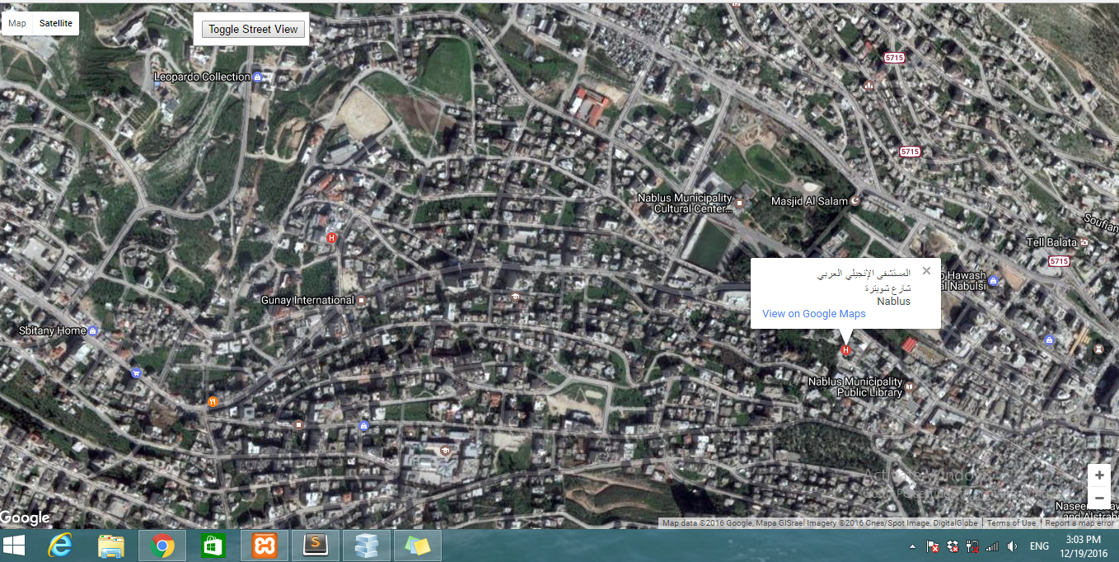
Map(cont.)

Slide 19
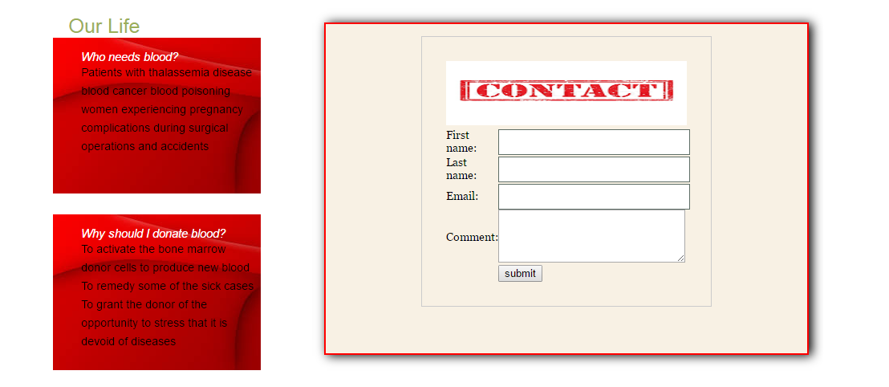
Contact

Slide 20
Part2 : Admin activities
Admin Activities
Add User.
Add Blood Group.
View number of units of each Blood Group.
Search About Donor.
Search About City.
.Search Blood Group
Delete Blood Group.
Report of Blood Group.

Slide 21
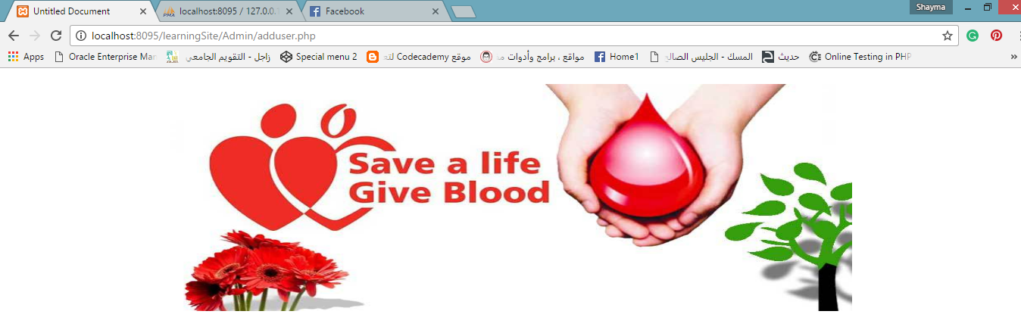
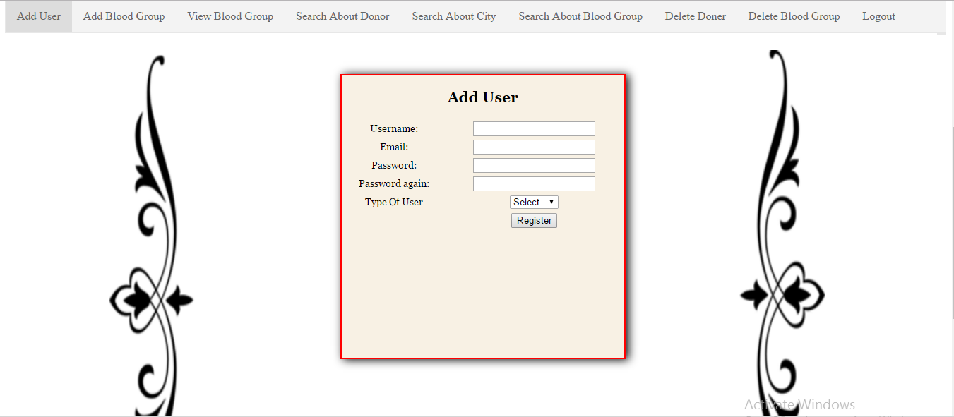
Add User

Slide 22
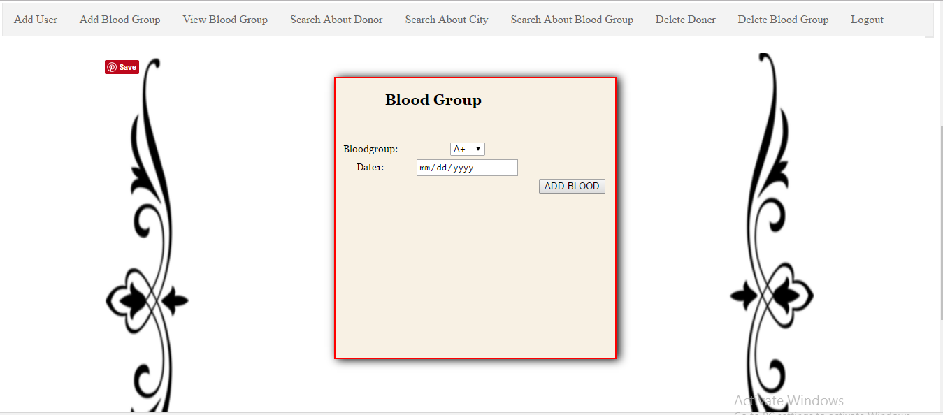
Add Blood Group

Slide 23
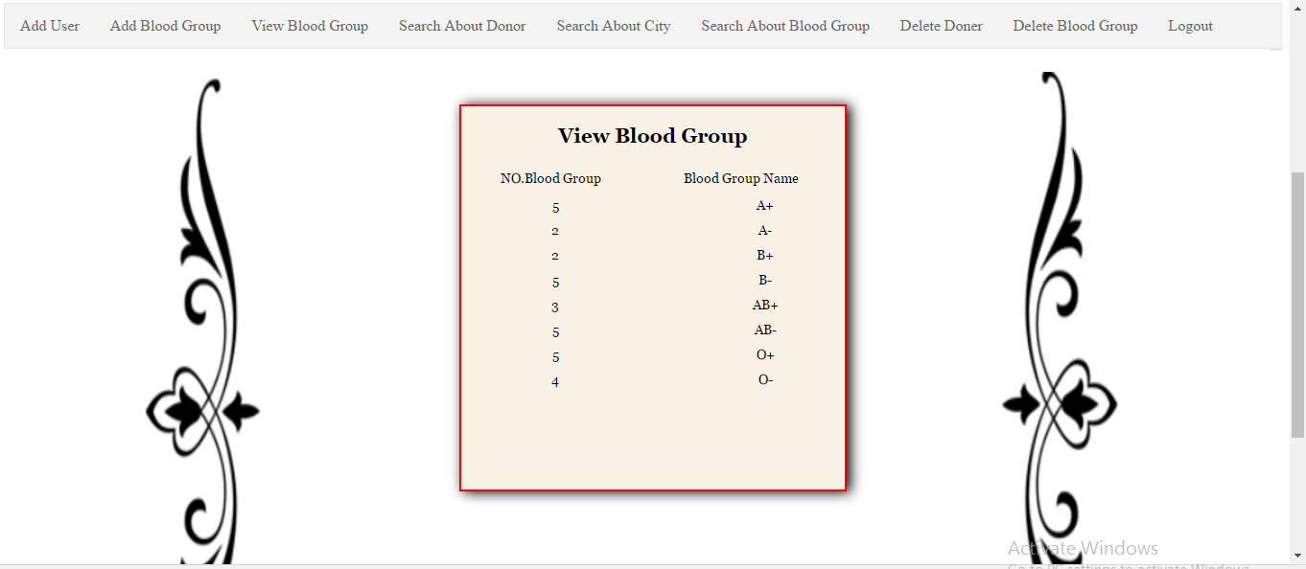
View number of each Blood Group

Slide 24
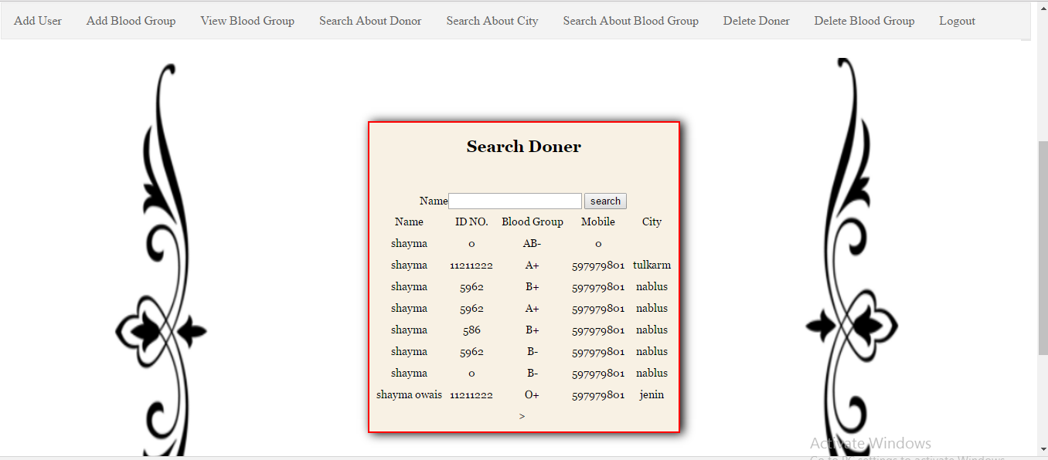
Search About Donor

Slide 25
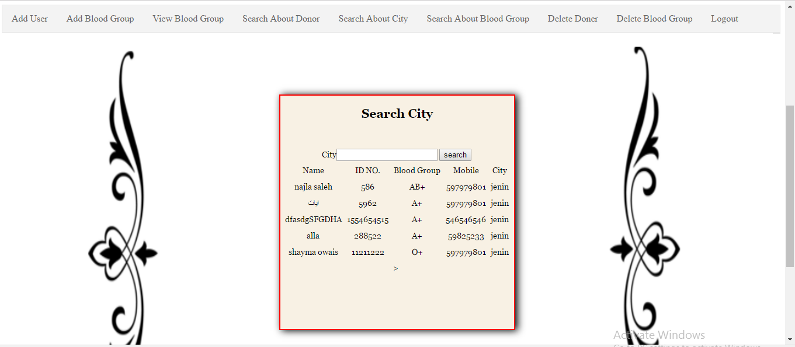
Search About City

Slide 26
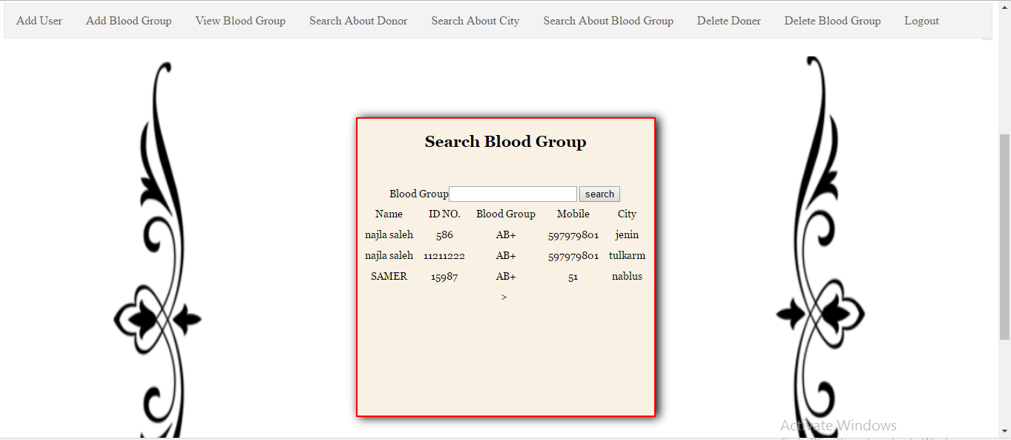
Search Blood Group

Slide 27
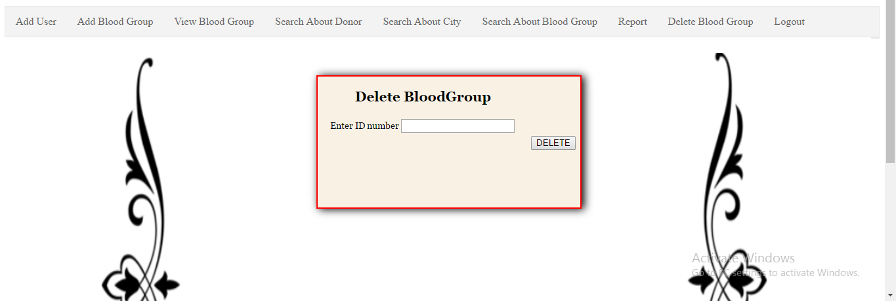
Delete Blood Group

Slide 28
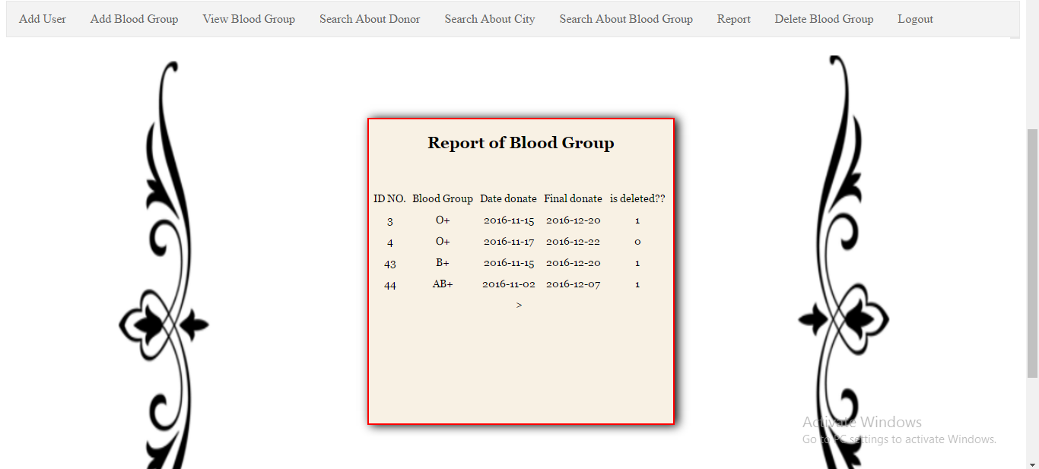
Report of Blood Group

Slide 29
Future Work
Develop our website to have more features such as:
Add a technique that :
* connect all hospitals with others .
* exchange any blood group between them .
* choose the nearest hospital to exchange it in short time in quick case .
Connect our website with mobile applications.

Slide 30

Thank you

