Slide 1
Development of a Water Master Plan for Tubas Governorate
Prepared By:
Malak Jaber.
Malak Mohammed .
Sama Yaish .
Tasneem Daraghmeh.
Under supervision of: Eng. Hamees Tubeileh

Slide 2
CONTENT
Objective
Methodology
Overview of Tubas Governorate
Clustering of the Communities
Future Population
Supply
Consumption
Future Demand
Gap
GAP REDUCTION
Phase One: Short-term Solution
Phase Two: Long-Term Solutions
The Transmission Pipeline
Water distribution network for Tayaseer
Recommendations
Conclusions

Slide 3
Objectives
In this report, an analysis will be carried out to study the quantity of water in Tubas governorate and find out whether the existing quantity of water is adequate to meet the needs of the population in the future or if there is a shortage of water. Therefore, work on discovering new and sufficient water sources to meet the water needs of the population for the next 20 years.

Slide 4
Methodology
Data collection
Analysis of present water demand
Create the concept of clusters in the Governorate
Estimation of future water gap.
Estimation of future water demand
Investigate potential future water resources.
Develop the needed infrastructure to convey water from proposed water resources to different clusters.

Slide 5
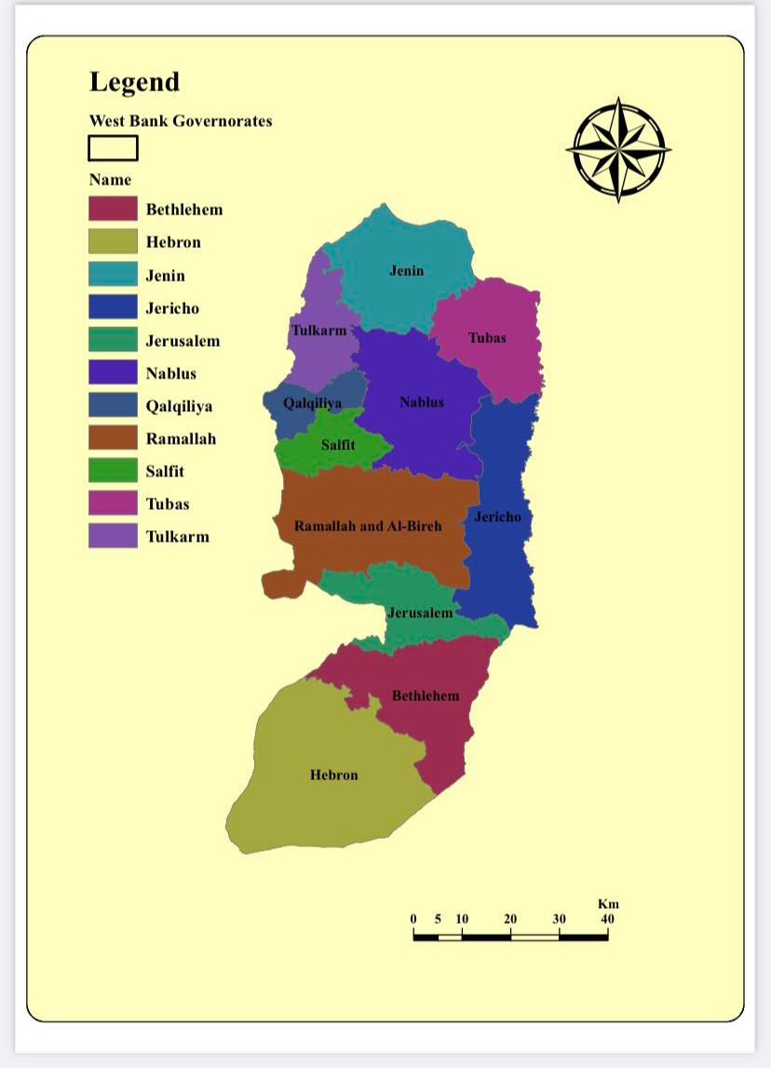
Overview of Tubas Governorate
Location and Area
Tubas Governorate is located in the eastern part of Palestine, specifically in the northeastern part of the West Bank
The area of the governorate is about 402 square kilometers.

Slide 6
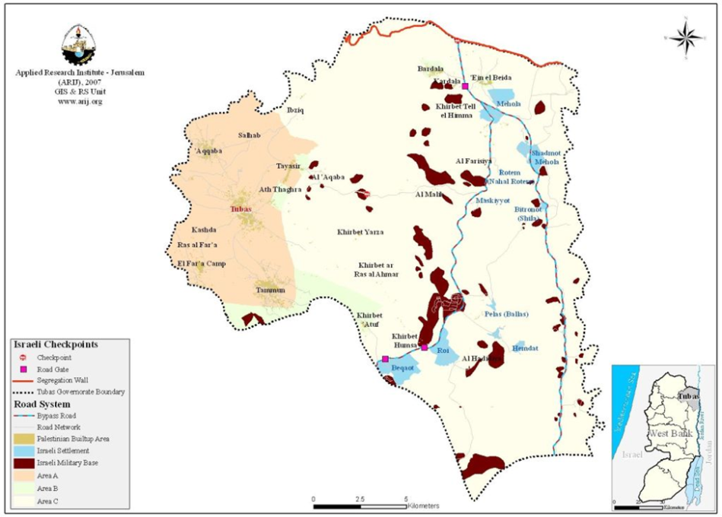
Overview of Tubas Governorate
Topography
The Governorate of Tubas has an average altitude of (600-300) meters above sea level
The key source of water in Tubas is underground wells, as, according to 2018 figures, the amount of pumping from these wells for both Tubas and the northern Jordan Valley amounts to 5.8 million cubic meters for domestic use and 6 for agricultural use.

Slide 7
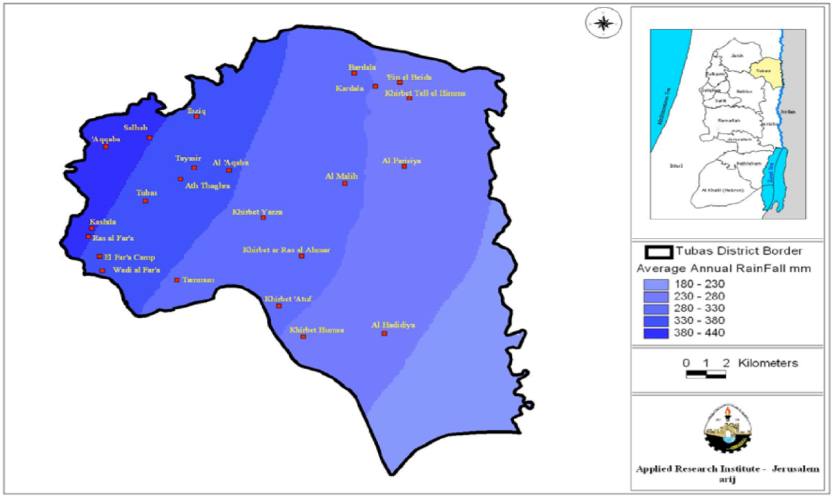
Overview of Tubas Governorate
Climate
In summer and winter, the climate of the city is mild, with an annual average of 414.6 mm of rain, and the nature of the land of the city is plain, with some hills and hills.

Slide 8
Overview of Tubas Governorate
Humidity
It doesn’t have station to measure its humidity, so according to Palestinian Central Bureau of Statistics, The relative humidity levels for 2018 in each of the neighboring stations, Nablus, Jenin and Jericho, respectively was 77%, 69% and 47%, so we will take the average of these stations and considering it as the relative humidity level of Tubas governorate, which equals 64.3%.

Slide 9
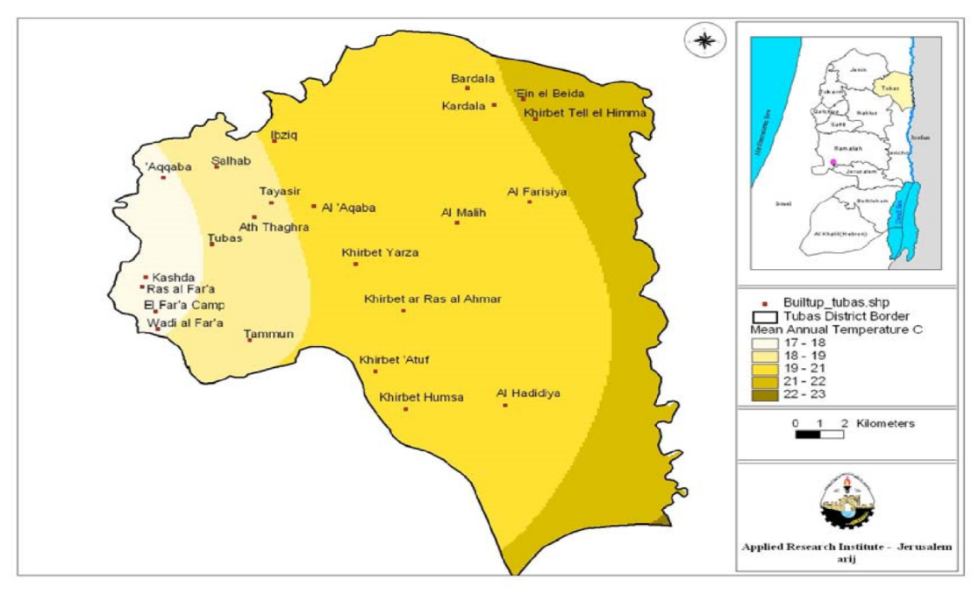
Overview of Tubas Governorate
Temperature
The average annual temperature in Tubas Governorate is 21 °C.

Slide 10
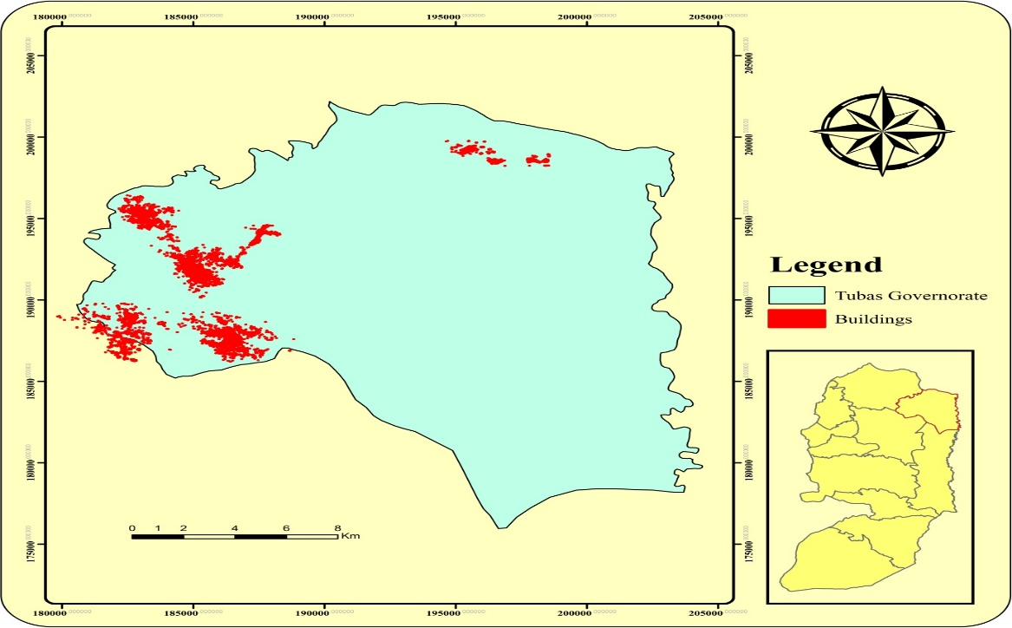
Socio-Economic Characteristics
Tubas Governorate is recognized as an agricultural area. Residents of Tubas Governorate are mainly depending on agricultural sector as well as on Israeli labor market as main source of their income.
The distribution of employed persons by economic activity, agricultural sector constitutes 35.4 % of the economic activities in Jenin and Tubas Governorates. It is considered the highest percentage in West Bank compared with other governorates.
Economic activity percentage
Agriculture | Industry | Construction | Commercial | Transportation | services
35.4 | 8.6 | 10.3 | 18 | 3.5 | 24.2

Slide 11
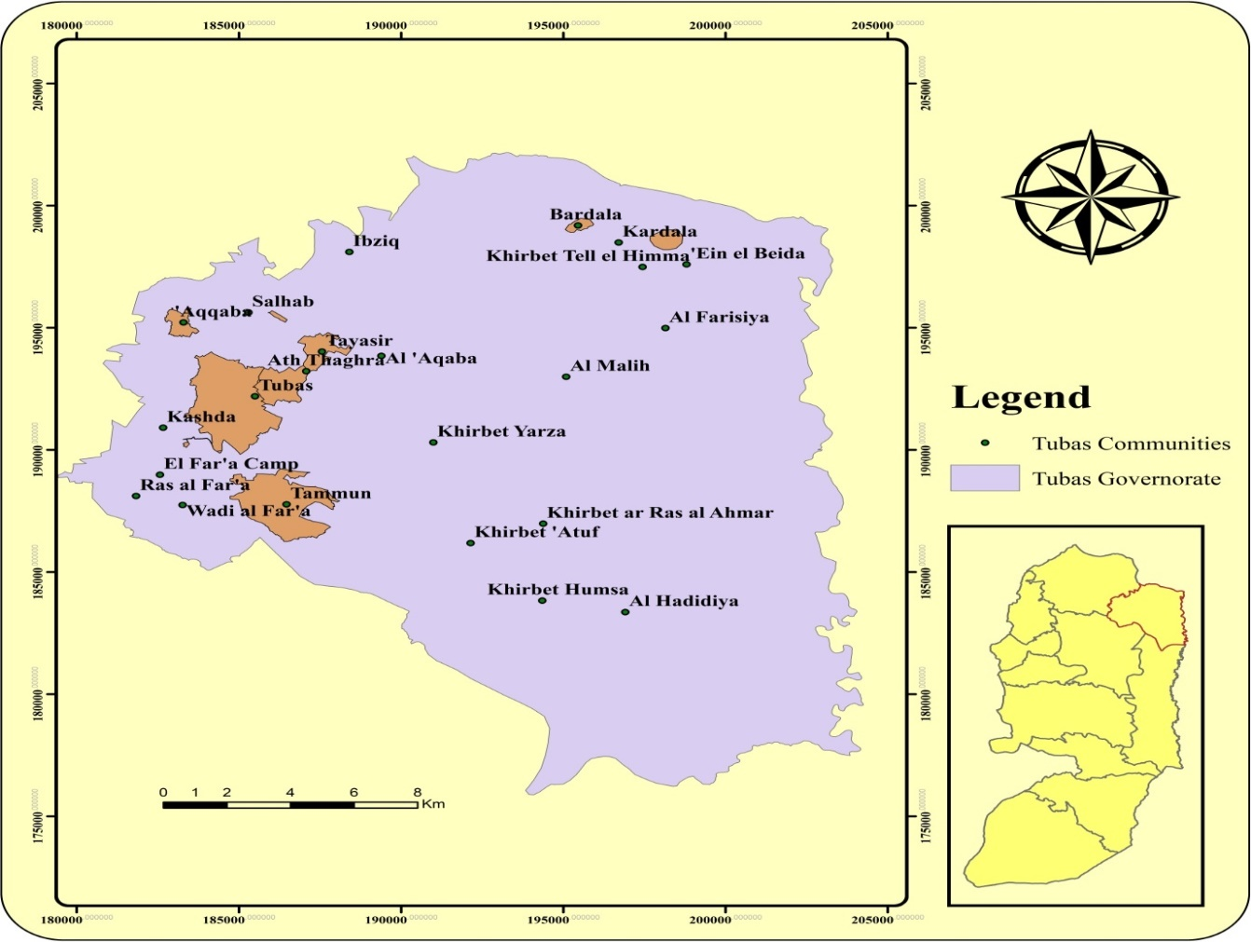
Water Sources and Effects
Underground wells are the source of water from the Tubas Governorate. Tubas is fed from its wells, which generates 135 cups/h and is pumped to Tubas 80/160 cup/h, as well as fed from Tammun well, which produces 250 cups/h and pumps to Tubas and Tammun 120 cups/h

Slide 12
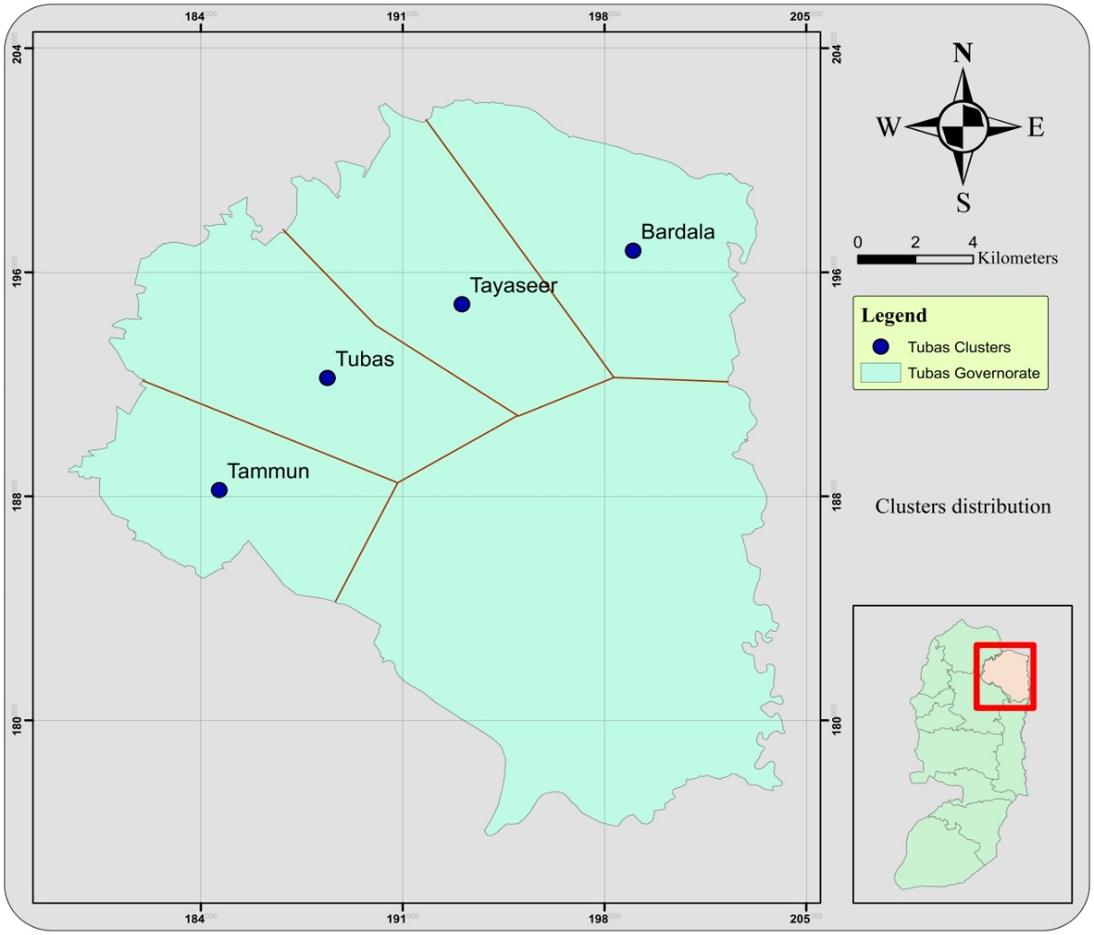
Population and Clustering of the Communities
The criteria are as the following:
The communities should be near each other and in the same regain.
The existing water network and the source of water supply.
The variation in the topographic elevation not exceed 80 m between any communities in the cluster.
The divisions were as follows:
1- Tubas cluster: contain, Tubas and Aqqaba.
2-Tammun cluster: contains, Tammun and Ras al Far’a.
3-Tayaseer cluster: contains, Tayaseer and Al-Aqaba.
4-Bardala cluster: contains, Kardala and Bardala

Slide 13
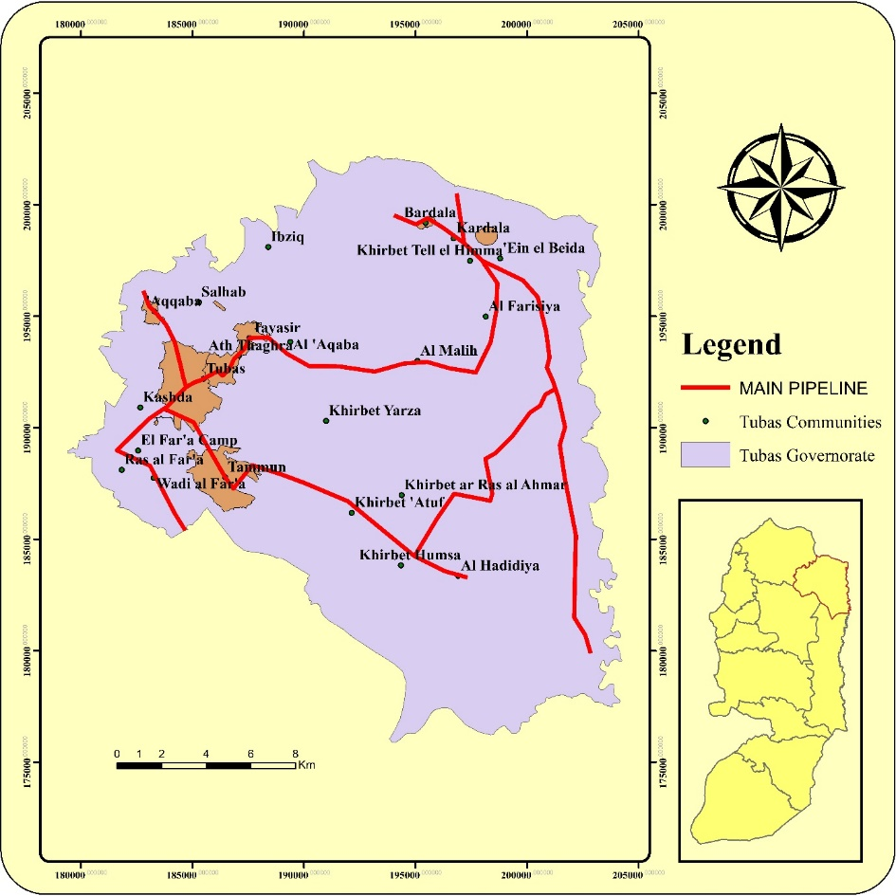
The figure below shows us the main pipe-line distribution in Tubas Governorate.

Slide 14
Future population
P_{n} = P_{0 (1+i)} ^{n}
Where:
Po: Current population.
i%:growth rate percent , i=2.2%
n: number of years
Pn: Future population
Tubas Population:
P2017= 29670 Capita
i=2.2%
Pn = P0 (1+i)n
P2025= 29670(1+0.022)8
= 35312 capita
cluster | Population
 | 2017 | 2019 | 2025 | 2030 | 2035 | 2040
Tubas | 29670 | 30990 | 35312 | 39371 | 43897 | 48943
Tammun | 14367 | 15006 | 17099 | 19065 | 21256 | 23699
Tayaseer | 3046 | 3181 | 3625 | 4042 | 4507 | 5025
Bardala | 2119 | 2577 | 2937 | 3275 | 3651 | 4071

Slide 15
Supply
Tubas Cluster Supply:
To calculate Total Supply in 2019= 643397.12 m3/year.
Supply =(𝑡𝑜𝑡𝑎𝑙 𝑠𝑢𝑝𝑝𝑙𝑦 ∗1000)/(𝑛𝑢𝑚𝑏𝑒𝑟 𝑜𝑓 𝑑𝑎𝑦𝑠 𝑖𝑛 𝑡ℎ𝑒 𝑦𝑒𝑎𝑟∗𝑝𝑜𝑝𝑢𝑙𝑎𝑡𝑖𝑜𝑛)
Supply2019=(643397.12∗1000)/(385∗25506.34)= 74.65762L/c. d
Total Supply2025 = 643397.12m3/year
Cluster | Population
 | 2019 | 2025 | 2030 | 2035 | 2040
Tubas | 774598.5 | 774598.5 | 774598.5 | 774598.5 | 774598.5
Tammun | 415815.7 | 415815.7 | 415815.7 | 415815.7 | 415815.7
Tayaseer | 98070 | 98070 | 98070 | 98070 | 98070
Bardala | 119801.30 | 119801.30 | 119801.30 | 119801.30 | 119801.30

Slide 16
Physical loss in all clusters
Year | Physical loss( %)
2025 | 30
2030 | 25
2035 | 20
2040 | 15

Slide 17
Consumption
Cluster | Consumption (L/C.D)
 | 2019 | 2025 | 2030 | 2035 | 2040
Tubas | 69 | 80 | 100 | 110 | 120
Tammun | 76 | 80 | 100 | 110 | 120
Tayaseer | 85 | 100 | 110 | 120 | 120
Bardala | 83 | 100 | 110 | 120 | 120

Slide 18
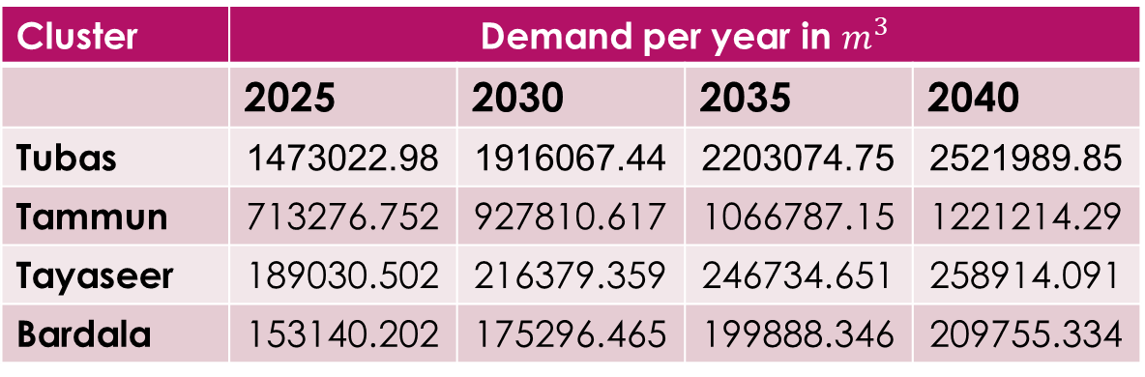
Future Demand
Demand with loss = (consumption∗population)/(1−loss%)
Future Water Demand for Tubas Cluster:
Demand2025 with loss = (80∗35312)/(1−0.3 ) =4035679.416L/D
Demand2025 with loss = (4035679.416/1000 )= 4035.679416M3/D
Demand2025 with loss =(4035.679416 *365) =1473022.98M3/year
Cluster | Demand per year in $m^{3}$
 | 2025 | 2030 | 2035 | 2040
Tubas | 1473022.98 | 1916067.44 | 2203074.75 | 2521989.85
Tammun | 713276.752 | 927810.617 | 1066787.15 | 1221214.29
Tayaseer | 189030.502 | 216379.359 | 246734.651 | 258914.091
Bardala | 153140.202 | 175296.465 | 199888.346 | 209755.334

Slide 19
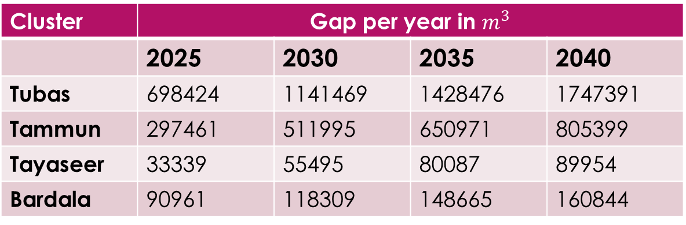
Gap
Water Gap in 2025 = Tot. supply 2025 – demand 2025
Water Gap in Tubas:
Water Gap in 2025 = 774598.5– 1473022.98 698424m^3/yr
Cluster | Gap per year in $m^{3}$
 | 2025 | 2030 | 2035 | 2040
Tubas | 698424 | 1141469 | 1428476 | 1747391
Tammun | 297461 | 511995 | 650971 | 805399
Tayaseer | 33339 | 55495 | 80087 | 89954
Bardala | 90961 | 118309 | 148665 | 160844

Slide 20
GAP REDUCTION
The overall water deficit in 2040 for the governorate as a whole is estimated to be 2.8Mm³.
We found the following possible alternatives and split them into two steps in order to bridge the water gap.
1-Phase one, which can be completed soon (short term solutions).
2-Phase two, which can be completed in the future (long term solutions).

Slide 21
Phase One: Short-term Solution
Rainwater Harvesting
Rainwater harvesting is the method of gathering rainwater from roofs and moving it to a storage tank inside the structure via gutters.
Rainwater may be used to supplement other water bodies as they become unavailable or of low quality. In periods of drought or when the water table rises, it also serves as a suitable substitute and supplement.

Slide 22
Phase One: Short-term Solution
Rainwater Harvesting
we used the following assumptions in our calculations:
• The average family size in the community is 5 capita.
• The number of floor in each building is 2 floors and each floor contain 2 apartments.
• The average area of each apartment is 150 m2.
• The average annual rainfall in the governorate is 430 mm.
• The rainwater collecting percentage 92%.
Harvested water volume =
No.ofbuildings*Avg.area*Avg.rainfall*Collecting factor

Slide 23
Phase One: Short-term Solution
Rainwater Harvesting
cluster | rainwater harvesting in each cluster
 | 2025 | 2030 | 2035 | 2040
Tubas | 209541 | 233628 | 260485 | 290428
Tammun | 101465 | 113132 | 126133 | 140630
Tayaseer | 21511 | 23985 | 26745 | 29818
Bardala | 17428 | 19431 | 21665 | 24157
Total | 349945 | 390176 | 435027 | 485033

Slide 24
Phase Two: Long-Term Solutions
Utilizing Groundwater
Owing to a lack of surface water sources, Palestine's main supply of water is groundwater. Although rain is the most common source of water, winter precipitation varies from year to year, and the absence of rainy months causes groundwater to become the main source of water. The three main basins in Palestine are the western, eastern, and northeastern basins. The eastern aquifer covers the majority of Tubas governorate, while the northeastern aquifer covers the remainder. The prospect of digging and constructing new wells in Tubas Governorate remains one of the most relevant planning possibilities for improving water quantities in the Palestinian Water Authority's policy and plan. New wells will be built with mains that link to the cluster's major water reservoirs.

Slide 25
Phase Two: Long-Term Solutions
Utilizing Jordan River
The Palestinian portion of Jordan river water is 250 Mcm/year, as stated in the Helsinki Principles. Tubas Governorate is obviously one of the closest governorates to the Jordan River, so it is more likely to take from and gain from this part. However, since this water is surface water, it is advised that it be treated before being used as domestic water. This part, however, will be treated as agricultural water and will not be included in our calculations.

Slide 26
Phase Two: Long-Term Solutions
Development of Non-Conventional Water Resources
This move would help us to rehabilitate some of the existing agricultural wells and redistribute them to be used as domestic wells. Flood water harvesting and wastewater disposal are two examples of emerging resources.
1- Dam construction and water harvesting from seasonal valley flooding
2- Wastewater Treatment

Slide 27
The Transmission Pipeline
The Palestinian Water Authority's hydrogeologist studies in Tubas Governorate have provided us with some potential locations for new wells in the governorate. According to gap estimates, the estimated remaining gap in 2040 is around 2.8 Mcm / year, and if we compare this value to the Palestinian Water Authority's expected well productivity, which is around 1.00 Mcm / year, we'll need 2 new wells to close the gap until 2040.

Slide 28
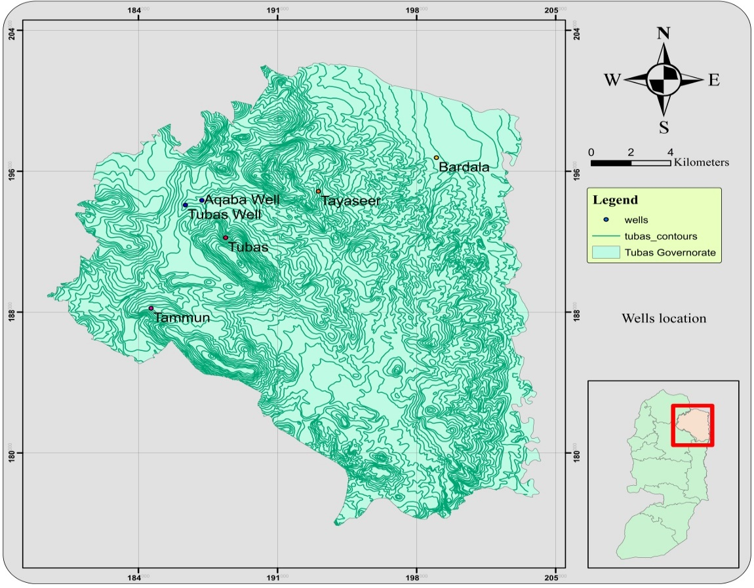
The Transmission Pipeline
Location and Parameters
There are two new suggestion wells in Tubas governorate, the first one called "Tubas well" which is used for agricultural purposes at this time so the plane is to rehabilitate this well so that it is suitable for residential uses, the second well called "Aqaba well" gives 70 m³/hr flow to feed the network.

Slide 29
The Transmission Pipeline
Design Criteria and Assumptions
The diameter of transmission pipelines, pump characteristics, and reservoir volume were determined using the following assumptions and calculations:
1- In transmission pipelines, the flow rate is assumed to be between 0.3 and 3 m/s
2- The continuity equation is used to determine the diameters of transmission pipelines.
Q = V * A
3- For planning purposes, the head loss in transmission pipelines is calculated using the following equation.
HL = 0.01 L

Slide 30
The Transmission Pipeline
Pipes calculations
For Aqaba well
*Assume velocity in pipes equals 1.5 m/s.
From the equation Q = V * A
A = (70/3600)/1.5 = 0.01296 m² → d =128mm so we select D = 6 in.
For management purposes, we split the calculated capacity of the Tubas tank, which equals 3000 m3, into two tanks, each of which will operate in a different year. The first part, equaling 2000 m3, will begin operations in 2020 and will cover demand until 2030. The remaining 1000 m3 section will begin operations in 2030 and will meet demand until 2040.
In the case of Tammun, the required tank volume of 1300 m3 is also divided into two parts: the first, equaling 800 m3, will begin operations in 2020 and will serve the assigned demand until 2030, while the second, equaling 500 m3, will begin operations in 2030 and will serve the assigned demand until 2040.
For Bardala tank the estimated volume equals 300 m3 will start operating in year 2020 and will serve the assigned demand until the year of 2040.

Slide 31
Water distribution network for Tayaseer village
One of our project's key goals is to raise per capita daily consumption; this would necessitate not only providing a supply of water for the targeted area, but also a distribution network. For our project we select Tayaseer village it has large population, so we will design a water distribution network sample for it.

Slide 32
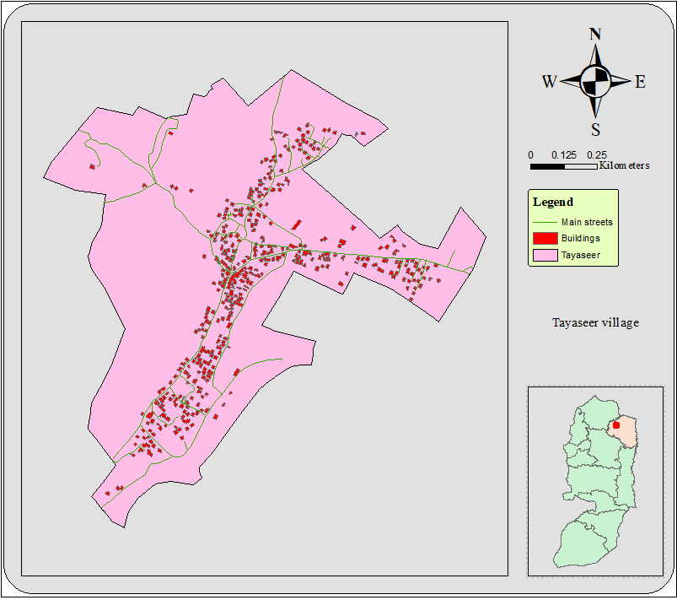
Water distribution network for Tayaseer
Location and Physical Characteristics
Tayaseer's total land area is approximately 26,000 acres, of which approximately 500 comprise the village's "built-up" area. Arable land covers approximately 5,000 acres, of which 3,545 are cultivated, primarily with field crops and fruit trees. For security and military purposes, Israeli authorities have confiscated 15,875 acres.

Slide 33
Water distribution network for Tayaseer
Demography, Population and Demand
According to the Palestinian Central Bureau of Statistics (PCBS), Tayaseer had a population of 2,489 in 2007. Tayaseer village's population accounts for approximately 5% of the total population of the Tubas Governorate.
The demand for Tayaseer village equals 710 m³/d.
Year | 2007 | 2019 | 2025 | 2030 | 2035 | 2040
Population per capita | 2489 | 3006 | 3425 | 3819 | 4258 | 4747

Slide 34
Water distribution network for Tayaseer Design parameters
To design Tayaseer network, we consider some parameters as follows:
• The design period is 20 years until 2040.
• Maximum daily factor = 1.8
• The growth rate is 2.2%.
• Average daily demand =120 L/c.d
• Ductile iron pipes with Hazen-Williams coefficient =140.

Slide 35
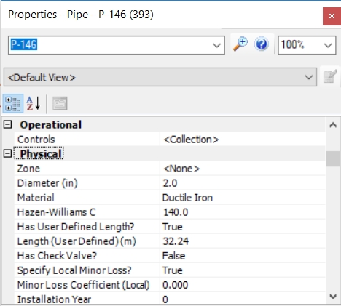
Water distribution network for Tayaseer
Design Method
In our project, we will build a water distribution network in Tayaseer village using WaterCAD program, in the project the team will use some components which include (junctions, pipes, reservoir and a pump).
The team have assumed some assumptions to meet the specification of cost, velocity and pressure. These specifications state that the cost should be at its least, the velocity should be within the range 0.3~2 m/s, and the pressure between 20~60 mH2O.
We defined a Ductile Iron pipe prototype and changed the Hazen Williams coefficient to 140 as shown.

Slide 36
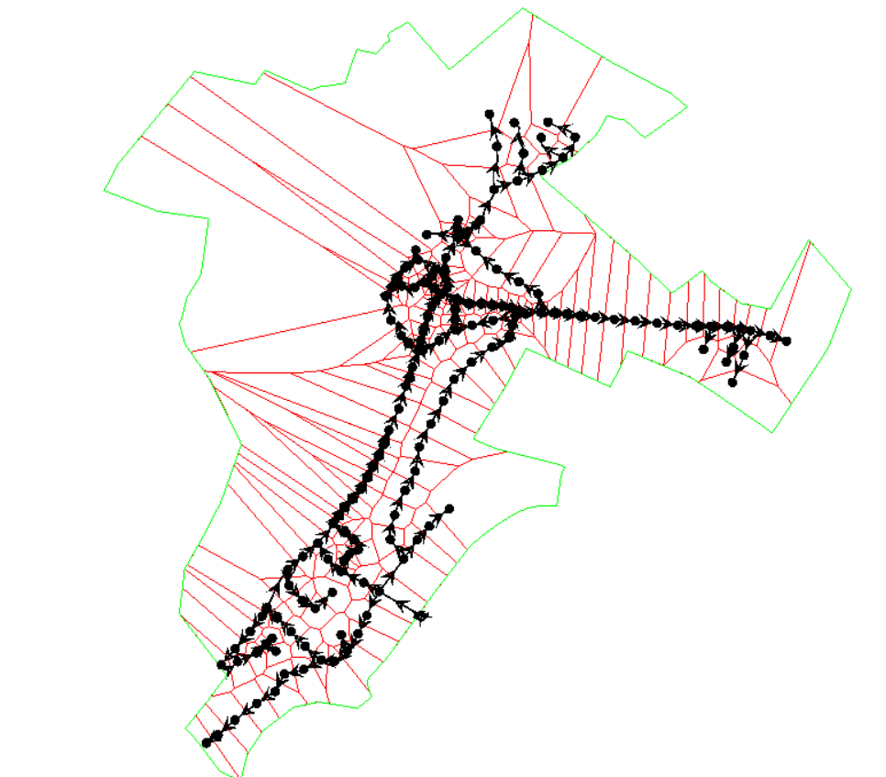
Water distribution network for Tayaseer
Design Method
The team use Thiessen polygon method to divide the loading area into small areas on all junctions (nodes) the we use load builder and serve out the total demand into all nodes using weighted average method as shown.

Slide 37
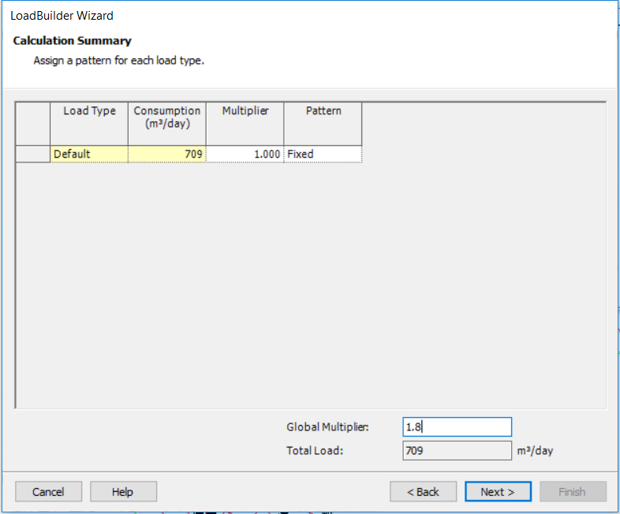
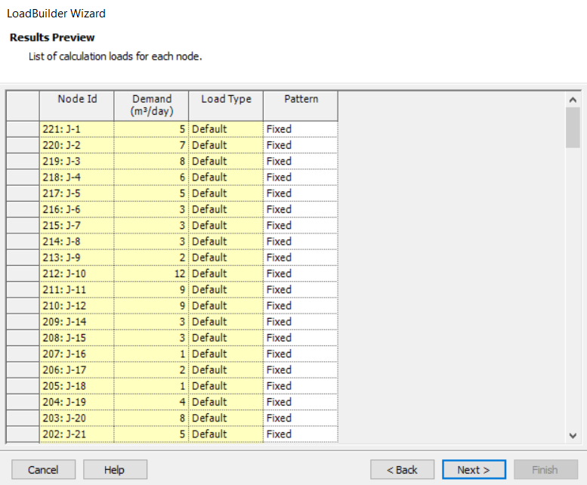
Water distribution network for Tayaseer
Design Method

Slide 38
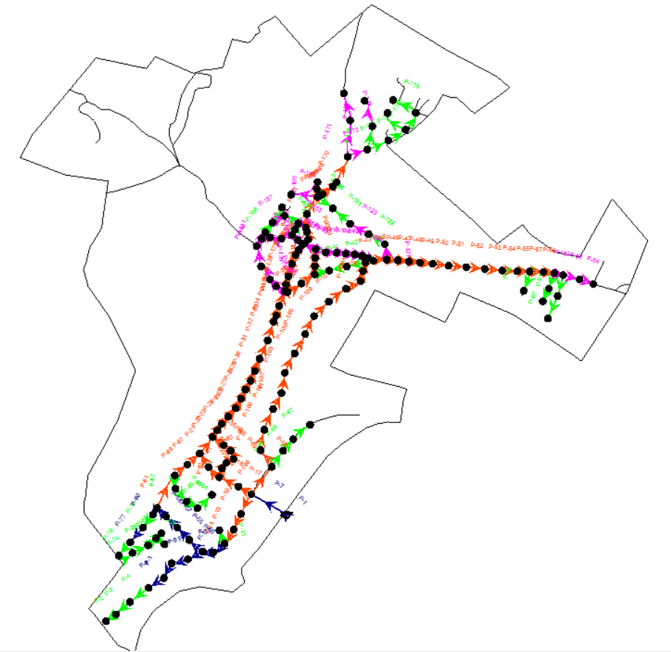
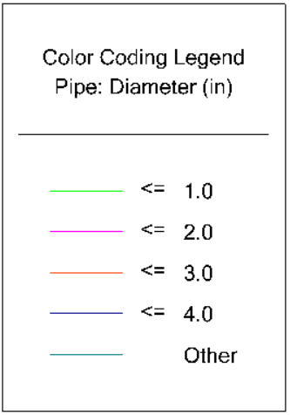
Water distribution network for Tayaseer
Design Method

Slide 39
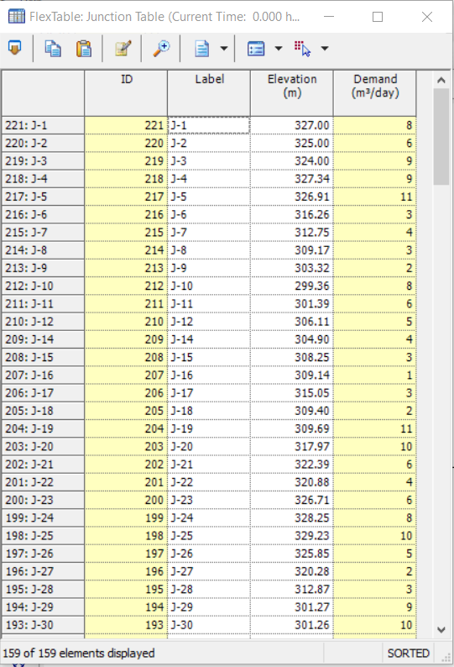
Water distribution network for Tayaseer
Design Method
After we have defined the reservoir location, the pump and Its location, junction’s elevations we define the demand for each junction for the steady state phase using load builder as shown

Slide 40
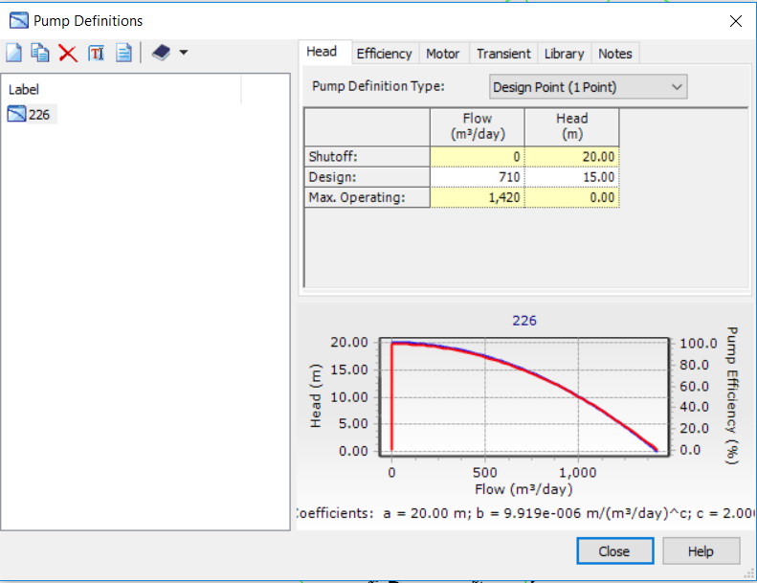
Water distribution network for Tayaseer
Design Method
Then the team define the pump definition as shown:

Slide 41
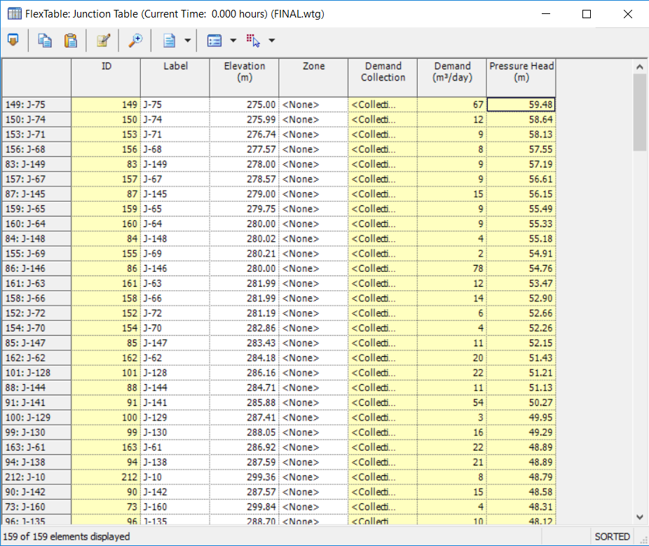
Water distribution network for Tayaseer
Design Method
Then we run the software and started the analysis and we got the results for the junctions as shown:

Slide 42
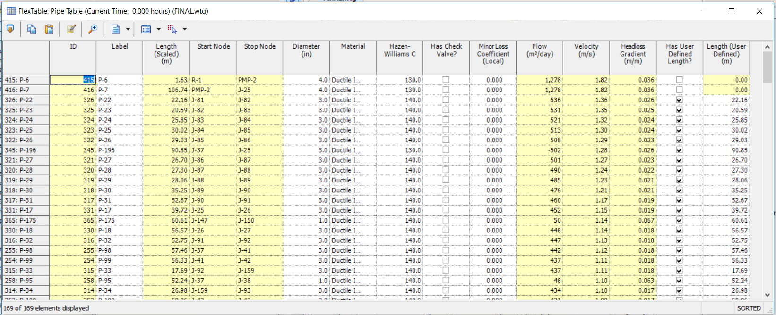
Water distribution network for Tayaseer
Design Method
Then we run the software and started the analysis and we got the results for the pipes as shown:
Diameter (in) | Length (m)
1.0 | 1819
2.0 | 1206
3.0 | 2986
4.0 | 478
Total | 6489

Slide 43
Water distribution network for Tayaseer
Design Method
Pressure and velocity results in Tayaseer network.
Constrains | Max. value | Min. value | Notes
Pressure (mH2O) | 59.48 | 20.03 | Min. and max. values are within specifications
Velocity (m/s) | 1.82 | 0.04 | It's less the 0.3 m/s but it’s accepted since the network is used for drinking water and it's more than 0.01 m/s

Slide 44
Recommendations
1-Do maintenance for pipes and water meters to decrease water losses.
2- Having new reservoirs to serve the expansion areas.
3- Replace the conveyance lines if needed.

Slide 45
Conclusions
The population of Tubas Governorate will become about 81,738 capita in 2040.
The total demand of Tubas Governorate is 4211874 m3/year in 2040.
The gap of water is 2.8Mm3/year in 2040.
To bridge this gap:
* 0.17Mcm/year from near-future solutions .
*2.63 Mcm/year from long-term solutions.
Our design is applicable and serviceable for the selected design period which is 20 years.

Slide 46


