Slide 1
Online Advertising
Students: Supervisor:
-Eng.Asma’a Afeefi
-Anwar Salman
-Mohammad Suboh

Slide 2
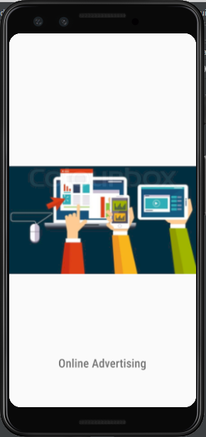
What is Online Advertising?
Online Advertising, is a web application that will be
designed for people who are looking for a business, house
or land for sale. The advertising process will be done
in a smart and innovative way through features that use
data mining to gather the most relevant demands,and will
recommend them to the customers through
a recommendation system, which depends on a chatbot
that interacts with the online customers.

Slide 3
Our system consists of two parts:
Website.
Mobile Application.

Slide 4
Language
1
JAVA
2
PHP
3
HTML & CSS

Slide 5
Features :
The user can add a new ad.
The user can view the details of the other ads and rate them.
The user can interact with a chat bot which replies with messages and when finished will update your ad recommendation preferences.

Slide 6
Methods and Techniques:
Get/Post with JSON.
Asynchronous tasks.
Sessions.
File utilities.
API.

Slide 7
Constraints:
Using new tools to build the program.
Some programs needed a license after a limited period, so alternatives were used after the license expired.
Time limitations.

Slide 8
Conclusion
At the end of the project, we made a website and an application which go along with modern uses, and we faced some problems along the way, but with
teamwork and effort we were able to challenge ourselves and solve the
problems that we faced.
We were satisfied with what we have achieved in this project, and we tested ourselves with the knowledge we have gathered through the years and we were able to put it into good production, and we managed to present a
complete system beneficial to the life of other users.

Slide 9
Future work
Increasing the security and durability of our servers by using cloudflare.
Renting a VPS to host our servers on and make them online all the time and increase their performance.
Adding more features to our website and application such as using the GPS system.

Slide 10
Thanks!
hope you enjoyed our presentation

