Slide 1

AN-Najah National University
Faculty of Engineering & Information Technology
Mechanical and Mechatronics Engineering Department
Graduation Project 2
Integrating Automation Systems into Pharmaceutical Machinery for Enhanced Efficiency
DONE BY:
Waleed Qartallo
Adnan Abutahnat
Taha Qanazeh
SUPERVISOR:
Dr. Mohammad Abuabiah
m.abuabiah@najah.edu
6/25/2025

Slide 2
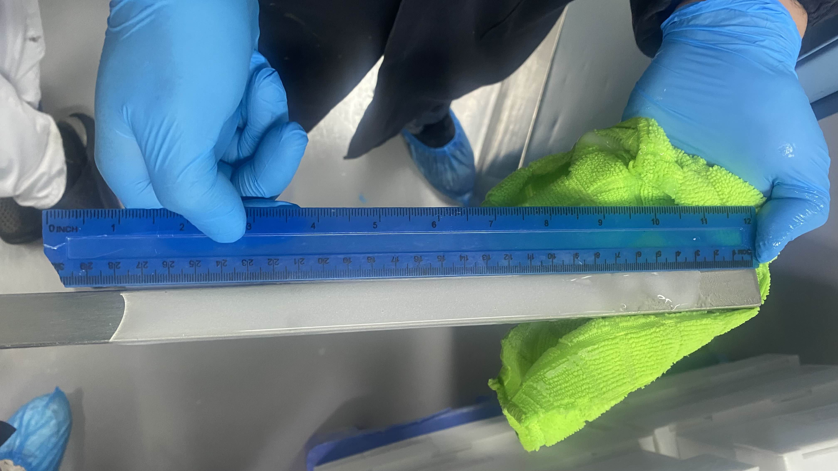
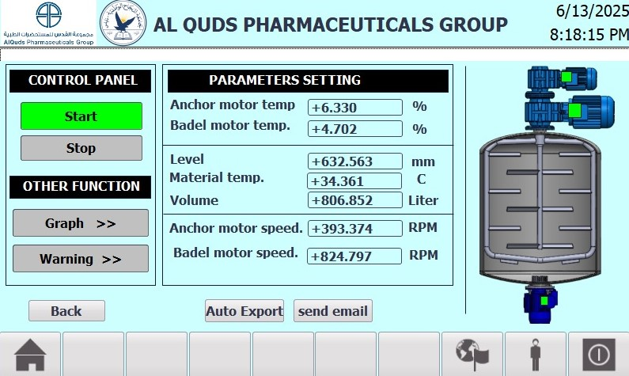
Motivation
2/20

Slide 3

Outline
Introduction
Objective
Project Structure
Conclusion
Bill of Martial
3/20

Slide 4
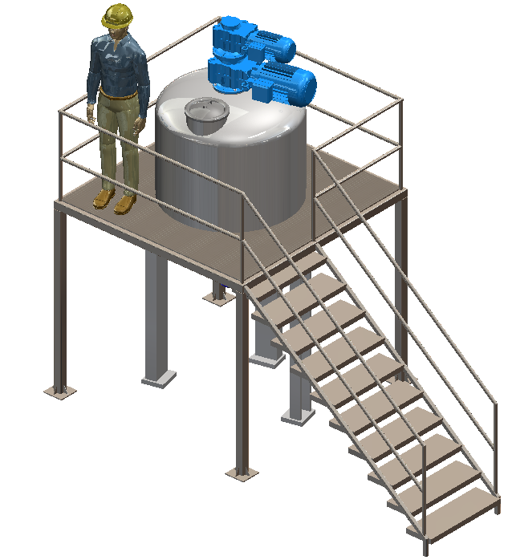
Introduction
Our project aims to upgrade a manufacturing machine from a traditional monitoring system to a modern one based on Programmable Logic Controller (PLC) and Human-Machine Interface (HMI). This will contribute to improving operational efficiency and achieving Pharma 4.0 standards.
Features of the automated mixing machine: The ability to monitor machine condition using sensors, reducing human error in the monitoring process..

Slide 5
Objective
Simplify the operation and monitoring of the mixing machine through automation.
Display all critical process values on an HMI screen for real-time monitoring.
Record and store process data in an Excel sheet for documentation and analysis.
Move towards implementing Pharma 4.0 standards by integrating smart and connected technologies.

Slide 6
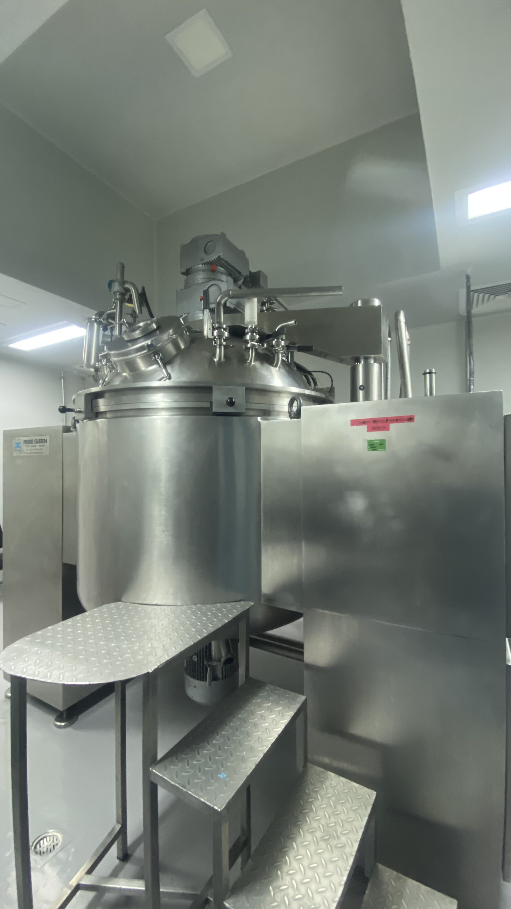
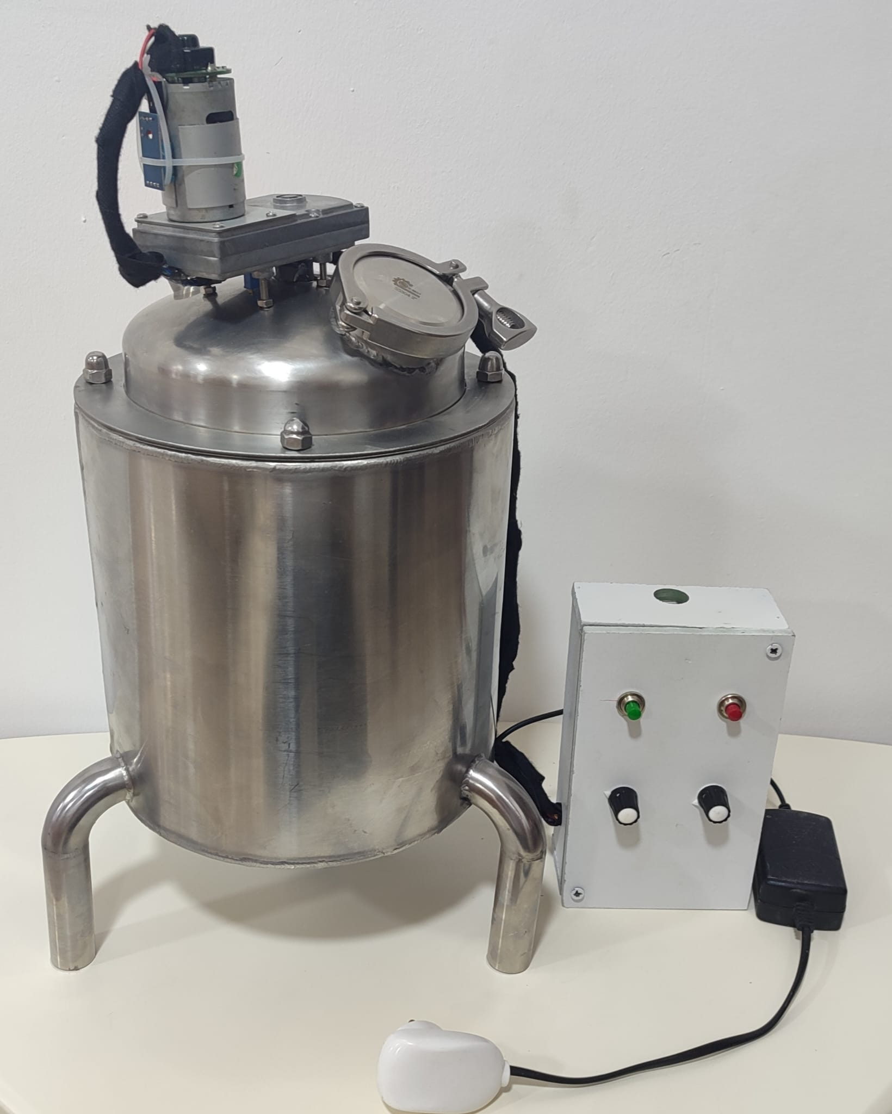
Project Structure
The project can be structured into two parallel phases:
Real Machine Phase
Prototype Phase

Slide 7
Real System Overview
Real Mixing Machine Overview
The machine includes a material mixing system that previously relied on traditional methods, without the ability to monitor material temperature or detect whether motor speed and temperature exceeded safe limits.
We upgraded the machine by adding various sensors to monitor these parameters. Key data stored in the driver is now transferred to the PLC, displayed on the HMI, and logged in real-time into an Excel sheet

Slide 8
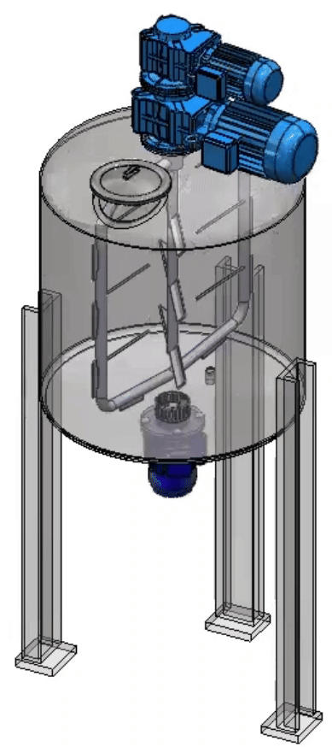
Electrical Components
Three-phase Motor
Several types of motors will be used in this project, including:
Anchor motor.
Blade paddle motor.
Homogenizer motor.

Slide 9
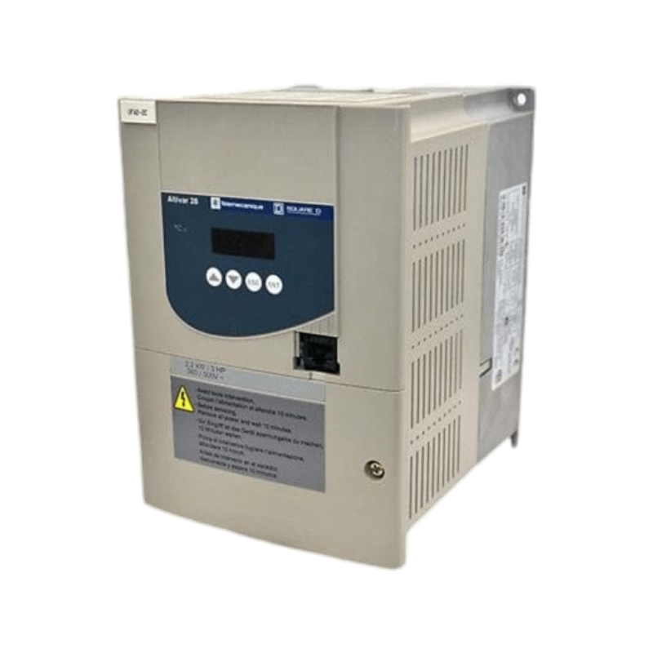
Electrical Components
Variable Frequency Driver (VFD)
Programmable Logic Controller (PLC)

Slide 10
Electrical Components
Variable Frequency Driver (VFD)
Programmable Logic Controller (PLC)

Slide 11
Electrical Components
Variable Frequency Driver (VFD)
Programmable Logic Controller (PLC)

Slide 12
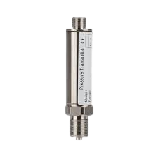
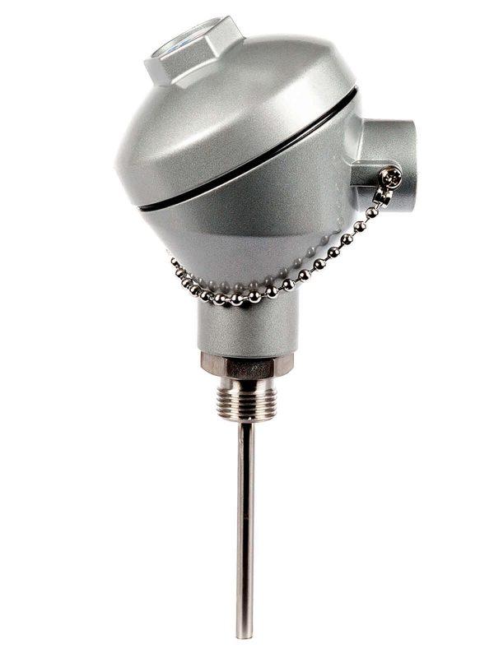
Sensors
Pressure transmitter
RTD sensor (pt100)
10/20

Slide 13
Sensors
Pressure transmitter
RTD sensor (pt100)
10/20

Slide 14
Sensors
Pressure transmitter
RTD sensor (pt100)
10/20

Slide 15
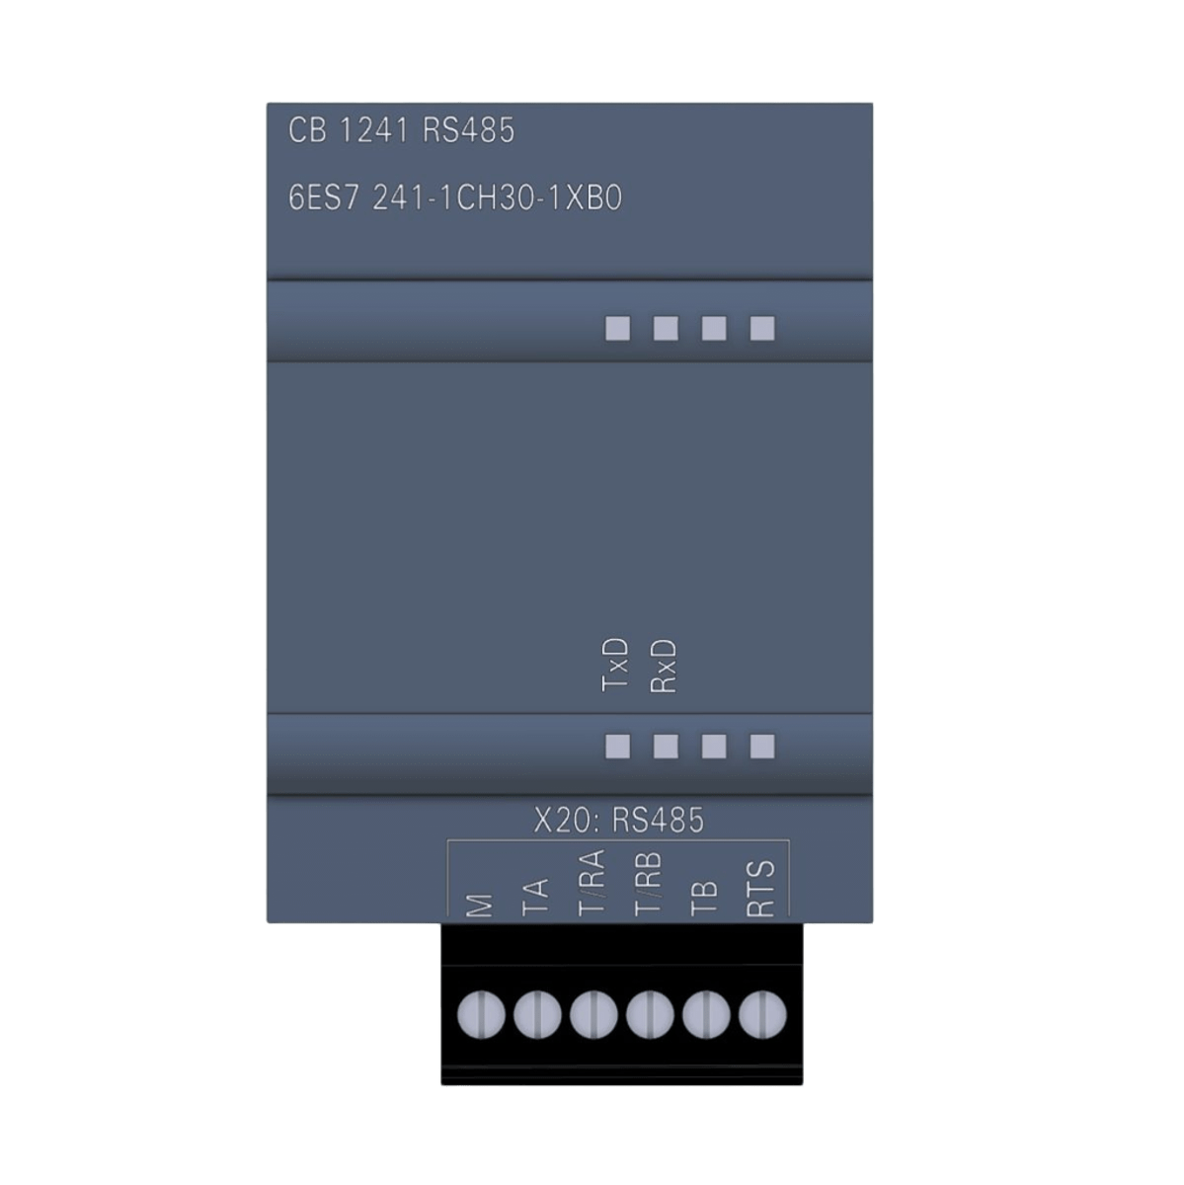
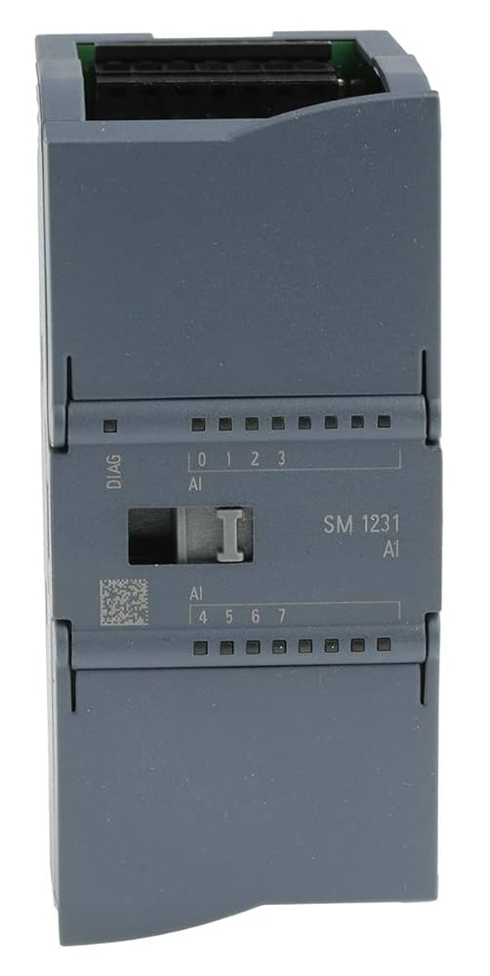
PLC Modules
CB 1241
Analoge input module
11/20

Slide 16
PLC Modules
CB 1241
Analoge input module
11/20

Slide 17
PLC Modules
CB 1241
Analoge input module
11/20

Slide 18
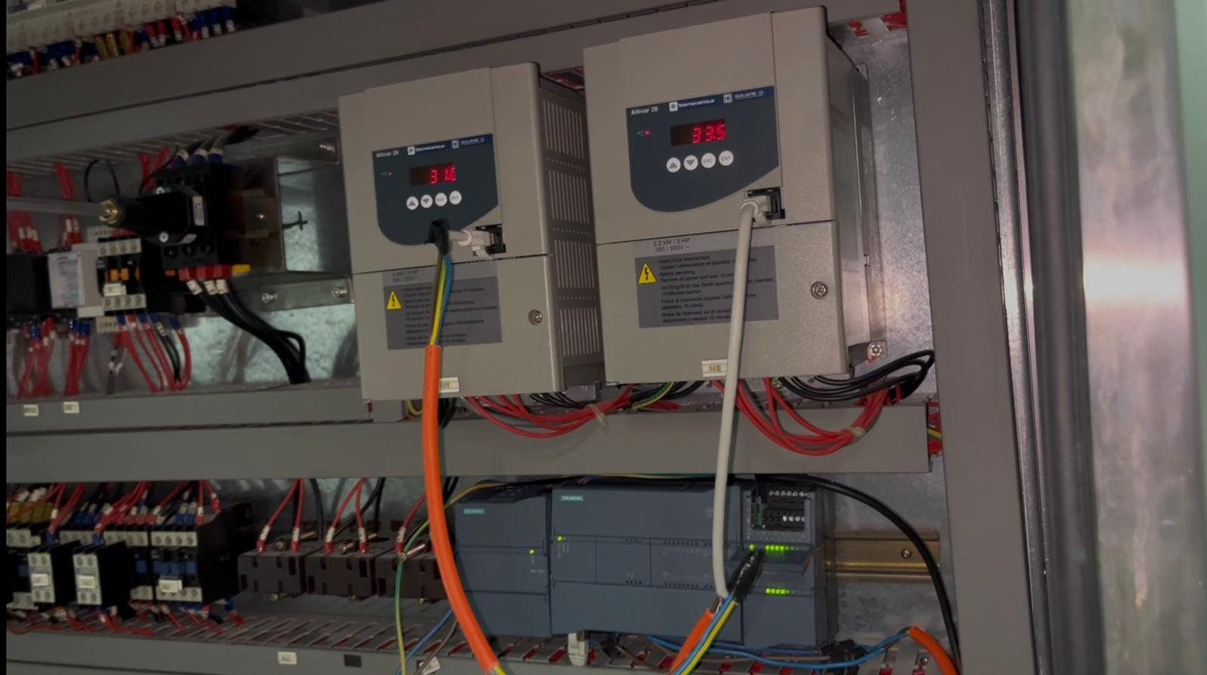
Electrical Design

Slide 19

Human-Machine Interface
13/20

Slide 20
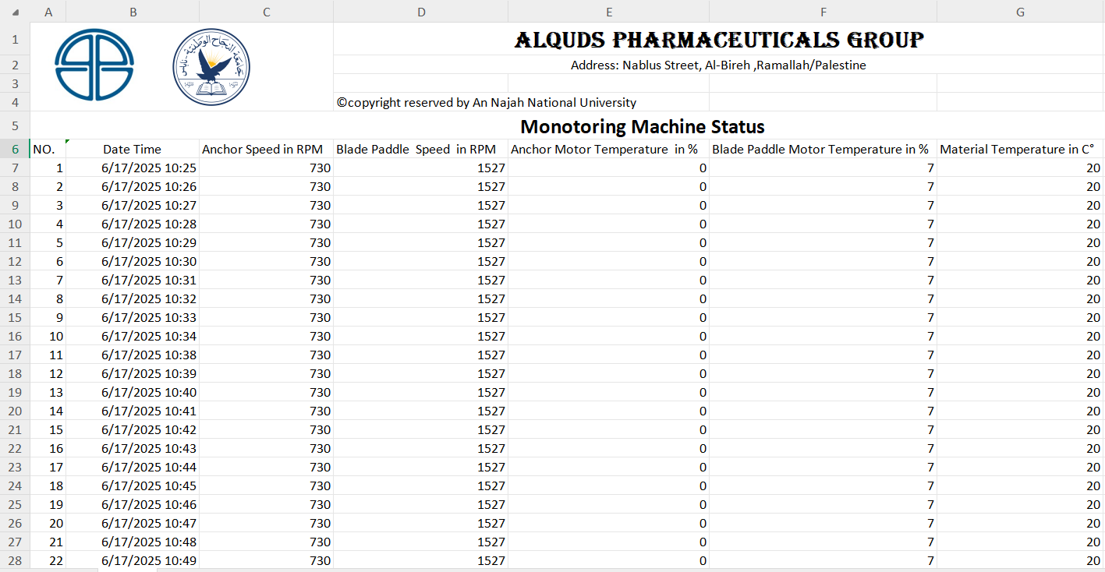
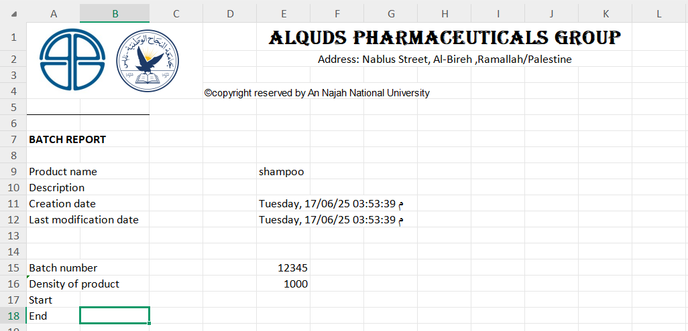
Data storage
Machine status
Recipe information

Slide 21
Project Structure
The project can be structured into two parallel phases:
Real Machine Phase
Prototype Phase

Slide 22
Prototype System Overview
Prototype Mixing Machine Overview
The stainless steel prototype features a double-jacket tank and two DC-powered mixers. It is equipped with sensors to monitor temperature (DHT11), speed (Hall Effect), and level (Ultrasonic HC-SR04). The control panel is housed in a wooden box that contains an Arduino board, on/off buttons, and a potentiometer for motor speed control. All sensor values are displayed in real-time using a graphical interface developed with App Designer, allowing for easy monitoring and system interaction.

Slide 23
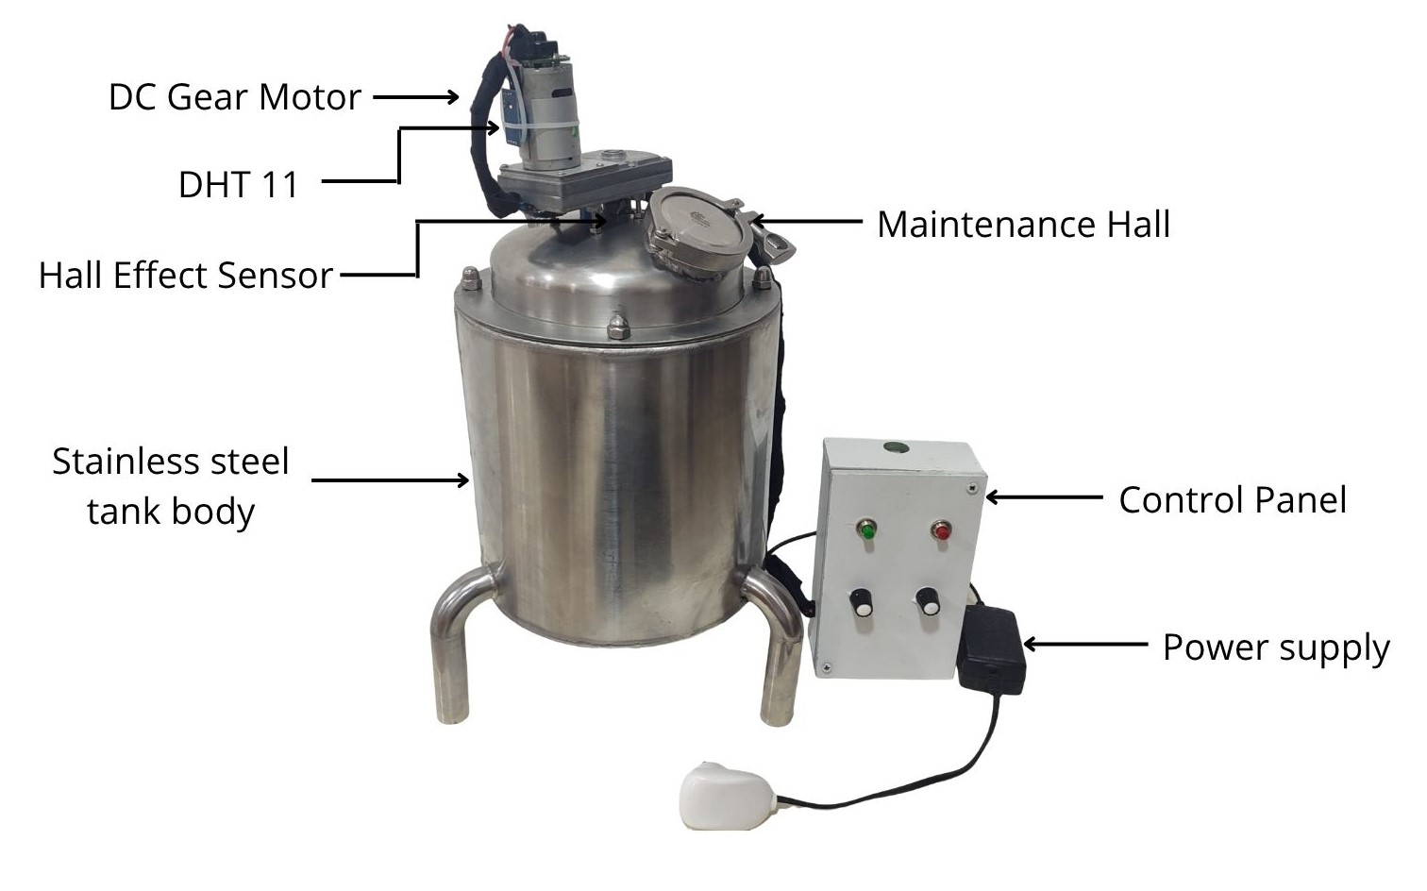
Prototype System Overview

Slide 24
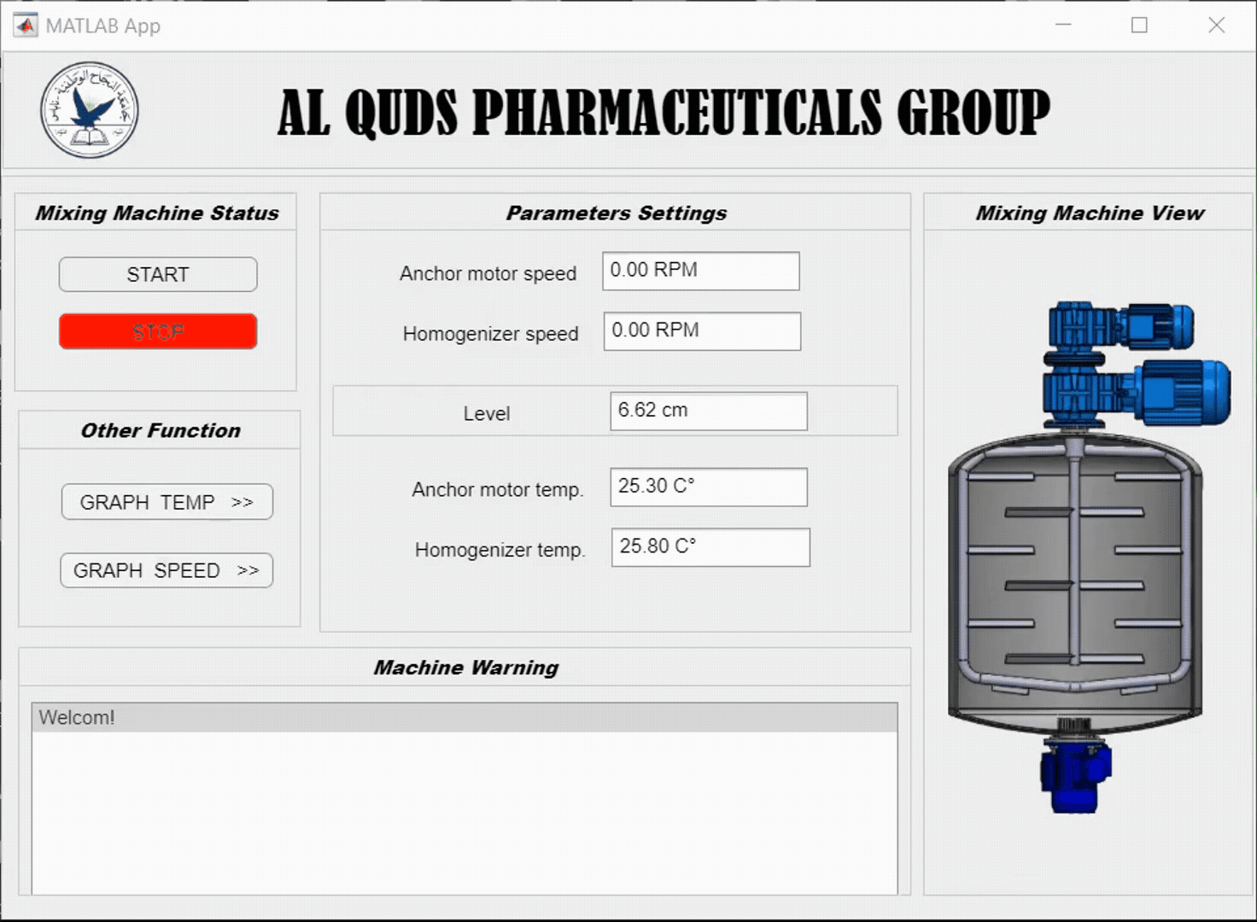
Graphical User interface
18/24

Slide 25
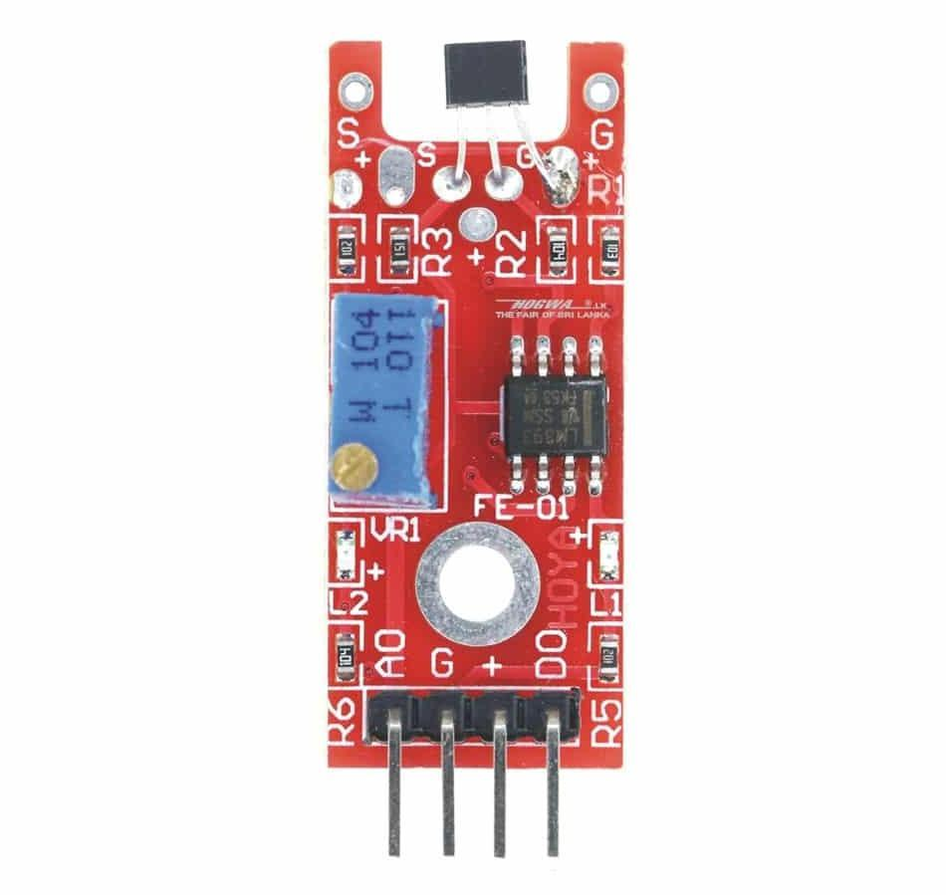
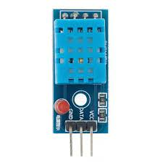
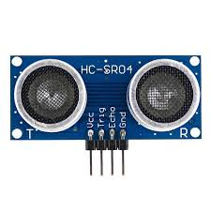
Sensors
Hall effect sensor
DHT11 sensor
Ultrasonic sensor
19/24

Slide 26
Sensors
Hall effect sensor
DHT11 sensor
Ultrasonic sensor
19/24

Slide 27
Sensors
Hall effect sensor
DHT11 sensor
Ultrasonic sensor
19/24

Slide 28
Sensors
Hall effect sensor
DHT11 sensor
Ultrasonic sensor
19/24

Slide 29

Conclusion
In this project, we focused on developing a monitoring system for an existing pharmaceutical mixing machine.
I designed the mechanical model using SOLIDWORKS, and we selected the sensors, motors, and the appropriate PLC unit for real-time data reading.
We created a user-friendly interface that enables the operator to monitor key variables such as temperature, speed, and liquid level.
We built a complete prototype that integrates the mechanical design, electrical circuits, and programming, and it demonstrated efficiency during practical tests.

Slide 30
Bill of Martial for real machine
# | Piece type | Comment | QTY | price (NIS)
1 | CPU | S7-1200 CPU 1215C | 1 | 2740.31
2 | Analog Input | SM 1231 AI – 8x13bit |  | 1750.29
3 | Power supply | SITOP PSU100C – 24V / 2.5A | 1 | 434.42
4 | CB 1421 (RS485) | CB 1241 – Communication board | 1 | 889.28
5 | Pressure transmitter | Autonics TPS20 Series, 0–0.5kg/cm² | 1 | 603.45
6 | RTD pt100 | - | 1 | 222
 |  | Total Price |  | 6639.75

Slide 31
Bill of Martial for Prototype machine
# | Piece type | Comment | QTY | price (NIS)
1 | DC Motor with Gear |  | 2 | 130
2 | Iron Bracelets |  |  | 30
3 | DHT11 sensor |  | 2 | 25
4 | Prototype Build |  | 1 | 820
5 | Ultrasonic Sensor |  | 1 | 10
6 | Hall effect sensor |  | 2 | 10
7 | Push Button (On/Off) |  | 2 | 5.5
8 | Silicone |  | 3 | 1

Slide 32
Bill of Martial for Prototype machine
# | Piece type | Comment | QTY | price (NIS)
9 | Fabric |  | 1 | 48
10 | Wires |  |  | 30
11 | Power Supply |  | 1 | 40
 |  | Total Price |  | 1298

Slide 33
Thanks !
Any questions ?

Slide 34
Backup Slides

Slide 35
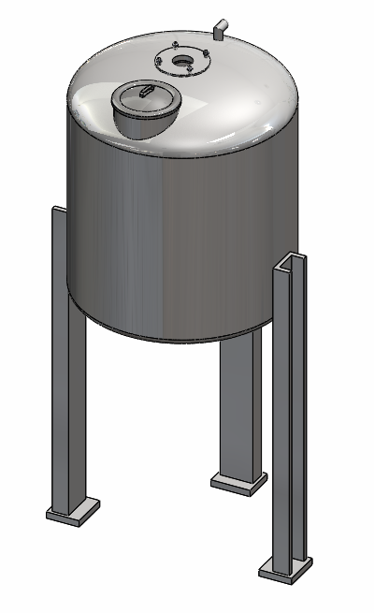
Mechanical Design
The mechanical design consists of :
Tank Body: A 1250mm diameter, 1500mm high, and 5mm thick will be used in this project.

Slide 36
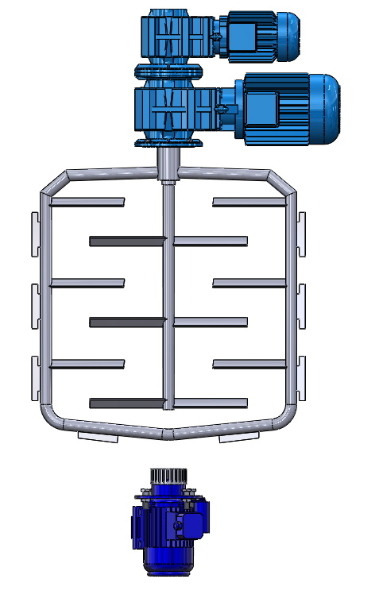
Mechanical Design
Blade Paddles Motor
Anchor Motor
Anchor
Scrapers
Blade Paddles
Shear Homogenizer
Emulsifying head

Slide 37
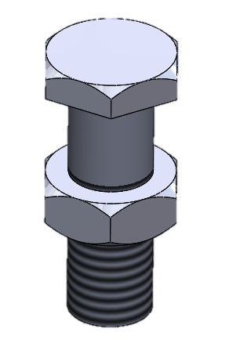
Mechanical Design
Tank access platform: This is used to facilitate access to the engines above for maintenance work or to access the maintenance hole.
Screw and bolt: Are used to securely fasten the motors to the tank body in the mixing machine, ensuring a strong and safe attachment of both the motors and the body.
The screws and bolts are tightened using a torque wrench, with a gasket added to prevent leaks.

Slide 38
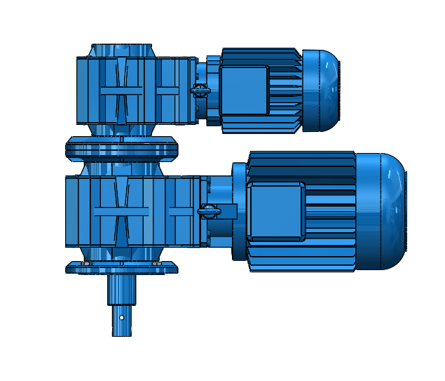
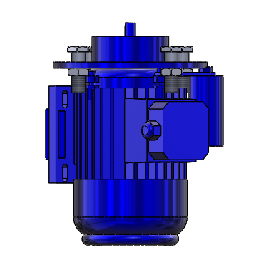
Electrical Design
Three-phase Motor
Several types of motors will be used in this project, including:
Gear motor flender (HP5.5 –KW4-VOLT 230/400 -Hz50-4 POLI), called anchor motor
Gear motor flender (HP3-KW2,2 -VOLT 230/400 -Hz50-4 POLI), called blade paddle motor
Electronic motor G160 (KW11/9 -VOLT 230/400 -Hz50-4POLI),
called homogenizer motor

Slide 39
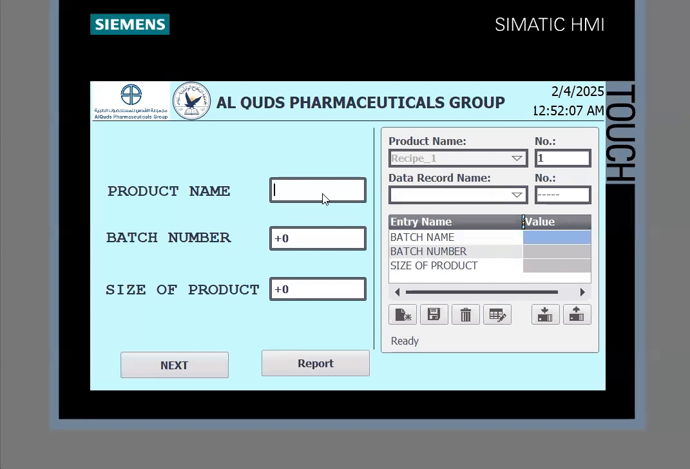
Recipe information
14/20

Slide 40
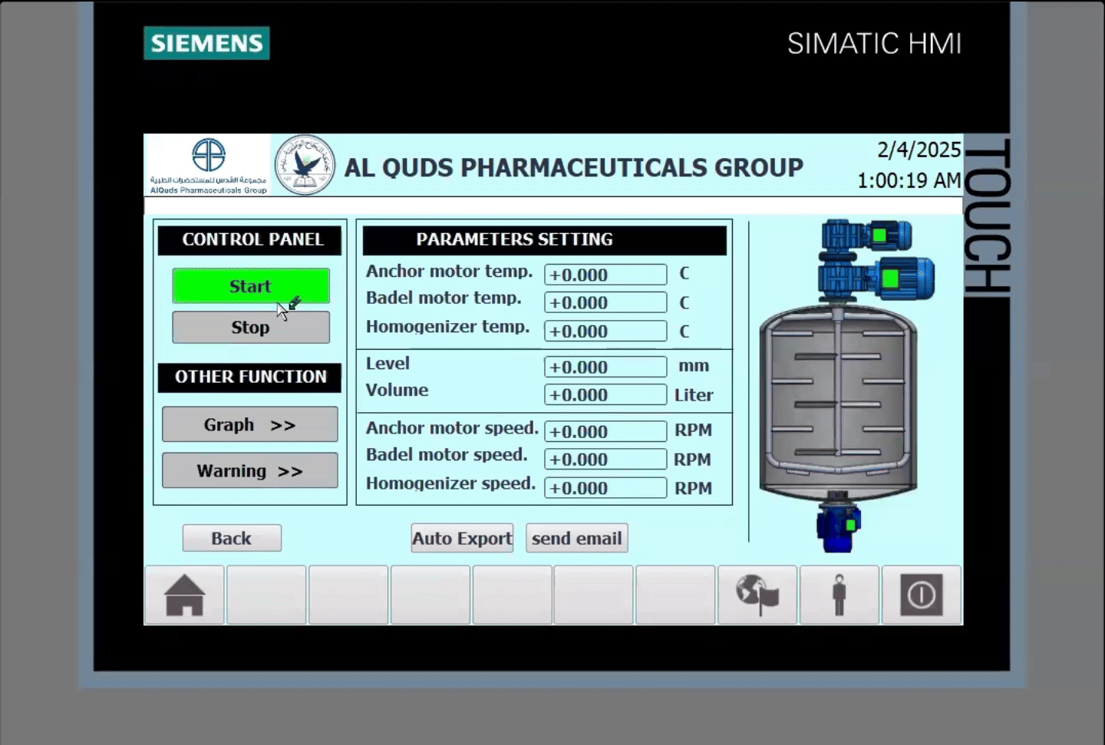
Control and monitoring system
15/20

Slide 41
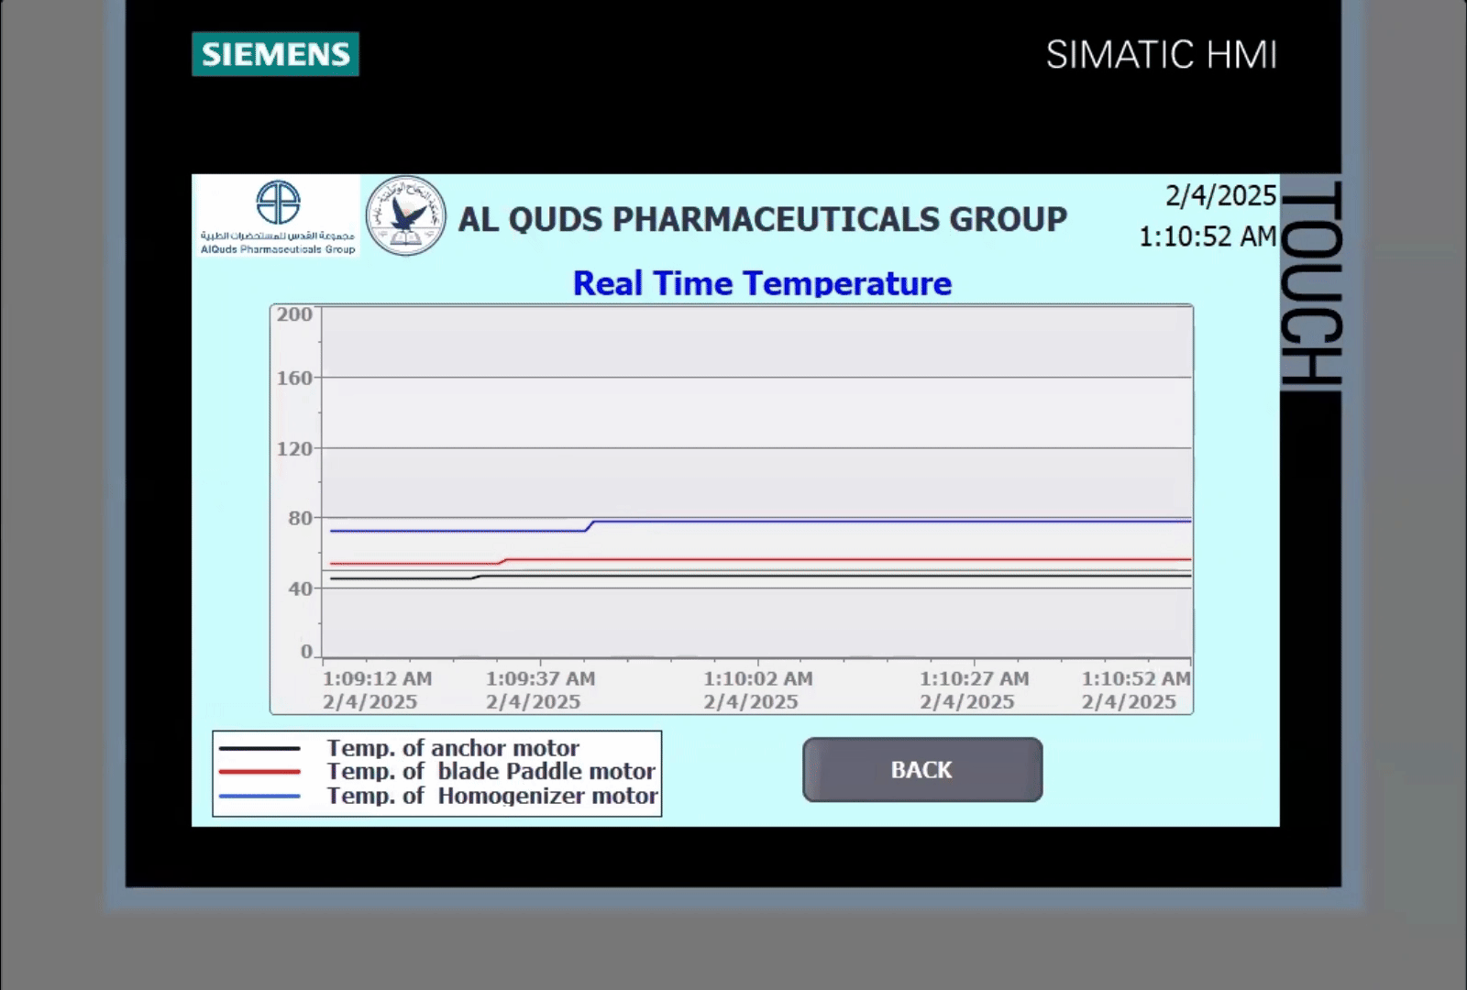
Real-time data graph

Slide 42
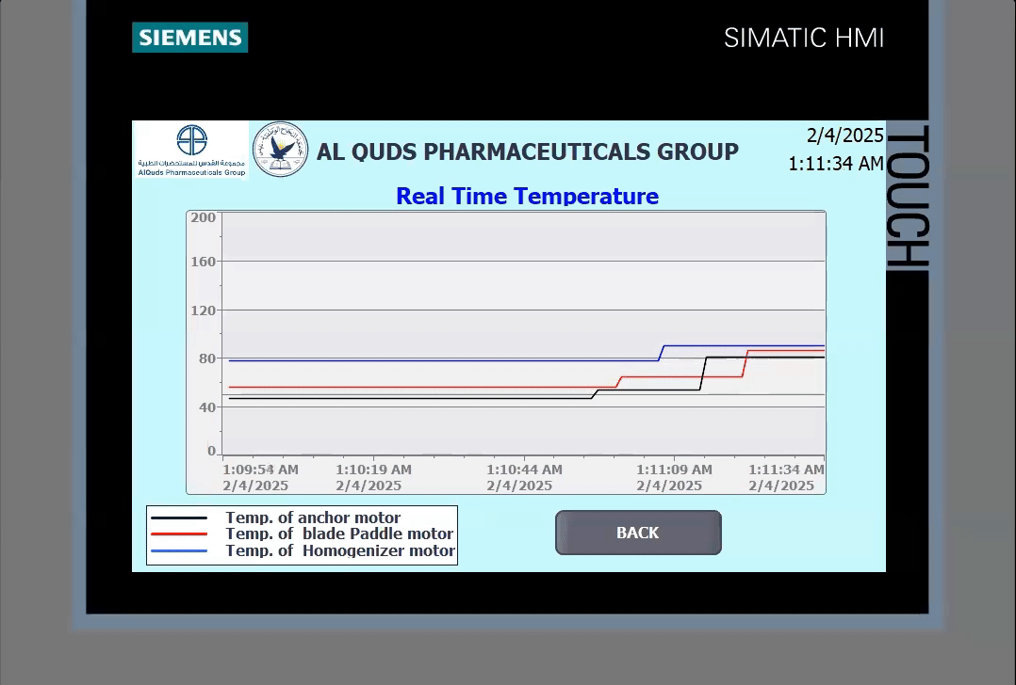
Warning

Slide 43
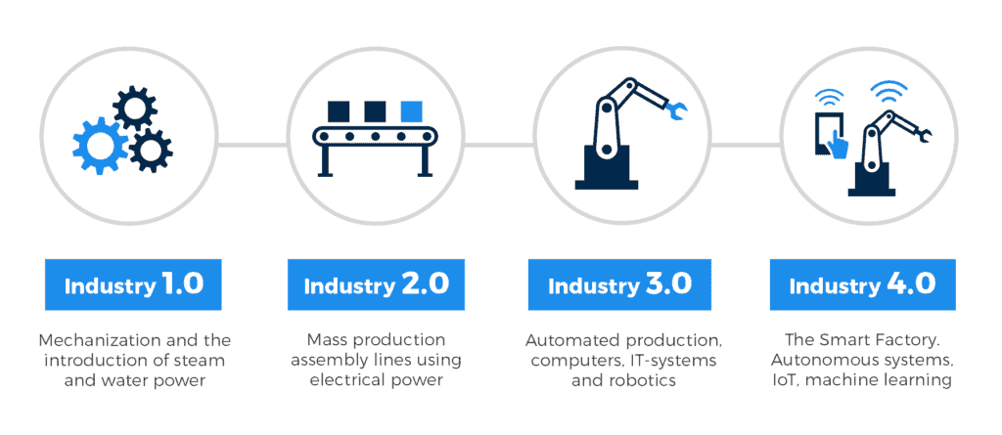
Industrial Revolutions
24/20

