Slide 1

Transportation Impacts of the Industrial - Crafting Area in Nablus
An-Najah National University
Engineering Collage
Civil Engineering Department
Prepared by
Najeeb Masri
Mohammad Hamami
Montaser Shaheen
Under the Supervision of
Dr. Khaled Al-Sahili

Slide 2
Presentation Outline
Introduction
Methodology
Data Collection and Analysis
Evaluation and Suggested Actios
Conclusion & Recommendations

Slide 3
Introduction

Slide 4
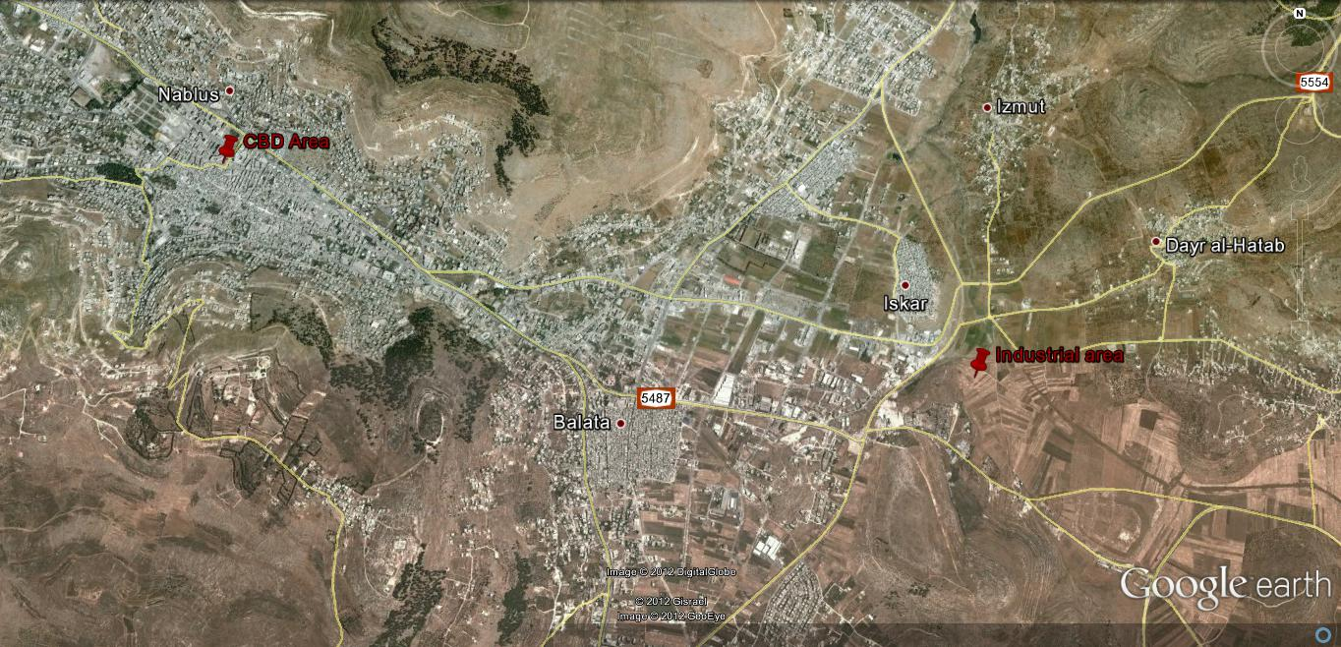
Project Description:
Location:

Slide 5
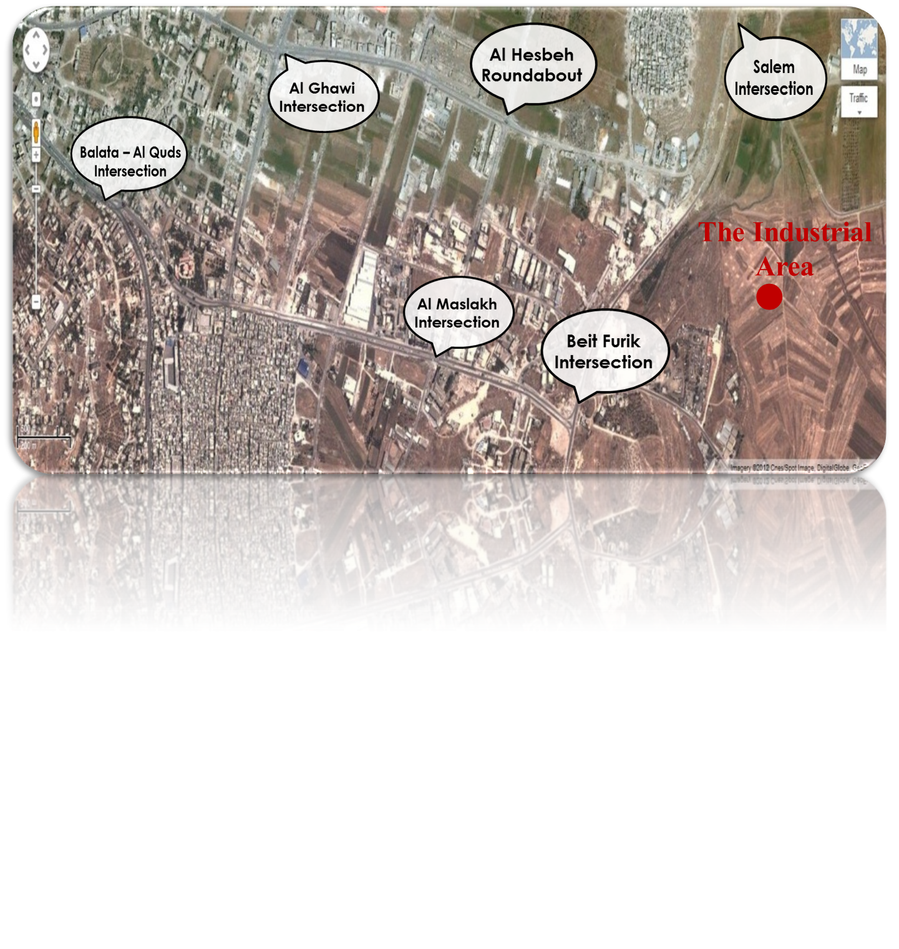
Project Description:
Study Area:
Intersections:
Links:
Sulaiman Al Nabulsi Street
Al Zoyoot Street
Al Hesbeh Street
Jamal Abdul-Nasser Street

Slide 6
Objectives
The main objective: Determine the traffic impact of Industrial Crafting Area Project on the surrounded road network.
Particular Objectives:
Evaluate current traffic conditions.
Estimate future traffic developed by industrial crafting area when it’s completely built.
Evaluation and redesign (geometric and traffic) of the road network intersections and links in the study area.

Slide 7
Methodology

Slide 8
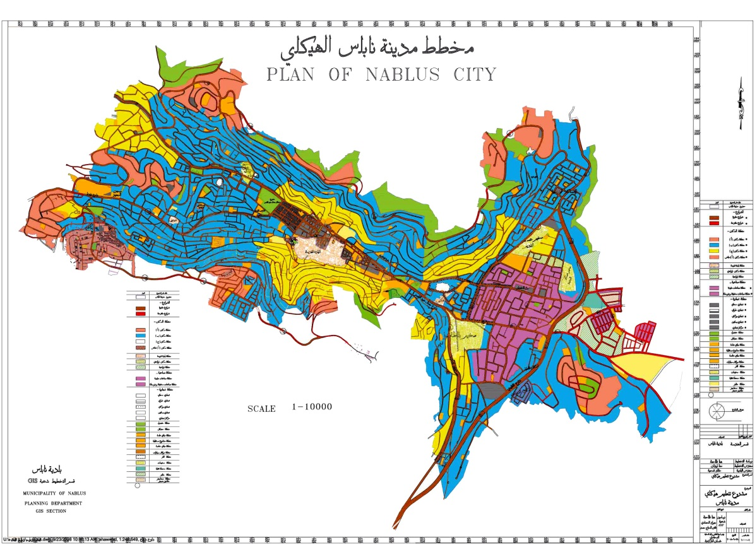
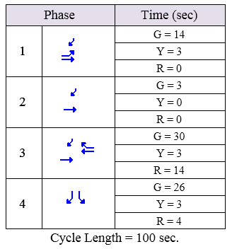
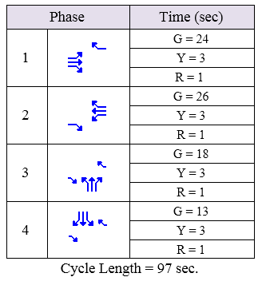
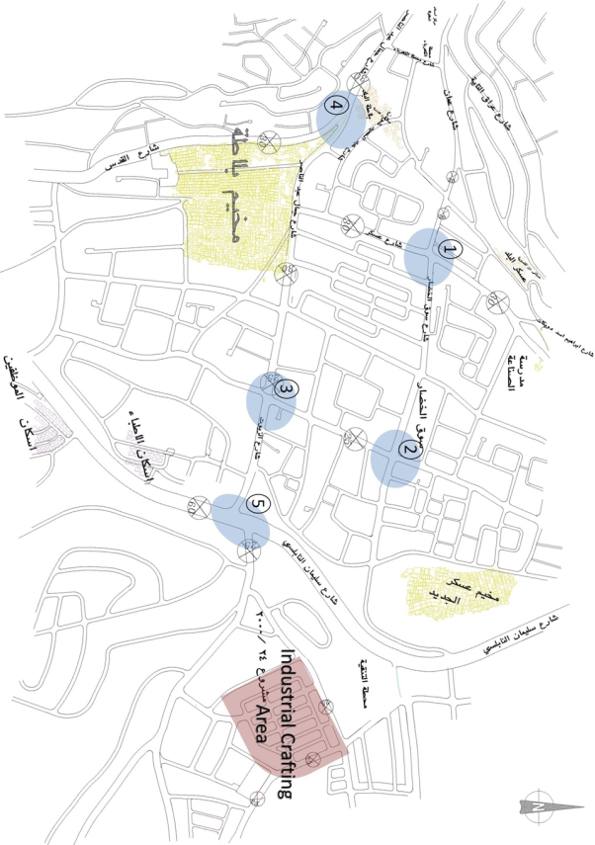
Methodology
Collecting Data

Slide 9
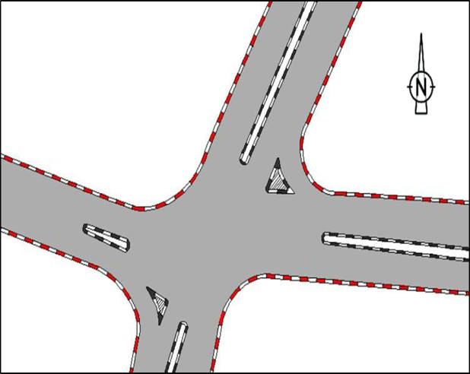
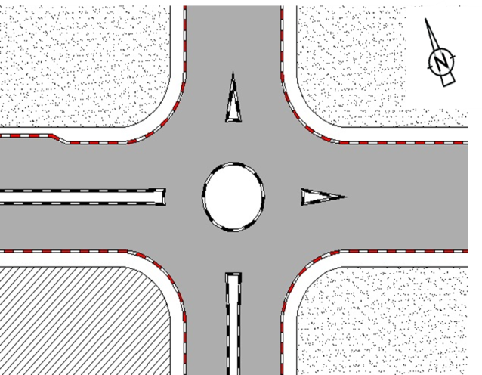
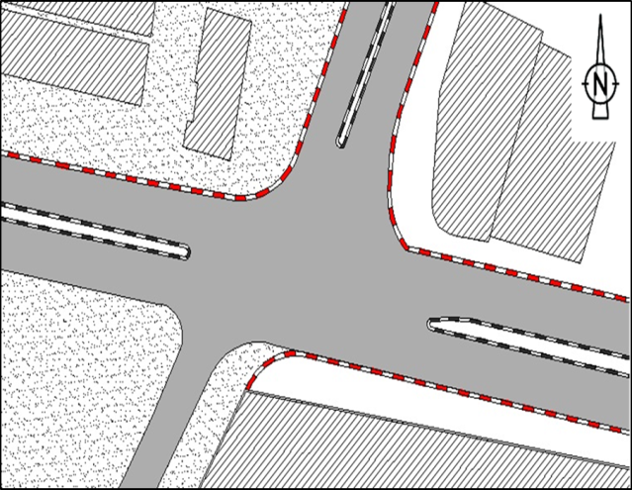
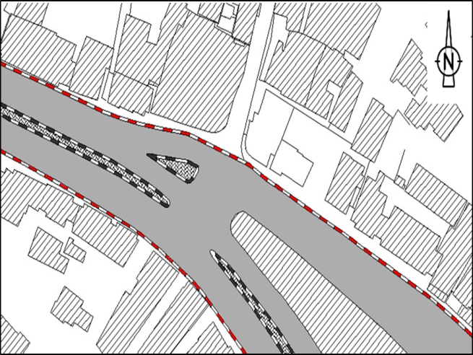
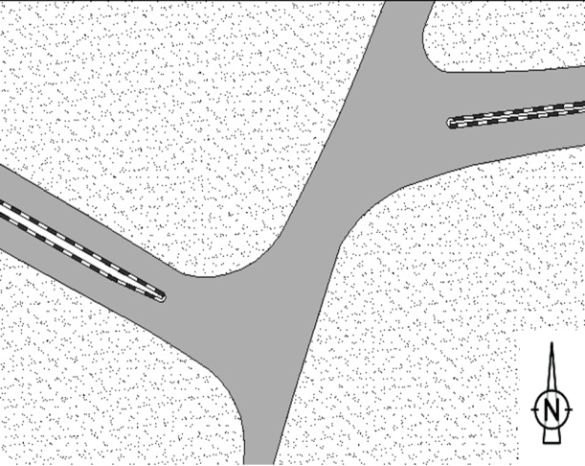
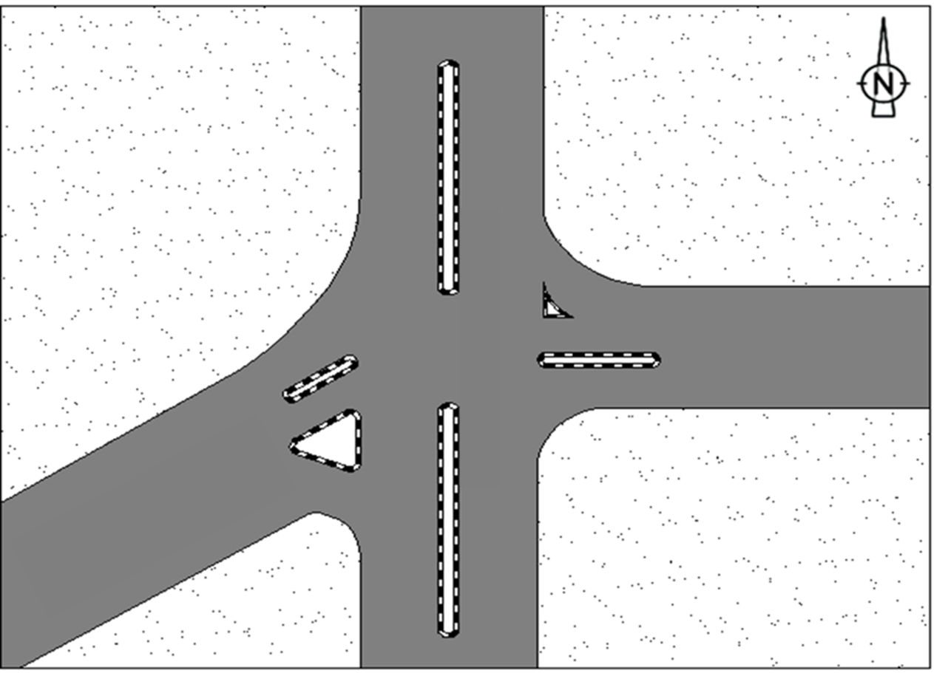
Methodology
Field Inventory
(#1) Al Ghawi Intersection
(#2) Al Hesbeh Roundabout
(#3) Al Maslakh Intersection
(#4) Balata – Al Quds Intersection
(#5) Beit Furik Intersection
(#6) Salem Intersection

Slide 10
Methodology
Traffic Volume studies:
  Volume Counts
  Peak Hour, Peak Hour Volume (PHV), and Peak Hour Factor (PHF).

Slide 11
Methodology
Traffic Impact Study (TIS)
  Trip Generation
  Trip Distribution
  Modal Split
  Route Assignment

Slide 12
Methodology
Level of service (LOS) :
  Existing Traffic Conditions
  Future (Generated) Traffic Conditions
  - Without the existence of the project
  - With the existence of the project

Slide 13
Methodology
Road Network Evaluation
  Expected Problems
  Solutions and Suggested Actions

Slide 14
Data Collection and Analysis

Slide 15
Data Collection and Analysis
Existing traffic
  Intersections
Intersection | Status | Peak Hour | PHV | PHF
(#1) Al Ghawi Intersection | Signalized | 2:00 ~ 3:00 PM | 1679 | 0.91
(#2) Al Hesbeh Roundabout | Roundabout | 2:45 ~ 3:45 PM | 723 | 0.96
(#3) Al Maslakh Intersection | Unsignalized | 3:00 ~ 4:00 PM | 831 | 0.94
(#4) Balata – Al Quds Intersection | Signalized | 7:00 ~ 8:00 AM | 2728 | 0.75
(#5) Beit Furik Intersection | Unsignalized | 2:00 ~ 3:00 PM | 707 | 0.90
(#6) Salem Intersection | Unsignalized | 2:45 ~ 3:45 PM | 524 | 0.93

Slide 16
Data Collection and Analysis
Existing traffic
  Links
Link Name | Status | Peak Hour | Direction | PHV | PHF
Sulaiman Al-Nabulsi | Two-Lane | 2:00 ~ 3:00 PM | Dir. 1 ↑ | 159 | 0.92
 |  |  | Dir. 2 ↓ | 179 | 0.92
Al-Zoyoot | Multi- Lane | 3:00 ~ 4:00 PM | Dir. 1 ← | 314 | 0.88
 |  |  | Dir. 2 → | 356 | 0.88
Al-Hesbeh | Multi- Lane | 2:00 ~ 3:00 PM | Dir. 1 ← | 412 | 0.90
 |  |  | Dir. 2 → | 745 | 0.90
Jamal Abdul Nasser | Multi- Lane | 7:00 ~ 8:00 AM | Dir. 1 ⤶ | 1275 | 0.70
 |  |  | Dir. 2 ⤴ | 753 | 0.80

Slide 17
Traffic Analysis
Analysis of the existing traffic
  Intersections
Intersection | Status |  |  | Level of Service
 |  |  |  | EB | WB | NB | SB
(#1) Al Ghawi Intersection | Signalized | Lane group |  | C~E | D | C~D | D
(#2) Al Hesbeh Roundabout | Roundabout | V/C | Up B | .37 | .17 | .16 | .11
 |  |  | L B | .44 | .2 | .19 | .14
(#3) Al Maslakh Intersection | Unsignalized | Movement |  | A | A | C~B | C~B
(#4) Balata- Al Quds Intersection | Signalized | Lane Group |  | C~F | D | NA | C
(#5) Beit Furik Intersection | Unsignalized | Movement |  | A | A | C~B | B
(#6) Salem Intersection | Unsignalized | Movement |  | A~C | A~C | A | A

Slide 18
Traffic Analysis
Analysis of the existing traffic
  Links
Link Name | Status | Direction | LOS
Sulaiman Al-Nabulsi | Two-Lane | Two-Way | B
 |  | Directional | B
Al-Zoyoot | Multi- Lane | Dir. 1 ← | A
 |  | Dir. 2 → | A
Al-Hesbeh | Multi- Lane | Dir. 1 ← | A
 |  | Dir. 2 → | A
Jamal Abdul Nasser | Multi- Lane | Dir. 1 ⤶ | B
 |  | Dir. 2 ⤴ | A

Slide 19
Traffic Analysis
Future Traffic Studies
Natural Growth
A value of 3.5% was considered to be used as a traffic growth rate based on previous counts.
Future traffic volume due to natural growth
= existing volume × (1 + i)^{n}

Slide 20
Traffic Analysis
Future Traffic Studies
Generated traffic due to the project
Generated Traffic Volumes due to Industrial Crafting Area Project
Vehicle Trips |  | Phase I Gross Area = 100 Donums | Phase II Gross Area = 250 Donums
AM Peak Hour | Using Avg. Rate | 544 | 1410
 | Using Fitted Curve Eq. | 603 | 1613
PM Peak Hour | Using Avg. Rate | 581 | 1508
 | Using Fitted Curve Eq. | 703 | 1922

Slide 21
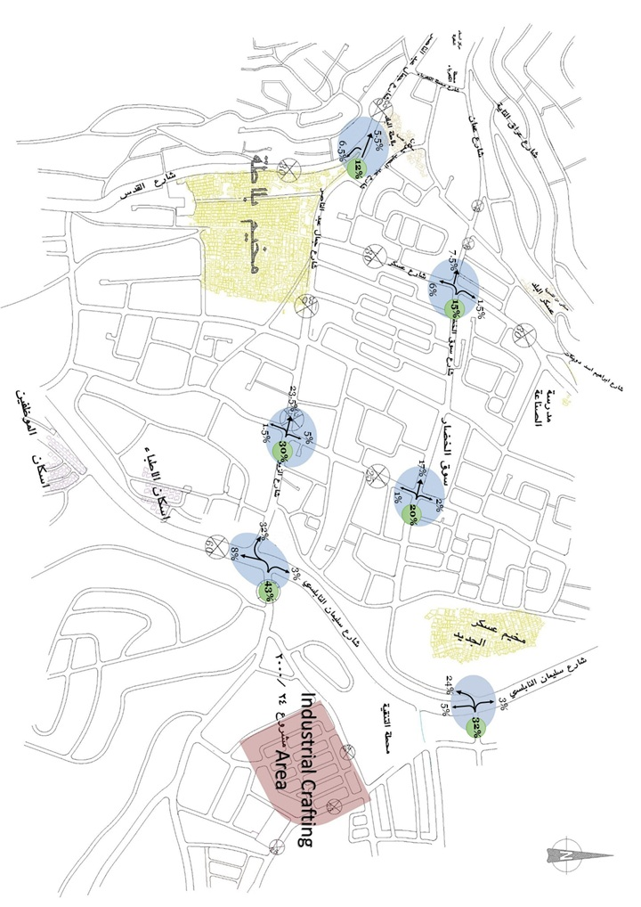
Traffic Analysis
Future Traffic Studies
Trip Distribution

Slide 22
Traffic Analysis
Analysis of the future traffic
Future traffic without the existence of the project (After 5 years).
Future traffic with the existence of the project (Phase I).
Future traffic with the existence of the project (Phase II).

Slide 23
Evaluations & Suggested Actions
Analysis of the future traffic (Intersections) :
  (#1) Al Ghawi Intersection (Signalized)
  Main Problem : Through movement in the EB direction
Future Traffic | Level of Service
 | EB | WB | NB | SB
Without the existence of the project | C~F | D | D~E | D
Phase I | C~F | D | D~E | D
Phase II | D~F | D | D~E | D

Slide 24
Evaluations & Suggested Actions
Analysis of the future traffic (Intersections) :
  (#1) Al Ghawi Intersection (Signalized)
  Solution : Adjustment of signal timing design
  LOS Results after improvement
Future Traffic | Level of Service
 | EB | WB | NB | SB
Without the existence of the project | D | C~E | D~E | E
Phase I | D | C~E | D~E | E
Phase II | D~E | D~E | D~E | E

Slide 25
Evaluations & Suggested Actions
Analysis of the future traffic (Intersections) :
  (#2) Al Hesbeh Roundabout
Future Traffic | v/c Ratio
 |  | EB | WB | NB | SB
Without the existence of the project | Up B | 0.44 | 0.21 | 0.20 | 0.14
 | L B | 0.53 | 0.25 | 0.25 | 0.17
Phase I | Up B | 0.58 | 0.23 | 0.23 | 0.15
 | L B | 0.69 | 0.28 | 0.28 | 0.18
Phase II | Up B | 0.81 | 0.26 | 0.29 | 0.15
 | L B | 0.97 | 0.32 | 0.37 | 0.19

Slide 26
Evaluations & Suggested Actions
Analysis of the future traffic (Intersections) :
  (#3) Al Maslakh Intersection
Future Traffic | Level of Service
 | EB | WB | NB | SB
Without the existence of the project | A | A | B~C | B~C
Phase I | A | A | B~C | B~C
Phase II | A | B | C~E | B~E

Slide 27
Evaluations & Suggested Actions
Analysis of the future traffic (Intersections) :
  (#4) Balata – Al Quds Intersection (Signalized)
Future Traffic | Level of Service
 | EB | WB | NB | SB
Without the existence of the project | D~F | F | NA | C
Phase I | D~F | F | NA | C
Phase II | D~F | F | NA | C

Slide 28
Evaluations & Suggested Actions
Analysis of the future traffic (Intersections) :
  (#5) Beit Furik Intersection (Unsignalized)
  Main Problem : (At the beginning of phase I of the project) NB direction and left-turn movement in the EB direction.
Future Traffic | Level of Service
 | EB | WB | NB | SB
Without the existence of the project | A | A | B~D | B~C
Phase I | A | A | C~F | B~D
Phase II | A | B | F | D~F

Slide 29
Evaluations & Suggested Actions
Analysis of the future traffic (Intersections) :
  (#5) Beit Furik Intersection (Unsignalized)
  Solution : Design a traffic signal for the intersection with the start of phase I
  LOS Results after improvement
Future Traffic | Level of Service
 | EB | WB | NB | SB
Phase I | C | C | D | D
Phase II | E | C | D | D

Slide 30
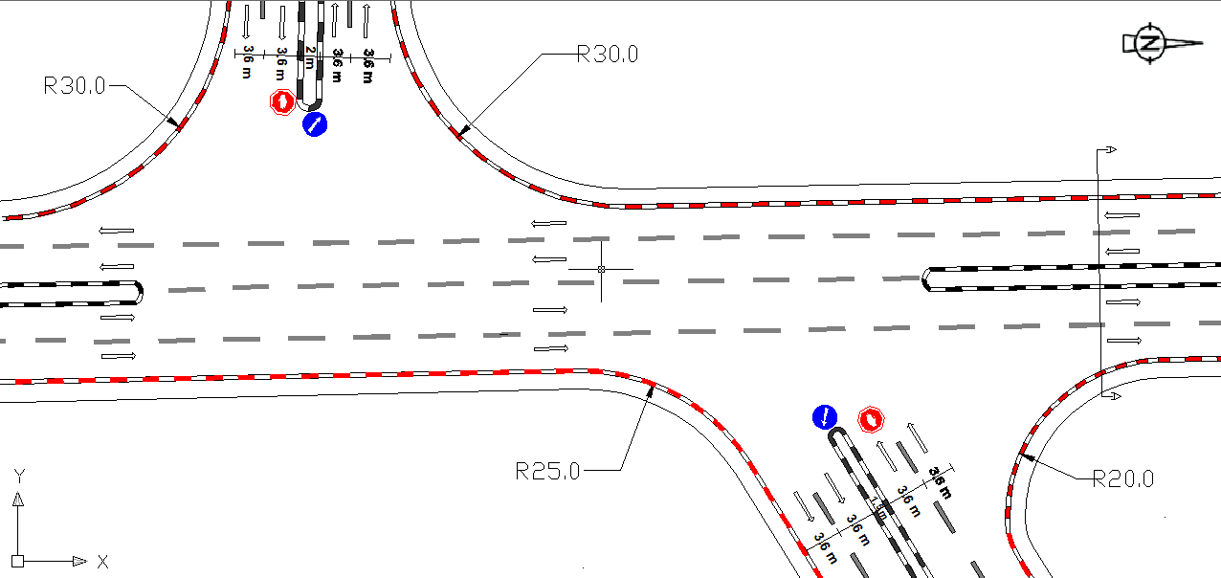
Evaluations & Suggested Actions
Analysis of the future traffic (Intersections) :
  (#5) Beit Furik Intersection (Unsignalized)

Slide 31
Evaluations & Suggested Actions
Analysis of the future traffic (Intersections) :
  (#6) Salem Intersection (Unsignalized)
  Main Problem : (At the beginning of phase I of the project) Left-turn movement in the EB and WB directions.
Future Traffic | Level of Service
 | EB | WB | NB | SB
Without the existence of the project | A~C | A~C | A | A
Phase I | A~F | A~D | A | A
Phase II | A~F | A~F | A | A

Slide 32
Evaluations & Suggested Actions
Analysis of the future traffic (Intersections) :
  (#6) Salem Intersection (Unsignalized)
  Solution : - Separating the left-turn movement in the EB and
  WB directions.
  - Design a traffic signal with the start of phase II.
  LOS Results after improvement
Future Traffic | Level of Service
 | EB | WB | NB | SB
Phase I | C~E | C~E | A | A
Phase II (Signalized) | C~E | C | C | D

Slide 33
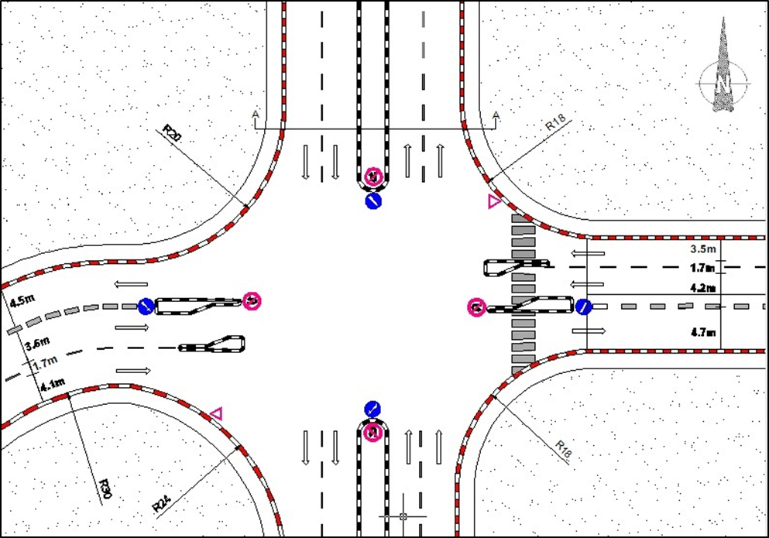
Evaluations & Suggested Actions
Analysis of the future traffic (Intersections) :
  (#6) Salem Intersection (Unsignalized)

Slide 34
Evaluations & Suggested Actions
Analysis of the future traffic (Links) :
Link Name | Status | Direction | LOS
 |  |  | Without the existence of the project | Phase I | Phase II
Sulaiman Al-Nabulsi | Two-Lane | Two-Way | B | B | C
 |  | Directional | C | C | D
Al-Zoyoot | Multi- Lane | Dir. 1 ← | A | A | A
 |  | Dir. 2 → | A | A | A
Al-Hesbeh | Multi- Lane | Dir. 1 ← | A | A | A
 |  | Dir. 2 → | A | A | A
Jamal Abdul Nasser | Multi- Lane | Dir. 1 ⤶ | C | C | C
 |  | Dir. 2 ⤴ | A | A | B

Slide 35
Conclusion and Recommendations

Slide 36
Conclusion & Recommendations
The importance of transportation impact studies.
Periodic traffic volume counting at the major intersections and links → Accurate value for the growth rate.
Extensive studies on local trip generation rates → Estimate the generated traffic with values very close to the reality
Consider more expensive, large-scale studies and actions in the future.

Slide 37


