Slide 1
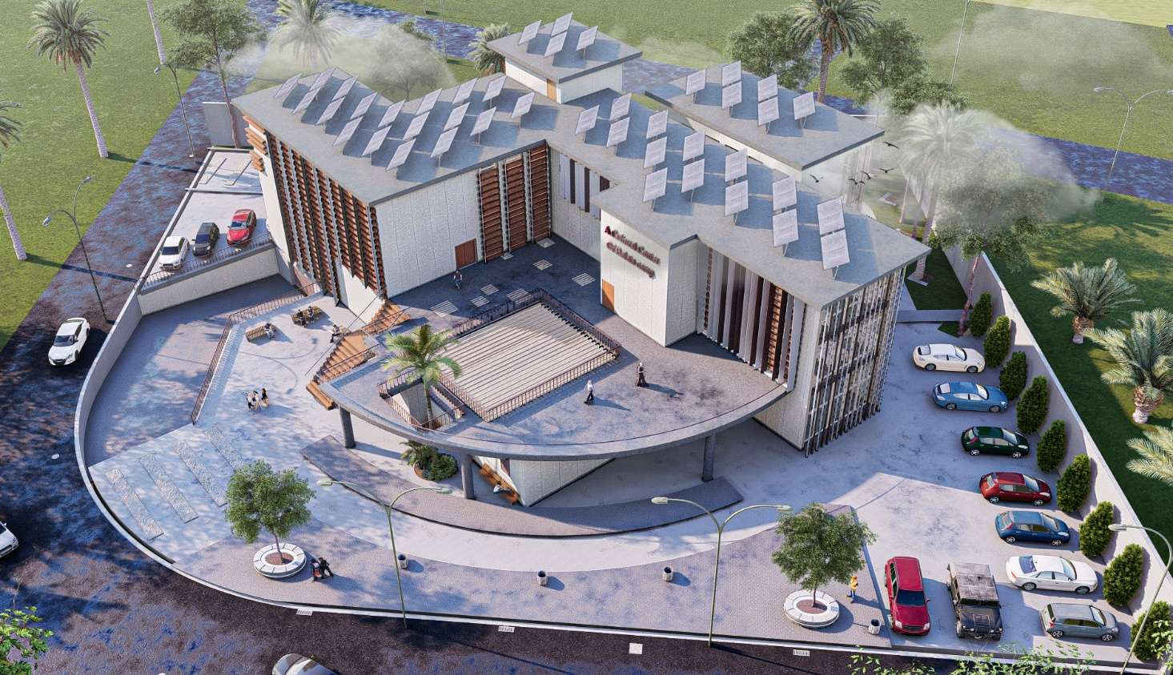

An-Najah National University
Building Engineering Department
Graduation Project – II (10611590)
A cultural center in Balata camp
Submitted By:
Amani Utt
Isra’ Abusamen
Reham Sawafta
2020-2021
Supervised name: Dr. Monther Dwaikat.

Slide 2
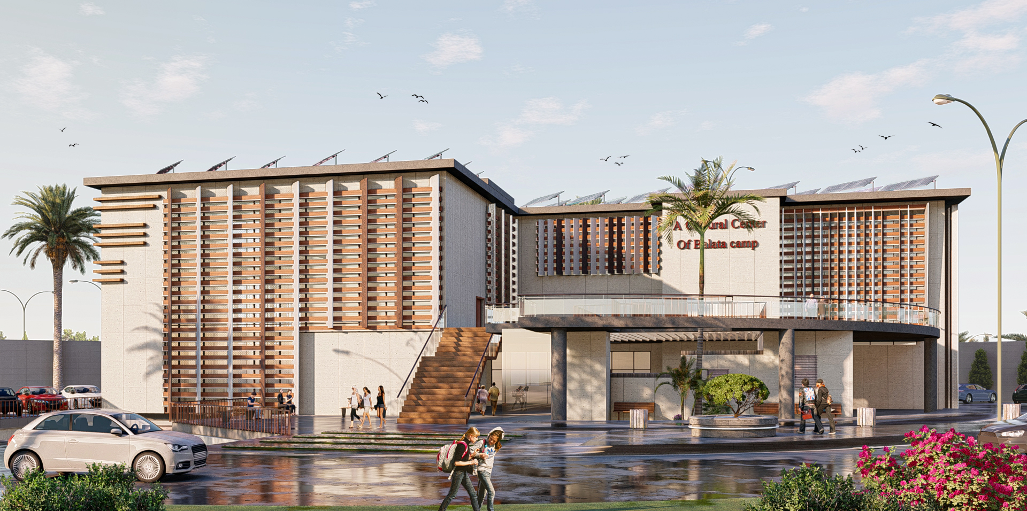
Contents
Introduction
Site Analysis
Architectural aspects
Environmental aspects
Structural aspects
Electro-mechanical
Cost estimated.

Slide 3
Introduction

Slide 4
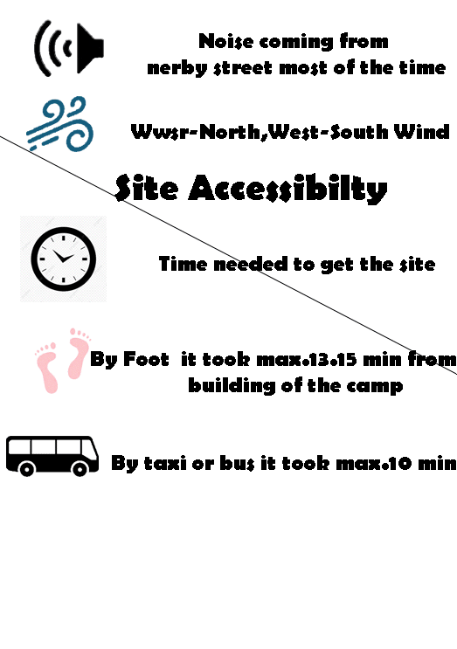
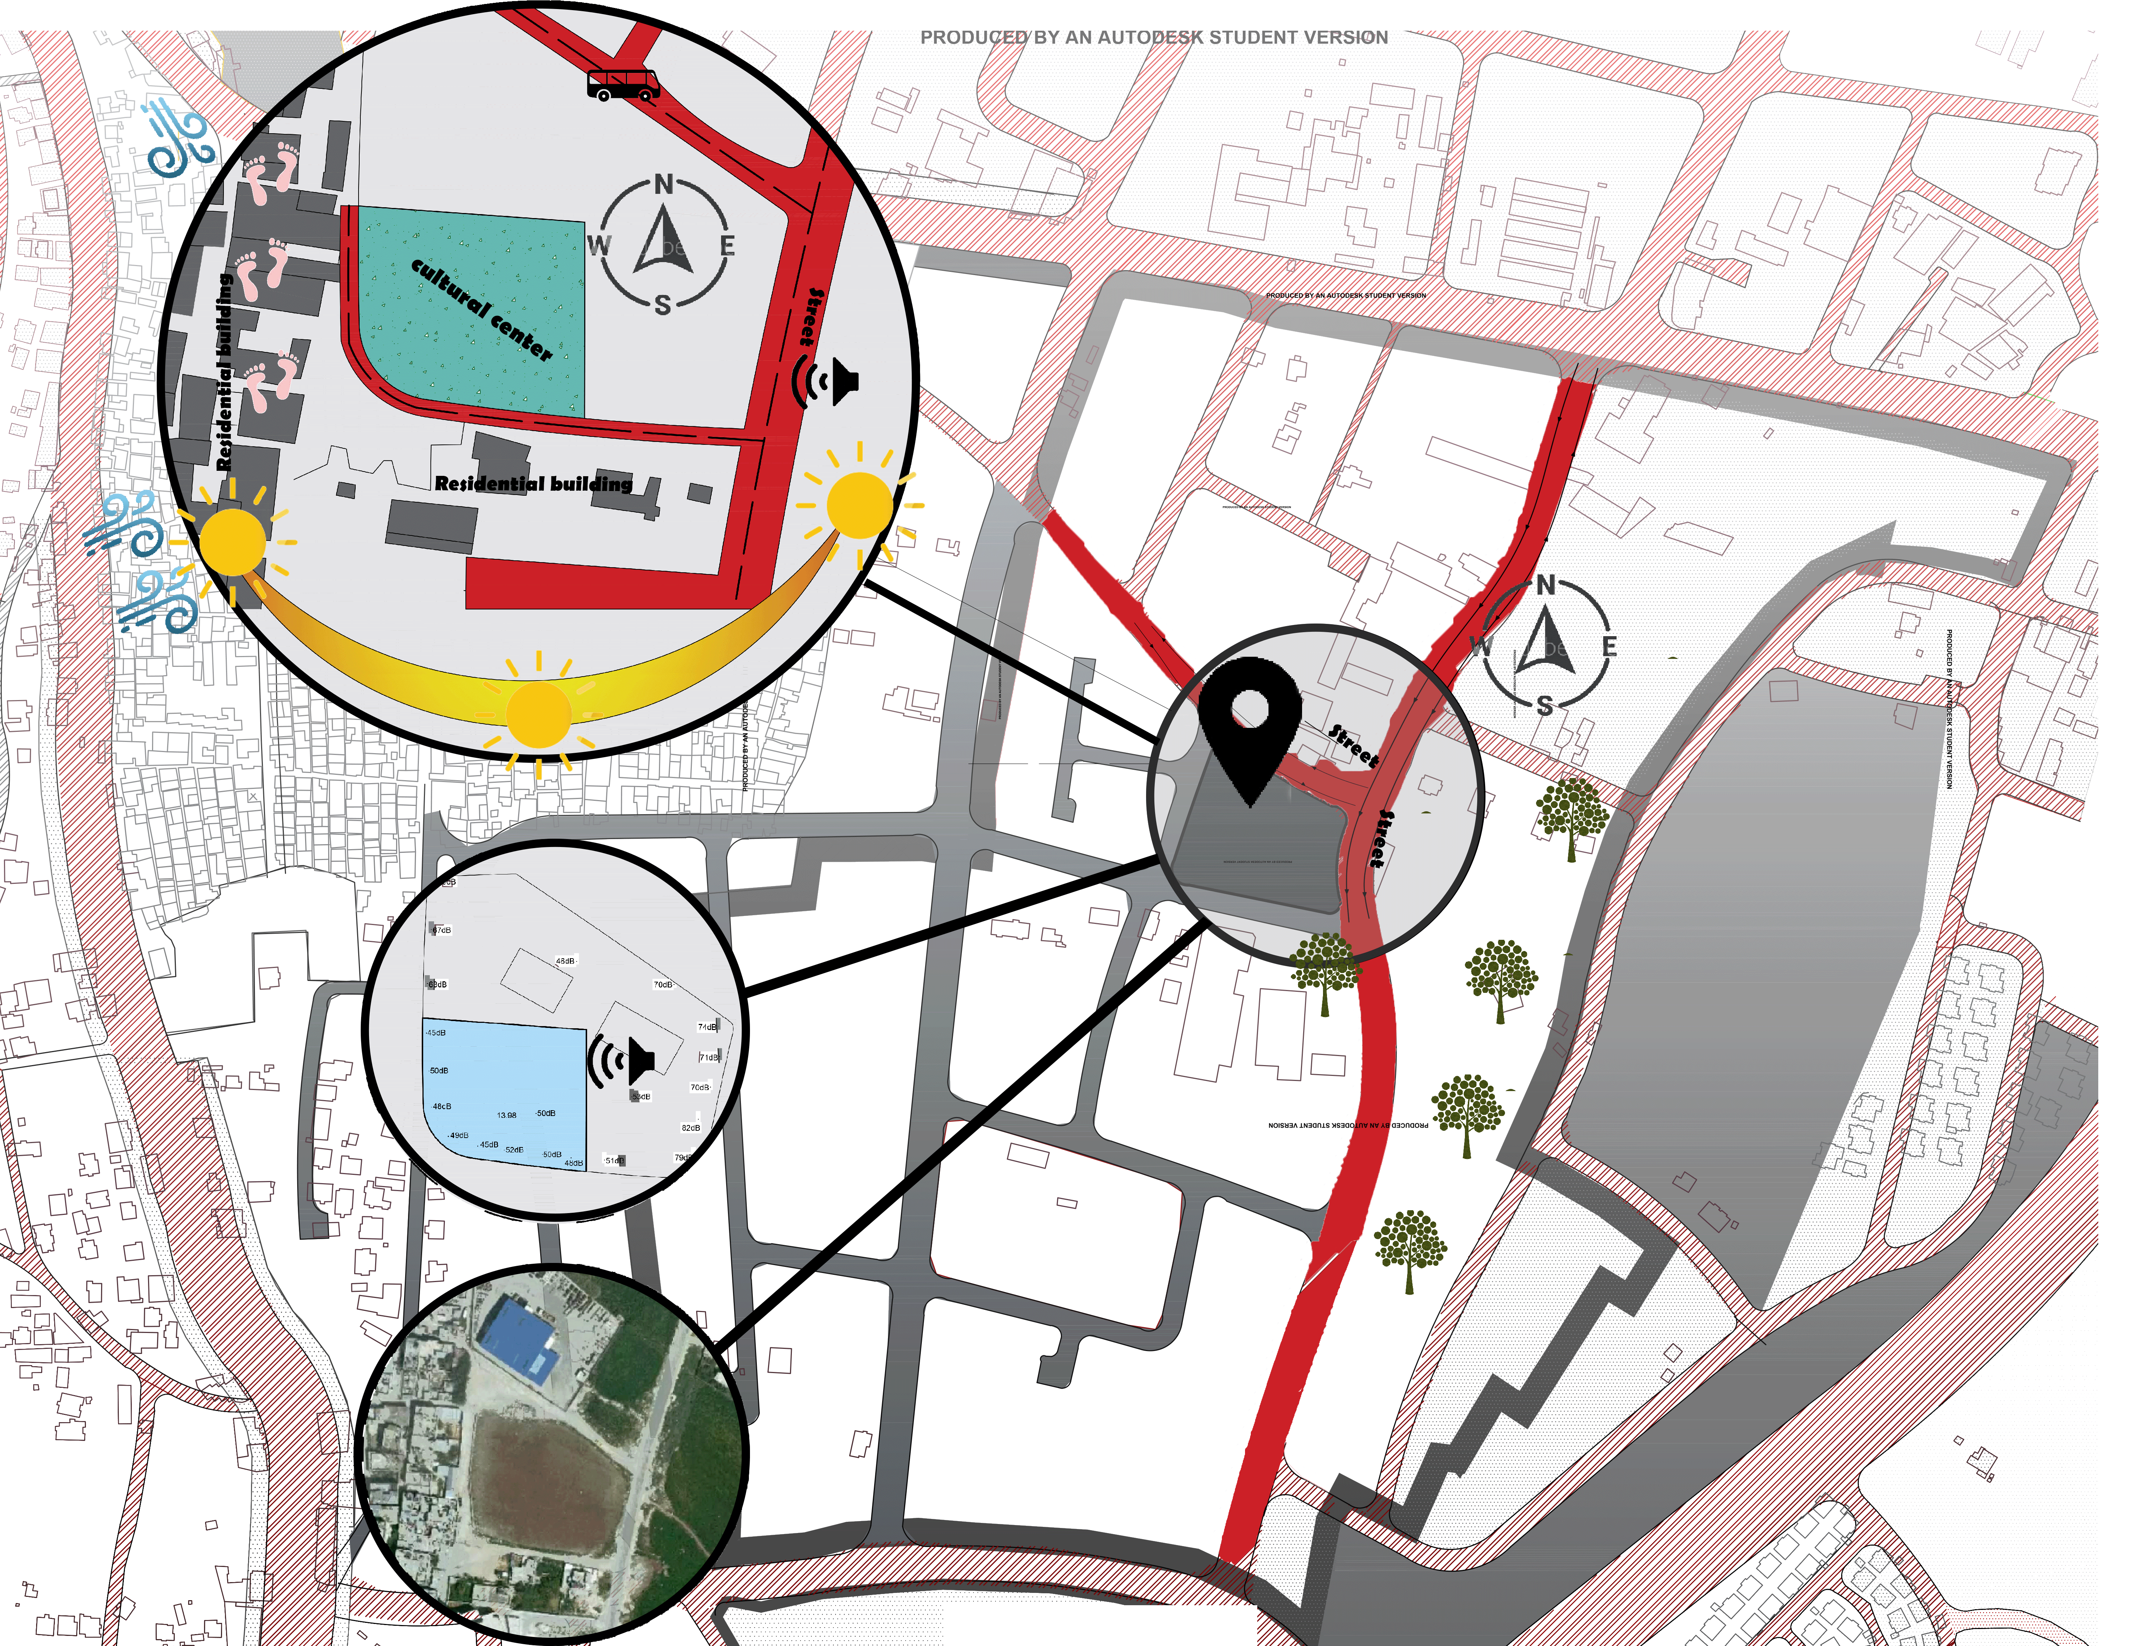
Site Analysis
Location
Orientation
Sun path
Access
Green area
Noise

Slide 5
Architectural design

Slide 6
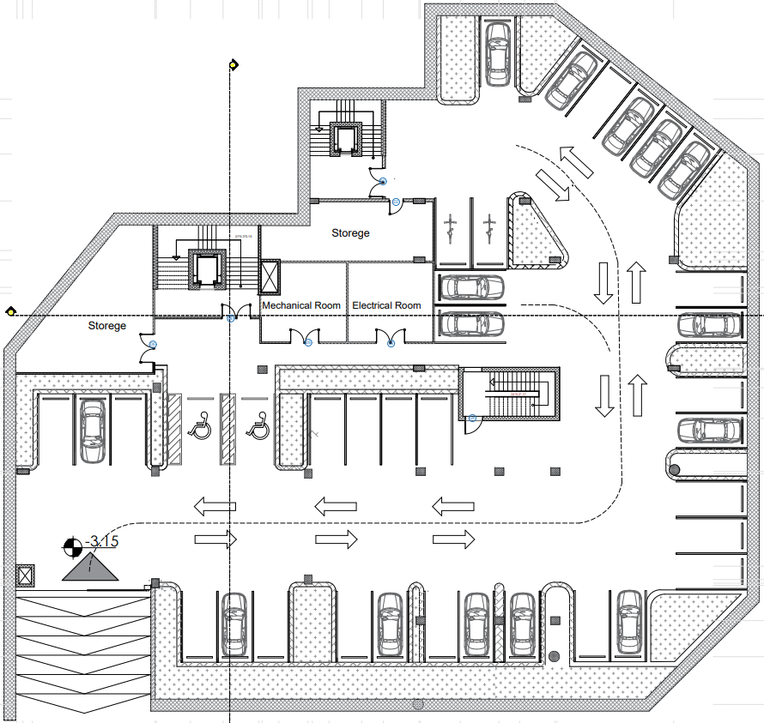
Basement Floor.
Floor area 1725 m2

Slide 7
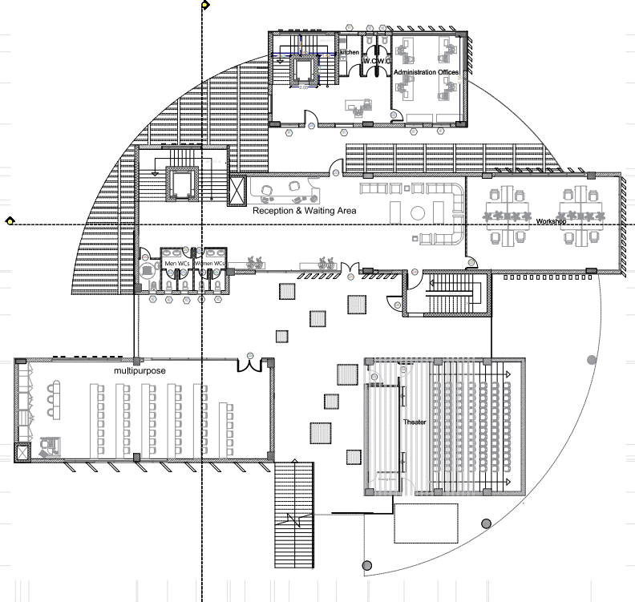
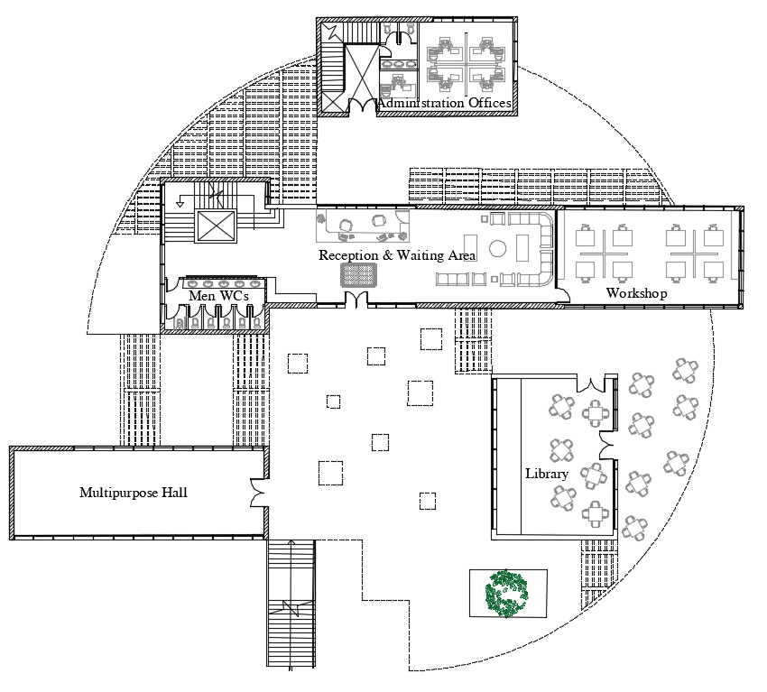
Ground Floor.
Before Modification.(Area 530 m2)
After Modification.(Area 665m2)

Slide 8
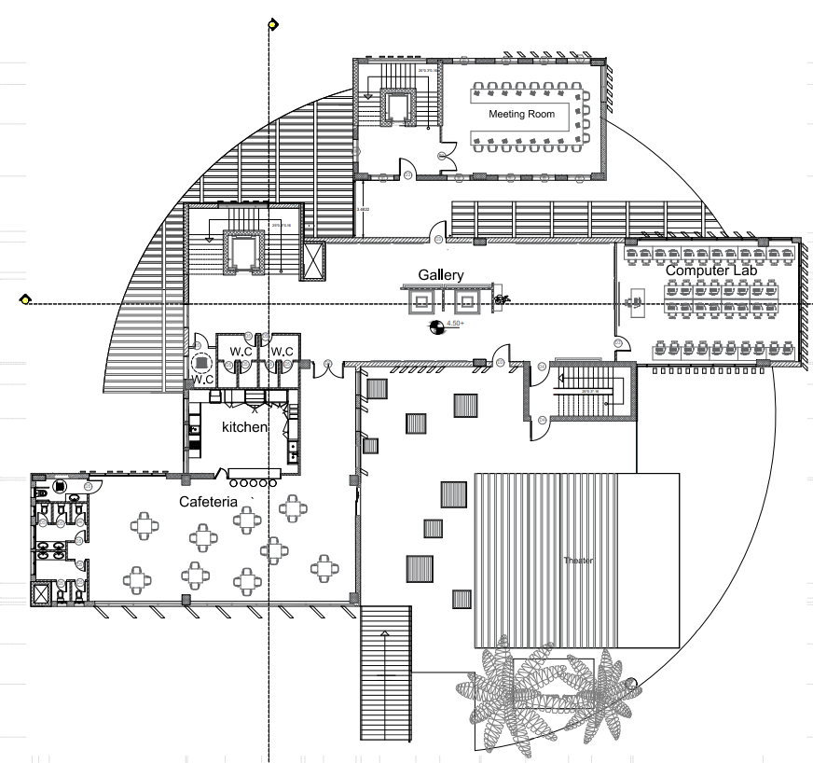
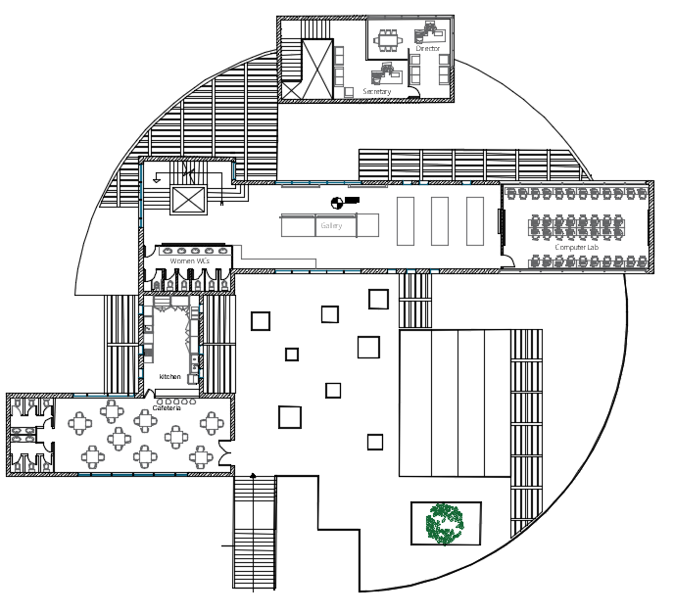
First Floor.
Before Modification.(Area 970 m2)
After Modification.(Area 1020 m2)

Slide 9
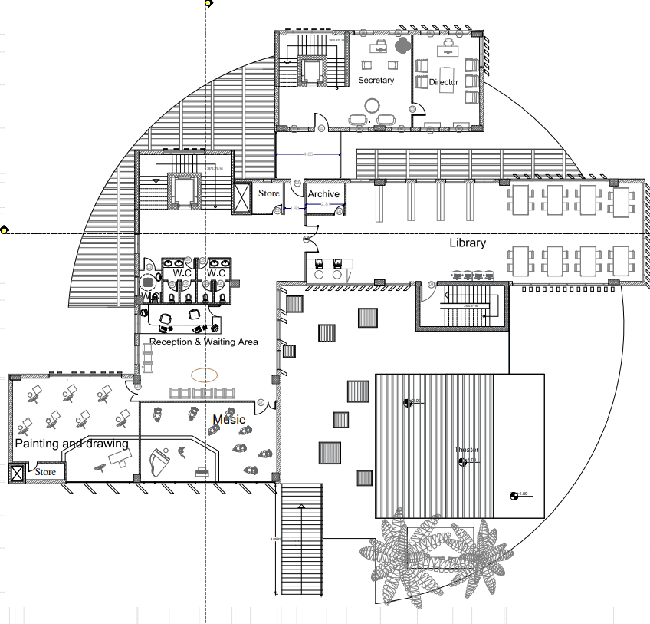
Second Floor.
Floor area 665 m2

Slide 10
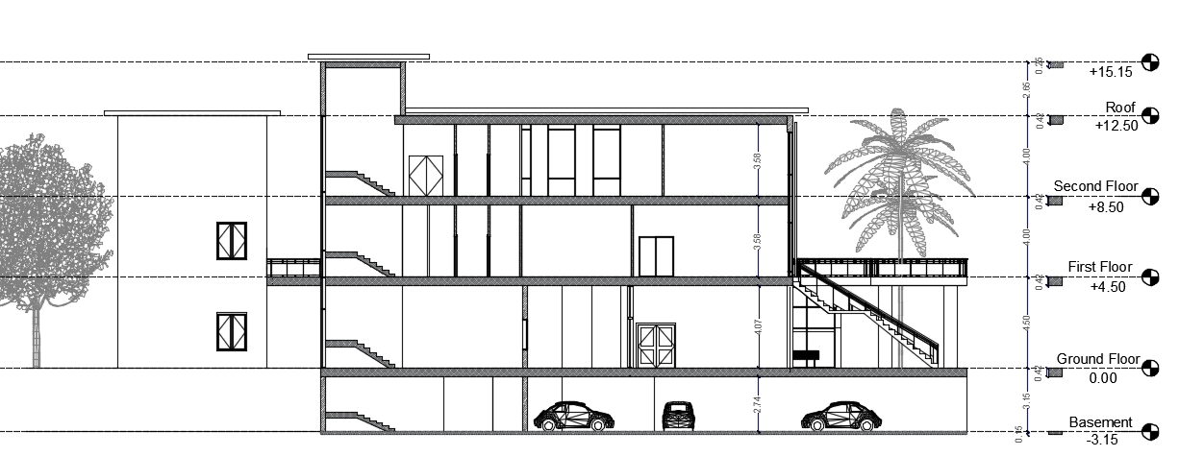
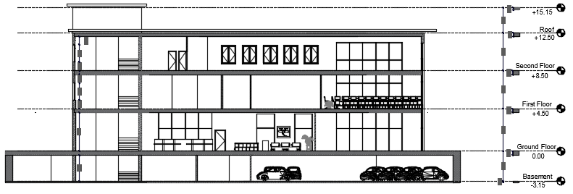
Section A-A.
Section B-B.

Slide 11
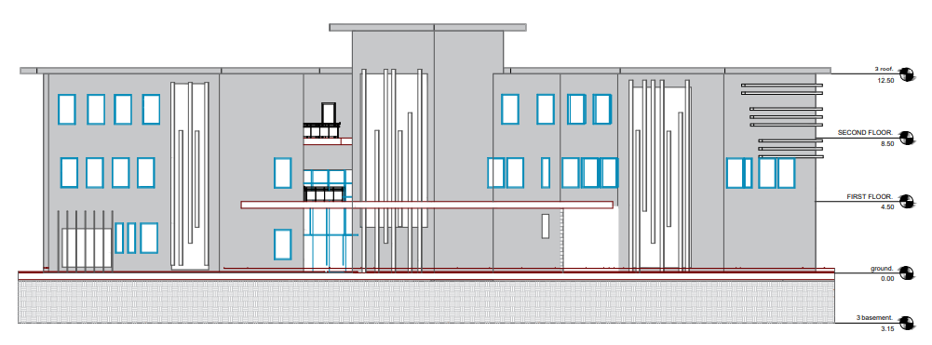
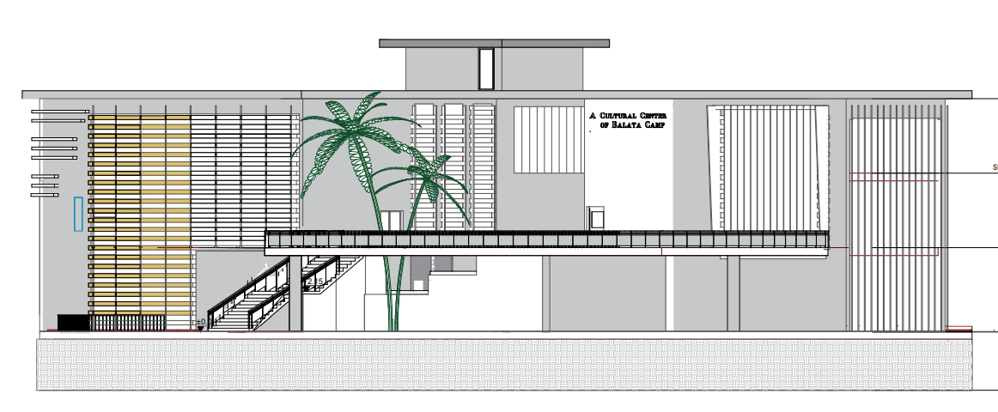
North Elevation.
South Elevation.

Slide 12
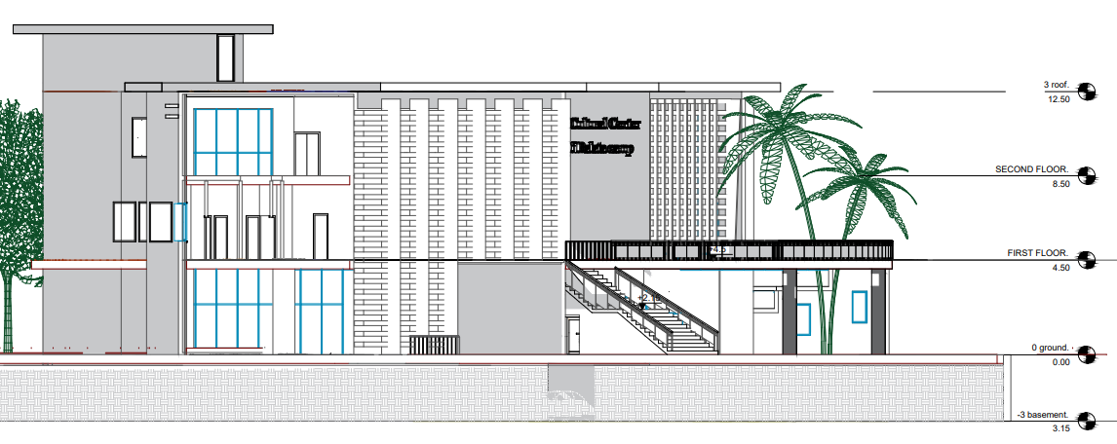
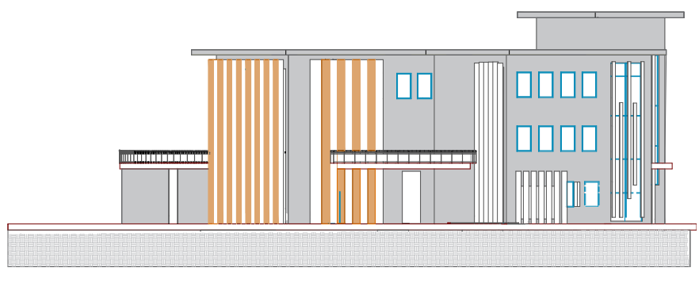
West Elevation.
East Elevation.

Slide 13
3 D VIEW

Slide 15
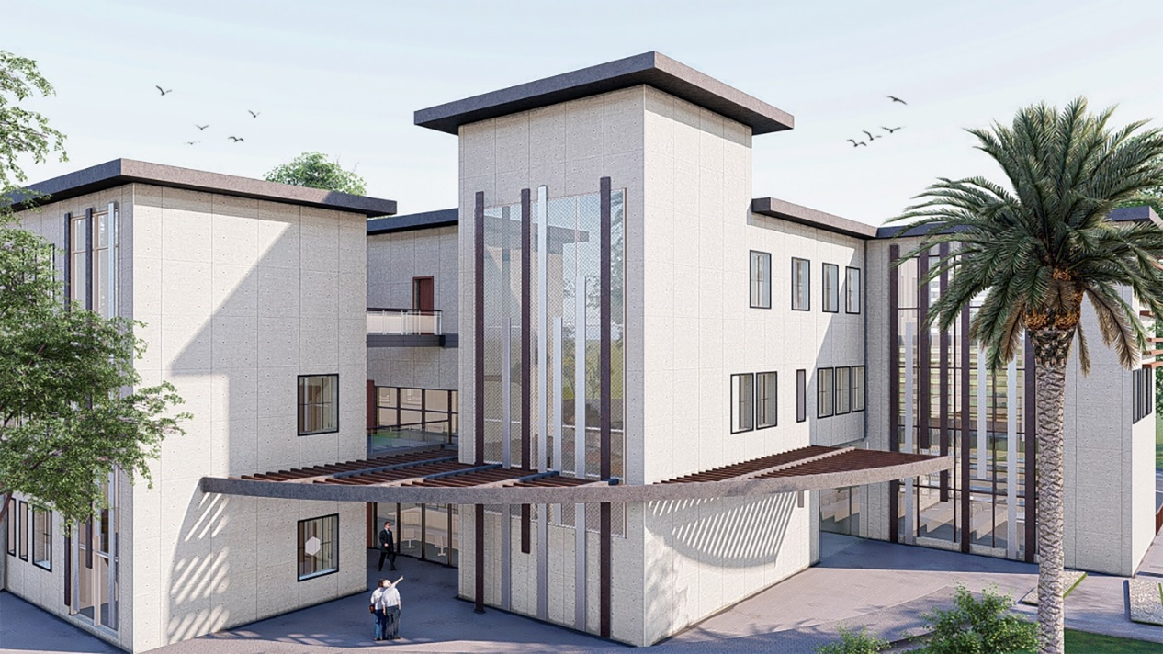
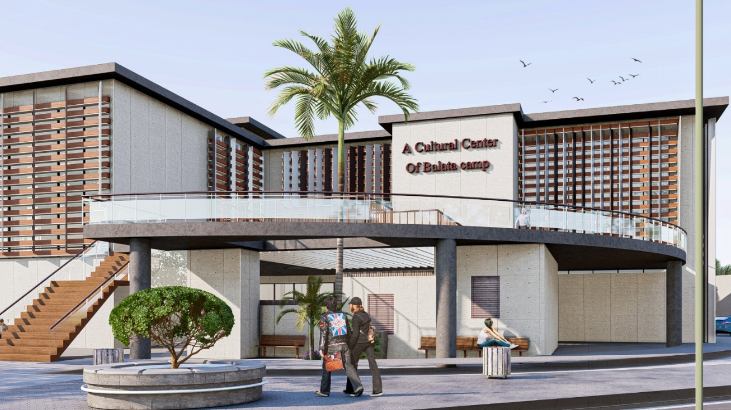
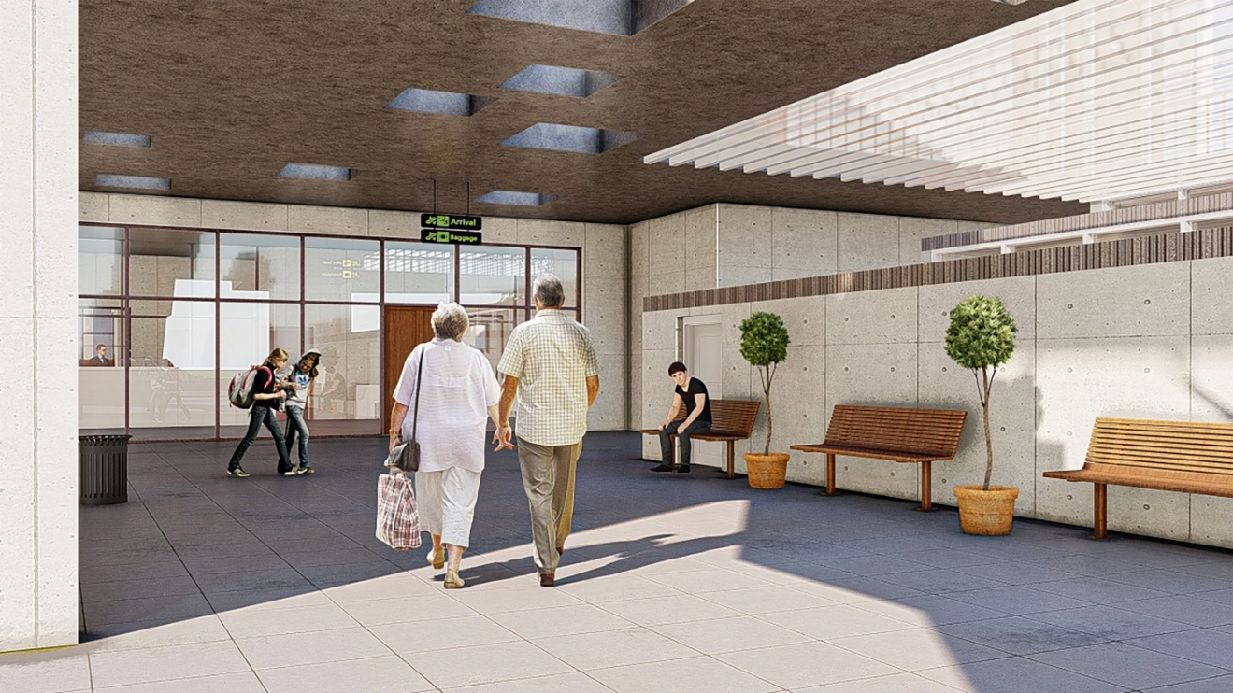
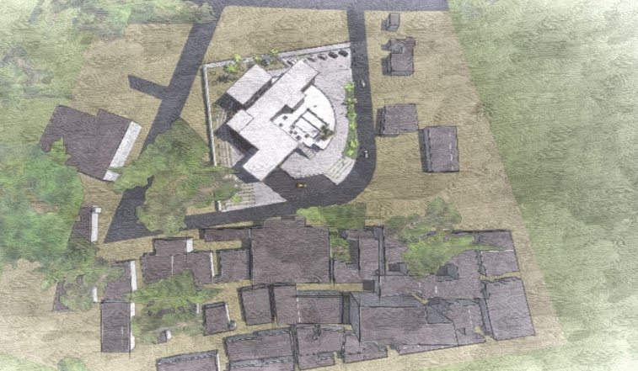

Slide 16
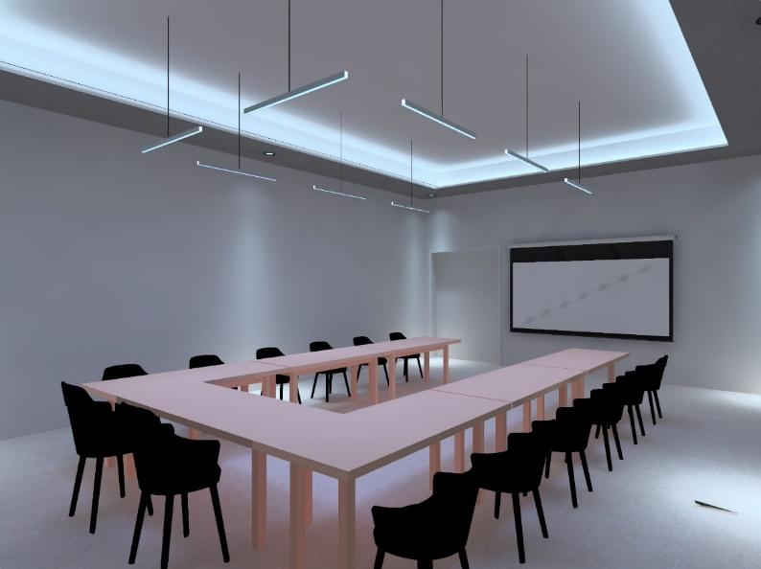
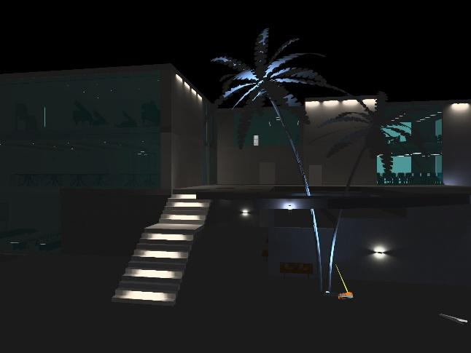
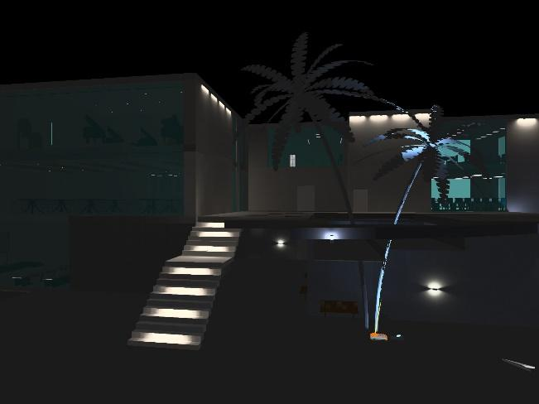
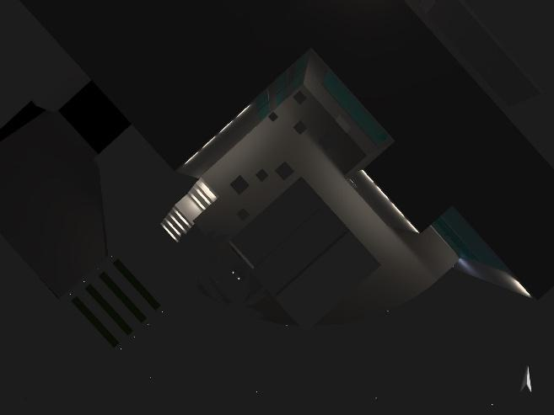

Slide 17
Environmental design
Environmental Adjustments
Daylighting
Thermal analysis
Over-shadowing effect on the building
HVAC design

Slide 18
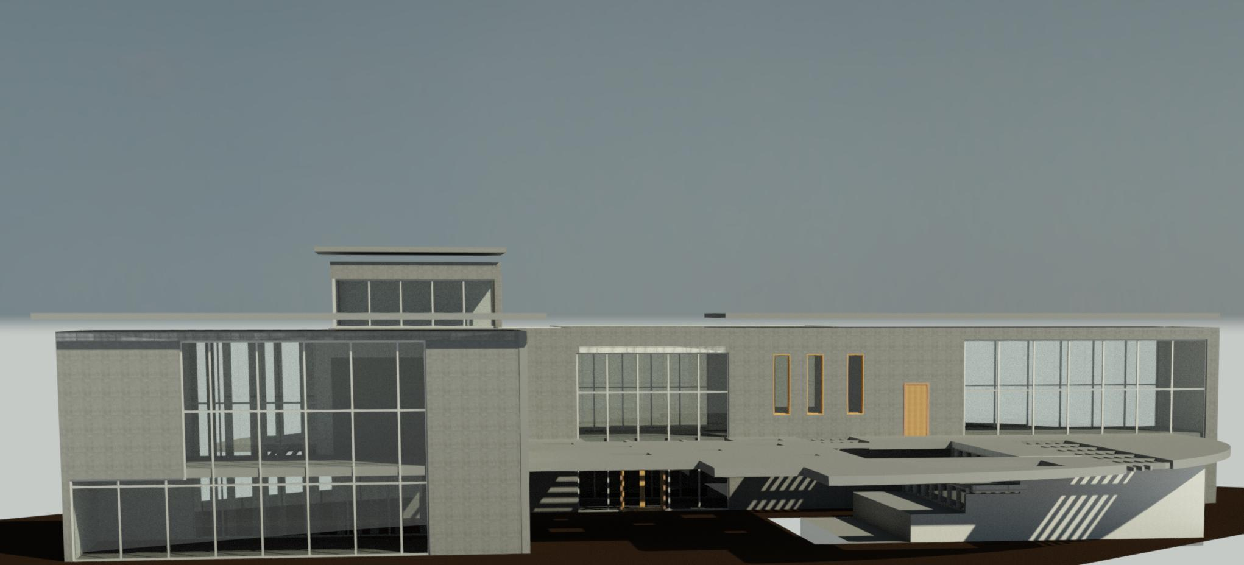
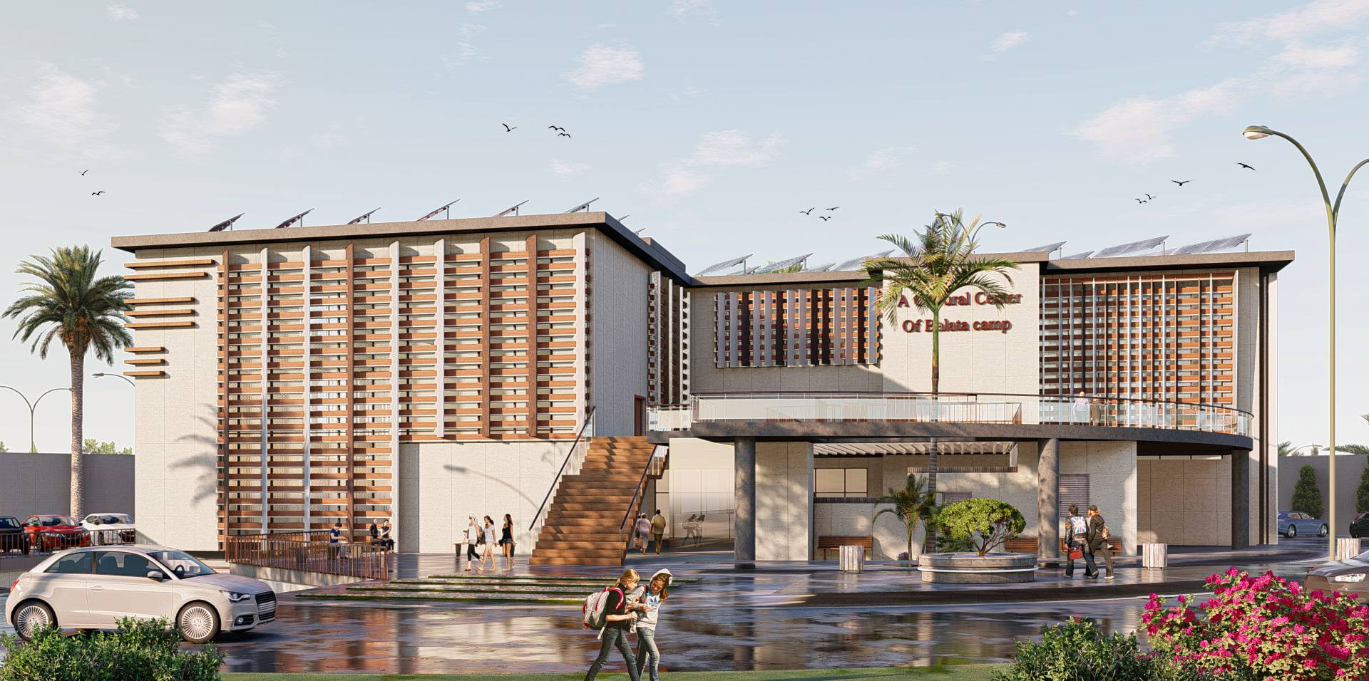
Environmental Adjustments
Before
After

Slide 19
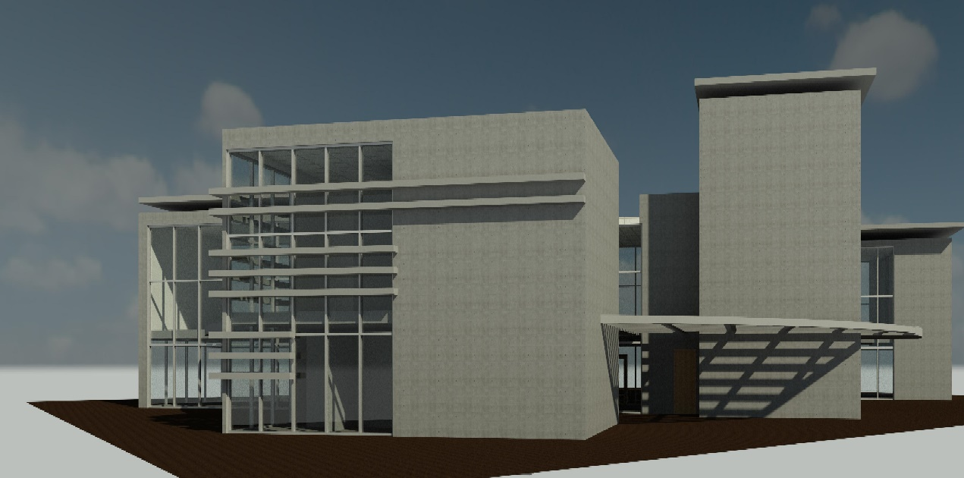
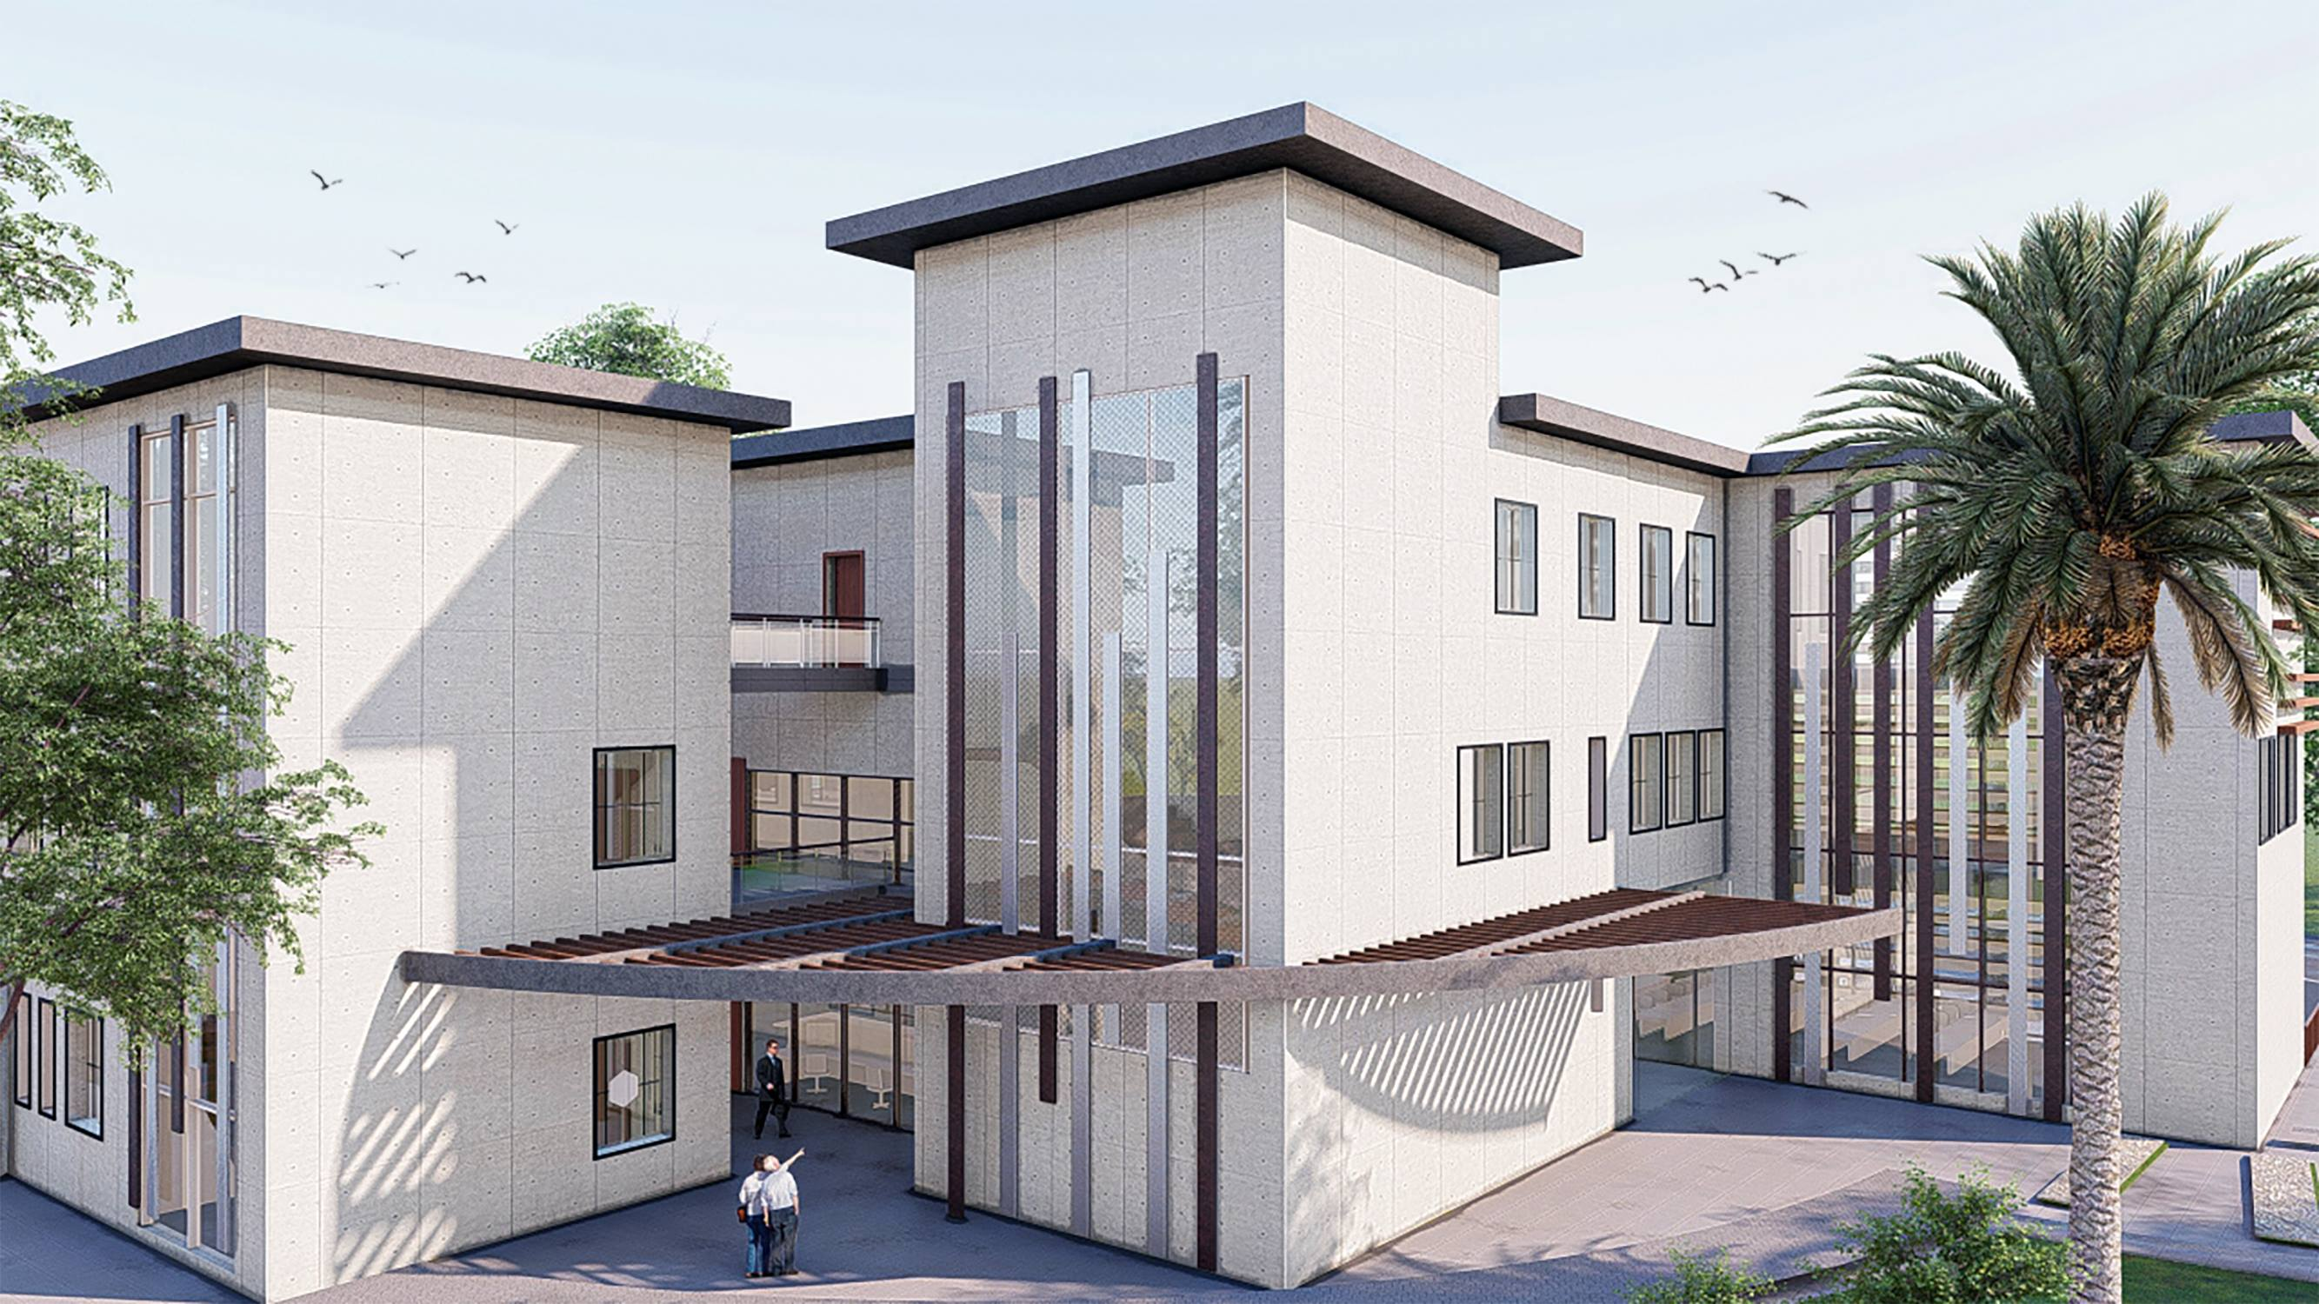
Before
After

Slide 20
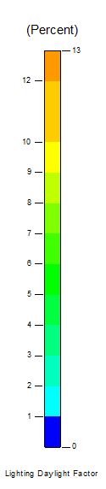
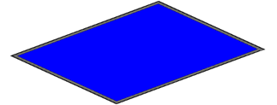
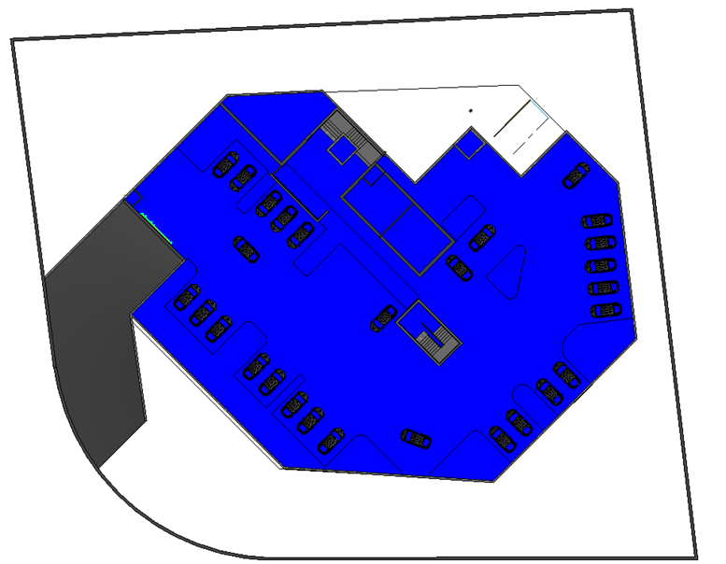
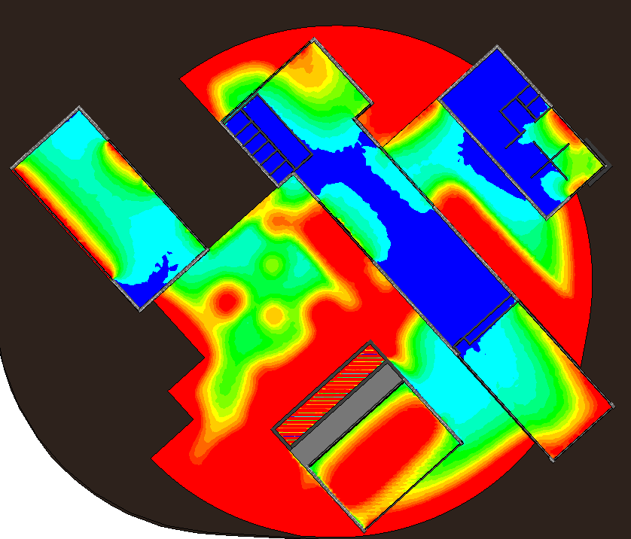
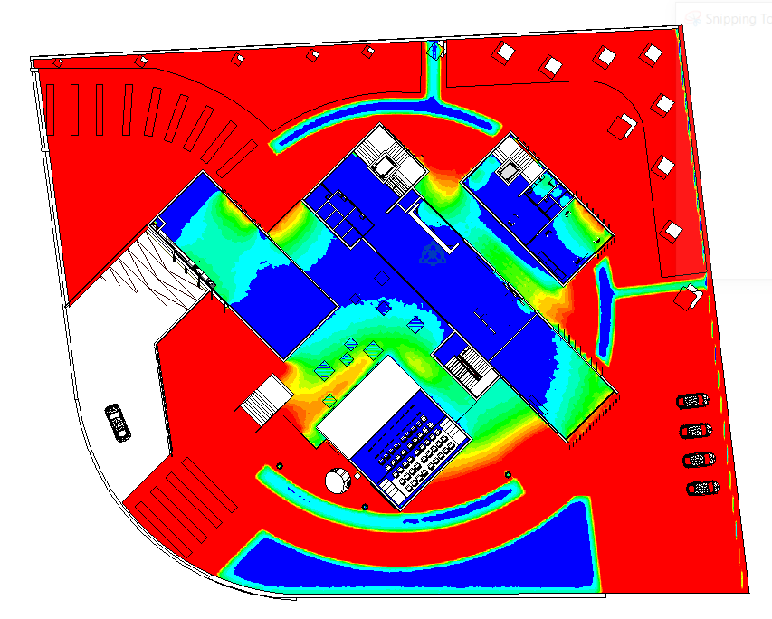
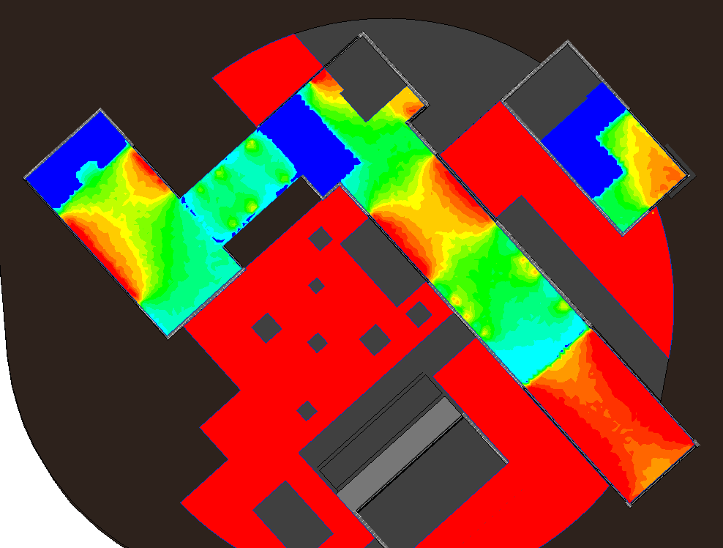
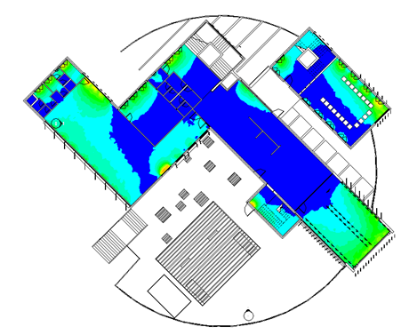
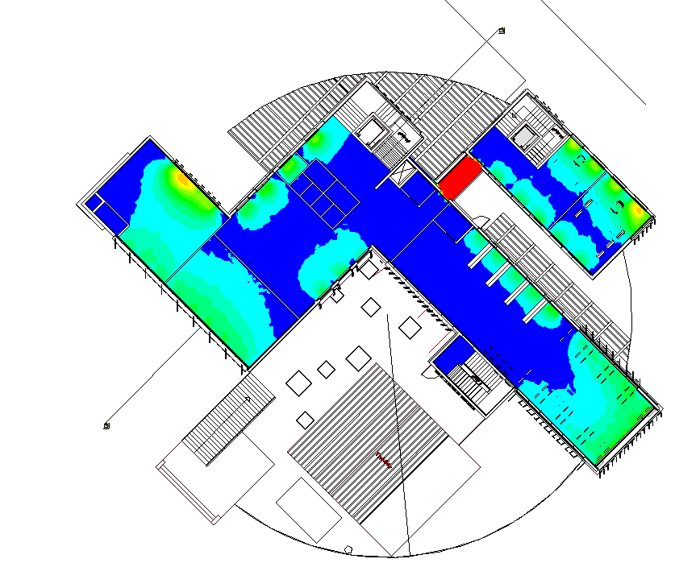
Daylighting
Floor | Before | After
Basement Floor
Ground Floor
First Floor
Second Floor

Slide 21
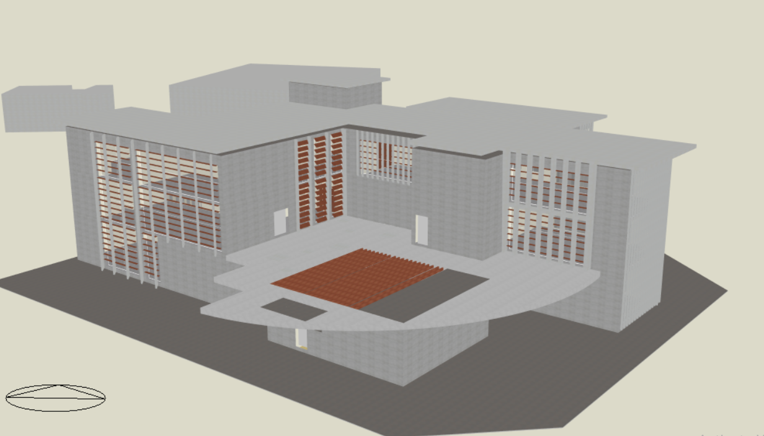
Thermal analysis

Slide 22
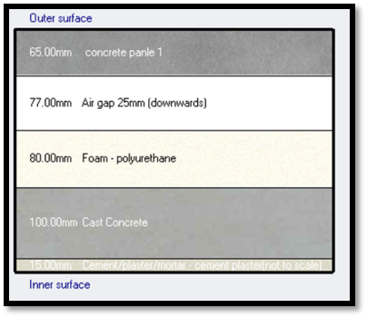
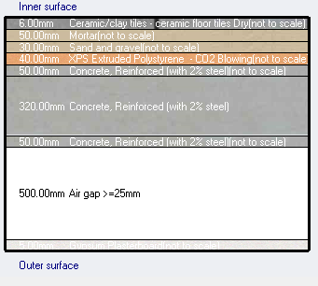
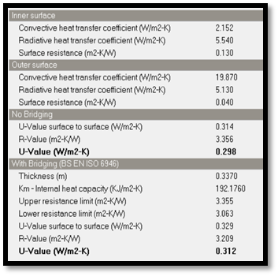
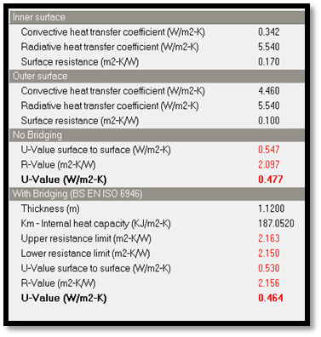
Elemental properties of structural and material layers within the element:
Floor
External wall
U-value for external wall =.31<.5
U-value for floor = .46<.85

Slide 23
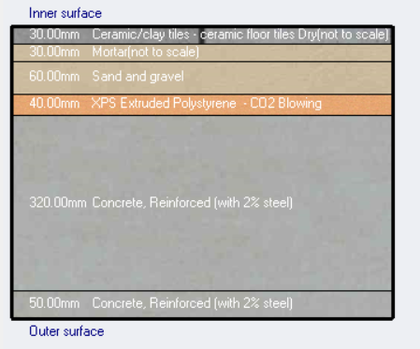
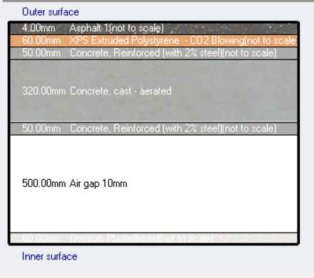
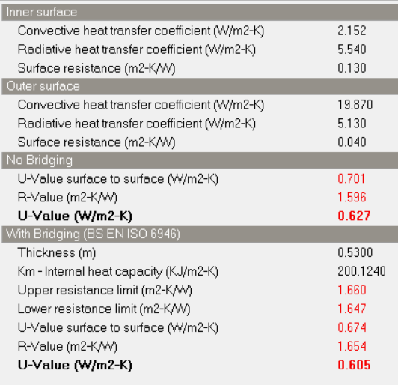
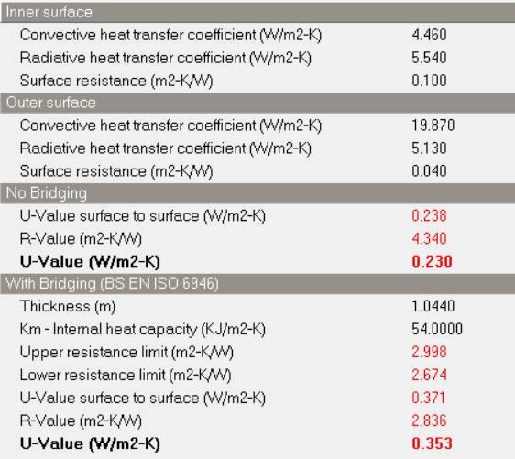
Elemental properties of structural and material layers within the element:
Roof
Semi exposed floor
U-value for semi exposed floor=.605<.85
U-value for roof =.35<.39

Slide 24
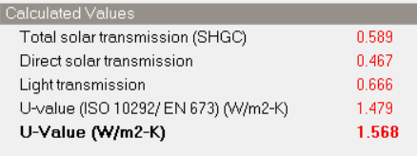
Elemental properties of structural and material layers within the element:
Curtain wall (Arcadia OPG3000 STC T / W)
double family glass type (double glazing, common PYR B CLEAR 6mm, with AIR 20 mm and Generic CLEAR (12 mm)

Slide 25
Thermal analysis
Results for heating & cooling load analysis:
Description | Heating load (KW) | Cooling load (KW) | Area(m²)
Whiteout insolation and Adjustments | 96.46 | 210.128 | 944
White insolation | 91.04 | 135.34 | 1579.5
White insolation and Adjustments | 78.61 | 113 | 1579.5

Slide 26
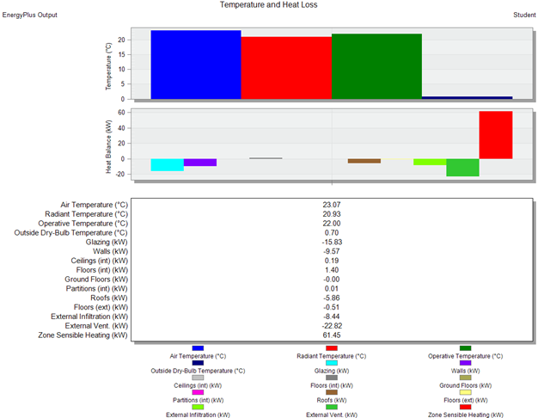
Thermal analysis
Results for heating load analysis
Total heating load =78.61KW
Design heating Load Per Floor Area
(W/m2) =47.9 W

Slide 27
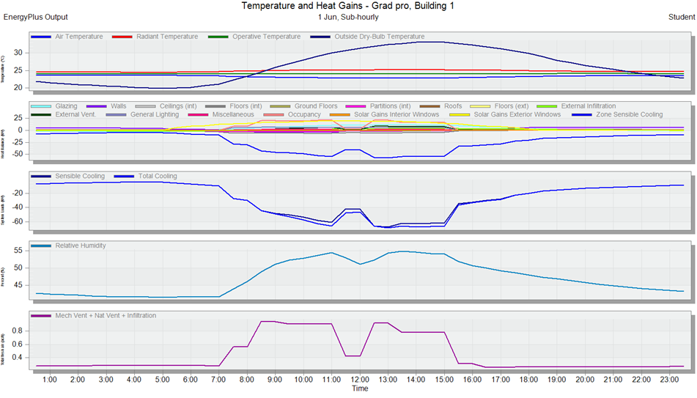
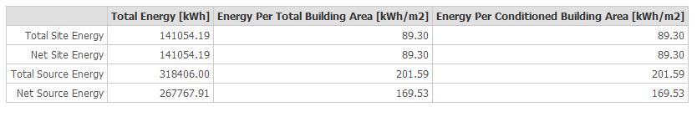
Thermal analysis
Results for cooling load analysis
Total cooling load =113kw
Design Cooling Load Per Floor Area
(W/m2) =66.6 W
Thermal analysis- Total energy consumed per meter square in the building :

Slide 28
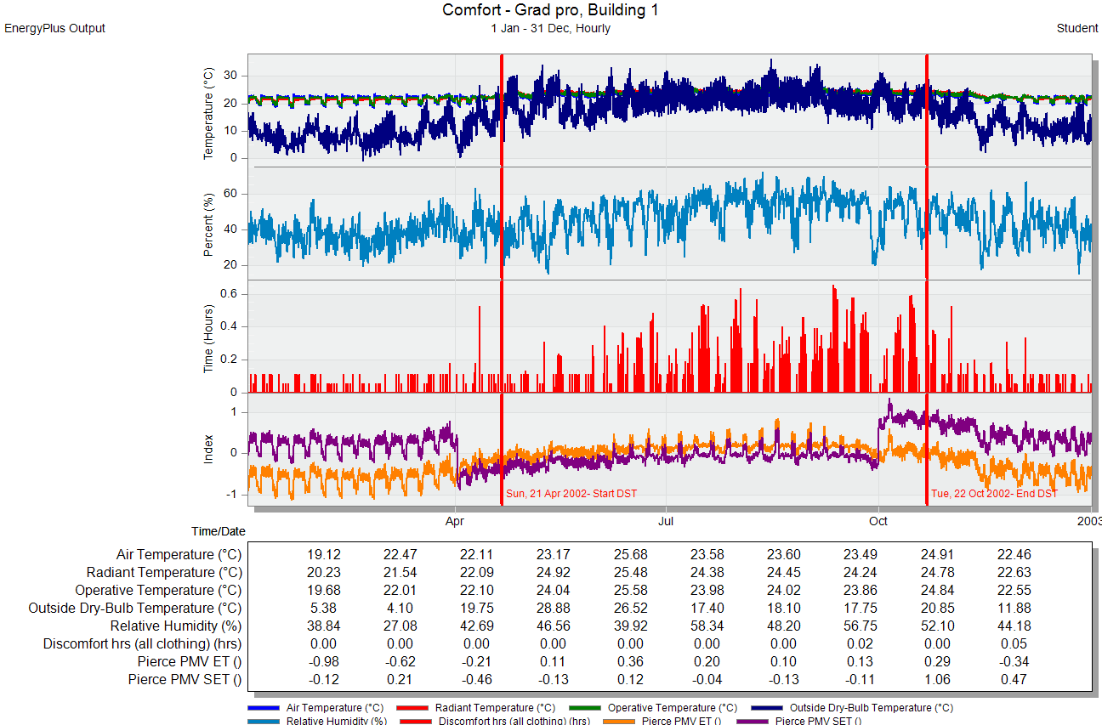

Thermal analysis
comfort results
The number of non-comfort hours in the building:

Slide 29


Thermal analysis
Computational Fluid Dynamics (CFD) analysis
Internal CFD analysis:
Air velocity between (0.08-0.22 m/s)
Temperatures (17.66-18.77°C) Temperature (16.95-20.14°C)

Slide 30






Over-shadowing effect on the building
In summer
Before
After
At 8 a.m.
At 8 a.m.
At 12 P.m.
At 12 P.m.
At 4 P.m.
At 4 P.m.

Slide 31





Over-shadowing effect on the build
In winter
Before
After
At 8 a.m.
At 8 a.m.
At 12 P.m.
At 12 P.m.
At 4 P.m.
At 4 P.m.

Slide 32

HVAC System
From the Design Builder program:
Total Heating Load = 78.61 kW.
Total Cooling Load = 113 kW.
Total Flowrate = 5308.6 L/s.

Slide 33






HVAC System
Outdoor unit :
2VRF unit with capacity 56&61 KW
Indoor unit:
Cassette unit
Fan coil
Diffuser
AP0152WH
AP0074MH-E
VRF units AP2014FT8-E, AP1814FT8-E
AP0724H-E, AP0274H-E Fan coil
Rectangular diffuser ).3X.3M)
Linear diffuser

Slide 34
HVAC System
Supply diffusers
Return diffusers
Zone | Design cooling Capacity (kW) | Design Flow Rate (m³/s) | No .DEF | Type
Administration | 3.16 | 0.1852 | 2 | R.D.(.3X.3M)
Secretary | 1.36 | 0.071 | 1 | R.D.(.3X.3M)
Kitchen | 0.48 | 0.0282 | 1 | R.D.(.3X.3M)
Multipurpose | 16.65 | 0.9867 | 6 | R.D.(.3X.3M)
Workshop | 7.64 | 0.3649 | 3 | R.D.(.3X.3M)
Reception Waiting Area | 9.58 | 0.4337 | 3 | L.D/R.D(.3X.3M)
Meeting-room | 4.04 | 0.1884 | 2 | R.D.(.3X.3M)
Gallery | 13.32 | 0.4424 | 6 | R.D.(.25X.25M)
Computer Lab | 7.17 | 0.4109 | 6 | R.D.(.25X.25M)
Cafeteria | 10.25 | 0.5364 | 3 | R.D.(.3X.3M)
Kitchen | 2.33 | 0.128 | 2 | R.D.(.25X.25M)
Secretary | 2.21 | 0.1165 | 2 | R.D.(.25X.25M)
Director | 1.67 | 0.0758 | 4 | L.D
Library | 9.23 | 0.5179 | 6 | R.D.(.25X.25M)
lobby | 8.27 | 0.3454 | 4 | L.D
Archive | 0.26 | 0.00699 | 1 | R.D.(.25X.25M)
Painting and drawing | 3.18 | 0.1425 | 2 | R.D.(.25X.25M)
Music | 3.1 | 0.1687 | 2 | R.D.(.25X.25M)
Dressing-Room | 0.13 | 0.003367 | 1 | AP0074MH-E
Theater | 9.25 | 0.3978 | 3 | AP0152WH-E
Lobby | 0.2 | 0.005628 | 1 | AP0074MH-E
Total | 105.24 | 5.3086
Zone | Fresh air (m³/s) | Return Flow Rate (m³/s) | NUMB .DEF | Type
Administration | 0.005 | 0.181 | 1 | R.D.(.3X.3M)
Secretary | 0.004 | 0.068 | 1 | R.D.(.3X.3M)
Kitchen | 0.007 | 0.021 | 1 | R.D.(.3X.3M)
Multipurpose | 0.426 | 0.561 | 4 | R.D.(.3X.3M)
Workshop | 0.082 | 0.283 | 2 | R.D.(.3X.3M)
Reception Waiting Area | 0.126 | 0.307 | 2 | L.D/R.D(.3X.3M)
Meeting-room | 0.081 | 0.108 | 1 | R.D.(.3X.3M)
Gallery | 0.263 | 0.179 | 2 | R.D.(.25X.25M)
Computer Lab | 0.096 | 0.315 | 2 | R.D.(.25X.25M)
Cafeteria | 0.329 | 0.207 | 2 | R.D.(.3X.3M)
Kitchen | 0.025 | 0.103 | 1 | R.D.(.25X.25M)
Secretary | 0.006 | 0.111 | 2 | R.D.(.25X.25M)
Director | 0.004 | 0.072 | 2 | L.D
Library | 0.042 | 0.476 | 5 | R.D.(.25X.25M)
lobby | 0.29 | 0.056 | 1 | L.D
Archive | 0.006 | 0.001 | 1 | R.D.(.25X.25M)
Painting and drawing | 0.062 | 0.08 | 2 | R.D.(.25X.25M)
Music | 0.097 | 0.072 | 1 | R.D.(.25X.25M)
Dressing-Room | 0.003 | 0.001 | 1 | AP0074MH-E
Theater | 0.188 | 0.21 | 2 | AP0152WH-E
Lobby | 0.004 | 0.001 | 1 | AP0074MH-E
Total | 2.146 | 3.413

Slide 35


HVAC System
Basement
Ground Floor

Slide 36


HVAC System
First Floor

Slide 37

HVAC System
Second Floor

Slide 38
Structural Design

Slide 39
Load material and code Data:
Load :
Type of load | Load considered (KN/m²)
Live load | 5 KN/m2
Superimposed dead load | 3.02KN/m2
Partitions dead load /m height | 1.66 KN/m2
Load of externals concert wall / (m height) | 5 KN/m2
Load of externals glass wall / (m height) | .312KN/m²
Snow load | .41KN/m2
Soil lateral pressure | Dependent on z
Materials Data
Construction materials that were used in the building:
For slab and beam use concrete B300 with fʹc =24 MPa.
For column and shear wall & mat foundation use concrete B350 with fʹc =28MPa.
Steel reinforcements with yielding strength fy=420MPa.
Design Codes:
ASCE: American society of civil engineers.
ACI 318-14: American concrete institute 2014.
Jordanian National Building Codes - Loads and Forces Code.
UBC-97 For seismic design

Slide 40



  The structural system of Slab
-Slab thickness design :
U-boot slab design is using with thickness H = 420mm.
Shear check:
Vu$=70.22KN$
ᴓVc=$262.7KN$˃Vu→ NO need to design for shear.

Slide 41

Column distribution :
Dimensions of Columns
column type |  | length (cm) | width (cm)
rectangular | c1 | 80 | 35
 | c2 | 40 | 75
 | c3 | 50 | 60
cylinder | dimeter (cm)
 | c4 | 70

Slide 42

Dimensions of Beams
Beam | Width | Depth | Effective depth
B1 | 800 | 420 | 390
B2 | 300 | 420 | 390
B3 | 1000 | 700 | 670
B4 | 1000 | 420 | 390

Slide 43

Structural analysis
Checks
Compatibility check
Equilibrium check
Stress σ & Strain ɛ check
Period check
Modal mass participation ratio check
Base shear check
Drift check

Slide 44



Compatibility check and Period
Period check.
T =1.4 × Ct (hn) ^{¾}
T =1.4 × 0.0488 (15.65) ^{¾} =0.537 Sec.
𝑇𝑒𝑡𝑎𝑏𝑠 𝑠ℎ𝑜𝑢𝑙𝑑 𝑏𝑒 ≤ 𝑇𝑚𝑒𝑡ℎ𝑜𝑑𝑎
𝑇𝑥 = 0.497 < 0.537 → 𝑂𝐾.
𝑇𝑦 = 0.423 < 0.537 → 𝑂𝐾.

Slide 45


Equilibrium check:
Error % Doesn’t exceed 5 %
Deflection check:
Maximum deflection calculate by Etabs from serves =40.5< 45mm .
Load | Etabs | Manual | Error%
Live | 20494.053 | 20081 | 2.06
SID | 27168.822 | 27979.816 | 2.90
Dead | 52580.342 | 135071 | 1.0

Slide 46

Stress-strain check:
Column internal force:
Beam internal force:
Column type | Manual load (KN) | Etabs load | %Error
Edge column | 681.25 | 681.187 | 0.01
Corner column | 542.825 | 542.79 | 0.01
BEAM | M manual (KN) | M etabs (KN) | % Error
AB | 39.11 | 38.67 | 1.125
BC | 35.32 | 36.9 | 2.64
CD | 43.056 | 43.06 | 0.0

Slide 47
Slab internal force:
-internal stress check for frame ABCD in Y-axis:
-internal stress check for frame ABCD in X-axis:
Frame | M manual | M Etabs (KN.m) | % Error
 | (kN.m)
AB | 224.35 | 222.05 | 1.02
BC | 353.06 | 344.66 | 2.37
CD | 413.05 | 406 | 1.70
Frame | M manual | M Etabs | % Error
 | (KN.m) | (KN.m)
AB | 345.47 | 344.79 | 0.2
BC | 290.96 | 283.385 | 2.6
CD | 290.45 | 286 | 1.5

Slide 48
    Seismic design criteria
Important parameters seismic analysis
•Mass source: | 100% * Dead & 25%*Live
•Seismic zone : | 2B |  | 0.20
•Soil profile: | Stiff soil profile |  | SD
• Force Reduction Factor (Building Frame System - shear wall) _ R | HBuilding | 2.5 | 5.5
•Importance Factor _ I |  |  | 1
•Acceleration-Dependent Seismic Coefficient (Ca) |  |  | 0.28
•Velocity-Dependent Seismic Coefficient (Cv) |  |  | 0.40

Slide 49
Modal mass participation ratio check
Sum UX= 0.9557
Sum UY= 0.9605
Sum of UX and UY ≥ 0.9 check is ok
Case | Mode | Period | UX | UY | UZ | Sum UX | Sum UY
 |  | sec
Modal | 49 | 0.025 | 0.0019 | 0.0003 | 0 | 0.5897 | 0.5784
Modal | 50 | 0.025 | 0.0049 | 0.0012 | 0 | 0.5945 | 0.5795
Modal | 51 | 0.025 | 0.0277 | 0.0058 | 0 | 0.6222 | 0.5854
Modal | 52 | 0.024 | 0.2081 | 0.0589 | 0 | 0.8303 | 0.6443
Modal | 53 | 0.024 | 0.0049 | 0.001 | 0 | 0.8352 | 0.6453
Modal | 54 | 0.024 | 0 | 0.0001 | 0 | 0.8352 | 0.6454
Modal | 55 | 0.024 | 0.0204 | 0.0389 | 0 | 0.8557 | 0.6843
Modal | 56 | 0.023 | 3.55E-05 | 0 | 0 | 0.8557 | 0.6843
Modal | 57 | 0.023 | 0.0011 | 0.0006 | 0 | 0.8567 | 0.6849
Modal | 58 | 0.023 | 0.0001 | 4.15E-06 | 0 | 0.8568 | 0.6849
Modal | 59 | 0.023 | 0.0136 | 0.0879 | 0 | 0.8704 | 0.7728
Modal | 60 | 0.023 | 0.0852 | 0.1877 | 0 | 0.9557 | 0.9605

Slide 50
Base shear check
BASE SHEAR CHECK
Soil profile | SD
I | 1
Ca | 0.28
Cv | 0.4
R | 5.5
Ω | 2.8
Ct | 0.0488
hn | 15.65
T | 0.537
Tetabs | 0.497
w | 8.4873E+04
Vmain | 1.1882E+04
Vsecondry | 3.5647E+03
EQx Max= 11889.136
EQy Max= 11888.827
EQ ≥ V its ok.

Slide 51

Drift check
Story | Height | Dis X | Dis Y | Drift X | Drift Y | Delta X | Delta Y | Delta Limits
0 | _ | 0 | 0 | _
Base | 3150 | 0.06 | 0.06 | 0.06 | 0.06 | 0.24 | 0.25 | 78.75
GF | 4500 | 3.61 | 3.59 | 3.55 | 3.53 | 13.66 | 13.58 | 112.5
FF | 4000 | 8.04 | 7.79 | 4.43 | 4.20 | 17.05 | 16.17 | 100
SF | 4000 | 13.20 | 12.52 | 5.16 | 4.73 | 19.85 | 18.20 | 100
T ˂ 0.7, Δ M =2.5% * H, H: story height.
T ≥ 0.7, Δ M =2.0% * H, H: story height.

Slide 52


Detailing requirements:
Diaphragm details:

Slide 53



Columns details details:
Circular columns details:
Rectangular columns details:

Slide 54



Beams details:

Slide 55

Mat foundation Layout

Slide 56




Mat foundation Details
3D Mat foundation details

Slide 57


Retaining wall dimension and details
Shear check
For toe and heal :
ØV_{C} = ( 0.75/6 )×√28 × 380 × 1000 ×10⁻³
= 251.3 KN/m
Toe maximum shear is:
98.45KN/m , less than ØV_{C} → ok
Heel maximum shear is :
154.48KN/m , less than ØV_{C}

Slide 58



Staircase details

Slide 59


Water tank details

Slide 60
Lighting units and switches /Electrical design

Slide 61

Lighting unit layout plan for basement.

Slide 62

Lighting Unit layout
plan for ground floor.

Slide 63

Lighting Unit layout
plan for first floor.

Slide 64

Lighting Unit layout
plan for second floor.

Slide 65







Computer Lab DIALUX results.
UGR Check.
Luminaire layout plan for Computer lab

Slide 66






Slide 67
Electrical power

Slide 68

Switch distribution
of basement floor

Slide 69

Switch distribution
of ground floor

Slide 70

Switch distribution
of first floor

Slide 71

Switch distribution
of second floor

Slide 72

Distribution Board
Main Distribution Board for bulding

Slide 73
Mechanical system

Slide 74


Ground floor
Diameter Of Pipes
Vertical | Horizontal | Branch | Sub-Branch
3 '' | 2'' | 1 ½'' | 1"

Slide 75


First floor

Slide 76


Second floor

Slide 77



Slide 78


Drainage of rainwater from the roof
Drainage of rainwater from outside area.

Slide 79
FIREFIGHTING SYSTEM

Slide 80


Slide 81


Slide 82
Acoustical- design.

Slide 83



Standard of RT60= (1.3-1.9) Sec
RT60 before treatment
absorption coefficient value of wood
RT60 after modification

Slide 84
  ROOF PHOTOVLTAIC SYSTEM DESIGN

Slide 85


Selection of module

Slide 86




Tilted landscape
Horizontal landscape
Tilted portrait
Horizontal portrait

Slide 87

Benefit to cost ratio (BCR)
Tilted landscape
Horizontal landscape
Tilted portrait
Horizontal portrait
Total initial cost | 123,225$
Benefit | 730,000$
BCR | 5.92
Total initial cost | 181,552$
Benefit | 1,100,000$
BCR | 6.05
Total initial cost | 98,580$
Benefit | 580,000$
BCR | 5.88
Total initial cost | 190,588$
Benefit | 1,150,000$
BCR | 6.03

Slide 88




cumulative cash flows graph

Slide 89
Quantity surveying and cost estimate

Slide 90
Work | Budget Cost (NIS)
Sub-Structure | 2714438.16
Super Structure | 1455057.05
Non- Structure | 1886985.95
Finishing | 911983.83
Mechanical Work | 1160453
Electrical Work | 37875
safety work | 110140
External work | 31611.6
PV system | 490190
Total cost that estimated for cultural center = 7,947,412 NIS.→2,445,360$
Cost for project building per m²= 7947412/2350=3,381.87 NIS →1,040$.

Slide 91
Thank you for listening ☺
Any questions

