Slide 1
Design of Alternative Modes of Public Transportation In Nablus City
Presented by:
Bashar Abu-Jneid
Mujahed Nassar

Slide 2
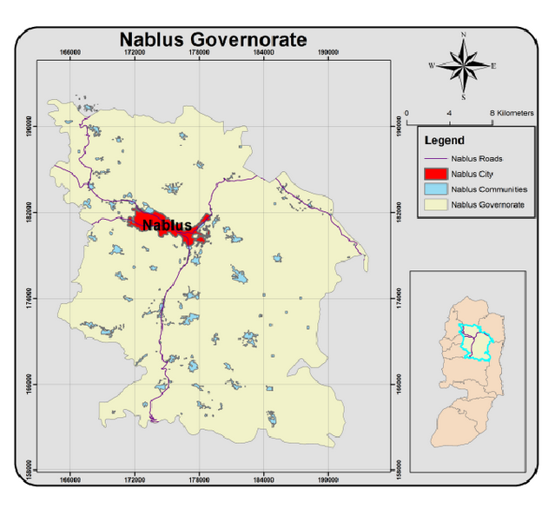
INTRODUCTION :
-Purpose : To study and evaluate the existing PT system and put some alternatives to improve it.
- The Study Area is Nablus City.
- Focused on the internal routes of PT system.

Slide 3
Methodology and Data Collection:
Visiting
The Main Terminal
Nablus Municipality – Road and Traffic Sector
Interviewing with
The Drivers
The Supervisors
Previous
Research and Studies
Statistics
Buses Co. Representatives
Passengers
PGUTW: Mr. Amjad Al-Baqa.

Slide 4
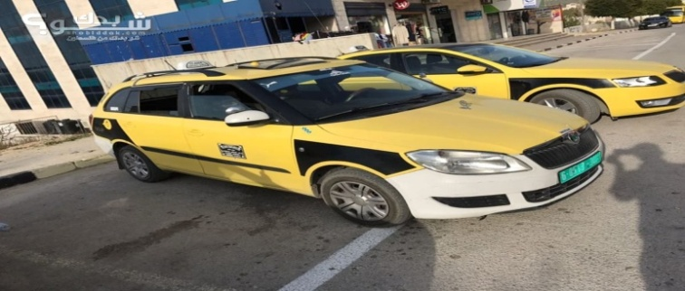
Current Situation :

Slide 5
Table 1: Number of Vehicles on Routes – Current Situation
No. | Route Name | Number of Vehicles (4 seats ) / Route | Number of Vans (7 seats ) / Route | Number of Drivers (Vehicles) / Route | Number of Drivers ) Van(/ Route
1 | Balata | 92 | - | 148 | -
2 | Al-Dahya | 40 | - | 62 | -
3 | Askar | 101 | - | 156 | -
4 | Ebn-Rushd | 27 | - | 43 | -
5 | Al-Ta’won | 38 | - | 60 | -
6 | Rafeedia | 178 | 6 | 286 | 6
7 | Al-Makhfiah | 100 | 23 | 147 | 23
8 | Al-Ein camp | 60 | - | 92 | -
9 | El-Etehad | 31 | - | 44 | -
 | Total | 667 | 29 | 1038 | 29

Slide 6
Table 2 : Length of Routes, Number of Trips and Number of Passengers for The PT Internal Routes in Nablus City – Current Situation
No. | Route Name | Length (Km) | Number of Trip / Vehicle / Day | Number of Passengers )One-Way / (Vehicle / Day | Number of Passengers) Round Trip / (Vehicle/ Day | Number of Passengers /Route /Day*
1 | Balata | 3.5 | 20 | 80 | 120 | 11,040
2 | Al-Dahya | 3.4 | 20 | 80 | 120 | 4800
3 | Askar | 5 | 23 | 92 | 138 | 13,938
4 | Ebn-Rushed | 2.3 | 27 | 108 | 162 | 4374
5 | Al-Ta’won | 2.3 | 21 | 89 | 126 | 4788
6 | Rafeedia | 4.4 | 28 | 112 | 168 | 29,904
7 | Al-Makhfiah | 2.5 | 24 | 106 | 159 | 15,900
8 | Al-Ein camp | 3.2 | 28 | 112 | 168 | 10,080
9 | El-Etehad | 2.9 | 23 | 92 | 138 | 4278
 | Total | 29.6 | 214 | 871 | 1299 | 99,102

Slide 7
Table 3: Rang Fare for Each Route and The Used Value – Current Situation
Route | Range Fare (NIS) | Used Value (NIS)
Balata | 2.5 - 3 | 2.75
Al-Dahya | 2.5 - 3.5 | 3
Askar | 2.5 - 3.5 | 3
Ebn-Rushed | 2.5 - 3 | 2.75
Al-Ta’won | 3 -3.5 | 3.25
Rafeedia | 2.5 -3 | 2.75
Al-Makhfiah | 2.5 - 3.5 | 3
Al-Ein camp | 2.5 - 3 | 2.75
El-Etehad | 2.5 - 3 | 2.75

Slide 8
*Costs Elements Considered for a (4seats) – Shared Taxi:
P=55,000₪
N= 10 years
F= 44,000₪

Slide 9
Table 4: Existing Situation of Income and Expenses Analysis (per Vehicle: (4Seats)) – Current Situation
No. | Route Name | License and Insurance/ Month ( ₪ ) | Fuel Cost / Month ( ₪ ) | Terminal Fee / Month ( ₪ ) | Taxes Per Month ( ₪ ) | Maintenance /Month ( ₪ ) | Driver's Salary ( ₪ ) | Total Expense / Month ( ₪ ) | Total Income / Month ( ₪ ) | Profit /Month ( ₪ )
1 | Balata | 550 | 3000 | 200 | 167 | 650 | 2000 | 6567 | 8250 | 1444
2 | Al-Dahya | 550 | 3000 | 200 | 167 | 650 | 2000 | 6567 | 9000 | 2194
3 | Askar | 417 | 3000 | 200 | 167 | 650 | 2000 | 6434 | 10,350 | 3677
4 | Ebn-Rushed | 425 | 2800 | 200 | 167 | 650 | 2000 | 6242 | 11,137 | 4656
5 | Al-Ta’won | 417 | 2900 | 200 | 167 | 650 | 2000 | 6334 | 10,237 | 3664
6 | Rafeedia | 417 | 3000 | 200 | 167 | 650 | 2000 | 6434 | 9,702 | 3029
7 | Al-Makhfiah | 460 | 3000 | 200 | 167 | 650 | 2000 | 6477 | 10,017 | 3301
8 | Al-Ein camp | 464 | 2800 | 200 | 167 | 650 | 2000 | 6281 | 9702 | 3182
9 | El-Etehad | 417 | 3000 | 200 | 167 | 650 | 2000 | 6434 | 9487 | 2814

Slide 10
Table 5 : Existing Situation for Buses Companies – Current Situation
No. | The Company's Name | No. of Buses |  | Routes Name | No. of Trips / Daily | Trip Time / Trip (Min)
1 | Al-Tamimi | 27 | 15 (Normal Bus) | Rafeedia Al-Makhfiah Al-Quds Open University | Rafeedia(10-12) Al-Makhfiah(12-15) Al-Quds Open University (18-20) | 12
 |  |  | 12 ( Small Bus )
2 | Al- Waleed | 6 | 4 ( Normal Bus) | Askar Balata | Askar( 10 ) Balata( 8 ) | 40
 |  |  | 2 ( Small Bus )
Table 6 : Expenses and Income for Buses Routes – Current Situation
No. | The Company's Name | License and Insurance/ Month ( ₪ ) | Fuel Cost/ Month ( ₪ ) | Maintenance /Month ( ₪ ) | Fee / Trip( ₪ ) | Drivers Salary/Month( ₪ )
1 | Al-Tamimi | 1100 ( Normal Bus) | 18900( Normal Bus) | (1000-2000) | (2- 2.5 ) | 2500 Plus Percentage
 |  | 600 ( Small Bus ) | 8300( Small Bus ) | (1000-2000)
2 | Al- Waleed | 1100 ( Normal Bus) | 9100 ( Normal Bus) | (1000-2000) | 2 | 2600
 |  | 600 ( Small Bus ) | 5000 ( Small Bus ) | (1000-2000)

Slide 11
Table 7 : Costs Considered in The Depreciation of The Buses
 | P (NIS) | N (years) | F (NIS)
Normal Bus | 150,000 | 19 | 10,000
Small Bus | 70,000 | 19 | 5000
Table 8: Existing Situation of Income and Expenses Analysis per Company – Current Situation
No. of Companies | The Company's Name | Total Income / Month ( ₪ ) | Total Expense / Month ( ₪ ) | Profit / Month ( ₪ )
1 | Al-Tamimi | 35,500 ( Normal Bus) | 24,000 ( Normal Bus) | 10,557 ( Normal Bus)
 |  | 15,600 ( Small Bus ) | 12,900 ( Small Bus ) | 2259 ( Small Bus )
2 | Al- Waleed | 23,400 (Normal Bus ) | 14,300 ( Normal Bus) | 8157 ( Normal Bus)
 |  | 10,300 ( Small Bus ) | 9,700 ( Small Bus ) | 160 ( Small Bus )

Slide 12
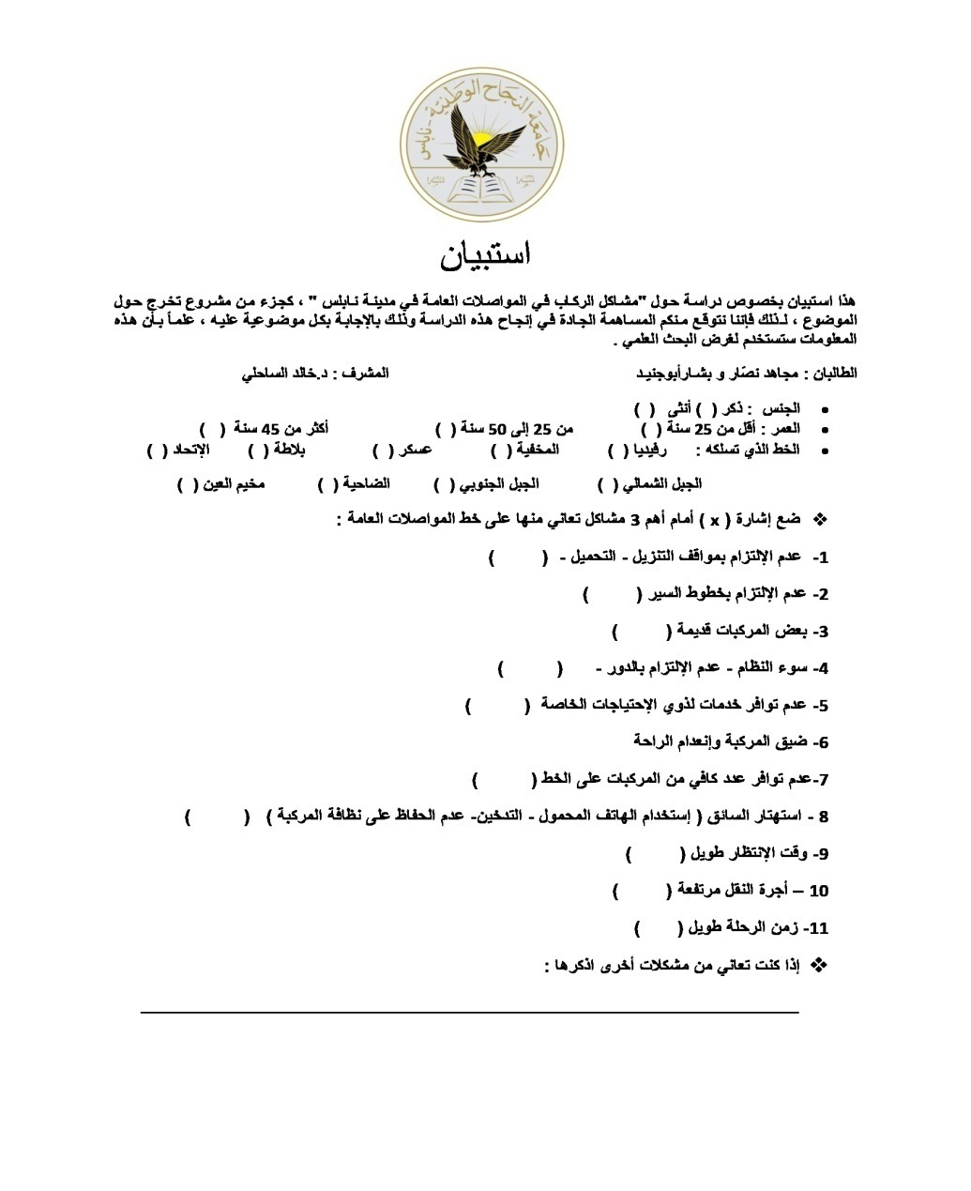
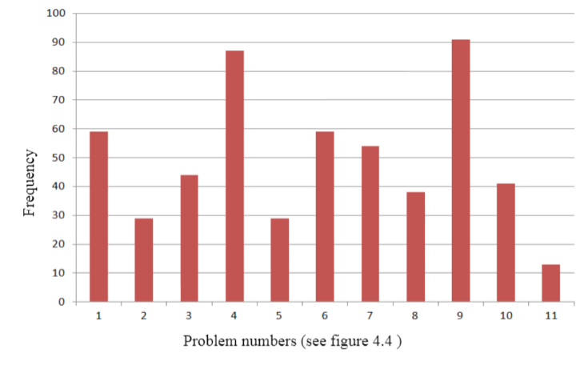
The PT Users’ Perception
The Distribution of Experienced Problems

Slide 13
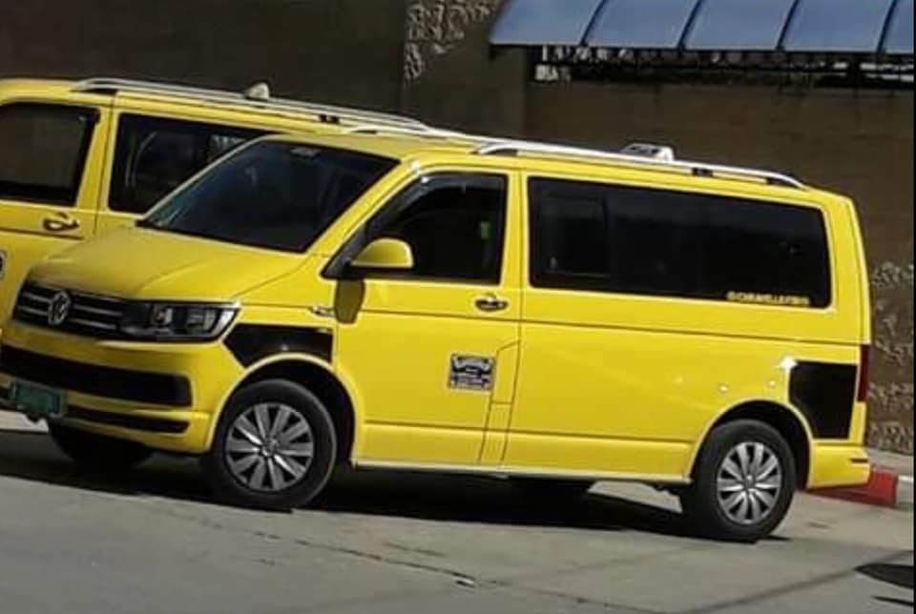
*Scenario No.1 (Shared Taxis and Vans):
Notes:
How presentation will benefit audience: Adult learners are more interested in a subject if they know how or why it is important to them.
Presenter’s level of expertise in the subject: Briefly state your credentials in this area, or explain why participants should listen to you.

Slide 14
Table 9: Number of Vehicles on Routes - Scenario-1
No. | Route Name | Number of Shared-Taxis (4 seats ) | Number of Vans (7 seats ) | Number of Reduced Shared-Taxis (4seats)
1 | Balata | 46 | 26 | 20
2 | Al-Dahya | 20 | 11 | 9
3 | Askar | 50 | 28 | 23
4 | Ebn-Rushd | 14 | 8 | 5
5 | Al-Ta’won | 19 | 11 | 8
6 | Rafeedia | 89 | 50 | 39
7 | Al-Makhfiah | 50 | 28 | 22
8 | Al-Ein camp | 30 | 17 | 13
9 | El-Etehad | 16 | 9 | 6
 | Total | 334 | 188 | 145

Slide 15
P=130,000₪
N= 10 years
F= 80,000₪
*Costs Elements Considered for a Van:

Slide 16
Table 10: Existing Situation of Income and Expenses Analysis (per Van) – Scenario-1
No. | Route Name | License and Insurance/ Month ( ₪ ) | Fuel Cost / Month ( ₪ ) | Terminal Fees / Month ( ₪ ) | Taxes/ Month ( ₪ ) | Maintenance /Month ( ₪ ) | Driver's salary ( ₪ ) | Total Expense / Month ( ₪ ) | Total Income / Month ( ₪ ) | Profit /Month ( ₪ )
1 | Balata | 750 | 4200 | 200 | 167 | 800 | 2000 | 8117 | 14,437 | 5,586
2 | Al-Dahya | 750 | 4200 | 200 | 167 | 800 | 2000 | 8117 | 15,750 | 6,899
3 | Askar | 750 | 4200 | 200 | 167 | 800 | 2000 | 8117 | 18,075 | 9,224
4 | Ebn-Rushed | 750 | 3920 | 200 | 167 | 800 | 2000 | 7819 | 19,456 | 10,903
5 | Al-Ta’won | 750 | 4060 | 200 | 167 | 800 | 2000 | 7977 | 17,875 | 9,164
6 | Rafeedia | 750 | 4200 | 200 | 167 | 800 | 2000 | 8117 | 16,978 | 8,127
7 | Al-Makhfiah | 750 | 4200 | 200 | 167 | 800 | 2000 | 8117 | 15,876 | 7,025
8 | Al-Ein camp | 750 | 3920 | 200 | 167 | 800 | 2000 | 7819 | 16,978 | 8,425
9 | El-Etehad | 750 | 4200 | 200 | 167 | 800 | 2000 | 8117 | 16,568 | 7,717

Slide 17
Table 11 : Profit per Route – Scenario-1
Route Name | Profit / Month / (4 seats)Vehicle ( ₪ ) | Profit / Month / Vans ( ₪ ) | Profit / Month / Route ( ₪ )
Balata | 1444 | 145,236 | 239,590
Al-Dahya | 2194 | 75,889 | 140,466
Askar | 3677 | 258,272 | 497,466
Ebn-Rushd | 4656 | 87,224 | 163,311
Al-Ta’won | 3664 | 100,804 | 188,748
Rafeedia | 3029 | 406,350 | 757,201
Al-Makhfiah | 3301 | 196,700 | 403,900
Al-Ein camp | 3182 | 143,225 | 263,960
El-Etehad | 2814 | 69,453 | 122,194

Slide 18
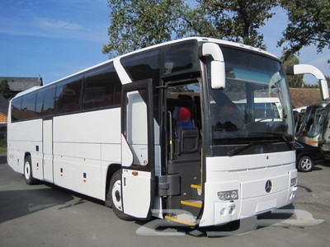
*Scenario No.2 (Current Shared Taxis Routes and Normal Buses Route):

Slide 19
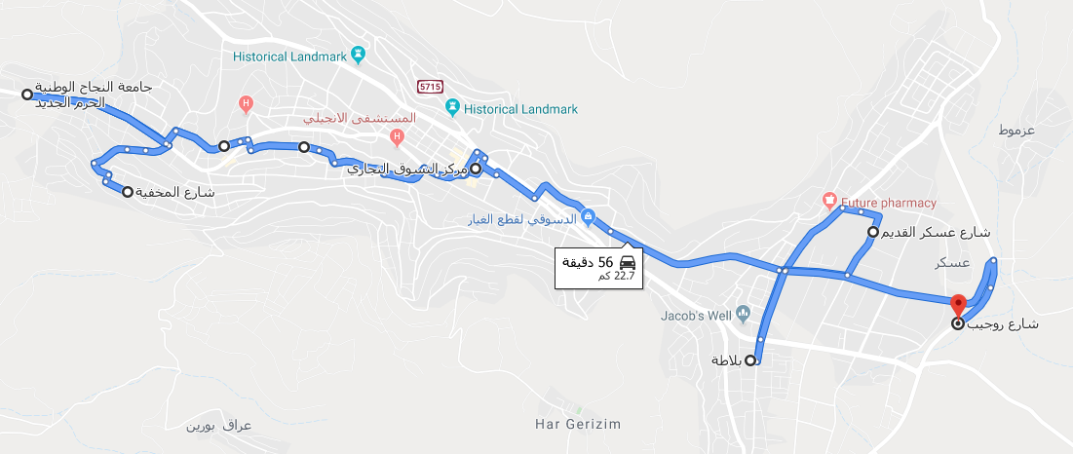
A main route is created (Busy route) by keeping the existing routes. It is aimed to have a high capacity main route and to solve the traffic jam by reducing the number of shared taxis partially. The main route is planned to work between east regions (Balata & Askar) and west regions (Rafeedia& Al-Makhfeiah) with central terminal at the center of the city.
Figure :The Busy Public Transport Route

Slide 20
Table 12 : Number of Reduced Taxis and Number of Buses to Add – Scenario-2
No. | Route Name | Number of Shared-Taxis (4 seats ) | Number of Buses | Number of Trips/ Bus/Day | Number of reduced Shared-Taxis (4seats)
1 | Askar and Balata | 105 | 7 | 14 | 88
2 | Rafeedia | 78 | 8 | 15 | 100
3 | Al-Makhfiah | 37 | 5 | 13 | 63
*No. of buses to add to the system = 20 buses.
*No. of reduced shared taxis = 251 (4seats).

Slide 21
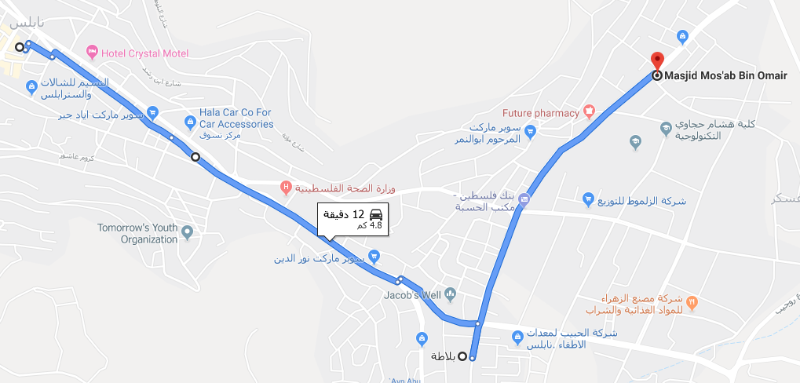
-How regions would be served by The Busy Route ?
-For the eastern regions
Figure :Route to Serve The Eastern Region by The Busy Route

Slide 22
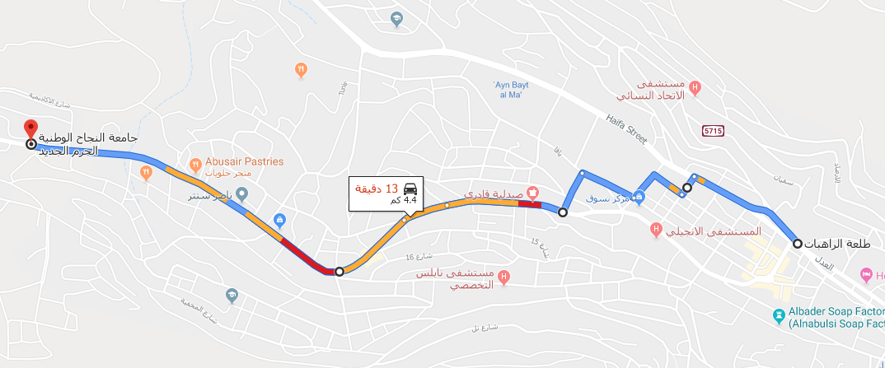
-For the western regions:
-Rafeedia :
Figure :Route to Serve Rafeedia by The Busy Route

Slide 23
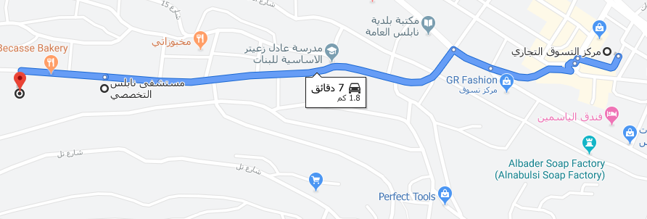
-Al-Makhfiah
Figure :Route to Serve Al-Makhfiah by The Busy Route
*For Al-Makhfiah, the bus route will serve the street from main terminal to Nablus Al-Takhasousi Hospital to An-Najah National University (The Old Campus), while Al-Makhfiah itself will be served by shared taxis according to the topographic difficulties and level of demand.

Slide 24
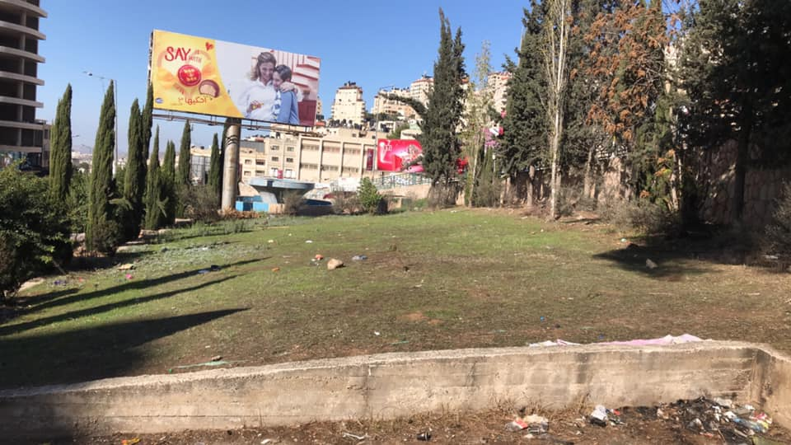
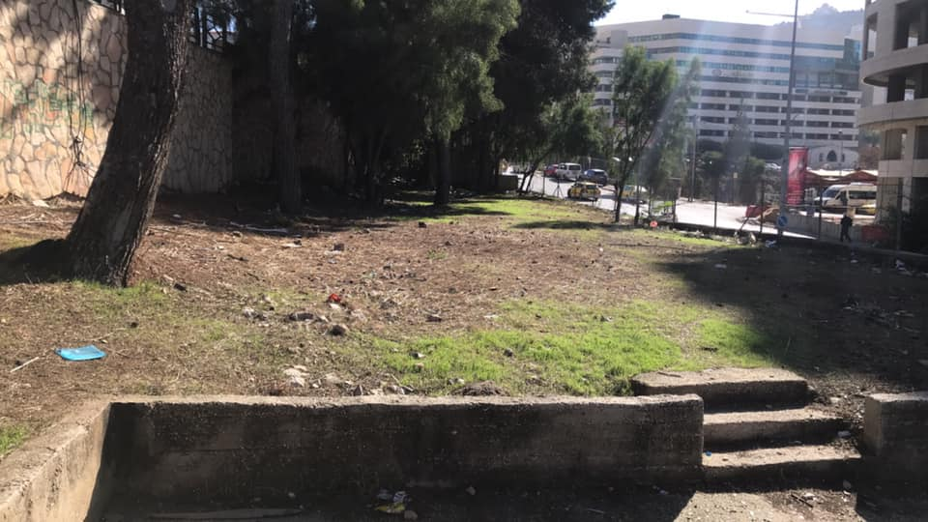
-Obviously, the new main rout needs a new terminal, this due to the fact that buses can’t fit in the main terminal at Nablus Mall and it is not practical, the suggested center of the buses terminal is near Al-Kindi secondary school.
Figure : The Suggested Center of The Buses Terminal

Slide 25
*Costs Elements Considered for a Bus (2015 or Newer):
P=200,000₪
N= 19 years
F= 10,000₪

Slide 26
Table 13: Expected Situation of Income and Expenses Analysis (per Bus) – Scenario-2
No. | Route Name | License and Insurance/ Month ( ₪ ) | Fuel Cost / Month ( ₪ ) | Terminal Fees / Month ( ₪ ) | Taxes/ Month ( ₪ ) | Maintenance /Month ( ₪ ) | Driver's Salary ( ₪ ) | Total Expense / Month ( ₪ ) | Total Income / Month ( ₪ ) | Profit /Month ( ₪ )
1 | Askar and Balata | 1100 | 11,500 | 200 | 167 | (700–1500 ) | 3000 | 17,067 | 28,000 | 9,686
2 | Rafeedia | 1100 | 12,000 | 200 | 167 | (700–1500 ) | 3000 | 17,567 | 30,000 | 11,186
3 | Al-Makhfiah* | 1100 | 7000 | 200 | 167 | (700–1500 ) | 3000 | 12,567 | 26,000 | 12,186
-Al-Makhfiah*: Only to An-Najah National University- The Old Campus.
-The total profit per month for the busy route is (9,686*7 + 11,186* 8+ 12,186*5) = 218,220 ₪.
-The average profit per bus = (218,220/20) = 10,911₪.
-From the profit/month/bus, 20 buses will pay off in 2 years.

Slide 27
Table 14 : Profit per Month per Route - Scenario-2
Route Name | Profit / Month /Vehicle ( ₪ ) |  | Profit / Month / Route ( ₪ )
Balata | 1444 |  | 72,200
Al-Dahya | 2194 |  | 87,760
Askar | 3677 |  | 202,235
Ebn-Rushd | 4656 |  | 125,712
Al-Ta’won | 3664 |  | 139,232
Rafeedia | 3029 |  | 236,262
Al-Makhfiah | 3301 |  | 122,137
Al-Ein camp | 3182 |  | 190,920
El-Etehad | 2814 |  | 87,234
Busy Route | Askar and Balata | 9,686 | 218,220
 | Rafeedia | 11,186
 | Al-Makhfiah* | 12,186
-The highest profit/Route is still for Rafeedia then for the busy route.
-But, the highest profit per vehicle goes to the busy route.

Slide 28
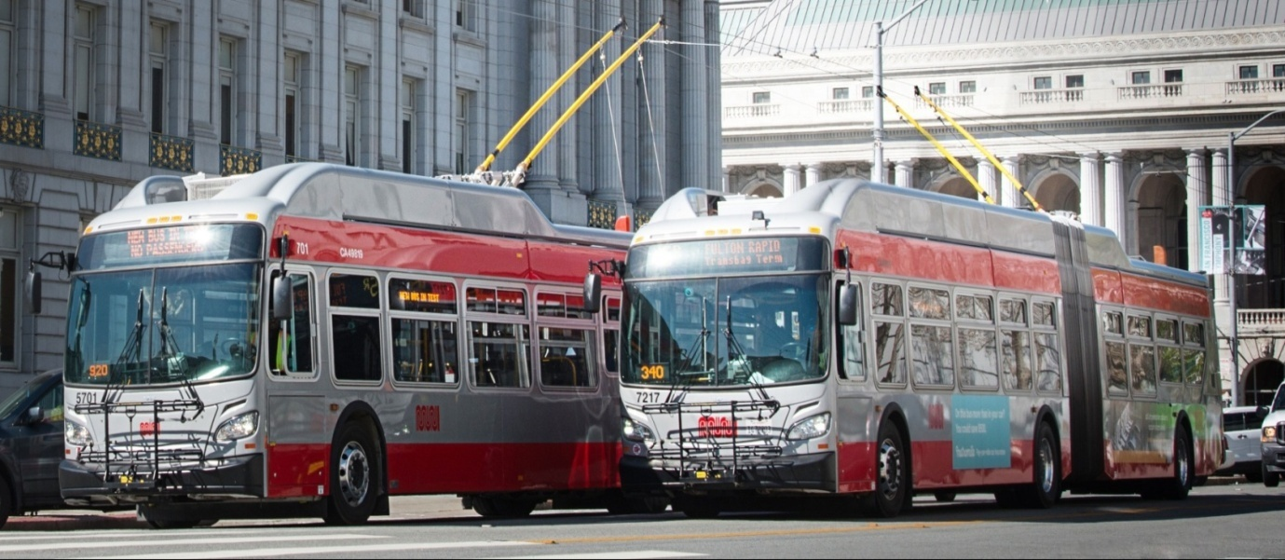
*Scenario No.3 (Taxis and Trolleybuses Route) :

Slide 29
Table 15 : Number of Reduced Shared Taxis and Number of Trolleybuses to Add – Scenario-3
No. | Region Name | Number of Shared-Taxis (4 seats ) | Number of Trolleybuses to Add | Number of Trips/ Bus/Day | Number of reduced Shared-Taxis ( 4 seats)
1 | Askar and Balata | 105 | 5 | 14 | 88
2 | Rafeedia | 78 | 6 | 15 | 100
3 | Al-Makhfiah* | 37 | 4 | 13 | 63
*No. of trolleybuses to add to the system = 15 Trolleybuses.
*No. of reduced shared taxis = 251 (4seats).

Slide 30
P=1,150,000₪
N= 20 years
F= 20,000₪
*Costs Elements Considered for a Trolleybus:

Slide 31
Table 16 : The Expected Expenses and Income of a Trolleybus - Scenario-3
No. | Region Name | License and Insurance/ Month ( ₪ ) | Fuel Cost / Month ( ₪ ) | Terminal Fees / Month ( ₪ ) | Taxes/ Month ( ₪ ) | Maintenance /Month ( ₪ ) | Driver's Salary ( ₪ ) | Total Expense / Month ( ₪ ) | Total Income / Month ( ₪ ) | Profit /Month ( ₪ )
1 | Askar and Balata | 1100 | 3800 | 200 | 167 | 7600 | 3000 | 15,867 | 38,500 | 15,827
2 | Rafeedia | 1100 | 4000 | 200 | 167 | 7600 | 3000 | 16,067 | 41,250 | 18,377
3 | Al-Makhfiah* | 1100 | 2400 | 200 | 167 | 7600 | 3000 | 14,467 | 35,750 | 14,477
- The total profit/month for the trolleybus route is (15,827*5+18,377*6+14,477*4) = 247,305 ₪.
- While the average profit/ month/trolleybus = 16,227 ₪.
- From the profit/month/Trolleybus, 15 Trolleybuses will pay off in 6-7 years.

Slide 32
Table 17: Profit per Month per Route – Scenario-3
Route Name | Profit / Month / Vehicle ( ₪ ) |  | Profit / Month / Route ( ₪ )
Balata | 1444 |  | 72,200
Al-Dahya | 2194 |  | 87,760
Askar | 3677 |  | 202,235
Ebn-Rushd | 4656 |  | 125,712
Al-Ta’won | 3664 |  | 139,232
Rafeedia | 3029 |  | 236,262
Al-Makhfiah | 3301 |  | 122,137
Al-Ein camp | 3182 |  | 190,920
El-Etehad | 2814 |  | 87,234
Busy Route | Askar and Balata | 15,827 | 247,305
 | Rafeedia | 18,377
 | Al-Makhfiah | 14,477

Slide 33

*Scenario No.4 ( Taxis , Vans and Trolleybuses ) :

Slide 34
Table 18 :Number of Trolleybuses for Each Region - Scenario-4
Region Name | Number of Trolleybus / Route
Askar and Balata | 5
Rafeedia | 6
Al-Makhfiah* | 4
Table 19 :Number of Vehicles on Each Route – Scenario-4
Route Name | Number of Vehicles (4 seats ) / Route | Number of Vans (7 seats ) / Route | Number of reduced Shared-Taxis ( 4 seats)
Balata | 15 | 20 | 15
Al-Dahya | 12 | 16 | 12
Askar | 16 | 22 | 17
Ebn-Rushd | 8 | 10 | 9
Al-Ta’won | 11 | 15 | 12
Rafeedia | 23 | 31 | 24
Al-Makhfiah | 11 | 14 | 12
Al-Ein camp | 18 | 24 | 18
El-Etehad | 9 | 12 | 10
Total | 123 | 164 | 129

Slide 35
Table 20:Profit of Trolleybus Main Route – Scenario-4
Region Name | Profit / Month / Trolley ( ₪ ) | Profit / Month / Route ( ₪ )
Askar and Balata | 15,827 | 247,305
Rafeedia | 18,377
Al-Makhfiah* | 14,477
Table 21: Profits of The Existing 9 Routes – Scenario-4
Route Name | Profit / Month / Vehicle (4 seats ) ( ₪ ) | Profit / Month / Vehicle (7 seats ) ( ₪ ) | Total Profit / Month / (4 seats)s ( ₪ ) | Total Profit / Month / (7 seats)s ( ₪ ) | Total Profit/ Month / Route ( ₪ )
Balata | 1444 | 5586 | 21,660 | 111,720 | 133,380
Al-Dahya | 2194 | 6899 | 26,328 | 110,384 | 136,712
Askar | 3677 | 9224 | 58,832 | 202,928 | 261,760
Ebn-Rushd | 4650 | 10903 | 37,200 | 109,030 | 146,230
Al-Ta’won | 3664 | 9163 | 40,304 | 137,445 | 177,749
Rafeedia | 3029 | 8127 | 69,667 | 251,937 | 321,604
Al-Makhfiah | 3301 | 7025 | 36,311 | 98,350 | 134,661
Al-Ein camp | 3182 | 8425 | 57,276 | 202,200 | 259,476
El-Etehad | 2814 | 7717 | 25,326 | 92,604 | 117,930

Slide 36
*Scenario No.5 (Vans and Trolleybuses Route):

Slide 37
-This scenario gits rid of all the shared taxis (4seats) and replaced them by two different modes, vans (7seats) and the trolleybuses.
Table 22 : Number of Vans and Profit for The Existing 9 Routes
– Scenario-5
Route Name | Number of Vans (7 seats ) / Route | Profit / Month / Vehicle (7 seats ) ( ₪ ) | Profit / Month / Route ( ₪ )
Balata | 29 | 5586 | 161,994
Al-Dahya | 23 | 6899 | 158,677
Askar | 32 | 9224 | 295,168
Ebn-Rushd | 16 | 10,903 | 174,448
Al-Ta’won | 22 | 9163 | 201,586
Rafeedia | 45 | 8127 | 365,715
Al-Makhfiah | 22 | 7025 | 154,550
Al-Ein camp | 34 | 8425 | 286,450
El-Etehad | 18 | 7717 | 138,906
Total | 241
-The Trolleybus Main Route will stay as studied in scenario-3, 15 trolleybuses with total profit per month 247,305 ₪.
-The (4seats) shared taxis that remained in the 9 routes will be decreased by 100% from each route and replaced by vans (7seats) with what it is equivalent in terms of number of passengers (a ratio of 4/7).
-In this Scenario, The highest profit per vehicle goes to the trolleybus then to the van.
-But as routes the highest profit goes respectively to Rafeedia, Askar, and Al-Ein camp then to the trolleybus main route.
-Number of vehicles on the existing PT system reduced from 667 shared taxis (4seasts) to 241 Vans and 15 Trolleybuses, which are 256 vehicles.

Slide 38
*Comparison of Scenarios :
Table 23 : Management Comparison Data
SCENARIO | Explanation | No. of Routes | Route Length (Avg.) | No. of Vehicles | No. of Trips / Day | No. of Driver | No. of Free Drivers
Current | Current situation | 9 | 3.2 | 696 | 142,458 | 1,067 | -
Scenario 1 | Vans (7 seats ) + Taxi (4 seats ) | 9 | 3.2 | 551 | 112,428 | 881 | 186
Scenario 2 | Normal bus main routs + current situation | 10 | 3.8 | 465 | 90,024 | 744 | 323
Scenario 3 | Trolleybus main routs + Current situation | 10 | 3.8 | 460 | 89,954 | 736 | 331
Scenario 4 | Trolleybus main routs + Vans (7seats) + Taxi (4seats) | 10 | 3.8 | 331 | 62,348 | 530 | 537
Scenario 5 | Trolleybus main routs + Vans (7 seats ) | 10 | 3.8 | 285 | 52,502 | 456 | 611

Slide 39
Table 24 : Income-Expense Comparison Data
SCENARIO | Explanation | Total Expense / Month ( ₪ ) | Total Income / Month ( ₪ ) | Profit / Month ( ₪ ) | Profit per Vehicle (Avg.)* ( ₪ )
Current | Current situation | 4,295,170 | 6,458,928 | 2,004,678 | 3005
Scenario 1 | Vans (7 seats ) + Taxi (4 seats ) | 3,667,712 | 6,372,752 | 2,487,389 | 4765
Scenario 2 | Normal bus main routs + current situation | 2,994,781 | 4,601,057 | 1,482,120 | 3400
Scenario 3 | Trolleybus main routs + Current situation | 2,905,546 | 4,618,057 | 1,511,205 | 3506
Scenario 4 | Trolleybus main routs + Vans (7seats) + Taxi (4seats) | 2,342,617 | 4,531,350 | 1,907,846 | 6317
Scenario 5 | Trolleybus main routs + Vans (7 seats ) | 2,261,057 | 4,618,627 | 2,155,736 | 8420
Profit per Vehicle (Avg.)*: It is not a comparable value, it shows the average profit per route considering all modes in that route.

Slide 40
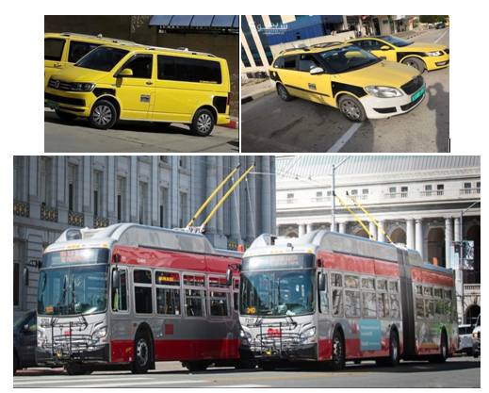
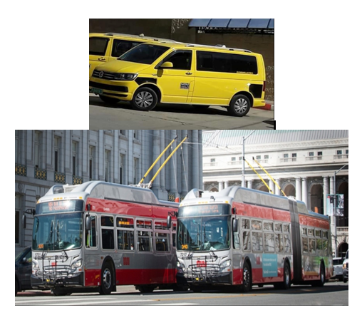
-The selected combination is going to happen at two phases.
At Phase-1, scenario-4 is selected for a certain period of time, for example 5 years to get to Phase-2 where scenario-5 is applied completely.
After 5 Years
Phase -1
Phase -2

Slide 41
Recommendations:
Create a time-plan to apply the selected scenarios and inform the drivers about it.
Most of the drivers can be involved in the new PT system by either hiring them to work on the vans, or two drivers can cooperate and share a van together. For the trolleybuses, according to its high profit, two drivers can be hired for each trolleybus with specified days per week.
Besides the developing of the existing PT system by using new modes, there are some procedures that could be done to enhance the system and increase the satisfaction of the users :

Slide 42
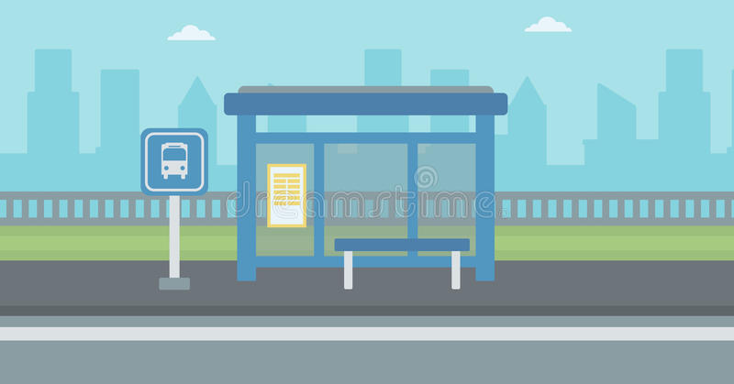
Using Stations/Stops along routes to allow the passengers to wait for vehicles, they should be defined and vehicles should be directed to visit these stations during their trips.
2. Using information display-screens inside the terminal to show the destinations and the expected time for the trip.

Slide 43
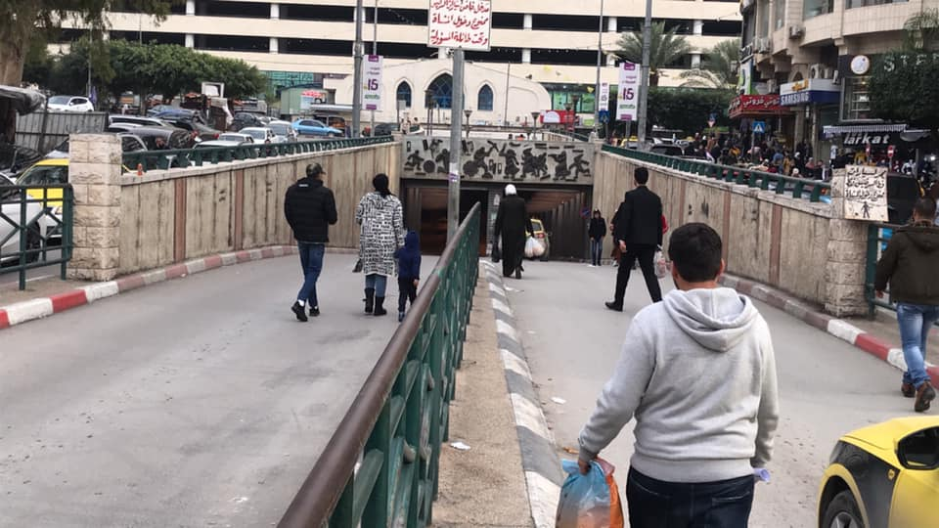
3. Preventing passengers from using the entrance of the shared taxis.

Slide 44
4. Preventing hawkers who impeded the movement of shared taxis inside the terminals and at the entrance for shared taxis.
5. The supervisors of each route should strictly organize the passengers according to the priority of arrival.
6. The supervisors of each route should also control and monitor the behavior of the drivers.

Slide 45
Thank You

