Slide 1
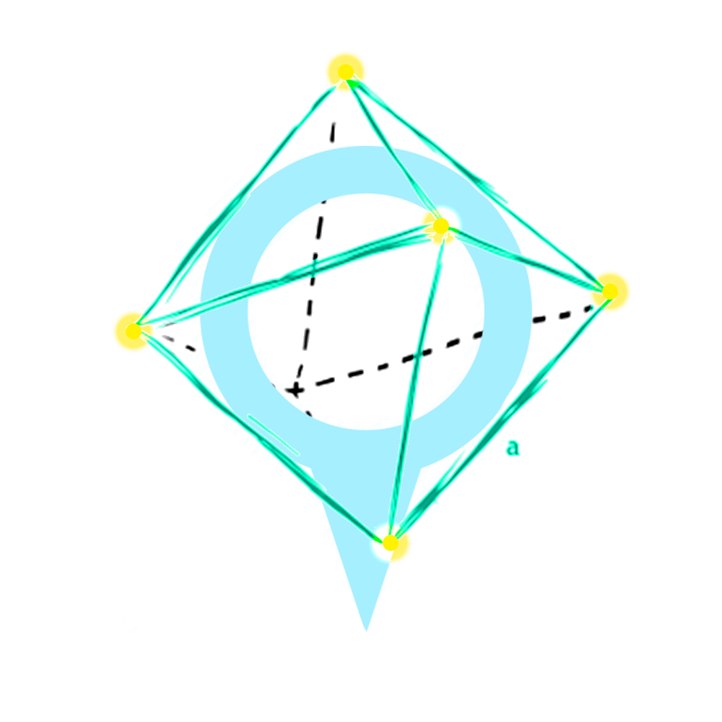
Street War

Slide 2
content
Idea.
Why this idea.
Features.
Technology.
Challenges/Problem.
Conclusion.
Street War

Slide 3
Idea
Street War, an augmented reality (AR) smartphone game, merged between the idea of online games in the strategy games (RPG Game) on the real map by using GPS system and make the user live like a warrior in the map of The real world.
Street War

Slide 4
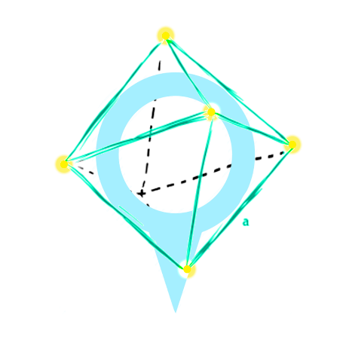
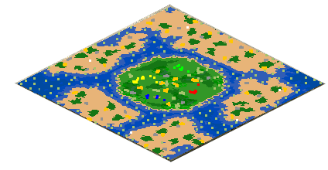

Idea (count..)
Street War

Slide 5


Idea (count..)
Street War

Slide 6


Why this Idea? (count..)
Street War
New Technology.
Augmented Reality
Google Map API

Slide 7

Why this Idea? (count..)
Street War
Multiplayer.

Slide 8



Why this Idea?
Street War
Pokémon Go.

Slide 9



Why this Idea? (count..)
Street War
Merged ideas to creative new one.

Slide 10


Similar Games
Street War

Slide 11


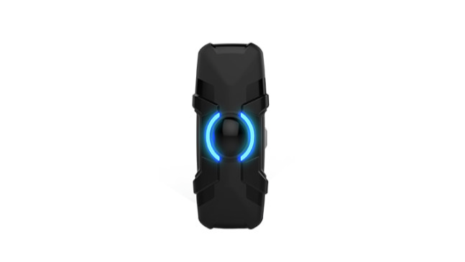


Similar Games (count..)
Street War
Father.io
=
=
Extra
Hardware
Costly
APP

Slide 12
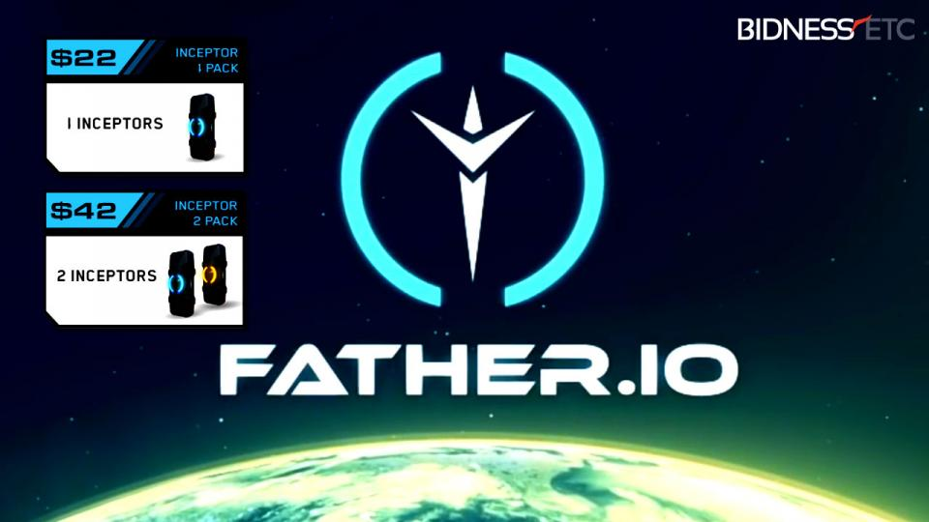
Similar Games (count..)
Street War

Slide 13

Similar Games (count..)
Street War
Pokémon GO
A lot of Pokémon an then what is next

Slide 15
Our Features
Street War
Real map multiplayer.
AR.
Free.

Slide 16
Technology
Street War
Unity3D
Google map API.
Vuforia.
The High Level API(HLAPI).

Slide 17

Technology
Street War
Unity3D
…………………………………
……………………………………..…..
…………………………………………
………………………………………..
………………………………………….
……………………………………………
……………………………………………..

Slide 18

Technology
Street War
Google Map API.
report………………………………………………………………………
………………………………………………………………….
………………………………………………………………….
……………………………………………………………………
…………………………………………………………………….
………………………………………………………...…………
………………………………………………….

Slide 19

Technology
Street War
Vuforia
……………………………………………………
..........................................................
……………………………………………………..
……………………………………………………
……………………………………………………..
………………………………………………………….
………………………………………………

Slide 20
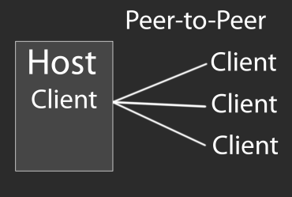
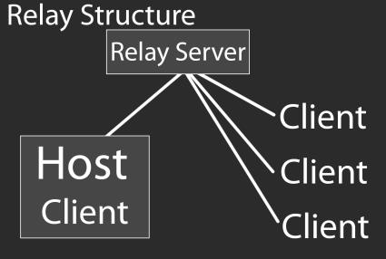
Technology
Street War
The High Level API(HLAPI).
……………………………………
………………………………………………
………………………………………………..
………………………………………………..
……………………………………………………………
……………………………………………………..
…………………………………………………

Slide 21
ptiuuih

Slide 22
Challenges/Problem
Street War

Slide 23
Future work
Street War

