Slide 1
Line Maze Solver
By : Loay Zawyani & Alaa Batta
Supervisor : Eng. Muhannad Al Jabi

Slide 2
Outline
  What is Line Maze ?
  Tools.
  Procedures.
  Future work and Conclusion.

Slide 3
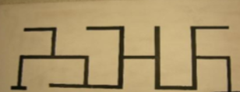
What is Line Maze?
A line maze is usually a black line on a white background.
It could also be a white line on a black background, but for this presentation black lines on a white background will be used.
Each line maze has a Start point and a Finish point. The robot is expected to follow the lines and find it's way from Start to Finish in the fastest time possible.

Slide 4
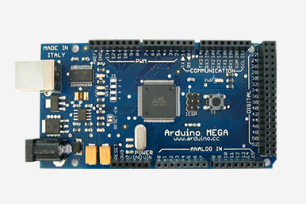
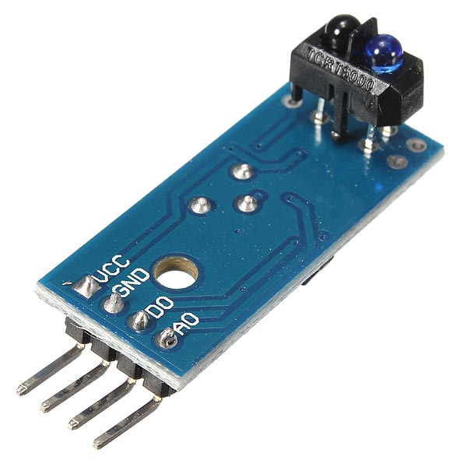
Materials
1) Arduino Mega
2) Five Infrared Sensors

Slide 5
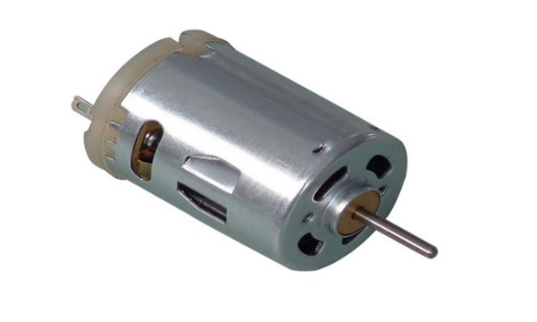
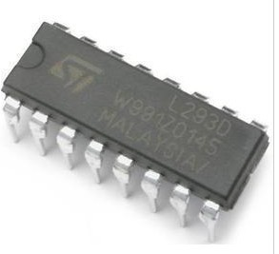
3)Two DC motors
4) H-Bridge

Slide 6
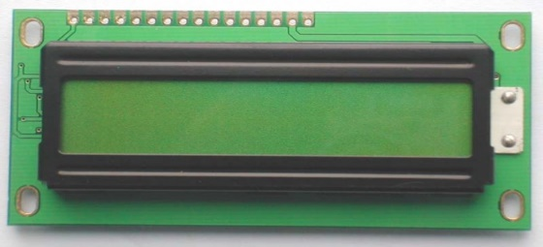
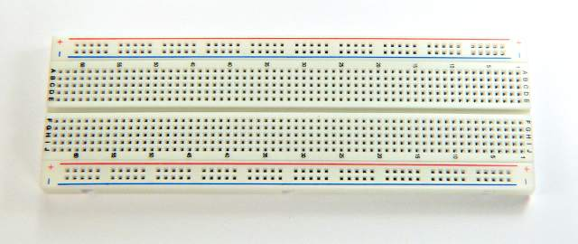
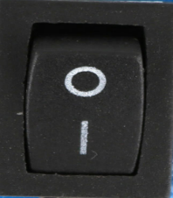
5)Power Bank
6)LCD, Breadboard and Switch Button

Slide 7
Procedures
1) Maze Solving
2)Analyzing Path
3) Solve Maze Correctly

Slide 8
1) Maze Solving
We solved the maze by implementing the left hand rule algorithm.
1) prefer left turn over straight or right turn.
2) prefer straight over right turn.

Slide 9
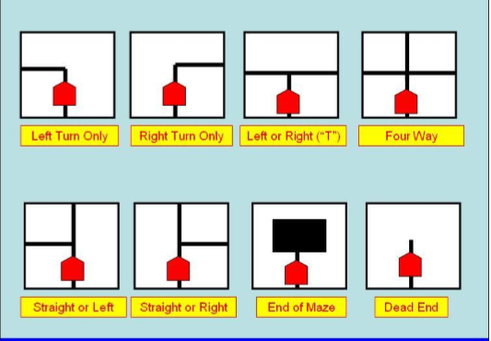
We have only 8 possible situations that the robot can encounter.

Slide 10
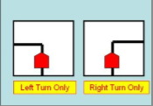
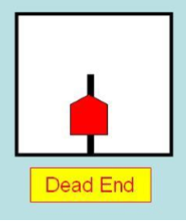
Actions
1) there is only one possible action (Not Intersection)
2)there is many possible actions (Intersection ) all other situations

Slide 11
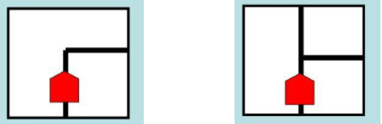
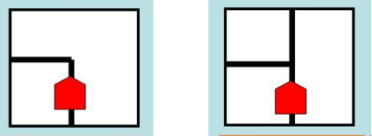
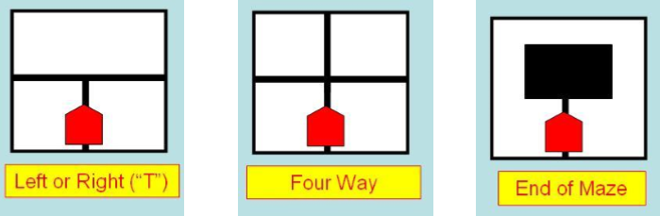
Conflict Situation
Conflict Situations when the sensors give the same values for different situations.
1)Right situation or Straight And Right Situation
  Sensors will give for both situation the values (00111)
2) Left situation or Straight and left situation
  Sensors will give for both situation the values (11100)
3) T intersection, Four Way intersection and End of maze
  ALL of these intersection types will present an initial pattern of “11111” to the robot

Slide 12
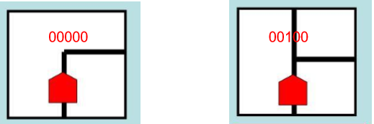
Solution
One Step Forward Solution
By moving the robot one step forward when the conflict situation occurs
The values will change from 00111 to 0000 if its right only
And it will change to 00100 when its straight or right situation
The values will change from 11100 to 00000 if its left only
And it will change to 00100 if its left and straight situation
The value for T intersection will be 00000, for Four way situation it will be 00100 and for end of the maze the value will be 11111

Slide 13
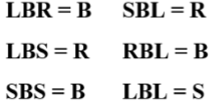
2) Analyzing Path
During Maze Solving, the robot analyzing every path it takes to find the correct path to the maze
By following this procedures.

Slide 14
R L R L L S L B R L L B S L L S R
R L R L L S B L L B S L L S R
R L R L L S B L L B S L L S R
R L R L L R L B S L L S R
R L R L L R L B S L L S R
R L R L L R R L L S R ➔ Correct Path

Slide 15
3) Solve Maze Correctly
When the robot reaches the end of the maze the correct path will be ready and displayed on LCD
We put the robot at the same start point and change the switch value to follow the path case , so the robot will start solving the maze by following the correct path without take any wrong turn.

Slide 16
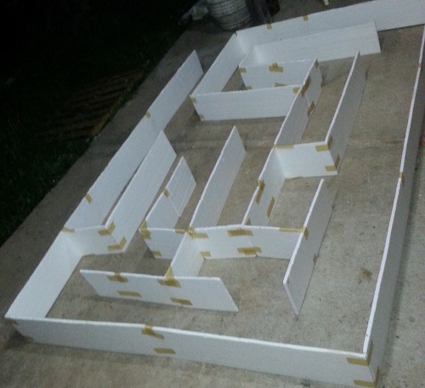
Future work
1) Save The Correct Pat h to the EEPROM so when the robot starts working on the same maze it will solve it directly
2)Maze with walls by using ultra sonic sensors instead of the infrared sensors

Slide 17
Conclusion
We started this semester with no practical knowledge, and the output was very pleasing.
Now we are capable of building useful Arduino base projects and have the ability to design and implement more complicated Hardware projects

Slide 18
Thanks for your attention

