Slide 1


Effect of Shiftwork System on Police Officers in Palestine
Presented By:
Supervisor :
Majd Adel Abu-Amshe
Basala Arafat Hinno Rasmiah Emad Odwan
Ghayda Samir AL-Azzeh Sajida Mustafa Shunnar

Slide 2
Outline
Introduction
Methodology
Data Analysis & Discussion
Recommendation & Suggestions
Conclusion

Slide 3

Introduction

Slide 4
    Research Objective
This research aims to study the shiftwork system at police stations in the West Bank and its effects on health, psychology, social life, circadian rhythm, fatigue, insomnia, and worker’s performance, in order to propose solutions to the problems that may face police officers due to shiftwork.

Slide 5
    Research Scope
This research focus on studying the impact of shiftwork on the Palestinian police.
The West Bank is divided into three main parts, North, Middle, and South. In this research the representative sample was distributed on police officers in two governorates of each part of the West Bank:
Nablus and Tulkarem from North,
Ramallah and Jericho from Middle, and
Bethlehem and Hebron from South

Slide 6
Methodology

Slide 7
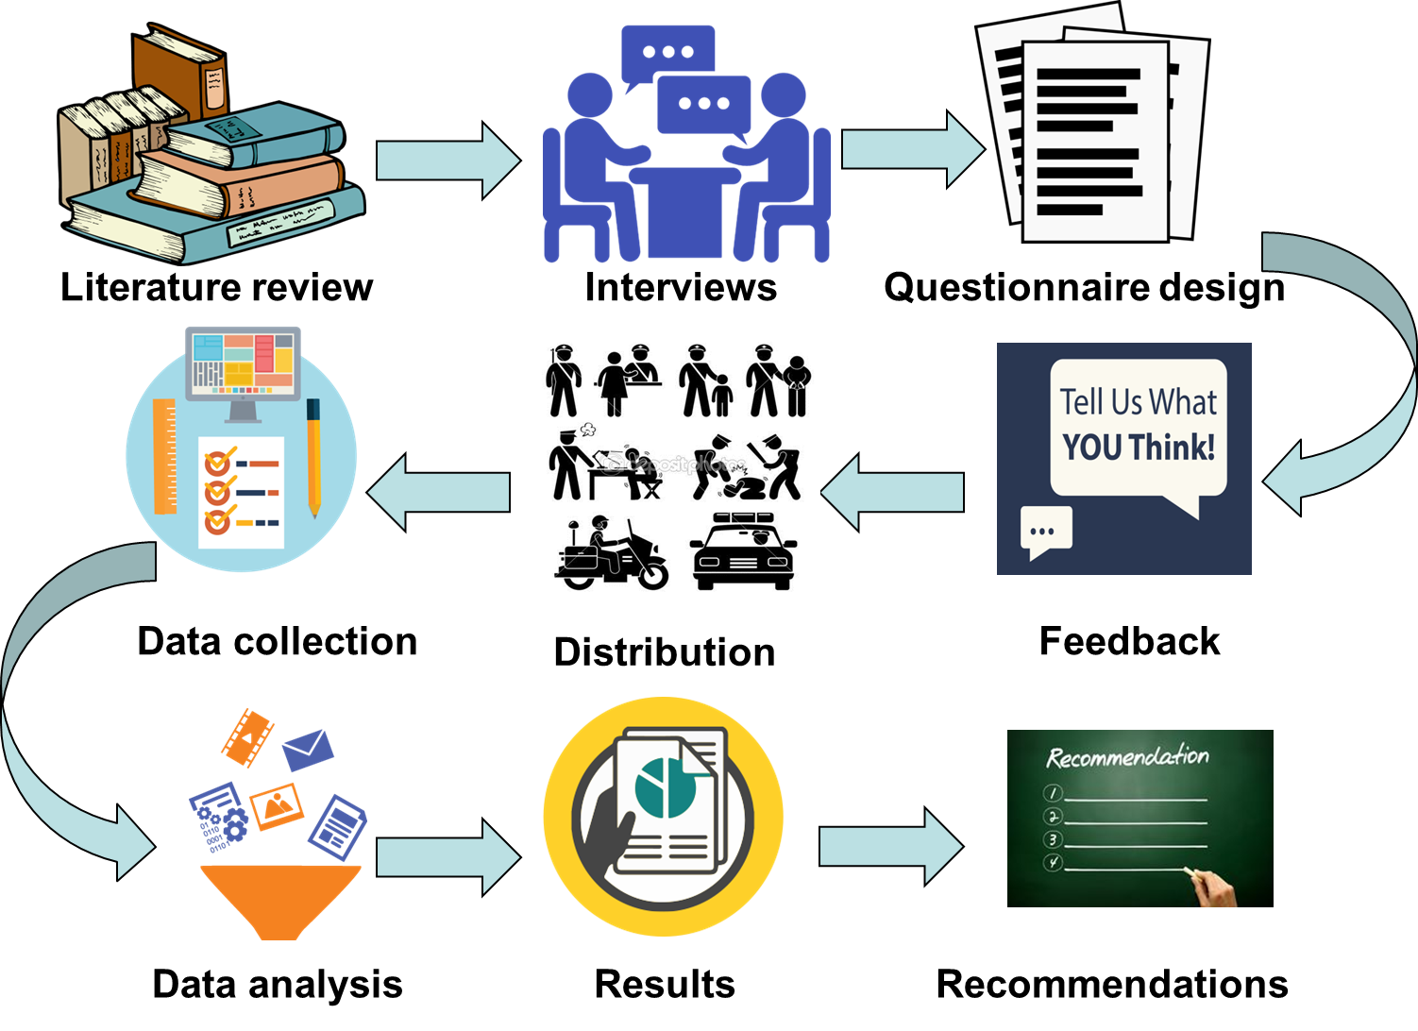
Methodology

Slide 8
Methodology
  Sample of Calculations:
Nablus population = 389328.
Number of police officers = 389,328\250=1557.312 ≈ 1558 policemen.
Using Thompson equation given that: d=0.05, α=0.05, z=1.96 and p=0.50
n (Nablus) = 309 policemen.
Multiplied by 0.5 to get number of police officers who work in shift work n =155 police officers.

Slide 9
Data Analysis & Discussion
Demographic analysis
Hypotheses analysis

Slide 10
Data Analysis & Discussion
Demographic Analysis

Slide 11
Police officers Distribution
Gender
Age
Education Level
Number of years Working in Shift

Slide 12

Police officers Distribution
marital status
Smoking
Salary Value
Type of shift
Salary
Notes:
© Copyright Showeet.com – Free PowerPoint Templates

Slide 13
Police officers Distribution by suffering from :
1.Hypertension
3.Diabetes
2. Stomach Ulcer

Slide 14
Data Analysis& Discussion
Hypotheses Analysis

Slide 15
H1
H2
H3
H4
Shiftworkers face sleep disturbances that may lead to chronic insomnia.
Results showed that shiftworkers really face sleep disturbances that may lead to chronic insomnia
Various health problems may result from shiftwork
Night shifts cause higher fatigue than other types of shifts
Police officers suffer from depression, stress, anxiety and work-family conflict
Police officers suffer from reduction in performance due to shiftwork
Police officers tend to quit from their jobs because of shiftwork effects
Police officers tend to consume high levels of caffeinated drinks and tend to smoke more to avoid sleepiness during their work
Factors of work environment can reduce some effect of shiftwork
H5
H6
H7
H8

Slide 16
H1: Sleep disturbances that may lead to chronic insomnia.
Sub hypotheses:
1-Trouble in sleeping at night
Agreed by 57.90%
2-Suffering from permanent drowsiness
Agreed by 43.33 %
3-Sleeping hours are less than daily need to sleep
4-Facing insomnia after working late hours
Agreed by 63.83%
5-Can sleep at work during breaks
Agreed by 64.81%
Agreed by 41.98%

Slide 17
Effects of demographic variables on hypothesis 1
1 -Type of shift
2 - SMOKING
Evening shift workers suffered from sleep problems more than rotating shift workers.
Smokers suffering from sleep problems more than Non-Smokers.
3 - Hypertension
4 - Stomach Ulcers
Officers suffering from hypertension either after or before shiftwork have a higher rate of sleep problems.
Officers suffering from Ulcers weather before or after shiftwork have the highest risk of experiencing sleep problems
5 - Diabetes
Officers who suffer from diabetes before or after working in shifts have a higher chance of experiencing sleep problems and insomnia

Slide 18
H1
H2
H3
H4
Results showed that shiftworkers really face sleep disturbances that may lead to chronic insomnia
Results showed that there aren’t health problems were found to be related to working in shifts
Night shifts cause higher fatigue than other types of shifts
Police officers suffer from depression, stress, anxiety and work-family conflict
Various health problems may result from shiftwork
Police officers suffer from reduction in performance due to shiftwork
Police officers tend to quit from their jobs because of shiftwork effects
Police officers tend to consume high levels of caffeinated drinks and tend to smoke more to avoid sleepiness during their work
Factors of work environment can reduce some effect of shiftwork
H5
H6
H7
H8

Slide 19
H2: Various health problems may result from shiftwork .
Sub hypotheses:
1-Suffering from cardiovascular disease
Disagreed by 71.85%
2-Suffering from hypertension or diabetes
Disagreed by 70.86%
3-Gaining weight due to shiftwork
Disagreed by 56.42%
4-Losing weight due to shiftwork
Disagreed by 57.4%
5-Already suffered injuries during work
Disagreed by 43.33%
6-Suffering from back and muscle pain
Agreed by 56.42%

Slide 20
Effects of demographic variables on hypothesis 2
Age
Officers aged between 50-60 years suffering from health problems more than others.

Slide 21
H1
H2
H3
H4
Results showed that shiftworkers really face sleep disturbances that may lead to chronic insomnia
Results showed that there aren’t health problems were found to be related to working in shifts
Night shifts cause higher fatigue than other types of shifts
Police officers suffer from depression, stress, anxiety and work-family conflict
Results showed that Night shifts caused higher fatigue than other types of shifts
Police officers suffer from reduction in performance due to shiftwork
Police officers tend to quit from their jobs because of shiftwork effects
Police officers tend to consume high levels of caffeinated drinks and tend to smoke more to avoid sleepiness during their work
Factors of work environment can reduce some effect of shiftwork
H5
H6
H7
H8

Slide 22
H3: Night shifts cause higher fatigue than other types of shifts.
Sub hypotheses:
1-Suffering from great stress and fatigue
Agreed by 70%
2-Feeling dizzy
3-Suffering from anorexia
4-Suffering from headaches states
5-Feeling nervous, depressed and frustrated
Agreed by 51.58%
Agreed by 42.22%
Agreed by 56.91%
Agreed by 46.91%

Slide 23
Effects of demographic variables on hypothesis 3
1 -Type of shift
2 - Number of years working in shifts
Evening shift workers suffering from fatigue more than rotating shift workers.
Officers who have shiftwork experience 5 years or less suffering from fatigue more than others.
3 - Salary value
4 - Hypertension
Officers who get salary less than 2000 NIS suffering from fatigue more than others.
Officers who have Hypertension before working in shifts suffering from fatigue than others.
5 – Stomach Ulcer
6 - Diabetes
Officers who have Stomach Ulcers after working in shifts faced higher effect on fatigue than others.
Officers who have Diabetes after working in shifts had higher effect fatigue than others.
Notes:
© Copyright Showeet.com

Slide 24
H1
H2
H3
H4
Results showed that shiftworkers really face sleep disturbances that may lead to chronic insomnia
Results showed that there aren’t health problems were found to be related to working in shifts
Night shifts cause higher fatigue than other types of shifts
Results agreed with this hypothesis and showed that Police officers suffered from depression, stress, anxiety and work-family conflict
Police officers suffer from depression, stress, anxiety and work-family conflict
Police officers suffer from reduction in performance due to shiftwork
Police officers tend to quit from their jobs because of shiftwork effects
Police officers tend to consume high levels of caffeinated drinks and tend to smoke more to avoid sleepiness during their work
Factors of work environment can reduce some effect of shiftwork
H5
H6
H7
H8

Slide 25
H4: Police officers suffer from depression, stress, anxiety and work-family conflict.
Sub hypotheses:
1-Feeling nervous and anxious
Agreed by 51.85%
2-Having social obligations negligence
Agreed by 72.47%
3-Having family problems due to shiftwork
Agreed by 52.22%
4-Have been affected by work and they become socially isolated
Agreed by 39.51%
5-Community's view of night shiftwork affect police officers psychological states
Agreed by 55.8%
6-Becoming tough due to shiftwork
Agreed by 51.11%

Slide 26
Effects of demographic variables on hypothesis 4
1 -Type of shift
2 - Number of years working in shifts
Evening shift workers suffering from Social and psychological problems more than rotating shift workers.
Officers who have shiftwork experience 5 years or less suffering from Social and psychological problems more than others.
3 - Salary value
4 - Hypertension
Officers who get salary less than 2000 NIS suffering from psychological and social problems more than others.
Officers who have Hypertension before working in shifts suffering from psychological and social problems than others.
5 – Stomach Ulcer
6 - Diabetes
Officers who have Stomach Ulcers after working in shifts faced higher effect on psychological and social problems than others.
Officers who have Diabetes before working in shifts had higher effect on psychological and social problems than others.
Notes:
© Copyright Showeet.com

Slide 27
H1
H2
H3
H4
Results showed that shiftworkers really face sleep disturbances that may lead to chronic insomnia
Results showed that there aren’t health problems were found to be related to working in shifts
Night shifts cause higher fatigue than other types of shifts
Police officers suffer from depression, stress, anxiety and work-family conflict
Results showed that police officers suffer from reduction in performance due to shiftwork
Police officers tend to quit from their jobs because of shiftwork effects
Police officers tend to consume high levels of caffeinated drinks and tend to smoke more to avoid sleepiness during their work
Factors of work environment can reduce some effect of shiftwork
Police officers suffer from reduction in performance due to shiftwork
H5
H6
H7
H8

Slide 28
H5: Police officers suffer from reduction in performance due to shiftwork
Sub hypotheses:
1- Difficulty concentrating in work
Agreed by 46.79%
2- Fail in making the most appropriate decision
Agreed by 40.37%
3-Performance declines due to sleepiness and fatigue
Agreed by 64.81%

Slide 29
Effects of demographic variables on hypothesis 5
1 -Type of shift
2 - Number of years working in shifts
Evening shift workers suffering from performance problems more than rotating shift workers.
Officers who have shiftwork experience 5 years or less and between 5 to10 suffering from performance problems more than other.
3 - Salary value
4 - Hypertension
Officers who get salary less than 2000 NIS suffering from performance problems more than
Officers who have Hypertension weather before or after working in shifts suffering from performance problems more other
5 – Stomach Ulcer
6 - Diabetes
Officers who have Stomach Ulcers weather before or after working in shifts suffering from performance problems more other
Officers who have Diabetes weather before or after working in shifts suffering from performance problems more than other
Notes:
© Copyright Showeet.com

Slide 30
H1
H2
H3
H4
Results showed that shiftworkers really face sleep disturbances that may lead to chronic insomnia
Results showed that there aren’t health problems were found to be related to working in shifts
Results showed that Night shifts caused higher fatigue than other types of shifts
Results agreed with this hypothesis and showed that Police officers suffered from depression, stress, anxiety and work-family conflict
Results show that there isn’t tendency to quit from jobs because of shiftwork effects
Police officers tend to consume high levels of caffeinated drinks and tend to smoke more to avoid sleepiness during their work
Factors of work environment can reduce some effect of shiftwork
Results showed that police officers suffer from reduction in performance due to shiftwork
Police officers tend to quit from their jobs because of shiftwork effects
H5
H6
H7
H8

Slide 31
H6: Police officers tend to quit from their jobs because of shiftwork effects.
Sub hypotheses:
1-Feeling desire to leave the work because of its impact on health
Disagreed by 45.43%
2-Feeling desire to leave the work because of work pressure
Disagreed by 46.30%
3- Feeling desire to leave the work because of its impact on my family
Disagreed by 64.81%

Slide 32
Effects of demographic variables on hypothesis 6
1 -Type of shift
2 - Number of years working in shifts
Working evening shifts had clear effect on work\non-work conflict.
Officers who worked in shifts for 10-20 years had work\non-work conflict.
3 - Hypertension
Officers who have Hypertension weather before or after working in shifts suffering from work\non-work conflict.
4 - Stomach Ulcers
Officers suffering from Stomach Ulcers weather before or after shiftwork suffering from work\non-work conflict .
5 - Diabetes
Officers who have Diabetes before or after working in shifts suffering from work\non-work conflict .

Slide 33
H1
H2
H3
H4
Results showed that shiftworkers really face sleep disturbances that may lead to chronic insomnia
Results showed that there aren’t health problems were found to be related to working in shifts
Results showed that Night shifts caused higher fatigue than other types of shifts
Results agreed with this hypothesis and showed that Police officers suffered from depression, stress, anxiety and work-family conflict
Results show that police officers responses to consume high levels of caffeinated drinks and tend to smoke more to avoid sleepiness during their work
Factors of work environment can reduce some effect of shiftwork
Results showed that police officers suffer from reduction in performance due to shiftwork
Results show that there isn’t tendency to quit from jobs because of shiftwork effects
Police officers tend to consume high levels of caffeinated drinks and tend to smoke more to avoid sleepiness during their work
H5
H6
H7
H8

Slide 34
H7: Police officers tend to consume high levels of caffeinated drinks and tend to smoke more to avoid sleepiness during their work.
Sub hypotheses:
1- Taking a large amount of coffee, energy and stimulant drinks to stay awake during shiftwork
Agreed by 63.46%
2-Smoking rate increase during shifts to stay awake
Agreed by 53.95%
3- following a bad diet due to shiftwork
Agreed by 51.85%

Slide 35
Effects of demographic variables on hypothesis 7
1- Gender
2-type of shift
Males tend to consume high levels of caffeinated drinks and smoke more than females.
evening shifts workers tend to consume high levels of caffeinated drinks and smoke to avoid sleepiness during shiftwork more than rotating shifts workers
3 - SMOKING
Smokers tend to consume high levels of caffeinated drinks and to smoke to avoid sleepiness during shiftwork more than Non-Smokers.
4 - Number of years working in shifts
Officers who work in shifts between 5 to 10 years and more than 20 years tend to consume higher levels of caffeinated drinks and smoke to avoid sleepiness during shiftwork than others
5 - Hypertension
Officers who have Hypertension weather before or after working in shifts tend to consume higher levels of caffeinated drinks and smoke than others.
6 – Stomach ulcer
Officers who have Stomach Ulcer
weather before or after working in shifts tend to consume higher levels of caffeinated drinks and smoke than others.
7 - Diabetes
officers who have Suffering from Diabetes weather before or after working in shifts tend to consume higher levels of caffeinated drinks and smoke than others.

Slide 36
H1
H2
H3
H4
Results showed that shiftworkers really face sleep disturbances that may lead to chronic insomnia
Results showed that there aren’t health problems were found to be related to working in shifts
Results showed that Night shifts caused higher fatigue than other types of shifts
Results agreed with this hypothesis and showed that Police officers suffered from depression, stress, anxiety and work-family conflict
Results show that there isn’t tendency to quit from jobs because of shiftwork effects
Results show that police officers responses to consume high levels of caffeinated drinks and tend to smoke more to avoid sleepiness during their work
Factors of work environment can reduce some effect of shiftwork
Results showed that police officers suffer from reduction in performance due to shiftwork
Results showed that factors of work environment can reduce some effect of shiftwork
H5
H6
H7
H8

Slide 37
H8: Factors of work environment can reduce some effect of shiftwork.
Sub hypotheses:
1-Distribution of work depend on ages and health conditions for officers
2-Distribution of work depend on gender
3-Distribution of work, taking into account the social situation and existence of children
4-Distribution of work depends on the places of staff housing
Agreed by 54.94%
Agreed by 70.37%
Agreed by 43.09%
Agreed by 41.48%
5-Distribution of shifts, taking into account the social relationships with the head of the work
6-There are places to take a break during work
7-The space and furniture allocated for the work is suitable
8-Provide meals during work shifts
9- Allows workers to easily switch shifts work among themselves
Disagreed by 40.37%
Agreed by 35.80%
Agreed by 54.20%
Agreed by 71.85%
Agreed by 60.74%

Slide 38
Effects of demographic variables on hypothesis 8
2 - SMOKING
1 -Gender
Factors of work environment can reduce some effects of shiftwork to smokers more than non smokers
Factors of work environment can reduce some effects of shiftwork to Male police officers more than females
3 - Salary value
4 - Hypertension
Officers who get salary less than 2000 NIS confirmed that Factors of work environment can reduce some effect of shiftwork more than others
Officers who had Hypertension before working in shifts agreed that Factors of work environment can reduce some effect of shiftwork more than others

Slide 39
Discussion
The overall conclusion after analyzing the questionnaire was comparable to previous studies where confirmed the existence of sleep problems, depression, stress, anxiety work-family conflict, reduction in performance, higher fatigue at night shifts than other shift types, high consumption levels of caffeine to avoid sleepiness during their work and that factors of work environment can reduce some effect of shiftwork. On other hand some results had contradicted with previous studies like that there is no existence of shift work effects on health problems and tending to quit from jobs.

Slide 40
Recommendations & Suggestions

Slide 41
Recommendations for Police Officers Management
1
2
3
4
5
Physical health problems
Distribution work
Psychological problems
Sleep disorders, insomnia and fatigue
Meeting & training
Breaks and appropriate resting area , manage the frequency and duration of shifts to ensure sufficient time for Officers to rest between their shifts.
Educate officers about the increased risk of those diseased and encourage them to conduct periodic visits to their doctor.
Transferred to day work or a different department, If officers had health problem
Consulted officers to determine the most suitable shift arrangement.
Effective workplace communications are key in improving the workplace environment
Provided by psychological counseling and support.
Increasing police officers’ salaries and providing them with moral and financial incentives.
Providing community support through social activities, media, and campaigns
Regular meetings must be held between police officers
Supervisors with responsibility for shift-working arrangements should be trained and educated on the risks associated with shift work

Slide 42
Recommendations for Police Officers
Sleep disorders, sleep loss and/or exacerbate existing sleep problems
Stimulants such as coffee or cigarettes
Timing and quality of police officers meals
Social Status
A good diet, regular meals and exercise can improve sleep quality, health and well-being
The police officers can improve their fitness by spending 30 minutes a day on a physical activity including housework and walking
Eating healthy meals on a regular basis; cutting down or giving up on smoking; reducing alcohol usage.
.
By a small dose, we mean one to three cups of coffee or tea , or one to three soft drinks per day. If police officers drink caffeinated beverages
Try to avoid caffeine late in the shift, especially in night shifts as it makes it difficult to fall asleep and/or sleep lighter
Reduce caffeine’s usage gradually over several days by cutting down only by one-half cup or one cup every couple of days because cutting down too fast could produce headaches, nervousness, and bad moods or irritable feelings.
Regular light meals/snacks are less likely to affect alertness or cause drowsiness than a single heavy meal
Avoid fatty, spicy and/or heavy meals as these are more difficult to digest. They may also disturb sleep when need to rest
Avoid sugary foods, such as chocolate, but fruit and vegetables are good snacks as their sugar is converted into energy relatively slowly and they also provide vitamins, minerals and fiber.
Important to keep contact with officers & share work shift with them so that they can understand what police officers go through so that they can be supportive and considerate especially when planning meal times and meeting on the weekends and evenings.
Plan household duties around shift schedule to ensure that they don’t complete them at the cost of rest or sleep

Slide 43
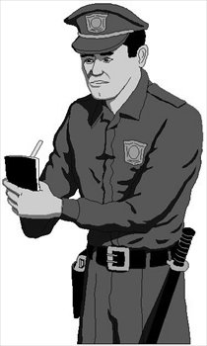
Police Officers Suggestions
Recruiting additional officers to relieve work pressure
2
Supporting the psychological &
physical health of officers while
providing psychological counseling
1
3
4
Separate areas for smokers
non-smokers in the workplace
Salary increase
Provide community support to change the community's view that make the regarding how officers are perceived
5
6
Consult police officers regarding
the distribution of their shifts

Slide 44
Conclusion

Slide 45
Conclusion
The results of the study offer the basis for future work for shiftwork researchers in practice and academics. From an academic point of view, the search provides a broad and deep understanding of problems facing shiftworkers in general; especially, the impact of those problems on police officers. From a practical point of view, officials and public health specialists can take advantage of the practical application of this research including implementing the suggestions to improve the overall health and performance of police officers working shifts.

Slide 46


