Slide 1

Graduation Project (2)
Multi purpose building
Prepared by :
Ahmad Fuqha
Mohammad Abu Alwafa
Yazan Tahaineh
Sewar Ahmad
Supervisor: Dr. Alaa M. Shaheen

Slide 2
Outline
Introduction
Site analysis
Architectural design
Environmental design
Structural design
Electrical design
Mechanical design
Safety
Quantity Survey

Slide 3
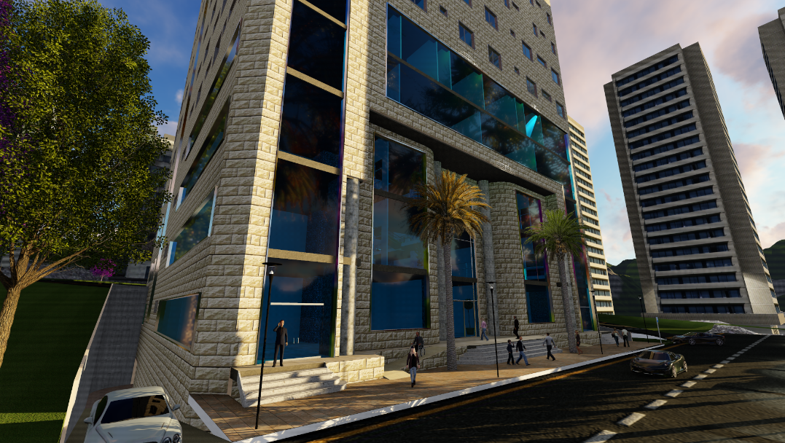
Introduction

Slide 4
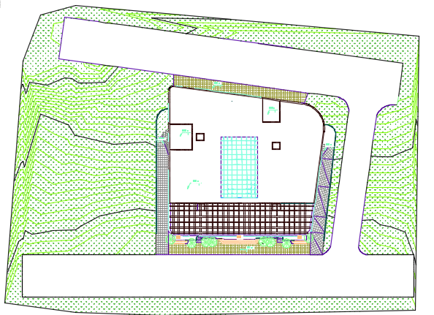
SITE ANALYSIS
The proposed land was chosen to be in Al-Basateen area, which west Nablus

Slide 5
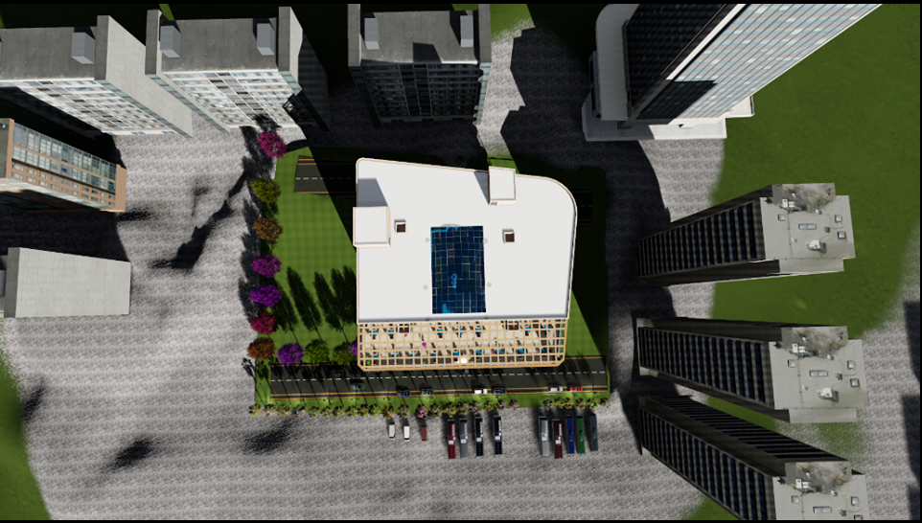
Site plane

Slide 6
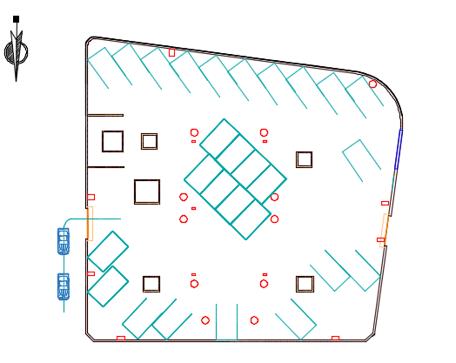
Architectural Design
All stories has a similar area 1682 m²
Two basement floors is parking

Slide 7
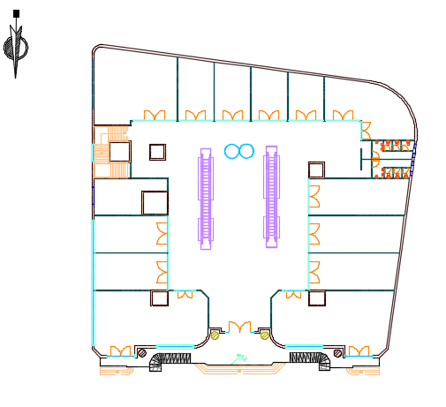
Architectural Design
Ground , first , second and third floor contains Shops

Slide 8
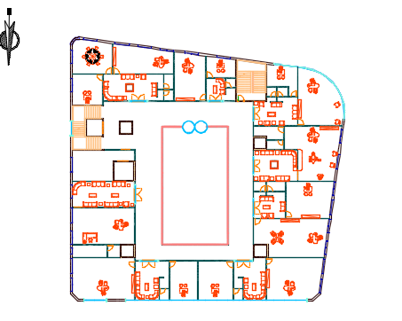
Architectural Design
Fourth , 5th & 6th floor which contains offices

Slide 9
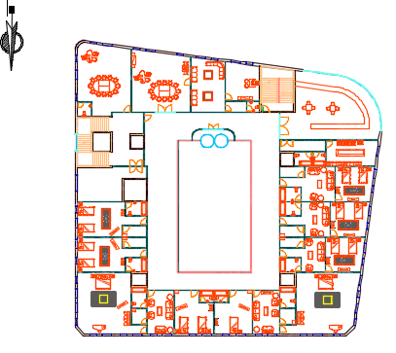
Architectural Design
Seventh , 8th and 9th floor contains motel

Slide 10
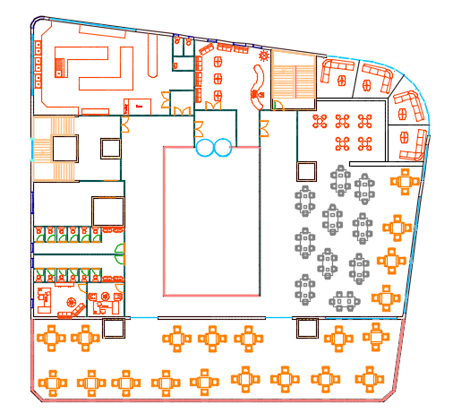
Architectural Design
Tenths floor is a restaurant:

Slide 11
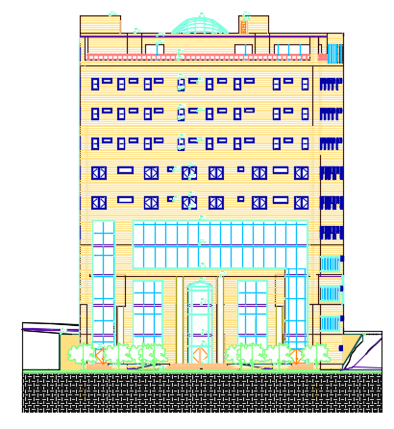
Elevations
NORTH ELEVATION

Slide 12
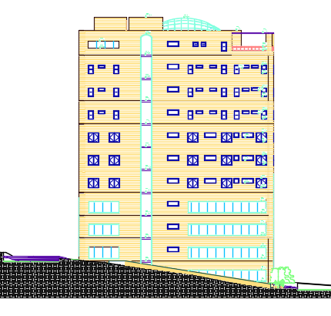
Elevations
EAST ELEVATION

Slide 13
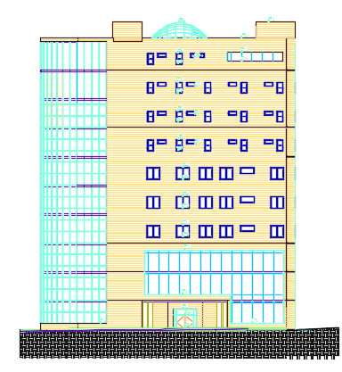
Elevations
SOUTH ELEVATION

Slide 14
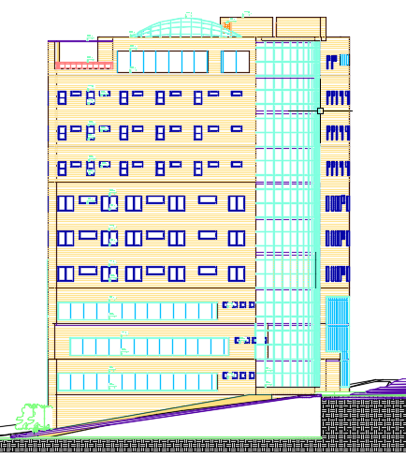
Elevations
WEST ELEVATION

Slide 15
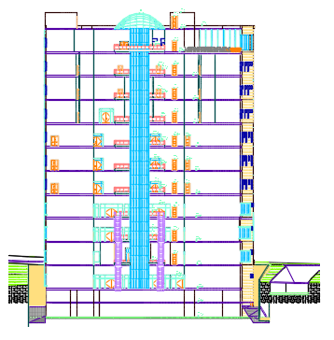
SECTIONS
SEC A-A

Slide 16
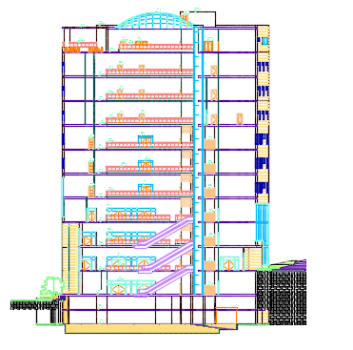
SECTIONS
SEC B-B

Slide 17
3D RENDER
3D

Slide 18
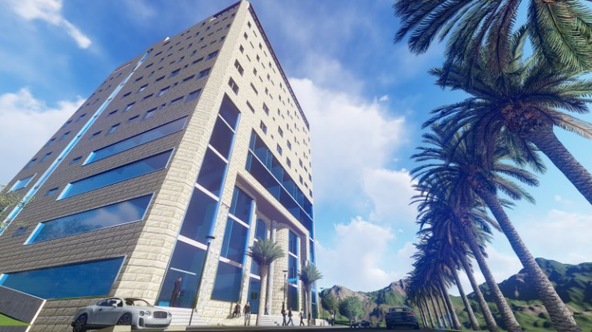
3D RENDER
ENTEANCE

Slide 19
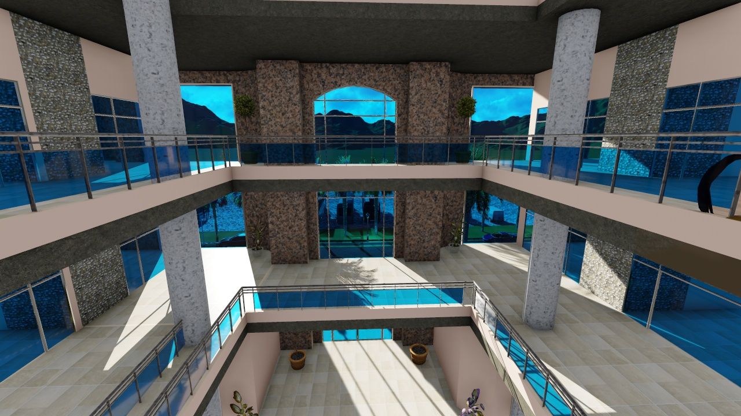
3D RENDER
3D

Slide 20
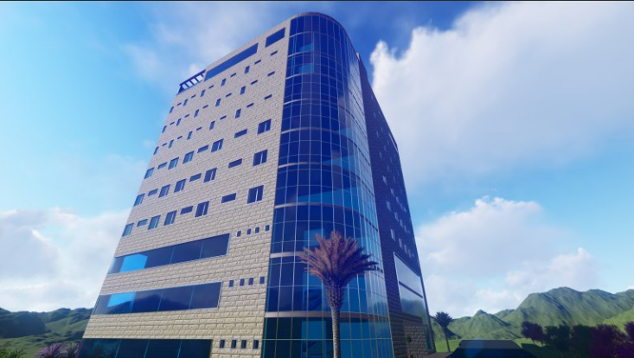
3D RENDER
3D

Slide 21
Environmental Design
Material used.
Thermal design.
Artificial lighting.
Acoustical design.

Slide 22
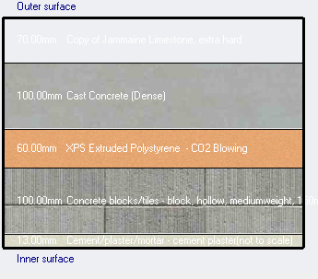

Environmental Design.
Materials.
External wall layers.
(7) cm jamaine lime stone.
(10) cm cast concrete.
(5) xps extruded polystrene.
(10) cm concrete block.
(1.5) cm cement plaster.
U-value= 0.452 W/ $m^{2}.k$

Slide 23
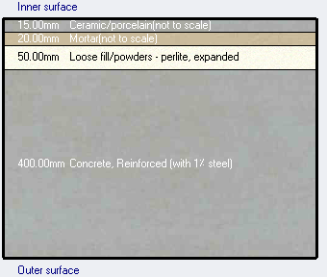

Environmental Design.
Internal floors layers :
(1.5) cm ceramic/porcelain tiles.
(2) cm mortar.
(5) cm loose filling.
(40) cm concrete.
U-value= 0.686 W/ $m^{2}.k$

Slide 24
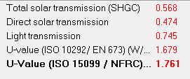
Environmental Design.
Glass Prosperities.
Double LoE (e2=0.1) clear glass with 6mm/13 mm Air gas.

Slide 25
Environmental Design.
Heating and cooling loads.
Site energy .
Heating load: | 465618 KW
Cooling load: | 890306 KW
Total site energy. | 118.42 KWh/m²

Slide 26

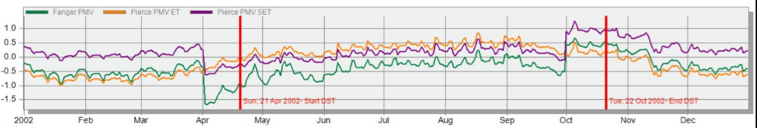
Environmental Design.
Simulation.
heating and cooling load analysis.

Slide 27
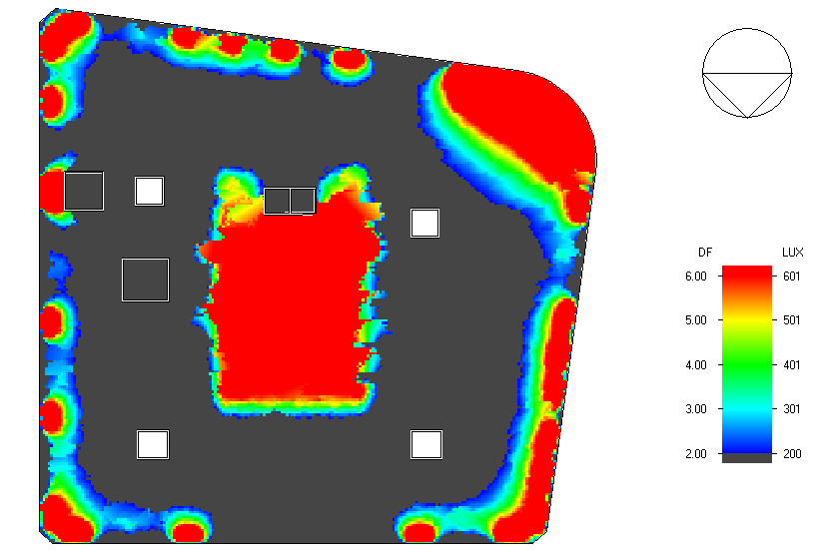
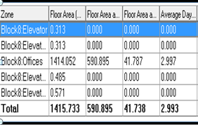
Environmental Design.
Natural daylight analysis.
Average daylight factor for 5th floor
465618 KW

Slide 28
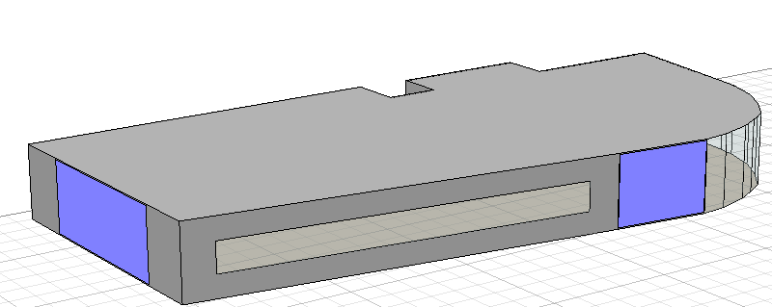
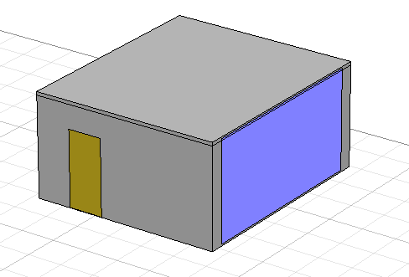
Acoustic Design
Reverberation Time(RT60):
ECOTECT program were used to test and analyze one of the bedrooms of the motel and the dinning room of the restaurant.

Slide 29
Reverberation time
For Dinning room - Restaurant:
RT60 for bed room from the graph should be < ( 0.6) sec
RT60 - Empty | RT60 – Half empty | RT60- Full | Freq. (Hz)
0.6 | 0.56 | 0.52 | 63
0.57 | 0.54 | 0.51 | 125
0.53 | 0.45 | 0.38 | 250
0.58 | 0.49 | 0.42 | 500
0.49 | 0.43 | 0.38 | 1K
0.39 | 0.35 | 0.31 | 2K

Slide 30
Reverberation time
For Dinning room - Restaurant:
RT60 for Restaurant should be between ( 0.6 - 1.0) sec
RT60 - Empty | RT60 – Half empty | RT60- Full | Freq. (Hz)
0.62 | 0.61 | 0.6 | 63
0.59 | 0.59 | 0.58 | 125
0.72 | 0.68 | 0.64 | 250
0.79 | 0.75 | 0.71 | 500
1.01 | 0.94 | 0.89 | 1K
0.94 | 0.88 | 0.82 | 2K

Slide 31
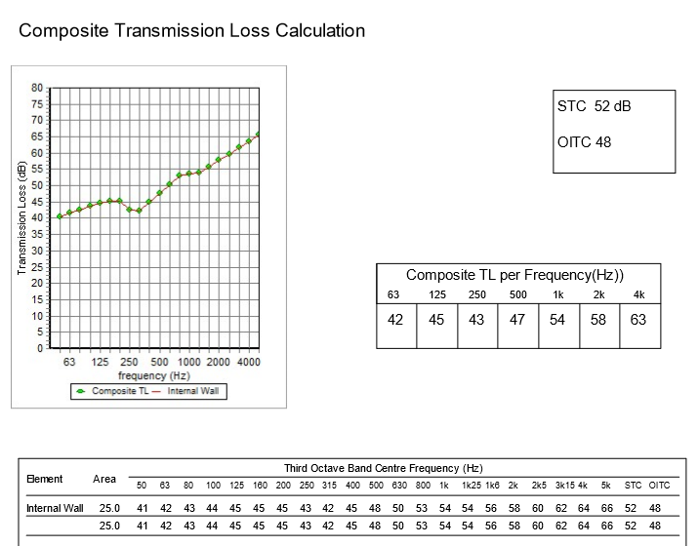
Acoustic Design
STC for Partition of Bedroom:
The STC for partition must =50 dB.

Slide 32
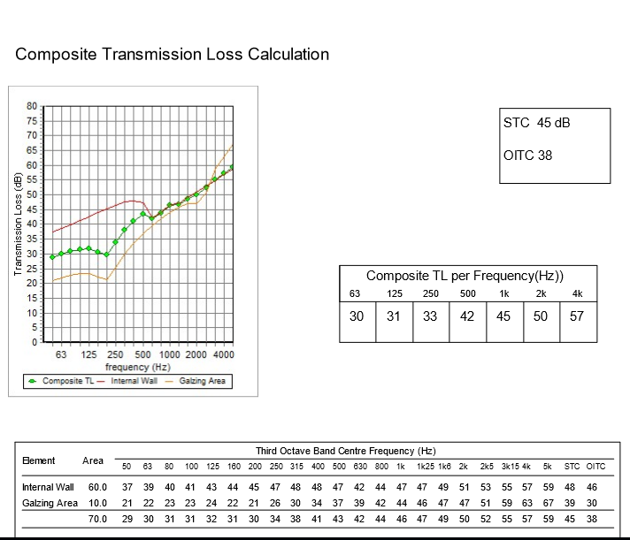
Acoustic Design
STC for Partition of Dinning room:
The STC for partition must =45 dB.

Slide 33
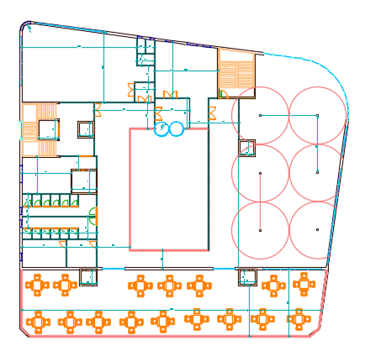
Speakers
use 6 speakers of VXC4 Ceiling speaker.
(195 mm H x 225 mm diameter) : coverage angle130° conical.

Slide 34
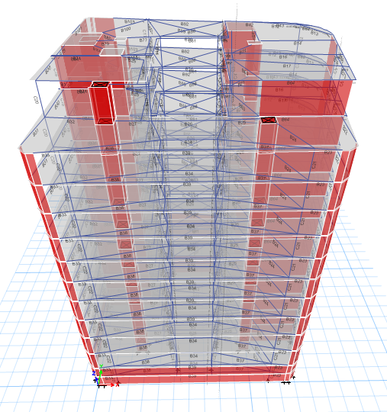
Structural Design
The multi-purpose building has 12 floors which made completely of reinforced concrete.

Slide 35
Structural Design
Codes and Standards:
ACI -318-11 for reinforced concrete structural design.
UBC -97 for earthquake design.
ASCE 7 2010 for load combinations
For the design of the structure and its elements ETABS , Safe and hand calculations were used .

Slide 36
Structural Design
Design data:
Concrete strength, f’_{c}=28 MPa.
Steel yield strength f_{y}=420 MPa.
Bearing capacity for soil = 250 kN/m²

Slide 37
Structural Design
Vertical Loads:
Load type | Spaces
Live Load (kN/m² ) | parking | 6
 | Shops | 5
 | Offices | 3.5
 | Motels | 3
 | Resturant | 4
 | Roof | 4
SID (kN/m² ) |  | 4

Slide 38
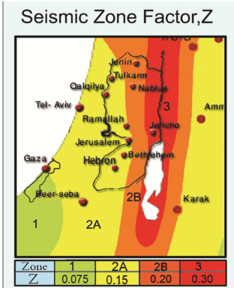
Structural Design
Seismic Design data :
The city of structure is Nablus.
The seismic zone factor. Z=0.2.
The soil profile is type Sd.
The acceleration seismic coefficient Ca=0.28
The velocity seismic coefficient Cv=0.40.
The Seismic importance factor is 1.
The structural design type is intermediate, R=5.5

Slide 39
Sections Dimensions
Structural Element | Dimensions
Ribbed Slab | 40 cm thickness
Solid Slab | 25 cm thickness
Columns | (70X100) cm, ( 70 X 40 ) cm , ( 1 m diameter)
Beams | ( 70X120) cm , ( 55 X 110 ) cm, ( 40 X 50 ) cm

Slide 40
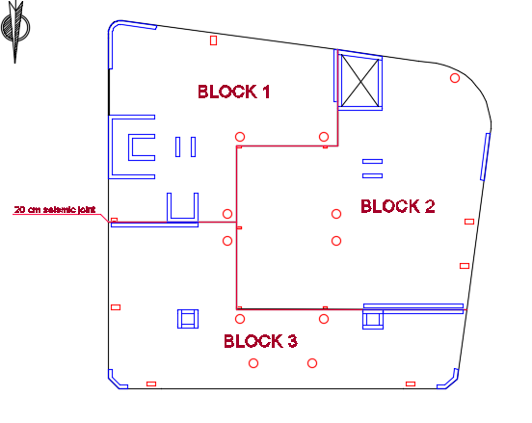
Building blocks

Slide 41
Verification of the model
Compatibility check
Equilibrium check
Internal force check

Slide 42
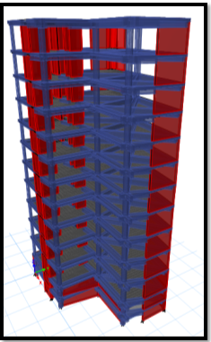
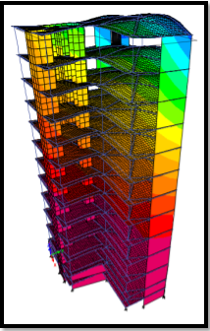
Verification of the model
Compatibility check
Deformed Shape >>

Slide 43
Verification of the model
Equilibrium Check
 | Live load (KN) | SID (kN) | Dead load (kN)
Manual | 22764 | 25288 | 108597
By ETABS | 23363 | 24885 | 109648
% Error | 2.6% < 5% | 1.6% < 5% | 1% < 5%

Slide 44
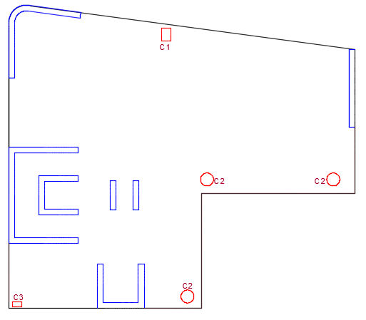
Verification of the model
Internal force check
Column Check:
 | Manual | By ETABS | %Error
Column 9 | 2497 kN | 2648 kN | 5.7%
Column 5 | 2865 KN | 2724 KN | 5%
Column 7 | 199 kN | 204 kN | 2.6%

Slide 45
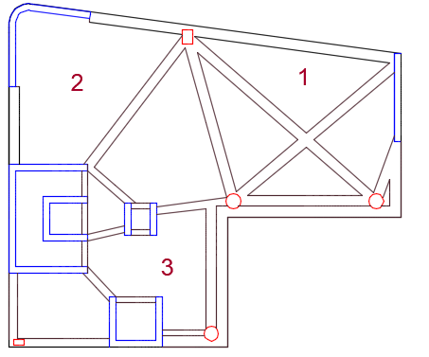
Verification of the model
Internal force check
Slab Check:
 | Manual | By ETABS | %Error
Slab 1 | 175 kN.m | 135 kN.m | 23.1%
Slab 2 | 289 KN.m | 319 KN.m | 9.4%
Slab 3 | 73 kN.m | 51.64 kN.m | 29.7%

Slide 46
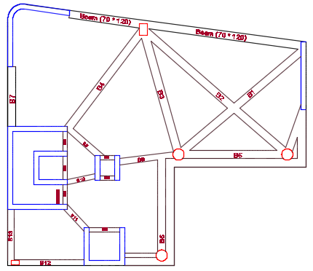
Verification of the model
Internal force check
Beam Check:
 | Manual | By ETABS | %Error
Beam 2 | 282 kN.m | 223 kN.m | 21%
Beam 5 | 2068 KN.m | 1850 KN.m | 10.5%
Beam 7 | 1983 kN.m | 1440 kN.m | 27.36%

Slide 47
Design checks
Period Check
1.3 sec < 1.44 sec
Drift
In X-direction=116.3 < 125 mm
In Y-direction=105.22 < 125 mm
Deflection check
22.5 mm < 59.46 mm
Base shear check
4717kN > 1782kN
4239kN > 1887kN
Modal participating mass ratio check
0.91 > 0.90

Slide 48
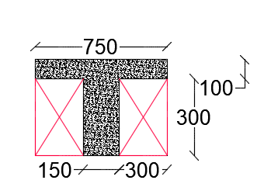
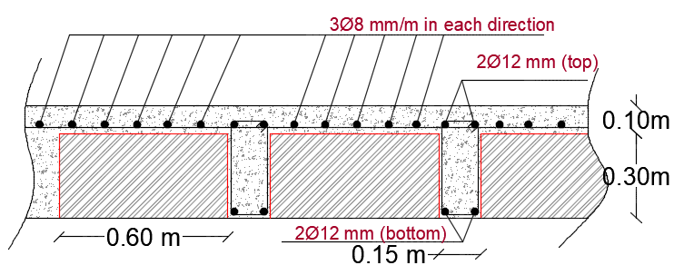
Ribbed Slab Reinforcement

Slide 49
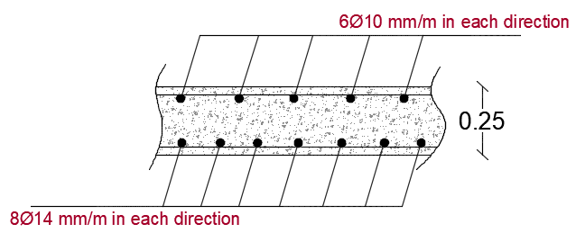
Solid Slab Reinforcement

Slide 50
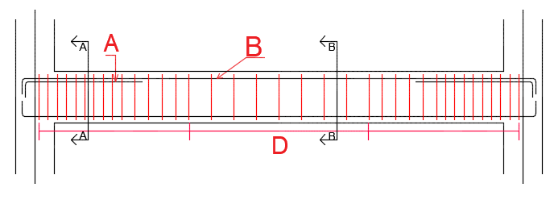
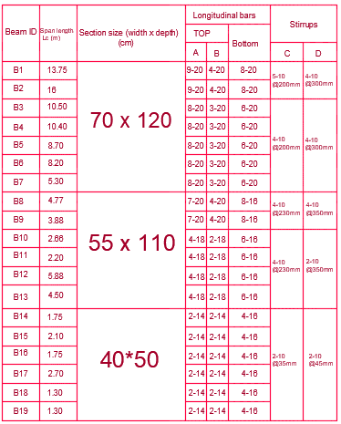
Beams Reinforcement

Slide 51
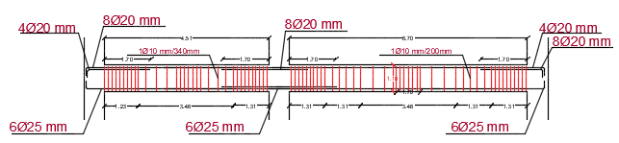
Beams Reinforcement

Slide 52
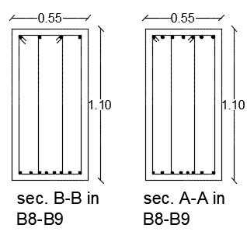
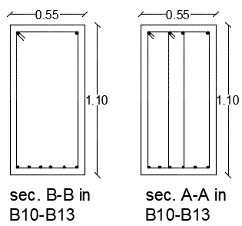
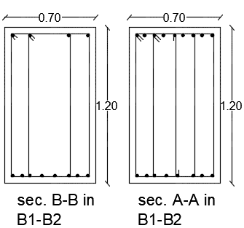
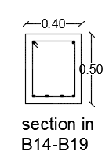
Beams Reinforcement

Slide 53
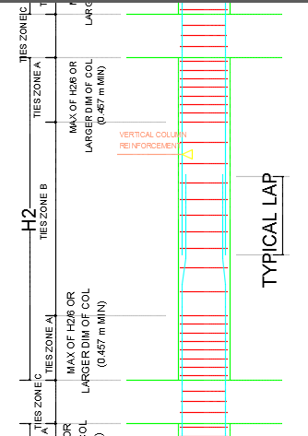
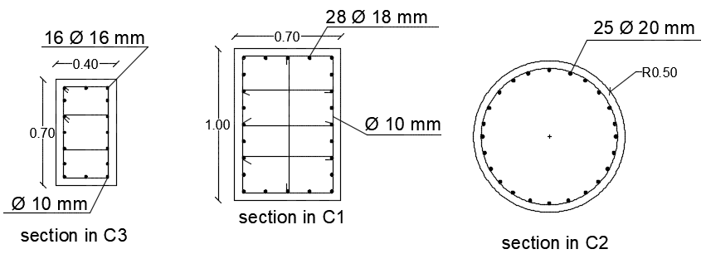
Columns Reinforcement

Slide 54


Stair Reinforcement

Slide 55

Mat Foundation
Foundation thickness = 1.40 m.

Slide 56

Model checks
Deflection shape check:
Max. deflection = 8.50 mm >10 mm

Slide 57
Model checks
Soil failure check:
q _{all =} 250 KN/m².
Stress under footing = ∑ Fz / Area of building
= 358205.812/1680
= 213 KN/m² ≤ 250 KN/m², which is OK.

Slide 58

Model checks
Shear check:
ΦVc =$\frac{0.75∗1000∗1300 \sqrt{28}}{6000}$ = 860 KN/m.
The ultimate shear in V13 direction is 790.36 KN/m and 586.59 KN/m in V23 direction, so,
shear check is OK.

Slide 59

Model checks
Punching shear check:
ØV_{c,p} = Ø * $\frac{1}{3}$ * $\sqrt{f_{c}^{′}}$ * b_{o} * d
= $\frac{0.75}{3000}$ *$\sqrt{28}$ * 6280*1300 = 10800 KN.
Compare this value with maximum axial load on a column as a conservative value.
Pu = 7256 KN < 10800 KN, so, punching shear check is OK.

Slide 60


Mat foundation design
Design for moment:
H = 1400 mm
D = 1300 mm
b_{w} = 1000 mm
As,_{min} = 0.0018*1000*1300 = 2340 mm²
M = 0.9*As*420 ( 460 - $\frac{420As}{1.7fc′ ∗bw}$ ) *10⁻⁶
= 0.9*2340*420 ( 460 - $\frac{420∗2340}{1.7∗28∗1000}$ ) *10⁻⁶
= 388 KN.m /m.

Slide 61

Mat foundation reinforcement
Reinforcement details:

Slide 62

Mat foundation reinforcement
Part 1 details:

Slide 63

Mat foundation reinforcement
Part 2 details:

Slide 64
Electrical Design.

Slide 65


Electrical design.
Recommended illumination.
Reflection factor.

Slide 66


Electrical design.
Artificial lighting.
Shops.
E(lux) | U | UGR | D.F
177 | 63 | 18.6 | 2.169

Slide 67


Electrical design.
Shops selected luminaires.

Slide 68


Electrical design.
Artificial lighting.
Offices (management room).

Slide 69


Electrical design.
Artificial lighting.
Offices (secretary room).

Slide 70


Electrical design.
Artificial lighting.
Offices (reception hall).

Slide 71

Electrical design.
Office rooms selected luminaires.

Slide 72


Electrical design.
Artificial lighting.
Motels (guest bedroom).

Slide 73


Electrical design.
Artificial lighting.
Motels (living room).

Slide 74




Electrical design.
Motels selected luminaires.

Slide 75

Electrical design.
Artificial lighting.
External lighting.

Slide 76

Electrical design.
Artificial lighting.
External lighting.

Slide 77

Electrical design.
Artificial lighting.
External lighting.

Slide 78

Electrical design.
Lighting arrangement for shops.

Slide 79

Electrical design.
Lighting arrangement for offices.
Lighting arrangement.

Slide 80

Electrical design.
Sockets arrangement for shops.

Slide 81

Electrical design.
Sockets arrangement for offices.

Slide 82

Electrical design.
Main distribution board.

Slide 83
Mechanical design.

Slide 84
Mechanical design
1- Water Supply System
2-Drainage System
3-H-VAC System

Slide 85

Mechanical design
Water supply design

Slide 86

Mechanical design
Water distribution System

Slide 87

Drainage System:
Amount of drainage water in each floor

Slide 88

Flush water Tank:
The total amount = 15391 Liter/Day.
= 15.391 Cubic meter
= 16 Cubic meter.
The flush water tank dimension:
(2 ×2 × 4) m.

Slide 89

Amount of flush water in each floor

Slide 90

Amount of Fresh water in each floor

Slide 91
Storm Water:
Total amount of fresh water per day = 16.807 m³
= 17 m³
Storm Water = Avg. Rain in the year × Area
= 0.6 m ×1300 m2 = 780 m³
The needed amount of fresh water for 7 days = 119 m³ So 120 m³ of rain water will be stored, and others will be drained.
The fresh water tank dimension: ( 5 ×6 × 4 ) m.

Slide 92

Safety design
Fire resistance system:
Sprinklers system was used:
HI-FOG sprinkler type was used.

Slide 93

Safety design
Sprinklers water supply connections :

Slide 94


Safety design
Fire resistance system:

Slide 95
Mechanical design.
HVAC system.
System used are :
VRF
This building was divided into several zones.
Main components of VRF system are :
Out door unit (for cooling and heating).
Controller.
Fan coil unit.
Ducts.
Diffusers.

Slide 96

Mechanical design.
Out door unit.

Slide 97

Mechanical design.
controller.

Slide 98



Mechanical design.
Fan coil unit.
Diffusers.

Slide 99

Mechanical design.
Hvac distribution for motels floor :

Slide 100

Reflecting cieling.

Slide 101

Quantities and Survey

Slide 102

Quantities and Survey

Slide 103

Quantities and Survey

Slide 104

Quantities and Survey

Slide 105

Quantities and Survey

Slide 106

Quantities and Survey
Total cost of the building = 32083690 NIS
Total cost per meter squared of the building (NIS) = 1671 NIS.
Total cost per meter squared of the building ($) = 500 $.

Slide 107



