Slide 1

“Separation and Medical Application of Clary Sage Oil”
Eman Daraghmeh
Reham Daraghmeh
Ghaydaa Al-Bzoor
Supervised By:
Dr. Husni Odeh

Slide 2
Outlines
Background of clary sage
Objectives of the project
Methodology
Extraction Method
The result of analysis (GC-MS)
Cream improvements and labeling
Cream tests
Results
The constrains of the project
Recommendation

Slide 3
Background of Clary sage
Salvia sclarea L. belongs to the family Labiatae. S. Sclarea, also known as Clary Sage (CS)
CS has shown diverse biological activities manifested by different components (mainly of essential oil) that allowed for many medicinal and pharmaceutical applications of the plant materials and/or extracts

Slide 4
Objectives of the project
The objectives of this project is to extract oil from sage seeds using several extraction methods:
1) ethanol extraction
2) Soxhlet extraction
3) Clevenger extraction
4) cold pressing
Determination the well-known health effective compounds in sage oil by using sophisticated techniques such as Gc-Ms system.
Suggestion new dosage form of the extracted oil for healing purposes
The other objective was to make laboratory bioassay at pharmaceutical department but the experiment was failed in genetic laboratory.

Slide 5
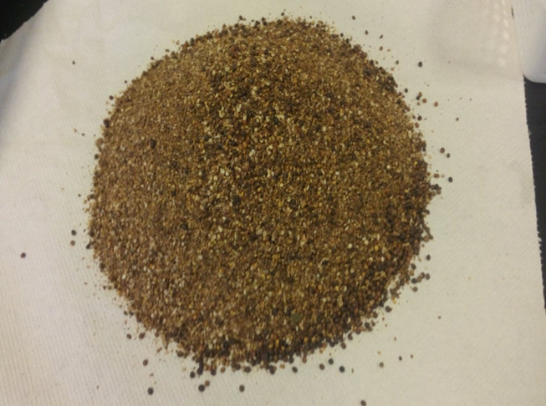
Methodology
Clary Sage seeds were collected and grinded

Slide 6
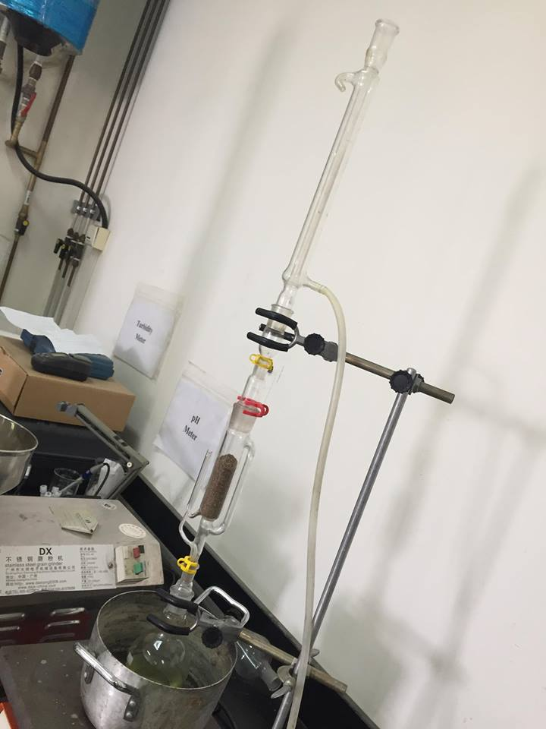
Soxhlet Extraction

Slide 7
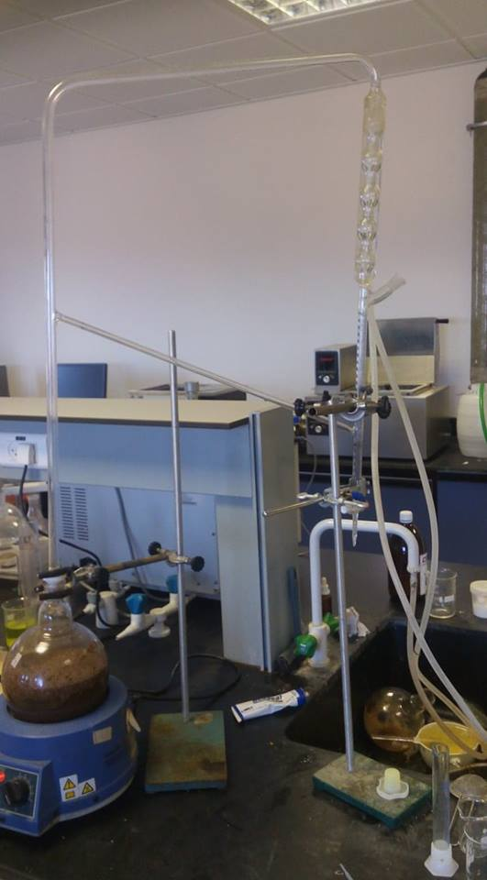
The Clevenger extraction

Slide 8
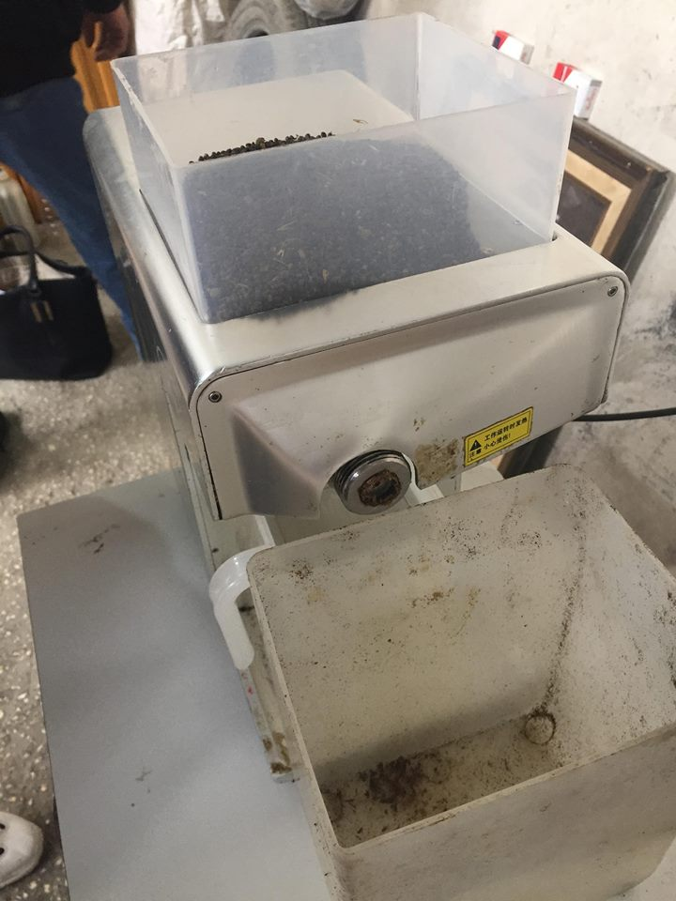
The cold Pressing method

Slide 9
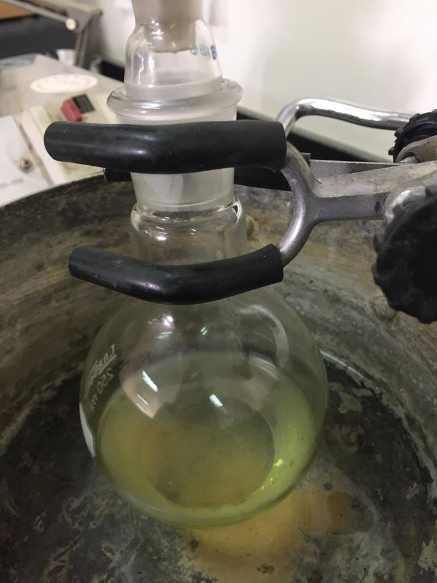
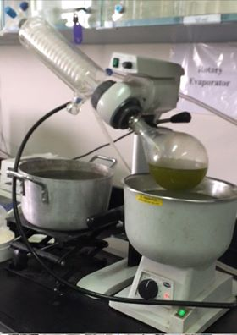
Ethanol Extraction
The Ethanol-Solvent.
The Rotary-Evaporator.

Slide 10
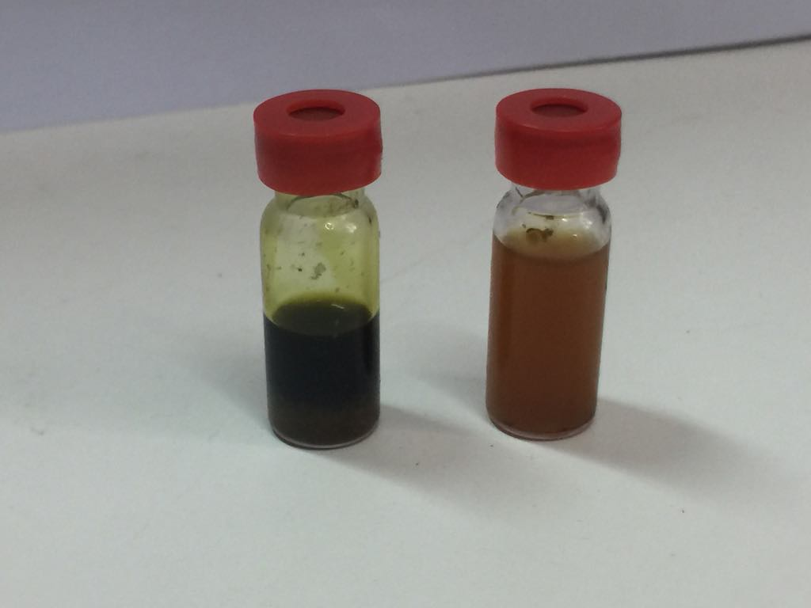
Results
The oil seed from ethanol extraction

Slide 11
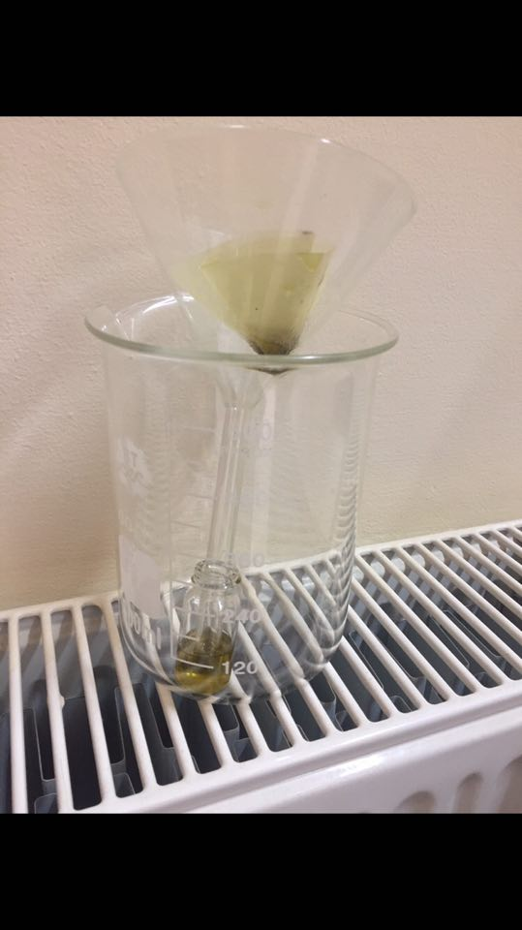
The pure oil from cold-press extraction

Slide 12
compression between the all methods
Type of Extraction | Yield wt.% | RI Value | Type of solvent
solid-liquid extraction (ethanol) | 2.4 | 1.31 | Ethanol
solid-liquid extraction (hexane) | 3 | 1.29 | CH2Cl2
Clevenger | - | - | -
Soxhlet-extraction | 4 | 1.36 | Hexane
cold-compression extraction | 4.5 | 1.4 | No solvent

Slide 13
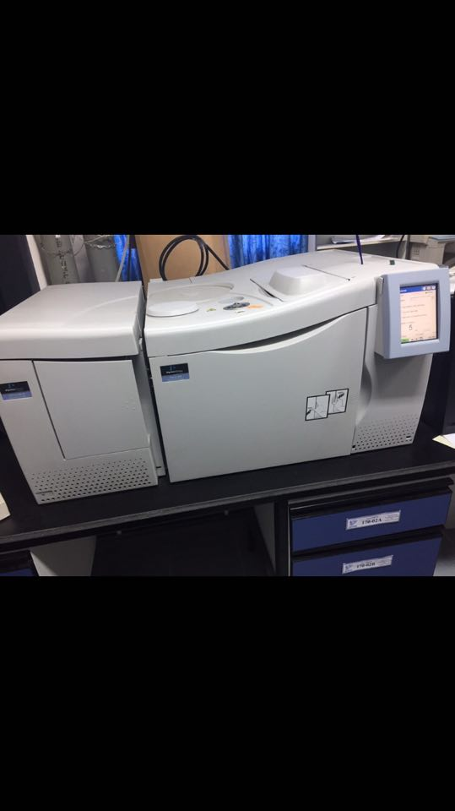
The Gas Chromatography–Mass Spectrometry (GC-MS)
It is a common type of chromatography used in analytical chemistry for separating and analyzing compounds that can be vaporized without decomposition.

Slide 14
The main components in the clary sage oil by GC-MS Analysis.
Name | R.T | height | area | R.I | %Area | %Height
EUCALYPTOL | 12.79 | 127800 | 2332937 | 753 | 1.365 | 1.1173
4.5-THIEPANEDIONE, 3,3,6,6-TETRAMETHYL- | 18.31 | 758345 | 11233167 | 542 | 6.572 | 6.6301
Z,Z-6,28-HEPTATRIACTONTADIEN-2-ONE | 46.27 | 1294013 | 15333105 | 884 | 8.97 | 11.313
TRIDECANOIC ACID | 42.12 | 260176 | 3927904 | 742 | 2.298 | 2.2747
ETHYL 9.CIS.,11.TRANS.-OCTADECADIENOATE | 53.39 | 2240897 | 15516640 | 800 | 9.078 | 19.592
ALANINE, N-METHYL-N-METHOXYCARBONYL-,UNDECYL ESTER | 15.85 | 110452 | 2184773 | 865 | 1.278 | 0.9657
ALPHA.-MUUROLENE | 32.66 | 4436369 | 80599248 | 799 | 47.15 | 38.787
1-METHYLENE-2B-HYDROXYMETHYL-3,3-DIMETHYL-4B-(3-METHYLBUT-2-ENYL)-CYCLOHEXANE | 29.81 | 1586773 | 28343450 | 927 | 16.58 | 13.873
DAUCOL | 33.84 | 236851 | 4890616 | 702 | 2.861 | 2.0708
(S)-(-)-2-AZETIDINECARBOXLIC ACID | 16.75 | 353680 | 5961118 | 774 | 3.487 | 3.0922
METHYL 2-HYDROXY-OCTADECA-9,12,15-TRIENOATE | 52.25 | 32531 | 611901 | 685 | 0.358 | 0.2844
 |  | 11437887 | 170934859

Slide 15
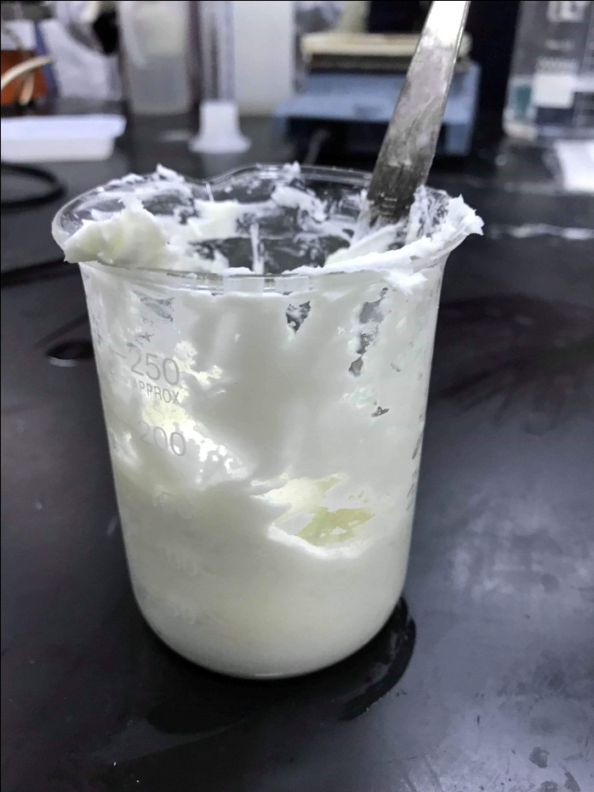
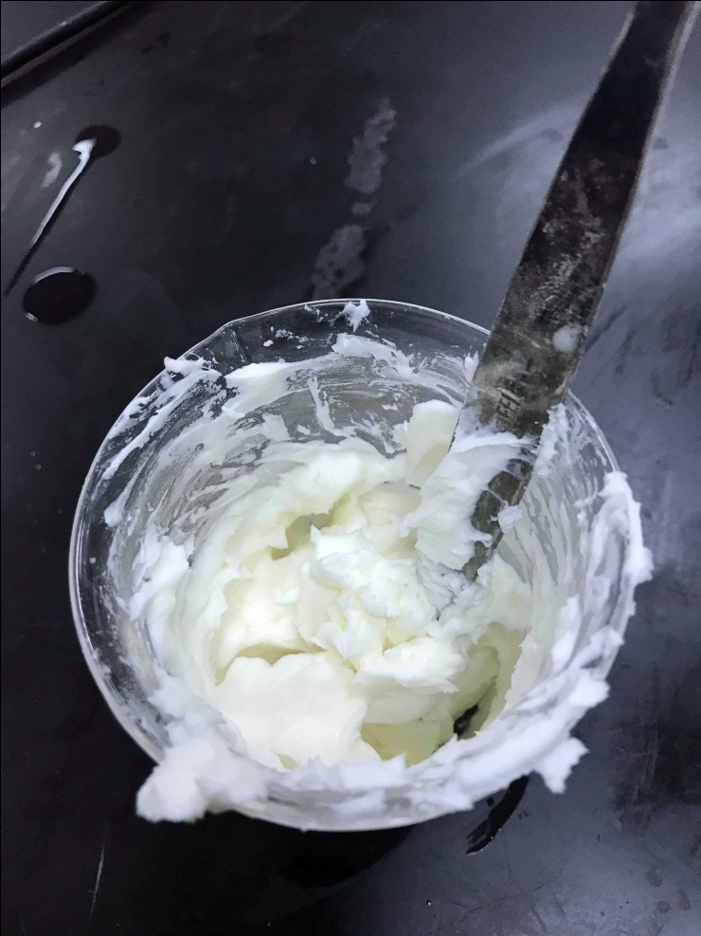
Ingredients of Cream
Clary sage oil
Bess Wax
Glycerilye Monostearate
Sodium Lauryl Sulfate
Lanoline
Glycerol
Clary sage seeds oil
Stearic acid
Triethanolamine (TEA)
Distilled water
Paraffin Oil
Cetyl/ Stearyl

Slide 16
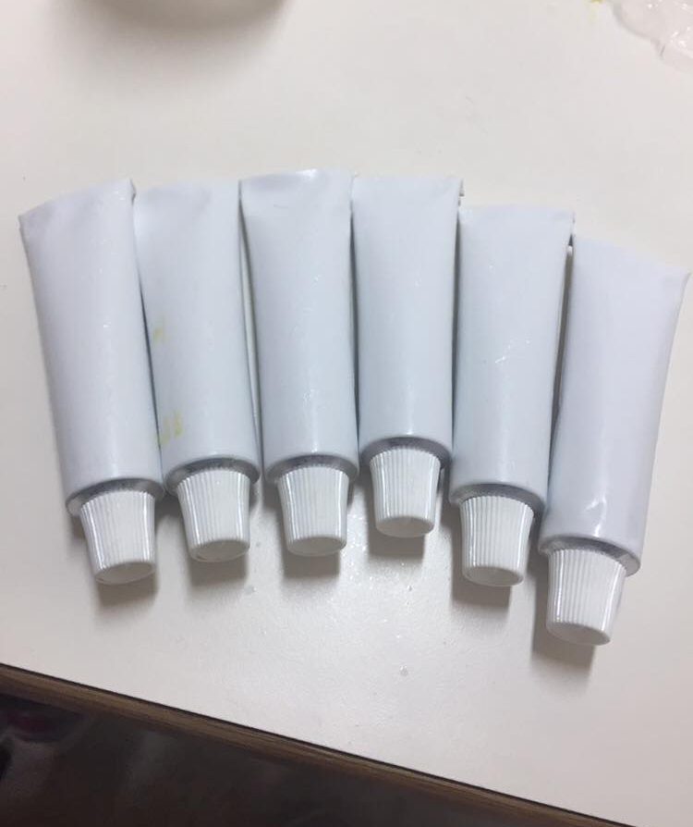
Filling
Labeling

Slide 17
Cream Tests
PH | 5.2
Viscosity (cp) | 790
Appearance | Its creamy appearance is homogeneous with acceptable viscosity.
Separation | No Separation during period of month
Homogeneity | Very good
Colour | Creamy
Odour | Aromatic substances were added
Content of Active Ingredient | 0.067
Average Filling Weight | 10ml filling tubes
Microbial Test | No. Particles
APC | 170
E. coli bacteria | 7
Biological tests result for cream.
Trial | PH
F1 | 4.2
F2 | 5.4
F3 | 5.19
PH values for different formula.
Physical tests result for cream

Slide 18
The constrains of the project
The collected seeds are bad quality containing very low amount of oil. It was very difficult to have new sage seeds with good quality and rich of oil
The supercritical extractor installed at Pharmacology College didn’t functionate well and it still has leakage of CO₂ gas.
Steam distillation or distillation by Clevenger was used to extract oil from seeds while the literatures ensure that it is not suggested for the seeds but only for leaves.

Slide 19
Recommendation
Cultivate larger amount of seeds at May month and to store it in cold place in closed pockets to extract a greater proportion of the active ingredient to ensure more effective cream.
Provision automatic cream homogenizer in department labs.
Study the active compounds for specific diseases.
Ensure a longer period of study of the healing process to convince the community to go towards this type of treatment.

Slide 20
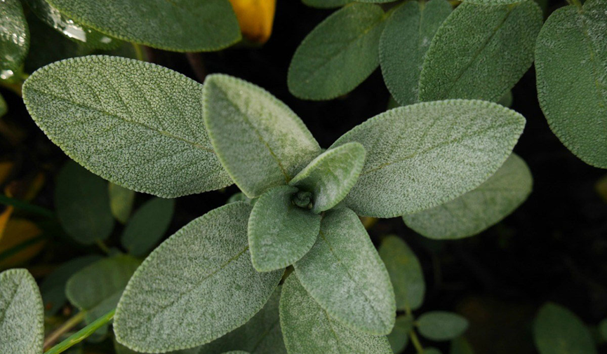
Thanks for Listening

