Slide 1
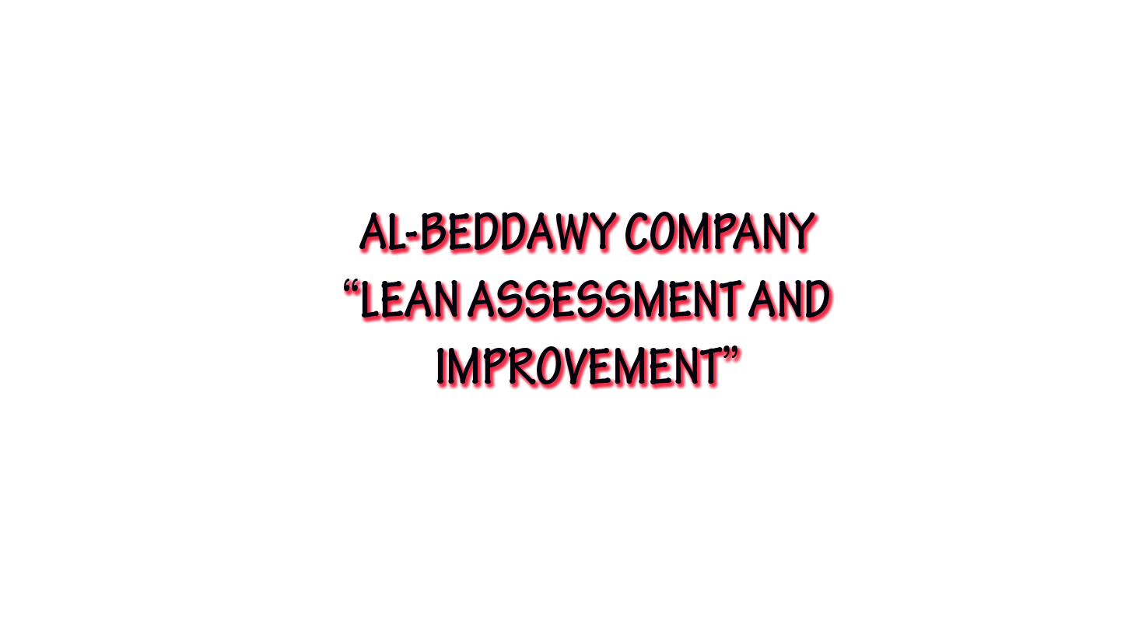

Slide 2
Agenda
Introduction to our project and the importance of it.
Introduction to Al-Beddawy company and to it`s processes.
Al-Beddawy lean assessment.
SIPOC Diagram & Value stream mapping.
Lean layout
Safety assessing tools and safety tips
5S’s and lean wastes
KANBAN & JIT system
Cash flow & costing systems

Slide 3
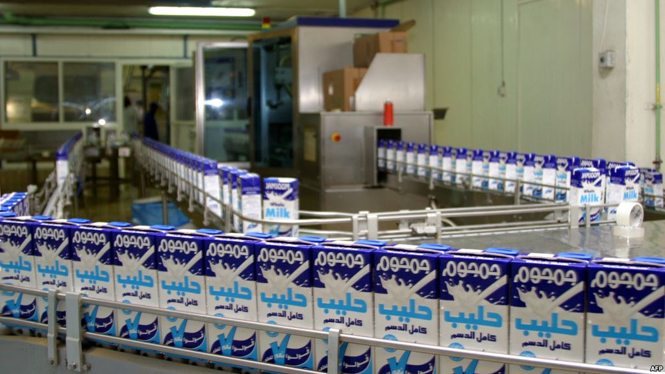


Slide 4
Furniture sector
Furniture sector was comprised of 2,954 firms in 2011, 70% of which are located in the
Bank and 30% of which are in Gaza.
Palestinian furniture sector currently employs 8,890 workers.
Sector production was valued at US$ 188.9 million in 2011.
Sector proportion of GDP in the State of Palestine: 8.7% in 2011.

Slide 5
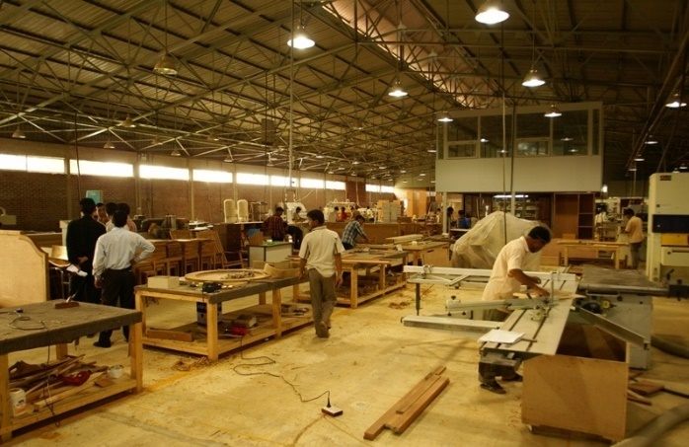
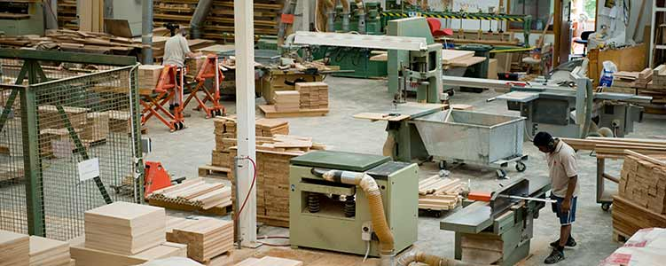
Al-Beddawy Company

Slide 6
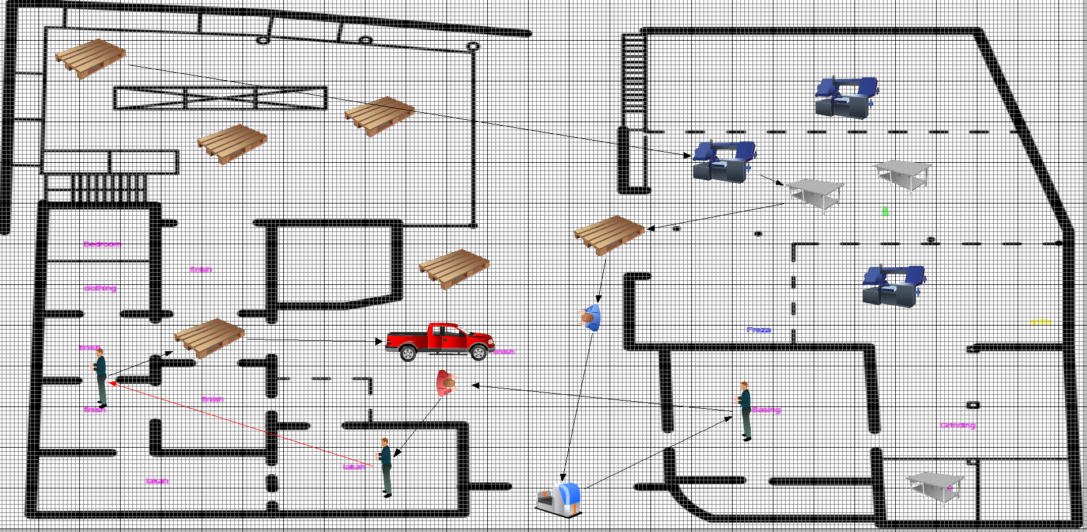
Product families and Processes

Slide 7
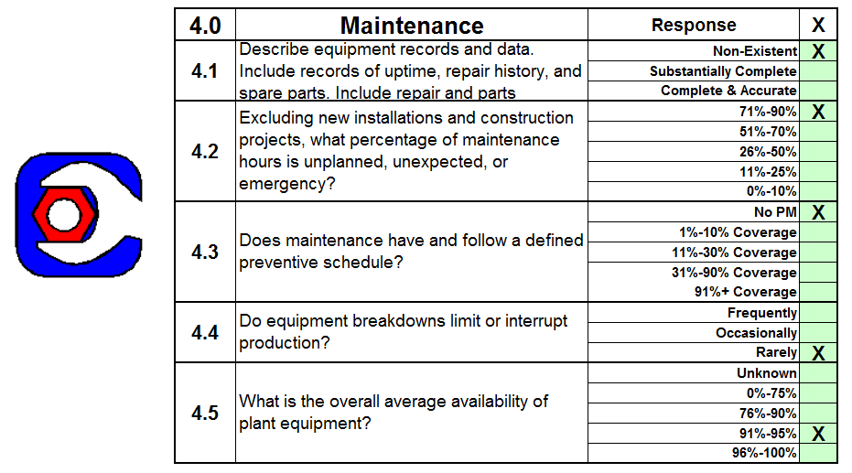
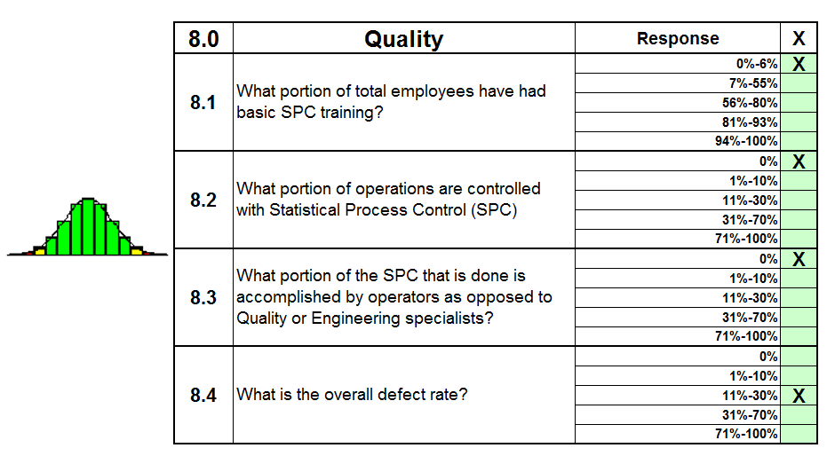
Lean assessment
Strategos Lean assessment tool

Slide 8
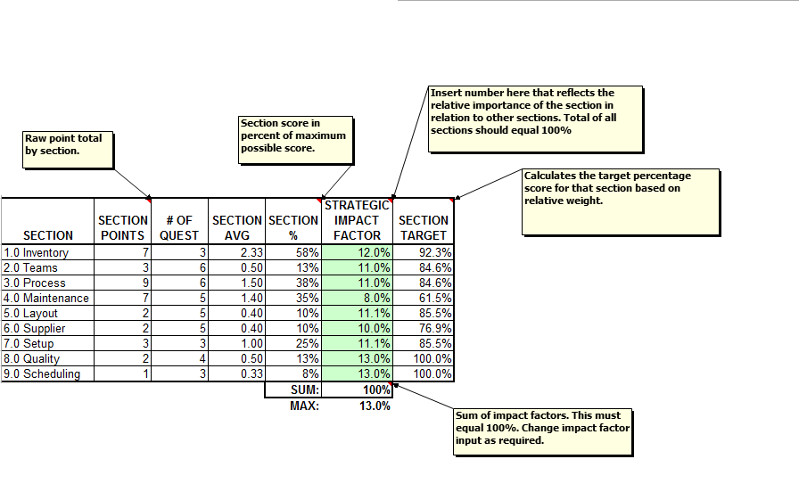

Slide 9
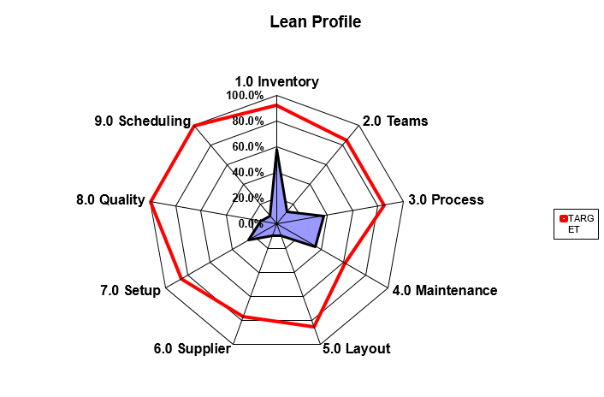

Slide 10

Safety assessment tools and useful tips
Musculoskeletal injuries (MSIs)
Avoid manually lifting, carrying, or pushing heavy objects.
Instead, use mechanical devices such as cranes, or hand trucks.
Bend your knees so that the stronger muscles in your legs take
most of the load.

Slide 11
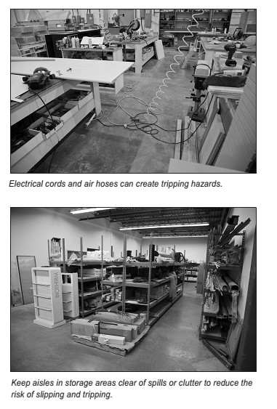
Slips and trips
Wear non-slip footwear that fits properly.
Make sure pathways and aisles are free of clutter, including cuttings, sawdust, and loose lumber. Stop and move any obstacle as soon as you see it.

Slide 12
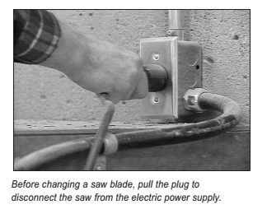
Lockout
Samples of general guidelines when locking out equipment:
Make sure turning off the equipment will not harm another worker.
Make sure all moving parts have stopped before touching the machine.

Slide 13
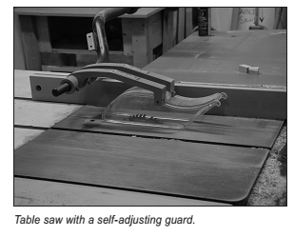
Safeguarding
Use equipment only if all the safeguards are in place.
Make sure safeguards are set for the correct height of the stock being machined.
Keep hands away from blades or moving parts.

Slide 14
Personal protective equipment (PPE)
Protective clothing
Wear close-fitting clothing, remove any dangling jewelers and rings, and confine long hair to avoid getting caught in equipment
Eye and face protection
To protect against hazards such as flying wood chips, broken saw teeth, and wood dust, wear safety glasses with side shields and a face shield.
Hearing protection
Wear earplugs or earmuffs to protect your hearing. The noise levels produced by most power woodworking equipment are high enough to damage hearing.

Slide 15
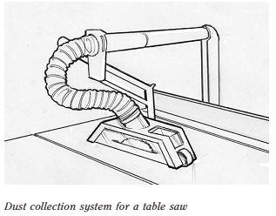
Wood dust
Choose work methods or processes that minimize the generation of dust.
Generally, you shouldn’t use compressed air to blow dust off clothing or work surfaces.

Slide 16

Forklifts and pallet jacks
Make sure all operators have been properly trained before operating a forklift or pallet jack.
Do not operate the forklift unless it’s running properly. If it isn’t working properly, get it fixed first.
Check the load capacity of the forklift before loading.

Slide 17
Emergencies
Review your building’s evacuation procedures from time to time. Make sure you know what do if there is a fire.
Know the location of fire extinguishers and escape routes.
If you spot an unintended fire, sound the nearest alarm and call 102.

Slide 18
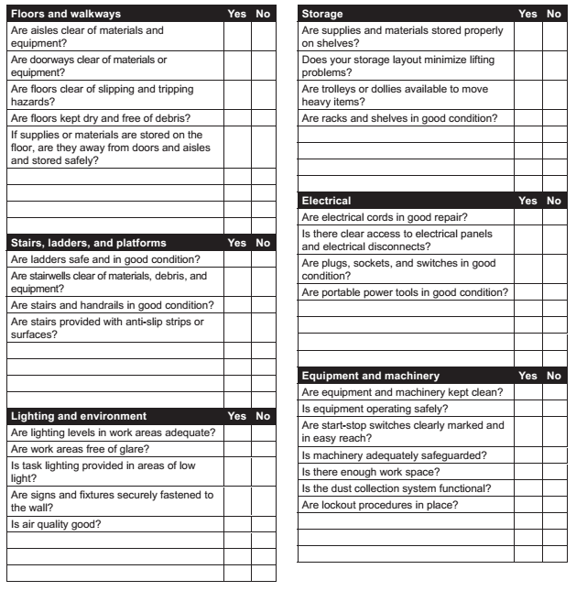
Inspection checklist

