Slide 1

An-Najah National University Hospital
Engineering College
Graduation Project II
Prepared by : Jamila Bani Odeh
Safaa’ Abu Qassidu
Somaya Yaseen
Submitted to : Dr . Imad Al-Qasem

Slide 2
Contents
Overview
Elements of Structural System
Materials
Computer Programs Used
Design Codes
Loads
Combinations
Preliminary Design
3-D Model Analysis
Seismic loads
Columns Design
Foundation Design

Slide 3
Overview
An-Najah National University Hospital which is located in Assira Street in Nablus. The project have a three blocks (A, B and C) which consist of a five basements, and ground floor.

Slide 4
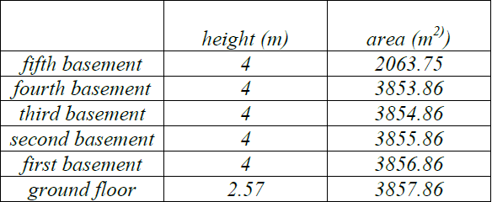
Overview
The hospital consists of one ground floor and five basements

Slide 5
Overview

Slide 6
Elements of Structural System
Each structural system consists of main structural elements as follows:
1) Slabs (Two way solid slab).
2) Beams (Drop Beams, T- section).
3) Columns (Short Columns).
4) Footings (Single and Strip footings).

Slide 7
Materials
Concrete
The values of compressive strength (f'c) were used in the project is 24 MPa for beams and slabs and 28 MPa for columns and footings
.
-Reinforcement Steel
Fy: Yielding strength = 420 MPa

Slide 8
Computer Programs Used
SAP2000 used to modeling the building using equivalent depth of slabs and make checks then the results will be taken for design . Also, AutoCAD will be used to get out the design as a drawings and ready for execution

Slide 9
Design Codes
1-American concrete institute code according to 2008 updating (ACI-318-08) .
2-UBC-97 (Uniform Building Code).

Slide 10
Loads
Gravity Loads , which include :
*Dead Loads :
-Own weight of the structure.
-super imposed dead load (SID).
Live Loads :
-Human being.
-Furniture

Slide 11
Combinations
1) Wu = 1.4DL
2)Wu = 1.2DL + 1.6LL
3)Wu = 0.9DL +1 EL + or – 1.6WL
4)Wu = 1.2DL +1 EL +1 LL + or – 1.6 WL
5)Wu = 1.2DL +0.5 LL + 1.6 SL

Slide 12
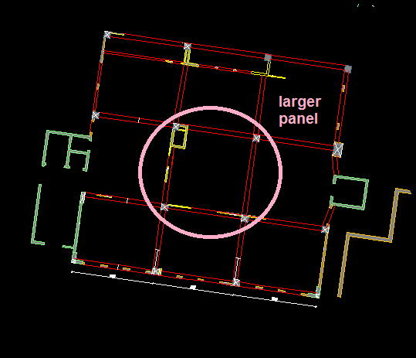
Preliminary Design
Block B

Slide 13
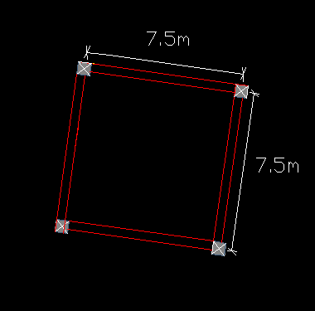
Preliminary Design

Slide 14

Preliminary Design
Determining thickness of slab
$\left(\frac{l}{27}−\frac{l}{35} \right)=\left(\frac{7.5}{27}−\frac{7.5}{35}\right)=\left(0.28−0.21\right)m$
We used h _{slab} = 0.25 m =25 cm.

Slide 15
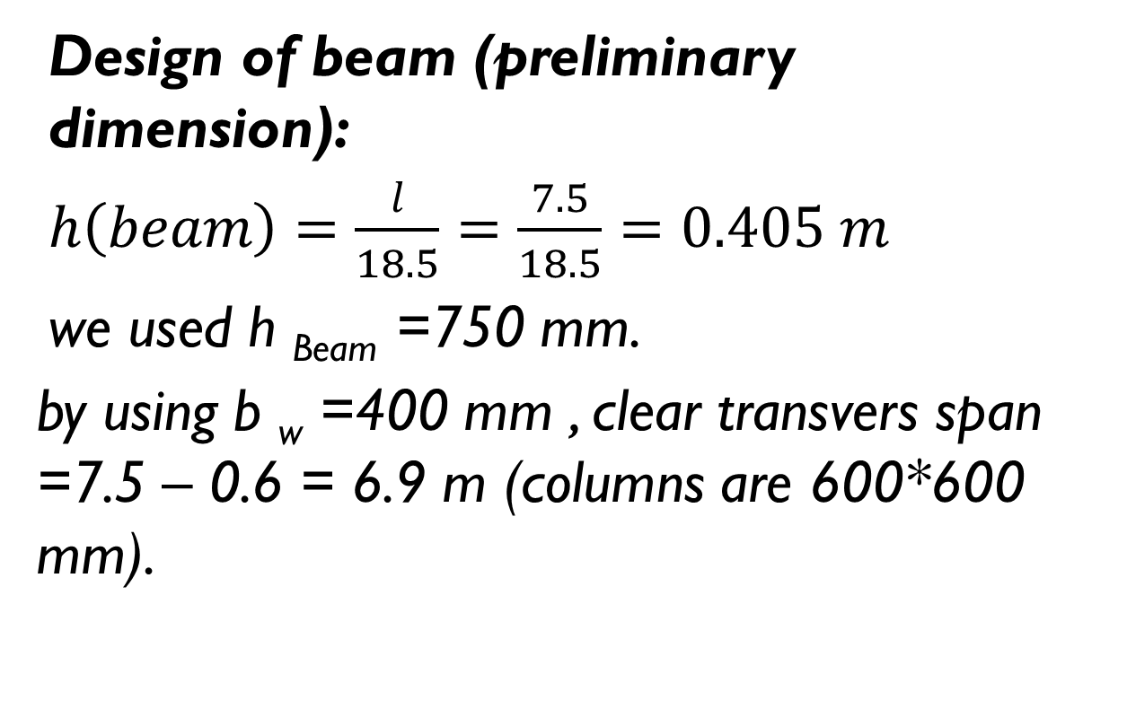
Preliminary Design
Design of beam (preliminary dimension):
$h\left(beam\right)=\frac{l}{18.5}=\frac{7.5}{18.5}=0.405 m$
we used h _{Beam} =750 mm.
by using b _{w} =400 mm , clear transvers span =7.5 – 0.6 = 6.9 m (columns are 600*600 mm).

Slide 16
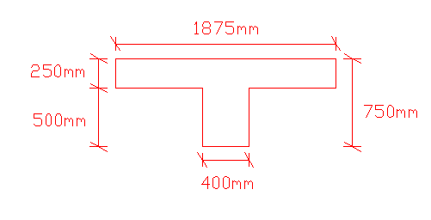
Preliminary Design

Slide 17
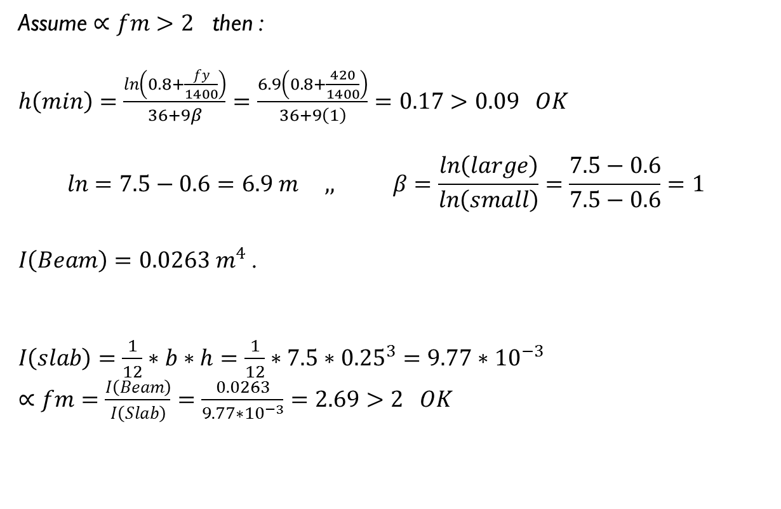
Preliminary Design
Assume $∝fm>2$ then :
$h\left(min\right)=\frac{\ln\left(0.8+\frac{fy}{1400}\right)}{36+9β}=\frac{6.9\left(0.8+\frac{420}{1400}\right)}{36+9\left(1\right)}=0.17>0.09 OK$
$$\ln{=7.5−0.6=6.9 m ,, β=\frac{\ln\left(large\right)}{\ln\left(small\right)}=\frac{7.5−0.6}{7.5−0.6}=1}$$
$I\left(Beam\right)=0.0263 m^{4}$ .
$I\left(slab\right)=\frac{1}{12}∗b∗h=\frac{1}{12}∗7.5∗{0.25}^{3}=9.77∗{10}^{−3}$
$∝fm=\frac{I\left(Beam\right)}{I\left(Slab\right)}=\frac{0.0263}{9.77∗{10}^{−3}}=2.69>2 OK$

Slide 18
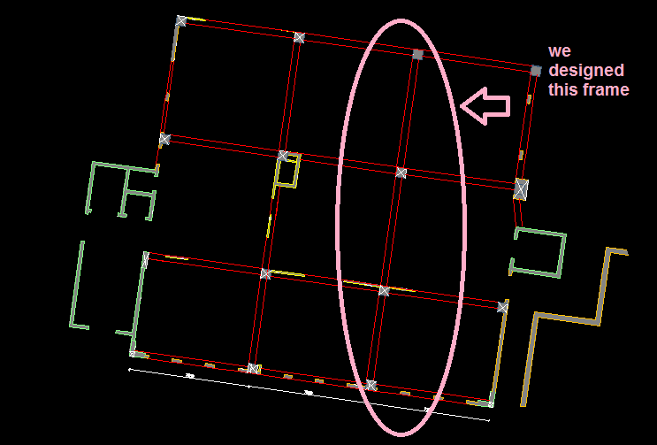
Preliminary Design
Design frames in X – Direction:

Slide 19
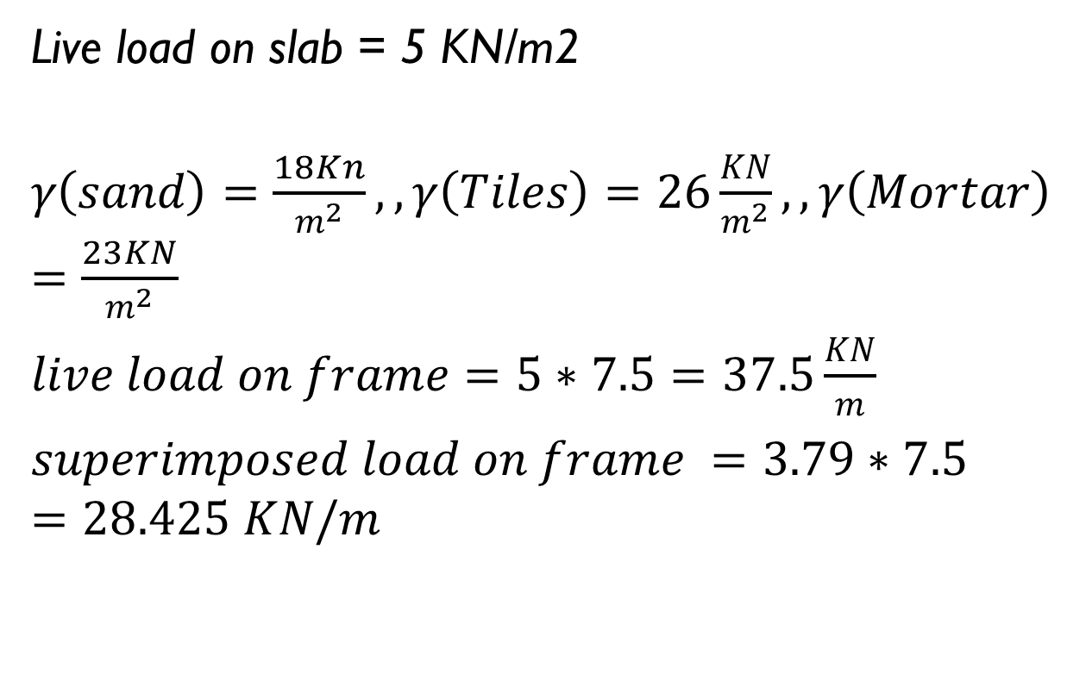
Preliminary Design
Live load on slab = 5 KN/m2
$γ\left(sand\right)=\frac{18Kn}{m^{2}},,γ\left(Tiles\right)=26\frac{KN}{m^{2}},, γ\left(Mortar\right)=\frac{23KN}{m^{2}}$
$live load on frame=5∗7.5=37.5\frac{KN}{m}$
$superimposed load on frame =3.79∗7.5=28.425 KN/m$

Slide 20
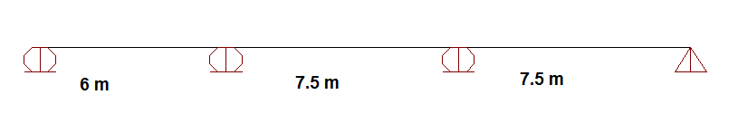
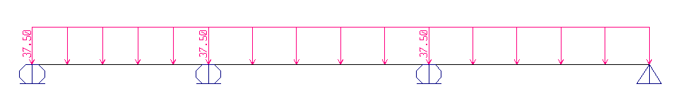
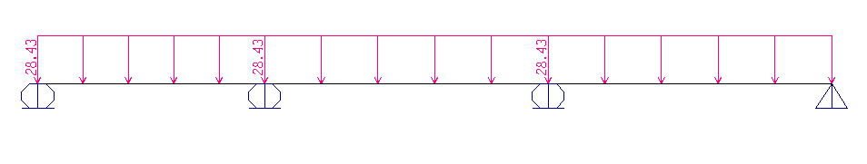
Preliminary Design

Slide 21
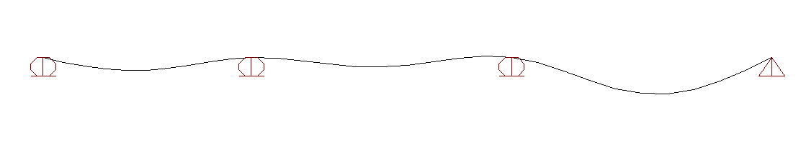
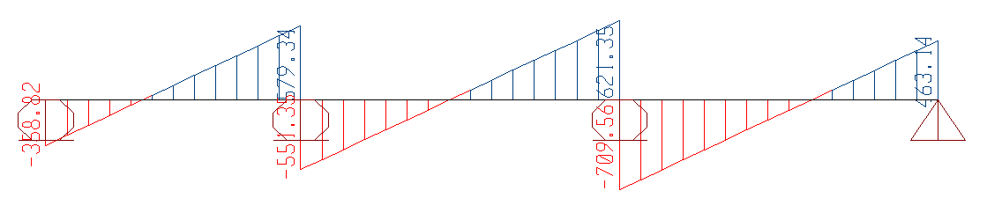
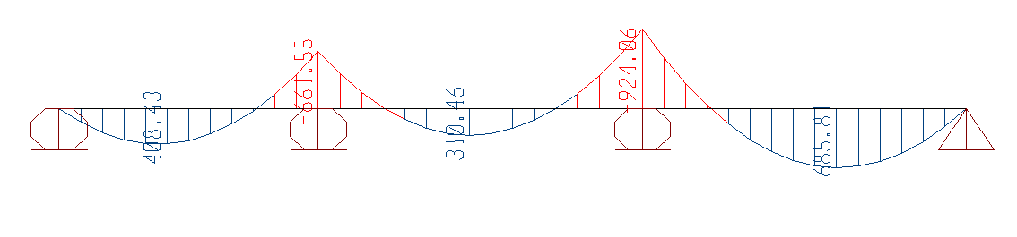
Preliminary Design

Slide 22
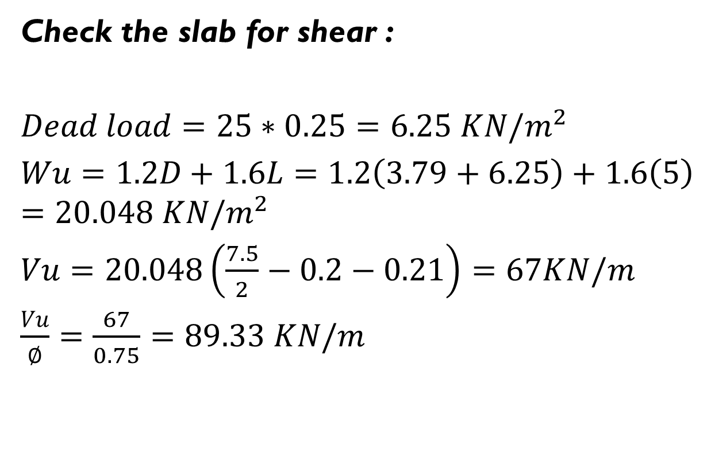
Preliminary Design
Check the slab for shear :
$Dead load=25∗0.25=6.25 KN/m^{2}$
$Wu=1.2D+1.6L=1.2\left(3.79+6.25\right)+1.6\left(5\right)=20.048 KN/m^{2}$
$Vu=20.048\left(\frac{7.5}{2}−0.2−0.21\right)=67KN/m$
$\frac{Vu}{∅}=\frac{67}{0.75}=89.33 KN/m$

Slide 23

Preliminary Design
$Vc=\frac{1}{6}∗\sqrt{f}`c∗bw∗d=\frac{\frac{1}{6}∗\sqrt{24}∗1000∗210}{1000}=171.46\frac{KN}{m}$
$\frac{Vu}{∅}<Vc….. OK$

Slide 24
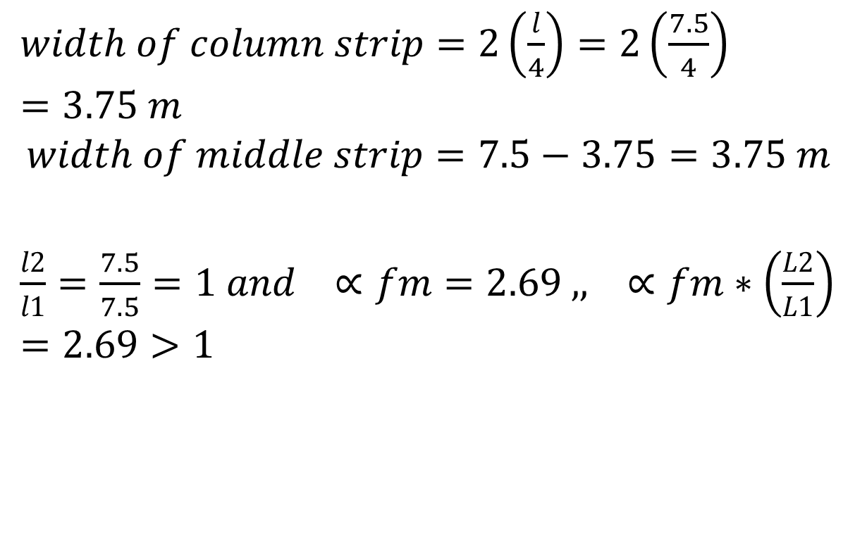
Preliminary Design
$width of column strip=2\left(\frac{l}{4}\right)=2\left(\frac{7.5}{4}\right)=3.75 m$
$$width of middle strip=7.5−3.75=3.75 m$$
$\frac{l2}{l1}=\frac{7.5}{7.5}=1 and ∝fm=2.69 ,, ∝fm∗\left(\frac{L2}{L1}\right)=2.69>1$

Slide 25
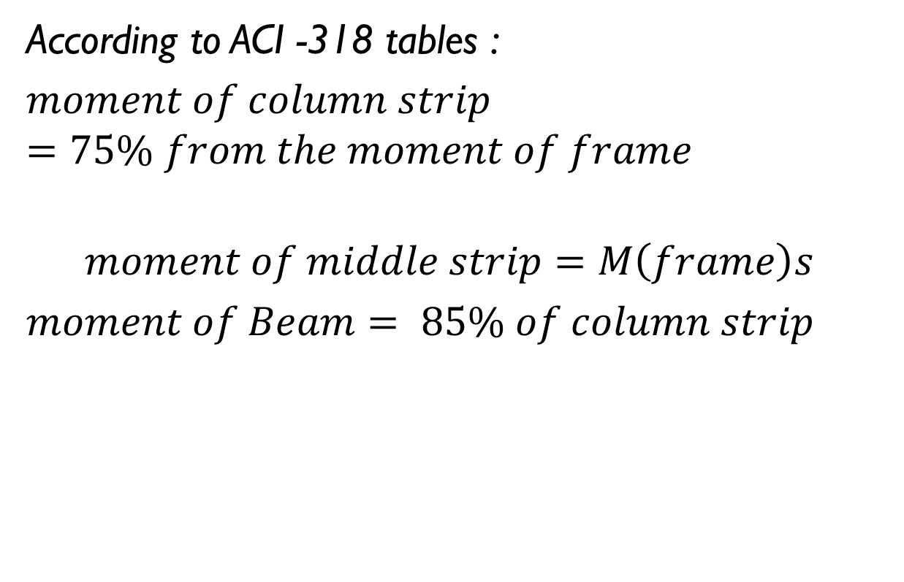
Preliminary Design
According to ACI -318 tables :
$moment of column strip=75\% from the moment of frame$
$$moment of middle strip=M\left(frame\right)s$$
$moment of Beam= 85\% of column strip$

Slide 26
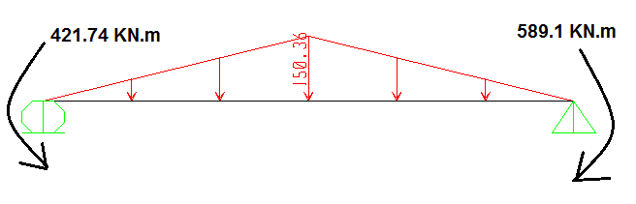
Preliminary Design
Design beam for shear
Own weight of beam =0.4*0.5*25*1.2 =6 KN/m.
Wu =7.5*20.048 =150.36 KN/m.

Slide 27
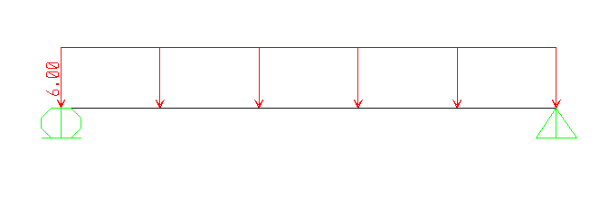
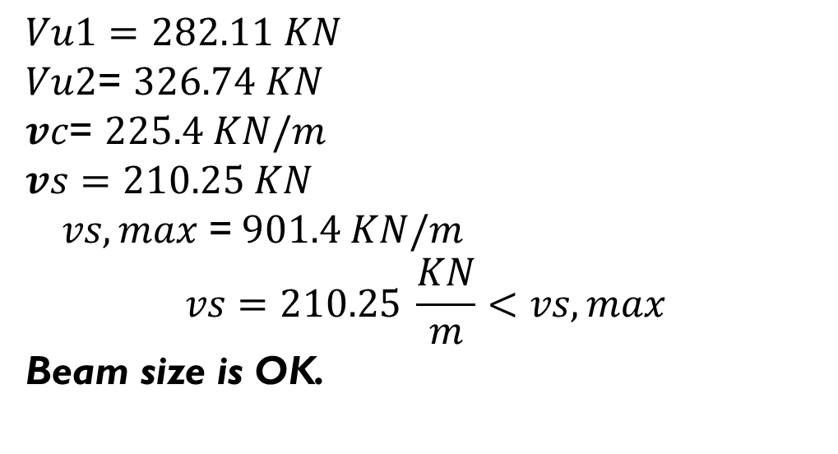
Preliminary Design
$Vu1=$ $282.11 KN$
$Vu2$= $326.74 KN$
$vc$= $225.4 KN/m$
$vs=$ $210.25 KN$
$vs,max$ =$901.4 KN/m$
$$vs=210.25 \frac{KN}{m}<vs,max$$
Beam size is OK.

Slide 28
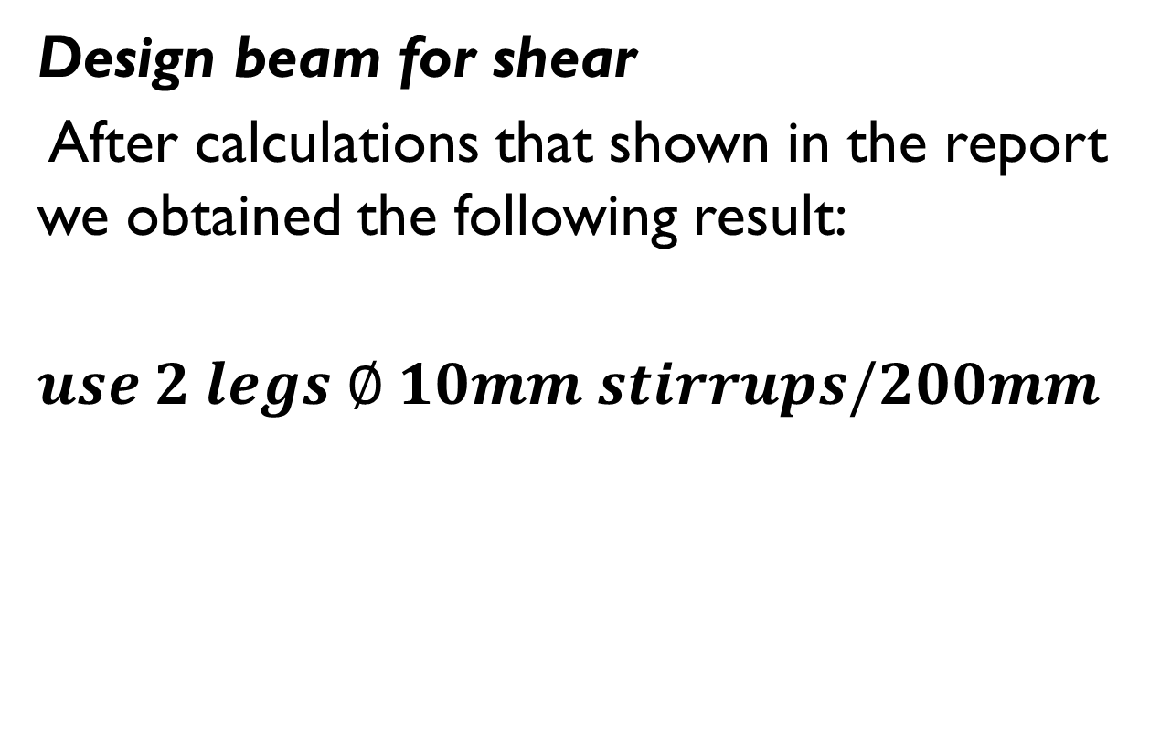
Preliminary Design
Design beam for shear
After calculations that shown in the report we obtained the following result:
$use 2 legs ∅ 10mm stirrups/200mm$

Slide 29
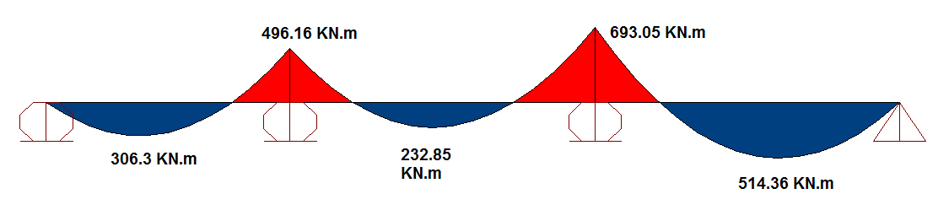
Preliminary Design
Column strip

Slide 30
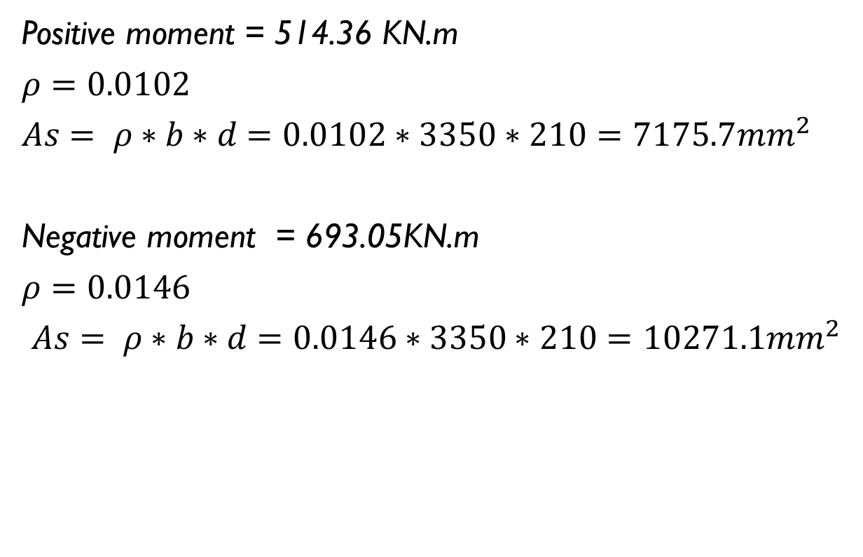
Preliminary Design
Positive moment = 514.36 KN.m
$ρ=0.0102$
$As= ρ∗b∗d=0.0102∗3350∗210=7175.7mm^{2}$
Negative moment = 693.05KN.m
$ρ=0.0146$
$As= ρ∗b∗d=0.0146∗3350∗210=10271.1mm^{2}$

Slide 31

Preliminary Design
$As= ρ∗b∗d=0.00384∗3750∗210=3024 mm^{2}$
Top steel : $13∅32$
Bottom steel : $19∅22$

Slide 32
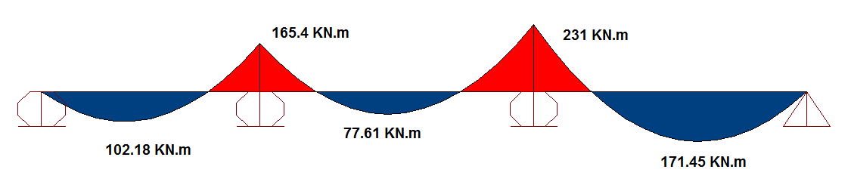
Preliminary Design
Middle Strip

Slide 33
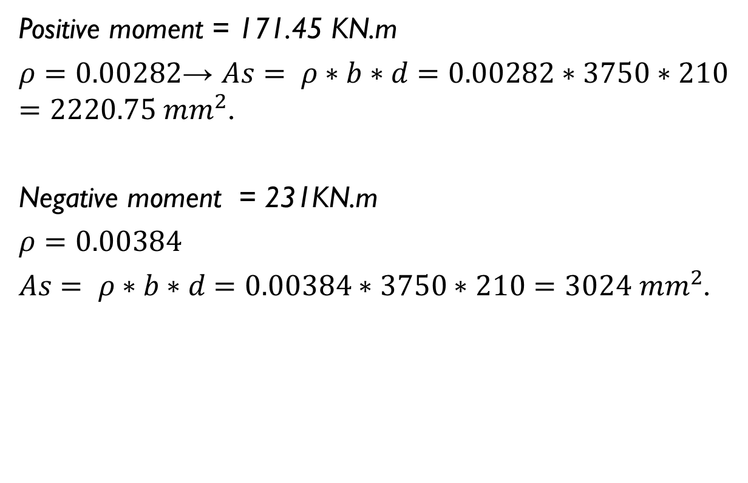
Preliminary Design
Positive moment = 171.45 KN.m
$ρ=0.00282$→ $As= ρ∗b∗d=0.00282∗3750∗210=2220.75 mm^{2}$.
Negative moment = 231KN.m
$ρ=0.00384$
$As= ρ∗b∗d=0.00384∗3750∗210=3024 mm^{2}$.

Slide 34
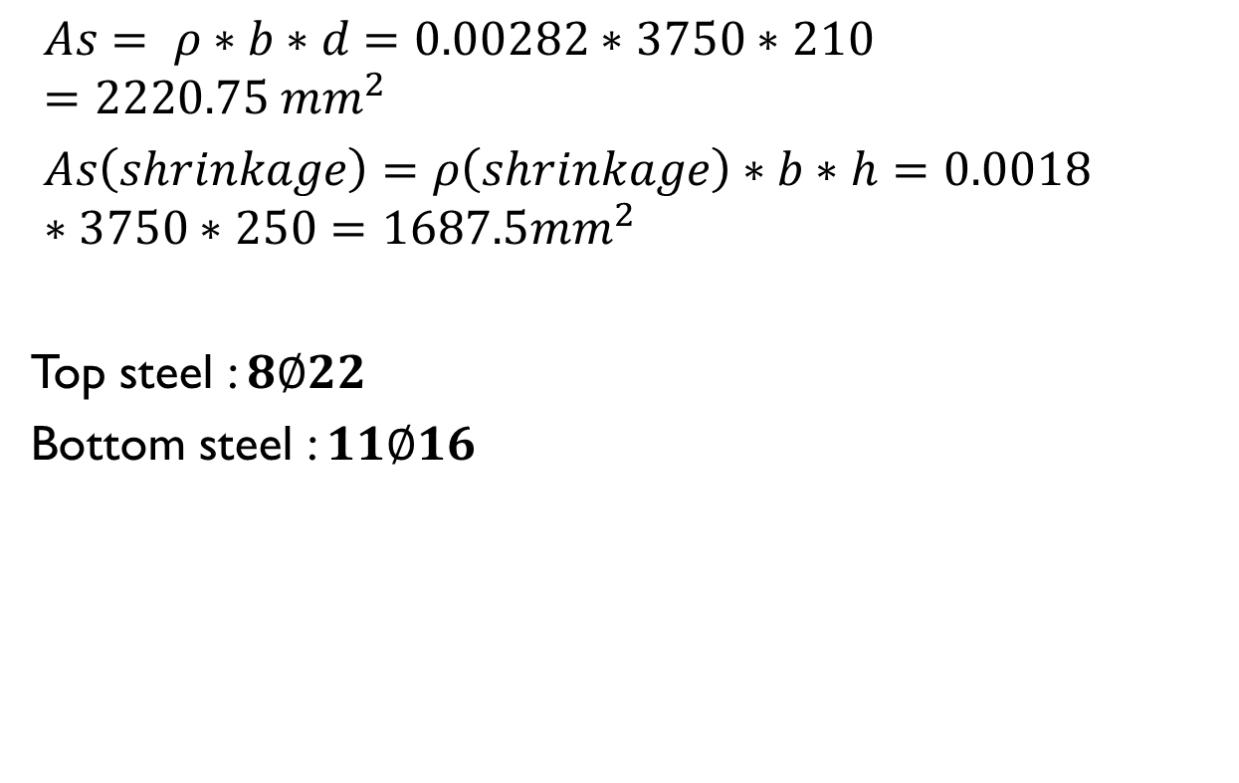
Preliminary Design
$As= ρ∗b∗d=0.00282∗3750∗210=2220.75 mm^{2}$
$As\left(shrinkage\right)=ρ\left(shrinkage\right)∗b∗h=0.0018∗3750∗250=1687.5mm^{2}$
Top steel : $8∅22$
Bottom steel : $11∅16$

Slide 35

Preliminary Design
Moment of Beam

Slide 36
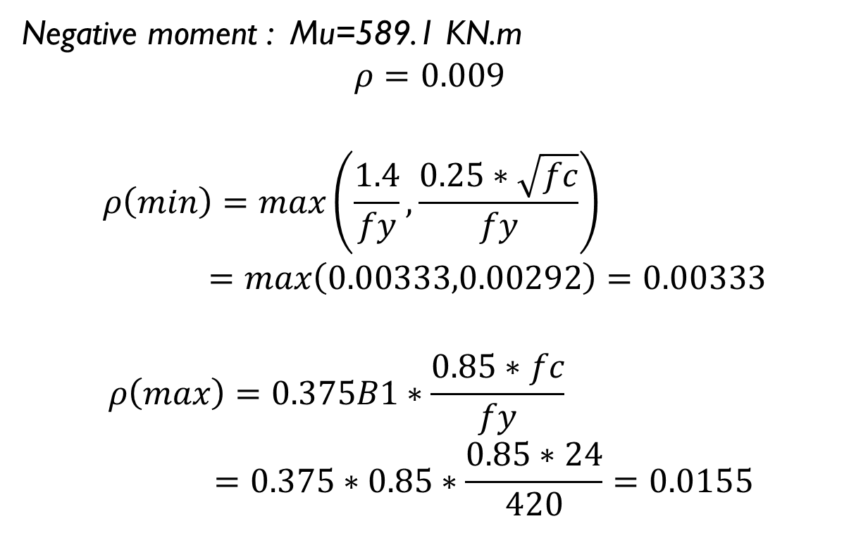
Preliminary Design
Negative moment : Mu=589.1 KN.m
$$ρ=0.009$$
$$ρ\left(min\right)=\max\left(\frac{1.4}{fy}, \frac{0.25∗\sqrt{fc}}{fy}\right)=\max\left(0.00333,0.00292\right)=0.00333$$
$$ρ\left(max\right)=0.375B1∗\frac{0.85∗fc}{fy}=0.375∗0.85∗\frac{0.85∗24}{420}=0.0155$$

Slide 37
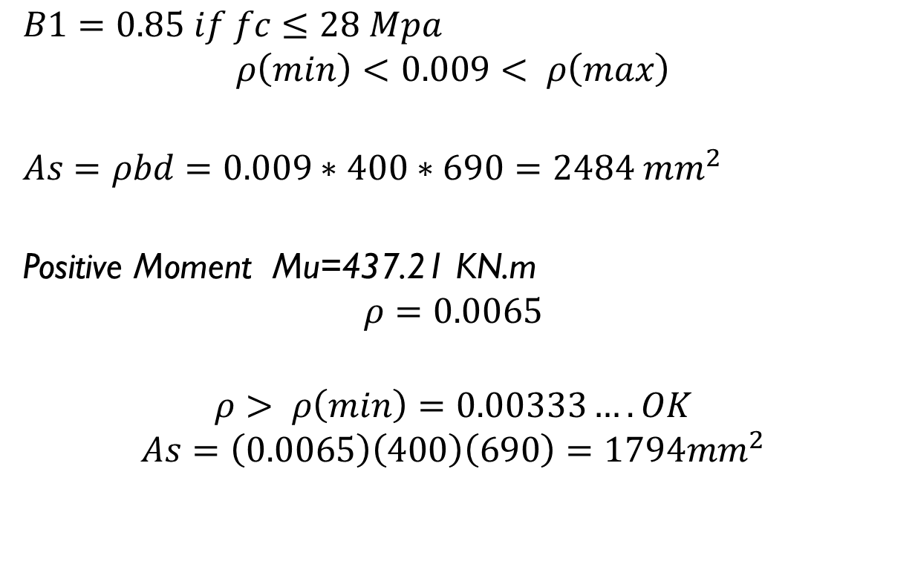
Preliminary Design
$B1=0.85 if fc≤28 Mpa$
$$ρ\left(min\right)<0.009< ρ\left(max\right)$$
$As=ρbd=0.009∗400∗690=2484 mm^{2}$
Positive Moment Mu=437.21 KN.m
$$ρ=0.0065$$
$$ρ> ρ\left(min\right)=0.00333…. OK$$
$$As=\left(0.0065\right)\left(400\right)\left(690\right)=1794mm^{2}$$

Slide 38

Preliminary Design
Top Steel : $5∅25$
Bottom Steel : $6∅20$

Slide 39
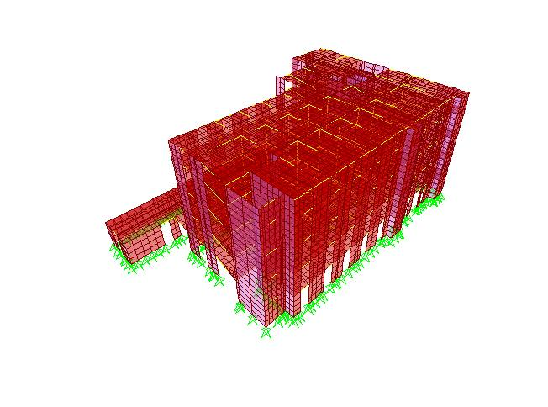
3-D Model Analysis
Block A

Slide 40
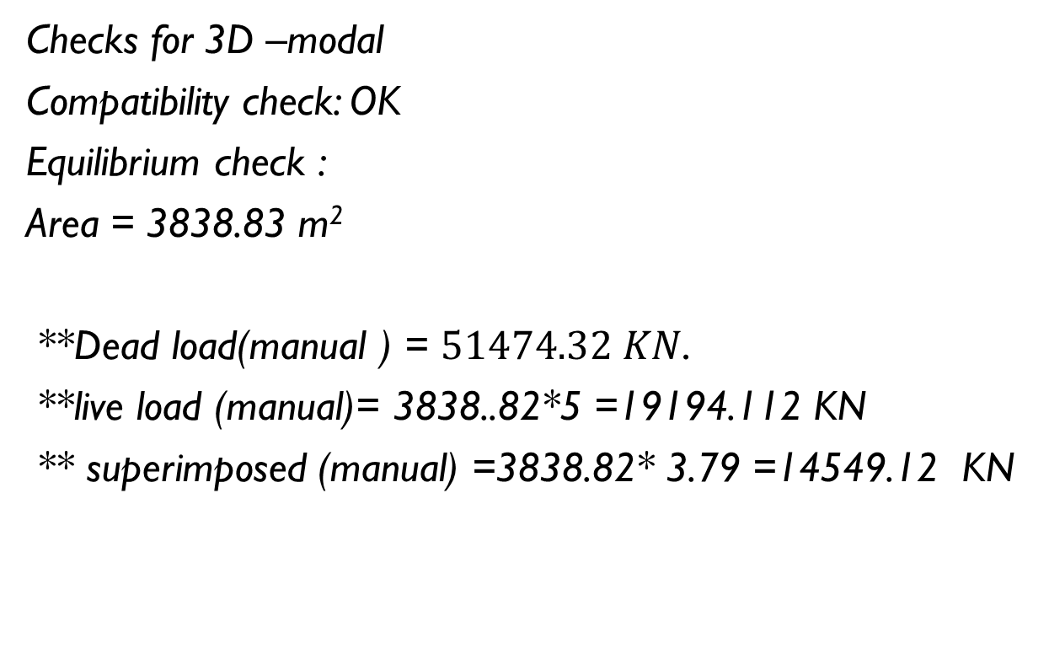
3-D Model Analysis
Checks for 3D –modal
Compatibility check: OK
Equilibrium check :
Area = 3838.83 m²
**Dead load(manual ) = $51474.32 KN$.
**live load (manual)= 3838..82*5 =19194.112 KN
** superimposed (manual) =3838.82* 3.79 =14549.12 KN

Slide 41
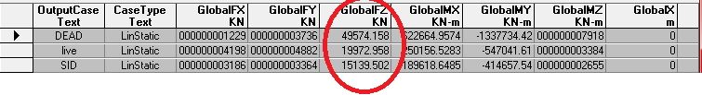
3-D Model Analysis
Loads from SAP

Slide 42
3-D Model Analysis
%of error (Dead load) =3.69 % < 5% OK
%of error (live load) = 4 % OK
%of error (superimposed) =4 % OK

Slide 43
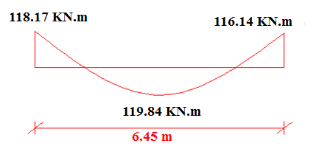

3-D Model Analysis
Stress – strain relationships :
Mu(manual) = $\frac{Wu∗{Ln}^{2}}{8}=221.26KN.m$.
:** Mu ( From SAP)
$$Mu\left(SAP\right)=\frac{118.17+116.14}{2}+119.84 =236.99 KN.m$$
% of error =7.11 % < 10% OK

Slide 44
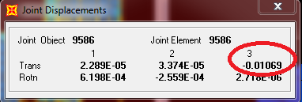

3-D Model Analysis
Deflection check:
** from live load
$$\max{deflection \left(live\right)=\frac{L}{360} =\frac{7.5}{360}=0.021m=21mm}$$
From SAP :
Deflection from live load = 10.69 mm < 21 mm→ OK

Slide 45
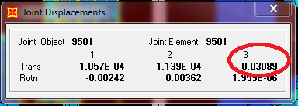

3-D Model Analysis
from service load(Dead + Live)
$$\max{deflection=\frac{l}{240}=\frac{7.5}{240}=0.03125 m=31.25 mm}$$
Deflection from SAP :
Deflection from service load = 30.89 mm < 31.25 mm OK

Slide 46

3-D Model Analysis
Period :
T= 0.326 sec < 2 sec OK.

Slide 47
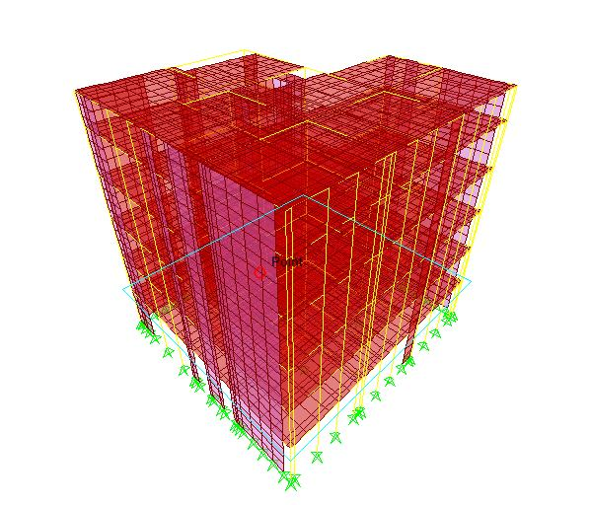
3-D Model Analysis
Block B(part 1) :

Slide 48
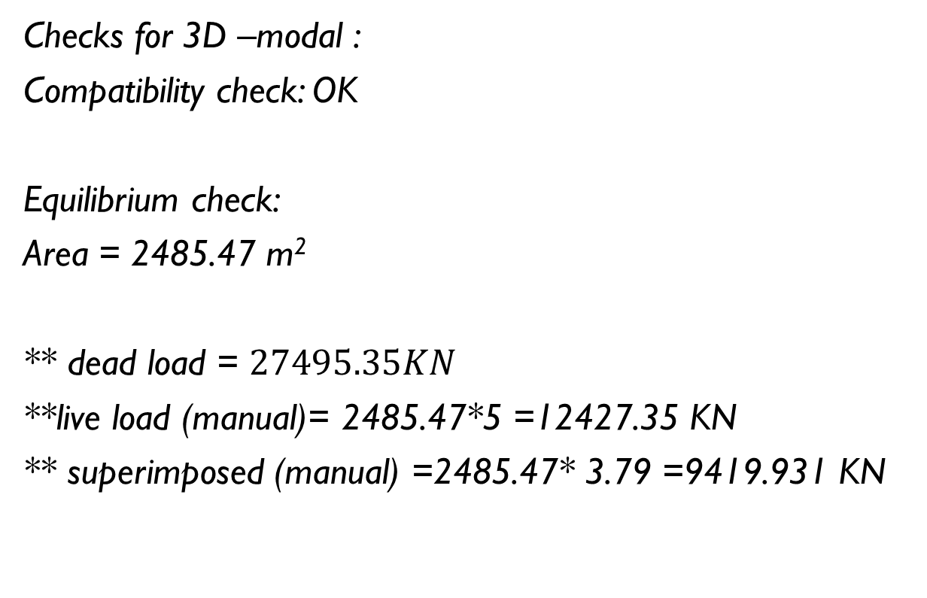
3-D Model Analysis
Checks for 3D –modal :
Compatibility check: OK
Equilibrium check:
Area = 2485.47 m²
** dead load = $27495.35KN$
**live load (manual)= 2485.47*5 =12427.35 KN
** superimposed (manual) =2485.47* 3.79 =9419.931 KN

Slide 49
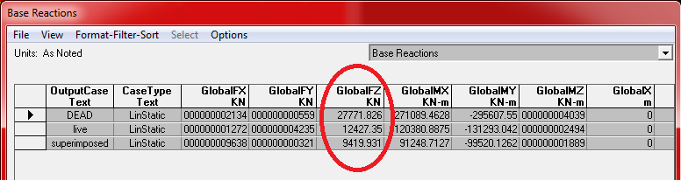
3-D Model Analysis
Loads From SAP :

Slide 50
3-D Model Analysis
%of error (Dead load) =1% < 5% OK
%of error (live load) = 0% OK
%of error (superimposed) =0% OK

Slide 51
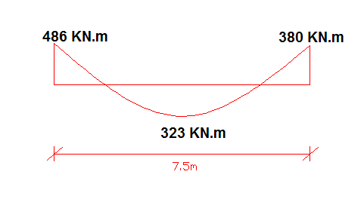
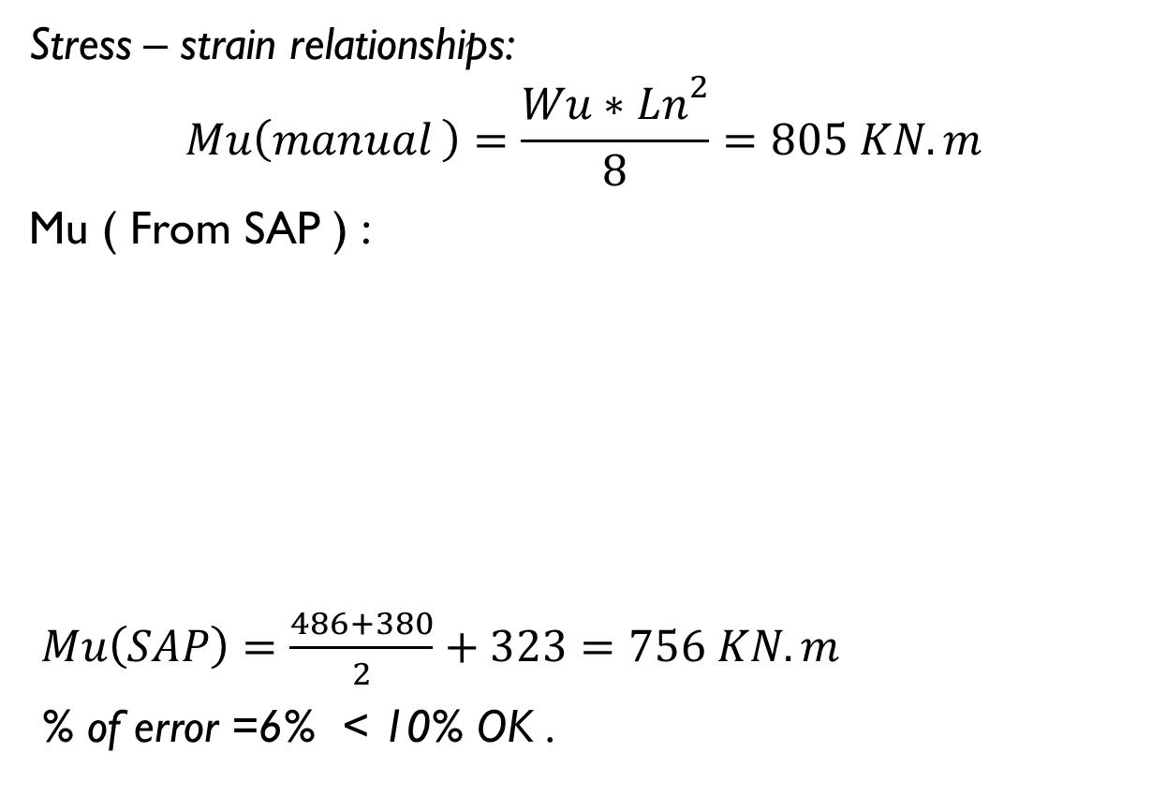
3-D Model Analysis
Stress – strain relationships:
$$Mu\left(manual \right)=\frac{Wu∗{Ln}^{2}}{8}=805 KN.m$$
Mu ( From SAP ) :
$Mu\left(SAP\right)=\frac{486+380}{2}+323=756 KN.m$
% of error =6% < 10% OK .

Slide 52
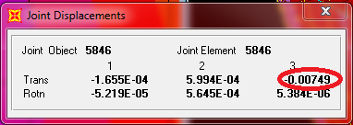

3-D Model Analysis
Deflection check
** from live load :
$\max{deflection \left(live\right)=\frac{L}{360} =\frac{7.5}{360}=0.021m=21mm}$ .
Deflection from SAP :
Deflection from live load = 7.5mm < 21 mm OK

Slide 53
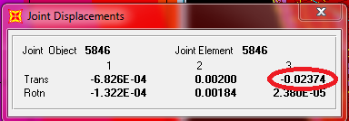

3-D Model Analysis
** from service load(Dead + Live)
$\max{deflection=\frac{l}{240}=\frac{7.5}{240}=0.03125 m=31.25 mm}$ .
From SAP :
Deflection from service load = 23.74 mm < 31.25 mm OK

Slide 54

3-D Model Analysis
Period :
T = 0.745 sec < 2 sec OK.

Slide 55

3-D Model Analysis
Block B(part 2):

Slide 56

3-D Model Analysis
Block C :

Slide 57

3-D Model Analysis
Checks for 3D –modal :
Compatibility check → OK
Equilibrium check :
Area =5793.17 m²
** Dead load ( Manual ) = $87534.26 KN$.
** Live load (manual)= 5793.17*5 =28965.9 KN
** Superimposed (manual) =5793.17* 3.79 =21956.1 KN

Slide 58

3-D Model Analysis
Loads From SAP :

Slide 59
3-D Model Analysis
%of error (Dead load) =4.5% < 5% OK
%of error (live load) = 5.3% OK
%of error (superimposed) =5.3% OK

Slide 60


3-D Model Analysis
Stress – strain relationships
Mu(manual) = $\frac{Wu∗{Ln}^{2}}{8}=156KN.m$
Mu (from SAP):
$Mu\left(SAP\right)=\frac{14+70}{2}+73 =145 KN.m$
% of error =7% < 10% OK .

Slide 61


3-D Model Analysis
Deflection check:
** from live load
$$\operatorname{Max}{deflection=\frac{L}{360} =\frac{8.1}{360}=0.023m=23 mm}$$
Deflection from SAP:
Deflection from live load =0.454 mm < 23 mm OK

Slide 62


3-D Model Analysis
from service load(Dead + Live) :
$$\max{deflection =\frac{l}{240}=\frac{8.1}{240}=0.0338 m=33.8 mm}$$
Deflection from SAP :
Deflection from service load =2.01 mm < 33.8 mm → OK .

Slide 63
3-D Model Analysis
Period :
T = 0.23203 sec < 2 sec OK .

Slide 64
Seismic loads
Seismic load will be calculated depending on UBC-97. According to the location of this project (Nablus), soil type (rock) and according to Palestine seismic map
For our project seismic zone is 2B thus the value of zone factor is (Z=0.2).

Slide 65

Seismic loads

Slide 66

Seismic loads
Determination of structure period (Block B):
$$T=ct∗{\left(hn\right)}^{\frac{3}{4}}$$
Ct = 0.0488
hn= 22.57 m
T= 0.505 sec.

Slide 67

Seismic loads
Determination of base shear :
$$V=\frac{Cv∗I}{R∗T}∗w$$
W= the total seismic dead load
I= the importance factor =1.25
R= the response modification =5.5
Cv = seismic coefficient = 0.2
$V=$ 0.09 w

Slide 68

Seismic loads
$$Vmax=\frac{2.5∗Ca∗I∗W}{R}=\frac{2.5∗0.2∗1.25∗W}{5.5}=0.114 W$$
$$Vmin=0.11∗Ca∗I∗w=0.11∗0.2∗1.25∗W=0.0275 W$$
Ca= seismic coefficient =0.2
0.0275 W< V < 0.114 W → OK

Slide 69

Seismic loads
Vertical component of seismic load:
$$E=ρ Eh+Ev$$
$ρ$ shall not be taken less than 1.0 and need not be greater than 1.5. When calculating drift, or when the structure is located in Seismic Zone 0,1 or 2, $ρ$ shall be taken equal to 1.
Eh= the earthquake load due to the base shear, v.
Ev= the load effect resulting from the vertical component of the earthquake ground motion and is equal to an addition of o.5CaID to the

Slide 70

Seismic loads
Response spectrum :

Slide 71

Seismic loads
Response spectrum:
R=5.5 ( Sway Intermediate )
$$scale factor=\frac{gI}{R}=\frac{\left(9.81\right)\left(1.25\right)}{5.5}=2.2295$$

Slide 72

Seismic loads
First we define function of earthquake (response spectrum UBC-97).

Slide 73

Seismic loads
Then we define load pattern .

Slide 74

Seismic loads
Then we define load cases :

Slide 75

Seismic loads

Slide 76
Columns Design
*Columns grouping (Block A):
Group number | Column number | Axial force range (KN)
1 | C1,C2,C4,C6,C7,C8,C9 | 100-600
2 | C3 | 600-1000
3 | C5,C15 | 1000-2000
4 | C11,C12,C13,C14,C18,C19,C21 | 2000-3000
5 | C10,C16,C17,C20 | 3000-5000

Slide 77

Columns Design
check buckling
slenderness effects shall be permitted to be neglected in the following cases:
For compression members not braced against sideway when:
$\frac{Klu}{r} ≤22$
For compression members braced against sideway when:
$\frac{Klu}{r} ≤34−12\left(\frac{M1}{M2}\right)$

Slide 78

Columns Design
In this structure, columns are braced then the second equation will be used
K= 0.57, using figure (R10.10.1.1) in ACI-318-11
Lu: Unbaked length of the column = 4
r= Radius of gyration for cross section of column.
$r=\sqrt{\frac{I}{A}}=0.1732$

Slide 79

Columns Design
M₁: the smaller design end moment on the column.
M₁= 0.7469 KN.m
M₂: the larger design end moment on the column.
M₂ = 8.6233 KN.m
$\frac{0.57∗4}{0.1732} <(34−12\left(\frac{0.7469}{8.6233}\right)$
$13.164<32.96$ → the column is short and slenderness can be neglected.

Slide 80

Columns Design
Column number 5 from group 3 (in Block A) will be taken as a sample
For computing gross area of the column, assume → $Pu=∅ Pn$
Where Pu = 1573.689 KN
$$∅Pn= ∅λ(0.85f^{′}c\left(Ag−As\right)+As\left(fy\right))$$
As: Area of steel in column, (As=ρ Ag)→ assuming ρ=0.01 then As=0.01 Ag

Slide 81

Columns Design
$$∅Pn=0.65∗0.8\left(0.85∗28∗\left(0.99Ag\right)+0.01Ag\left(420\right)\right)=1979∗{10}^{3}$$
$14.44 Ag=1573.689∗{10}^{3}$
$Ag=108981.232mm^{2}$ → (330*330)mm
Column dimensions are (400*400)mm
As=0.01* Ag =0.01*(400*400)= 1600mm²
Use 8$∅$16

Slide 82

Columns Design
For stirrups, using stirrups with $∅10$ diameter
$$spacing=min\left\{\begin{aligned}16 db \\ 48∗ds \\ b\end{aligned}\right\}=min\left\{\begin{aligned}16∗16=256mm \\ 48∗10=480mm \\ 450mm\end{aligned}\right\}$$
$=288mm$
Use (1$∅$10/ 200mm).

Slide 83

Columns Design
Block A
Group# | Critical column # | Pn (KN) | Ag (mm²) | Dimension (mm) | As (mm²) | Reinforcement | Ties (mm)
1 | C2 | 547 | 37851 | (300*300) | 900 | 8$∅$12 | 1$∅$10/ 200
2 | C3 | 821 | 56825 | (350*350) | 1225 | 8$∅$14 | 1$∅$10/ 200
3 | C5 | 1574 | 108981 | (400*400) | 1600 | 8$∅$16 | 1$∅$10/ 200
4 | C14 | 2968 | 205523 | (500*500) | 2500 | 8$∅$20 | 1$∅$10/ 200
5 | C16 | 4333 | 300053 | (550*550) | 3025 | 12$∅$18 | 1$∅$10/ 200

Slide 84

Columns Design
Block B (part 1).
Group# | Critical column # | Pn (KN) | Ag (mm²) | Dimension (mm) | As (mm²) | Reinforcement | Ties (mm)
1 | C31 | 599 | 41482 | (300*300) | 900 | 8$∅$12 | 1$∅$10/ 200
2 | C13 | 943 | 65305 | (350*350) | 1225 | 8$∅$14 | 1$∅$10/ 200
3 | C12 | 1979 | 137050 | (400*400) | 2025 | 8$∅$16 | 1$∅$10/ 200
4 | C11 | 3044 | 210803 | (500*500) | 2500 | 8$∅$20 | 1$∅$10/ 200
5 | C15 | 6219 | 430679 | (700*700) | 4900 | 16$∅$20 | 1$∅$10/ 200

Slide 85

Columns Design
Block B (part 2)
Group # | Critical column # | Pn (KN) | Ag (mm²) | Dimension (mm) | As (mm²) | Reinforcement | Ties (mm)
1 | C12 | 483 | 33449 | (300*300) | 900 | 8$∅$12 | 1$∅$10/ 200
2 | C24 | 943 | 65305 | (350*350) | 1225 | 8$∅$14 | 1$∅$10/ 200
3 | C14 | 2125 | 147161 | (400*400) | 2025 | 8$∅$16 | 1$∅$10/ 200
4 | C16 | 4431 | 306856 | (600*600) | 3600 | 12$∅$20 | 1$∅$10/ 200
5 | C15 | 7660 | 530471 | (750*750) | 5625 | 12$∅$25 | 1$∅$10/ 200

Slide 86

Columns Design
Block C
Group# | Critical column # | Pn (KN) | Ag (mm²) | Dimension (mm) | As (mm²) | Reinforcement | Ties (mm)
1 | C65 | 784 | 54308 | (300*300) | 900 | 6$∅$14 | 1$∅$10/ 200
2 | C47 | 948 | 65668 | (350*350) | 1225 | 8$∅$14 | 1$∅$10/ 200
3 | C28 | 1426 | 98779.2 | (400*400) | 1600 | 8$∅$16 | 1$∅$10/ 200
4 | C54 | 1976 | 136878 | (450*450) | 2025 | 8$∅$18 | 1$∅$10/ 200
5 | C14 | 2040 | 141312 | (450*450) | 2025 | 8$∅$18 | 1$∅$10/ 200

Slide 87

Foundation Design
In our project we used two type of footing:
Single footing
Strip footing
The combinations that we used to calculate service load on footing :

Slide 88
Foundation Design
footing grouping
The footings were classified as groups according to the range of the axial loads. As a result, the same groups of the columns were adopted.

Slide 89

Foundation Design
footing design (Single footing):
Block C
Footing dimension
$A=\frac{Pservice}{qall}=\frac{1140}{400}=2.85 m^{2}$
Use square footing then $L=B=\sqrt{A}=1.7 m$
Use L=B=1.7m

Slide 90

Foundation Design
Calculate (d) depending on wide beam shear.
Pu= 1470 KN.
$qu=\frac{Pu}{A}=\frac{1470}{{1.7}^{2}}=509 KN/m^{2}$
$Vu=qu\left(\frac{l−c1}{2}−d\right)=509\left(\frac{1.7−0.4}{2}−d\right)$
$Vu=331−509 d$
$∅Vc=∅\frac{1}{6} λ \sqrt{f^{′}c} bw d=$
$∅Vc=0.75∗\frac{1}{6}∗1∗\sqrt{28}∗\left(1000\right)∗\frac{d∗1000}{1000}=661.44d$

Slide 91

Foundation Design
Then $Vu= ∅Vc$
$331−509d=661.44d$
d=0.3 m
check punching shear:
$Vupunching=Pu−qu{\left(c+d\right)}^{2}=1221 KN$
$∅Vc,p= ∅∗0.33∗\sqrt{f^{′}c}∗bo∗d$
$bo=4∗1000\left(c+d\right)=4∗1000\left(0.4+0.3\right)=2800$

Slide 92

Foundation Design
$∅Vc,p=\frac{\left(0.75\right)∗\left(0.33\right)∗\sqrt{28}∗\left(2800\right)∗300}{1000}=1100.1 KN$
→$∅Vc=1100.1 KN<Vu,punching$
Use h=500 mm →d=430 mm
$Vu,punching=1119.4 KN$
$∅Vc,p=1870KN$
$∅Vc,p>Vu,punching$
Then use h=500 mm

Slide 93

Foundation Design
Sap2000 analysis
*Deflection:

Slide 94


Foundation Design
*Bearing capacity:
$σ=\frac{reaction}{mesh area}=\frac{18.474}{0.0625}=296 KN/m^{2}$
$σ is less than 400 KN/m^{2}$ →OK

Slide 95

Foundation Design
*Check wide beam shear:

Slide 96

Foundation Design
Vu =279.9 KN (for total width of footing= 1.7 m).
$Vu\left(for 1m of footing\right)=\frac{shear}{width of footing}=\frac{279.9}{1.7}=164.7 KN/m$
$∅Vc= ∅\frac{1}{6}\sqrt{f^{′}c} bw d$
$∅Vc=0.75∗\frac{1}{6}∗\sqrt{28}∗1000∗\frac{430}{1000}=284.42 KN$
$Vu< ∅Vc$ → OK

Slide 97

Foundation Design
Check punching shear
$∅Vc,p=∅∗0.33∗\sqrt{f^{′}c}∗bo∗d$
$bo=4∗1000∗\left(c+d\right)=4∗1000∗\left(0.4+0.43\right)=3320mm$
$∅Vc,p=\frac{0.75∗0.33∗\sqrt{28}∗3320∗430}{1000}=1870KN$.

Slide 98

Foundation Design
From SAP :
$Vu=average value∗bo$
$bo=4∗\left(C+d\right)=4∗\left(0.4+0.43\right)=3.32 m$
$Vu=\left(496∗3.32\right)=1646.72 KN$
As $Vu<∅Vc,p$ , punching shear is OK.

Slide 99

Foundation Design
Flexural design :

Slide 100

Foundation Design
Bottom steel
Mu=182.1 KN.m
$ρ=\frac{0.85∗f`c}{fy}∗\left(1− \sqrt{1−\frac{2.61∗Mu}{b∗d^{2}∗f`c}}\right)$
$ρ=0.00267$
$As=ρbd=\left(0.00267∗1000∗430\right)=1146 mm^{2}$
$As\min\left(shrinkage steel\right)=0.0018bh=\left(0.0018\right)∗\left(1000\right)∗\left(500\right)=900mm^{2}$

Slide 101

Foundation Design
Use As= 1146 mm²
Use $1∅14/200mm$
$Number of bars in 1.7m=\frac{1.7}{0.2}=9 bar$
Top steel
Use half of the shrinkage steel in each direction
$As=0.5∗900=450 mm^{2}$
$Use 1∅12/200mm$ in each direction .

Slide 102

Foundation Design
Check development length:
$Ld=\frac{1.7−0.4}{1.7}−side cover \left(0.07\right)=0.7 m$
$Ldt=\frac{0.48∗fy}{\sqrt{f^{′}c}} db for db<20mm$
$Ldt=\frac{0.59∗fy}{\sqrt{f^{′}c}} db for db≥20mm$
$∅=14 mm$ → $Ldt=\frac{0.48∗420}{\sqrt{28}}∗14=533.4 mm$
$Ld>Ldt$ → No need to have hook

Slide 103
Foundation Design
Block A:
Number Of footing | Reinforcement |  | Dimensions
 | Shrinkage steel (top steel) | main steel (bottom steel) | depth(m) | width(m) | length(m) | foundation
7 | 1Ø12/200mm | 1Ø12/150 mm | 0.3 | 1 | 1 | F1
1 | 1Ø12/200 mm | 1Ø12/150 mm | 0.4 | 1.35 | 1.35 | F2
2 | 1Ø12/200mm | 1Ø14/150 mm | 0.5 | 2 | 2 | F3
7 | 1Ø12/200mm | 1Ø18/200 mm | 0.6 | 2.45 | 2.45 | F4
4 | 1Ø12/200 mm | 1Ø18/200 mm | 0.6 | 1.5 | 1.5 | F5

Slide 104
Foundation Design
Block B (part 1):
Number of footings | reinforcement |  | Dimensions
 | shrinkage steel (top steel) | main steel (bottom steel) | depth(m) | width(m) | length(m) | foundation
4 | 1Ø12/200 mm | 1Ø12/200 mm | 0.3 | 1 | 1 | F1
2 | 1Ø12/200 mm | 1Ø12/150mm | 0.35 | 1.35 | 1.35 | F2
1 | 1Ø12/200mm | 1Ø14/150 mm | 0.5 | 2 | 2 | F3
4 | 1Ø12/200mm | 1Ø16/150 mm | 0.6 | 2.45 | 2.45 | F4
2 | 1Ø12/150 mm | 1Ø20/150 mm | 0.8 | 3.45 | 3.45 | F5
4 | in x:1Ø16/150mm | in x:1Ø18/150mm | 0.7 | 1.6 | 2 | F6
 | in Y:1Ø12/150mm | in Y:1Ø14/150mm

Slide 105
Foundation Design
Block B (part 2):
Number of footings | reinforcement |  | Dimensions
 | shrinkage steel (top steel) | main steel (bottom steel) | depth(m) | width(m) | length(m) | foundation
4 | 1Ø12/200 mm | 1Ø12/200 mm | 0.25 | 1 | 1 | F1
3 | 1Ø12/200 mm | 1Ø12/150mm | 0.35 | 1.4 | 1.4 | F2
4 | 1Ø12/200mm | 1Ø14/150 mm | 0.5 | 1.8 | 1.8 | F3
4 | 1Ø12/150mm | 1Ø18/150 mm | 0.7 | 2.95 | 2.95 | F4
2 | 1Ø14/150 mm | 1Ø20/150mm | 0.9 | 3.85 | 3.85 | F5
6 | in x:1Ø12/150mm | in x:1Ø18/150mm | 0.7 | 1.6 | 2 | F6
 | in Y:1Ø14/150mm | in Y:1Ø14/150mm

Slide 106
Foundation Design
Block C
Number of footing | reinforcement |  | Dimensions
 | shrinkage steel (top steel) | main steel (Bottom steel) | depth(m) | width(m) | length(m) | foundation
7 | 1Ø12/200 mm | 1Ø14/200 mm | 0.5 | 1.4 | 1.4 | F1
8 | 1Ø12/200 mm | 1Ø14/200 mm | 0.5 | 1.5 | 1.5 | F2
9 | 1Ø12/200mm | 1Ø14/200 mm | 0.5 | 1.7 | 1.7 | F3
10 | 1Ø12/200mm | 1Ø14/200 mm | 0.6 | 2 | 2 | F4
10 | 1Ø12/200 mm | 1Ø14/200 mm | 0.6 | 2 | 2 | F5

