Slide 1

Joint Venture in construction company
in West Bank

Slide 2
Outline :
Objectives
Introduction
Research methodology
Data collection and analysis
Discussion
Conclusion
Recommendation

Slide 3
Objectives
The main objectives of this project are:
make useful guidelines for the contractors to know how to take joint venture decision,
determine risk factor and success factor
and investigate benefits of JV.
between contractors
minimize the risk and conflict between the parties,

Slide 4
Introduction
Construction industry is one of the most common and important industries in Palestine as in all of the world, the construction project become more large and complex due to development of the world, from here appear the idea of joint ventures in order to share the risk and benefits of the complex and large projects between different companies which form the joint venture.

Slide 5
A joint venture is a speculation for profit in which the risks and rewards are shared by two or more Companies which have formed in association to combine their expertise, capital, property, skills and knowledge in order to execute a specific project.

Slide 6
Research methodology
Recommendation
Conclusion
4
Discussion
3
Data collection and analysis
2
1

Slide 7
Data collection
We collected data by questionnaire and interviews with contractors and companies and these data will be analyzed to rank the success factor and risk factor and discover what has the most impact on the project and who is responsible on each factor.
The sample was 63 contracting companies in Jenin and Ramallah in all classification and in all sectors.
About 60% of these companies responded to the questionnaire and gave information about their experience in joint venture; the other companies did not provide us any information.

Slide 8
questionnaire
The questionnaires contain two parts, the first part is about the experience of the company in joint venture, and the second part contains the factors that affect in joint venture project. scale will be used from (1 to 10) to determine which factor is responsible for, number 1 means not important and number 10 means extremely important.
Questionnaire link

Slide 9
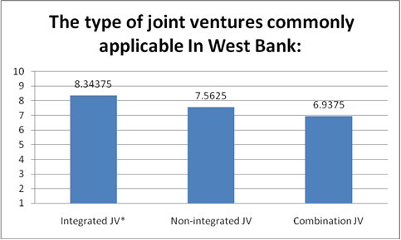
Data analysis

Slide 10
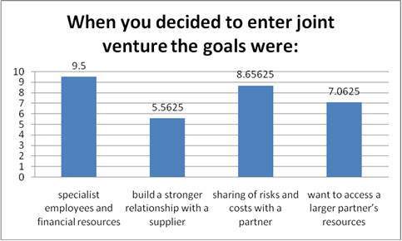

Slide 11
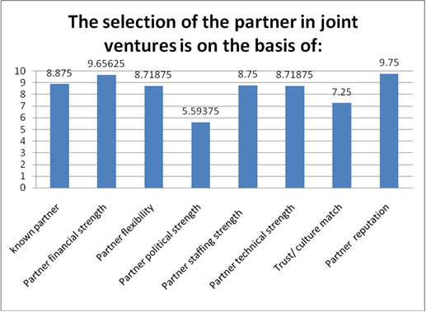

Slide 12
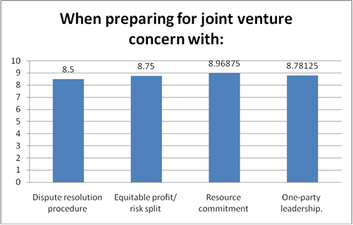

Slide 13
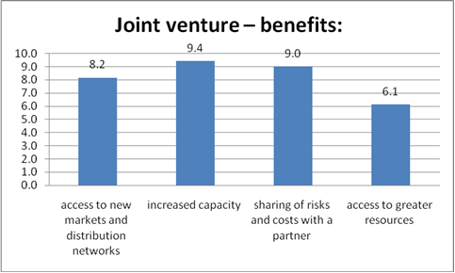

Slide 14
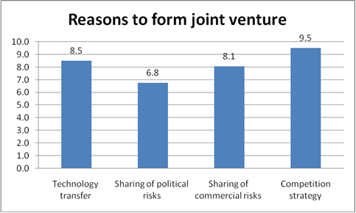

Slide 15
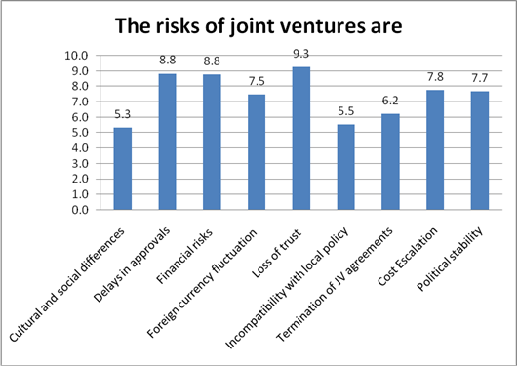

Slide 16
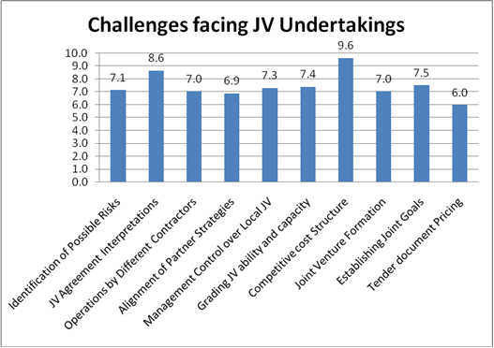

Slide 17
Discussion
Joint Venture in West Bank has different opinions where some contractors encourage entering into joint venture because J.V. can help the companies to overcome the risk in different market, large project and new project.
But there is another part of contractors do not prefer J.V. and says “We can use prime/ sub arrangement if the project is large, because it make a better line of communication and clear responsibility statement”.

Slide 18
when the companies decide to enter joint venture they choose the partner primary according to:
financial strength
reputation
and the contractor must confirm that the partner is committed to (and is capable of) bringing the required financial and technical strengths to the project will ensure that the reasons for joint venturing are not in vain.

Slide 19
The formation process of joint venture is complex, as are the projects that cause the formation. The result is the need for a flexible, and a lot of hard work to keep the partnership together.
One of the respondents from its past experience in the JV project says “due to the current status of West Bank I do not prefer to enter in JV. Arrangement since there are some problems can appear at the end of projects such as Income tax, value added tax and tax recovery.

Slide 20
Conclusion
The joint ventures between construction companies is very important to overcome problems facing the contractors such as inadequate work opportunities, weak financial capability, lack of equipment and lack of management skills. The usual purpose of joint venture is to share risk in large projects and to pool resources in a way that permits to execute a project.
In the planning for a joint venture arrangement, it is important to consider all important factors in order to deliver a project successfully.
Result table link

Slide 21
Recommendation
From the conclusion there are important risky and challenger factors facing joint venture arrangement, there is no specific method to overcome this factors, but good management and experience will lead to avoiding these problems as much as possible, some tips will be recommended to overcome some of these problems.

Slide 22
The JV Agreement must be clear and comprehensive in critical areas, such as liabilities for the individual partners; type and value of contributions; method of assessing the values; management structure, control, and decision-making process; and profit distribution policies.

Slide 23
Select credit-worthy and financially strong partner, selecting a suitable partner is based on its experience, reputation, and particular strengths to undertake such a project.
Use experienced and familiar subcontractors and supplier and employ unbiased and experienced staff, Maintain good contact, Allocate work to partner according to his ability, Conduct detailed feasibility study of project.

Slide 24
To overcome the potential misunderstandings and coordination difficulties that can arise from differences in managerial or organizational practices, the main points are:
Contractor’s proper planning,
Contractor’s good site management,
Adequate contractor experience,
Adequate client’s finance and payments for completed work and,
Good communication between parties and Cooperation

Slide 25
Thank You! ☺

